Slide 1
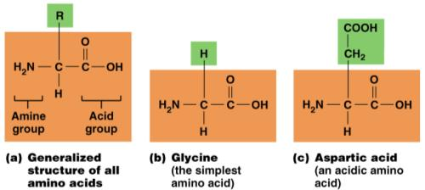
Amino Acids
Building blocks of protein, containing an _
Amino group _
Carboxyl groups _

Slide 2
Protein
Macromolecules composed of combinations of 20 types of amino acids bound together with peptide bonds
Peptide bond
H
R
O
H
R
O
Dehydration
synthesis
H₂O
H
R
O
H
R
O
N
C
C
+
N
C
C
N
C
C
N
C
C
H
H
OH
H
H
OH
Hydrolysis
H
H
H
OH
Amino acid
Amino acid
H₂O
Dipeptide

Slide 3
Structural Levels of Proteins
Primary
Secondary
alpha helices or _
superimposed folding of secondary structures
polypeptide chains linked together in a specific manner

Slide 4
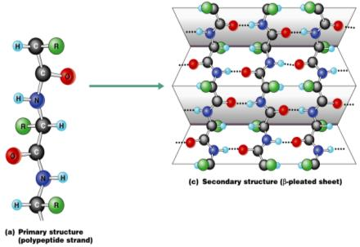
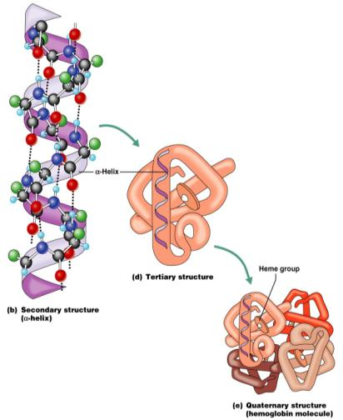
Structural Levels of Proteins
Figure 2.18a–c

Slide 5
Fibrous and Globular Proteins
Fibrous proteins
Extended and _
Examples:
keratin, _______________________, collagen, and certain _

Slide 6
Fibrous and Globular Proteins
Globular proteins
Compact, __________________________ with tertiary and quaternary structures
Examples:
__________________________________, hormones, and _

Slide 7
Characteristics of Enzymes
Most are ___________________________ that act as _
Enzymes are chemically specific

Slide 8
Characteristics of Enzymes
Frequently named for the _
Enzyme names usually end in _______

Slide 9
Mechanism of Enzyme Action
Enzyme binds with _
_____________________ is formed at a lower activation energy
Product is released

Slide 10
Nucleic Acids
Composed of carbon, oxygen, hydrogen, nitrogen, and phosphorus
Their structural unit is the _
composed of _
a _
a _

Slide 11
Nucleic Acids
Five nitrogen bases contribute to nucleotide structure –
Two major classes
DNA and RNA

Slide 12
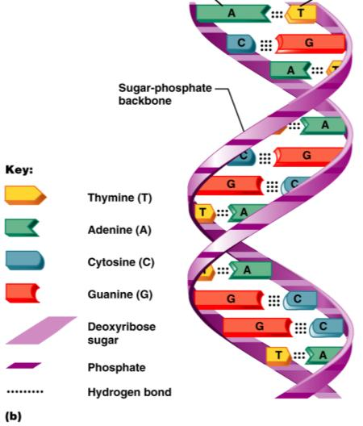
Deoxyribonucleic Acid (DNA)
___________________ helical molecule found in the nucleus of the cell
Replicates itself before the cell divides, ensuring genetic continuity
Provides _

Slide 13
Ribonucleic Acid (RNA)
______________________________molecule found in both the ___________________ and the _____________________________ of a cell
Uses the nitrogenous base ________________ instead of thymine
Three varieties of RNA:

Slide 14
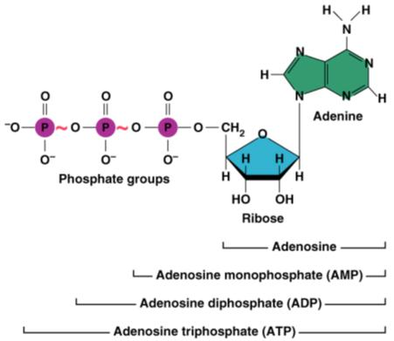
Adenosine Triphosphate (ATP)
Source of immediately usable _______________ for the cell
Adenine-containing RNA nucleotide with _

Slide 15
3
Cells: The Living Units

Slide 16
Cell Theory
The ______________________ is the basic structural and functional unit of life
Organismal activity depends on individual and collective activity of cells
Biochemical activities of cells are dictated by _
Continuity of life has a _

Slide 17
Plasma Membrane
Separates intracellular fluids from extracellular fluids
Plays a __________________________ role in cellular activity

Slide 18
Fluid Mosaic Model
_________________________________ with imbedded, dispersed proteins
Bilayer consists of _
Glycolipids are lipids with bound carbohydrate
Phospholipids have ________________________ and hydrophilic bipoles

Slide 19
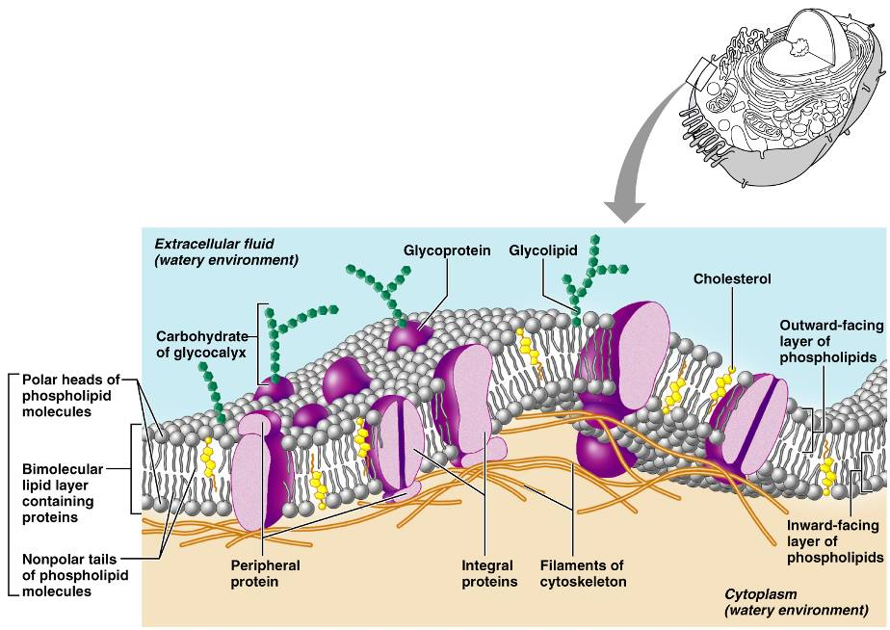
Fluid Mosaic Model
Figure 3.3

Slide 20
Functions of Membrane Proteins
Enzymatic activity
_____________________________ for signal transduction

Slide 21
Functions of Membrane Proteins
Cell-cell _
Attachment to cytoskeleton and extracellular matrix

Slide 22
Membrane Junctions
impermeable junction that encircles the cell
Desmosome
anchoring junction ___________________________ along the sides of cells
___________________ junction
a ______________________________ that allows chemical substances to pass between cells

Slide 23
Passive Membrane Transport: Diffusion
Simple diffusion – nonpolar and lipid-soluble substances
Diffuse directly through the _
Diffuse through _

Slide 24
Passive Membrane Transport: Diffusion
_________________________ diffusion
Transport of glucose, amino acids, and ions
Transported substances bind carrier proteins or _

Slide 25
Carrier Proteins
Are integral _
Show specificity for certain polar molecules including _

Slide 26
Passive Membrane Transport: Osmosis
Occurs when the concentration of a solvent is different on opposite sides of a membrane
Diffusion of water across a _

Slide 27
Passive Membrane Transport: Filtration
The passage of water and solutes through a membrane by _
Pressure gradient pushes solute-containing fluid from a _

Slide 28
Effects of Solutions of Varying Tonicity
Isotonic
solutions with the __________________________________________ as that of the cytosol
solutions having _____________________________ solute concentration than that of the cytosol
solutions having _____________________________ solute concentration than that of the cytosol

Slide 29
Active Transport
Uses _____________________ to move solutes across a membrane
Requires _

Slide 30
Types of Active Transport
__________________________ system
two substances are moved across a membrane in the _
__________________________ system
two substances are moved across a membrane in _

Slide 31
Vesicular Transport
Transport of large particles and macromolecules across plasma membranes
Exocytosis
moves substance from the cell _
enables large particles and macromolecules to enter the cell

Slide 32
Vesicular Transport
Transcytosis
moving substances _
Vesicular trafficking
moving substances from one area in the cell to another
pseudopods engulf solids and bring them into the cell’s interior

Slide 33
Vesicular Transport
the plasma membrane infolds, bringing extracellular fluid and solutes into the interior of the cell
_____________________________ endocytosis
clathrin-coated pits provide the main route for endocytosis and transcytosis
Non-clathrin-coated vesicles
caveolae that are platforms for a variety of signaling molecules

Slide 34
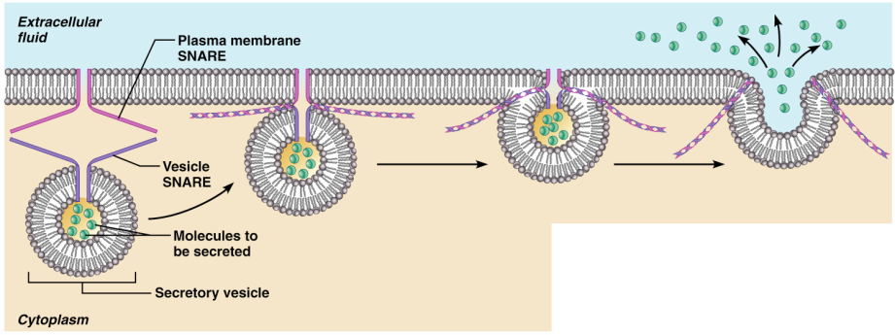
Exocytosis
Figure 3.12a

Slide 35
Cell Adhesion Molecules (CAMs)
_______________________________ to the extracellular matrix
Assist in _________________________ of cells past one another
Rally protective _________________________________ to injured or infected areas

Slide 36
Roles of Membrane Receptors
important in normal development and immunity
Electrical signaling
voltage-regulated ______________________ in nerve and muscle tissue

Slide 37
Roles of Membrane Receptors
neurotransmitters bind to chemically gated channel-linked receptors in nerve and muscle tissue
G protein-linked receptors
bind to a receptor which activates a G protein, causing the ____________________________________, such as cyclic AMP

