Slide 1
Epithelial Membranes
Cutaneous
Mucus
_________________________________open to the exterior (e.g., digestive and respiratory tracts)
Serous
moist membranes found in _

Slide 2
Epithelia: Simple Cuboidal
Single layer of _________________________________with large, spherical central nuclei
Function in _
Present in kidney tubules, ducts and secretory portions of small glands, and ovary surface

Slide 3
Epithelia: Simple Columnar
Single layer of ___________________________________; many contain _
Goblet cells are often found in this layer
Function in _
Nonciliated type line digestive tract and gallbladder
Ciliated type line small bronchi, uterine tubes, and some regions of the uterus
Cilia help _________________________________ through internal passageways

Slide 4
Epithelia: Pseudostratified Columnar
Single layer of cells with ________________________________; some do not reach the free surface
Nuclei are seen at _
Function in _
Present in the male sperm-carrying ducts (nonciliated) and trachea (ciliated)

Slide 5
Epithelia: Stratified Squamous
Thick membrane composed of several layers of cells
Function in _______________________ of underlying areas subjected to abrasion
Forms the __________________________________(keratinized cells), and linings of the esophagus, mouth, and vagina (nonkeratinized cells)

Slide 6
Epithelia: Stratified Cuboidal and Columnar
Stratified cuboidal
Quite ________________________ in the body
Found in some ____________________________________
Typically two cell layers thick

Slide 7
Epithelia: Stratified Cuboidal and Columnar
Stratified columnar
Limited distribution in the body
Found in the pharynx, male urethra, and lining some glandular ducts
Also occurs at ____________________________________between two other types of epithelia

Slide 8
Epithelia: Transitional
Several cell layers, _________________________________, surface cells are dome shaped
_____________________________ to permit the distension of the urinary bladder
Lines the urinary bladder, ureters, and part of the urethra

Slide 9
Epithelia: Glandular
A gland is ____________________________ that makes and _
Classified by:
Site of product release – endocrine or exocrine
Relative ______________________________the gland – unicellular or multicellular

Slide 10
Endocrine Glands
___________________________glands that produce _
Secretions include amino acids, proteins, glycoproteins, and steroids

Slide 11
Exocrine Glands
More numerous than endocrine glands
Secrete their products onto _
Examples include mucous, sweat, oil, and salivary glands
The only important ___________________________ gland is the _
Multicellular exocrine glands are composed of a duct and secretory unit

Slide 12
Modes of Secretion
products are secreted by __________________________ (e.g., pancreas, sweat, and salivary glands)
products are secreted by the _____________________________ of gland cells (e.g., sebaceous glands)

Slide 13
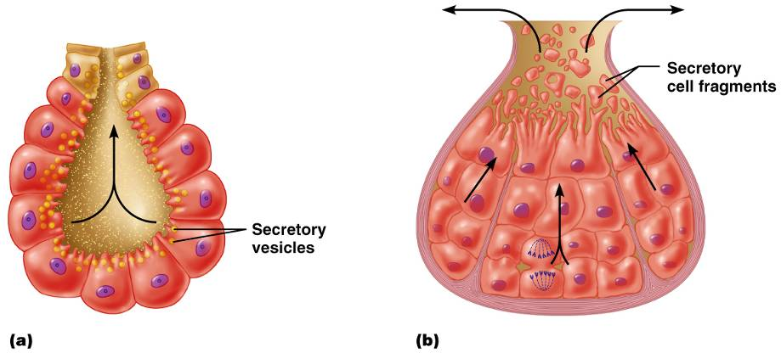
Modes of Secretion
Figure 4.5

Slide 14
Connective Tissue
Found throughout the body; most abundant and widely distributed in primary tissues

Slide 15
Functions of Connective Tissue
Protection
Transportation

Slide 16
Characteristics of Connective Tissue
Connective tissues have:
Varying degrees of _
Nonliving __________________________________, consisting of ground substance and fibers

Slide 17
Structural Elements of Connective Tissue
Ground substance
unstructured material that _
collagen, elastic, or reticular
Cells
_______________________________, chondroblasts, __________________________, and hematopoietic stem cells

Slide 18
Ground Substance
Adhesion proteins
Proteoglycans
Functions as a _________________________________ through which nutrients ________________________________ between blood capillaries and cells

Slide 19
Fibers
tough; provides high tensile strength
long, thin fibers that allow for stretch
branched collagenous fibers that form delicate networks

Slide 20
Cells
connective tissue proper
cartilage
bone
_______________________________ stem cells
blood
White blood cells, plasma cells, macrophages, and mast cells

Slide 21
Connective Tissue Proper: Loose
Gel-like matrix with all three connective tissue fibers
Fibroblasts, macrophages, mast cells, and some white blood cells
Widely distributed throughout the body

Slide 22
Connective Tissue Proper: Loose
Adipose connective tissue
Matrix similar to areolar connective tissue with closely packed _
Reserves _____________________________, insulates against heat loss, and supports and protects
Found ____________________________________, within abdomen, and in breasts
Local fat deposits serve nutrient needs of highly active organs

Slide 23
Connective Tissue Proper: Loose
Reticular connective tissue
Reticular cells lie in a fiber network
Forms a soft internal skeleton, or stroma, _
Found in lymph nodes, bone marrow, and the spleen

Slide 24
Connective Tissue Proper: Dense Regular
Parallel collagen fibers with a few elastic fibers
Major cell type is _
Attaches __________________________ or to other muscles, and _
Found in tendons, ligaments, and _

Slide 25
Connective Tissue Proper: Dense Irregular
____________________ arranged collagen fibers with some elastic fibers
Major cell type is _
Withstands _______________________in many directions providing structural strength
Found in the dermis, submucosa of the digestive tract, and fibrous organ capsules

Slide 26
Connective Tissue: Hyaline Cartilage
Amorphous, ______________________ with imperceptible network of collagen fibers
_______________________________lie in lacunae
Supports, reinforces, cushions, and _
Forms the _
Found in embryonic skeleton, the end of long bones, nose, trachea, and larynx

Slide 27
Connective Tissue: Elastic Cartilage
Similar to hyaline cartilage but with _
Maintains _________________________________while allowing flexibility
Supports external ear (pinna) and _

Slide 28
Connective Tissue: Fibrocartilage Cartilage
Matrix similar to hyaline cartilage but _______________________________with thick collagen fibers
Provides ____________________________________ and absorbs compression shock
Found in ________________________________, the pubic symphysis, and in discs of the knee joint

Slide 29
Connective Tissue: Bone (Osseous Tissue)
Hard, ___________________________ with collagen fibers found in bone
___________________________ are found in lacunae and are well vascularized
Supports, protects, and _
Stores calcium, minerals, and fat
_____________________________ inside bones is the site of hematopoiesis

Slide 30
Connective Tissue: Blood
Red and white cells in a _
Contained within blood vessels
Functions in the ______________________ of respiratory gases, nutrients, and wastes

Slide 31
Nervous Tissue
Branched neurons with long cellular processes and _
Transmits __________________________________from sensory receptors to effectors
Found in the brain, spinal cord, and peripheral nerves

Slide 32
Muscle Tissue: Skeletal
Long, cylindrical, _________________________________ with obvious striations
Initiates and controls _
Found in _______________________________ that attach to bones or skin

Slide 33
Muscle Tissue: Cardiac
Branching, striated, _____________________________ interlocking at _
Propels blood into the circulation
Found in the walls of the _

Slide 34
Muscle Tissue: Smooth
Sheets of ___________________________ with central nuclei that have _
Propels substances along internal passageways (i.e., peristalsis)
Found in the walls of _

