Slide 1
Chapter 2

Slide 2
Matter
The “stuff” of the universe
Anything that has _
States of matter
Solid
has _
Liquid
has definite volume, _
Gas
has changeable shape and volume

Slide 3
Energy
The _____________________________ (put matter into motion)
Types of energy
Kinetic
Potential
energy of position; _

Slide 4
Forms of Energy
Chemical
______________________________________ of chemical substances
Electrical
results from the _
directly involved in moving matter
Radiant or electromagnetic
energy traveling in waves (i.e., visible light, ultraviolet light, and X-rays)

Slide 5
Energy Form Conversions
Energy is easily converted from one form to another
During conversion, some _

Slide 6
Composition of Matter
Elements
______________________ substances that cannot be broken down by ordinary chemical means
identical building blocks for each element
Atomic symbol
_______________________________ for each element

Slide 7
Major Elements of the Human Body
Oxygen (O)
Carbon (C)
Hydrogen (H)
Nitrogen (N)

Slide 8
Lesser and Trace Elements of the Human Body
Lesser elements make up 3.9% of the body and include:
Calcium _
phosphorus _
potassium _
sulfur (S),
sodium _
chlorine _
magnesium _
iodine (I),
iron _

Slide 9
Lesser and Trace Elements of the Human Body
______________________ elements make up less than 0.01% of the body
They are required in minute amounts, and are found as part of ______________________

Slide 10
Atomic Structure
The _______________________________ consists of neutrons and protons
Neutrons
have ___________________________________ and a mass of one atomic mass unit (amu)
Protons
have a ______________________________________ and a mass of 1 amu
Electrons are found orbiting the nucleus
Electrons
have a __________________________________________ and 1/2000 the mass of a proton (0 amu)

Slide 11
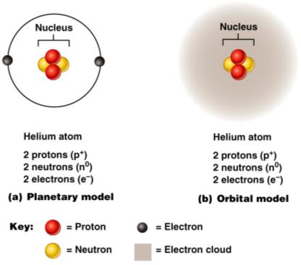
Models of the Atom
electrons move around the nucleus in fixed, circular orbits
regions around the nucleus in which electrons are most likely to be found

Slide 12
Identification of Elements
equal to the number of _
Mass number
equal to the _
Atomic weight
____________________________________ of all isotopes

Slide 13
Identification of Elements
Isotope
atoms with _
Radioisotopes
atoms that undergo spontaneous decay called radioactivity

Slide 14
Above: Variations in elements
Below: isotopes of hydrogen

Slide 15
Molecules and Compounds
Molecule
two or more atoms held together by _
two or more different kinds of atoms chemically bonded together

Slide 16
Mixtures and Solutions
Mixtures
two or more components ________________________________ (not chemically bonded)
Solutions
homogeneous mixtures of components
____________________________ – substance present in greatest amount
______________________________ – substance(s) present in smaller amounts

Slide 17
Colloids and Suspensions
________________________ (emulsions)
heterogeneous mixtures whose solutes do not settle out
heterogeneous mixtures with visible solutes that tend to settle out

Slide 18
Chemical Bonds
Electron shells, or energy levels, surround the nucleus of an atom
Bonds are formed _
Valence shell
outermost energy level _

Slide 19
Octet rule
except for the ____________________________________, atoms interact in a manner to have _

Slide 20
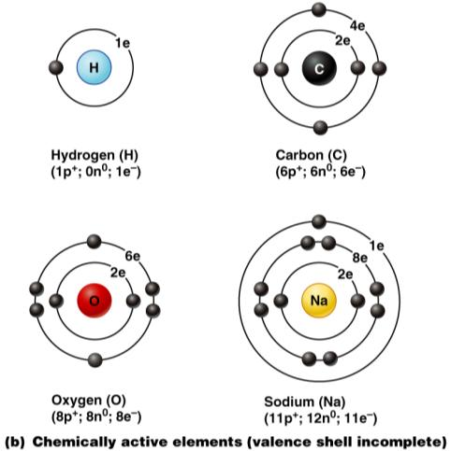
Chemically Reactive Elements
_____________ elements _____________ have their outermost energy level fully occupied by electrons

Slide 21
Types of Chemical Bonds

Slide 22
Ionic Bonds
Ions are charged atoms resulting from the _
gained one or more electrons
lost one or more electrons

Slide 23
Formation of an Ionic Bond
Ionic bonds form between atoms by the _
Ionic compounds form crystals instead of individual molecules
Example: NaCl (sodium chloride)

Slide 24
Covalent Bonds
Covalent bonds are formed by the _
Electron sharing produces molecules

Slide 25
Polar and Nonpolar Molecules
_________________________________ between atoms produce nonpolar molecules
_________________________________ of electrons produces polar molecules
Atoms with six or seven valence shell electrons are _
Atoms with one or two valence shell electrons are _

Slide 26
Hydrogen Bonds
Too weak to bind atoms together
Common in _
Responsible for _
Important as intramolecular bonds, giving the molecule a three-dimensional shape

Slide 27
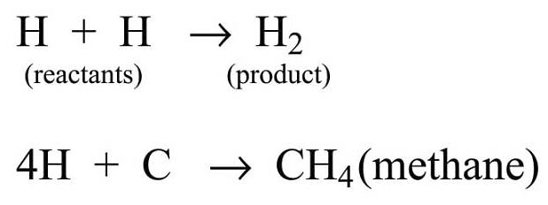
Chemical Reactions
Occur when _
Written in symbolic form using chemical equations
Chemical equations contain:
Number and type of reacting substances, and products produced
Relative amounts of reactants and products

Slide 28
Patterns of Chemical Reactions
Combination reactions:
___________________________ reactions which always involve _
A + B → AB
_________________________ reactions:
Molecules are ________________________ into smaller molecules
AB → A + B

Slide 29
Patterns of Chemical Reactions
_______________________ reactions:
Bonds are both _
AB + C → AC + B

Slide 30
Oxidation-Reduction (Redox) Reactions
Reactants ______________________ are electron donors and are _
Reactants _______________________ are electron acceptors and become _

Slide 31
Energy Flow in Chemical Reactions
Exergonic reactions
reactions that _
__________________________ reactions
reactions whose products contain more potential energy than did its reactants

Slide 32
Reversibility in Chemical Reactions
All chemical reactions are theoretically reversible
A + B → AB
AB → A + B
If neither a forward nor reverse reaction is dominant, _

Slide 33
Factors Influencing Rate of Chemical Reactions
chemical reactions proceed quicker at higher temperatures
the smaller the particle the faster the chemical reaction
higher reacting particle concentrations produce faster reactions

Slide 34
Factors Influencing Rate of Chemical Reactions
increase the rate of a reaction without being chemically changed
biological catalysts

Slide 35
Biochemistry
Organic compounds
Contain _______________________, are _______________________ bonded, and are often large
Inorganic compounds
Do not contain _
Water, salts, and many acids and bases

Slide 36
Properties of Water
Polar solvent properties
dissolves _
forms ______________________________ around large charged molecules,
serves as the body’s major transport medium

Slide 37
Properties of Water
Reactivity
is an important part of ____________________________________ reactions
resilient cushion around certain body organs

Slide 38
Salts
Inorganic compounds
Contain _
other than H⁺
and _
other than OH–
Are electrolytes; they _

Slide 39
Acids and Bases
Acids __________________________ and are therefore _
HCl → H⁺ + Cl –
__________________ release ______ and are _
NaOH → Na⁺ + OH–

Slide 40
Acid-Base Concentration (pH)
Acidic solutions have _________________________________ and therefore a _
Alkaline solutions have ______________ concentration and therefore a _
Neutral solutions have __________________________________ concentrations

Slide 41
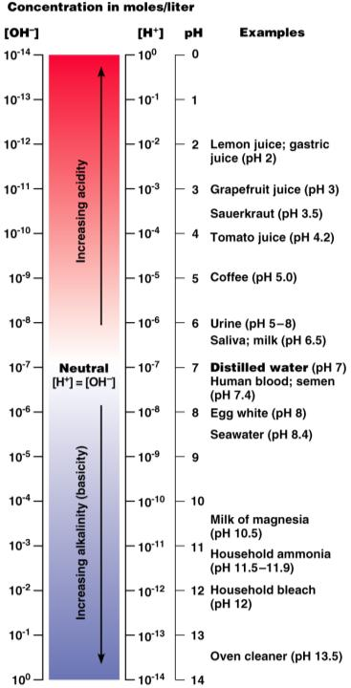
Acid-Base Concentration (pH)
Acidic: pH 0–6.99
Basic: pH 7.01–14
Neutral: pH 7.00

Slide 42
Buffers
Systems that ______________ abrupt and large swings in the _
Carbonic acid-bicarbonate system
Carbonic acid dissociates, reversibly releasing _
The chemical equilibrium between carbonic acid and bicarbonate _

Slide 43
Organic Compounds
Molecules unique to living systems contain ______________________ and hence are organic compounds
They include:

Slide 44
Carbohydrates
Contain _
Their major function is to supply a _
Examples:
Monosaccharides or simple sugars

Slide 45
Lipids
Contain C, H, and O, but the _______________________________ in lipids is less than in carbohydrates
Examples:
Neutral fats or _
Steroids
Eicosanoids

Slide 46
Neutral Fats (Triglycerides)
Composed of _

Slide 47
Other Lipids
Phospholipids – modified triglycerides with _

Slide 48
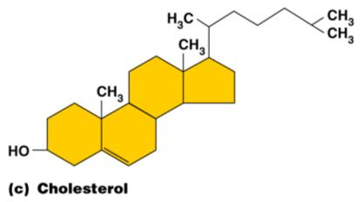
Other Lipids
flat molecules with four interlocking hydrocarbon rings
20-carbon fatty acids found in cell membranes

Slide 49
Representative Lipids Found in the Body
Neutral fats
found in _
chief component of _
Steroids
____________________, bile salts, vitamin D, ________________________________, and adrenal cortical hormones

Slide 50
Representative Lipids Found in the Body
Fat-soluble vitamins
vitamins A, E, and K
Eicosanoids
prostaglandins, leukotrienes, and thromboxanes
________________________fatty acids and cholesterol _

