Slide 1
Cytoplasm
Cytoplasm
material between _
largely water with dissolved protein, salts, sugars, and other solutes

Slide 2
Cytoplasm
Cytoplasmic organelles
metabolic machinery of the cell
Inclusions
_________________________________ such as glycosomes, glycogen granules, and pigment

Slide 3
Cytoplasmic Organelles
Specialized cellular compartments
Mitochondria, peroxisomes, lysosomes, endoplasmic reticulum, and Golgi apparatus
Cytoskeleton, centrioles, and ribosomes

Slide 4
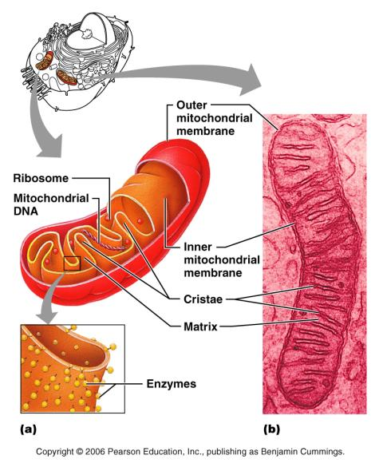
Mitochondria
___________________________________ with shelf-like cristae
Provide most of the cell’s ____________ via aerobic cellular respiration
Contain their own DNA and RNA

Slide 5
Ribosomes
Granules containing _
Site of _
Free ribosomes synthesize _
Membrane-bound ribosomes synthesize proteins to be incorporated into membranes

Slide 6
Endoplasmic Reticulum (ER)
Interconnected tubes and ________________________________ enclosing cisternae
________________________ with the nuclear membrane
Two varieties

Slide 7
Rough (ER)
External surface studded with _
Manufactures all secreted proteins
Responsible for the __________________________________ and phospholipids for cell membranes

Slide 8
Smooth ER
Tubules arranged in a looping network
Catalyzes the following reactions in various organs of the body
In the liver – ___________________________________, breakdown of glycogen and, along with the kidneys, detoxification of drugs
In the testes – _

Slide 9
Golgi Apparatus
Stacked and flattened membranous sacs
Functions in _________________________________, concentration, and ________________________ of proteins
Transport vessels from the ER fuse with the cis face of the Golgi apparatus

Slide 10
Golgi Apparatus
Proteins then pass through the Golgi apparatus to the trans face
________________________________ leave the trans face of the Golgi stack and move to designated parts of the cell

Slide 11
Lysosomes
Spherical membranous bags containing _
_________________________ ingested bacteria, viruses, and toxins
__________________________ nonfunctional organelles
Breakdown nonuseful tissue
Breakdown _
Secretory lysosomes are found in white blood cells, immune cells, and melanocytes

Slide 12
Peroxisomes
Membranous sacs containing _
_______________________________ harmful or toxic substances
Neutralize dangerous free radicals
Free radicals – highly reactive chemicals with unpaired electrons (i.e., O₂–)

Slide 13
Cytoskeleton
The “skeleton” of the cell
Dynamic, elaborate series of rods running through the cytosol
Consists of _

Slide 14
Microtubules
Dynamic, hollow tubes made of the _
Determine the overall ______________________ of the cell and distribution of _

Slide 15
Microfilaments
Dynamic strands of the _
Attached to the cytoplasmic side of the plasma membrane
Attach to CAMs and function in _

Slide 16
Intermediate Filaments
Tough, ___________________________ with high tensile strength
Resist pulling forces on the cell and help form _

Slide 17
Motor Molecules
Protein complexes that function in motility
Powered by _
Attach to __________________________ on organelles

Slide 18
Centrioles
Small barrel-shaped organelles located in the centrosome near the nucleus
Pinwheel array of nine triplets of microtubules
_________________________________ during mitosis
Form the _

Slide 19
Cilia
Whip-like, motile _________________________________ on exposed surfaces of certain cells
Move substances in _______________________________ across cell surfaces

Slide 20
Nucleus
Contains _
_________________________________ control center of the cell
Contains the genetic library with blueprints for nearly all cellular proteins
Dictates the kinds and amounts of proteins to be synthesized

Slide 21
Nuclear Envelope
Encloses jellylike nucleoplasm

Slide 22
Nuclear Envelope
Outer membrane is _________________________________ and is studded with ribosomes
Inner membrane is lined with the nuclear lamina,
which maintains the _
________________________ complex regulates transport of large molecules into and out of the nucleus

Slide 23
Nucleoli
Dark-staining spherical bodies within the nucleus
Site of _

Slide 24
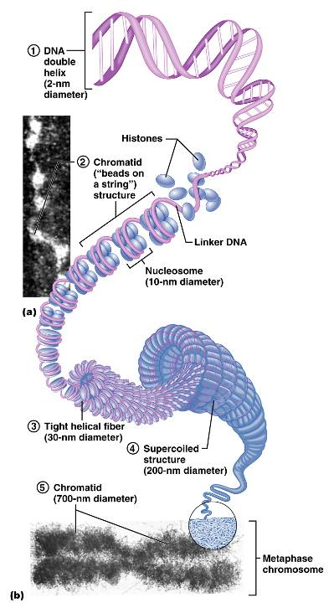
Chromatin
__________________ strands of DNA and histones
Form _________________, barlike bodies of __________________ when the nucleus starts to divide

Slide 25
Cell Cycle
Growth (G₁), synthesis (S), growth (G₂)
Mitosis and cytokinesis

Slide 26
Interphase: DNA Replication
DNA helices ______________________________ from the nucleosomes
Helicase untwists the double helix and _
Each nucleotide strand serves as a ______________________________ for building a new complementary strand

Slide 27
DNA Replication
uses ___________________________ to begin DNA synthesis
DNA polymerase III continues from the primer and adds __________________________________ to the template

Slide 28
DNA Replication
Since DNA polymerase only works in one direction:
A continuous leading strand is synthesized
A discontinuous lagging strand is synthesized
DNA ligase splices together the short segments of the discontinuous strand
Two new telomeres are also synthesized
This process is called _

Slide 29
Cell Division
Essential for body growth and tissue repair
Mitosis
Cytokinesis
division of the _

Slide 30
Mitosis
The phases of mitosis are:

Slide 31
Cytokinesis
_________________________________ formed in late anaphase by contractile ring
Cytoplasm is pinched into two parts after mitosis ends

Slide 32
Early and Late Prophase
Asters are seen as chromatin condenses into chromosomes
Centriole pairs separate and the mitotic spindle is formed

Slide 33
Metaphase
Chromosomes ____________________________________ with their centromeres aligned at the exact center, or equator, of the cell
This arrangement of chromosomes along a plane midway between the poles is called the _

Slide 34
Anaphase
_______________________________ of the chromosomes _
Motor proteins in kinetochores _

Slide 35
Telophase and Cytokinesis
New sets of chromosomes extend into chromatin
__________________________________ from the rough ER
Generally cytokinesis completes cell division

Slide 36
Control of Cell Division
Surface-to-volume ratio of cells
_______________________________ such as growth factors and hormones
Cyclins and cyclin-dependent kinases (Cdks) complexes

Slide 37
Protein Synthesis
DNA serves as master blueprint for _
Genes are ________________________ carrying instructions for a polypeptide chain
Triplets of nucleotide bases form the genetic library
Each triplet specifies coding for an _

Slide 38
Roles of the Three Types of RNA
carries the genetic information from DNA in the nucleus to the ribosomes in the cytoplasm
bound to amino acids base pair with the codons of mRNA at the ribosome to begin the process of protein synthesis
a structural component of ribosomes

Slide 39
Transcription
Transfer of information from the sense strand of _

Slide 40
Transcription: RNA Polymerase
An enzyme that oversees the synthesis of RNA
Adds complementary ____________nucleoside triphosphates on the DNA template
Joins these RNA nucleotides together
Encodes a _________________________ to stop transcription

Slide 41
Genetic Code
____________ code for amino acids according to a genetic code

Slide 42
Information Transfer from DNA to RNA
DNA triplets are _______________________________ into mRNA codons by RNA polymerase
Codons base pair with ______________ anticodons at the _
Amino acids are peptide bonded at the ribosomes to form _
Start and stop codons are used in initiating and ending translation

Slide 43
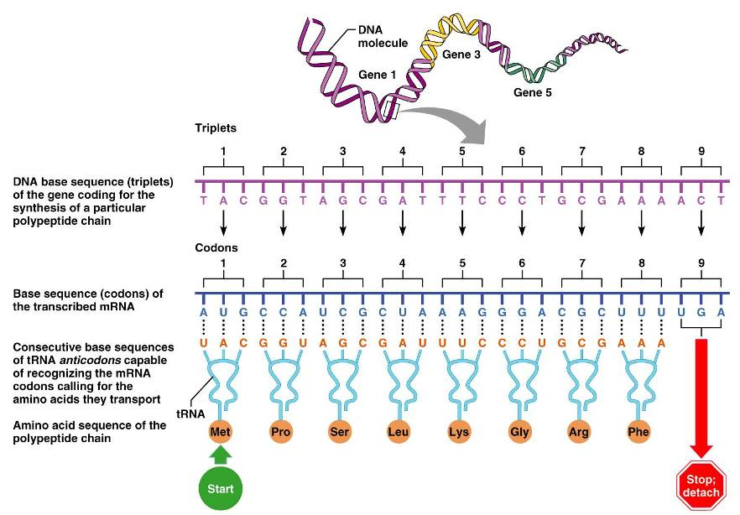
Information Transfer from DNA to RNA
Figure 3.38

Slide 44
4
Tissue: The Living Fabric

Slide 45
Tissues
Groups of cells similar in structure and function
The four types of tissues

Slide 46
Epithelial Tissue
composed almost entirely of cells
Special _
form continuous sheets held together by _

Slide 47
Epithelial Tissue
Supported by _
reticular and basal laminae
______________________________but innervated
contains no blood vessels but supplied by nerve fibers
rapidly replaces lost cells by cell division

Slide 48
Classification of Epithelia
Simple or stratified
Squamous, cuboidal, or columnar

Slide 49
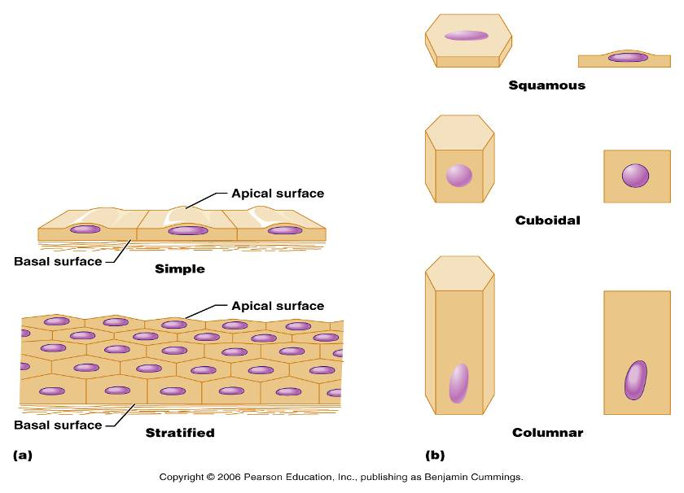
Classification of Epithelia

Slide 50
Epithelia: Simple Squamous
Single layer of flattened cells with __________________________________and sparse cytoplasm
Functions
Provide a slick, _______________________________________ in lymphatic and cardiovascular systems
Present in the kidney glomeruli, lining of heart, blood vessels, lymphatic vessels, and serosae

