Slide 1
Chapter Eleven
Exam Four Material Chapters 11, 12, &13

Slide 2
Nervous System
The master _________________________________ system of the body
Functions
monitoring stimuli
Integration
________________________ output
response to stimuli

Slide 3
Organization of the Nervous System
Central nervous system (CNS)
Integration and command center
Peripheral nervous system (PNS)
Carries messages to and from the spinal cord and brain

Slide 4
PNS: Two Functional Divisions
Sensory (_______________________) division
Sensory afferent fibers
carry impulses from _
Visceral afferent fibers
transmit impulses from _
Motor (__________________________) division
Transmits impulses from the _

Slide 5
Motor Division: Two Main Parts
__________________________ nervous system
________________________________ control of skeletal muscles
_____________________________ nervous system (ANS)
Regulates _
sympathetic
parasympathetic

Slide 6
Histology of Nerve Tissue
The two cell divisions in the nervous system are:
excitable cells that transmit electrical signals
cells that _

Slide 7
Supporting Cells: Neuroglia
The supporting cells: neuroglia or glial cells
Provide a _
Segregate and insulate neurons
____________________________ young neurons to the proper connections
Promote _

Slide 8
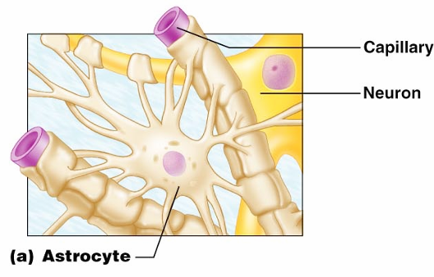
Astrocytes
Most _
They cling to neurons and their synaptic endings, and _

Slide 9
Astrocytes
Functionally, they:
Support and brace neurons
______________________________ neurons to their nutrient supplies
Guide migration of young neurons
Control the _

Slide 10
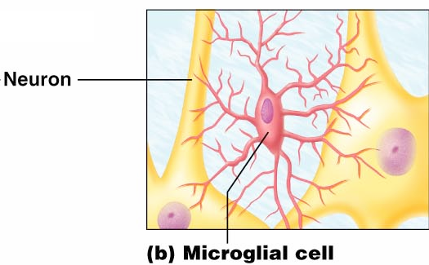
Microglia
small, ovoid cells with spiny processes
____________________________ that monitor the health of neurons

Slide 11
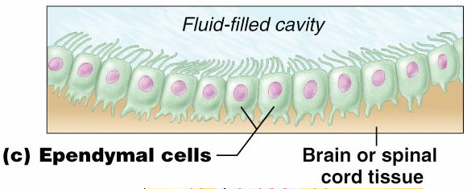
Ependymal Cells
Ependymal cells
range in shape from squamous to columnar
They ____________________________________ of the brain and spinal column

Slide 12
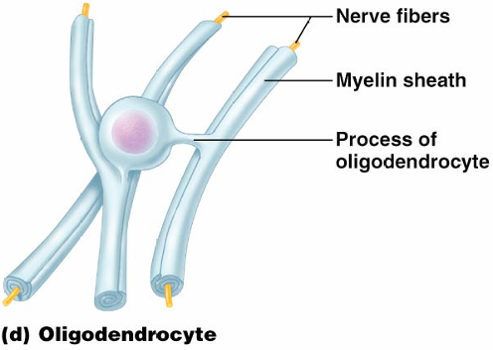
Oligodendrocytes,
Oligodendrocytes

Slide 13
Schwann Cells, and Satellite Cells
Schwann cells
surround _
Satellite cells
surround _

Slide 14
Neurons
Structural units of the nervous system
Composed of a _
Long-lived, _____________________, and have a high metabolic rate
Their plasma membrane function in:
Cell-to-cell signaling during development

Slide 15
Nerve Cell Body: Soma
Contains the _
Is the major biosynthetic center
Is the focal point for the outgrowth of neuronal processes
Has well-developed _
Contains an axon hillock
cone-shaped area _

Slide 16
Processes
Armlike extensions from the soma
Called _________________ in the _
Called _________________ in the _
There are two types:

Slide 17
Dendrites of Motor Neurons
Short, tapering, and diffusely branched processes
They are the ______________________________, regions of the neuron
Electrical signals are conveyed as _________________________________ (not action potentials)

Slide 18
Axons: Structure
Slender processes _
Long axons are called _
Usually there is only one unbranched axon per neuron
Rare branches, if present, are called _
Axonal terminal
branched terminus of an axon

Slide 19
Axons: Function
Secrete ________________________________ from the axonal terminals
Movement along axons occurs in two ways
_____________________________________ axonal terminal
____________________________________ axonal terminal

Slide 20
Myelin Sheath
Whitish, fatty (protein-lipoid), _______________________________ around most long axons
It functions to:
Electrically ___________________________ fibers from one another
Increase the _

Slide 21
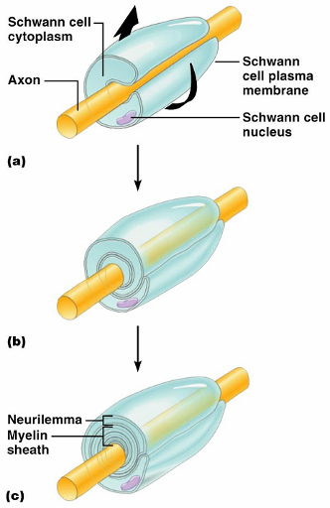
Myelin Sheath and Neurilemma
Formed by _________________ cells in the _
A Schwann cell:
Envelopes an axon
Encloses the axon with its plasma membrane
Has concentric layers of membrane that make up the myelin sheath
Neurilemma

Slide 22
Nodes of Ranvier
____________________ in the myelin sheath _
They are the sites where _

Slide 23
Unmyelinated Axons
A Schwann cell surrounds nerve fibers _
Schwann cells partially enclose 15 or more axons

Slide 24
Axons of the CNS
Both myelinated and unmyelinated fibers are present
______________________________ are formed by _
Nodes of Ranvier are _
There is no neurilemma

Slide 25
Regions of the Brain and Spinal Cord
________________________ matter
dense collections of _
________________________ matter
mostly _

Slide 26
Neuron Classification
Structural:
Multipolar
Bipolar
Unipolar

Slide 27
Neuron Classification
Functional:
transmit impulses _
Motor _
carry impulses _
_________________________________ (association neurons)
shuttle signals through CNS pathways

Slide 28
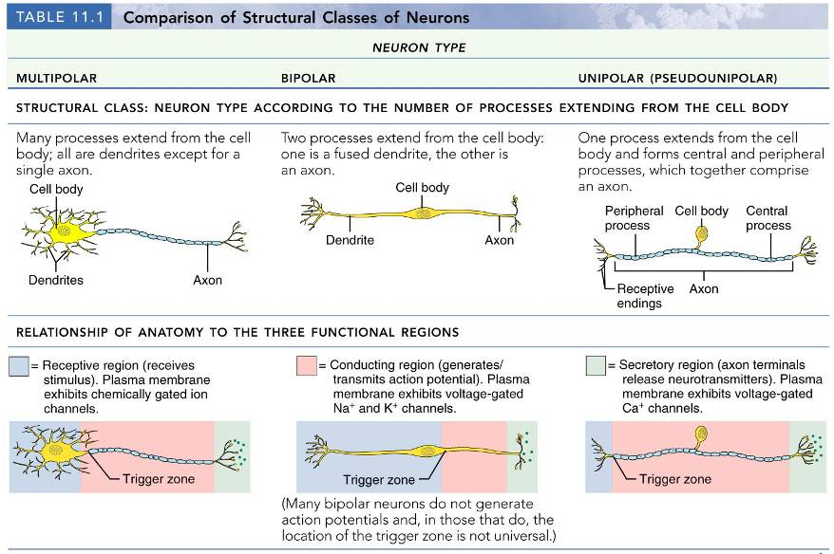

Slide 29
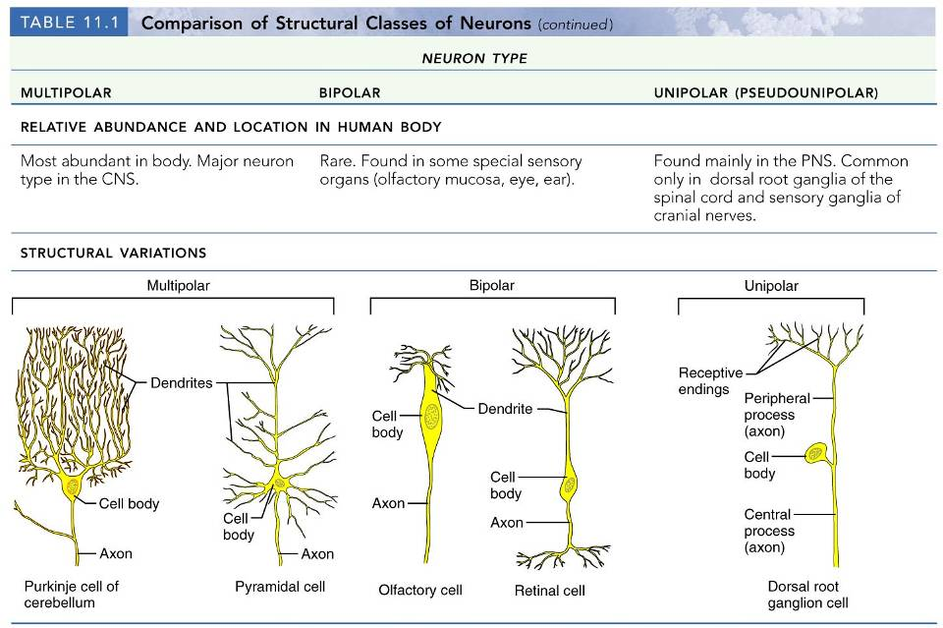

Slide 31
Neurophysiology
Neurons are _
Action potentials, or nerve impulses, are:
__________________________________ carried along the length of axons
The underlying _______________________________ of the nervous system

Slide 32
Electrical Current and the Body
Reflects the flow of ________________ rather than electrons
There is a potential on either side of membranes when:
The number of ions is _
The membrane provides a resistance to ion flow

Slide 33
Role of Ion Channels
Types of plasma membrane ion channels:
always open
open with binding of a specific neurotransmitter
open and close in response to membrane potential
open and close in response to physical deformation of receptors

Slide 34
Electrochemical Gradient
chemical gradient
________ movement from an area of _
electrical gradient
Ion movement toward an area of _
Electrochemical gradient
the ____________________________________ gradients taken together

Slide 35
Resting Membrane Potential (V_{r})
The potential difference (–70 mV) across the membrane of a resting neuron
It is generated by different concentrations of Na⁺, K⁺, Cl⁻, and protein anions (A⁻)
Ionic differences are the consequence of:
Differential __________________________ of the neurilemma to Na⁺ and K⁺
Operation of the _

Slide 36
Membrane Potentials: Signals
Membrane potential changes are produced by:
Changes in membrane permeability to ions
Alterations of ion concentrations across the membrane
Types of signals

Slide 37
Changes in Membrane Potential
Changes are caused by three events
the inside of the membrane becomes _
the membrane returns to its resting membrane potential
the inside of the membrane becomes _______________________________________ than the resting potential

Slide 38
Graded Potentials
_________________________________ in membrane potential
Magnitude varies directly with the strength of the stimulus
Sufficiently strong graded potentials can initiate action potentials

Slide 39
Graded Potentials
Current is quickly dissipated due to the _
Only travel over _

Slide 40
Action Potentials (APs)
A brief reversal of membrane potential with a total amplitude of 100 mV
Action potentials are only generated by _
do ________ decrease in strength over distance
principal means of neural communication
An ________________________ in the axon of a neuron _

Slide 41
Action Potential: Resting State
Leakage accounts for small movements of Na⁺ and K⁺
Each Na⁺ channel has two voltage-regulated gates

Slide 42
Action Potential: Depolarization Phase
Na⁺_______________________________ increases; membrane potential reverses
Threshold
a critical level of depolarization
-55 to -50 mV
At threshold, depolarization becomes _

Slide 43
Action Potential: Repolarization Phase
Sodium inactivation gates close
Membrane permeability to Na⁺ declines to resting levels
As sodium gates close, _
K⁺ exits the cell and _

Slide 44
Action Potential: Hyperpolarization
Potassium gates remain open, causing an _
This movement causes _________________________________ of the membrane (undershoot)
The neuron is ___________________________ to stimulus and depolarization during this time

Slide 45
Action Potential: Role of the Sodium-Potassium Pump
___________________________________ electrical conditions of the neuron
Does _________ restore the resting ionic conditions
Ionic redistribution back to resting conditions _

Slide 46
Phases of the Action Potential
1 –
2 –
3 –
4 –

