Slide 1
Chapter Eleven
Exam Four Material
Chapter 11, chapter 12 up to spinal cord

Slide 2
Nervous System
The master controlling and communicating system of the body
Functions
monitoring stimuli
interpretation of sensory input
response to stimuli

Slide 3
Organization of the Nervous System
Central nervous system (CNS)
Brain and spinal cord
Peripheral nervous system (PNS)
_________________________ spinal and cranial nerves
Carries messages _

Slide 4
PNS: Two Functional Divisions
Sensory (____________________) division
Sensory afferent fibers
carry impulses from _
Visceral afferent fibers
transmit impulses from _______________________________ to the brain
Motor (________________________) division
Transmits impulses from the CNS to _

Slide 5
Motor Division: Two Main Parts
Somatic nervous system
Conscious control of _
Autonomic nervous system (ANS)
Regulates _
sympathetic
parasympathetic

Slide 6
Histology of Nerve Tissue
The two cell divisions in the nervous system are:
excitable cells that _
cells that _

Slide 7
Supporting Cells: Neuroglia
The supporting cells: neuroglia or glial cells
Provide a supportive scaffolding for neurons
Segregate and _
Guide young neurons to the proper connections
Promote _

Slide 8
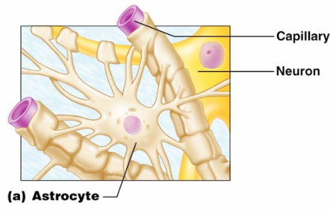
Astrocytes
Most abundant, versatile, and _
They cling to neurons and their synaptic endings, and _

Slide 9
Astrocytes
Functionally, they:
Support and _
_____________________________ neurons to their nutrient supplies
Guide _______________________________ of young neurons
Control the chemical environment

Slide 10
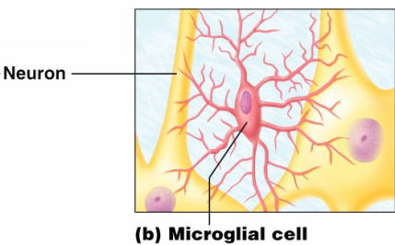
Microglia
Microglia
small, ________________________ with spiny processes
____________________________that monitor the health of neurons

Slide 11
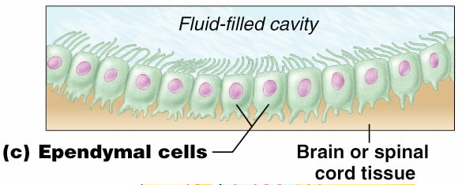
Ependymal Cells
Ependymal cells
range in shape from _
They line the ______________________________________ of the brain and spinal column

Slide 12
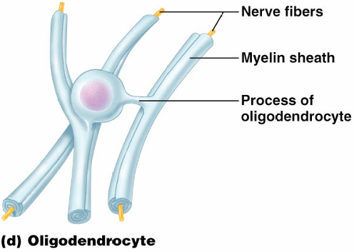
Oligodendrocytes,
Oligodendrocytes
branched cells that _

Slide 13
Schwann Cells, and Satellite Cells
Schwann cells
surround fibers of the _
surround neuron cell bodies _

Slide 14
Neurons
Structural units of the nervous system
Composed of a _
Long-lived, ________________________, and have a high metabolic rate
Their plasma membrane function in:
Cell-to-cell signaling during development

Slide 15
Nerve Cell Body: Soma
Contains the _
Is the major biosynthetic center
Is the focal point for the outgrowth of neuronal processes
Has well-developed ____________________: rough ER
Contains an _
cone-shaped area from which axons arise

Slide 16
Processes
Armlike extensions from the soma
Called __________________ in the _
Called __________________ in the _
There are two types:
Axons
Dendrites

Slide 17
Dendrites of Motor Neurons
Short, tapering, and _
They are the receptive regions of the neuron
input
_________________________________ are conveyed as graded potentials
not action potentials

Slide 18
Axons: Structure
Slender processes arising from the hillock
Long axons are called _
Usually there is only _
Rare branches, if present, are called axon collaterals
branched terminus of an axon

Slide 19
Axons: Function
__________________________________ action potentials
___________________________________ from the axonal terminals
Movement along axons occurs in two ways
toward axonal terminal
away from axonal terminal

Slide 20
Myelin Sheath
__________________________________ (protein-lipoid), segmented ____________________ around most long axons
It functions to:
___________________________________ fibers from one another
____________________________________________ of nerve impulse transmission

Slide 21
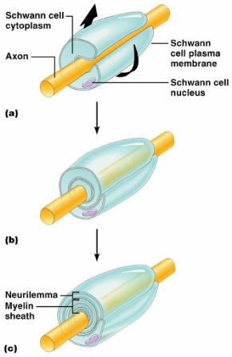
Myelin Sheath and Neurilemma
Formed by Schwann cells in the PNS
A Schwann cell:
Encloses the axon with its plasma membrane
Has concentric layers of membrane that make up the myelin sheath
remaining nucleus and cytoplasm of a Schwann cell

Slide 22
Nodes of Ranvier
___________________ in the myelin sheath between _
They are the sites where axon collaterals can emerge

Slide 23
Unmyelinated Axons
A Schwann cell surrounds nerve fibers but _
Schwann cells partially enclose 15 or more axons

Slide 24
Axons of the CNS
Both myelinated and unmyelinated fibers are present
Myelin sheaths are formed _
Nodes of Ranvier are _
There is no _

Slide 25
Regions of the Brain and Spinal Cord
dense collections of _
mostly ______________________ and unmyelinated fibers

Slide 26
Neuron Classification
Structural:
three or more processes
two processes (axon and dendrite)
single, short process

Slide 27
Neuron Classification
Functional:
transmit impulses toward the CNS
carry impulses away from the CNS
shuttle signals through CNS pathways

Slide 28
Neurophysiology
Neurons are _
_______________________________, or nerve impulses, are:
_____________________________________ carried along the length of axons
The underlying functional feature of the nervous system

Slide 29
Electrical Current and the Body
Reflects the flow of ____________ rather than ____________________
There is a ___________________________ on either side of membranes when:
The number of ions is different across the membrane
The membrane provides a resistance to ion flow

Slide 30
Role of Ion Channels
Types of plasma membrane ion channels:
always open
open with binding of a specific neurotransmitter
open and close in response to membrane potential
Mechanically gated channels
open and close in response to physical deformation of receptors

Slide 31
Electrochemical Gradient
chemical gradient
_______________________ movement from an area of _
electrical gradient
________________________movement toward an area of _
Electrochemical gradient
the electrical and chemical _

Slide 32
Resting Membrane Potential (V_{r})
The potential _________________________ (–70 mV) across the membrane of a resting neuron
It is generated by different concentrations of Na⁺, K⁺, Cl⁻, and protein anions (A⁻)
Ionic differences are the consequence of:
Differential permeability of the neurilemma to Na⁺ and K⁺

Slide 33
Membrane Potentials: Signals
Membrane potential changes are produced by:
Changes in ___________________________________ to ions
Alterations of ion concentrations across the membrane
Types of signals
graded potentials and action potentials

Slide 34
Changes in Membrane Potential
Changes are caused by three events
the inside of the membrane becomes _
the membrane _____________________________ to its resting membrane potential
the inside of the membrane becomes _____________________________________________ than the resting potential

Slide 35
Graded Potentials
_____________________________________ in membrane potential
Magnitude varies directly with the strength of the stimulus
Sufficiently strong graded potentials _

Slide 36
Graded Potentials
Current is quickly dissipated _
Only travel over _

Slide 37
Action Potentials (APs)
A brief ____________________________________ with a total amplitude of 100 mV
Action potentials are _
do not decrease in strength over distance
principal means of neural communication
An action potential in the axon of a neuron is _

Slide 38
Action Potential: Resting State
________________________ channels are _
Leakage accounts for small movements of Na⁺ and K⁺
Each Na⁺ channel has two ______________________________ gates

Slide 39
Action Potential: Depolarization Phase
Na⁺ permeability increases; membrane potential reverses
____________________________________; K⁺ gates are closed
Threshold
a critical level of depolarization
At threshold, depolarization becomes _

Slide 40
Action Potential: Repolarization Phase
Sodium inactivation gates close
Membrane permeability to Na⁺ declines to resting levels
As sodium gates close, _
_______________________ the cell and internal negativity of the resting neuron is restored

Slide 41
Action Potential: Hyperpolarization
Potassium gates remain open, causing an _
This movement causes ____________________________________ of the membrane (undershoot)
The neuron is ____________________________________ and depolarization during this time

Slide 42
Action Potential: Role of the Sodium-Potassium Pump
Repolarization
__________________________________ electrical conditions of the neuron
Does not restore the _
Ionic redistribution back to resting conditions is restored by the _

Slide 43
Phases of the Action Potential
1 –
2 –
3 –
4 –

Slide 44
Phases of the Action Potential

Slide 45
Threshold and Action Potentials
Threshold
membrane is _
Established by the total amount of current flowing through the membrane
Subthreshold: _
______________________________: action potentials
___________________________________ phenomenon
action potentials either happen completely, or not at all

Slide 46
Coding for Stimulus Intensity
All action potentials are _________________ and are independent of stimulus intensity
Strong stimuli can generate an action potential ________________________ than weaker stimuli
The CNS determines stimulus intensity by _

Slide 47
Absolute Refractory Period
The ____________________________ period:
Prevents the neuron from generating an action potential
Ensures that each _
Enforces _________________________________ of nerve impulses

Slide 48
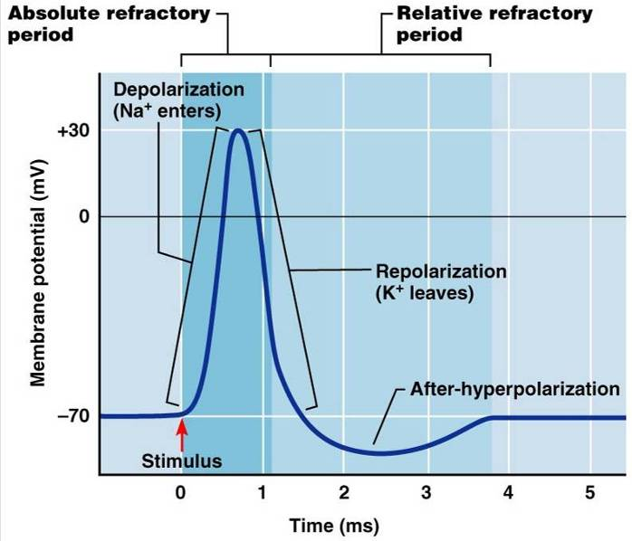
Absolute and Relative Refractory Periods

Slide 49
Relative Refractory Period
The interval following the absolute refractory period when _
The threshold level is elevated, allowing _____________________________________of action potential events

Slide 50
Conduction Velocities of Axons
Rate of impulse propagation is determined by:
the larger the diameter, the _
Presence of a _
myelination dramatically __________________________________ impulse speed

Slide 51
Saltatory Conduction
Current passes through a _
Voltage-gated Na⁺ channels are concentrated at these nodes
Action potentials are triggered only at the nodes and _
Much faster than conduction along unmyelinated axons

Slide 52
Nerve Fiber Classification
Nerve fibers are classified according to:

Slide 53
Synapses
A junction that mediates information transfer from one neuron:
To an _
Presynaptic neuron
conducts impulses _
Postsynaptic neuron
transmits impulses _

Slide 54
Synaptic Cleft
Fluid-filled space separating the presynaptic and postsynaptic neurons
Prevents nerve impulses from __________________________________ from one neuron to the next
Transmission across the synaptic cleft:
Is a ____________________________ event (as opposed to an electrical one)
Ensures unidirectional communication between neurons

Slide 55
Synaptic Cleft: Information Transfer
Nerve impulses reach the axonal terminal of the presynaptic neuron and _
Neurotransmitter is released into the synaptic cleft via _
Neurotransmitter crosses the synaptic cleft
binds to _
Postsynaptic membrane permeability changes, causing an _

Slide 56
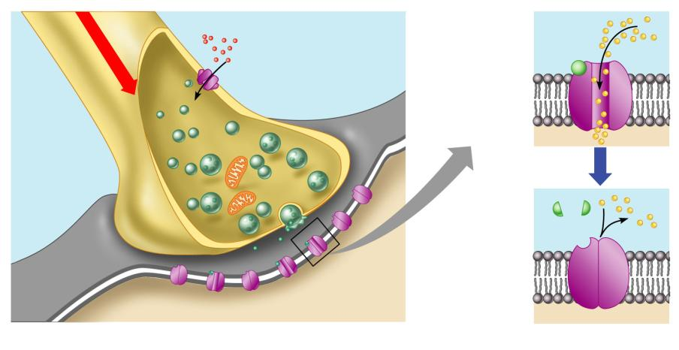
Synaptic Cleft: Information Transfer
Ca²⁺
Neurotransmitter
Na⁺
Action potential
Axon terminal of
presynaptic neuron
Receptor
1
Mitochondrion
Postsynaptic
membrane
Axon of
presynaptic
neuron
Postsynaptic
membrane
Ion channel open
Synaptic vesicles
containing
neurotransmitter
molecules
5
Degraded
neurotransmitter
2
Synaptic
cleft
3
4
Ion channel
(closed)
Ion channel closed
Ion channel (open)
Figure 11.18

Slide 57
Termination of Neurotransmitter Effects
Neurotransmitter bound to a postsynaptic receptor:
Produces a _
Blocks reception of additional “messages”
___________________________________ from its receptor
Removal of neurotransmitters occurs when they:
degraded by _
___________________________________________ by astrocytes or the presynaptic terminals
___________________________________ from the synaptic cleft

