Slide 1
Cerebral Hemispheres
Contains ridges
and shallow grooves
Contain deep grooves
Are separated by the _
Have three basic regions:
cortex, white matter, and basal nuclei

Slide 2
Major Lobes, Gyri, and Sulci of the Cerebral Hemisphere
Deep sulci divide the hemispheres into five lobes:
separates the frontal and parietal lobes

Slide 3
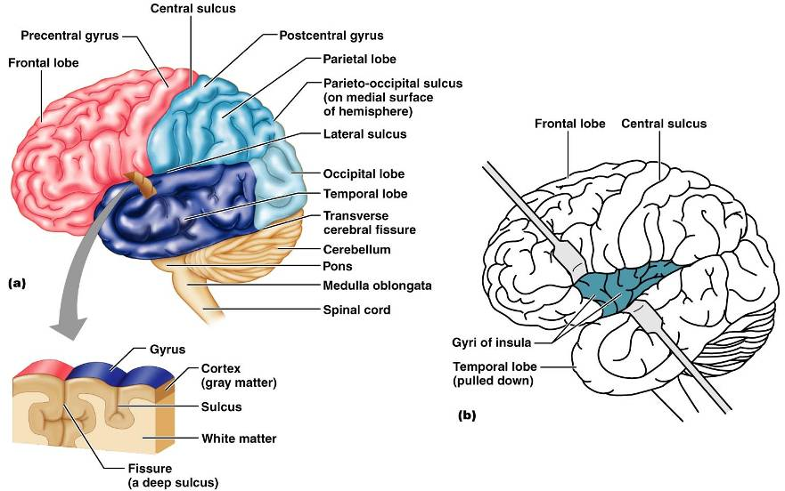
Brain Lobes

Slide 4
Major Lobes, Gyri, and Sulci of the Cerebral Hemisphere
separates the parietal and occipital lobes
separates the parietal and temporal lobes
The

Slide 5
Cerebral Cortex
The cortex
superficial gray matter
accounts for 40% of the mass of the brain
It enables
Each hemisphere acts _____________________________ (controls the opposite side of the body)
Hemispheres are not equal in function
No functional area acts alone; conscious behavior involves the entire cortex

Slide 6
Functional Areas of the Cerebral Cortex
The three types of functional areas are:
control voluntary movement
conscious awareness of sensation
integrate diverse information

Slide 7
Cerebral Cortex: Motor Areas
Primary _
Premotor cortex
Frontal eye field

Slide 8
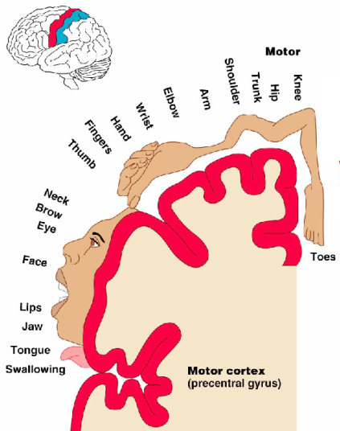
Primary Motor Cortex
Located in the _
Pyramidal cells whose axons make up the _
Allows conscious control of precise, skilled, voluntary movements

Slide 9
Premotor Cortex
Located _
Controls _
Coordinates simultaneous or sequential actions
Involved in the planning of movements

Slide 10
Broca’s Area
Broca’s area
Located anterior to the inferior region of the premotor area
Present in _
A motor speech area that _
Is active as one prepares to speak

Slide 11
Frontal Eye Field
Located anterior to the premotor cortex and superior to Broca’s area
Controls _

Slide 12
Sensory Areas
Primary _
Somatosensory association cortex
Visual and _
Olfactory, ___________________________, and vestibular cortices

Slide 13
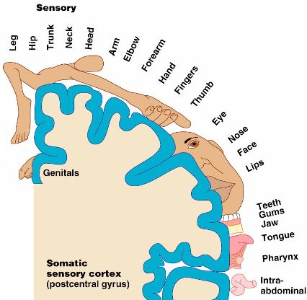
PrImary Somatosensory Cortex
Located in the postcentral gyrus, this area:
Receives information from the _
Exhibits _

Slide 14
Somatosensory Association Cortex
Located posterior to the primary somatosensory cortex
Forms _____________________________ understanding of the stimulus
Determines size, texture, and relationship of parts

Slide 15
Visual Areas
Primary visual (striate) cortex
Seen on the _
Most of it is buried in the calcarine sulcus
Receives visual information from the retinas
Visual association area
Interprets visual stimuli (e.g., color, form, and movement)

Slide 16
Auditory Areas
Primary auditory cortex
Located at the superior margin of the _
Receives information related to _
Auditory association area
Located posterior to the primary auditory cortex
____________________________________ and permits perception of sounds

Slide 17
Association Areas
Language areas
General (common) interpretation area

Slide 18
Prefrontal Cortex
Located in the _
Involved with ________________________, cognition, recall, and _
Necessary for judgment, _______________________, persistence, and conscience
Closely linked to the __________________ system (emotional part of the brain)

Slide 19
Cerebellar Cognitive Function
Plays a role in _
Recognizes and ______________________ sequences of events

Slide 20
Language Areas
Located in a large area surrounding the ________________ (or language-dominant) _
Major parts and functions:
sounding out unfamiliar words
speech preparation and production
language comprehension and word analysis
Lateral and ventral temporal lobe
coordinate auditory and visual aspects of language

Slide 21
General (Common) Interpretation Area
__________________________ region including parts of the temporal, parietal, and occipital lobes
Found in one hemisphere, _
Integrates incoming signals _
Involved in processing spatial relationships

Slide 22
Visceral Association Area
Located in the _
Involved in conscious perception of _

Slide 23
Lateralization of Cortical Function
Lateralization
each hemisphere has _
Cerebral dominance
designates the hemisphere _
Left hemisphere
controls _
Right hemisphere
controls _

Slide 24
Cerebral White Matter
Consists of deep _
It is responsible for communication between:
The cerebral cortex and lower CNS center, and areas of the cerebrum

Slide 25
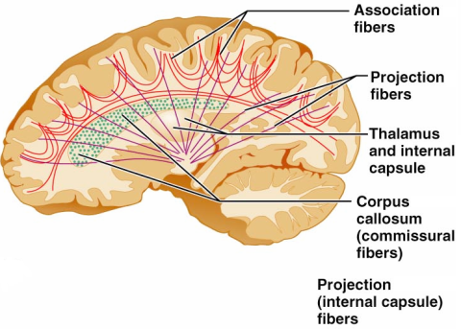
Cerebral White Matter
Types include:
connect corresponding gray areas of the two hemispheres
connect different parts of the same hemisphere
enter the hemispheres from lower brain or cord centers

Slide 26
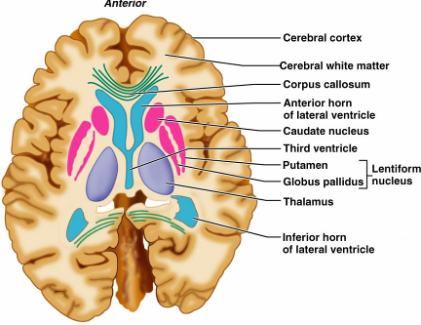
Basal Nuclei
Masses of ________ _________________ found deep within the cortical white matter
The corpus striatum is composed of three parts
composed of the putamen and the globus pallidus
_______________________________ running between and through caudate and lentiform nuclei

Slide 27
Functions of Basal Nuclei
the following are thought to be functions of basal nuclei
Influence muscular activity
Regulate _
Regulate intensity of slow or stereotyped movements
_____________________________________ and unnecessary movement

Slide 28
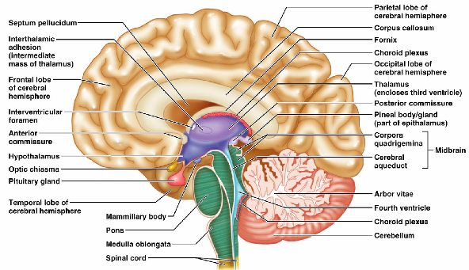
Diencephalon
Central core of the forebrain
Consists of three paired structures –
Encloses the _

Slide 29
Thalamus
Paired, egg-shaped masses that form the superolateral walls of the third ventricle
Contains four groups of nuclei
anterior, ventral, dorsal, and posterior
Nuclei _

Slide 30
Thalamic Function
___________________________________ and synapse in the thalamus
Impulses of similar function are sorted out, _________________________, and ______________________ as a group
All inputs ascending to the cerebral cortex pass through the thalamus
Mediates sensation, motor activities, cortical arousal, learning, and memory

Slide 31
Hypothalamus
Located below the thalamus, it caps the brainstem and forms the inferolateral walls of the third ventricle
Small, paired nuclei bulging anteriorly from the hypothalamus
_________________________________ for olfactory pathways
Infundibulum
stalk of the hypothalamus; _
Main _____________________________________ of the body

Slide 32
Hypothalamic Function
Regulates _
rate and force of _
______________________________ motility
rate and depth of _
many other visceral activities
Perception of _
Maintains normal body _
Regulates feelings of hunger and _
Regulates sleep and the _

Slide 33
Endocrine Functions of the Hypothalamus
____________________________________ control secretion of hormones by the anterior pituitary

Slide 34
Epithalamus
Most _______________________ of the diencephalon; forms roof of the third ventricle
extends from the posterior border and secretes _
a hormone involved with sleep regulation, sleep-wake cycles, and mood
a structure that _

Slide 35
Chapter 12

Slide 36
Brain Stem
Consists of three regions
Similar to spinal cord
but contains _
Controls ___________________________ behaviors necessary for survival
Provides the pathway for tracts between higher and lower brain centers

Slide 37
Midbrain
Located between the diencephalon and the pons
Midbrain structures include:
two bulging structures that contain descending pyramidal motor tracts
hollow tube that connects the _
Various nuclei

Slide 38
Pons
________________________________ region between the midbrain and the medulla oblongata
Fibers of the pons:
Connect higher brain centers and the spinal cord
_____________________________________ between the motor cortex and the cerebellum

Slide 39
Pons
Origin of cranial nerves

Slide 40
Medulla Oblongata
Most _______________________ part of the brain stem
Contains a ___________________________ of the fourth ventricle
two longitudinal ridges formed by _
___________________________ of the pyramids
____________________________ points of the corticospinal tracts

Slide 41
The Cerebellum
Located _
Protrudes under the occipital lobes of the cerebrum
Makes up 11% of the brain’s mass
Provides ____________________________ and appropriate patterns of skeletal muscle contraction
Cerebellar activity occurs _

Slide 42
Cerebellar Cognitive Function
Plays a role in _
Recognizes and ___________________________ sequences of events

Slide 43
Consciousness
Encompasses perception of _____________ __________________________________, and capabilities associated with higher mental processing
Involves simultaneous activity of large areas of the cerebral cortex
Is superimposed on other types of neural activity

Slide 44
Consciousness
Is holistic and _
Clinical consciousness is defined on a continuum that grades levels of behavior

Slide 45
Cerebrospinal Fluid (CSF)
Prevents the brain from _
Protects the CNS from _
_______________________________ the brain and carries chemical signals throughout it

Slide 46
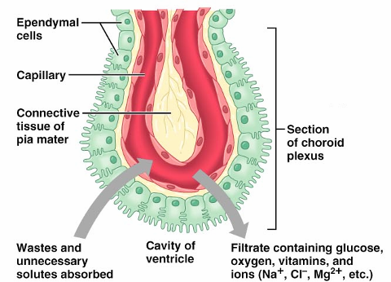
Choroid Plexuses
Clusters of _________________ that form tissue fluid filters, which hang from the roof of each ventricle
Help _

Slide 47
Blood-Brain Barrier
Protective mechanism that helps maintain a stable environment for the brain
Bloodborne substances are separated from neurons by:
Continuous _
Relatively thick _
Bulbous feet of _

Slide 48
Blood-Brain Barrier: Functions
Selective barrier that allows _______________________ to pass freely
Is ineffective against substances that can diffuse through plasma membranes
Absent in some areas __________________________________ allowing these areas to monitor the chemical composition of the blood
_____________________ increases the ability of chemicals to pass through the blood-brain barrier

