Slide 1
Protection of the Brain
The brain is protected by _
Harmful substances are shielded from the brain by the _

Slide 2
Meninges
Three connective tissue membranes lie external to the CNS
Functions of the meninges
_____________________________________ and enclose venous sinuses
Contain cerebrospinal fluid (CSF)
Form ___________________________ within the skull

Slide 3
Dura Mater
Leathery, strong covering composed of _
The two layers _______________________ in certain areas and _

Slide 4
Dura Mater
Three ___________________________ extend inward and limit excessive movement of the brain
fold that dips into the _
Falx _
runs along the _
Tentorium cerebelli
horizontal dural fold extends into the _

Slide 5
Arachnoid Mater
forms a _
It is separated from the dura mater by the _
Beneath the arachnoid is a wide subarachnoid space filled with CSF and large blood vessels
Arachnoid villi protrude superiorly and _

Slide 6
Pia Mater
_______________________ layer composed of delicate connective tissue that _

Slide 7
Cerebrospinal Fluid (CSF)
Watery solution similar in composition _
Forms a _____________________________ that gives buoyancy to the CNS organs

Slide 8
Cerebrospinal Fluid (CSF)
Prevents the brain from _
Protects the CNS from _
_______________________________ the brain and carries chemical signals throughout it

Slide 9
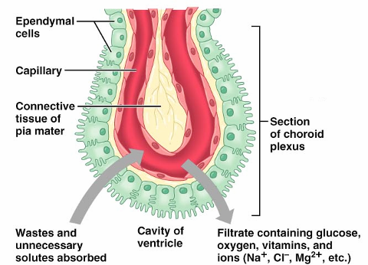
Choroid Plexuses
Clusters of _________________ that form tissue fluid filters, which hang from the roof of each ventricle
Help _

Slide 10
Blood-Brain Barrier
Protective mechanism that helps maintain a stable environment for the brain
Bloodborne substances are separated from neurons by:
Continuous _
Relatively thick _
Bulbous feet of _

Slide 11
Blood-Brain Barrier: Functions
Selective barrier that allows _______________________ to pass freely
Is ineffective against substances that can diffuse through plasma membranes
Absent in some areas __________________________________ allowing these areas to monitor the chemical composition of the blood
_____________________ increases the ability of chemicals to pass through the blood-brain barrier

Slide 12
Spinal Cord
CNS tissue is enclosed within the vertebral column from the _
Provides two-way communication to and from the brain
Protected by _
space between the vertebrae and the dural mater filled with _

Slide 13
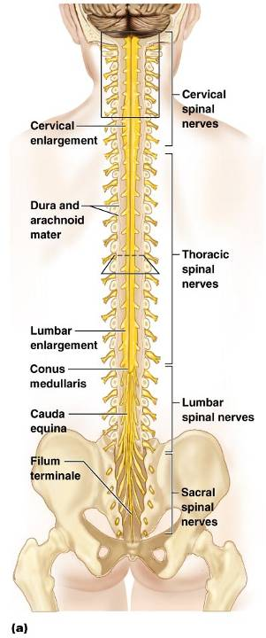
Spinal Cord
terminal portion of the spinal cord
fibrous extension of the pia mater; anchors the spinal cord to the coccyx
delicate shelves of pia mater; attach the spinal cord to the vertebrae

Slide 14
Spinal Cord
Spinal nerves
_________________ attach to the cord by paired roots
Cervical and lumbar _
sites where nerves _
collection of nerve roots at the inferior end of the vertebral canal

Slide 15
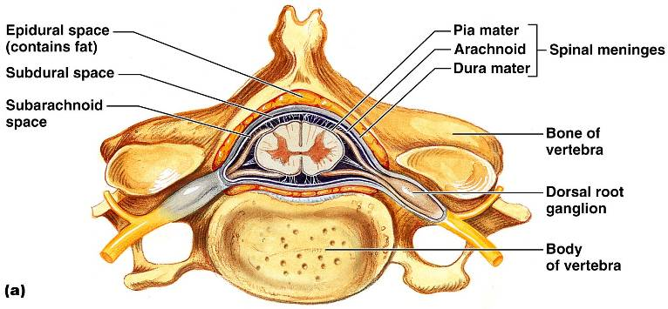
Cross-Sectional Anatomy of the Spinal Cord
__________________________ – separates anterior funiculi
__________________________ – divides posterior funiculi

Slide 16
Gray Matter and Spinal Roots
Gray matter consists of
neuroglia
Gray _
connects masses of gray matter; encloses central canal
Posterior (dorsal) horns
Anterior (ventral) horns
interneurons and _
Lateral horns
contain _

Slide 17
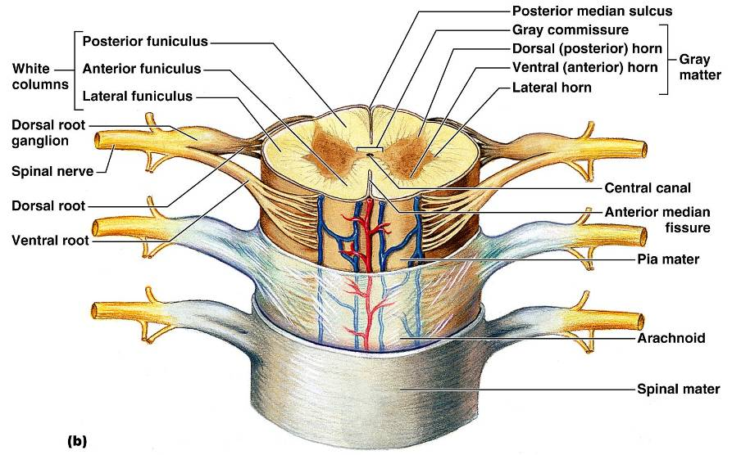
Gray Matter and Spinal Roots

Slide 18
Gray Matter: Organization
Dorsal half
Dorsal and ventral roots _________________________ to form _

Slide 19
White Matter in the Spinal Cord
Fibers run in three directions
Divided into three funiculi _
posterior, lateral, and anterior
Each funiculus contains several fiber tracks
Fiber tract names reveal their _
Fiber tracts are composed of axons with similar functions

Slide 20
White Matter: Pathway Generalizations
Pathways _
Most consist of two or three neurons
Pathways are _
one on each side of the _

Slide 21
Main Ascending Pathways
The central processes of fist-order neurons branch diffusely _
Some branches take part in spinal cord reflexes
Others synapse with second-order neurons in the _
Fibers from touch and pressure receptors form collateral synapses with _

Slide 22
Three Ascending Pathways
The nonspecific and specific ascending pathways _
These pathways are responsible for _
The spinocerebellar tracts send impulses to the ___________________________ and do not contribute to _

Slide 23
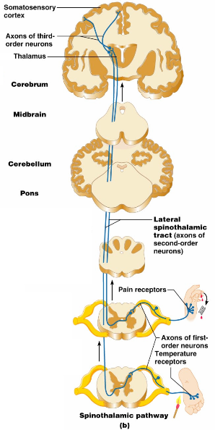
Nonspecific Ascending Pathway
Nonspecific pathway for
within the ____________________ tract

Slide 24
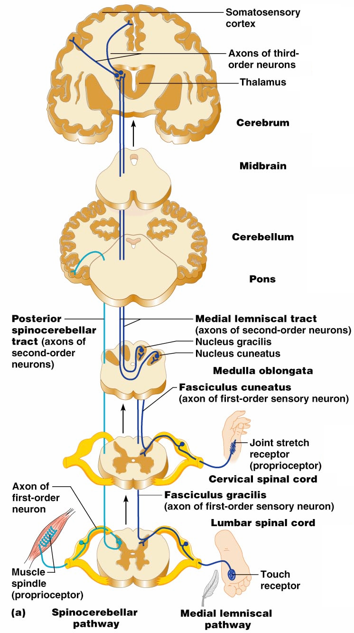
Specific and Posterior Spinocerebellar Tracts
Specific ascending pathways within the
fasciculus gracilis
fasciculus cuneatus tracts, and their continuation in the
medial lemniscal tracts
The _

Slide 25
Descending (Motor) Pathways
Descending tracts deliver ___________________________ impulses from the brain to the spinal cord, and are divided into two groups
_______________________ pathways equivalent to the _
_______________________ pathways, essentially all others
Motor pathways involve two neurons _

Slide 26
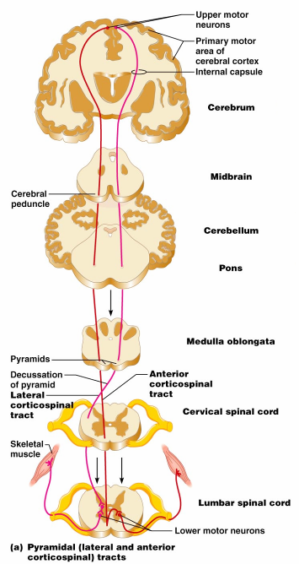
The Direct (Pyramidal) System
Direct pathways originate with the pyramidal neurons in the _
Impulses are sent through the _____________________ and synapse in the _
Stimulation of anterior horn neurons activates skeletal muscles
The direct pathway regulates _

Slide 27
Indirect (Extrapyramidal) System
Includes the
motor nuclei
motor pathways ____________ part of the pyramidal system
This system includes the
Vestibulospinal
Reticulospinal
Tectospinal tracts

Slide 28
Indirect (Extrapyramidal) System
These motor pathways are complex and ___________________________, and regulate:
Axial muscles that maintain _
Muscles controlling ___________________________________ of the proximal portions of limbs
Head, neck, and eye movement

Slide 29
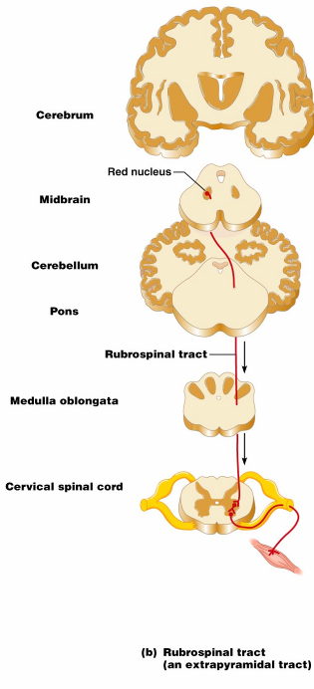
Extrapyramidal Pathways
Reticulospinal tracts
Rubrospinal tracts
control _
Superior colliculi and tectospinal tracts
mediate _

Slide 30
Spinal Cord Trauma: Paralysis
Paralysis
Flaccid paralysis
severe damage to the _
_______________________________________ are damaged and impulses do not reach muscles
There is no _

Slide 31
Spinal Cord Trauma: Paralysis
Spastic paralysis
only ___________________________________ of the primary motor cortex are damaged
Spinal neurons remain intact and _
There is ____________________________________ of muscles

Slide 32
Spinal Cord Trauma: Transection
Cross sectioning of the spinal cord at any level results in total motor and sensory loss in regions inferior to the cut
Paraplegia
Quadriplegia

Slide 33
Chapter 13

Slide 34
Peripheral Nervous System (PNS)
PNS
all neural structures _
Includes
associated ganglia
Provides links to and from the external environment

Slide 35
Sensory Receptors
Structures specialized to _
Activation of sensory receptors results in ______________________________ that trigger impulses to the CNS
The realization of these stimuli, _________________________________, occur in the brain

Slide 36
Receptor Classification by Stimulus Type
Mechanoreceptors
respond to _
sensitive to changes in temperature
Photoreceptors
respond to _
Chemoreceptors
respond to chemicals (e.g., smell, taste, changes in blood chemistry)
sensitive to _

Slide 37
Receptor Class by Location: Exteroceptors
Respond to stimuli arising _
Found near the _
Sensitive to touch, pressure, pain, and temperature
Include the _

Slide 38
Receptor Class by Location: Interoceptors
Respond to stimuli _
Found in _
Sensitive to chemical changes, stretch, and temperature changes

Slide 39
Receptor Class by Location: Proprioceptors
Respond to _____________________________ of the organs they occupy
Found in skeletal muscles, tendons, joints, ligaments, and connective tissue coverings of bones and muscles

Slide 40
Receptor Classification by Structural Complexity
Receptors are structurally classified as either _
Most receptors are simple and include __________________________________ varieties
Complex receptors are _

Slide 41
Simple Receptors: Unencapsulated
Respond chiefly to _
Merkel (tactile) discs
Hair follicle receptors

Slide 42
Simple Receptors: Encapsulated
___________________________ corpuscles
tactile corpuscles
___________________________ corpuscles
lamellated corpuscles
Muscle spindles, _____________________________, and Ruffini’s corpuscles
Joint kinesthetic receptors

Slide 43
From Sensation to Perception
Survival depends upon sensation and perception
Sensation
the ________________________________ in the internal and external environment
Perception
the conscious _________________________ of those stimuli

Slide 44
Organization of the Somatosensory System
Input comes from _
The three main levels of neural integration in the somatosensory system are:
Receptor level
the _
Circuit level
Perceptual level
neuronal circuits in the _

Slide 45
Adaptation of Sensory Receptors
Adaptation occurs when sensory receptors are subjected to an _
Receptor membranes become _
Receptor __________________________ decline in frequency or stop

Slide 46
Adaptation of Sensory Receptors
Receptors responding to _
Receptors responding slowly include Merkel’s discs, Ruffini’s corpuscles, and interoceptors that _

