Slide 1
Processing at the Circuit Level
Chains of three neurons conduct sensory impulses upward to the brain
soma reside in dorsal root or cranial ganglia, and conduct impulses from _
Second-order neurons
soma reside in the dorsal horn of the spinal cord or medullary nuclei and _
Third-order neurons
located in the thalamus and conduct impulses to the _

Slide 2
Main Aspects of Sensory Perception
detecting that a stimulus has occurred and requires summation
Magnitude estimation
Spatial discrimination
identifying the site or _

Slide 3
Main Aspects of Sensory Perception
Feature abstraction
used to identify a substance that has _
the ability to identify submodalities of a sensation (e.g., sweet or sour tastes)
ability to recognize patterns in stimuli (e.g., melody, familiar face)

Slide 4
Structure of a Nerve
Nerve
cordlike organ of the PNS consisting of _
Connective tissue coverings include:
_____________________________ – loose connective tissue that surrounds axons
_____________________________ – coarse connective tissue that bundles fibers into fascicles
_____________________________ – tough fibrous sheath around a nerve

Slide 5
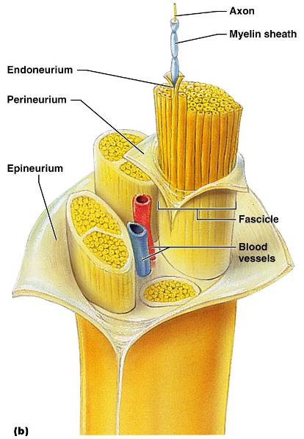
Structure of a Nerve

Slide 6
Classification of Nerves
Sensory and motor divisions
Sensory (afferent)
Motor (efferent)
carry impulses _
sensory and motor fibers carry impulses to and from CNS; _

Slide 7
Peripheral Nerves
Mixed nerves
carry _
The four types of mixed nerves are:
____________________ afferent and somatic efferent
____________________ afferent and visceral efferent
Peripheral nerves originate from the brain or spinal column

Slide 8
Regeneration of Nerve Fibers
Damage to nerve tissue is serious because mature neurons are _
If the soma of a damaged nerve remains intact, _
Regeneration involves coordinated activity among:
Macrophages – _
______________________ – form regeneration tube and secrete growth factors
_____________________ – regenerate damaged part

Slide 9
Cranial Nerves
_____________________________ of cranial nerves arise from the brain
They have sensory, motor, or both sensory and motor functions
Each nerve is identified by a ___________________ (I through XII) and a _
Four cranial nerves carry _______________________________ that serve muscles and glands

Slide 10
Cranial Nerve I: Olfactory
Arises from the _
Passes through the __________________ plate of the ethmoid bone
Fibers run through the ________________________ and terminate in the primary _
Functions solely by carrying _

Slide 11
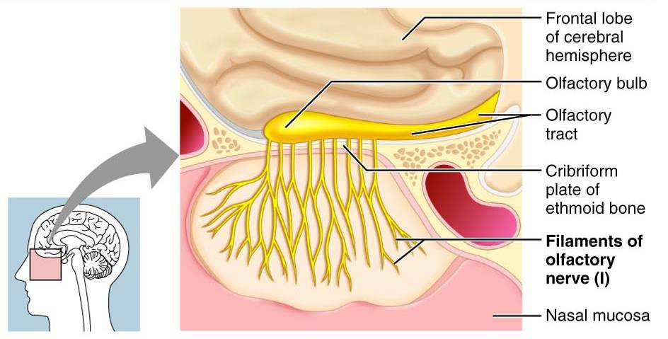
Cranial Nerve I: Olfactory

Slide 12
Cranial Nerve II: Optic
Arises from the _
Optic nerves pass through the __________________________ and converge at the _
They continue to the _____________________ where they synapse
From there, the ______________________________ run to the visual cortex
Functions solely by carrying _

Slide 13
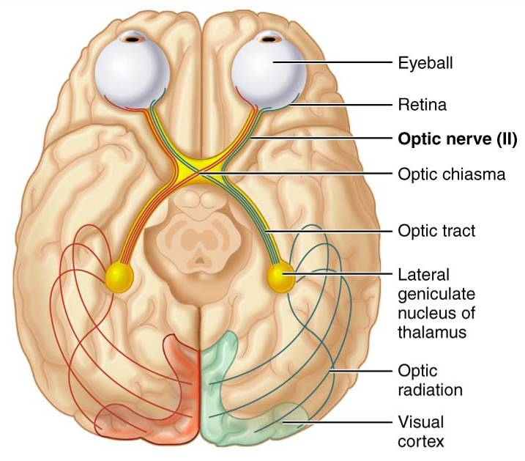
Cranial Nerve II: Optic

Slide 14
Cranial Nerve III: Oculomotor
Fibers extend from the ventral midbrain, pass through the superior orbital fissure, and go to the _
Functions in __________________________, directing the eyeball, constricting the iris, and controlling lens shape
_____________________________ cell bodies are in the _

Slide 15
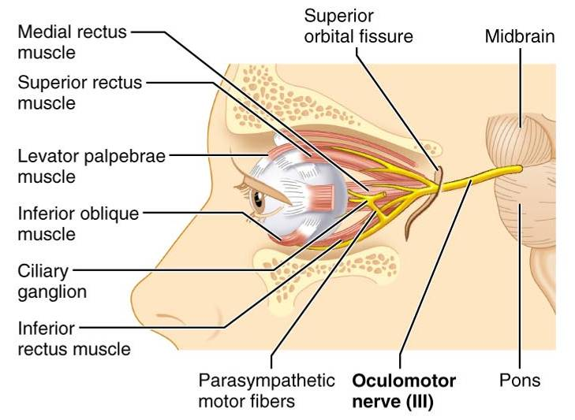
Cranial Nerve III: Oculomotor

Slide 16
Cranial Nerve IV: Trochlear
Fibers emerge from the _____________________ and enter the orbits via the superior orbital fissures; innervate the _
Primarily a _________________________ that directs the eyeball

Slide 17
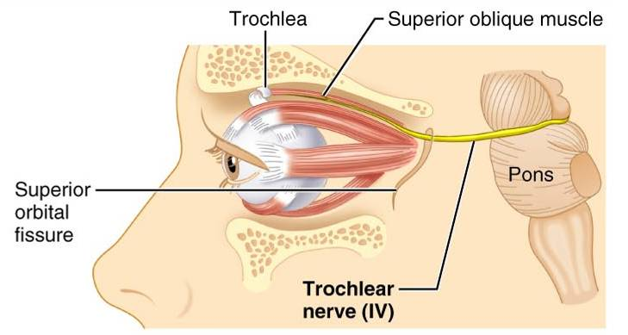
Cranial Nerve IV: Trochlear

Slide 18
Cranial Nerve V: Trigeminal
Three divisions:
Conveys _______________________ impulses from various areas of the face (V₁) and (V₂), and supplies _

Slide 19
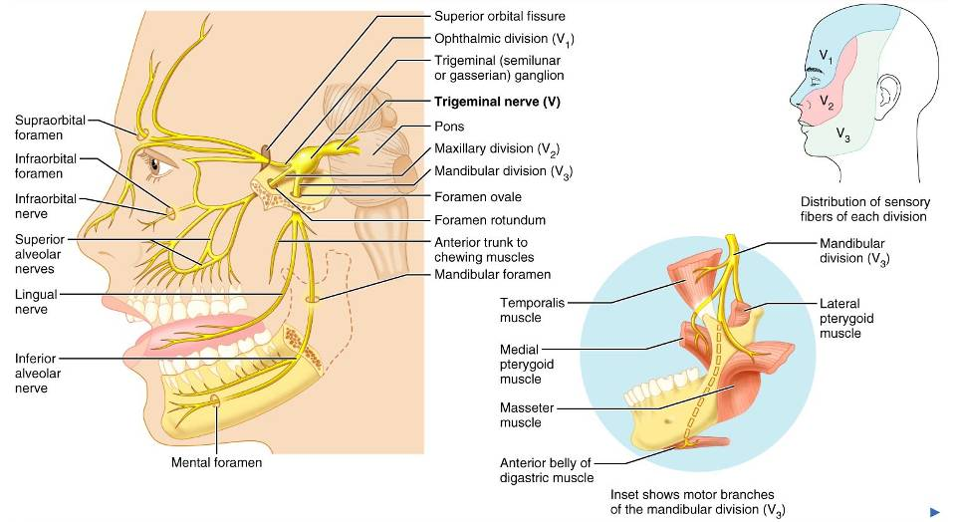
Cranial Nerve V: Trigeminal

Slide 20
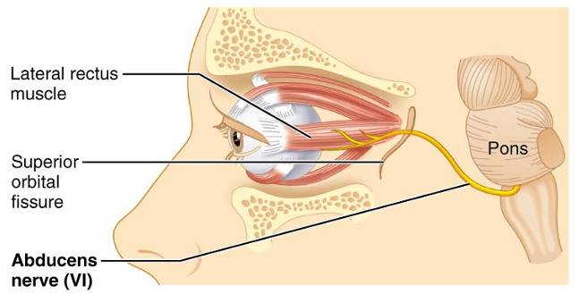
Cranial Nerve VI: Abdcuens
Fibers leave the __________________________ and enter the orbit via the _
Primarily a motor nerve innervating the _

Slide 21
Cranial Nerve VII: Facial
Fibers leave the pons, travel through the _______________________________, and emerge through the stylomastoid foramen to the lateral aspect of the face
__________________________ with five major branches
Motor functions include ____________________________, and the transmittal of ___________________________ impulses to lacrimal and salivary glands
______________________________________ from the anterior two-thirds of the tongue

Slide 22
Cranial Nerve VII: Facial

Slide 23
Cranial Nerve VIII: Vestibulocochlear
Fibers arise from the hearing and equilibrium apparatus of the inner ear, pass through the _
Two divisions
Functions are solely _
equilibrium and hearing

Slide 24
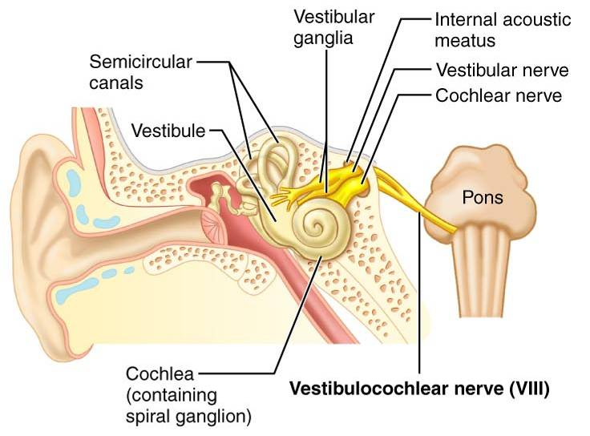
Cranial Nerve VIII: Vestibulocochlear

Slide 25
Cranial Nerve IX: Glossopharyngeal
Fibers emerge from the medulla, leave the skull via the jugular foramen, and run _
Nerve IX is a _______________________ with motor and sensory functions
Motor
innervates part of the ________________________, and provides motor fibers to the ________________________________ gland
Sensory
fibers _______________________________ and general sensory impulses from the tongue and pharynx

Slide 26
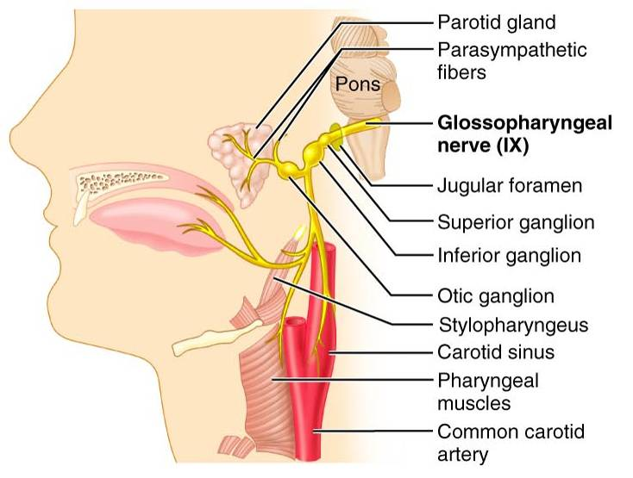
Cranial Nerve IX: Glossopharyngeal

Slide 27
Cranial Nerve X: Vagus
The _
Fibers emerge from the medulla via the jugular foramen
The vagus is a _
Most motor fibers are __________________________________ to the heart, lungs, and visceral organs
Its sensory function is _

Slide 28
Cranial Nerve X: Vagus

Slide 29
Cranial Nerve XI: Accessory
Formed from a cranial root emerging from the ___________________________ and a spinal root arising from the _
The spinal root passes upward into the cranium via the _
The accessory nerve leaves the cranium via the jugular foramen

Slide 30
Cranial Nerve XI: Accessory
Primarily a _
Supplies fibers to the _
Innervates the ____________________________________ which move the head and neck

Slide 31
Cranial Nerve XI: Accessory

Slide 32
Cranial Nerve XII: Hypoglossal
Fibers arise from the medulla and exit the skull via the _
Innervates both _________________________________, which contribute to swallowing and speech

Slide 33
Cranial Nerve XII: Hypoglossal

Slide 34
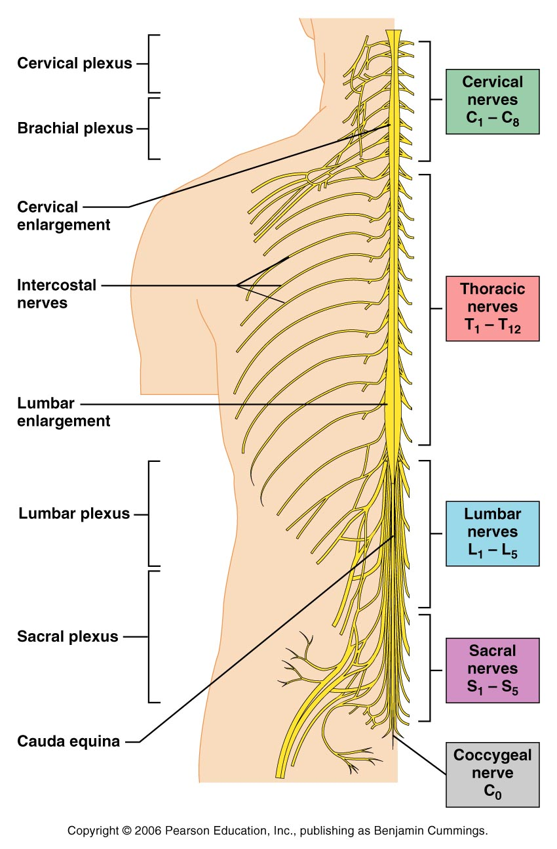
Spinal Nerves
Thirty-one pairs of ______________________ nerves arise from the spinal cord and supply all parts of the body _
They are named according to their point of issue
8 cervical (C₁-C₈)
12 thoracic (T₁-T₁₂)
5 Lumbar (L₁-L₅)
5 Sacral (S₁-S₅)
1 Coccygeal (C₀)

Slide 35
Spinal Nerves: Roots
Each spinal nerve connects to the _
Each root forms a series of rootlets that attach to the spinal cord
____________________________ arise from the _________________________ and contain _
____________________________ arise from _________________________ in the dorsal root ganglion and contain _

Slide 36
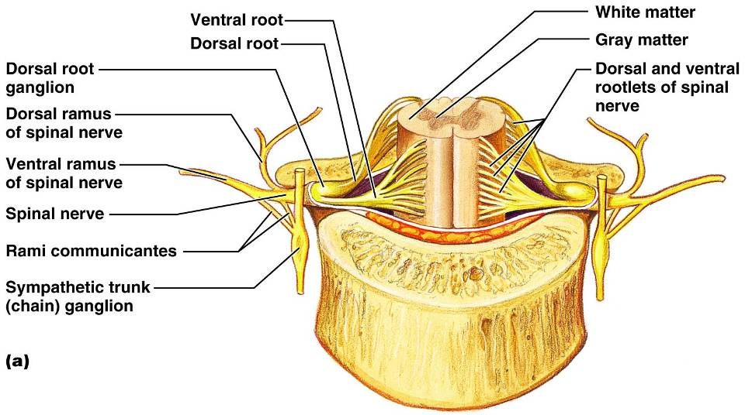
Spinal Nerves: Roots

Slide 37
Spinal Nerves: Rami
The short spinal nerves branch into three or four mixed, distal rami
Rami communicantes at the base of the ventral rami in the thoracic region

Slide 38
Nerve Plexuses
All ventral rami except T₂-T₁₂ form interlacing nerve networks called _
Plexuses are found in the cervical, brachial, lumbar, and sacral regions
Each resulting branch of a plexus contains fibers _

Slide 39
Nerve Plexuses
Fibers travel to the periphery via several different routes
Each muscle receives a nerve supply from _
Damage to _________________________________ cannot completely paralyze a muscle

Slide 40
Spinal Nerve Innervation:
The back is innervated by ______________________ via several branches
The thorax is innervated by __________________________ T₁-T₁₂ as intercostal nerves
Intercostal nerves supply muscles of the ribs, anterolateral thorax, and abdominal wall

Slide 41
Cervical Plexus
The ____________________________ is formed by ventral rami of C₁-C₄
Most branches are _________________________________ of the neck, ear, back of head, and shoulders
The ______________________ nerve of this plexus is the _
The phrenic nerve is the major motor and sensory nerve of the diaphragm

Slide 42
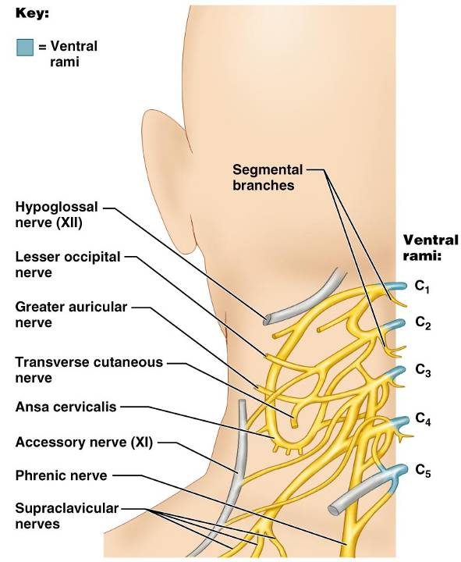
Cervical Plexus

Slide 43
Brachial Plexus
Formed by C₅-C₈ and T₁ (C₄ and T₂ may also contribute to this plexus)
It gives rise to the nerves that _

Slide 44
Brachial Plexus
There are four major branches of this plexus
____________________________ – five ventral rami (C₅-T₁)
____________________________ – upper, middle, and lower, which form divisions
____________________________ – anterior and posterior serve the front and back of the limb
_____________________________ – lateral, medial, and posterior fiber bundles

Slide 45
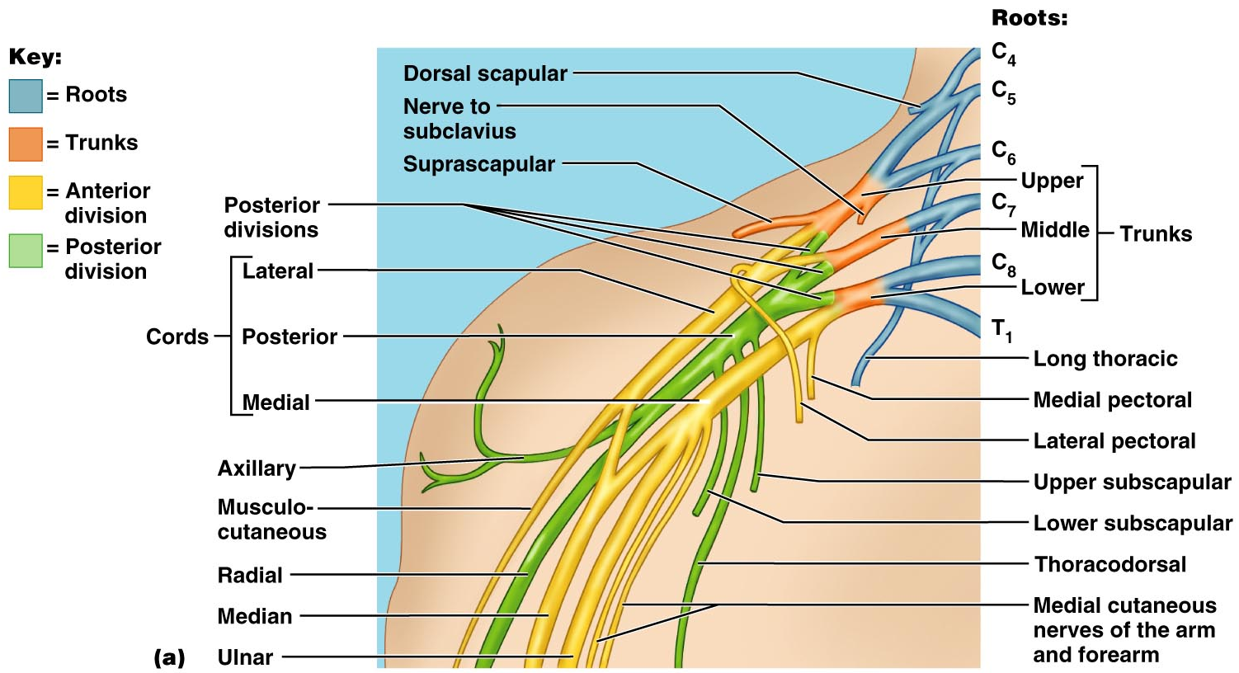
Brachial Plexus

Slide 46
Brachial Plexus: Nerves
innervates the _
sends fibers to the _
branches to most of the _
supplies the flexor carpi ulnaris and part of the flexor digitorum profundus
innervates essentially _

Slide 47
Lumbar Plexus
Arises from L₁-L₄ and innervates the _
The major nerves are the _

Slide 48
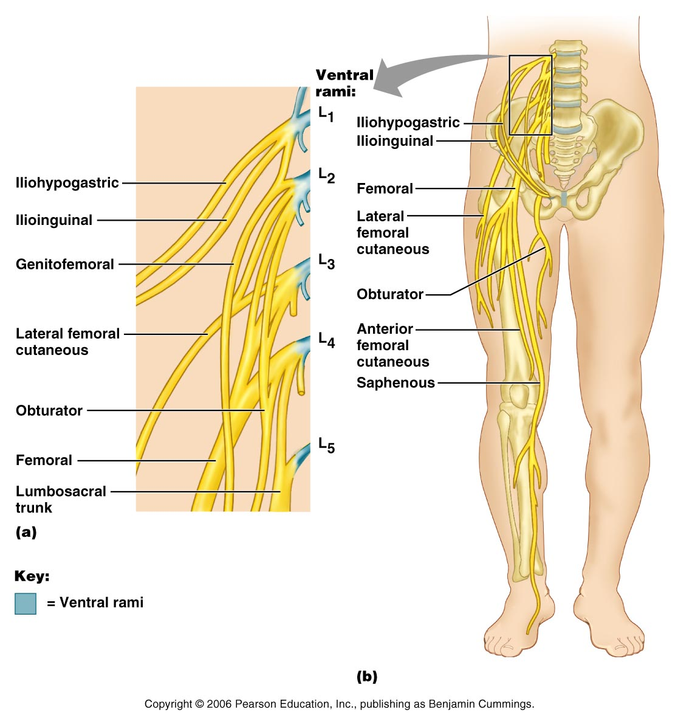
Lumbar Plexus
Figure 13.10

Slide 49
Sacral Plexus
Arises from L₄-S₄ and serves the _
The major nerve is the _________________________, the longest and thickest nerve of the body
The sciatic is actually composed of two nerves:

Slide 50
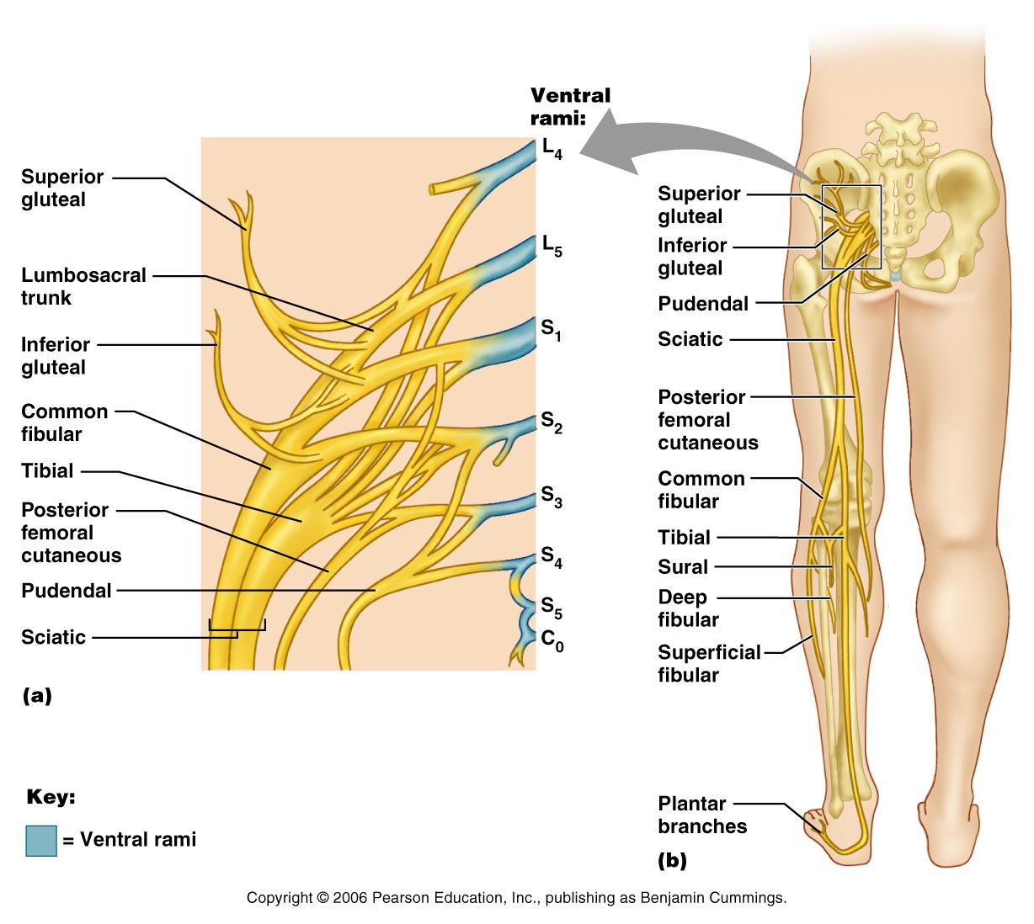
Sacral Plexus

