Slide 1
Innervation of Joints
Hilton’s law: any nerve serving a muscle that _____________________________ at a joint also innervates the ___________________________ and the _

Slide 2
Reflexes
A reflex is a ______________________, predictable motor response to a stimulus
Reflexes may:
Be inborn _
Involve only _________________________ and the _
Involve higher brain centers as well

Slide 3
Reflex Arc
There are five components of a reflex arc
site of stimulus
transmits the afferent impulse to the CNS
either monosynaptic or polysynaptic region within the CNS
conducts efferent impulses from the integration center to an effector
muscle fiber or gland that responds to the efferent impulse

Slide 4
Reflex Arc
Figure 13.14

Slide 5
Stretch and Deep Tendon Reflexes
For skeletal muscles to perform normally:
The ____________________________________ must constantly inform the brain as to the state of the muscle
___________________________________ initiated by muscle spindles must maintain healthy muscle tone

Slide 6
Muscle Spindles
Muscle spindles are wrapped with two types of afferent endings: primary sensory endings of type ____________________ and secondary sensory endings of _
These regions are innervated by gamma (γ) efferent fibers
Note: contractile muscle fibers are extrafusal fibers and are innervated by alpha (α) efferent fibers

Slide 7
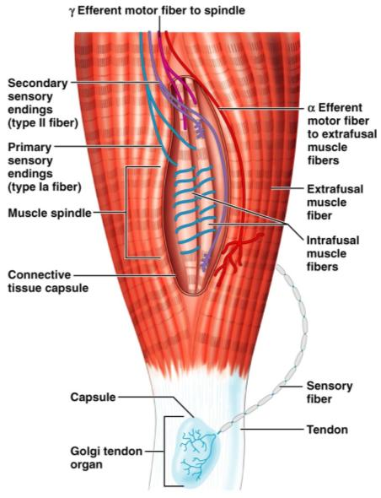
Muscle Spindles
Figure 13.15

Slide 8
Operation of the Muscle Spindles
_________________________________ activates the muscle spindle
There is an increased rate of action potential in _
Contracting the muscle _________________________________ on the muscle spindle
There is a __________________________ rate of action potential on Ia fibers

Slide 9
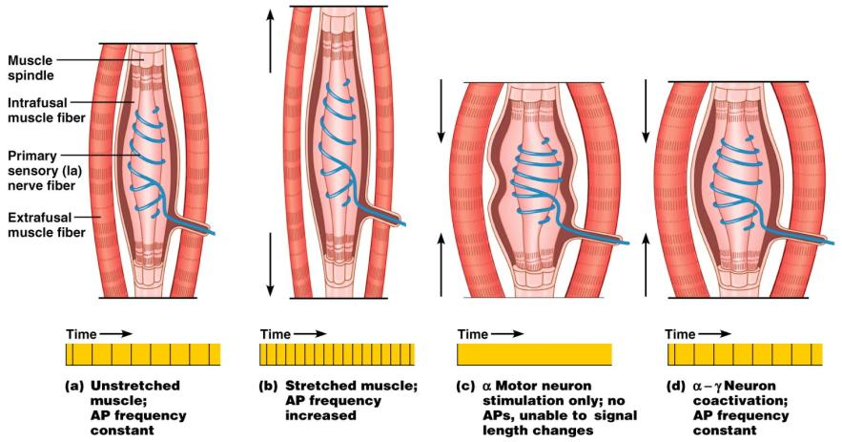
Operation of the Muscle Spindle
Figure 13.17

Slide 10
Stretch Reflex
Stretching the muscle _
Excited γ motor neurons of the spindle cause the stretched muscle to contract
Afferent impulses from the spindle result in _
Example: patellar reflex
Tapping the patellar tendon stretches the quadriceps and starts the reflex action
The quadriceps contract _

Slide 11
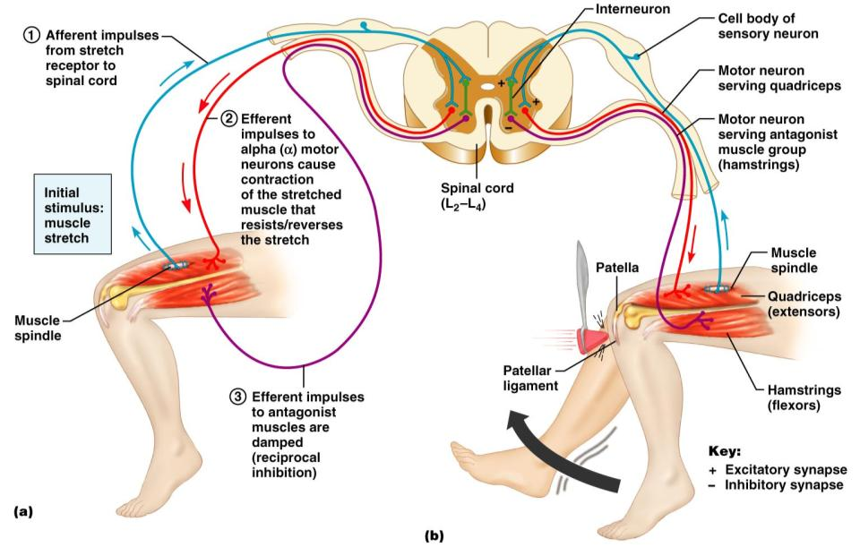
Stretch Reflex

Slide 12
Golgi Tendon Reflex
The _
_______________________ the muscle activates the Golgi tendon organs
Afferent Golgi tendon neurons are stimulated, _________________________________, and the antagonistic muscle is activated
As a result, the _

Slide 13
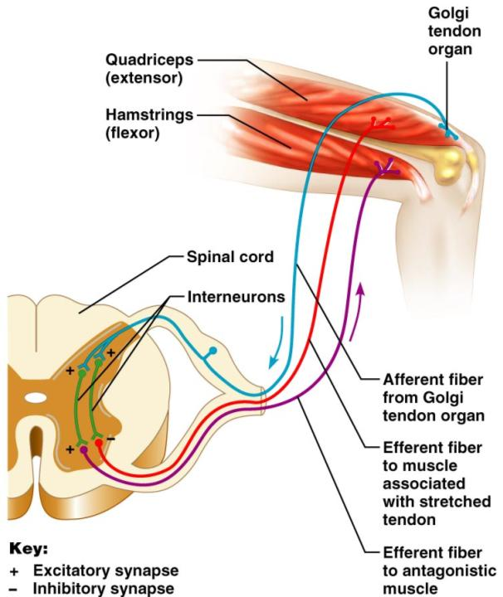
Golgi Tendon Reflex

Slide 14
Flexor and Crossed Extensor Reflexes
The ____________________________ is initiated by a ______________________ (actual or perceived) that causes automatic withdrawal of the threatened body part
The ______________________________ has two parts
The stimulated side is _
The contralateral side is _

Slide 15
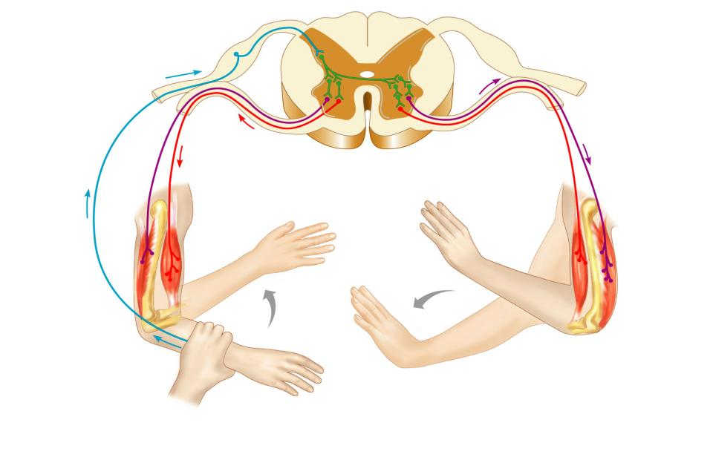
Crossed Extensor Reflex
+
Interneurons
+
–
+
+
–
Afferent
fiber
Efferent
fibers
Efferent
fibers
Extensor
inhibited
Flexor
inhibited
Flexor
stimulated
Flexes
Arm movements
Extensor
stimulated
Extends
Key:
+ Excitatory synapse
– Inhibitory synapse
Right arm
(site of stimulus)
Left arm (site of
reciprocal activation)

Slide 16
Superficial Reflexes
Initiated by gentle _
Example:
_________________________________ is initiated by stimulating the lateral aspect of the sole of the foot
The response is _
Indirectly tests for proper _
__________________________________: abnormal plantar reflex indicating corticospinal damage where the _

