Slide 1
Cranial Nerve V: Trigeminal
Three divisions:
Conveys sensory impulses from various areas of the face (V₁) and (V₂), and supplies motor fibers (V₃) for _

Slide 2
Cranial Nerve VI: Abdcuens
Fibers leave the inferior pons and enter the orbit via the superior orbital fissure
Primarily a ____________________________innervating the _

Slide 3
Cranial Nerve VII: Facial
Fibers leave the pons, travel through the _____________________________________, and emerge through the stylomastoid foramen to the lateral aspect of the face
_____________________________________ with five major branches
Motor functions ____________________________________, and the transmittal of autonomic impulses to lacrimal and salivary glands
Sensory function is __________________________ from the anterior two-thirds of the tongue

Slide 4
Cranial Nerve VIII: Vestibulocochlear
Fibers arise from the hearing and equilibrium apparatus of the inner ear, pass through the internal acoustic meatus, and enter the brainstem at the pons-medulla border
Two divisions
Functions are solely sensory

Slide 5
Cranial Nerve IX: Glossopharyngeal
Fibers emerge from the medulla, leave the skull via the jugular foramen, and run to the _
Nerve IX is a ________________________________ with motor and sensory functions
Motor
innervates part of the ______________________________________________, and provides motor fibers to the parotid salivary gland
Sensory
fibers conduct ___________________________________ and general sensory impulses from the _

Slide 6
Cranial Nerve X: Vagus
The _________________________ cranial nerve that extends _
Fibers emerge from the medulla via the jugular foramen
The vagus is a _
Most motor fibers are _____________________________________ to the heart, lungs, and visceral organs
Its sensory function is in _

Slide 7
Cranial Nerve XI: Accessory
Formed from a cranial root emerging from the medulla _____________a __________________________________ arising from the superior region of the spinal cord
The spinal root passes upward into the cranium via the foramen magnum
The accessory nerve leaves the cranium via the jugular foramen

Slide 8
Cranial Nerve XI: Accessory
Primarily a motor nerve
Supplies fibers to the _
Innervates the _________________________________________________________________________________, which move the head and neck

Slide 9
Cranial Nerve XII: Hypoglossal
Fibers arise from the medulla and exit the skull via the _
Innervates both _____________________________________ of the tongue, which contribute to _

Slide 10
Spinal Nerves
Thirty-one pairs of mixed nerves arise from the spinal cord and supply _
They are named according to their point of issue
8 cervical (C₁-C₈)
12 thoracic (T₁-T₁₂)
5 Lumbar (L₁-L₅)
5 Sacral (S₁-S₅)
1 Coccygeal (C₀)

Slide 11
Spinal Nerves: Roots
Each spinal nerve connects to the spinal cord via _
Each root forms a series of rootlets that attach to the spinal cord
____________________________________ arise from the _________________________________and contain _
Dorsal roots arise from _______________________________________ in the dorsal root ganglion and contain sensory (afferent) fibers

Slide 12
Spinal Nerves: Rami
The short spinal nerves branch into three or four mixed, distal rami
Tiny _
Rami communicantes at the base of the ventral rami in the thoracic region

Slide 13
Nerve Plexuses
All ventral rami except T₂-T₁₂ form interlacing nerve ___________________________called _
Plexuses are found in the cervical, brachial, lumbar, and sacral regions
Each resulting branch of a plexus contains _

Slide 14
Nerve Plexuses
Fibers travel to the periphery via several different routes
Each muscle receives a nerve supply _
Damage to _____________________________________ cannot completely paralyze a muscle

Slide 15
Spinal Nerve Innervation:
The back is innervated by ______________________________ via several branches
The thorax is innervated by _________________________________ T₁-T₁₂ as intercostal nerves
Intercostal nerves supply muscles of the ribs, anterolateral thorax, and abdominal wall

Slide 16
Cervical Plexus
The __________________________________ is formed by ventral rami of C₁-C₄
Most branches are ________________________________ nerves of the neck, ear, back of head, and shoulders
The most important nerve of this plexus is the _
The phrenic nerve is the major _

Slide 17
Brachial Plexus
Formed by C₅-C₈ and T₁ (C₄ and T₂ may also contribute to this plexus)
It gives rise to the _

Slide 18
Brachial Plexus
There are four major branches of this plexus
_______________________________________ – five ventral rami (C₅-T₁)
_______________________________________– upper, middle, and lower, which form divisions
_______________________________________– anterior and posterior serve the front and back of the limb
_______________________________________– lateral, medial, and posterior fiber bundles

Slide 19
Brachial Plexus: Nerves
Axillary
Musculocutaneous
sends fibers to the biceps brachii and brachialis
branches to most of the flexor muscles of arm
supplies the flexor carpi ulnaris and part of the flexor digitorum profundus
Radial
innervates essentially all _

Slide 20
Lumbar Plexus
Arises from L₁-L₄ and innervates the _
The major nerves are the _

Slide 21
Sacral Plexus
Arises from L₄-S₄ and serves the buttock, lower limb, pelvic structures, and the perineum
The major nerve is the _
The sciatic is actually composed of two nerves:

Slide 22
Innervation of Joints
Hilton’s law: any nerve serving a muscle that produces _____________________________ at a joint also innervates the _

Slide 23
Reflexes
A reflex is a _
Reflexes may:
Be inborn _
Involve only peripheral nerves and the _
Involve higher brain centers as well

Slide 24
Reflex Arc
There are five components of a reflex arc
site of stimulus
transmits the afferent impulse to the CNS
either monosynaptic or polysynaptic region within the CNS
conducts efferent impulses from the integration center to an effector
muscle fiber or gland that responds to the efferent impulse

Slide 25
Stretch and Deep Tendon Reflexes
For skeletal muscles to perform normally:
The Golgi tendon organs (_______________________________________) must constantly inform the brain as to the state of the muscle
Stretch reflexes initiated by muscle spindles must maintain healthy _

Slide 26
Muscle Spindles
Muscle spindles are wrapped with ______________________________________: primary sensory endings of type Ia fibers and secondary sensory endings of type II fibers
These regions are innervated by gamma (γ) efferent fibers
Note: contractile muscle fibers are extrafusal fibers and are innervated by alpha (α) efferent fibers

Slide 27
Operation of the Muscle Spindles
__________________________________ the muscles activates the muscle spindle
There is an _________________________________________________________________________________ in Ia fibers
___________________________________ the muscle ________________________________________on the muscle spindle
There is a decreased rate of action potential on Ia fibers

Slide 28
Stretch Reflex
Stretching the muscle _
Excited γ motor neurons of the spindle cause the stretched muscle to contract
Afferent impulses from the spindle result in inhibition of the antagonist
Example:
Tapping the patellar tendon _
The quadriceps contract and the _

Slide 29
Golgi Tendon Reflex
The _____________________________ of the stretch reflex
____________________________________ the muscle _
Afferent Golgi tendon neurons are stimulated, neurons inhibit the contracting muscle, and the antagonistic muscle is activated
As a result, the contracting muscle relaxes and the antagonist contracts

Slide 30
Flexor and Crossed Extensor Reflexes
_____________________________________ is initiated by a _________________________ stimulus (actual or perceived) that causes automatic _____________________________________ of the threatened body part
The crossed extensor reflex has two parts
The stimulated side is _
The _

Slide 31
Superficial Reflexes
Initiated by gentle ___________________________________ stimulation
Example:
__________________________________________ is initiated by stimulating the lateral aspect of the sole of the foot
The response is _
Indirectly tests for proper ____________________________________________ functioning
_________________________________________ : abnormal plantar reflex indicating corticospinal damage where the great toe dorsiflexes and the smaller toes fan laterally

Slide 32
Autonomic Nervous System (ANS)
The ANS consists of motor neurons that:
Innervate _
Make adjustments to ensure optimal support for body activities
Operate via _
Have ____________________________________ as most of their _

Slide 33
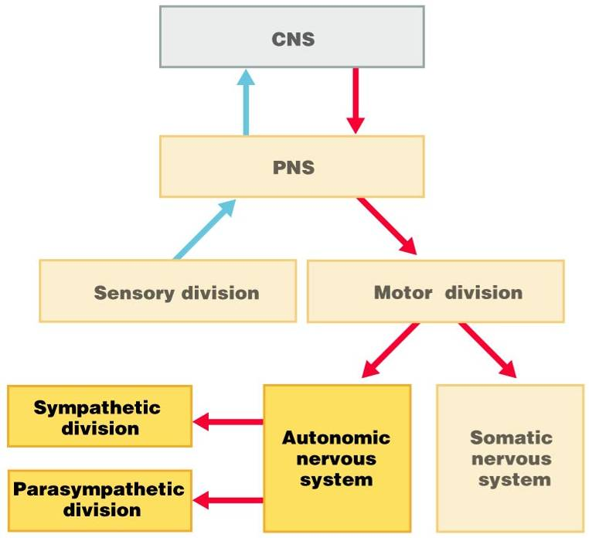

Slide 34
ANS Versus Somatic Nervous System (SNS)
The ANS differs from the SNS in the following three areas
Efferent _
Target organ responses

Slide 35
Effectors
The effectors of the _____________ are _
The effectors of the ________________ are _

Slide 36
Efferent Pathways
_____________________________________ axons of the _______________________________________ extend from the CNS to the effector
Axons of the ANS are a _
The ______________________________________ (first) neuron has a lightly myelinated axon
The _______________________________________ (second) neuron extends to an effector organ

