Slide 1
Autonomic Nervous System (ANS)
ANS consists of _________________________ that
Innervate smooth and cardiac muscle, and glands
Make adjustments to ensure optimal support for body activities
Operate via _
Also called involuntary nervous system or general visceral motor system

Slide 2
Somatic Versus Autonomic Nervous Systems
Both have motor fibers
Differ in
Efferent _____________________________ and ganglia
________________________________________ to neurotransmitters

Slide 3
Effectors
Somatic nervous system
ANS
Smooth muscle

Slide 4
Efferent Pathways and Ganglia
Somatic nervous system
Cell body in _
thick, ________________________________, group A fiber
extends in _________________________________________ to skeletal muscle

Slide 5
Efferent Pathways and Ganglia
ANS pathway uses two-neuron chain
has a thin, lightly myelinated preganglionic axon.
2. Postganglionic (ganglionic) neuron in autonomic ganglion outside CNS
has __________________________________ postganglionic axon that extends to effector organ

Slide 6
Neurotransmitter Effects
Somatic nervous system
________ somatic motor neurons release _
Effects ___________________________________ stimulatory
ANS
_____________________________________fibers release _
____________________________________________ fibers release _____________________________________________ or ACh at effectors
Effect is either stimulatory or inhibitory, depending on type of receptors

Slide 7
Overlap of Somatic and Autonomic Function
Most spinal and many cranial nerves contain ________________________ somatic and autonomic fibers
Adaptations usually involve both skeletal muscles and visceral organs

Slide 8
Divisions of the ANS
Sympathetic division
Parasympathetic division
Dual innervation
~ All visceral organs served by both divisions, _
__________________________________ between two divisions maintains homeostasis

Slide 9
Role of the Parasympathetic Division
Promotes _______________________________ and conserves body energy
Directs _
As in person relaxing and reading after a meal
Blood pressure, heart rate, and respiratory rates are _
Gastrointestinal tract activity _
Pupils constricted; lenses accommodated for close vision

Slide 10
Role of the Sympathetic Division
Mobilizes body during activity; “____________________________" system
_______________________________ , excitement, ____________________________, embarrassment
___________________________ heart rate
cold, sweaty skin

Slide 11
Role of the Sympathetic Division
During ________________________ physical activity
Shunts blood to skeletal muscles and heart
Causes liver to release _

Slide 12
Parasympathetic (Craniosacral) Division
____________________________________ from brain stem and sacrum
Extend from CNS almost to _
Synapse with postganglionic neurons in __________________________________________ close to/within target organs
_________________________ postganglionic fibers synapse with _

Slide 13
Cranial Part of Parasympathetic Division
Cell bodies in _
Preganglionic fibers in
Oculomotor nerves
stimulate large glands in head
Glossopharyngeal nerves
_________________________________________ salivary glands
Vagus nerves
neck and nerve plexuses for most _

Slide 14
Sacral Part of Parasympathetic Division
Serves ________________________________ and distal half of large intestine
From neurons in lateral gray matter of S₂-S₄
Axons travel in _
Synapse with
__________________________________ in pelvic floor
Intramural ganglia in walls of distal half of large intestine, urinary bladder, ureters, and reproductive organs

Slide 15
Sympathetic (Thoracolumbar) Division
Preganglionic neurons are in _
Form ___________________________________ of spinal cord
_____________________________ fibers pass through _______________________ rami communicantes and enter sympathetic trunk (chain or paravertebral) ganglia

Slide 16
Sympathetic Trunks and Pathways
____________________________________ vary in size, position, and number
There are 23 paravertebral ganglia in the sympathetic trunk (chain)
3 cervical
11 thoracic
4 lumbar
4 sacral
1 coccygeal

Slide 17
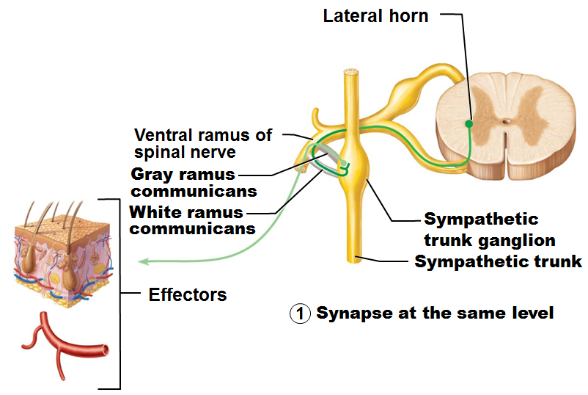
Sympathetic Trunks and Pathways
Upon entering sympathetic trunk ganglion short preganglionic fiber may
Synapse with ganglionic neuron in _

Slide 18
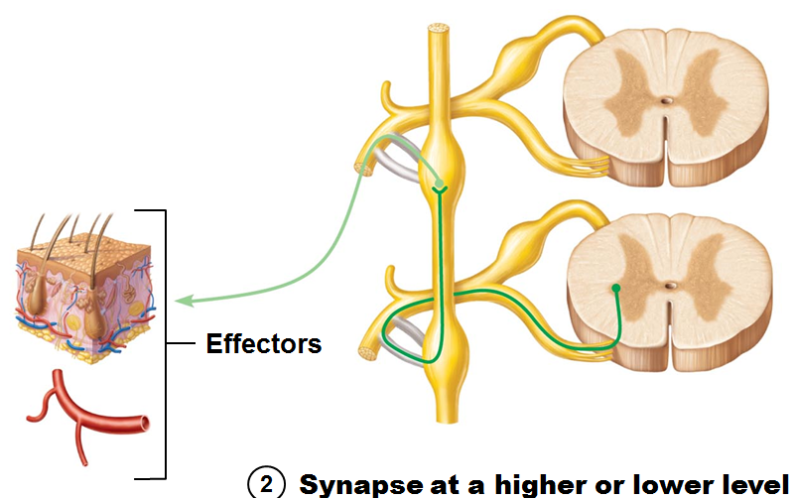
Sympathetic Trunks and Pathways
Upon entering sympathetic trunk ganglion short preganglionic fiber may
2. __________________________________ sympathetic trunk to synapse in another trunk ganglion

Slide 19
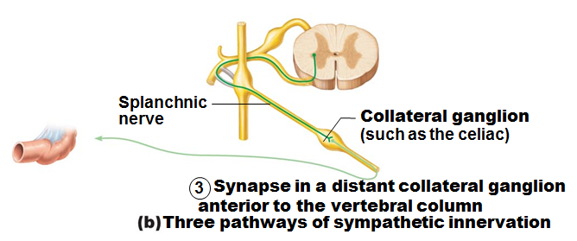
Sympathetic Trunks and Pathways
Upon entering sympathetic trunk ganglion short preganglionic fiber may
3. Pass through trunk ganglion and _______________________________________ (only in abdomen and pelvis)

Slide 20
Visceral Reflexes
Visceral reflex arcs have ____________________________ as somatic reflex arcs
But visceral reflex arc has _
Visceral pain afferents travel along same pathways as somatic pain fibers, contributing to phenomenon of _

Slide 21
Neurotransmitters
_________________________________ release neurotransmitter _
All ANS preganglionic axons
All parasympathetic postganglionic axons at effector synapse
__________________________________ fibers release neurotransmitter _
Most ___________________________________________ axons
Exception: sympathetic postganglionic fibers secrete ACh at _

Slide 22
Receptors for Neurotransmitters
Cholinergic ________________________ for ACh
_____________________________________ receptors for NE

Slide 23
Cholinergic Receptors
Two types of _________________________ bind ACh
Named after drugs that bind to them and mimic ACh effects

Slide 24
Nicotinic Receptors
Found on
Sarcolemma of skeletal muscle cells (Chapter 9) at _
__________ ________________________ neurons (sympathetic and parasympathetic)
Hormone-producing cells of _
Effect of ACh at nicotinic receptors is _
Opens ion channels, depolarizing postsynaptic cell

Slide 25
Muscarinic Receptors
Found on
All _______________________________ cells stimulated by ________________________________________ fibers
Effect of ACh at muscarinic receptors
Can be ________________ inhibitory or excitatory
Depends on _____________________________ of target organ

Slide 26
Adrenergic Receptors
Two major classes
Alpha
Beta
Effects of NE depend on which subclass of ___________________________ predominates on _

Slide 27
Interactions of the Autonomic Divisions
Most __________________________________ organs have dual innervation
Dynamic antagonism allows for ___________________________________________________ of visceral activity
increases heart rate
Increase respiratory rates
inhibits digestion and elimination
decreases heart rate
Decreases respiratory rates
Encourages digestion and discarding of wastes

Slide 28
Sympathetic Tone
Sympathetic division controls _______________________________________, even at rest
Vascular system
Almost entirely innervated by sympathetic fibers
Sympathetic tone (________________________)
Keeps blood vessels in continual state of partial constriction

Slide 29
Sympathetic Tone
To _______________________________ blood pressure:
Sympathetic fibers fire _______________________________________ to constrict blood vessels
To ________________________________ blood pressure
Sympathetic fibers fire less rapidly to prompt vessels to _

Slide 30
Parasympathetic Tone
Parasympathetic division normally dominates
Slows the heart
smooth muscle of digestive and urinary tract organs
Encourages function
most glands
except for _
The sympathetic division can override these effects during times of _
Drugs that block parasympathetic responses increase heart rate and cause fecal and urinary retention

Slide 31
Cooperative Effects
Best seen in control of _
Parasympathetic fibers
cause _
responsible for erection of penis and clitoris
cause ejaculation of semen
Cause vaginal and pelvic floor contractions

Slide 32
Unique Roles of the Sympathetic Division
Influenced __________________ by sympathetic fibers
Sweat glands
most blood vessels

Slide 33
Unique Roles of the Sympathetic Division
Sympathetic division controls
Thermoregulatory responses to heat
Release of ______________________ from kidneys
Metabolic effects
Increases _
Raises blood glucose levels
Mobilizes fats for use as fuels

Slide 34
Localized Versus Diffuse Effects
Parasympathetic division
highly _______________________________ control over effectors
ACh quickly destroyed by acetylcholinesterase
Sympathetic division
____________________________________ effects
NE inactivated more slowly than ACh
NE and epinephrine hormones from adrenal medulla prolong effects

Slide 35
Control of ANS Function
Hypothalamus
main ________________________ of ANS activity
Subconscious cerebral input via limbic system structures
Other controls come from
cerebral cortex
reticular formation
and _

Slide 36
Hypothalamic Controls
Centers of hypothalamus control
Heart activity and blood pressure
water balance
endocrine activity
Emotional stages
biological drives
hunger, thirst, sex
Reactions to fear and "fight-or-flight" system

Slide 37
Homeostatic Imbalances of the ANS
___________________________________ (high blood pressure)
Overactive sympathetic vasoconstrictor response to stress
Raynaud's disease
Exaggerated ____________________________ in fingers and toes
Pale, then cyanotic and _

Slide 38
Homeostatic Imbalances of the ANS
Uncontrolled activation of autonomic neurons in quadriplegics and those with spinal cord injuries above T₆
Blood pressure skyrockets

Slide 39
Developmental Aspects of the ANS
Effects of ________________ on ANS
Constipation
Frequent eye infections
Orthostatic hypotension
Low blood pressure after _
Pressure receptors less responsive to blood pressure changes
Cardiovascular centers fail to maintain healthy blood pressure

Slide 40
Special Senses
Special sensory receptors
Distinct, ______________________________ receptor cells in _
Vision
Taste
Smell
Hearing
Equilibrium

Slide 41
The Eye and Vision
_____________ of body's sensory receptors in eye
Visual processing is performed by _
eye protection
cushion of fat
bony orbit

Slide 42
Accessory Structures of the Eye
Protect the eye and aid eye function
Eyelids (palpebrae)
Lacrimal apparatus
Extrinsic eye muscles

Slide 43
Eyebrows
Overlie supraorbital margins
Function
Prevent __________________________________ from reaching eye

Slide 44
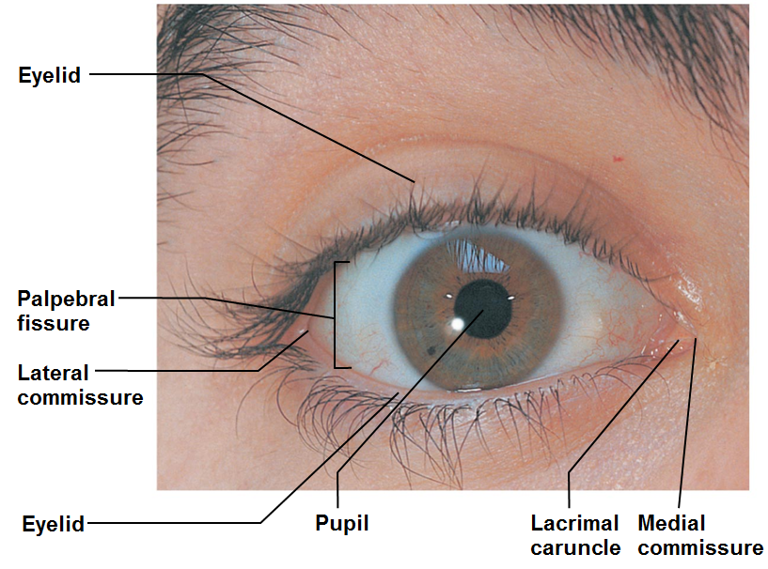
Eyelids
Protect eye anteriorly
Separated at _
Meet at medial and lateral commissures
At medial commissure
Contains oil and _
Tarsal _
supporting connective tissue

Slide 45
Eyelid Muscles
Levator palpebrae superioris
Gives _______________________________ mobility
Innervated by _
Blink reflexively every 3-7 seconds
Protection
______________________________________ to moisten eye

Slide 46
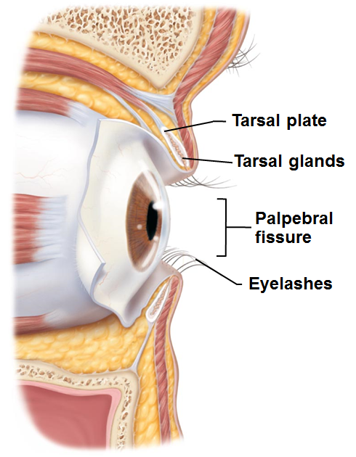
Eyelids
Nerve endings of follicles initiate _
Lubricating glands associated with eyelids
Tarsal _
(Meibomian glands)
Modified _
Oily secretion lubricates lid and eye
Ciliary glands _
Modified sweat glands

Slide 47
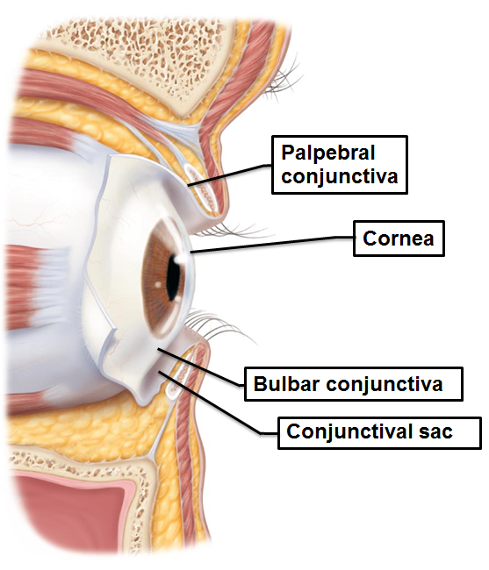
Conjunctiva
Produces a lubricating mucous secretion
____________________ conjunctiva
lines eyelids
____________________ conjunctiva
covers white of eyes
Conjunctival sac between palpebral and bulbar conjunctiva
Where contact lens rests

Slide 48
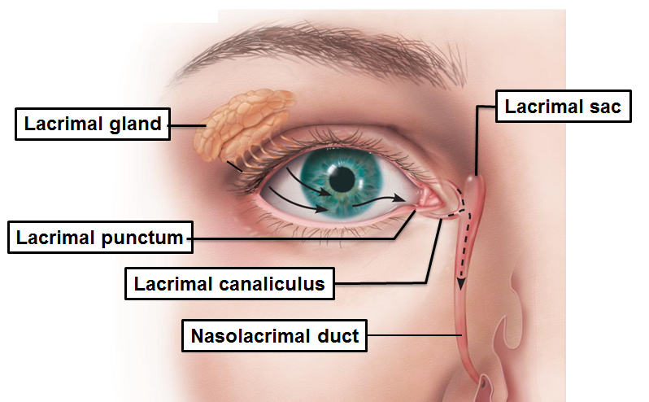
Lacrimal Apparatus
Lacrimal gland and ducts that drain into nasal cavity
in orbit above lateral end of eye
Lacrimal secretion (______________________)
Dilute saline solution containing mucus, antibodies, and lysozyme
Blinking spreads tears toward _
Tears enter paired lacrimal canaliculi via _
Then drain into lacrimal sac and nasolacrimal duct

Slide 49
Extrinsic Eye Muscles
Six straplike extrinsic eye muscles
Originate from _
insert on eyeball
Enable eye to follow moving objects
hold eye within orbit
_______________ rectus muscles
Superior, inferior, lateral, medial rectus muscles
_______________ oblique muscles
move eye in vertical plane and rotate eyeball
Superior and inferior oblique muscles

Slide 50
Figure 15.3c Extrinsic eye muscles.
Muscle
Action
Controlling cranial nerve
Lateral rectus
Moves eye laterally
VI (abducens)
Medial rectus
Moves eye medially
III (oculomotor)
Superior rectus
Elevates eye and turns it medially
III (oculomotor)
Inferior rectus
Depresses eye and turns it medially
III (oculomotor)
Inferior oblique
Elevates eye and turns it laterally
III (oculomotor)
Superior oblique
Depresses eye and turns it laterally
IV (trochlear)
Summary of muscle actions and innervating cranial nerves

Slide 51
Structure of the Eyeball
Wall of eyeball contains three layers
Internal cavity filled with fluids
called _
Lens separates internal cavity into
anterior segment
posterior segments

Slide 52
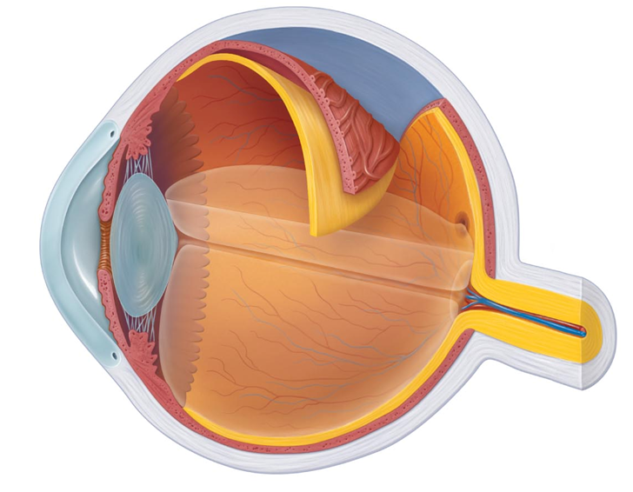
Fibrous Layer
sclera
Outermost layer
dense
connective tissue
Two regions: sclera and cornea
1. Sclera
Opaque _
Protects, shapes eyeball
Continuous with dura mater of brain posteriorly

Slide 53
Fibrous Layer
2. Cornea
___________________ anterior 1/6 of fibrous layer
___________________ as it enters eye
Numerous ___________________ receptors
contribute to blinking and tearing reflexes
cornea

Slide 54
Vascular Layer (Uvea)
Three regions: choroid, ciliary body, and iris
1. Choroid region
Posterior portion of uvea
Supplies blood to all layers of eyeball
prevent light scattering
Choroid region

Slide 55
Vascular Layer
2. Ciliary body
Ring of tissue surrounding lens
ciliary muscles
control _
Capillaries of ciliary processes _
suspensory ligament holds lens in position
Ciliary body
Suspensory ligament

Slide 56
Vascular Layer
3. Iris
central opening
regulates amount of light entering eye
Iris
pupil

Slide 57
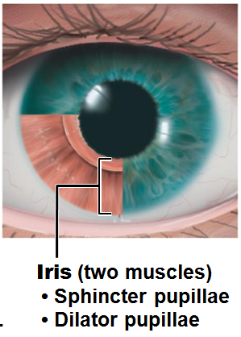
Vascular Layer
Iris
_____________________________ and bright light
circular muscles contract
Distant vision and _
radial muscles contract
sympathetic fibers
Changes in emotional state
_______________________________ when subject matter is appealing or requires problem-solving skills

Slide 58
Inner Layer: Retina
Originates as outpocketing of brain
Delicate ____________________ membrane
Outer Pigmented layer
Absorbs light and prevents its scattering
Phagocytize photoreceptor cell fragments
retina

Slide 59
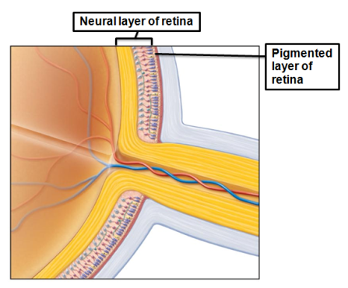
Inner Layer: Retina
Inner _
Composed of three main types of neurons
Photoreceptors
bipolar cells
ganglion cells

Slide 60
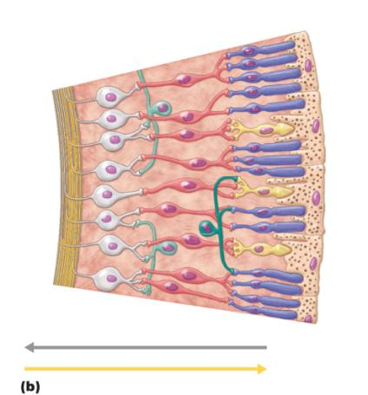
Inner Layer: Retina
Signals spread from photoreceptors
to _
to _
Ganglion cell axons exit eye as _
photoreceptor
bipolar
Ganglion cell
signal
light

Slide 61
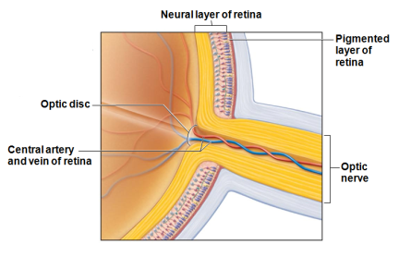
The Retina
Optic disc (__________)
Site where optic nerve leaves eye
Quarter-billion photoreceptors of two types
Optic disc

Slide 62
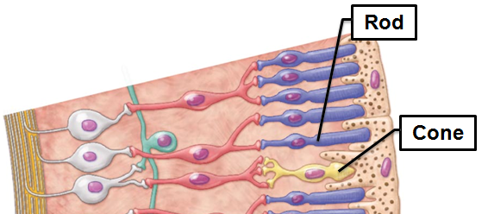
Photoreceptors
Rods
peripheral vision receptors
more ____________________________ to light than cones
_________________________________________ or sharp images
Numbers greatest at periphery

Slide 63
Photoreceptors
Cones
Vision receptors for _
________________________________ color vision
________________________________ exactly at posterior pole
Mostly cones
Fovea centralis
Tiny pit in center of macula with _

Slide 64
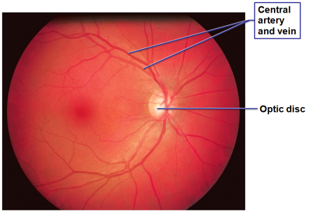
Blood Supply to the Retina
Two sources of blood supply
Choroid supplies _
Photoreceptors
__________________ of retina supply inner two-thirds
Enter/exit eye in center of optic nerve

Slide 65
Internal Chambers and Fluids
The lens and ciliary zonule separate eye into two segments
____________________________ and posterior segments
Anterior segment composed of two chambers
Anterior chamber
between _
Posterior chamber
between _

Slide 66
Internal Chambers and Fluids
Posterior segment contains ___________________ that
Transmits light
Supports posterior surface of lens
Contributes to intraocular pressure
Forms in embryo;

Slide 67
Internal Chambers and Fluids
Anterior segment contains _
_______________________________________ by capillaries of ciliary processes
Drains via ____________________________________ (canal of Schlemm) at sclera-cornea junction
Supplies nutrients and oxygen mainly to lens and cornea but also to retina, and removes wastes

Slide 68
Glaucoma
Glaucoma
__________________________________ of aqueous humor increases pressure
causes __________________________________ and optic nerve
Can lead to blindness

Slide 69
Lens
Biconvex, transparent, flexible, and _
______________________________________ to precisely focus light on retina
Lens becomes ______________________, convex, less elastic _

Slide 70
Cataracts
Clouding of lens
Consequence of
diabetes mellitus
frequent exposure to intense sunlight
Some _
Crystallin proteins clump
___________________________________ increases cataract formation
Lens can be replaced surgically with artificial lens

Slide 71
Focusing Light on The Retina
Pathway of light entering eye:
Lens
vitreous humor
entire neural layer of retina
photoreceptors
Light refracted three times along pathway
Bending of light rays
Entering lens
Majority of refractory power in cornea
Change in lens curvature allows for fine focusing

Slide 72
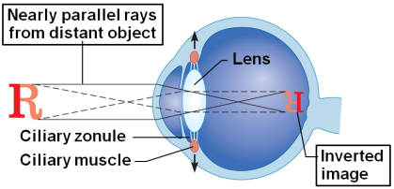
Focusing For Distant Vision
Eyes best adapted for _
Far point of vision
Distance beyond which no change in lens shape needed for focusing
20 feet for ______________________ (normal) eye
Cornea and lens focus light precisely on retina
Lens stretched flat by tension in ciliary zonule

Slide 73
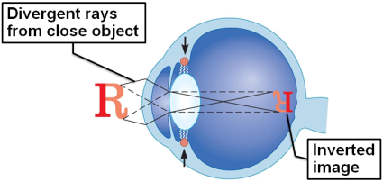
Focusing For Close Vision
Light from close objects diverges as approaches eye
Requires eye to make active adjustments using ________________ simultaneous processes
______________________ of lens
______________________ of pupils
______________________ of eyeballs

Slide 74
Focusing For Close Vision
Accommodation
_________________________________________ of vision
Closest point on which the eye can focus
loss of accommodation _
Constriction
Accommodation pupillary reflex constricts pupils to prevent most divergent light rays from entering eye
Medial rotation of eyeballs toward object being viewed

Slide 75
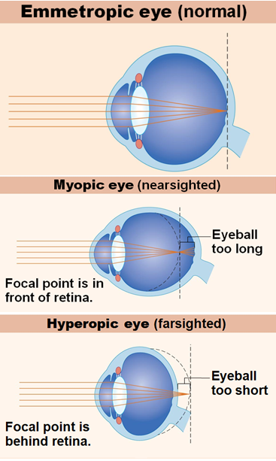
Problems Of Refraction
_______________________ (nearsightedness)
Focal point in front of retina,
eyeball too long
Corrected with a concave lens
_______________________ (farsightedness)
Focal point behind retina
eyeball too short
Corrected with a convex lens
________________________
Unequal curvatures in different parts of cornea or lens
Corrected with cylindrically ground lenses or laser procedures

Slide 76
Light Adaptation
Move from darkness into bright light
Both rods and cones strongly stimulated
Large amounts of pigments broken down instantaneously
Visual acuity improves over 5–10 minutes as:
Rod system turns off
Retinal sensitivity decreases
Cones and neurons _

Slide 77
Dark Adaptation
Move from bright light into darkness
Rod pigments bleached
system turned off
Retinal sensitivity increases within 20–30 minutes

Slide 78
Night Blindness
________________ degeneration
Commonly caused by _
If administered early, vitamin A supplements restore function

Slide 79
Visual Pathway To The Brain
Axons of retinal ________________________ form _
Medial fibers of optic nerve decussate at _
Most fibers of optic tracts continue to _____________________________________ of thalamus
Fibers from thalamic neurons form optic radiation and project to _______________________________________ in occipital lobes

Slide 80
Visual Pathway
Fibers from thalamic neurons form optic radiation
Optic radiation fibers connect to primary visual cortex in _
Other optic tract fibers send branches to midbrain, ending in ____________________________________ (initiating visual reflexes)

Slide 81
Visual Pathway
A small subset of ganglion cells in retina contain melanopsin (circadian pigment), which projects to:
________________________________ nuclei
involved with _
Suprachiasmatic nucleus of hypothalamus
timer for _

Slide 82
Depth Perception
Both eyes view same image from _
three-dimensional vision results from _____________________________________ of slightly different images
Requires input from both eyes

Slide 83
The Chemical Senses: Smell And Taste
Smell
taste
____________________________________ respond to chemicals in aqueous solution

Slide 84
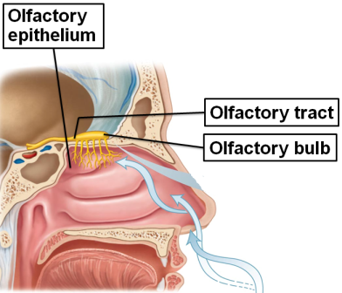
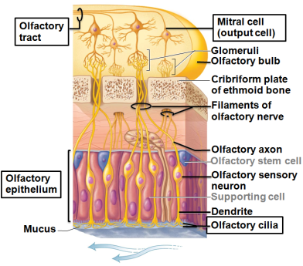
Olfactory Epithelium
Olfactory epithelium in roof of nasal cavity
Covers _
Contains olfactory sensory neurons
with olfactory cilia
Supporting cells surround and cushion olfactory receptor cells
Bundles of nonmyelinated axons of olfactory receptor cells form olfactory nerve (cranial nerve I)

Slide 85
Specificity of Olfactory Receptors
Humans can distinguish about 10,000 odors
Approximately 400 "smell" genes active only in nose
Each encodes unique receptor protein
Protein responds to _
Each odor binds to several different receptors
Each receptor has one type of receptor protein
____________________________ and temperature receptors also in nasal cavities

Slide 86
Physiology of Smell
Gaseous odorant must ____________________________________ of olfactory epithelium
Activation of olfactory sensory neurons
Dissolved odorants bind to ___________________________________ in olfactory cilium membranes
Olfactory receptors subject to _

Slide 87
Olfactory Pathway
Olfactory receptor cells synapse with ______________________________ in glomeruli of olfactory bulbs
Mitral cells amplify, refine, and relay signals
from mitral cells via ______________________________________________ to olfactory cortex
Some information to _
Smell consciously interpreted and identified
Some information to hypothalamus, amygdala, and other regions _
_____________________________________________ responses to odor elicited

Slide 88
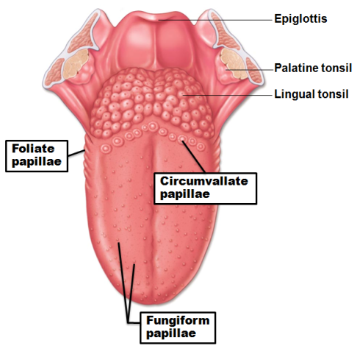
Taste Buds and the Sense of Taste
Receptor organs are taste buds
Most of 10,000 taste buds on _
On tops of ______________________ papillae
On side walls of foliate and circumvallate (vallate) papillae
Few on soft palate, cheeks, _

Slide 89
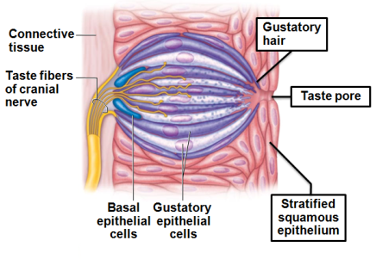
Structure of a Taste Bud
50–100 flask-shaped epithelial cells of 2 types
Gustatory epithelial cells
Microvilli (____________________) are receptors
Basal epithelial cells
divide every 7-10 days

Slide 90
Basic Taste Sensations
There are five basic taste sensations
sugars, saccharin, alcohol, some amino acids, some lead salts
hydrogen ions in solution
metal ions (inorganic salts)
alkaloids such as quinine and nicotine; aspirin
amino acids glutamate and aspartate

Slide 91
Basic Taste Sensations
Possible sixth taste
Growing evidence humans can taste _
Perhaps explain liking of fatty foods
Taste likes/dislikes have homeostatic value
Guide intake of beneficial and potentially harmful substances

Slide 92
Physiology of Taste
To taste, chemicals must
Diffuse into _
Contact _

Slide 93
Activation of Taste Receptors
Binding of food chemical depolarizes taste cell membrane → neurotransmitter release
Initiates a generator potential that elicits an action potential
Different thresholds for activation
Bitter receptors _
All adapt in _________________________; complete adaptation in _

Slide 94
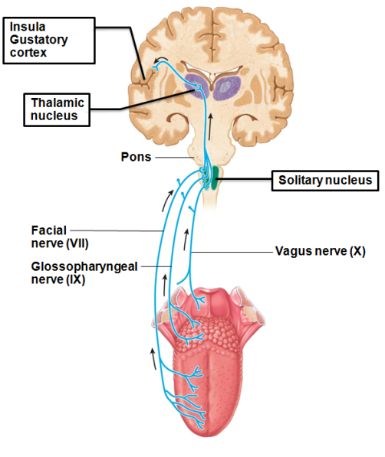
Gustatory Pathway
Cranial nerves VII and IX carry impulses from taste buds
to _______________________ of medulla
to _
To Gustatory cortex in the _______________________
and to the Hypothalamus and limbic system for appreciation of taste
_______________________ nerve transmits from epiglottis and lower pharynx

Slide 95
Role Of Taste
Triggers reflexes involved in _
Increase secretion of _______________________ into mouth
Increase secretion of _
May initiate protective reactions
Gagging
Reflexive vomiting

Slide 96
Influence of other Sensations on Taste
Taste is 80% _
_______________________________, mechanoreceptors, _______________________ in mouth also influence tastes
Temperature and _______________________________ enhance or detract from taste

Slide 97
Homeostatic Imbalances of the Chemical Senses
olfactory disorders
Most result of _____________________________ and neurological disorders
Parkinson's disease
Olfactory auras prior to _
Taste problems less common
Infections, head injuries, chemicals, medications, radiation therapy

Slide 98
The Ear: Hearing and Balance
Three major areas of ear
External (outer) ear
Middle ear
tympanic cavity
Internal (inner) ear
hearing and _
Receptors for hearing and balance respond to separate stimuli

Slide 99
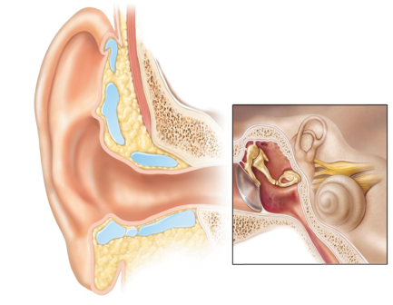
External Ear
Auricle (pinna)Composed of
Funnels sound waves into auditory canal
External acoustic meatus (auditory canal)
Short, curved tube
lined with
Skin
Hair
Transmits _____________________________ eardrum
Auricle
Auditory Canal
Helix
Lobule

Slide 100
External Ear
Tympanic membrane (eardrum)
_________________ between external and middle ears
__________________________________ that vibrates in response to sound
Transfers sound energy to _
Tympanic Membrane

Slide 101
Middle Ear (Tympanic Cavity)
A small, _____________________________, mucosa-lined cavity in temporal bone
Flanked laterally by _
Flanked medially by bony wall containing ________________________(vestibular) and ________________________ (cochlear) windows

Slide 102
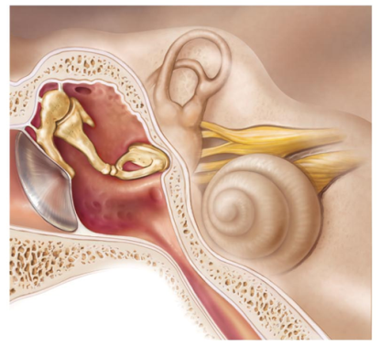
Middle Ear
Epitympanic recess
Mastoid antrum
superior portion of middle ear
Mastoid antrum
__________________ for communication with mastoid air cells
Pharyngotympanic (auditory) tube
connects middle ear to nasopharynx
________________________________________ in middle ear cavity with external air pressure
Pharyngotympanic tube

Slide 103
Otitis Media
Middle ear inflammation
Especially in _
____________________________________________ pharyngotympanic tubes
Most frequent cause of _______________________________________ in children
Most treated with antibiotics
____________________________________________ to relieve pressure if severe

Slide 104
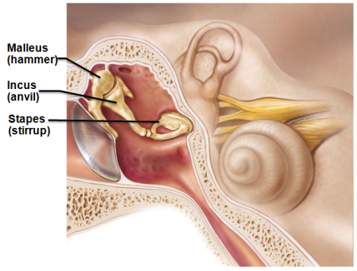
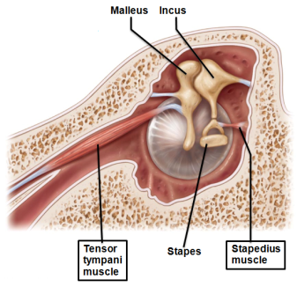
Ear Ossicles
Three small bones in tympanic cavity
Suspended by ligaments and joined by synovial joints
Transmit vibratory motion of eardrum to _
______________________________ and _________________________________ contract reflexively in response to loud sounds to prevent damage to hearing receptors

Slide 105
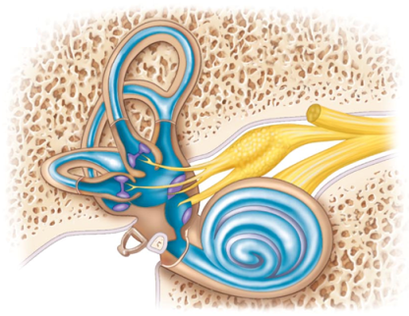
Two Major Divisions of Internal Ear
Tortuous channels in _
Three regions
Semicircular canals
Cochlea
Filled with _
similar to _
Membranous labyrinth
Series of membranous sacs and ducts
Filled with _

Slide 106
Vestibule
Central _________________________of bony labyrinth
Contains two membranous sacs
is continuous with semicircular canals
is continuous with _
These sacs
House equilibrium receptor regions (_________________________)
Respond to gravity and changes in position of head
utricle
maculae
Saccule

Slide 107
Semicircular Canals
Three canals
Lie in _
Membranous semicircular ducts line each canal and _
________________________ of each canal houses equilibrium receptor region called the _
Receptors respond to angular (__________________________) movements of the head
ampulla
Crista ampullaris

Slide 108
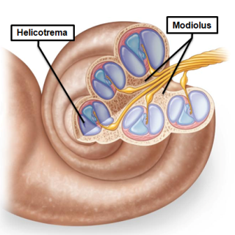
The Cochlea
A spiral, conical, bony chamber
Size of _
Extends from _
Coils around bony pillar called _
Contains cochlear duct
which houses spiral organ (organ of Corti)
ends at _
cochlea

Slide 109
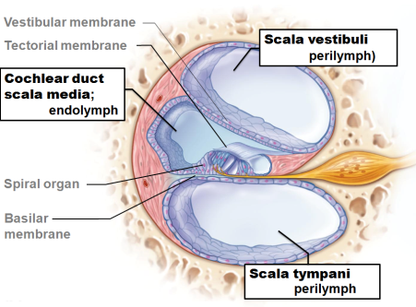
The Cochlea
Cavity of cochlea divided into three chambers
abuts oval window
contains perilymph
cochlear duct
contains endolymph
terminates at round window
contains perilymph
Scalae tympani and vestibuli are continuous with each other at _____________________ (apex)

Slide 110
The Cochlea
The "roof" of cochlear duct is vestibular membrane
External wall is stria vascularis – _
"Floor" of cochlear duct composed of
Bony spiral lamina
Basilar membrane, which supports _
The cochlear branch of nerve VIII runs from spiral organ to brain

Slide 111
Transmission of Sound to the Internal Ear
Sound waves vibrate tympanic membrane
Ossicles vibrate and ________________________ pressure at _
Pressure waves move through perilymph of scala vestibuli

Slide 112
Transmission of Sound to the Internal Ear
Waves with frequencies below threshold of hearing travel through _______________________________ and scali tympani to _
Sounds in hearing range go through ____________________________________ vibrating basilar membrane at specific location, according to frequency of sound

Slide 113
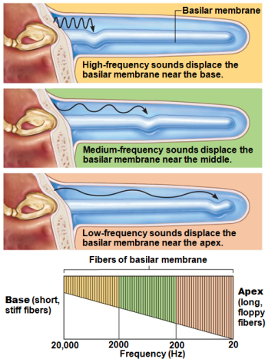
Resonance of the Basilar Membrane
Fibers near oval window _
Resonate with ______________________________ pressure waves
Fibers near cochlear apex longer, more _
Resonate with ______________________________ pressure waves
This mechanically processes sound before signals reach receptors

Slide 114
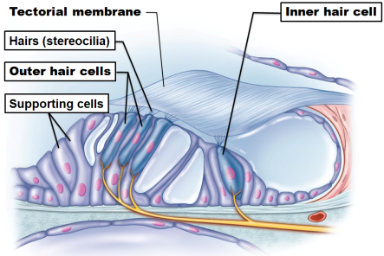
Excitation of Hair Cells in the Spiral Organ
Cells of _
Supporting cells
One row of _
Three rows _
Have many stereocilia and one kinocilium
Afferent fibers of cochlear nerve coil about bases of hair cells

Slide 115
Excitation of Hair Cells in the Spiral Organ
Stereocilia
Protrude into _
Longest enmeshed in gel-like tectorial membrane
Sound bending these toward _
Opens mechanically gated ion channels
Inward K⁺ and Ca²⁺ current causes graded potential and release of neurotransmitter glutamate

Slide 116
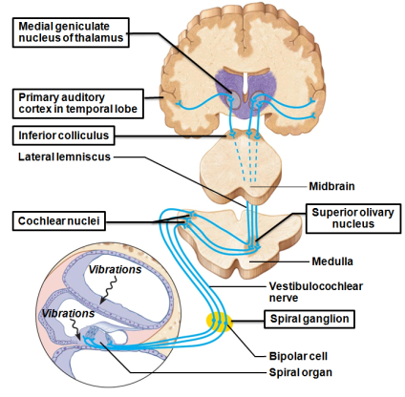
Auditory Pathways to the Brain
Impulses from cochlea pass via ________________________ to ________________________ of medulla
From there, impulses sent
To _
Via lateral lemniscus to Inferior colliculus (auditory reflex center)
From there, impulses pass to _____________________________________________________, then to primary auditory cortex
Auditory pathways __________________________ so that both cortices receive input from both ears

Slide 117
Auditory Processing
Pitch perceived by impulses from specific hair ______________________________________ along basilar membrane
_____________________________ detected by increased ____________________________________________ that result when hair cells experience larger deflections
Localization of sound depends on relative intensity and relative timing of sound waves reaching both ears

Slide 118
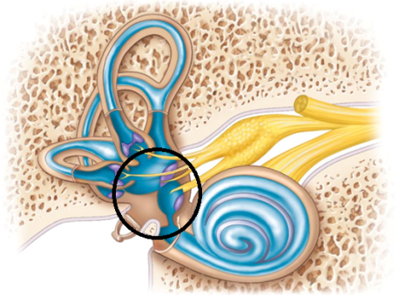
Equilibrium and Orientation
Equilibrium receptors in _______________________ and vestibule
Vestibular receptors monitor _
Semicircular canal receptors monitor _
Semicircular canals
dynamic
Vestibule
static

Slide 119
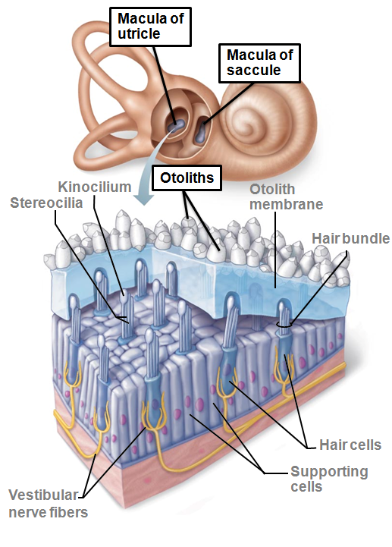
Maculae
Sensory receptors for static equilibrium
One in each _________________________ wall and one in each utricle wall
Monitor the position of head in space
necessary for _
Respond to _
not rotation
Contain supporting cells and hair cells
Stereocilia and kinocilia are embedded in the otolith membrane studded with ___________________________ (tiny CaCO₃ stones)

Slide 120
Maculae
Maculae in utricle respond to ________________________________ and tilting head side to side
Maculae in saccule respond to _
Hair cells synapse with vestibular nerve fibers

Slide 121
Activating Maculae Receptors
Hair cells release neurotransmitter continuously
__________________________________ modifies amount they release
Bending of hairs _
Increases amount of neurotransmitter release
More impulses travel up vestibular nerve to brain

Slide 122
Activating Maculae Receptors
Bending ___________________________ kinocilium
____________________________________receptors
Less neurotransmitter released
Reduces rate of impulse generation
Thus brain informed of changing position of head

Slide 123
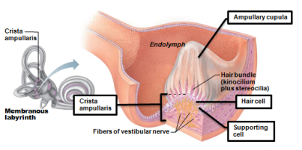
The Crista Ampullares (Crista)
Sensory receptor for _
One in ampulla of each _
Major stimuli are rotational movements
Each crista has supporting cells and hair cells that extend into gel-like mass called _
Dendrites of vestibular nerve fibers encircle base of hair cells

Slide 124
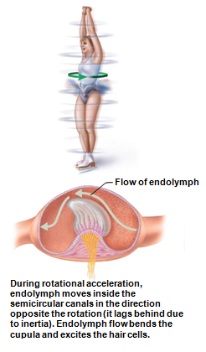
Activating Crista Ampullaris Receptors
Cristae respond to ___________________________ of rotational movements of the head
Bending of hairs in cristae causes
rapid impulses reach brain at faster rate

Slide 125
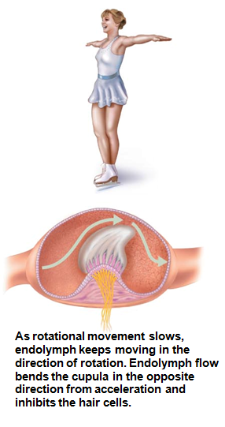
Activating Crista Ampullaris Receptors
Bending of hairs in the __________________________ causes
Hyperpolarizations, and _
Thus brain informed of rotational movements of head

Slide 126
Vestibular Nystagmus
Strange __________________________ during and immediately after rotation
Often _
As rotation ___________________ eyes drift in direction __________________________________, then CNS compensation causes rapid jump ________________________ direction of rotation
As rotation ___________________________ eyes continue in direction of spin then jerk rapidly in opposite direction

Slide 127
Equilibrium Pathway to the Brain
Equilibrium information goes to _
Allows fast, reflexive responses to imbalance
Impulses travel to vestibular nuclei in brain stem or cerebellum, both of which receive other input
Three modes of input for balance and orientation:
Somatic receptors

Slide 128
Motion Sickness
Sensory input mismatches
Visual input differs from equilibrium input
Conflicting information causes _
Warning signs are
Pallor
profuse sweating
Treatment with antimotion drugs that depress vestibular input

Slide 129
Homeostatic Imbalances of Hearing
Blocked sound conduction to fluids of internal ear
______________________________________, perforated eardrum, ____________________________________, otosclerosis of the ossicles
_______________________________ deafness
Damage to neural structures at any point _
Typically from gradual hair cell loss

Slide 130
Treating Deafness
Research trying to prod ____________________________________ into hair cells to treat sensorineural deafness
Cochlear implants for congenital or age/noise cochlear damage
Convert sound _
Inserted into drilled recess in temporal bone

Slide 131
Homeostatic Imbalances of Hearing
Ringing or clicking sound in ears in _
Due to
inflammation of middle or internal ears
side effects of _
Ménière's syndrome
labyrinth disorder that affects _________________________ and _
Causes ___________________________, nausea, and vomiting

