Slide 1
Exam Five
Chapter 12 and 13

Slide 2
Spinal Cord
CNS tissue is _____________________________________ from the foramen magnum to L₁
Provides _______________________________________ to and from the brain
Protected by bone, meninges, and CSF
space between the vertebrae and the dural mater filled with fat and a network of veins

Slide 3
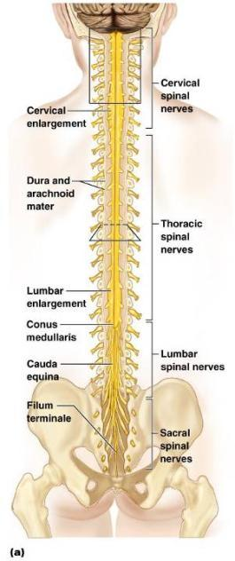
Spinal Cord
terminal portion of the spinal cord
fibrous extension of the __________________________ anchors the spinal cord to the coccyx
Denticulate ligaments
delicate shelves of pia mater; _

Slide 4
Spinal Cord
31 pairs attach to the cord by paired roots
Cervical and _
sites where nerves serving the upper and lower limbs emerge
collection of nerve roots at the _

Slide 5
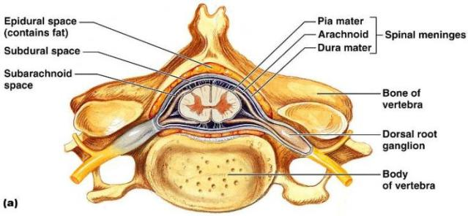
Cross-Sectional Anatomy of the Spinal Cord
______________________________________– separates anterior funiculi
______________________________________– divides posterior funiculi

Slide 6
Gray Matter and Spinal Roots
__________________________matter consists of
unmyelinated processes
Gray _
connects masses of gray matter; encloses central canal
Posterior (dorsal) _
interneurons
Anterior (ventral) horns
interneurons and _
Lateral horns
contain _

Slide 7
Gray Matter: Organization
Dorsal half
Ventral half
Dorsal and ventral roots _

Slide 8
White Matter in the Spinal Cord
Fibers run in three directions
Divided into three funiculi (_______________________)
posterior, lateral, and anterior
Each funiculus contains several fiber tracks
Fiber tract names reveal their _
Fiber tracts are composed of _

Slide 9
White Matter: Pathway Generalizations
Pathways _
Most consist of two or three neurons
Pathways are _
one on each side of the spinal cord or brain

Slide 10
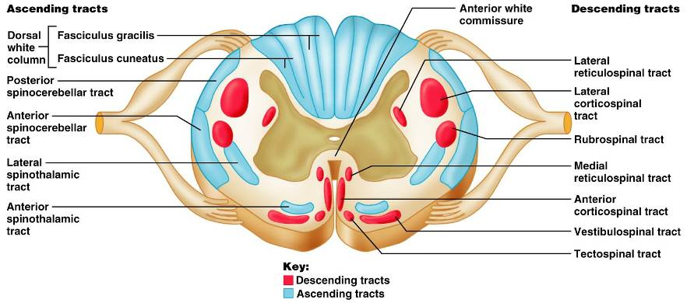
White Matter: Pathway Generalizations

Slide 11
Main Ascending Pathways
The central processes of first-order neurons branch diffusely as they enter the spinal cord and medulla
Some branches take part in spinal cord reflexes
Others synapse with ________________________________________in the cord and medullary nuclei
Fibers from touch and pressure receptors form collateral synapses with _______________________________________ in the dorsal horns

Slide 12
Three Ascending Pathways
The nonspecific and specific ascending pathways send impulses to the _
These pathways are responsible for discriminative_
The _________________________________ tracts send impulses to the cerebellum and do not contribute to sensory perception

Slide 13
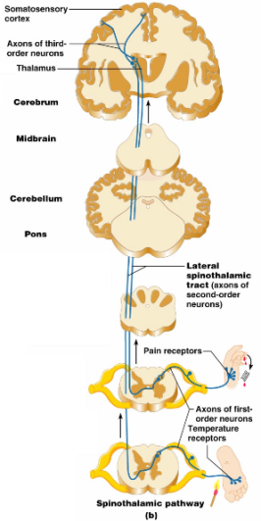
Nonspecific Ascending Pathway
Nonspecific pathway for
within the lateral ________________________tract

Slide 14
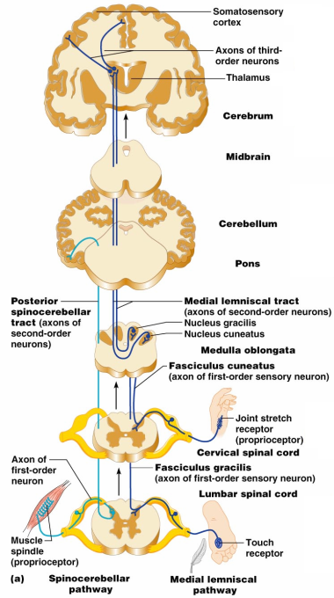
Specific and Posterior Spinocerebellar Tracts
Specific ascending pathways within the
fasciculus gracilis
fasciculus cuneatus tracts, and their continuation in the
medial lemniscal tracts
The posterior _

Slide 15
Descending (Motor) Pathways
Descending tracts deliver ____________________________________ from the brain to the spinal cord, and are divided into two groups
Direct pathways equivalent to the _
Indirect pathways, essentially _
Motor pathways involve _

Slide 16
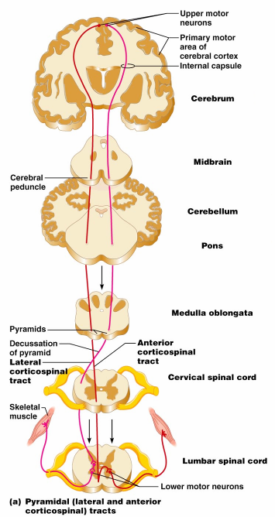
The Direct (Pyramidal) System
Direct pathways originate with the ___________________________ in the precentral gyri
Impulses are sent through the ____________________________ and synapse in the anterior horn
Stimulation of anterior horn neurons activates skeletal muscles
The direct pathway regulates fast and _

Slide 17
Indirect (Extrapyramidal) System
Includes the
motor nuclei
motor pathways not part of the pyramidal system
This system includes the
Vestibulospinal
Tectospinal tracts

Slide 18
Indirect (Extrapyramidal) System
These motor pathways are complex and multisynaptic, and regulate:
Axial muscles that maintain _
Muscles controlling ______________________________________ of the proximal portions of limbs
Head, neck, and eye movement

Slide 19
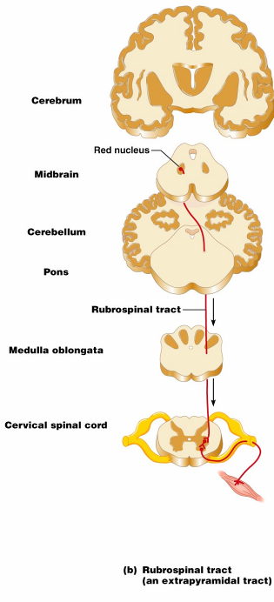
Extrapyramidal Pathways
Reticulospinal tracts
Rubrospinal tracts
control _
Superior colliculi and tectospinal tracts
mediate _

Slide 20
Spinal Cord Trauma: Paralysis
Paralysis
loss of _
_______________________________ paralysis
severe damage to the _
Lower motor neurons are damaged and impulses do not reach muscles
There is no _

Slide 21
Spinal Cord Trauma: Paralysis
________________________________ paralysis
only _____________________________________ of the primary motor cortex are damaged
Spinal neurons remain intact and _
There is no ________________________________________ of muscles

Slide 22
Spinal Cord Trauma: Transection
Cross sectioning of the spinal cord at any level results in __________________________________________________________________________ in regions inferior to the cut
Paraplegia
transection between _
transection in the _

Slide 23
Peripheral Nervous System (PNS)
PNS
all neural structures outside the brain and spinal cord
Includes
associated ganglia
Provides links to and from the external environment

Slide 24
Sensory Receptors
Structures specialized to _
Activation of sensory receptors results in _____________________________________ that trigger impulses to the CNS
The realization of these stimuli, sensation and perception, _

Slide 25
Receptor Classification by Stimulus Type
Mechanoreceptors
respond to _
sensitive to changes in temperature
Photoreceptors
respond to light energy (e.g., retina)
respond to chemicals (e.g., smell, taste, changes in _
Nociceptors
sensitive to _

Slide 26
Receptor Class by Location: Exteroceptors
Respond to stimuli arising _
Found near the body surface
Sensitive to _
Include the special sense organs

Slide 27
Receptor Class by Location: Interoceptors
Respond to stimuli arising _
Found in internal _______________________ and blood vessels
Sensitive to chemical changes, ___________________________________, and temperature changes

Slide 28
Receptor Class by Location: Proprioceptors
Respond to degree of stretch of the organs they occupy
Found in skeletal muscles, tendons, joints, ligaments, and connective tissue coverings of bones and muscles

Slide 29
Receptor Classification by Structural Complexity
Receptors are structurally classified as either simple or complex
Most receptors are _____________________________________ and include encapsulated and unencapsulated varieties
Complex receptors are _

Slide 30
Simple Receptors: Unencapsulated
Free dendritic nerve endings
Respond chiefly to _
_____________________________________ (tactile) discs
Hair _

Slide 31
Simple Receptors: Encapsulated
tactile corpuscles
lamellated corpuscles
Muscle spindles, Golgi tendon organs, and Ruffini’s corpuscles
Joint kinesthetic receptors

Slide 32
From Sensation to Perception
Survival depends upon sensation and perception
Sensation
the _________________________________________in the internal and external environment
Perception
the conscious _______________________________________ of those stimuli

Slide 33
Organization of the Somatosensory System
Input comes from exteroceptors, proprioceptors, and interoceptors
The three main levels of neural integration in the somatosensory system are:
the sensor receptors
ascending pathways
neuronal circuits in the cerebral cortex

Slide 34
Adaptation of Sensory Receptors
___________________________________ occurs when sensory receptors are subjected to an _
Receptor membranes become _
Receptor potentials decline in frequency or stop

Slide 35
Adaptation of Sensory Receptors
Receptors responding to _____________________________________ adapt quickly
Receptors responding slowly include Merkel’s discs, Ruffini’s corpuscles, and interoceptors that respond to chemical levels in the blood
_____________________________________and proprioceptors do not exhibit adaptation

Slide 36
Processing at the Circuit Level
Chains of three neurons conduct sensory impulses upward to the brain
soma reside in dorsal root or cranial ganglia, and conduct impulses _
_______________________________neurons
soma reside in the dorsal horn of the spinal cord or medullary nuclei and transmit impulses _
located in the thalamus and conduct impulses to the somatosensory _

Slide 37
Main Aspects of Sensory Perception
detecting that a stimulus has occurred and requires summation
Magnitude estimation
how much of a stimulus is acting
identifying the site or pattern of the stimulus

Slide 38
Main Aspects of Sensory Perception
Feature abstraction
used to identify a substance that has _
Quality discrimination
the ability to identify ______________________________________ of a sensation (e.g., sweet or sour tastes)
ability to recognize patterns in stimuli (e.g., melody, familiar face)

Slide 39
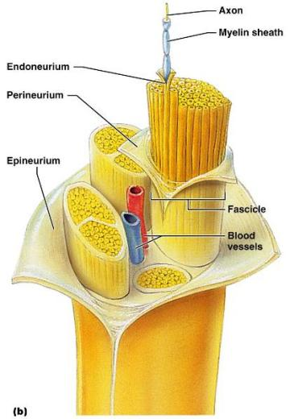
Structure of a Nerve
Nerve
cordlike organ of the PNS consisting of _
Connective tissue coverings include:
_____________________________– loose connective tissue that surrounds axons
_____________________________ coarse connective tissue that bundles fibers into fascicles
_____________________________tough fibrous sheath around a nerve

Slide 40
Classification of Nerves
Sensory and motor divisions
Sensory (afferent)
Motor (efferent)
Mixed

Slide 41
Peripheral Nerves
Mixed nerves
carry ____________________________________ (visceral) impulses
The _____________________________ of mixed nerves are:
Somatic afferent and somatic efferent
Visceral afferent and visceral efferent
Peripheral nerves originate from the brain or spinal column

Slide 42
Regeneration of Nerve Fibers
Damage to nerve tissue is serious _
If the _____________________________ of a damaged nerve remains intact, damage can be repaired
Regeneration involves coordinated activity among:
______________________________________– remove debris
Schwann cells – form regeneration tube and secrete growth factors
__________________________________________– regenerate damaged part

Slide 43
Cranial Nerves
____________________________________ of cranial nerves arise from the brain
They have sensory, motor, or both sensory and motor functions
Each nerve is identified by a ____________________________ (I through XII) and a _
Four cranial nerves carry ______________________________________ that serve muscles and glands

Slide 44
Cranial Nerve I: Olfactory
Arises from the _
Passes through the cribiform plate of the ethmoid bone
Fibers run through the _____________________________________ and terminate in the primary olfactory cortex
Functions solely by carrying _

Slide 45
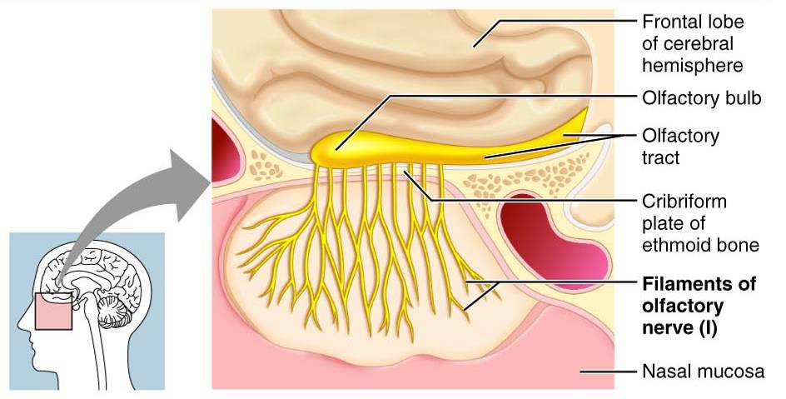
Cranial Nerve I: Olfactory

Slide 46
Cranial Nerve II: Optic
Arises from the _
Optic nerves pass through the optic canals and ______________________________ at the _
They continue to the _________________________________ where they synapse
From there, the _______________________________________ run to the visual cortex
Functions solely by carrying afferent impulses for vision

Slide 47
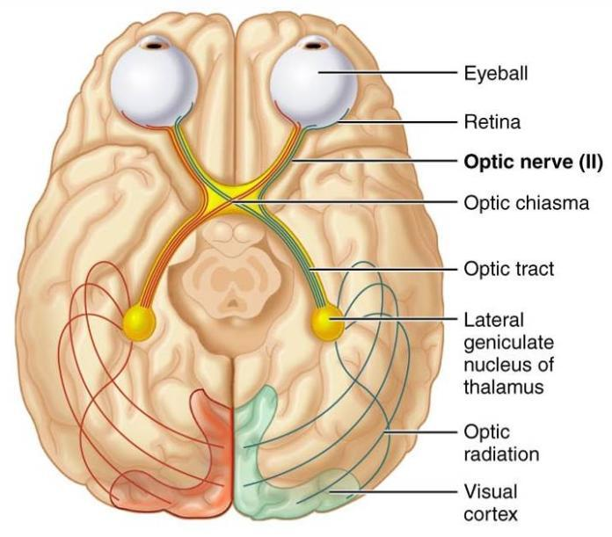
Cranial Nerve II: Optic

Slide 48
Cranial Nerve III: Oculomotor
Fibers extend from the ventral midbrain, pass through the superior orbital fissure, and go to the _
Functions in ____________________________________, directing the eyeball, _______________________________________, and controlling lens shape
Parasympathetic cell bodies are in the ciliary ganglia

Slide 49
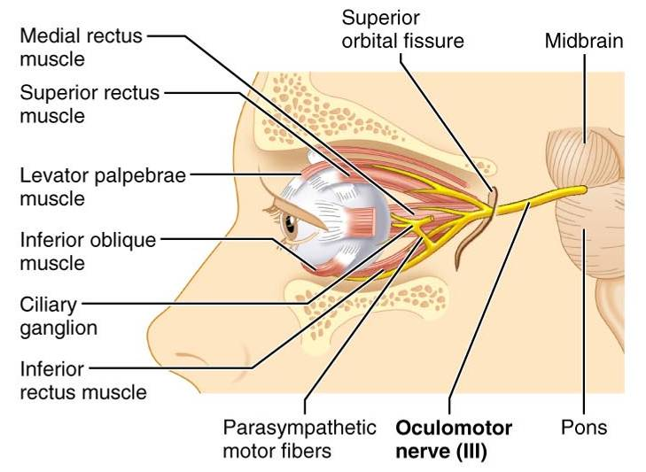
Cranial Nerve III: Oculomotor

Slide 50
Cranial Nerve IV: Trochlear
Fibers emerge from the dorsal midbrain and enter the orbits via the _____________________________________; innervate the _
Primarily a motor nerve that directs the eyeball

Slide 51
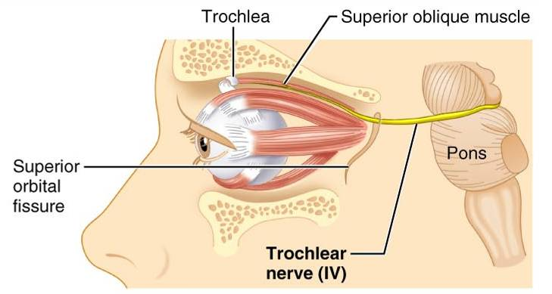
Cranial Nerve IV: Trochlear

Slide 52
Cranial Nerve V: Trigeminal
Three divisions:
Conveys sensory impulses from various areas of the face (V₁) and (V₂), and supplies motor fibers (V₃) for _

Slide 53
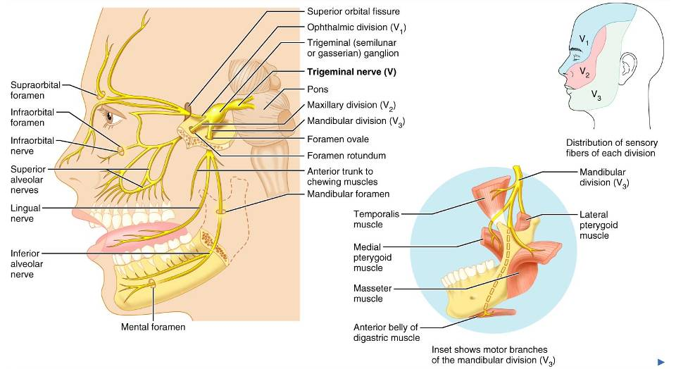
Cranial Nerve V: Trigeminal

Slide 54
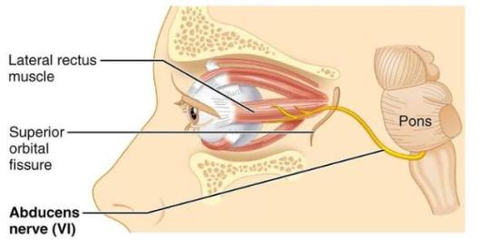
Cranial Nerve VI: Abdcuens
Fibers leave the inferior pons and enter the orbit via the superior orbital fissure
Primarily a ____________________________innervating the _

Slide 55
Cranial Nerve VII: Facial
Fibers leave the pons, travel through the _____________________________________, and emerge through the stylomastoid foramen to the lateral aspect of the face
_____________________________________ with five major branches
Motor functions ____________________________________, and the transmittal of autonomic impulses to lacrimal and salivary glands
Sensory function is __________________________ from the anterior two-thirds of the tongue

Slide 56
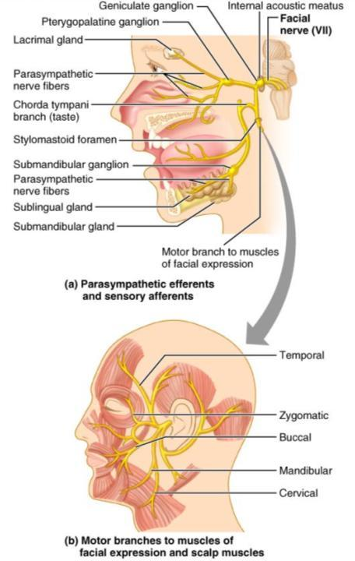
Cranial Nerve VII: Facial

Slide 57
Cranial Nerve VIII: Vestibulocochlear
Fibers arise from the hearing and equilibrium apparatus of the inner ear, pass through the internal acoustic meatus, and enter the brainstem at the pons-medulla border
Two divisions
Functions are solely sensory

Slide 58
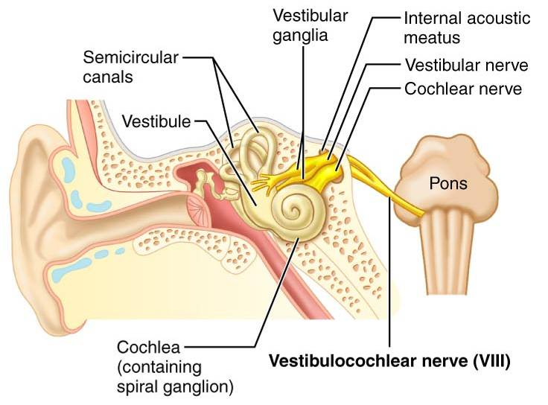
Cranial Nerve VIII: Vestibulocochlear

Slide 59
Cranial Nerve IX: Glossopharyngeal
Fibers emerge from the medulla, leave the skull via the jugular foramen, and run to the _
Nerve IX is a ________________________________ with motor and sensory functions
Motor
innervates part of the ______________________________________________, and provides motor fibers to the parotid salivary gland
Sensory
fibers conduct ___________________________________ and general sensory impulses from the _

Slide 60
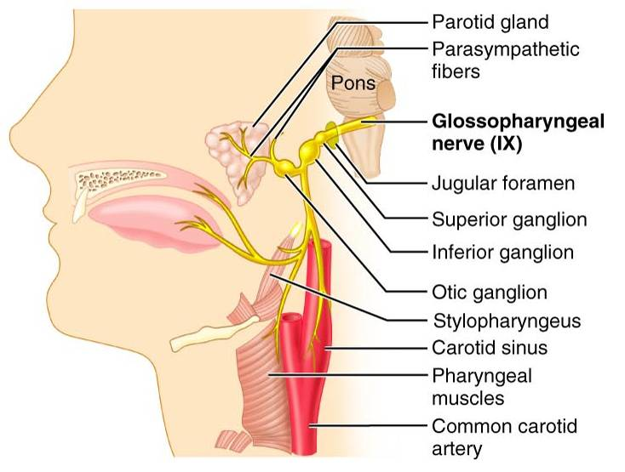
Cranial Nerve IX: Glossopharyngeal

Slide 61
Cranial Nerve X: Vagus
The _________________________ cranial nerve that extends _
Fibers emerge from the medulla via the jugular foramen
The vagus is a _
Most motor fibers are _____________________________________ to the heart, lungs, and visceral organs
Its sensory function is in _

Slide 62
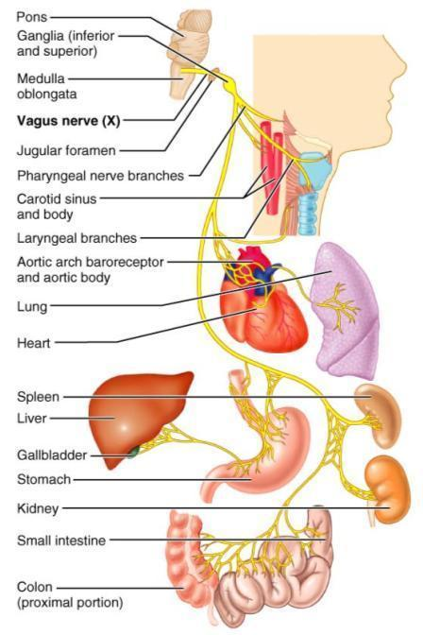
Cranial Nerve X: Vagus

Slide 63
Cranial Nerve XI: Accessory
Formed from a cranial root emerging from the medulla _____________a __________________________________ arising from the superior region of the spinal cord
The spinal root passes upward into the cranium via the foramen magnum
The accessory nerve leaves the cranium via the jugular foramen

Slide 64
Cranial Nerve XI: Accessory
Primarily a motor nerve
Supplies fibers to the _
Innervates the _________________________________________________________________________________, which move the head and neck

Slide 65
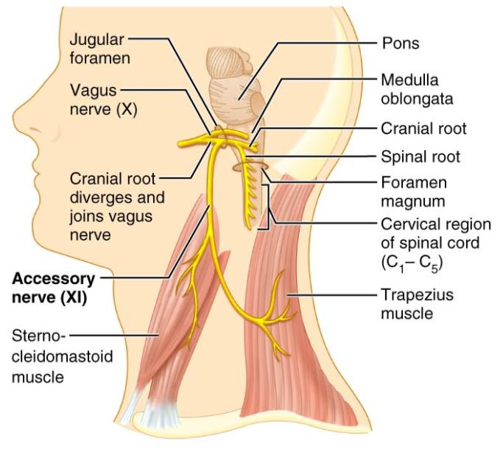
Cranial Nerve XI: Accessory

Slide 66
Cranial Nerve XII: Hypoglossal
Fibers arise from the medulla and exit the skull via the _
Innervates both _____________________________________ of the tongue, which contribute to _

Slide 67
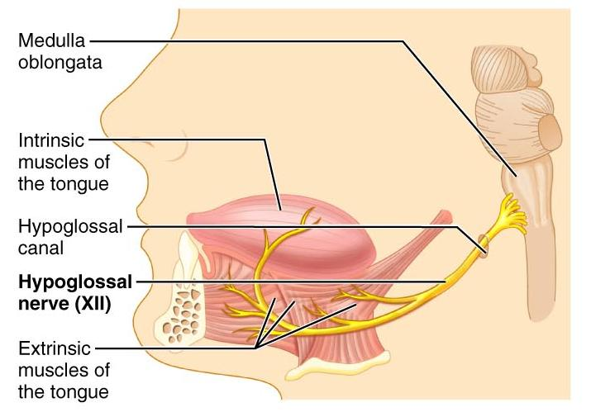
Cranial Nerve XII: Hypoglossal

Slide 68
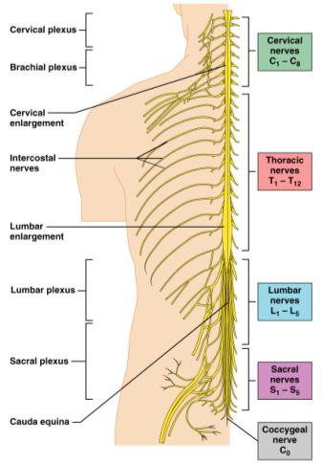
Spinal Nerves
Thirty-one pairs of mixed nerves arise from the spinal cord and supply _
They are named according to their point of issue
8 cervical (C₁-C₈)
12 thoracic (T₁-T₁₂)
5 Lumbar (L₁-L₅)
5 Sacral (S₁-S₅)
1 Coccygeal (C₀)

Slide 69
Spinal Nerves: Roots
Each spinal nerve connects to the spinal cord via _
Each root forms a series of rootlets that attach to the spinal cord
____________________________________ arise from the _________________________________and contain _
Dorsal roots arise from _______________________________________ in the dorsal root ganglion and contain sensory (afferent) fibers

Slide 70
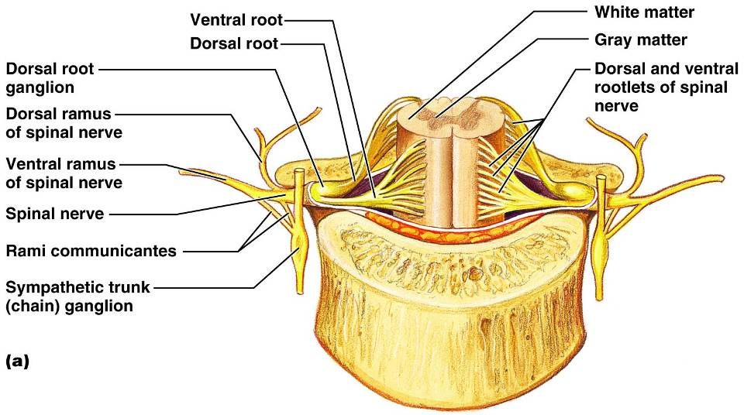
Spinal Nerves: Roots

Slide 71
Spinal Nerves: Rami
The short spinal nerves branch into three or four mixed, distal rami
Tiny _
Rami communicantes at the base of the ventral rami in the thoracic region

Slide 72
Nerve Plexuses
All ventral rami except T₂-T₁₂ form interlacing nerve ___________________________called _
Plexuses are found in the cervical, brachial, lumbar, and sacral regions
Each resulting branch of a plexus contains _

Slide 73
Nerve Plexuses
Fibers travel to the periphery via several different routes
Each muscle receives a nerve supply _
Damage to _____________________________________ cannot completely paralyze a muscle

Slide 74
Spinal Nerve Innervation:
The back is innervated by ______________________________ via several branches
The thorax is innervated by _________________________________ T₁-T₁₂ as intercostal nerves
Intercostal nerves supply muscles of the ribs, anterolateral thorax, and abdominal wall

Slide 75
Cervical Plexus
The __________________________________ is formed by ventral rami of C₁-C₄
Most branches are ________________________________ nerves of the neck, ear, back of head, and shoulders
The most important nerve of this plexus is the _
The phrenic nerve is the major _

Slide 76
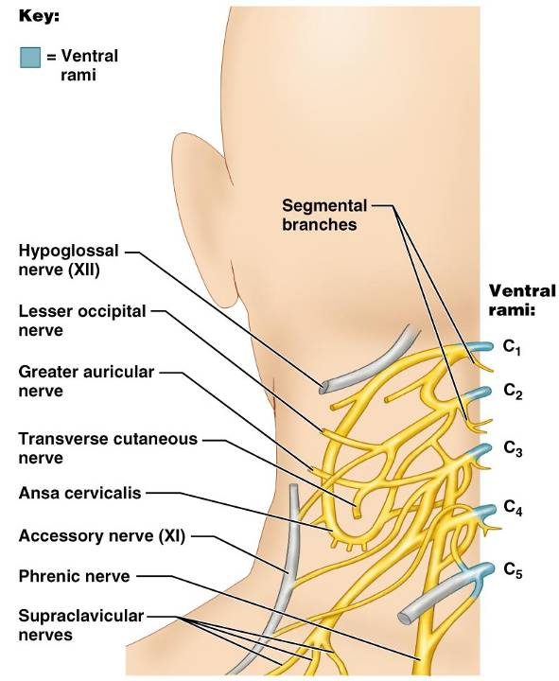
Cervical Plexus

Slide 77
Brachial Plexus
Formed by C₅-C₈ and T₁ (C₄ and T₂ may also contribute to this plexus)
It gives rise to the _

Slide 78
Brachial Plexus
There are four major branches of this plexus
_______________________________________ – five ventral rami (C₅-T₁)
_______________________________________– upper, middle, and lower, which form divisions
_______________________________________– anterior and posterior serve the front and back of the limb
_______________________________________– lateral, medial, and posterior fiber bundles

Slide 79
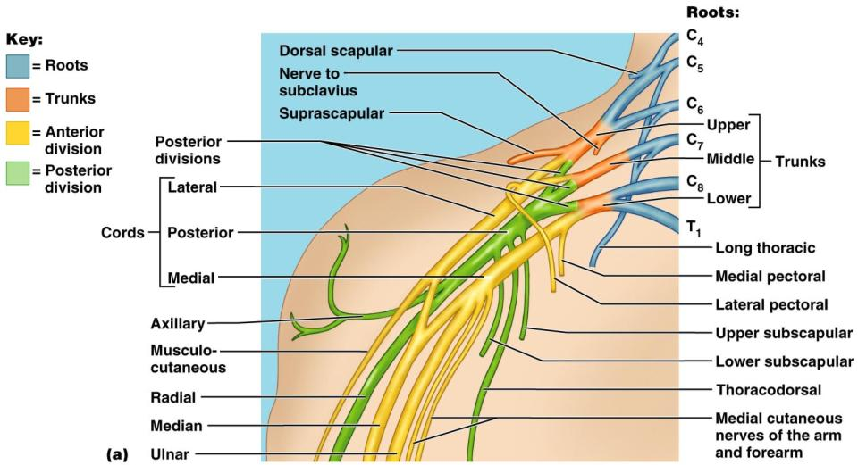
Brachial Plexus

Slide 80
Brachial Plexus: Nerves
Axillary
Musculocutaneous
sends fibers to the biceps brachii and brachialis
branches to most of the flexor muscles of arm
supplies the flexor carpi ulnaris and part of the flexor digitorum profundus
Radial
innervates essentially all _

Slide 81
Lumbar Plexus
Arises from L₁-L₄ and innervates the _
The major nerves are the _

Slide 82
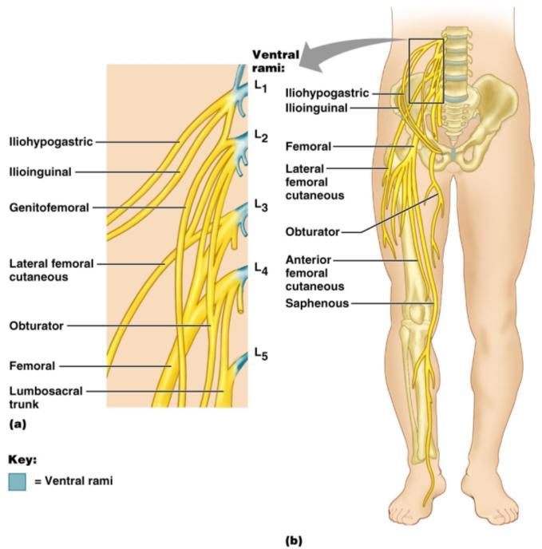
Lumbar Plexus
Figure 13.10

Slide 83
Sacral Plexus
Arises from L₄-S₄ and serves the buttock, lower limb, pelvic structures, and the perineum
The major nerve is the _
The sciatic is actually composed of two nerves:

Slide 84
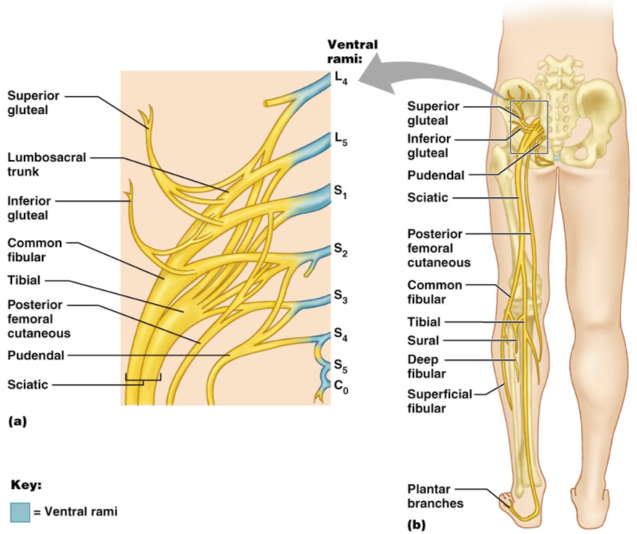
Sacral Plexus

Slide 85
Innervation of Joints
Hilton’s law: any nerve serving a muscle that produces _____________________________ at a joint also innervates the _

Slide 86
Reflexes
A reflex is a _
Reflexes may:
Be inborn _
Involve only peripheral nerves and the _
Involve higher brain centers as well

Slide 87
Reflex Arc
There are five components of a reflex arc
site of stimulus
transmits the afferent impulse to the CNS
either monosynaptic or polysynaptic region within the CNS
conducts efferent impulses from the integration center to an effector
muscle fiber or gland that responds to the efferent impulse

Slide 88
Reflex Arc
Figure 13.14

Slide 89
Stretch and Deep Tendon Reflexes
For skeletal muscles to perform normally:
The Golgi tendon organs (_______________________________________) must constantly inform the brain as to the state of the muscle
Stretch reflexes initiated by muscle spindles must maintain healthy _

Slide 90
Muscle Spindles
Muscle spindles are wrapped with ______________________________________: primary sensory endings of type Ia fibers and secondary sensory endings of type II fibers
These regions are innervated by gamma (γ) efferent fibers
Note: contractile muscle fibers are extrafusal fibers and are innervated by alpha (α) efferent fibers

Slide 91
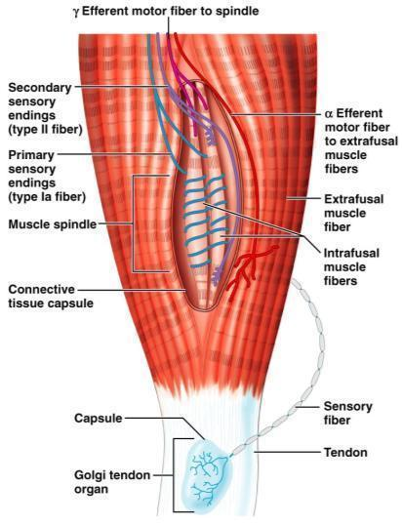
Muscle Spindles
Figure 13.15

Slide 92
Operation of the Muscle Spindles
__________________________________ the muscles activates the muscle spindle
There is an _________________________________________________________________________________ in Ia fibers
___________________________________ the muscle ________________________________________on the muscle spindle
There is a decreased rate of action potential on Ia fibers

Slide 93
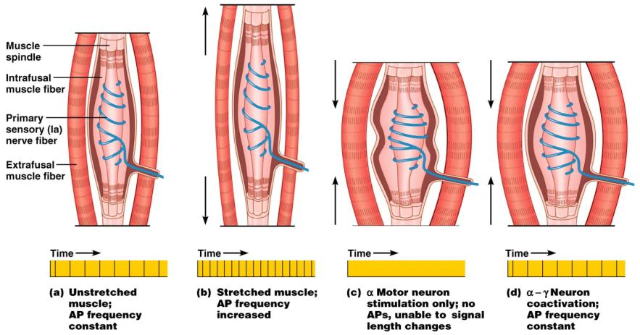
Operation of the Muscle Spindle
Figure 13.17

Slide 94
Stretch Reflex
Stretching the muscle _
Excited γ motor neurons of the spindle cause the stretched muscle to contract
Afferent impulses from the spindle result in inhibition of the antagonist
Example:
Tapping the patellar tendon _
The quadriceps contract and the _

Slide 95
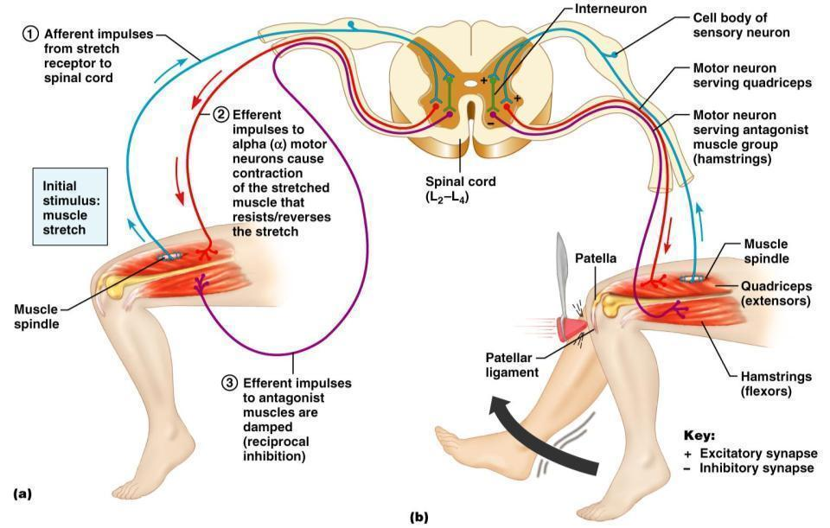
Stretch Reflex

Slide 96
Golgi Tendon Reflex
The _____________________________ of the stretch reflex
____________________________________ the muscle _
Afferent Golgi tendon neurons are stimulated, neurons inhibit the contracting muscle, and the antagonistic muscle is activated
As a result, the contracting muscle relaxes and the antagonist contracts

Slide 97
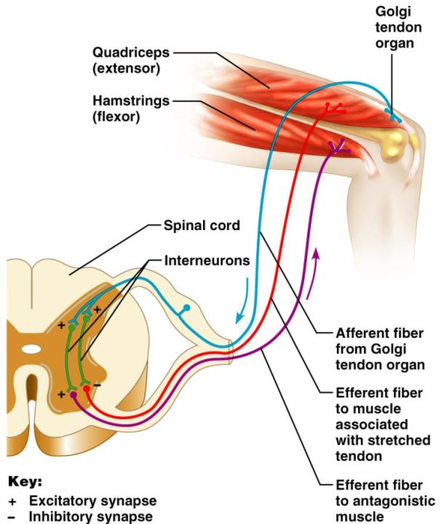
Golgi Tendon Reflex

Slide 98
Flexor and Crossed Extensor Reflexes
_____________________________________ is initiated by a _________________________ stimulus (actual or perceived) that causes automatic _____________________________________ of the threatened body part
The crossed extensor reflex has two parts
The stimulated side is _
The _

Slide 99
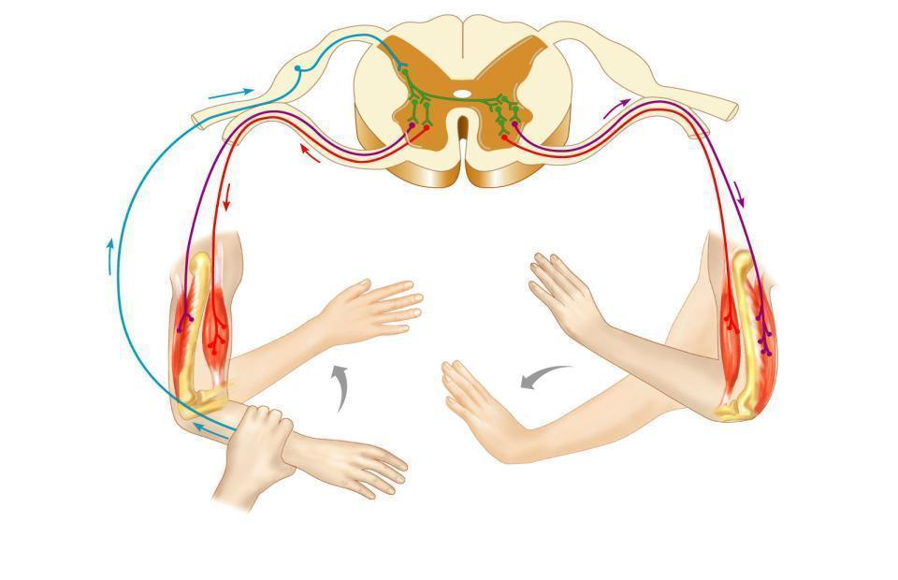
Crossed Extensor Reflex
+
Interneurons
+
–
+
+
–
Afferent
fiber
Efferent
fibers
Efferent
fibers
Extensor
inhibited
Flexor
inhibited
Flexor
stimulated
Flexes
Arm movements
Extensor
stimulated
Extends
Key:
+ Excitatory synapse
– Inhibitory synapse
Right arm
(site of stimulus)
Left arm (site of
reciprocal activation)

Slide 100
Superficial Reflexes
Initiated by gentle ___________________________________ stimulation
Example:
__________________________________________ is initiated by stimulating the lateral aspect of the sole of the foot
The response is _
Indirectly tests for proper ____________________________________________ functioning
_________________________________________ : abnormal plantar reflex indicating corticospinal damage where the great toe dorsiflexes and the smaller toes fan laterally

Slide 101
Autonomic Nervous System (ANS)
The ANS consists of motor neurons that:
Innervate _
Make adjustments to ensure optimal support for body activities
Operate via _
Have ____________________________________ as most of their _

Slide 102
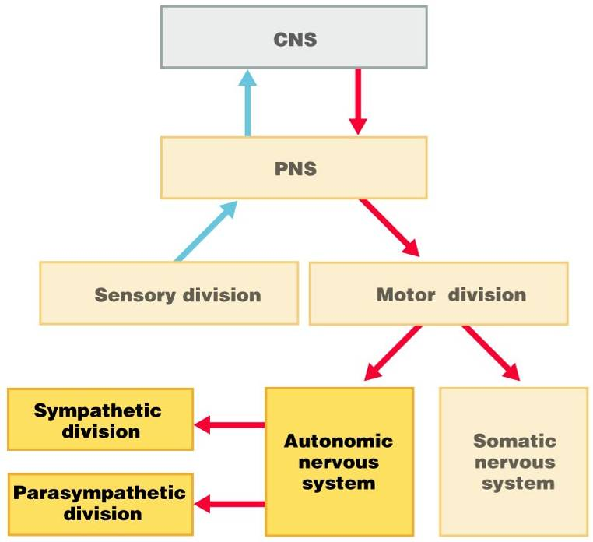

Slide 103
ANS Versus Somatic Nervous System (SNS)
The ANS differs from the SNS in the following three areas
Efferent _
Target organ responses

Slide 104
Effectors
The effectors of the _____________ are _
The effectors of the ________________ are _

Slide 105
Efferent Pathways
_____________________________________ axons of the _______________________________________ extend from the CNS to the effector
Axons of the ANS are a _
The ______________________________________ (first) neuron has a lightly myelinated axon
The _______________________________________ (second) neuron extends to an effector organ

Slide 106
Neurotransmitter Effects
All ____________________________________ neurons release _
which has an _
In the ANS:
Preganglionic fibers _
Postganglionic fibers release
or _
the effect is either _
ANS effect depends on the
neurotransmitter released
and the _

Slide 107
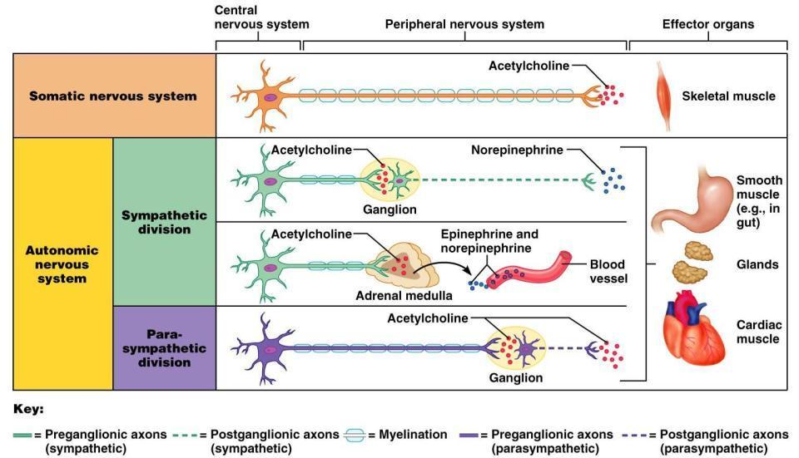
Comparison of Somatic and Autonomic Systems

Slide 108
Divisions of the ANS
ANS divisions:
mobilizes the body during _
performs ___________________________________________ and conserves body energy
The two divisions provide _

Slide 109
Role of the Parasympathetic Division
Concerned with keeping body energy use low
Involves the _
Its activity is illustrated in a person who relaxes after a meal
Blood pressure, heart rate, and respiratory rates are low
Gastrointestinal tract activity is high
The skin is warm and the pupils are constricted

Slide 110
Role of the Sympathetic Division
The sympathetic division is the _
Involves _
exercise, excitement, emergency, and embarrassment

Slide 111
Role of the Sympathetic Division
Promotes adjustments during exercise
blood flow to organs is reduced, _
Its activity is illustrated by a person who is threatened
Heart rate ______________________________ and breathing is _
The skin is cold and sweaty, and the pupils dilate

Slide 112
Anatomy of ANS
Division | Origin of Fibers | Length of Fibers | Location of Ganglia
Sympathetic | Thoracolumbar region of the spinal cord | Short preganglionic and long postganglionic | Close to the spinal cord
Parasympathetic | Brain and sacral spinal cord | Long preganglionic and short postganglionic | In the visceral effector organs

Slide 113
Parasympathetic Division Outflow
Cranial Outflow | Cranial Nerve | Ganglion | Effector Organ(s)
 | Occulomotor (III) | Ciliary | Eye
 | Facial (VII) | Pterygopalatin Submandibular | Salivary, nasal, and lacrimal glands
 | Glossopharyngeal (IX) | Otic | Parotid salivary glands
 | Vagus (X) | Located within the walls of target organs | Heart, lungs, and most visceral organs
Sacral Outflow | S₂-S₄ | Located within the walls of the target organs | Large intestine, urinary bladder, ureters, and reproductive organs

Slide 114
Sympathetic Outflow
Arises from spinal cord segments T₁ through L₂
Sympathetic neurons form _
Preganglionic fibers pass through the ______________________________________ and synapse in the chain (paravertebral) ganglia

Slide 115
Sympathetic Outflow
Fibers from T₅-L₂
form _
synapse with _
Postganglionic fibers innervate the numerous organs of the body

Slide 116
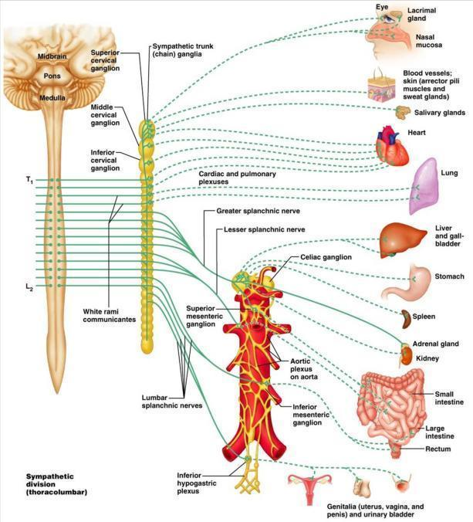

Slide 117
Sympathetic Trunks and Pathways
The __________________________________ form part of the sympathetic trunk or chain
Typically there are 23 ganglia
3 cervical
11 thoracic
4 lumbar
4 sacral
1 coccygeal

Slide 118
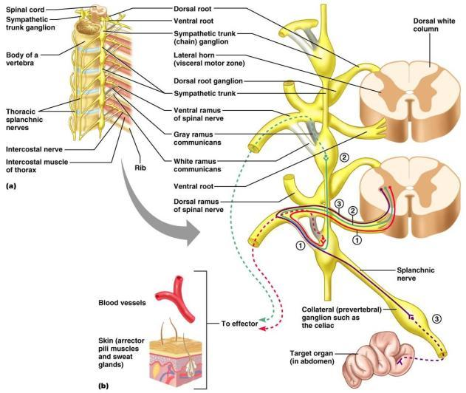
Sympathetic Trunks and Pathways
Figure 14.6

Slide 119
Sympathetic Trunks and Pathways
A preganglionic fiber follows one of three pathways upon entering the paravertebral ganglia
Synapse with the _
_______________________________________ the sympathetic chain to synapse in another chain ganglion
Pass through the chain ganglion and _

Slide 120
Pathways with Synapses in Chain Ganglia
Postganglionic axons enter the ventral rami via the _
These fibers innervate _
Rami communicantes are associated _______________ with the sympathetic division

Slide 121
Pathways to the Head
Preganglionic fibers emerge from T₁-T₄ and synapse in the superior cervical ganglion
These fibers:
Serve the _
Stimulate dilator muscles of the _
Inhibit nasal and salivary glands

Slide 122
Pathways to the Thorax
Preganglionic fibers emerge from T₁-T₆ and synapse in the _
Postganglionic fibers emerge from the middle and inferior cervical ganglia and enter nerves C₄-C₈
These fibers innervate the ___________________ via the cardiac plexus, as well as innervating the _

Slide 123
Pathways to the Thorax
Other T₁-T₆ preganglionic fibers synapse in the nearest chain ganglia
Postganglionic fibers directly serve the

Slide 124
Pathways with Synapses in Collateral Ganglia
These fibers (T₅-L₂) leave the sympathetic chain _
They form thoracic, lumbar, and sacral _
Their ganglia include
the
the superior and inferior mesenterics
the

Slide 125
Pathways to the Abdomen
Sympathetic nerves innervating the abdomen have preganglionic fibers from T₅-L₂
They travel through the thoracic splanchnic nerves and synapse at the celiac and superior mesenteric ganglia
Postganglionic fibers serve the

Slide 126
Pathways to the Pelvis
Preganglionic fibers originate from T₁₀-L₂
Most travel via the _____________________________________ splanchnic nerves to the inferior mesenteric and hypogastric ganglia
Postganglionic fibers serve the distal half of the large intestine, the ____________________________________, and the reproductive organs

Slide 127
Pathways with Synapses in the Adrenal Medulla
Fibers of the thoracic splanchnic nerve pass _
Upon stimulation, medullary cells secrete ____________________________________________________________________________into the blood

Slide 128
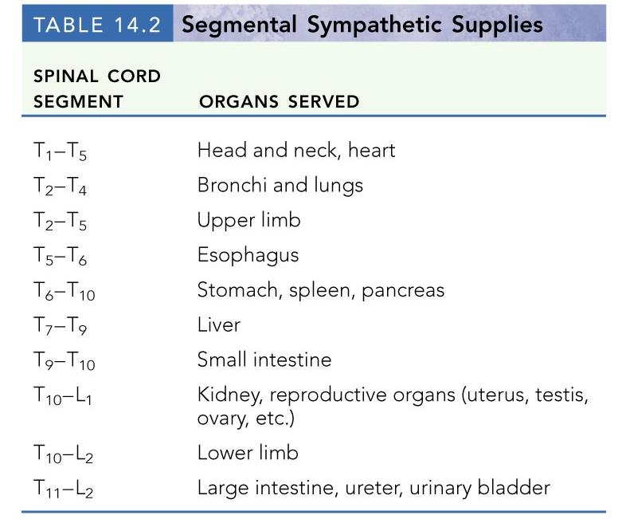

Slide 129
Visceral Reflexes
____________________________reflexes have the same elements as _______________________________reflexes
They are always _
Afferent fibers are found in spinal and autonomic nerves

Slide 130
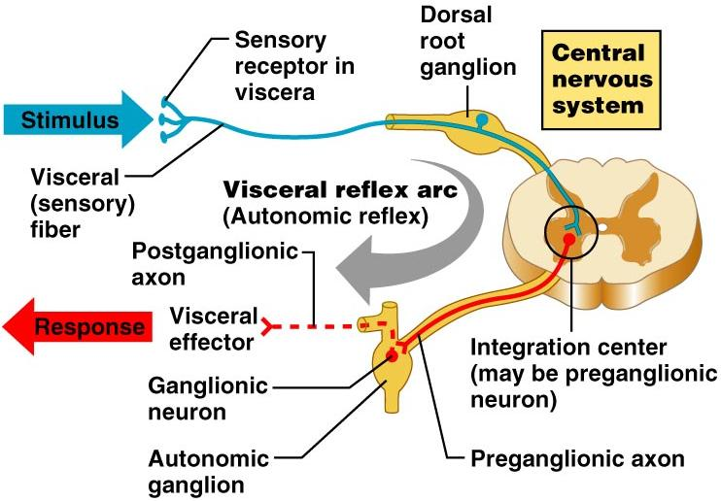

Slide 131
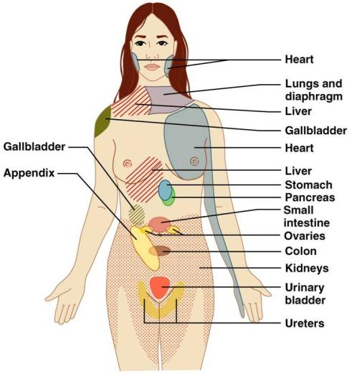
Referred Pain
Pain stimuli arising from the __________________are _
This may be due to the fact that visceral pain afferents travel along the same pathways as somatic pain fibers

Slide 132
Neurotransmitters and Receptors
Acetylcholine (ACh) and norepinephrine (NE) are the two major neurotransmitters of the _
ACh-releasing fibers
ACh is released by all __________________________________________ axons and all parasympathetic _
Adrenergic fibers
______________________________________________ postganglionic axons that release NE
effects (excitatory/inhibitory) _

Slide 133
Cholinergic Receptors
The __________________________of receptors that bind ACh are _
These are named after drugs that bind to them and mimic _

Slide 134
Nicotinic Receptors
Nicotinic receptors are found on:
________________________________________ (somatic targets)
All ganglionic neurons of both sympathetic and parasympathetic divisions
The __________________________________ cells of the _
The effect of ACh binding to nicotinic receptors is _

Slide 135
Muscarinic Receptors
Muscarinic receptors occur on all effector cells stimulated by _
The effect of ACh binding:
Can be either _
Depends on the _________________________________________ of the target organ

Slide 136
Adrenergic Receptors
The two types of adrenergic receptors _
Effects of NE binding to:
α receptors is _
β receptors is _
A notable exception
NE binding to β receptors of the heart is stimulatory

Slide 137
Effects of Drugs
Atropine
blocks _
Tricyclic antidepressants
prolong the activity of NE on postsynaptic membranes
Over-the-counter drugs for colds, allergies, and nasal congestion
Beta-blockers
attach mainly to β₁ receptors and _

Slide 138
Interactions of the Autonomic Divisions
Most _________________________ organs are innervated by both _
increase heart and respiratory rates, and inhibit digestion and elimination
decrease heart and respiratory rates, and allow for digestion and the discarding of wastes

Slide 139
Sympathetic Tone
The sympathetic division ______________________________________ and keeps the blood vessels in a continual state of partial constriction
This sympathetic tone (vasomotor tone):
Constricts blood vessels and causes blood pressure to rise as needed
Prompts vessels to _______________________ if blood pressure is to be _

Slide 140
Parasympathetic Tone
Parasympathetic tone:
Dictates normal activity levels of the digestive and urinary systems
The sympathetic division can override these effects during times _
Drugs that block parasympathetic responses increase heart rate and block fecal and urinary retention

Slide 141
Cooperative Effects
ANS ______________________________ is best seen in control of the external genitalia
__________________________________ fibers cause ______________________________and are responsible for erection of the penis and clitoris
________________________________ fibers cause __________________________________ in males and reflex peristalsis in females

Slide 142
Unique Roles of the Sympathetic Division
Regulates many functions not subject to _
These include the activity of the
sweat glands
arrector pili muscles
most blood vessels

Slide 143
Unique Roles of the Sympathetic Division
The sympathetic division controls:
Thermoregulatory responses to _
Release of _
Metabolic effects

Slide 144
Thermoregulatory Responses to Heat
Applying heat to the skin causes ___________________________________ of blood vessels
Systemic body temperature elevation results in widespread dilation of blood vessels
This dilation brings warm blood to the surface
When temperature falls, blood vessels constrict and blood is retained in deeper vital organs

Slide 145
Release of Renin from the Kidneys
Sympathetic impulses activate the kidneys _
Renin is an enzyme that _

Slide 146
Metabolic Effects
The sympathetic division promotes metabolic effects _
Increases the metabolic rate of body cells
Raises _
Mobilizes _
Stimulates the reticular activating system (RAS) of the brain, increasing mental alertness

Slide 147
Localized Versus Diffuse Effects
The parasympathetic division exerts _
The sympathetic division exerts _

Slide 148
Effects of Sympathetic Activation
Sympathetic activation is long-lasting because NE:
Is ___________________________________ more slowly than _
Is an indirectly acting neurotransmitter, using a _
And epinephrine are released into the blood and _

Slide 149
Levels of ANS Control
The hypothalamus is the main ____________________________________ center of ANS activity
Subconscious cerebral input via limbic lobe connections influences hypothalamic function
Other controls come from the _______________________________ , the reticular formation, and the _

Slide 150
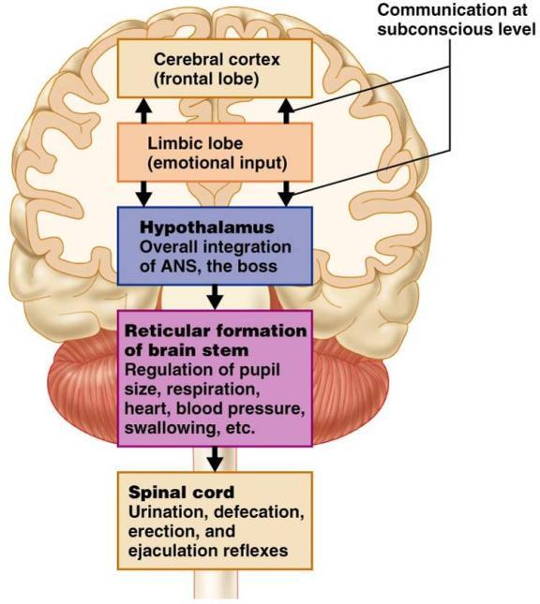
Levels of ANS Control

Slide 151
Hypothalamic Control
Centers of the hypothalamus control:
Body temperature, ________________________________________, and endocrine activity
________________________________________ (rage, pleasure) and biological drives (hunger, thirst, sex)
Reactions to ____________________________ and the “fight-or-flight” system

