Slide 1
Exam Three Material
Chapters 8, 9, 10

Slide 2
Joints (Articulations)
_____________________________ parts of the skeleton
__________________________________ – site where two or more bones meet
Functions of joints
Give the skeleton _
Hold the skeleton together

Slide 3
Classification of Joints: Structural
_________________________________ classification focuses on the _____________________________________ and whether or not ___________________________ is present
The three structural classifications are:
Fibrous
Cartilaginous
Synovial

Slide 4
Classification of Joints: Functional
_______________________________ classification is based on the ___________________________________ allowed by the joint
The three functional classes of joints are:
Synarthroses –
Amphiarthroses –
Diarthroses –

Slide 5
Fibrous Structural Joints
The bones are joined by _
There is _
Most are _
There are three types –
Syndesmoses

Slide 6
Fibrous Structural Joints: Sutures
Occur between the _
Comprised of interlocking junctions completely filled with _
Bind bones tightly together, but allow for _
In middle age, skull bones ___________________ and are called _

Slide 7
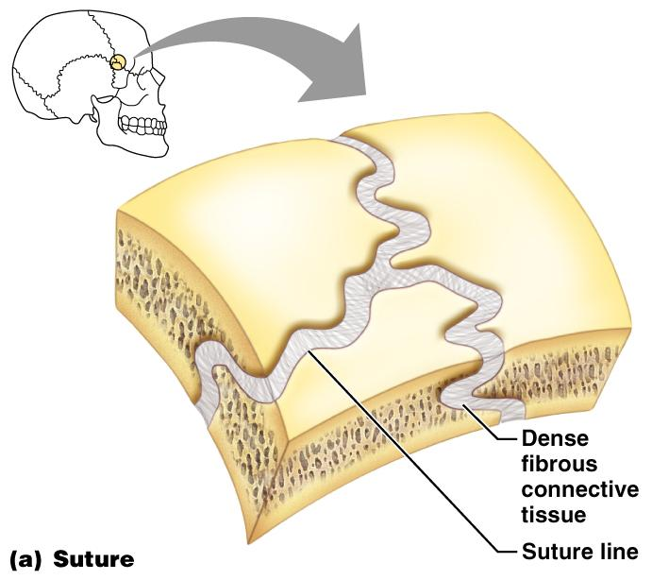
Fibrous Structural Joints: Sutures
Figure 8.1a

Slide 8
Fibrous Structural Joints: Syndesmoses
Bones are connected by a _
Movement varies from immovable to slightly variable
Examples include the connection between the _

Slide 9
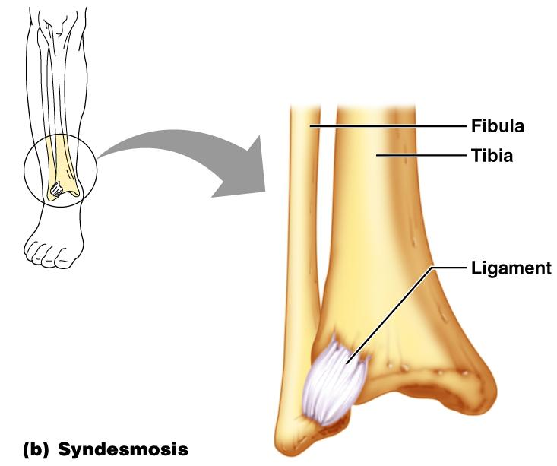
Fibrous Structural Joints: Syndesmoses
Figure 8.1b

Slide 10
Fibrous Structural Joints: Gomphoses
The __________________________________ fibrous joint between a tooth and its _
The fibrous connection is the _

Slide 11
Cartilaginous Joints
Articulating bones are united by _
_________________________a joint cavity
Two types –

Slide 12
Cartilaginous Joints: Synchondroses
A bar or ________________ of _____________________________ cartilage unites the bones
Examples include:
_______________________________ of children
Joint between the _

Slide 13
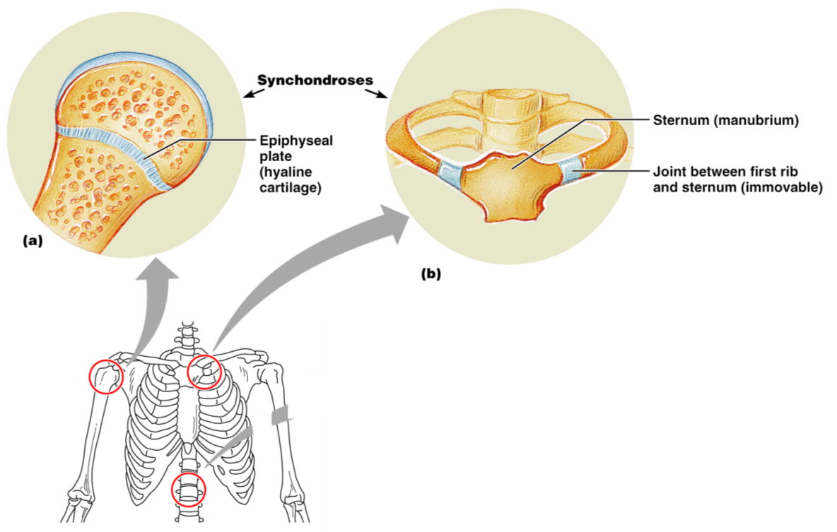
Cartilaginous Joints: Synchondroses
Figure 8.2a, b

Slide 14
Cartilaginous Joints: Symphyses
_________________________________ covers the articulating surface of the bone and is fused to an intervening pad of _
Examples include _________________________ and the _________________________________of the pelvis

Slide 15
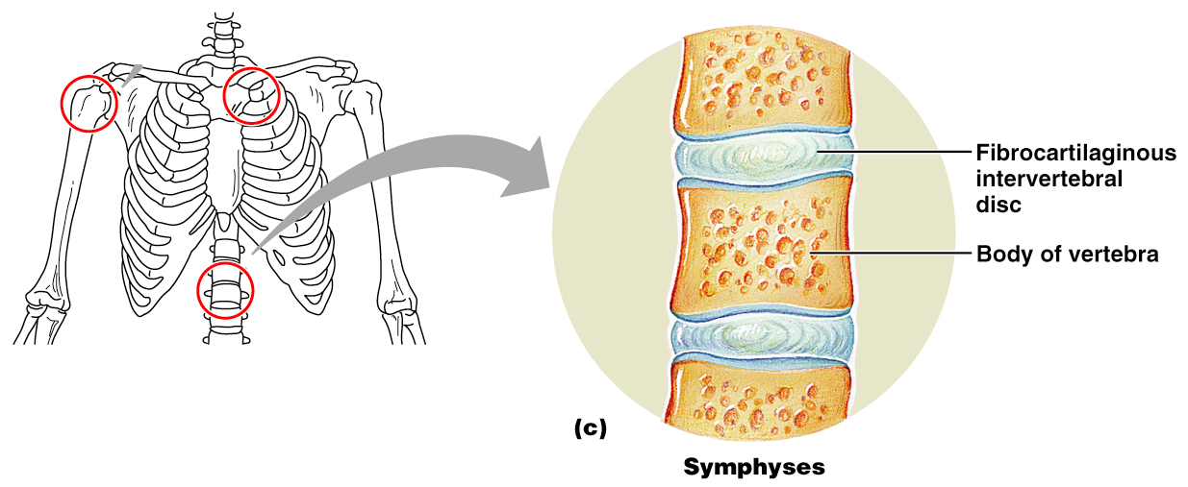
Cartilaginous Joints: Symphyses
Figure 8.2c

Slide 16
Synovial Joints
Those joints in which the articulating bones are separated by a _
Examples – all limb joints, and most joints of the body

Slide 17
Synovial Joints: General Structure
Synovial joints all have the following
Joint (________________________) cavity
Synovial fluid
Reinforcing ligaments

Slide 18
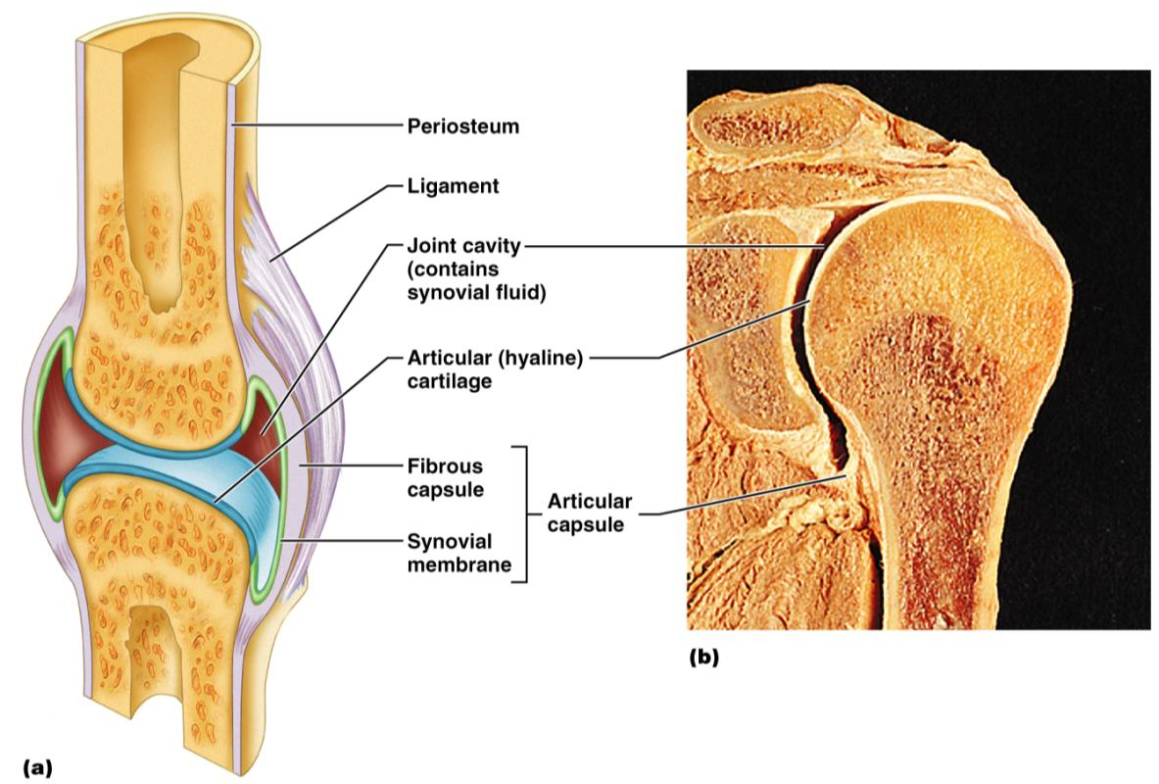
Synovial Joints: General Structure
Figure 8.3a, b

Slide 19
Synovial Joints: Friction-Reducing Structures
___________________________– flattened, fibrous sacs lined with synovial membranes and containing _
Common where ligaments, muscles, skin, tendons, or bones rub together
___________________________________ – elongated bursa that wraps completely around a tendon

Slide 20
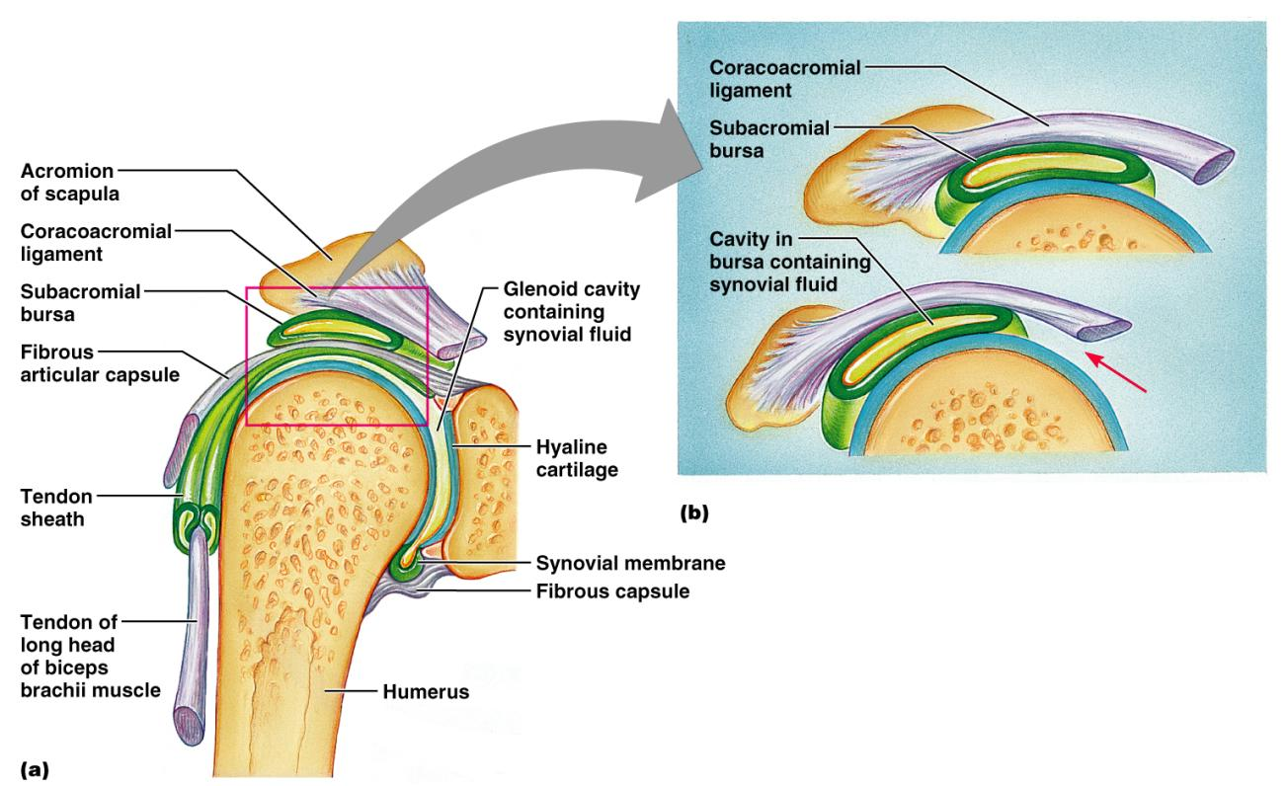
Synovial Joints: Friction-Reducing Structures
Figure 8.4

Slide 21
Synovial Joints: Stability
Stability is determined by:
_____________________________________– shape determines what movements are possible
______________________________________– unite bones and prevent excessive or undesirable motion

Slide 22
Synovial Joints: Stability
__________________________________ is accomplished by:
Muscle tendons across joints acting as _
Tendons that are __________________________ at all times by _

Slide 23
Synovial Joints: Movement
The two muscle attachments across a joint are:
____________________________________– attachment to the _
____________________________________– attachment to the _
Described as movement along transverse, frontal, or sagittal planes

Slide 24
Synovial Joints: Range of Motion
______________________
slipping movements only
______________________
movement in one plane
______________________
movement in two planes
______________________
movement in or around all three planes

Slide 25
Gliding Movements
One _____________________________ glides or slips over another similar surface
Examples
_______________________________ and intertarsal joints
between the flat articular processes of _

Slide 26
Angular Movement
bending movement that decreases the angle of the joint
Extension
reverse of flexion; joint angle is _
____________________________ and plantar flexion
up and down movement of the foot

Slide 27
Angular Movement
movement away from the midline
movement toward the midline
movement describes a ______________________ in space

Slide 28
Rotation
The turning of a bone _
Examples
Between _
___________________________and shoulder joints

Slide 29
Special Movements
____________________________and pronation
Inversion and _
___________________________and retraction
Elevation and _
_

Slide 30
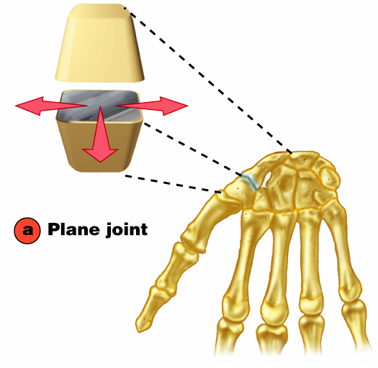
Plane Joint
Plane joints
Articular surfaces are _
Allow only slipping or gliding movements

Slide 31
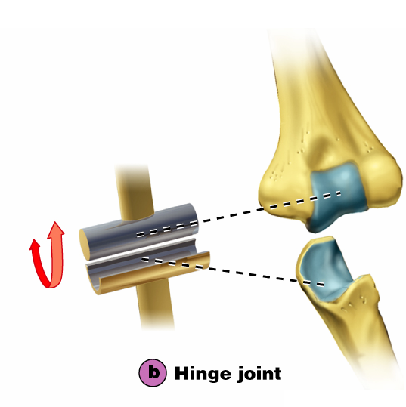
Types of Synovial Joints
Hinge joints
Cylindrical projections of one bone fits into a _
Motion is along a _
Uniaxial joints permit _
Examples: ______________________ and interphalangeal joints

Slide 32
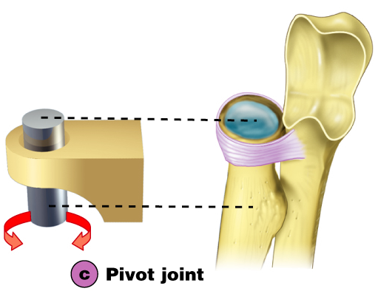
Pivot Joints
Rounded end of one bone protrudes into a “sleeve,” or ring, composed of bone (and possibly ______________________) of another
Only uniaxial movement allowed
Examples: joint between the ____________________________________, and the proximal _

Slide 33
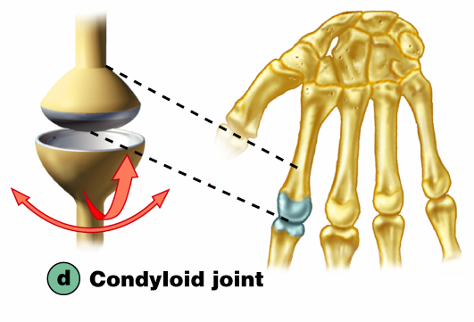
Condyloid or Ellipsoidal Joints
Oval articular surface of one bone fits into a _______________________in another
Both articular surfaces _
Biaxial joints permit all angular motions
Examples: ______________________ (wrist) joints, and _______________________ (knuckle) joints

Slide 34
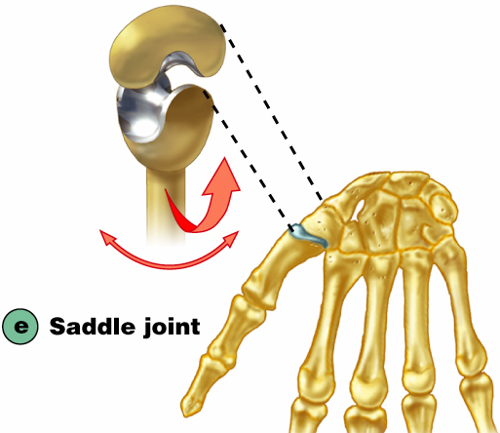
Saddle Joints
Similar to condyloid joints but allow _
Each articular surface has both a _
Example: carpometacarpal joint of the thumb

Slide 35
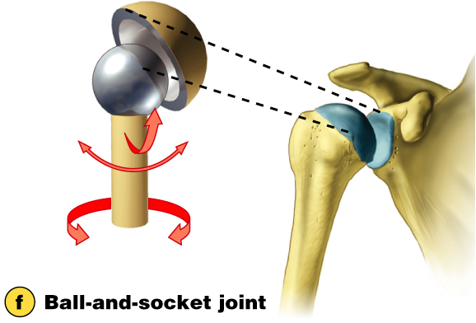
Ball-and-Socket Joints
A __________________________or hemispherical head of one bone articulates with a _
Multiaxial joints permit the _
Examples: shoulder and hip joints

Slide 36
Synovial Joints: Knee
Largest and ____________________________ joint of the body
Allows _
__________________ joints in one surrounded by a single joint cavity
Femoropatellar joint
Lateral and medial _________________________ joints

Slide 37
Synovial Joints: Shoulder (Glenohumeral)
Ball-and-socket joint in which _________________________is sacrificed to obtain greater _
Head of humerus articulates with the ____________________________________ of the scapula

Slide 38
Synovial Joints: Elbow
_________________________ joint that allows flexion and extension _
Radius and ulna articulate with _

Slide 39
Synovial Joints: Shoulder Stability
Weak stability is maintained by:
Thin, loose joint capsule
Four ligaments – coracohumeral, and three glenohumeral
Tendon of the ______________________________________, which travels through the ____________________________________groove and secures the humerus to the glenoid cavity
____________________________________(four tendons) that encircles the shoulder joint and blends with the articular capsule

Slide 40
Synovial Joints: Hip (Coxal) Joint
Head of the femur articulates with the acetabulum
Good range of motion, but _

Slide 41
Temporomandibular Joint (TMJ)
Mandibular condyle articulate with the _
Two types of movement
____________________________– depression and elevation of mandible
Side to side – (____________________________) grinding of teeth

Slide 42
Sprains
The _____________________________ reinforcing a joint are _
Partially torn ligaments slowly repair themselves
___________________________________ ligaments require prompt surgical repair

Slide 43
Cartilage Injuries
The snap and pop of overstressed cartilage
Common aerobics injury
Repaired with _

Slide 44
Dislocations
Occur when bones are forced out of alignment
Usually accompanied by ___________________________________ inflammation, and joint immobilization
Caused by serious falls and are common sports injuries
_
______________________________________ dislocation of a joint

Slide 45
Inflammatory and Degenerative Conditions
Bursitis
An inflammation of a ______________________ , usually caused by a _
Symptoms are _
Treated with anti-inflammatory drugs; excessive fluid may be aspirated

Slide 46
Inflammatory and Degenerative Conditions
Tendonitis
Inflammation of _______________________________________ typically caused by overuse
Symptoms and treatment are similar to _

Slide 47
Arthritis
More than ______________________________ of inflammatory or degenerative diseases that damage the joints
Most widespread crippling disease in the U.S.
Symptoms
pain, stiffness, and _
Acute forms are caused by ___________________________ and are treated with antibiotics
Chronic forms include osteoarthritis, rheumatoid arthritis, and gouty arthritis

Slide 48
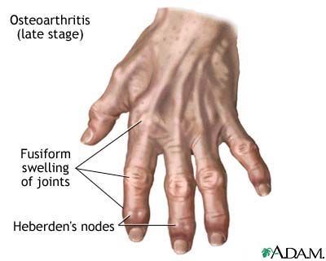
Osteoarthritis (OA)
Most common chronic arthritis; often called “______________________________ ” arthritis
Affects _______________________more than men
______________of all Americans develop OA
More prevalent in the aged, and is probably related to the normal aging process

Slide 49
Osteoarthritis: Course
OA reflects the years of ________________________________________ causing increased production of metalloproteinase enzymes that break down cartilage
As one ages, cartilage is destroyed more quickly than it is replaced
The exposed bone ends ________________________, enlarge, form bone spurs, and _
Joints most affected are the cervical and lumbar spine, fingers, knuckles, knees, and hips

Slide 50
Osteoarthritis: Treatments
OA is slow and _
Treatments include:
Mild ___________________________________, along with moderate activity
Magnetic therapy
Glucosamine sulfate decreases pain and inflammation

Slide 51
Rheumatoid Arthritis (RA)
Chronic, inflammatory, ______________________________________ of unknown cause, with an insidious onset
Usually arises between the ages of ________________, but may occur at any age
Signs and symptoms include joint tenderness, anemia, osteoporosis, _________________________, and cardiovascular problems
The course of RA is marked with _

Slide 52
Rheumatoid Arthritis: Course
RA begins with _________________________ of the affected joint
Inflammatory chemicals are _________________________________ released
Inflammatory blood cells migrate to the joint, causing swelling

Slide 53
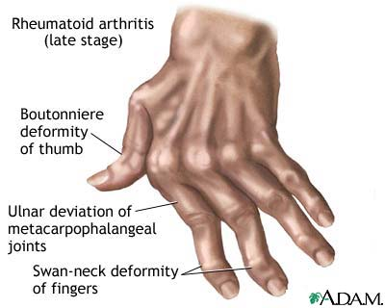
Rheumatoid Arthritis:
Inflamed ________________________________ thickens into a pannus
Pannus ______________________________ , scar tissue forms, articulating bone ends connect
The end result, _______________________, produces bent, deformed fingers

Slide 54
Rheumatoid Arthritis: Treatment
Conservative therapy – _________________, long-term use of antibiotics, and physical therapy
Progressive treatment – anti-inflammatory drugs or _
The drug Enbrel, a biological response modifier, neutralizes the harmful properties of inflammatory chemicals

Slide 55
Comparison of arthritic joints

Slide 56
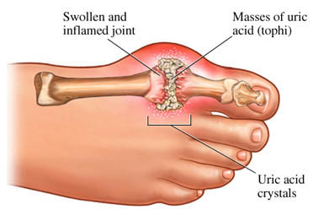
Gouty Arthritis
Deposition of ________________________________________in joints and soft tissues, followed by an _
Typically, gouty arthritis affects the joint at the _
In untreated gouty arthritis, the _________________________________________ and immobilize the joint
Treatment – colchicine, nonsteroidal anti-inflammatory drugs, and glucocorticoids

Slide 57
Muscle Overview
The three types of muscle tissue are
These types differ in structure, location, function, and means of activation

Slide 58
Muscle Similarities
Skeletal and smooth _________________________ are elongated
called _
Muscle contraction depends on two kinds of myofilaments
Muscle terminology is similar
muscle plasma membrane
cytoplasm of a muscle cell
Prefixes
myo, mys, and sarco all refer to _

Slide 59
Skeletal Muscle Tissue
Has obvious ____________________called _
Is controlled _
Contracts rapidly
but _
Is responsible for overall body motility
Is extremely _
can exert wide range of forces

Slide 60
Cardiac Muscle Tissue
Occurs _
Is ______________________________ like skeletal muscle
not _
Rhythmicity controlled by _
Pacemaker located within the heart
Neural controls temper the heart’s response
Elevates or depresses rate as needed

Slide 61
Smooth Muscle Tissue
Found in the walls of hollow _______________________________organs,
the _
urinary bladder,
respiratory passages
Forces food and other substances through internal body channels
It is _

Slide 62
Functional Characteristics of Muscle Tissue
the ability to receive and respond to stimuli
the ability to shorten forcibly
the ability to be stretched or extended
the ability to recoil and resume the original resting length

Slide 63
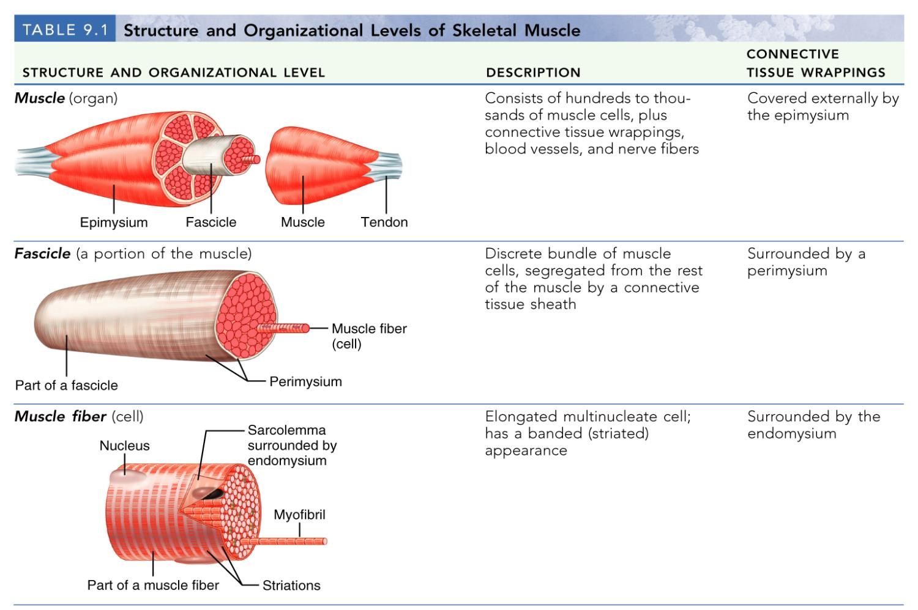
Structure and Organization of Skeletal Muscle

Slide 64
Structure and Organization of Skeletal Muscle
Table 9.1b

Slide 65
Skeletal Muscle
Each muscle is a ___________________________ composed of muscle tissue, blood vessels, nerve fibers, and connective tissue

Slide 66
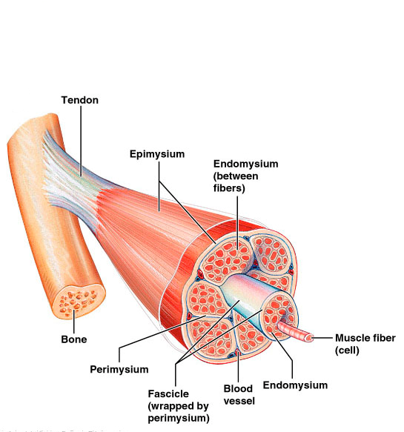
Skeletal Muscle
The three connective tissue sheaths are:
fine sheath of _____________________ tissue composed of reticular fibers surrounding each muscle fiber
fibrous connective tissue that surrounds groups of muscle fibers called _
an overcoat of dense regular connective tissue that surrounds the entire muscle

Slide 67
Skeletal Muscle: Attachments
Most skeletal muscles ______________________________ and are attached to bone _
When muscles contract the movable bone, the muscle’s _

Slide 68
Skeletal Muscle: Attachments
Muscles attach:
epimysium of the muscle is fused to the _
connective tissue wrappings extend beyond the muscle as a _

Slide 69
Microscopic Anatomy of a Skeletal Muscle Fiber
Each fiber is a long, cylindrical cell with __________________________________ just beneath the sarcolemma
Fibers are up to __________________________ long
Each cell is a ___________________________ produced by fusion of embryonic cells

Slide 70
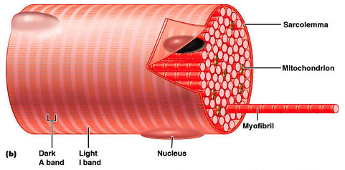
Myofibrils
Myofibrils are densely packed, rodlike contractile elements
They make up most of the _
The arrangement of myofibrils creates a repeating series of _

Slide 71
Sarcomeres
The smallest ________________________ of a muscle
Composed of ______________________________ made up of contractile proteins
Myofilaments are of two types – _

Slide 72
Myofilaments: Banding Pattern
Thick filaments are composed of the _
extend the entire length of an A band
extend across the I band and partway into the A band
Z-disc
coin-shaped sheet of proteins (connectins) that anchors the thin filaments and connects myofibrils to one another

Slide 73
Ultrastructure of Myofilaments: Thick Filaments
Each ________________________________ molecule has a rod-like tail and two globular heads
two interwoven, heavy polypeptide chains
two smaller, light polypeptide chains called cross bridges

Slide 74
Ultrastructure of Myofilaments: Thin Filaments
Thin filaments are chiefly composed of the protein _
The subunits contain the ____________________________ to which myosin heads attach during contraction
Tropomyosin and troponin are regulatory subunits bound to actin

Slide 75
Sarcoplasmic Reticulum (SR)
SR is ___________________________________ that runs longitudinally and _
Functions in the regulation of _

Slide 76
T Tubules
T tubules are continuous with the _
They conduct impulses to the _
These impulses signal for the release of _

Slide 77
Sliding Filament Model of Contraction
Thin filaments _____________________ past the thick ones so that the actin and myosin filaments overlap to a greater degree
In the relaxed state, thin and thick filaments overlap _
Upon stimulation, myosin heads bind to actin and sliding begins

Slide 78
Sliding Filament Model of Contraction
Each myosin head binds and detaches several times during contraction, ______________________________________ to generate tension and propel the thin filaments to the center of the sarcomere
As this event occurs throughout the sarcomeres, the _

Slide 79
Skeletal Muscle Contraction
In order to contract, a skeletal muscle must:
Be ____________________________by a nerve ending
Send an electrical current, or ________________________________, along its sarcolemma
Have a ___________________ in intracellular Ca²⁺ levels, the final trigger for contraction
Linking the ______________________________________ is excitation-contraction coupling

Slide 80
Nerve Stimulus of Skeletal Muscle
Skeletal muscles are stimulated by _______________________________ of the somatic nervous system
Axons of these neurons travel in ____________________to muscle cells
Axons of motor neurons __________________ profusely as they enter muscles
Each axonal branch forms a _______________________________________ with a single muscle fiber

Slide 81
Neuromuscular Junction
The neuromuscular junction is formed from:
___________________________________, which have small membranous sacs (synaptic vesicles) that contain the neurotransmitter acetylcholine (ACh)
The __________________________________of a muscle, which is a specific part of the sarcolemma that contains ACh receptors and helps form the neuromuscular junction

Slide 82
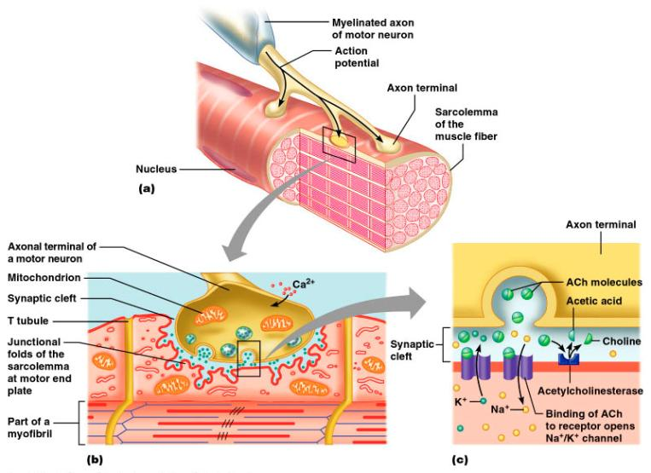
Neuromuscular Junction
Though exceedingly close, axonal ends and muscle fibers are ____________________________________ called the synaptic cleft

Slide 83
Neuromuscular Junction
When a nerve impulse reaches the end of an axon at the neuromuscular junction:
___________________________________________ calcium channels open and allow Ca²⁺ to enter the axon
Ca²⁺ causes axonal vesicles to ____________________ with the axonal membrane
This fusion releases _____________________ into the synaptic cleft
ACh _______________________________ across the synaptic cleft to ACh receptors on the sarcolemma
Binding of ACh to its receptors _

Slide 84
Destruction of Acetylcholine
ACh bound to ACh receptors is quickly _____________________________________by the enzyme _
This destruction prevents __________________________________ in the absence of additional stimuli

Slide 85
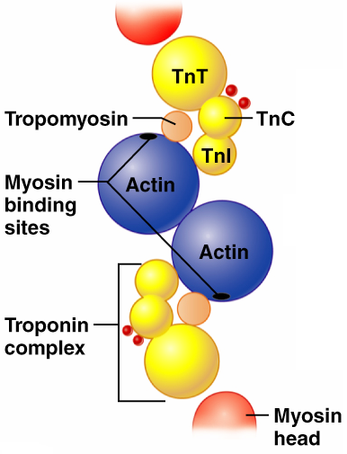
Role of Ionic Calcium (Ca²⁺) in the Contraction Mechanism
At __________ intracellular Ca²⁺ concentration:
Tropomyosin ________________the binding sites on actin
Myosin cross bridges cannot attach to binding sites on actin
Muscle remains _
Figure 9.11a

Slide 86
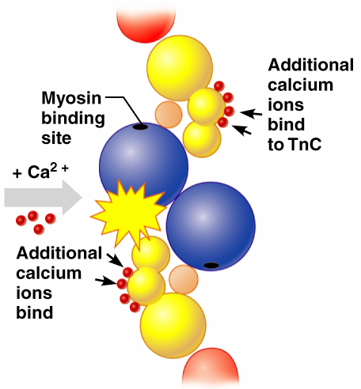
Role of Ionic Calcium (Ca²⁺) in the Contraction Mechanism
At __________________ intracellular Ca²⁺ concentrations:
Additional calcium binds to troponin
Calcium-activated troponin binds an additional two Ca²⁺ at a separate regulatory site
Figure 9.11b

Slide 87
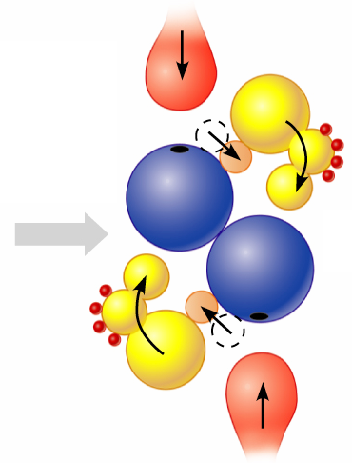
Role of Ionic Calcium (Ca²⁺) in the Contraction Mechanism
Calcium-activated troponin undergoes a _
This change moves tropomyosin away from _
Figure 9.11c

Slide 88
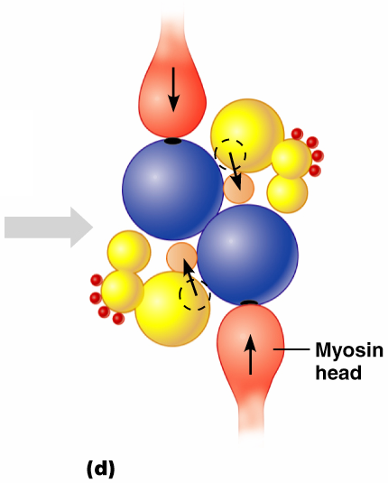
Role of Ionic Calcium (Ca²⁺) in the Contraction Mechanism
Myosin head can now _
This permits _
sliding of the thin filaments by the myosin cross bridges
Figure 9.11d

Slide 89
Sequential Events of Contraction
myosin cross bridge attaches to actin filament
myosin head pivots and pulls actin filament toward M line
ATP attaches to myosin head and the cross bridge detaches
“Cocking” of the myosin head
energy from hydrolysis of ATP cocks the myosin head into the high-energy state

Slide 90
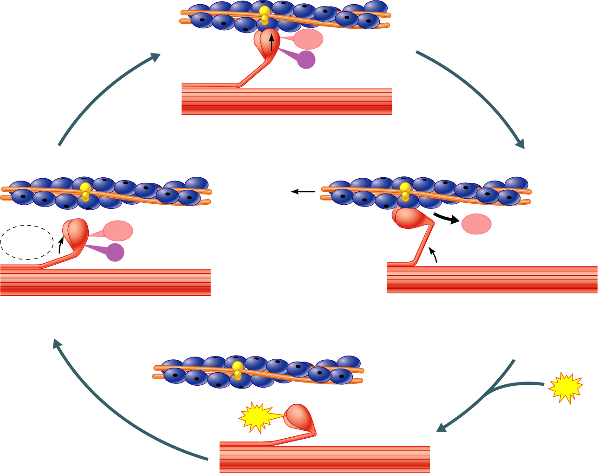
Myosin head
(high-energy
configuration)
ADP
P_{i}
1
Myosin head attaches to the actin
myofilament, forming a cross bridge.
Thin filament
ATP
ADP
ADP
Thick filament
hydrolysis
P_{i}
4
As ATP is split into ADP and P_{i}, the myosin
head is energized (cocked into the high-energy
conformation).
2
Inorganic phosphate (P_{i}) generated in the
previous contraction cycle is released, initiating
the power (working) stroke. The myosin head
pivots and bends as it pulls on the actin filament,
sliding it toward the M line. Then ADP is released.
ATP
ATP
Myosin head
(low-energy
configuration)
3
As new ATP attaches to the myosin head, the link between
myosin and actin weakens, and the cross bridge detaches.
Figure 9.12

Slide 91
Contraction of Skeletal Muscle Fibers
Contraction
refers to the _
ends when cross bridges become inactive, the tension generated declines, and relaxation is induced

Slide 92
Contraction of Skeletal Muscle (Organ Level)
The two types of muscle contractions are:
________________________contraction
muscle shortens during contraction
Iso = same; tonic = tone
increasing muscle tension
muscle does not ___________________________ during contraction
Iso = same; metric =length

Slide 93
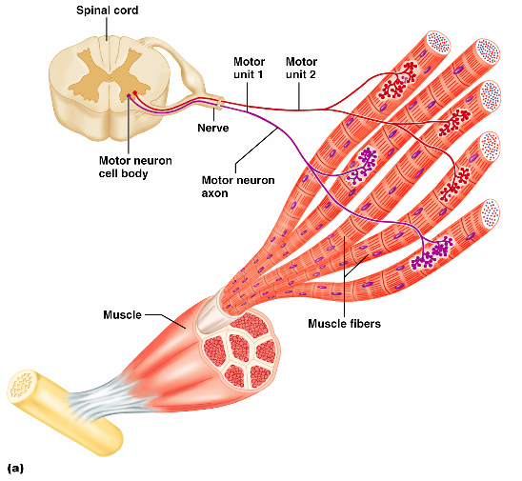
Motor Unit: The Nerve-Muscle Functional Unit
A motor unit is a _
The number of muscle fibers per motor unit varies
from _

Slide 94
Motor Unit: The Nerve-Muscle Functional Unit
Muscles that control fine movements have _
fingers, eyes
________________________weight-bearing muscles have ________________motor units
thighs, hips
Muscle fibers from a motor unit are spread throughout the muscle; therefore, contraction of a single motor unit causes weak contraction of the entire muscle

Slide 95
Muscle Tone
Muscle tone:
Is the _________________________________ state of all muscles, which does not _
Keeps the muscles firm, healthy, and _
Spinal reflexes account for muscle tone by:
Activating one motor unit and then another
Responding to activation of _

Slide 96
Heat Production During Muscle Activity
Only 40% of the energy released in muscle activity is _
The remaining 60% is _
Dangerous heat levels are prevented by radiation of heat from the skin and sweating

Slide 97
Force of Muscle Contraction
The force of contraction is affected by:
The _______________________________________ contracting
the more motor fibers in a muscle, the stronger the contraction
The relative _______________________ of the muscle
the bulkier the muscle, the greater its strength
____________________________ of muscle stretch
muscles contract strongest when muscle fibers are 80-120% of their normal resting length

Slide 98
Effects of Aerobic Exercise
Aerobic exercise results in an increase of:
Muscle _
Number of _
_______________________________ synthesis

Slide 99
Effects of Resistance Exercise
_____________________________ exercise (typically anaerobic) results in:
Muscle _
Increased
Myofilaments

Slide 100
The Overload Principle
Forcing a muscle to work promotes increased muscular strength
Muscles ______________________________ to increased demands
Muscles must be ______________________ to produce further gains

Slide 101
Smooth Muscle
Composed of _
____________________ the coarse connective tissue sheaths of skeletal muscle,
have fine endomysium

Slide 102
Smooth Muscle
Organized into ____________________ of closely apposed fibers
longitudinal
circular
Found in _
Have essentially the same contractile mechanisms as skeletal muscle

Slide 103
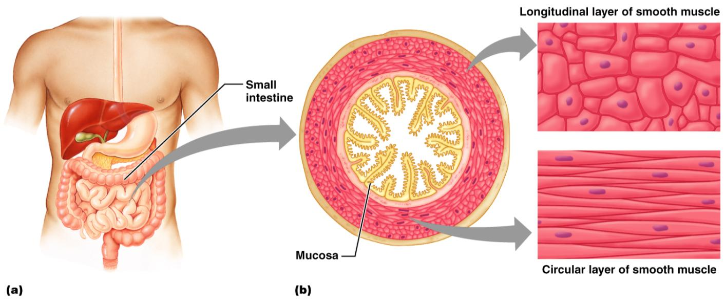
Smooth Muscle
Figure 9.24

Slide 104
Peristalsis
When the ________________________layer contracts
the organ dilates and contracts
When the _____________________ layer contracts
the organ elongates
alternating contractions and relaxations of smooth muscles that _____________________________ substances through the lumen of hollow organs

Slide 105
Innervation of Smooth Muscle
Smooth muscle _
Innervating nerves have bulbous swellings called _
Varicosities ____________________________ into wide synaptic clefts called diffuse junctions

Slide 106
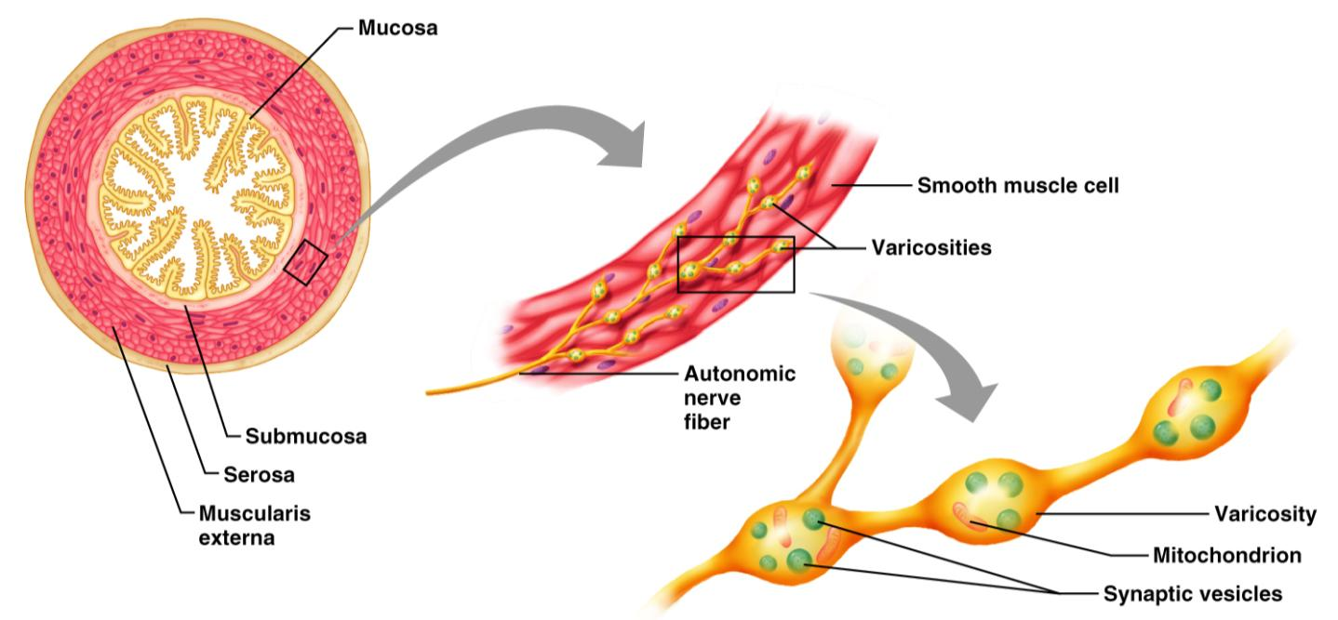
Innervation of Smooth Muscle
Figure 9.25

Slide 107
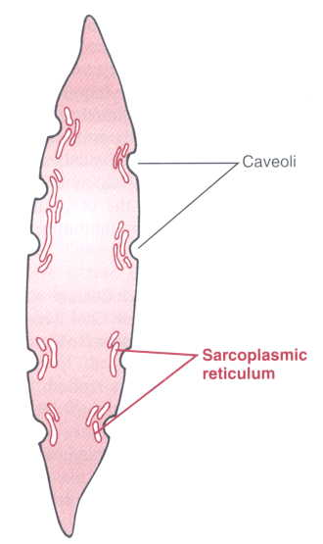
Microscopic Anatomy of Smooth Muscle
Sarcoplasmic Reticulum
is _____________________ than in skeletal muscle
lacks a specific pattern
T tubules are _
Plasma membranes have pouchlike infoldings called _

Slide 108
Microscopic Anatomy of Smooth Muscle
______________ is kept in the extracellular space near the caveoli, allowing rapid influx when channels are opened
There are ____________________________ and no sarcomeres
Thin and thick filaments are present

Slide 109
Myofilaments in Smooth Muscle
Ratio of thick to thin filaments is much lower than in skeletal muscle
Thick filaments have heads along their entire length
There is _

Slide 110
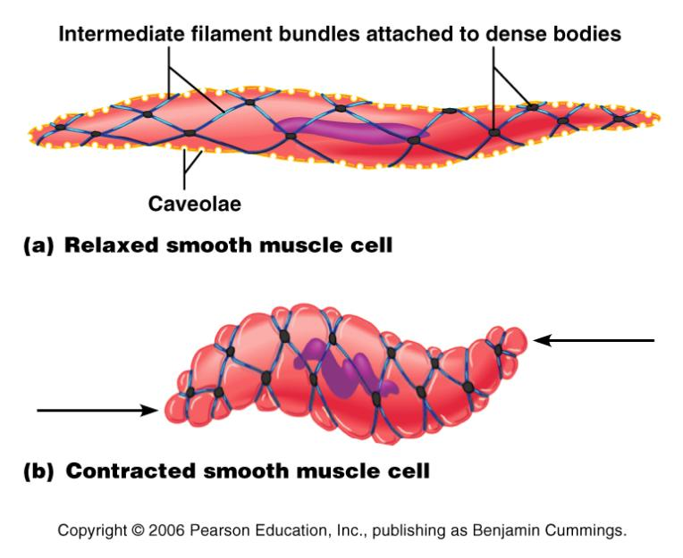
Myofilaments in Smooth Muscle
Thick and thin filaments are _____________________________, causing smooth muscle to contract in a _

Slide 111
Contraction of Smooth Muscle
Whole sheets of smooth muscle exhibit _
They contract in unison, reflecting their electrical coupling _
Action potentials are transmitted from cell to cell

Slide 112
Contraction of Smooth Muscle
Some smooth muscle cells:
Act as ______________________________ and set the contractile pace for _____________________________ of muscle
Are ___________________________________ and depolarize without external stimuli

Slide 113
Contraction Mechanism
Actin and myosin interact according to the _
The final trigger for contractions is a _
Ca²⁺ is released from the SR and from the extracellular space
Ca²⁺ interacts with calmodulin and myosin light chain kinase to activate myosin

Slide 114
Role of Calcium Ion
Ca²⁺ binds to __________________________ and activates it
Activated calmodulin activates the _
Activated kinase transfers ________________ from ATP to myosin cross bridges
Phosphorylated cross bridges interact with actin to produce shortening
Smooth muscle relaxes when intracellular Ca²⁺ levels drop

Slide 115
Special Features of Smooth Muscle Contraction
Unique characteristics of smooth muscle include:
Smooth muscle _
___________________________, prolonged contractile activity
Low energy requirements
Response _

Slide 116
Response to Stretch
Smooth muscle exhibits a phenomenon called ____________________________ response in which:
Smooth muscle responds to stretch only briefly, and then _
The new length, however, _
This enables organs such as the stomach and bladder to temporarily store contents

Slide 117
Hyperplasia
Certain _______________________ muscles can divide and ____________________________ by undergoing hyperplasia
This is shown by estrogen’s effect on _
At puberty,
estrogen stimulates the synthesis of more smooth muscle, causing the uterus to grow to adult size
During _
estrogen stimulates uterine growth to accommodate the increasing size of the growing fetus

Slide 118
Types of Smooth Muscle: Single Unit
The cells of single-unit smooth muscle, commonly called _______________________ muscle:
Contract rhythmically as a unit
Are electrically coupled to one another via _
Often exhibit _
Are arranged in opposing sheets and exhibit stress-relaxation response

Slide 119
Types of Smooth Muscle: Multiunit
Multiunit smooth muscles are found:
In large airways to the lungs
In _
In arrector pili muscles
Attached to _
In the internal eye muscles

Slide 120
Types of Smooth Muscle: Multiunit
Their characteristics include:
_________________ gap junctions
_________________________________ spontaneous depolarizations
Structurally independent muscle fibers
A rich nerve supply, which, with a number of muscle fibers, forms motor units
______________________________________ in response to neural stimuli

Slide 121
Interactions of Skeletal Muscles
Skeletal muscles work _________________________ or in _
Muscles only _______________(never push)
As muscles shorten, the insertion generally moves toward the origin

Slide 122
Muscles: Functional Groups
provide the major force for producing a specific movement
oppose or reverse a particular movement
Add force to a movement
Reduce undesirable or unnecessary movement
synergists that immobilize a bone or muscle’s origin

Slide 123
Naming Skeletal Muscles
bone or body region associated with the muscle
e.g., the deltoid muscle (deltoid = triangle)

Slide 124
Naming Skeletal Muscles
maximus (largest), minimus (smallest), longus (long)
rectus (fibers run straight), transversus, and oblique (fibers run at angles to an imaginary defined axis)

Slide 125
Naming Skeletal Muscles
Number of _
biceps (two origins) and triceps (three origins)
Location of _
named according to point of origin or insertion
flexor or extensor, as in the names of muscles that flex or extend, respectively

Slide 126
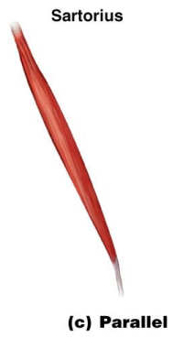
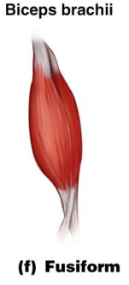
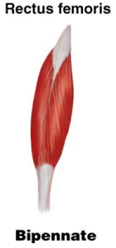
Arrangement of Fascicles
fascicles run parallel to the long axis of the muscle
sartorius
spindle-shaped muscles
biceps brachii
short fascicles that attach obliquely to a central tendon running the length of the muscle
rectus femoris

Slide 127
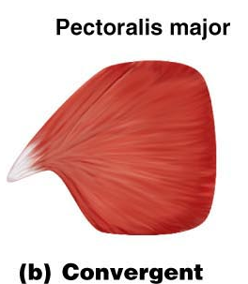
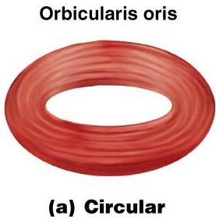
Arrangement of Fascicles
fascicles converge from a broad origin to a single tendon insertion
pectoralis major
fascicles are arranged in concentric rings
orbicularis oris

Slide 128
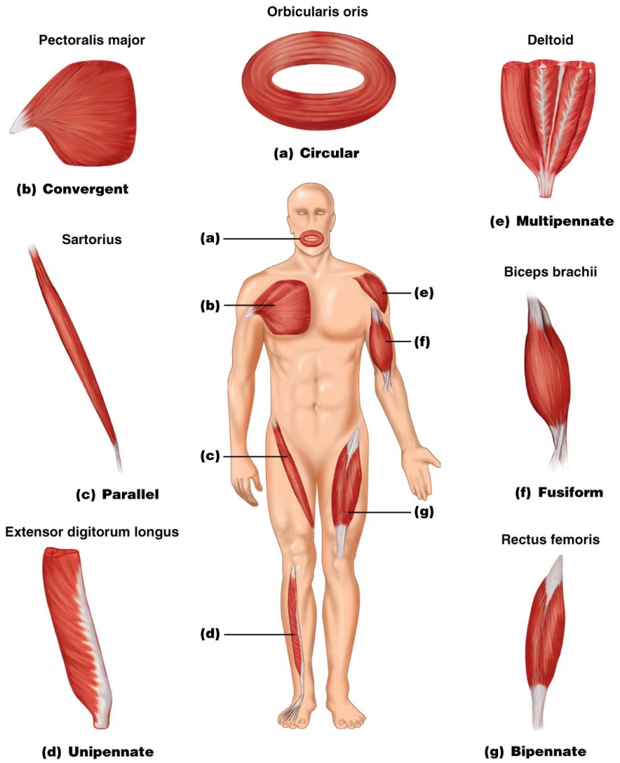
Figure 10.1

Slide 129
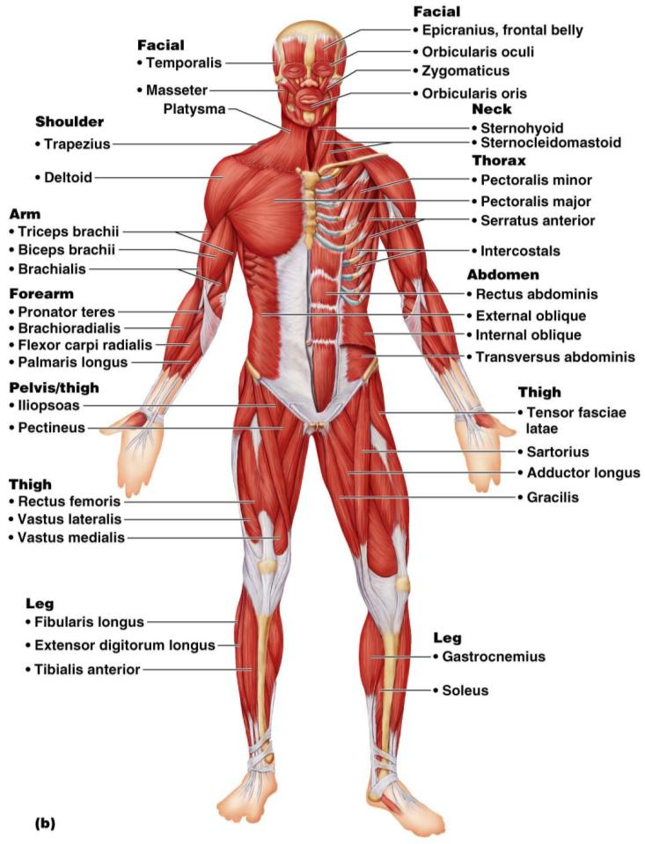
Major Skeletal Muscles: Anterior View
The 40 superficial muscles here are divided into 10 regional areas of the body
Figure 10.4b

Slide 130
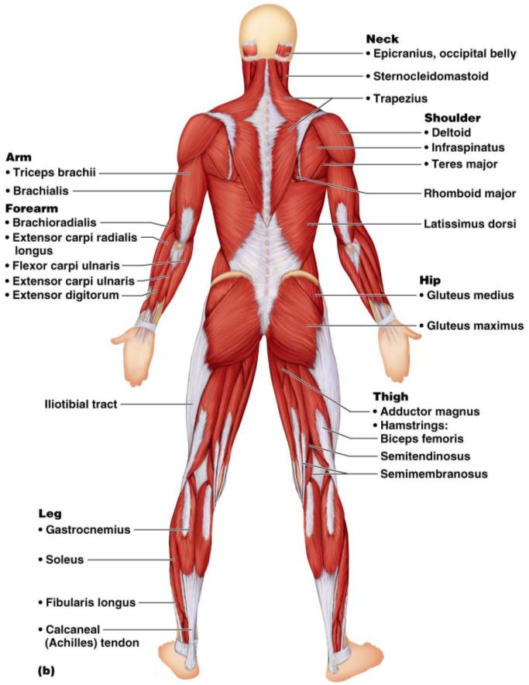
Major Skeletal Muscles: Posterior View
The 27 superficial muscles here are divided into seven regional areas of the body
Figure 10.5b

Slide 131
Muscles: Name, Action, and Innervation
Name and description of the muscle
be alert to information given in the name
Origin and insertion
Action
best learned by _________________________________________ on one’s own body
Nerve supply
name of major nerve that innervates the muscle

Slide 132
Muscles of the Scalp
Epicranius (___________________________) – bipartite muscle consisting of the:
Galea aponeurotica – cranial ___________________________________ connecting above muscles
These two muscles have alternate actions of pulling the scalp forward and backward

Slide 133
Muscles of the Face
11 muscles are involved in lifting the eyebrows, flaring the nostrils, opening and closing the eyes and mouth, and smiling
All are innervated by __________________________________ (facial nerve)
Usually insert ______________________ (rather than bone), and adjacent muscles often fuse

Slide 134
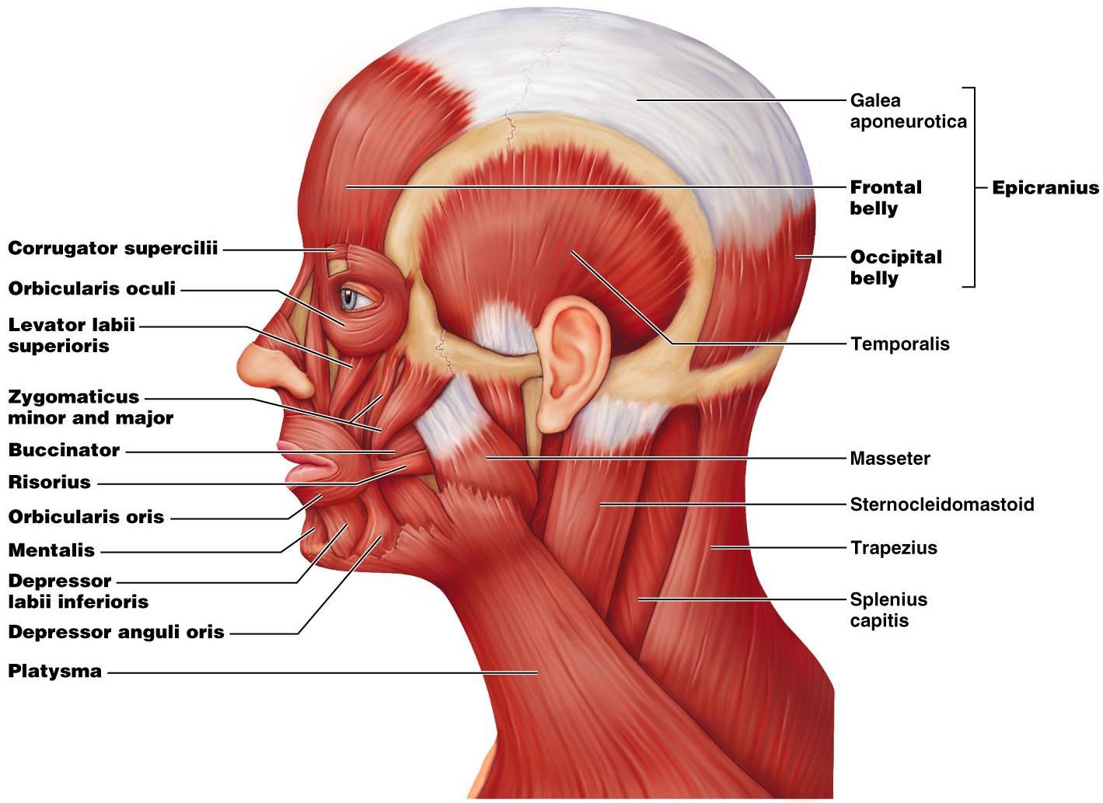

Slide 135
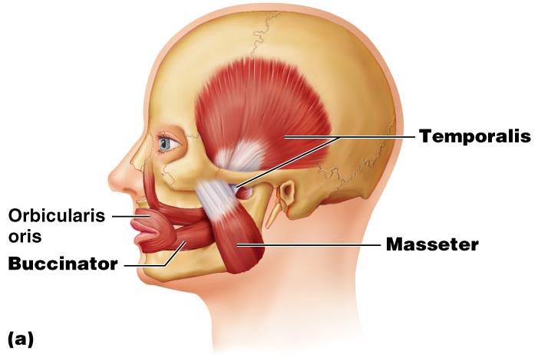
Muscles of Mastication
There are ____________________________________ of muscles involved in mastication
Prime movers
Grinding movements
All are innervated by _

Slide 136
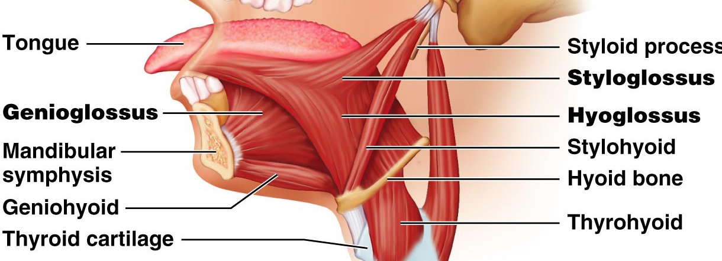
Extrinsic Tongue Muscles
Three major muscles that _
All are innervated by cranial nerve _

Slide 137
Muscles of the Neck: Head Movements
sternocleidomastoid
_____________________________ to head flexion
suprahyoid and infrahyoid
sternocleidomastoid and scalene muscles
Head extension
deep splenius muscles and aided by the _

Slide 138
Trunk Movements: Deep Back Muscles
The prime mover of _
erector spinae
Erector spinae muscles consist of ______________________________ on each side of the vertebrae
Lateral bending of the back
unilateral contraction of these muscles
Other deep back extensors include the semispinalis muscles and the quadratus lumborum

Slide 139
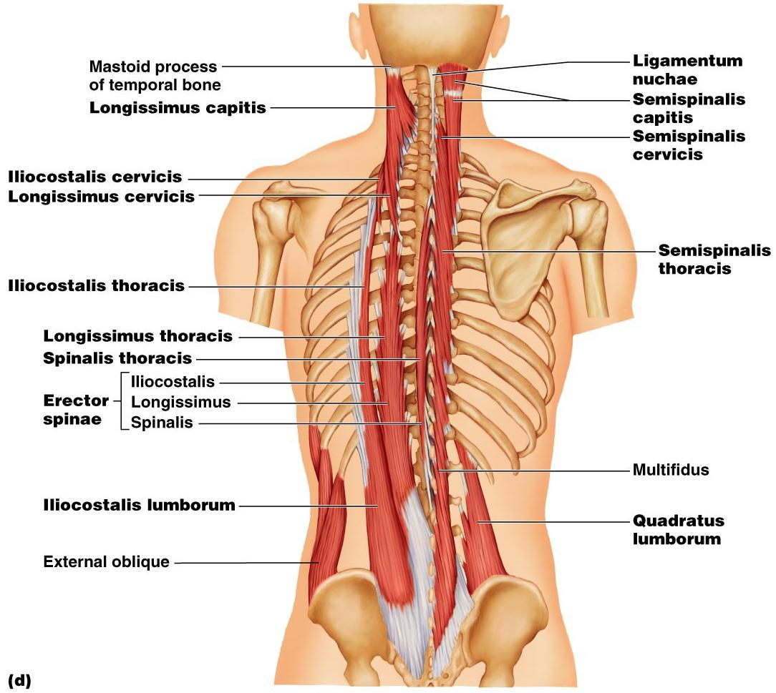
Figure 10.9d

Slide 140
Trunk Movements: Short Muscles
Four short muscles extend from one vertebra to another
These muscles are synergists in ________________________________ of the spine

Slide 141
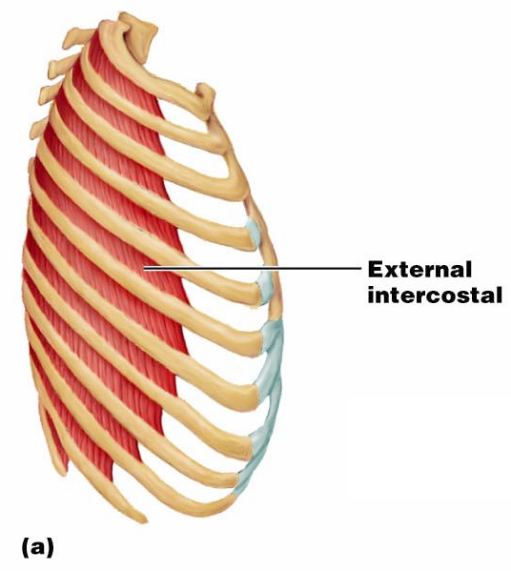
Muscles of Respiration: External Intercostals
The primary function of deep thoracic muscles is to _
______________________
more superficial layer that lifts the rib cage
increases thoracic volume to allow inspiration

Slide 142
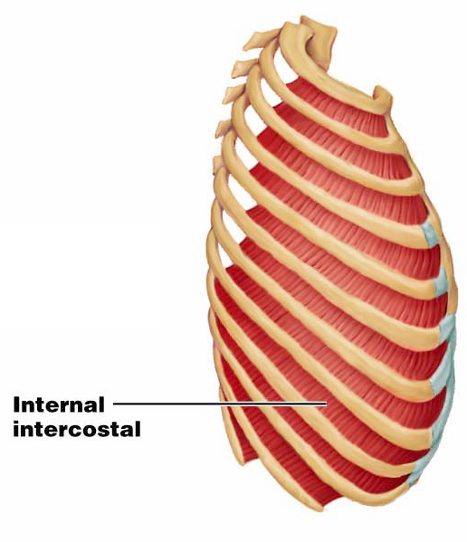
Muscles of Respiration: Internal Intercostals
deeper layer that aids in forced expiration
most important muscle in inspiration

Slide 143
Muscles of the Abdominal Wall
The abdominal wall is composed of four paired muscles
external obliques,
rectus abdominis),
their fasciae, and their _
Fascicles of these muscles run at right and oblique angles to one another, giving the abdominal wall added strength

Slide 144
Muscles of the Abdominal Wall
In addition to forming the abdominal wall, these muscles:
Are involved with ________________________ and rotation of the trunk
Help promote __________________________, defecation, ___________________________, vomiting, coughing, and _

Slide 145
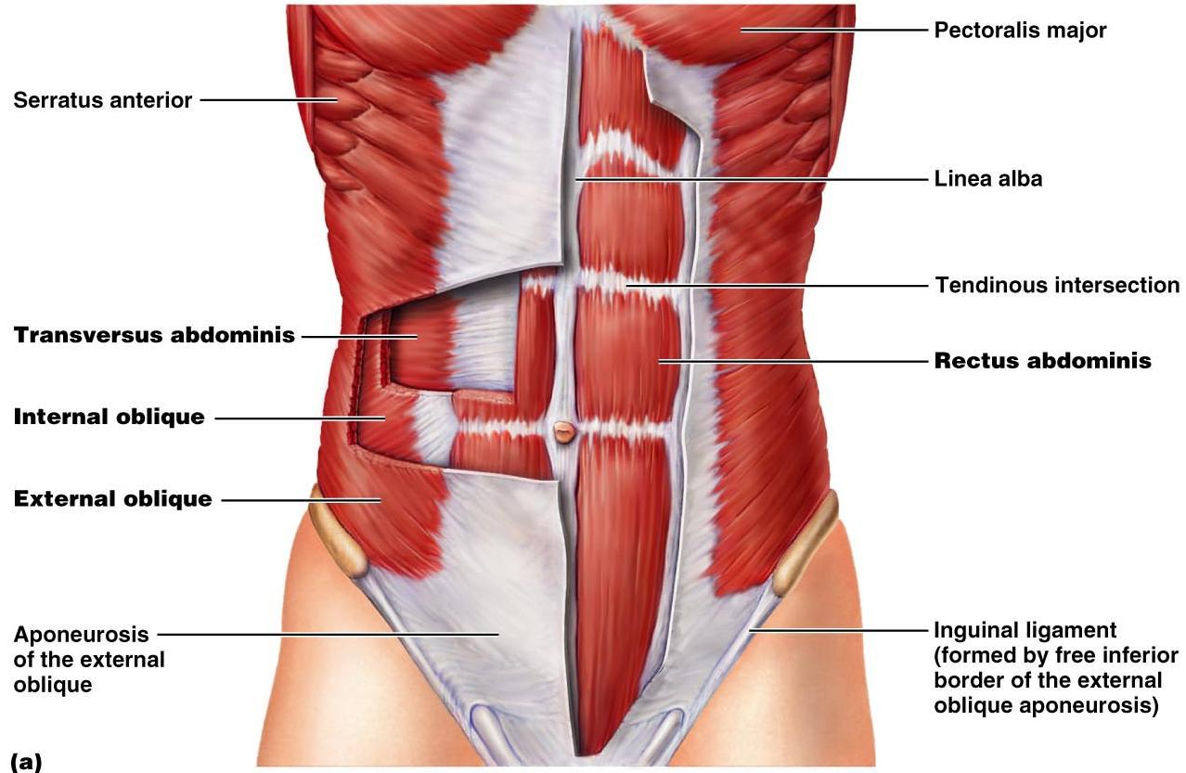
Muscles of the Abdominal Wall
Figure 10.11a

Slide 146
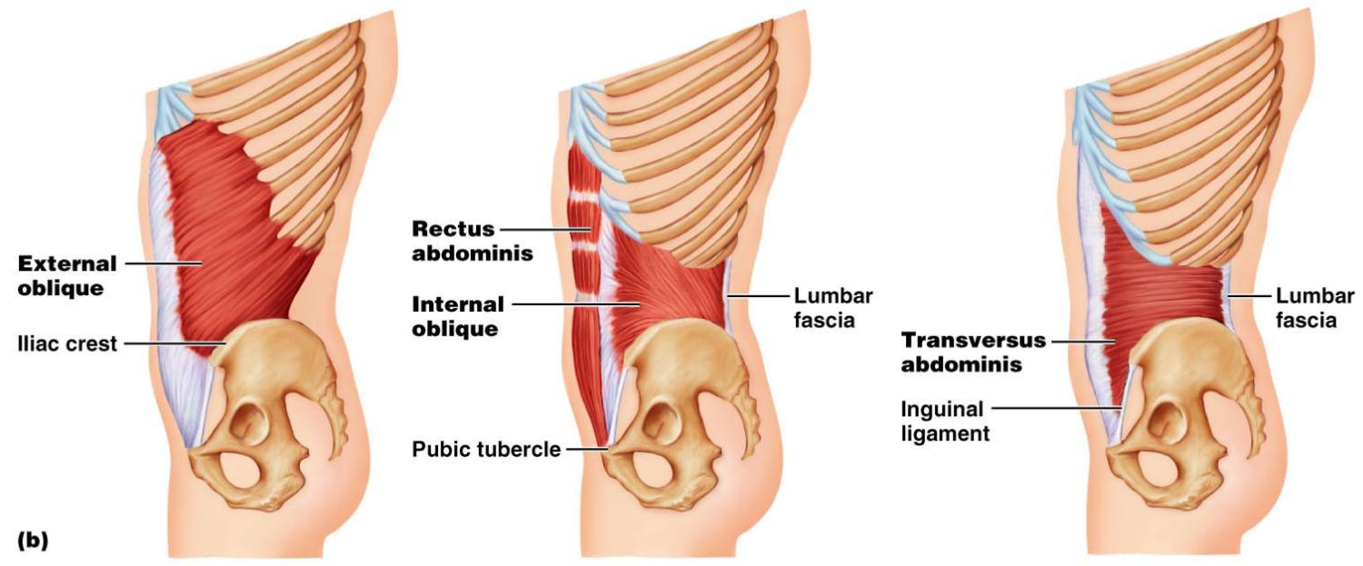
Muscles of the Abdominal Wall
Figure 10.11b

Slide 147
Extrinsic Shoulder Muscles
Muscles of the thorax
Anterior:
pectoralis major, pectoralis minor, serratus anterior, and subclavius
Posterior:
latissimus dorsi, trapezius muscles, levator scapulae, and rhomboids
These muscles are involved with the _________________________________________ including elevation, depression, rotation, and lateral and medial movements
Prime movers of shoulder elevation are the _

Slide 148
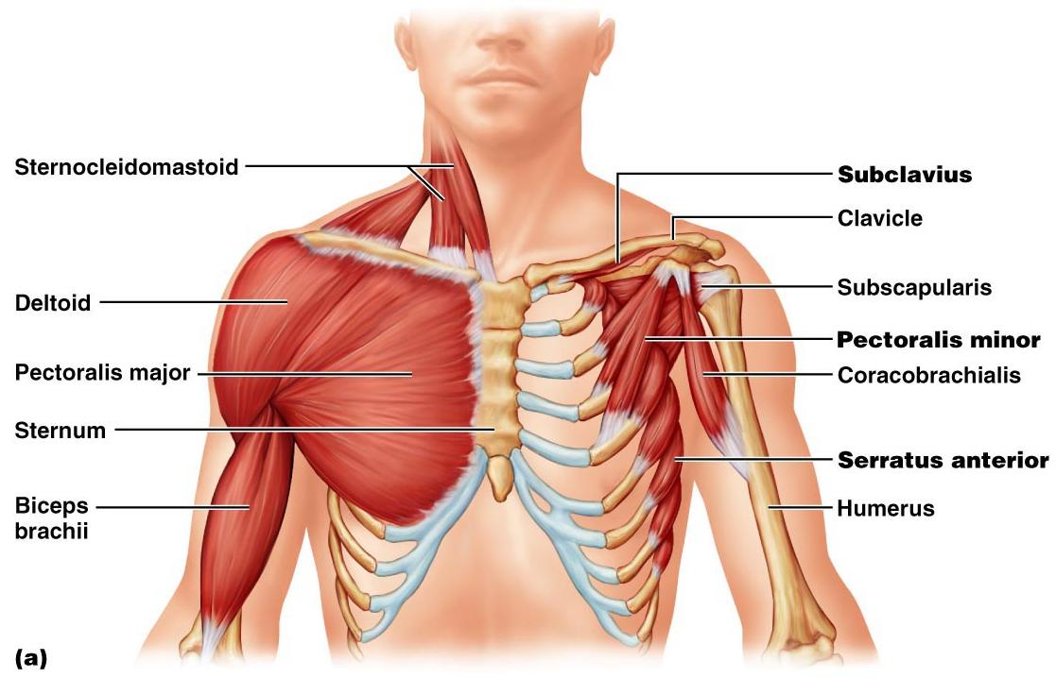
Extrinsic Shoulder Muscles
Figure 10.13a

Slide 149
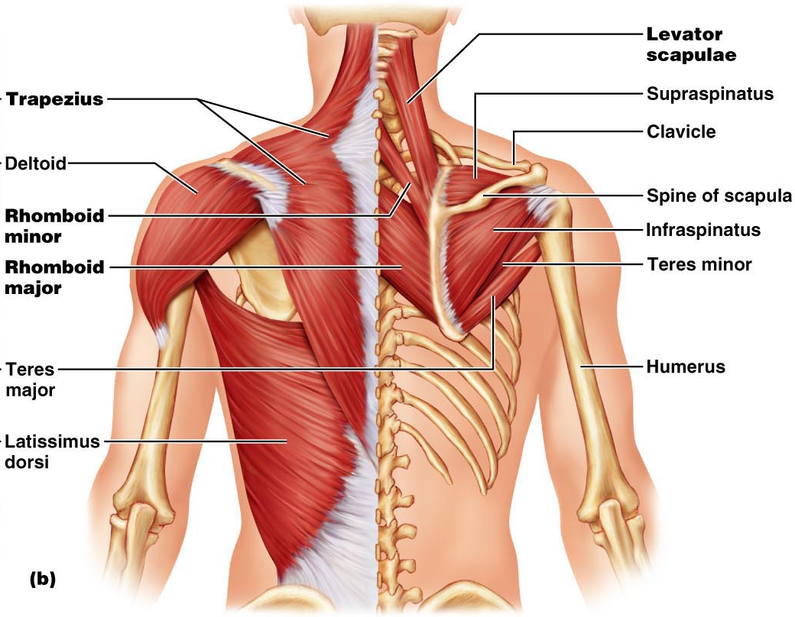
Figure 10.13b

Slide 150
Muscles Crossing the Shoulder
Nine muscles cross the shoulder joint and insert into the humerus
Prime movers include:
Pectoralis major
Latissimus dorsi and posterior fibers of the deltoid
Middle fibers of the deltoid

Slide 151
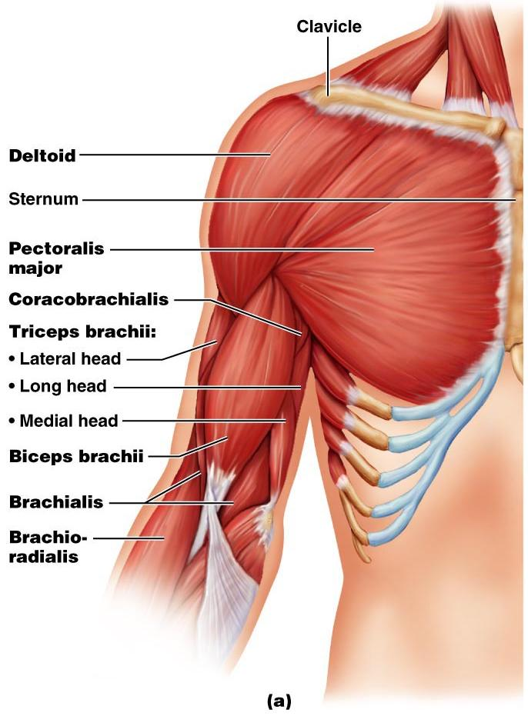
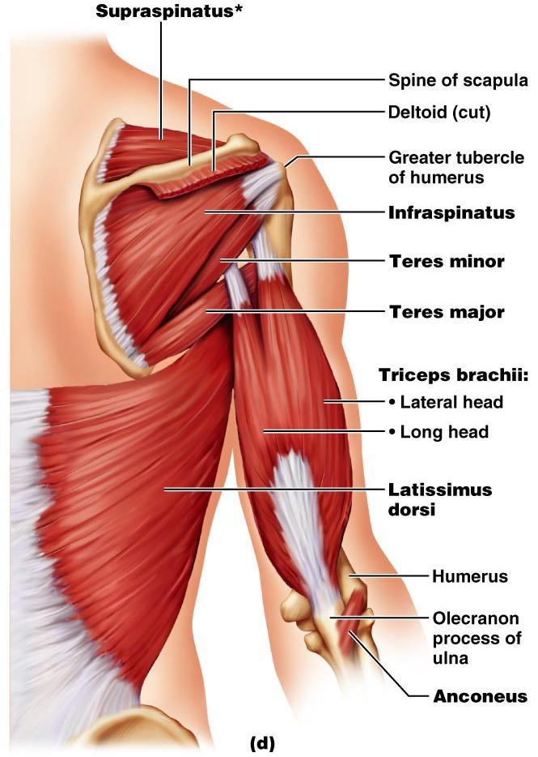
Muscles Crossing the Shoulder

Slide 152
Muscles Crossing the Shoulder
Rotator cuff muscles
Function mainly to reinforce the capsule of the shoulder
Secondarily act as synergists and fixators

Slide 153
Muscles Crossing the Elbow
Forearm extension
prime mover of forearm extension
weak synergist
The

Slide 154
Muscles Crossing the Elbow
Forearm flexion
chief forearm flexors
synergist
The _
helps stabilize the _

Slide 155
Muscles of the Forearm
Forearm muscle groups:
those that cause _
those that move the _
These muscles insert via the flexor and extensor retinacula
Most _
Most _

Slide 156
Muscles of the Forearm
The pronator teres and pronator quadratus are not flexors, but _
The supinator muscle is a synergist with the biceps brachii in _

Slide 157
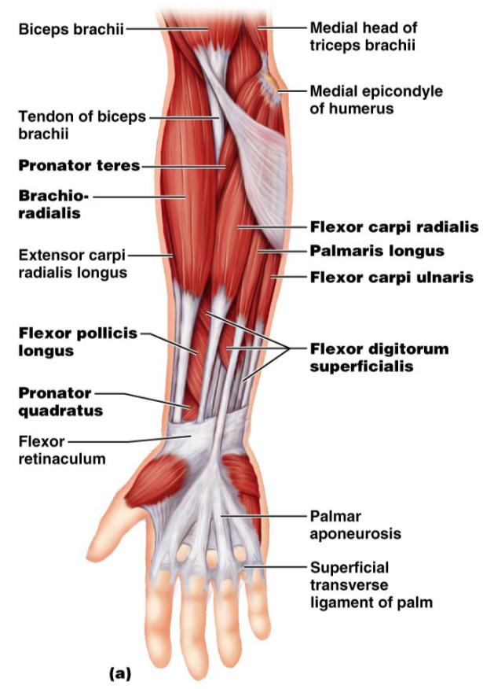
Muscles of the Forearm: Anterior
These muscles are primarily flexors of the wrist and fingers

Slide 158
Figure 10.15b, c

Slide 159
Muscles of the Forearm: Posterior
These muscles are primarily extensors of the wrist and digits
Figure 10.16a

Slide 160
Intrinsic Muscles of the Hand
These small muscles:
Lie ____________________________ of the hand
none on the dorsal side
Move the ______________________________ and fingers
Control precise movements
Are the main abductors and adductors of the fingers
Produce _
move the thumb toward the little finger

Slide 161
Intrinsic Muscles of the Hand
Figure 10.18a

Slide 162
Intrinsic Muscles of the Hand
Figure 10.18b

Slide 163
Finger and Thumb Movements
Flexion
Thumb –
Fingers –
Extension
Thumb –
Fingers –

Slide 164
Intrinsic Muscles of the Hand: Groups
There are _____________________ groups of intrinsic hand muscles
The thenar eminence and hypothenar eminence
each have a _
The midpalm muscles, the lumbricals and interossei,
The _
abduct and adduct the fingers

Slide 165
Intrinsic Muscles of the Hand: Groups
Figure 10.18c, d

Slide 166
Muscles Crossing Hip and Knee Joints
Most ___________________________________ muscles of the hip and thigh
Posterior compartment muscles of the hip and thigh
extend _
flex _
The medial compartment muscles
These three groups are enclosed by the fascia lata

Slide 167
Movements of the thigh at the Hip: Flexion and Extension
The ball-and-socket hip joint permits
Extension
Adduction
Rotation
The most important thigh flexors
The medially located adductor muscles and sartorius assist in thigh flexion

Slide 168
Movements of the Thigh at the Hip: Flexion and Extension
Thigh extension is primarily effected by the _
Forceful extension is aided by the gluteus maximus

Slide 170
Movements of the Thigh at the Hip:
Abduction and rotation assisted by
antagonized by
lateral rotators
Thigh adduction is the role of five adductor muscles
adductor _
adductor _
adductor _
the _
gracilis

Slide 171
Movements of the Knee Joint
The sole extensor of the knee
flex the _
and act as antagonists to the quadriceps femoris
Figure 10.19a

Slide 172
Fascia of the Leg
A deep fascia of the leg is continuous with the fascia lata
This fascia segregates the leg into _
Distally, the fascia thickens and forms the flexor, extensor, and fibular retinaculae
Figure 10.22a

Slide 173
Muscles of the Leg: Movements
Various leg muscles produce the following movements at the:
Ankle
Intertarsal joints
Toes

Slide 174
Muscles of the Anterior Compartment
primary toe extensors and ankle dorsiflexors
extensor digitorum longus,
fibularis tertius
Figure 10.21a

Slide 175
Muscles of the Lateral Compartment
Plantar-flex and evert the foot
fibularis _
Figure 10.22a

Slide 176
Muscles of the Posterior Compartment
flex the foot and the toes
Tibialis posterior
Flexor digitorum longus
Figure 10.23a

Slide 177
Muscles of the Posterior Compartment
Figure 10.23b, c

Slide 178
Muscle Actions of the Thigh: Summary
Thigh muscles:
Flex and extend the thigh (____________________________________)
Extend the leg (______________________________________)
Adduct the thigh (____________________________________)

Slide 180
Muscle Actions of the Leg: Summary
Leg muscles:
Plantar flex and evert the foot
Plantar flex the foot and flex the toes
Dorsiflex the foot and extend the toes

Slide 182
Intrinsic Muscles of the Foot
These muscles help _
In addition, along with some leg tendons, they support the _
There is a single dorsal foot muscle, the ___________________________________, which extends the toes
The plantar muscles occur in four layers

Slide 183
Plantar Muscles: First Layer (Superficial)
Superficial muscles of the _________________of the foot
These muscles are similar to the corresponding muscles of the hand

Slide 184
Figure 10.25b

Slide 185
Plantar Muscles: Fourth Layer

