Slide 1
Joints (Articulations)
Articulation
Site where two or more bones meet
Functions of joints
Give skeleton mobility
Hold skeleton together
Two classifications
Functional
Structural

Slide 2
Functional Classification of Joints
Based on
Amount of movement joint allows
Three functional classifications:
Synarthroses—immovable joints
Amphiarthroses—slightly movable joints
Diarthroses—freely movable joints

Slide 3
Structural Classification of Joints
Based on
Material binding bones together
Presence/absence of joint cavity
Three structural classifications:
Fibrous joints
Cartilaginous joints
Synovial joints

Slide 4
Fibrous Joints
Bones joined by dense fibrous connective tissue
No joint cavity
Most synarthrotic (immovable)
Depends on length of connective tissue fibers
Three types:
Sutures
Syndesmoses
Gomphoses

Slide 5
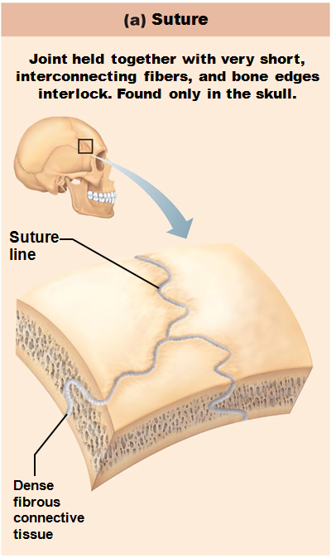
Fibrous Joints: Sutures
Rigid, interlocking joints
Immovable joints for protection of brain
Contain connective tissue
Allow for growth during youth
In middle age, sutures ossify and fuse
Called Synostoses

Slide 6
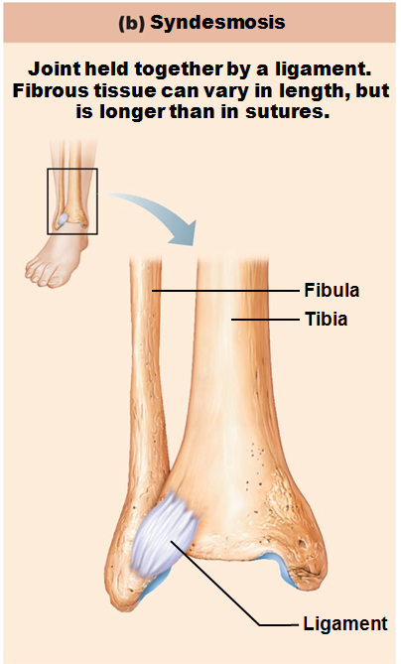
Fibrous Joints: Syndesmoses
Bones connected by ligaments
distal tibiofibular joint
interosseous membrane connecting radius and ulna

Slide 7
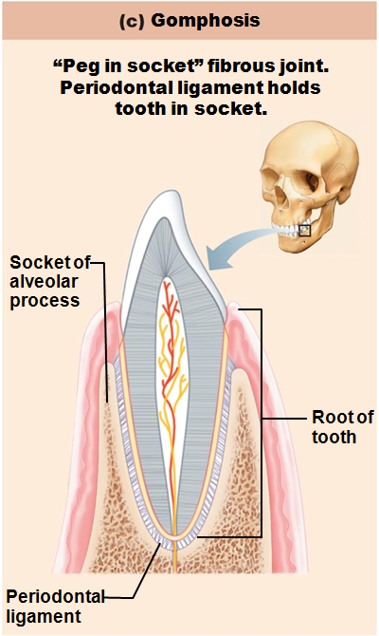
Fibrous Joints: Gomphoses
Peg-in-socket joints of teeth in alveolar sockets
Fibrous connection is the periodontal ligament

Slide 8
Cartilaginous Joints
Bones united by cartilage
No joint cavity
Not highly movable
Two types:
Synchondroses
Symphyses

Slide 9
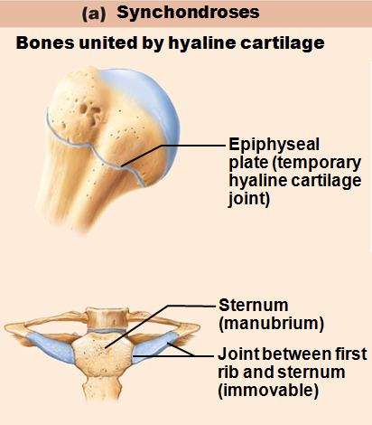
Cartilaginous Joints: Synchondroses
Bar/plate of hyaline cartilage unites bones e.g.,
Temporary epiphyseal plate joints
Become synostoses after plate closure
Cartilage of 1st rib with manubrium

Slide 10
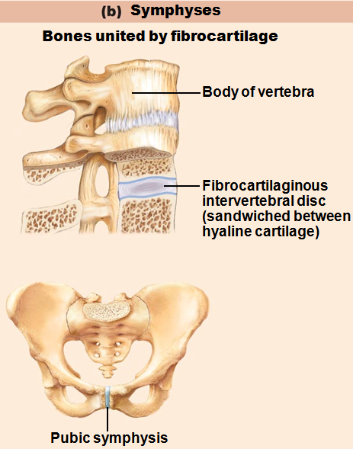
Cartilaginous Joints: Symphyses
Fibrocartilage unites bone
Hyaline cartilage present as articular cartilage
Strong, flexible
Intervertebral joints
Pubic symphysis

Slide 11
Synovial Joints
Bones separated by fluid-filled joint cavity
Include most
limb joints
joints of body

Slide 12
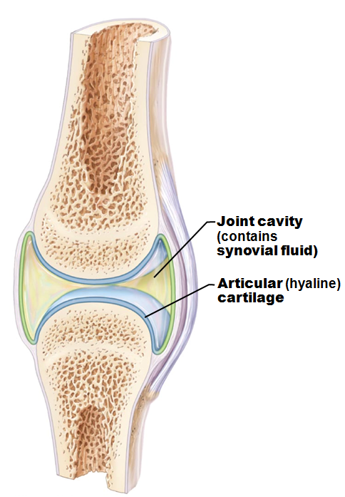
Synovial Joints: Six Distinguishing Features
1. Articular cartilage: hyaline cartilage
Prevents crushing of bone ends
2. Joint (synovial) cavity
Small, fluid-filled potential space

Slide 13
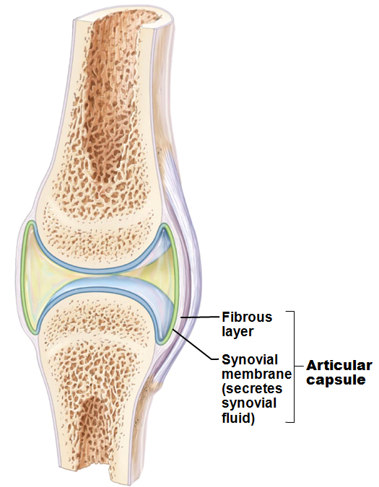
Synovial Joints: Six Distinguishing Features
3. Articular (joint) capsule
Two layers
External Fibrous layer
Dense irregular connective tissue
Inner Synovial membrane
Loose connective tissue
Makes synovial fluid

Slide 14
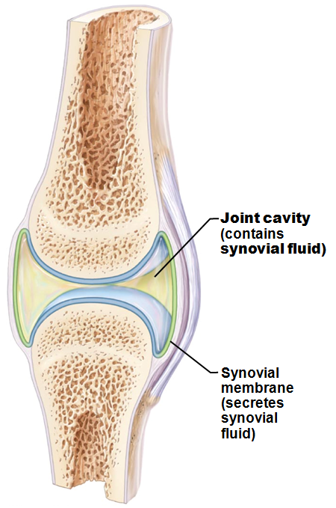
Synovial Joints: Six Distinguishing Features
4. Synovial fluid
Viscous, slippery filtrate of plasma
Lubricates and nourishes cartilage
Contains phagocytic cells to remove microbes and debris

Slide 15
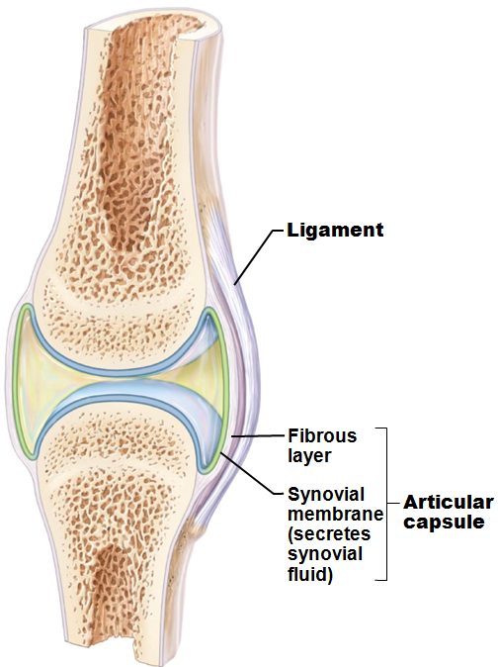
Synovial Joints: Six Distinguishing Features
5. Different types of reinforcing ligaments
Capsular
Thickened part of fibrous layer
Extracapsular
Outside the capsule
Intracapsular
Deep to capsule; covered by synovial membrane

Slide 16
Synovial Joints: Six Distinguishing Features
6. Nerves and blood vessels
Nerve fibers detect pain, monitor joint position and stretch
Capillary beds supply filtrate for synovial fluid

Slide 17
Other Features of Some Synovial Joints
Articular discs (menisci)
Fibrocartilage separates articular surfaces to improve "fit" of bone ends, stabilize joint, and reduce wear and tear

Slide 18
Structures Associated with Synovial Joints
Bursae
Sacs lined with synovial membrane
Contain synovial fluid
Reduce friction where ligaments, muscles, skin, tendons, or bones rub together
Tendon Sheaths
Elongated bursa wrapped completely around tendon subjected to friction

Slide 19
Three Stabilizing Factors at Synovial Joints
1. Shapes of articular surfaces
Minor role
2. Ligament number and location
Minor role
3. Muscle tendons that cross joint
most important role
Muscle tone keeps tendons taut
Extremely important in reinforcing shoulder and knee joints and arches of the foot

Slide 20
Synovial Joints: Movements Allowed
All muscles attach to bone or connective tissue at no fewer than two points
Origin
attachment to immovable bone
Insertion
attachment to movable bone
Muscle contraction causes insertion to move toward origin

Slide 21
Synovial Joints: Range of Motion
Nonaxial
slipping movements only
Ex: Wrists and vertebrae
Uniaxial
movement in one plane
Hinge joints: flexion/extension only
Biaxial
movement in two planes
Ex: Flex/Extension and abduction/adduction
Multiaxial
movement in or around all three planes
Ex: Flex/Extend and abd/adduct AND rotation

Slide 22
Three General Types of Movements at Synovial Joints
1. Gliding
2. Angular movements
Flexion, extension, hyperextension
Abduction, adduction
Circumduction
3. Rotation
Medial and lateral rotation

Slide 23
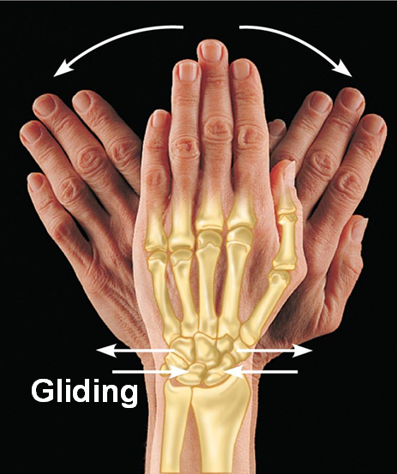
Gliding Movements
One flat bone surface glides or slips over another similar surface
Examples:
Intercarpal joints
Intertarsal joints
Between articular processes of vertebrae

Slide 24
Angular Movements
Increase or decrease angle between two bones
Movement along sagittal plane
Flexion
decreases the angle of the joint
Extension
increases the angle of the joint
Hyperextension
excessive extension beyond normal range of motion

Slide 25
Angular Movements
Movement along frontal plane
Abduction
movement away from the midline
Adduction
movement toward the midline
Circumduction
Involves flexion, abduction, extension, and adduction of limb
Limb describes cone in space

Slide 26
Rotation
Turning of bone around its own long axis
Toward midline or away from it
Medial and lateral rotation
Examples:
Between C₁ and C₂ vertebrae
Rotation of humerus and femur

Slide 27
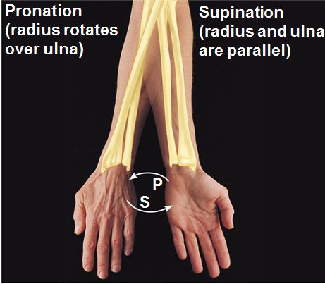
Special Movements at Synovial Joints
Supination and pronation of radius and ulna

Slide 28
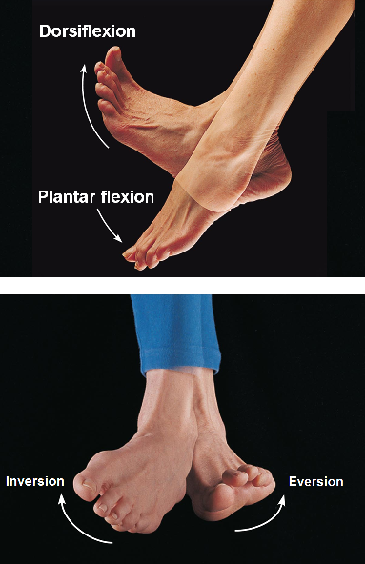
Special Movements at Synovial Joints
Dorsiflexion and plantar flexion of foot
Inversion and eversion of foot

Slide 29
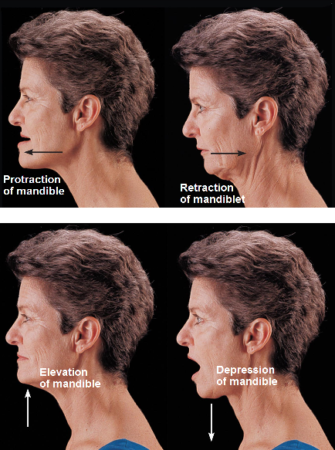
Special Movements at Synovial Joints
Protraction and retraction
Elevation and depression of mandible

Slide 30
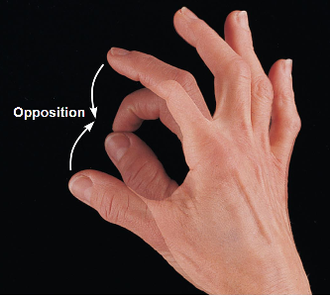
Special Movements at Synovial Joints
Opposition of thumb

Slide 31
Types of Synovial Joints
Six types, based on shape of articular surfaces:
Plane
Hinge
Pivot
Condylar
Saddle
Ball-and-socket

Slide 32
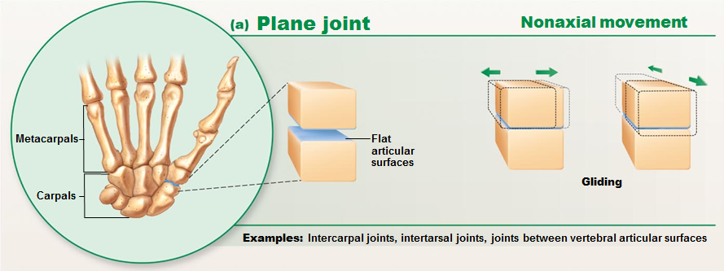
Plane Joint
Plane joints
Articular surfaces are essentially flat
Allow only slipping or gliding movements
Only examples of nonaxial joints

Slide 33
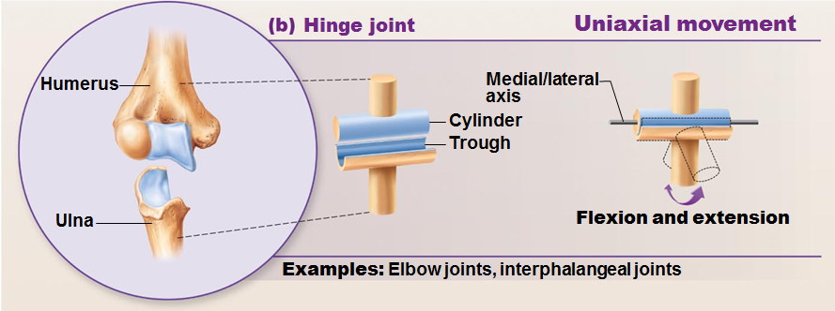
Types of Synovial Joints
Hinge joints
Cylindrical projections of one bone fits into a trough-shaped surface on another
Motion is along a single plane
Uniaxial joints permit flexion and extension only
Examples: elbow and interphalangeal joints

Slide 34
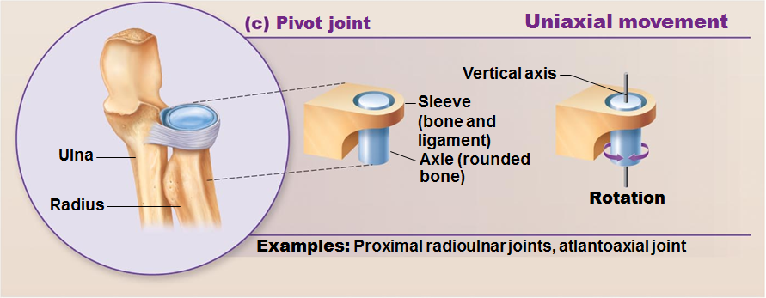
Pivot Joints
Rounded end of one bone protrudes into a “sleeve,” or ring, composed of bone (and possibly ligaments) of another
Only uniaxial movement allowed
Examples: joint between the axis and the dens, and the proximal radio-ulnar joint

Slide 35
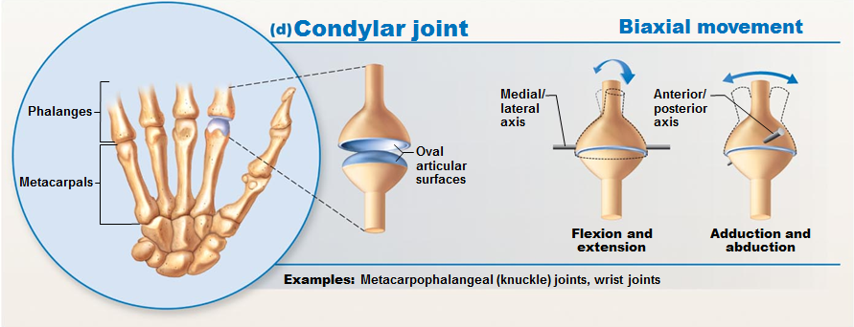
Condyloid or Ellipsoidal Joints
Oval articular surface of one bone fits into a complementary depression in another
Both articular surfaces are oval
Biaxial joints permit all angular motions
Examples:
radiocarpal (wrist) joints,
metacarpophalangeal (knuckle) joints

Slide 36
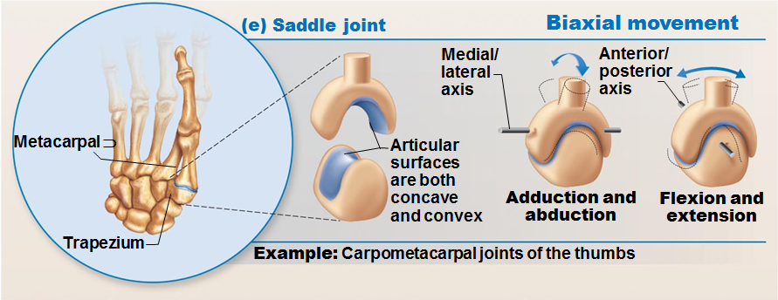
Saddle Joints
Similar to condyloid joints but allow greater movement
Each articular surface has both a concave and a convex surface
Example: carpometacarpal joint of the thumb

Slide 37
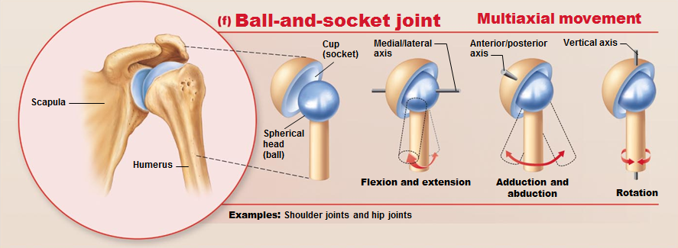
Ball-and-Socket Joints
A spherical or hemispherical head of one bone articulates with a cuplike socket of another
Multiaxial joints permit the most freely moving synovial joints
Examples: shoulder and hip joints

Slide 38
Common Joint Injuries
Cartilage tears
Due to compression and shear stress
Fragments may cause joint to lock or bind
Cartilage rarely repairs itself
Repaired with arthroscopic surgery
Ligaments repaired, cartilage fragments removed with minimal tissue damage or scarring
Meniscal transplant in younger patients

Slide 39
Common Joint Injuries
Sprains
Reinforcing ligaments stretched or torn
Partial tears slowly repair heal
Poor vascularization
Three options if torn completely
Ends sewn together
Replaced with grafts
Time and immobilization

Slide 40
Common Joint Injuries
Dislocations (luxations)
Bones forced out of alignment
Accompanied by sprains, inflammation, and difficulty moving joint
Caused by serious falls or contact sports
Must be reduced to treat
Subluxation
partial dislocation of a joint

Slide 41
Inflammatory and Degenerative Conditions
Bursitis
Inflammation of bursa, usually caused by blow or friction
Treated with rest and ice and, if severe, anti-inflammatory drugs
Tendonitis
Inflammation of tendon sheaths typically caused by overuse
Symptoms and treatment similar to bursitis

Slide 42
Arthritis
More than 100 different types of inflammatory or degenerative diseases that damage the joints
Most widespread crippling disease in the U.S.
Symptoms
pain, stiffness, and swelling of a joint
Acute forms are caused by bacteria and are treated with antibiotics
Chronic forms include osteoarthritis, rheumatoid arthritis, and gouty arthritis

Slide 43
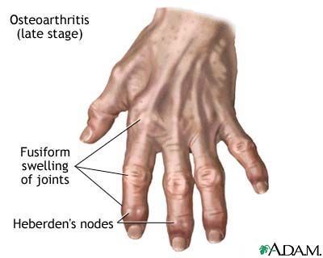
Osteoarthritis (OA)
Most common chronic arthritis; often called “wear-and-tear” arthritis
Affects women more than men
85% of all Americans develop OA
More prevalent in the aged, and is probably related to the normal aging process

Slide 44
Osteoarthritis: Course
OA reflects the years of abrasion and compression causing enzymes to break down cartilage
As one ages, cartilage is destroyed more quickly than it is replaced
The exposed bone ends thicken, enlarge, form bone spurs, and restrict movement
Joints most affected are the cervical and lumbar spine, fingers, knuckles, knees, and hips

Slide 45
Osteoarthritis: Treatments
OA is slow and irreversible
Treatments include:
Mild pain relievers, along with moderate activity
Magnetic therapy
Glucosamine sulfate decreases pain and inflammation

Slide 46
Rheumatoid Arthritis (RA)
Chronic, inflammatory, autoimmune disease of unknown cause, with an insidious onset
Usually arises between the ages of 40 to 50, but may occur at any age
Signs and symptoms include joint tenderness, anemia, osteoporosis, muscle atrophy, and cardiovascular problems
The course of RA is marked with exacerbations and remissions

Slide 47
Rheumatoid Arthritis: Course
RA begins with synovitis of the affected joint
Inflammatory chemicals are inappropriately released
Inflammatory blood cells migrate to the joint, causing swelling

Slide 48
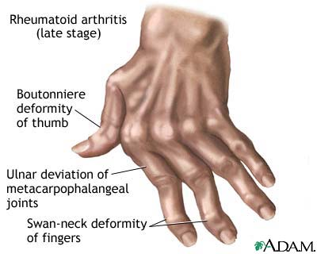
Rheumatoid Arthritis:
Inflamed synovial membrane thickens into a pannus
Pannus erodes cartilage, scar tissue forms, articulating bone ends connect
The end result, ankylosis, produces bent, deformed fingers

Slide 49
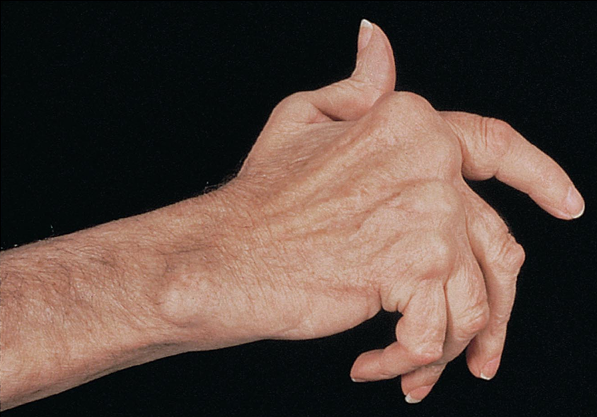
Rheumatoid Arthritis: Treatment
Conservative therapy
aspirin, long-term use of antibiotics, and physical therapy
Progressive treatment
anti-inflammatory drugs or immunosuppressants

Slide 50
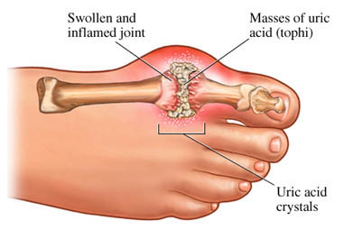
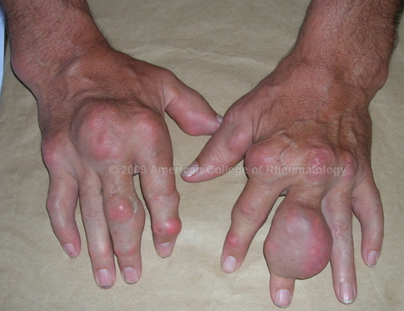
Gouty Arthritis
Deposition of uric acid crystals in joints and soft tissues, followed by an inflammation response
Typically, gouty arthritis affects the joint at the base of the great toe
In untreated gouty arthritis, the bone ends fuse and immobilize the joint
Treatment
drugs, plenty of water, avoidance of alcohol

Slide 51
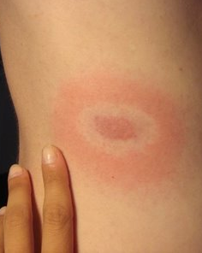
Lyme Disease
Caused by bacteria transmitted by tick bites
Symptoms: skin rash, flu-like symptoms, and foggy thinking
May lead to joint pain and arthritis
Treatment
Long course of antibiotics

Slide 52
Muscle Tissue
Nearly half of body's mass
Transforms chemical energy (ATP) to directed mechanical energy → exerts force
Three types
Skeletal
Cardiac
Smooth
Myo, mys, and sarco - prefixes for muscle

Slide 53
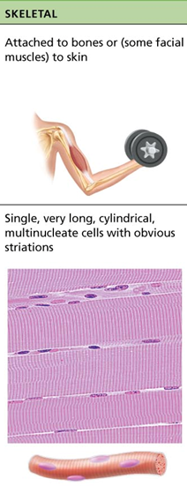
Types of Muscle Tissue
Skeletal muscles
Organs attached to bones and skin
Elongated cells called muscle fibers
Striated (striped)
Voluntary (i.e., conscious control)
Contract rapidly; tire easily; powerful
Require nervous system stimulation

Slide 54
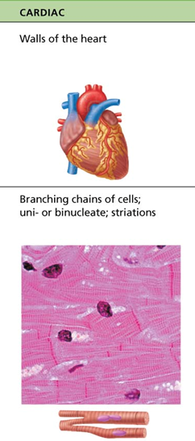
Types of Muscle Tissue
Cardiac muscle
Only in heart;
bulk of heart walls
Striated
Can contract without nervous system stimulation
Involuntary

Slide 55
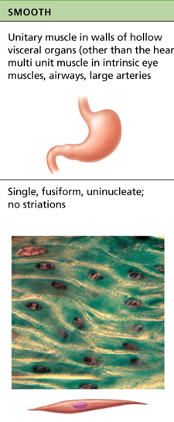
Types of Muscle Tissue
Smooth muscle
In walls of hollow organs
Stomach
Urinary bladder
Airways
Not striated
Can contract without nervous system stimulation
Involuntary

Slide 56
Special Characteristics of Muscle Tissue
Excitability
responsiveness or irritability
ability to receive and respond to stimuli
Contractility:
ability to shorten forcibly when stimulated
Extensibility:
ability to be stretched
Elasticity:
ability to recoil to resting length

Slide 57
Muscle Functions
Four important functions
Movement of bones or fluids
Ex: Blood and lymph are moved by muscle contractions
Maintaining posture and body position
Stabilizing joints
Heat generation
especially skeletal muscle
Additional functions
Protects organs
forms valves
controls pupil size

Slide 58
Skeletal Muscle
Connective tissue sheaths of skeletal muscle
Support cells; reinforce whole muscle
External to internal
Epimysium:
dense irregular connective tissue surrounding entire muscle; may blend with fascia
Perimysium:
fibrous connective tissue surrounding fascicles (groups of muscle fibers)
Endomysium:
fine areolar connective tissue surrounding each muscle fiber

Slide 59
Skeletal Muscle: Attachments
Attach in at least two places
Insertion
movable bone
Origin
immovable (less movable) bone

Slide 60
Microscopic Anatomy of A Skeletal Muscle Fiber
Long, cylindrical cell
10 to 100 µm in diameter; up to 30 cm long
Multiple peripheral nuclei
Sarcolemma
plasma membrane
Sarcoplasm
cytoplasm
Modified structures:
myofibrils, sarcoplasmic reticulum, and T tubules

Slide 61
Myofibrils
Densely packed, rodlike elements
most of cell volume
Contain sarcomeres
the contractile units
contain myofilaments
Exhibit striations
repeating series of dark and light bands

Slide 62
Sarcomere
Smallest contractile unit (functional unit) of muscle fiber
Composed of thick and thin myofilaments made of contractile proteins

Slide 63
Sarcoplasmic Reticulum (SR)
Network of smooth endoplasmic reticulum surrounding each myofibril
Most run longitudinally
Functions in regulation of intracellular Ca²⁺ levels
Stores and releases Ca²⁺

Slide 64
T Tubules
Continuations of sarcolemma
Lumen continuous with extracellular space
Increase muscle fiber's surface area

Slide 65
Sliding Filament Model of Contraction
Myosin heads bind to actin; sliding begins
Cross bridges form and break several times, ratcheting thin filaments toward center of sarcomere
Causes shortening of muscle fiber

Slide 66
Physiology of Skeletal Muscle Fibers
For skeletal muscle to contract
Activation (at neuromuscular junction)
Must be nervous system stimulation
Must generate action potential in sarcolemma
Excitation-contraction coupling
Action potential propagated along sarcolemma
Intracellular Ca²⁺ levels must rise briefly

Slide 67
The Nerve Stimulus and Events at the Neuromuscular Junction
Skeletal muscles stimulated by somatic motor neurons
Axons of motor neurons travel from central nervous system to skeletal muscle
Each axon forms several branches as it enters muscle
Each axon ending forms neuromuscular junction with single muscle fiber
Usually only one per muscle fiber

Slide 68
Neuromuscular Junction (NMJ)
Axon terminal and muscle fiber separated by gel-filled space called synaptic cleft
Synaptic vesicles of axon terminal contain neurotransmitter acetylcholine (ACh)
Muscle side of the NMJ contains ACh receptors
NMJ includes axon terminals, synaptic cleft, junctional folds

Slide 69
Events at the Neuromuscular Junction
Nerve impulse arrives at axon terminal → ACh released into synaptic cleft
ACh diffuses across cleft and binds with receptors on sarcolemma →
Electrical events → generation of action potential

Slide 70
Destruction of Acetylcholine
ACh effects quickly terminated by enzyme acetylcholinesterase in synaptic cleft
Breaks down ACh to acetic acid and choline
Prevents continued muscle fiber contraction in absence of additional stimulation

Slide 71
Role of Calcium (Ca²⁺) in Contraction
At low intracellular Ca²⁺ concentration
Tropomyosin blocks active sites on actin
Myosin heads cannot attach to actin
Muscle fiber relaxed

Slide 72
Role of Calcium (Ca²⁺) in Contraction
At higher intracellular Ca²⁺ concentrations
Ca²⁺ binds to troponin
Troponin changes shape and moves tropomyosin away from myosin-binding sites
Myosin heads bind to actin, causing sarcomere shortening and muscle contraction
When nervous stimulation ceases, Ca²⁺ pumped back into SR and contraction ends

Slide 73
Cross Bridge Cycle
Continues as long as Ca²⁺ signal and adequate ATP present
Cross bridge formation
high-energy myosin head attaches to thin filament
Working (power) stroke
myosin head pivots and pulls thin filament toward M line

Slide 74
Cross Bridge Cycle
Cross bridge detachment
ATP attaches to myosin head and cross bridge detaches
"Cocking" of myosin head
energy from hydrolysis of ATP cocks myosin head into high-energy state

Slide 75
Homeostatic Imbalance
Rigor mortis
Cross bridge detachment requires ATP
3–4 hours after death muscles begin to stiffen with weak rigidity at 12 hours post mortem
Dying cells take in calcium → cross bridge formation
No ATP generated to break cross bridges

Slide 76
Review Principles of Muscle Mechanics
Same principles apply to contraction of single fiber and whole muscle
Contraction produces muscle tension, force exerted on load or object to be moved

Slide 77
Review Principles of Muscle Mechanics
Contraction may/may not shorten muscle
Isometric contraction:
“same meter”
no shortening;
may actually cause the muscle to be pulled longer (braking movements)
muscle tension increases but does not exceed load
Isotonic contraction:
muscle shortens because muscle tension exceeds load
“same tone”
Force and duration of contraction vary in response to stimuli of different frequencies and intensities

Slide 78
Isotonic Contractions
Muscle changes in length and moves load
Thin filaments slide
Isotonic contractions either concentric or eccentric:
Concentric contractions—muscle shortens and does work
Eccentric contractions—muscle generates force as it lengthens

Slide 79
Isometric Contractions
Load greater than tension muscle can develop
Tension increases to muscle's capacity, but muscle neither shortens nor lengthens
Cross bridges generate force but do not move actin filaments

Slide 80
Motor Unit: The Nerve-Muscle Functional Unit
Each muscle served by at least one motor nerve
Axons branch into terminals, each of which create a neuromuscular junction with a single muscle fiber
Motor unit : motor neuron and all muscle fibers it supplies
Smaller number
fine control, like fingers or eyes
Larger number
Bulk movement as in low back muscles

Slide 81
Motor Unit
single motor unit causes weak contraction of entire muscle
Muscle fibers from motor unit spread throughout muscle
Motor units in muscle usually contract out of sync to help prevent fatigue of skeletal muscles

Slide 82
Graded Muscle Responses
Graded muscle responses
Varying strength of contraction for different demands
Required for proper control of skeletal movement
Responses graded by
Changing frequency of stimulation
Changing strength of stimulation

Slide 83
Muscle Tone
Constant, slightly contracted state of all muscles
Due to spinal reflexes
Groups of motor units alternately activated in response to input from stretch receptors in muscles
Keeps muscles firm, healthy, and ready to respond

Slide 84
Muscle Metabolism: Energy for Contraction
ATP only source used directly for contractile activities
Available stores of ATP depleted in 4–6 seconds

Slide 85
Muscle Fatigue
inability to contract despite continued stimulation
Occurs with
Ionic imbalances
Prolonged exercise
interferes with Ca²⁺
Total lack of ATP occurs rarely, during states of continuous contraction, and causes contractures (continuous contractions)

Slide 86
Excess Postexercise Oxygen Consumption
To return muscle to resting state
Oxygen reserves replenished
Lactic acid converted to pyruvic acid
Glycogen stores replaced
ATP and creatine phosphate reserves replenished
All require extra oxygen; occur post exercise

Slide 87
Heat Production During Muscle Activity
~40% of energy released in muscle activity useful as work
Remaining energy (60%) given off as heat
Dangerous heat levels prevented
by release of heat from skin
sweating
Shivering
result of muscle contractions to generate heat when cold

Slide 88
Homeostatic Imbalance
Disuse atrophy
Results from immobilization
Muscle strength declines 5% per day
Without neural stimulation muscles atrophy to ¼ initial size
Fibrous connective tissue replaces lost muscle tissue → rehabilitation impossible

Slide 89
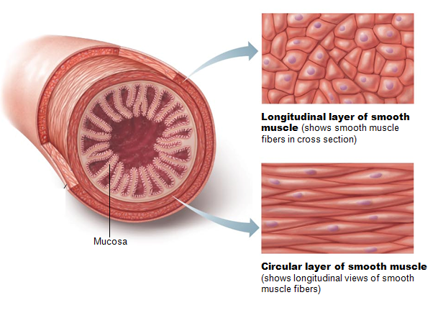
Smooth Muscle
Found in walls of most hollow organs (except heart)
Usually in two layers (longitudinal and circular)

Slide 90
Microscopic Structure
Spindle-shaped fibers
thin and short compared with skeletal muscle fibers
only one nucleus
no striations
Pouchlike infoldings called caveolae
sequester Ca²⁺
most calcium influx from outside cell; rapid
No sarcomeres, myofibrils, or T tubules

Slide 91
Microscopic Structure of Smooth Muscle Fibers
Longitudinal layer
Fibers parallel to long axis of organ
contraction → dilates and shortened
Circular layer
Fibers in circumference of organ
contraction → constricts lumen, elongates organ
Allows peristalsis
Alternating contractions and relaxations of smooth muscle
mix and squeeze substances through lumen of hollow organs

Slide 92
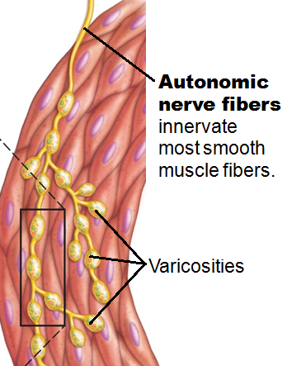
Innervation of Smooth Muscle
No NMJ as in skeletal muscle
Autonomic nerve fibers innervate smooth muscle at diffuse junctions
Varicosities (swellings) of nerve fibers
store and release neurotransmitters

Slide 93
Myofilaments in Smooth Muscle
Thick filaments have heads along entire length
No troponin complex;
protein calmodulin binds Ca²⁺

Slide 94
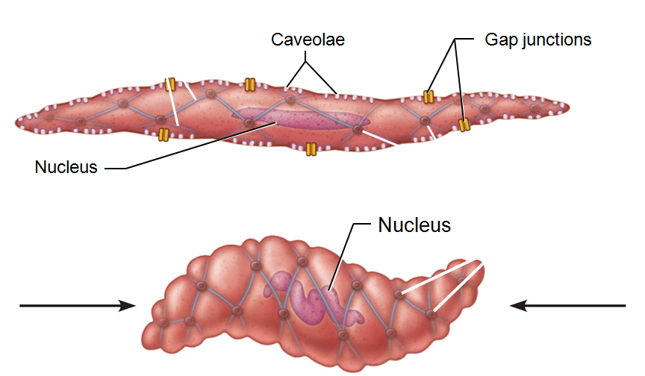
Myofilaments in Smooth Muscle
Myofilaments are spirally arranged, causing smooth muscle to contract in corkscrew manner

Slide 95
Contraction of Smooth Muscle
Slow, synchronized contractions
Cells electrically coupled by gap junctions
Some cells self-excitatory
act as pacemakers for sheets of muscle
Rate and intensity of contraction may be modified by neural and chemical stimuli

Slide 96
Contraction of Smooth Muscle
Slow to contract and relax
maintained for prolonged periods with little energy cost
Slow ATPases

Slide 97
Regulation of Contraction
By nerves, hormones, or local chemical changes
Neural regulation
Response depends on neurotransmitter released and type of receptor molecules

Slide 98
Regulation of Contraction
Hormones and local chemicals
Some smooth muscle cells have no nerve supply
Depolarize spontaneously or in response to chemical stimuli
Some respond to both neural and chemical stimuli
Chemical factors include
hormones
CO₂
pH

Slide 99
Special Features of Smooth Muscle Contraction
Stress-relaxation response
Responds to stretch only briefly, then adapts to new length
Retains ability to contract on demand
Enables organs such as stomach and bladder to temporarily store contents

Slide 100
Special Features of Smooth Muscle Contraction
Hyperplasia
Smooth muscle cells can divide and increase numbers
Example
Estrogen effects on uterus at puberty and during pregnancy

Slide 101
Types of Smooth Muscle
Smooth muscle varies in different organs
Fiber arrangement and organization
Innervation
Responsiveness to various stimuli
Categorized as single unit (unitary) and multi unit

Slide 102
Types of Smooth Muscle
Unitary (visceral) smooth muscle
In all hollow organs except heart
Arranged in opposing sheets
Innervated by varicosities
Often exhibit spontaneous action potentials
Electrically coupled by gap junctions
Respond to various chemical stimuli

Slide 103
Types of Smooth Muscle: Multiunit
Multiunit smooth muscle
Located in large airways, large arteries, arrector pili muscles, and iris of eye
Gap junctions
spontaneous depolarization rare
Independent muscle fibers
innervated by autonomic NS
graded contractions occur
Has motor units; responds to hormones

Slide 104
The Muscular System
Muscle tissue
Skeletal, cardiac, smooth muscle
Focus on skeletal muscle
How muscles interact to → movement
Criteria for naming muscles
Principles of leverage

Slide 105
Actions and Interactions of Skeletal Muscles
Muscles can only pull; never push
What one muscle group "does", another "undoes"

Slide 106
Actions and Interactions of Skeletal Muscles
Functional Groups
Prime mover (agonist)
Major responsibility for producing specific movement
Antagonist
Opposes or reverses particular movement
Prime mover and antagonist on opposite sides of joint across which they act

Slide 107
Skeletal Muscles: Functional Groups
Synergist helps prime movers
Adds extra force to same movement
Reduces undesirable or unnecessary movement
Fixator
Synergist that immobilizes bone or muscle's origin
Gives prime mover stable base on which to act

Slide 108
Naming Skeletal Muscles
Muscle location
bone or body region with which muscle associated
Muscle shape
deltoid muscle
deltoid = triangle
Muscle size
maximus
largest
minimus
smallest
longus
long

Slide 109
Naming Skeletal Muscles
Direction of muscle fibers or fascicles
rectus
fibers run straight
transversus
fibers run at right angles
oblique
fibers run at angles to imaginary defined axis
Number of origins
Biceps
2 origins
Triceps
3 origins
Location of attachments
named according to point of origin and insertion

Slide 110
Naming Skeletal Muscles
Muscle action
named for action they produce
flexor or extensor
Several criteria can be combined, e.g., extensor carpi radialis longus

Slide 111
Major Skeletal Muscles of the Body
grouped by function and location
Information for each muscle
Shape
Location relative to other muscles
Origin and insertion
usually a joint between origin and insertion
Actions
insertion moves toward origin
Innervation
name of major nerve that supplies muscle

Slide 112
Muscles of the Head
Two groups
Muscles of facial expression
Muscles of mastication and tongue movement

Slide 113
Muscles of Facial Expression
Insert into skin
Important in nonverbal communication
All innervated by cranial nerve VII
Facial nerve

Slide 114
Muscles of Facial Expression: The Scalp
Epicranius (occipitofrontalis)
Bipartite muscle consisting of
Galea aponeurotica—cranial aponeurosis connecting the two muscles
Frontal belly; occipital belly
Have alternate actions; pull scalp forward and backward

Slide 115
Muscles of Facial Expression: The Face
Corrugator supercilii
Zygomaticus
Risorius
Levator labii superioris
Depressor labii inferioris
Depressor anguli oris
Orbicularis oris
Mentalis
Buccinator
Platysma

Slide 116
Muscles of Mastication
Four pairs involved in mastication
all innervated by cranial nerve V
Trigeminal nerve
Prime movers of jaw closure
Temporalis and masseter
Grinding movements
Medial and lateral pterygoids
Chewing role - holds food between teeth
Buccinator

Slide 117
Muscles of Tongue Movement
Three muscles anchor and move tongue
Genioglossus
Hyoglossus
Styloglossus
All innervated by cranial nerve XII
Hypoglossal nerve

Slide 118
Muscles of the Neck and Vertebral Column
Two functional groups
Muscles that move head
Muscles that extend trunk and maintain posture

Slide 119
Muscles of the Neck and Vertebral Column: Head Movement
Sternocleidomastoid
major head flexor
Sternocleidomastoid and scalenes
lateral head movements
Splenius capitis and cervicis portions
head extension, rotation, and lateral bending
Semispinalis capitis
synergist with sternocleidomastoid

Slide 120
Muscles of the Neck and Vertebral Column: Trunk Extension
Deep (intrinsic) back muscles
Erector spinae (sacrospinalis) group
prime movers of back extension and lateral bending
Iliocostalis
Longissimus
Spinalis
Semispinalis and quadratus lumborum—synergists in extension and rotation

Slide 121
Deep Muscles of the Thorax: Breathing
Muscles of respiration
External intercostals
more superficial muscles
elevate ribs for inspiration
Internal intercostals
deeper muscles
aid forced expiration
Diaphragm
Partition between thoracic and abdominal cavities
Most important muscle in inspiration
Innervated by phrenic nerves

Slide 122
Muscles of the Abdominal Wall
Four paired muscles, their fasciae and aponeuroses form lateral and anterior abdominal wall
Rectus abdominis
External obliques
Internal obliques
Transversus abdominis

Slide 123
Muscles of the Abdominal Wall
Fascicles run at angles to one another, provide added strength
All innervated by intercostal nerves
Actions of these muscles
Lateral flexion and rotation of trunk
Help promote urination, defecation, childbirth, vomiting, coughing, and screaming

Slide 124
Superficial Muscles of the Thorax
Most - extrinsic shoulder muscles
Act in combination to fix shoulder girdle (mostly scapula); move it to increase range of arm movements
Actions
Elevation
Depression
Rotation
lateral and medial movements
protraction and retraction
Two groups of muscles: anterior and posterior

Slide 125
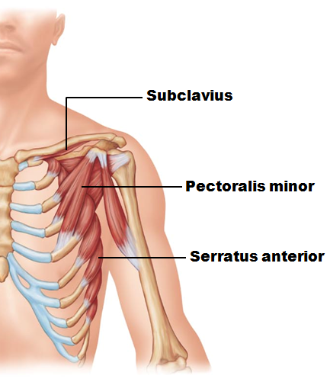
Superficial Muscles of the Thorax
Muscles of anterior thorax
Pectoralis minor
Serratus anterior
Subclavius

Slide 126
Superficial Muscles of the Posterior Thorax
Posterior extrinsic shoulder muscles
Trapezius
Levator scapulae
Rhomboids (major and minor)

Slide 127
Muscles Crossing the Shoulder Joint
Nine muscles cross shoulder joint; insert on and move humerus
Some originate from scapula; others from axial skeleton
Actions include flexion, extension, adduction

Slide 128
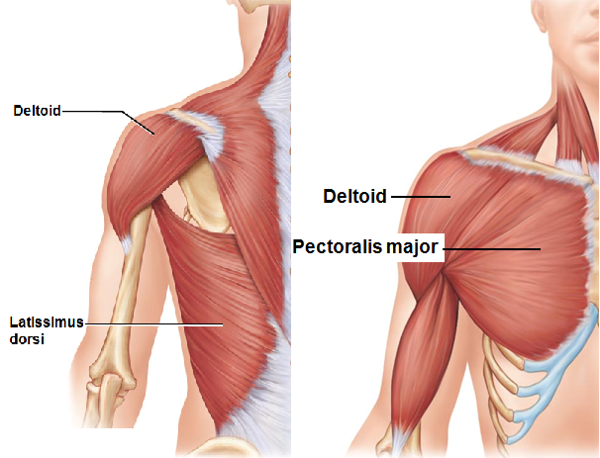
Muscles Crossing the Shoulder Joint
Three prime movers of arm
Pectoralis major
flexion
Latissimus dorsi
extension
Deltoid
abduction

Slide 129
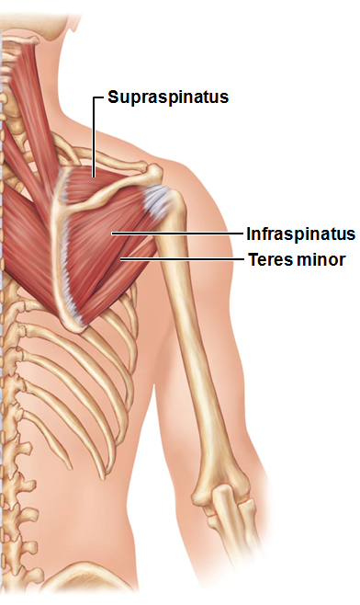
Muscles Crossing the Shoulder Joint
Rotator cuff muscles
synergists and fixators;
originate on scapula;
reinforce shoulder capsule
prevent dislocation
Supraspinatus
Infraspinatus
Teres minor
Subscapularis
Coracobrachialis and teres major - synergists

Slide 130
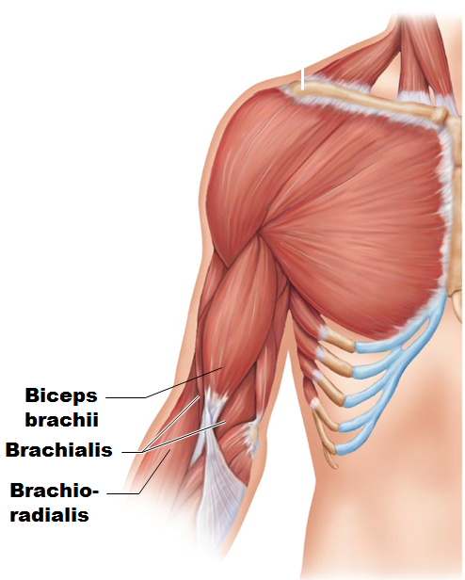
Muscles Crossing the Elbow Joint
Anterior flexor muscles
Brachialis and biceps brachii
chief forearm flexors
Brachioradialis
synergist and stabilizer

Slide 131
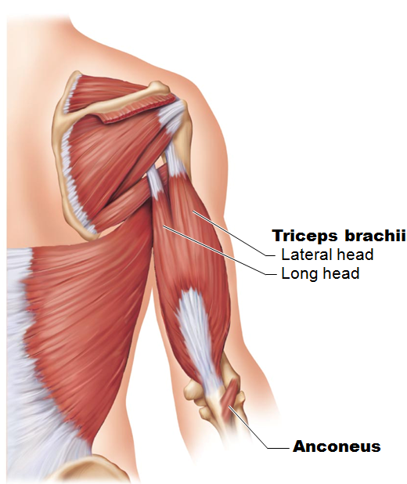
Muscles Crossing the Elbow Joint
Posterior extensor muscles
Triceps brachii
prime mover of forearm extension
Anconeus
weak synergist

Slide 132
Muscles of the Forearm
Actions - movements of wrist, fingers, thumb, pronation, supination
Most anterior muscles
flexors
Most posterior muscles
Extensors

Slide 133
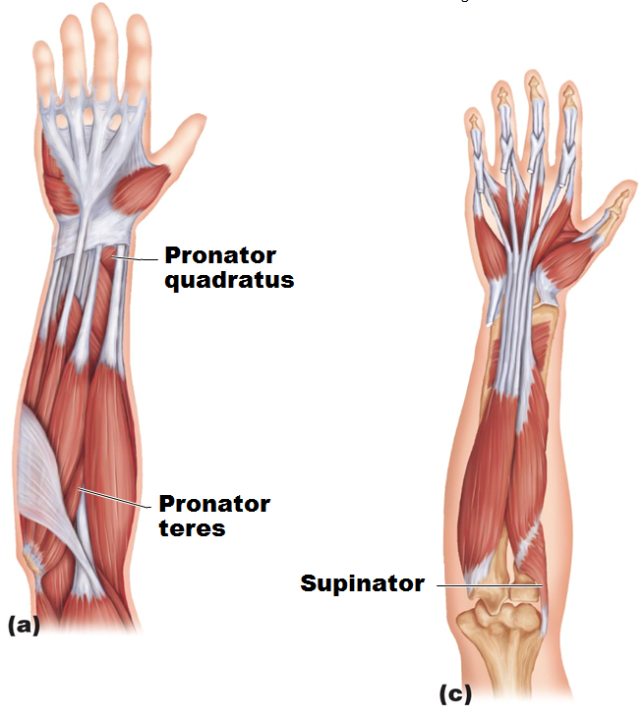
Muscles of the Forearm
Pronator teres and pronator quadratus pronate forearm
Supinator - synergist with biceps brachii in forearm supination

Slide 134
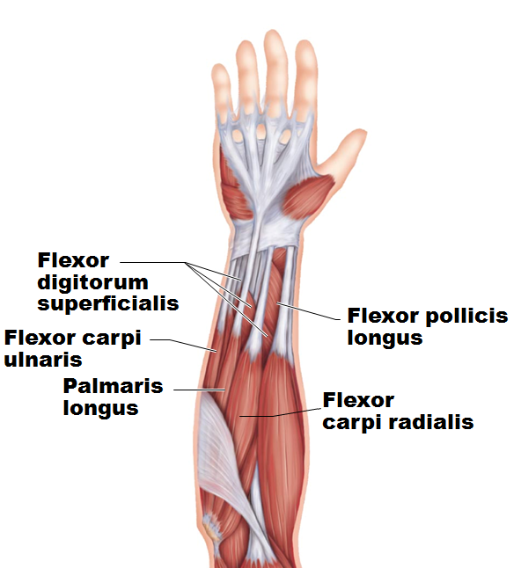
Muscles of the Forearm: Anterior Compartment
Flexors
Flexor carpi radialis
Palmaris longus
Flexor carpi ulnaris
Flexor digitorum superficialis and flexor digitorum profundus
Flexor pollicis longus

Slide 135
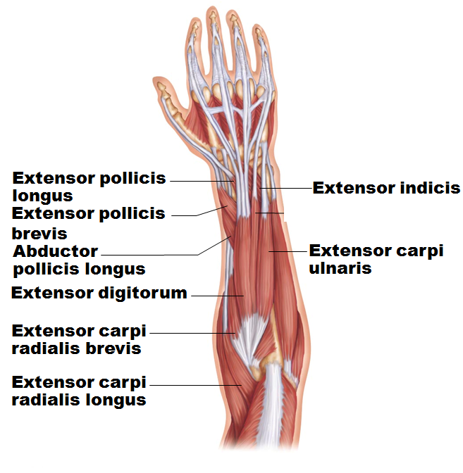
Muscles of the Forearm: Posterior Compartment
Extensors
Extensor carpi radialis longus and brevis
Extensor digitorum
Extensor carpi ulnaris
Extensor pollicis brevis and longus
Extensor indicis
Abductor pollicis longus

Slide 136
Intrinsic Muscles of the Hand
Small weak muscles
Lie entirely within palm of hand
Control precise movements of metacarpals and fingers (e.g., threading a needle)
Abductors and adductors of fingers
Produce opposition
move thumb toward little finger

Slide 137
Finger and Thumb Movements
Flexion
Thumb
bends medially along palm
Fingers
bend anteriorly
Extension
Thumb
points laterally
Fingers
move posteriorly

Slide 138
Intrinsic Muscles of the Palm
Three groups
Thenar eminence (ball of thumb)
Hypothenar eminence (ball of the little finger)
Each of above groups has flexor, abductor, and opponens muscle
Midpalmar muscles
lumbricals and interossei extend fingers
Interossei muscles also abduct and adduct fingers

Slide 139
Muscles Crossing Hip and Knee Joints
Most anterior muscles
flex femur at hip
extend leg at knee
Most posterior muscles
extend thigh
flex leg
Medial muscles all adduct thigh

Slide 140
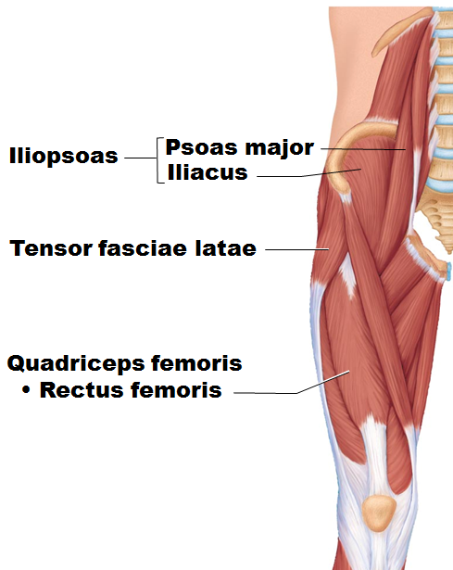
Movements of the Thigh
Include
Flexion
Extension
Abduction
Adduction
Circumduction
Rotation
Thigh flexors pass in front of hip joint
Iliopsoas
prime mover of flexion
Tensor fasciae latae
Rectus femoris
Assisted by medial adductors and sartorius

Slide 141
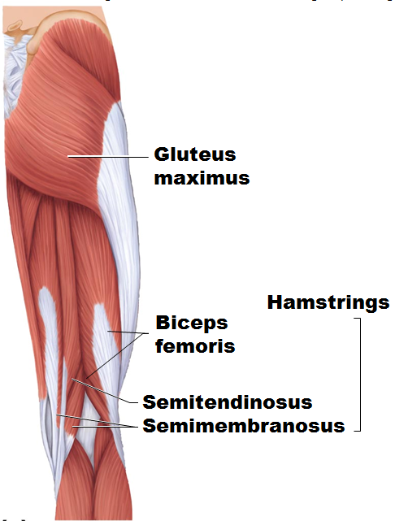
Movements of the Thigh
Thigh extensors
Hamstring muscles
prime movers of extension
Biceps femoris
Semitendinosus
Semimembranosus
Gluteus maximus
assists hamstrings in forceful thigh extension

Slide 142
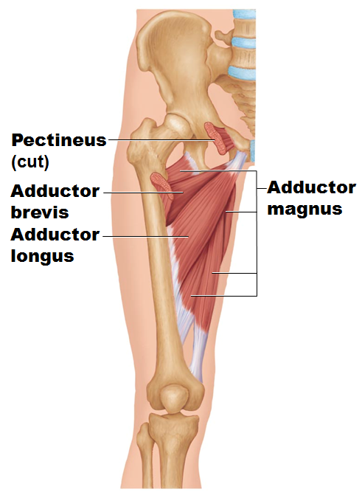
Movements of the Thigh
Adductors (also medially rotate thigh)
Adductor magnus
Adductor longus
Adductor brevis
Pectineus
Gracilis

Slide 143
Movements of the Thigh
Abductors
Gluteus maximus
Gluteus medius
Gluteus minimus
Piriformis
Obturator externus
Obturator internus
Gemellus

Slide 144
Muscles of the Thigh that Move the Knee Joint
Quadriceps femoris
sole extensor of knee
Hamstring muscles
flex knee

Slide 145
Fascia of the Leg
Deep fascia of leg continuous with fascia lata
Segregates leg into three compartments –
Anterior
Lateral
Posterior
Fascia thickens distally; forms flexor, extensor, and fibular retinaculae

Slide 146
Muscles of the Leg: Movements
Various leg muscles produce following movements
Ankle
dorsiflexion and plantar flexion
Intertarsal joints
inversion and eversion of the foot
Toes
flexion and extension

Slide 147
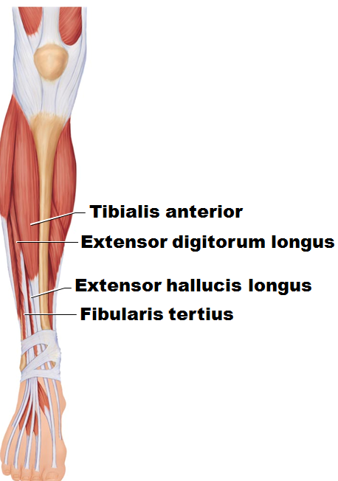
Muscles of the Anterior Compartment, Leg
Primary movers for
toe extensors
ankle dorsiflexors
Tibialis anterior
Extensor digitorum longus
Extensor hallucis longus
Fibularis tertius (not always present)

Slide 148
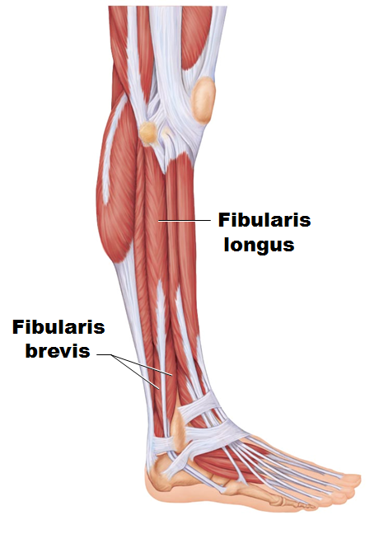
Muscles of the Lateral Compartment, Leg
Plantar flexion
eversion of the foot;
stabilize
lateral ankle
arch of foot
Fibularis longus
Fibularis brevis

Slide 149
Muscles of the Posterior Compartment of the Leg
Plantar flex ankle
Gastrocnemius
Soleus
Plantaris
Popliteus
Flexor digitorum longus
Flexor hallucis longus
Tibialis posterior

Slide 150
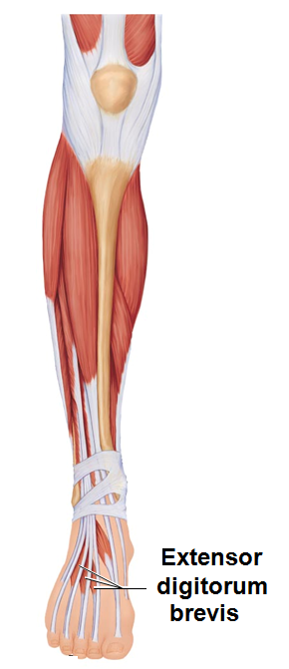
Intrinsic Muscles of the Foot
Help flex, extend, abduct, and adduct toes
Support arches of foot; some leg tendons assist
Extensor digitorum brevis
dorsal foot muscle
helps extend toes

Slide 151
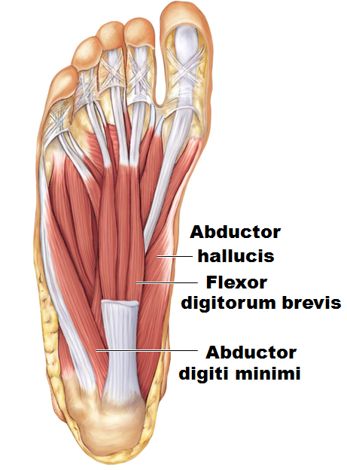
Plantar Muscles
Four layers of plantar muscles
Superficial layer
Flexor digitorum brevis
Abductor hallucis
Abductor digiti minimi
Second layer
Flexor accessorius
Lumbricals

Slide 152
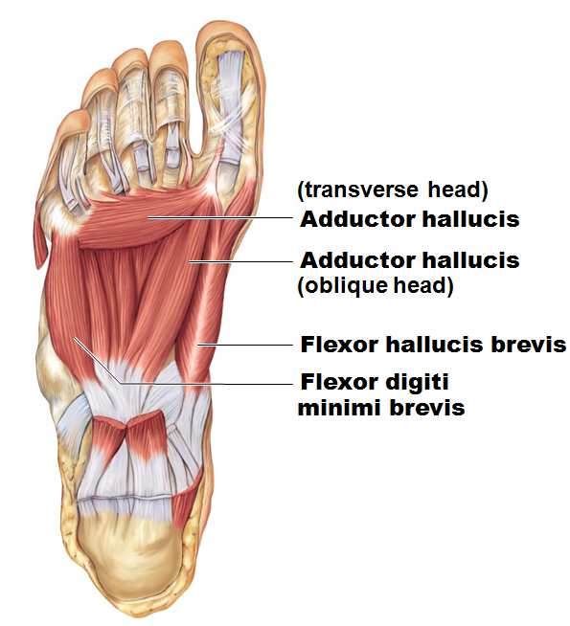
Plantar Muscles
Third layer
Flexor hallucis brevis
Adductor hallucis
Flexor digiti minimi brevis
Deepest layer
Plantar and dorsal interossei

