Slide 1
Exam Two Material
Chapter 5: The Integumentary System
Chapter 6: Skeletal Tissues
Chapter 7: The Skeleton

Slide 2
Skin (Integument)
Consists of three major regions
Epidermis
outermost superficial region
Dermis
middle region
Hypodermis (superficial fascia)
deepest region

Slide 3
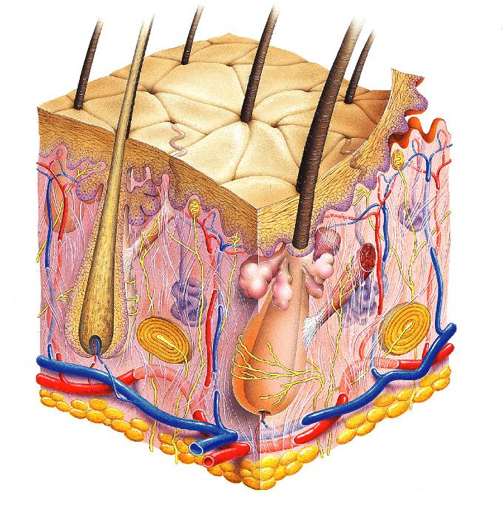
Hair shaft
Pore
Dermal papillae
(papillary layer
of dermis)
Epidermis
Meissner's corpuscle
Free nerve ending
Reticular layer of dermis
Sebaceous (oil) gland
Dermis
Arrector pili muscle
Sensory nerve fiber
Eccrine sweat gland
Pacinian corpuscle
Hypodermis
(superficial
fascia)
Artery
Vein
Hair root
Adipose tissue
Hair follicle
Eccrine sweat
gland
Hair follicle receptor
(root hair plexus)

Slide 4
Epidermis
Composed of keratinized stratified squamous epithelium
consisting of four distinct cell types
Keratinocytes
produce the fibrous protein keratin
Melanocytes
produce the brown pigment melanin
Merkel cells
function as touch receptors in association with sensory nerve endings
Langerhans’ cells
epidermal macrophages that help activate the immune system
And four or five layers

Slide 5
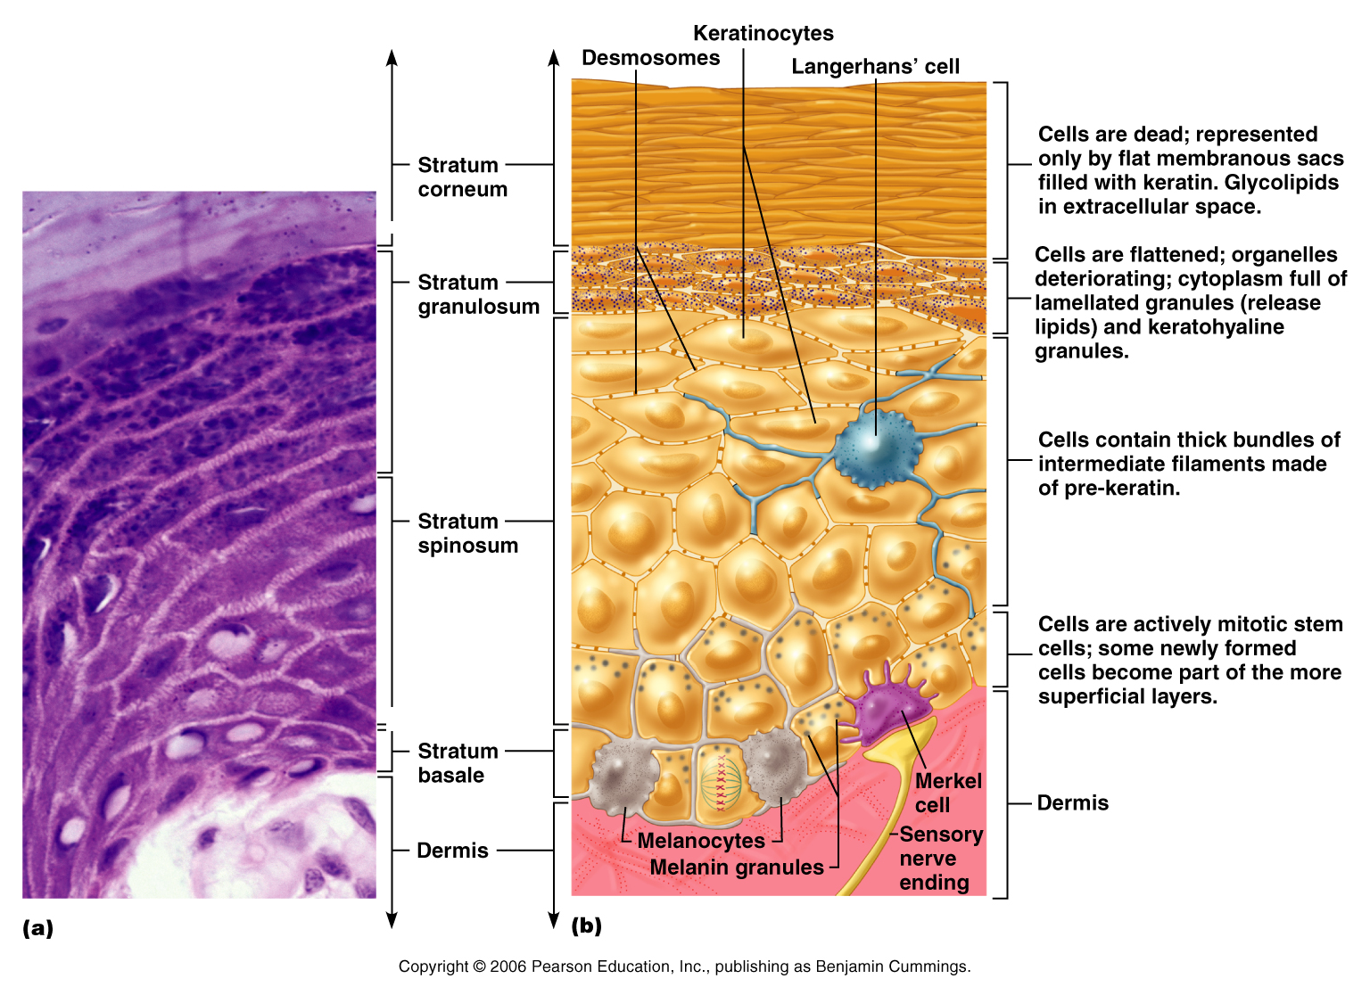

Slide 6
Layers of the Epidermis: Stratum Basale (Basal Layer)
Deepest epidermal layer
firmly attached to the dermis
single row of the youngest keratinocytes
Cells undergo rapid division
stratum germinativum

Slide 7
Layers of the Epidermis: Stratum Spinosum (Prickly Layer)
Cells contain a weblike system of intermediate filaments attached to desmosomes
Melanin granules and Langerhans’ cells are abundant in this layer

Slide 8
Layers of the Epidermis: Stratum Granulosum (Granular Layer)
Thin layer
three to five cell layers

Slide 9
Layers of the Epidermis: Stratum Lucidum (Clear Layer)
Thin, transparent band
superficial to the stratum granulosum
Consists of a few rows of flat, dead keratinocytes
Present only in thick skin

Slide 10
Layers of the Epidermis: Stratum Corneum (Horny Layer)
Outermost layer of keratinized cells
Accounts for three quarters of the epidermal thickness
Functions include:
Waterproofing
Protection from abrasion and penetration
Rendering the body relatively insensitive to biological, chemical, and physical assaults

Slide 11
Dermis
Second major skin region containing strong, flexible connective tissue
Cell types include
Fibroblasts
Macrophages
Mast cells
White blood cells
Composed of two layers
papillary and reticular

Slide 12
Layers of the Dermis: Papillary Layer
Papillary layer
Areolar connective tissue
with collagen and elastic fibers
Its superior surface contains projections called dermal papillae
Dermal papillae contain
capillary loops
Meissner’s corpuscles
free nerve endings

Slide 13
Layers of the Dermis: Reticular Layer
Reticular layer
Accounts for approximately 80% of the thickness of the skin
Collagen fibers add strength and resiliency
Elastin fibers provide stretch-recoil properties

Slide 14
Hypodermis
Subcutaneous layer deep to the skin
Composed of adipose and areolar connective tissue

Slide 15
Skin Color
Three pigments contribute to skin color
Melanin
yellow to reddish-brown to black pigment, responsible for dark skin colors
Freckles and pigmented moles
Carotene
yellow to orange pigment
most obvious in the palms and soles of the feet
Hemoglobin
reddish pigment responsible for the pinkish hue of the skin

Slide 16
Sweat Glands
Different types prevent overheating of the body; secrete cerumen and milk
Eccrine sweat glands
found in palms, soles of the feet, and forehead
Apocrine sweat glands
found in axillary and anogenital areas
Ceruminous glands
modified apocrine glands in external ear canal that secrete cerumen
Mammary glands
specialized sweat glands that secrete milk

Slide 17
Sebaceous Glands
Simple alveolar glands found all over the body
Soften skin when stimulated by hormones
Secrete an oily secretion called sebum

Slide 18
Hair
Filamentous strands of dead keratinized cells produced by hair follicles
Contains hard keratin
tougher and more durable than soft keratin of the skin
Made up of
shaft projecting from the skin
root embedded in the skin
Pigmented by melanocytes at the base of the hair

Slide 19
Hair Function and Distribution
Functions of hair include:
Helping to maintain warmth
Alerting the body to presence of insects on the skin
Guarding the scalp against physical trauma, heat loss, and sunlight

Slide 20
Hair Function and Distribution
Hair is distributed over the entire skin surface except:
Palms
Soles
Lips
Nipples
Portions of the external genitalia

Slide 21
Hair Follicle
Root sheath extending from the epidermal surface into the dermis
Deep end is expanded forming a hair bulb
A knot of sensory nerve endings (a root hair plexus) wraps around each hair bulb
Bending a hair stimulates these endings, hence our hairs act as sensitive touch receptors

Slide 22
Types of Hair
Vellus
pale, fine body hair found in children and the adult female
Terminal
coarse, long hair of eyebrows, scalp, axillary, and pubic regions

Slide 23
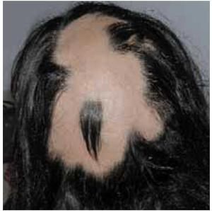
Hair Thinning and Baldness
Alopecia
hair thinning in both sexes
Alopecia areata:
localized hair loss
May be autoimmune related
True, or frank, baldness
Genetically determined and sex-influenced condition
Male pattern baldness
caused by follicular response to DHT

Slide 24
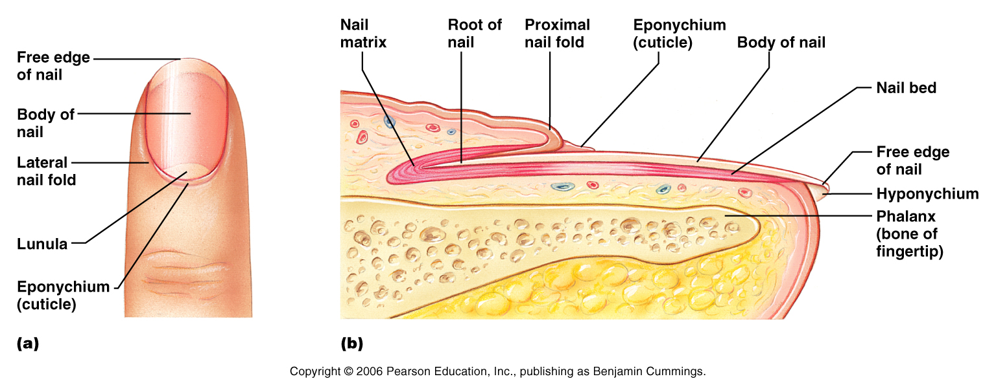
Structure of a Nail
Scalelike modification of the epidermis on the distal, dorsal surface of fingers and toes

Slide 25
Functions of the Integumentary System
Protection
chemical, physical, and mechanical barrier
Body temperature regulation is accomplished by:
Dilation (cooling)
Constriction (warming) of dermal vessels
Increasing sweat gland secretions to cool the body
Cutaneous sensation
exoreceptors sense touch and pain

Slide 26
Functions of the Integumentary System
Metabolic functions
synthesis of vitamin D in dermal blood vessels
Blood reservoir
skin blood vessels store up to 5% of the body’s blood volume
Excretion
limited amounts of nitrogenous wastes are eliminated from the body in sweat

Slide 27
Skin Cancer
Most skin tumors are benign and do not metastasize
A crucial risk factor for non-melanoma skin cancers is the disabling of the p53 gene
Newly developed skin lotions can fix damaged DNA

Slide 28
Skin Cancer
The three major types of skin cancer are:
Basal cell carcinoma
Squamous cell carcinoma
Melanoma

Slide 29
Basal Cell Carcinoma
Least malignant
Most common skin cancer
Stratum basale cells proliferate and invade the dermis and hypodermis
Slow growing
do not often metastasize
Can be cured by surgical excision in 99% of the cases

Slide 30
Squamous Cell Carcinoma
Arises from keratinocytes of stratum spinosum
Arise most often on scalp, ears, and lower lip
Grows rapidly
metastasizes if not removed
Prognosis is good if treated by radiation therapy or removed surgically

Slide 31
Melanoma
Cancer of melanocytes is the most dangerous type of skin cancer
Highly metastatic
Resistant to chemotherapy

Slide 32
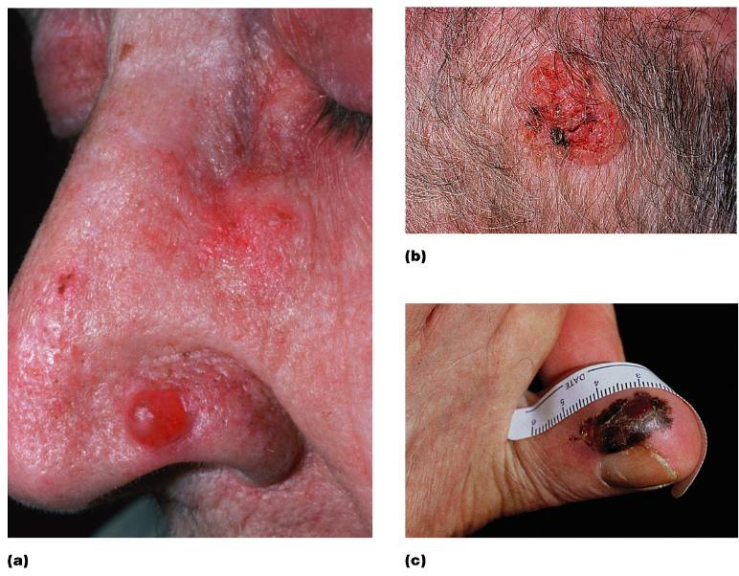

Slide 33
Melanoma
Melanomas have the following characteristics (ABCD rule)
A: Asymmetry
the two sides of the pigmented area do not match
B: Border
irregular
exhibits indentations
C: Color
black, brown, tan, and sometimes red or blue
D: Diameter
larger than 6 mm (size of a pencil eraser)

Slide 34
Melanoma
Treated by wide surgical excision accompanied by immunotherapy
Chance of survival is poor if the lesion is over 4 mm thick

Slide 35
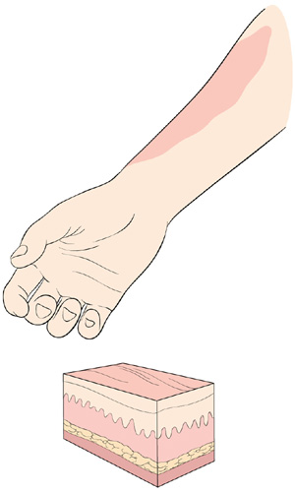
Burns
First-degree
only the epidermis is damaged
Symptoms
localized redness
Swelling
Pain

Slide 36
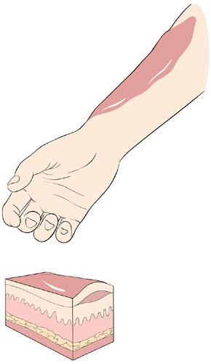
Burns
Second-degree
epidermis and upper regions of dermis are damaged
Symptoms mimic first degree burns
blisters also appear

Slide 37
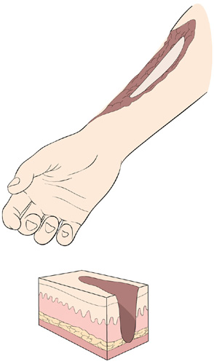
Burns
Third-degree
entire thickness of the skin is damaged
Burned area appears gray-white, cherry red, or black
there is no initial edema
No pain
nerve endings are destroyed

Slide 38
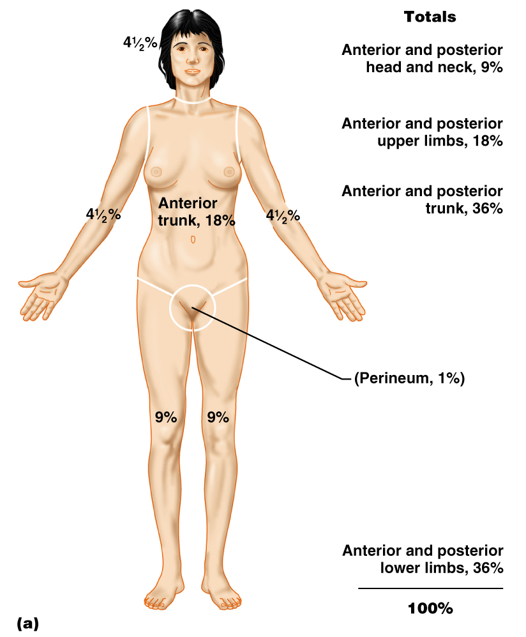
Rule of Nines
Estimates the severity of burns
Burns considered critical if:
Over 25% of the body has second-degree burns
Over 10% of the body has third-degree burns
There are third-degree burns on face, hands, or feet

Slide 39
Classification of Bones
Axial skeleton
bones of the skull, vertebral column, and rib cage
Appendicular skeleton
bones of the upper and lower limbs, shoulder, and hip

Slide 40
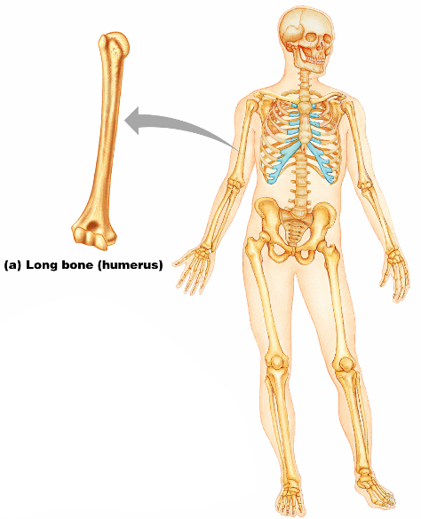
Classification of Bones: By Shape
Long bones
longer than they are wide
humerus
Figure 6.2a

Slide 41
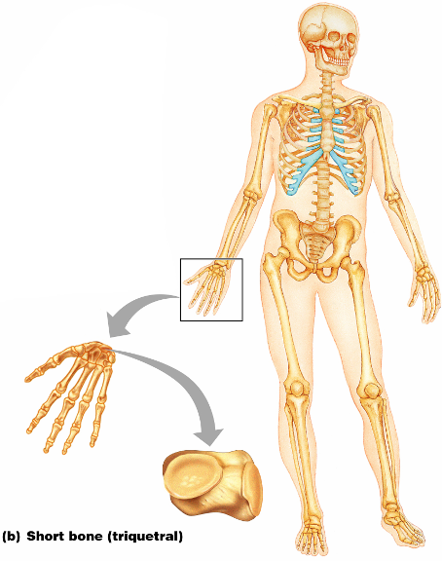
Classification of Bones: By Shape
Short bones
Cube-shaped bones of the wrist and ankle
Bones that form within tendons (e.g., patella)
Figure 6.2b

Slide 42
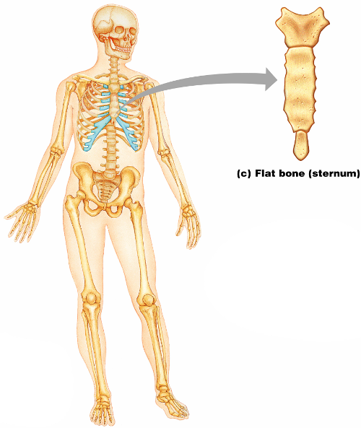
Classification of Bones: By Shape
Flat bones –
thin, flattened, and a bit curved
sternum,
most skull bones
Figure 6.2c

Slide 43
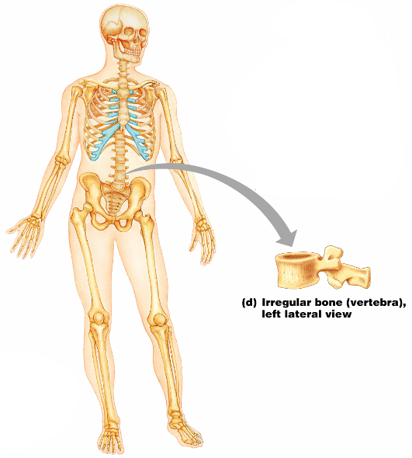
Classification of Bones: By Shape
Irregular bones
bones with complicated shapes
vertebrae
hip bones
Figure 6.2d

Slide 44
Function of Bones
Support
form the framework that supports the body and cradles soft organs
Protection
provide a protective case for the brain, spinal cord, and vital organs
Movement
provide levers for muscles

Slide 45
Function of Bones
Mineral storage
reservoir for minerals, especially calcium and phosphorus
Blood cell formation
hematopoiesis occurs within the marrow cavities of bones

Slide 46
Bone Markings
Bulges, depressions, and holes that serve as:
Sites of attachment for muscles, ligaments, and tendons
Joint surfaces
Conduits for blood vessels and nerves

Slide 47
Bone Markings: Projections – Sites of Muscle and Ligament Attachment
Tuberosity
rounded projection
Crest
narrow, prominent ridge of bone
Trochanter
large, blunt, irregular surface
Line
narrow ridge of bone
Tubercle
small rounded projection
Epicondyle
raised area above a condyle
Spine
sharp, slender projection
Process
any bony prominence

Slide 48
Bone Markings: Projections – Projections That Help to Form Joints
Head
bony expansion carried on a narrow neck
Facet
smooth, nearly flat articular surface
Condyle
rounded articular projection
Ramus
armlike bar of bone

Slide 49
Bone Markings: Depressions and Openings
Meatus
canal-like passageway
Sinus
cavity within a bone
Fossa
shallow, basin-like depression
Groove
furrow
Fissure
narrow, slit-like opening
Foramen
round or oval opening through a bone

Slide 50
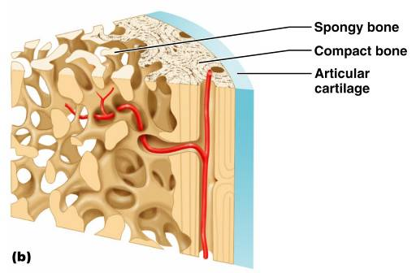
Bone Textures
Compact bone
dense outer layer
Spongy bone
honeycomb of trabeculae filled with yellow bone marrow

Slide 51
Structure of Long Bone
Long bones consist of a diaphysis and an epiphysis
Diaphysis
Tubular shaft
Composed of compact bone
surrounds the medullary cavity
Yellow bone marrow in the medullary cavity

Slide 52
Structure of Long Bone
Epiphyses
Expanded ends of long bones
Exterior is compact bone, and the interior is spongy bone
Joint surface is covered with articular (hyaline) cartilage
Epiphyseal line separates the diaphysis from the epiphyses

Slide 53
Bone Membranes
Periosteum – double-layered protective membrane
Richly supplied with nerve fibers, blood, and lymphatic vessels, which enter the bone via nutrient foramina
Secured to underlying bone by Sharpey’s fibers

Slide 54
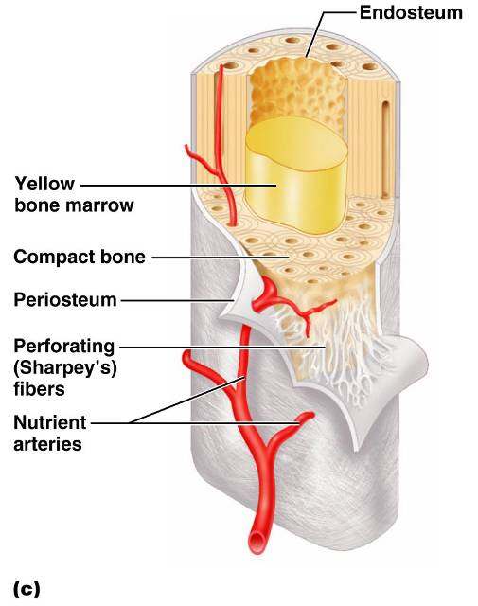
Bone Membranes
Endosteum
delicate membrane covering internal surfaces of bone

Slide 55
Structure of Short, Irregular, and Flat Bones
Thin plates of periosteum-covered compact bone on the outside with endosteum-covered spongy bone on the inside
Have no diaphysis or epiphyses
Contain bone marrow between the trabeculae

Slide 56
Location of Hematopoietic Tissue (Red Marrow)
In infants
Found in the medullary cavity
all areas of spongy bone
In adults
Found in the flat bones
the head of the femur and humerus
the head of the humerus

Slide 57
Microscopic Structure of Bone: Compact Bone
Haversian system, or osteon – the structural unit of compact bone
Lamella
weight-bearing, column-like matrix tubes composed mainly of collagen
Haversian, or central canal
containing blood vessels and nerves
Volkmann’s canals
channels lying at right angles to the central canal, connecting blood and nerve supply of the periosteum to that of the Haversian canal

Slide 58
Microscopic Structure of Bone: Compact Bone
Osteocytes
mature bone cells
Lacunae
small cavities in bone that contain osteocytes
Canaliculi
hairlike canals that connect lacunae to each other and the central canal

Slide 59
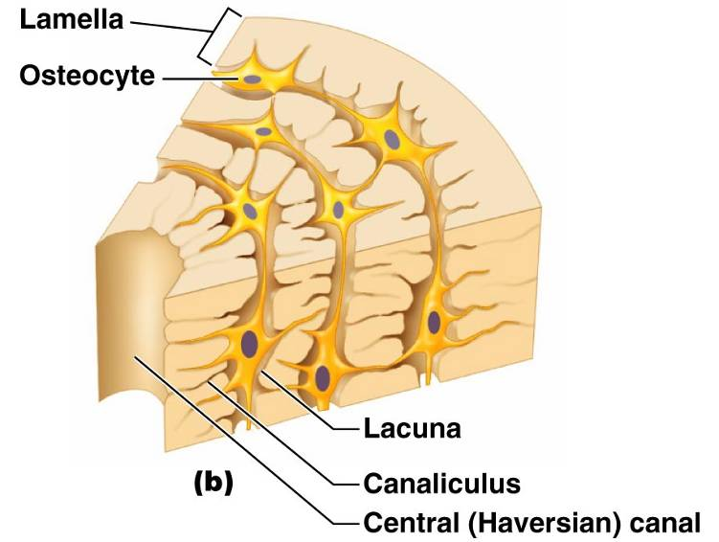
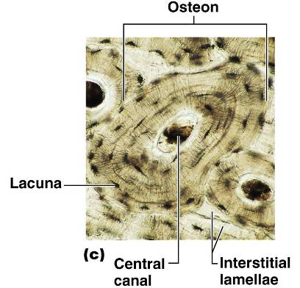

Slide 60
Chemical Composition of Bone: Organic
Osteoblasts
bone-forming cells
Osteocytes
mature bone cells
Osteoclasts
large cells that resorb or break down bone matrix

Slide 61
Bone Development
Osteogenesis and ossification – the process of bone tissue formation, which leads to:
The formation of the bony skeleton in embryos
Bone growth until early adulthood
Bone thickness, remodeling, and repair

Slide 62
Formation of the Bony Skeleton
Begins at week 8 of embryo development
Intramembranous ossification
bone develops from a fibrous membrane
Endochondral ossification
bone forms by replacing hyaline cartilage

Slide 63
Intramembranous Ossification
Formation of most of the flat bones of the skull and the clavicles

Slide 64
Stages of Intramembranous Ossification
An ossification center appears in the fibrous connective tissue membrane
Bone matrix is secreted within the fibrous membrane
Woven bone and periosteum form
Bone collar of compact bone forms, and red marrow appears

Slide 65
Stages of Intramembranous Ossification
Figure 6.7.1

Slide 66
Stages of Intramembranous Ossification
Figure 6.7.2

Slide 67
Stages of Intramembranous Ossification
Figure 6.7.3

Slide 68
Stages of Intramembranous Ossification
Figure 6.7.4

Slide 69
Endochondral Ossification
Begins in the second month of development
Uses hyaline cartilage “bones” as models for bone construction
Requires breakdown of hyaline cartilage prior to ossification

Slide 70
Stages of Endochondral Ossification
Formation of bone collar
Cavitation of the hyaline cartilage
Invasion of internal cavities by the periosteal bud, and spongy bone formation
Formation of the medullary cavity; appearance of secondary ossification centers in the epiphyses
Ossification of the epiphyses, with hyaline cartilage remaining only in the epiphyseal plates

Slide 71
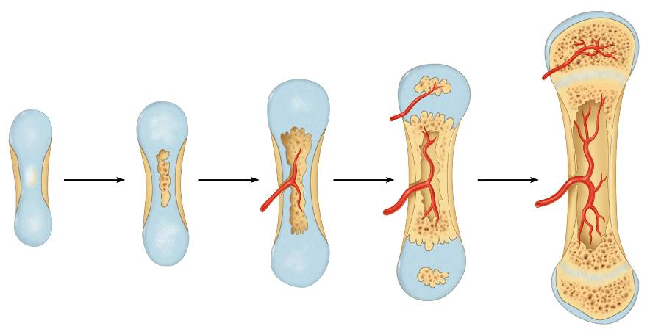
Endochondral Ossification
Secondary
ossificaton
center
Articular
cartilage
Epiphyseal
blood vessel
Spongy
bone
Deteriorating
cartilage
matrix
Hyaline
cartilage
Spongy
bone
formation
Epiphyseal
plate
cartilage
Primary
ossification
center
Medullary
cavity
Bone collar
Blood
vessel of
periosteal
bud
1
Formation of
bone collar
around hyaline
cartilage model.
2
Cavitation of
the hyaline carti-
lage within the
cartilage model.
3
Invasion of
internal cavities
by the periosteal
bud and spongy
bone formation.
4
Formation of the
medullary cavity as
ossification continues;
appearance of sec-
ondary ossification
centers in the epiphy-
ses in preparation
for stage 5.
5
Ossification of the
epiphyses; when
completed, hyaline
cartilage remains only
in the epiphyseal plates
and articular cartilages.
Figure 6.8

Slide 72
Postnatal Bone Growth
Growth in length of long bones
Cells of the epiphyseal plate proximal to the resting cartilage form three functionally different zones:
growth.
transformation
osteogenic

Slide 73
Functional Zones in Long Bone Growth
Growth zone
cartilage cells undergo mitosis, pushing the epiphysis away from the diaphysis
Transformation zone
older cells enlarge, the matrix becomes calcified, cartilage cells die, and the matrix begins to deteriorate
Osteogenic zone
new bone formation occurs

Slide 74
Hormonal Regulation of Bone Growth During Youth
During infancy and childhood, epiphyseal plate activity is stimulated by growth hormone
During puberty, testosterone and estrogens:
Initially promote adolescent growth spurts
Later induce epiphyseal plate closure, ending longitudinal bone growth

Slide 75
Response to Mechanical Stress
Wolff’s law
a bone grows or remodels in response to the forces or demands placed upon it
Observations supporting Wolff’s law include
Long bones are thickest midway along the shaft (where bending stress is greatest)
Curved bones are thickest where they are most likely to buckle

Slide 76
Bone Fractures (Breaks)
Bone fractures are classified by:
The position of the bone ends after fracture
The completeness of the break
The orientation of the bone to the long axis
Whether or not the bones ends penetrate the skin

Slide 77
Types of Bone Fractures
Nondisplaced
bone ends retain their normal position
Displaced
bone ends are out of normal alignment

Slide 78
Types of Bone Fractures
Complete
bone is broken all the way through
Incomplete
bone is not broken all the way through
Linear
the fracture is parallel to the long axis of the bone

Slide 79
Types of Bone Fractures
Transverse
the fracture is perpendicular to the long axis of the bone
Compound (open)
bone ends penetrate the skin
Simple (closed)
bone ends do not penetrate the skin

Slide 80
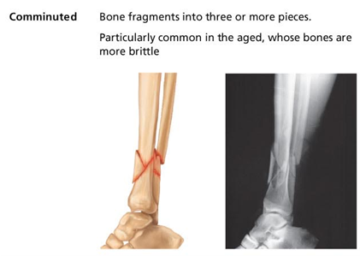
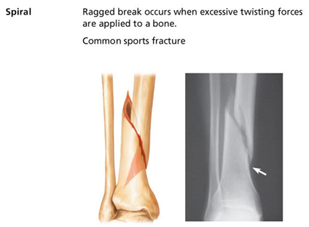
Common Types of Fractures
Comminuted
bone fragments into three or more pieces; common in the elderly
Spiral
ragged break when bone is excessively twisted; common sports injury

Slide 81
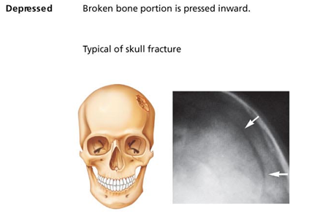
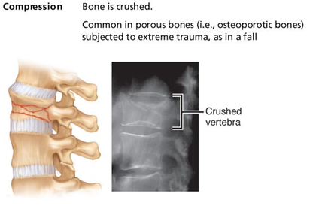
Common Types of Fractures
Depressed
broken bone portion pressed inward; typical skull fracture
Compression
bone is crushed; common in porous bones

Slide 82
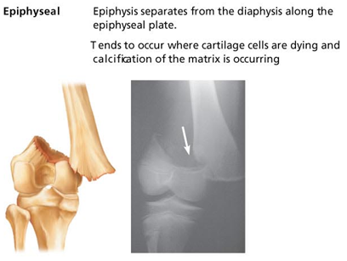
Common Types of Fractures
Epiphyseal
epiphysis separates from diaphysis along epiphyseal line; occurs where cartilage cells are dying
Greenstick
incomplete fracture where one side of the bone breaks and the other side bends; common in children

Slide 83
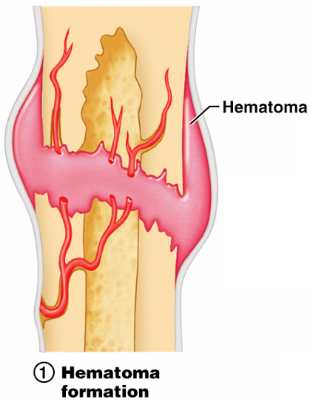
Stages in the Healing of a Bone Fracture
Hematoma formation
Torn blood vessels hemorrhage
A mass of clotted blood (hematoma) forms at the fracture site
Site becomes swollen, painful, and inflamed
Figure 6.13.1

Slide 84
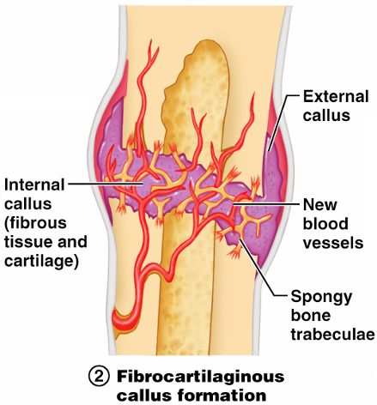
Stages in the Healing of a Bone Fracture
Fibrocartilaginous callus forms
Granulation tissue (soft callus) forms a few days after the fracture
Capillaries grow into the tissue and phagocytic cells begin cleaning debris
Figure 6.13.2

Slide 85
Stages in the Healing of a Bone Fracture
The fibrocartilaginous callus forms when:
Osteoblasts and fibroblasts migrate to the fracture and begin reconstructing the bone
Fibroblasts secrete collagen fibers that connect broken bone ends
Osteoblasts begin forming spongy bone

Slide 86
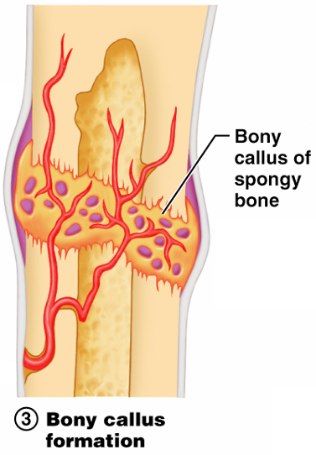
Stages in the Healing of a Bone Fracture
Bony callus formation
New bone trabeculae appear in the fibrocartilaginous callus
Fibrocartilaginous callus converts into a bony (hard) callus
Bone callus begins 3-4 weeks after injury, and continues until firm union is formed 2-3 months later
Figure 6.13.3

Slide 87
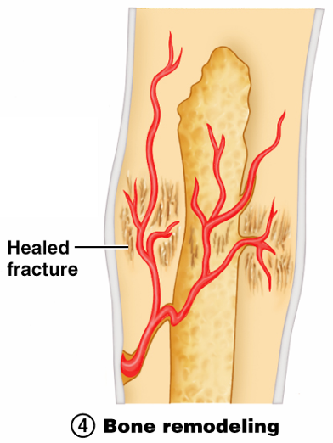
Stages in the Healing of a Bone Fracture
Bone remodeling
Excess material on the bone shaft exterior and in the medullary canal is removed
Compact bone is laid down to reconstruct shaft walls
Figure 6.13.4

Slide 88
Homeostatic Imbalances
Osteomalacia
Bones are inadequately mineralized causing softened, weakened bones
Main symptom is pain when weight is put on the affected bone
Caused by insufficient calcium in the diet, or by vitamin D deficiency

Slide 89
Homeostatic Imbalances
Rickets
Bones of children are inadequately mineralized causing softened, weakened bones
Bowed legs and deformities of the pelvis, skull, and rib cage are common
Caused by insufficient calcium in the diet, or by vitamin D deficiency

Slide 90
Isolated Cases of Rickets
Rickets has been essentially eliminated in the US
Only isolated cases appear
Example: Infants of breastfeeding mothers deficient in Vitamin D will also be Vitamin D deficient and develop rickets

Slide 91
Homeostatic Imbalances
Osteoporosis
Group of diseases in which bone reabsorption outpaces bone deposit
Spongy bone of the spine is most vulnerable
Occurs most often in postmenopausal women
Bones become so fragile that sneezing or stepping off a curb can cause fractures

Slide 92
Osteoporosis: Treatment
Calcium and vitamin D supplements
Increased weight-bearing exercise
Hormone (estrogen) replacement therapy (HRT) slows bone loss
Natural progesterone cream prompts new bone growth
Statins increase bone mineral density

Slide 93
Chapter Seven

Slide 94
The Axial Skeleton
Eighty bones segregated into three regions
Skull
Vertebral column
Bony thorax

Slide 95
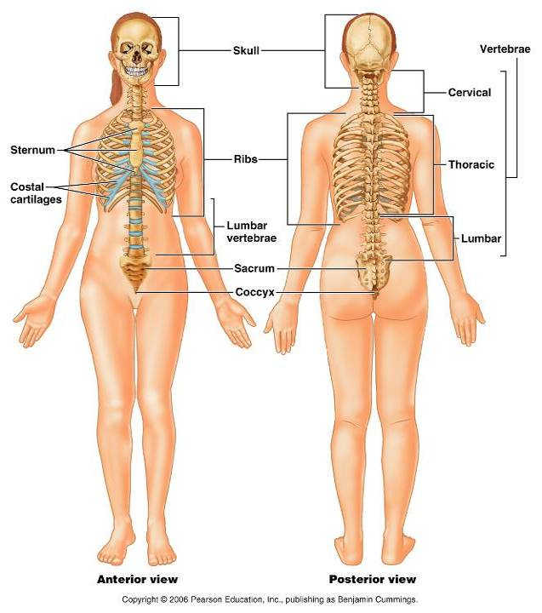
Bones of the Axial Skeleton
Figure 7.1

Slide 96
The Skull
most complex bony structure
formed by the cranium and facial bones
Cranium
protects the brain and is the site of attachment for head and neck muscles
Facial bones
Supply the framework of the face, the sense organs, and the teeth
Provide openings for the passage of air and food
Anchor the facial muscles of expression

Slide 97
Anatomy of the Cranium
The eight cranial bones thin and remarkably strong for their weight
two parietal
two temporal
Frontal
Occipital
Sphenoid
ethmoid

Slide 98
Wormian Bones
Tiny irregularly shaped bones that appear within sutures

Slide 99
Facial Bones
Fourteen bones of which only the mandible and vomer are unpaired
The paired bones are
Maxillae
Zygomatics
Nasals
lacrimals
Palatines
inferior conchae

Slide 100
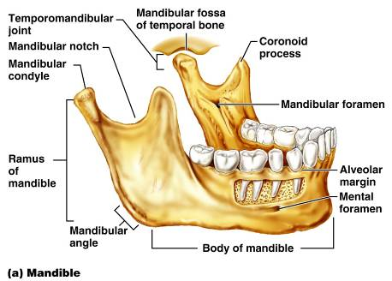
Mandible and Its Markings
The mandible is the largest and strongest bone of the face
Its major markings include the
coronoid process,
mandibular condyle,
alveolar margin, and
mandibular foramina
mental foramina

Slide 101
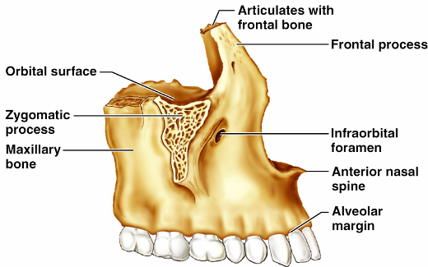
Maxillary Bones
upper jaw and the central portion of the facial skeleton
articulate with all other facial bones except the mandible
Their major markings include
palatine,
frontal,
zygomatic processes
the alveolar margins
inferior orbital fissure
the maxillary sinuses

Slide 102
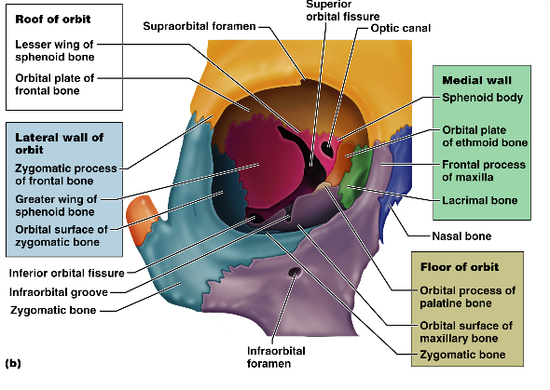
Orbits
Bony cavities in which the eyes are firmly encased and cushioned by fatty tissue
Formed by parts of seven bones
Frontal
Sphenoid
Zygomatic
Maxilla
Palatine
Lacrimal
ethmoid

Slide 103
Hyoid Bone
Not part of the skull
lies just inferior to the mandible in the anterior neck
Only bone of the body that does not articulate directly with another bone
Attachment point for neck muscles that raise and lower the larynx during swallowing and speech

Slide 104
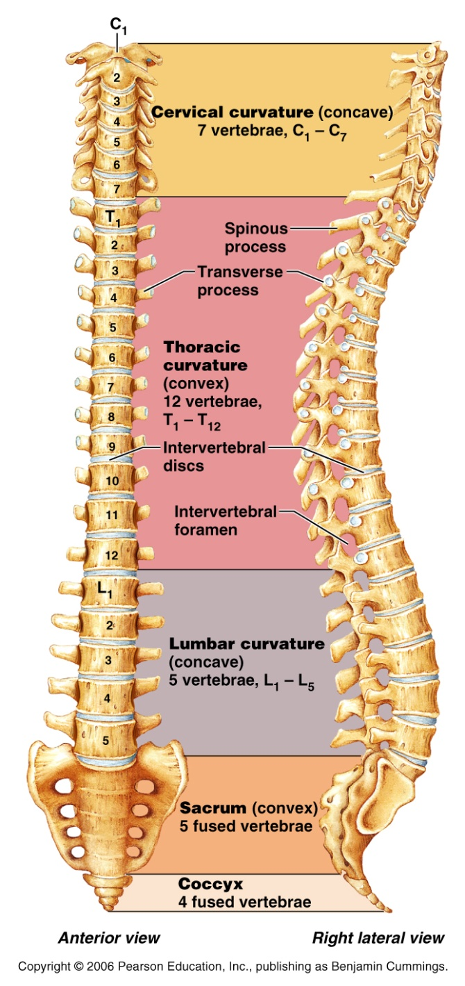
Vertebral Column
Formed from 26 irregular bones (vertebrae) connected in such a way that a flexible curved structure results
Cervical vertebrae
7 bones of the neck
Thoracic vertebrae
12 bones of the torso
Lumbar vertebrae
5 bones of the lower back
Sacrum
bone inferior to the lumbar vertebrae that articulates with the hip bones

Slide 105
Vertebral Column: Curvatures
Posteriorly concave curvatures
cervical and lumbar
Secondary curvatures
cervical and lumbar – are convex anteriorly and are associated with the child’s development
Posteriorly convex curvatures
thoracic and sacral
present at birth
convex posteriorly
causing the infant spine to arch like a four-legged animal

Slide 106
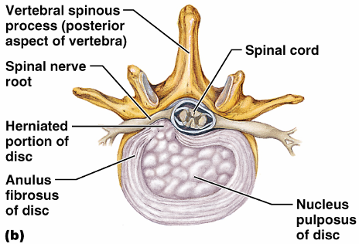
Vertebral Column: Intervertebral Discs
Cushion-like pad composed of two parts
Nucleus pulposus
inner gelatinous nucleus that gives the disc its elasticity and compressibility
Annulus fibrosus
surrounds the nucleus pulposus with a collar composed of collagen and fibrocartilage

Slide 107
General Structure of Vertebrae
Body or centrum
disc-shaped, weight-bearing region
Vertebral arch
composed of pedicles and laminae that, along with the centrum, enclose the vertebral foramen
Vertebral foramina
make up the vertebral canal through which the spinal cord passes

Slide 108
General Structure of Vertebrae
Spinous processes
project posteriorly,
transverse processes
project laterally
Superior and inferior articular processes
protrude superiorly and inferiorly from the pedicle-lamina junctions
Intervertebral foramina
lateral openings formed from notched areas on the superior and inferior borders of adjacent pedicles

Slide 109
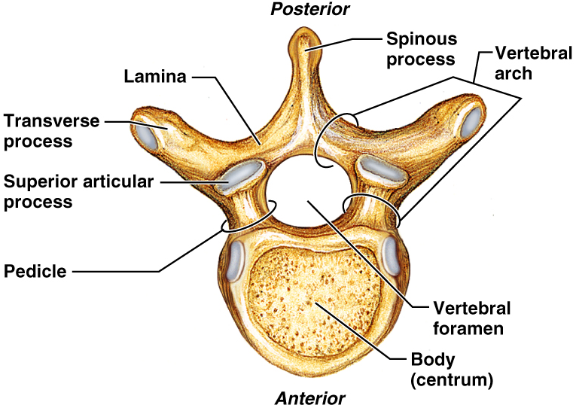
General Structure of Vertebrae

Slide 110
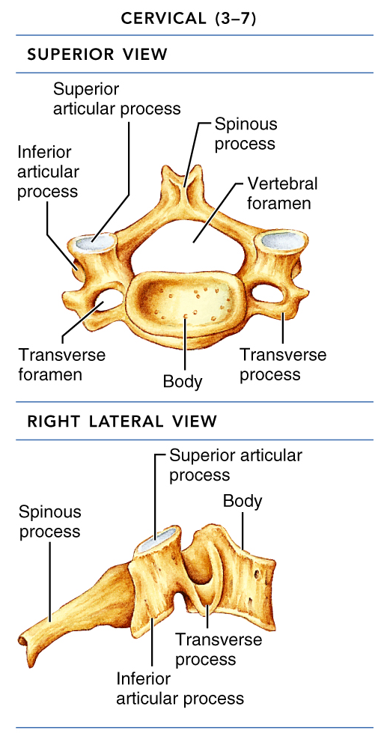
Cervical Vertebrae
Seven vertebrae (C₁-C₇) are the smallest, lightest vertebrae
C₃-C₇
oval body
short spinous processes,
large, triangular vertebral foramina
Each transverse process contains a transverse foramen

Slide 111
Cervical Vertebrae: The Atlas (C₁)
The atlas has no body and no spinous process
It consists of anterior and posterior arches, and two lateral masses
The superior surfaces of lateral masses articulate with the occipital condyles

Slide 112
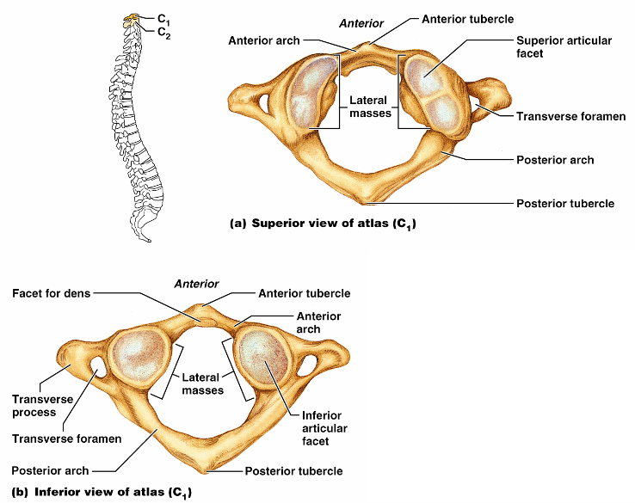
Cervical Vertebrae: The Atlas (C₁)
Figure 7.16a, b

Slide 113
Cervical Vertebrae: The Axis (C₂)
The axis has a body, spine, and vertebral arches as do other cervical vertebrae
Also has the dens, or odontoid process,
projects superiorly from the body and is cradled in the anterior arch of the atlas
The dens is a pivot for the rotation of the atlas

Slide 114
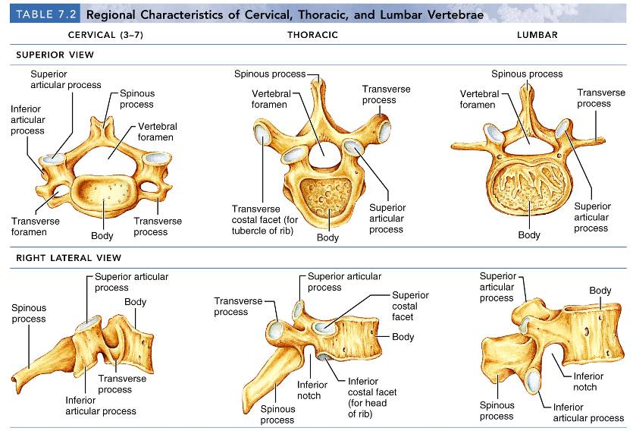
Regional Characteristics of Vertebrae

Slide 115
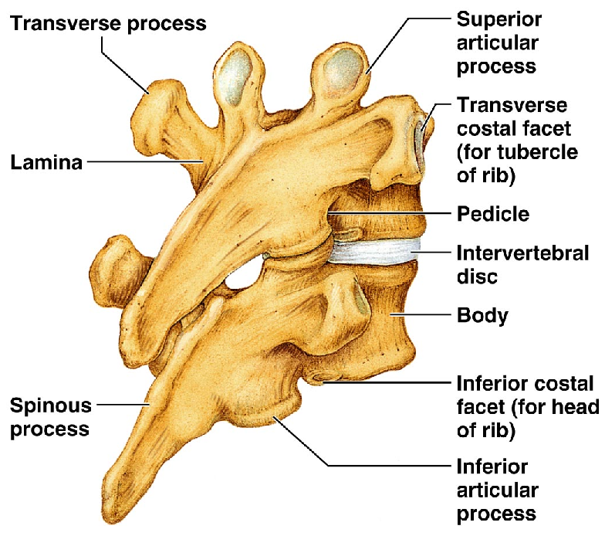
Thoracic Vertebrae
12 Thoracic vertebrae
All articulate with ribs
Major markings include
two facets
two demifacets on the heart-shaped body,
circular vertebral foramen
transverse processes,
long spinous process
facets prevents flexion and extension
allows rotation of this area of the spine

Slide 116
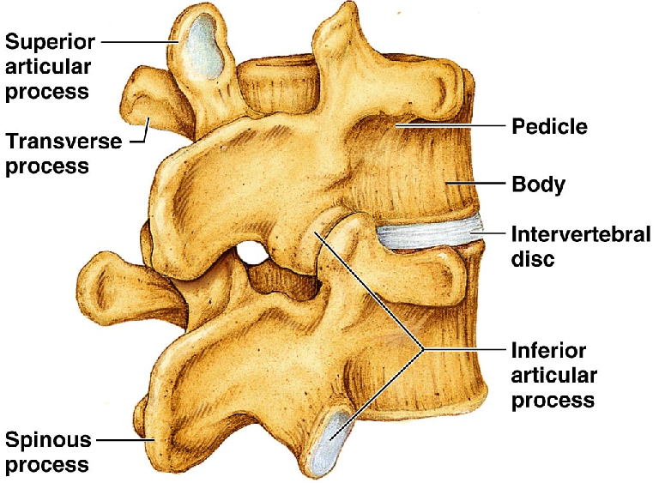
Lumbar Vertebrae
five lumbar vertebrae
have an enhanced weight-bearing function
They have
short, thick pedicles and laminae
flat hatchet-shaped spinous processes,
triangular-shaped vertebral foramen
Orientation of articular facets locks the lumbar vertebrae together to provide stability

Slide 117
Sacrum
Sacrum
five fused vertebrae (S₁-S₅
shape the posterior wall of the pelvis
It articulates with L₅ superiorly, and with the auricular surfaces of the hip bones
Major markings include
sacral promontory
transverse lines
Alae
dorsal sacral foramina
sacral canal
sacral hiatus

Slide 118
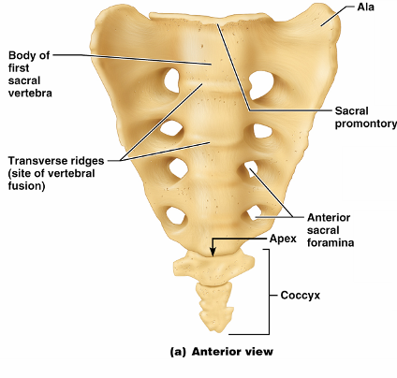
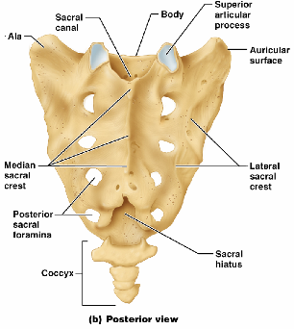
Coccyx
Coccyx (Tailbone)
The coccyx is made up of four fused vertebrae that articulate superiorly with the sacrum

Slide 119
Bony Thorax (Thoracic Cage)
The thoracic cage is composed of
the thoracic vertebrae dorsally
ribs laterally
sternum and costal cartilages anteriorly

Slide 120
Bony Thorax (Thoracic Cage)
Functions
Forms a protective cage around the heart, lungs, and great blood vessels
Supports the shoulder girdles and upper limbs
Provides attachment for many neck, back, chest, and shoulder muscles
Uses intercostal muscles to lift and depress the thorax during breathing

Slide 121
Sternum (Breastbone)
A dagger-shaped, flat bone
lies in the anterior midline of the thorax
Results from the fusion of three bones –
Superior: manubrium
the body
Inferior: xiphoid process
Anatomical landmarks include the jugular (suprasternal) notch, the sternal angle, and the xiphisternal joint

Slide 122
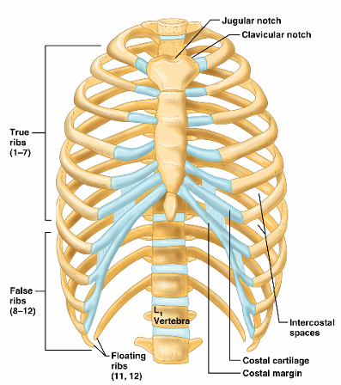
Ribs
There are twelve pair of ribs
All ribs attach posteriorly to the thoracic vertebrae
The superior 7 pair
True ribs or vertebrosternal
attach directly to the sternum via costal cartilages
Ribs 8-10 (
False ribs or vertebrocondral ribs
attach indirectly to the sternum via costal cartilage
Ribs 11-12
Floating ribs
have no anterior attachment

Slide 123
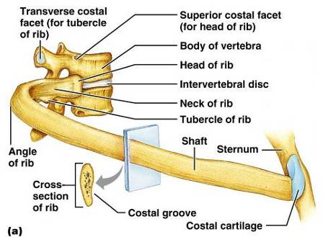
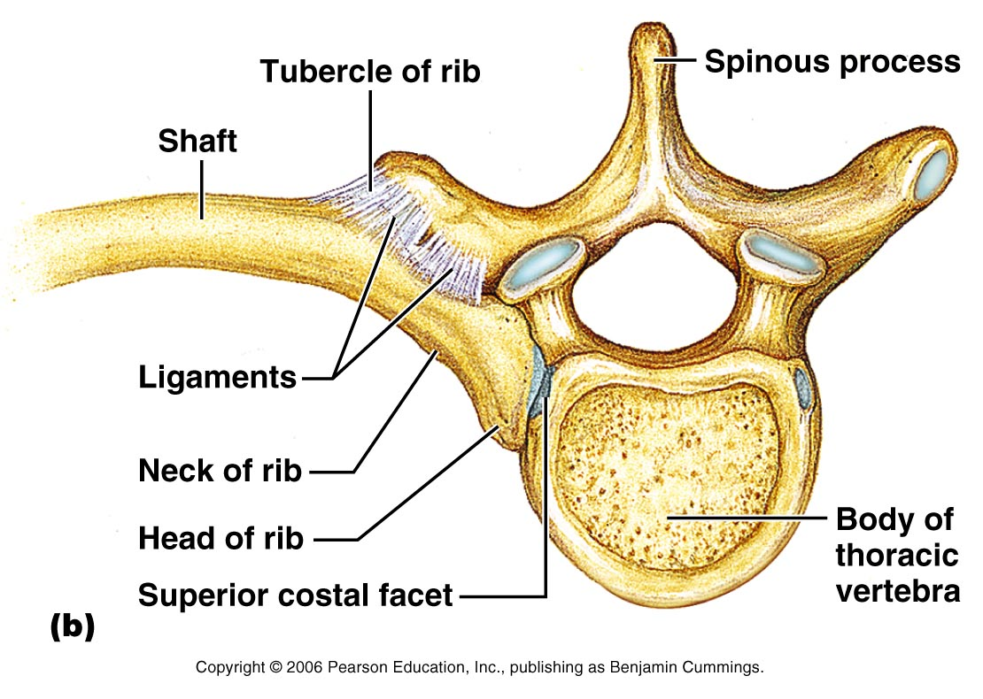
Structure of a Typical True Rib
Bowed, flat bone consisting of a head, neck, tubercle, and shaft

Slide 124
Appendicular Skeleton
The appendicular skeleton is made up of
the bones of the limbs
and their girdles
Pectoral girdles
attach the upper limbs to the body trunk
Pelvic girdle
secures the lower limbs

Slide 125
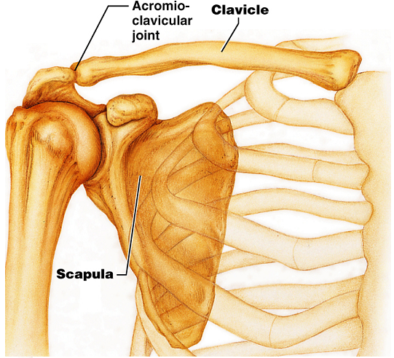
Pectoral Girdles (Shoulder Girdles)
The pectoral girdles consist of the anterior clavicles and the posterior scapulae
They provide attachment points for muscles that move the upper limbs
Arrangement allows increased range of motion

Slide 126
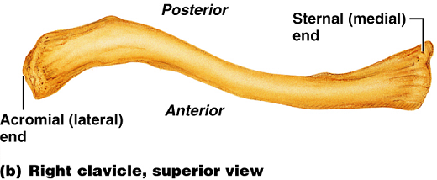
Clavicles (Collarbones)
Slender, doubly curved long bones lying across the superior thorax
The acromial (lateral) end articulates with the scapula
The sternal (medial) end articulates with the sternum

Slide 127
Scapulae (Shoulder Blades)
Triangular, flat bones lying on the dorsal surface of the rib cage
between the second and seventh ribs
Scapulae have three borders and three angles

Slide 128
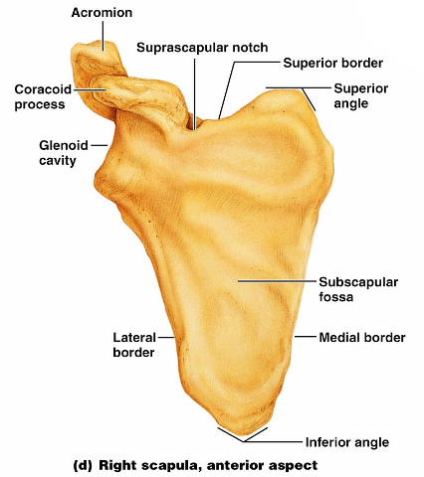
Major markings include the suprascapular notch, the supraspinous and infraspinous fossae, the spine, the acromion, and the coracoid process
Figure 7.22d

Slide 129
The Upper Limb
The upper limb consists of the
arm (brachium)
forearm (antebrachium)
hand (manus)
Thirty-seven bones form the skeletal framework of each upper limb

Slide 130
Arm
The humerus is the sole bone of the arm
It articulates with the scapula at the shoulder, and the radius and ulna at the elbow

Slide 131
Arm
Major markings
Proximal humerus includes the head, anatomical and surgical necks, greater and lesser tubercles, and the intertubercular groove

Slide 132
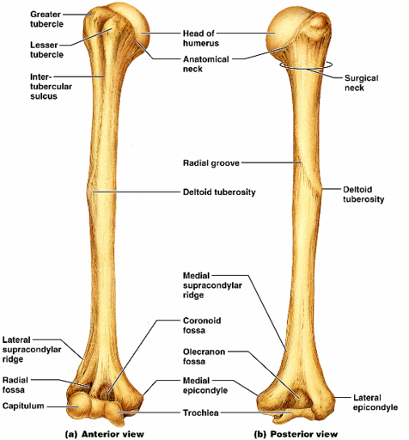
Humerus of the Arm
Distal humerus includes the
capitulum,
trochlea,
medial and lateral epicondyles,
the coronoid
olecranon fossae
Medial portion includes the
radial groove
deltoid process

Slide 133
Forearm
The bones of the forearm are the radius and ulna
They articulate proximally with the humerus and distally with the wrist bones
They also articulate with each other proximally and distally at small radioulnar joints
Interosseous membrane connects the two bones along their entire length

Slide 134
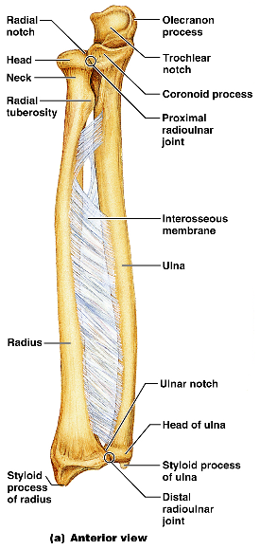
Ulna
The ulna lies medially in the forearm and is slightly longer than the radius
Forms the major portion of the elbow joint with the humerus
Its major markings include the olecranon, coronoid process, trochlear notch, radial notch, and the styloid process

Slide 135
Radius
The radius lies opposite (lateral to) the ulna and is thin at its proximal end, widened distally
The superior surface of the head articulates with the capitulum of the humerus
Medially, the head articulates with the radial notch of the ulna
Major markings include the radial tuberosity, ulnar notch, and styloid process

Slide 136
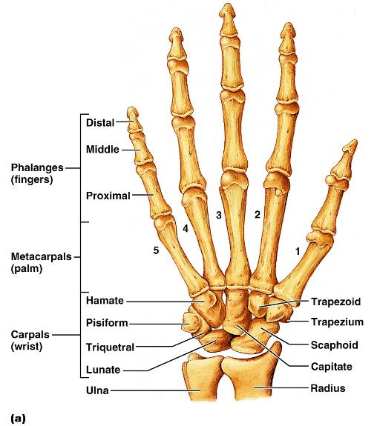
Hand
Skeleton of the hand contains
wrist bones (carpals),
bones of the palm (metacarpals),
bones of the fingers (phalanges)

Slide 137
Carpus (Wrist)
Consists of eight bones
Scaphoid, lunate, triquetral, and pisiform proximally
Trapezium, trapezoid, capitate, and hamate distally

Slide 138
Metacarpus (Palm)
Five numbered (1-5) metacarpal bones radiate from the wrist to form the palm
Their bases articulate with the carpals proximally, and with each other medially and laterally
Heads articulate with the phalanges

Slide 139
Phalanges (Fingers)
Each hand contains 14 miniature long bones called phalanges
Fingers (digits) are numbered 1-5, beginning with the thumb (pollex)
Each finger (except the thumb) has three phalanges – distal, middle, and proximal
The thumb has no middle phalanx

Slide 140
Pelvic Girdle
The hip is formed by a pair of hip bones (os coxae, or coxal)
Together with the sacrum and the coccyx, these bones form the bony pelvis

Slide 141
Pelvic Girdle (Hip)
The pelvis
Attaches the lower limbs to the axial skeleton with the strongest ligaments of the body
Transmits weight of the upper body to the lower limbs
Supports the visceral organs of the pelvis

Slide 142
Ilium
The ilium is a large flaring bone that forms the superior region of the coxal bone
It consists of
a body
a superior winglike portion called the ala
The broad posterolateral surface is called the gluteal surface

Slide 143
Ilium
The auricular surface articulates with the sacrum (sacroiliac joint)
Major markings include the iliac crests, four spines, greater sciatic notch, iliac fossa, arcuate line, and the pelvic brim

Slide 144
Ischium
The ischium forms the posteroinferior part of the hip bone
The thick body articulates with the ilium, and the thinner ramus articulates with the pubis
Major markings include the ischial spine, lesser sciatic notch, and the ischial tuberosity

Slide 145
Pubis
The pubic bone forms the anterior portion of the hip bone
It articulates with the ischium and the ilium
Major markings include superior and inferior rami, the pubic crest, pubic tubercle, pubic arch, pubic symphysis, and obturator foramen (along with ilium and ischium)

Slide 146
Comparison of Male and Female Pelvic Structure
Female pelvis
Tilted forward, adapted for childbearing
True pelvis defines birth canal
Cavity of the true pelvis is broad, shallow, and has greater capacity
Male pelvis
Tilted less forward
Adapted for support of heavier male build and stronger muscles
Cavity of true pelvis is narrow and deep

Slide 147
Comparison of Male and Female Pelvic Structure
Characteristic | Female | Male
Bone thickness | Lighter, thinner, and smoother | Heavier, thicker, and more prominent markings
Pubic arch/angle | 80˚–90˚ | 50˚–60˚
Acetabula | Small; farther apart | Large; closer together
Sacrum | Wider, shorter; sacral curvature is accentuated | Narrow, longer; sacral promontory more ventral
Coccyx | More movable; straighter | Less movable; curves ventrally

Slide 148
The Lower Limb
The three segments of the lower limb are the thigh, leg, and foot
They carry the weight of the erect body, and are subjected to exceptional forces when one jumps or runs

Slide 149
Femur
The sole bone of the thigh is the femur, the largest and strongest bone in the body
It articulates proximally with the hip and distally with the tibia and fibula

Slide 150
Femur
Major markings include the
head,
fovea capitis
greater and lesser trochanters
gluteal tuberosity
lateral and medial condyles
Epicondyles
linea aspera
patellar surface,
intercondylar notch
Figure 7.28b

Slide 151
Leg
The tibia and fibula form the skeleton of the leg
They are connected to each other by the interosseous membrane
They articulate with the femur proximally and with the ankle bones distally
They also articulate with each other via the immovable tibiofibular joints

Slide 152
Tibia
Receives the weight of the body from the femur and transmits it to the foot
Major markings include medial and lateral condyles, intercondylar eminence, the tibial tuberosity, anterior crest, medial malleolus, and fibular notch

Slide 153
Fibula
Sticklike bone with slightly expanded ends located laterally to the tibia
Major markings include the head and lateral malleolus

Slide 154
Foot
The skeleton of the foot includes the
tarsus,
metatarsus,
phalanges (toes)
The foot supports body weight and acts as a lever to propel the body forward in walking and running

Slide 155
Tarsus
Composed of seven bones that form the posterior half of the foot
Body weight is carried primarily on the talus and calcaneus
Talus articulates with the tibia and fibula superiorly, and the calcaneus inferiorly
Other tarsus bones include the cuboid and navicular, and the medial, intermediate, and lateral cuneiforms

Slide 156
Calcaneus
Forms the heel of the foot
Carries the talus on its superior surface
Point of attachment for the calcaneal (Achilles) tendon of the calf muscles

Slide 157
Metatarsus and Phalanges
Metatarsals
Five (1-5) long bones that articulate with the proximal phalanges
The enlarged head of metatarsal 1 forms the “ball of the foot”
Phalanges
The 14 bones of the toes
Each digit has three phalanges except the hallux, which has no middle phalanx

