Slide 1
Exam Five
Chapter 12

Slide 2
Spinal Cord
CNS tissue is enclosed within the vertebral column from the foramen magnum to L₁
Provides two-way communication to and from the brain
Protected by bone, meninges, and CSF
Epidural space
  space between the vertebrae and the dural mater filled with fat and a network of veins

Slide 3
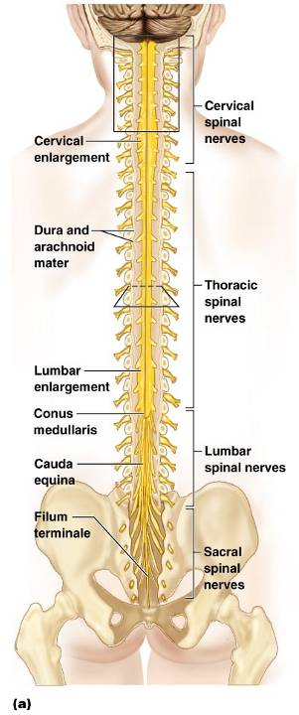
Spinal Cord
Conus medullaris
  terminal portion of the spinal cord
Filum terminale
  fibrous extension of the pia mater; anchors the spinal cord to the coccyx
Denticulate ligaments
  delicate shelves of pia mater; attach the spinal cord to the vertebrae

Slide 4
Spinal Cord
Spinal nerves
  31 pairs attach to the cord by paired roots
Cervical and lumbar enlargements
  sites where nerves serving the upper and lower limbs emerge
Cauda equina
  collection of nerve roots at the inferior end of the vertebral canal

Slide 5
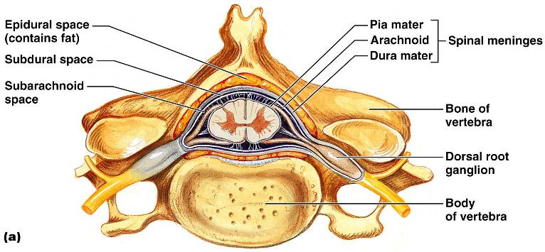
Cross-Sectional Anatomy of the Spinal Cord
Anterior median fissure – separates anterior funiculi
Posterior median sulcus – divides posterior funiculi

Slide 6
Gray Matter and Spinal Roots
Gray matter consists of
  Soma
  unmyelinated processes
  neuroglia
Gray commissure
  connects masses of gray matter; encloses central canal
Posterior (dorsal) horns
  interneurons
Anterior (ventral) horns
  interneurons and somatic motor neurons
Lateral horns
  contain sympathetic nerve fibers

Slide 7
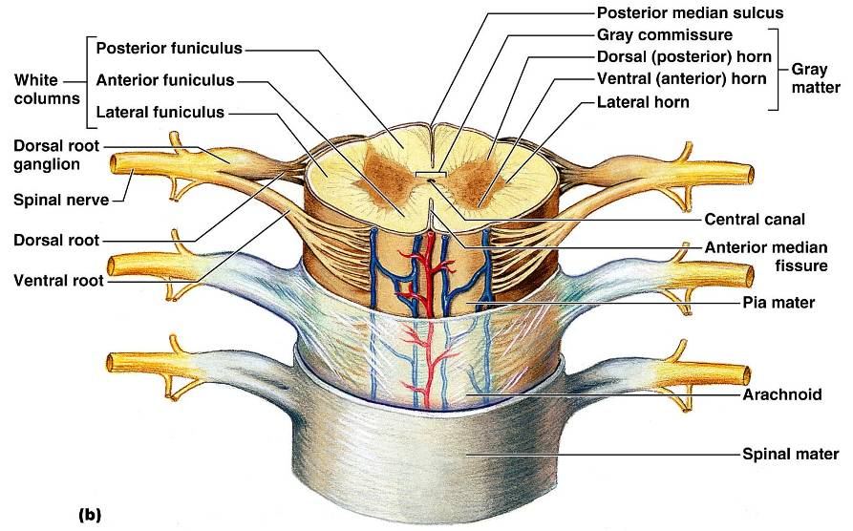
Gray Matter and Spinal Roots

Slide 8
Gray Matter: Organization
Dorsal half
  sensory roots and ganglia
Ventral half
  motor roots
Dorsal and ventral roots fuse laterally to form spinal nerves

Slide 9
White Matter in the Spinal Cord
Fibers run in three directions
  Ascending
  Descending
  Transverse
Divided into three funiculi (columns)
  posterior, lateral, and anterior
Each funiculus contains several fiber tracks
  Fiber tract names reveal their origin and destination
  Fiber tracts are composed of axons with similar functions

Slide 10
White Matter: Pathway Generalizations
Pathways decussate
Most consist of two or three neurons
Pathways are paired
  one on each side of the spinal cord or brain

Slide 11
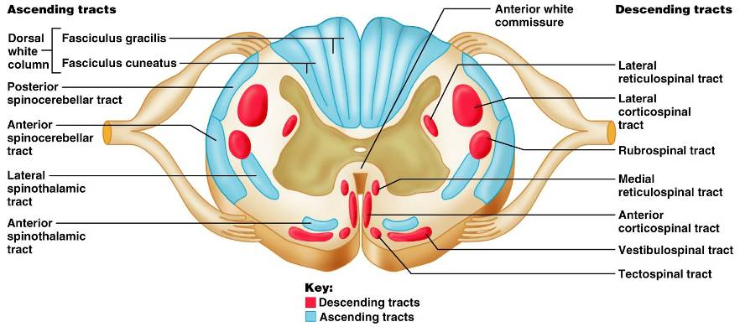
White Matter: Pathway Generalizations

Slide 12
Main Ascending Pathways
The central processes of fist-order neurons branch diffusely as they enter the spinal cord and medulla
Some branches take part in spinal cord reflexes
Others synapse with second-order neurons in the cord and medullary nuclei
Fibers from touch and pressure receptors form collateral synapses with interneurons in the dorsal horns

Slide 13
Three Ascending Pathways
The nonspecific and specific ascending pathways send impulses to the sensory cortex
  These pathways are responsible for discriminative touch and conscious proprioception
The spinocerebellar tracts send impulses to the cerebellum and do not contribute to sensory perception

Slide 14
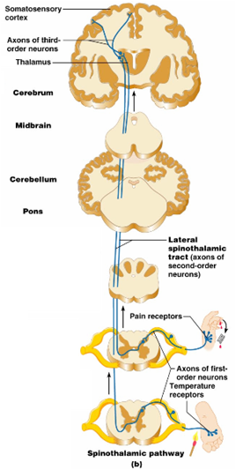
Nonspecific Ascending Pathway
Nonspecific pathway for
  Pain
  Temperature
  crude touch
within the lateral spinothalamic tract

Slide 15
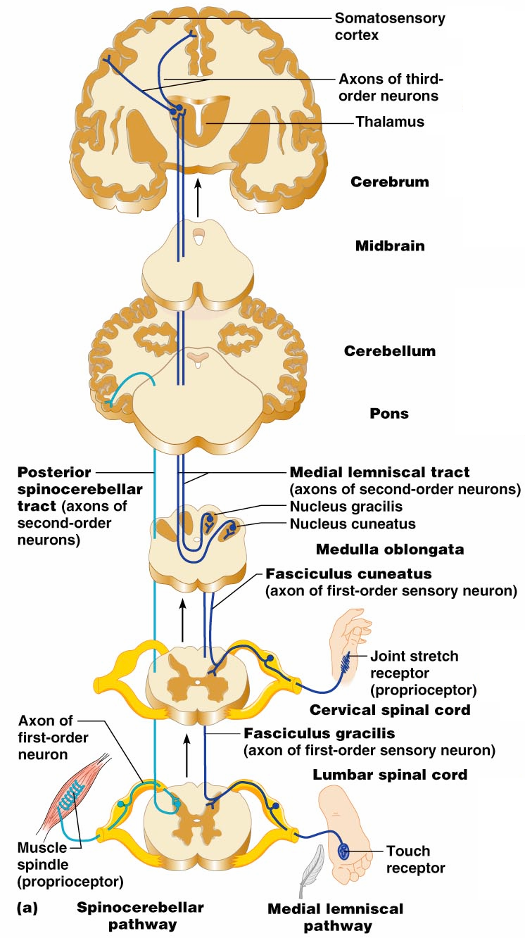
Specific and Posterior Spinocerebellar Tracts
Specific ascending pathways within the
  fasciculus gracilis
  fasciculus cuneatus tracts, and their continuation in the
  medial lemniscal tracts
The posterior spinocerebellar tract

Slide 16
Descending (Motor) Pathways
Descending tracts deliver efferent impulses from the brain to the spinal cord, and are divided into two groups
  Direct pathways equivalent to the pyramidal tracts
  Indirect pathways, essentially all others
Motor pathways involve two neurons (upper and lower)

Slide 17
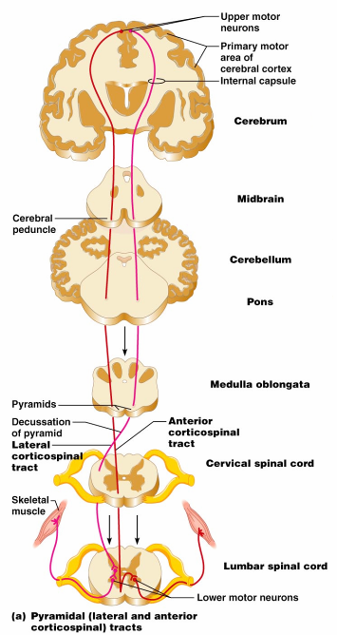
The Direct (Pyramidal) System
Direct pathways originate with the pyramidal neurons in the precentral gyri
Impulses are sent through the corticospinal tracts and synapse in the anterior horn
  Stimulation of anterior horn neurons activates skeletal muscles
The direct pathway regulates fast and fine (skilled) movements

Slide 18
Indirect (Extrapyramidal) System
Includes the
  brain stem
  motor nuclei
  motor pathways not part of the pyramidal system
This system includes the
  Rubrospinal
  Vestibulospinal
  Reticulospinal
  Tectospinal tracts

Slide 19
Indirect (Extrapyramidal) System
These motor pathways are complex and multisynaptic, and regulate:
  Axial muscles that maintain balance and posture
  Muscles controlling coarse movements of the proximal portions of limbs
  Head, neck, and eye movement

Slide 20
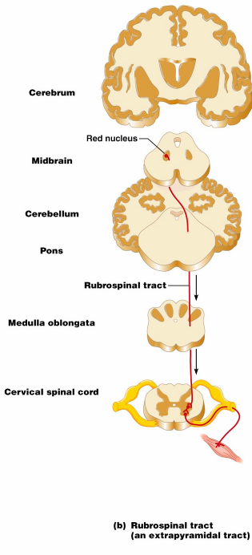
Extrapyramidal Pathways
Reticulospinal tracts
  maintain balance
Rubrospinal tracts
  control flexor muscles
Superior colliculi and tectospinal tracts
  mediate head movements

Slide 21
Spinal Cord Trauma: Paralysis
Paralysis
  loss of motor function
Flaccid paralysis
  severe damage to the ventral root or anterior horn cells
  Lower motor neurons are damaged and impulses do not reach muscles
  There is no voluntary or involuntary control of muscles

Slide 22
Spinal Cord Trauma: Paralysis
Spastic paralysis
  only upper motor neurons of the primary motor cortex are damaged
  Spinal neurons remain intact and muscles are stimulated irregularly
  There is no voluntary control of muscles

Slide 23
Spinal Cord Trauma: Transection
Cross sectioning of the spinal cord at any level results in total motor and sensory loss in regions inferior to the cut
Paraplegia
  transection between T₁ and L₁
Quadriplegia
  transection in the cervical region

Slide 24
Peripheral Nervous System (PNS)
PNS
  all neural structures outside the brain and spinal cord
Includes
  sensory receptors
  peripheral nerves
  associated ganglia
  motor endings
Provides links to and from the external environment

Slide 25
Sensory Receptors
Structures specialized to respond to stimuli
Activation of sensory receptors results in depolarizations that trigger impulses to the CNS
The realization of these stimuli, sensation and perception, occur in the brain

Slide 26
Receptor Classification by Stimulus Type
Mechanoreceptors
  respond to touch, pressure, vibration, stretch, and itch
Thermoreceptors
  sensitive to changes in temperature
Photoreceptors
  respond to light energy (e.g., retina)
Chemoreceptors
  respond to chemicals (e.g., smell, taste, changes in blood chemistry)
Nociceptors
  sensitive to pain-causing stimuli

Slide 27
Receptor Class by Location: Exteroceptors
Respond to stimuli arising outside the body
Found near the body surface
Sensitive to touch, pressure, pain, and temperature
Include the special sense organs

Slide 28
Receptor Class by Location: Interoceptors
Respond to stimuli arising within the body
Found in internal viscera and blood vessels
Sensitive to chemical changes, stretch, and temperature changes

Slide 29
Receptor Class by Location: Proprioceptors
Respond to degree of stretch of the organs they occupy
Found in skeletal muscles, tendons, joints, ligaments, and connective tissue coverings of bones and muscles
Constantly “advise” the brain of one’s movements

Slide 30
Receptor Classification by Structural Complexity
Receptors are structurally classified as either simple or complex
Most receptors are simple and include encapsulated and unencapsulated varieties
Complex receptors are special sense organs

Slide 31
Simple Receptors: Unencapsulated
Free dendritic nerve endings
  Respond chiefly to temperature and pain
Merkel (tactile) discs
Hair follicle receptors

Slide 32
Simple Receptors: Encapsulated
Meissner’s corpuscles
  tactile corpuscles
Pacinian corpuscles
  lamellated corpuscles
Muscle spindles, Golgi tendon organs, and Ruffini’s corpuscles
Joint kinesthetic receptors

Slide 33
From Sensation to Perception
Survival depends upon sensation and perception
Sensation
  the awareness of changes in the internal and external environment
Perception
  the conscious interpretation of those stimuli

Slide 34
Organization of the Somatosensory System
Input comes from exteroceptors, proprioceptors, and interoceptors
The three main levels of neural integration in the somatosensory system are:
  Receptor level
    the sensor receptors
  Circuit level
    ascending pathways
  Perceptual level
    neuronal circuits in the cerebral cortex

Slide 35
Adaptation of Sensory Receptors
Adaptation occurs when sensory receptors are subjected to an unchanging stimulus
  Receptor membranes become less responsive
  Receptor potentials decline in frequency or stop

Slide 36
Adaptation of Sensory Receptors
Receptors responding to pressure, touch, and smell adapt quickly
Receptors responding slowly include Merkel’s discs, Ruffini’s corpuscles, and interoceptors that respond to chemical levels in the blood
Pain receptors and proprioceptors do not exhibit adaptation

Slide 37
Processing at the Circuit Level
Chains of three neurons conduct sensory impulses upward to the brain
First-order neurons
  soma reside in dorsal root or cranial ganglia, and conduct impulses from the skin to the spinal cord or brain stem
Second-order neurons
  soma reside in the dorsal horn of the spinal cord or medullary nuclei and transmit impulses to the thalamus or cerebellum
Third-order neurons
  located in the thalamus and conduct impulses to the somatosensory cortex of the cerebrum

Slide 38
Main Aspects of Sensory Perception
Perceptual detection
  detecting that a stimulus has occurred and requires summation
Magnitude estimation
  how much of a stimulus is acting
Spatial discrimination
  identifying the site or pattern of the stimulus

Slide 39
Main Aspects of Sensory Perception
Feature abstraction
  used to identify a substance that has specific texture or shape
Quality discrimination
  the ability to identify submodalities of a sensation (e.g., sweet or sour tastes)
Pattern recognition
  ability to recognize patterns in stimuli (e.g., melody, familiar face)

Slide 40
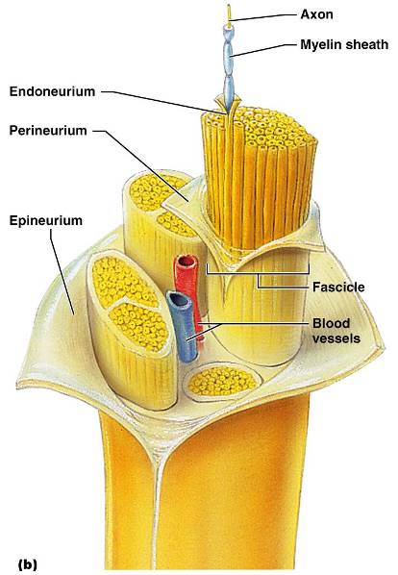
Structure of a Nerve
Nerve
  cordlike organ of the PNS consisting of peripheral axons enclosed by connective tissue
Connective tissue coverings include:
  Endoneurium
    loose connective tissue that surrounds axons
  Perineurium
    coarse connective tissue that bundles fibers into fascicles
  Epineurium
    tough fibrous sheath around a nerve

Slide 41
Classification of Nerves
Sensory and motor divisions
Sensory (afferent)
  carry impulse to the CNS
Motor (efferent)
  carry impulses from CNS
Mixed
  sensory and motor fibers carry impulses to and from CNS; most common type of nerve

Slide 42
Peripheral Nerves
Mixed nerves
  carry somatic and autonomic (visceral) impulses
The four types of mixed nerves are:
  Somatic afferent and somatic efferent
  Visceral afferent and visceral efferent
Peripheral nerves originate from the brain or spinal column

Slide 43
Regeneration of Nerve Fibers
Damage to nerve tissue is serious because mature neurons are amitotic
If the soma of a damaged nerve remains intact, damage can be repaired
Regeneration involves coordinated activity among:
  Macrophages – remove debris
  Schwann cells – form regeneration tube and secrete growth factors
  Axons – regenerate damaged part

Slide 44
Cranial Nerves
Twelve pairs of cranial nerves arise from the brain
They have sensory, motor, or both sensory and motor functions
Each nerve is identified by a number (I through XII) and a name
Four cranial nerves carry parasympathetic fibers that serve muscles and glands

Slide 45
Cranial Nerve I: Olfactory
Arises from the olfactory epithelium
Passes through the cribriform plate of the ethmoid bone
Fibers run through the olfactory bulb and terminate in the primary olfactory cortex
Functions solely by carrying afferent impulses for the sense of smell

Slide 46
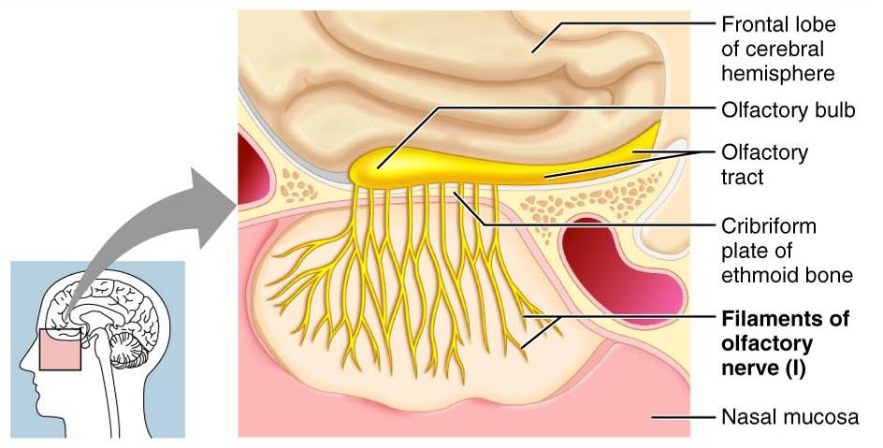
Cranial Nerve I: Olfactory

Slide 47
Cranial Nerve II: Optic
Arises from the retina of the eye
Optic nerves pass through the optic canals and converge at the optic chiasm
They continue to the thalamus where they synapse
From there, the optic radiation fibers run to the visual cortex
Functions solely by carrying afferent impulses for vision

Slide 48
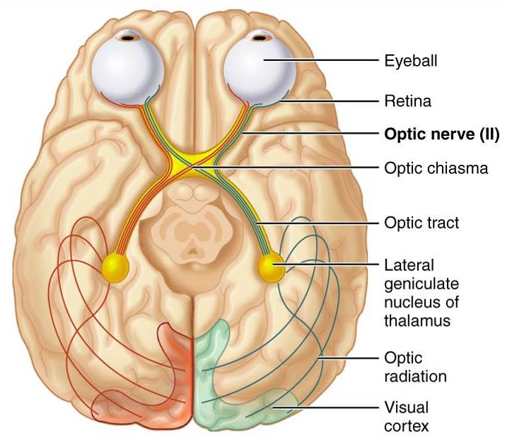
Cranial Nerve II: Optic

Slide 49
Cranial Nerve III: Oculomotor
Fibers extend from the ventral midbrain, pass through the superior orbital fissure, and go to the extrinsic eye muscles
Functions in raising the eyelid, directing the eyeball, constricting the iris, and controlling lens shape
Parasympathetic cell bodies are in the ciliary ganglia

Slide 50
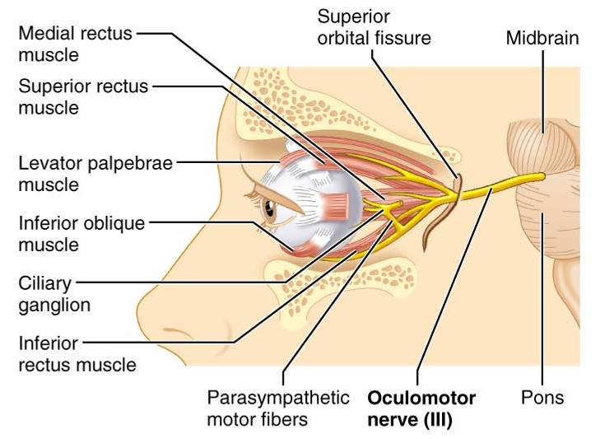
Cranial Nerve III: Oculomotor

Slide 51
Cranial Nerve IV: Trochlear
Fibers emerge from the dorsal midbrain and enter the orbits via the superior orbital fissures; innervate the superior oblique muscle
Primarily a motor nerve that directs the eyeball

Slide 52
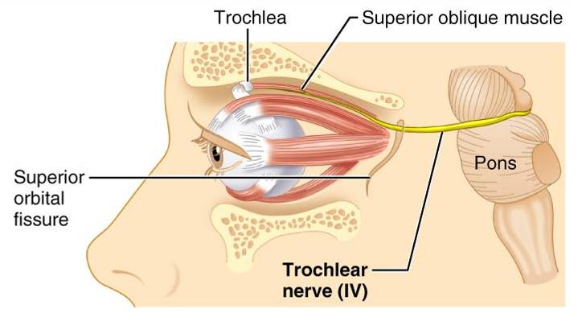
Cranial Nerve IV: Trochlear

Slide 53
Cranial Nerve V: Trigeminal
Three divisions:
  ophthalmic (V₁)
  maxillary (V₂
  mandibular (V₃)
Conveys sensory impulses from various areas of the face (V₁) and (V₂), and supplies motor fibers (V₃) for mastication

Slide 54
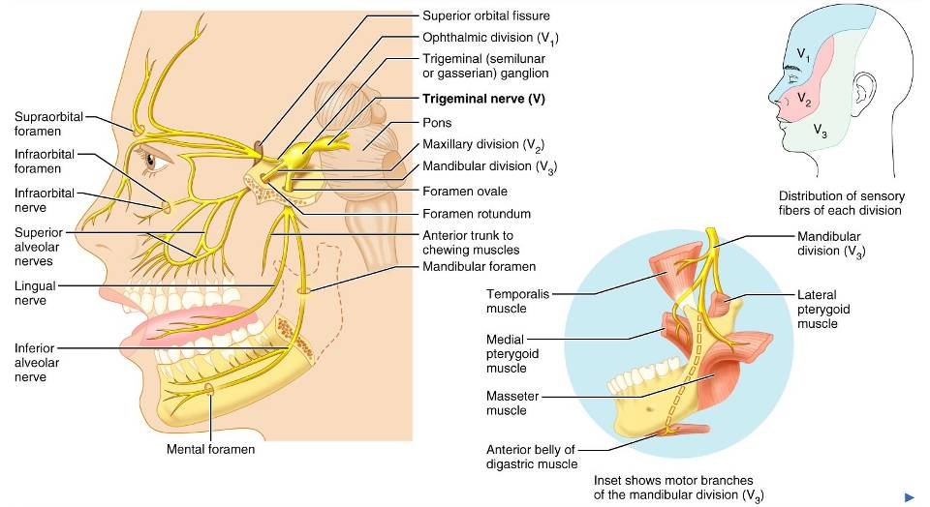
Cranial Nerve V: Trigeminal

Slide 55
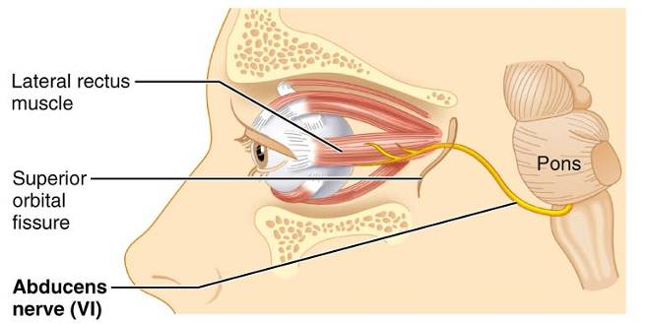
Cranial Nerve VI: Abdcuens
Fibers leave the inferior pons and enter the orbit via the superior orbital fissure
Primarily a motor nerve innervating the lateral rectus muscle

Slide 56
Cranial Nerve VII: Facial
Fibers leave the pons, travel through the internal acoustic meatus, and emerge through the stylomastoid foramen to the lateral aspect of the face
Mixed nerve with five major branches
Motor functions include facial expression, and the transmittal of autonomic impulses to lacrimal and salivary glands
Sensory function is taste from the anterior two-thirds of the tongue

Slide 57
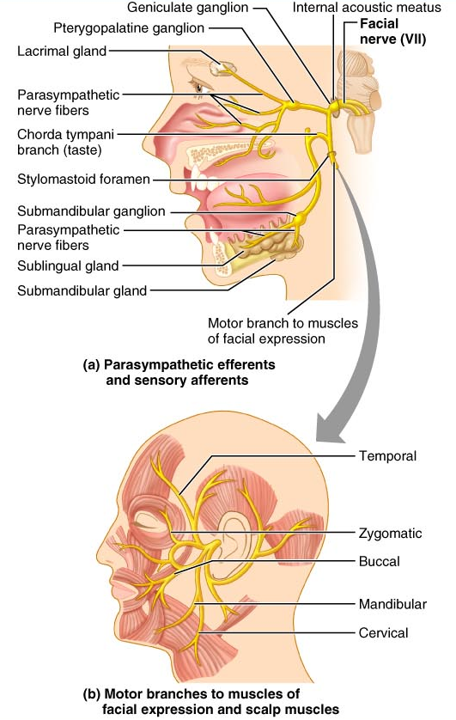
Cranial Nerve VII: Facial

Slide 58
Cranial Nerve VIII: Vestibulocochlear
Fibers arise from the hearing and equilibrium apparatus of the inner ear, pass through the internal acoustic meatus, and enter the brainstem at the pons-medulla border
Two divisions
  cochlear (hearing) and vestibular (balance)
Functions are solely sensory
  equilibrium and hearing

Slide 59
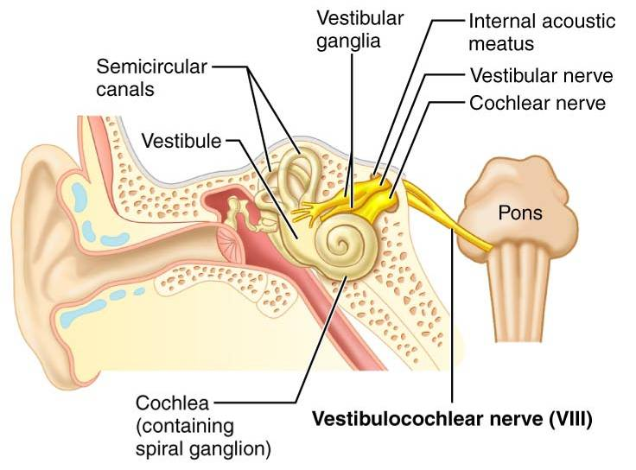
Cranial Nerve VIII: Vestibulocochlear

Slide 60
Cranial Nerve IX: Glossopharyngeal
Fibers emerge from the medulla, leave the skull via the jugular foramen, and run to the throat
Nerve IX is a mixed nerve with motor and sensory functions
Motor
  innervates part of the tongue and pharynx, and provides motor fibers to the parotid salivary gland
Sensory
  fibers conduct taste and general sensory impulses from the tongue and pharynx

Slide 61
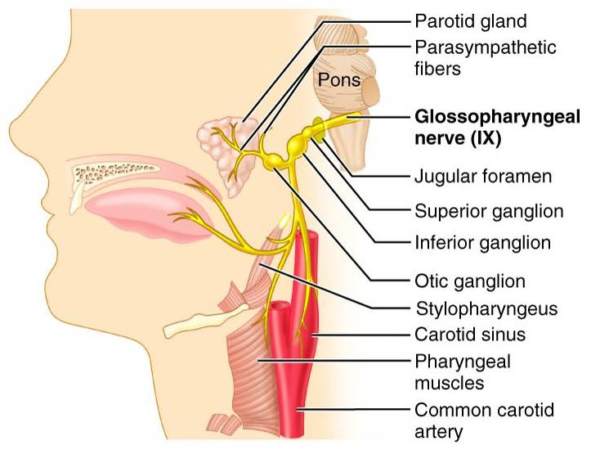
Cranial Nerve IX: Glossopharyngeal

Slide 62
Cranial Nerve X: Vagus
The only cranial nerve that extends beyond the head and neck
Fibers emerge from the medulla via the jugular foramen
The vagus is a mixed nerve
Most motor fibers are parasympathetic fibers to the heart, lungs, and visceral organs
Its sensory function is in taste

Slide 63
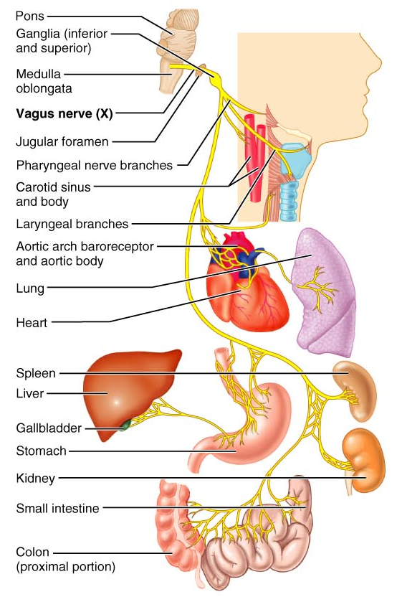
Cranial Nerve X: Vagus

Slide 64
Cranial Nerve XI: Accessory
Formed from a cranial root emerging from the medulla and a spinal root arising from the superior region of the spinal cord
The spinal root passes upward into the cranium via the foramen magnum
The accessory nerve leaves the cranium via the jugular foramen

Slide 65
Cranial Nerve XI: Accessory
Primarily a motor nerve
  Supplies fibers to the larynx, pharynx, and soft palate
  Innervates the trapezius and sternocleidomastoid, which move the head and neck

Slide 66
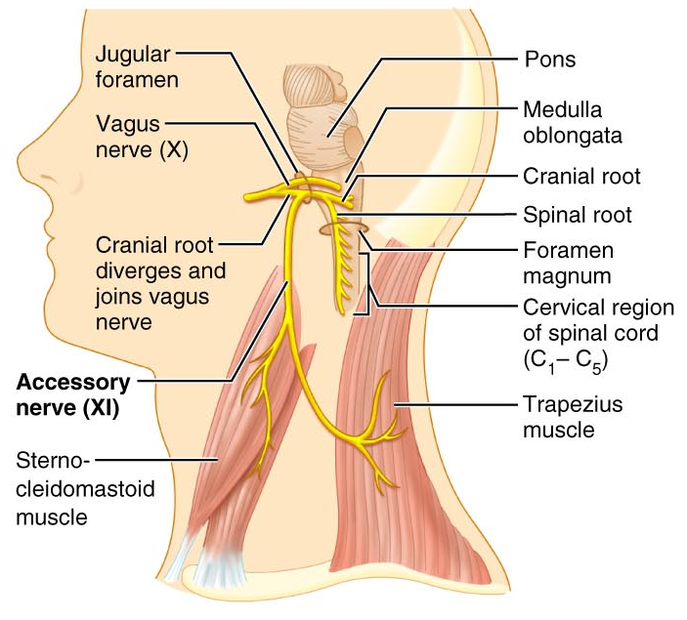
Cranial Nerve XI: Accessory

Slide 67
Cranial Nerve XII: Hypoglossal
Fibers arise from the medulla and exit the skull via the hypoglossal canal
Innervates both extrinsic and intrinsic muscles of the tongue, which contribute to swallowing and speech

Slide 68
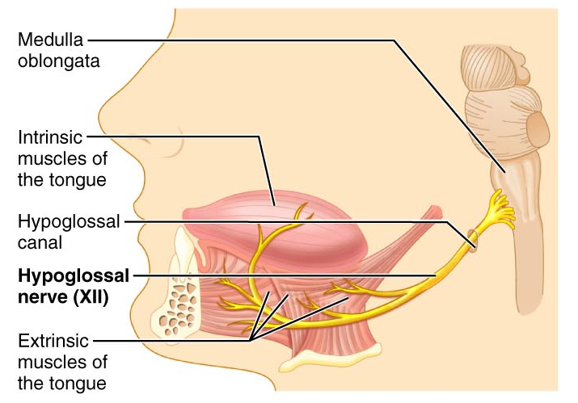
Cranial Nerve XII: Hypoglossal

Slide 69
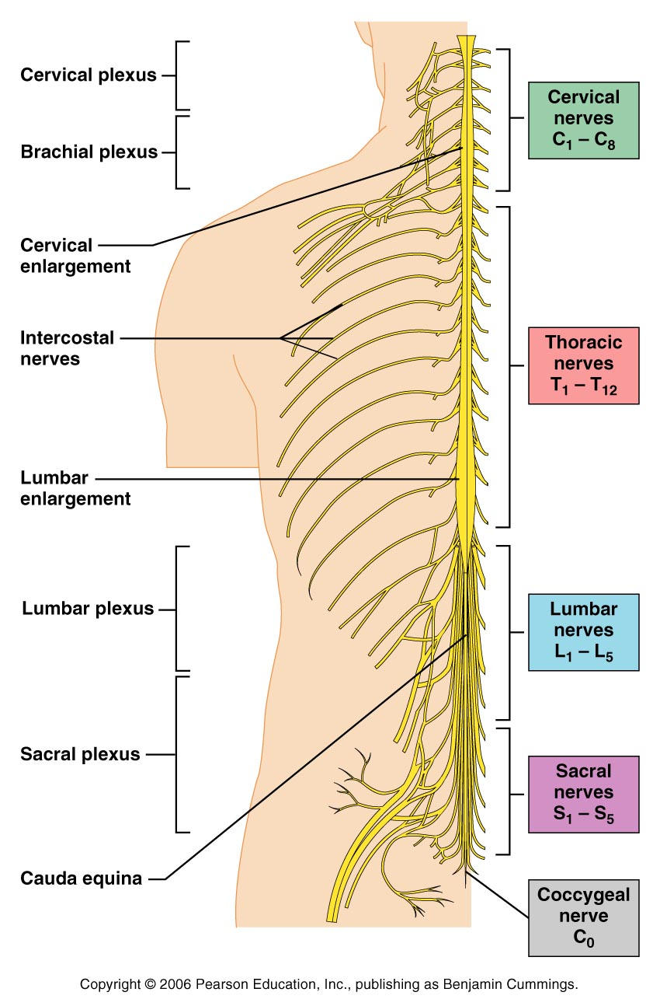
Spinal Nerves
Thirty-one pairs of mixed nerves arise from the spinal cord and supply all parts of the body except the head
They are named according to their point of issue
  8 cervical (C₁-C₈)
  12 thoracic (T₁-T₁₂)
  5 Lumbar (L₁-L₅)
  5 Sacral (S₁-S₅)
  1 Coccygeal (C₀)

Slide 70

Typical Spinal Nerve
Please note that due to differing operating systems, some animations will not appear until the presentation is viewed in Presentation Mode (Slide Show view). You may see blank slides in the “Normal” or “Slide Sorter” views. All animations will appear after viewing in Presentation Mode and playing each animation. Most animations will require the latest version of the Flash Player, which is available at http://get.adobe.com/flashplayer.

Slide 71
Spinal Nerves: Roots
Each spinal nerve connects to the spinal cord via two medial roots
Each root forms a series of rootlets that attach to the spinal cord
Ventral roots arise from the anterior horn and contain motor (efferent) fibers
Dorsal roots arise from sensory neurons in the dorsal root ganglion and contain sensory (afferent) fibers

Slide 72
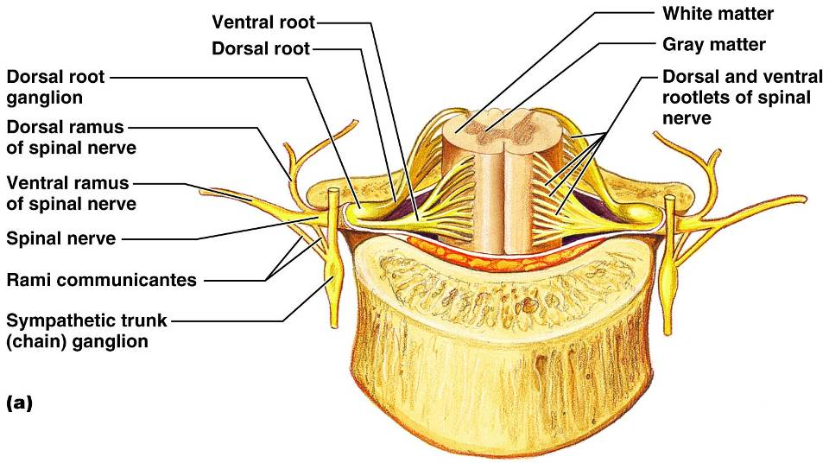
Spinal Nerves: Roots

Slide 73
Spinal Nerves: Rami
The short spinal nerves branch into three or four mixed, distal rami
  Small dorsal ramus
  Larger ventral ramus
  Tiny meningeal branch
  Rami communicantes at the base of the ventral rami in the thoracic region

Slide 74
Nerve Plexuses
All ventral rami except T₂-T₁₂ form interlacing nerve networks called plexuses
Plexuses are found in the cervical, brachial, lumbar, and sacral regions
Each resulting branch of a plexus contains fibers from several spinal nerves

Slide 75
Nerve Plexuses
Fibers travel to the periphery via several different routes
Each muscle receives a nerve supply from more than one spinal nerve
Damage to one spinal segment cannot completely paralyze a muscle

Slide 76
Spinal Nerve Innervation:
The back is innervated by dorsal rami via several branches
The thorax is innervated by ventral rami T₁-T₁₂ as intercostal nerves
Intercostal nerves supply muscles of the ribs, anterolateral thorax, and abdominal wall

Slide 77
Cervical Plexus
The cervical plexus is formed by ventral rami of
C₁-C₄
Most branches are cutaneous nerves of the neck, ear, back of head, and shoulders
The most important nerve of this plexus is the phrenic nerve
The phrenic nerve is the major motor and sensory nerve of the diaphragm

Slide 78
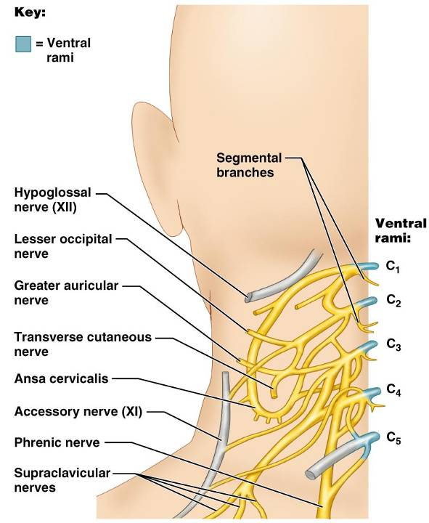
Cervical Plexus

Slide 79
Brachial Plexus
Formed by C₅-C₈ and T₁ (C₄ and T₂ may also contribute to this plexus)
It gives rise to the nerves that innervate the upper limb

Slide 80
Brachial Plexus
There are four major branches of this plexus
  Roots – five ventral rami (C₅-T₁)
  Trunks – upper, middle, and lower, which form divisions
  Divisions – anterior and posterior serve the front and back of the limb
  Cords – lateral, medial, and posterior fiber bundles

Slide 81
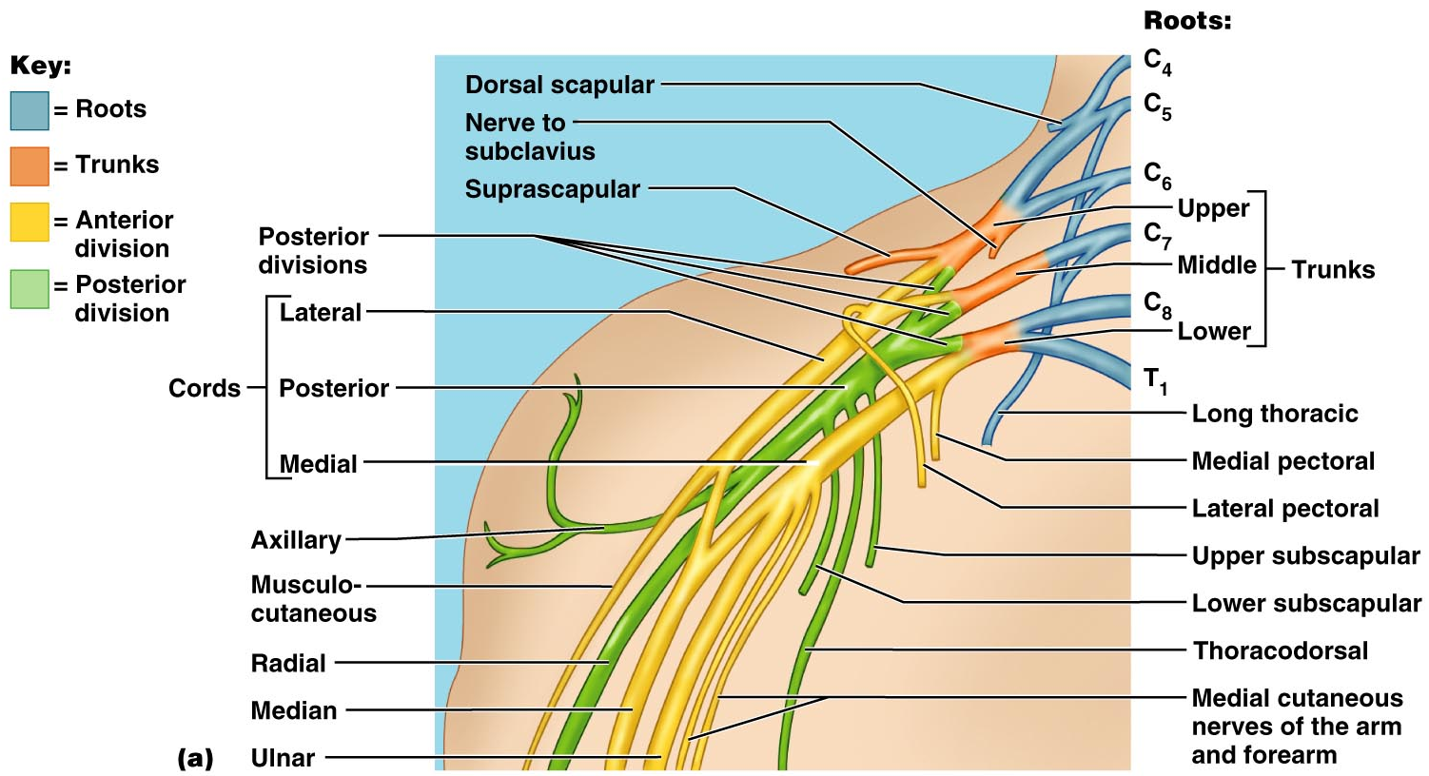
Brachial Plexus

Slide 82
Brachial Plexus: Nerves
Axillary
  innervates the deltoid and teres minor
Musculocutaneous
  sends fibers to the biceps brachii and brachialis
Median
  branches to most of the flexor muscles of arm
Ulnar
  supplies the flexor carpi ulnaris and part of the flexor digitorum profundus
Radial
  innervates essentially all extensor muscles

Slide 83
Lumbar Plexus
Arises from L₁-L₄ and innervates the thigh, abdominal wall, and psoas muscle
The major nerves are the femoral and the obturator

Slide 84
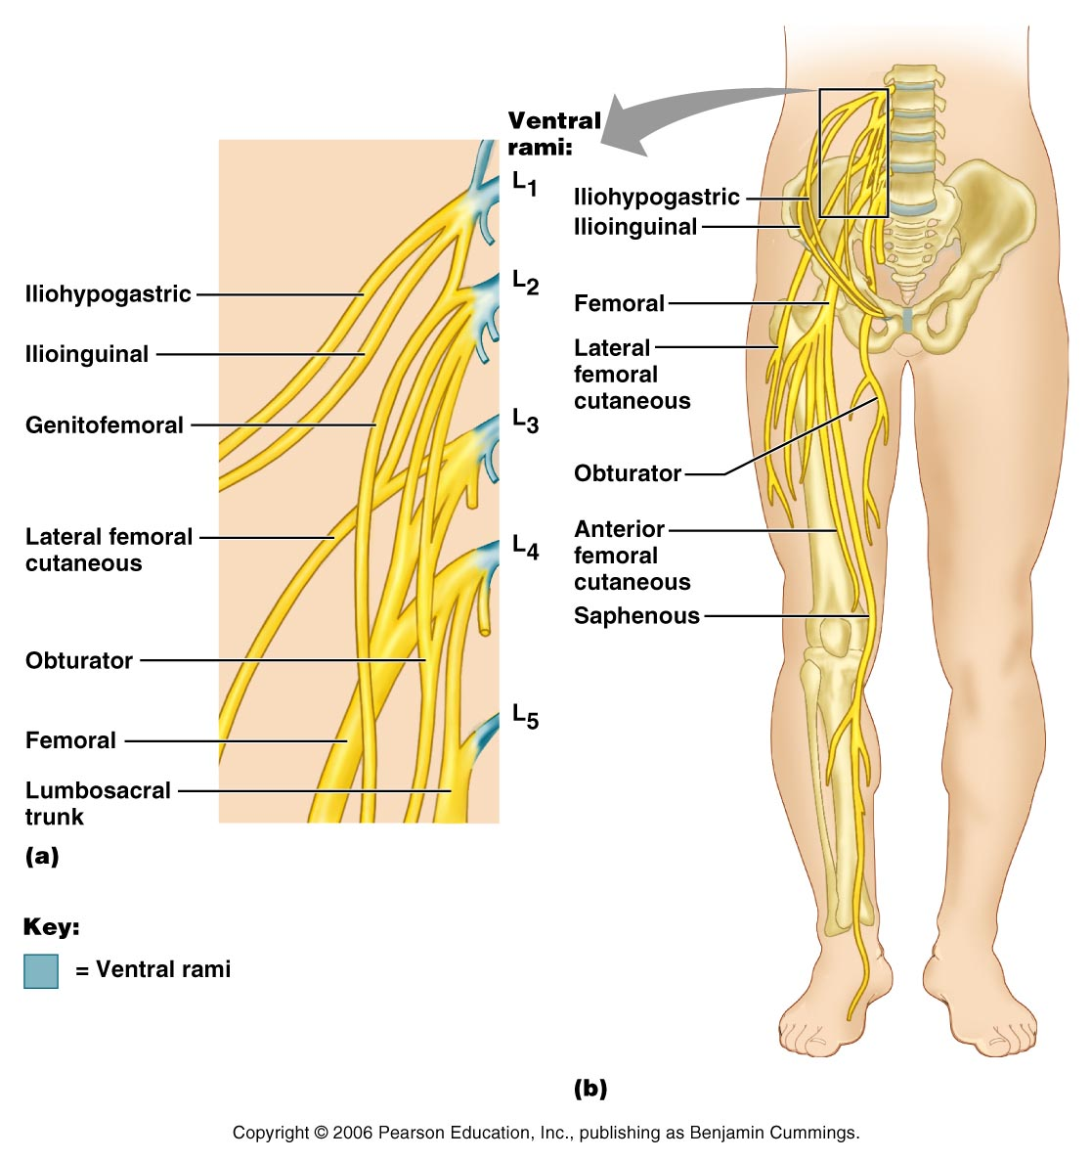
Lumbar Plexus
Figure 13.10

Slide 85
Sacral Plexus
Arises from L₄-S₄ and serves the buttock, lower limb, pelvic structures, and the perineum
The major nerve is the sciatic, the longest and thickest nerve of the body
The sciatic is actually composed of two nerves:
  tibial
  common fibular (peroneal) nerves

Slide 86
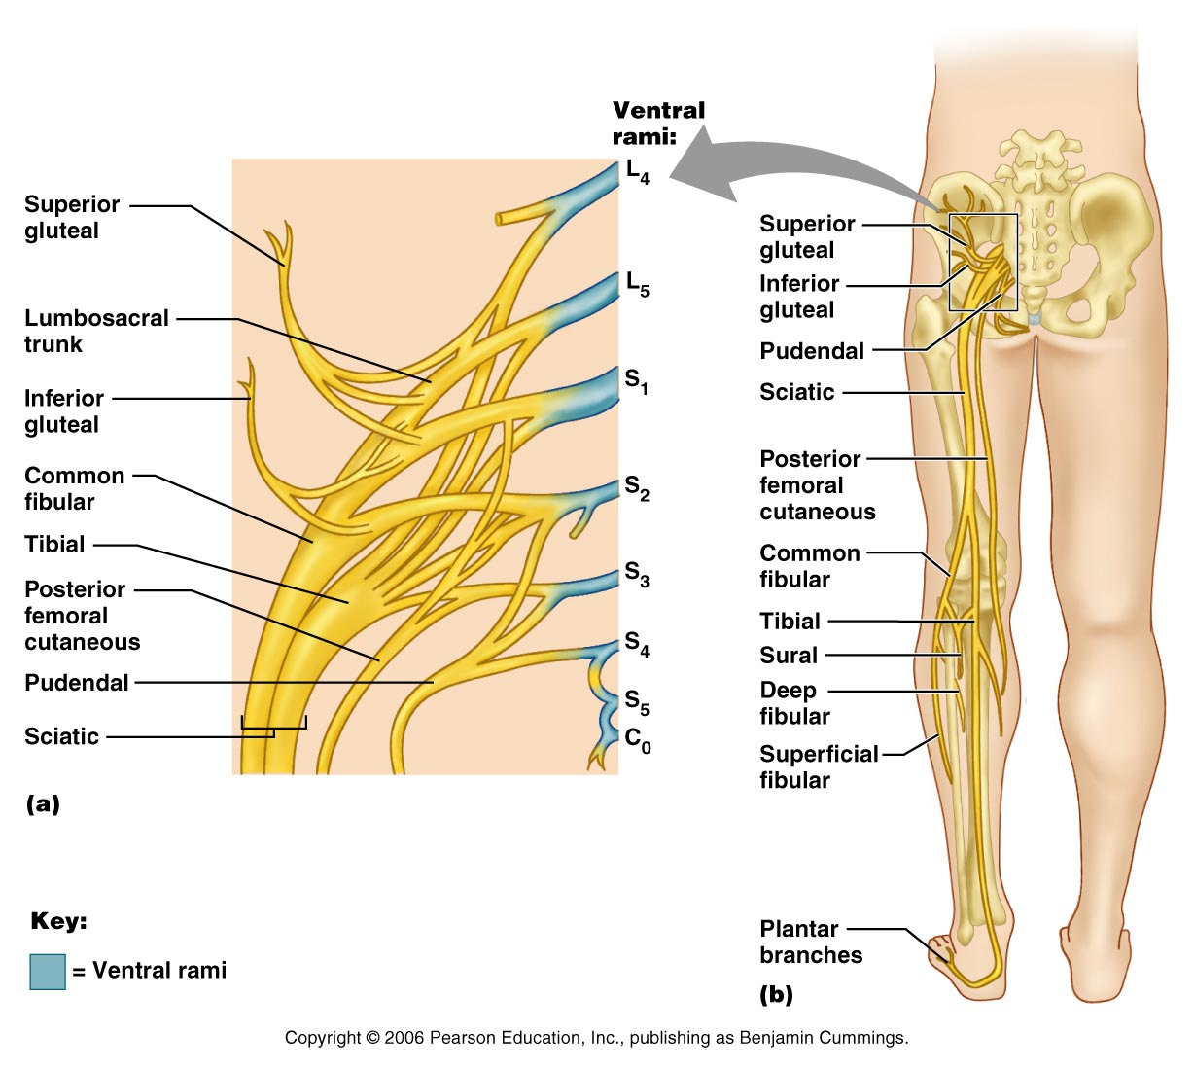
Sacral Plexus

Slide 87
Innervation of Joints
Hilton’s law: any nerve serving a muscle that produces movement at a joint also innervates the joint itself and the skin over the joint

Slide 88
Reflexes
A reflex is a rapid, predictable motor response to a stimulus
Reflexes may:
  Be inborn (intrinsic) or learned (acquired)
  Involve only peripheral nerves and the spinal cord
  Involve higher brain centers as well

Slide 89
Reflex Arc
There are five components of a reflex arc
  Receptor
    site of stimulus
  Sensory neuron
    transmits the afferent impulse to the CNS
  Integration center
    either monosynaptic or polysynaptic region within the CNS
  Motor neuron
    conducts efferent impulses from the integration center to an effector
  Effector
    muscle fiber or gland that responds to the efferent impulse

Slide 90
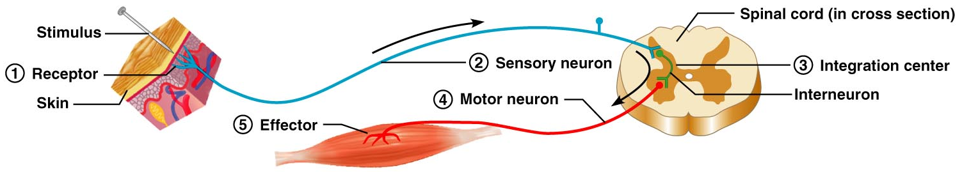
Reflex Arc
Figure 13.14

Slide 91
Reflex Arc
Please note that due to differing operating systems, some animations will not appear until the presentation is viewed in Presentation Mode (Slide Show view). You may see blank slides in the “Normal” or “Slide Sorter” views. All animations will appear after viewing in Presentation Mode and playing each animation. Most animations will require the latest version of the Flash Player, which is available at http://get.adobe.com/flashplayer.

Slide 92
Stretch and Deep Tendon Reflexes
For skeletal muscles to perform normally:
  The Golgi tendon organs (proprioceptors) must constantly inform the brain as to the state of the muscle
  Stretch reflexes initiated by muscle spindles must maintain healthy muscle tone

Slide 93
Muscle Spindles
Muscle spindles are wrapped with two types of afferent endings: primary sensory endings of type Ia fibers and secondary sensory endings of type II fibers
These regions are innervated by gamma (γ) efferent fibers
Note: contractile muscle fibers are extrafusal fibers and are innervated by alpha (α) efferent fibers

Slide 94
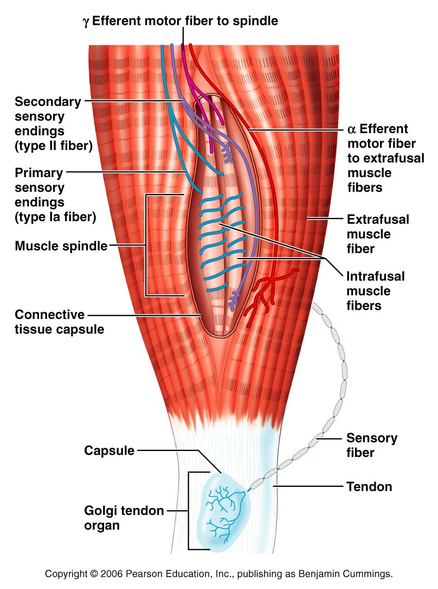
Muscle Spindles
Figure 13.15

Slide 95
Operation of the Muscle Spindles
Stretching the muscles activates the muscle spindle
  There is an increased rate of action potential in Ia fibers
Contracting the muscle reduces tension on the muscle spindle
  There is a decreased rate of action potential on Ia fibers

Slide 96
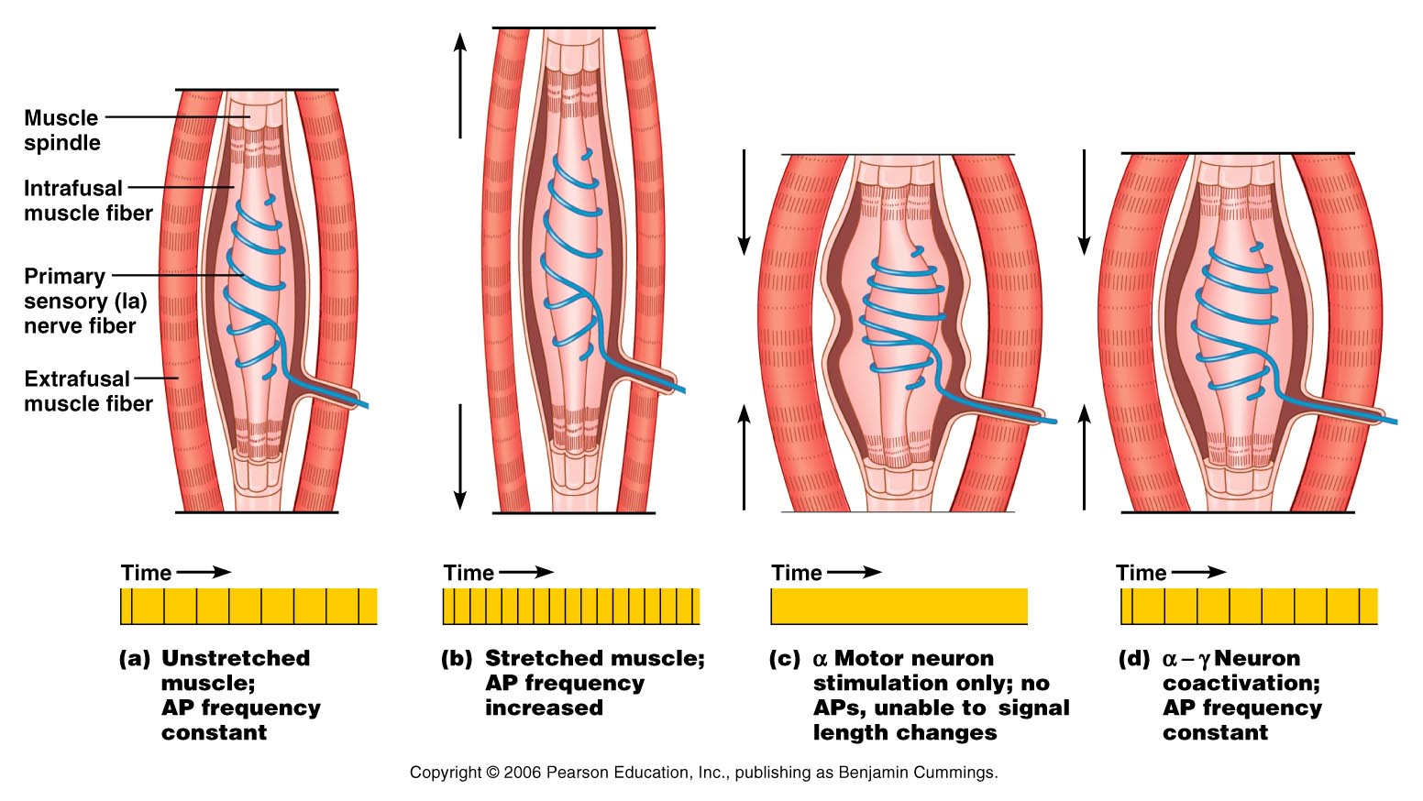
Operation of the Muscle Spindle

Slide 97
Stretch Reflex
Stretching the muscle activates the muscle spindle
Excited γ motor neurons of the spindle cause the stretched muscle to contract
Afferent impulses from the spindle result in inhibition of the antagonist
Example: patellar reflex
  Tapping the patellar tendon stretches the quadriceps and starts the reflex action
  The quadriceps contract and the antagonistic hamstrings relax

Slide 98
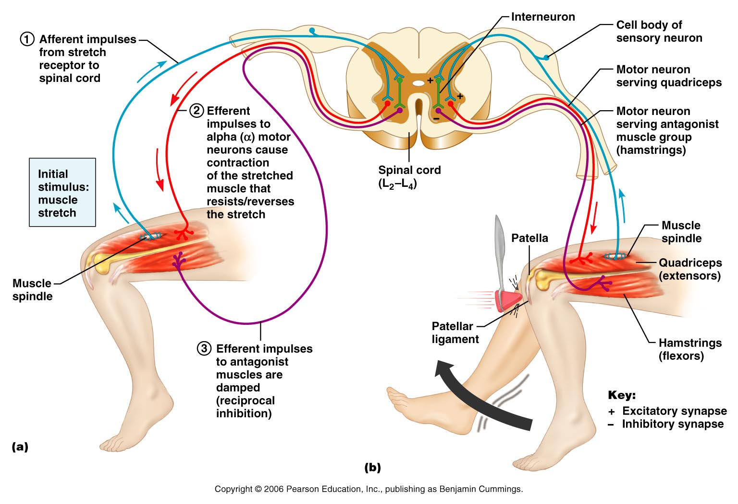
Stretch Reflex

Slide 99
Golgi Tendon Reflex
The opposite of the stretch reflex
Contracting the muscle activates the Golgi tendon organs
Afferent Golgi tendon neurons are stimulated, neurons inhibit the contracting muscle, and the antagonistic muscle is activated
As a result, the contracting muscle relaxes and the antagonist contracts

Slide 100
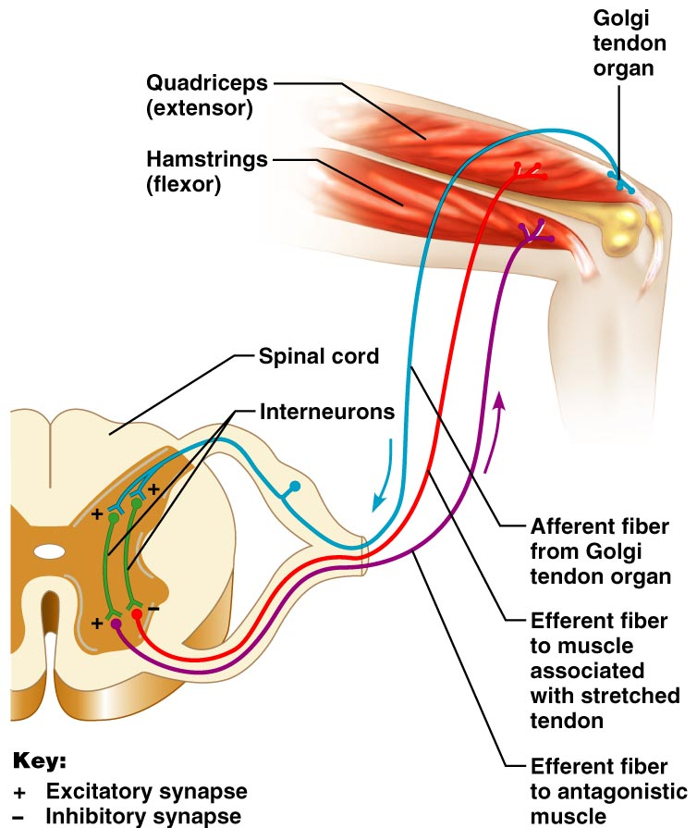
Golgi Tendon Reflex

Slide 101
Flexor and Crossed Extensor Reflexes
The flexor reflex is initiated by a painful stimulus (actual or perceived) that causes automatic withdrawal of the threatened body part
The crossed extensor reflex has two parts
  The stimulated side is withdrawn
  The contralateral side is extended

Slide 102
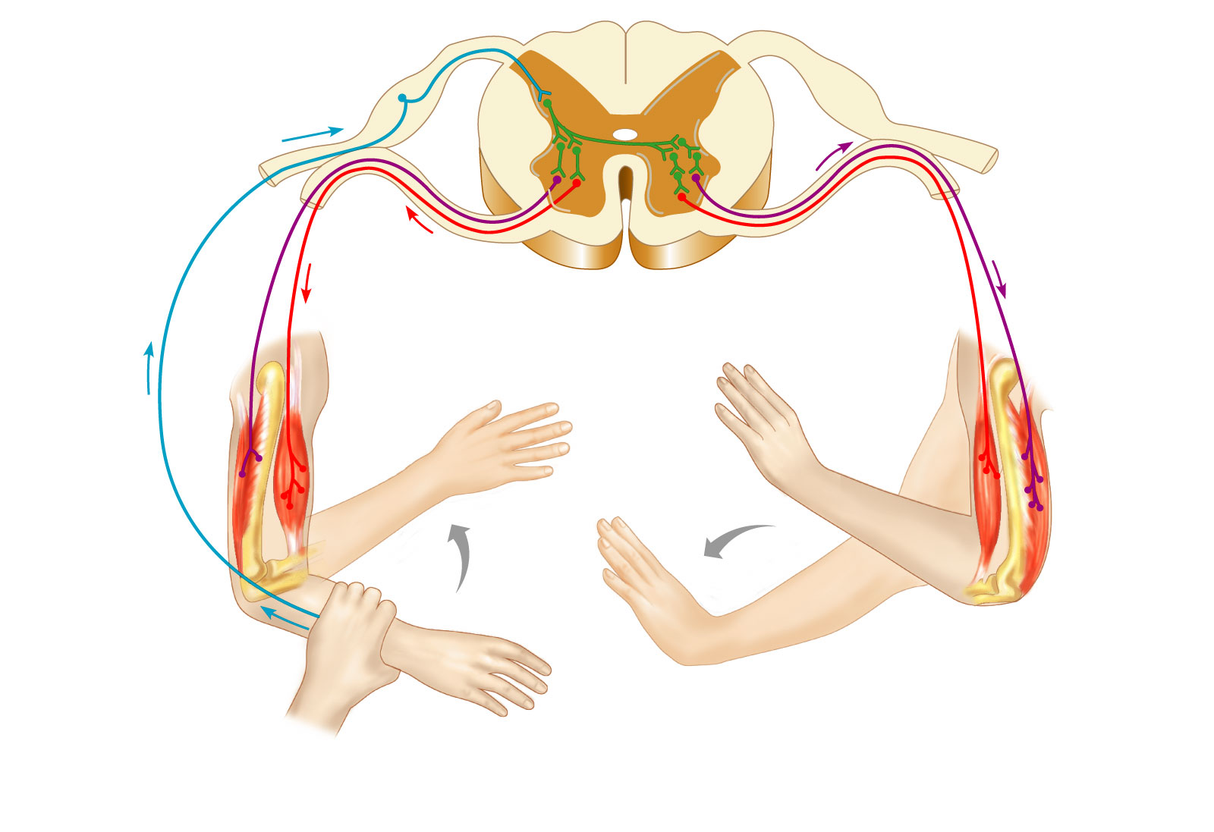
Crossed Extensor Reflex
+
Interneurons
+
–
+
+
–
Afferent
fiber
Efferent
fibers
Efferent
fibers
Extensor
inhibited
Flexor
inhibited
Flexor
stimulated
Flexes
Arm movements
Extensor
stimulated
Extends
Key:
+ Excitatory synapse
– Inhibitory synapse
Right arm
(site of stimulus)
Left arm (site of
reciprocal activation)

Slide 103
Superficial Reflexes
Initiated by gentle cutaneous stimulation
Example:
  Plantar reflex is initiated by stimulating the lateral aspect of the sole of the foot
  The response is downward flexion of the toes
  Indirectly tests for proper corticospinal tract functioning
  Babinski’s sign: abnormal plantar reflex indicating corticospinal damage where the great toe dorsiflexes and the smaller toes fan laterally

Slide 104
Autonomic Nervous System (ANS)
The ANS consists of motor neurons that:
  Innervate smooth and cardiac muscle and glands
  Make adjustments to ensure optimal support for body activities
  Operate via subconscious control
  Have viscera as most of their effectors

Slide 105
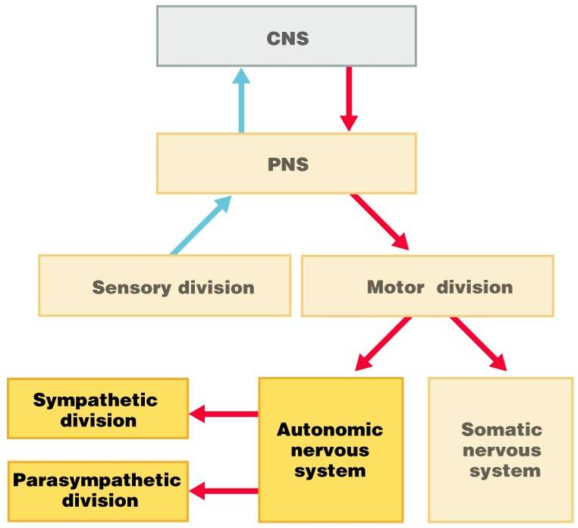

Slide 106
ANS Versus Somatic Nervous System (SNS)
The ANS differs from the SNS in the following three areas
  Effectors
  Efferent pathways
  Target organ responses

Slide 107
Effectors
The effectors of the SNS are skeletal muscles
The effectors of the ANS are cardiac muscle, smooth muscle, and glands

Slide 108
Efferent Pathways
Heavily myelinated axons of the somatic motor neurons extend from the CNS to the effector
Axons of the ANS are a two-neuron chain
  The preganglionic (first) neuron has a lightly myelinated axon
  The ganglionic (second) neuron extends to an effector organ

Slide 109
Neurotransmitter Effects
All somatic motor neurons release Acetylcholine
  which has an excitatory effect
In the ANS:
  Preganglionic fibers release ACh
  Postganglionic fibers release
    norepinephrine
    or ACh
    the effect is either stimulatory or inhibitory
  ANS effect depends on the
    neurotransmitter released
    and the receptor type of the effector

Slide 110
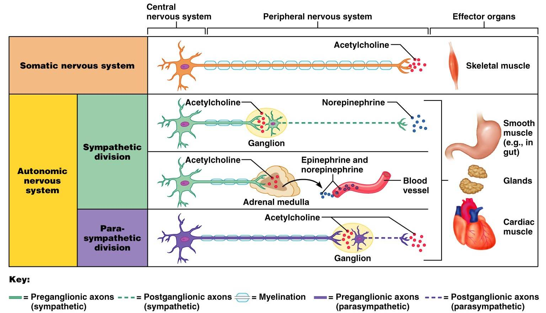
Comparison of Somatic and Autonomic Systems

Slide 111
Divisions of the ANS
ANS divisions:
  sympathetic
    mobilizes the body during extreme situations
  parasympathetic
    performs maintenance activities and conserves body energy
The two divisions provide balance

Slide 112
Role of the Parasympathetic Division
Concerned with keeping body energy use low
Involves the “D” activities
  digestion, defecation, and diuresis
Its activity is illustrated in a person who relaxes after a meal
Rest and Digest
  Blood pressure, heart rate, and respiratory rates are low
  Gastrointestinal tract activity is high
  The skin is warm and the pupils are constricted

Slide 113
Role of the Sympathetic Division
The sympathetic division is the “fight-or-flight” system
Involves “E” activities
  exercise, excitement, emergency, and embarrassment

Slide 114
Role of the Sympathetic Division
Promotes adjustments during exercise
  blood flow to organs is reduced, flow to muscles is increased
Its activity is illustrated by a person who is threatened
  Heart rate increases, and breathing is rapid and deep
  The skin is cold and sweaty, and the pupils dilate

Slide 115
Anatomy of ANS
Division | Origin of Fibers | Length of Fibers | Location of Ganglia
Sympathetic | Thoracolumbar region of the spinal cord | Short preganglionic and long postganglionic | Close to the spinal cord
Parasympathetic | Brain and sacral spinal cord | Long preganglionic and short postganglionic | In the visceral effector organs

Slide 116
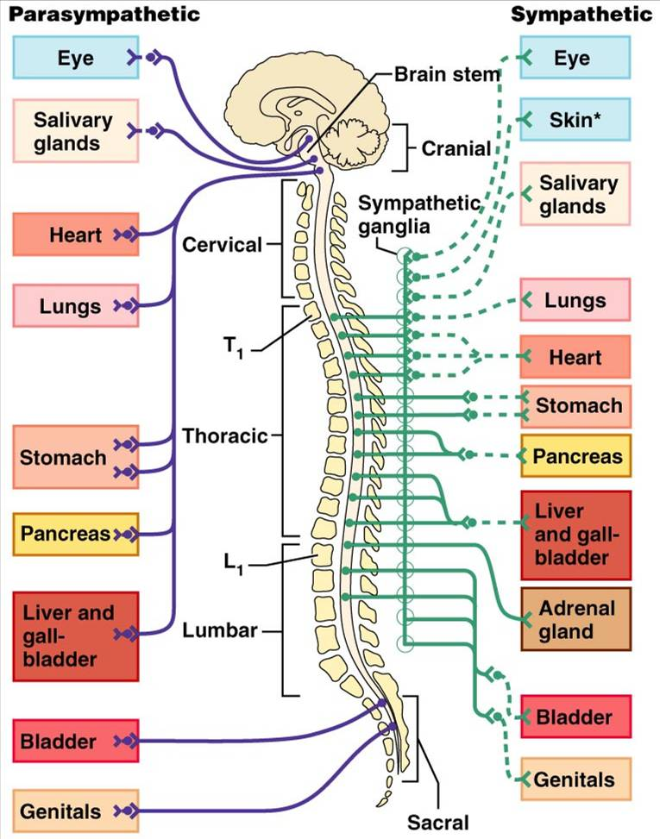

Slide 117
Parasympathetic Division Outflow
Cranial Outflow | Cranial Nerve | Ganglion | Effector Organ(s)
 | Occulomotor (III) | Ciliary | Eye
 | Facial (VII) | Pterygopalatin Submandibular | Salivary, nasal, and lacrimal glands
 | Glossopharyngeal (IX) | Otic | Parotid salivary glands
 | Vagus (X) | Located within the walls of target organs | Heart, lungs, and most visceral organs
Sacral Outflow | S₂-S₄ | Located within the walls of the target organs | Large intestine, urinary bladder, ureters, and reproductive organs

Slide 118
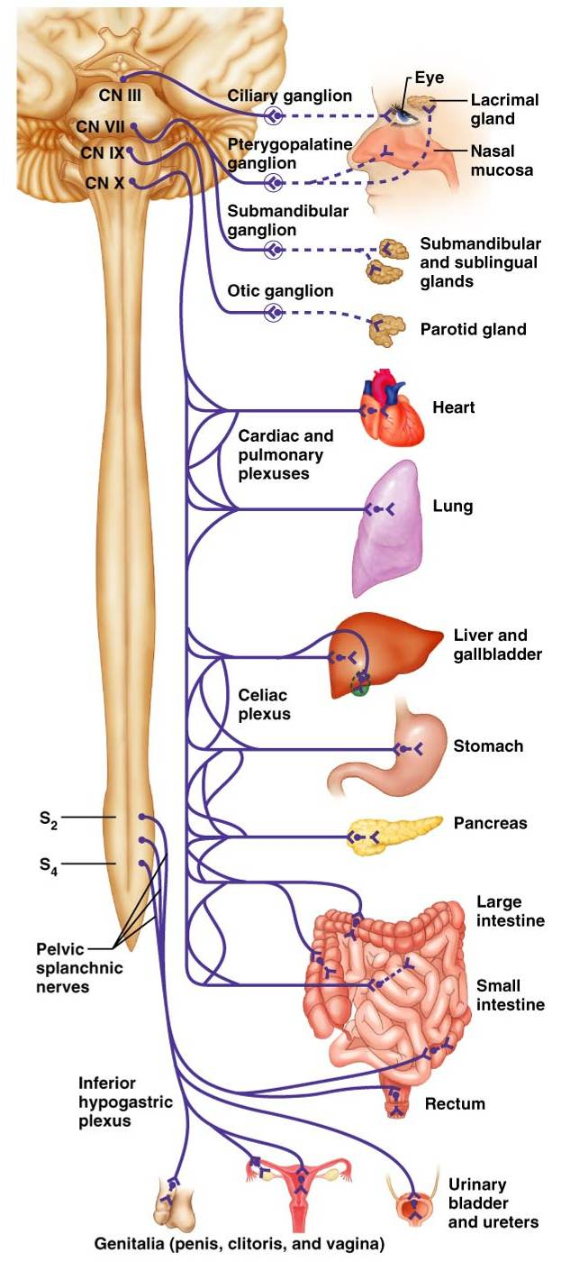
Figure 14.4

Slide 119
Sympathetic Outflow
Arises from spinal cord segments T₁ through L₂
Sympathetic neurons form the lateral horns of the spinal cord
Preganglionic fibers pass through the white rami communicantes and synapse in the chain (paravertebral) ganglia

Slide 120
Sympathetic Outflow
Fibers from T₅-L₂
  form splanchnic nerves
  synapse with collateral ganglia
Postganglionic fibers innervate the numerous organs of the body

Slide 121
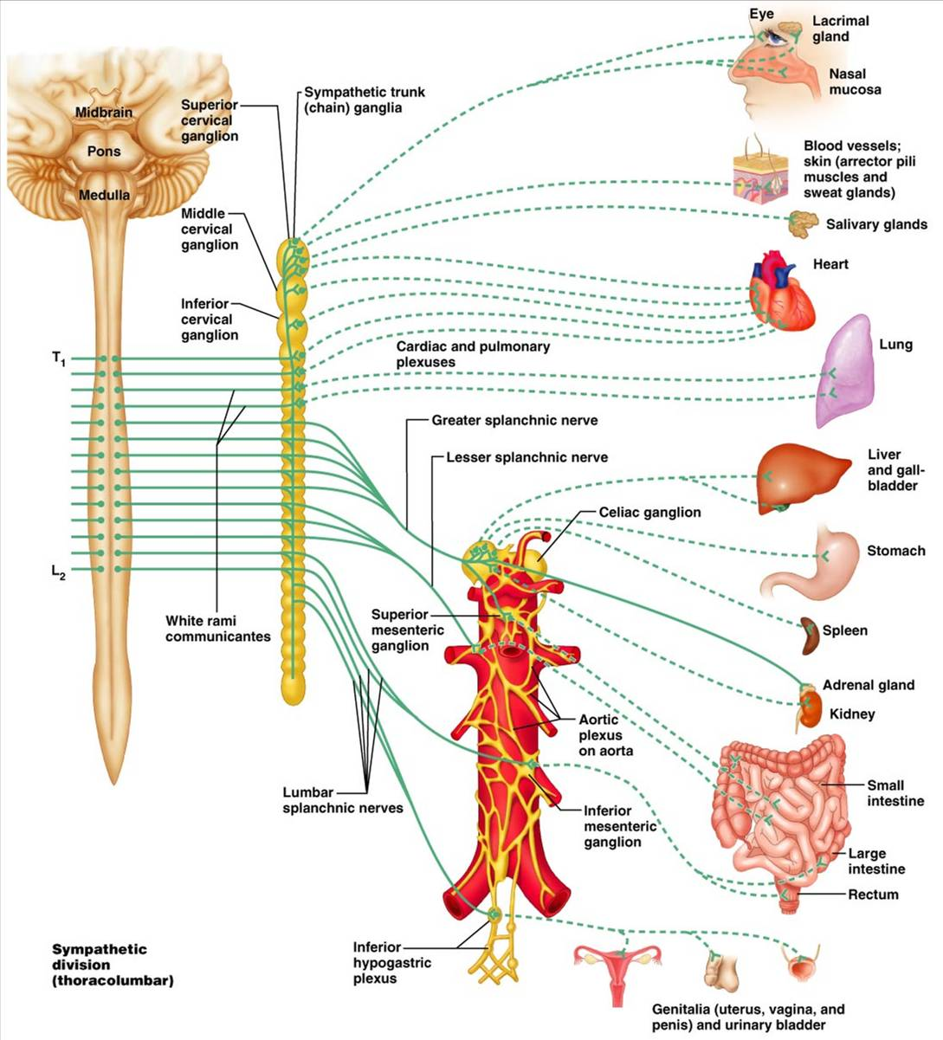

Slide 122
Sympathetic Trunks and Pathways
The paravertebral ganglia form part of the sympathetic trunk or chain
Typically there are 23 ganglia
  3 cervical
  11 thoracic
  4 lumbar
  4 sacral
  1 coccygeal

Slide 123
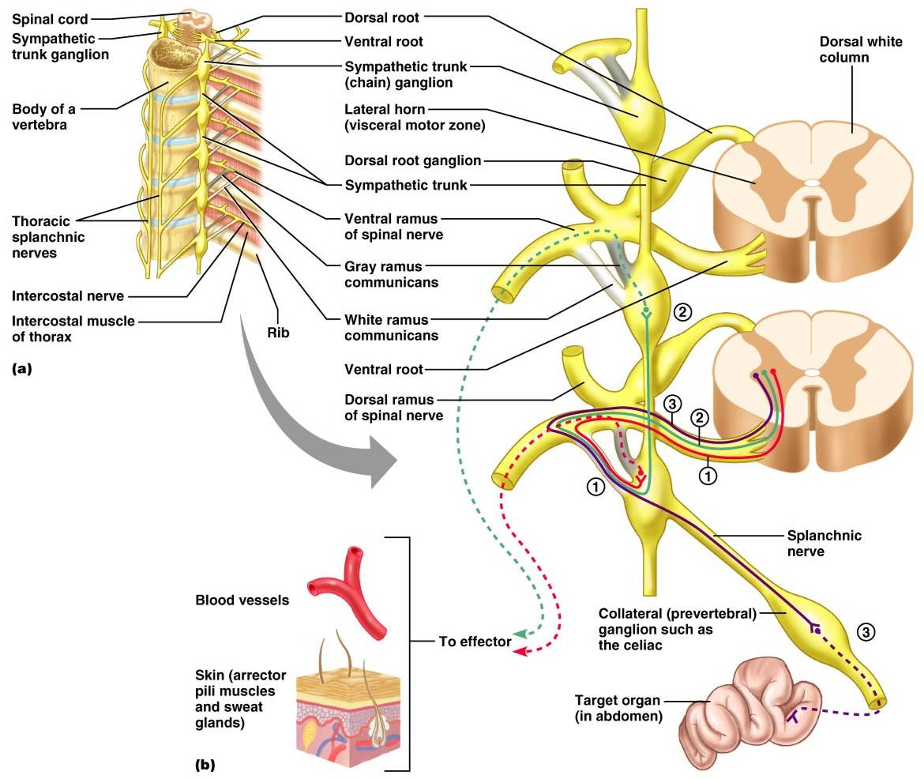
Sympathetic Trunks and Pathways

Slide 124
Sympathetic Trunks and Pathways
A preganglionic fiber follows one of three pathways upon entering the paravertebral ganglia
  Synapse with the ganglionic neuron within the same ganglion
  Ascend or descend the sympathetic chain to synapse in another chain ganglion
  Pass through the chain ganglion and emerge without synapsing

Slide 125
Pathways with Synapses in Chain Ganglia
Postganglionic axons enter the ventral rami via the gray rami communicantes
These fibers innervate sweat glands and arrector pili muscles
Rami communicantes are associated only with the sympathetic division

Slide 126
Pathways to the Head
Preganglionic fibers emerge from T₁-T₄ and synapse in the superior cervical ganglion
These fibers:
  Serve the skin and blood vessels of the head
  Stimulate dilator muscles of the iris
  Inhibit nasal and salivary glands

Slide 127
Pathways to the Thorax
Preganglionic fibers emerge from T₁-T₆ and synapse in the cervical chain ganglia
Postganglionic fibers emerge from the middle and inferior cervical ganglia and enter nerves C₄-C₈
These fibers innervate the heart via the cardiac plexus, as well as innervating the thyroid and the skin

Slide 128
Pathways to the Thorax
Other T₁-T₆ preganglionic fibers synapse in the nearest chain ganglia
Postganglionic fibers directly serve the
  Heart
  Aorta
  Lungs
  Esophagus

Slide 129
Pathways with Synapses in Collateral Ganglia
These fibers (T₅-L₂) leave the sympathetic chain without synapsing
They form thoracic, lumbar, and sacral splanchnic nerves
Their ganglia include
  the celiac
  the superior and inferior mesenterics
  the hypogastric

Slide 130
Pathways to the Abdomen
Sympathetic nerves innervating the abdomen have preganglionic fibers from T₅-L₂
They travel through the thoracic splanchnic nerves and synapse at the celiac and superior mesenteric ganglia
Postganglionic fibers serve the stomach, intestines, liver, spleen, and kidneys

Slide 131
Pathways to the Pelvis
Preganglionic fibers originate from T₁₀-L₂
Most travel via the lumbar and sacral splanchnic nerves to the inferior mesenteric and hypogastric ganglia
Postganglionic fibers serve the distal half of the large intestine, the urinary bladder, and the reproductive organs

Slide 132
Pathways with Synapses in the Adrenal Medulla
Fibers of the thoracic splanchnic nerve pass directly to the adrenal medulla
Upon stimulation, medullary cells secrete norepinephrine and epinephrine into the blood

Slide 133
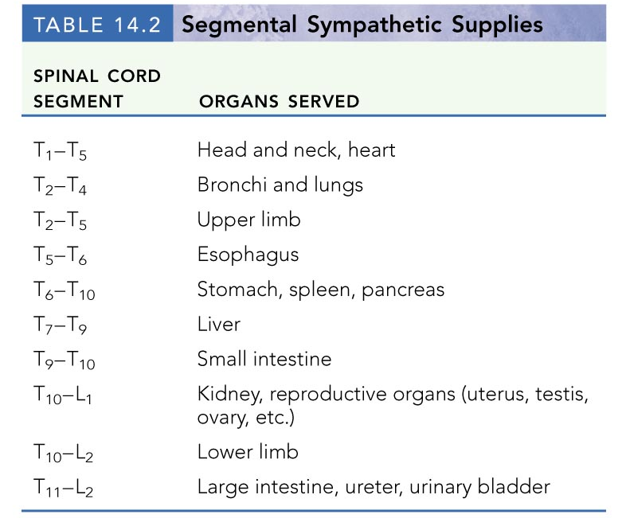

Slide 134
Visceral Reflexes
Visceral reflexes have the same elements as somatic reflexes
They are always polysynaptic pathways
Afferent fibers are found in spinal and autonomic nerves

Slide 135
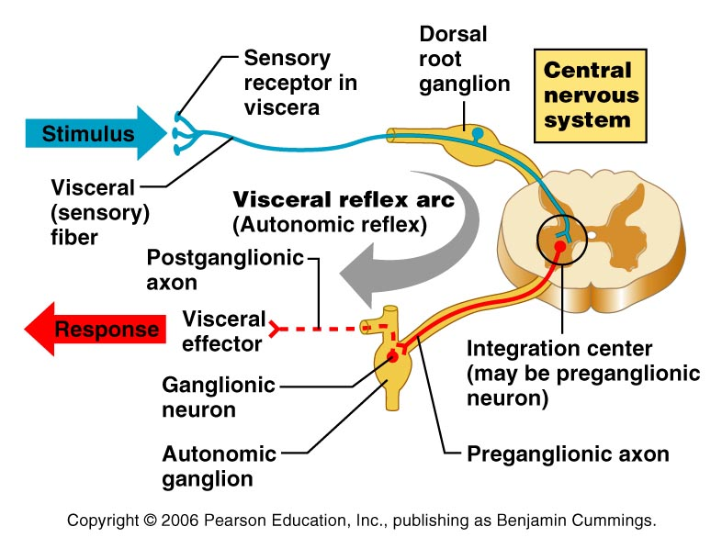

Slide 136
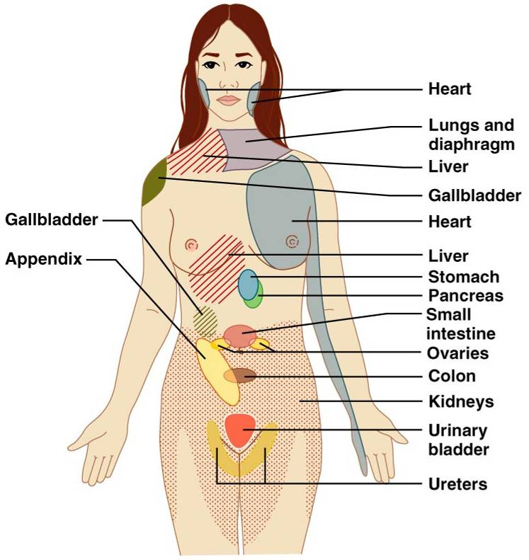
Referred Pain
Pain stimuli arising from the viscera are perceived as somatic in origin
This may be due to the fact that visceral pain afferents travel along the same pathways as somatic pain fibers

Slide 137
Neurotransmitters and Receptors
Acetylcholine (ACh) and norepinephrine (NE) are the two major neurotransmitters of the ANS
Cholinergic fibers
  ACh-releasing fibers
  ACh is released by all preganglionic axons and all parasympathetic postganglionic axons
Adrenergic fibers
  sympathetic postganglionic axons that release NE
effects (excitatory/inhibitory) depend on the receptor

Slide 138
Cholinergic Receptors
The two types of receptors that bind ACh are nicotinic and muscarinic
These are named after drugs that bind to them and mimic ACh effects

Slide 139
Nicotinic Receptors
Nicotinic receptors are found on:
  Motor end plates (somatic targets)
  All ganglionic neurons of both sympathetic and parasympathetic divisions
  The hormone-producing cells of the adrenal medulla
The effect of ACh binding to nicotinic receptors is always stimulatory

Slide 140
Muscarinic Receptors
Muscarinic receptors occur on all effector cells stimulated by postganglionic cholinergic fibers
The effect of ACh binding:
  Can be either inhibitory or excitatory
  Depends on the receptor type of the target organ

Slide 141
Adrenergic Receptors
The two types of adrenergic receptors are alpha and beta
Effects of NE binding to:
  α receptors is generally stimulatory
  β receptors is generally inhibitory
A notable exception
  NE binding to β receptors of the heart is stimulatory

Slide 142
Effects of Drugs
Atropine
  blocks parasympathetic effects
Tricyclic antidepressants
  prolong the activity of NE on postsynaptic membranes
Over-the-counter drugs for colds, allergies, and nasal congestion
  stimulate α-adrenergic receptors
Beta-blockers
  attach mainly to β₁ receptors and reduce heart rate and prevent arrhythmias

Slide 143
Interactions of the Autonomic Divisions
Most visceral organs are innervated by both sympathetic and parasympathetic fibers
Sympathetic fibers
  increase heart and respiratory rates, and inhibit digestion and elimination
Parasympathetic fibers
  decrease heart and respiratory rates, and allow for digestion and the discarding of wastes

Slide 144
Sympathetic Tone
The sympathetic division controls blood pressure and keeps the blood vessels in a continual state of partial constriction
This sympathetic tone (vasomotor tone):
  Constricts blood vessels and causes blood pressure to rise as needed
  Prompts vessels to dilate if blood pressure is to be decreased

Slide 145
Parasympathetic Tone
Parasympathetic tone:
  Slows the heart
  Dictates normal activity levels of the digestive and urinary systems
The sympathetic division can override these effects during times of stress
Drugs that block parasympathetic responses increase heart rate and block fecal and urinary retention

Slide 146
Cooperative Effects
ANS cooperation is best seen in control of the external genitalia
Parasympathetic fibers cause vasodilation and are responsible for erection of the penis and clitoris
Sympathetic fibers cause ejaculation of semen in males and reflex peristalsis in females

Slide 147
Unique Roles of the Sympathetic Division
Regulates many functions not subject to parasympathetic influence
These include the activity of the
  adrenal medulla
  sweat glands
  arrector pili muscles
  Kidneys
  most blood vessels

Slide 148
Unique Roles of the Sympathetic Division
The sympathetic division controls:
  Thermoregulatory responses to heat
  Release of renin from the kidneys
  Metabolic effects

Slide 149
Thermoregulatory Responses to Heat
Applying heat to the skin causes reflex dilation of blood vessels
Systemic body temperature elevation results in widespread dilation of blood vessels
This dilation brings warm blood to the surface
  activates sweat glands to cool the body
When temperature falls, blood vessels constrict and blood is retained in deeper vital organs

Slide 150
Release of Renin from the Kidneys
Sympathetic impulses activate the kidneys to release renin
Renin is an enzyme that promotes increased blood pressure

Slide 151
Metabolic Effects
The sympathetic division promotes metabolic effects that are not reversed by the parasympathetic division
  Increases the metabolic rate of body cells
  Raises blood glucose levels
  Mobilizes fat as a food source
  Stimulates the reticular activating system (RAS) of the brain, increasing mental alertness

Slide 152
Localized Versus Diffuse Effects
The parasympathetic division exerts short-lived, highly localized control
The sympathetic division exerts long-lasting, diffuse effects

Slide 153
Effects of Sympathetic Activation
Sympathetic activation is long-lasting because NE:
  Is inactivated more slowly than ACh
  Is an indirectly acting neurotransmitter, using a second-messenger system
  And epinephrine are released into the blood and remain there until destroyed by the liver

Slide 154
Levels of ANS Control
The hypothalamus is the main integration center of ANS activity
Subconscious cerebral input via limbic lobe connections influences hypothalamic function
Other controls come from the cerebral cortex, the reticular formation, and the spinal cord

Slide 155
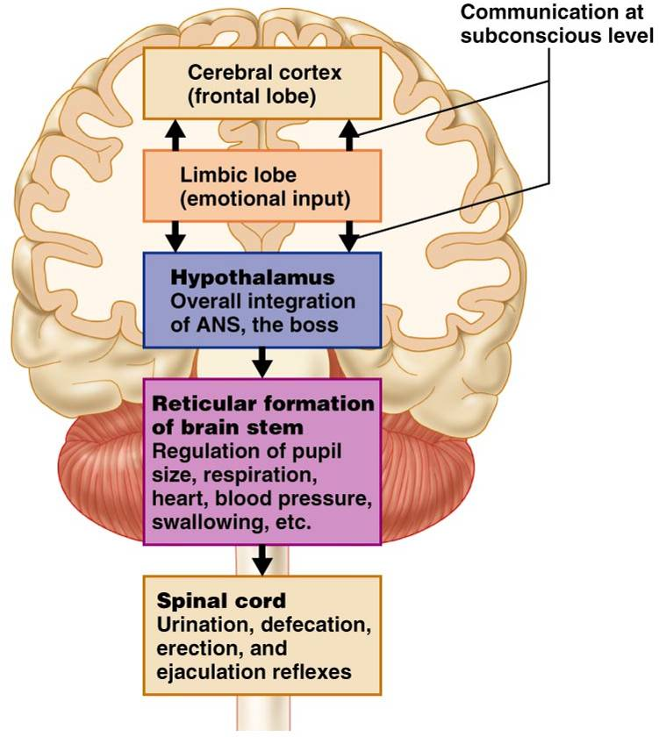
Levels of ANS Control

Slide 156
Hypothalamic Control
Centers of the hypothalamus control:
  Heart activity and blood pressure
  Body temperature, water balance, and endocrine activity
  Emotional stages (rage, pleasure) and biological drives (hunger, thirst, sex)
  Reactions to fear and the “fight-or-flight” system

