Slide 1
Chapter 15
Exam Six Material

Slide 2
Eye and Associated Structures
70% of all sensory receptors are in the eye
Most of the eye is protected by a cushion of fat and the bony orbit
Accessory structures include
eyebrows,
eyelids,
conjunctiva,
lacrimal apparatus
extrinsic eye muscles

Slide 3
Eyebrows
Coarse hairs that overlie the supraorbital margins
Functions include:
Shading the eye
Preventing perspiration from reaching the eye
Orbicularis muscle
depresses the eyebrows
Corrugator muscles
move the eyebrows medially

Slide 4
Palpebrae (Eyelids)
Protect the eye anteriorly
Palpebral fissure
separates eyelids
Canthi
medial and lateral angles

Slide 5
Palpebrae (Eyelids)
Lacrimal caruncle
contains glands that secrete a whitish, oily secretion (Sandman’s eye sand)
Tarsal plates of connective tissue support the eyelids internally
Levator palpebrae superioris
gives the upper eyelid mobility

Slide 6
Palpebrae (Eyelids)
Eyelashes
Project from the free margin of each eyelid
Initiate reflex blinking
Lubricating glands associated with the eyelids
Meibomian glands and sebaceous glands
Ciliary glands lie between the hair follicles

Slide 7
Conjunctiva
Transparent membrane that:
Lines the eyelids as the palpebral conjunctiva
Covers the whites of the eyes as the ocular conjunctiva
Lubricates and protects the eye

Slide 8
Lacrimal Apparatus
Consists of the lacrimal gland and associated ducts
Lacrimal glands secrete tears
Tears
Contain mucus, antibodies, and lysozyme
Enter the eye via superolateral excretory ducts
Exit the eye medially via the lacrimal punctum
Drain into the nasolacrimal duct

Slide 9
Extrinsic Eye Muscles
Six straplike extrinsic eye muscles
Enable the eye to follow moving objects
Maintain the shape of the eyeball
Four rectus muscles originate from the annular ring
Two oblique muscles move the eye in the vertical plane

Slide 10
Summary of Cranial Nerves and Muscle Actions
Names, actions, and cranial nerve innervation of the extrinsic eye muscles

Slide 11
Structure of the Eyeball
A slightly irregular hollow sphere with anterior and posterior poles
The wall is composed of three tunics –
Fibrous
Vascular
sensory
The internal cavity is filled with fluids called humors
The lens separates the internal cavity into anterior and posterior segments

Slide 12
Fibrous Tunic
Forms the outermost coat of the eye and is composed of:
Opaque sclera (posteriorly)
Clear cornea (anteriorly)
The sclera protects the eye and anchors extrinsic muscles
The cornea lets light enter the eye

Slide 13
Vascular Tunic: Choroid Region
Has three regions:
Choroid
ciliary body
iris
Choroid region
A dark brown membrane that forms the posterior portion of the vascular layer
Supplies blood to all eye tunics

Slide 14
Vascular Tunic: Ciliary Body
A thickened ring of tissue surrounding the lens
Composed of smooth muscle bundles
ciliary muscles
Anchors the suspensory ligament that holds the lens in place

Slide 15
Vascular Tunic: Iris
The colored part of the eye
Pupil
central opening of the iris
Regulates the amount of light entering the eye during:
Close vision and bright light
pupils constrict
Distant vision and dim light
pupils dilate
Changes in emotional state
pupils dilate when the subject matter is appealing or requires problem-solving skills

Slide 16
Sensory Tunic: Retina
A delicate two-layered membrane
Pigmented layer
the outer layer that absorbs light and prevents its scattering
Neural layer, which contains:
Photoreceptors that transduce light energy
Bipolar cells and ganglion cells
Amacrine and horizontal cells

Slide 17
The Retina: Ganglion Cells and the Optic Disc
Ganglion cell axons:
Run along the inner surface of the retina
Leave the eye as the optic nerve
The optic disc:
Is the site where the optic nerve leaves the eye
Lacks photoreceptors
the blind spot

Slide 18
The Retina: Photoreceptors
Rods:
Respond to dim light
Are used for peripheral vision
Cones:
Respond to bright light
Have high-acuity color vision
Are found in the macula lutea
Are concentrated in the fovea centralis

Slide 19
Blood Supply to the Retina
The neural retina receives its blood supply from two sources
The outer third receives its blood from the choroid
The inner two-thirds is served by the central artery and vein
Small vessels radiate out from the optic disc

Slide 20
Inner Chambers and Fluids
The lens separates the internal eye into anterior and posterior segments
The posterior segment is filled with vitreous humor that:
Transmits light
Supports the posterior surface of the lens
Holds the neural retina firmly against the pigmented layer
Contributes to intraocular pressure

Slide 21
Anterior Segment
Composed of two chambers
Anterior
between the cornea and the iris
Posterior
between the iris and the lens
Aqueous humor
A plasmalike fluid that fills the anterior segment
Drains via the canal of Schlemm
Supports, nourishes, and removes wastes

Slide 22
Lens
A biconvex, transparent, flexible, avascular structure that:
Allows precise focusing of light onto the retina
Is composed of epithelium and lens fibers
Lens fibers
cells filled with the transparent protein crystallin
With age,
the lens becomes more compact
dense
loses its elasticity

Slide 23
Light
Our eyes respond to a small portion of this spectrum called the visible spectrum
Different cones in the retina respond to different wavelengths of the visible spectrum

Slide 24
Refraction and Lenses
When light passes from one transparent medium to another its speed changes and it refracts (bends)
Light passing through a convex lens is bent so that the rays converge to a focal point
When a convex lens forms an image, the image is upside down and reversed right to left

Slide 25
Focusing Light on the Retina
Pathway of light entering the eye:
cornea, aqueous humor, lens, vitreous humor, and the neural layer of the retina to the photoreceptors
Light is refracted:
At the cornea
Entering the lens
Leaving the lens
The lens curvature and shape allow for fine focusing of an image

Slide 26
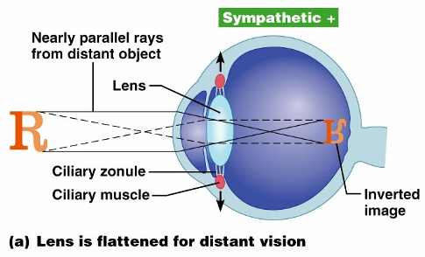
Focusing for Distant Vision
Light from a distance needs little adjustment for proper focusing
Far point of vision – the distance beyond which the lens does not need to change shape to focus (20 ft.)

Slide 27
Focusing for Close Vision
Close vision requires:
Accommodation
changing the lens shape by ciliary muscles to increase refractory power
Constriction
the pupillary reflex constricts the pupils to prevent divergent light rays from entering the eye
Convergence
medial rotation of the eyeballs toward the object being viewed

Slide 28
Problems of Refraction
Emmetropic eye
normal eye with light focused properly
Myopic eye (nearsighted)
the focal point is in front of the retina
Corrected with a concave lens
Hyperopic eye (farsighted)
the focal point is behind the retina
Corrected with a convex lens

Slide 29
Photoreception: Functional Anatomy of Photoreceptors
Photoreception
process by which the eye detects light energy
Rods and cones contain visual pigments (photopigments)

Slide 30
Rods
Functional characteristics
Sensitive to dim light and best suited for night vision
Absorb all wavelengths of visible light
Perceived input is in gray tones only
Sum of visual input from many rods feeds into a single ganglion cell
Results in fuzzy and indistinct images

Slide 31
Cones
Functional characteristics
Need bright light for activation
have low sensitivity
Have pigments that allow a colored view
Each cone synapses with a single ganglion cell
Vision is detailed and has high resolution

Slide 32
Excitation of Cones
There are three types of cones: blue, green, and red
Intermediate colors are perceived by activation of more than one type of cone
Method of excitation is similar to rods

Slide 33
Adaptation
Adaptation to bright light (going from dark to light) involves:
Dramatic decreases in retinal sensitivity
rod function is lost
Switching from the rod to the cone system
visual acuity is gained
Adaptation to dark is the reverse
Cones stop functioning in low light
Rhodopsin accumulates in the dark and retinal sensitivity is restored

Slide 34
Visual Pathways
Axons of retinal ganglion cells form the optic nerve
Medial fibers of the optic nerve decussate at the optic chiasm
Most fibers of the optic tracts continue to the lateral geniculate body of the thalamus

Slide 35
Visual Pathways
Other optic tract fibers end in superior colliculi and pretectal nuclei
Optic radiations travel from the thalamus to the visual cortex

Slide 36
Visual Pathways
Some nerve fibers send tracts to the midbrain ending in the superior colliculi
A small subset of visual fibers contain melanopsin (circadian pigment) which:
Mediates papillary light reflexes
Sets daily biorhythms

Slide 37
Depth Perception
Achieved by both eyes viewing the same image from slightly different angles
Three-dimensional vision results from cortical fusion of the slightly different images
If only one eye is used, depth perception is lost and the observer must rely on learned clues to determine depth

Slide 38
Thalamic Processing
The lateral geniculate nuclei of the thalamus:
Relay information on movement
Segregate the retinal axons in preparation for depth perception
Emphasize visual inputs from regions of high cone density
Sharpen the contrast information received by the retina

Slide 39
Cortical Processing
Striate cortex processes
Basic dark/bright and contrast information
Prestriate cortices (association areas) processes
Form, color, and movement
Visual information then proceeds anteriorly to the:
Temporal lobe – processes identification of objects
Parietal cortex and postcentral gyrus – processes spatial location

Slide 40
Chemical Senses
Chemical senses
gustation (taste)
olfaction (smell)
Their chemoreceptors respond to chemicals in aqueous solution
Taste
to substances dissolved in saliva
Smell
to substances dissolved in fluids of the nasal membranes

Slide 41
Sense of Smell
The organ of smell is the olfactory epithelium, which covers the superior nasal concha
Olfactory receptor cells are bipolar neurons with radiating olfactory cilia
Basal cells lie at the base of the epithelium

Slide 42
Physiology of Smell
Olfactory receptors respond to several different odor-causing chemicals
When bound to ligand these proteins initiate a second messenger
cAMP (the second messenger) opens ion channels,
causing depolarization of the receptor membrane that then triggers an action potential

Slide 43
Olfactory Pathway
Olfactory receptor cells synapse with mitral cells
Glomerular mitral cells process odor signals
Mitral cells send impulses to:
The olfactory cortex
The hypothalamus, amygdala, and limbic system

Slide 44
Taste Buds
Most of the 10,000 or so taste buds are found on the tongue
Taste buds are found in papillae of the tongue mucosa
Papillae come in three types:
Filiform
Fungiform
Circumvallate
Fungiform and circumvallate papillae contain taste buds

Slide 45
Structure of a Taste Bud
Each gourd-shaped taste bud consists of three major cell types
Supporting cells
insulate the receptor
Basal cells
dynamic stem cells
Gustatory cells
taste cells

Slide 46
Taste Sensations
There are five basic taste sensations
Sweet
sugars, saccharin, alcohol, and some amino acids
Salt
metal ions
Sour
hydrogen ions
Bitter
alkaloids such as quinine and nicotine
Umami
elicited by the amino acid glutamate

Slide 47
Physiology of Taste
In order to be tasted, a chemical:
Must be dissolved in saliva
Must contact gustatory hairs
Binding of the food chemical:
Depolarizes the taste cell membrane, releasing neurotransmitter
Initiates a generator potential that elicits an action potential

Slide 48
Gustatory Pathway
Cranial Nerves VII and IX carry impulses from taste buds to the solitary nucleus of the medulla
These impulses then travel to the thalamus, and from there fibers branch to the:
Gustatory cortex (taste)
Hypothalamus and limbic system (appreciation of taste)

Slide 49
Influence of Other Sensations on Taste
Taste is 80% smell
Thermoreceptors, mechanoreceptors, nociceptors also influence tastes
Temperature and texture enhance or detract from taste

Slide 50
The Ear: Hearing and Balance
The three parts of the ear are the inner, outer, and middle ear
The outer and middle ear are involved with hearing
The inner ear functions
hearing and equilibrium
Receptors for hearing and balance:
Respond to separate stimuli
Are activated independently

Slide 51
Outer Ear
The auricle (pinna) is composed of:
The helix (rim)
The lobule (earlobe)
External auditory canal
Short, curved tube filled with ceruminous glands

Slide 52
Outer Ear
Tympanic membrane (eardrum)
Thin connective tissue membrane that vibrates in response to sound
Transfers sound energy to the middle ear ossicles
Boundary between outer and middle ears

Slide 53
Middle Ear (Tympanic Cavity)
A small, air-filled, mucosa-lined cavity
Flanked laterally by the eardrum
Flanked medially by the oval and round windows
Epitympanic recess
superior portion of the middle ear
Pharyngotympanic tube
connects the middle ear to the nasopharynx
Equalizes pressure in the middle ear cavity with the external air pressure

Slide 54
Ear Ossicles
The tympanic cavity contains three small bones:
Malleus
Incus
Stapes
Transmit vibratory motion of the eardrum to the oval window
Dampened by the tensor tympani and stapedius muscles

Slide 55
Inner Ear
Bony labyrinth
Tortuous channels worming their way through the temporal bone
Contains the vestibule, the cochlea, and the semicircular canals
Filled with perilymph
Membranous labyrinth
Series of membranous sacs within the bony labyrinth
Filled with a potassium-rich fluid

Slide 56
The Vestibule
The central egg-shaped cavity of the bony labyrinth
Suspended in its perilymph are two sacs:
saccule
utricle
The saccule extends into the cochlea

Slide 57
The Vestibule
The utricle extends into the semicircular canals
These sacs:
House equilibrium receptors called maculae
Respond to gravity and changes in the position of the head

Slide 58
The Semicircular Canals
Three canals that lie in the three planes of space
Membranous semicircular ducts line each canal and communicate with the utricle
The ampulla is the swollen end of each canal and it houses equilibrium receptors in a region called the crista ampullaris
These receptors respond to angular movements of the head

Slide 59
The Cochlea
A spiral, conical, bony chamber that:
Extends from the anterior vestibule
Coils around a bony pillar called the modiolus
Contains the cochlear duct, which ends at the cochlear apex
Contains the organ of Corti (hearing receptor)

Slide 60
The Cochlea
The cochlea is divided into three chambers:
Scala vestibuli
Scala media
Scala tympani

Slide 61
The Cochlea
The scala tympani terminates at the round window
The scalas tympani and vestibuli:
Are filled with perilymph
Are continuous with each other via the helicotrema
The scala media is filled with endolymph

Slide 62
The Cochlea
The “floor” of the cochlear duct is composed of:
The bony spiral lamina
The basilar membrane, which supports the organ of Corti
The cochlear branch of nerve VIII runs from the organ of Corti to the brain

Slide 63
Sound and Mechanisms of Hearing
Sound vibrations beat against the eardrum
The eardrum pushes against the ossicles, which presses fluid in the inner ear against the oval and round windows
This movement sets up shearing forces that pull on hair cells
Moving hair cells stimulates the cochlear nerve that sends impulses to the brain

Slide 64
Properties of Sound
Frequency
the number of waves that pass a given point in a given time
Pitch
perception of different frequencies (we hear from 20–20,000 Hz)
Amplitude
intensity of a sound measured in decibels (dB)
Loudness
subjective interpretation of sound intensity

Slide 65
Transmission of Sound to the Inner Ear
The route of sound to the inner ear follows this pathway:
Outer ear
pinna, auditory canal, eardrum
Middle ear
malleus, incus, and stapes to the oval window
Inner ear
scalas vestibuli and tympani to the cochlear duct
Stimulation of the organ of Corti
Generation of impulses in the cochlear nerve

Slide 66
Resonance of the Basilar Membrane
Sound waves of low frequency (inaudible):
Travel around the helicotrema
Do not excite hair cells
Audible sound waves:
Penetrate through the cochlear duct
Vibrate the basilar membrane
Excite specific hair cells according to frequency of the sound

Slide 67
The Organ of Corti
Is composed of supporting cells and outer and inner hair cells
Afferent fibers of the cochlear nerve attach to the base of hair cells
The stereocilia (hairs):
Protrude into the endolymph
Touch the tectorial membrane

Slide 68
Excitation of Hair Cells in the Organ of Corti
Bending cilia:
Opens mechanically gated ion channels
Causes a graded potential and the release of a neurotransmitter
The neurotransmitter causes cochlear fibers to transmit impulses to the brain, where sound is perceived

Slide 69
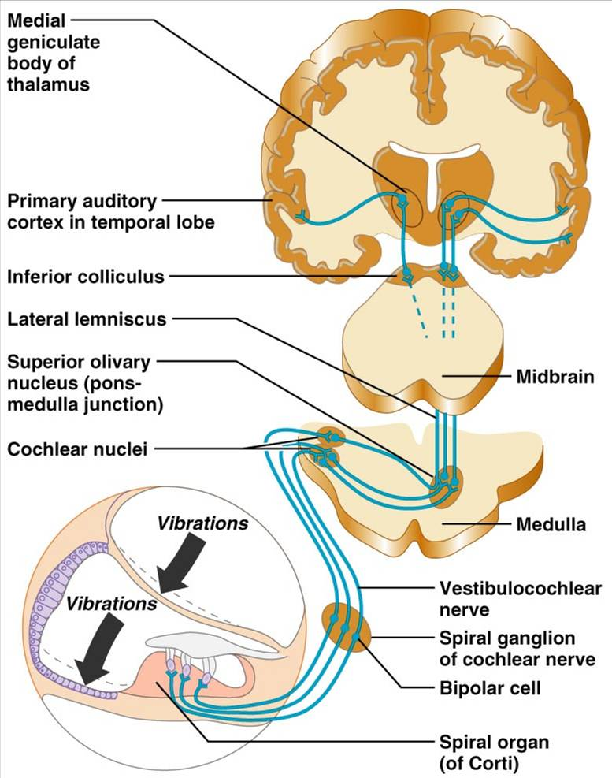
Auditory Pathway to the Brain
Impulses from the cochlea pass via the spiral ganglion to the cochlear nuclei
From there, impulses are sent to the:
Superior olivary nucleus
Inferior colliculus (auditory reflex center)
From there, impulses pass to the auditory cortex
Auditory pathways decussate so that both cortices receive input from both ears

Slide 70
Deafness
Conduction deafness
something hampers sound conduction to the fluids of the inner ear
impacted earwax, perforated eardrum, osteosclerosis of the ossicles
Sensorineural deafness
results from damage to the neural structures at any point from the cochlear hair cells to the auditory cortical cells

Slide 71
Deafness
Tinnitus
ringing or clicking sound in the ears in the absence of auditory stimuli
Meniere’s syndrome
labyrinth disorder that affects the cochlea and the semicircular canals, causing vertigo, nausea, and vomiting

Slide 72
Mechanisms of Equilibrium and Orientation
Vestibular apparatus
equilibrium receptors in the semicircular canals and vestibule
Maintains our orientation and balance in space
Vestibular receptors
monitor static equilibrium
Semicircular canal receptors
monitor dynamic equilibrium

Slide 73
Anatomy of Maculae
Maculae are the sensory receptors for static equilibrium
Contain supporting cells and hair cells
Each hair cell has stereocilia and kinocilium embedded in the otolithic membrane
Otolithic membrane
jellylike mass studded with tiny stones called otoliths
Utricular hairs respond to horizontal movement
Saccular hairs respond to vertical movement

Slide 74
Effect of Gravity on Utricular Receptor Cells
Otolithic movement in the direction of the kinocilia:
Depolarizes vestibular nerve fibers
Increases the number of action potentials generated
Movement in the opposite direction:
Hyperpolarizes vestibular nerve fibers
Reduces the rate of impulse propagation

Slide 75
Crista Ampullaris and Dynamic Equilibrium
The crista ampullaris (or crista):
Is the receptor for dynamic equilibrium
Is located in the ampulla of each semicircular canal
Responds to angular movements
Each crista has support cells and hair cells that extend into a gel-like mass called the cupula
Dendrites of vestibular nerve fibers encircle the base of the hair cells

Slide 76
Activating Crista Ampullaris Receptors
Cristae respond to changes in velocity of rotatory movements of the head
Directional bending of hair cells in the cristae causes:
Depolarizations, and rapid impulses reach the brain at a faster rate
Hyperpolarizations, and fewer impulses reach the brain
The result is that the brain is informed of rotational movements of the head

Slide 77
Balance and Orientation Pathways
There are three modes of input for balance and orientation
Vestibular receptors
Visual receptors
Somatic receptors
These receptors allow our body to respond reflexively

