Slide 1
Chapter 15
Exam Six Material

Slide 2
Eye and Associated Structures
70% of all sensory receptors are in the eye
Most of the eye is protected by a cushion of fat and the bony orbit
Accessory structures include
  eyebrows,
  eyelids,
  conjunctiva,
  lacrimal apparatus
  extrinsic eye muscles

Slide 3
Eyebrows
Coarse hairs that overlie the supraorbital margins
Functions include:
  Shading the eye
  Preventing perspiration from reaching the eye
Orbicularis muscle
  depresses the eyebrows
Corrugator muscles
  move the eyebrows medially

Slide 4
Palpebrae (Eyelids)
Protect the eye anteriorly
Palpebral fissure
  separates eyelids
Canthi
  medial and lateral angles

Slide 5
Palpebrae (Eyelids)
Lacrimal caruncle
  contains glands that secrete a whitish, oily secretion (Sandman’s eye sand)
Tarsal plates of connective tissue support the eyelids internally
Levator palpebrae superioris
  gives the upper eyelid mobility

Slide 6
Palpebrae (Eyelids)
Eyelashes
  Project from the free margin of each eyelid
  Initiate reflex blinking
Lubricating glands associated with the eyelids
  Meibomian glands and sebaceous glands
  Ciliary glands lie between the hair follicles

Slide 7
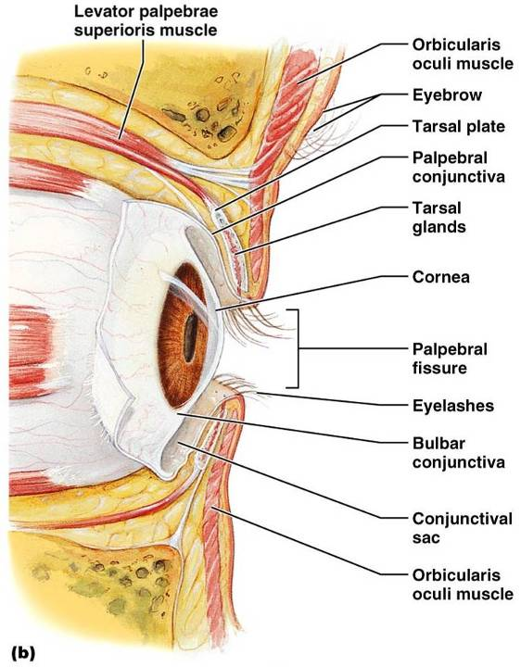
Palpebrae (Eyelids)

Slide 8
Conjunctiva
Transparent membrane that:
  Lines the eyelids as the palpebral conjunctiva
  Covers the whites of the eyes as the ocular conjunctiva
  Lubricates and protects the eye

Slide 9
Lacrimal Apparatus
Consists of the lacrimal gland and associated ducts
Lacrimal glands secrete tears
Tears
  Contain mucus, antibodies, and lysozyme
  Enter the eye via superolateral excretory ducts
  Exit the eye medially via the lacrimal punctum
  Drain into the nasolacrimal duct

Slide 10
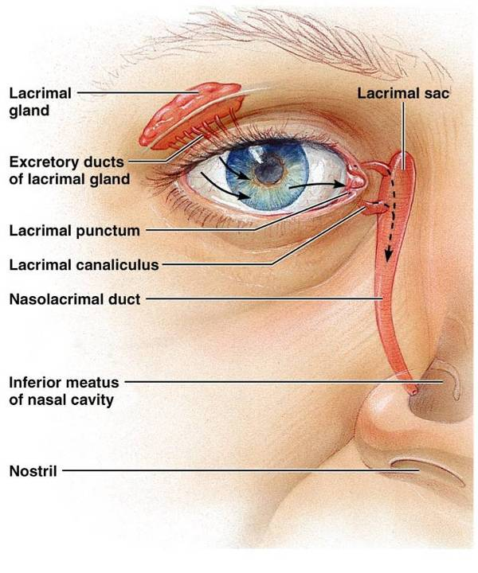
Lacrimal Apparatus
Figure 15.2

Slide 11
Extrinsic Eye Muscles
Six straplike extrinsic eye muscles
  Enable the eye to follow moving objects
  Maintain the shape of the eyeball
Four rectus muscles originate from the annular ring
Two oblique muscles move the eye in the vertical plane

Slide 12
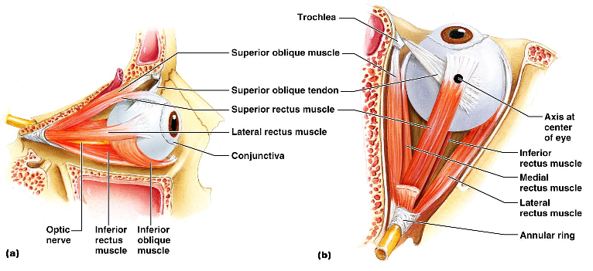
Extrinsic Eye Muscles

Slide 13
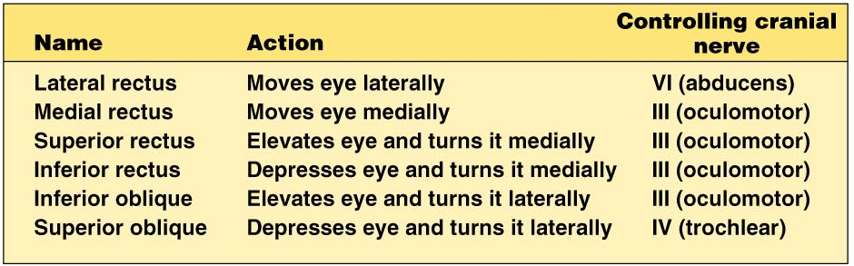
Summary of Cranial Nerves and Muscle Actions
Names, actions, and cranial nerve innervation of the extrinsic eye muscles

Slide 14
Structure of the Eyeball
A slightly irregular hollow sphere with anterior and posterior poles
The wall is composed of three tunics –
  Fibrous
  Vascular
  sensory
The internal cavity is filled with fluids called humors
The lens separates the internal cavity into anterior and posterior segments

Slide 15
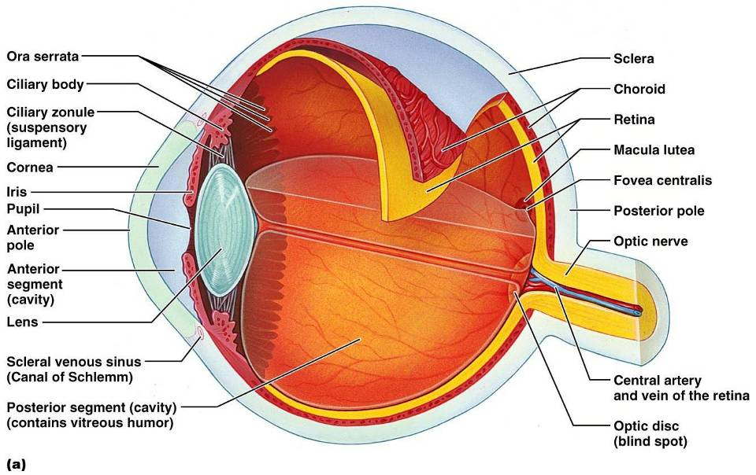
Structure of the Eyeball

Slide 16
Fibrous Tunic
Forms the outermost coat of the eye and is composed of:
  Opaque sclera (posteriorly)
  Clear cornea (anteriorly)
The sclera protects the eye and anchors extrinsic muscles
The cornea lets light enter the eye

Slide 17
Vascular Tunic: Choroid Region
Has three regions:
  Choroid
  ciliary body
  iris
Choroid region
  A dark brown membrane that forms the posterior portion of the vascular layer
  Supplies blood to all eye tunics

Slide 18
Vascular Tunic: Ciliary Body
A thickened ring of tissue surrounding the lens
Composed of smooth muscle bundles
  ciliary muscles
Anchors the suspensory ligament that holds the lens in place

Slide 19
Vascular Tunic: Iris
The colored part of the eye
Pupil
  central opening of the iris
  Regulates the amount of light entering the eye during:
    Close vision and bright light
      pupils constrict
    Distant vision and dim light
      pupils dilate
    Changes in emotional state
      pupils dilate when the subject matter is appealing or requires problem-solving skills

Slide 20
Sensory Tunic: Retina
A delicate two-layered membrane
Pigmented layer
  the outer layer that absorbs light and prevents its scattering
Neural layer, which contains:
  Photoreceptors that transduce light energy
  Bipolar cells and ganglion cells
  Amacrine and horizontal cells

Slide 21
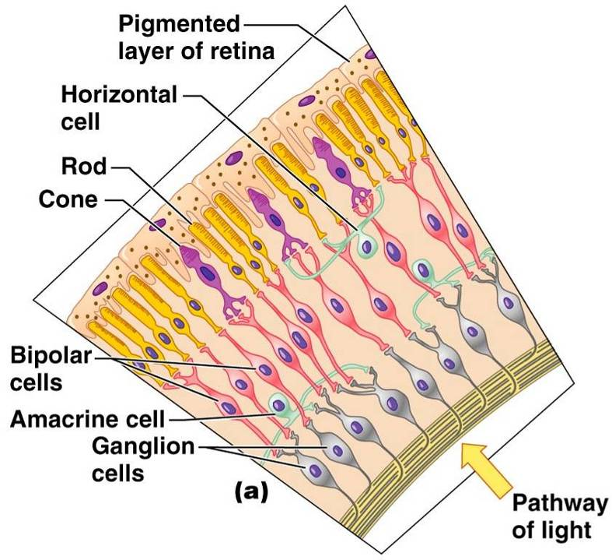
Sensory Tunic: Retina

Slide 22
The Retina: Ganglion Cells and the Optic Disc
Ganglion cell axons:
  Run along the inner surface of the retina
  Leave the eye as the optic nerve
The optic disc:
  Is the site where the optic nerve leaves the eye
  Lacks photoreceptors
    the blind spot

Slide 23
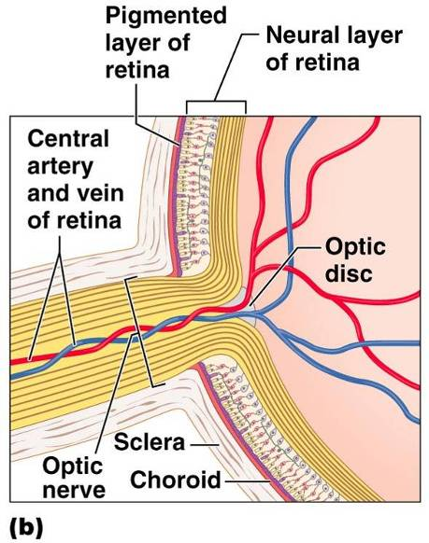
The Retina: Ganglion Cells and the Optic Disc

Slide 24
Vision
Please note that due to differing operating systems, some animations will not appear until the presentation is viewed in Presentation Mode (Slide Show view). You may see blank slides in the “Normal” or “Slide Sorter” views. All animations will appear after viewing in Presentation Mode and playing each animation. Most animations will require the latest version of the Flash Player, which is available at http://get.adobe.com/flashplayer.

Slide 25
The Retina: Photoreceptors
Rods:
  Respond to dim light
  Are used for peripheral vision
Cones:
  Respond to bright light
  Have high-acuity color vision
  Are found in the macula lutea
  Are concentrated in the fovea centralis

Slide 26
Blood Supply to the Retina
The neural retina receives its blood supply from two sources
  The outer third receives its blood from the choroid
  The inner two-thirds is served by the central artery and vein
Small vessels radiate out from the optic disc

Slide 27
Inner Chambers and Fluids
The lens separates the internal eye into anterior and posterior segments
The posterior segment is filled with vitreous humor that:
  Transmits light
  Supports the posterior surface of the lens
  Holds the neural retina firmly against the pigmented layer
  Contributes to intraocular pressure

Slide 28
Anterior Segment
Composed of two chambers
  Anterior
    between the cornea and the iris
  Posterior
    between the iris and the lens
Aqueous humor
  A plasmalike fluid that fills the anterior segment
  Drains via the canal of Schlemm
Supports, nourishes, and removes wastes

Slide 29
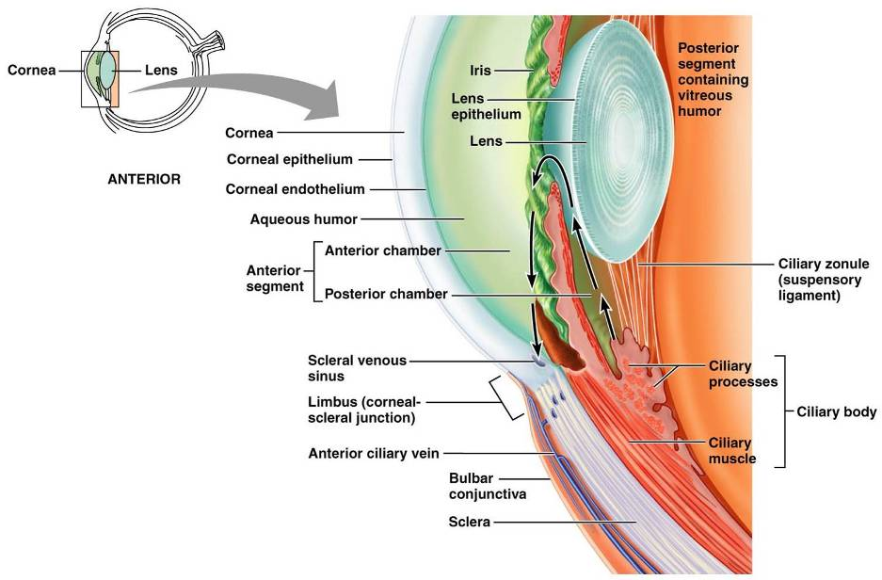
Anterior Segment

Slide 30
Lens
A biconvex, transparent, flexible, avascular structure that:
  Allows precise focusing of light onto the retina
  Is composed of epithelium and lens fibers
Lens fibers
  cells filled with the transparent protein crystallin
With age,
  the lens becomes more compact
  dense
  loses its elasticity

Slide 31
Light
Our eyes respond to a small portion of this spectrum called the visible spectrum
Different cones in the retina respond to different wavelengths of the visible spectrum

Slide 32
Refraction and Lenses
When light passes from one transparent medium to another its speed changes and it refracts (bends)
Light passing through a convex lens is bent so that the rays converge to a focal point
When a convex lens forms an image, the image is upside down and reversed right to left

Slide 33
Focusing Light on the Retina
Pathway of light entering the eye:
  cornea, aqueous humor, lens, vitreous humor, and the neural layer of the retina to the photoreceptors
Light is refracted:
  At the cornea
  Entering the lens
  Leaving the lens
The lens curvature and shape allow for fine focusing of an image

Slide 34
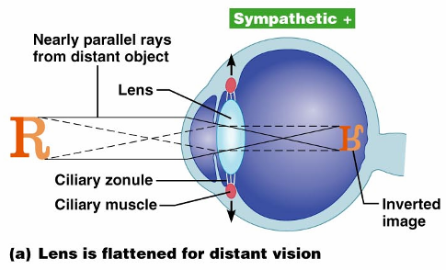
Focusing for Distant Vision
Light from a distance needs little adjustment for proper focusing
Far point of vision – the distance beyond which the lens does not need to change shape to focus (20 ft.)

Slide 35
Focusing for Close Vision
Close vision requires:
  Accommodation
    changing the lens shape by ciliary muscles to increase refractory power
  Constriction
    the pupillary reflex constricts the pupils to prevent divergent light rays from entering the eye
  Convergence
    medial rotation of the eyeballs toward the object being viewed

Slide 36
Problems of Refraction
Emmetropic eye
  normal eye with light focused properly
Myopic eye (nearsighted)
  the focal point is in front of the retina
  Corrected with a concave lens
Hyperopic eye (farsighted)
  the focal point is behind the retina
  Corrected with a convex lens

Slide 37
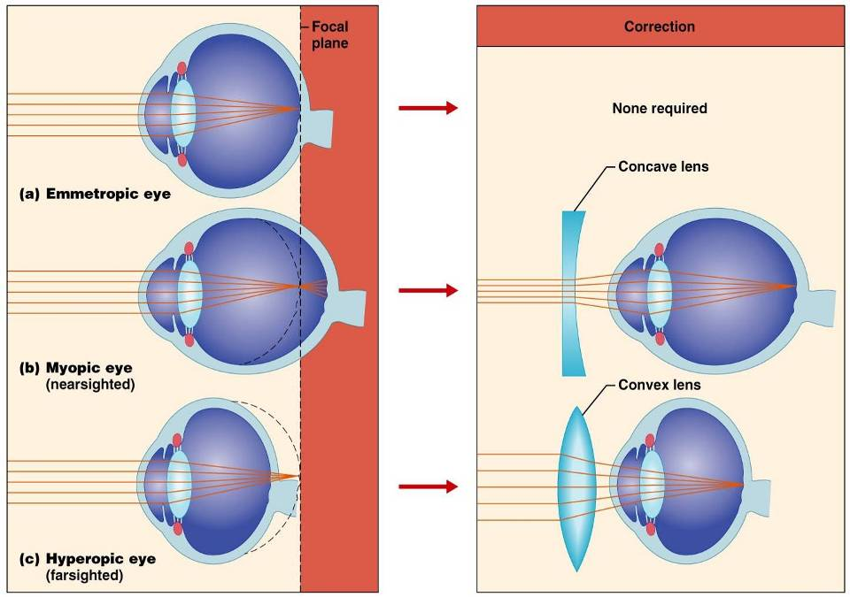

Slide 38
Photoreception:
Functional Anatomy of Photoreceptors
Photoreception
  process by which the eye detects light energy
Rods and cones contain visual pigments (photopigments)

Slide 39
Rods
Functional characteristics
  Sensitive to dim light and best suited for night vision
  Absorb all wavelengths of visible light
  Perceived input is in gray tones only
  Sum of visual input from many rods feeds into a single ganglion cell
  Results in fuzzy and indistinct images

Slide 40
Cones
Functional characteristics
  Need bright light for activation
    have low sensitivity
  Have pigments that allow a colored view
  Each cone synapses with a single ganglion cell
  Vision is detailed and has high resolution

Slide 41
Excitation of Cones
There are three types of cones: blue, green, and red
Intermediate colors are perceived by activation of more than one type of cone
Method of excitation is similar to rods

Slide 42
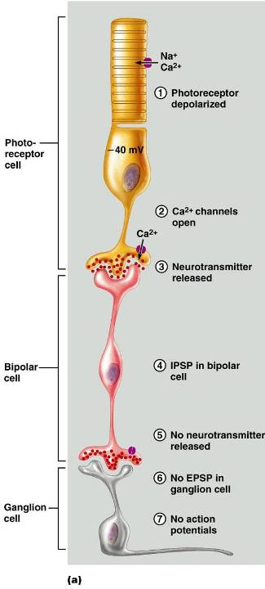
Signal Transmission in the Retina

Slide 43
Adaptation
Adaptation to bright light (going from dark to light) involves:
  Dramatic decreases in retinal sensitivity
    rod function is lost
  Switching from the rod to the cone system
    visual acuity is gained
Adaptation to dark is the reverse
  Cones stop functioning in low light
  Rhodopsin accumulates in the dark and retinal sensitivity is restored

Slide 44
Visual Pathways
Axons of retinal ganglion cells form the optic nerve
Medial fibers of the optic nerve decussate at the optic chiasm
Most fibers of the optic tracts continue to the lateral geniculate body of the thalamus

Slide 45
Visual Pathways
Other optic tract fibers end in superior colliculi and pretectal nuclei
Optic radiations travel from the thalamus to the visual cortex

Slide 46
Visual Pathways
Some nerve fibers send tracts to the midbrain ending in the superior colliculi
A small subset of visual fibers contain melanopsin (circadian pigment) which:
  Mediates papillary light reflexes
  Sets daily biorhythms

Slide 47
Depth Perception
Achieved by both eyes viewing the same image from slightly different angles
Three-dimensional vision results from cortical fusion of the slightly different images
If only one eye is used, depth perception is lost and the observer must rely on learned clues to determine depth

Slide 48
Thalamic Processing
The lateral geniculate nuclei of the thalamus:
  Relay information on movement
  Segregate the retinal axons in preparation for depth perception
  Emphasize visual inputs from regions of high cone density
  Sharpen the contrast information received by the retina

Slide 49
Cortical Processing
Striate cortex processes
  Basic dark/bright and contrast information
Prestriate cortices (association areas) processes
  Form, color, and movement
Visual information then proceeds anteriorly to the:
  Temporal lobe – processes identification of objects
  Parietal cortex and postcentral gyrus – processes spatial location

Slide 50
Chemical Senses
Chemical senses
  gustation (taste)
  olfaction (smell)
Their chemoreceptors respond to chemicals in aqueous solution
  Taste
    to substances dissolved in saliva
  Smell
    to substances dissolved in fluids of the nasal membranes

Slide 51
Sense of Smell
The organ of smell is the olfactory epithelium, which covers the superior nasal concha
Olfactory receptor cells are bipolar neurons with radiating olfactory cilia
Basal cells lie at the base of the epithelium

Slide 52
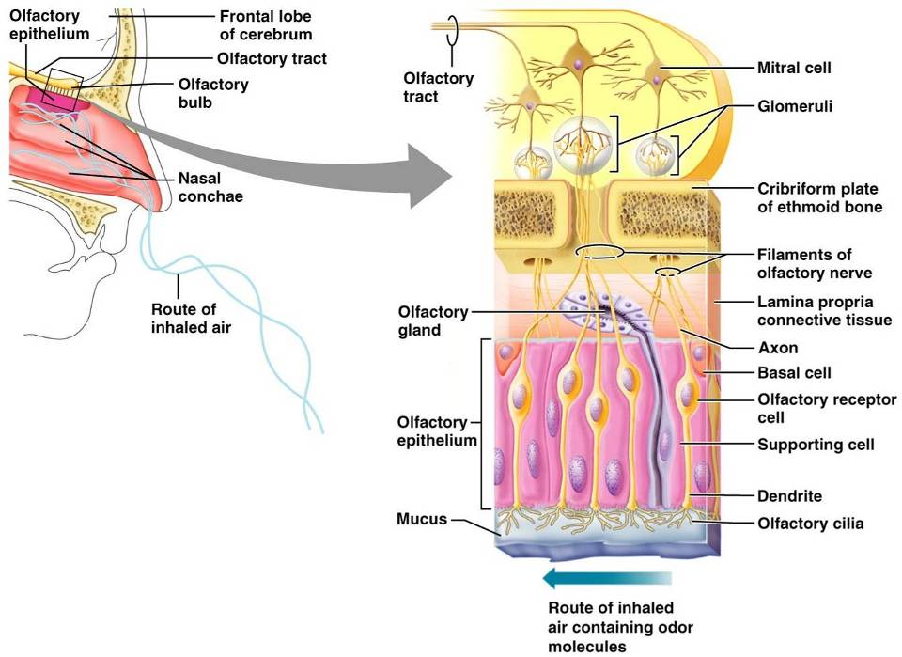
Olfactory Receptors

Slide 53
Physiology of Smell
Olfactory receptors respond to several different odor-causing chemicals
When bound to ligand these proteins initiate a second messenger
cAMP (the second messenger) opens ion channels,
  causing depolarization of the receptor membrane that then triggers an action potential

Slide 54
Olfactory Pathway
Olfactory receptor cells synapse with mitral cells
Glomerular mitral cells process odor signals
Mitral cells send impulses to:
  The olfactory cortex
  The hypothalamus, amygdala, and limbic system

Slide 55
Taste Buds
Most of the 10,000 or so taste buds are found on the tongue
Taste buds are found in papillae of the tongue mucosa
Papillae come in three types:
  Filiform
  Fungiform
  Circumvallate
Fungiform and circumvallate papillae contain taste buds

Slide 56
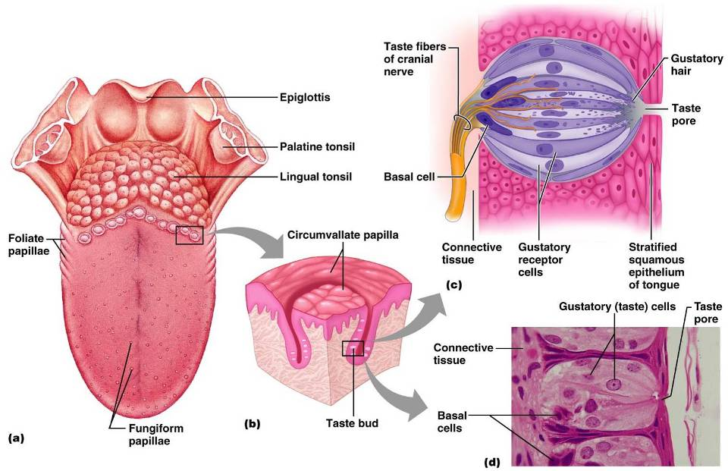

Slide 57
Structure of a Taste Bud
Each gourd-shaped taste bud consists of three major cell types
  Supporting cells
    insulate the receptor
  Basal cells
    dynamic stem cells
  Gustatory cells
    taste cells

Slide 58
Taste Sensations
There are five basic taste sensations
  Sweet
    sugars, saccharin, alcohol, and some amino acids
  Salt
    metal ions
  Sour
    hydrogen ions
  Bitter
    alkaloids such as quinine and nicotine
  Umami
    elicited by the amino acid glutamate

Slide 59
Physiology of Taste
In order to be tasted, a chemical:
  Must be dissolved in saliva
  Must contact gustatory hairs
Binding of the food chemical:
  Depolarizes the taste cell membrane, releasing neurotransmitter
  Initiates a generator potential that elicits an action potential

Slide 60
Gustatory Pathway
Cranial Nerves VII and IX carry impulses from taste buds to the solitary nucleus of the medulla
These impulses then travel to the thalamus, and from there fibers branch to the:
  Gustatory cortex (taste)
  Hypothalamus and limbic system (appreciation of taste)

Slide 61
Influence of Other Sensations on Taste
Taste is 80% smell
Thermoreceptors, mechanoreceptors, nociceptors also influence tastes
Temperature and texture enhance or detract from taste

Slide 62
The Ear: Hearing and Balance
The three parts of the ear are the inner, outer, and middle ear
The outer and middle ear are involved with hearing
The inner ear functions
  hearing and equilibrium
Receptors for hearing and balance:
  Respond to separate stimuli
  Are activated independently

Slide 63
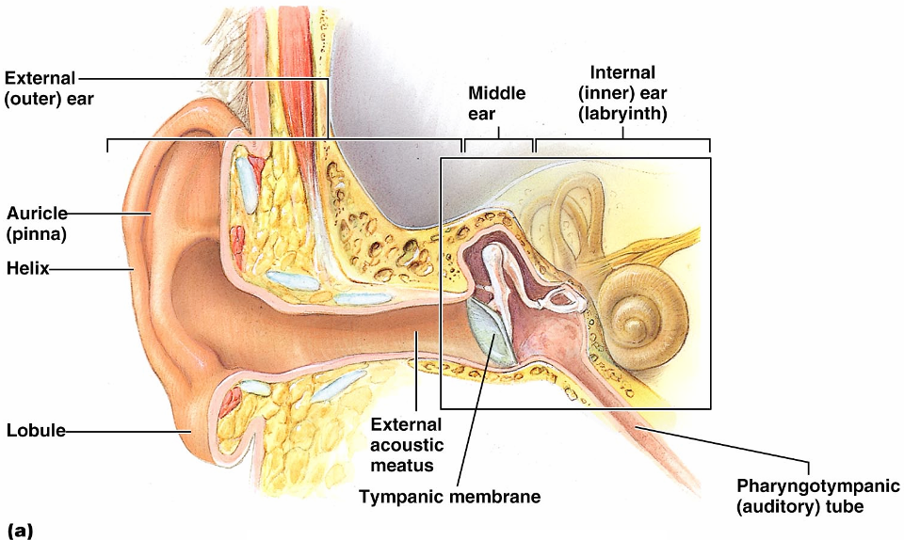
The Ear: Hearing and Balance

Slide 64
Outer Ear
The auricle (pinna) is composed of:
  The helix (rim)
  The lobule (earlobe)
External auditory canal
  Short, curved tube filled with ceruminous glands

Slide 65
Outer Ear
Tympanic membrane (eardrum)
  Thin connective tissue membrane that vibrates in response to sound
  Transfers sound energy to the middle ear ossicles
  Boundary between outer and middle ears

Slide 66
Middle Ear (Tympanic Cavity)
A small, air-filled, mucosa-lined cavity
  Flanked laterally by the eardrum
  Flanked medially by the oval and round windows
Epitympanic recess
  superior portion of the middle ear
Pharyngotympanic tube
  connects the middle ear to the nasopharynx
  Equalizes pressure in the middle ear cavity with the external air pressure

Slide 67
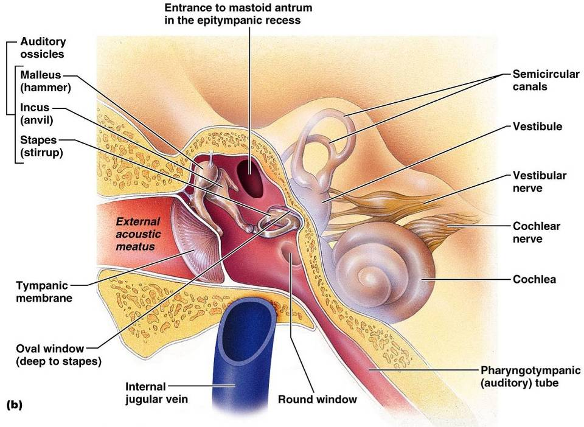
Middle and Internal Ear

Slide 68
Ear Ossicles
The tympanic cavity contains three small bones:
    Malleus
    Incus
    Stapes
  Transmit vibratory motion of the eardrum to the oval window
  Dampened by the tensor tympani and stapedius muscles

Slide 69
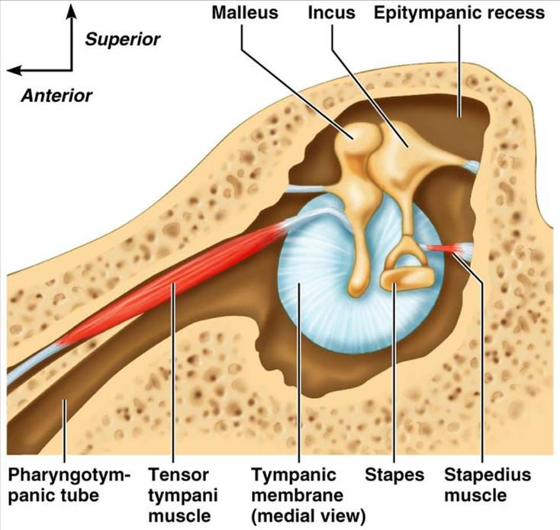

Slide 70
Inner Ear
Bony labyrinth
  Tortuous channels worming their way through the temporal bone
  Contains the vestibule, the cochlea, and the semicircular canals
  Filled with perilymph
Membranous labyrinth
  Series of membranous sacs within the bony labyrinth
  Filled with a potassium-rich fluid

Slide 71
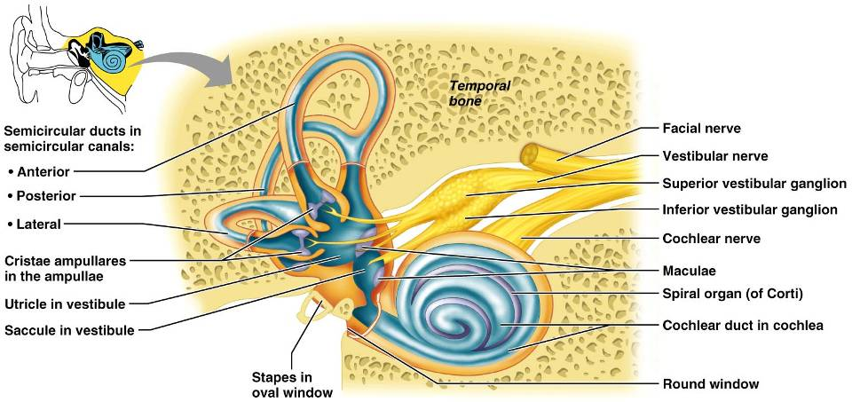
Inner Ear

Slide 72
The Vestibule
The central egg-shaped cavity of the bony labyrinth
Suspended in its perilymph are two sacs:
  saccule
  utricle
The saccule extends into the cochlea

Slide 73
The Vestibule
The utricle extends into the semicircular canals
These sacs:
  House equilibrium receptors called maculae
  Respond to gravity and changes in the position of the head

Slide 74
The Semicircular Canals
Three canals that lie in the three planes of space
Membranous semicircular ducts line each canal and communicate with the utricle
The ampulla is the swollen end of each canal and it houses equilibrium receptors in a region called the crista ampullaris
These receptors respond to angular movements of the head

Slide 75
The Cochlea
A spiral, conical, bony chamber that:
  Extends from the anterior vestibule
  Coils around a bony pillar called the modiolus
  Contains the cochlear duct, which ends at the cochlear apex
  Contains the organ of Corti (hearing receptor)

Slide 76
The Cochlea
The cochlea is divided into three chambers:
  Scala vestibuli
  Scala media
  Scala tympani

Slide 77
The Cochlea
The scala tympani terminates at the round window
The scalas tympani and vestibuli:
  Are filled with perilymph
  Are continuous with each other via the helicotrema
The scala media is filled with endolymph

Slide 78
The Cochlea
The “floor” of the cochlear duct is composed of:
  The bony spiral lamina
  The basilar membrane, which supports the organ of Corti
The cochlear branch of nerve VIII runs from the organ of Corti to the brain

Slide 79
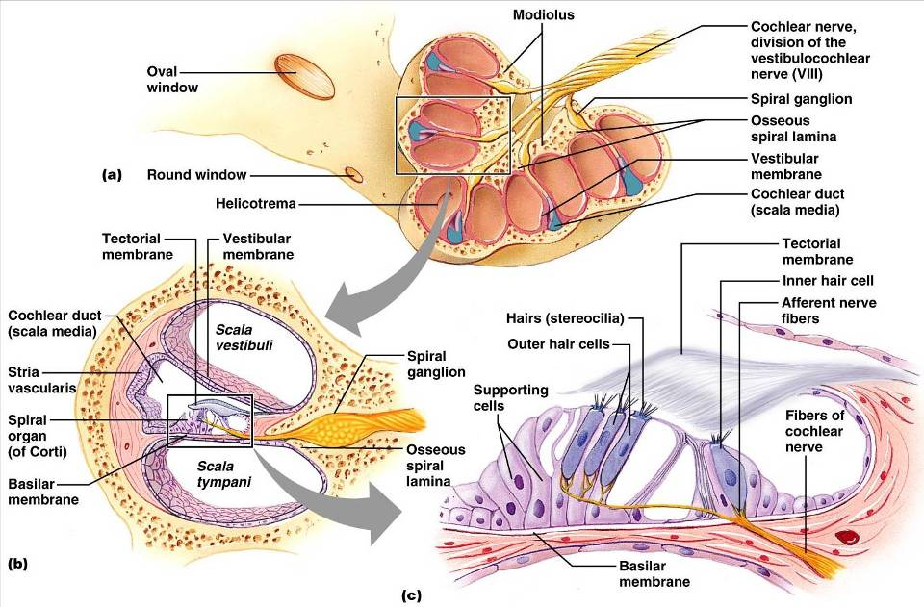

Slide 80
Sound and Mechanisms of Hearing
Sound vibrations beat against the eardrum
The eardrum pushes against the ossicles, which presses fluid in the inner ear against the oval and round windows
  This movement sets up shearing forces that pull on hair cells
  Moving hair cells stimulates the cochlear nerve that sends impulses to the brain

Slide 81
Properties of Sound
Frequency
  the number of waves that pass a given point in a given time
Pitch
  perception of different frequencies (we hear from 20–20,000 Hz)
Amplitude
  intensity of a sound measured in decibels (dB)
Loudness
  subjective interpretation of sound intensity

Slide 82
Transmission of Sound to the Inner Ear
The route of sound to the inner ear follows this pathway:
  Outer ear
    pinna, auditory canal, eardrum
  Middle ear
    malleus, incus, and stapes to the oval window
  Inner ear
    scalas vestibuli and tympani to the cochlear duct
    Stimulation of the organ of Corti
    Generation of impulses in the cochlear nerve

Slide 83
Resonance of the Basilar Membrane
Sound waves of low frequency (inaudible):
  Travel around the helicotrema
  Do not excite hair cells
Audible sound waves:
  Penetrate through the cochlear duct
  Vibrate the basilar membrane
  Excite specific hair cells according to frequency of the sound

Slide 84
The Organ of Corti
Is composed of supporting cells and outer and inner hair cells
Afferent fibers of the cochlear nerve attach to the base of hair cells
The stereocilia (hairs):
  Protrude into the endolymph
  Touch the tectorial membrane

Slide 85
Excitation of Hair Cells in the Organ of Corti
Bending cilia:
  Opens mechanically gated ion channels
  Causes a graded potential and the release of a neurotransmitter
  The neurotransmitter causes cochlear fibers to transmit impulses to the brain, where sound is perceived

Slide 86
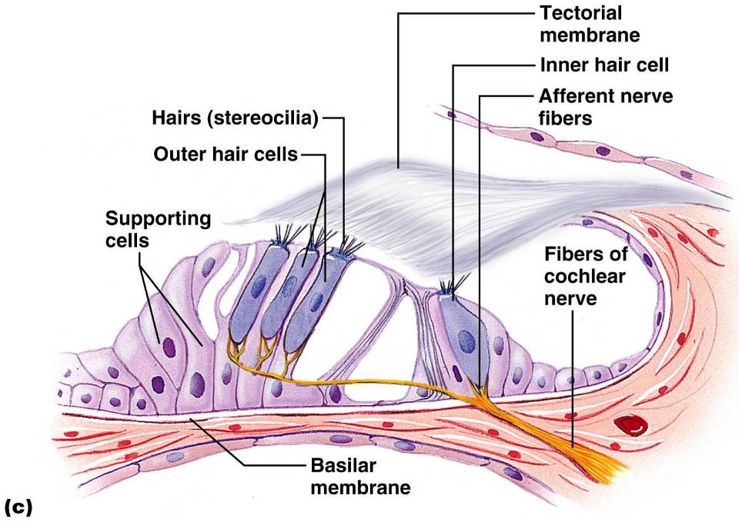

Slide 87
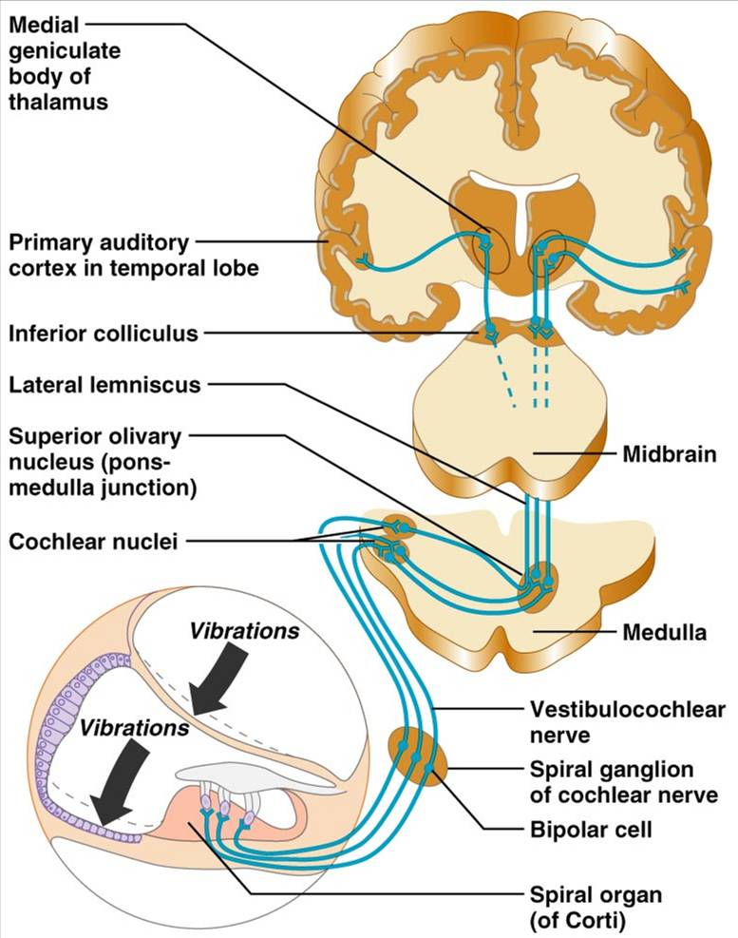
Auditory Pathway to the Brain
Impulses from the cochlea pass via the spiral ganglion to the cochlear nuclei
From there, impulses are sent to the:
  Superior olivary nucleus
  Inferior colliculus (auditory reflex center)
From there, impulses pass to the auditory cortex
Auditory pathways decussate so that both cortices receive input from both ears

Slide 88
Deafness
Conduction deafness
  something hampers sound conduction to the fluids of the inner ear
  impacted earwax, perforated eardrum, osteosclerosis of the ossicles
Sensorineural deafness
  results from damage to the neural structures at any point from the cochlear hair cells to the auditory cortical cells

Slide 89
Deafness
Tinnitus
  ringing or clicking sound in the ears in the absence of auditory stimuli
Meniere’s syndrome
  labyrinth disorder that affects the cochlea and the semicircular canals, causing vertigo, nausea, and vomiting

Slide 90
Mechanisms of Equilibrium and Orientation
Vestibular apparatus
  equilibrium receptors in the semicircular canals and vestibule
  Maintains our orientation and balance in space
  Vestibular receptors
    monitor static equilibrium
  Semicircular canal receptors
    monitor dynamic equilibrium

Slide 91
Anatomy of Maculae
Maculae are the sensory receptors for static equilibrium
  Contain supporting cells and hair cells
  Each hair cell has stereocilia and kinocilium embedded in the otolithic membrane
Otolithic membrane
  jellylike mass studded with tiny stones called otoliths
Utricular hairs respond to horizontal movement
Saccular hairs respond to vertical movement

Slide 92
Effect of Gravity on Utricular Receptor Cells
Otolithic movement in the direction of the kinocilia:
  Depolarizes vestibular nerve fibers
  Increases the number of action potentials generated
Movement in the opposite direction:
  Hyperpolarizes vestibular nerve fibers
  Reduces the rate of impulse propagation

Slide 93
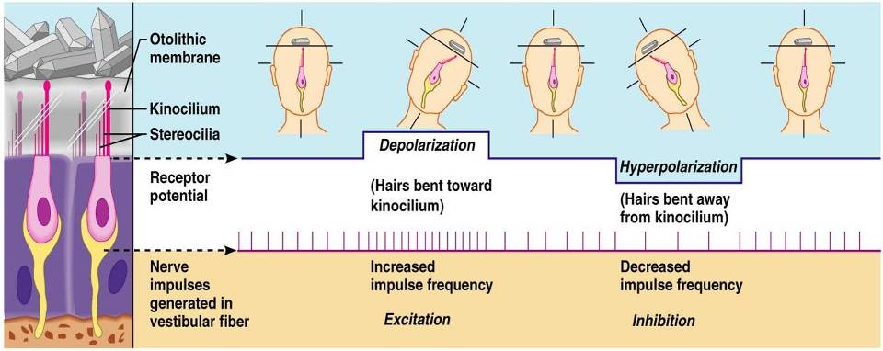
Effect of Gravity on Utricular Receptor Cells

Slide 94
Crista Ampullaris and Dynamic Equilibrium
The crista ampullaris (or crista):
  Is the receptor for dynamic equilibrium
  Is located in the ampulla of each semicircular canal
  Responds to angular movements
Each crista has support cells and hair cells that extend into a gel-like mass called the cupula
Dendrites of vestibular nerve fibers encircle the base of the hair cells

Slide 95
Activating Crista Ampullaris Receptors
Cristae respond to changes in velocity of rotatory movements of the head
Directional bending of hair cells in the cristae causes:
  Depolarizations, and rapid impulses reach the brain at a faster rate
  Hyperpolarizations, and fewer impulses reach the brain
The result is that the brain is informed of rotational movements of the head

Slide 96
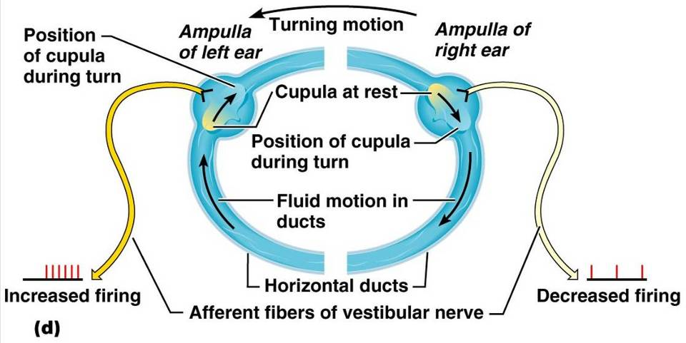
Rotary Head Movement

Slide 97
Balance and Orientation Pathways
There are three modes of input for balance and orientation
  Vestibular receptors
  Visual receptors
  Somatic receptors
These receptors allow our body to respond reflexively

