Slide 1
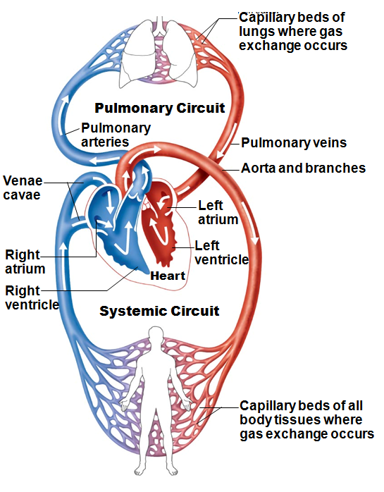
The Pulmonary and Systemic Circuits
Heart is transport system; two side-by-side pumps
Right side
receives deoxygenated blood from tissues
Pumps to lungs
pulmonary circuit
Left side receives oxygenated blood from lungs
Pumps to body tissues
systemic circuit

Slide 2
The Pulmonary and Systemic Circuits
Receiving chambers of heart:
Right atrium
Receives blood returning from systemic circuit
Left atrium
Receives blood returning from pulmonary circuit

Slide 3
The Pulmonary and Systemic Circuits
Pumping chambers of heart:
Right ventricle
Pumps blood through pulmonary circuit
Left ventricle
Pumps blood through systemic circuit

Slide 4
Heart Anatomy
Approximately size of fist
Location:
In mediastinum between second rib and fifth intercostal space
On superior surface of diaphragm
Anterior to vertebral column, posterior to sternum

Slide 5
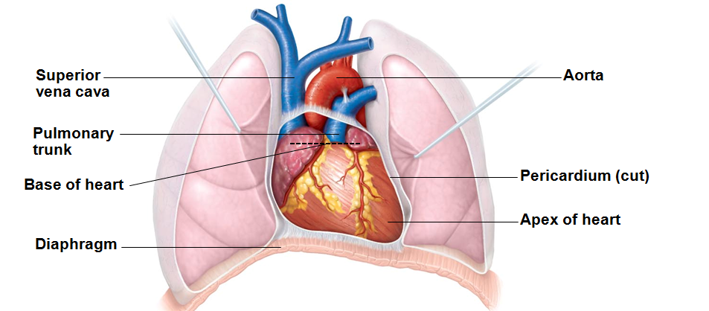
Heart Anatomy
Base (posterior surface) leans toward right shoulder
Apex points toward left hip
Apical impulse palpated between fifth and sixth ribs, just below left nipple

Slide 6
Coverings of the Heart: Pericardium
Double-walled sac
Superficial fibrous pericardium
Protects, anchors to surrounding structures, and prevents overfilling

Slide 7
Pericardium
Deep two-layered serous pericardium
Parietal layer
lines internal surface of fibrous pericardium
Visceral layer (epicardium)
on external surface of heart
Two layers separated by fluid-filled pericardial cavity (decreases friction)

Slide 8
Homeostatic Imbalance
Pericarditis
Inflammation of pericardium
Roughens membrane surfaces → pericardial friction rub (creaking sound) heard with stethoscope
Three heart sounds as opposed to two
Compared to normal
Cardiac tamponade
Excess fluid sometimes compresses heart → limited pumping ability

Slide 9
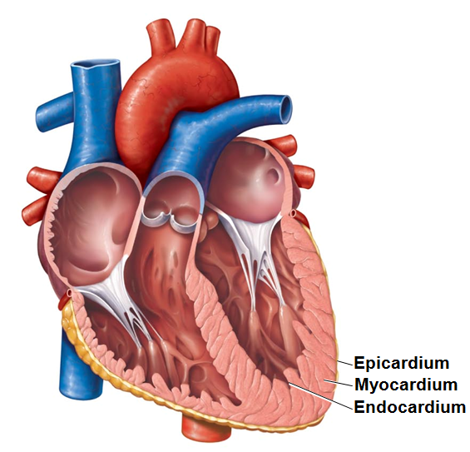
Layers of the Heart Wall
Three layers of heart wall:
Epicardium
Myocardium
Endocardium
Epicardium
Visceral layer of serous pericardium

Slide 10
Layers of the Heart Wall
Myocardium
contractile cardiac muscle cells
Cardiac skeleton
connective tissue
Anchors cardiac muscle fibers
Supports great vessels and valves
Limits spread of action potentials to specific paths

Slide 11
Layers of the Heart Wall
Endocardium continuous with endothelial lining of blood vessels
Lines heart chambers; covers cardiac skeleton of valves

Slide 12
Chambers
Four chambers:
Two superior atria
Two inferior ventricles
Interatrial septum – separates atria
Fossa ovalis
remnant of foramen ovale of fetal heart
Interventricular septum – separates ventricles

Slide 13
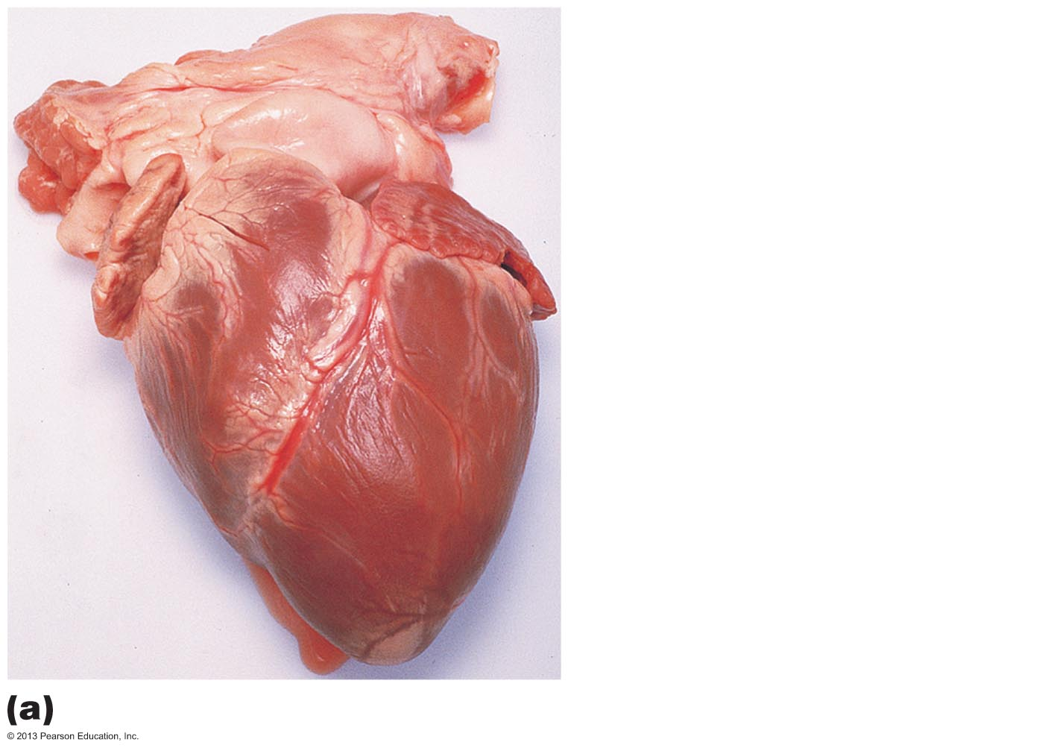
Figure 18.5a Gross anatomy of the heart.
Aortic arch (fat covered)
Pulmonary trunk
Auricle of right atrium
Auricle of left atrium
Anterior interventricular
artery
Right ventricle
Apex of heart (left ventricle)
Anterior aspect (pericardium removed)

Slide 14
Chambers and Associated Great Vessels
Coronary sulcus (atrioventricular groove)
Encircles junction of atria and ventricles
Anterior interventricular sulcus
Anterior position of interventricular septum
Posterior interventricular sulcus
Landmark on posteroinferior surface

Slide 15
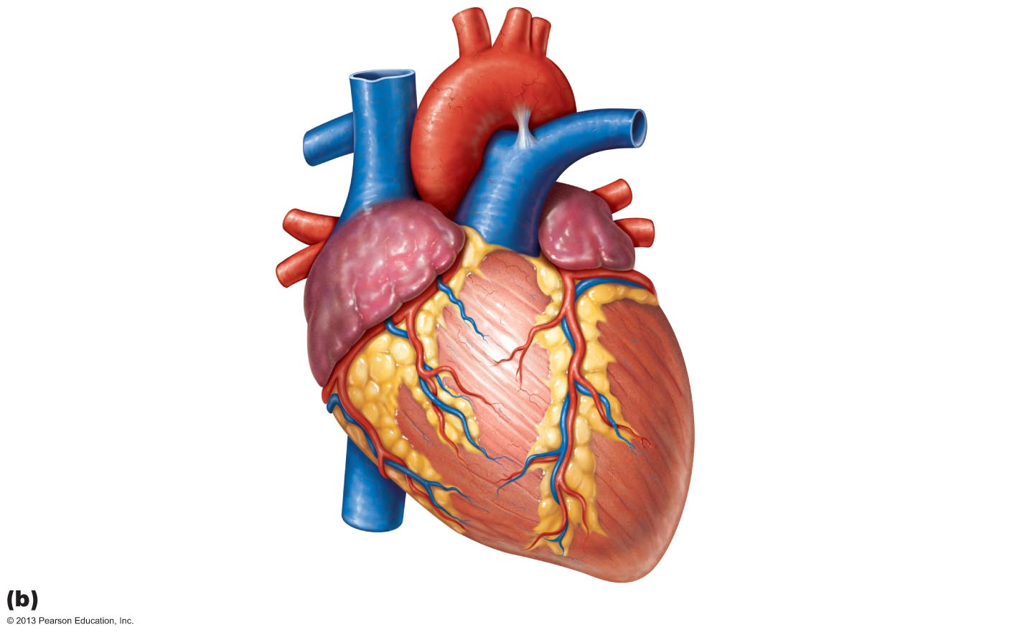
Figure 18.5b Gross anatomy of the heart.
Left atrium
Auricle of
left atrium
Right atrium
Auricle of
Right atrium
Right coronary artery
(in coronary sulcus)
Left coronary artery
(in coronary sulcus)
Left ventricle
Right ventricle
Anterior interventricular
artery (in anterior
interventricular sulcus)
Apex
Anterior view

Slide 16
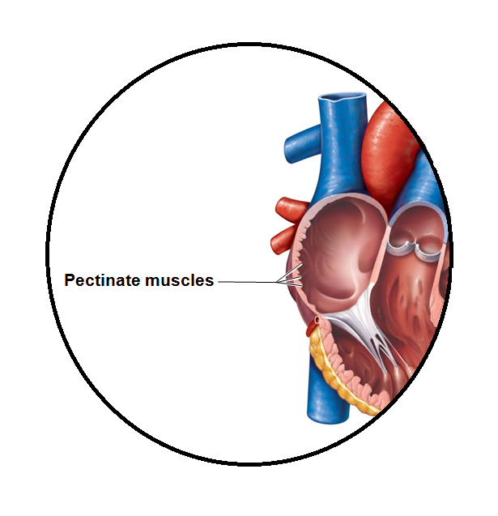
Atria: The Receiving Chambers
Auricles
Appendages that increase atrial volume
Right atrium
Pectinate muscles
Posterior and anterior regions separated by crista terminalis
Left atrium
Pectinate muscles only in auricles

Slide 17
Atria: The Receiving Chambers
Small, thin-walled
Contribute little to propulsion of blood
Three veins empty into right atrium:
Superior vena cava, inferior vena cava, coronary sinus
Four pulmonary veins empty into left atrium

Slide 18
Ventricles: The Discharging Chambers
Most of the volume of heart
Right ventricle
most of anterior surface
Left ventricle
posteroinferior surface
Trabeculae carneae
irregular ridges of muscle on walls
Papillary muscles
anchor chordae tendineae

Slide 19
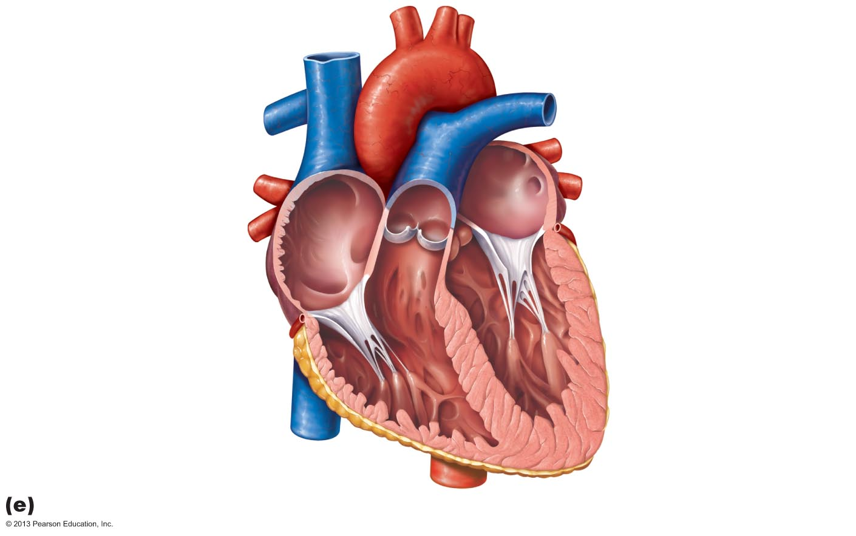
Figure 18.5e Gross anatomy of the heart.
Left atrium
Right atrium
Mitral (bicuspid) valve
Fossa ovalis
Aortic valve
Pectinate muscles
Pulmonary valve
Tricuspid valve
Right ventricle
Left ventricle
Chordae tendineae
Papillary muscle
Trabeculae carneae
Interventricular septum
Frontal section

Slide 20
Ventricles: The Discharging Chambers
Thicker walls than atria
Actual pumps of heart
Right ventricle
Pumps blood into pulmonary trunk
Left ventricle
Pumps blood into aorta (largest artery in body)

Slide 21
Heart Valves
Ensure unidirectional blood flow through heart
Open and close in response to pressure changes
Two atrioventricular (AV) valves
Tricuspid valve (right AV valve)
Mitral valve (left AV valve, bicuspid valve)
Prevent backflow into atria when ventricles contract
Chordae tendineae anchor cusps to papillary muscles
Hold valve flaps in closed position

Slide 22
Heart Valves
Two semilunar (SL) valves
Aortic semilunar valve
Pulmonary semilunar valve
Prevent backflow into ventricles when ventricles relax
Open and close in response to pressure changes

Slide 23
Homeostatic Imbalance
Two conditions severely weaken heart:
Incompetent valve
Blood backflows so heart repumps same blood over and over
Valvular stenosis
Stiff flaps – constrict opening → heart must exert more force to pump blood
Valve replaced with mechanical, animal, or cadaver valve

Slide 24
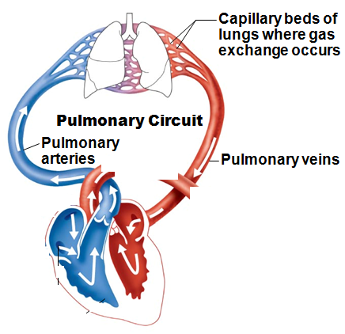
Pathway of Blood Through the Heart
Pulmonary circuit
Right atrium → tricuspid valve → right ventricle
Right ventricle → pulmonary semilunar valve → pulmonary trunk → pulmonary arteries → lungs
Lungs → pulmonary veins → left atrium

Slide 25
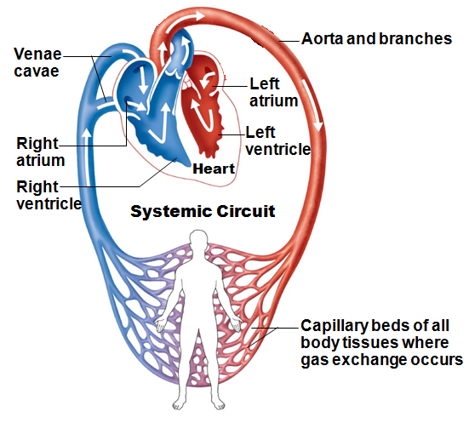
Pathway of Blood Through the Heart
Systemic circuit
Left atrium → mitral valve → left ventricle
Left ventricle → aortic semilunar valve → aorta
Aorta → systemic circulation

Slide 26
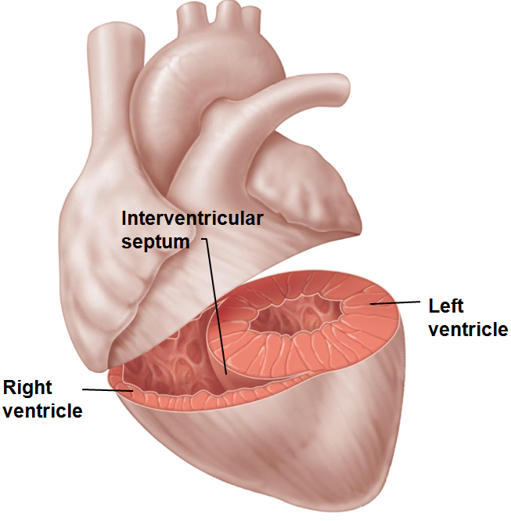
Pathway of Blood Through the Heart
Equal volumes of blood pumped to pulmonary and systemic circuits
Pulmonary circuit short, low-pressure circulation
Systemic circuit long, high-friction circulation
Anatomy of ventricles reflects differences
Left ventricle walls 3X thicker than right
Pumps with greater pressure

Slide 27
Coronary Circulation
Functional blood supply to heart muscle itself
Delivered when heart relaxed
Left ventricle receives most blood supply
Contains many anastomoses (junctions)
Provide additional routes for blood delivery
Cannot compensate for coronary artery occlusion

Slide 28
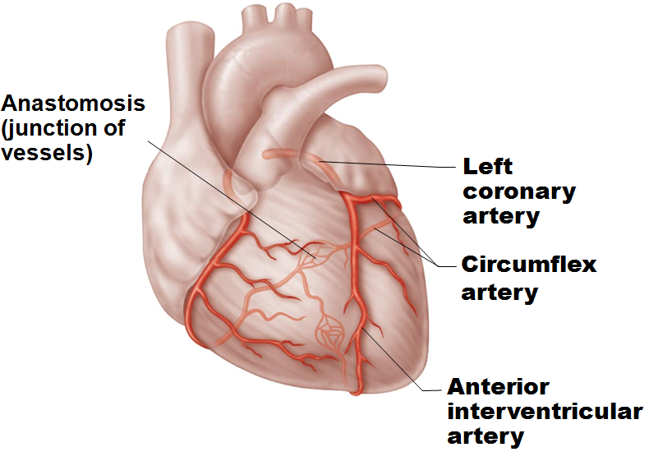
Coronary Circulation: Arteries
Arteries arise from base of aorta
Left coronary artery branches
anterior interventricular artery
circumflex artery
Supplies interventricular septum, anterior ventricular walls, left atrium, and posterior wall of left ventricle

Slide 29
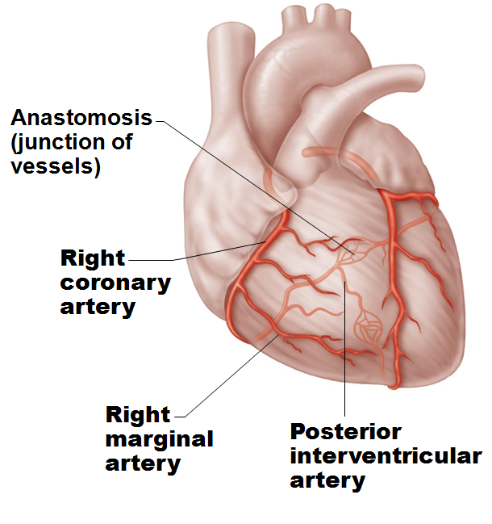
Coronary Circulation: Arteries
Right coronary artery branches
right marginal artery
posterior interventricular artery
Supplies right atrium and most of right ventricle

Slide 30
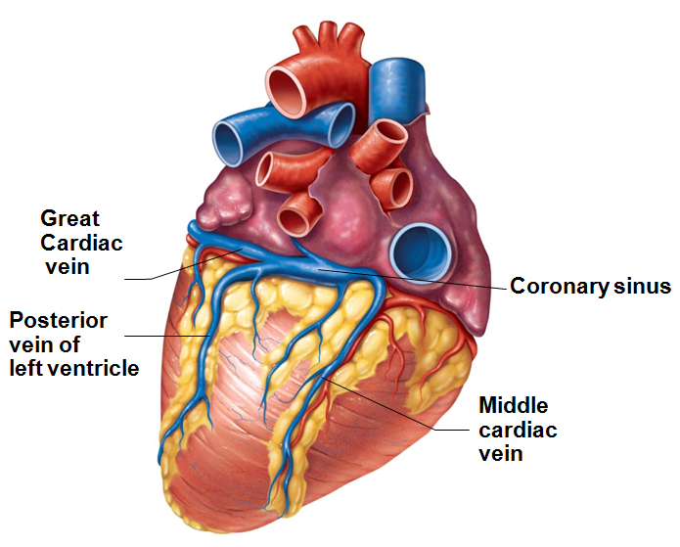
Coronary Circulation: Veins
Cardiac veins collect blood from capillary beds
Coronary sinus empties into right atrium; formed by merging cardiac veins
Great cardiac vein of anterior interventricular sulcus
Middle cardiac vein in posterior interventricular sulcus
Small cardiac vein from inferior margin
Several anterior cardiac veins empty directly into right atrium anteriorly

Slide 31
Homeostatic Imbalances
Angina pectoris
Thoracic pain caused by fleeting deficiency in blood delivery to myocardium
Cells weakened
Myocardial infarction (heart attack)
Prolonged coronary blockage
Areas of cell death repaired with non-contractile scar tissue

Slide 32
Heart Physiology: Electrical Events
Heart depolarizes and contracts without nervous system stimulation
Rhythm can be altered by autonomic nervous system

Slide 33
Heart Physiology: Setting the Basic Rhythm
Coordinated heartbeat is a function of
Presence of gap junctions
Intrinsic cardiac conduction system
Network of non-contractile (autorhythmic) cells
Initiate and distribute impulses → coordinated depolarization and contraction of heart

Slide 34
Sequence of Excitation
Cardiac pacemaker cells pass impulses, in order, across heart in ~220 ms
Sinoatrial node →
Atrioventricular node →
Atrioventricular bundle →
Right and left bundle branches →
Subendocardial conducting network (Purkinje fibers)

Slide 35
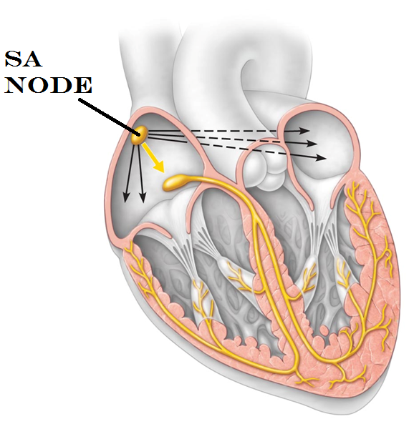
Heart Physiology: Sequence of Excitation
Sinoatrial (SA) node
Pacemaker of heart in right atrial wall
Depolarizes faster than rest of myocardium
Generates impulses about 75X/minute (sinus rhythm)
Inherent rate of 100X/minute tempered by extrinsic factors
Impulse spreads across atria, and to AV node

Slide 36
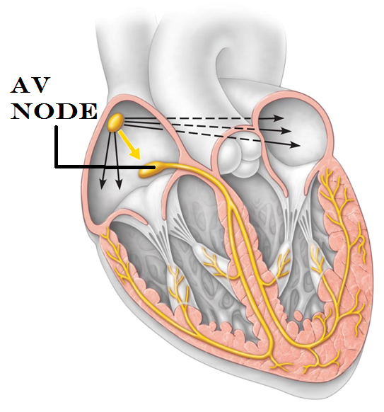
Heart Physiology: Sequence of Excitation
Atrioventricular (AV) node
In inferior interatrial septum
Delays impulses approximately 0.1 second
Because fibers are smaller diameter, have fewer gap junctions
Allows atrial contraction prior to ventricular contraction
Inherent rate of 50X/minute in absence of SA node input

Slide 37
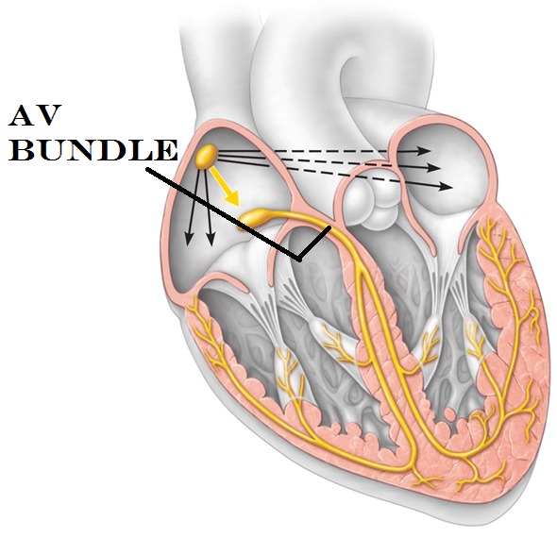
Heart Physiology: Sequence of Excitation
Atrioventricular (AV) bundle (bundle of His)
In superior interventricular septum
Only electrical connection between atria and ventricles
Atria and ventricles not connected via gap junctions

Slide 38
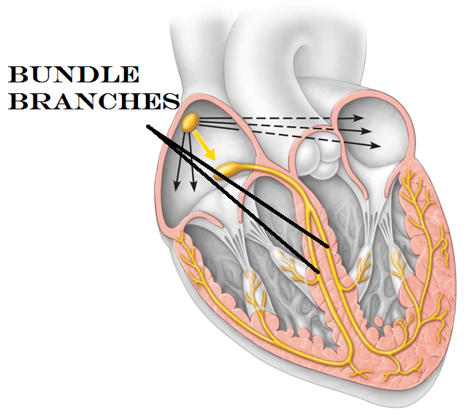
Heart Physiology: Sequence of Excitation
Right and left bundle branches
Two pathways in interventricular septum
Carry impulses toward apex of heart

Slide 39
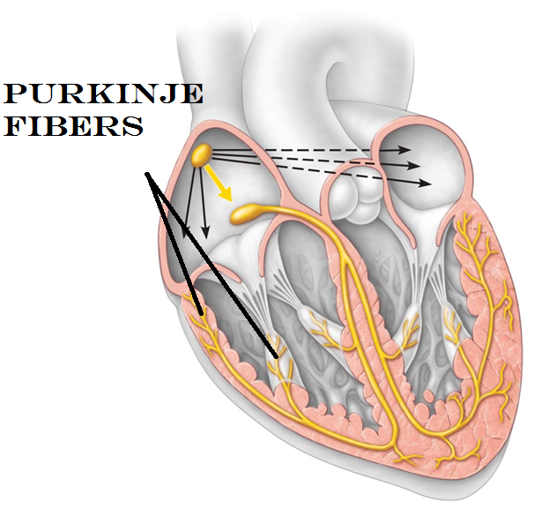
Heart Physiology: Sequence of Excitation
Subendocardial conducting network (Purkinje Fibers)
Complete pathway through interventricular septum into apex and ventricular walls
More elaborate on left side of heart
AV bundle and subendocardial conducting network depolarize 30X/minute in absence of AV node input
Ventricular contraction immediately follows from apex toward atria

Slide 40
Extrinsic Innervation of the Heart
Heartbeat modified by Autonomic Nervous System via cardiac centers in medulla oblongata
Sympathetic
Increases rate
Increases force
Parasympathetic
Decreases rate
Cardioacceleratory center
sympathetic
affects SA, AV nodes, heart muscle, coronary arteries
Cardioinhibitory center
parasympathetic
inhibits SA and AV nodes via Vagus nerves

Slide 41
Electrocardiography
Electrocardiogram (ECG or EKG)
Composite of all action potentials generated by nodal and contractile cells at given time
Three waves:
P wave
depolarization SA node → atria
QRS complex
ventricular depolarization and atrial repolarization
T wave
ventricular repolarization

Slide 42
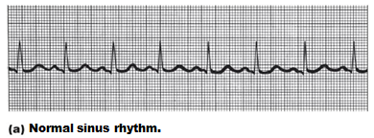
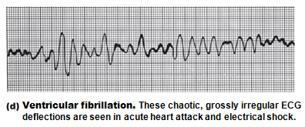
Homeostatic Imbalances
Defects in intrinsic conduction system may cause
Arrhythmias
irregular heart rhythms
Uncoordinated atrial and ventricular contractions
Fibrillation
rapid, irregular contractions; useless for pumping blood
circulation ceases → brain death
Defibrillation to treat

Slide 43
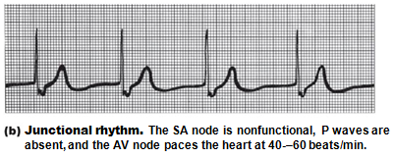
Homeostatic Imbalances
Defective SA node may cause
Ectopic focus
abnormal pacemaker
AV node may take over; sets junctional rhythm (40–60 beats/min)
Extrasystole (premature contraction)
Ectopic focus sets high rate
Can be from excessive caffeine or nicotine

Slide 44
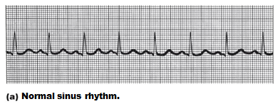
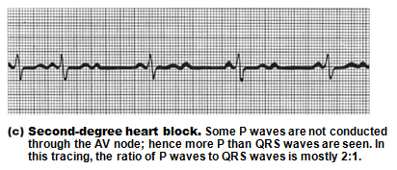
Homeostatic Imbalance
To reach ventricles, impulse must pass through AV node
Defective AV node may cause
Heart block
Few (partial block) or no (total block) impulses reach ventricles
Ventricles beat at intrinsic rate – too slow for life
Artificial pacemaker to treat

Slide 45
Heart Sounds
Two sounds (lub-dup) associated with closing of heart valves
First as AV valves close; beginning of systole
Second as SL valves close; beginning of ventricular diastole
Pause indicates heart relaxation
Heart murmurs - abnormal heart sounds; usually indicate incompetent or stenotic valves

Slide 46
Figure 18.20 Areas of the thoracic surface where the sounds of individual valves can best be detected.
Aortic valve sounds
heard in 2nd intercostal
space at right sternal
margin
Pulmonary valve
sounds heard in 2nd
intercostal space at left
sternal margin
Mitral valve sounds
heard over heart apex
(in 5th intercostal space)
in line with middle of
clavicle
Tricuspid valve sounds
typically heard in right
sternal margin of 5th
intercostal space

Slide 47
Mechanical Events: The Cardiac Cycle
Cardiac cycle
Blood flow through heart during one complete heartbeat: atrial systole and diastole followed by ventricular systole and diastole
Systole
contraction
Diastole
relaxation
Series of pressure and blood volume changes

Slide 48
Phases of the Cardiac Cycle
1. Ventricular filling
takes place in mid-to-late diastole
AV valves are open; pressure low
80% of blood passively flows into ventricles
Atrial systole occurs, delivering remaining 20%

Slide 49
Phases of the Cardiac Cycle
2. Ventricular systole
Atria relax; ventricles begin to contract
Rising ventricular pressure → closing of AV valves
Isovolumetric contraction phase (all valves are closed)
In ejection phase, ventricular pressure exceeds pressure in large arteries, forcing semilunar valves open

Slide 50
Phases of the Cardiac Cycle
3. Isovolumetric relaxation - early diastole
Ventricles relax; atria relaxed and filling
Backflow of blood in aorta and pulmonary trunk closes semilunar valves
Ventricles totally closed chambers
When atrial pressure exceeds that in ventricles → AV valves open; cycle begins again

Slide 51
Cardiac Output (CO)
Volume of blood pumped by each ventricle in one minute
CO = heart rate (HR) × stroke volume (SV)
HR = number of beats per minute
SV = volume of blood pumped out by one ventricle with each beat
Normal – 5.25 L/min

Slide 52
Regulation of Stroke Volume
Three main factors affect SV:
Preload
degree of stretch of cardiac muscle cells before they contract
Most important factor stretching cardiac muscle is amount of blood returning to heart: venous return
Slow heartbeat and exercise increase venous return
Increased venous return distends (stretches) ventricles and increases contraction force
Contractility
contractile strength at given muscle length
Afterload
pressure ventricles must overcome to eject blood

Slide 53
Autonomic Nervous System Regulation
Sympathetic nervous system activated by emotional or physical stressors
Norepinephrine causes pacemaker
to fire more rapidly
and increases contractility
Results in faster relaxation and filling
Increases heart-rate

Slide 54
Autonomic Nervous System Regulation
Parasympathetic nervous system opposes sympathetic effects
Acetylcholine → slower HR
Little to no effect on contractility
Heart at rest exhibits Vagal tone
Parasympathetic dominant influence

Slide 55
Chemical Regulation of Heart Rate
Hormones
Epinephrine from adrenal medulla
increases heart rate
Increases contractility
Thyroxine
increases heart rate
enhances effects of norepinephrine and epinephrine

Slide 56
Homeostatic Imbalance
Hypocalcemia →
Not enough Calcium
depresses heart
Hypercalcemia →
Too much calcium
increased HR and contractility
Hypokalemia →
Not enough Potassium (K)
feeble heartbeat; arrhythmias
Hyperkalemia →
Too much Potassium (K)
alters electrical activity → heart block and cardiac arrest

Slide 57
Other Factors that Influence Heart Rate
Age
Fetus has fastest HR
Gender
Females faster than males
Exercise
Increases HR
Body temperature
Increases with increased temperature

Slide 58
Homeostatic Imbalances
Tachycardia - abnormally fast heart rate
Exceeds 100 beats/min
If persistent, may lead to fibrillation
Bradycardia
heart rate slower than 60 beats/min
May result in inadequate blood circulation in non-athletes
May be desirable result of endurance training

Slide 59
Homeostatic Imbalance
Congestive heart failure (CHF)
Progressive condition
Cardiac Output is so low that blood circulation is inadequate to meet tissue needs
Reflects weakened myocardium caused by
Coronary atherosclerosis—clogged arteries
Persistent high blood pressure
Multiple myocardial infarcts
Dilated cardiomyopathy (DCM)

Slide 60
Homeostatic Imbalance
Pulmonary congestion
Left side fails → blood backs up in lungs
Peripheral congestion
Right side fails → blood pools in body organs → edema
Failure of either side ultimately weakens other
Treat by removing fluid, reducing afterload, increasing contractility

Slide 61
Developmental Aspects of the Heart
Fetal heart structures that bypass pulmonary circulation
Foramen ovale connects two atria
Remnant is fossa ovalis in adult
Ductus arteriosus connects pulmonary trunk to aorta
Remnant - ligamentum arteriosum in adult
Close at or shortly after birth

Slide 62
Developmental Aspects of the Heart
Congenital heart defects
Most common birth defects; treated with surgery
Most are one of two types:
Mixing of oxygen-poor and oxygen-rich blood
Narrowed valves or vessels
Tetralogy of Fallot
Both types of disorders present

Slide 63
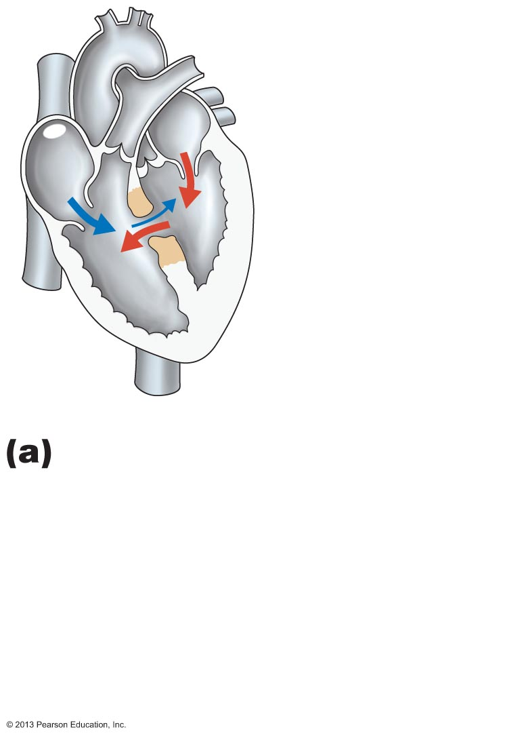
Figure 18.25a Three examples of congenital heart defects.
Ventricular septal defect.
The superior part of the inter-ventricular septum fails to form, allowing blood to mix between the two ventricles.
More blood is shunted from left to right because the left
ventricle is stronger.

Slide 64
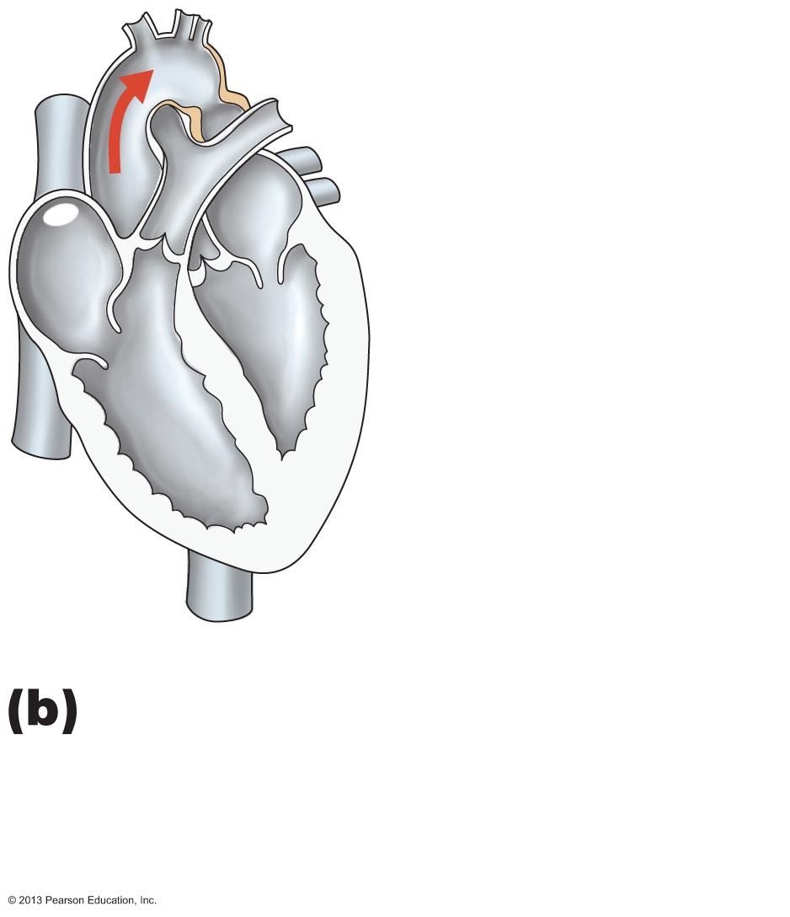
Figure 18.25b Three examples of congenital heart defects.
Coarctation of the aorta.
A part of the aorta is narrowed, increasing the workload of the left ventricle.
Narrowed
aorta

Slide 65
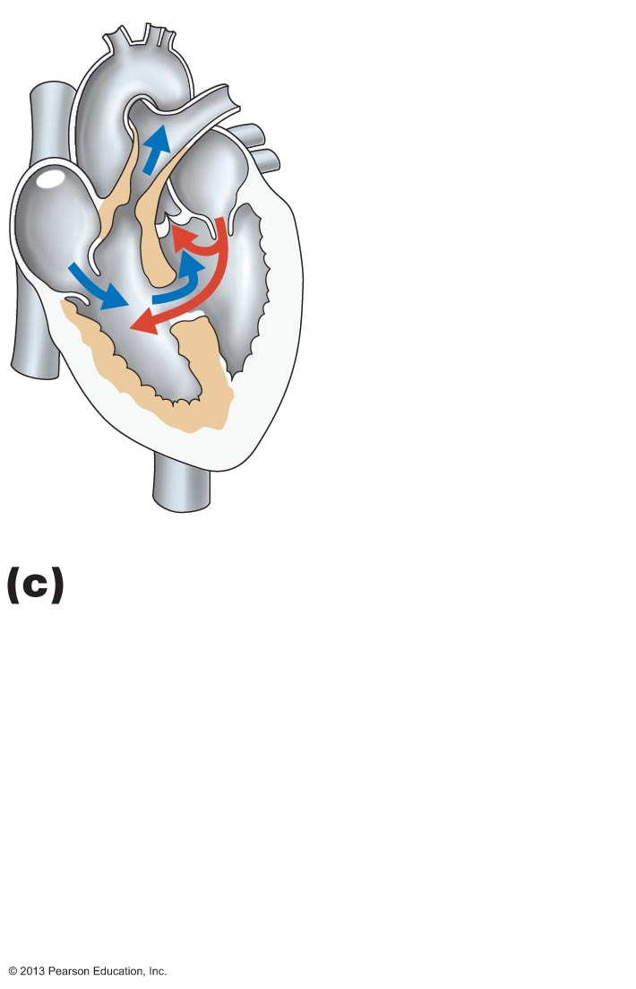
Figure 18.25c Three examples of congenital heart defects.
Tetralogy of Fallot.
Multiple defects (tetra =four):
Pulmonary trunk too narrow and pulmonary valve stenosed (narrowed), resulting in
hypertrophied right ventricle
Ventricular septal defect
Aorta opens from both ventricles.

Slide 66
Age-Related Changes Affecting the Heart
Sclerosis and thickening of valve flaps
Decline in cardiac reserve
Fibrosis of cardiac muscle
Atherosclerosis

Slide 67
Blood Vessels
Delivery system of dynamic structures that begins and ends at heart
Arteries:
carry blood away from heart
oxygenated except for
pulmonary circulation
umbilical vessels of fetus
Capillaries:
contact tissue cells; directly serve cellular needs
Veins:
carry blood toward heart

Slide 68
Structure of Blood Vessel Walls
Lumen
Central blood-containing space
Three wall layers in arteries and veins
Tunica intima, tunica media, and tunica externa
Capillaries
Endothelium with sparse basal lamina

Slide 69
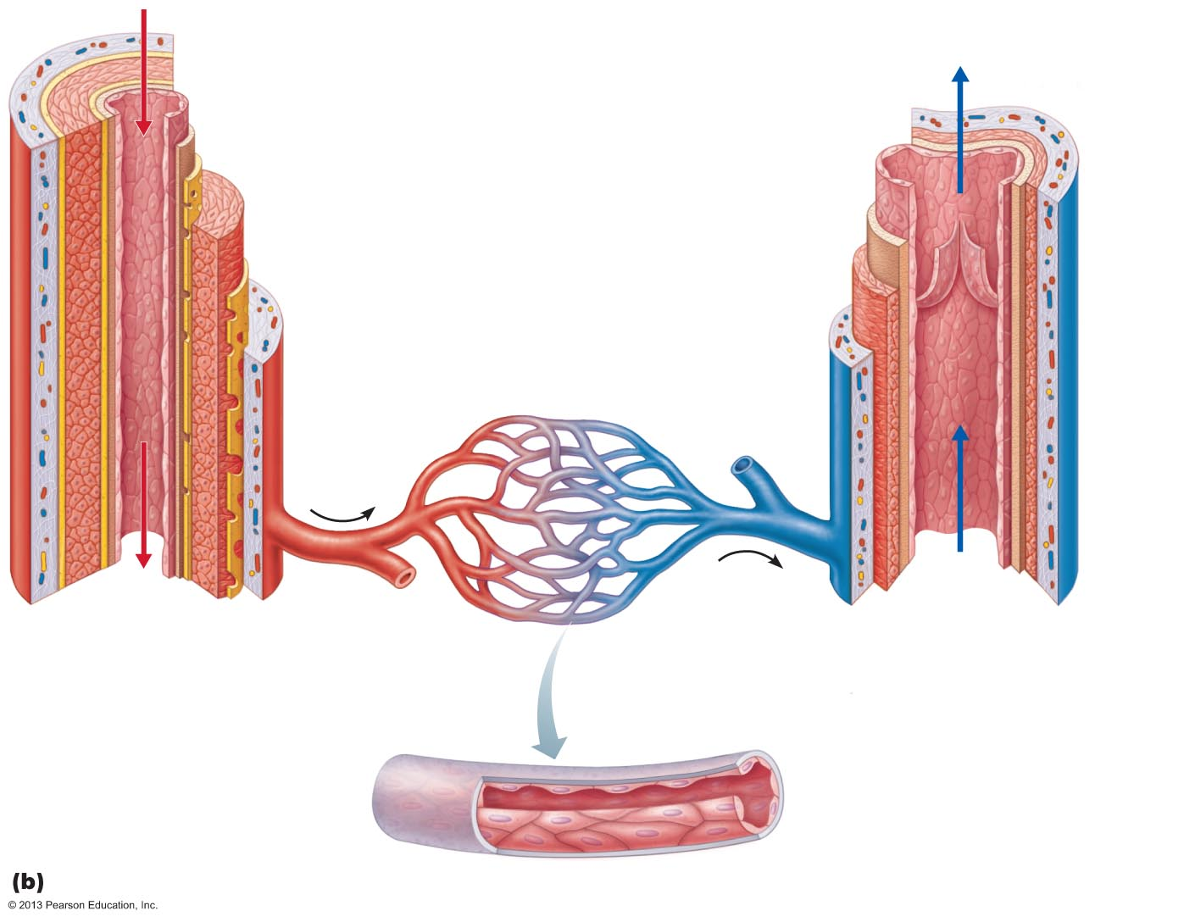
Figure 19.1b Generalized structure of arteries, veins, and capillaries.
Tunica intima
• Endothelium
• Subendothelial layer
• Internal elastic membrane
Tunica media
(smooth muscle and
elastic fibers)
Valve
• External elastic membrane
Tunica externa
(collagen fibers)
• Vasa vasorum
Lumen
Lumen
Artery
Capillary network
Vein
Basement membrane
Endothelial cells
Capillary

Slide 70
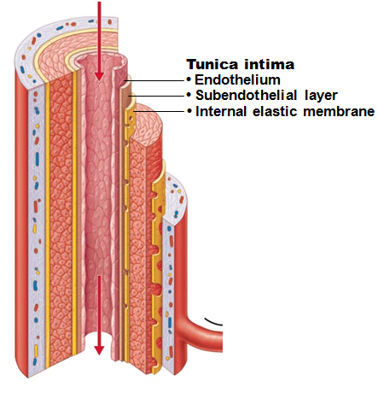
Tunics
Tunica intima
Endothelium lines lumen of all vessels
Continuous with endocardium
Slick surface reduces friction
Subendothelial layer in vessels larger than 1 mm; connective tissue basement membrane

Slide 71
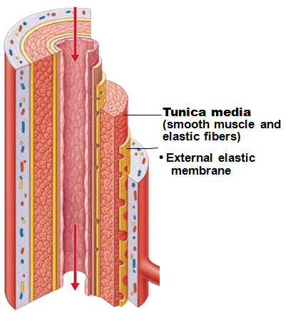
Tunics
Tunica media
Smooth muscle and sheets of elastin
Sympathetic vasomotor nerve fibers control vasoconstriction and vasodilation of vessels
Influence blood flow and blood pressure

Slide 72
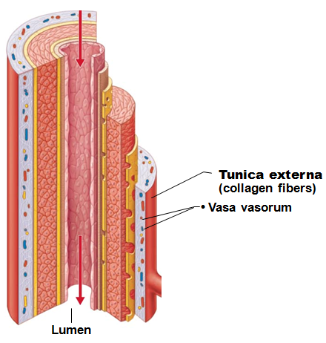
Tunics
Tunica externa (tunica adventitia)
Collagen fibers protect and reinforce; anchor to surrounding structures
Contains nerve fibers, lymphatic vessels
Vasa vasorum
“vessel’s vessels”
of larger vessels nourishes external layer

Slide 73
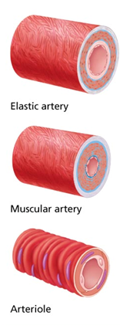
Arterial System: Elastic Arteries
Large thick-walled arteries with elastin in all three tunics
Aorta and its major branches
Large lumen offers low-resistance
Act as pressure reservoirs
expand and recoil as blood ejected from heart
Smooths pressure downstream

Slide 74
Arterial System: Muscular Arteries
Distal to elastic arteries
Deliver blood to body organs
Thick tunica media with more smooth muscle
Active in vasoconstriction
Can help to control blood pressure

Slide 75
Arterial System: Arterioles
Smallest arteries
Lead to capillary beds
Control flow into capillary beds via vasodilation and vasoconstriction

Slide 76
Capillaries
Microscopic blood vessels
Walls of thin tunica intima
In the smallest capillaries, one squamous cell forms entire circumference
Diameter allows only single RBC to pass at a time

Slide 77
Capillaries
In all tissues except for cartilage, epithelia, cornea and lens of eye
Provide direct access to almost every cell
Functions
Exchange of gases, nutrients, wastes, hormones, etc., between blood and interstitial fluid

Slide 78
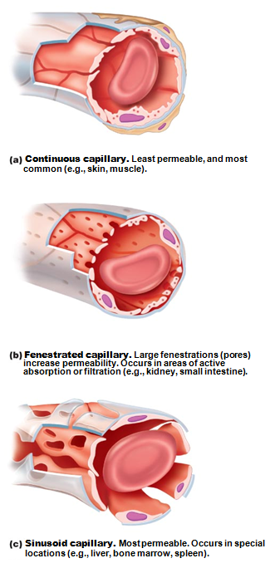
Capillaries
Three structural types
Continuous capillaries
Fenestrated capillaries
Sinusoid capillaries (sinusoids)
Also called “discontinuous”

Slide 79
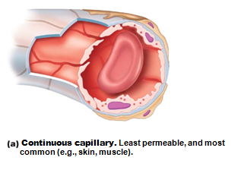
Continuous Capillaries
Abundant in skin and muscles
Tight junctions connect endothelial cells
Intercellular clefts allow passage of fluids and small solutes
Continuous capillaries of brain unique
Tight junctions complete, forming blood-brain barrier

Slide 80
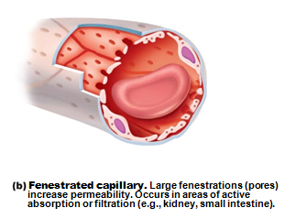
Fenestrated Capillaries
Some endothelial cells contain pores (fenestrations)
More permeable than continuous capillaries
Function in absorption or filtrate formation
small intestines, endocrine glands, and kidneys

Slide 81
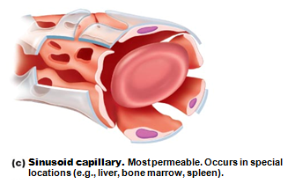
Sinusoid Capillaries
Fewer tight junctions
usually fenestrated
larger intercellular clefts
large lumens
Blood flow sluggish
Large molecules and blood cells pass between blood and surrounding tissues
Found only in the liver, bone marrow, spleen, adrenal medulla
Macrophages in lining to destroy bacteria

Slide 82
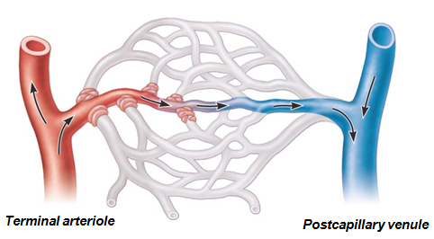
Blood Flow Through Capillary Beds
True capillaries normally branch from metarteriole and return to thoroughfare channel
Precapillary sphincters regulate blood flow into true capillaries
Blood may go into true capillaries or to shunt
Regulated by local chemical conditions and vasomotor nerves

Slide 83
Venous System: Venules
Formed when capillary beds unite
Smallest postcapillary venules
Very porous; allow fluids and WBCs into tissues
Consist mostly of endothelium
Larger venules have one or two layers of smooth muscle cells

Slide 84
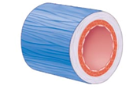
Veins
Formed when venules converge
Have thinner walls, larger lumens compared with corresponding arteries
Blood pressure lower than in arteries
Thin tunica media; thick tunica externa of collagen fibers and elastic networks
Called capacitance vessels
Acts as blood reservoirs
contain up to 65% of blood supply

Slide 85
Veins
Adaptations ensure return of blood to heart despite low pressure
Large-diameter lumens offer little resistance
Venous valves prevent backflow of blood
Most abundant in veins of limbs

Slide 86
Vascular Anastomoses
Interconnections of blood vessels
Arterial anastomoses provide alternate pathways to given body region
Common at joints, in abdominal organs, brain, and heart; none in retina, kidneys, spleen
Vascular shunts of capillaries are examples of arteriovenous anastomoses
Venous anastomoses are common

Slide 87
Physiology of Circulation: Definition of Terms
Blood pressure (BP)
Force per unit area exerted on wall of blood vessel by blood
Expressed in mm Hg
Measured as systemic arterial BP in large arteries near heart
Pressure gradient provides driving force that keeps blood moving from higher to lower pressure areas

Slide 88
Physiology of Circulation: Definition of Terms
Resistance (peripheral resistance)
Opposition to flow
Measure of amount of friction blood encounters with vessel walls, generally in peripheral (systemic) circulation
Three important sources of resistance
Blood viscosity
Total blood vessel length
Blood vessel diameter

Slide 89
Resistance
Factors that remain relatively constant:
Blood viscosity
The "stickiness" of blood due to formed elements and plasma proteins
Increased viscosity = increased resistance
Blood vessel length
Longer vessel = greater resistance encountered
Blood vessel diameter
Greatest influence on resistance
Small arterioles greatly influence resistance

Slide 90
Systemic Blood Pressure
Pumping action of heart generates blood flow
Pressure results when flow is opposed by resistance
Systemic pressure
Highest in aorta
Declines throughout pathway
0 mm Hg in right atrium
Steepest drop occurs in arterioles

Slide 91
Arterial Blood Pressure
Reflects two factors of arteries close to heart
Elasticity (compliance or distensibility)
Volume of blood forced into them at any time
Blood pressure near heart is pulsatile

Slide 92
Arterial Blood Pressure
Systolic pressure:
pressure exerted in aorta during ventricular contraction
Averages 120 mm Hg in normal adult
Diastolic pressure:
lowest level of aortic pressure
Pulse pressure
difference between systolic and diastolic pressure
Pulse
Expansion and recoil of arteries as they are exposed to the changing pressures

Slide 93
Factors Aiding Venous Return
Muscular pump:
contraction of skeletal muscles "milks" blood toward heart; valves prevent backflow
Respiratory pump:
pressure changes during breathing move blood toward heart by squeezing abdominal veins as thoracic veins expand
Venoconstriction under sympathetic control pushes blood toward heart

Slide 94
Maintaining Blood Pressure
Requires
Cooperation of heart, blood vessels, and kidneys
Supervision by brain
Main factors influencing blood pressure
Cardiac output (CO)
Peripheral resistance (PR)
Blood volume

Slide 95
Control of Blood Pressure
Short-term neural and hormonal controls
Counteract fluctuations in blood pressure by altering peripheral resistance and CO
Long-term renal regulation
Counteracts fluctuations in blood pressure by altering blood volume

Slide 96
Short-term Mechanisms: Neural Controls
Neural controls of peripheral resistance
altering blood vessel diameter
If low blood volume all vessels constricted except those to heart and brain
Alter blood distribution to organs in response to specific demands

Slide 97
Short-term Mechanisms: Neural Controls
Neural controls operate via reflex arcs that involve
Baroreceptors
Carotid sinuses
Aortic arch
Walls of large arteries of neck and thorax
Cardiovascular center of medulla
Vasomotor fibers to heart and vascular smooth muscle
Sometimes input from chemoreceptors and higher brain centers

Slide 98
The Cardiovascular Center
Clusters of sympathetic neurons in medulla oversee changes in CO and blood vessel diameter
Consists of cardiac centers and vasomotor center
Vasomotor center sends steady impulses via sympathetic efferents to blood vessels → moderate constriction called vasomotor tone
Receives inputs from baroreceptors, chemoreceptors, and higher brain centers

Slide 99
Short-term Mechanisms: Chemoreceptor Reflexes
Chemoreceptors in aortic arch and large arteries of neck detect increase in CO₂, or drop in pH or O₂
Cause increased blood pressure by
Signaling cardioacceleratory center → increase CO
Signaling vasomotor center → increase vasoconstriction

Slide 100
Short-term Mechanisms: Influence of Higher Brain Centers
Reflexes in medulla
Hypothalamus and cerebral cortex can modify arterial pressure via relays to medulla
Hypothalamus increases blood pressure during stress
Hypothalamus mediates redistribution of blood flow during exercise and changes in body temperature

Slide 101
Short-term Mechanisms: Hormonal Controls
Short term regulation via changes in peripheral resistance
Long term regulation via changes in blood volume

Slide 102
Short-term Mechanisms: Hormonal Controls
Cause increased blood pressure
Epinephrine and norepinephrine from adrenal gland → increased Cardiac Output and vasoconstriction
Angiotensin II stimulates vasoconstriction
High ADH levels cause vasoconstriction
Cause lowered blood pressure
Atrial natriuretic peptide causes decreased blood volume by antagonizing aldosterone

Slide 103
Long-term Mechanisms: Renal Regulation
Baroreceptors quickly adapt to chronic high or low BP so are ineffective for long term support
Long-term mechanisms control BP by altering blood volume via kidneys
Direct renal mechanism
Increased BP or blood volume causes elimination of more urine, thus reducing BP
Decreased BP or blood volume causes kidneys to conserve water, and BP rises
Indirect renal mechanism
Dependent on hormones: renin-angiotensin-aldosterone

Slide 104
Indirect Mechanism
The renin-angiotensin-aldosterone mechanism
Decreased Arterial blood pressure triggers release of renin
Renin catalyzes conversion of angiotensinogen from liver to angiotensin I
Angiotensin converting enzyme, especially from lungs, converts angiotensin I to angiotensin II
Increases blood volume because angiotensin II
Stimulates aldosterone secretion
Retains water
Causes ADH release
Retains water by reducing urine output
Triggers the thirst center in the brain
Brings external water into the system

Slide 105
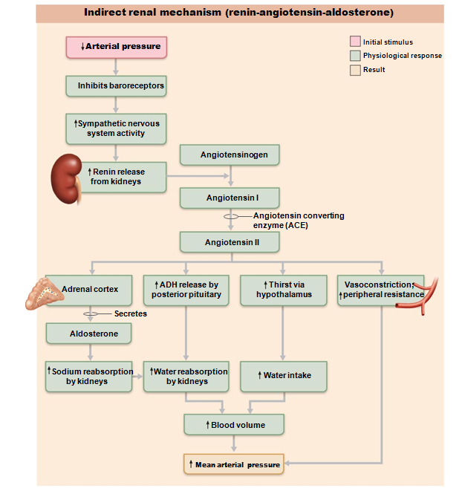
Indirect:
triggers hormones

Slide 106
Monitoring Circulatory Efficiency
Vital signs:
pulse and blood pressure, along with respiratory rate and body temperature
Pulse:
pressure wave caused by expansion and recoil of arteries
Radial pulse
(taken at the Radial Artery in the wrist) routinely used
Pressure points
where arteries close to body surface
Can be compressed to stop blood flow

Slide 107
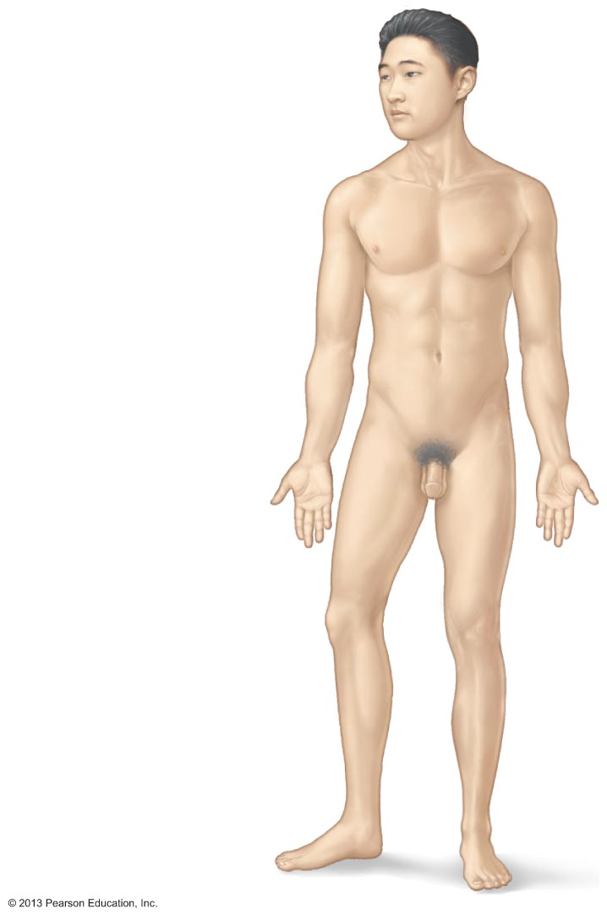
Figure 19.12 Body sites where the pulse is most easily palpated.
Superficial temporal artery
Facial artery
Common carotid artery
Brachial artery
Radial artery
Femoral artery
Popliteal artery
Posterior tibial
artery
Dorsalis pedis
artery

Slide 108
Measuring Blood Pressure
Systemic arterial BP
Measured indirectly by auscultatory method using a sphygmomanometer
Pressure increased in cuff until it exceeds systolic pressure in brachial artery
Pressure released slowly and examiner listens for sounds of Korotkoff with a stethoscope

Slide 109
Measuring Blood Pressure
Systolic pressure,
normally less than 120 mm Hg
when sounds first occur as blood starts to spurt through artery
Diastolic pressure
normally less than 80 mm Hg
when sounds disappear because artery no longer constricted
blood flowing freely

Slide 110
Variations in Blood Pressure
Transient elevations occur during changes in
Posture
physical exertion
emotional upset
fever
Age, sex, weight, race, mood, and posture may cause BP to vary

Slide 111
Alterations in Blood Pressure
Hypertension: high blood pressure
Sustained elevated arterial pressure of 140/90 or higher
Prehypertension if values elevated but not yet in hypertension range
May be transient adaptations during fever, physical exertion, and emotional upset
Often persistent in obese people

Slide 112
Homeostatic Imbalance: Hypertension
Prolonged hypertension major cause of heart failure, vascular disease, renal failure, and stroke
Heart must work harder → myocardium enlarges and weakens
accelerates atherosclerosis

Slide 113
Primary or Essential Hypertension
90% of hypertensive conditions
No underlying cause identified
Risk factors include heredity, diet, obesity, age, diabetes mellitus, stress, and smoking
No cure but can be controlled
Restrict salt, fat, cholesterol intake
Increase exercise, lose weight, stop smoking
Antihypertensive drugs

Slide 114
Homeostatic Imbalance: Hypertension
Secondary hypertension less common
Due to identifiable disorders including obstructed renal arteries, kidney disease, and endocrine disorders such as hyperthyroidism and Cushing's syndrome
Treatment focuses on correcting underlying cause

Slide 115
Alterations in Blood Pressure
Hypotension: low blood pressure
Blood pressure below 90/60 mm Hg
Usually not a concern
Only if leads to inadequate blood flow to tissues
Often associated with long life and lack of cardiovascular illness

Slide 116
Homeostatic Imbalance: Hypotension
Orthostatic hypotension:
temporary low BP and dizziness when suddenly rising from sitting or reclining position
Chronic hypotension:
May point towards poor nutrition
warning sign for Addison's disease or hypothyroidism
Acute hypotension:
important sign of circulatory shock

Slide 117
Capillary Exchange of Respiratory Gases and Nutrients
Diffusion down concentration gradients
O₂ and nutrients from blood to tissues
CO₂ and metabolic wastes from tissues to blood
Lipid-soluble molecules diffuse directly through endothelial membranes
Water-soluble solutes pass through clefts and fenestrations
Larger molecules, such as proteins, are actively transported in pinocytotic vesicles or caveolae

Slide 118
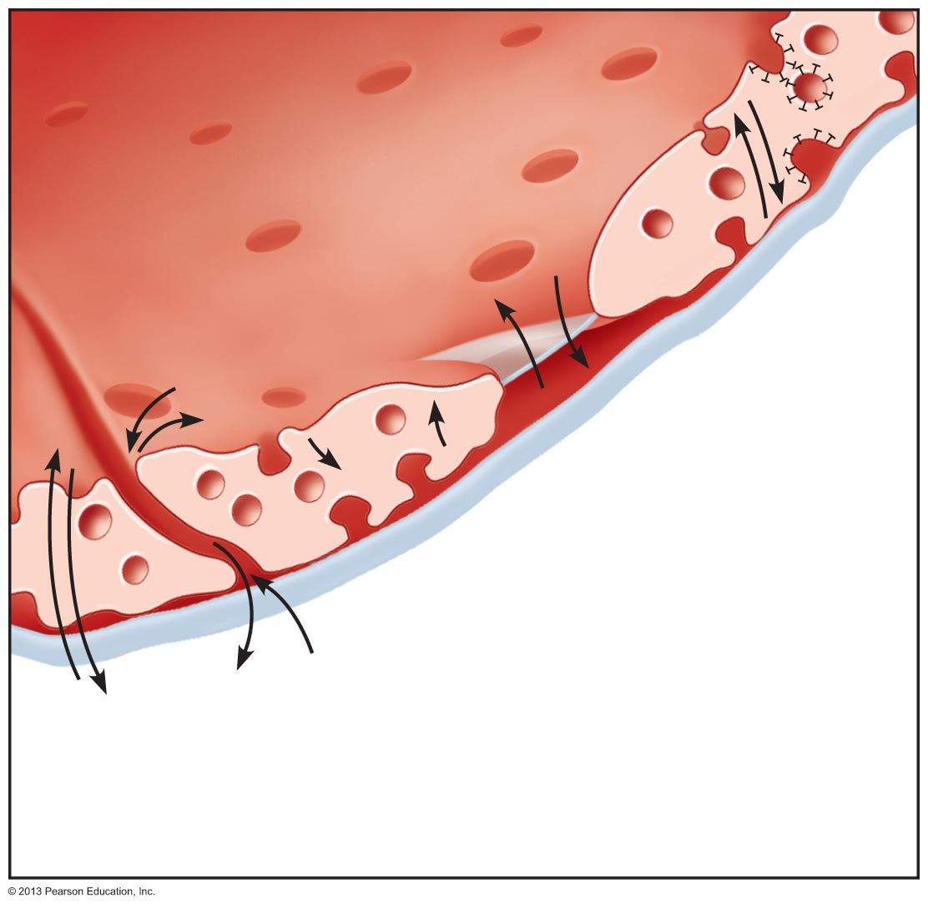
Figure 19.16 Capillary transport mechanisms. (2 of 2)
Lumen
Caveolae
Pinocytotic
vesicles
Endothelial
fenestration
(pore)
Intercellular
cleft
4
Transport
via vesicles
or caveolae
(large
substances)
3
Movement
through
fenestrations (water-soluble
substances)
Basement
membrane
2
Movement
through
intercellular
clefts (water-
soluble
substances)
1
Diffusion
through
membrane
(lipid-soluble
substances)

Slide 119
Circulatory Shock
Any condition in which
Blood vessels inadequately filled
Blood cannot circulate normally
Results in inadequate blood flow to meet tissue needs

Slide 120
Circulatory Shock
Hypovolemic shock:
results from large-scale blood loss
Vascular shock:
results from extreme vasodilation and decreased peripheral resistance
Cardiogenic shock:
results when an inefficient heart cannot sustain adequate circulation

Slide 121
Identifying Arteries and Veins
Most arteries and veins share a name
Femoral Artery
Femoral Vein
Many vessels are named for nearby anatomy and regions
Renal Artery
Gonadal Artery
Iliac Artery
Axillary Artery

Slide 122
Note on Vessel Images
The upcoming images have been edited to reflect the structures I’d like for you to know.
They match up with the images in your worksheets. In the presentation, you’ll notice that some of the veins are in brown. These are the structures that do not have an arterial twin.
Example
Internal Carotid Artery does NOT have an Internal Carotid Vein that runs with it.
Instead, we have an Internal Jugular Vein

Slide 123
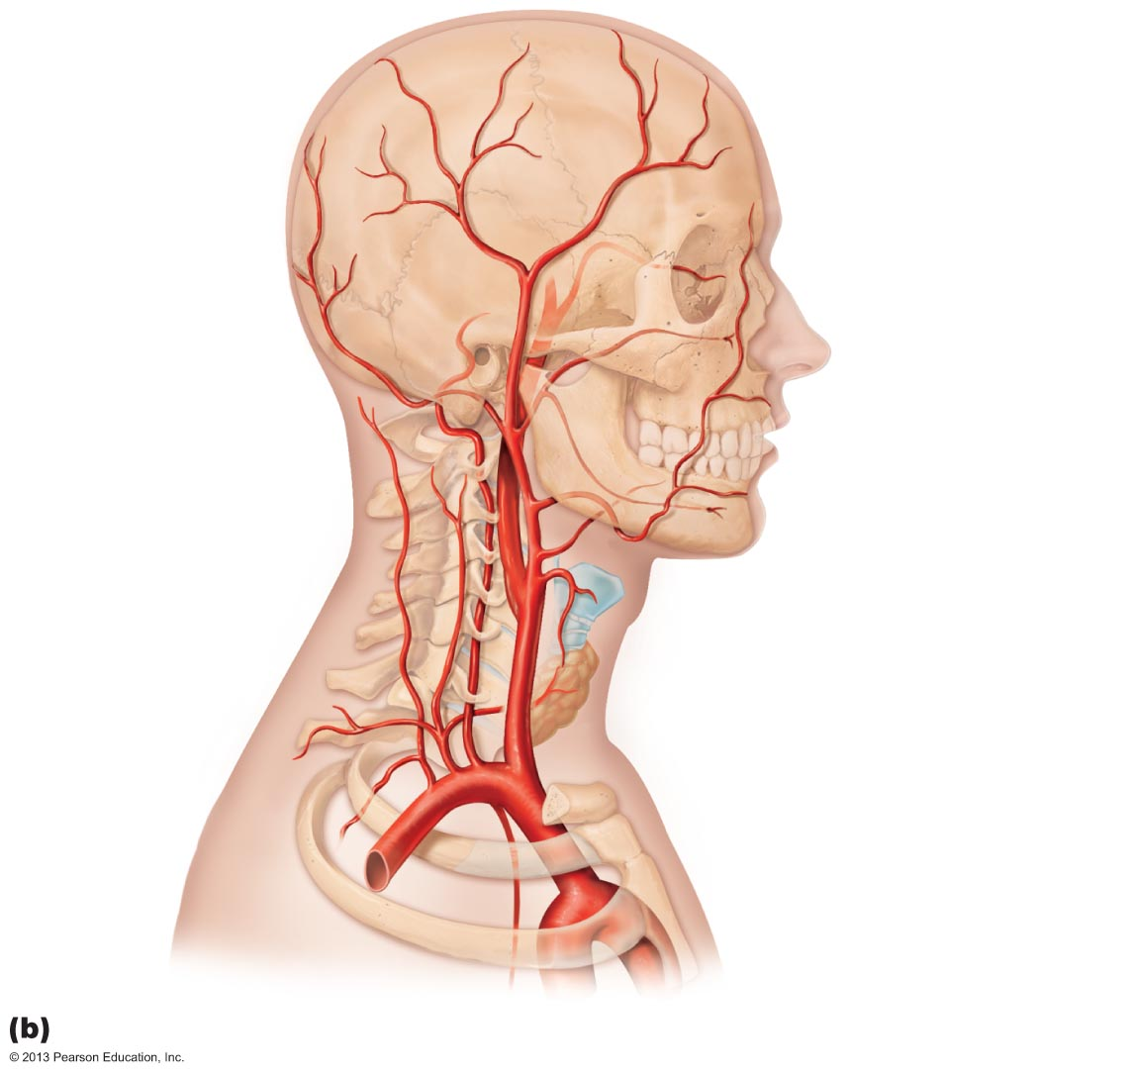
Figure 19.22b Arteries of the head, neck, and brain.
Ophthalmic artery
Branches of
the external
carotid artery
Vertebral
artery
• Superficial
temporal artery
Internal
carotid artery
External
carotid artery
Common
carotid artery
Arteries of the head and neck, right aspect

Slide 124
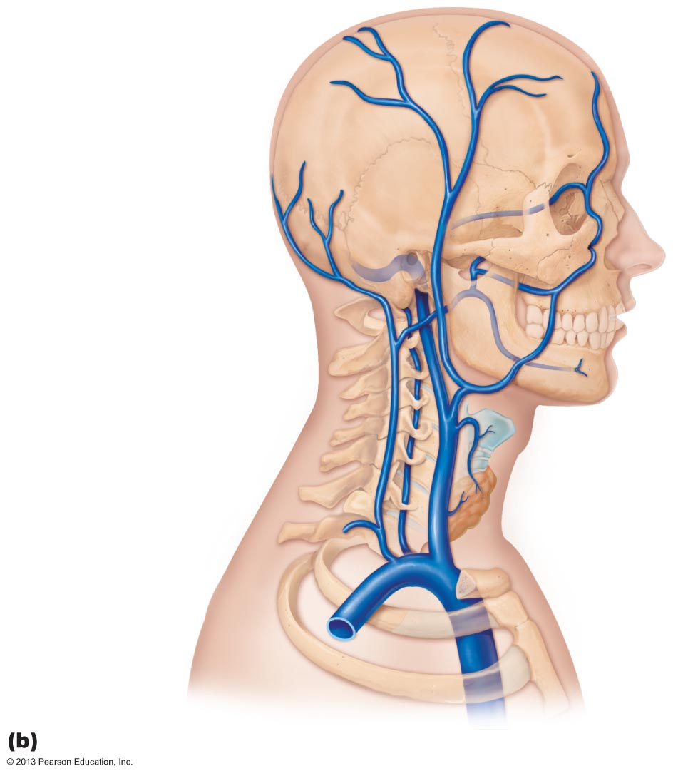
Figure 19.27b Venous drainage of the head, neck, and brain.
Ophthalmic vein
Facial vein
Occipital vein
Superficial
temporal vein
Posterior
auricular vein
External
jugular vein
Vertebral vein
Internal
jugular vein
Brachiocephalic
vein
Subclavian vein
Superior
vena cava

Slide 125
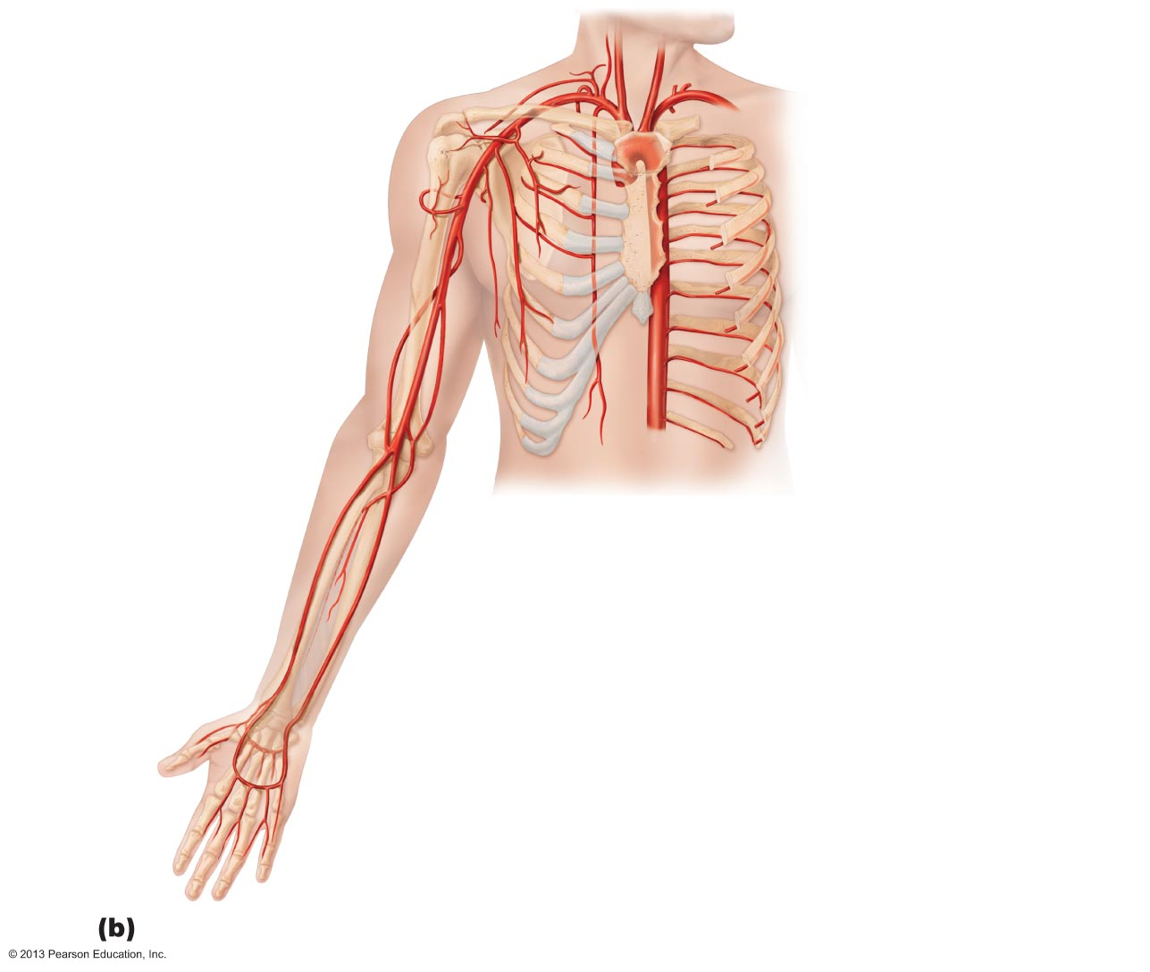
Common carotid arteries
Right subclavian artery
Left subclavian artery
Axillary artery
Brachiocephalic trunk
Subscapular artery
Brachial artery
Deep artery of arm
Thoracic aorta
Common
interosseous artery
Radial artery
Ulnar artery
Deep palmar arch
Superficial palmar arch
Digital arteries

Slide 126
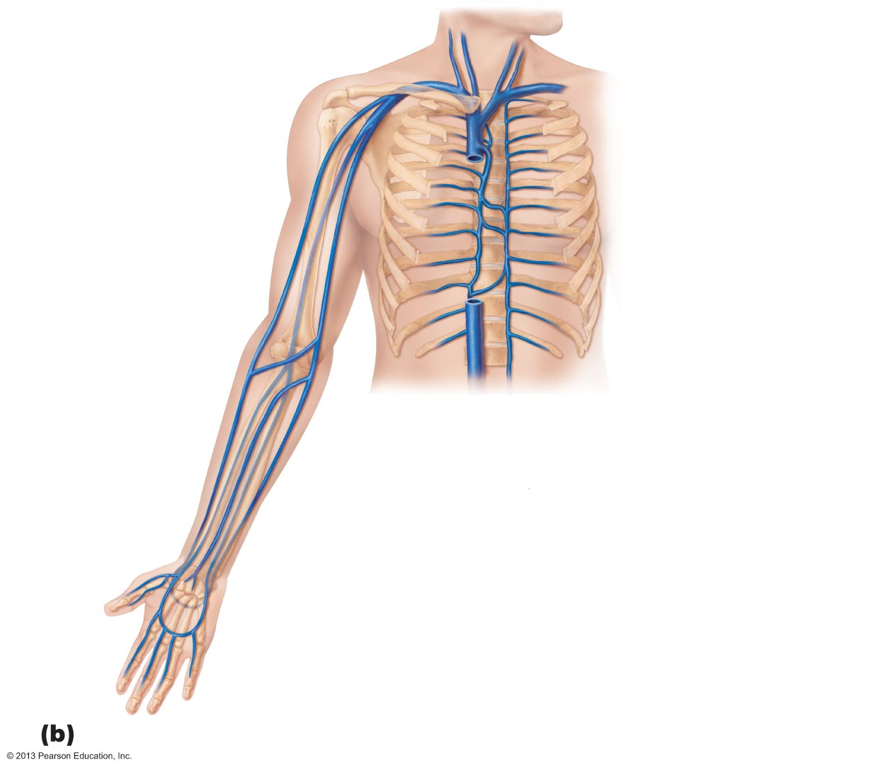
Brachiocephalic veins
Internal jugular vein
Right subclavian vein
External jugular vein
Axillary vein
Left subclavian vein
Brachial vein
Superior vena cava
Cephalic vein
Azygos vein
Basilic vein
Accessory hemiazygos
vein
Hemiazygos vein
Inferior vena cava
Median cubital
vein
Median
antebrachial vein
Cephalic vein
Basilic vein
Radial vein
Ulnar vein
Deep venous
palmar arch
Superficial venous
palmar arch
Digital veins

Slide 127
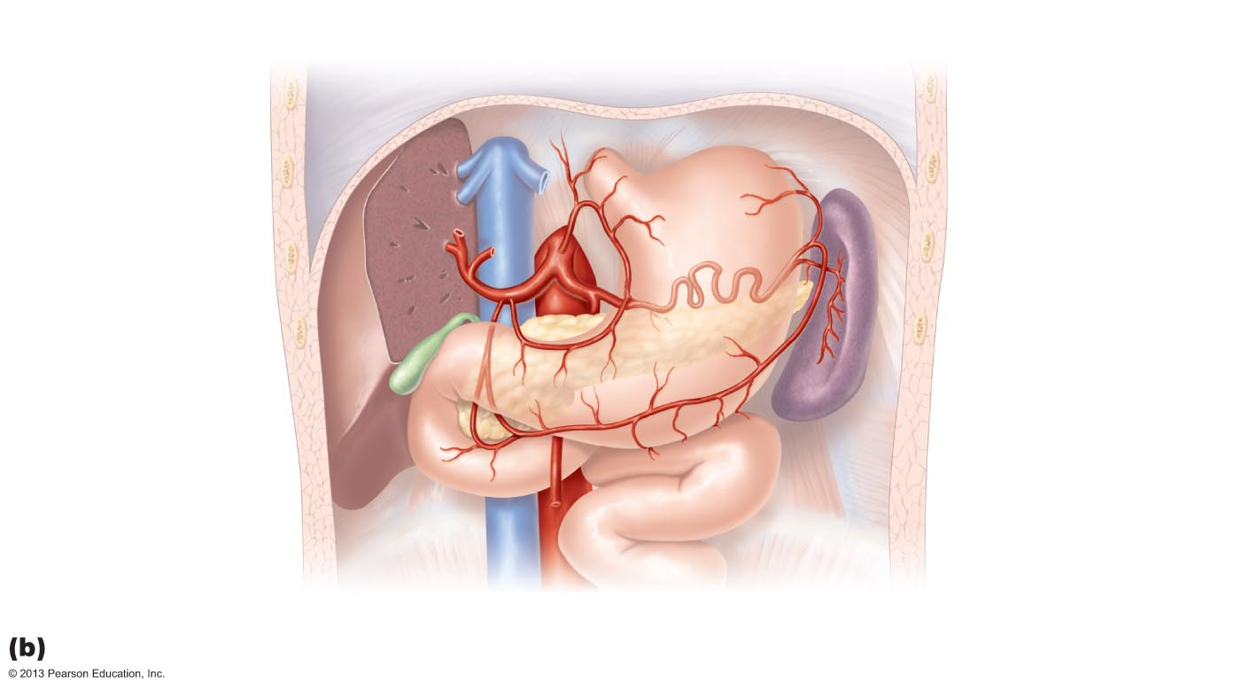
Figure 19.24b Arteries of the abdomen.
Inferior vena cava
Celiac trunk
Common
hepatic artery
Left gastric artery
Hepatic
artery proper
Splenic artery
Gastroduodenal
artery
Right
gastric artery
Superior mesenteric
artery
Abdominal aorta

Slide 128
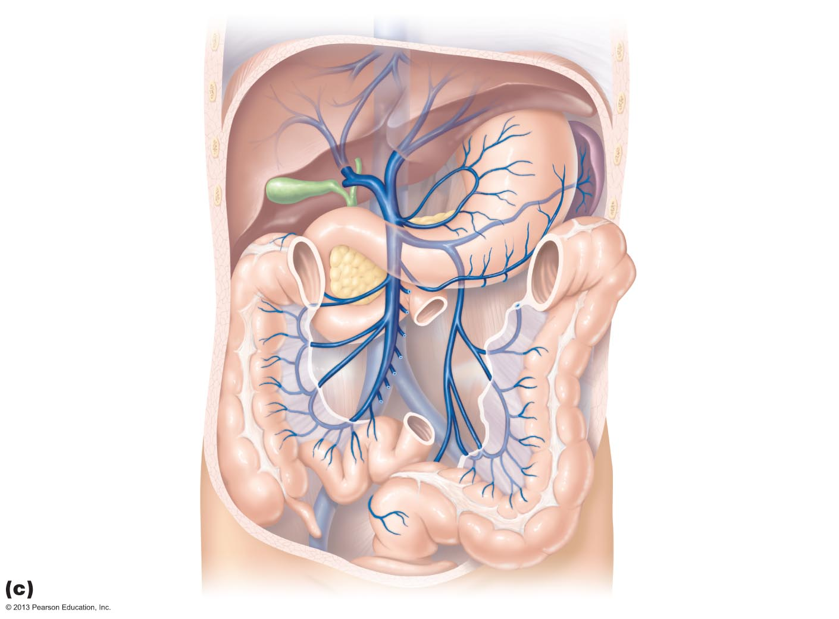
Figure 19.29c Veins of the abdomen.
Hepatic veins
Gastric veins
Inferior vena cava
Hepatic portal
vein
Splenic vein
Right
gastroepiploic vein
Inferior
mesenteric vein
Superior
mesenteric vein
The hepatic portal circulation.

Slide 129
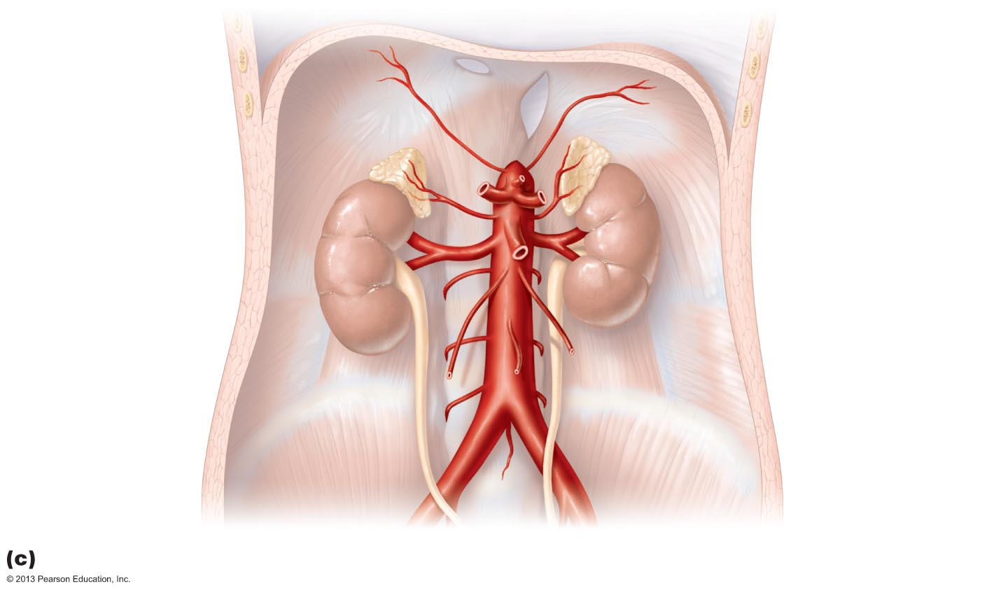
Figure 19.24c Arteries of the abdomen.
Inferior
phrenic artery
Adrenal
(suprarenal) gland
Middle
suprarenal artery
Celiac trunk
Renal artery
Superior
mesenteric artery
Abdominal aorta
Gonadal
(testicular
or ovarian) artery
Lumbar arteries
Inferior
mesenteric artery
Median
sacral artery
Common
iliac artery

Slide 130
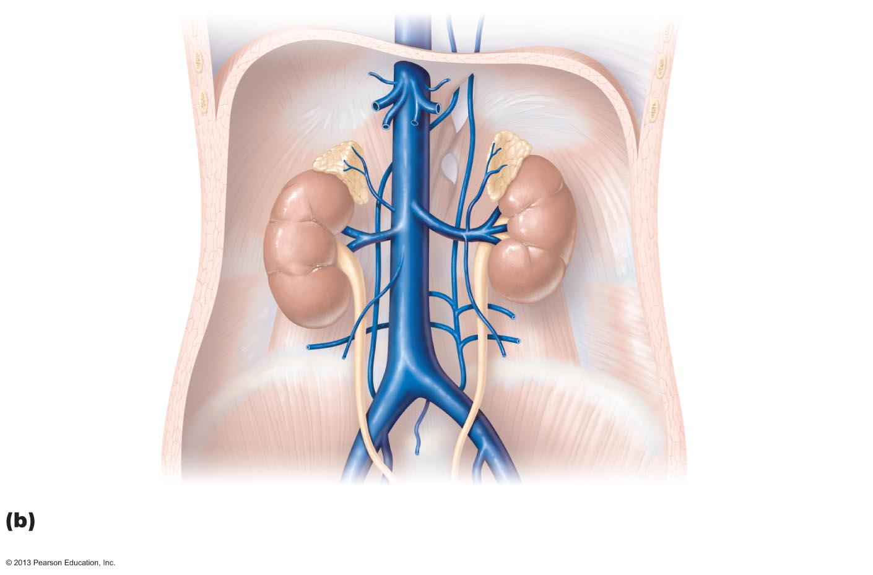
Figure 19.29b Veins of the abdomen.
Inferior phrenic
vein
Hepatic veins
Inferior vena cava
Left suprarenal
vein
Right suprarenal
vein
Renal veins
Left ascending
lumbar vein
Right gonadal
vein
Lumbar veins
Left gonadal
vein
Common iliac
vein
External iliac
vein
Internal iliac
vein

Slide 131
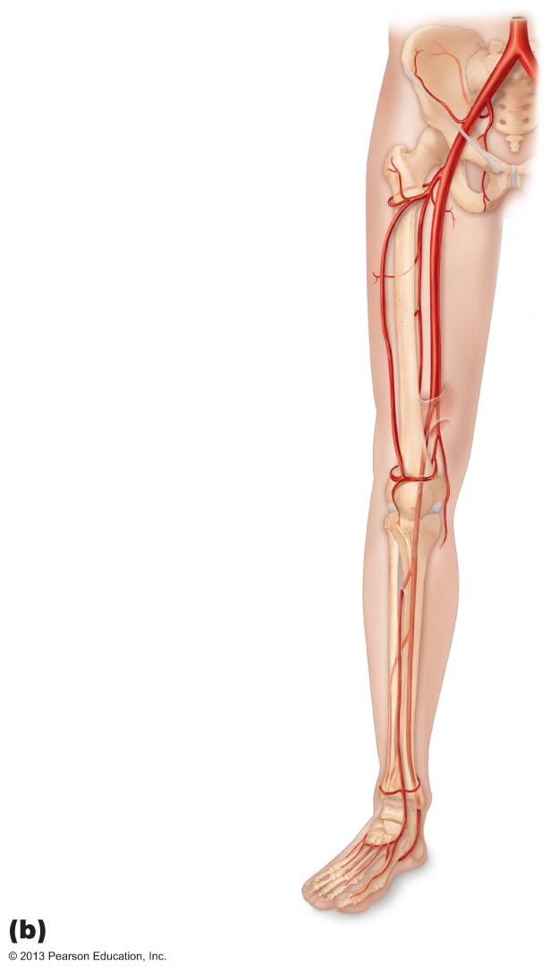
Common iliac artery
Internal iliac artery
External iliac artery
Deep artery of thigh
Lateral circumflex
femoral artery
Femoral artery
Popliteal artery
Anterior tibial artery
Posterior tibial artery
Fibular artery
Dorsalis pedis artery
Dorsal metatarsal
arteries
Anterior view

Slide 132
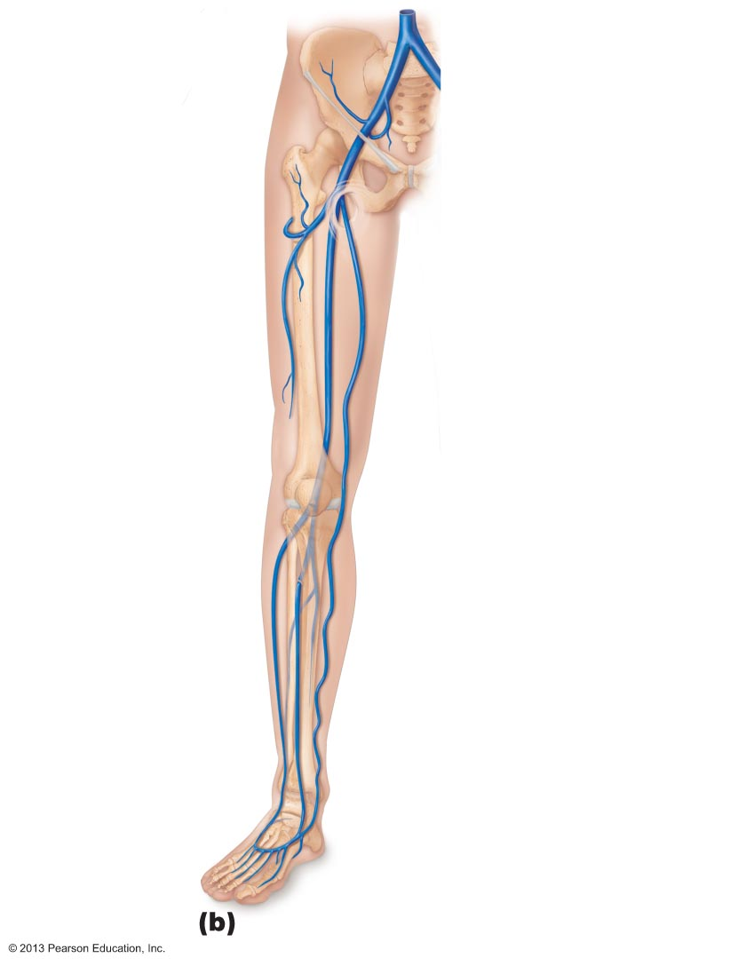
Common iliac vein
Internal iliac vein
External iliac vein
Femoral vein
Great saphenous
vein (superficial)
Popliteal vein
Small
saphenous vein
Fibular vein
Anterior
tibial vein
Dorsalis
pedis vein
Dorsal
venous arch
Dorsal
metatarsal veins

Slide 133
Figure 19.25c Arteries of the right pelvis and lower limb.
Popliteal artery
Anterior tibial
artery
Fibular artery
Posterior tibial
artery
Dorsalis pedis
artery (from top
of foot)
Plantar arch

Slide 134
Figure 19.30c Veins of the right lower limb.
Great
saphenous
vein
Popliteal
vein
Anterior
tibial vein
Fibular
vein
Small
saphenous
vein
(superficial)
Posterior
tibial
vein
Plantar
veins
Deep
plantar arch
Digital veins

