Slide 1
Exam Two Material
Chapters 18 & 19

Slide 2
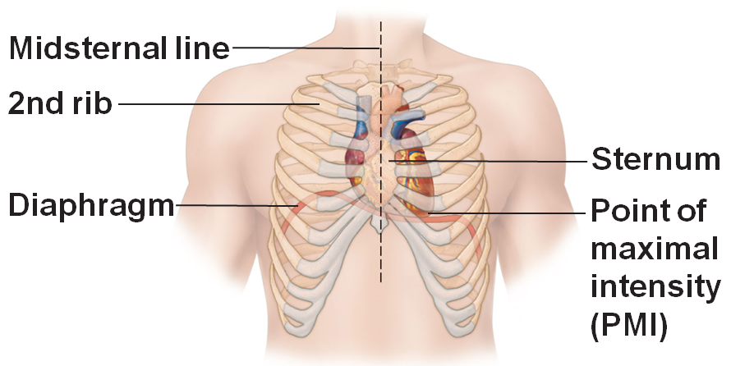
Heart Anatomy
Approximately the size of a fist
Location
In the mediastinum between second rib and fifth intercostal space
On the superior surface of diaphragm
Anterior to the vertebral column, posterior to the sternum
Enclosed in pericardium, a double-walled sac

Slide 3
Pericardium
Superficial fibrous pericardium
Protects, anchors, and prevents overfilling

Slide 4
Pericardium
Deep two-layered serous pericardium
Parietal layer
lines the internal surface of the fibrous pericardium
Visceral layer
(epicardium) on external surface of the heart
Separated by fluid-filled pericardial cavity (decreases friction)

Slide 5
Layers of the Heart Wall
Epicardium
visceral layer of the serous pericardium

Slide 6
Layers of the Heart Wall
Myocardium
Spiral bundles of cardiac muscle cells
Fibrous skeleton of the heart
connective tissue
Anchors cardiac muscle fibers
Supports great vessels and valves
Limits spread of action potentials to specific paths

Slide 7
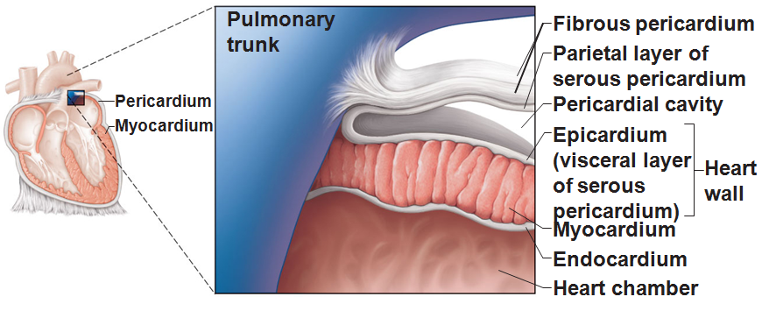
Layers of the Heart Wall
Endocardium is continuous with endothelial lining of blood vessels

Slide 8
Chambers
Four chambers
Two atria
Separated by the interatrial septum
Coronary sulcus
atrioventricular groove
encircles the junction of the atria and ventricles
Auricles increase atrial volume

Slide 9
Chambers
Two ventricles
Separated by the interventricular septum
Anterior and posterior interventricular sulci mark the position of the septum externally

Slide 10
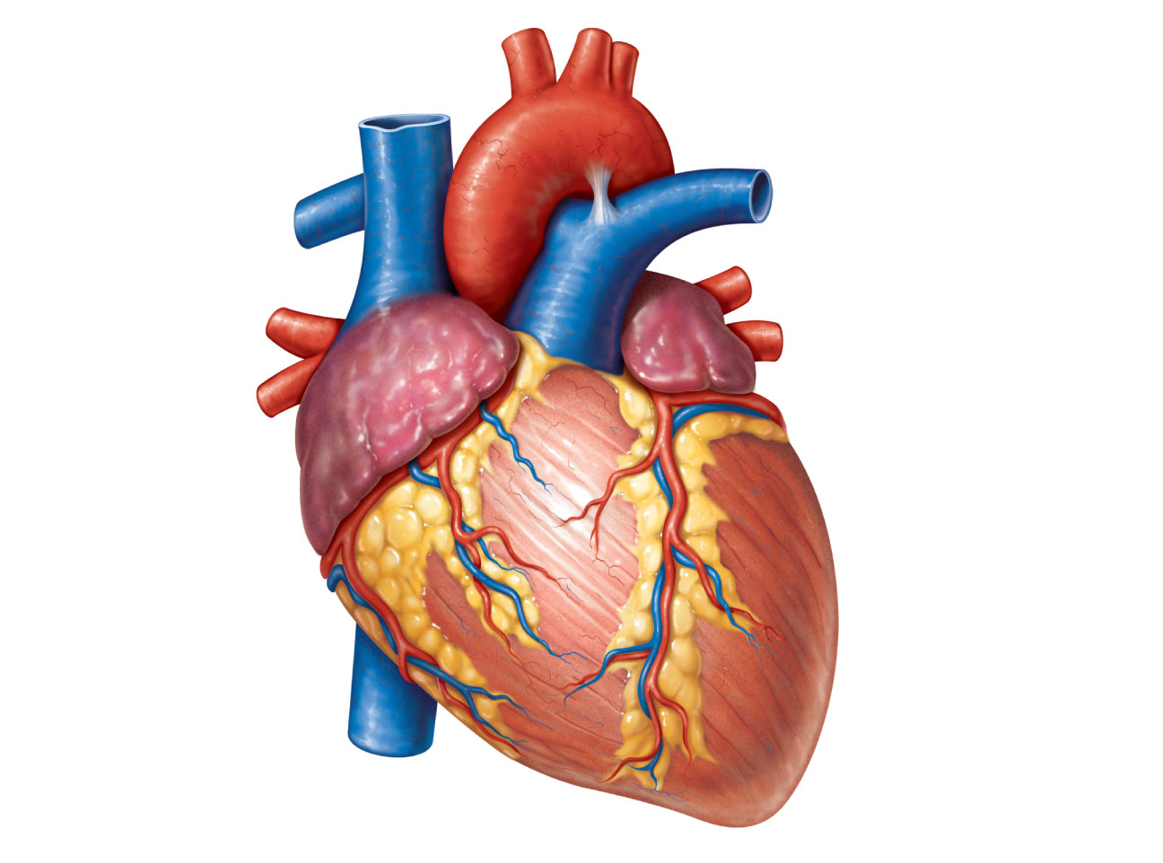
Brachiocephalic trunk
Left common carotid
artery
Left subclavian artery
Superior vena cava
Aortic arch
Right pulmonary
artery
Ligamentum arteriosum
Left pulmonary artery
Ascending aorta
Left pulmonary veins
Pulmonary trunk
Right pulmonary
veins
Auricle of
left atrium
Circumflex artery
Right atrium
Right coronary artery
(in coronary sulcus)
Left coronary artery
(in coronary sulcus)
Anterior cardiac vein
Left ventricle
Right ventricle
Right marginal artery
Great cardiac vein
Small cardiac vein
Anterior interventricular
artery (in anterior
interventricular sulcus)
Inferior vena cava
(b) Anterior view
Apex

Slide 11
Atria: The Receiving Chambers
Walls are ridged by pectinate muscles
Vessels entering right atrium
Superior vena cava
Inferior vena cava
Coronary sinus
Vessels entering left atrium
Right and left pulmonary veins

Slide 12
Ventricles: The Discharging Chambers
Walls are ridged by trabeculae carneae
Papillary muscles project into the ventricular cavities
Vessel leaving the right ventricle
Pulmonary trunk
Vessel leaving the left ventricle
Aorta

Slide 13
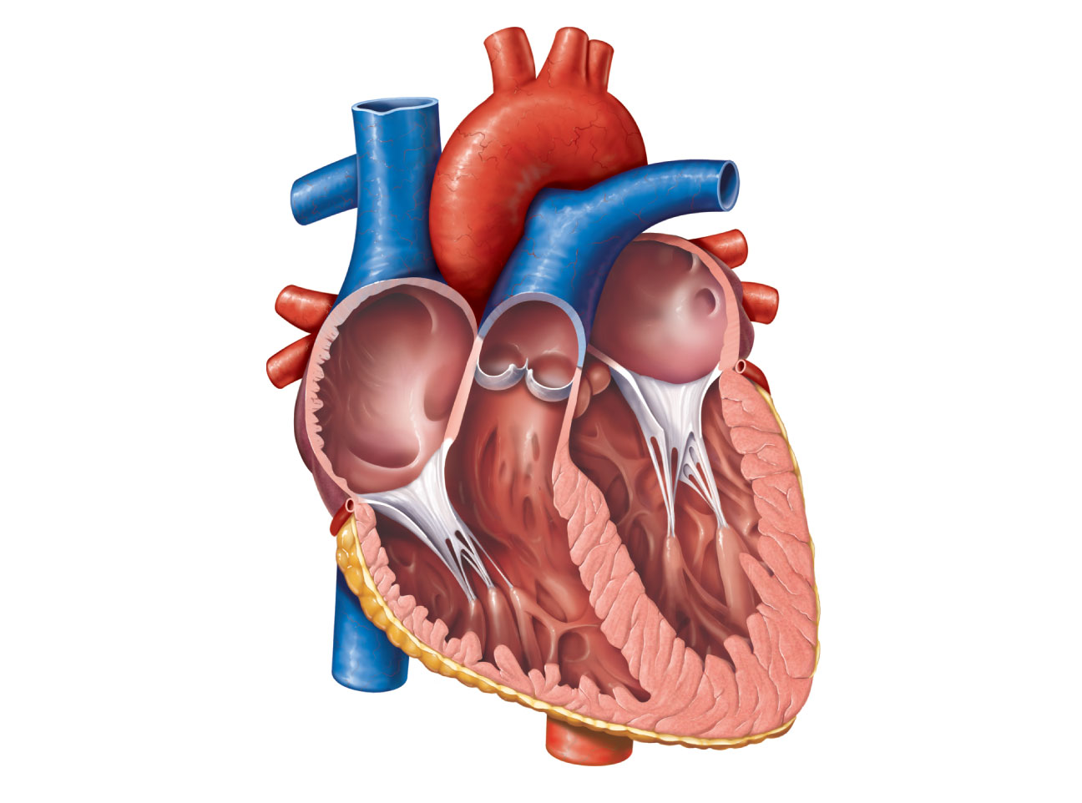
Aorta
Superior vena cava
Left pulmonary
artery
Right pulmonary
artery
Left atrium
Left pulmonary
veins
Pulmonary trunk
Right atrium
Mitral (bicuspid)
valve
Right pulmonary
veins
Fossa ovalis
Aortic valve
Pectinate muscles
Pulmonary valve
Tricuspid valve
Left ventricle
Right ventricle
Papillary muscle
Chordae tendineae
Interventricular
septum
Trabeculae carneae
Epicardium
Inferior vena cava
Myocardium
Endocardium
(e) Frontal section

Slide 14
Pathway of Blood Through the Heart
The heart is two side-by-side pumps
Right side is the pump for the pulmonary circuit
Vessels that carry blood to and from the lungs
Left side is the pump for the systemic circuit
Vessels that carry the blood to and from all body tissues

Slide 15
Pathway of Blood Through the Heart
Right atrium → tricuspid valve → right ventricle
Right ventricle → pulmonary semilunar valve → pulmonary trunk → pulmonary arteries → lungs

Slide 16
Pathway of Blood Through the Heart
Lungs → pulmonary veins → left atrium
Left atrium → bicuspid valve → left ventricle
Left ventricle → aortic semilunar valve → aorta
Aorta → systemic circulation

Slide 17
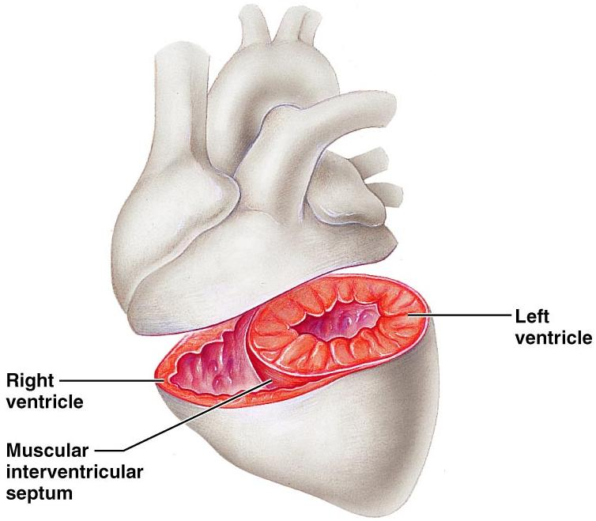
Pathway of Blood Through the Heart
Equal volumes of blood are pumped to the pulmonary and systemic circuits
Pulmonary circuit
is a short, low-pressure circulation
Systemic circuit blood
encounters much resistance in the long pathways
Anatomy of the ventricles reflects these differences

Slide 18
Please note that due to differing operating systems, some animations will not appear until the presentation is viewed in Presentation Mode (Slide Show view). You may see blank slides in the “Normal” or “Slide Sorter” views. All animations will appear after viewing in Presentation Mode and playing each animation. Most animations will require the latest version of the Flash Player, which is available at http://get.adobe.com/flashplayer.

Slide 19
Coronary Circulation
The functional blood supply to the heart muscle itself
Arterial supply varies considerably and contains many anastomoses (junctions) among branches
Collateral routes provide additional routes for blood delivery

Slide 20
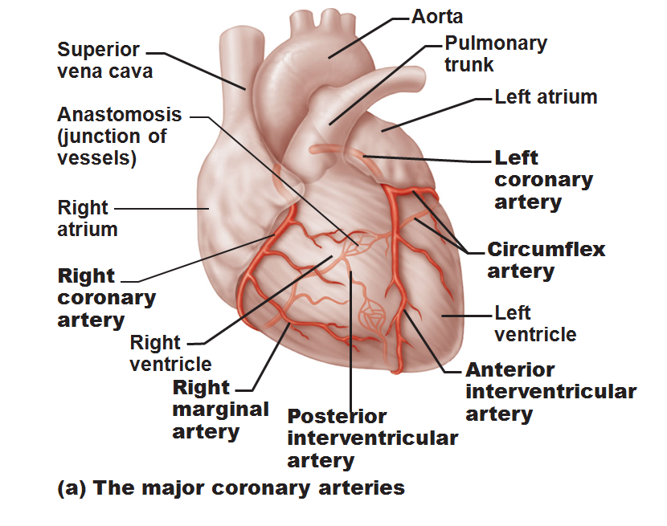
Coronary Circulation
Arteries
Right and left coronary (in atrioventricular groove)
Marginal
Circumflex
anterior interventricular arteries

Slide 21
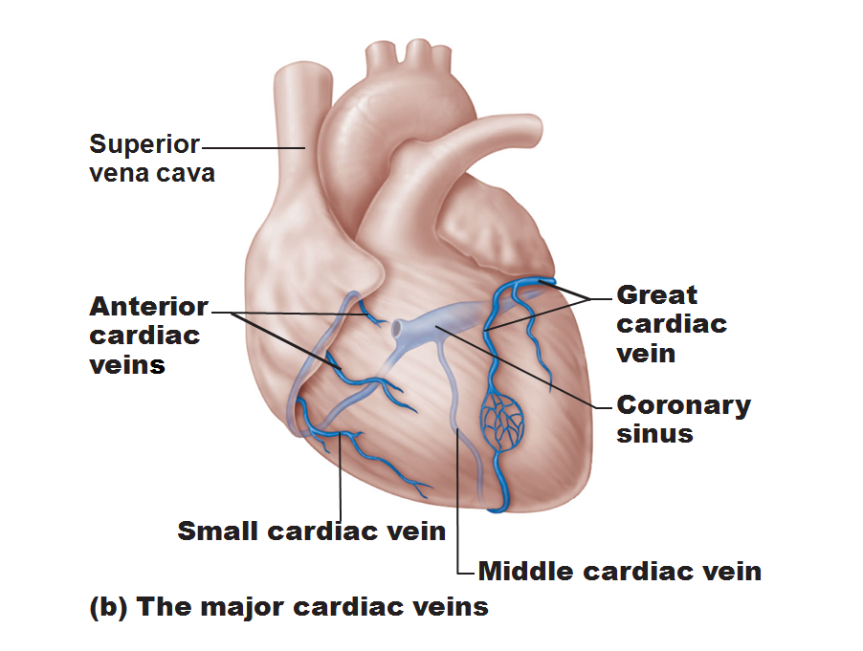
Coronary Circulation
Veins
Small cardiac,
anterior cardiac,
great cardiac veins

Slide 22
Homeostatic Imbalances
Angina pectoris
Thoracic pain caused by a fleeting deficiency in blood delivery to the myocardium
Cells are weakened
Myocardial infarction (heart attack)
Prolonged coronary blockage
Areas of cell death are repaired with noncontractile scar tissue

Slide 23
Heart Valves
Ensure unidirectional blood flow through the heart
Atrioventricular (AV) valves
Prevent backflow into the atria when ventricles contract
Tricuspid valve (right)
Mitral valve (left)
Chordae tendineae anchor AV valve cusps to papillary muscles

Slide 24
Heart Valves
Semilunar valves
Prevent backflow into the ventricles when ventricles relax
Aortic semilunar valve
Pulmonary semilunar valve

Slide 25
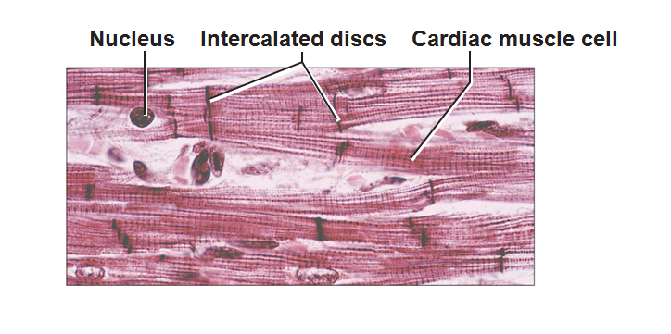
Microscopic Anatomy of Cardiac Muscle
Cardiac muscle cells are striated, short, fat, branched, and interconnected
Numerous large mitochondria

Slide 26
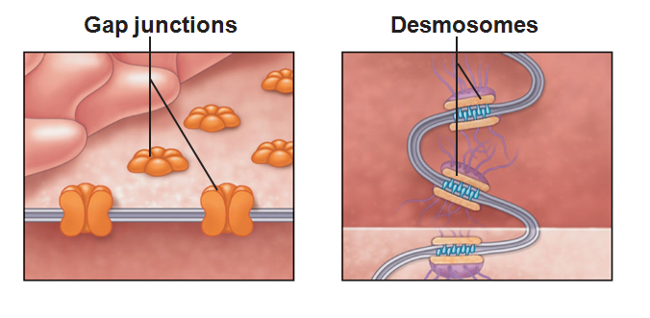
Microscopic Anatomy of Cardiac Muscle
Intercalated discs: junctions between cells anchor cardiac cells
Desmosomes prevent cells from separating during contraction
Gap junctions allow ions to pass; electrically couple adjacent cells
Heart muscle behaves as a functional syncytium

Slide 27
Cardiac Muscle Contraction
Depolarization of the heart is rhythmic and spontaneous
Gap junctions ensure the heart contracts as a unit

Slide 28
Heart Physiology: Electrical Events
Intrinsic cardiac conduction system
A network of noncontractile,autorhythmic cells that initiate and distribute impulses to coordinate the depolarization and contraction of the heart

Slide 29
Heart Physiology: Sequence of Excitation
Sinoatrial
SA node or pacemaker
Generates impulses about 75 times/minute (sinus rhythm)
Depolarizes faster than any other part of the myocardium

Slide 30
Heart Physiology: Sequence of Excitation
Atrioventricular (AV) node
Smaller diameter fibers; fewer gap junctions
Delays impulses approximately 0.1 second
Depolarizes 50 times per minute in absence of SA node input

Slide 31
Heart Physiology: Sequence of Excitation
Atrioventricular (AV) bundle (bundle of His)
Only electrical connection between the atria and ventricles

Slide 32
Heart Physiology: Sequence of Excitation
Right and left bundle branches
Two pathways in the interventricular septum that carry the impulses toward the apex of the heart

Slide 33
Heart Physiology: Sequence of Excitation
Purkinje fibers
Complete the pathway into the apex and ventricular walls
AV bundle and Purkinje fibers depolarize only 30 times per minute in absence of AV node input

Slide 34
Conducting System of Heart
Please note that due to differing operating systems, some animations will not appear until the presentation is viewed in Presentation Mode (Slide Show view). You may see blank slides in the “Normal” or “Slide Sorter” views. All animations will appear after viewing in Presentation Mode and playing each animation. Most animations will require the latest version of the Flash Player, which is available at http://get.adobe.com/flashplayer.
Notes:
Conduction system

Slide 35
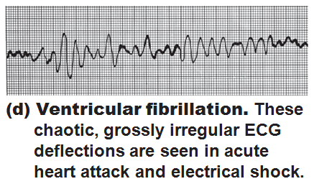
Homeostatic Imbalances
Defects in the intrinsic conduction system may result in
Arrhythmias
irregular heart rhythms
Uncoordinated atrial and ventricular contractions
Fibrillation
rapid, irregular contractions; useless for pumping blood

Slide 36
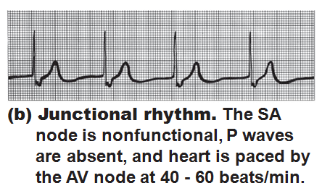
Homeostatic Imbalances
Defective SA node may result in
Ectopic focus: abnormal pacemaker takes over
If AV node takes over, there will be a junctional rhythm (40–60 bpm)

Slide 37
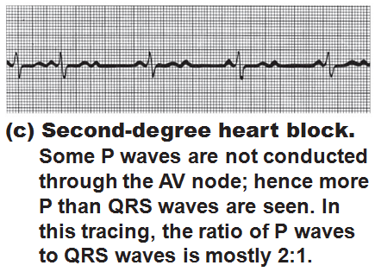
Homeostatic Imbalances
Defective AV node may result in
Partial or total heart block
Few or no impulses from SA node reach the ventricles

Slide 38
Extrinsic Innervation of the Heart
Heartbeat is modified by the ANS
Cardiac centers are located in the medulla oblongata
Cardioacceleratory center innervates SA and AV nodes, heart muscle, and coronary arteries through sympathetic neurons
Cardioinhibitory center inhibits SA and AV nodes through parasympathetic fibers in the vagus nerves

Slide 39
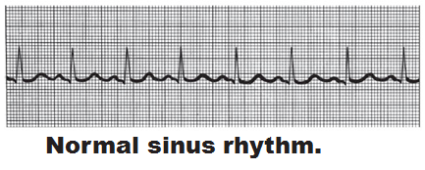
Electrocardiography
Electrocardiogram (ECG or EKG): a composite of all the action potentials
Three waves
P wave: depolarization of SA node
QRS complex: ventricular depolarization
T wave: ventricular repolarization

Slide 41
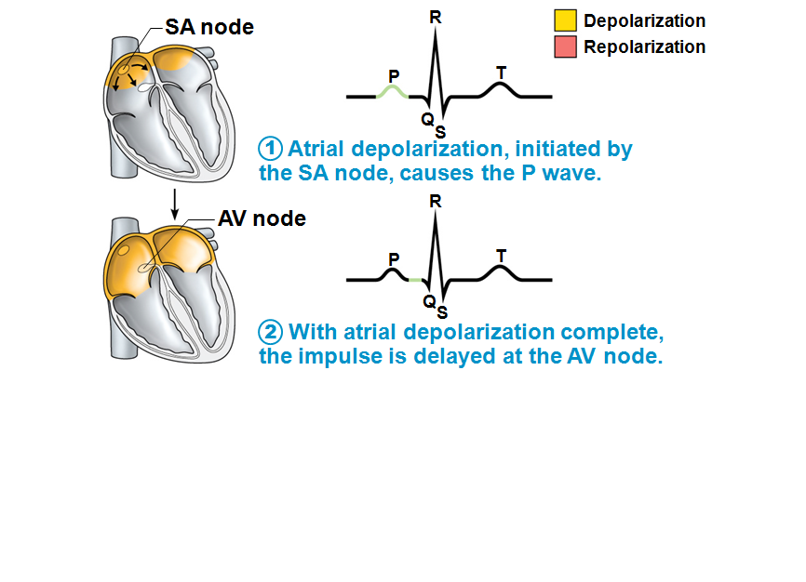

Slide 42
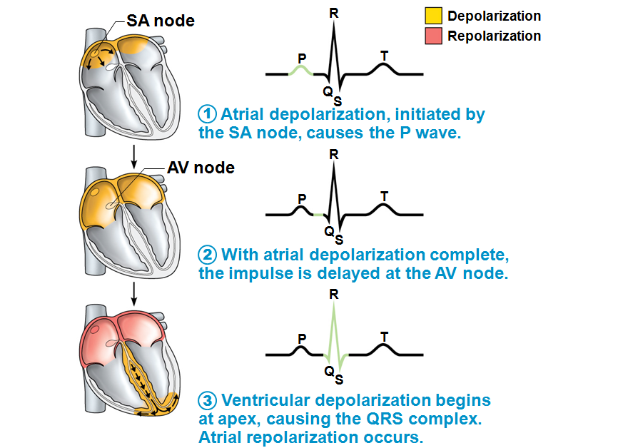

Slide 43
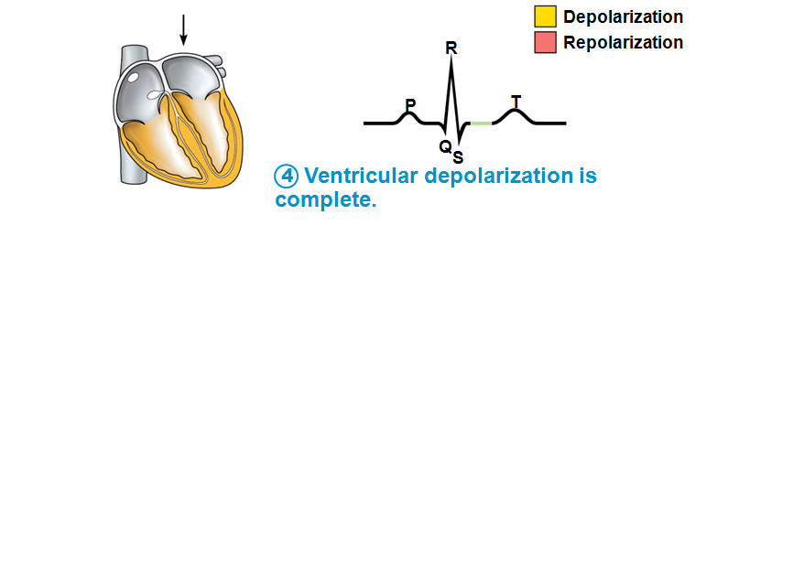

Slide 44
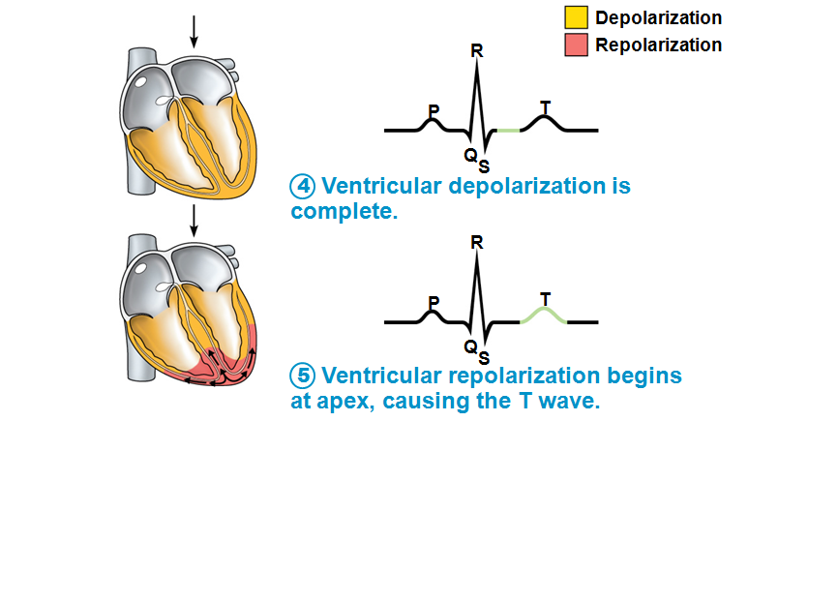

Slide 45
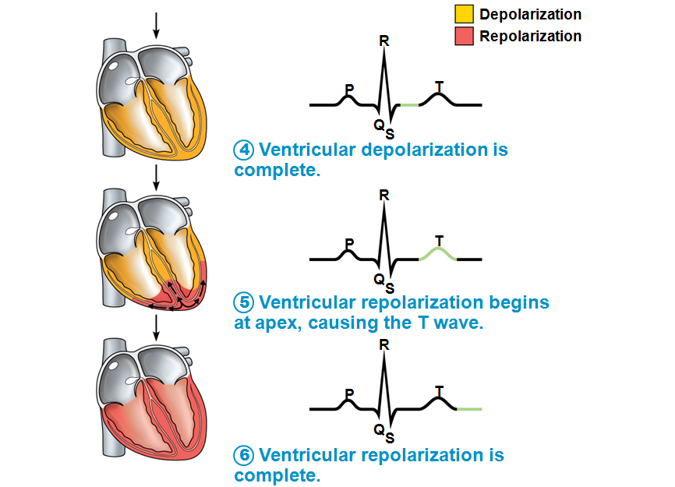

Slide 46
Heart Sounds
Two sounds (lub-dup) associated with closing of heart valves
First sound occurs as AV valves close and signifies beginning of systole
Second sound occurs when SL valves close at the beginning of ventricular diastole
Heart murmurs
abnormal heart sounds most often indicative of valve problems

Slide 47
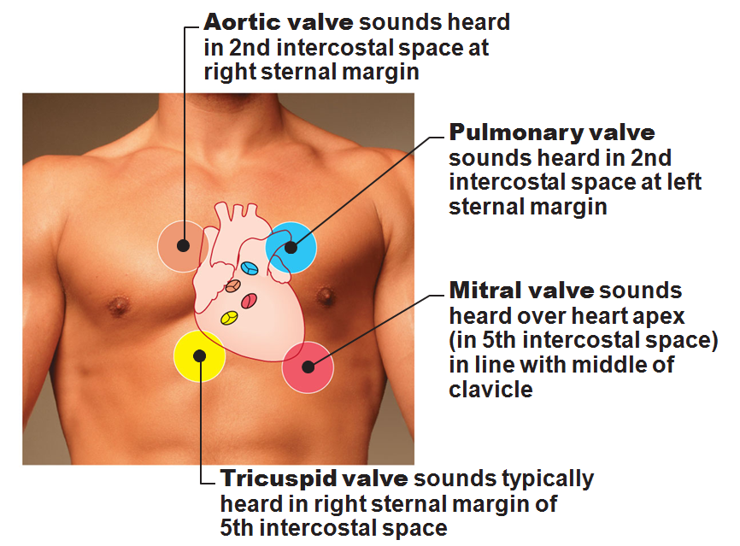

Slide 48
Mechanical Events: The Cardiac Cycle
Cardiac cycle: all events associated with blood flow through the heart during one complete heartbeat
Systole—contraction
Diastole—relaxation

Slide 49
Phases of the Cardiac Cycle
Ventricular filling—takes place in mid-to-late diastole
AV valves are open
80% of blood passively flows into ventricles
Atrial systole occurs, delivering the remaining 20%

Slide 50
Phases of the Cardiac Cycle
Ventricular systole
Atria relax and ventricles begin to contract
Rising ventricular pressure results in closing of AV valves
In ejection phase, ventricular pressure exceeds pressure in the large arteries, forcing the SL valves open

Slide 51
Phases of the Cardiac Cycle
Isovolumetric relaxation occurs in early diastole
Ventricles relax
Backflow of blood in aorta and pulmonary trunk closes SL valves

Slide 52
Cardiac Output (CO)
Volume of blood pumped by each ventricle in one minute
CO = heart rate (HR) x stroke volume (SV)
HR = number of beats per minute
SV = volume of blood pumped out by a ventricle with each beat

Slide 53
Autonomic Nervous System Regulation
Sympathetic nervous system is activated by emotional or physical stressors
Norepinephrine causes the pacemaker to fire more rapidly and at the same time increases contractility

Slide 54
Autonomic Nervous System Regulation
Parasympathetic nervous system opposes sympathetic effects
Acetylcholine hyperpolarizes pacemaker cells by opening K⁺ channels
The heart at rest exhibits vagal tone (parasympathetic)

Slide 55
Chemical Regulation of Heart Rate
Hormones
Epinephrine from adrenal medulla enhances heart rate and contractility
Thyroxine increases heart rate and enhances the effects of norepinephrine and epinephrine
Takes longer to act, but causes a sustained increase in heart rate
Can lead to weakened heart in hyperthyroid conditions

Slide 56
Chemical Regulation of Heart Rate
Intra- and extracellular ion concentrations (e.g., Ca²⁺ and K⁺) must be maintained for normal heart function

Slide 57
Chemical regulation
Ion imbalances: Calcium
Hypocalcemia
Depresses the heart
Hypercalcemia
Increase heart irritability
Spastic heart contractions

Slide 58
Chemical regulation
Ion imbalances: Potassium
Hypokalemia
Feeble irregular heart beat
Hyperkalemia
Interferes with depolarization
Can lead to cardiac arrest

Slide 59
Other Factors that Influence Heart Rate
Age
Gender
Exercise
Body temperature

Slide 60
Homeostatic Imbalances
Tachycardia:
abnormally fast heart rate
above100 bpm
If persistent, may lead to fibrillation
Bradycardia
heart rate slower than 60 bpm
May result in grossly inadequate blood circulation
May be desirable result of endurance training

Slide 61
Congestive Heart Failure (CHF)
Progressive condition where the CO is so low that blood circulation is inadequate to meet tissue needs
Caused by
Coronary atherosclerosis
Persistent high blood pressure
Multiple myocardial infarcts
Dilated cardiomyopathy (DCM)

Slide 62
Developmental Aspects of the Heart
Fetal heart structures that bypass pulmonary circulation
Foramen ovale connects the two atria
Ductus arteriosus connects the pulmonary trunk and the aorta

Slide 63
Developmental Aspects of the Heart
Congenital heart defects
Lead to mixing of systemic and pulmonary blood
Involve narrowed valves or vessels that increase the workload on the heart

Slide 65
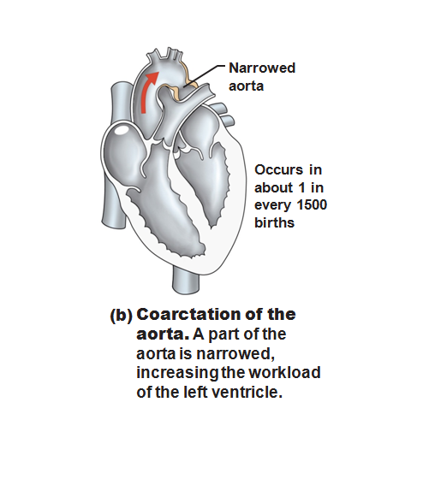

Slide 66
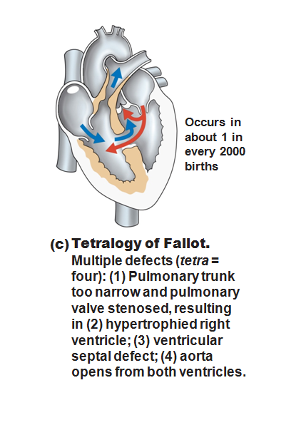

Slide 67
Age-Related Changes Affecting the Heart
Sclerosis and thickening of valve flaps
Decline in cardiac reserve
Fibrosis of cardiac muscle
Atherosclerosis
End Chapter 18, begin Chapter 19

Slide 68
Blood Vessels
Delivery system of dynamic structures that begins and ends at the heart
Arteries: carry blood away from the heart; oxygenated except for pulmonary circulation and umbilical vessels of a fetus
Capillaries: contact tissue cells and directly serve cellular needs
Veins: carry blood toward the heart

Slide 69
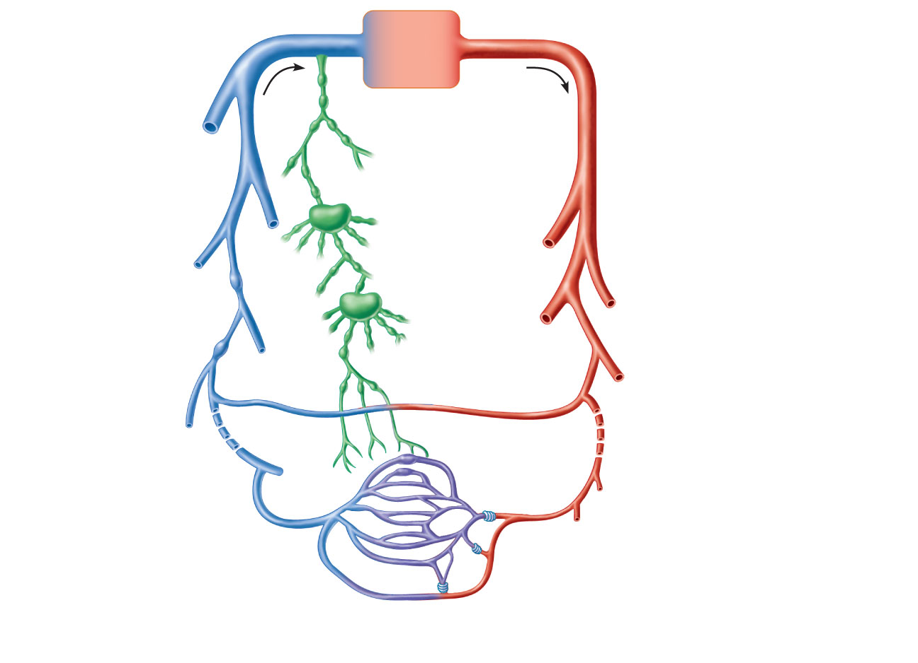
Venous system
Arterial system
Large veins
(capacitance
vessels)
Heart
Elastic arteries
(conducting
vessels)
Large
lymphatic
vessels
Lymph
node
Muscular arteries
(distributing
vessels)
Lymphatic
system
Small veins
(capacitance
vessels)
Arteriovenous
anastomosis
Lymphatic
capillary
Sinusoid
Arterioles
(resistance vessels)
Postcapillary
venule
Terminal arteriole
Metarteriole
Thoroughfare
channel
Capillaries
(exchange vessels)
Precapillary sphincter
Figure 19.2

Slide 70
Structure of Blood Vessel Walls
Arteries and veins
Tunica intima, tunica media, and tunica externa
Lumen
Central blood-containing space
Capillaries
Endothelium with sparse basal lamina

Slide 71
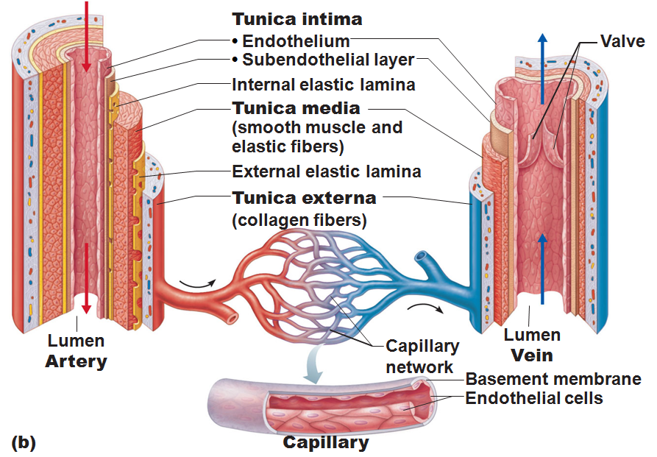

Slide 72
Tunics
Tunica intima
Endothelium lines the lumen of all vessels
In vessels larger than 1 mm, a connective tissue basement membrane is present

Slide 73
Tunics
Tunica media
Smooth muscle and sheets of elastin
Sympathetic vasomotor nerve fibers control vasoconstriction and vasodilation of vessels

Slide 74
Tunics
Tunica externa (tunica adventitia)
Collagen fibers protect and reinforce
Larger vessels contain vasa vasorum to nourish the external layer

Slide 75
Elastic (Conducting) Arteries
Large thick-walled arteries with elastin in all three tunics
Aorta and its major branches
Large lumen offers low resistance
Act as pressure reservoirs
expand and recoil as blood is ejected from the heart

Slide 76
Muscular (Distributing) Arteries and Arterioles
Distal to elastic arteries; deliver blood to body organs
Have thick tunica media with more smooth muscle
Active in vasoconstriction

Slide 77
Arterioles
Smallest arteries
Lead to capillary beds
Control flow into capillary beds via vasodilation and vasoconstriction

Slide 78
Capillaries
Microscopic blood vessels
Walls of thin tunica intima, one cell thick
Size allows only a single RBC to pass at a time

Slide 79
Capillaries
Present in all tissues except for
Cartilage
Epithelia
cornea
lens of eye
Functions: exchange of gases, nutrients, wastes, hormones, etc.

Slide 80
Capillaries
Three structural types
Continuous capillaries
Fenestrated capillaries
Sinusoidal capillaries (sinusoids)

Slide 81
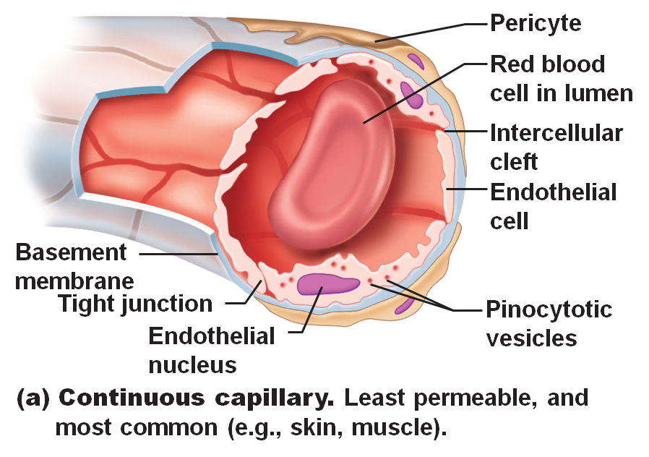
Continuous Capillaries
Abundant in the skin and muscles
Tight junctions connect endothelial cells
Intercellular clefts allow the passage of fluids and small solutes
Continuous capillaries of the brain
Tight junctions are complete, forming the blood-brain barrier

Slide 82
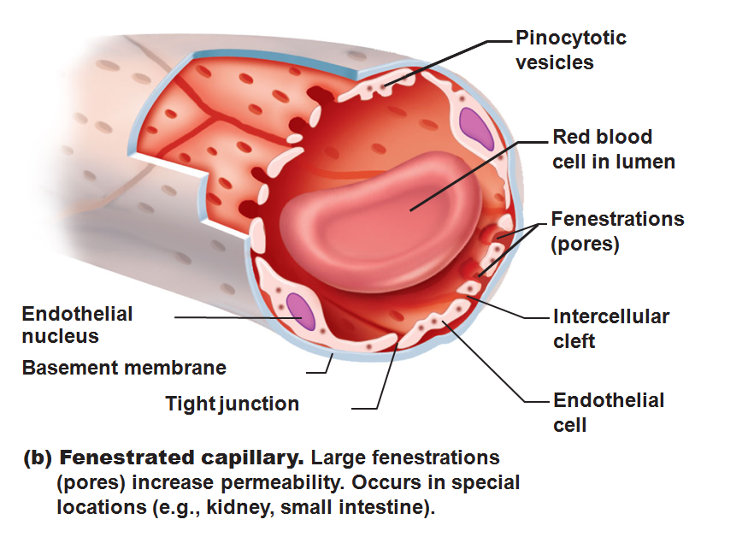
Fenestrated Capillaries
Some endothelial cells contain pores
fenestrations
More permeable than continuous capillaries
Function in absorption or filtrate formation
small intestines, endocrine glands, and kidneys

Slide 83
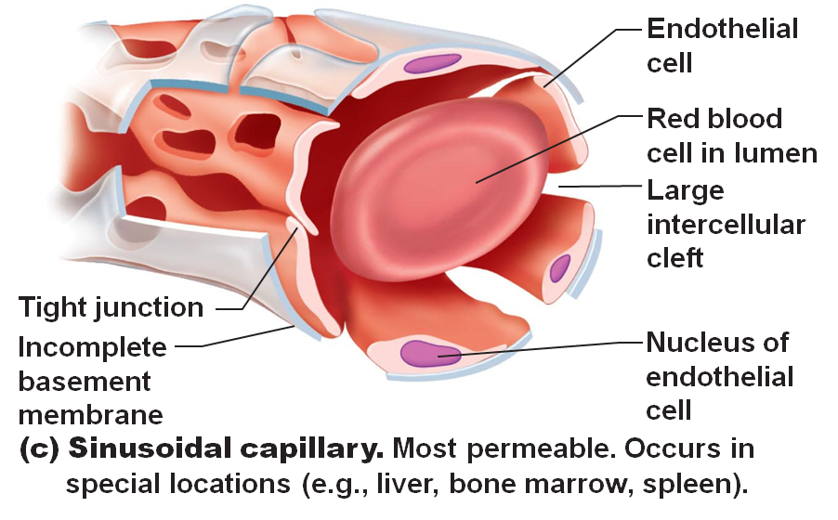
Sinusoidal Capillaries
Fewer tight junctions, larger intercellular clefts, large lumens
Usually fenestrated
Allow large molecules and blood cells to pass between the blood and surrounding tissues
Found in the liver, bone marrow, spleen

Slide 84
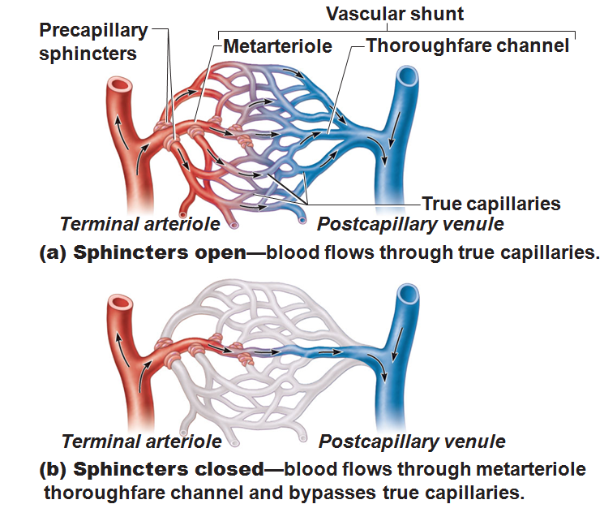
Blood Flow Through Capillary Beds
Precapillary sphincters regulate blood flow into true capillaries
Regulated by local chemical conditions and vasomotor nerves

Slide 85
Venules
Formed when capillary beds unite
Very porous
allow fluids and WBCs into tissues
Larger venules have one or two layers of smooth muscle cells

Slide 86
Veins
Formed when venules converge
Have thinner walls, larger lumens compared with corresponding arteries
Blood pressure is lower than in arteries
Thin tunica media and a thick tunica externa consisting of collagen fibers and elastic networks
Called capacitance vessels (blood reservoirs); contain up to 65% of the blood supply

Slide 87
Veins
Adaptations that ensure return of blood to the heart
Large-diameter lumens offer little resistance
Valves prevent backflow of blood
Most abundant in veins of the limbs
Venous sinuses: flattened veins with extremely thin walls (e.g., coronary sinus of the heart and dural sinuses of the brain)

Slide 88
Veins
Venous constriction helps maintain bp by returning more blood to the heart.
Ensures a nearly normal blood flow even with a 25% blood loss.

Slide 89
Veins
Blood flow through the venous system depends more on the contraction of skeletal muscles, breathing movements, and vasoconstriction of veins than on the direct result of the heart action.

Slide 90
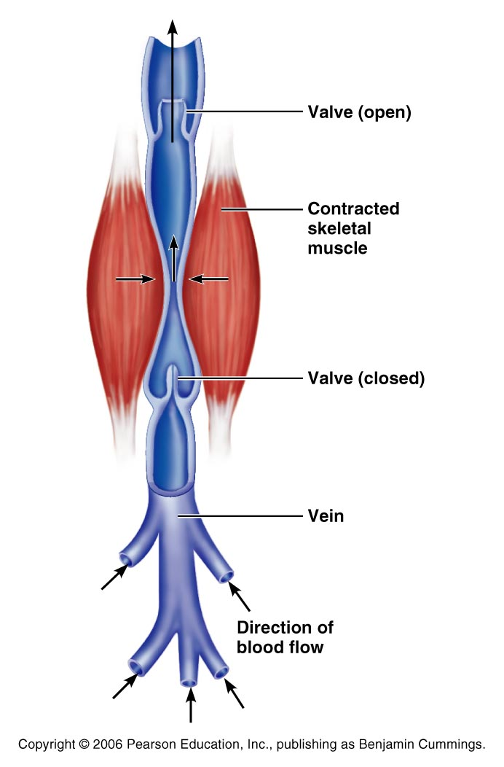
Veins
Contracting muscles press on veins, squeezing the blood inside towards heart from one valved section to another.
The presence of the valves keeps the blood from a backwards flow.

Slide 91
Veins
Respiratory movements move venous blood.
Pressure in thoracic cavity is reduced as the diaphragm contracts and the rib cage moves up and out.

Slide 92
Veins
The pressure in the abdominal cavity is increased as the diaphragm presses on the abdominal viscera….
the blood moves from area of high pressure to low pressure….
from abdomen towards thoracics. (towards heart)

Slide 93
Terms for circulation
Blood flow
Volume of blood flowing through a structure/time
Relatively constant at rest
Varies with individual organs: based on need
Blood pressure
The force on the vessel wall based on the blood

Slide 94
Terms for circulation
Resistance
Opposition to flow
Friction, mostly occurring peripherally
Causes of Peripheral resistance
Blood viscosity: Increased viscosity yeilds increased resistance
Vessel length: The longer the vessel the greater the resistance
Vessel diameter: the smaller the vessel, the greater the resistance

Slide 95
Viscosity
the ease/difficulty with which its molecules flow past one another.
The higher the viscosity, the more difficult the fluid is to move
Blood cells and plasma proteins increase viscosity.
The greater the blood’s resistance to flowing, the greater the force needed to move it through the system.
BP rises as viscosity increases.

Slide 96
Viscosity
Anemia decreases viscosity
Lowers blood pressure.
Excess red blood cells increase viscosity and blood pressure

Slide 97
Central Venous Pressure
All veins except for the pulmonary v. drain into the R atrium…
the pressure within the right atrium is called the central venous pressure.
Affects the pressure within the peripheral veins.

Slide 98
Central Venous Pressure
Heart beats weakly →the central venous pressure increases,
blood backs up into the venous network →raising its pressure.

Slide 99
Central Venous Pressure
if heart is beating forcefully, the CVP and the pressure within the venous network decreases.

Slide 100
Central Venous Pressure
Factors that increase the blood flow into RA…elevate the CVP:
Increase in blood volume
Widespread venoconstriction.
Increased CVP can lead to peripheral edema due to the hydrostatic pressure forcing fluid into tissues.

Slide 101
Blood Pressure
Is the force the blood exerts against the inner walls of the blood vessels.
Most commonly refers to pressure in the systemic arteries

Slide 102
Blood Pressure
Arterial blood pressure: rises and falls in a pattern with the phases of the cardiac cycle.
When ventricles contract: ventricular systole: walls squeeze blood into pulmonary trunk and aorta. Pressure in the arteries increases sharply.

Slide 103
Blood Pressure
Maximum pressure achieved during ventricular contraction is Systolic pressure

Slide 104
Blood Pressure
When ventricles relax =ventricular diastole,
the arterial pressure drops, and the lowest pressure that remains in the arteries before the next contraction is the diastolic pressure

Slide 105
Blood Pressure
BP read as systolic/diastolic which translates into
ventricular contraction pressure/ventricular relaxation pressure.

Slide 106
Short term BP control
Short term controls of blood pressure
Nervous system
Chemicals
Hormones
Function to correct minor fluctuations in BP
By altering peripheral resistance
By altering cardiac output

Slide 107
Vasomotor Center
Short term control: neural
Two main goals
Maintaining adequate mean arterial pressure by altering blood vessel diameter
Distributing blood to those organs with a higher demand

Slide 108
Vasomotor center
Vasomotor center: neurons located in the medulla
With the cardiac center in the medulla, they form the cardiovascular center
Vasomotor center in medulla →sympathetic efferent fibers → smooth muscles of the arterioles
Arterioles under state of constant constriction called vasomotor tone

Slide 109
Vasomotor activity
Vasomotor control modified by
Baroreceptors
Chemoreceptors
Higher brain centers

Slide 110
Vasomotor: Baroreceptors
Increased arterial BP causes stretch in baroreceptors
Located in carotid sinuses
Carotid provides the major blood flow to the brain
Carotid sinus reflex protects the brain
Located in aortic arch and walls of large arteries
Aortic sinus reflex protects the systemic circuit

Slide 111
Vasomotor: baroreceptors
Increased BP →
stretches vessels →
triggers baroreceptors →
impulses sent to vasomotor center →
arterioles and veins vasodilate →
BP drops

Slide 112
Baroreceptor Reflex
Please note that due to differing operating systems, some animations will not appear until the presentation is viewed in Presentation Mode (Slide Show view). You may see blank slides in the “Normal” or “Slide Sorter” views. All animations will appear after viewing in Presentation Mode and playing each animation. Most animations will require the latest version of the Flash Player, which is available at http://get.adobe.com/flashplayer.

Slide 113
Vasomotor: chemoreceptors
Sensitive to
Oxygen
pH
Carbon dioxide
Locations:
Carotid bodies located in Carotid artery
Aortic bodies located in Aorta
Main function:
regulating respiratory rate, but does have some blood pressure function

Slide 114
Vasomotor: chemoreceptors
Decreased oxygen → stimulates chemoreceptors →
signals sent to cardioacceleratory center → cardiac output increases
AND signals sent to vasomotor center → vasoconstriction → blood pressure rises → blood supply returns to heart (and lungs) quickly

Slide 115
Chemoreceptor Reflex
Please note that due to differing operating systems, some animations will not appear until the presentation is viewed in Presentation Mode (Slide Show view). You may see blank slides in the “Normal” or “Slide Sorter” views. All animations will appear after viewing in Presentation Mode and playing each animation. Most animations will require the latest version of the Flash Player, which is available at http://get.adobe.com/flashplayer.

Slide 116
Vasomotor: brain functions
Medulla is not the only brain area that controls blood pressure
Cerebral cortex
Hypothalamus
Both of these regions have input into medulla to indirectly control BP

Slide 117
Hormone effects on BP
Adrenal medulla
Epinephrine
increases CO
General vasoconstriction
Specific vasodilation: skeletal and cardiac muscles
Norepinephrine
vasoconstriction
Enhance sympathetic fight/flight response

Slide 118
Hormone effects on BP
Atrial natriuretic peptide: ANP
Increased blood pressure stimulates ANP release.
Results in decrease BP after ANP causes sodium to be excreted from kidneys
Where sodium goes, water goes

Slide 119
Hormone effects on BP
Antidiuretic Hormone ADH/ vasopressin
Results in the conservation of water in the body
If low BP or blood volume, ADH will prevent water from being lost as urine
Water restores blood volume/pressure
Also can cause vasoconstriction

Slide 120
Hormone effects on BP
Angiotensin II
stimulates vasoconstriction
Causes the release of ADH and Aldosterone
Causes long-term regulation by increasing blood volume

Slide 121
Hormone effects on BP
Angiotensin II
Low BP →
Kidneys release renin
Renin acts as an enzyme, breaking angiotensinogen into angiotensin I
Angiotensin I is changed into angiotensin II by ACE: Angiotensin Converting Enzyme

Slide 122
BP Control: Long term
Will change blood pressure based on changes in blood volume
Recall that short term controls dealt mostly with altering peripheral resistance to control blood pressure
Short term solutions like baroreceptors can
Respond quickly
Adapt to chronic conditions

Slide 123
BP control: long term
Kidneys
Directly regulate arterial pressure
Alters blood volume as a function of filtration pressure
High blood pressure forces blood to be filtered and processed quickly through the renal system. Larger amounts of water will be lost as urine causing the blood pressure to lower
Indirectly regulates arterial pressure
Renin-angiotensin mechanism:
stimulates aldosterone which reabsorbs sodium and in turn causes the reabsorption of water

Slide 124
Monitoring Circulatory Efficiency
Vital signs:
pulse and blood pressure, along with respiratory rate and body temperature
Pulse:
pressure wave caused by the expansion and recoil of arteries

Slide 125
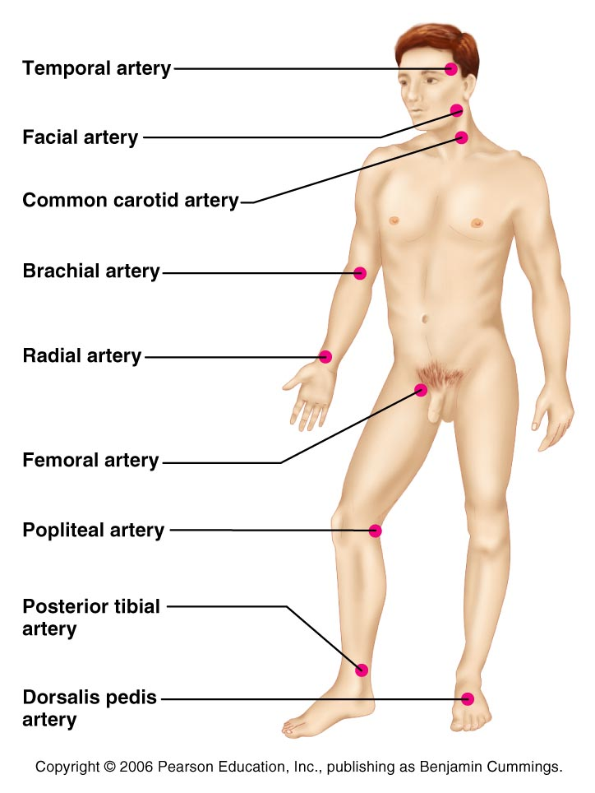
Pulse
the expansion/recoil of artery walls due to increased pressure from ventricular contraction.
Felt near surfaces.

Slide 126
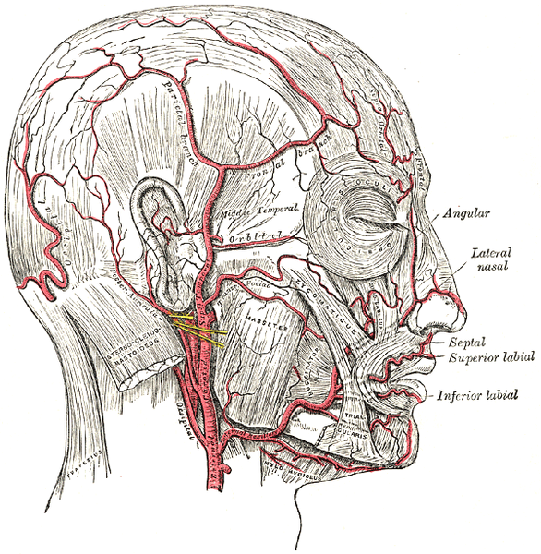
Head and neck pulses
Temporal artery
Branches off of external carotid artery
Pulse is palpable superior to the zygomatic arch, anterior and superior to the tragus

Slide 127
Head and neck pulses
Common carotid artery
The left common carotid artery is one of three arteries that originate along the aortic arch
The right common carotid artery arises from the brachiocephalic artery
Pulse: palpated in the neck at lateral aspects of trachea
Baroreceptors in carotids are sensitive to bilateral palpation, may cause bradycardia or fainting

Slide 128
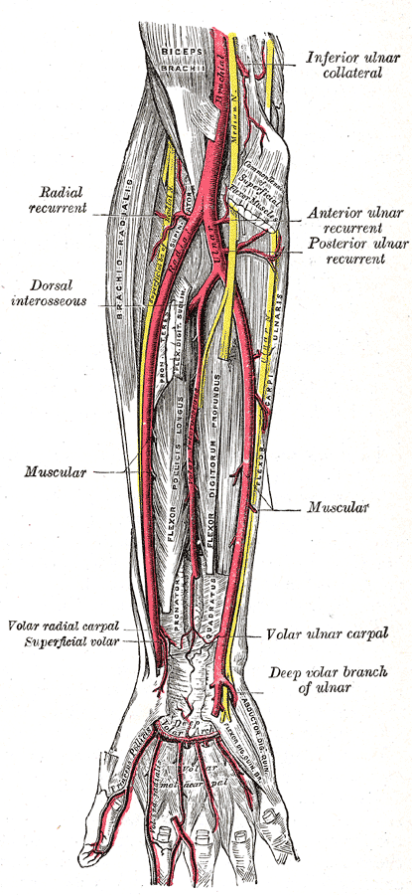
Upper limb pulses
Brachial artery
Origin: subclavian artery → axillary artery → to brachial artery
Palpation: at the antecubital fossa
Is the artery used to determine arterial blood pressure

Slide 129
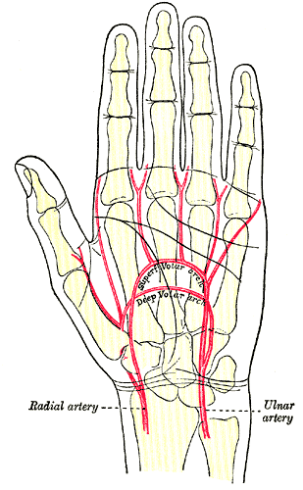
Upper limb pulses
Radial Artery
Origin: Subclavian a → axillary a → brachial a → splits into radial a and ulnar a
Palpation: at the anterior wrist: three finger-widths proximal to the thenar eminence

Slide 130
Lower Limb Pulses
four arterial pulses are routinely felt in the lower limb.
femoral
popliteal
Posterior tibial
Dorsalis pedis (dorsum of foot)

Slide 131
Femoral pulse
Most of the blood supply to the lower limb is carried in the external iliac artery.
Aorta →
descending aorta →
common iliac artery →
external iliac artery →
becomes the femoral artery →
deep femoral

Slide 132
Finding the Femoral Pulse
Locate the superior border of the pubis in the mid line of the body;
Feel the anterior iliac crest. The femoral pulse can be found midway between these two bony points
(the mid-inguinal point)

Slide 133
Popliteal
The femoral artery leaves enters the popliteal fossa by passing through the adductor magnus muscle.
The name of the vessel then changes to the popliteal artery.

Slide 134
Palpating popliteal artery
bend the knee so that it is flexed to about 90 degrees.
press the tips of your fingers into the popliteal fossa.
The popliteal pulse is deep and diffuse
Can be difficult to palpate

Slide 135
Posterior Tibial
The Popliteal artery branches into anterior tibial and posterior tibial arteries.

Slide 136
Palpating Posterior tibial artery
Locate the medial malleolus
inferior and posterior to the medial malleolus you should find the posterior tibial pulse.

Slide 137
Dorsalis Pedis
Below the knee, the popliteal artery divides into the anterior and posterior tibial arteries.
The anterior branch enters the anterior compartment of the leg by passing between the tibia and fibula above the interosseous membrane.
It continues on to the dorsum of the foot as the dorsalis pedis artery

Slide 138
Palpating dorsalis pedis pulse
Place your fingers half way down the dorsum of the foot in the line between the first and second toes.
The bones you can feel are the dorsal aspect of the navicular and the intermediate cuneiform bones.
The pulse is palpated where the artery passes over this area.

Slide 139
Measuring Blood Pressure
Systemic arterial BP
Measured indirectly by the auscultatory method using a sphygmomanometer
Pressure is increased in the cuff until it exceeds systolic pressure in the brachial artery

Slide 140
Alterations in Blood Pressure
Hypotension:
low blood pressure
Systolic pressure below 100 mm Hg
Often associated with long life and lack of cardiovascular illness

Slide 141
Homeostatic Imbalance: Hypotension
Orthostatic hypotension
temporary low BP and dizziness when suddenly rising from a sitting or reclining position
Chronic hypotension
hint of poor nutrition
warning sign for Addison’s disease or hypothyroidism
Acute hypotension
important sign of circulatory shock

Slide 142
Alterations in Blood Pressure
Hypertension
high blood pressure
Sustained elevated arterial pressure of 140/90 or higher
May be transient adaptations during fever, physical exertion, and emotional upset
Often persistent in obese people

Slide 143
Temperature Regulation
As temperature rises (e.g., heat exposure, fever, vigorous exercise)
Hypothalamic signals reduce vasomotor stimulation of the skin vessels
Heat radiates from the skin

Slide 144
Temperature Regulation
Sweat also causes vasodilation via bradykinin in perspiration
Bradykinin stimulates the release of NO
As temperature decreases, blood is shunted to deeper, more vital organs

Slide 145
Capillary Exchange of Respiratory Gases and Nutrients
Diffusion of
O₂ and nutrients from the blood to tissues
CO₂ and metabolic wastes from tissues to the blood
Lipid-soluble molecules diffuse directly through endothelial membranes
Water-soluble solutes pass through clefts and fenestrations
Larger molecules, such as proteins, are actively transported in pinocytotic vesicles or caveolae

Slide 146
Circulatory Shock
Any condition in which
Blood vessels are inadequately filled
Blood cannot circulate normally
Results in inadequate blood flow to meet tissue needs

Slide 147
Circulatory Shock
Hypovolemic shock
results from large-scale blood loss
Vascular shock
results from extreme vasodilation and decreased peripheral resistance
Cardiogenic shock
results when an inefficient heart cannot sustain adequate circulation

Slide 148
Circulatory Pathways
Two main circulations
Pulmonary circulation: short loop that runs from the heart to the lungs and back to the heart
Systemic circulation: long loop to all parts of the body and back to the heart

Slide 149
Pulmonary and Systemic Circulation
Please note that due to differing operating systems, some animations will not appear until the presentation is viewed in Presentation Mode (Slide Show view). You may see blank slides in the “Normal” or “Slide Sorter” views. All animations will appear after viewing in Presentation Mode and playing each animation. Most animations will require the latest version of the Flash Player, which is available at http://get.adobe.com/flashplayer.

Slide 150
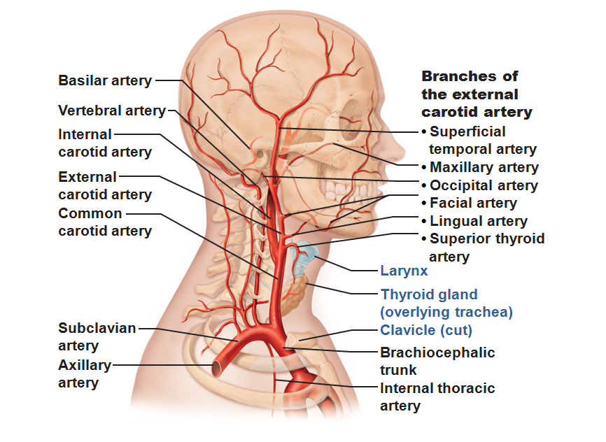

Slide 151
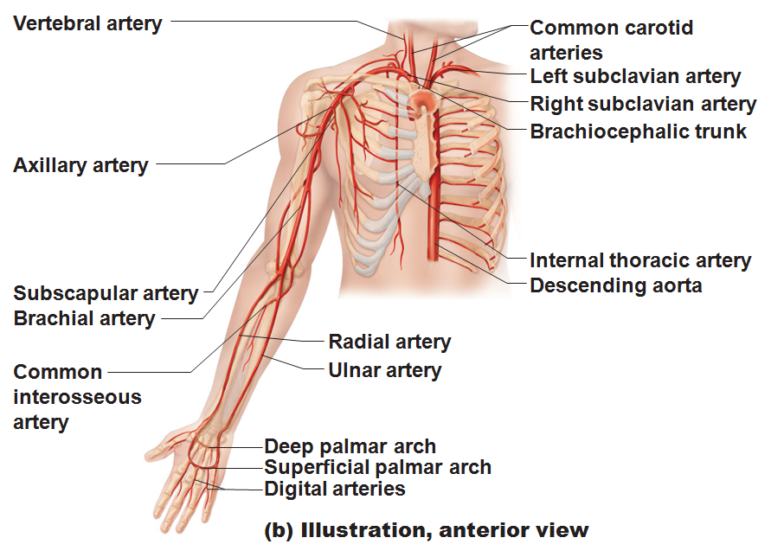

Slide 152
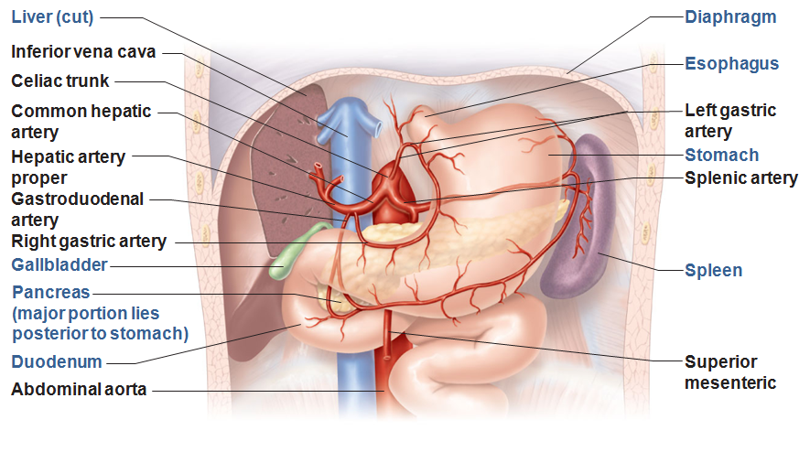

Slide 153
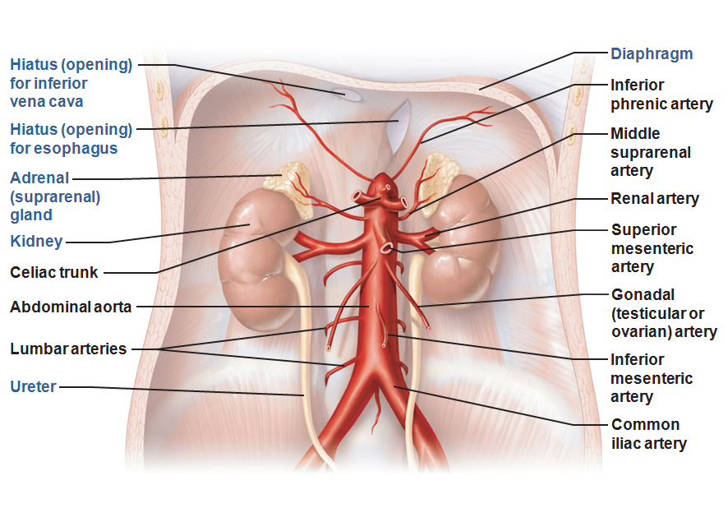

Slide 154
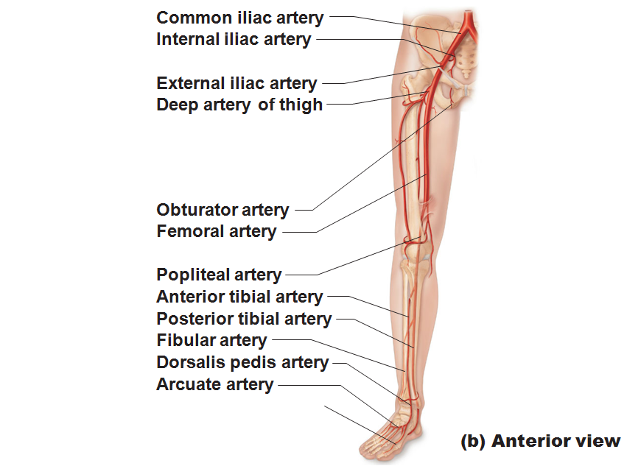

Slide 155
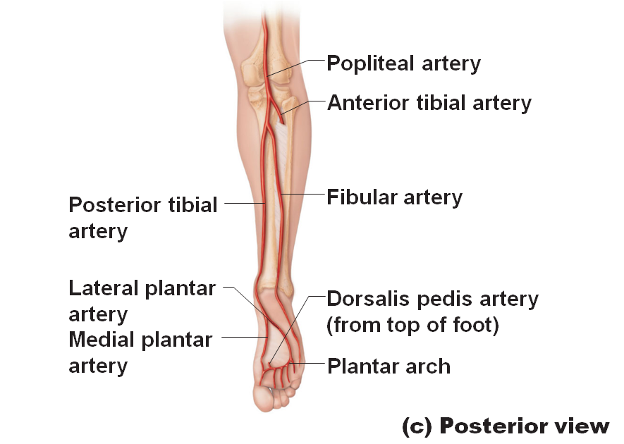

Slide 156
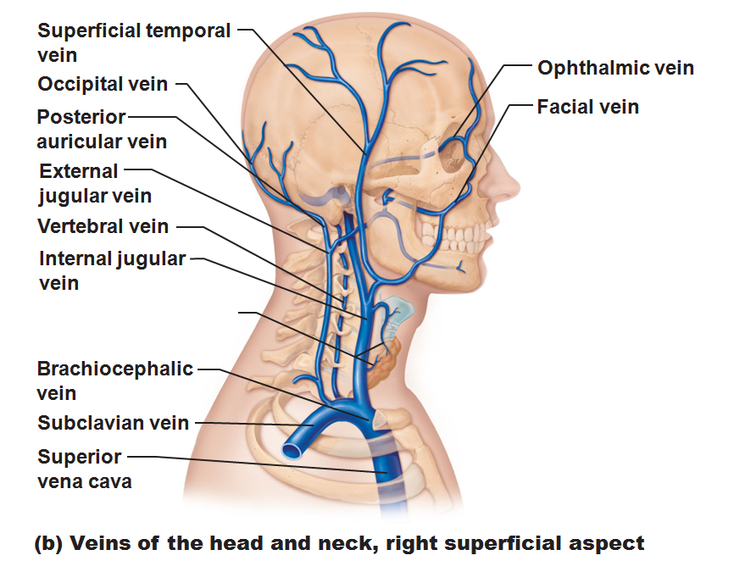

Slide 157
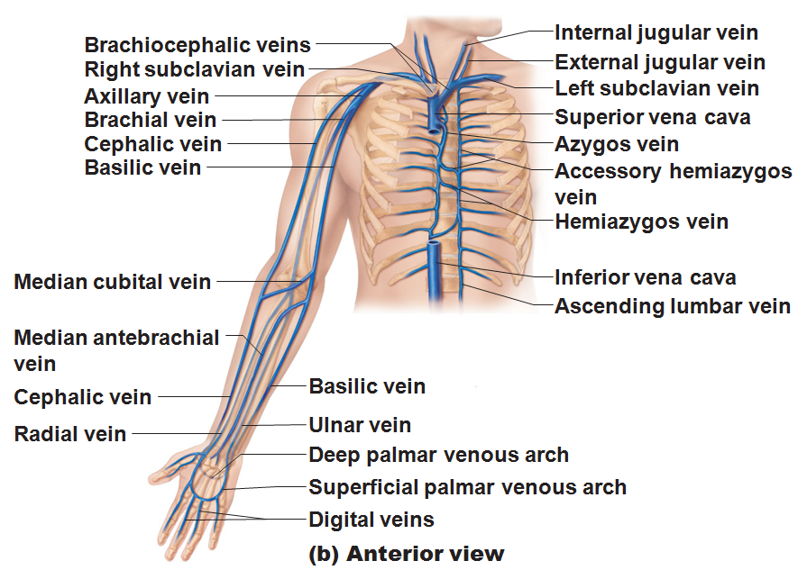

Slide 158
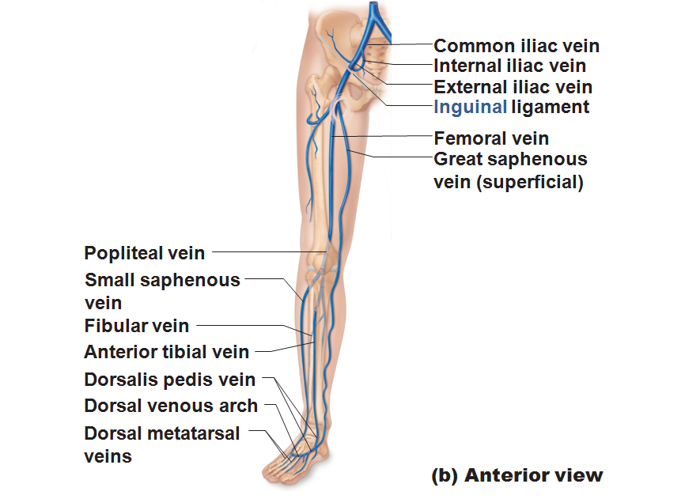

Slide 159
