Slide 1
The Heart
Structure: hollow, cone shaped Muscular pump.
Found in the middle mediastinum

Slide 2
The Heart
Size varies with person.
Length runs from second rib to fifth rib
About the size of a fist
Weighs less than a pound
Heart borders:
Laterally: lungs
Posteriorly: spinal cord
Anteriorly: sternum

Slide 3
The Heart
Base:
attached to large blood vessels, lies beneath second rib
Distal end:
Apex: fifth intercostal space
area of apical heartbeat.
5 ICS, mid clavicular line
Referred to as PMI: point of maximum intensity

Slide 4
Pericardium
encloses the heart and the proximal ends of the large blood vessels.
Consists of an outer fibrous bag:
fibrous pericardium surrounds visceral pericardium (epicardium) which covers the heart.

Slide 5
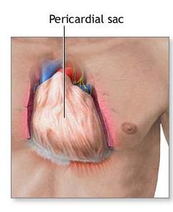
Pericardium
At the base of the heart, the lining turns back and becomes the parietal pericardium.
This in turn forms the inner lining of the fibrous pericardium.

Slide 6
Pericardial layers

Slide 7
Pericardium
Three layers of pericardium:
1. fibrous outer layer:
protects and anchors
Two inner layers (serous):
2. Visceral layer: adheres to heart. Epicardium
3. Parietal layer: adherent to fibrous pericardium

Slide 8
Pericardial Cavity
pericardial cavity: Space between parietal and visceral layers
contains small amount of serous fluid that is secreted by the pericardial membrane.

Slide 9
Pericardial Cavity
Functions to reduce friction between the membranes as the heart moves.
Allows the heart to work in a relatively friction free environment.

Slide 10
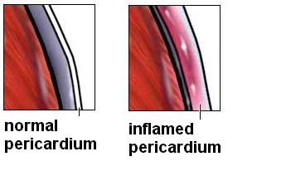
Pericarditis
inflammation of the pericardium
due to viral or bacterial infection
results in adhesions that attach the layers of the pericardium.

Slide 11
Pericardititis
Hinders production of serous fluid,
Painful and interferes with heart movements.
Beating heart rubs against pericardial sac causes a rustling sound that can be heard with a stethoscope…
Pericardial friction rub

Slide 12
Walls of the Heart
Three Layers
Epicardium
Myocardium
Endocardium

Slide 13
Epicardium
corresponds to visceral pericardium.
Protective outer layer. Secretes serous fluid.

Slide 14
Myocardium
Middle layer
thick.
Consists largely of the cardiac muscle tissue.
Fibers are arranged in planes, separated by connective tissues

Slide 15
Endocardium
inner layer…
Contains blood vessels and specialized muscle fibers
Purkinje fibers.
Protective inner lining of the chambers and valves.
Continuous with the endothelial linings of the blood vessels leaving and entering the heart.

Slide 16
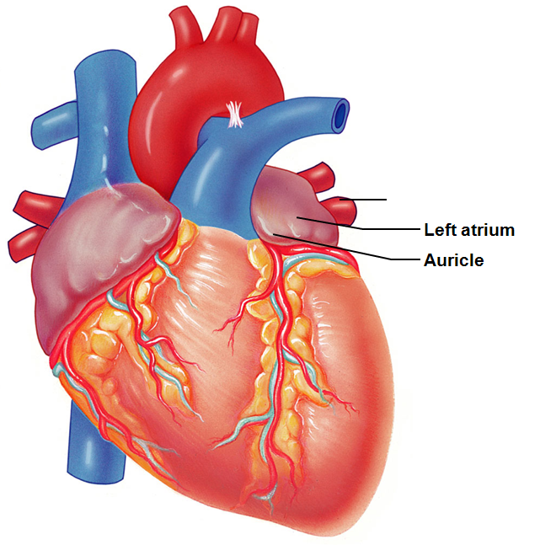
Chambers of the Heart
Atria: upper chambers.
Have thin walls. Receive blood returning to heart.
Auricles: small ear-like projections extend anteriorly.
Increases the atrial volume.

Slide 17
Chambers of the Heart
Atria
Pectinate muscles
Comb-like appearance
Present in the anterior right atrium
Also found in both auricles
Anterior and posterior atria are separated by crista terminalis (terminal crest)

Slide 18
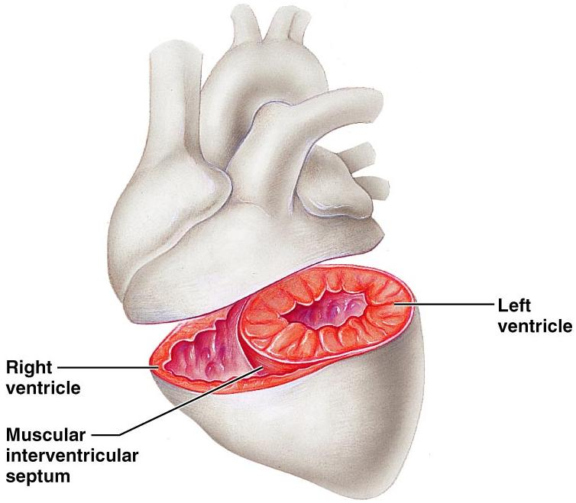
Chambers of the Heart
Ventricles: Lower chambers.
Force the blood out of heart into arteries

Slide 19
Septums
Interatrial septum: separates right from left atrium.
Fossa ovale: shallow depression that was once an opening in the fetal heart
Interventricular septum: separates right from left ventricle.

Slide 20
Right side of Heart
Right side = pulmonary circuit pump.
Right atrium:
Receives blood from
Superior vena cava and
Inferior vena cava.
Coronary sinus

Slide 21
Right side of heart
Tricuspid valve:
guards the AV (atrialventricular)orifice.
Composed of three leaflets or cusps.
Permits blood to move from atrium to ventricle.
Close passively due to pressure

Slide 22
Right side of heart
Chordae tendinae: strong fibrous strings attach to cusps and ventricles.
Originate from papillary muscles. Papillary muscles contract and pull on the chordae tendinae and prevent the cusps from swinging back into the atrium

Slide 23
Right side of the heart
Right ventricle is thinner than left.
Right pumps to lungs.
Left pumps to entire body and has a greater resistance to overcome.

Slide 24
Tricuspid Valve
Right vent contracts and the pressure rises.
Tricuspid valve closes passively.
Exit is through the pulmonary trunk…turns into pulmonary arteries.
Must pass through pulmonary valve or semilunar valve.

Slide 25
Pulmonary Valve
Opens as right ventricle contracts. When there is ventricular relaxation: blood begins to back up into pulmonary trunk and it closes the pulmonary valve, preventing a return flow.
No chordae tendinae with semilunar valves.

Slide 26
Left side of heart
Left side of heart is the systemic circuit pump.
Left atrium:
receives blood from lungs through pulmonary veins

Slide 27
Left side of the heart
Blood goes from atrium through
bicuspid/mitral valve and
into the left ventricle.
Chordae tendinae prevent valve from flapping up into atrium

Slide 28
Left side of heart
Ventricle contracts,
mitral valve closes passively
blood is forced through aorta,
Which has semilunar valves. When ventricle relaxes, valve closes.

Slide 29
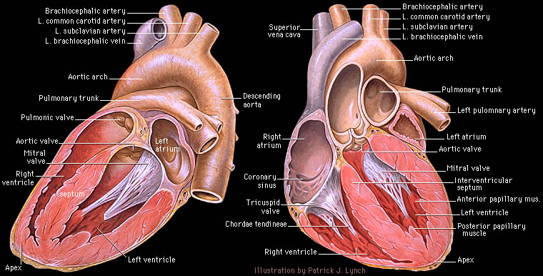

Slide 30
Mitral valve prolapse
cusps of the mitral valve stretches and bulges into the left atrium during the ventricular contraction.
Blood regurgitates into the left atrium.

Slide 31
Mitral valve prolapse
Symptoms:
chest pain, palpitations,
fatigue, and anxiety.
Can be damaged by Streptococcus. May lead to endocarditis: an inflammation of the endocardium due to infection.

Slide 32
Heart Skeleton
Rings of dense connective tissue
provide attachments for the heart valves and muscle fibers and
prevents dilation during contraction.
Helps heart keep its shape. Otherwise, the heart would balloon outward with the increased pressure.

Slide 33
Pathway of Blood
Enters Right Atrium from Superior Vena Cava, Inferior Vena Cava, and Coronary Sinus
Blood is deoxygenated. High in CO₂. Low in O₂

Slide 34
Pathway
Pressure in R. Atrium forces open
Tricuspid Valve
Blood passes into R. Ventricle

Slide 35
Pathway
From the Right Ventricle, contractions force blood
through Pulmonary Valve (pressure closes the Tricuspid Valve)
Blood travels to Lungs

Slide 36
Pathway
Blood returns from lungs freshly oxygenated.
Enters Left Atrium
Passes through Bicuspid Valve (also called Mitral Valve)
Into Left Ventricle

Slide 37
Pathway
L. Ventricle contracts.
Bicuspid/Mitral valve closes due to pressure
Blood passes through Aortic Valve
Into Aorta

Slide 38
Heart’s blood supply
Aorta…branches off.
First two branches are called right and left coronary arteries.
They supply blood to the tissues of the heart.

Slide 39
Heart’s Blood supply
From the Left coronary artery….
circumflex artery follows AV sulcus on left.
Supplies blood to walls of the left atrium and the left ventricle.
anterior interventricular artery or LAD Left Anterior Descending…
travels in the anterior Interventricular sulcus and branches supply walls of both ventricles.

Slide 40
Heart’s Blood Supply
From the Right Coronary Artery
Two major branches:
Posterior interventricular artery
supplies the walls of both ventricles.
Marginal artery:
Supplies right atrium and right ventricles.

Slide 41
Heart’s blood supply
Cardiac veins drain the capillaries of the myocardium.
Veins join the coronary sinus at the AV sulcus.
Coronary sinus empties into right atrium

Slide 42
Heart Activity
coordinated movement
Atrial walls contract while the ventricular walls relax;
ventricular walls contract while the atrial walls relax.
There is a moment of relaxation. This relaxation denotes the beginning and the end of a cycle.

Slide 43
Foramen ovale
Foramen ovale: “oval door”
present in fetal heart
connects the two atria and allows blood entering the right heart to bypass the pulmonary circuit

Slide 44
Ductus arteriosus
Ductus arteriosus between the pulmonary trunk and the aorta.
Shortly after birth, it closes, separating right and left sides of the heart.

Slide 45
Congenital Heart Defects
Patent ductus arteriosus...in which the connection between the aorta and pulmonary trunk remains open.
A patent ductus arteriosus allows mixing of oxygenated and deoxygenated blood
children become cyanotic after physical exertion.

Slide 46
Heart Sounds
“lubb dubb” sounds are from the contraction and relaxation of heart tissues and the opening and closing of the heart valves.

Slide 47
Heart Sounds
Lubb:
first sound
Ventricular contraction: systole
Tricuspid Valve and Mitral Valve slamming shut due to the ventricular pressure
Dubb:
second sound.
ventricular relaxation: diastole
Pulmonary and aortic valves closing.

Slide 48
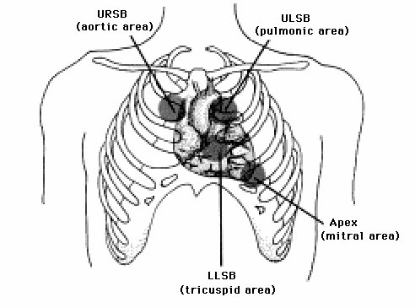
Heart Sounds
Auscultation: Listening
Aortic valve
2nd ICS at R sternal margin
Pulmonary Valve
2nd ICS at L sternal margin
Tricuspid Valve
5th ICS at R sternal margin
Mitral Valve
5th ICS, midclavicular line
PMI

Slide 49
Cardiac Fibers
Sinoatrial node = SA node.
specialized cardiac muscle tissue beneath the epicardium.
Located in R atrium near the opening of the Sup vena cava.
Fibers are continuous with those of the atrial syncytium.

Slide 50
Cardiac Fibers
SA node can reach threshold on their own,
membranes contact one another.
Need no outside stimulation.
initiates impulses that spread to the myocardium and stimulate the muscles to contract.

Slide 51
SA Node
SA node activity is rhythmic.
Generates impulses 75 – 100 times a minute on its own.
Tempered by the Vagus nerve
Slows rate to 60 to 80 bpm
Called the Pacemaker.
Determines sinus rhythm

Slide 52
SA node
From SA node into the atrial syncytium, the impulse goes from cell to cell via gap junctions.
R and L atria contract almost simultaneously.

Slide 53
Cardiac Conduction
Before the impulses reach the ventricular syncytium, they are delayed by a group of tissues called the AV node,
located in the inferior portion of the septum that separates that atria

Slide 54
Cardiac conduction
AV node provides the normal conduction pathway between atrial and ventricular syncytia
Because of the AV node there is a time delay.
allows time for the atria to contract completely before the coming ventricular contraction

Slide 55
Cardiac Conduction
The impulse reaches the far side of the AV node
it passes into a group of fibers called the AV Bundle or Bundle of His and the impulse passes through them

Slide 56
Cardiac Conduction
Bundle of His divides into right and left branches .
gives rise to enlarged Purkinje fibers that carry the impulses faster than the cell to cell contact could

Slide 57
Cardiac Conduction
Purkinje fibers
transmit the impulses to the apex
allows the contraction to push the blood superiorly towards the aortic and pulmonary valves.
Allows the ventricular myocardium to contract as a unit rather than in a wave.

Slide 58
Intrinsic Cardiac Conduction
1. Sinoatrial node
2. Atrioventricular node
3. Atrioventricular bundle
Bundle of His
4. R/L bundle branches
5. Purkinje fibers

Slide 59
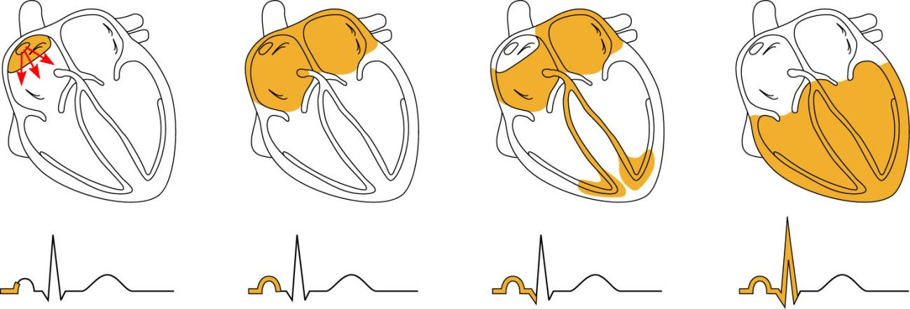
Heart Excitation Related to ECG
SA node generates impulse;
atrial excitation begins
Impulse delayed
at AV node
Impulse passes to
heart apex; ventricular
excitation begins
Ventricular excitation
complete
SA node
AV node
Bundle
branches
Purkinje
fibers
Figure 18.17

Slide 60
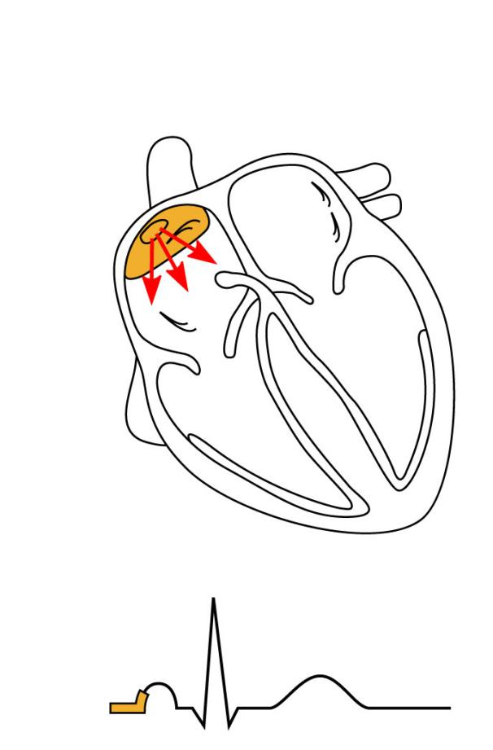
SA node generates impulse;
atrial excitation begins
SA node
Figure 18.17

Slide 61
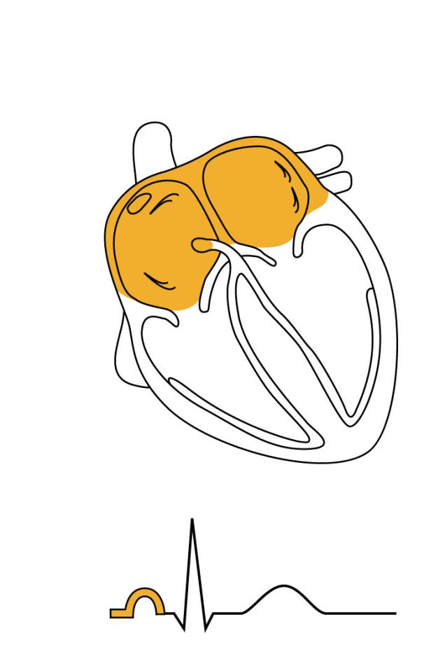
Impulse delayed
at AV node
AV node
Figure 18.17

Slide 62
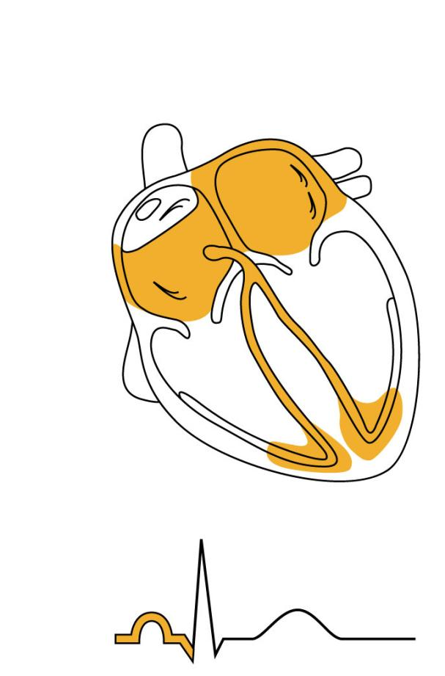
Impulse passes to
heart apex; ventricular
excitation begins
Bundle
branches
Figure 18.17

Slide 63
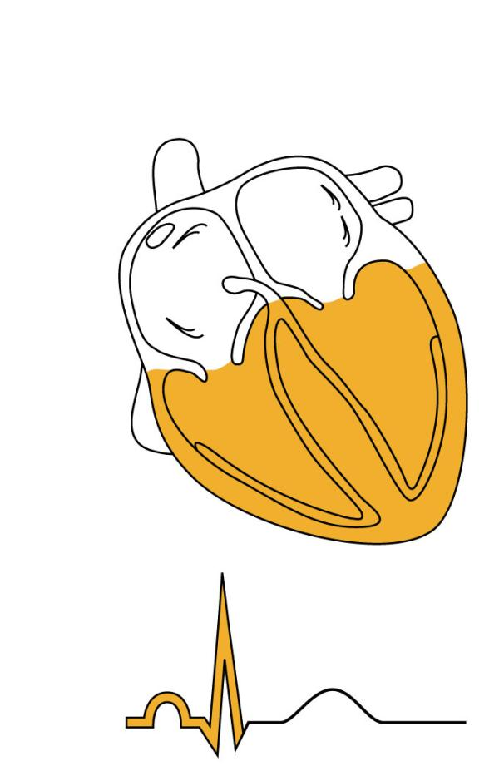
Ventricular excitation
complete
Purkinje
fibers
Figure 18.17

Slide 64
SA node generates impulse;
atrial excitation begins
Impulse delayed
at AV node
Impulse passes to
heart apex; ventricular
excitation begins
Ventricular excitation
complete
SA node
AV node
Bundle
branches
Purkinje
fibers
Figure 18.17

Slide 65
Conduction Defects
Arrhythmias
Uncoordinated atrial and ventricular contractions
Fibrillation
Rapid and irregular contractions
SA node no longer in control
Defibrillation: electrical shock to the heart interrupts chaotic fibrillations and attempts to restore SA control

Slide 66
Cardiac Output
Stroke Volume
Volume of blood pumped out by one ventricle with each beat
Cardiac output (CO)
Amount of blood pumped out by each ventricle in one minute
Heart rate multiplied by stroke volume = Cardiac Output

Slide 67
EKG
electrical changes occur in the myocardium during a cardiac cycle.
Body fluids conduct electrical currents that can be detected on the surface of the body

Slide 68
EKG
Normal ECG has predictable wave patterns.
SA node triggers impulses, electrical change in atrium.
Produces a P wave.
Corresponds to the depolarization of the atrial fibers that will soon lead to the contraction of the atrium.

Slide 69
EKG
When the impulses reach the ventricular fibers, they depolarize.
Ventricle walls are thicker and the electrical charge is greater
Forms the QRS complex.
Contains Q wave, R wave, and S wave.

Slide 70
EKG
ventricle muscles repolarize slowly and produce the T wave.

Slide 71
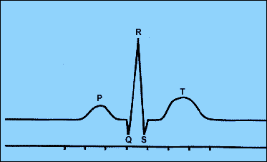
EKG
P: depolarization of atrium
QRS: repolarization of atria and overlapping depolarization of ventricles
T: repolarization of ventricle

Slide 72
Regulation
Remember, the SA node on its own will cause the heart to beat at 75-100 bpm
Tempered by Parasympathetic and Sympathetic systems

Slide 73
Extrinsic Regulation of the Cardiac Cycle
Parasympathetic fibers that innervate the heart arise from neurons in the medulla oblongata and make up parts of the Vagus nerves.
These fibers branch into the SA and AV nodes. At nerve fiber endings, releases Acetylcholine: decreases heart rate.

Slide 74
Regulation
Parasympathetic system can change heart rate in either direction.
Increase in the impulses →increases Acetylcholine →decreases heart rate.
Decrease in the impulse →decreases acetylcholine →increases the heart rate

Slide 75
Extrinsic Regulation
Vagal Tone
Resting heart rate is approximately 70 bpm due to the parasympathetic innervation from the Vagus Nerve
The Vagus Nerve/Parasympathetic input slows the pacemaker cells

Slide 76
Extrinsic Regulation
Sympathetic System:
secrete norepinephrine:
increases rate and FORCE of myocardial contractions.

Slide 77
Regulation
baroreceptors or pressoreceptors
found in aortic arch and carotid sinuses:
Detects changes in blood pressure.

Slide 78
Regulation
Increase in pressure →stretches the receptors →signals the cardio-inhibitor →sends parasympathetic impulses to decrease the heart rate and force of contraction.
Helps to lower blood pressure towards normal

Slide 79
Regulation
Stretch receptors in vena cava:
when blood pressure increases →signals cardioaccelerators →
Sympathetic impulses → heart rate and force of contraction increase →
Venous pressure is reduced

Slide 80
Chemical Regulation
Hormones
Epinephrine
From adrenal medulla
Short term, rapid increase in heart rate
Thyroxine
From Thyroid gland
Takes longer to act, but causes a sustained increase in heart rate
Can lead to weakened heart in hyperthyroid conditions

Slide 81
Chemical regulation
Ion imbalances: Calcium
Hypocalcemia
Depresses the heart
Hypercalcemia
Increase heart irritability
Spastic heart contractions

Slide 82
Chemical regulation
Ion imbalances: Potassium
Hypokalemia
Feeble irregular heart beat
Hyperkalemia
Interferes with depolarization
Can lead to cardiac arrest

Slide 83
Heart rate
Tachycardia
Increased heart rate
Above 100 bpm
Can be caused by
increased body temperatures
Stress
Drugs
Heart disease

Slide 84
Heart Rate
Bradycardia
Decreased heart rate
Below 60 bpm
Can be caused by
Low body temperature
Drugs
Parasympathetic nervous system
Desirable if cardiac output is increased while HR is decreased
Pathological if cardiac output falls
Indicative of brain edema following head trauma

Slide 85
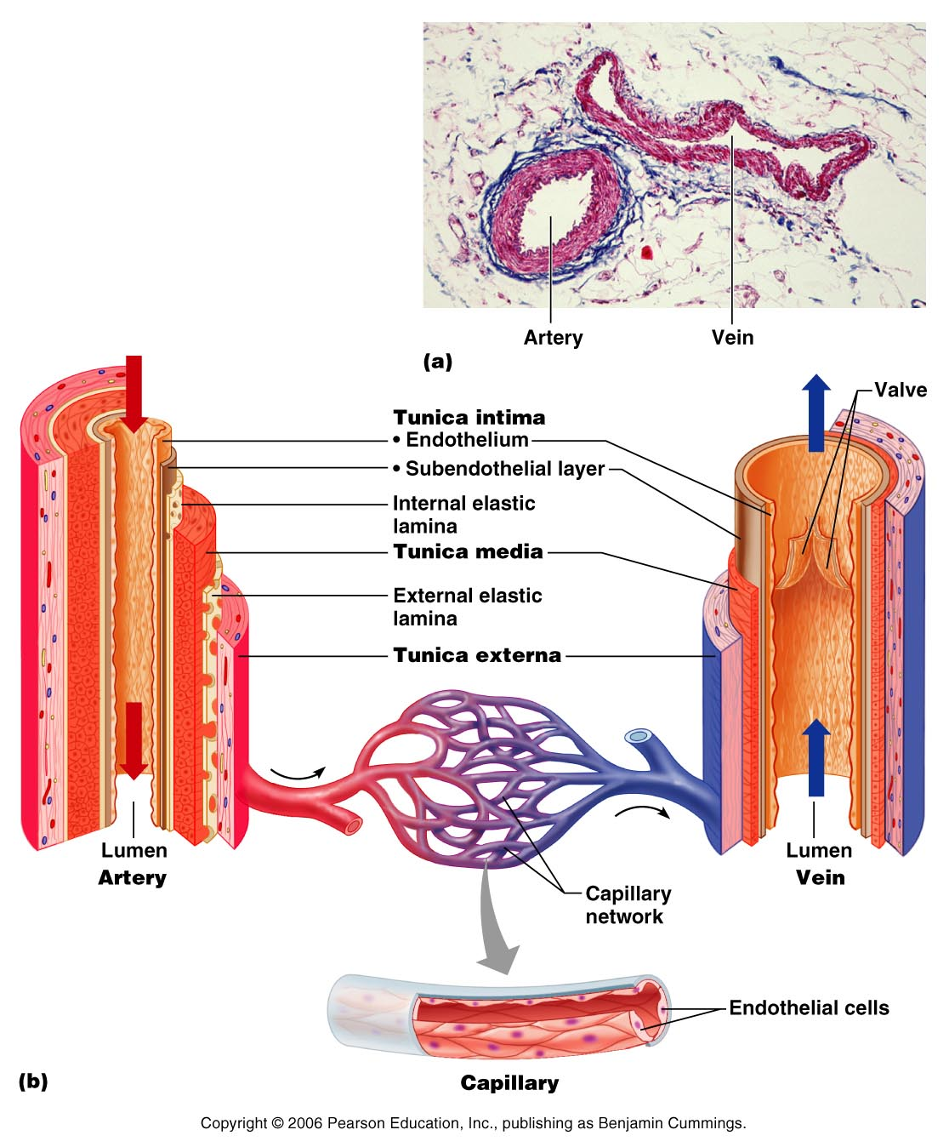
Blood Vessels
Arteries → arterioles → capillaries → venules → veins → heart

Slide 86
Arteries
strong elastic vessels adapted to carry blood under high pressure.
Three layers or tunics
Tunica intima
Tunica media
Tunica adventitia

Slide 87
Arteries
Innermost: tunica interna/intima:
Separates the blood from the vessel wall
helps to prevent clotting by secreting chemicals that inhibit platelet aggregation.
Provides a smooth surface

Slide 88
Arteries
Middle layer: tunica media:
bulk of arterial wall is smooth muscle fibers and thick layer of elastic connective tissue.
gives the vessels an elasticity that helps it to stand up to the force of the blood pressure.

Slide 89
Arteries
Tunica Media
Activity of the smooth muscle is regulated by vasomotor nerves
From sympathetic system
Increased impulses allow vasoconstriction: reduction in lumen
Decreased impulses allow vasodilation: increase in lumen

Slide 90
Arteries
Outer layer: tunica externa/adventitia:
thin connective tissue with irregular fibers.
Attaches the artery to the surrounding tissues.

Slide 91
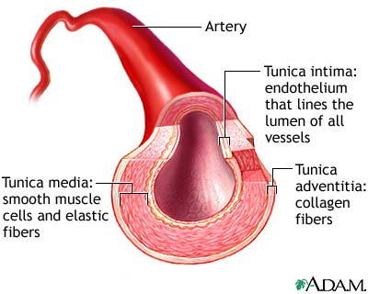
Arteries

Slide 92
Types of Arteries
Elastic arteries
Muscular arteries
Arterioles

Slide 93
Elastic Arteries
Thick walled arteries near the heart
A.k.a. conducting arteries
Contain a lot of elastin
Act as pressure reservoirs
Keeps blood flow continuous rather than stop/start

Slide 94
Muscular arteries
Also: distributing arteries
Tunica media contains more smooth muscle and less elastic tissue than elastic arteries
.More active in vasoconstriction

Slide 95
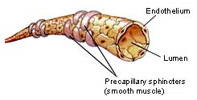
Arterioles
Larger arterioles have all three layers
Small arterioles have only smooth muscle and endothelial lining
These vessels will feed into the capillaries

Slide 96
Capillaries
Smallest blood vessels.
Connect the smallest arterioles and smallest venules.
Three types
Continuous
Fenestrated
Sinusoidal

Slide 97
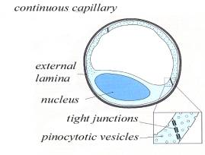
Capillaries
Continuous
Abundant in skin and muscles
Most common
Endothelial cells provide a continuous lining joined together by tight junctions
Gaps in membranes called intercellular clefts
Allow passage of fluids and small solutes

Slide 98
Continuous

Slide 99
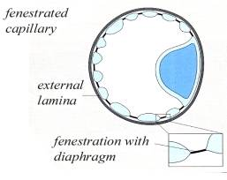
Capillaries
Fenestrated
Contains pores or openings called fenestrations
More permeable
Located where absorption or filtration takes place
Small intestine
Kidneys
Endocrine glands like pituitary and thyroid

Slide 100
Fenestrated

Slide 101
Capillaries
Sinusoid
Also called discontinuous capillaries
Very leaky
Found in
Liver: associated with macrophages called Kupffer cells that destroy bacteria
Bone marrow
Lymph tissue: Spleen
Some endocrine organs
Fenestrated with few tight junctions
Allows large molecules and blood cells to get into the nearby tissue

Slide 102
Sinusoid or discontinuous

Slide 103
Capillaries
Walls are endothelium, single layer of squamous epithelial cells.
Form a semipermeable layer through which the exchange of gasses and wastes take place

Slide 104
Capillaries
Exchange of gasses and nutrients occurs in the capillaries.
Biochemicals move through the walls by diffusion, filtration, and osmosis.
Diffusion is the most important means of transfer.

Slide 105
Capillaries
High O₂ conc and nutrients, substances diffuse through the capillary walls and enter the tissue fluid.
CO₂ concentration is higher in the tissue. Will diffuse into capillaries from tissues

Slide 106
Regulation of capillary
smooth muscle that encircles the capillary entrances.
Precapillary sphincters: may close a capillary by contracting or open it by relaxing.
Sphincters respond to the demands of the cell.

Slide 107
Veins and Venules
microscopic vessels that emerge from capillaries and merge to form veins.
Veins carry blood back to atria.

Slide 108
Veins and Venules
Walls of veins are similar to arteries. Middle layer of venous wall is poorly developed. Therefore, have thinner walls
Lumen has greater diameter.
Veins have valves, which maintain the blood flow in one direction.

Slide 109
Veins
Veins function as blood reservoirs
useful in times of blood loss.
Hemorrhaging:
drop in arterial pressure → muscular walls of the veins stimulated by sympathetic nerve impulses.

Slide 110
Veins
Venous constriction helps maintain bp by returning more blood to the heart.
Ensures a nearly normal blood flow even with a 25% blood loss.

Slide 111
Veins
Blood flow through the venous system depends more on the contraction of skeletal muscles, breathing movements, and vasoconstriction of veins than on the direct result of the heart action.

Slide 112
Veins
Contracting muscles press on veins, squeezing the blood inside towards heart from one valved section to another.
The presence of the valves keeps the blood from a backwards flow.

Slide 113
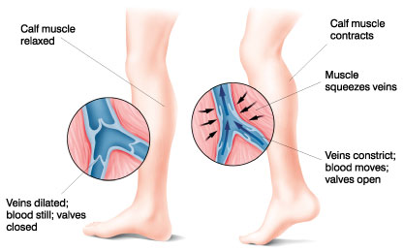
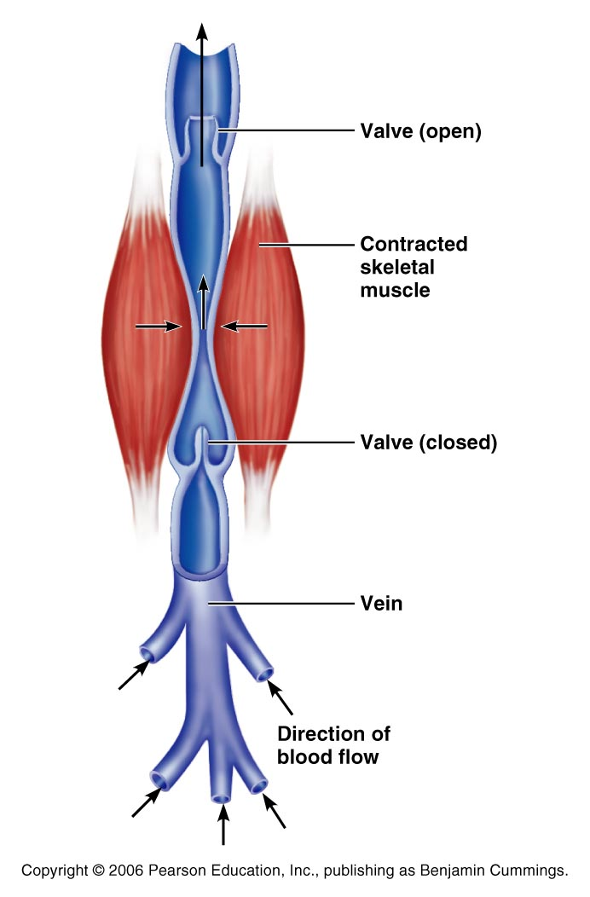

Slide 114
Veins
Respiratory movements move venous blood.
Pressure in thoracic cavity is reduced as the diaphragm contracts and the rib cage moves up and out.

Slide 115
Veins
The pressure in the abdominal cavity is increased as the diaphragm presses on the abdominal viscera….
the blood moves from area of high pressure to low pressure….
from abdomen towards thoracics. (towards heart)

Slide 116
Terms for circulation
Blood flow
Volume of blood flowing through a structure/time
Relatively constant at rest
Varies with individual organs: based on need
Blood pressure
The force on the vessel wall based on the blood

Slide 117
Terms for circulation
Resistance
Opposition to flow
Friction, mostly occurring peripherally
Causes of Peripheral resistance
Blood viscosity: Increased viscosity yeilds increased resistance
Vessel length: The longer the vessel the greater the resistance
Vessel diameter: the smaller the vessel, the greater the resistance

Slide 118
Viscosity
the ease/difficulty with which its molecules flow past one another.
The higher the viscosity, the more difficult the fluid is to move
Blood cells and plasma proteins increase viscosity.
The greater the blood’s resistance to flowing, the greater the force needed to move it through the system.
BP rises as viscosity increases.

Slide 119
Viscosity
Anemia decreases viscosity…. Lowers blood pressure.
Excess red blood cells increase viscosity and blood pressure

Slide 120
Central Venous Pressure
All veins except for the pulmonary v. drain into the R atrium…
the pressure within the right atrium is called the central venous pressure.
Affects the pressure within the peripheral veins.

Slide 121
Central Venous Pressure
Heart beats weakly →the central venous pressure increases,
blood backs up into the venous network →raising its pressure.

Slide 122
Central Venous Pressure
if heart is beating forcefully, the CVP and the pressure within the venous network decreases.

Slide 123
Central Venous Pressure
Factors that increase the blood flow into RA…elevate the CVP:
Increase in blood volume
Widespread venoconstriction.
Increased CVP can lead to peripheral edema due to the hydrostatic pressure forcing fluid into tissues.

Slide 124
Blood Pressure
Is the force the blood exerts against the inner walls of the blood vessels.
Most commonly refers to pressure in the systemic arteries

Slide 125
Blood pressure
Arterial blood pressure: rises and falls in a pattern with the phases of the cardiac cycle.
When ventricles contract: ventricular systole: walls squeeze blood into pulmonary trunk and aorta. Pressure in the arteries increases sharply.

Slide 126
Blood pressure
Maximum pressure achieved during ventricular contraction is Systolic pressure

Slide 127
Blood pressure
When ventricles relax =ventricular diastole,
the arterial pressure drops, and the lowest pressure that remains in the arteries before the next contraction is the diastolic pressure

Slide 128
Blood Pressure
BP read as systolic/diastolic which translates into
ventricular contraction pressure/ventricular relaxation pressure.

Slide 129
Pulse
the expansion/recoil of artery walls due to increased pressure from ventricular contraction.
Felt near surfaces.
Radial artery: near wrist: two finger widths below thumb. Equal to the rate at which the left ventricle contracts and can be used to determine heart rate.

Slide 130
Short term BP control
Short term controls of blood pressure
Nervous system
Chemicals
Hormones
Function to correct minor fluctuations in BP
By altering peripheral resistance
By altering cardiac output

Slide 131
Vasomotor Center
Short term control: neural
Two main goals
Maintaining adequate mean arterial pressure by altering blood vessel diameter
Distributing blood to those organs with a higher demand

Slide 132
Vasomotor center
Vasomotor center: neurons located in the medulla
With the cardiac center in the medulla, they form the cardiovascular center
Vasomotor center in medulla →sympathetic efferent fibers → smooth muscles of the arterioles
Arterioles under state of constant constriction called vasomotor tone

Slide 133
Vasomotor activity
Vasomotor control modified by
Baroreceptors
Chemoreceptors
Higher brain centers

Slide 134
Vasomotor: Baroreceptors
Increased arterial BP causes stretch in baroreceptors
Located in carotid sinuses
Carotid provides the major blood flow to the brain
Carotid sinus reflex protects the brain
Located in aortic arch and walls of large arteries
Aortic sinus reflex protects the systemic circuit

Slide 135
Vasomotor: baroreceptors
Increased BP →
stretches vessels →
triggers baroreceptors →
impulses sent to vasomotor center →
arterioles and veins vasodilate →
BP drops

Slide 136
Vasomotor: chemoreceptors
Sensitive to
Oxygen
pH
Carbon dioxide
Locations:
Carotid bodies located in Carotid artery
Aortic bodies located in Aorta
Main function:
regulating respiratory rate, but does have some blood pressure function

Slide 137
Vasomotor: chemoreceptors
Decreased oxygen → stimulates chemoreceptors →
signals sent to cardioacceleratory center → cardiac output increases
AND signals sent to vasomotor center → vasoconstriction → blood pressure rises → blood supply returns to heart (and lungs) quickly

Slide 138
Vasomotor: brain functions
Medulla is not the only brain area that controls blood pressure
Cerebral cortex
Hypothalamus
Both of these regions have input into medulla to indirectly control BP

Slide 139
Hormone effects on BP
Adrenal medulla
Epinephrine
increases CO
General vasoconstriction
Specific vasodilation: skeletal and cardiac muscles
Norepinephrine
vasoconstriction
Enhance sympathetic fight/flight response

Slide 140
Hormone effects on BP
Atrial natriuretic peptide: ANP
Increased blood pressure stimulates ANP release.
Results in decrease BP after ANP causes sodium to be excreted from kidneys
Where sodium goes, water goes

Slide 141
Hormone effects on BP
Antidiuretic Hormone ADH/ vasopressin
Results in the conservation of water in the body
If low BP or blood volume, ADH will prevent water from being lost as urine
Water restores blood volume/pressure
Also can cause vasoconstriction

Slide 142
Hormone effects on BP
Angiotensin II
stimulates vasoconstriction
Causes the release of ADH and Aldosterone
Causes long-term regulation by increasing blood volume

Slide 143
Hormone effects on BP
Angiotensin II
Low BP →
Kidneys release renin
Renin acts as an enzyme, breaking angiotensinogen into angiotensin I
Angiotensin I is changed into angiotensin II by ACE: Angiotensin Converting Enzyme

Slide 144
BP Control: Long term
Will change blood pressure based on changes in blood volume
Recall that short term controls dealt mostly with altering peripheral resistance to control blood pressure
Short term solutions like baroreceptors can
Respond quickly
Adapt to chronic conditions

Slide 145
BP control: long term
Kidneys
Directly regulate arterial pressure
Alters blood volume as a function of filtration pressure
High blood pressure forces blood to be filtered and processed quickly through the renal system. Larger amounts of water will be lost as urine causing the blood pressure to lower
Indirectly regulates arterial pressure
Renin-angiotensin mechanism:
stimulates aldosterone which reabsorbs sodium and in turn causes the reabsorption of water

Slide 146
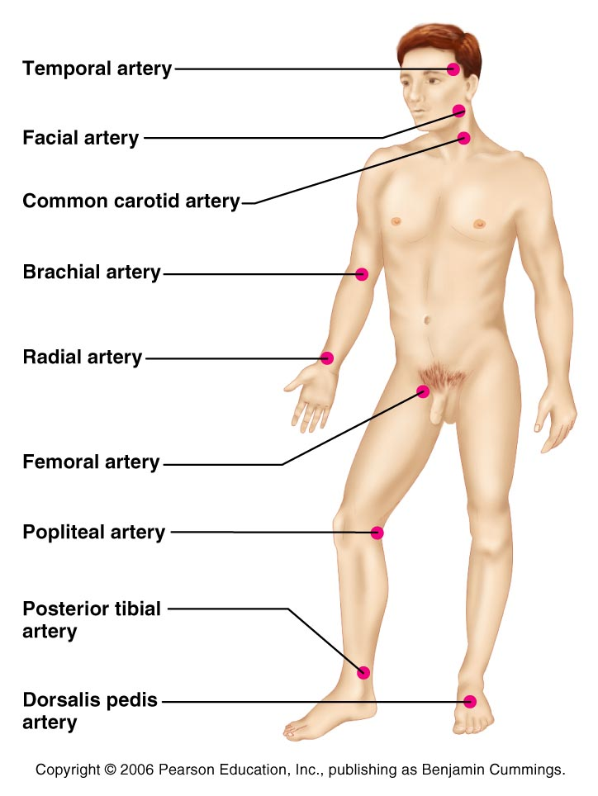
Pulse
the expansion/recoil of artery walls due to increased pressure from ventricular contraction.
Felt near surfaces.

Slide 147
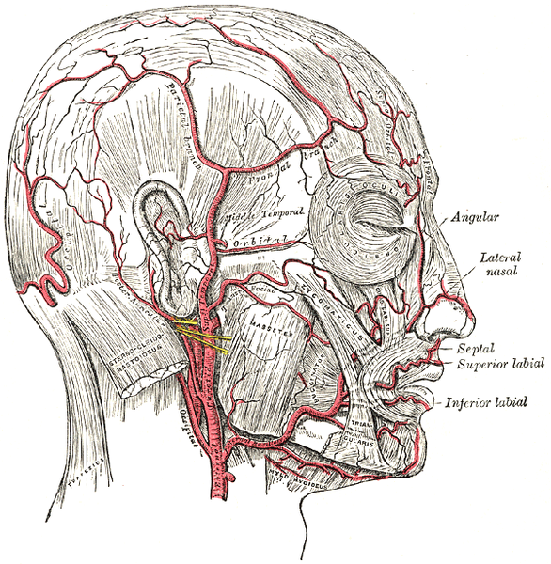
Head and neck pulses
Temporal artery
Branches off of external carotid artery
Pulse is palpable superior to the zygomatic arch, anterior and superior to the tragus

Slide 148
Head and neck pulses
Common carotid artery
The left common carotid artery is one of three arteries that originate along the aortic arch
The right common carotid artery arises from the brachiocephalic artery
Pulse: palpated in the neck at lateral aspects of trachea
Baroreceptors in carotids are sensitive to bilateral palpation, may cause bradycardia or fainting

Slide 149
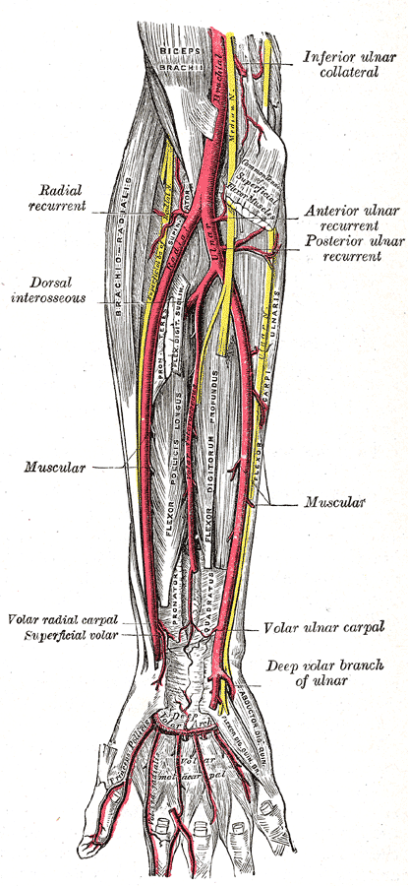
Upper limb pulses
Brachial artery
Origin: subclavian artery → axillary artery → to brachial artery
Palpation: at the antecubital fossa
Is the artery used to determine arterial blood pressure

Slide 150
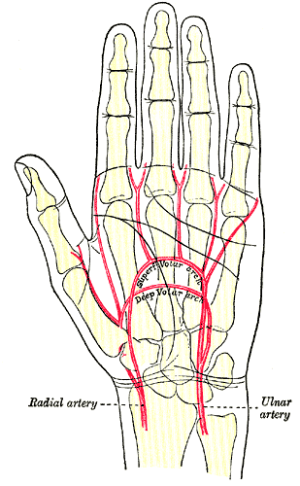
Upper limb pulses
Radial Artery
Origin: Subclavian a → axillary a → brachial a → splits into radial a and ulnar a
Palpation: at the anterior wrist: three finger-widths proximal to the thenar eminence

Slide 151
Lower Limb Pulses
four arterial pulses are routinely felt in the lower limb.
femoral
popliteal
Posterior tibial
Dorsalis pedis (dorsum of foot)

Slide 152
Femoral pulse
Most of the blood supply to the lower limb is carried in the external iliac artery.
Aorta →
descending aorta →
common iliac artery →
external iliac artery →
becomes the femoral artery →
deep femoral

Slide 153
Finding the Femoral Pulse
Locate the superior border of the pubis in the mid line of the body;
Feel the anterior iliac crest. The femoral pulse can be found midway between these two bony points
(the mid-inguinal point)

Slide 154
Popliteal
The femoral artery leaves enters the popliteal fossa by passing through the adductor magnus muscle.
The name of the vessel then changes to the popliteal artery.

Slide 155
Palpating popliteal artery
bend the knee so that it is flexed to about 90 degrees.
press the tips of your fingers into the popliteal fossa.
The popliteal pulse is deep and diffuse
Can be difficult to palpate

Slide 156
Posterior Tibial
The Popliteal artery branches into anterior tibial and posterior tibial arteries.

Slide 157
Palpating Posterior tibial artery
Locate the medial malleolus
inferior and posterior to the medial malleolus you should find the posterior tibial pulse.

Slide 158
Dorsalis Pedis
Below the knee, the popliteal artery divides into the anterior and posterior tibial arteries.
The anterior branch enters the anterior compartment of the leg by passing between the tibia and fibula above the interosseous membrane.
It continues on to the dorsum of the foot as the dorsalis pedis artery

Slide 159
Palpating dorsalis pedis pulse
Place your fingers half way down the dorsum of the foot in the line between the first and second toes.
The bones you can feel are the dorsal aspect of the navicular and the intermediate cuneiform bones.
The pulse is palpated where the artery passes over this area.

Slide 160
Alterations in Blood pressure
Hypotension
Low blood pressure
Systolic below 100 mm Hg
Orthostatic hypotension
Temporary positional low blood pressure
Getting up quickly

Slide 161
Alterations in blood pressure
Chronic hypotension
May be related to anemia or deficient blood proteins causing low blood viscosity
May be symptomatic of
Addison’s disease
Hypothyroidism
Tissue wasting
Acute hypotension
Circulatory shock

Slide 162
Alterations in blood pressure
Hypertension
Transient changes seen during
Fevers
Physical exertion
Emotional stress
Persistent changes are related to
Increased peripheral resistance due to
Obesity
Diet
Diabetes mellitus
Hereditary
Smoking

Slide 163
Circulatory shock
Any condition in which blood vessels are inadequately filled and blood can not circulate normally
Can result in cell death

Slide 164
Hypovolemic shock
Hypovolemic shock
Most common form
Due to low blood volume
Blood volume drops rapidly
heart rate increases
Intense vasoconstriction
Blood pressure stabilizes until further blood loss

Slide 165
Vascular shock
Vascular shock
Blood volume normal
Circulation poor due to extreme vasodilation
Causes a drop in peripheral resistance
Blood pressure falls
Common causes
Loss of vasomotor tone
Anaphylaxis → histamines → autonomic nervous system fails to maintain vasomotor tone
Septicemia

Slide 166
Cardiogenic shock
Cardiogenic shock results from failure at the heart
Weak pump due to myocardial damage

