Slide 1
BSC 182
Human Physiology & Anatomy II
Dr. Betsy A. Wargo

Slide 2
Introduction
Dr. Wargo
    bawargo@ilstu.edu
    Office hours: MWF 11 – 11:45
    Background
      Graduated from ISU 1994
        Major: Biology
      Graduated from National College of Chiropractic 1997
        B.S. in Human Biology
        Doctorate for Chiropractic

Slide 3
Introduction
Syllabus
  Posted on ReggieNet
Exams
  Six semester exams worth 100 points
    Lowest exam from 1 – 5 automatically dropped when calculating grades
    No make up exams
Grading
  89.5 and up A
  79.5 – 89.4 B
  69.5 – 79.5 C
  59.5 – 69.4 D
  Below 69.4 F

Slide 4
Introduction
Assignments
  You will submit one assignment by each of our six exam dates. The assignment will be open in ReggieNet several days before the due date. Instructions will be provided.
  Encourage a type of Active Study
  Ten high-quality quiz questions
    Eight multiple choice questions that include at least four options. Indicate the correct response.
    Two short answer questions. Asked and answered correctly
  No late assignments will be accepted

Slide 5
Introduction
Format
  Class will consist of PowerPoint lecture based on the information from your text book.
    Lectures are intended to help you digest and comprehend the material from your book, not replace it.
    Templates for the lectures will be available through the MODULES section of ReggieNet for you to download and print.
    A picture is worth a thousand words…
      Generally, if I draw it on the board, make sure it gets into your notes.

Slide 6
Introduction
Active versus Passive Studying
  Passive:
    reading or re-reading notes, listening to taped lectures
    Low energy requirements
    Begin to understand material

Slide 7
Introduction
  Active Studying
    Developing comprehension
    Re-writing sections you don’t understand
      Study efficiently!
    Note-cards
    Study groups
      Discussing pathways or processes
      Explaining to those who don’t get it yet
      Forcing verbal recall of written material
    Making exam questions
      Answering exam questions correctly
      Exchanging and reviewing assignments.
      This then becomes a study guide for class material.
    Using supplemental study sites for practice quizzes

Slide 8
Introduction
Exam Format
  Exams will be created mostly from material presented in lecture
    We omit certain sections from the textbook chapters. Review from your class notes/templates.
  You will be responsible for diagrams (Anatomy)
    Images from the lecture presentation will be used. You will have access to these images through your notes (templates) as well as the through the posted exam reveiws

Slide 9
Lab
There will be lab this week
  Please be sure to bring the BSC 182 lab manual with you to lab
  Lab manuals can be purchased at the Phi Sigma bookstore (Felmley 101A) this week and next for $15.00
  Lab format
    There will be four lab practicals this semester
    Lab assignments (case studies or article summaries) may be assigned throughout the semester.

Slide 10
Ready?
Before we begin, take a moment to introduce yourself to your neighbors
make sure you have contact information from a classmate should you need to get a copy of the notes

Slide 11
Endocrine System: Overview
Acts with nervous system
  to coordinate and integrate activity of body cells
Influences metabolic activities
Response slower but longer lasting than nervous system

Slide 12
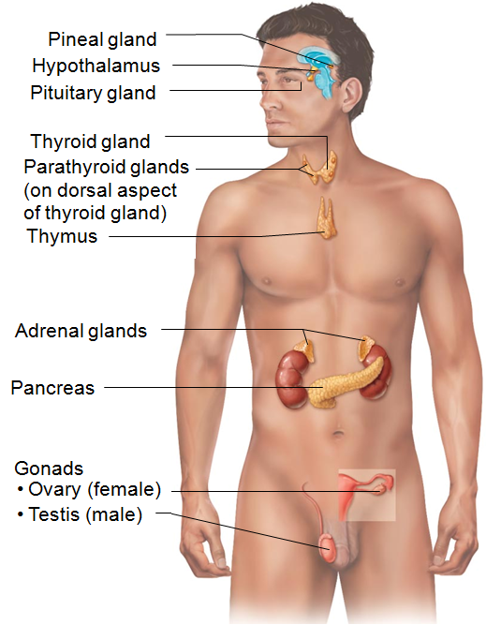
Endocrine System: Overview
Exocrine glands
  Nonhormonal substances
    sweat, saliva
  Have ducts to carry secretion to membrane surface
Endocrine glands
  Produce hormones
  No ducts

Slide 13
Chemical Messengers
Hormones
  long-distance chemical signals; travel in blood or lymph
Autocrines:
  chemicals that exert effects on same cells that secrete them
Paracrines:
  locally acting chemicals that affect cells other than those that secrete them
Autocrines and paracrines are local chemical messengers; not considered part of endocrine system

Slide 14
Chemistry of Hormones
Two main classes
  Amino acid-based hormones
    Amino acid derivatives, peptides, and proteins
  Steroids
    Synthesized from cholesterol
    Gonadal and adrenocortical hormones

Slide 15
Mechanisms of Hormone Action
Though hormones circulate systemically only cells with receptors for that hormone affected
Target cells
  Tissues with receptors for specific hormone
Hormones alter target cell activity

Slide 16
Mechanisms of Hormone Action
Hormones act at receptors in one of two ways, depending on their chemical nature and receptor location
  Water-soluble hormones (all amino acid–based hormones except thyroid hormone)
    Act on plasma membrane receptors
    Use second messengers
    Cannot enter cell

Slide 17
Mechanisms of Hormone Action
  2. Lipid-soluble hormones (steroid and thyroid hormones)
    Act on intracellular receptors that directly activate genes
    Can enter cell

Slide 18
Intracellular Receptors and Direct Gene Activation
Steroid hormones and thyroid hormone
  Diffuse into target cells and bind with receptors within the cell
  Receptor+hormone enters nucleus
    binds to specific region of DNA
  Prompts DNA transcription to produce mRNA
  mRNA directs protein synthesis
  Promote metabolic activities, or promote synthesis of structural proteins or proteins for export from cell

Slide 19
Target Cell Specificity
Target cells must have specific receptors to which hormone binds, for example
  Some hormones have only a few target cells
    ACTH receptors found only on certain cells of adrenal cortex
  Some hormones have many different target cells
    Thyroxin receptors are found on nearly all cells of body

Slide 20
Control of Hormone Release
Blood levels of hormones
  Controlled by negative feedback systems
  Vary only within narrow, desirable range
Endocrine gland stimulated to synthesize and release hormones in response to
  Humoral stimuli
  Neural stimuli
  Hormonal stimuli

Slide 21
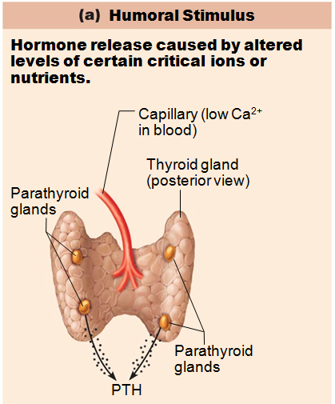
Humoral Stimuli
Changing blood levels of ions and nutrients directly stimulate secretion of hormones
Example: Ca²⁺ in blood
  Declining blood Ca²⁺ concentration stimulates parathyroid glands to secrete PTH (parathyroid hormone)
  PTH causes Ca²⁺ concentrations to rise and stimulus is removed

Slide 22
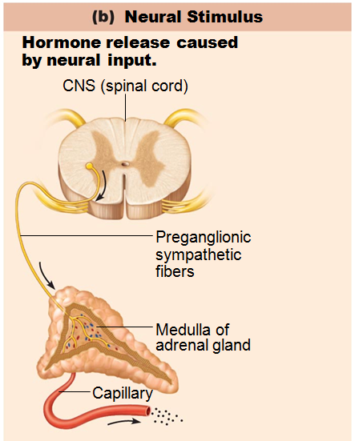
Neural Stimuli
Nerve fibers stimulate hormone release
  Sympathetic nervous system fibers stimulate adrenal medulla to secrete catecholamines

Slide 23
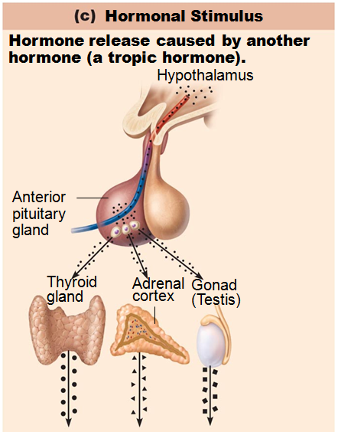
Hormonal Stimuli
Hormones stimulate other endocrine organs to release their hormones
  Hypothalamic hormones stimulate release of most anterior pituitary hormones
  Anterior pituitary hormones stimulate targets to secrete still more hormones
  Hypothalamic-pituitary-target endocrine organ feedback loop: hormones from final target organs inhibit release of anterior pituitary hormones

Slide 24
Nervous System Modulation
Nervous system modifies stimulation of endocrine glands and their negative feedback mechanisms
  Example: under severe stress, hypothalamus and sympathetic nervous system activated
    → body glucose levels rise
Nervous system can override normal endocrine controls

Slide 25
Onset of Hormone Activity
Some responses are almost immediate
Some, especially steroid, hours to days
Some must be activated in target cells

Slide 26
Duration of Hormone Activity
Limited
  Ranges from 10 seconds to several hours
  Effects may disappear as blood levels drop
  Some persist at low blood levels

Slide 27
The Pituitary Gland and Hypothalamus
Pituitary gland (hypophysis) has two major lobes
  Posterior pituitary
    neurohypophysis
    Neural tissue
  Anterior pituitary
    adenohypophysis
    Glandular tissue

Slide 28
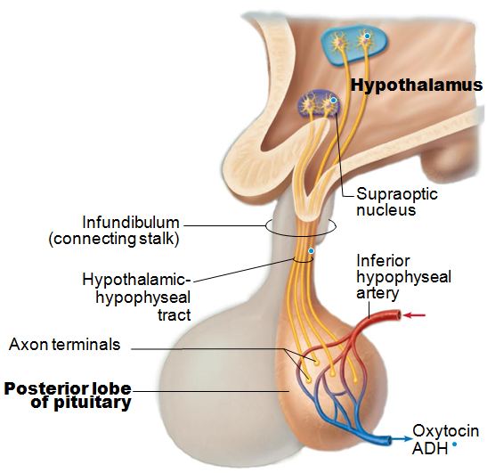
Pituitary-hypothalamic Relationships
Posterior pituitary (lobe)
  Extension of hypothalamic neural tissue
  Neural connection to hypothalamus
    hypothalamic-hypophyseal tract
  Nuclei of hypothalamus make oxytocin and antidiuretic hormone
  Neurohormones are transported to and stored in posterior pituitary

Slide 29
Posterior Pituitary and Hypothalamic Hormones
Oxytocin and ADH
  Each composed of nine amino acids
  Almost identical
    differ in two amino acids

Slide 30
Oxytocin
Strong stimulant of uterine contraction
  Released during childbirth
Hormonal trigger for milk ejection
Acts as neurotransmitter in brain

Slide 31
ADH (Vasopressin)
prevents urine formation
Regulates water balance
Release also triggered by pain, low blood pressure, and drugs
Inhibited by alcohol, diuretics
High concentrations → vasoconstriction

Slide 32
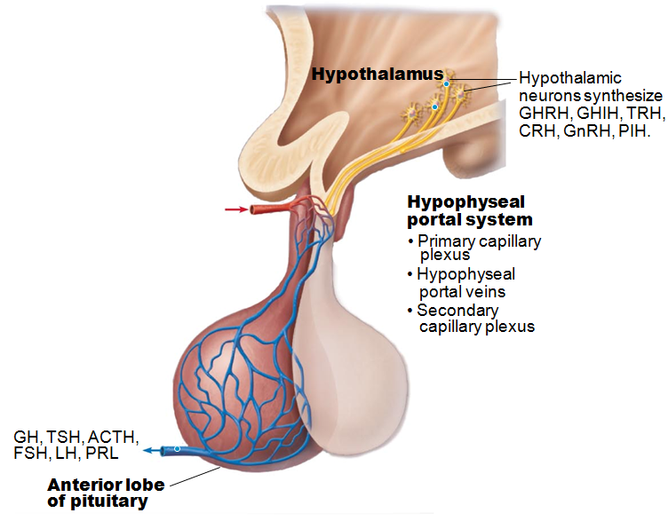
Pituitary-hypothalamic Relationships
Anterior Lobe:
  Vascular connection to hypothalamus
    Hypophyseal portal system
      Carries releasing and inhibiting hormones
      regulate hormone secretion

Slide 33
Anterior Pituitary Hormones
Growth hormone (GH)
Thyroid-stimulating hormone (TSH) or thyrotropin
Adrenocorticotropic hormone (ACTH)
Follicle-stimulating hormone (FSH)
Luteinizing hormone (LH)
Prolactin (PRL)

Slide 34
Growth Hormone (GH)
GH release chiefly regulated by hypothalamic hormones
  Growth hormone–releasing hormone (GHRH)
    Stimulates release
  Growth hormone–inhibiting hormone (GHIH) (somatostatin)
    Inhibits release
Ghrelin (hunger hormone) also stimulates release

Slide 35
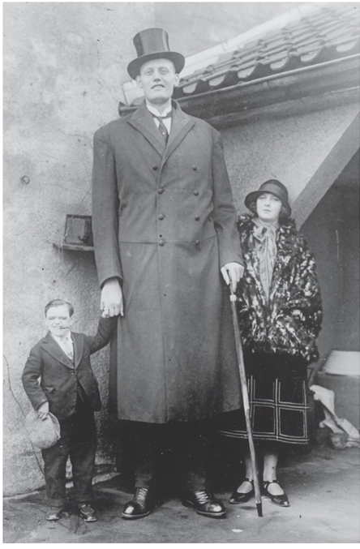
Homeostatic Imbalances of Growth Hormone
Hypersecretion
  In children results in gigantism
  In adults results in acromegaly
Hyposecretion
  In children results in pituitary dwarfism

Slide 36
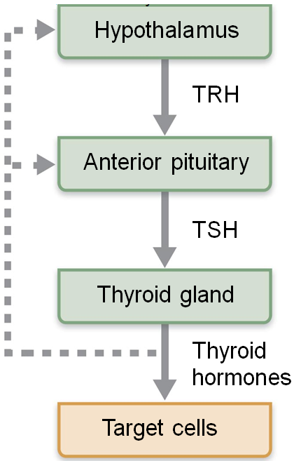
Thyroid-stimulating Hormone (Thyrotropin)
Produced by thyrotropic cells of anterior pituitary
Stimulates normal development and secretory activity of thyroid
Release triggered by thyrotropin-releasing hormone from hypothalamus
Inhibited by rising blood levels of thyroid hormones that act on pituitary and hypothalamus

Slide 37
Adrenocorticotropic Hormone (Corticotropin)
Secreted by corticotropic cells of anterior pituitary
Stimulates adrenal cortex to release corticosteroids

Slide 38
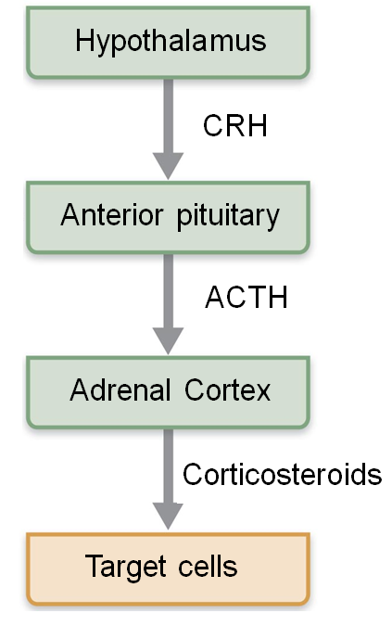
Adrenocorticotropic Hormone (Corticotropin)
Regulation of ACTH release
  Triggered by hypothalamic corticotropin-releasing hormone (CRH) in daily rhythm
  Internal and external factors such as fever, hypoglycemia, and stressors can alter release of CRH

Slide 39
Gonadotropins
Follicle-stimulating hormone (FSH) and luteinizing hormone (LH)
Secreted by gonadotrophs of anterior pituitary
FSH stimulates gamete (egg or sperm) production
LH promotes production of gonadal hormones
Absent from the blood in prepubertal boys and girls

Slide 40
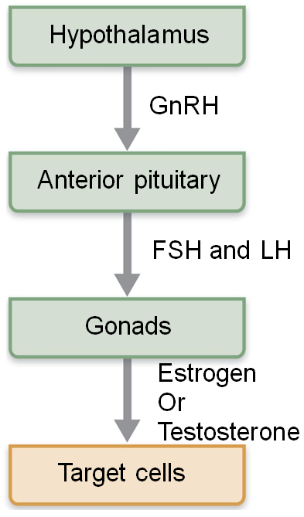
Gonadotropins
Regulation of gonadotropin release
  Triggered by gonadotropin-releasing hormone (GnRH) during and after puberty
  Suppressed by gonadal hormones (feedback)

Slide 41
Prolactin (PRL)
Secreted by prolactin cells of anterior pituitary
Stimulates milk production
Role in males not well understood

Slide 42
Prolactin (PRL)
Regulation of PRL release
  Primarily controlled by prolactin-inhibiting hormone (PIH) (dopamine)
Blood levels rise toward end of pregnancy
Suckling stimulates PRL release and promotes continued milk production
Hypersecretion causes inappropriate lactation, lack of menses, infertility in females, and impotence in males

Slide 43
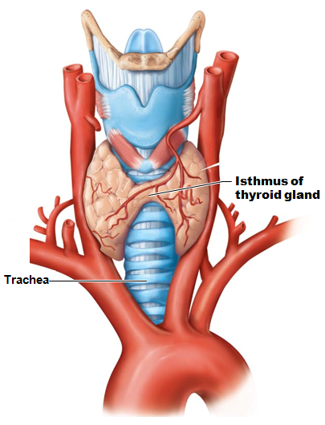
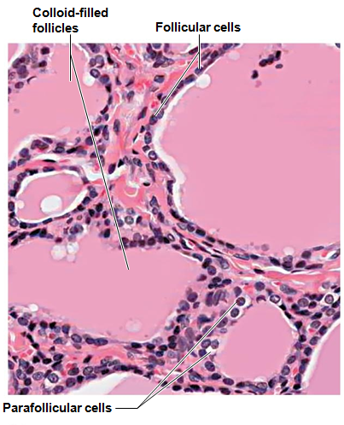
Thyroid Gland
Two lateral lobes connected by isthmus
Composed of follicles that produce thyroglobulin
Parafollicular cells produce the hormone calcitonin

Slide 44
Thyroid Hormone (TH)
Actually two related compounds
  T₄ (thyroxine
  T₃ (triiodothyronine)
Affects virtually every cell in body

Slide 45
Thyroid Hormone
Major metabolic hormone
Increases metabolic rate
Regulation of tissue growth and development
  Development of skeletal and nervous systems
  Reproductive capabilities
Maintenance of blood pressure

Slide 46
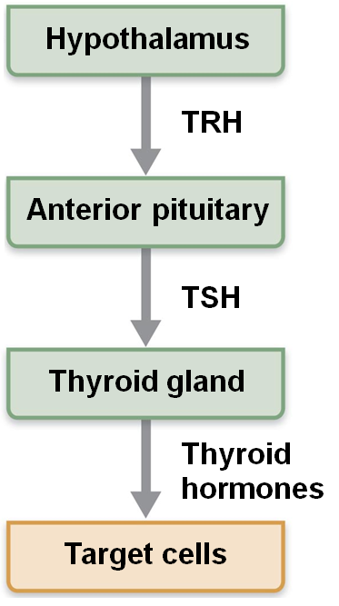
Transport and Regulation of TH
Negative feedback regulation of TH release
  Rising TH levels provide negative feedback inhibition on release of TSH
  Hypothalamic thyrotropin-releasing hormone (TRH) can overcome negative feedback during pregnancy or exposure to cold

Slide 47
Calcitonin
Produced by parafollicular* cells
  *Also called extrafollicular cells
Antagonist to parathyroid hormone (PTH)
At higher than normal doses
  Helps to keep Ca²⁺ in bones
  Stimulates Ca²⁺ uptake and incorporation into bone matrix

Slide 48
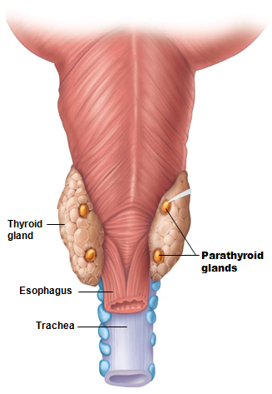
Parathyroid Glands
Four to eight tiny glands embedded in posterior aspect of thyroid
Contain oxyphil cells
  function unknown
parathyroid cells
  secrete parathyroid hormone (PTH)
  PTH
    most important hormone in Ca²⁺ homeostasis

Slide 49
Parathyroid Hormone
Functions
  Stimulates osteoclasts to digest bone matrix and release Ca²⁺ to blood
  Enhances reabsorption of Ca²⁺ and secretion of phosphate by kidneys
  Promotes activation of vitamin D (by kidneys);
    increases absorption of Ca²⁺ by intestinal mucosa
Negative feedback control: rising Ca²⁺ in blood inhibits PTH release

Slide 50
Homeostatic Imbalances of PTH
Hyperparathyroidism due to tumor
  Bones soften and deform
  Elevated Ca²⁺
    depresses nervous system
    contributes to formation of kidney stones
Hypoparathyroidism following gland trauma or removal or dietary magnesium deficiency
  Results in tetany, respiratory paralysis, and death

Slide 51
Adrenal (Suprarenal) Glands
Paired, pyramid-shaped organs atop kidneys
Structurally and functionally are two glands in one
  Adrenal medulla—nervous tissue; part of sympathetic nervous system
  Adrenal cortex—three layers of glandular tissue that synthesize and secrete corticosteroids

Slide 52
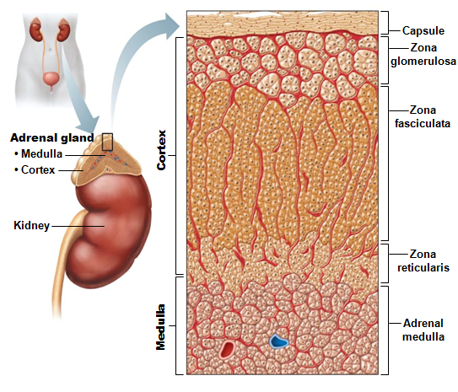
Adrenal Cortex
Three layers of cortex produce the different corticosteroids
  Zona glomerulosa
    mineralocorticoids
  Zona fasciculata
    glucocorticoids
  Zona reticularis
    gonadocorticoids

Slide 53
Mineralocorticoids
Regulate electrolytes
  Na⁺ and K⁺ in extracellular fluid
Aldosterone most potent mineralocorticoid
  Causes water retention by kidneys
  elimination of K⁺

Slide 54
Aldosterone
Release triggered by
  Decreasing blood volume and blood pressure
  Rising blood levels of K⁺

Slide 55
Mechanisms of Aldosterone Secretion
Renin-angiotensin-aldosterone mechanism: decreased blood pressure stimulates kidneys to release renin
  → triggers formation of angiotensin II, a potent stimulator of aldosterone release
ACTH: causes small increases of aldosterone during stress
Atrial natriuretic peptide (ANP): blocks renin and aldosterone secretion to decrease blood pressure

Slide 56
Glucocorticoids
Keep blood glucose levels relatively constant
Maintain blood pressure by increasing action of vasoconstrictors
  Cortisol (hydrocortisone)
    Only one in significant amounts in humans
  Cortisone
  Corticosterone

Slide 57
Glucocorticoids: Cortisol
Released in response to
  ACTH
  Patterns of eating and activity
  Stress
Prime metabolic effect is gluconeogenesis
  formation of glucose from fats and proteins
  Promotes rises in blood glucose, fatty acids, and amino acids
"Saves" glucose for brain
Enhances vasoconstriction → rise in blood pressure to quickly distribute nutrients to cells

Slide 58
Gonadocorticoids (Sex Hormones)
Most weak androgens (male sex hormones) converted to testosterone in tissue cells, some to estrogens
May contribute to
  Onset of puberty
  Appearance of secondary sex characteristics
  Sex drive in women
  Estrogens in postmenopausal women

Slide 59
Adrenal Medulla
Medullary chromaffin cells synthesize epinephrine (80%) and norepinephrine (20%)
Effects
  Vasoconstriction
  Increased heart rate
  Increased blood glucose levels
  Blood diverted to brain, heart, and skeletal muscle

Slide 60
Adrenal Medulla
Responses are brief
Epinephrine stimulates metabolic activities, bronchial dilation, and blood flow to skeletal muscles and heart
Norepinephrine influences peripheral vasoconstriction and blood pressure

Slide 61
Pineal Gland
Small gland hanging from roof of third ventricle
  secretes melatonin
    derived from serotonin
Melatonin may affect
  Timing of sexual maturation and puberty
  Day/night cycles
  Physiological processes that show rhythmic variations
    body temperature, sleep, appetite

Slide 62
Pancreas
Triangular gland partially behind stomach
Has both exocrine and endocrine cells
  Acinar cells (exocrine) produce enzyme-rich juice for digestion
  Pancreatic islets (islets of Langerhans) contain endocrine cells
    Alpha (α) cells produce glucagon
    Beta (β) cells produce insulin

Slide 63
Glucagon
Major target
  liver
Causes increased blood glucose levels
  Effects: Release of glucose to blood
  Glycogenolysis
    breakdown of glycogen to glucose
  Gluconeogenesis
    synthesis of glucose from lactic acid and noncarbohydrates

Slide 64
Insulin
Effects of insulin
  Lowers blood glucose levels
  Enhances membrane transport of glucose into fat and muscle cells
  Inhibits glycogenolysis and gluconeogenesis
  Participates in neuronal development and learning and memory
Not needed for glucose uptake in liver, kidney or brain

Slide 65
Homeostatic Imbalances of Insulin
Diabetes mellitus (DM)
  Due to hyposecretion (type 1) or hypoactivity (type 2) of insulin
  Blood glucose levels remain high → nausea → higher blood glucose levels
  Glycosuria
    glucose spilled into urine

Slide 66
Diabetes Mellitus: Signs
Three cardinal signs of DM
  Polyuria
    huge urine output
    Glucose acts as osmotic diuretic
  Polydipsia
    excessive thirst
    From water loss due to polyuria
  Polyphagia
    excessive hunger and food consumption
    Cells cannot take up glucose; are "starving"

Slide 67
Homeostatic Imbalances of Insulin
Hyperinsulinism:
  Excessive insulin secretion
  Causes hypoglycemia
    Low blood glucose levels
    Anxiety, nervousness, disorientation, unconsciousness, even death
  Treated by sugar ingestion

Slide 68
Ovaries and Placenta
Gonads produce steroid sex hormones
  Same as those of adrenal cortex
Ovaries produce estrogens and progesterone
  Estrogen
    Maturation of reproductive organs
    Appearance of secondary sexual characteristics
    With progesterone, causes breast development and cyclic changes in uterine mucosa
Placenta secretes estrogens, progesterone, and human chorionic gonadotropin (hCG)

Slide 69
Testes
Testes produce testosterone
  Initiates maturation of male reproductive organs
  Causes appearance of male secondary sexual characteristics and sex drive
  Necessary for normal sperm production
  Maintains reproductive organs in functional state

Slide 70
Other Hormone-producing Structures
Adipose tissue
  Leptin
    appetite control; stimulates increased energy expenditure
  Resistin
    insulin antagonist
  Adiponectin
    enhances sensitivity to insulin

Slide 71
Other Hormone-producing Structures
Enteroendocrine cells of gastrointestinal tract
  Gastrin
    stimulates release of HCl
  Secretin
    stimulates liver and pancreas
  Cholecystokinin
    stimulates pancreas and gallbladder,

Slide 72
Other Hormone-producing Structures
Heart
  Atrial natriuretic peptide (ANP) decreases blood Na⁺ concentration
    blood pressure and blood volume decreases
Kidneys
  Erythropoietin signals production of red blood cells
  Renin initiates the renin-angiotensin-aldosterone mechanism
    Results in increased blood pressure

Slide 73
Blood Composition
Blood
  Fluid connective tissue
  Plasma
    non-living fluid matrix
  Formed elements
    living blood "cells" suspended in plasma
      Erythrocytes
        red blood cells, or RBCs
      Leukocytes
        white blood cells, or WBCs
      Platelets

Slide 74
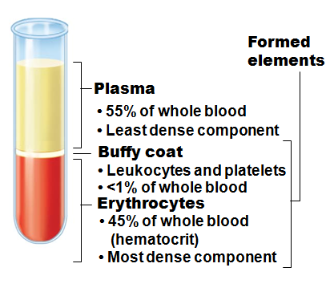
Blood Composition
Spun tube of blood yields three layers
  Plasma on top
  Erythrocytes on bottom
  WBCs and platelets in Buffy coat
Hematocrit
  Percent of blood volume that is RBCs
  47% ± 5% for males; 42% ± 5% for females

Slide 75
Physical Characteristics and Volume
Color varies with O₂ content
  High O₂
    scarlet
  Low O₂
    dark red
pH 7.35–7.45
Average volume
  5 - 6 L for males
  4 - 5 L for females

Slide 76
Functions of Blood
Functions include
  Distributing substances
    Delivering O₂ and nutrients to body cells
    Transporting metabolic wastes to lungs and kidneys for elimination
    Transporting hormones from endocrine organs to target organs

Slide 77
Functions of Blood
  Regulating blood levels of substances
    Maintaining body temperature by absorbing and distributing heat
    Maintaining normal pH using buffers; alkaline reserve of bicarbonate ions
    Maintaining adequate fluid volume in circulatory system

Slide 78
Functions of Blood
  Protection
    Preventing blood loss
      Plasma proteins and platelets initiate clot formation
    Preventing infection
      Antibodies
      Complement proteins
      WBCs

Slide 79
Blood Plasma
90% water
Over 100 dissolved solutes
  Nutrients, gases, hormones, wastes, proteins, inorganic ions
  Plasma proteins most abundant solutes
    Remain in blood; not taken up by cells
    Proteins produced mostly by liver

Slide 80
Albumin
60% of plasma protein
Functions
  Substance carrier
  Blood buffer
  Major contributor of plasma osmotic pressure

Slide 81
Globulins
Three sub-categories
  Alpha
    Transport molecule
  Beta
    Transport molecule
  Gamma
    Antibodies
  Transport molecules carry those compounds that do not circulate well in a watery (plasma) environment
    Fats, cholesterol, etc

Slide 82
Formed Elements
Only WBCs are complete cells
  RBCs have no nuclei or other organelles
  Platelets are cell fragments
Most formed elements survive in bloodstream only few days
Most blood cells originate in bone marrow and do not divide

Slide 83
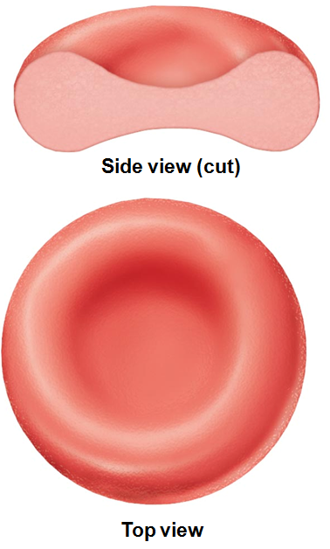
Erythrocytes
Biconcave discs
Anucleate
  No nucleus
  essentially no organelles
Diameters larger than some capillaries
Filled with hemoglobin (Hb) for gas transport
Major factor contributing to blood viscosity

Slide 84
Erythrocytes
Structural characteristics contribute to gas transport
  Biconcave shape
    huge surface area relative to volume
    >97% hemoglobin (not counting water)
  No mitochondria;
    do not consume O₂ they transport

Slide 85
Erythrocyte Function
RBCs dedicated to respiratory gas transport
Hemoglobin binds reversibly with oxygen

Slide 86
Hemoglobin Structure
Globin composed of 4 polypeptide chains
  Two alpha and two beta chains
Heme pigment bonded to each globin chain
  Gives blood red color
Heme's central iron atom binds one O₂
Each Hb molecule can transport four O₂
Each RBC contains 250 million Hb molecules

Slide 87
Hemoglobin (Hb)
O₂ loading in lungs
  Oxygen binds with hemoglobin
  Produces oxyhemoglobin (ruby red)
O₂ unloading in tissues
  Oxygen detaches from hemoglobin
  Produces deoxyhemoglobin or reduced hemoglobin (dark red)
CO₂ can also be carried on hemoglobin
  At a site separate from where oxygen binds

Slide 88
Hematopoiesis
Blood cell formation in red bone marrow
In adult, found in
  axial skeleton
  Girdles
  proximal epiphyses of humerus and femur

Slide 89
Hematopoiesis
Hematopoietic stem cells (Hemocytoblasts)
  Give rise to all formed elements
  Hormones and growth factors push cell toward specific pathway of blood cell development
  Committed cells cannot change

Slide 90
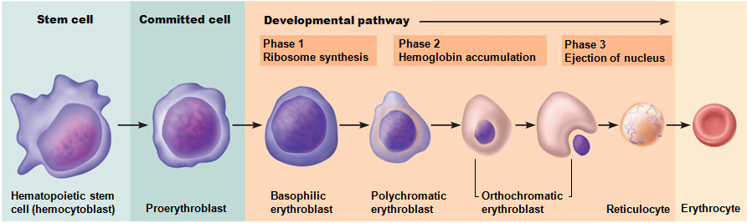
Erythropoiesis: Red Blood Cell Production
Stages
  Myeloid stem cell transformed into proerythroblast
  In 15 days proerythroblasts develop into
    Basophilic erythroblasts
    then polychromatic erythroblasts
    then orthochromatic erythroblasts
    then into reticulocytes
  Reticulocytes enter bloodstream; in 2 days mature RBC

Slide 91
Regulation of Erythropoiesis
Too few RBCs leads to tissue hypoxia
Too many RBCs increases blood viscosity

Slide 92
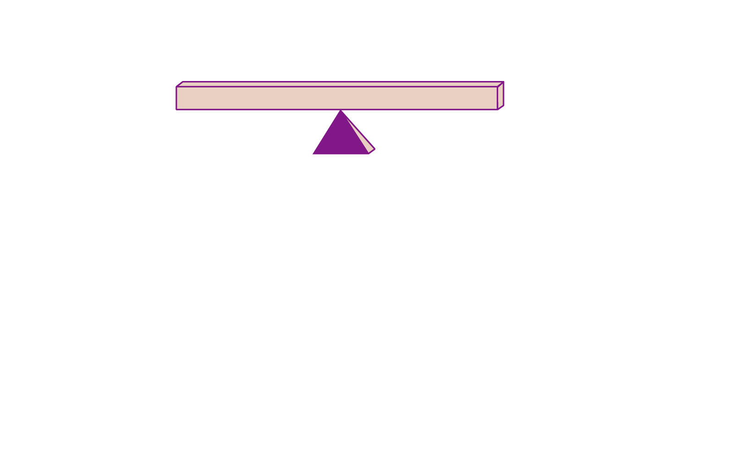
Homeostasis: Normal blood oxygen levels
Figure 17.6

Slide 93
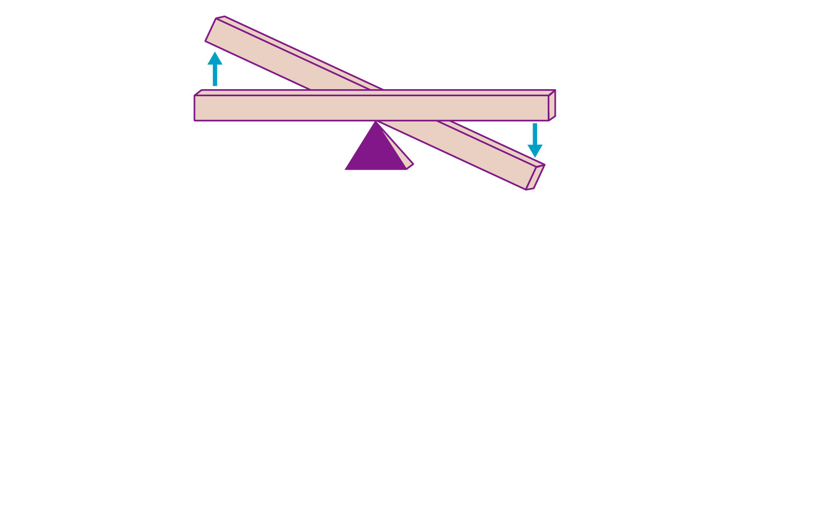
Imbalance
Start
Homeostasis: Normal blood oxygen levels
Stimulus: Hypoxia due to
decreased RBC count,
decreased amount of
hemoglobin, or decreased
availability of O₂
Imbalance
Figure 17.6

Slide 94
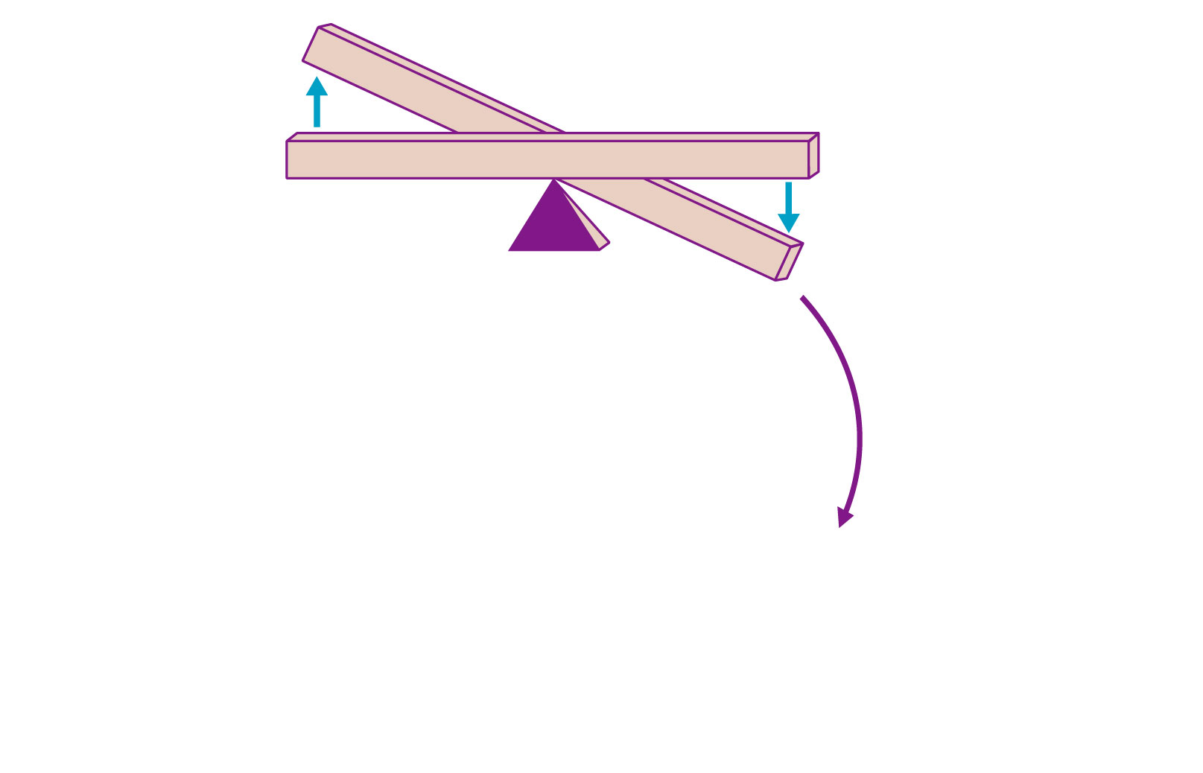
Imbalance
Start
Homeostasis: Normal blood oxygen levels
Stimulus: Hypoxia due to
decreased RBC count,
decreased amount of
hemoglobin, or decreased
availability of O₂
Imbalance
Reduces O₂ levels
in blood
Figure 17.6

Slide 95
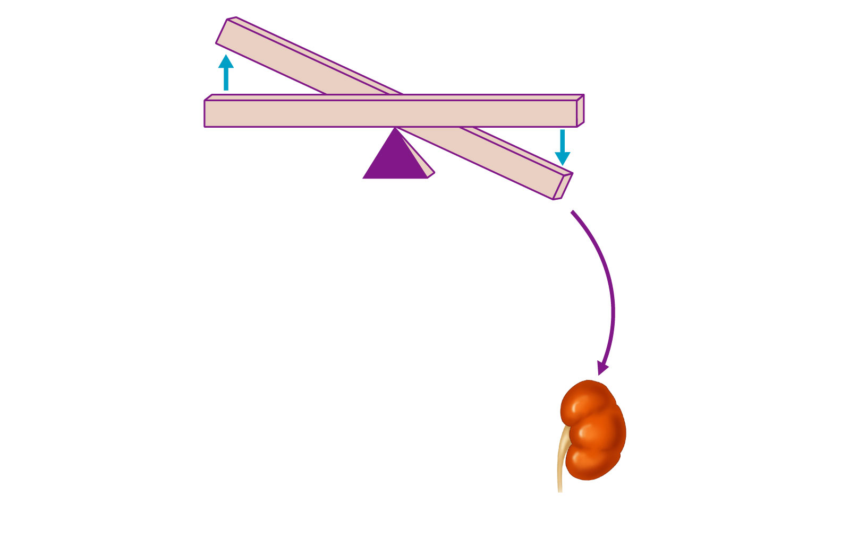
Imbalance
Start
Homeostasis: Normal blood oxygen levels
Stimulus: Hypoxia due to
decreased RBC count,
decreased amount of
hemoglobin, or decreased
availability of O₂
Imbalance
Reduces O₂ levels
in blood
Kidney (and liver to a smaller
extent) releases erythropoietin
Figure 17.6

Slide 96
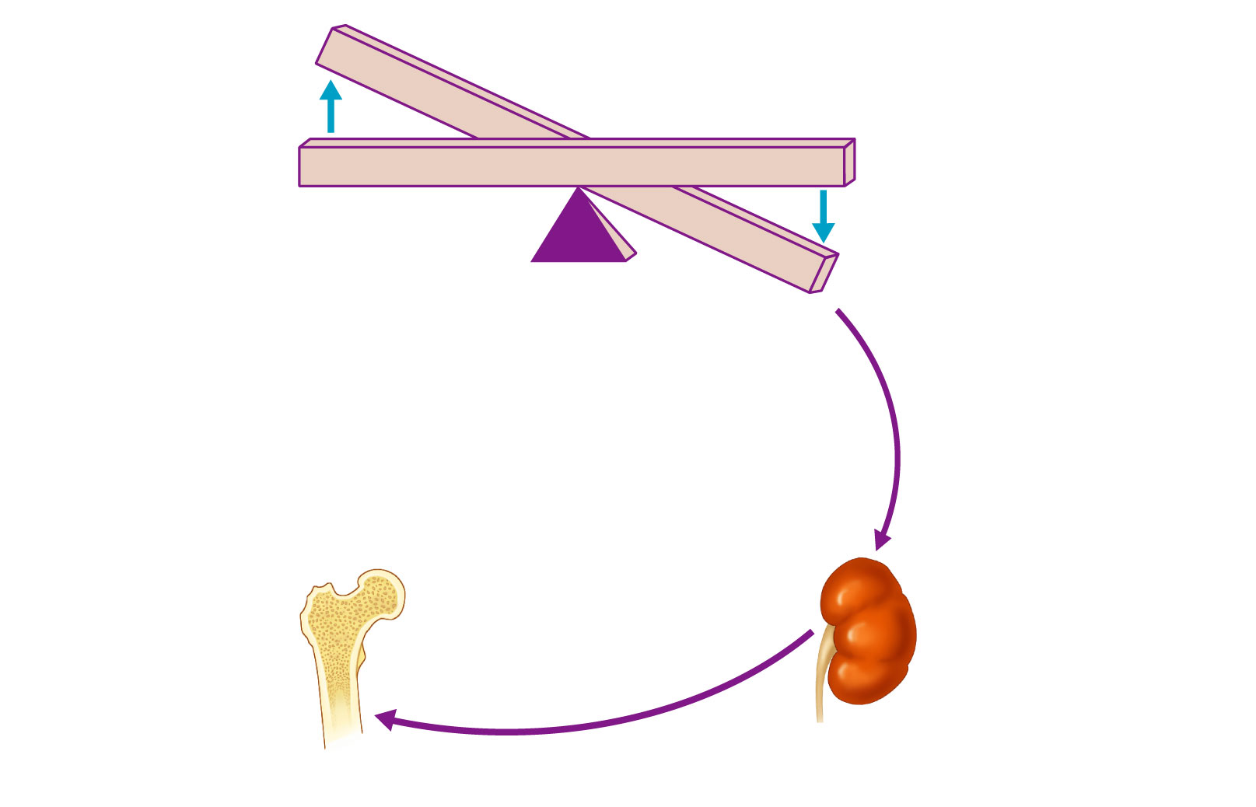
Imbalance
Start
Homeostasis: Normal blood oxygen levels
Stimulus: Hypoxia due to
decreased RBC count,
decreased amount of
hemoglobin, or decreased
availability of O₂
Imbalance
Reduces O₂ levels
in blood
Kidney (and liver to a smaller
extent) releases erythropoietin
Erythropoietin
stimulates red
bone marrow
Figure 17.6

Slide 97
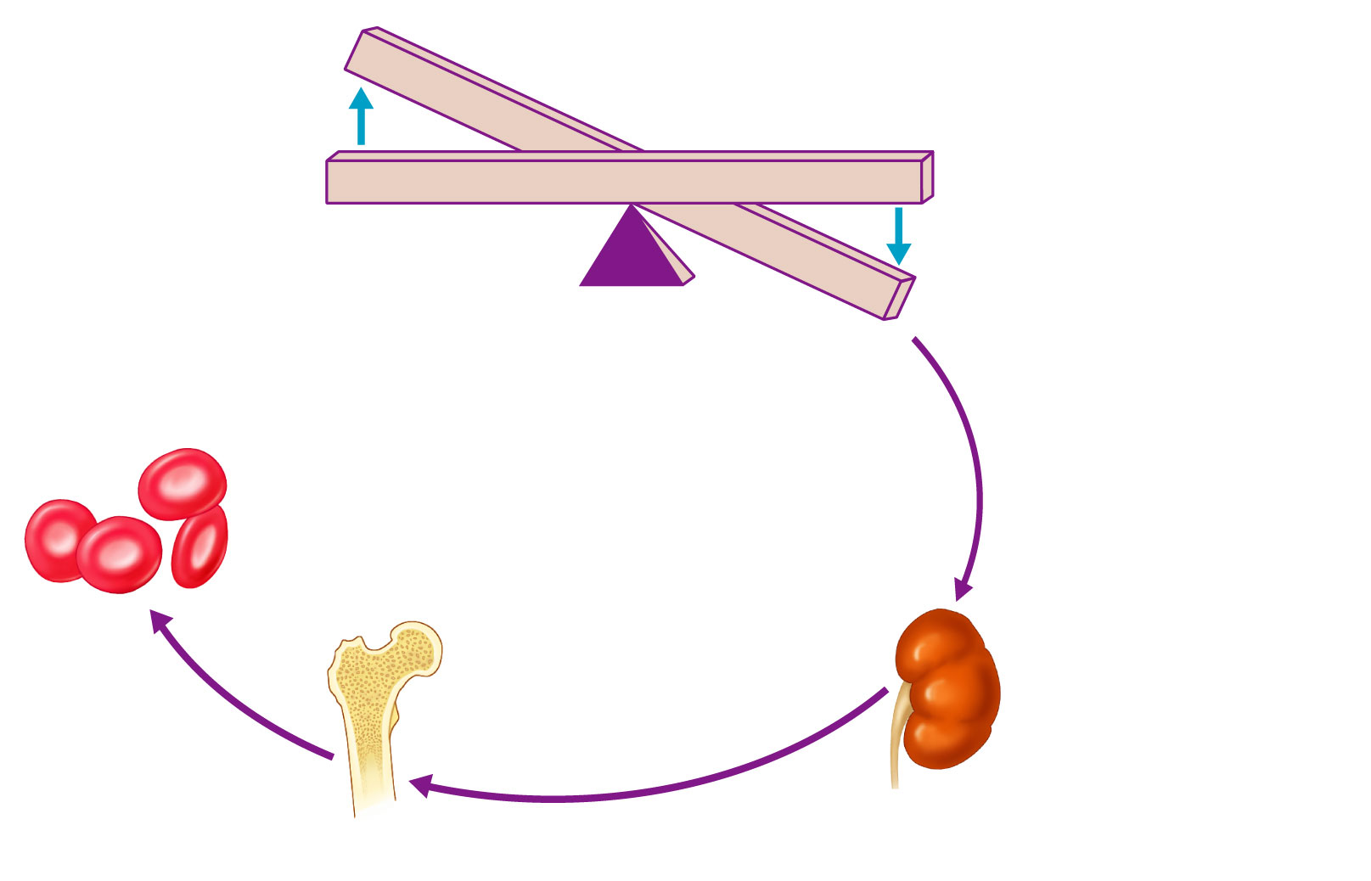
Imbalance
Start
Homeostasis: Normal blood oxygen levels
Stimulus: Hypoxia due to
decreased RBC count,
decreased amount of
hemoglobin, or decreased
availability of O₂
Imbalance
Reduces O₂ levels
in blood
Enhanced
erythropoiesis
increases
RBC count
Kidney (and liver to a smaller
extent) releases erythropoietin
Erythropoietin
stimulates red
bone marrow

Slide 98
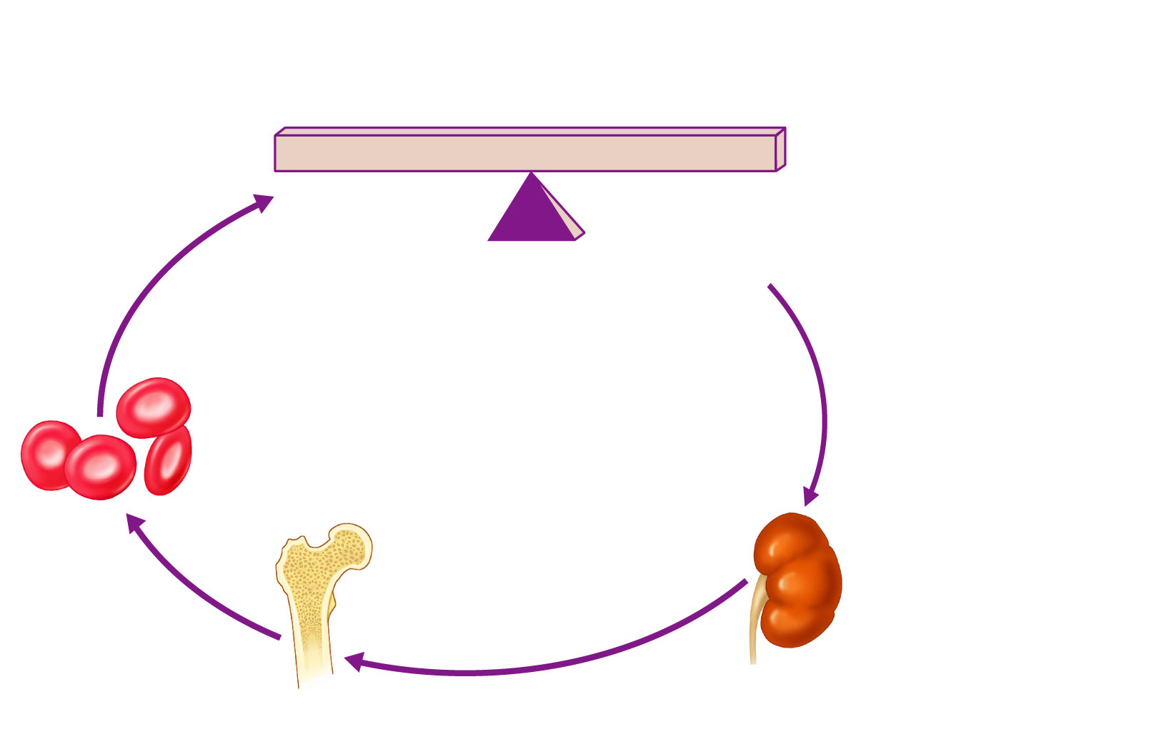
Start
Homeostasis: Normal blood oxygen levels
Stimulus: Hypoxia due to
decreased RBC count,
decreased amount of
hemoglobin, or decreased
availability of O₂
Increases
O₂-carrying
ability of blood
Reduces O₂ levels
in blood
Enhanced
erythropoiesis
increases
RBC count
Kidney (and liver to a smaller
extent) releases erythropoietin
Erythropoietin
stimulates red
bone marrow
Figure 17.6

Slide 99
Hormonal Control of Erythropoiesis
Hormone Erythropoietin (EPO)
  Direct stimulus for erythropoiesis
  Always a small amount in blood to maintain basal rate
    High RBC or O₂ levels depress production
  Released by kidneys (some from liver) in response to hypoxia

Slide 100
Hormonal Control of Erythropoiesis
Causes of hypoxia
  Decreased RBC numbers
    hemorrhage or increased destruction
  Insufficient hemoglobin per RBC
    iron deficiency
  Reduced availability of O₂
    high altitudes

Slide 101
Dietary Requirements for Erythropoiesis
Nutrients
  amino acids, lipids, and carbohydrates
Iron
  Available from diet
  65% in Hb; rest in liver, spleen, and bone marrow
Vitamin B₁₂ and folic acid necessary for DNA synthesis for rapidly dividing cells
  developing RBCs

Slide 102
Fate and Destruction of Erythrocytes
Life span: 100–120 days
  No protein synthesis, growth, division
Old RBCs become fragile
  Hb begins to degenerate
Get trapped in smaller circulatory channels especially in spleen
  Macrophages engulf dying RBCs in spleen

Slide 103
Fate and Destruction of Erythrocytes
Heme and globin are separated
  Iron salvaged for reuse
  Heme degraded to yellow pigment bilirubin
  Liver secretes bilirubin (in bile) into intestines
  Globin metabolized into amino acids
    Released into circulation

Slide 104
Erythrocyte Disorders
Anemia
  Blood has abnormally low O₂-carrying capacity
  Clinical sign
    Not a disease itself
  Blood O₂ levels cannot support normal metabolism
  Accompanied by fatigue, pallor, shortness of breath, and chills

Slide 105
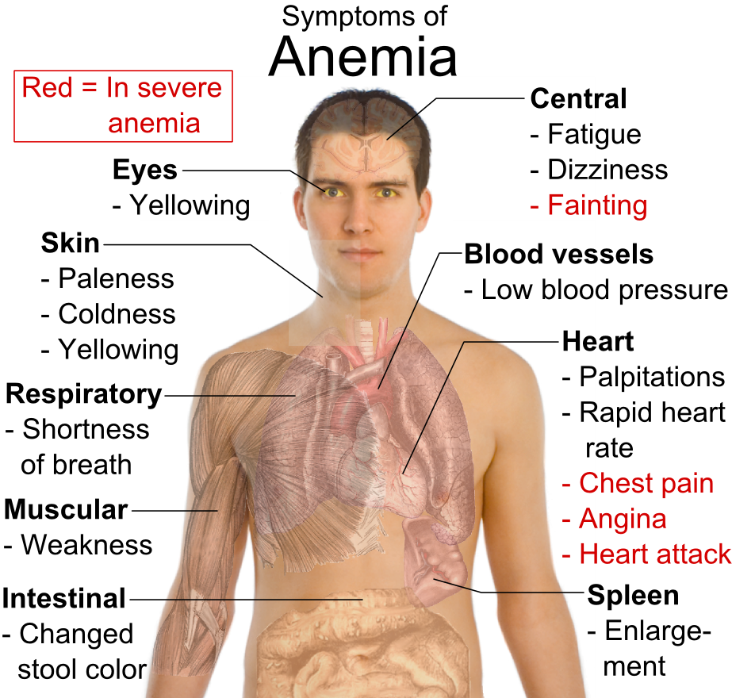
Causes of Anemia
Three groups
  Blood loss
  Low RBC production
  High RBC destruction

Slide 106
Causes of Anemia: Blood Loss
Acute hemorrhagic anemia
  Rapid blood loss
  Treated by blood replacement
Chronic hemorrhagic anemia
  Slight but persistent blood loss
    Hemorrhoids, bleeding ulcer
  Primary problem treated

Slide 107
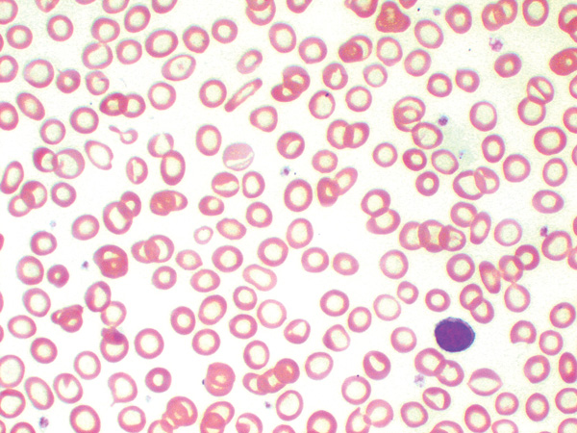
Causes of Anemia: Low RBC Production
Iron-deficiency anemia
  Caused by hemorrhagic anemia, low iron intake, or impaired absorption
  Microcytic, hypochromic RBCs
  Iron supplements to treat

Slide 108
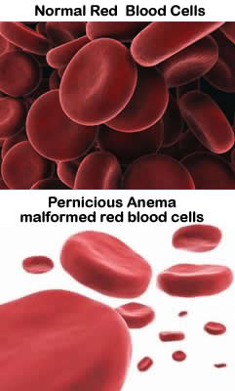
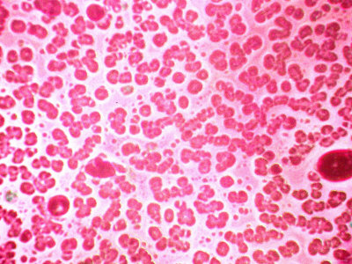
Causes of Anemia: Low RBC Production
Pernicious anemia
  Autoimmune disease
    destroys stomach mucosa
  Lack of intrinsic factor needed to absorb B₁₂
    Deficiency of vitamin B₁₂
  RBCs cannot divide → macrocytes
  Treated with B₁₂ injections or nasal gel
  Also caused by low dietary B₁₂ (vegetarians)
Notes:
108

Slide 109
Causes of Anemia: Low RBC Production
Renal anemia
  Lack of erythropoeitin
  Often accompanies renal disease
  Treated with synthetic erythropoeitin
Notes:
109

Slide 110
Causes of Anemia: Low RBC Production
Aplastic anemia
  Destruction or inhibition of red marrow by drugs, chemicals, radiation, viruses
  Usually cause unknown
  All cell lines affected
    Anemia; clotting and immunity defects
  Treated short-term with transfusions; long-term with transplanted stem cells

Slide 111
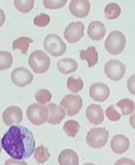
Causes of Anemia: High RBC Destruction
Hemolytic anemias
  Premature RBC lysis
  Caused by
    Hb abnormalities
    Incompatible transfusions
    Infections

Slide 112
Causes of Anemia: High RBC Destruction
Usually genetic basis for abnormal Hb
Globin abnormal
  Fragile RBCs lyse prematurely

Slide 113
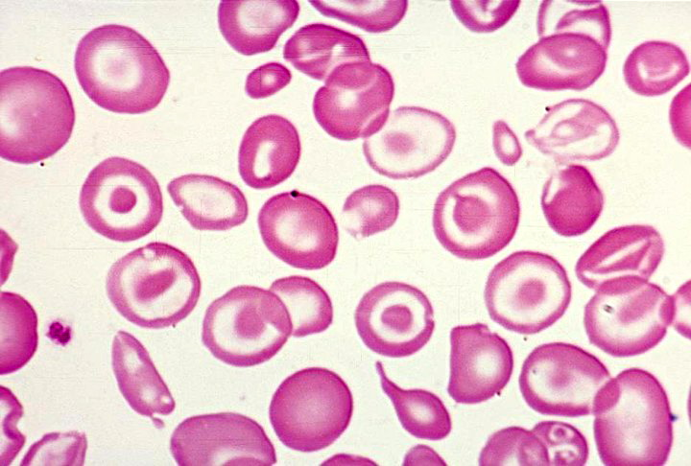
Causes of Anemia: High RBC Destruction
Thalassemias
  Typically Mediterranean ancestry
  One globin chain absent or faulty
  RBCs thin, delicate, deficient in Hb
  Many subtypes
    Severity from mild to severe

Slide 114
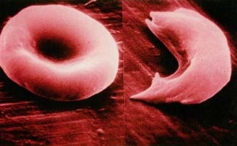
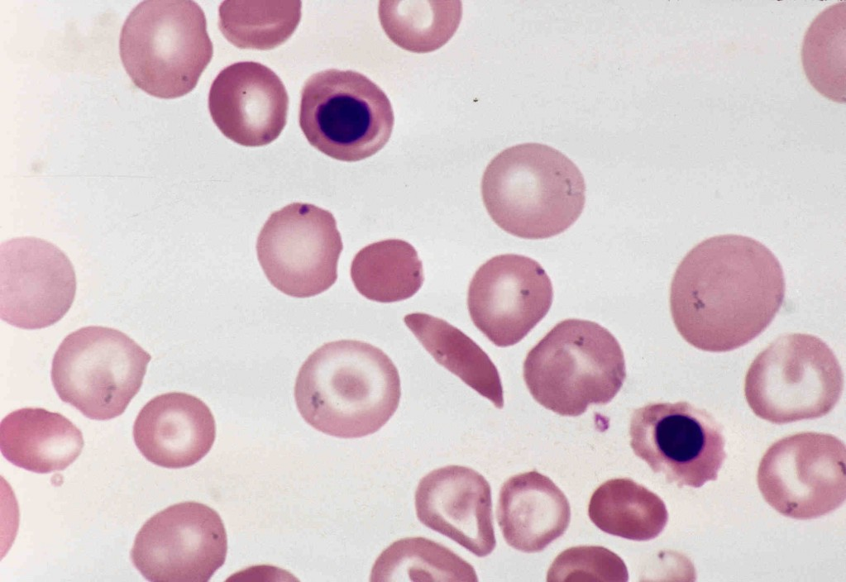
Causes of Anemia: High RBC Destruction
Sickle-cell anemia
  Hemoglobin S
    One amino acid wrong in a globin beta chain
  RBCs crescent shaped when they unload O₂ or when blood O₂ low
  RBCs rupture easily and block small vessels
    Poor O₂ delivery; pain

Slide 115
Sickle-cell Anemia
Black people of African malarial belt and descendants
Malaria
  Kills 1 million each year
Sickle-cell gene
  Two copies → Sickle-cell anemia
  One copy → Sickle-cell trait;
    milder disease
    better chance to survive malaria

Slide 116
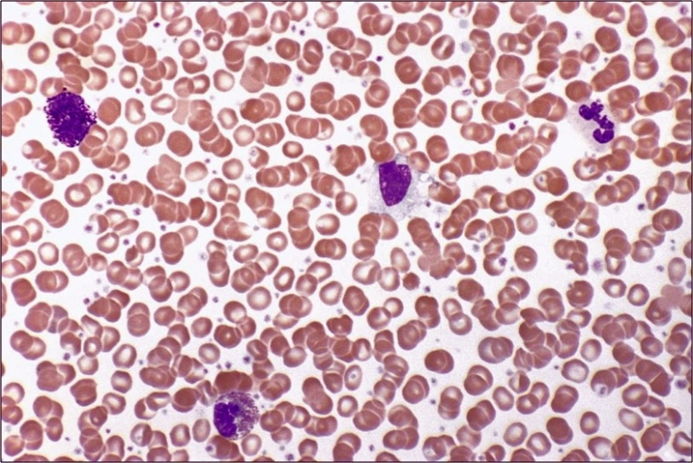
Erythrocyte Disorders
Polycythemia vera
  Bone marrow cancer → excess RBCs
  Severely increased blood viscosity
Secondary polycythemia
  Less O₂ available and/or EPO production increases → higher RBC count
  Blood doping

Slide 117
Leukocytes
Make up <1% of total blood volume
Function in defense against disease
  Can leave capillaries via diapedesis
  Move through tissue spaces by ameboid motion and positive chemotaxis
Leukocytosis: WBC count over 11,000/mm₃
  Normal response to infection

Slide 118
Leukocytes: Two Categories
Granulocytes
  Visible cytoplasmic granules
    Neutrophils, eosinophils, basophils
Agranulocytes
  No visible cytoplasmic granules
    Lymphocytes, monocytes
Memory tools:
  Never let monkeys eat bananas
  “60-40-8-3-0 Nanna lost my Easter bow’

Slide 119
Granulocytes
Granulocytes
  Larger and shorter-lived than RBCs
  Lobed nuclei
  Cytoplasmic granules stain specifically with Wright's stain
  All phagocytic to some degree

Slide 120
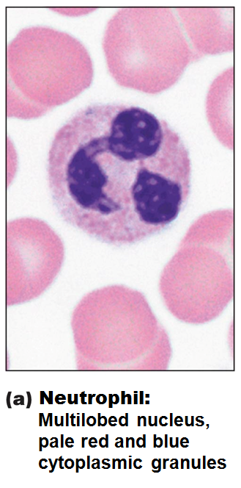
Neutrophils
Most numerous WBCs
Granules stain lilac (hot purple);
contain hydrolytic enzymes or defensins
3-6 lobes in nucleus;
twice size of RBCs
Very phagocytic
  "bacteria slayers"

Slide 121
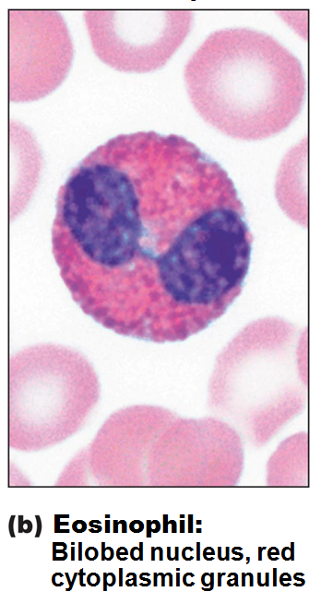
Eosinophils
Red-staining granules
Bilobed nucleus
Granules lysosome-like
  Release enzymes to digest parasitic worms
Role in allergies and asthma
Role in modulating immune response

Slide 122
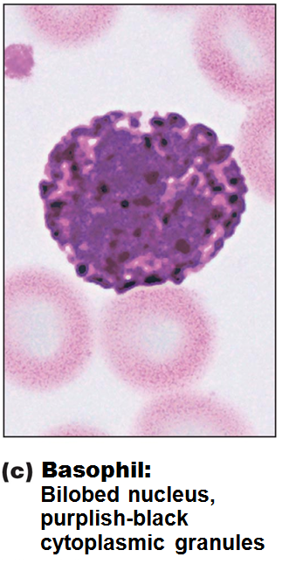
Basophils
Rarest WBCs
Bilobed nucleus
Large, purplish-black granules contain histamine
  Histamine: inflammatory chemical that acts as vasodilator to attract WBCs to inflamed sites
Are functionally similar to mast cells

Slide 123
Agranulocytes
Agranulocytes
  Lack visible cytoplasmic granules
  Have spherical or kidney-shaped nuclei

Slide 124
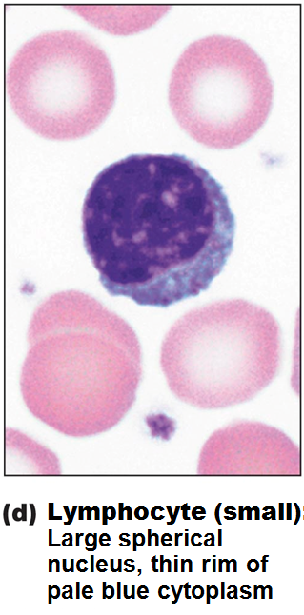
Lymphocytes
Second most numerous WBC
Large, dark-purple, circular nuclei with thin rim of blue cytoplasm
Mostly in lymphoid tissue (e.g., lymph nodes, spleen); few circulate in blood
Crucial to immunity

Slide 125
Lymphocytes
Two types
  T lymphocytes (T cells) act against virus-infected cells and tumor cells
  B lymphocytes (B cells) give rise to plasma cells, which produce antibodies

Slide 126
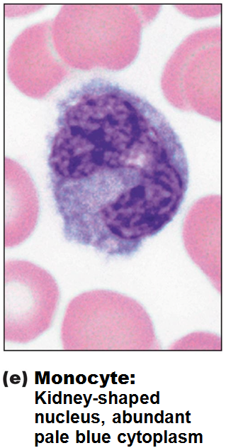
Monocytes
Largest leukocytes
Abundant pale-blue cytoplasm
Dark purple-staining, U- or kidney-shaped nuclei

Slide 127
Monocytes
Leave circulation, enter tissues, and differentiate into macrophages
  Actively phagocytic cells; crucial against viruses, intracellular bacterial parasites, and chronic infections
Activate lymphocytes to mount an immune response

Slide 128
Leukopoiesis
All leukocytes originate from hemocytoblasts
Lymphoid stem cells → lymphocytes
Myeloid stem cells → all others
Progression of all granulocytes
  Myeloblast → promyelocyte → myelocyte → band → mature cell
Granulocytes stored in bone marrow
3 times more WBCs produced than RBCs
  Shorter life span; die fighting microbes

Slide 129
Leukopoiesis
Progression of agranulocytes differs
Monocytes
  live several months
    Share common precursor with neutrophils
    Monoblast → promonocyte → monocyte
Lymphocytes
  live few hours to decades
    Lymphoid stem cell → T lymphocyte precursors (travel to thymus) and B lymphocyte precursors

Slide 130
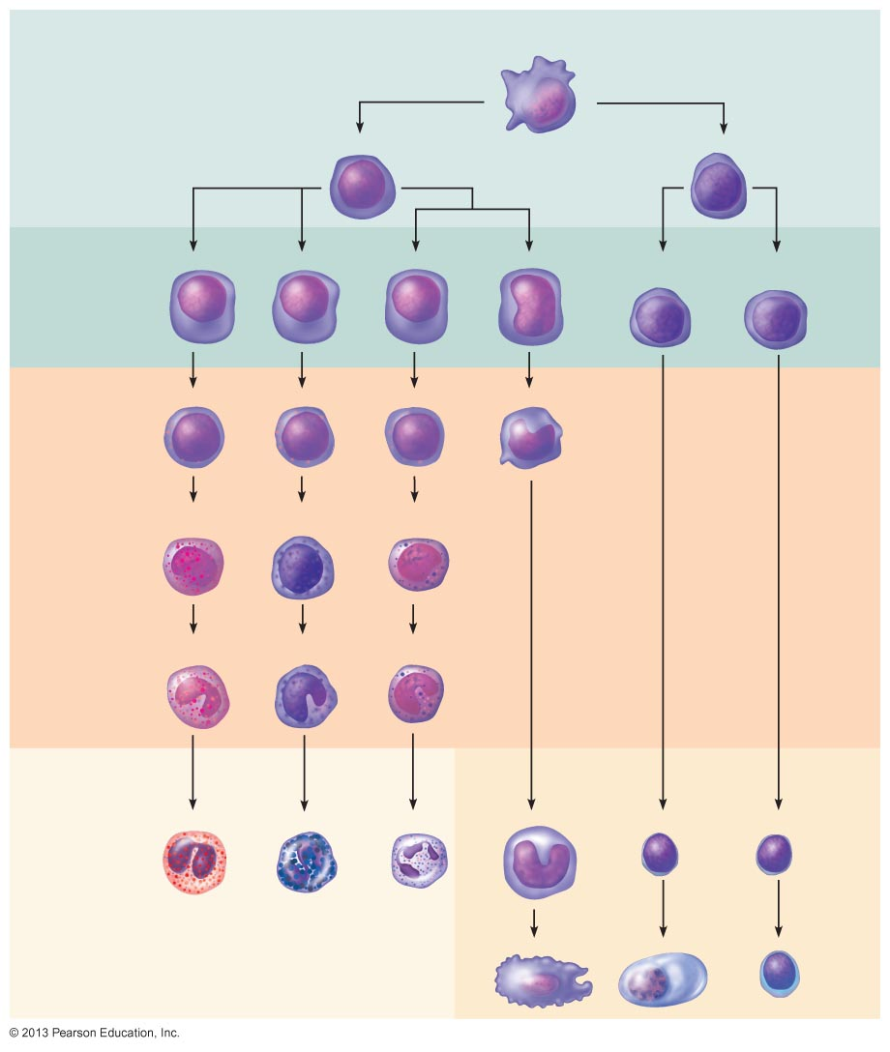
Figure 17.11 Leukocyte formation.
Stem cells
Hematopoietic stem cell
(hemocytoblast)
Myeloid stem cell
Lymphoid stem cell
Committed
cells
Myeloblast
Myeloblast
Myeloblast
Monoblast
B lymphocyte
precursor
T lymphocyte
precursor
Developmental
pathway
Promyelocyte
Promyelocyte
Promyelocyte
Promonocyte
Eosinophilic
myelocyte
Basophilic
myelocyte
Neutrophilic
myelocyte
Eosinophilic
band cells
Basophilic
band cells
Neutrophilic
band cells
Granular
leukocytes
Agranular
leukocytes
Eosinophils
Basophils
Neutrophils
Monocytes
B lymphocytes
T lymphocytes
(a)
(b)
(c)
(d)
(e)
(f)
Some become
Some become
Some become
Macrophages (tissues)
Plasma cells
Effector T cells

Slide 131
Leukocyte disorders
Leukopenia
  Abnormally low WBC count
Leukemias – all fatal if untreated
  Cancer → overproduction of abnormal WBCs
  Myeloid leukemia
    involves myeloblast descendants:
      neutrophil, eosinophil, basophil, monocyte
  Lymphocytic (Lymphoid) leukemia involves lymphocytes
Acute leukemia
  derives from stem cells; primarily affects children
Chronic leukemia
  more prevalent in older people

Slide 132
Leukemia
Cancerous leukocytes fill red bone marrow
  Other cells compromised
    Fewer functional RBCs: anemia
    Fewer functional platelets: bleeding
Immature nonfunctional WBCs in bloodstream
Death from
  internal hemorrhage
  overwhelming infections
Treatments
  Irradiation, antileukemic drugs; stem cell transplants

Slide 133
Infectious Mononucleosis
Highly contagious viral disease
  Epstein-Barr virus
High numbers atypical agranulocytes
  monocytes and lymphocytes
Symptoms
  Tired, achy, chronic sore throat, low fever
Runs course with rest

Slide 134
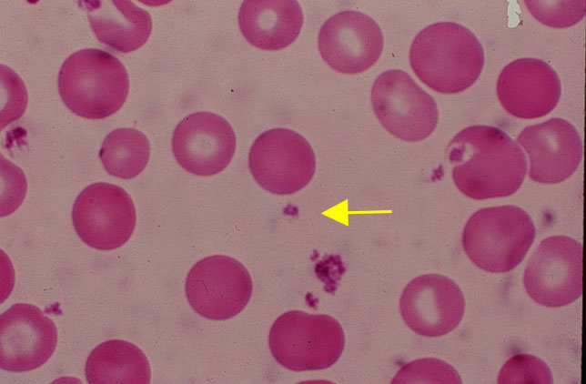
Platelets
Cytoplasmic fragments of megakaryocytes
Blue-staining outer region; purple granules

Slide 135
Platelets
Form temporary platelet plug that helps seal breaks in blood vessels
Circulating platelets kept inactive until needed
Age quickly; degenerate in about 10 days

Slide 136
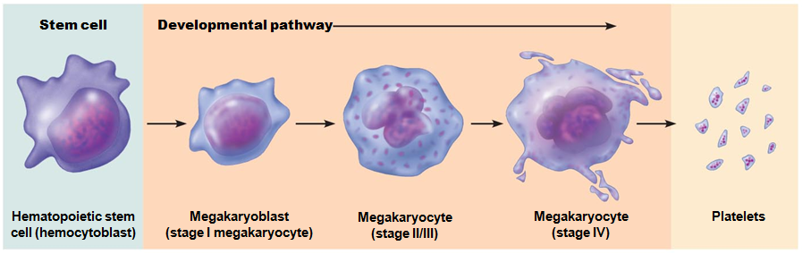
Platelets
Formation regulated by thrombopoietin
Derive from megakaryoblast

Slide 137
Hemostasis
Fast series of reactions for stoppage of bleeding
Requires clotting factors, and substances released by platelets and injured tissues
Three steps
  Vascular spasm
  Platelet plug formation
  Coagulation (blood clotting)

Slide 138
Hemostasis: Vascular Spasm
Vasoconstriction of damaged blood vessel
Triggers
  Direct injury to vascular smooth muscle
  Chemicals released by endothelial cells and platelets
  Pain reflexes
Most effective in smaller blood vessels

Slide 139
Hemostasis: Platelet Plug Formation
Positive feedback cycle
Damaged endothelium exposes collagen fibers
  Platelets stick to collagen fibers
  Swell, become spiked and sticky
    release chemical messengers
    Process encourages more vascular spasm and more platelet formation: Positive feedback

Slide 140
Hemostasis: Coagulation
Reinforces platelet plug with fibrin threads
Blood transformed from liquid to gel
Series of reactions using clotting factors

Slide 141
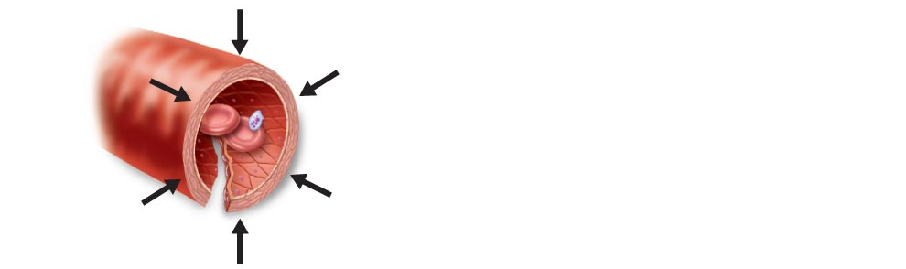
Figure 17.13 Events of hemostasis.
Slide 2
Step 1 Vascular spasm
• Smooth muscle contracts,
causing vasoconstriction.

Slide 142
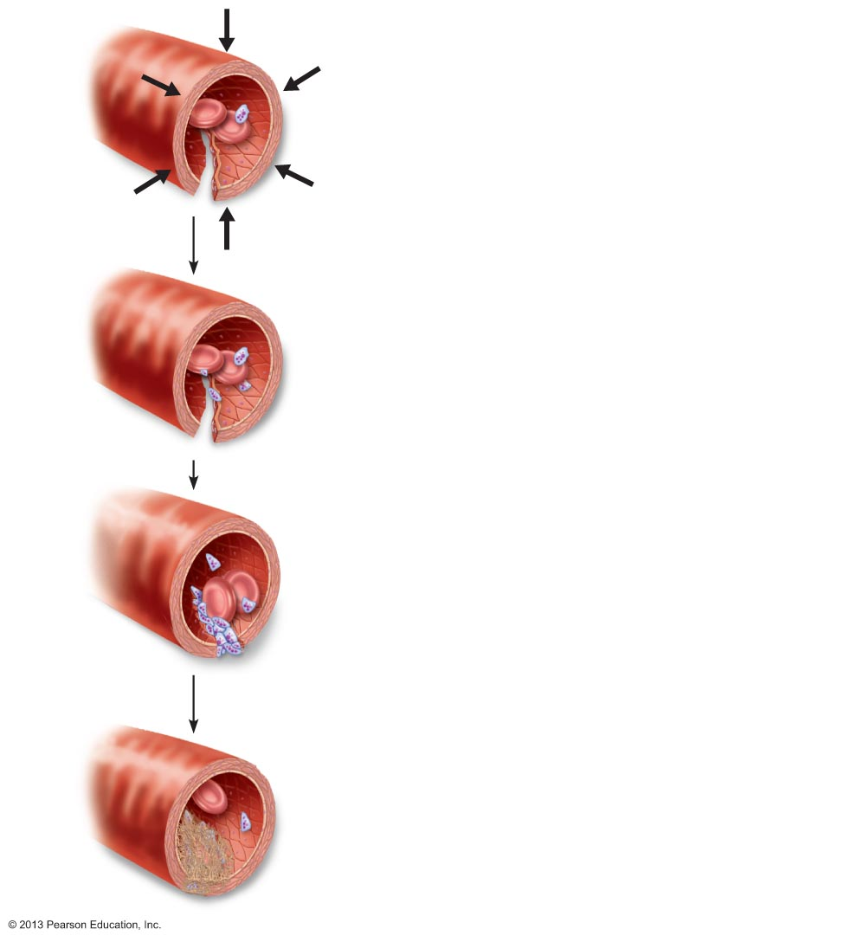
Figure 17.13 Events of hemostasis.
Slide 3
Step 1 Vascular spasm
• Smooth muscle contracts,
causing vasoconstriction.
Step 2 Platelet plug
formation
• Injury to lining of vessel
exposes collagen fibers;
platelets adhere.
Collagen
fibers

Slide 143
Figure 17.13 Events of hemostasis.
Slide 4
Step 1 Vascular spasm
• Smooth muscle contracts,
causing vasoconstriction.
Step 2 Platelet plug
formation
• Injury to lining of vessel
exposes collagen fibers;
platelets adhere.
Collagen
fibers
• Platelets release chemicals
that make nearby platelets
sticky; platelet plug forms.
Platelets

Slide 144
Figure 17.13 Events of hemostasis.
Slide 5
Step 1 Vascular spasm
• Smooth muscle contracts,
causing vasoconstriction.
Step 2 Platelet plug
formation
• Injury to lining of vessel
exposes collagen fibers;
platelets adhere.
Collagen
fibers
• Platelets release chemicals
that make nearby platelets
sticky; platelet plug forms.
Platelets
Step 3 Coagulation
• Fibrin forms a mesh that traps
red blood cells and platelets,
forming the clot.
Fibrin

Slide 145
Coagulation Phase 1: Two Pathways
Intrinsic pathway
  Uses factors present within blood (intrinsic)
  Causes clotting outside of the body
    Blood in a glass test tube
Extrinsic pathway
  Typically triggered with tissue damage
  Bypasses several steps of intrinsic pathway
    Faster
Both Extrinsic and Intrinsic pathways merge together to create a common pathway that results in coagulation

Slide 146
Coagulation Phase 3: Common Pathway to the Fibrin Mesh
Thrombin converts soluble fibrinogen to fibrin
Fibrin strands form structural basis of clot
Fibrin causes plasma to become a gel-like trap for formed elements
Thrombin with Ca²⁺ activates another clotting factor which:
  Cross-links fibrin
  Strengthens and stabilizes clot

Slide 147
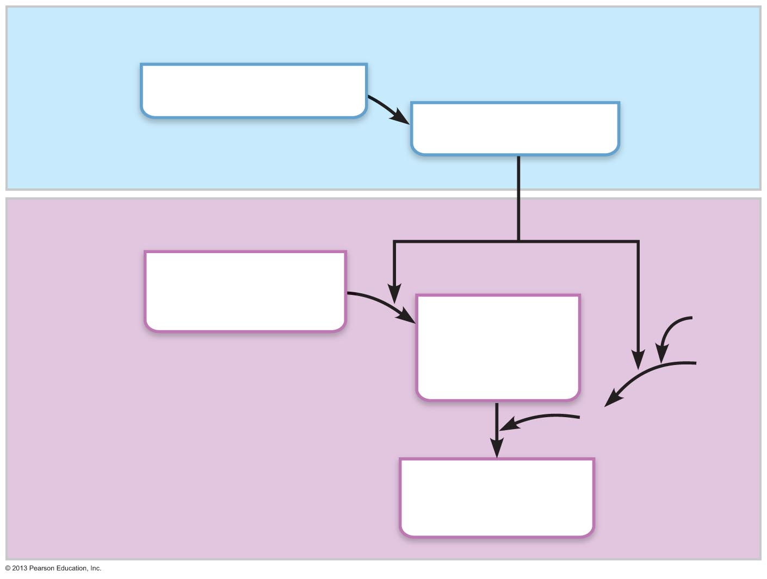
Figure 17.14 The intrinsic and extrinsic pathways of blood clotting (coagulation). (2 of 2)
Phase 2
Prothrombin (II)
Thrombin (II_{a})
Phase 3
Fibrinogen (I)
(soluble)
Fibrin
(insoluble
polymer)
Ca²⁺
XIII
XIII_{a}
Cross-linked
fibrin mesh

Slide 148
Clot Retraction
Stabilizes clot
Actin and myosin in platelets contract within 30–60 minutes
Contraction pulls on fibrin strands, squeezing serum from clot
Draws ruptured blood vessel edges together

Slide 149
Fibrinolysis
Removes unneeded clots after healing
Begins within two days; continues for several
Plasminogen in clot is converted to plasmin by tissue plasminogen activator, more clotting factors and thrombin
Plasmin is a fibrin-digesting enzyme

Slide 150
Disorders of Hemostasis
Thromboembolic disorders
  undesirable clot formation
Bleeding disorders:
  abnormalities that prevent normal clot formation
Disseminated intravascular coagulation (DIC)
  Involves both types of disorders

Slide 151
Thromboembolic Conditions
Thrombus:
  clot that develops and persists in unbroken blood vessel
  May block circulation leading to tissue death
Embolus:
  thrombus freely floating in bloodstream
Embolism:
  embolus obstructing a vessel
  E.g., pulmonary and cerebral emboli
Risk factors – atherosclerosis, inflammation, slowly flowing blood or blood stasis from immobility

Slide 152
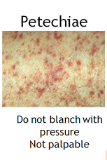
Bleeding Disorders
Thrombocytopenia: deficient number of circulating platelets
  Petechiae appear due to spontaneous, widespread hemorrhage
  Due to suppression or destruction of red bone marrow
  Treated with transfusion of concentrated platelets

Slide 153
Bleeding Disorders
Impaired liver function
  Inability to synthesize procoagulants
  Causes include vitamin K deficiency, hepatitis, and cirrhosis
  Impaired fat absorption and liver disease can also prevent liver from producing bile, impairing fat and vitamin K absorption

Slide 154
Bleeding Disorders
Hemophilia includes several similar hereditary bleeding disorders
  Hemophilia A: most common type (77% of all cases); factor VIII deficiency
  Hemophilia B: factor IX deficiency
  Hemophilia C: mild type; factor XI deficiency
Symptoms include prolonged bleeding, especially into joint cavities
Memory tools
  A8
  B9

Slide 155
Disseminated Intravascular Coagulation (DIC)
Clotting causes bleeding
  Widespread clotting blocks intact blood vessels
  Severe bleeding occurs because residual blood unable to clot
Occurs
  as pregnancy complication
  in septicemia
  with incompatible blood transfusions

Slide 156
Transfusions
Whole-blood transfusions used when blood loss rapid and substantial
Packed red cells (plasma and WBCs removed) transfused to restore oxygen-carrying capacity
Transfusion of incompatible blood can be fatal

Slide 157
Human Blood Groups
RBC membranes bear 30 types of glycoprotein antigens
  Anything perceived as foreign; generates an immune response
  Promoters of agglutination; called agglutinogens
Mismatched transfused blood perceived as foreign
  May be agglutinated and destroyed; can be fatal
Presence or absence of each antigen is used to classify blood cells into different groups

Slide 158
Blood Groups
Antigens of ABO and Rh blood groups cause vigorous transfusion reactions
Other blood groups (MNS, Duffy, Kell, and Lewis) usually weak agglutinogens

Slide 159
ABO Blood Groups
Types A, B, AB, and O
Based on presence or absence of two agglutinogens (A and B) on surface of RBCs
Blood may contain circulating anti-A or anti-B antibodies
  Antibodies seek out and attach to non-self markers
Anti-A or anti-B form in blood at about 2 months of age
  adult levels by 8-10 years of age

Slide 160

Type A Blood
Type A Blood has antigen A on the cell surface
It has antibody B circulating in the plasma
  Will attach to any type B antigen
  B antigens would be foreign (non-self) to this individual
  There will be NO reaction between the Type A antigen on the surface and the Anti-B antibody in the plasma.

Slide 161

Type B Blood
Type B Blood has antigen B on the cell surface
It has antibody A circulating in the plasma
  Will attach to any type A antigen
  A antigens would be foreign (non-self) to this individual
  There will be NO reaction between the Type B antigen on the surface and the Anti-A antibody in the plasma.

Slide 162

Type AB Blood
Type AB blood has both antigens A and B displayed on the surface
There will be NO ABO antibodies circulating in the blood
  (if there were, there would be an agglutination response which could be fatal.)
  Because there are NO antibodies in the bloodstream, this blood type is considered a Universal Recipient.
    You can put any blood cell into this environment and not have an agglutination reaction because there are no antibodies in the host plasma.

Slide 163
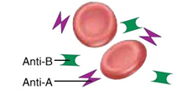
Type O blood
Type O blood has NO antigens on the cell surface.
Because of this, ANY antigen is considered non-self, so the plasma will have BOTH anti-A and anti-B antibodies.
Type O blood is considered a Universal Donor because the Type O blood cell with no antigens can safely go into any other blood type.
  With no antigens on the surface, there will be no interaction with any of the antibodies found in the host.

Slide 164
Rh Blood Groups
52 named Rh factors
C, D, and E are most common
Rh⁺ indicates presence of D antigen
  85% Americans Rh⁺

Slide 165
Rh Blood Groups
An individual with no D antigen on the blood cell surface will NOT have circulating Rh antibodies, but they CAN make them following exposure to antigen D.
Second exposure to Rh⁺ blood will result in typical transfusion reaction

Slide 166
Homeostatic Imbalance: Hemolytic Disease of the Newborn
Also called erythroblastosis fetalis
  Only occurs in Rh– mom with Rh⁺ fetus
Rh– mom exposed to Rh⁺ blood of fetus during delivery of first baby – baby healthy
  Mother synthesizes anti-Rh antibodies
  Antibodies are IgM type (huge) and can not cross the placenta
Second pregnancy (or second exposure)
  Antibodies formed are IgG type (tiny) and CAN cross the placenta
  destroy RBCs of Rh⁺ baby

Slide 167
Homeostatic Imbalance: Hemolytic Disease of the Newborn
Baby treated with prebirth transfusions and exchange transfusions after birth
RhoGAM serum containing anti-Rh can prevent Rh– mother from becoming sensitized

Slide 168
Transfusion Reactions
Occur if mismatched blood infused
Donor's cells
  Attacked by recipient's plasma agglutinins
  Agglutinate and clog small vessels
  Rupture and release hemoglobin into bloodstream
Result in
  Diminished oxygen-carrying capacity
  Diminished blood flow beyond blocked vessels
  Hemoglobin in kidney tubules → renal failure

Slide 169
Transfusion Reactions
Symptoms
  Fever, chills, low blood pressure, rapid heartbeat, nausea, vomiting
Treatment
  Preventing kidney damage
    Fluids and diuretics to wash out hemoglobin

