Slide 1
Respiration
Involves both the respiratory and the circulatory systems
Four processes that supply the body with O₂ and dispose of CO₂

Slide 2
Respiration
Pulmonary ventilation (breathing): movement of air into and out of the lungs
External respiration: O₂ and CO₂ exchange between the lungs and the blood
Transport: O₂ and CO₂ in the blood
Internal respiration: O₂ and CO₂ exchange between systemic blood vessels and tissues
Respiratory
system
Circulatory
system

Slide 3
Respiratory System: Functional Anatomy
Major organs
Nose, nasal cavity, and paranasal sinuses
Pharynx
Larynx
Trachea
Bronchi and their branches
Lungs and alveoli

Slide 4
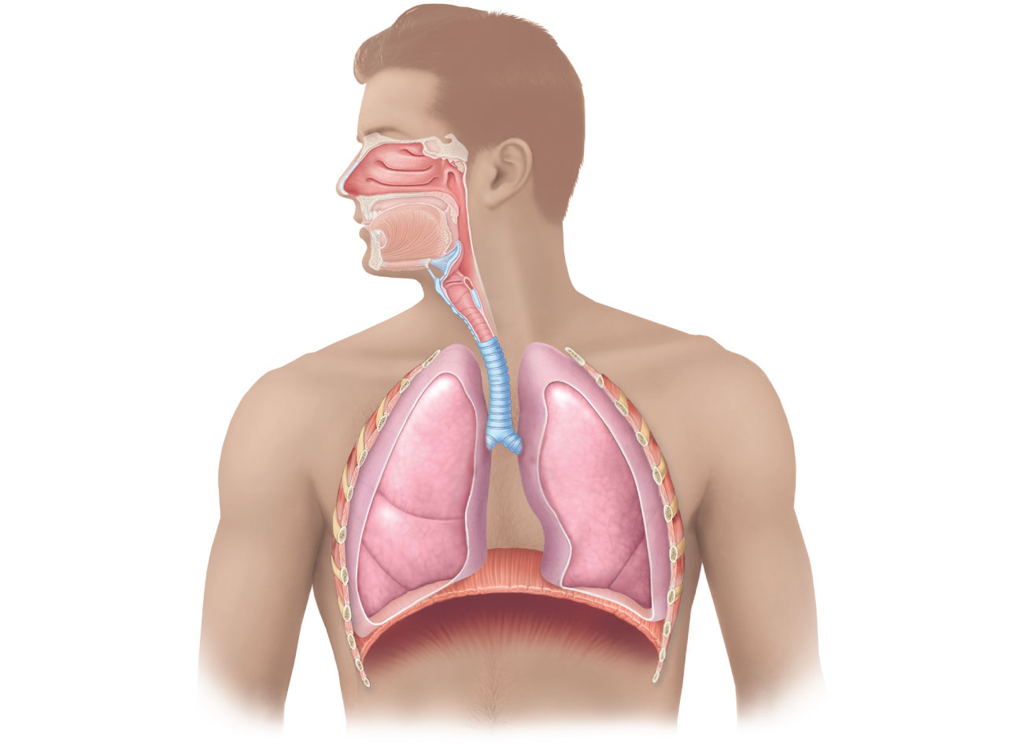
Nasal cavity
Oral cavity
Nostril
Pharynx
Larynx
Trachea
Left main
(primary)
bronchus
Carina of
trachea
Right main
(primary)
bronchus
Left lung
Right lung
Diaphragm

Slide 5
Functional Anatomy
Respiratory zone: site of gas exchange
Microscopic structures: respiratory bronchioles, alveolar ducts, and alveoli
Conducting zone: conduits to gas exchange sites
Includes all other respiratory structures
Respiratory muscles: diaphragm and other muscles that promote ventilation

Slide 6
The Nose
Functions
Provides an airway for respiration
Moistens and warms the entering air
Filters and cleans inspired air
Serves as a resonating chamber for speech
Houses olfactory receptors

Slide 7
The Nose
Two regions: external nose and nasal cavity
External nose: root, bridge, dorsum nasi, and apex
Philtrum: a shallow vertical groove inferior to the apex
Nostrils (nares): bounded laterally by the alae

Slide 8
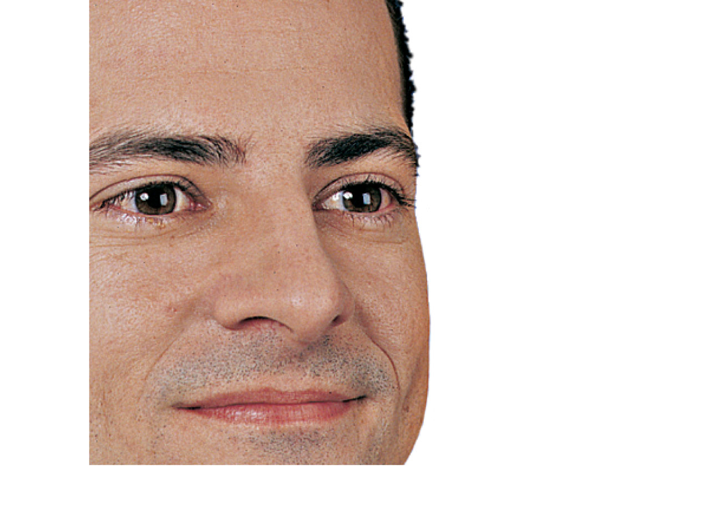
Epicranius,
frontal belly
Root and
bridge of
nose
Dorsum nasi
Ala of nose
Apex of nose
Naris (nostril)
Philtrum
(a) Surface anatomy
Figure 22.2a

Slide 9
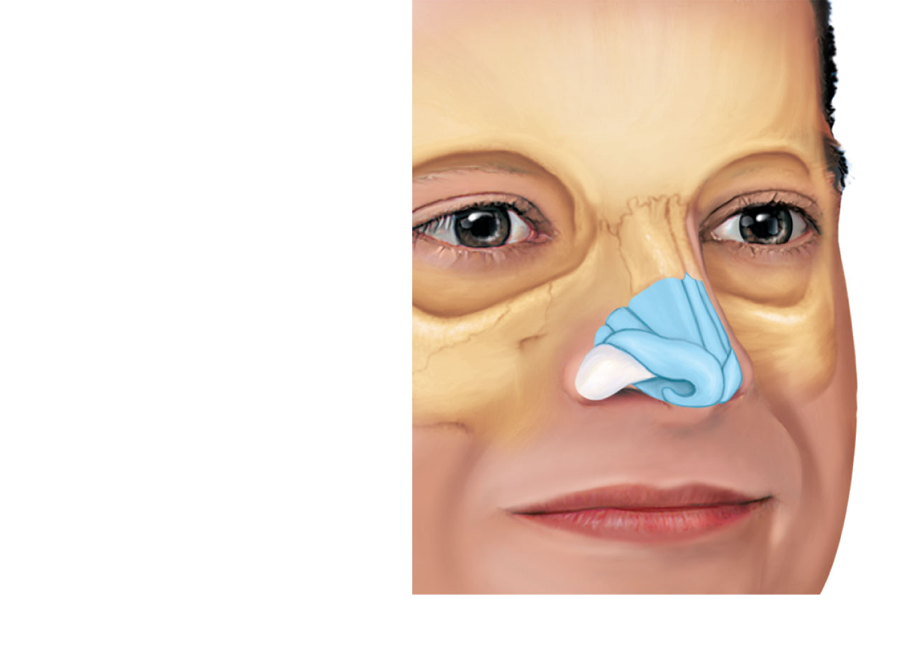
Frontal bone
Nasal bone
Septal cartilage
Maxillary bone
(frontal process)
Lateral process of
septal cartilage
Minor alar cartilages
Dense fibrous
connective tissue
Major alar
cartilages
(b) External skeletal framework

Slide 10
The Nose
Nasal cavity: in and posterior to the external nose
Divided by a midline nasal septum
Posterior nasal apertures (choanae) open into the nasal pharynx
Roof: ethmoid and sphenoid bones
Floor: hard and soft palates

Slide 11
Nasal Cavity
Vestibule:
nasal cavity superior to the nostrils
Vibrissae
Nose hair
filter coarse particles from inspired air
Olfactory mucosa
Lines the superior nasal cavity
Contains smell receptors

Slide 12
Nasal Cavity
Respiratory mucosa
Pseudostratified ciliated columnar epithelium
Mucous and serous secretions contain lysozyme and defensins
Cilia move contaminated mucus posteriorly to throat
Inspired air is warmed by blood vessels
Sensory nerve endings triggers sneezing

Slide 13
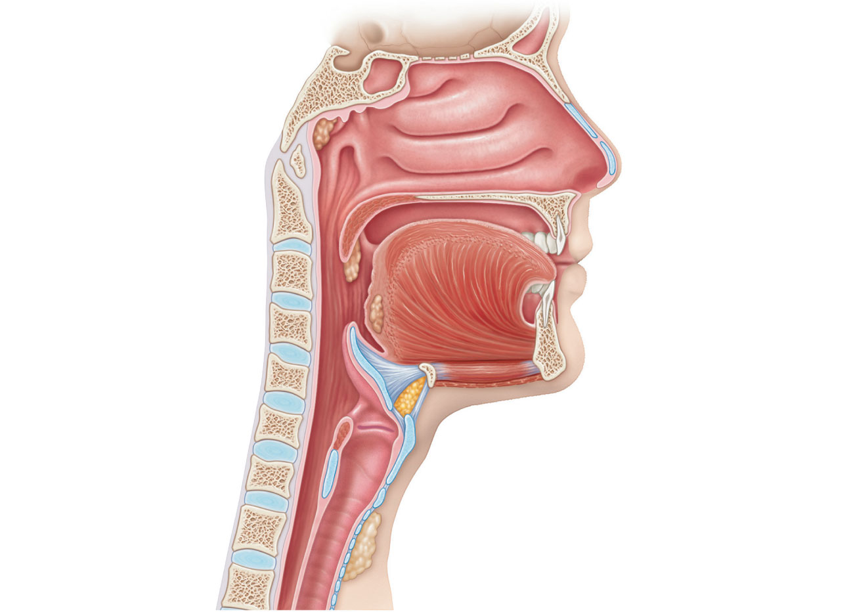
Cribriform plate
of ethmoid bone
Sphenoid sinus
Frontal sinus
Posterior nasal
aperture
Nasal cavity
Nasal conchae
(superior, middle
and inferior)
Nasopharynx
Pharyngeal tonsil
Nasal meatuses
(superior, middle,
and inferior)
Opening of
pharyngotympanic
tube
Nasal vestibule
Uvula
Nostril
Oropharynx
Hard palate
Palatine tonsil
Soft palate
Isthmus of the
fauces
Tongue
Lingual tonsil
Laryngopharynx
Hyoid bone
Larynx
Epiglottis
Esophagus
Vestibular fold
Thyroid cartilage
Vocal fold
Trachea
Cricoid cartilage
(c) Illustration
Thyroid gland
Figure 22.3c

Slide 14
Nasal Cavity
Superior, middle, and inferior nasal conchae
Protrude from the lateral walls
Increase mucosal area
Enhance air turbulence

Slide 15
Functions of the Nasal Mucosa and Conchae
During inhalation, the conchae and nasal mucosa
Filter, heat, and moisten air
During exhalation these structures
Reclaim heat and moisture

Slide 16
Paranasal Sinuses
In frontal, sphenoid, ethmoid, and maxillary bones
Lighten the skull and help to warm and moisten the air

Slide 17
Pharynx
Muscular tube that connects to the
Nasal cavity and mouth superiorly
Larynx and esophagus inferiorly
From the base of the skull to the level of the sixth cervical vertebra

Slide 18
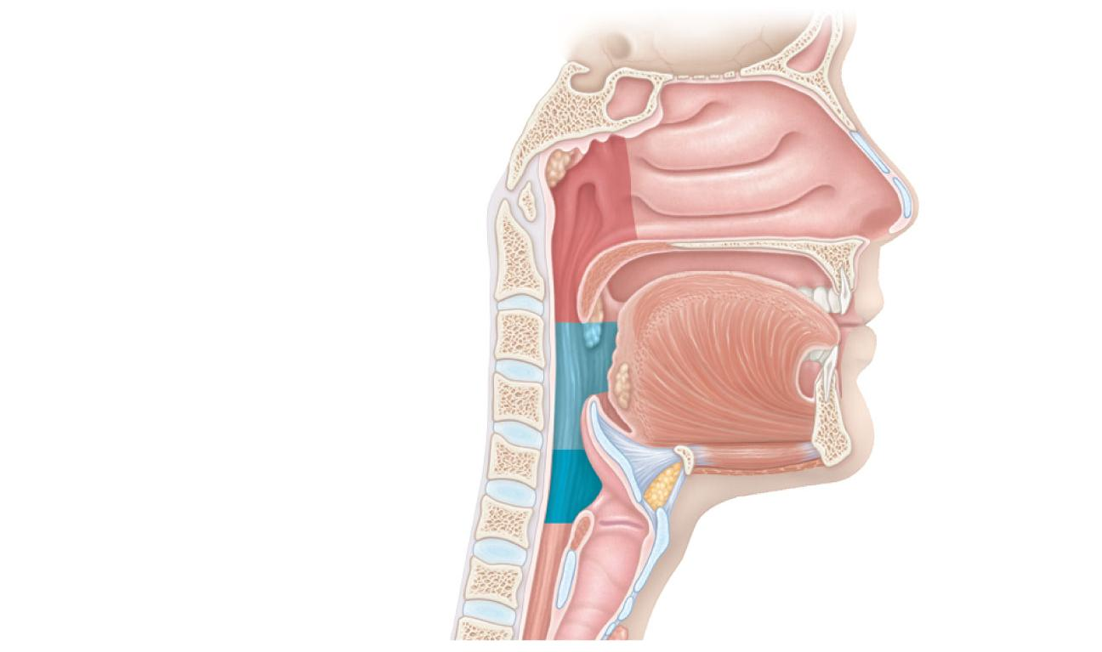
Pharynx
Nasopharynx
Oropharynx
Laryngopharynx
(b) Regions of the pharynx

Slide 19
Nasopharynx
Air passageway posterior to the nasal cavity
Lining
pseudostratified columnar epithelium
Soft palate and uvula
close nasopharynx during swallowing

Slide 20
Nasopharynx
Pharyngeal tonsil
also called adenoids
Located on posterior wall
Pharyngotympanic tubes
Also called auditory tubes
open into the lateral walls

Slide 21
Oropharynx
Passageway for food and air from the level of the soft palate to the epiglottis
Lining is stratified squamous epithelium
Palatine tonsils in the lateral walls
Lingual tonsil on the posterior surface of the tongue

Slide 22
Laryngopharynx
Passageway for food and air
Posterior to the upright epiglottis
Extends to the larynx, where it is also continuous with the esophagus

Slide 23
Larynx
Attaches to the hyoid bone and opens into the laryngopharynx
Continuous with the trachea
Functions
Provides an open airway
Routes air and food into proper channels
Voice production

Slide 24
Larynx
Cartilages of the larynx
Hyaline cartilage except for the epiglottis
Thyroid cartilage with laryngeal prominence (Adam’s apple)
Ring-shaped cricoid cartilage
Paired arytenoid, cuneiform, and corniculate cartilages
Epiglottis: elastic cartilage; covers the laryngeal inlet during swallowing

Slide 25
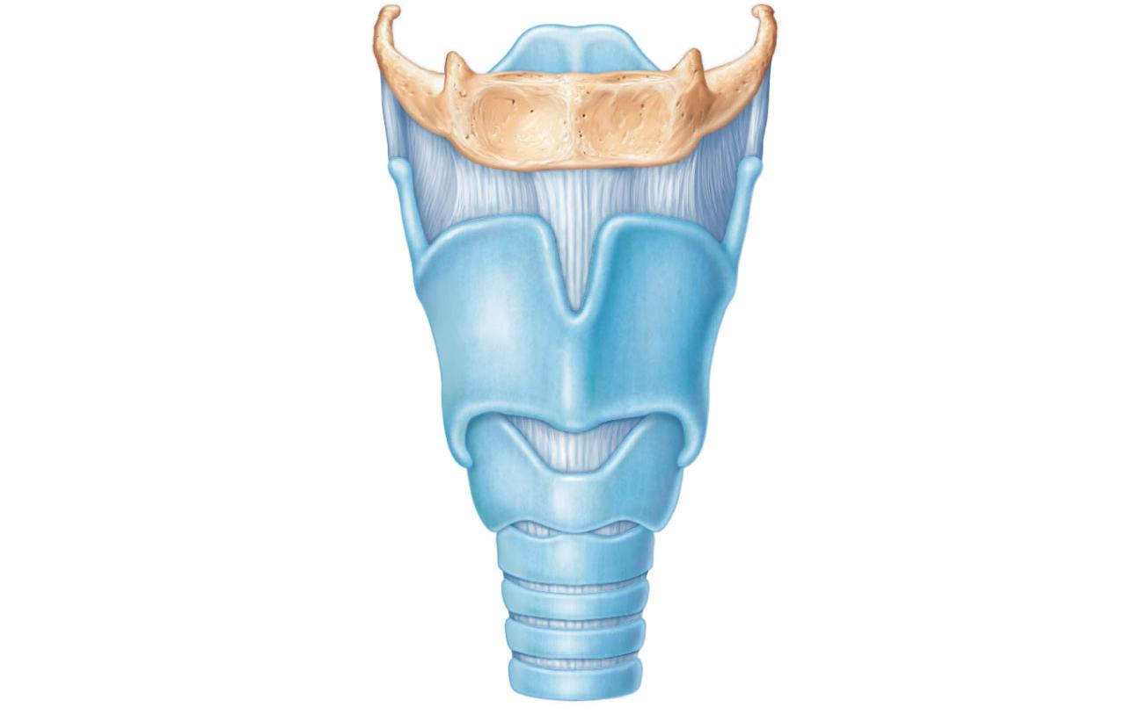
Epiglottis
Body of hyoid bone
Thyrohyoid
membrane
Thyroid cartilage
Laryngeal prominence
(Adam’s apple)
Cricothyroid ligament
Cricoid cartilage
Cricotracheal ligament
Tracheal cartilages
(a) Anterior superficial view

Slide 26
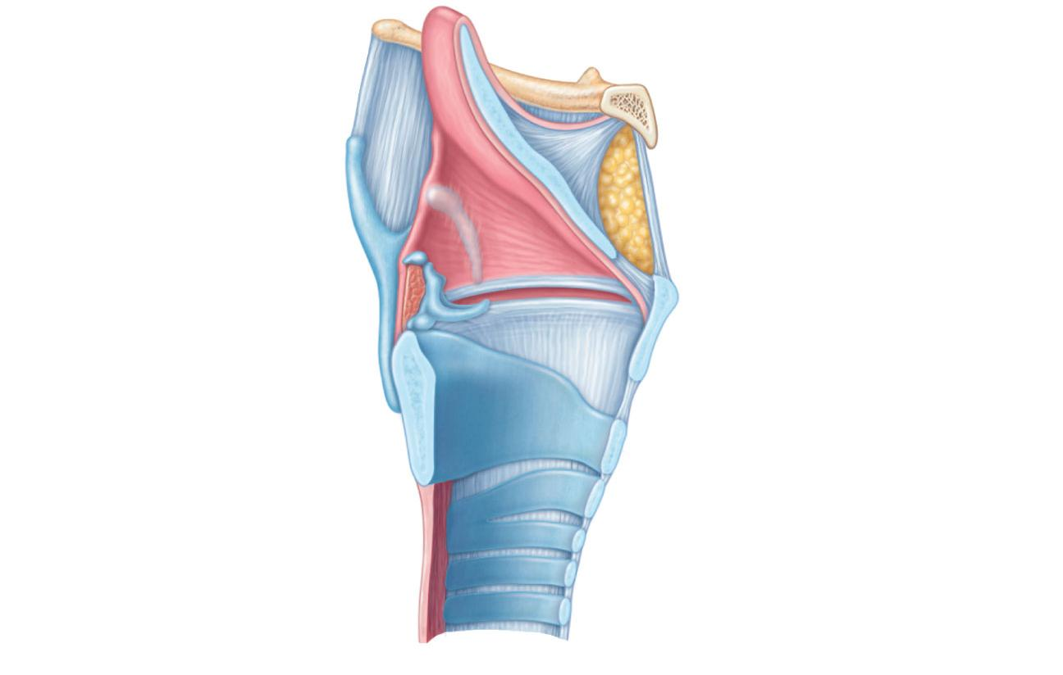
Epiglottis
Body of hyoid bone
Thyrohyoid
membrane
Thyrohyoid membrane
Fatty pad
Cuneiform cartilage
Vestibular fold
(false vocal cord)
Corniculate cartilage
Arytenoid cartilage
Thyroid cartilage
Arytenoid muscles
Vocal fold
(true vocal cord)
Cricoid cartilage
Cricothyroid ligament
Cricotracheal ligament
Tracheal cartilages
(b) Sagittal view; anterior surface to the right

Slide 27
Larynx
Vocal ligaments
Contain elastic fibers
Form the core of vocal folds (true vocal cords)
Opening between them is the glottis
Folds vibrate to produce sound as air rushes up from the lungs

Slide 28
Larynx
Vestibular folds (false vocal cords)
Superior to the vocal folds
No part in sound production
Help to close the glottis during swallowing

Slide 29
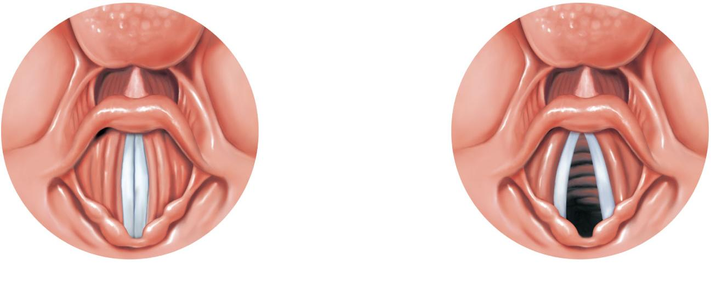
Base of tongue
Epiglottis
Vestibular fold
(false vocal cord)
Vocal fold
(true vocal cord)
Glottis
Inner lining of trachea
Cuneiform cartilage
Corniculate cartilage
(a) Vocal folds in closed position;
closed glottis
(b) Vocal folds in open position;
open glottis

Slide 30
Voice Production
Speech:
intermittent release of expired air while opening and closing the glottis
Pitch
determined by the length and tension of the vocal cords
Loudness
depends upon the force of air
Chambers of pharynx, oral, nasal, and sinus cavities amplify and enhance sound quality
Sound is “shaped” into language by muscles of the pharynx, tongue, soft palate, and lips

Slide 31
Larynx
Vocal folds may act as a sphincter to prevent air passage
Example: Valsalva’s maneuver
Glottis closes to prevent exhalation
Abdominal muscles contract
Intra-abdominal pressure rises
Helps to empty the rectum or stabilizes the trunk during heavy lifting

Slide 32
Trachea
Windpipe: from the larynx into the mediastinum
Wall composed of three layers
Mucosa: ciliated pseudostratified epithelium with goblet cells
Submucosa: connective tissue with seromucous glands
Adventitia: outermost layer made of connective tissue that encases the C-shaped rings of hyaline cartilage

Slide 33
Trachea
Trachealis muscle
Connects posterior parts of cartilage rings
Contracts during coughing to expel mucus
Carina
Last tracheal cartilage
Point where trachea branches into two bronchi

Slide 34
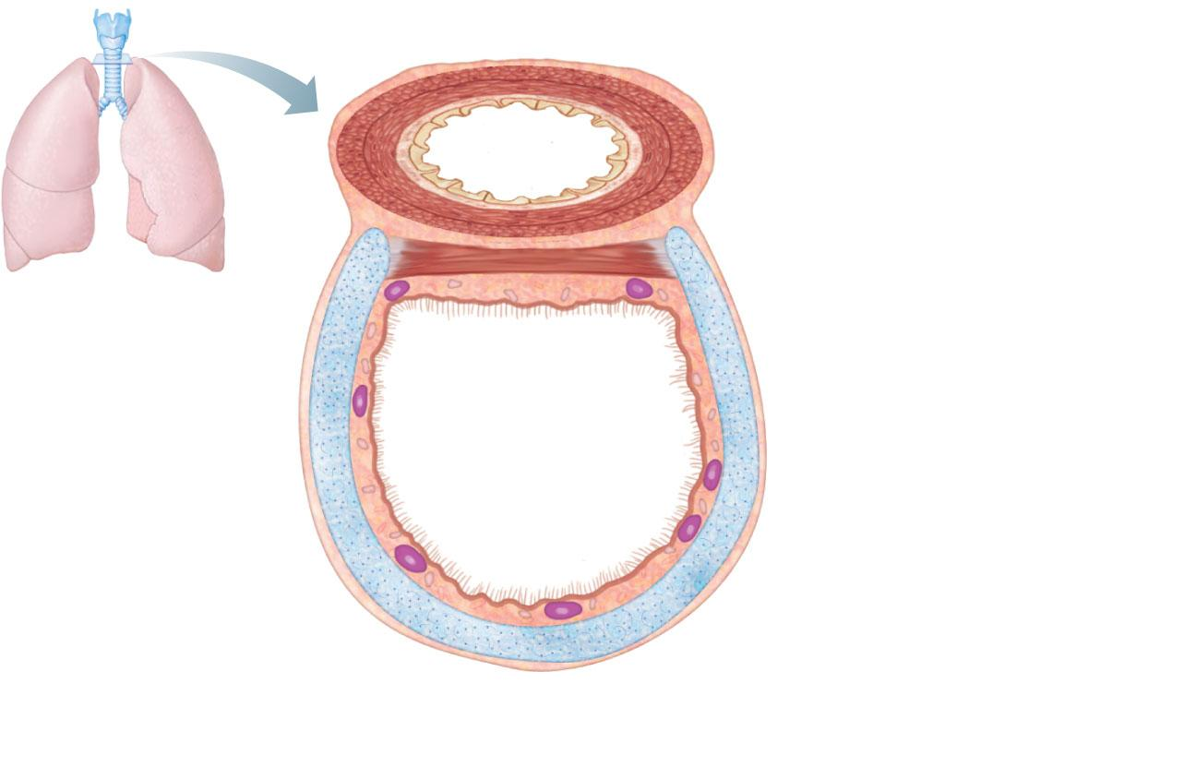
Posterior
Mucosa
Esophagus
Submucosa
Trachealis
muscle
Lumen of
trachea
Seromucous gland
in submucosa
Hyaline cartilage
Adventitia
Anterior
(a) Cross section of the trachea and esophagus
Figure 22.6a

Slide 35
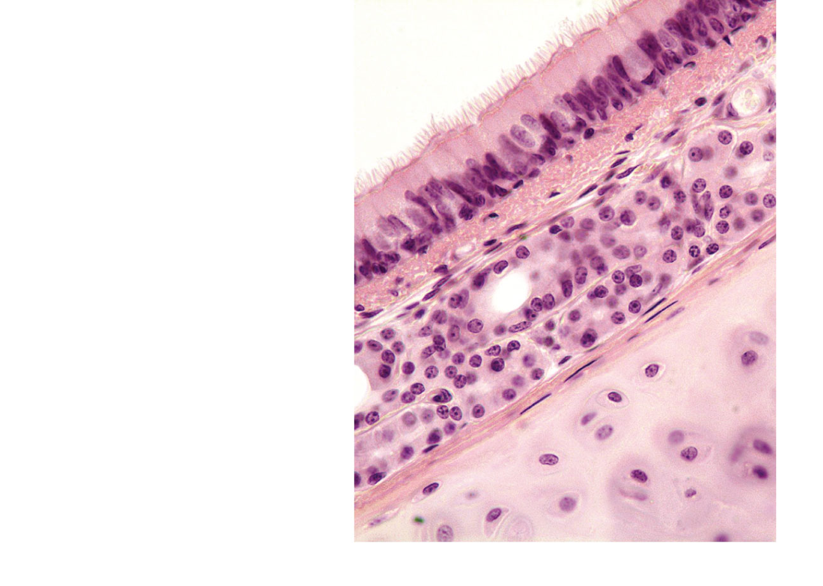
Mucosa
• Pseudostratified
ciliated columnar
epithelium
• Lamina propria
(connective tissue)
Submucosa
Seromucous gland
in submucosa
Hyaline cartilage
(b) Photomicrograph of the tracheal wall (320x)
Figure 22.6b

Slide 36
Bronchi and Subdivisions
Air passages undergo 23 orders of branching
Branching pattern called the bronchial (respiratory) tree

Slide 37
Conducting Zone Structures
Trachea → right and left main (primary) bronchi
Each main bronchus enters the hilum of one lung
Right main bronchus is wider, shorter, and more vertical than the left
Each main bronchus branches into lobar (secondary) bronchi (three right, two left)
Each lobar bronchus supplies one lobe

Slide 38
Conducting Zone Structures
Each lobar bronchus branches into segmental (tertiary) bronchi
Segmental bronchi divide repeatedly
Bronchioles are less than 1 mm in diameter
Terminal bronchioles are the smallest, less than 0.5 mm diameter

Slide 39
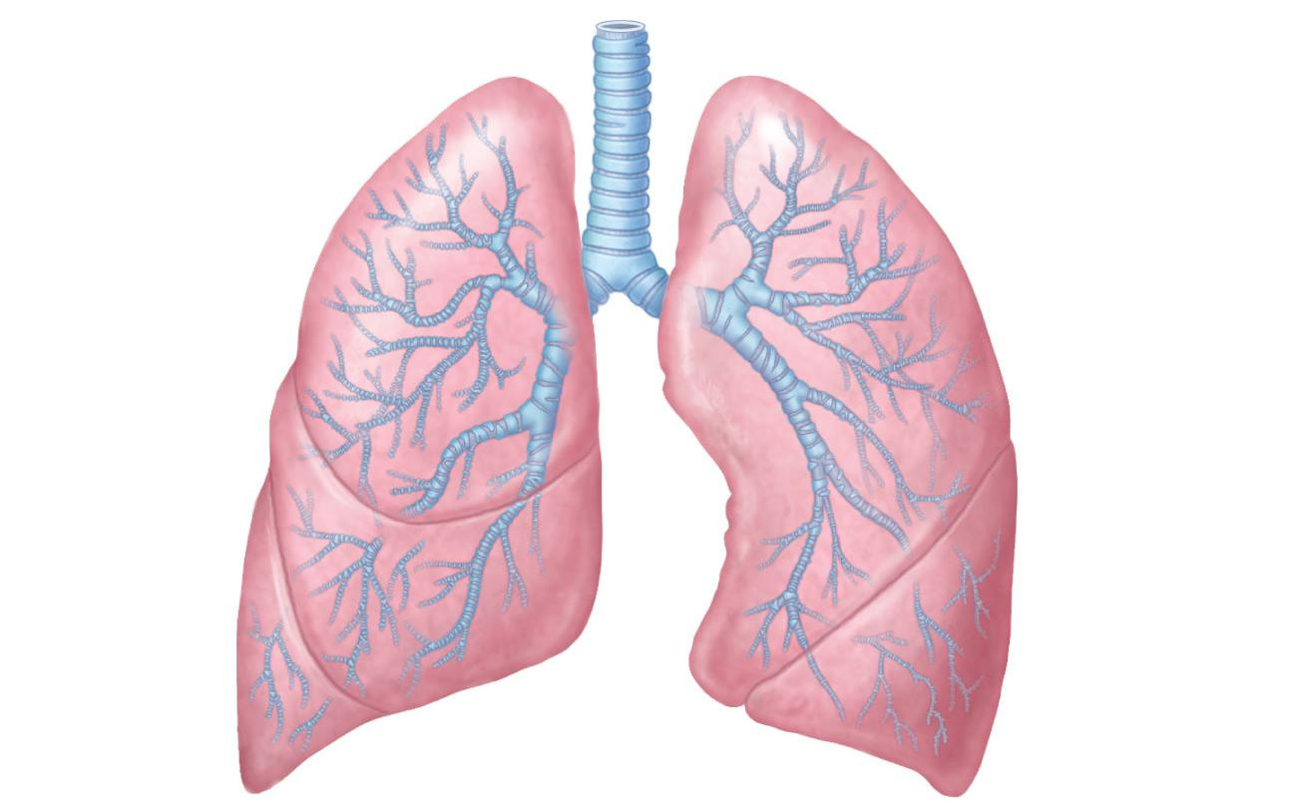
Trachea
Superior lobe
of left lung
Left main
(primary)
bronchus
Superior lobe
of right lung
Lobar
(secondary)
bronchus
Segmental
(tertiary)
bronchus
Middle lobe
of right lung
Inferior lobe
of right lung
Inferior lobe
of left lung
Figure 22.7

Slide 40
Conducting Zone Structures
From bronchi through bronchioles, structural changes occur
Cartilage rings give way to plates; cartilage is absent from bronchioles
Epithelium changes from pseudostratified columnar to cuboidal; cilia and goblet cells become sparse
Relative amount of smooth muscle increases

Slide 41
Respiratory Zone
Respiratory bronchioles, alveolar ducts, alveolar sacs (clusters of alveoli)
~300 million alveoli account for most of the lungs’ volume and are the main site for gas exchange

Slide 42
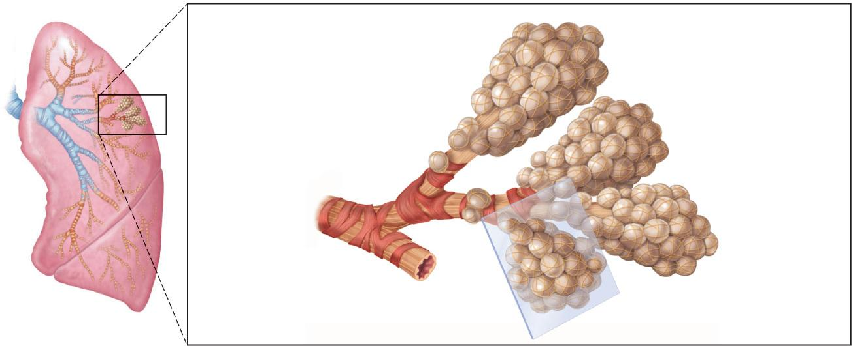
Alveoli
Alveolar duct
Respiratory
bronchioles
Alveolar duct
Terminal
bronchiole
Alveolar
sac
(a)
Figure 22.8a

Slide 43
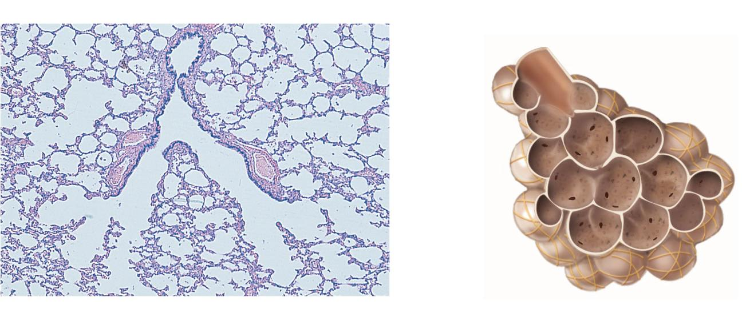
Respiratory
bronchiole
Alveolar
duct
Alveolar
pores
Alveoli
Alveolar
sac
(b)
Figure 22.8b

Slide 44
Respiratory Membrane
~0.5-μm-thick air-blood barrier
Alveolar and capillary walls and their fused basement membranes
Alveolar walls
Single layer of squamous epithelium (type I cells)
Scattered type II cuboidal cells secrete surfactant and antimicrobial proteins

Slide 45
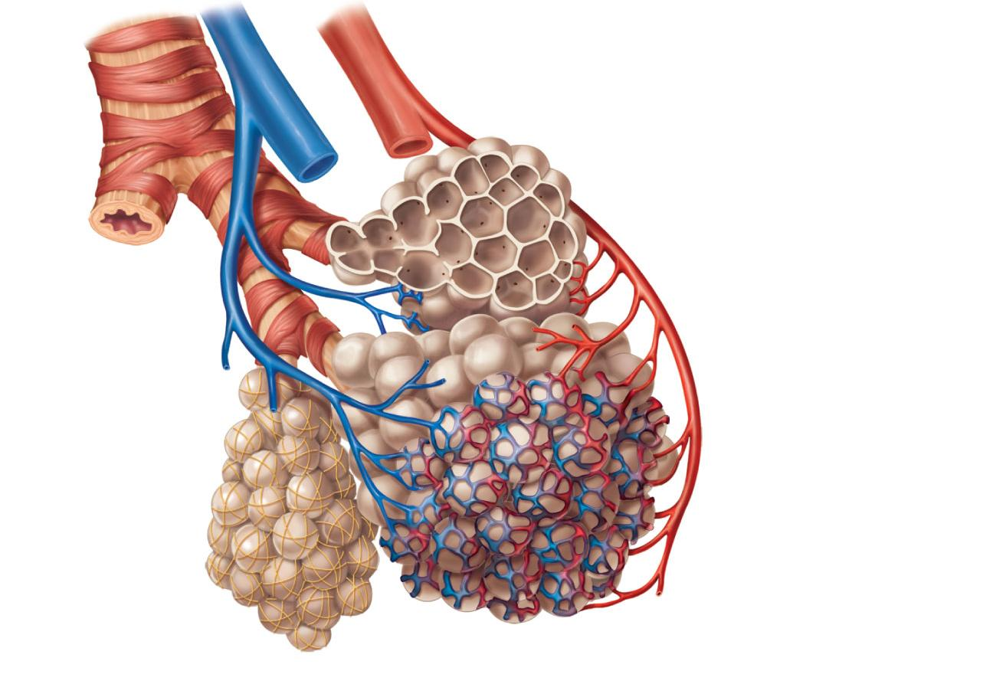
Terminal bronchiole
Respiratory bronchiole
Smooth
muscle
Elastic
fibers
Alveolus
Capillaries
(a) Diagrammatic view of capillary-alveoli relationships
Figure 22.9a

Slide 46
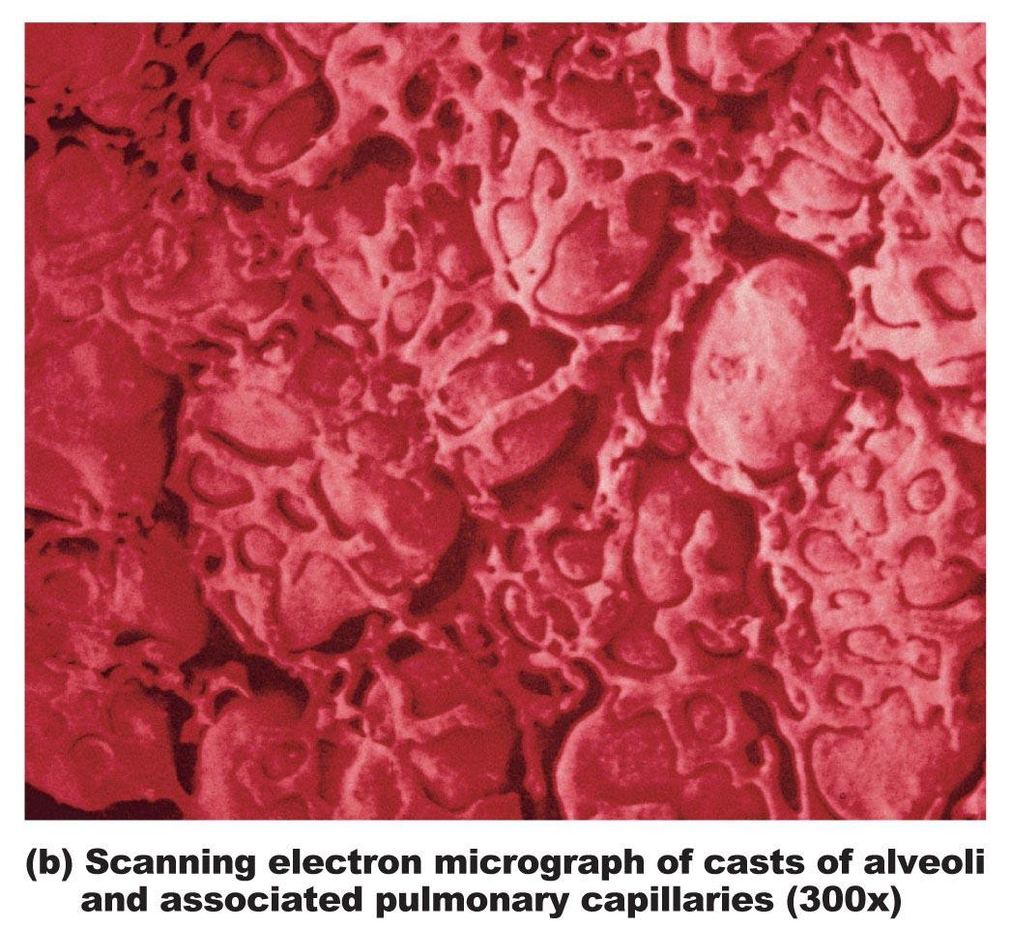
Figure 22.9b

Slide 47
Alveoli
Surrounded by fine elastic fibers
Contain open pores that
Connect adjacent alveoli
Allow air pressure throughout the lung to be equalized
House alveolar macrophages that keep alveolar surfaces sterile

Slide 48
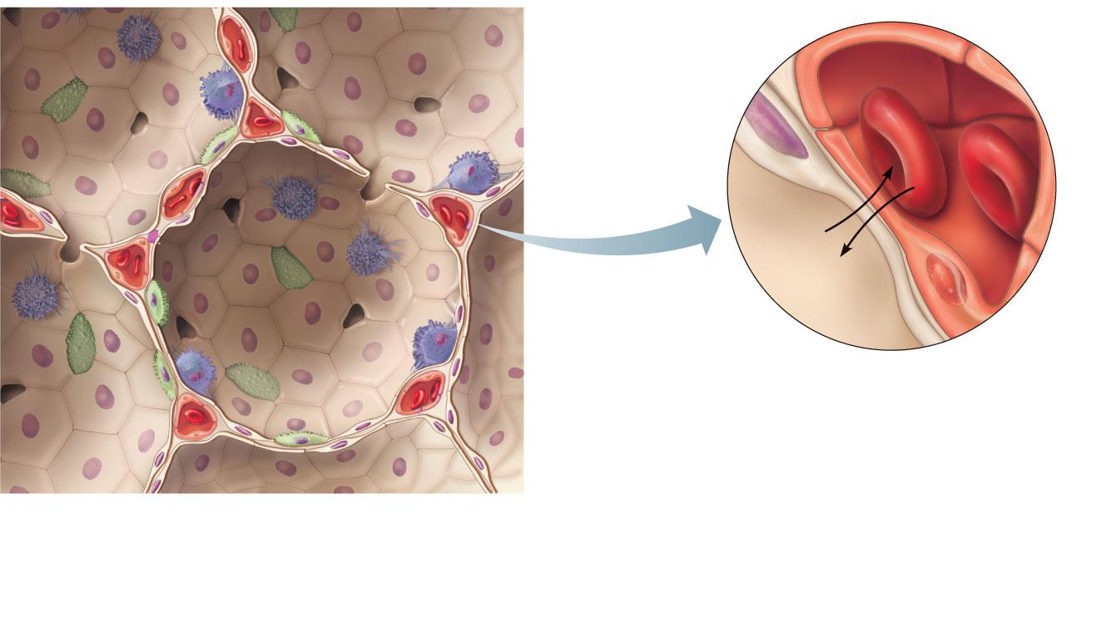
Red blood
cell
Nucleus of type I
(squamous
epithelial) cell
Alveolar pores
Capillary
O₂
Capillary
Type I cell
of alveolar wall
CO₂
Macrophage
Alveolus
Alveolus
Endothelial cell nucleus
Alveolar
epithelium
Fused basement
membranes of the
alveolar epithelium
and the capillary
endothelium
Respiratory
membrane
Red blood cell
in capillary
Alveoli (gas-filled
air spaces)
Type II (surfactant-
secreting) cell
Capillary
endothelium
(c) Detailed anatomy of the respiratory membrane
Figure 22.9c

Slide 49
Lungs
Occupy all of the thoracic cavity except the mediastinum
Root: site of vascular and bronchial attachments
Costal surface: anterior, lateral, and posterior surfaces

Slide 50
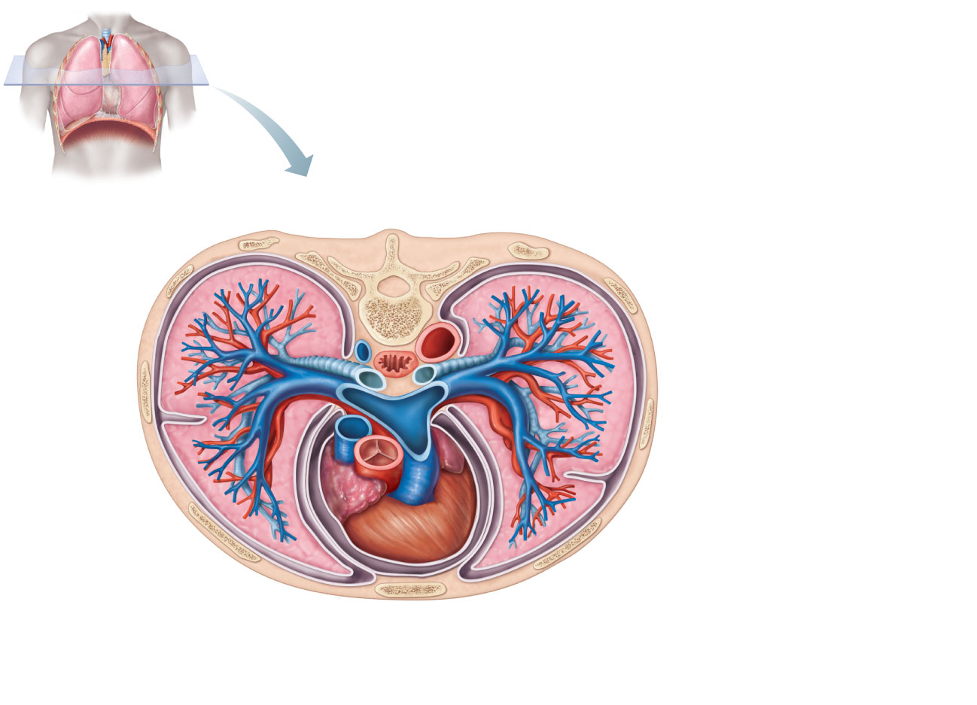
Vertebra
Posterior
Esophagus
(in mediastinum)
Right lung
Root of lung
at hilum
Parietal
pleura
• Left main bronchus
• Left pulmonary artery
Visceral
pleura
• Left pulmonary vein
Left lung
Pleural
cavity
Thoracic wall
Pulmonary trunk
Pericardial
membranes
Heart (in mediastinum)
Sternum
Anterior mediastinum
Anterior
(c) Transverse section through the thorax, viewed from above. Lungs,
pleural membranes, and major organs in the mediastinum are shown.
Figure 22.10c

Slide 51
Lungs
Apex: superior tip
Base: inferior surface that rests on the diaphragm
Hilum: on mediastinal surface; site for attachment of blood vessels, bronchi, lymphatic vessels, and nerves
Cardiac notch of left lung: concavity that accommodates the heart

Slide 52
Lungs
Left lung is smaller, separated into two lobes by an oblique fissure
Right lung has three lobes separated by oblique and horizontal fissures
Bronchopulmonary segments (10 right, 8–9 left)
Lobules are the smallest subdivisions; served by bronchioles and their branches

Slide 53
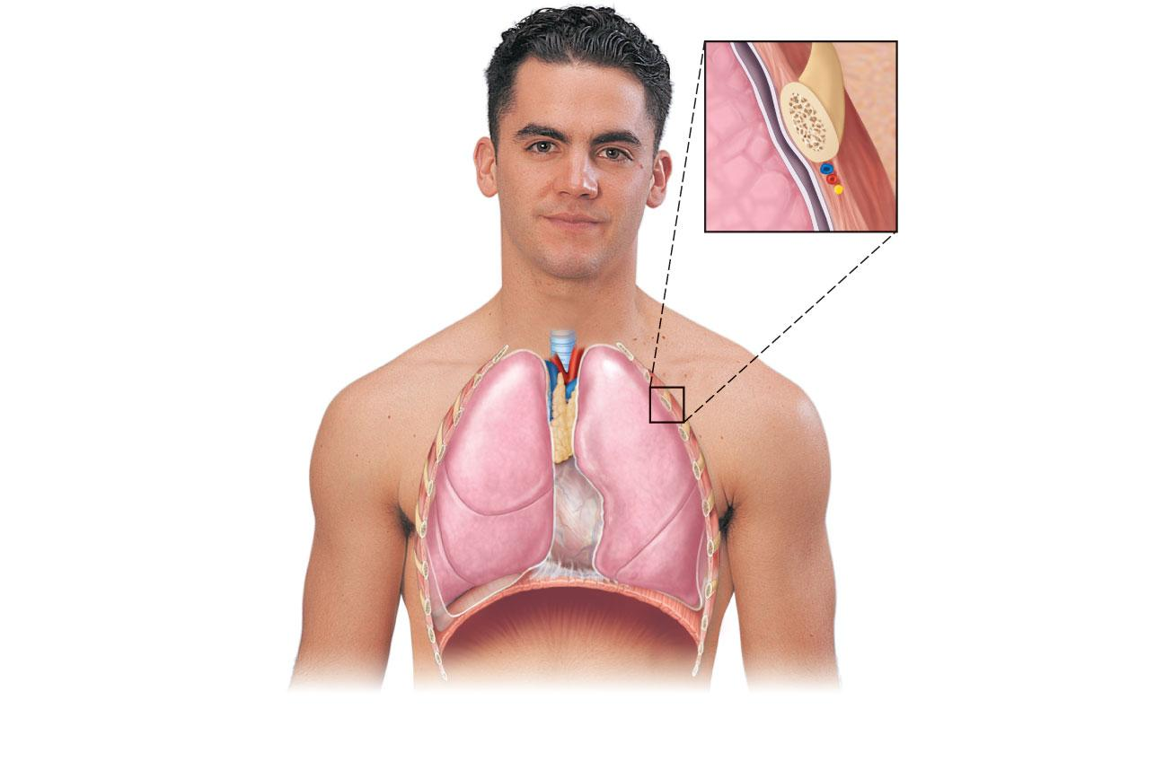
Intercostal
muscle
Rib
Parietal pleura
Trachea
Lung
Pleural cavity
Thymus
Visceral pleura
Apex of lung
Right superior lobe
Horizontal fissure
Left
superior lobe
Heart
(in mediastinum)
Oblique
fissure
Right middle lobe
Left inferior
lobe
Oblique fissure
Right inferior lobe
Diaphragm
Base of lung
Cardiac notch
(a) Anterior view. The lungs flank mediastinal structures laterally.
Figure 22.10a

Slide 54
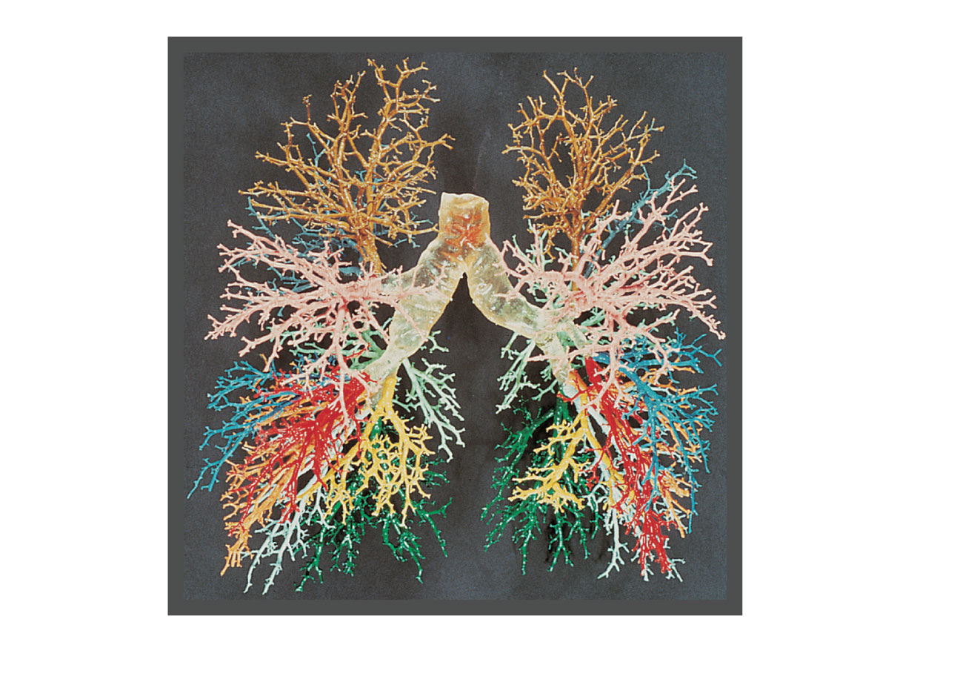
Right lung
Left lung
Right
superior
lobe (3
segments)
Left superior
lobe
(4 segments)
Right
middle
lobe (2
segments)
Right
inferior lobe (5 segments)
Left inferior
lobe (5 segments)
Figure 22.11

Slide 55
Blood Supply
Pulmonary circulation (low pressure, high volume)
Pulmonary arteries deliver systemic venous blood
Branch profusely, along with bronchi
Feed into the pulmonary capillary networks
Pulmonary veins carry oxygenated blood from respiratory zones to the heart

Slide 56
Blood Supply
Systemic circulation (high pressure, low volume)
Bronchial arteries provide oxygenated blood to lung tissue
Arise from aorta and enter the lungs at the hilum
Supply all lung tissue except the alveoli
Bronchial veins anastomose with pulmonary veins
Pulmonary veins carry most venous blood back to the heart

Slide 57
Pleurae
Thin, double-layered serosa
Parietal pleura on thoracic wall and superior face of diaphragm
Visceral pleura on external lung surface
Pleural fluid fills the slitlike pleural cavity
Provides lubrication and surface tension

Slide 58
Vertebra
Posterior
Esophagus
(in mediastinum)
Right lung
Root of lung
at hilum
Parietal
pleura
• Left main bronchus
• Left pulmonary artery
Visceral
pleura
• Left pulmonary vein
Left lung
Pleural
cavity
Thoracic wall
Pulmonary trunk
Pericardial
membranes
Heart (in mediastinum)
Sternum
Anterior mediastinum
Anterior
(c) Transverse section through the thorax, viewed from above. Lungs,
pleural membranes, and major organs in the mediastinum are shown.
Figure 22.10c

Slide 59
Mechanics of Breathing
Pulmonary ventilation consists of two phases
Inspiration: gases flow into the lungs
Expiration: gases exit the lungs

Slide 60
Pressure Relationships in the Thoracic Cavity
Atmospheric pressure (P_{atm})
Pressure exerted by the air surrounding the body
760 mm Hg at sea level
Respiratory pressures are described relative to P_{atm}
Negative respiratory pressure is less than P_{atm}
Positive respiratory pressure is greater than P_{atm}
Zero respiratory pressure = P_{atm}

Slide 61
Intrapulmonary Pressure
Intrapulmonary (intra-alveolar) pressure (P_{pul})
Pressure in the alveoli
Fluctuates with breathing
Always eventually equalizes with P_{atm}

Slide 62
Intrapleural Pressure
Intrapleural pressure (P_{ip}):
Pressure in the pleural cavity
Fluctuates with breathing
Always a negative pressure (<P_{atm} and <P_{pul})

Slide 63
Intrapleural Pressure
Negative P_{ip} is caused by opposing forces
Two inward forces promote lung collapse
Elastic recoil of lungs decreases lung size
Surface tension of alveolar fluid reduces alveolar size
One outward force tends to enlarge the lungs
Elasticity of the chest wall pulls the thorax outward

Slide 64
Pressure Relationships
If P_{ip} = P_{pul} the lungs collapse
(P_{pul} – P_{ip}) = transpulmonary pressure
Keeps the airways open
The greater the transpulmonary pressure, the larger the lungs

Slide 65
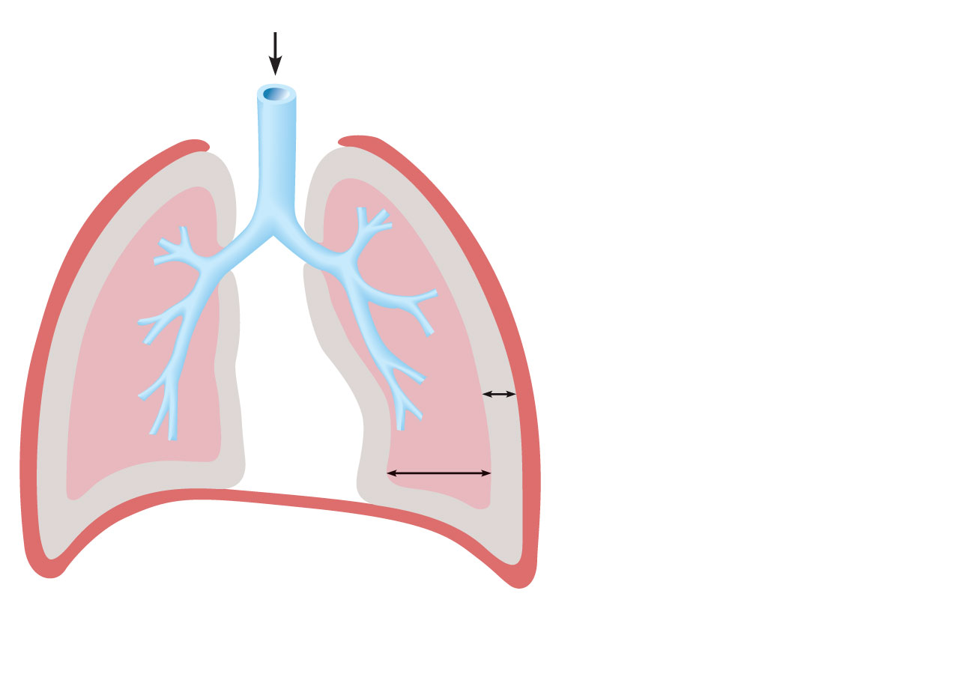
Atmospheric pressure
Parietal pleura
Thoracic wall
Visceral pleura
Pleural cavity
Transpulmonary
pressure
760 mm Hg
–756 mm Hg
= 4 mm Hg
756
Intrapleural
pressure
756 mm Hg
(–4 mm Hg)
760
Intrapulmonary
pressure 760 mm Hg
(0 mm Hg)
Lung
Diaphragm
Figure 22.12

Slide 66
Homeostatic Imbalance
Atelectasis (lung collapse) is due to
Plugged bronchioles → collapse of alveoli
Wound that admits air into pleural cavity (pneumothorax)

Slide 67
Pulmonary Ventilation
Inspiration and expiration
Mechanical processes that depend on volume changes in the thoracic cavity
Volume changes → pressure changes
Pressure changes → gases flow to equalize pressure

Slide 68
Boyle’s Law
The relationship between the pressure and volume of a gas
Pressure (P) varies inversely with volume (V):
P₁V₁ = P₂V₂

Slide 69
Inspiration
An active process
Inspiratory muscles contract
Thoracic volume increases
Lungs are stretched and intrapulmonary volume increases
Intrapulmonary pressure drops (to −1 mm Hg)
Air flows into the lungs, down its pressure gradient, until P_{pul} = P_{atm}

Slide 70
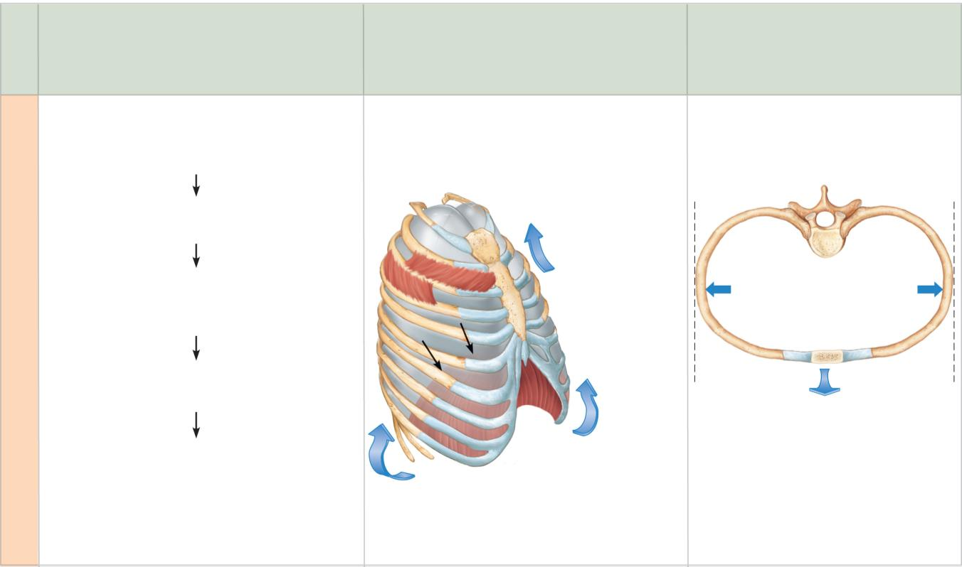
Changes in anterior-
posterior and superior-
inferior dimensions
Changes in lateral
dimensions
(superior view)
Sequence of events
1
Inspiratory muscles
contract (diaphragm
descends; rib cage rises).
Ribs are elevated
and sternum flares
as external
intercostals
contract.
Thoracic cavity volume
increases.
2
3
External
intercostals
contract.
Lungs are stretched;
intrapulmonary volume
increases.
Intrapulmonary pressure
drops (to –1 mm Hg).
4
5
Air (gases) flows into
lungs down its pressure
gradient until intrapulmonary
pressure is 0 (equal to
atmospheric pressure).
Diaphragm
moves inferiorly
during contraction.
Figure 22.13 (1 of 2)

Slide 71
Expiration
Quiet expiration is normally a passive process
Inspiratory muscles relax
Thoracic cavity volume decreases
Elastic lungs recoil and intrapulmonary volume decreases
P_{pul} rises (to +1 mm Hg)
Air flows out of the lungs down its pressure gradient until Ppul = 0
Note: forced expiration is an active process: it uses abdominal and internal intercostal muscles

Slide 72
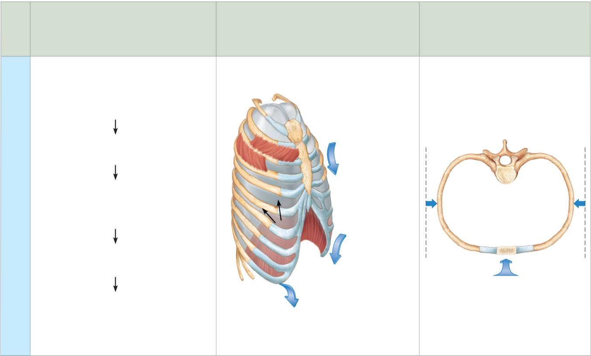
Changes in anterior-
posterior and superior-
inferior dimensions
Changes in
lateral dimensions
(superior view)
Sequence
of events
1
Inspiratory muscles
relax (diaphragm rises; rib
cage descends due to
recoil of costal cartilages).
Ribs and sternum
are depressed
as external
intercostals
relax.
2
Thoracic cavity volume
decreases.
3
Elastic lungs recoil
passively; intrapulmonary
volume decreases.
External
intercostals
relax.
4
Intrapulmonary pres-
sure rises (to +1 mm Hg).
Diaphragm
moves
superiorly
as it relaxes.
5
Air (gases) flows out of
lungs down its pressure
gradient until intra-
pulmonary pressure is 0.
Figure 22.13 (2 of 2)

Slide 73
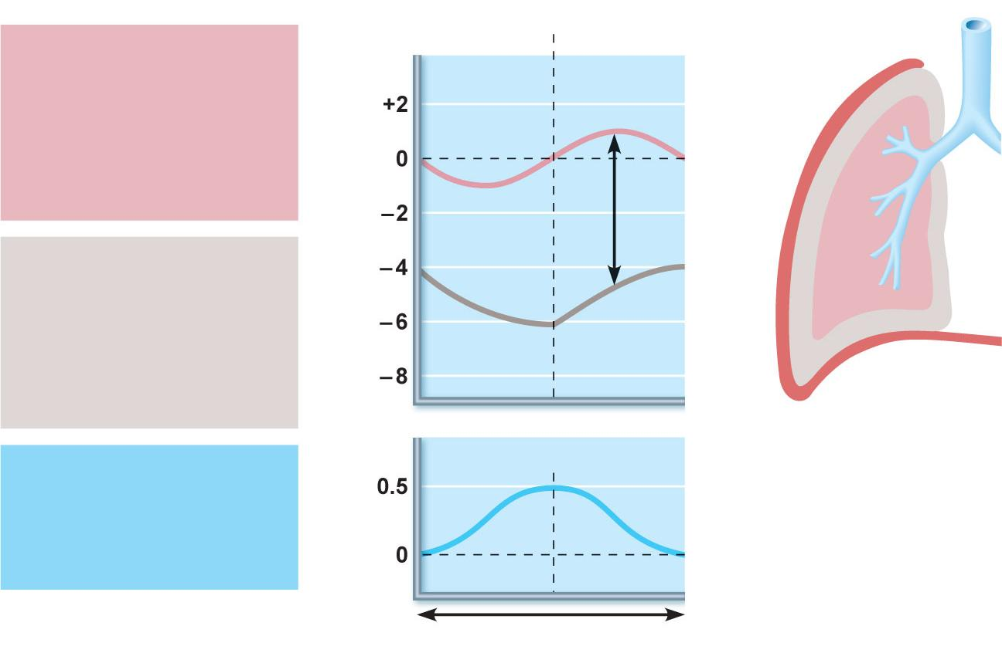
Intrapulmonary
pressure. Pressure
inside lung decreases as
lung volume increases
during inspiration;
pressure increases
during expiration.
Inspiration
Expiration
Intrapulmonary
pressure
Trans-
pulmonary
pressure
Intrapleural pressure.
Pleural cavity pressure
becomes more negative
as chest wall expands
during inspiration.
Returns to initial value
as chest wall recoils.
Intrapleural
pressure
Volume of breath.
During each breath, the
pressure gradients move
0.5 liter of air into and out
of the lungs.
Volume of breath
5 seconds elapsed
Figure 22.14

Slide 74
Physical Factors Influencing Pulmonary Ventilation
Inspiratory muscles consume energy to overcome three factors that hinder air passage and pulmonary ventilation
Airway resistance
Alveolar surface tension
Lung compliance

Slide 75
Airway Resistance
Friction is the major nonelastic source of resistance to gas flow
The relationship between flow (F), pressure (P), and resistance (R) is:
F = ΔP
R
ΔP is the pressure gradient between the atmosphere and the alveoli (2 mm Hg or less during normal quiet breathing)
Gas flow changes inversely with resistance

Slide 76
Airway Resistance
Resistance is usually insignificant because of
Large airway diameters in the first part of the conducting zone
Progressive branching of airways as they get smaller, increasing the total cross-sectional area
Resistance disappears at the terminal bronchioles where diffusion drives gas movement

Slide 77
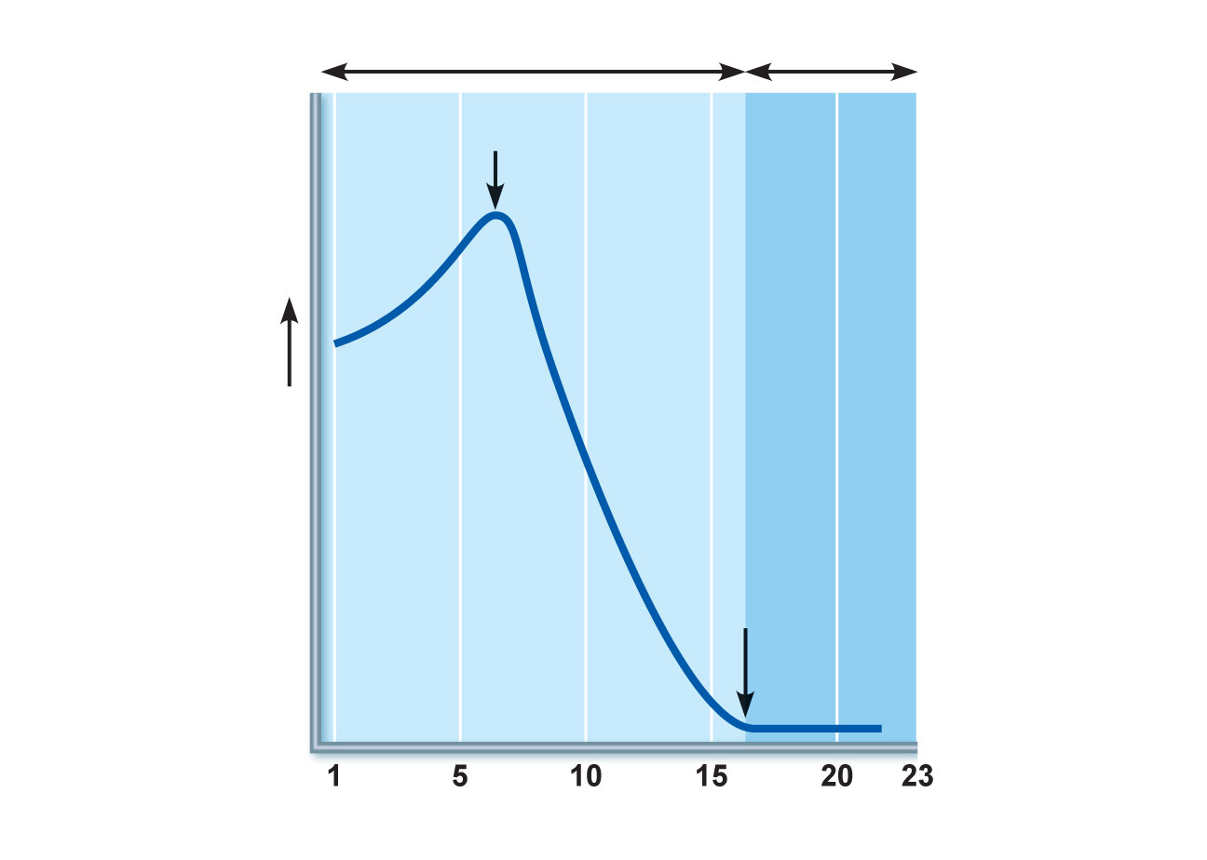
Conducting
zone
Respiratory
zone
Medium-sized
bronchi
Terminal
bronchioles
Airway generation
(stage of branching)
Figure 22.15

Slide 78
Airway Resistance
As airway resistance rises, breathing movements become more strenuous
Severely constricting or obstruction of bronchioles
Can prevent life-sustaining ventilation
Can occur during acute asthma attacks and stop ventilation
Epinephrine dilates bronchioles and reduces air resistance

Slide 79
Alveolar Surface Tension
Surface tension
Attracts liquid molecules to one another at a gas-liquid interface
Resists any force that tends to increase the surface area of the liquid

Slide 80
Alveolar Surface Tension
Surfactant
Detergent-like lipid and protein complex produced by type II alveolar cells
Reduces surface tension of alveolar fluid and discourages alveolar collapse
Insufficient quantity in premature infants causes infant respiratory distress syndrome

Slide 81
Lung Compliance
A measure of the change in lung volume that occurs with a given change in transpulmonary pressure
Normally high due to
Distensibility of the lung tissue
Alveolar surface tension

Slide 82
Lung Compliance
Diminished by
Nonelastic scar tissue (fibrosis)
Reduced production of surfactant
Decreased flexibility of the thoracic cage

Slide 83
Lung Compliance
Homeostatic imbalances that reduce compliance
Deformities of thorax
Ossification of the costal cartilage
Paralysis of intercostal muscles

Slide 84
22
The Respiratory System: Part B

Slide 85
Respiratory Volumes
Used to assess a person’s respiratory status
Tidal volume (TV)
Inspiratory reserve volume (IRV)
Expiratory reserve volume (ERV)
Residual volume (RV)

Slide 86
Adult male
average value
Adult female
average value
Measurement
Description
Amount of air inhaled or
exhaled with each breath
under resting conditions
Tidal volume (TV)
500 ml
500 ml
Inspiratory reserve
volume (IRV)
Amount of air that can be
forcefully inhaled after a nor-
mal tidal volume inhalation
3100 ml
1900 ml
Respiratory
volumes
Amount of air that can be
forcefully exhaled after a nor-
mal tidal volume exhalation
Expiratory reserve
volume (ERV)
1200 ml
700 ml
Amount of air remaining in
the lungs after a forced
exhalation
Residual volume (RV)
1200 ml
1100 ml
Figure 22.16b

Slide 87
Respiratory Capacities
Inspiratory capacity (IC)
Functional residual capacity (FRC)
Vital capacity (VC)
Total lung capacity (TLC)

Slide 88
Maximum amount of air
contained in lungs after a
maximum inspiratory effort:
TLC = TV + IRV + ERV + RV
Total lung capacity (TLC)
6000 ml
4200 ml
Maximum amount of air that
can be expired after a maxi-
mum inspiratory effort:
VC = TV + IRV + ERV
Vital capacity (VC)
4800 ml
3100 ml
Respiratory
capacities
Maximum amount of air that
can be inspired after a normal
expiration: IC = TV + IRV
Inspiratory capacity (IC)
3600 ml
2400 ml
Volume of air remaining in
the lungs after a normal tidal
volume expiration:
FRC = ERV + RV
Functional residual
capacity (FRC)
2400 ml
1800 ml
(b) Summary of respiratory volumes and capacities for males and females
Figure 22.16b

Slide 89
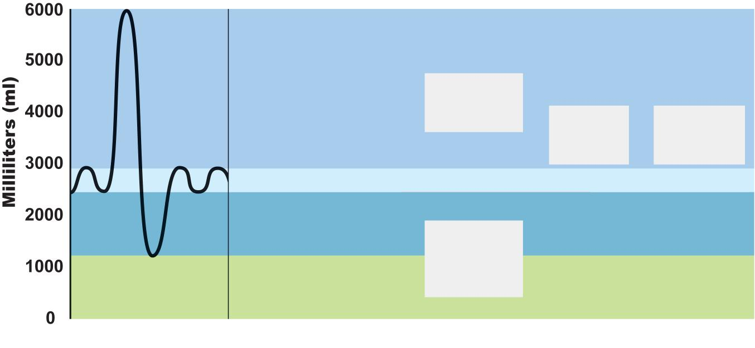
Inspiratory
reserve volume
3100 ml
Inspiratory
capacity
3600 ml
Vital
capacity
4800 ml
Total lung
capacity
6000 ml
Tidal volume 500 ml
Expiratory
reserve volume
1200 ml
Functional
residual
capacity
2400 ml
Residual volume
1200 ml
(a) Spirographic record for a male
Figure 22.16a

Slide 90
Dead Space
Some inspired air never contributes to gas exchange
Anatomical dead space: volume of the conducting zone conduits (~150 ml)
Alveolar dead space: alveoli that cease to act in gas exchange due to collapse or obstruction
Total dead space: sum of above nonuseful volumes

Slide 91
Pulmonary Function Tests
Spirometer: instrument used to measure respiratory volumes and capacities
Spirometry can distinguish between
Obstructive pulmonary disease—increased airway resistance (e.g., bronchitis)
Restrictive disorders—reduction in total lung capacity due to structural or functional lung changes (e.g., fibrosis or TB)

Slide 92
Pulmonary Function Tests
Minute ventilation: total amount of gas flow into or out of the respiratory tract in one minute
Forced vital capacity (FVC): gas forcibly expelled after taking a deep breath
Forced expiratory volume (FEV): the amount of gas expelled during specific time intervals of the FVC

Slide 93
Pulmonary Function Tests
Increases in TLC, FRC, and RV may occur as a result of obstructive disease
Reduction in VC, TLC, FRC, and RV result from restrictive disease

Slide 94
Alveolar Ventilation
Alveolar ventilation rate (AVR): flow of gases into and out of the alveoli during a particular time
Dead space is normally constant
Rapid, shallow breathing decreases AVR
AVR | = | frequency | X | (TV – dead space)
(ml/min) |  | (breaths/min) |  | (ml/breath)

Slide 95
Table 22.2

Slide 96
Nonrespiratory Air Movements
Most result from reflex action
Examples include: cough, sneeze, crying, laughing, hiccups, and yawns

Slide 97
Gas Exchanges Between Blood, Lungs, and Tissues
External respiration
Internal respiration
To understand the above processes, first consider
Physical properties of gases
Composition of alveolar gas

Slide 98
Basic Properties of Gases: Dalton’s Law of Partial Pressures
Total pressure exerted by a mixture of gases is the sum of the pressures exerted by each gas
The partial pressure of each gas is directly proportional to its percentage in the mixture

Slide 99
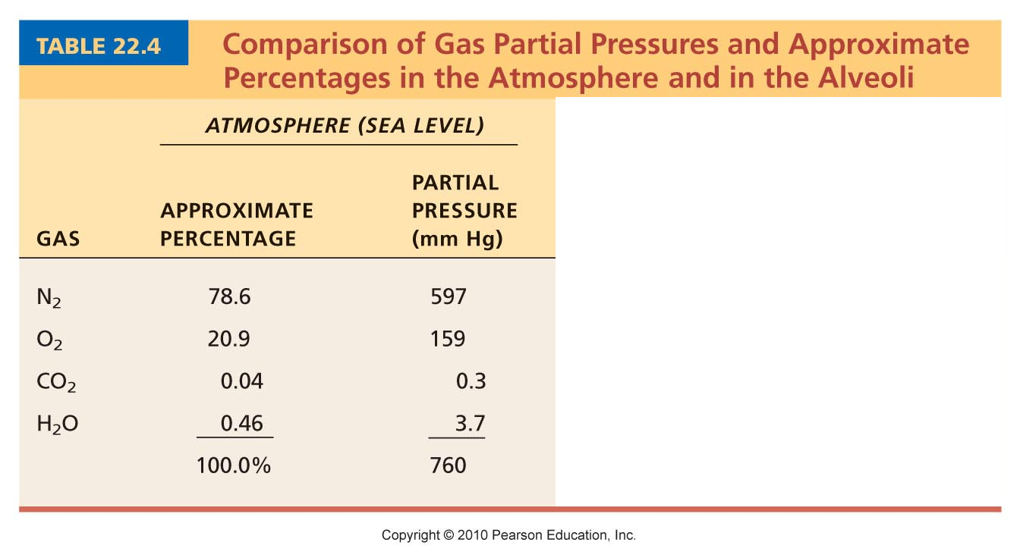
Table 22.4

Slide 100
Basic Properties of Gases: Henry’s Law
When a mixture of gases is in contact with a liquid, each gas will dissolve in the liquid in proportion to its partial pressure
At equilibrium, the partial pressures in the two phases will be equal
The amount of gas that will dissolve in a liquid also depends upon its solubility
CO₂ is 20 times more soluble in water than O₂
Very little N₂ dissolves in water

Slide 101
Composition of Alveolar Gas
Alveoli contain more CO₂ and water vapor than atmospheric air, due to
Gas exchanges in the lungs
Humidification of air
Mixing of alveolar gas that occurs with each breath

Slide 102
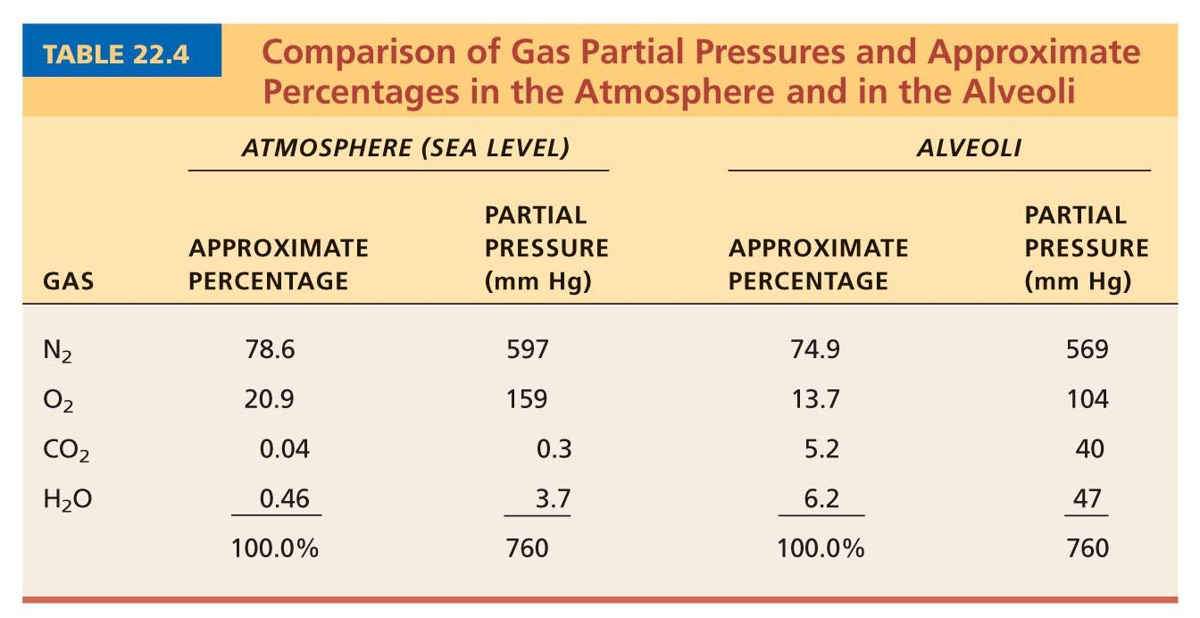
Table 22.4

Slide 103
External Respiration
Exchange of O₂ and CO₂ across the respiratory membrane
Influenced by
Partial pressure gradients and gas solubilities
Ventilation-perfusion coupling
Structural characteristics of the respiratory membrane

Slide 104
Partial Pressure Gradients and Gas Solubilities
Partial pressure gradient for O₂ in the lungs is steep
Venous blood Po₂ = 40 mm Hg
Alveolar Po₂ = 104 mm Hg
O₂ partial pressures reach equilibrium of 104 mm Hg in ~0.25 seconds, about 1/3 the time a red blood cell is in a pulmonary capillary

Slide 105
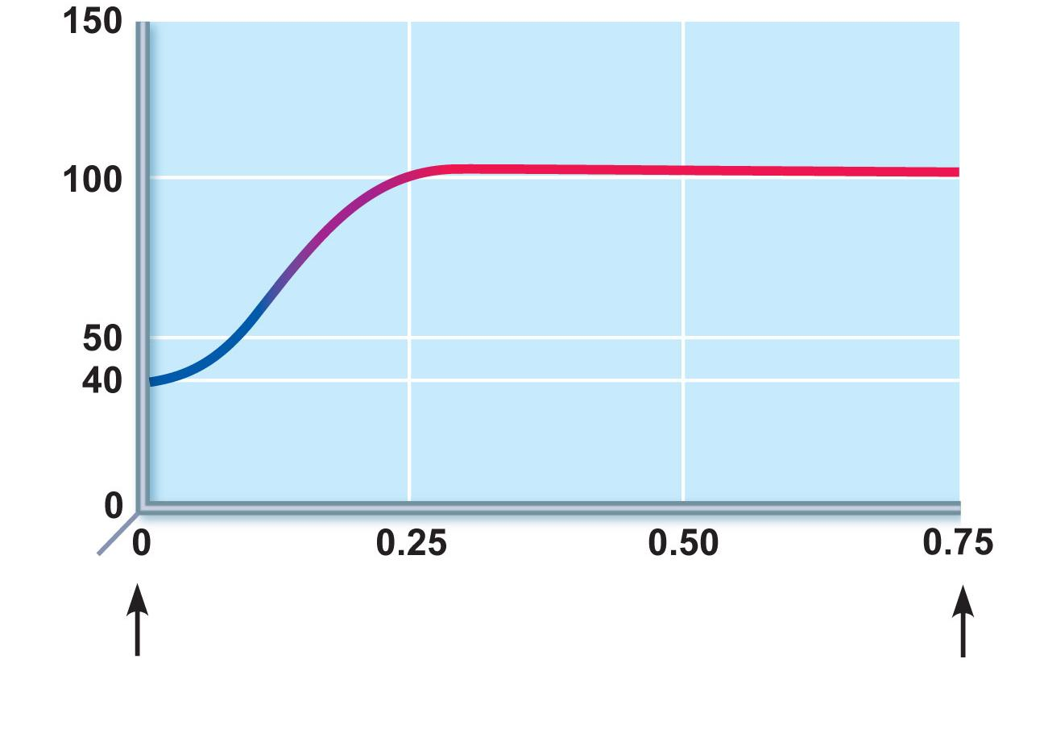
P 104 mm Hg
O₂
Time in the
pulmonary capillary (s)
Start of
capillary
End of
capillary
Figure 22.18

Slide 106
Partial Pressure Gradients and Gas Solubilities
Partial pressure gradient for CO₂ in the lungs is less steep:
Venous blood Pco₂ = 45 mm Hg
Alveolar Pco₂ = 40 mm Hg
CO₂ is 20 times more soluble in plasma than oxygen
CO₂ diffuses in equal amounts with oxygen

Slide 107
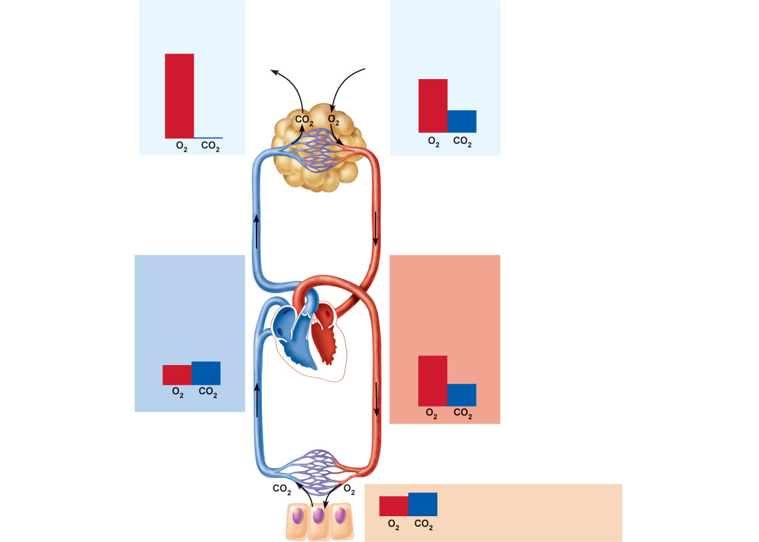
Inspired air:
P 160 mm Hg
P 0.3 mm Hg
Alveoli of lungs:
P 104 mm Hg
P 40 mm Hg
O₂
O₂
CO₂
CO₂
External
respiration
Pulmonary
arteries
Pulmonary
veins (P
100 mm Hg)
O₂
Blood leaving
tissues and
entering lungs:
P 40 mm Hg
P 45 mm Hg
Blood leaving
lungs and
entering tissue
capillaries:
P 100 mm Hg
P 40 mm Hg
O₂
O₂
CO₂
CO₂
Heart
Systemic
veins
Systemic
arteries
Internal
respiration
Tissues:
P less than 40 mm Hg
P greater than 45 mm Hg
O₂
CO₂
Figure 22.17

Slide 108
Ventilation-Perfusion Coupling
Ventilation: amount of gas reaching the alveoli
Perfusion: blood flow reaching the alveoli
Ventilation and perfusion must be matched (coupled) for efficient gas exchange

Slide 109
Ventilation-Perfusion Coupling
Changes in Po₂ in the alveoli cause changes in the diameters of the arterioles
Where alveolar O₂ is high, arterioles dilate
Where alveolar O₂ is low, arterioles constrict

Slide 110
Ventilation-Perfusion Coupling
Changes in Pco₂ in the alveoli cause changes in the diameters of the bronchioles
Where alveolar CO₂ is high, bronchioles dilate
Where alveolar CO₂ is low, bronchioles constrict

Slide 111
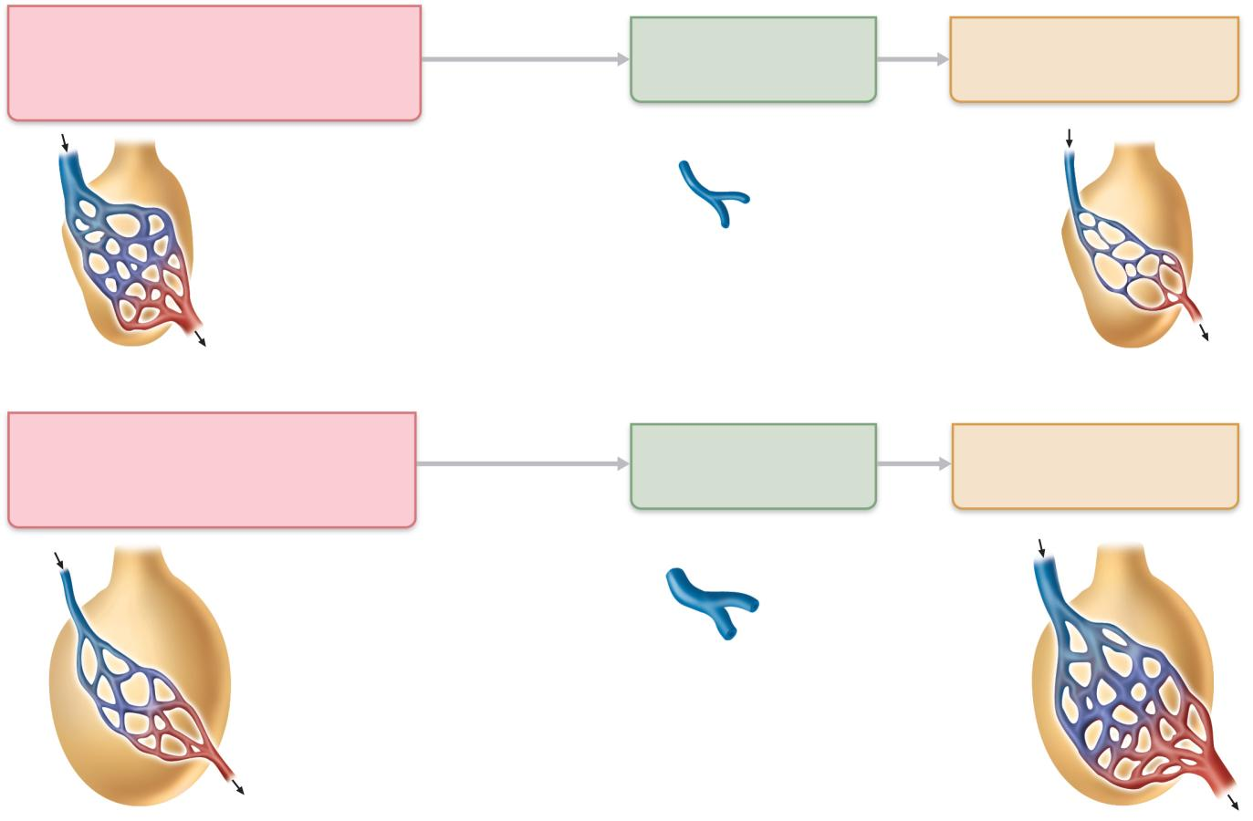
Mismatch of ventilation and
perfusion ventilation and/or
perfusion of alveoli causes local
P and P
O₂
autoregulates
arteriole
diameter
Pulmonary arterioles
serving these alveoli
constrict
Match of ventilation
and perfusion
ventilation, perfusion
CO₂
O₂
(a)
Mismatch of ventilation and
perfusion ventilation and/or
perfusion of alveoli causes local
P and P
O₂
autoregulates
arteriole
diameter
Pulmonary arterioles
serving these alveoli
dilate
Match of ventilation
and perfusion
ventilation, perfusion
CO₂
O₂
(b)
Figure 22.19

Slide 112
Thickness and Surface Area of the Respiratory Membrane
Respiratory membranes
0.5 to 1 μm thick
Large total surface area (40 times that of one’s skin)
Thicken if lungs become waterlogged and edematous, and gas exchange becomes inadequate
Reduction in surface area with emphysema, when walls of adjacent alveoli break down

Slide 113
Internal Respiration
Capillary gas exchange in body tissues
Partial pressures and diffusion gradients are reversed compared to external respiration
Po₂ in tissue is always lower than in systemic arterial blood
Po₂ of venous blood is 40 mm Hg and Pco₂ is 45 mm Hg

Slide 114
Inspired air:
P 160 mm Hg
P 0.3 mm Hg
Alveoli of lungs:
P 104 mm Hg
P 40 mm Hg
O₂
O₂
CO₂
CO₂
External
respiration
Pulmonary
arteries
Pulmonary
veins (P
100 mm Hg)
O₂
Blood leaving
tissues and
entering lungs:
P 40 mm Hg
P 45 mm Hg
Blood leaving
lungs and
entering tissue
capillaries:
P 100 mm Hg
P 40 mm Hg
O₂
O₂
CO₂
CO₂
Heart
Systemic
veins
Systemic
arteries
Internal
respiration
Tissues:
P less than 40 mm Hg
P greater than 45 mm Hg
O₂
CO₂
Figure 22.17

Slide 115
Transport of Respiratory Gases by Blood
Oxygen (O₂) transport
Carbon dioxide (CO₂) transport

Slide 116
O₂ Transport
Molecular O₂ is carried in the blood
1.5% dissolved in plasma
98.5% loosely bound to each Fe of hemoglobin (Hb) in RBCs
4 O₂ per Hb

Slide 117
O₂ and Hemoglobin
Oxyhemoglobin (HbO₂): hemoglobin-O₂ combination
Reduced hemoglobin (HHb): hemoglobin that has released O₂

Slide 118
O₂ and Hemoglobin
Loading and unloading of O₂ is facilitated by change in shape of Hb
As O₂ binds, Hb affinity for O₂ increases
As O₂ is released, Hb affinity for O₂ decreases
Fully (100%) saturated if all four heme groups carry O₂
Partially saturated when one to three hemes carry O₂

Slide 119
O₂ and Hemoglobin
Rate of loading and unloading of O₂ is regulated by
Po₂
Temperature
Blood pH
Pco₂
Concentration of BPG

Slide 120
Influence of Po₂ on Hemoglobin Saturation
Oxygen-hemoglobin dissociation curve
Hemoglobin saturation plotted against Po₂ is not linear
S-shaped curve
Shows how binding and release of O₂ is influenced by the Po₂

Slide 121
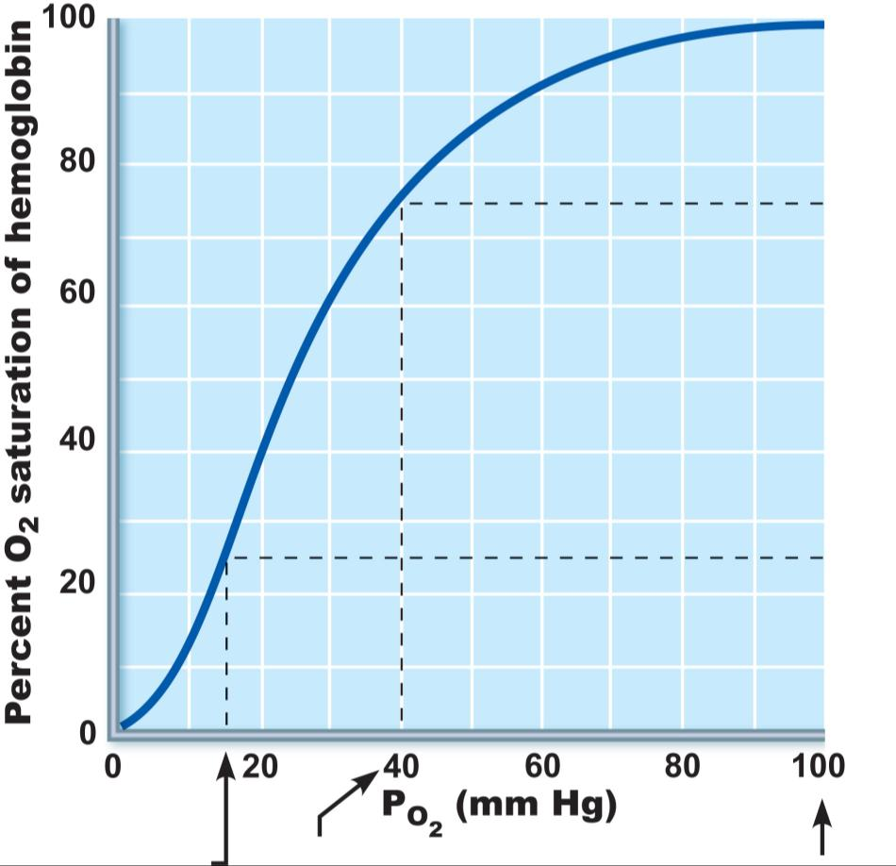
O₂ unloaded
to resting
tissues
Additional
O₂ unloaded
to exercising
tissues
Exercising
tissues
Resting
tissues
Lungs
Figure 22.20

Slide 122
Influence of Po₂ on Hemoglobin Saturation
In arterial blood
Po₂ = 100 mm Hg
Contains 20 ml oxygen per 100 ml blood (20 vol %)
Hb is 98% saturated
Further increases in Po₂ (e.g., breathing deeply) produce minimal increases in O₂ binding

Slide 123
Influence of Po₂ on Hemoglobin Saturation
In venous blood
Po₂ = 40 mm Hg
Contains 15 vol % oxygen
Hb is 75% saturated

Slide 124
Influence of Po₂ on Hemoglobin Saturation
Hemoglobin is almost completely saturated at a Po₂ of 70 mm Hg
Further increases in Po₂ produce only small increases in O₂ binding
O₂ loading and delivery to tissues is adequate when Po₂ is below normal levels

Slide 125
Influence of Po₂ on Hemoglobin Saturation
Only 20–25% of bound O₂ is unloaded during one systemic circulation
If O₂ levels in tissues drop:
More oxygen dissociates from hemoglobin and is used by cells
Respiratory rate or cardiac output need not increase

Slide 126
O₂ unloaded
to resting
tissues
Additional
O₂ unloaded
to exercising
tissues
Exercising
tissues
Resting
tissues
Lungs
Figure 22.20

Slide 127
Other Factors Influencing Hemoglobin Saturation
Increases in temperature, H⁺, Pco₂, and BPG
Modify the structure of hemoglobin and decrease its affinity for O₂
Occur in systemic capillaries
Enhance O₂ unloading
Shift the O₂-hemoglobin dissociation curve to the right
Decreases in these factors shift the curve to the left

Slide 128
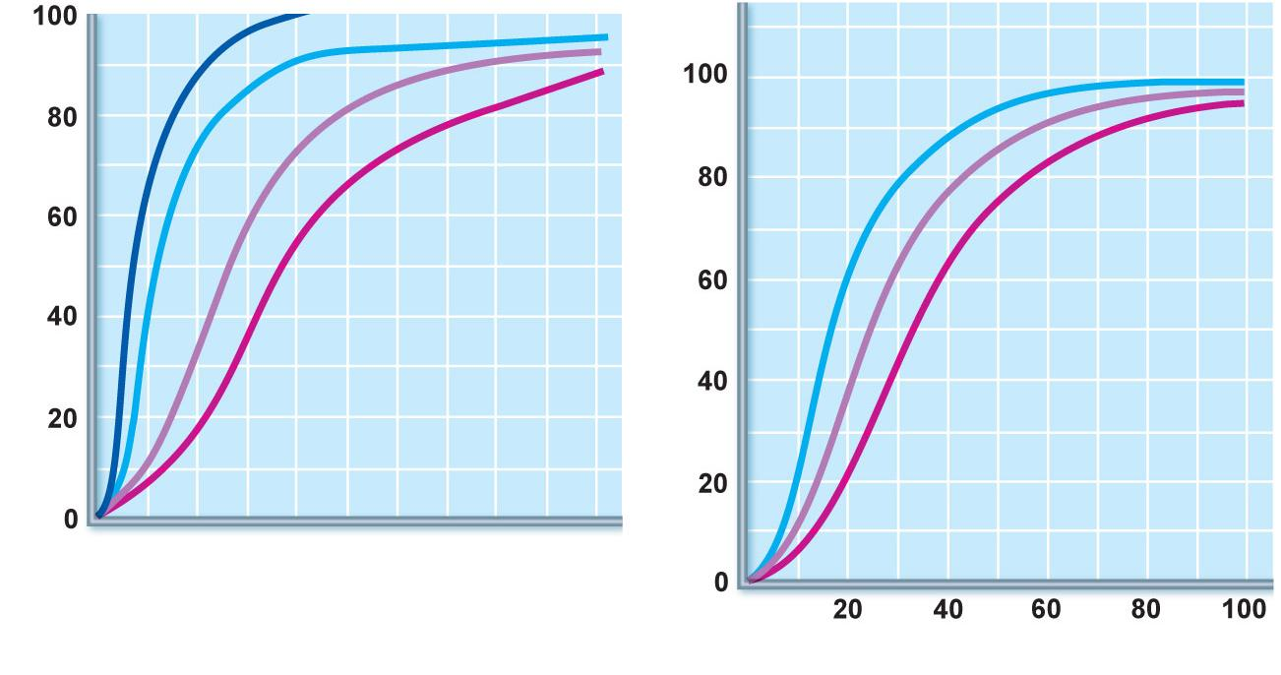
10°C
Decreased carbon dioxide
(P 20 mm Hg) or H⁺ (pH 7.6)
CO₂
20°C
38°C
43°C
Normal arterial
carbon dioxide
(P 40 mm Hg)
or H⁺ (pH 7.4)
CO₂
Normal body
temperature
Increased carbon dioxide
(P 80 mm Hg)
or H⁺ (pH 7.2)
CO₂
(a)
P (mm Hg)
(b)
O₂
Figure 22.21

Slide 129
Factors that Increase Release of O₂ by Hemoglobin
As cells metabolize glucose
Pco₂ and H⁺ increase in concentration in capillary blood
Declining pH weakens the hemoglobin-O₂ bond (Bohr effect)
Heat production increases
Increasing temperature directly and indirectly decreases Hb affinity for O₂

Slide 130
Homeostatic Imbalance
Hypoxia
Inadequate O₂ delivery to tissues
Due to a variety of causes
Too few RBCs
Abnormal or too little Hb
Blocked circulation
Metabolic poisons
Pulmonary disease
Carbon monoxide

Slide 131
CO₂ Transport
CO₂ is transported in the blood in three forms
7 to 10% dissolved in plasma
20% bound to globin of hemoglobin (carbaminohemoglobin)
70% transported as bicarbonate ions (HCO₃–) in plasma

Slide 132
Transport and Exchange of CO₂
CO₂ combines with water to form carbonic acid (H₂CO₃), which quickly dissociates:
Most of the above occurs in RBCs, where carbonic anhydrase reversibly and rapidly catalyzes the reaction
CO₂ | + | H₂O | ↔ | H₂CO₃ | ↔ | H⁺ | + | HCO₃–
Carbon dioxide |  | Water |  | Carbonic acid |  | Hydrogen ion |  | Bicarbonate ion

Slide 133
Transport and Exchange of CO₂
In systemic capillaries
HCO₃– quickly diffuses from RBCs into the plasma
The chloride shift occurs: outrush of HCO₃– from the RBCs is balanced as Cl– moves in from the plasma

Slide 134
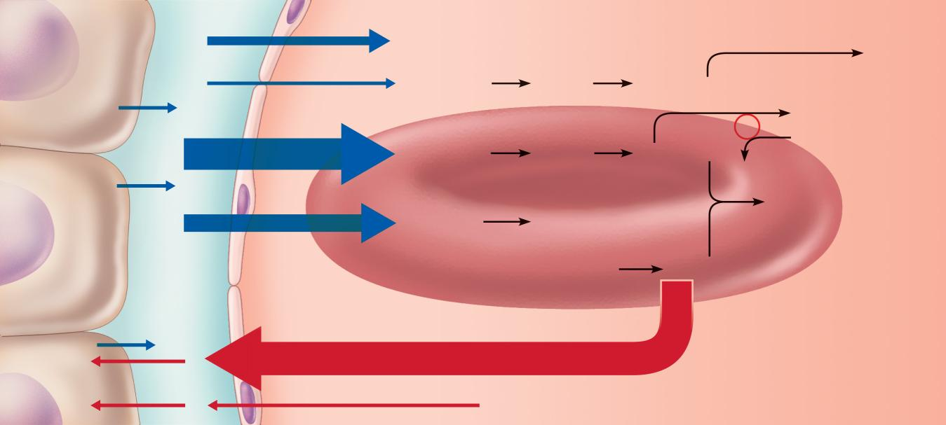
Tissue cell
Interstitial fluid
CO₂
CO₂ (dissolved in plasma)
Binds to
plasma
proteins
CO₂
CO₂ + H₂O
Slow
H₂CO₃
HCO₃– + H⁺
CO₂
HCO₃–
Chloride
shift
(in) via
transport
protein
CO₂
Fast
Cl–
CO₂ + H₂O
H₂CO₃
HCO₃– + H⁺
CO₂
Carbonic
anhydrase
Cl–
HHb
CO₂
CO₂ + Hb
HbCO₂
(Carbamino-
hemoglobin)
Red blood cell
HbO₂
O₂ + Hb
CO₂
O₂
O₂
O₂ (dissolved in plasma)
Blood plasma
(a) Oxygen release and carbon dioxide pickup at the tissues
Figure 22.22a

Slide 135
Transport and Exchange of CO₂
In pulmonary capillaries
HCO₃– moves into the RBCs and binds with H⁺ to form H₂CO₃
H₂CO₃ is split by carbonic anhydrase into CO₂ and water
CO₂ diffuses into the alveoli

Slide 136
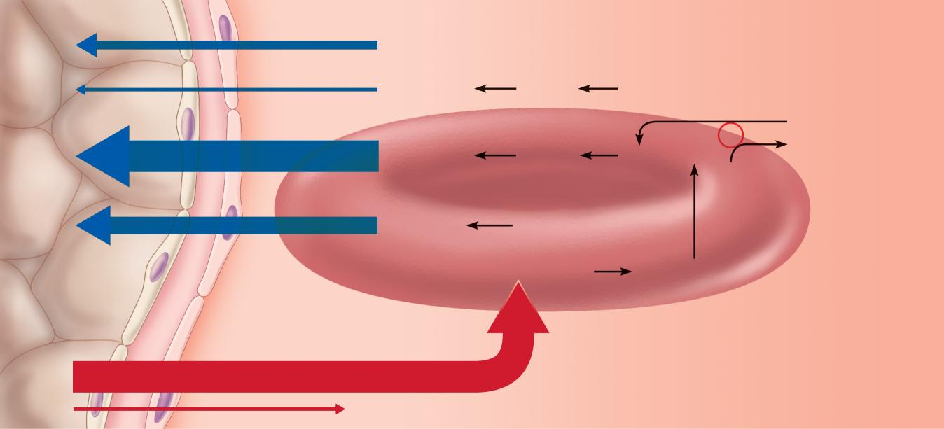
Alveolus
Fused basement membranes
CO₂
CO₂ (dissolved in plasma)
CO₂
CO₂ + H₂O
Slow
H₂CO₃
HCO₃– + H⁺
HCO₃–
Chloride
shift
(out) via
transport
protein
CO₂
CO₂ + H₂O
Fast
H₂CO₃
HCO₃– + H⁺
Cl–
Carbonic
anhydrase
Cl–
CO₂
CO₂ + Hb
HbCO₂
(Carbamino-
hemoglobin)
Red blood cell
O₂ + HHb
HbO₂ + H⁺
O₂
O₂
O₂ (dissolved in plasma)
Blood plasma
(b) Oxygen pickup and carbon dioxide release in the lungs
Figure 22.22b

Slide 137
Haldane Effect
The amount of CO₂ transported is affected by the Po₂
The lower the Po₂ and hemoglobin saturation with O₂, the more CO₂ can be carried in the blood

Slide 138
Haldane Effect
At the tissues, as more carbon dioxide enters the blood
More oxygen dissociates from hemoglobin (Bohr effect)
As HbO₂ releases O₂, it more readily forms bonds with CO₂ to form carbaminohemoglobin

Slide 139
Influence of CO₂ on Blood pH
HCO₃– in plasma is the alkaline reserve of the carbonic acid–bicarbonate buffer system
If H⁺ concentration in blood rises, excess H⁺ is removed by combining with HCO₃–
If H⁺ concentration begins to drop, H₂CO₃ dissociates, releasing H⁺

Slide 140
Influence of CO₂ on Blood pH
Changes in respiratory rate can also alter blood pH
For example, slow shallow breathing allows CO₂ to accumulate in the blood, causing pH to drop
Changes in ventilation can be used to adjust pH when it is disturbed by metabolic factors

Slide 141
Control of Respiration
Involves neurons in the reticular formation of the medulla and pons

Slide 142
Medullary Respiratory Centers
Dorsal respiratory group (DRG)
Near the root of cranial nerve IX
Integrates input from peripheral stretch and chemoreceptors

Slide 143
Medullary Respiratory Centers
2. Ventral respiratory group (VRG)
Rhythm-generating and integrative center
Sets eupnea (12–15 breaths/minute)
Inspiratory neurons excite the inspiratory muscles via the phrenic and intercostal nerves
Expiratory neurons inhibit the inspiratory neurons

Slide 144
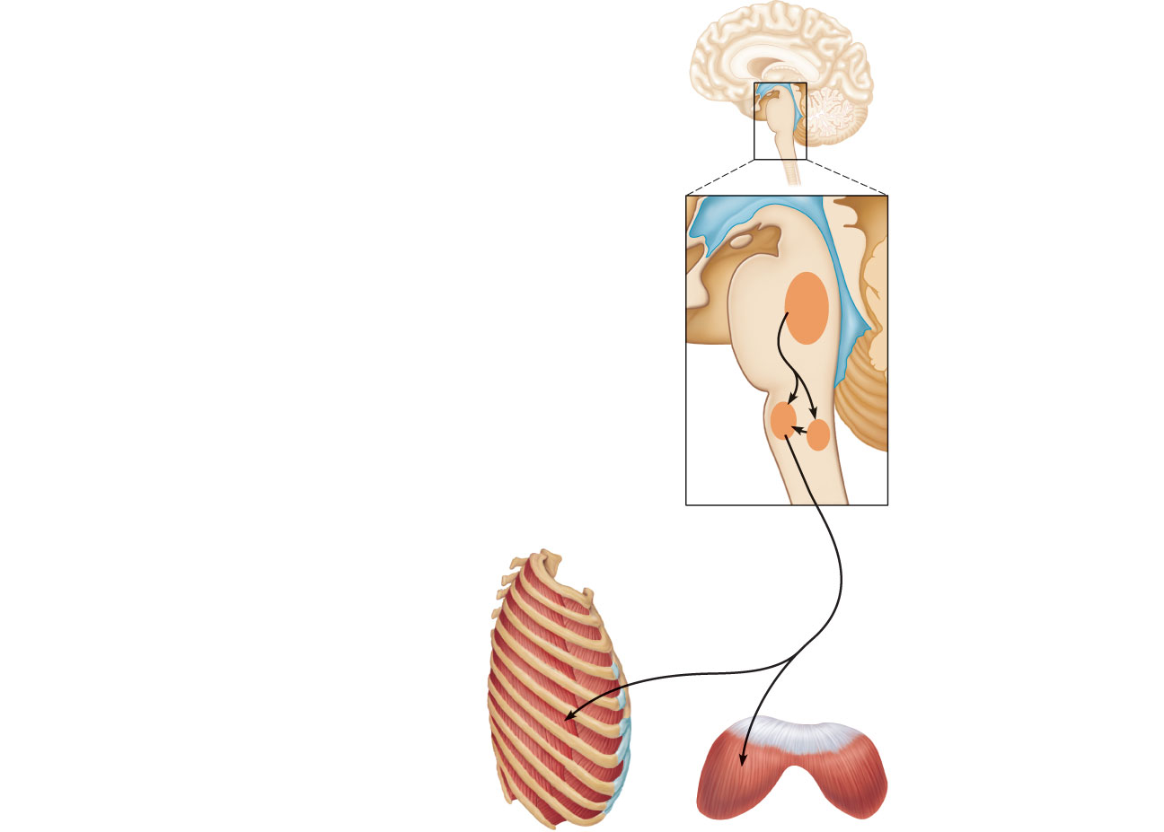
Pons
Medulla
Pontine respiratory centers
interact with the medullary
respiratory centers to smooth
the respiratory pattern.
Ventral respiratory group (VRG)
contains rhythm generators
whose output drives respiration.
Pons
Medulla
Dorsal respiratory group (DRG)
integrates peripheral sensory
input and modifies the rhythms
generated by the VRG.
To inspiratory
muscles
Diaphragm
External
intercostal
muscles
Figure 22.23

Slide 145
Pontine Respiratory Centers
Influence and modify activity of the VRG
Smooth out transition between inspiration and expiration and vice versa

Slide 146
Genesis of the Respiratory Rhythm
Not well understood
Most widely accepted hypothesis
Reciprocal inhibition of two sets of interconnected neuronal networks in the medulla sets the rhythm

Slide 147
Depth and Rate of Breathing
Depth is determined by how actively the respiratory center stimulates the respiratory muscles
Rate is determined by how long the inspiratory center is active
Both are modified in response to changing body demands

Slide 148
Chemical Factors
Influence of Pco₂:
If Pco₂ levels rise (hypercapnia), CO₂ accumulates in the brain
CO₂ is hydrated; resulting carbonic acid dissociates, releasing H⁺
H⁺ stimulates the central chemoreceptors of the brain stem
Chemoreceptors synapse with the respiratory regulatory centers, increasing the depth and rate of breathing

Slide 149
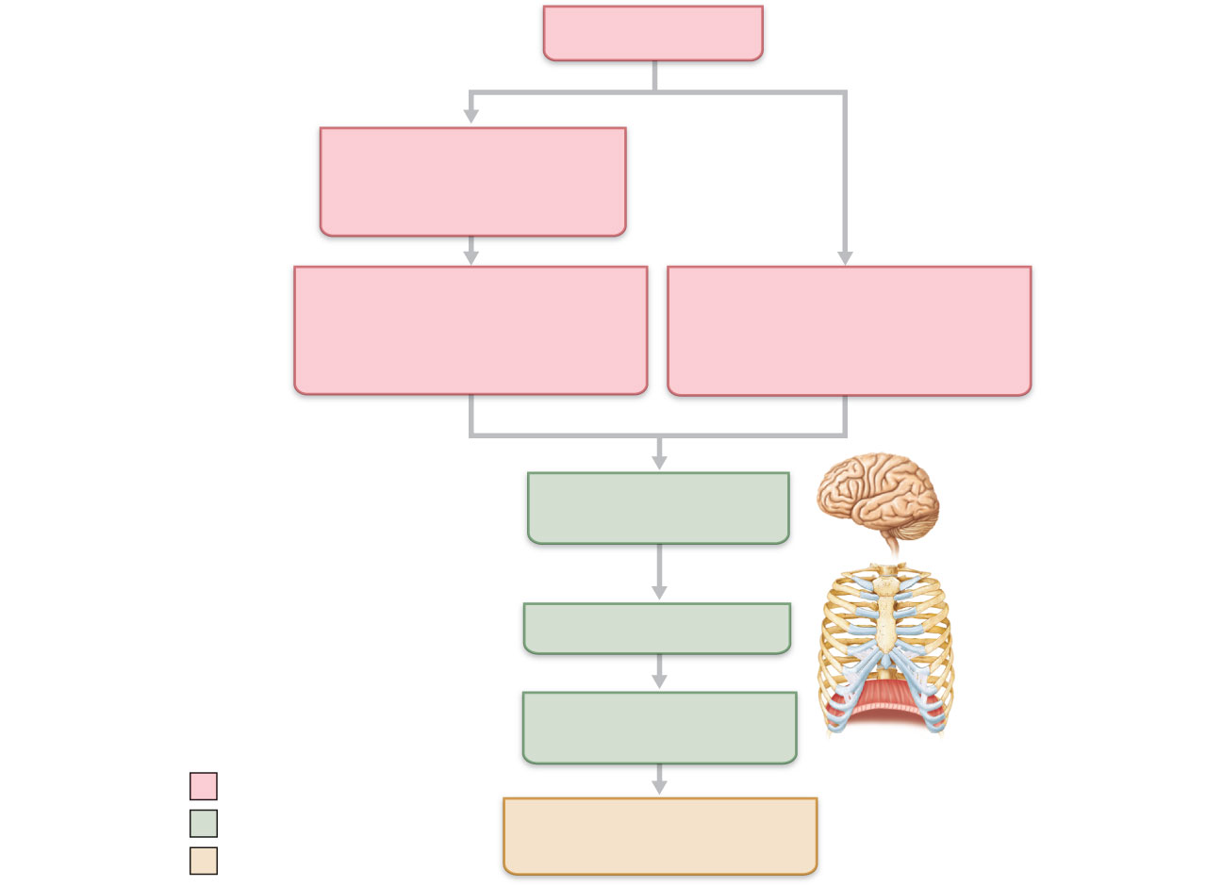
Arterial P
CO₂
P decreases pH in
brain extracellular
fluid (ECF)
CO₂
Central chemoreceptors
in medulla respond to H⁺
in brain ECF (mediate 70%
of the CO₂ response)
Peripheral chemoreceptors
in carotid and aortic bodies
(mediate 30% of the CO₂
response)
Afferent impulses
Medullary
respiratory centers
Efferent impulses
Respiratory muscle
Ventilation
(more CO₂ exhaled)
Initial stimulus
Physiological response
Arterial P and pH
return to normal
CO₂
Result
Figure 22.25

Slide 150
Depth and Rate of Breathing
Hyperventilation: increased depth and rate of breathing that exceeds the body’s need to remove CO₂
Causes CO₂ levels to decline (hypocapnia)
May cause cerebral vasoconstriction and cerebral ischemia
Apnea: period of breathing cessation that occurs when Pco₂ is abnormally low

Slide 151
Chemical Factors
Influence of Po₂
Peripheral chemoreceptors in the aortic and carotid bodies are O₂ sensors
When excited, they cause the respiratory centers to increase ventilation
Substantial drops in arterial Po₂ (to 60 mm Hg) must occur in order to stimulate increased ventilation

Slide 152
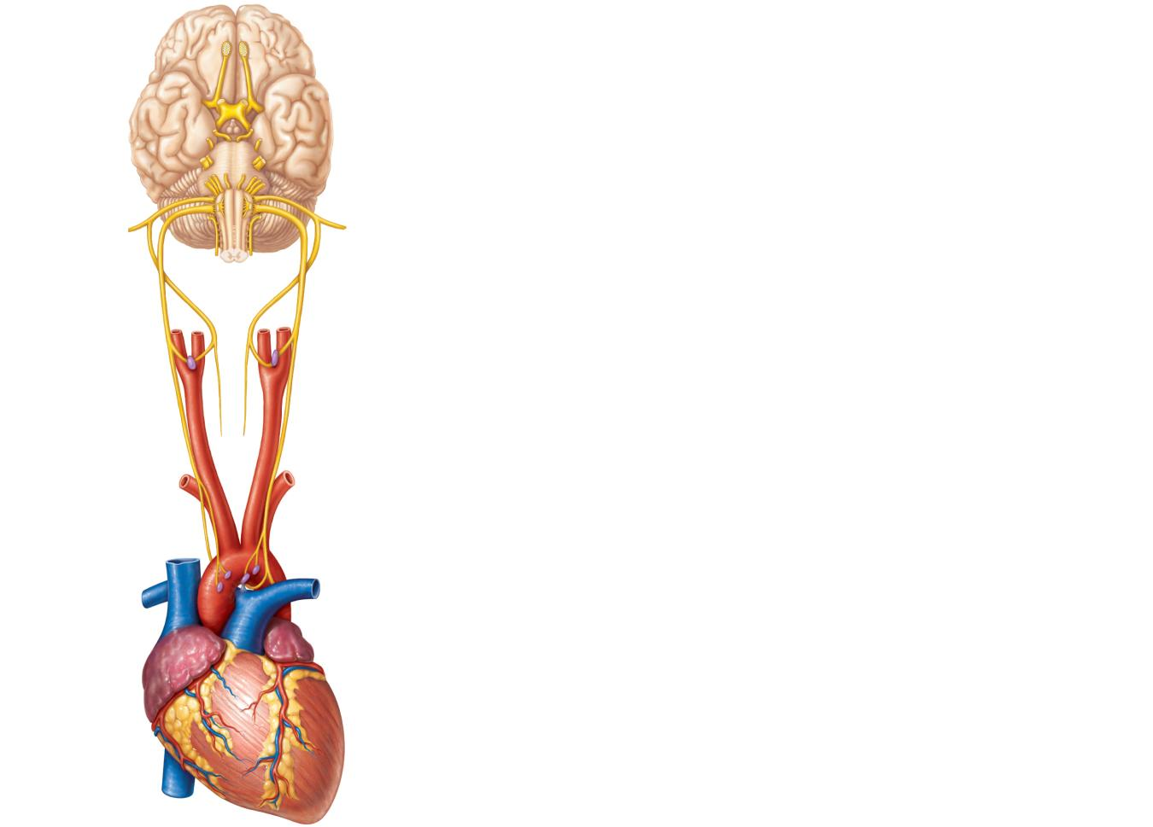
Brain
Sensory nerve fiber in cranial nerve IX
(pharyngeal branch of glossopharyngeal)
External carotid artery
Internal carotid artery
Carotid body
Common carotid artery
Cranial nerve X (vagus nerve)
Sensory nerve fiber in
cranial nerve X
Aortic bodies in aortic arch
Aorta
Heart
Figure 22.26

Slide 153
Chemical Factors
Influence of arterial pH
Can modify respiratory rate and rhythm even if CO₂ and O₂ levels are normal
Decreased pH may reflect
CO₂ retention
Accumulation of lactic acid
Excess ketone bodies in patients with diabetes mellitus
Respiratory system controls will attempt to raise the pH by increasing respiratory rate and depth

Slide 154
Summary of Chemical Factors
Rising CO₂ levels are the most powerful respiratory stimulant
Normally blood Po₂ affects breathing only indirectly by influencing peripheral chemoreceptor sensitivity to changes in Pco₂

Slide 155
Summary of Chemical Factors
When arterial Po₂ falls below 60 mm Hg, it becomes the major stimulus for respiration (via the peripheral chemoreceptors)
Changes in arterial pH resulting from CO₂ retention or metabolic factors act indirectly through the peripheral chemoreceptors

Slide 156
Influence of Higher Brain Centers
Hypothalamic controls act through the limbic system to modify rate and depth of respiration
Example: breath holding that occurs in anger or gasping with pain
A rise in body temperature acts to increase respiratory rate
Cortical controls are direct signals from the cerebral motor cortex that bypass medullary controls
Example: voluntary breath holding

Slide 157
Pulmonary Irritant Reflexes
Receptors in the bronchioles respond to irritants
Promote reflexive constriction of air passages
Receptors in the larger airways mediate the cough and sneeze reflexes

Slide 158
Inflation Reflex
Hering-Breuer Reflex
Stretch receptors in the pleurae and airways are stimulated by lung inflation
Inhibitory signals to the medullary respiratory centers end inhalation and allow expiration to occur
Acts more as a protective response than a normal regulatory mechanism

Slide 159
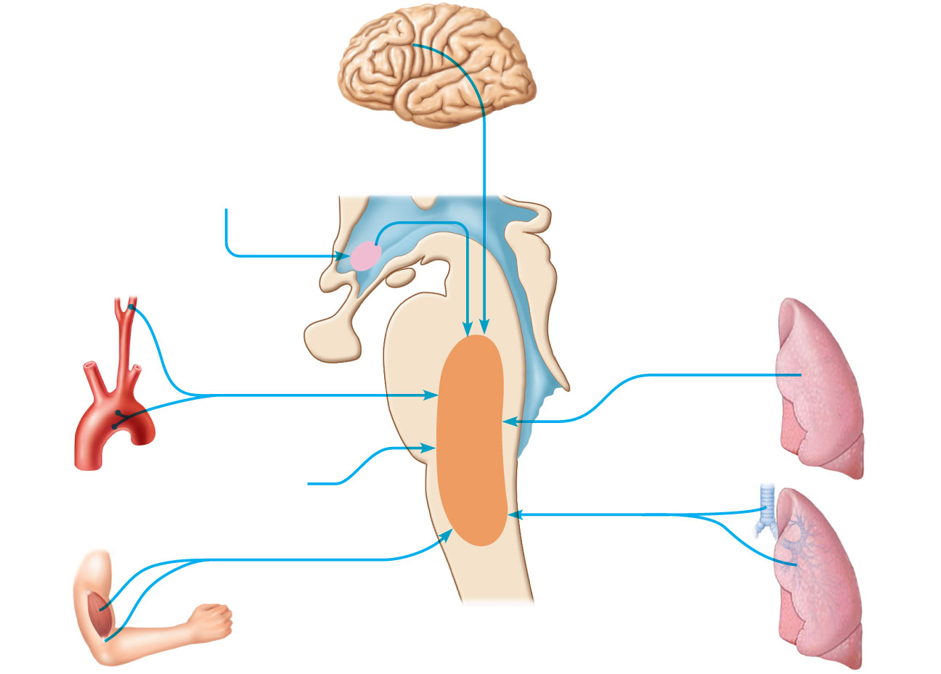
Higher brain centers
(cerebral cortex—voluntary
control over breathing)
Other receptors (e.g., pain)
and emotional stimuli acting
through the hypothalamus
+
–
+
–
Respiratory centers
(medulla and pons)
Peripheral
chemoreceptors
O₂ , CO₂ , H⁺
+
+
–
Stretch receptors
in lungs
Central
Chemoreceptors
CO₂ , H⁺
–
+
Irritant
receptors
Receptors in
muscles and joints
Figure 22.24

Slide 160
Respiratory Adjustments: Exercise
Adjustments are geared to both the intensity and duration of exercise
Hyperpnea
Increase in ventilation (10 to 20 fold) in response to metabolic needs
Pco₂, Po₂, and pH remain surprisingly constant during exercise

Slide 161
Respiratory Adjustments: Exercise
Three neural factors cause increase in ventilation as exercise begins
Psychological stimuli—anticipation of exercise
Simultaneous cortical motor activation of skeletal muscles and respiratory centers
Exictatory impulses reaching respiratory centers from

Slide 162
Respiratory Adjustments: Exercise
As exercise ends
Ventilation declines suddenly as the three neural factors shut off

Slide 163
Respiratory Adjustments: High Altitude
Quick travel to altitudes above 8000 feet may produce symptoms of acute mountain sickness (AMS)
Headaches, shortness of breath, nausea, and dizziness
In severe cases, lethal cerebral and pulmonary edema

Slide 164
Acclimatization to High Altitude
Acclimatization: respiratory and hematopoietic adjustments to altitude
Chemoreceptors become more responsive to Pco₂ when Po₂ declines
Substantial decline in Po₂ directly stimulates peripheral chemoreceptors
Result: minute ventilation increases and stabilizes in a few days to 2–3 L/min higher than at sea level

Slide 165
Acclimatization to High Altitude
Decline in blood O₂ stimulates the kidneys to accelerate production of EPO
RBC numbers increase slowly to provide long-term compensation

Slide 166
Homeostatic Imbalances
Chronic obstructive pulmonary disease (COPD)
Exemplified by chronic bronchitis and emphysema
Irreversible decrease in the ability to force air out of the lungs
Other common features
History of smoking in 80% of patients
Dyspnea: labored breathing (“air hunger”)
Coughing and frequent pulmonary infections
Most victims develop respiratory failure (hypoventilation) accompanied by respiratory acidosis

Slide 167
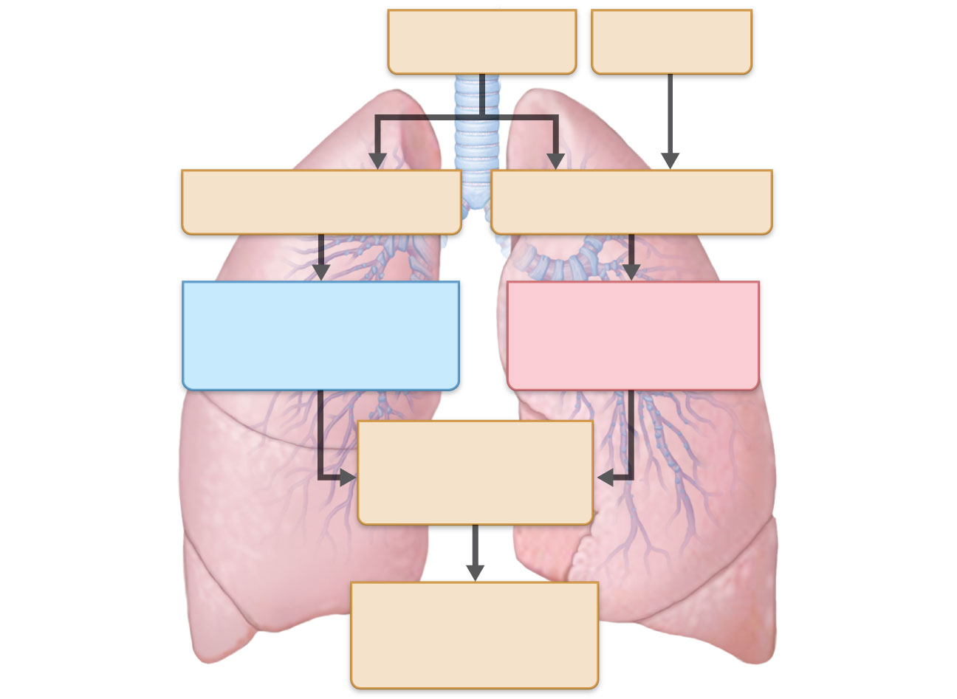
• Tobacco smoke
• Air pollution
α-1 antitrypsin
deficiency
Continual bronchial
irritation and inflammation
Breakdown of elastin in
connective tissue of lungs
Chronic bronchitis
Bronchial edema,
chronic productive cough,
bronchospasm
Emphysema
Destruction of alveolar
walls, loss of lung
elasticity, air trapping
• Airway obstruction
or air trapping
• Dyspnea
• Frequent infections
• Abnormal ventilation-
perfusion ratio
• Hypoxemia
• Hypoventilation
Figure 22.27

Slide 168
Homeostatic Imbalances
Asthma
Characterized by coughing, dyspnea, wheezing, and chest tightness
Active inflammation of the airways precedes bronchospasms
Airway inflammation is an immune response caused by release of interleukins, production of IgE, and recruitment of inflammatory cells
Airways thickened with inflammatory exudate magnify the effect of bronchospasms

Slide 169
Homeostatic Imbalances
Tuberculosis
Infectious disease caused by the bacterium Mycobacterium tuberculosis
Symptoms include fever, night sweats, weight loss, a racking cough, and spitting up blood
Treatment entails a 12-month course of antibiotics

Slide 170
Homeostatic Imbalances
Lung cancer
Leading cause of cancer deaths in North America
90% of all cases are the result of smoking
The three most common types
Squamous cell carcinoma (20–40% of cases) in bronchial epithelium
Adenocarcinoma (~40% of cases) originates in peripheral lung areas
Small cell carcinoma (~20% of cases) contains lymphocyte-like cells that originate in the primary bronchi and subsequently metastasize

Slide 171
Developmental Aspects
Olfactory placodes invaginate into olfactory pits by the fourth week
Laryngotracheal buds are present by the fifth week
Mucosae of the bronchi and lung alveoli are present by the eighth week

Slide 172
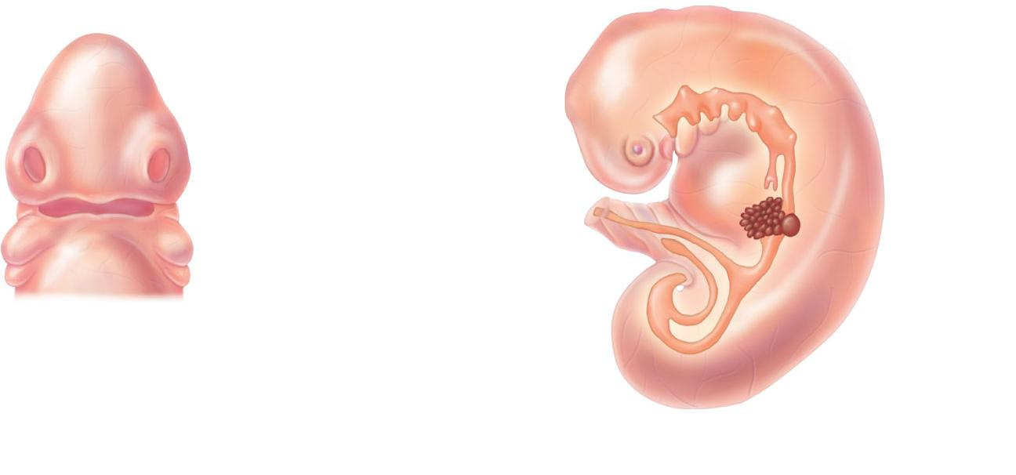
Future mouth
Pharynx
Frontonasal
elevation
Eye
Olfactory
placode
Foregut
Olfactory
placode
Stomodeum
(future mouth)
Esophagus
Trachea
Liver
Laryngotracheal
bud
Bronchial
buds
(a) 4 weeks: anterior
superficial view of
the embryo’s head
(b) 5 weeks: left lateral view of the developing lower
respiratory passageway mucosae
Figure 22.28

Slide 173
Developmental Aspects
By the 28th week, a baby born prematurely can breathe on its own
During fetal life, the lungs are filled with fluid and blood bypasses the lungs
Gas exchange takes place via the placenta

Slide 174
Developmental Aspects
At birth, respiratory centers are activated, alveoli inflate, and lungs begin to function
Respiratory rate is highest in newborns and slows until adulthood
Lungs continue to mature and more alveoli are formed until young adulthood
Respiratory efficiency decreases in old age

