Slide 1
Digestive System
Two groups of organs
1. Alimentary canal (gastrointestinal or GI tract)
Extends from mouth to anus
Digests food and absorbs fragments
Mouth, pharynx, esophagus, stomach, small intestine, and large intestine

Slide 2
Digestive System
2. Accessory digestive organs
Teeth, tongue, gallbladder
Digestive glands
Salivary glands
Liver
Pancreas

Slide 3
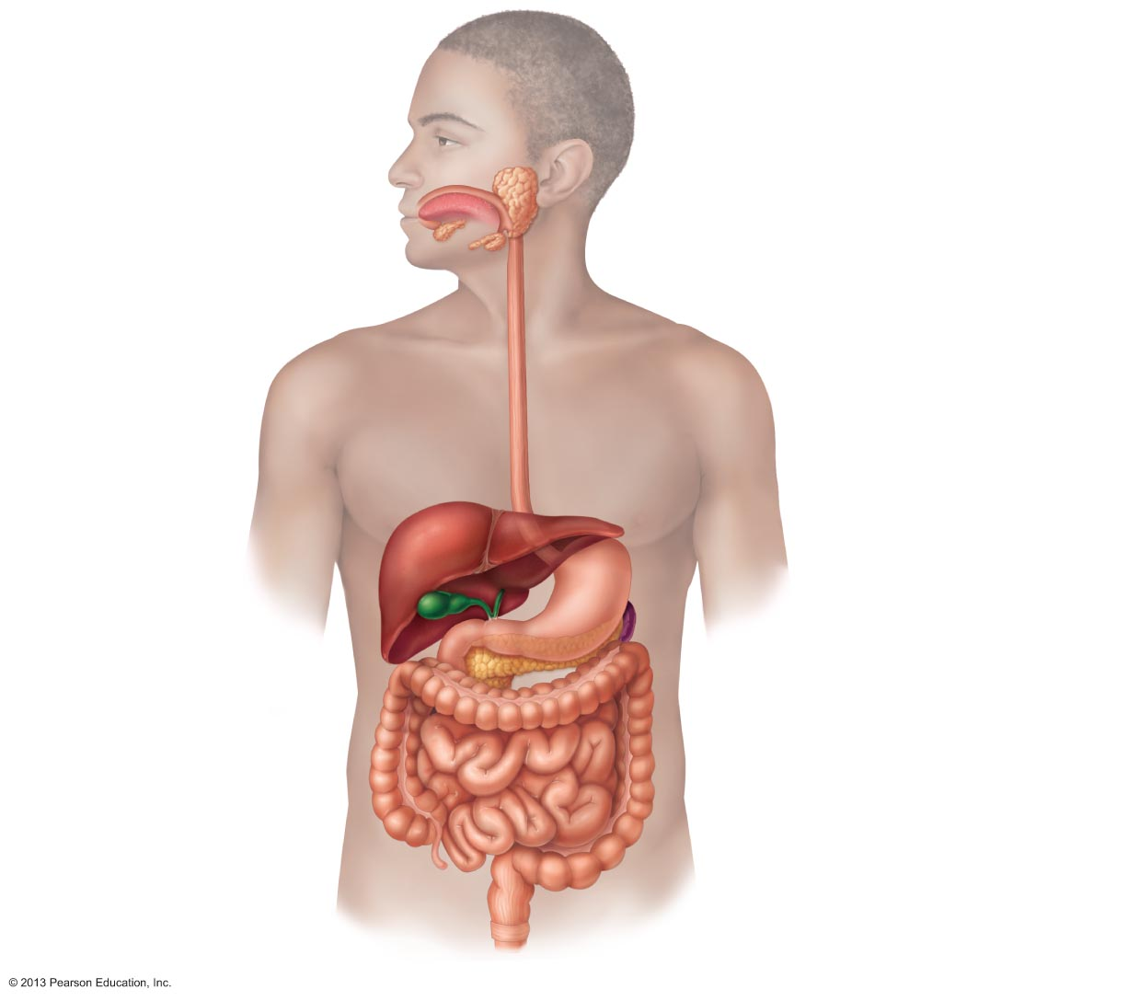
Figure 23.1 Alimentary canal and related accessory digestive organs.
Mouth (oral cavity)
Salivary
glands*
Tongue*
Esophagus
Pharynx
Stomach
Liver*
Pancreas*
Gallbladder*
Small
intestine
Large
intestine
Anus
Anal canal

Slide 4
Please note that due to differing operating systems, some animations will not appear until the presentation is viewed in Presentation Mode (Slide Show view). You may see blank slides in the “Normal” or “Slide Sorter” views. All animations will appear after viewing in Presentation Mode and playing each animation. Most animations will require the latest version of the Flash Player, which is available at http://get.adobe.com/flashplayer.
Notes:
DigestionOverview

Slide 5
Digestive Processes
Six essential activities
Ingestion
Propulsion
Mechanical breakdown
Digestion
Absorption
Defecation

Slide 6
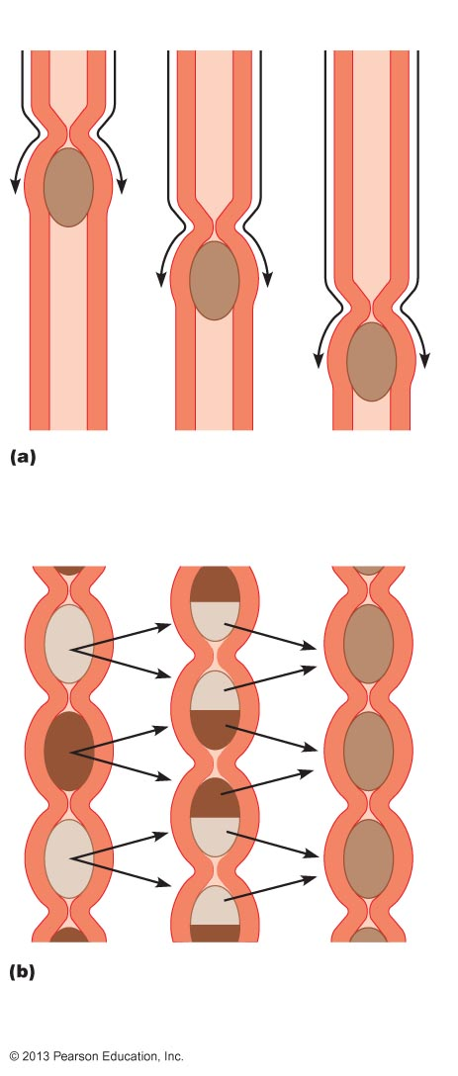
Figure 23.3 Peristalsis and segmentation.
From
mouth
Peristalsis: Adjacent segments of alimentary tract organs alternately contract and relax, moving food along the tract distally.
Segmentation: Nonadjacent segments of alimentary tract organs alternately contract and relax, moving food forward then backward.
Food mixing and slow food propulsion occur.

Slide 7
GI Tract Regulatory Mechanisms
Mechanoreceptors and chemoreceptors
Respond to
Stretch
changes in osmolarity
pH
presence of substrate
end products of digestion
Initiate reflexes that
Activate or inhibit digestive glands
Stimulate smooth muscle to mix and move lumen contents

Slide 8
GI Tract Regulatory Mechanisms
Intrinsic and extrinsic controls
Short reflexes
enteric nerve plexuses (gut brain) respond to stimuli in GI tract
Long reflexes
respond to stimuli inside or outside GI tract
involve CNS centers and autonomic nerves

Slide 9
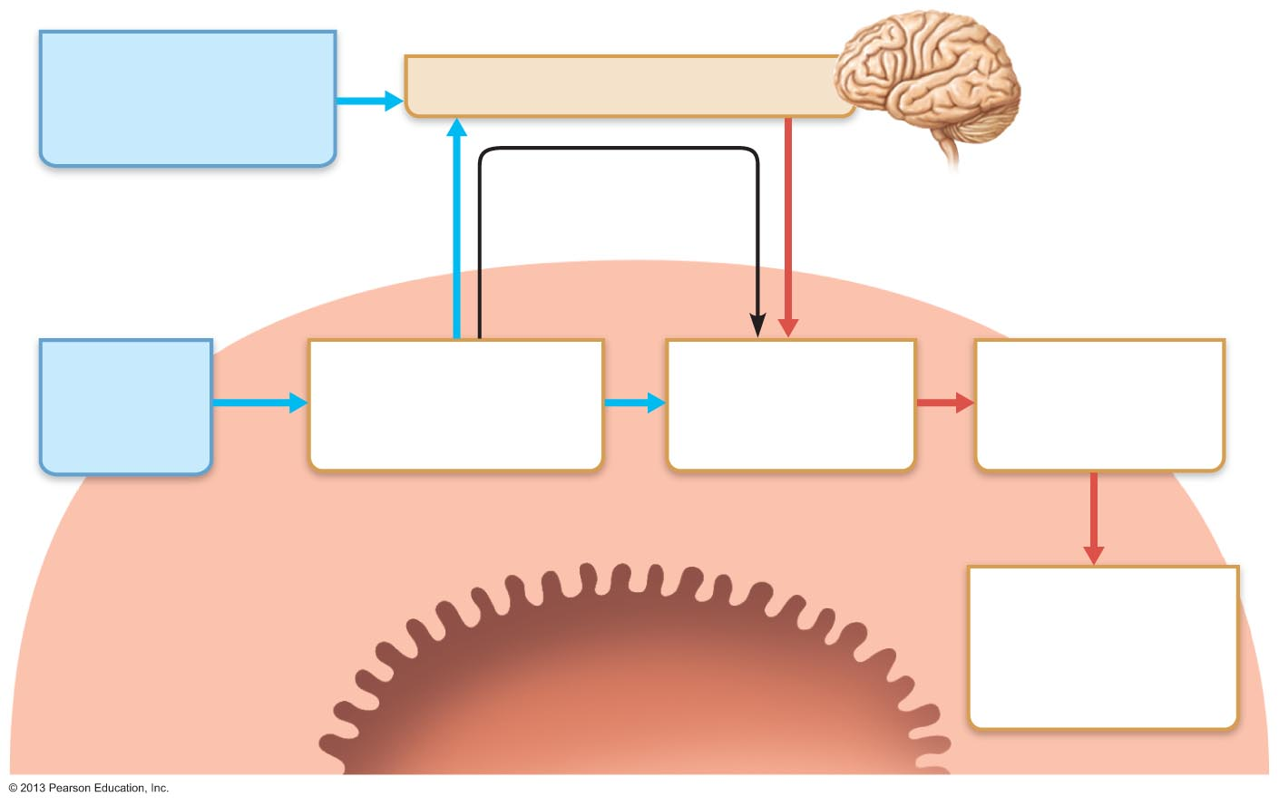
Figure 23.4 Neural reflex pathways initiated by stimuli inside or outside the gastrointestinal tract.
External stimuli
(sight, smell, taste,
thought of food)
Central nervous system
Long reflexes
Visceral afferents
Extrinsic visceral (autonomic)
efferents
Internal
(GI tract)
stimuli
Chemoreceptors,
osmoreceptors, or
mechanoreceptors
Local (intrinsic)
nerve plexus
("gut brain")
Effectors:
Smooth muscle
or glands
Short reflexes
Gastrointestinal
wall (site of short
reflexes)
Response:
Change in
contractile or
secretory activity
Lumen of the
alimentary canal

Slide 10
Peritoneum and Peritoneal Cavity
Peritoneum
serous membrane of abdominal cavity
Visceral peritoneum
external surface of most digestive organs
Parietal peritoneum
lines body wall
Peritoneal cavity
Between two peritoneums
Fluid lubricates mobile organs

Slide 11
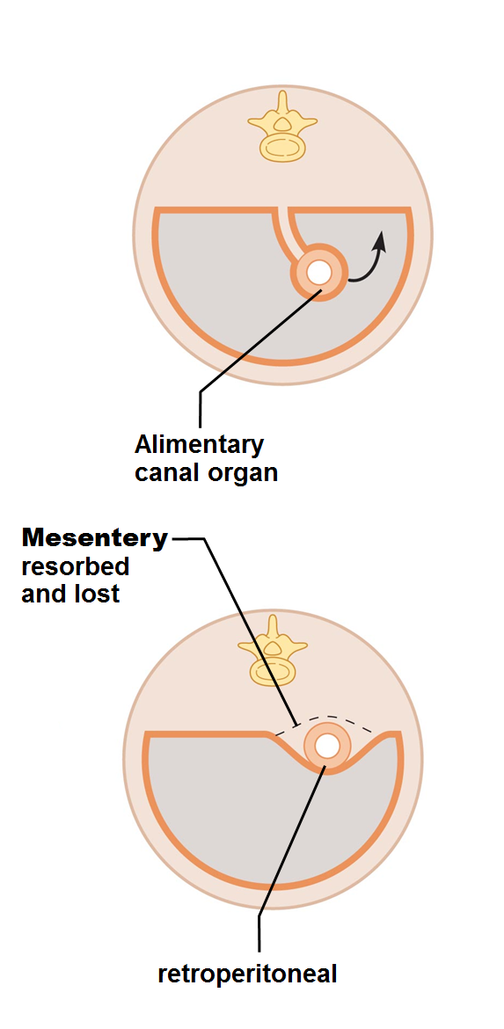
Peritoneum and Peritoneal Cavity
Mesentery
double layer of peritoneum
Routes for blood vessels, lymphatics, and nerves
Holds organs in place; stores fat
Intraperitoneal (peritoneal) organs surrounded by peritoneum
Retroperitoneal organs posterior to peritoneum

Slide 12
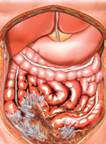
Homeostatic Imbalance
Peritonitis
Inflammation of peritoneum
Caused by
piercing abdominal wound
perforating ulcer
ruptured appendix
Peritoneal coverings stick together, localizing infection
Dangerous and lethal if widespread
Treated with debris removal and antibiotics

Slide 13
Histology of the Alimentary Canal
Four basic layers (tunics)
Mucosa
Submucosa
Muscularis externa
Serosa

Slide 14
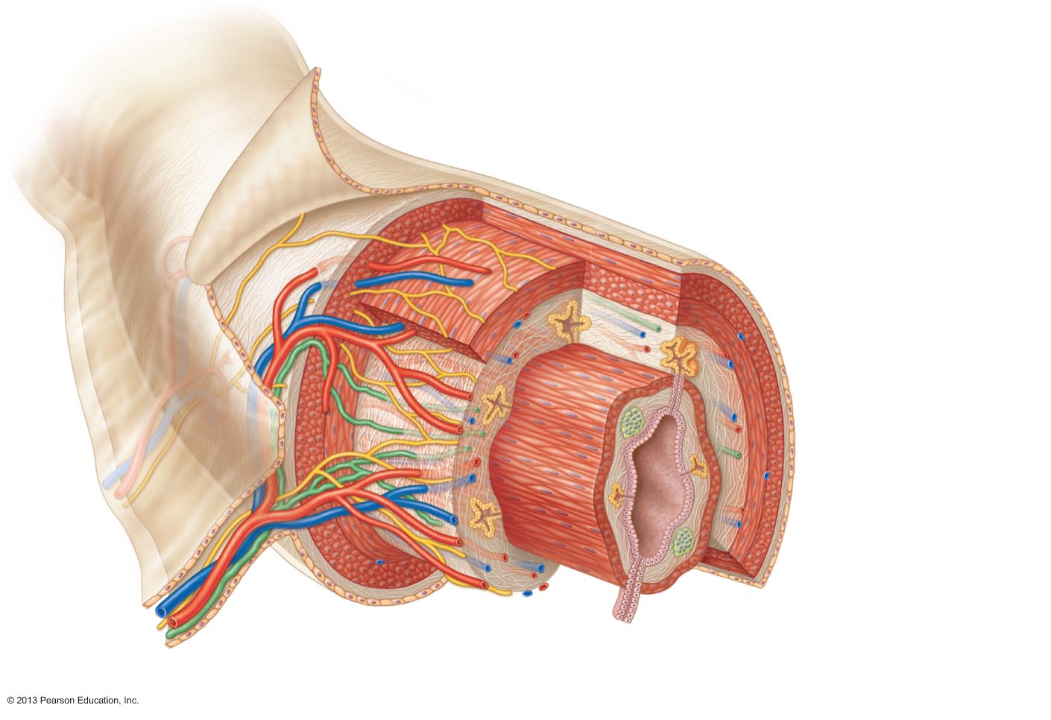
Figure 23.6 Basic structure of the alimentary canal.
Glands in
submucosa
Mucosa
Epithelium
Lamina propria
Muscularis
mucosae
Submucosa
Muscularis externa
Longitudinal muscle
Circular muscle
Serosa
Gland in mucosa
Lumen
Mucosa-associated
lymphoid tissue
Mesentery

Slide 15
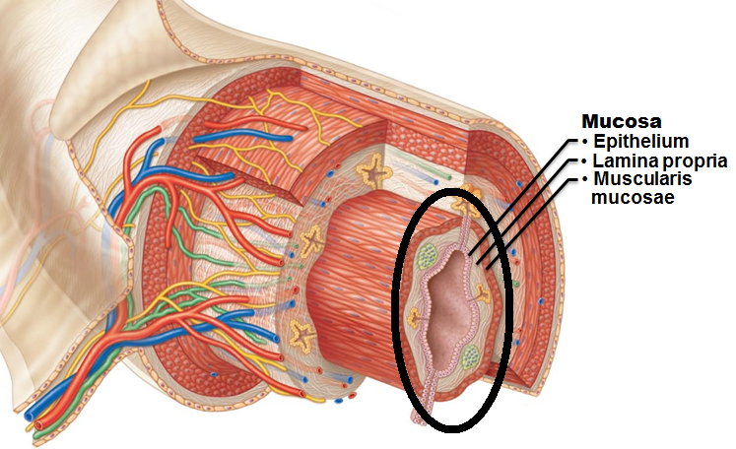
Mucosa
Lines lumen
Functions
Secretes
Mucus
digestive enzymes
hormones
Absorbs end products of digestion
Protects against infectious disease
Three sublayers:
Epithelium
lamina propria
muscularis mucosae

Slide 16
Mucosa
Epithelium
Simple columnar epithelium and mucus-secreting cells (most of tract)
Mucus
Protects digestive organs from enzymes
Eases food passage
May secrete enzymes and hormones
in stomach and small intestine

Slide 17
Mucosa
Lamina propria
Loose areolar connective tissue
Capillaries for nourishment and absorption
Lymphoid follicles (part of MALT)
Defend against microorganisms
Muscularis mucosae: smooth muscle → local movements of mucosa

Slide 18
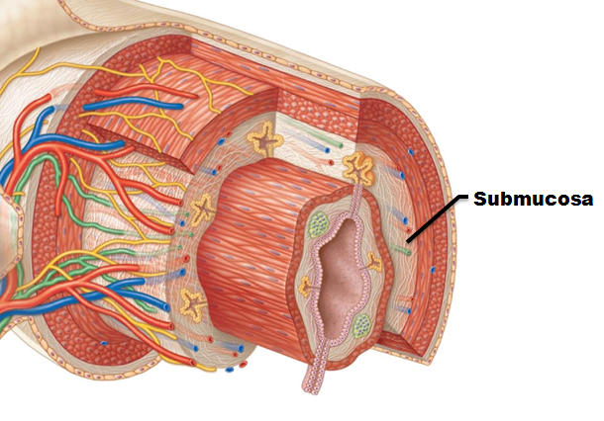
Submucosa
Submucosa
Areolar connective tissue
Blood and lymphatic vessels, lymphoid follicles, and submucosal nerve plexus

Slide 19
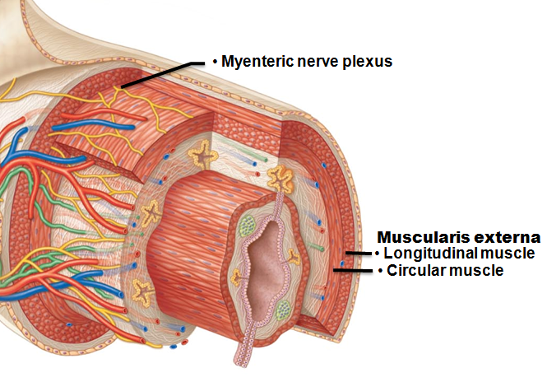
Muscularis Externa
Muscularis externa
Responsible for segmentation and peristalsis
Inner circular and outer longitudinal layers
Circular layer thickens in some areas → sphincters
Myenteric nerve plexus between two muscle layers

Slide 20
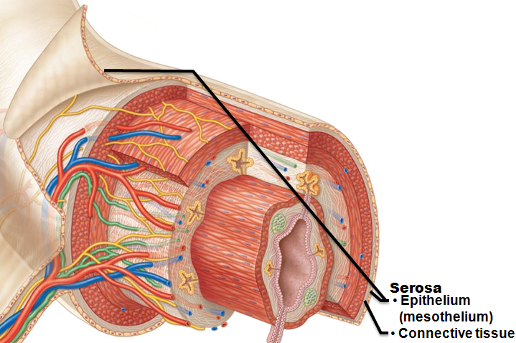
Serosa
Visceral peritoneum
Areolar connective tissue covered with mesothelium in most organs
Replaced by fibrous adventitia in esophagus
Retroperitoneal organs have both an adventitia and serosa

Slide 21
Enteric Nervous System
Intrinsic nerve supply of alimentary canal
enteric neurons
Major nerve supply to GI tract wall; control motility
Submucosal nerve plexus
Regulates glands and smooth muscle in the mucosa
Myenteric nerve plexus
Controls GI tract motility

Slide 22
Enteric Nervous System
Linked to CNS via afferent visceral fibers
Long ANS fibers synapse with enteric plexuses
Sympathetic impulses inhibit digestive activities
Parasympathetic impulses stimulate digestive activities

Slide 23
Functional Anatomy: Mouth
Oral (buccal) cavity
Bounded by
Lips
Cheeks
Palate
Tongue
Oral orifice is anterior opening
Lined with stratified squamous epithelium

Slide 24
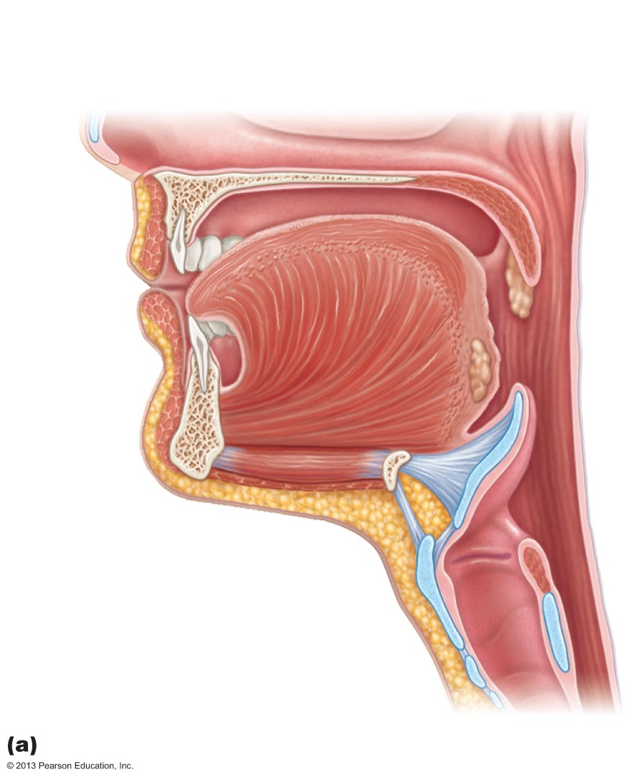
Figure 23.7a Anatomy of the oral cavity (mouth).
Soft
palate
Uvula
Hard
palate
Oral cavity
Palatine
tonsil
Tongue
Oropharynx
Lingual tonsil
Epiglottis
Hyoid bone
Laryngopharynx
Esophagus
Trachea
Sagittal section of the oral cavity and pharynx

Slide 25
Lips and Cheeks
Contain orbicularis oris and buccinator muscles
Vestibule
recess internal to lips (labia) and cheeks, external to teeth and gums
Oral cavity proper
lies within teeth and gums
Labial frenulum
median attachment of each lip to gum

Slide 26
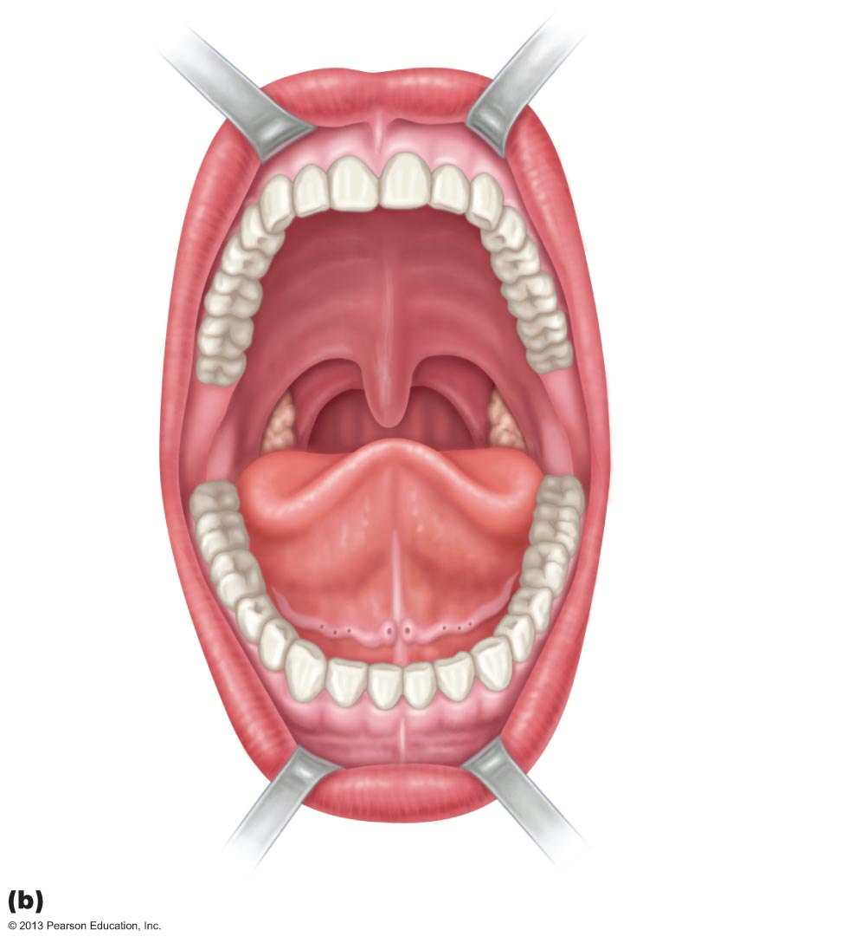
Figure 23.7b Anatomy of the oral cavity (mouth).
Upper lip
Gingivae
(gums)
Superior
labial
frenulum
Palatine
raphe
Palatoglossal
arch
Hard
palate
Soft
palate
Palatopharyngeal
arch
Uvula
Posterior wall
of oropharynx
Palatine
tonsil
Tongue
Lingual frenulum
Opening of
Submandibular
duct
Gingivae (gums)
Oral vestibule
Lower lip
Inferior labial
frenulum
Anterior view

Slide 27
Palate
Hard palate
palatine bones and palatine processes of maxillae
Slightly corrugated to help create friction against tongue
Soft palate
fold formed mostly of skeletal muscle
Closes off nasopharynx during swallowing
Uvula projects downward from its free edge

Slide 28
Tongue
Skeletal muscle
Functions include
Repositioning and mixing food during chewing
Formation of bolus
Initiation of swallowing, speech, and taste
Intrinsic muscles
change shape of tongue
Extrinsic muscles
alter tongue's position
Lingual frenulum
attachment to floor of mouth

Slide 29
Tongue
Surface bears papillae
Filiform
whitish, give the tongue roughness and provide friction
do not contain taste buds
Fungiform
reddish, scattered over tongue
contain taste buds
Circumvallate (vallate)
V-shaped row in back of tongue
contain taste buds
Foliate
on lateral aspects of posterior tongue; contain taste buds that function primarily in infants and children

Slide 30
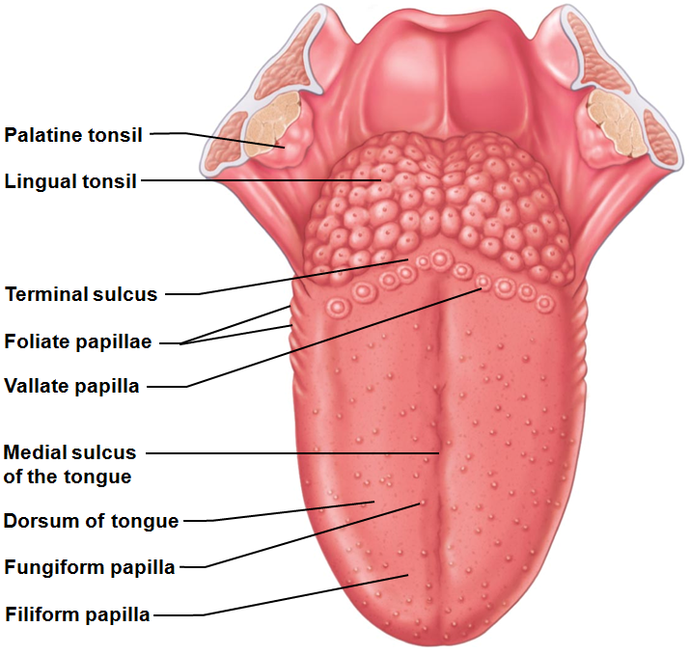
Tongue
Lingual lipase
Secreted by serous cells beneath foliate and vallate papillae secrete
Fat-digesting enzyme functional in stomach
Terminal sulcus marks division between
Body
anterior 2/3 residing in oral cavity
Root
posterior third residing in oropharynx
Just posterior to vallate papillae

Slide 31
Salivary Glands
Function of saliva
Cleanses mouth
Dissolves food chemicals for taste
Moistens food; compacts into bolus
Begins breakdown of starch with enzymes

Slide 32
Salivary Glands
Extrinsic salivary glands
Produce most saliva; lie outside oral cavity
Parotid
Submandibular
Sublingual
Intrinsic salivary glands
Scattered throughout oral cavity; augment slightly
continuously keep mouth moist

Slide 33
Salivary Glands
Parotid gland
Anterior to ear
External to masseter muscle
Parotid duct opens into vestibule next to second upper molar
Mumps is inflammation of parotid glands
Submandibular gland
Medial to body of mandible
Duct opens at base of lingual frenulum

Slide 34
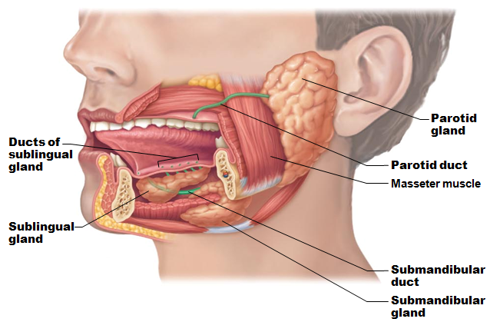
Salivary Glands
Sublingual gland
Anterior to submandibular gland under tongue
Opens via 10–12 ducts into floor of mouth

Slide 35
Salivary Glands
Two types of secretory cells
Serous cells
Watery, enzymes, ions, bit of mucin
Mucous cells
Mucus
Parotid gland, submandibular glands are mostly serous
Sublingual gland is mostly mucous

Slide 36
Composition of Saliva
97–99.5% water, slightly acidic
Electrolytes
Na⁺, K⁺, Cl–, PO₄ ^{2–}, HCO₃–
Salivary amylase
Lingual lipase
Mucin
Metabolic wastes
urea and uric acid
Lysozyme, IgA, defensins, and a cyanide compound protect against microorganismsa

Slide 37
Control of Salivation
Extrinsic salivary glands activated by parasympathetic nervous system when
Ingested food stimulates chemoreceptors and mechanoreceptors in mouth →
Salivatory nuclei in brain stem send impulses along parasympathetic fibers in cranial nerves VII and IX
Strong sympathetic stimulation inhibits salivation and results in dry mouth
xerostomia

Slide 38
Teeth
Tear and grind food for digestion
Primary and permanent dentitions formed by age 21
20 deciduous teeth erupt (6–24 months of age)
Roots resorbed
teeth fall out (6–12 years of age) as permanent teeth develop
32 permanent teeth
All but third molars in by end of adolescence
Third molars at 17–25, or may not erupt

Slide 39
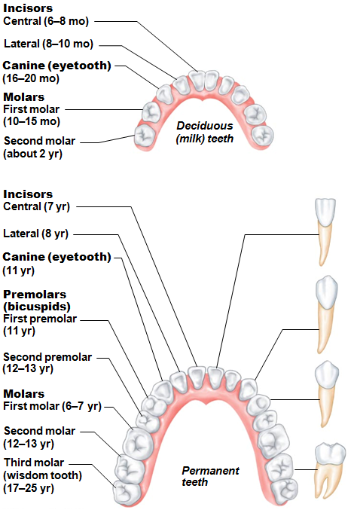
Classes of Teeth
Incisors
Chisel shaped for cutting
Canines
Fanglike teeth that tear or pierce
Premolars (bicuspids)
Broad crowns, rounded cusps
grind/crush
Molars
Broad crowns, rounded cusps – best grinders

Slide 40
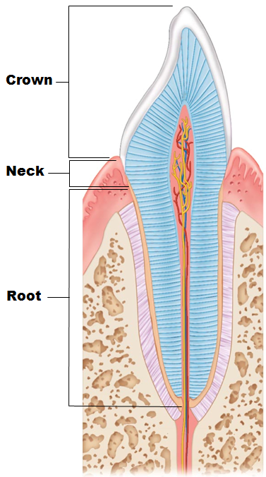
Tooth Structure
Crown
exposed part above gingiva (gum)
Covered by enamel
hardest substance in body
Enamel-producing cells degenerate when tooth erupts → no healing if decay or crack
Root
portion embedded in jawbone
Connected to crown by neck

Slide 41
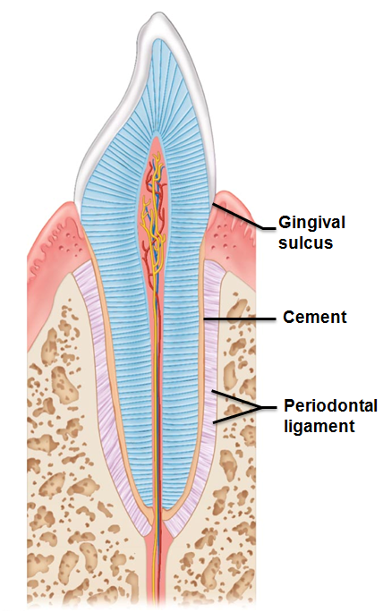
Tooth Structure
Cement
calcified connective tissue
Covers root
Attaches it to periodontal ligament
Periodontal ligament
Forms fibrous joint called gomphosis
Anchors tooth in bony socket
Gingival sulcus
groove where gingiva borders tooth

Slide 42
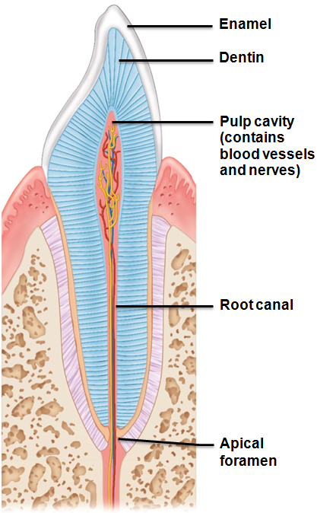
Tooth Structure
Dentin
bonelike material under enamel
Maintained by odontoblasts of pulp cavity
Pulp cavity
surrounded by dentin
Pulp - connective tissue, blood vessels, and nerves
Root canal
as pulp cavity extends to root
Apical foramen at proximal end of root
Entry for blood vessels, nerves, etc.

Slide 43
Tooth and Gum Disease
Dental caries (cavities)
demineralization of enamel and dentin from bacterial action
Dental plaque (film of sugar, bacteria, and debris) adheres to teeth
Acid from bacteria dissolves calcium salts
Proteolytic enzymes digest organic matter
Prevention: daily flossing and brushing

Slide 44
Tooth and Gum Disease
Gingivitis
Plaque calcifies to form calculus (tartar)
Calculus disrupts seal between gingivae and teeth
Anaerobic bacteria infect gums
Infection reversible if calculus removed

Slide 45
Tooth and Gum Disease
Periodontitis (from neglected gingivitis)
Immune cells attack intruders and body tissues
Destroy periodontal ligament
Activate osteoclasts → dissolve bone
Possible tooth loss
may promote
atherosclerosis
clot formation in coronary and cerebral arteries
Risk factors - smoking, diabetes mellitus, oral piercing

Slide 46
Pharynx
Food passes from mouth → oropharynx → laryngopharynx
Allows passage of food, fluids, and air
Stratified squamous epithelium lining; mucus-producing glands
Skeletal muscle layers: inner longitudinal, outer pharyngeal constrictors

Slide 47
Esophagus
Flat muscular tube from laryngopharynx to stomach
Pierces diaphragm at esophageal hiatus
Joins stomach at cardial orifice
Gastroesophageal (cardiac) sphincter
Surrounds cardial orifice

Slide 48
Homeostatic Imbalance
Heartburn
Stomach acid regurgitates into esophagus
Likely with excess food/drink, extreme obesity, pregnancy, running
Also with hiatal hernia
structural abnormality
Part of stomach above diaphragm

Slide 49
Esophagus
Esophageal mucosa contains stratified squamous epithelium
Changes to simple columnar at stomach
Esophageal glands in submucosa secrete mucus to aid in bolus movement
Muscularis externa
skeletal superiorly; mixed in middle; smooth inferiorly
Adventitia instead of serosa

Slide 50
Digestive Processes: Mouth
Ingestion
Mechanical digestion
Chewing
Propulsion
Deglutition
swallowing
Chemical digestion
salivary amylase
lingual lipase
Almost no absorption takes place

Slide 51
Mastication
Cheeks and closed lips hold food between teeth
Tongue mixes food with saliva; compacts food into bolus
Teeth cut and grind
Partly voluntary
Partly reflexive
Stretch reflexes; pressure receptors in cheeks, gums, tongue

Slide 52
Deglutition
Involves tongue, soft palate, pharynx, esophagus
Buccal phase
Voluntary contraction of tongue
Pharyngeal-esophageal phase
Involuntary
primarily vagus nerve
Control center in the medulla and lower pons

Slide 53
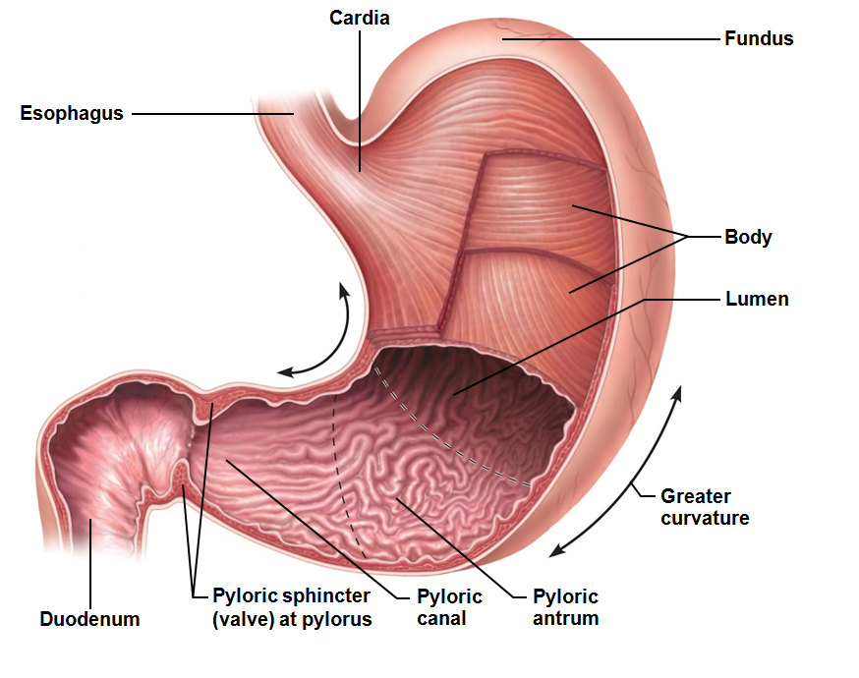
Stomach: Gross Anatomy
In upper left quadrant; temporary storage; chemical digestion of bolus to chyme
Cardial part (cardia)
Surrounds cardial orifice
Fundus
Dome-shaped region beneath diaphragm
Body
Midportion
Pyloric part
Antrum (superior portion) → pyloric canal → pylorus
Pylorus continuous with duodenum through pyloric valve (sphincter controlling stomach emptying)

Slide 54
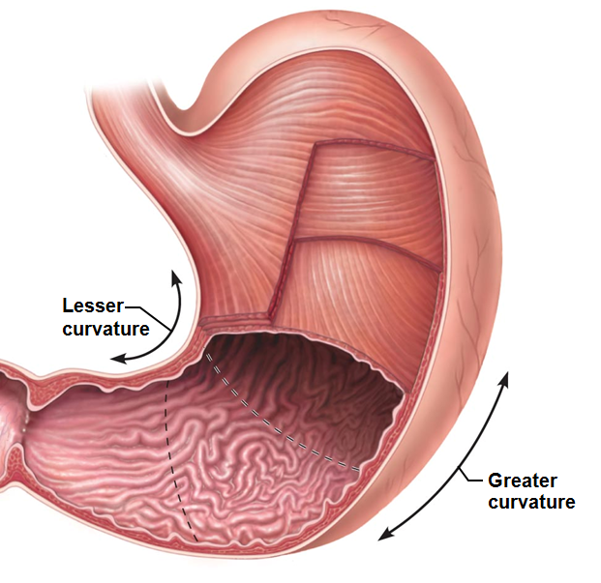
Stomach: Gross Anatomy
Greater curvature
convex lateral surface
Lesser curvature
concave medial surface
Mesenteries tether stomach
Lesser omentum
From liver to lesser curvature
Greater omentum – contains fat deposits & lymph nodes
Greater curvature → over small intestine → spleen & transverse colon

Slide 55
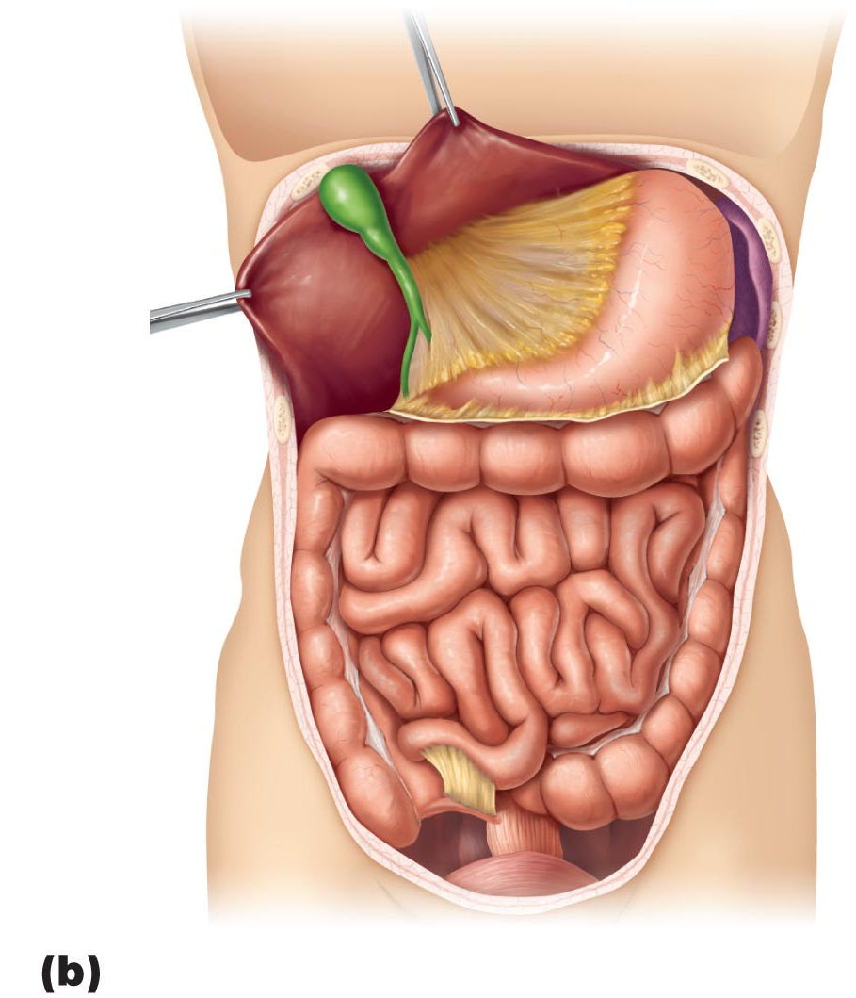
Figure 23.30b Mesenteries of the abdominal digestive organs.
Liver
Gallbladder
Lesser omentum
Stomach
Duodenum
Transverse colon
Small intestine
Cecum
Urinary bladder

Slide 56
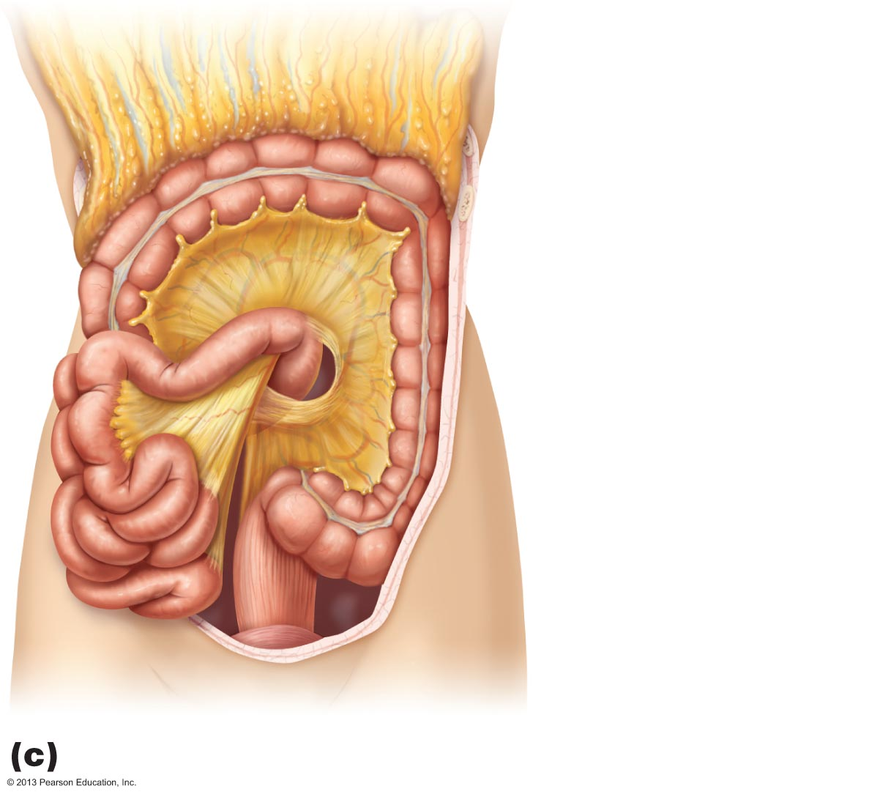
Figure 23.30c Mesenteries of the abdominal digestive organs.
Greater omentum
Transverse colon
Transverse
mesocolon
Descending colon
Jejunum
Mesentery
Sigmoid
mesocolon
Sigmoid colon
Ileum

Slide 57
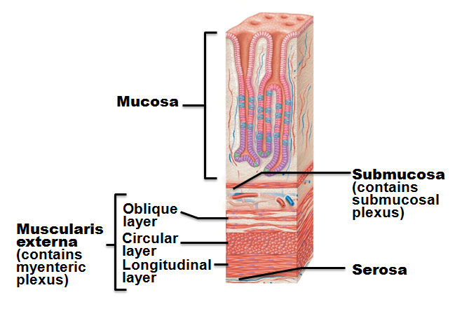
Stomach: Microscopic Anatomy
Four tunics
Muscularis and mucosa modified
Muscularis externa
Three layers of smooth muscle
Inner oblique layer allows stomach to churn, mix, move, and physically break down food

Slide 58
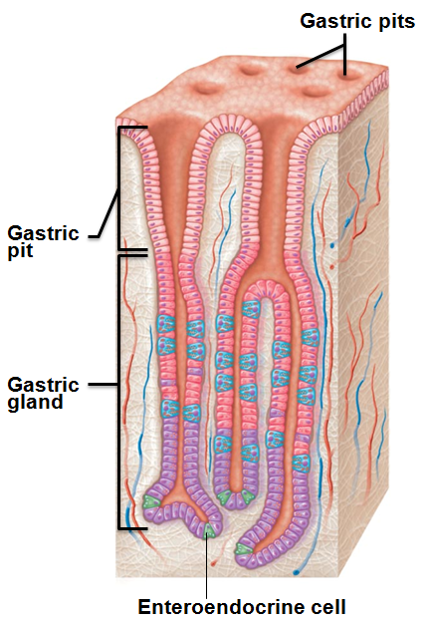
Stomach: Microscopic Anatomy
Mucosa
Simple columnar epithelium composed of mucous cells
Secrete two-layer coat of alkaline mucus
Surface layer traps bicarbonate-rich fluid beneath it
Dotted with gastric pits → gastric glands
Gastric glands produce gastric juice

Slide 59
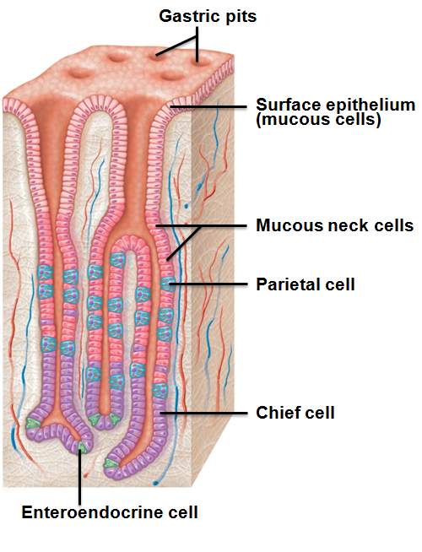
Gastric Glands
Cell types
Mucous neck cells (secrete thin, acidic mucus of unknown function)
Parietal cells
Chief cells
Enteroendocrine cells

Slide 60
Gastric Gland Secretions
Glands in fundus and body produce most gastric juice
Parietal cell secretions
Hydrochloric acid (HCl)
→ pH 1.5–3.5
denatures protein
activates pepsin
breaks down plant cell walls
kills many bacteria
Intrinsic factor
Glycoprotein required for absorption of vitamin B₁₂ in small intestine

Slide 61
Gastric Gland Secretions
Chief cell secretions
Pepsinogen - inactive enzyme
Activated to pepsin by HCl and by pepsin itself
a positive feedback mechanism
Lipases
Digest ~15% of lipids

Slide 62
Gastric Gland Secretions
Enteroendocrine cells
Secrete chemical messengers into lamina propria
Act as paracrines
Serotonin and histamine
Hormones
Somatostatin (also acts as paracrine) and gastrin

Slide 63
Mucosal Barrier
Harsh digestive conditions in stomach
Has mucosal barrier to protect
Thick layer of bicarbonate-rich mucus
Tight junctions between epithelial cells
Prevent juice seeping underneath tissue
Damaged epithelial cells quickly replaced by division of stem cells
Surface cells replaced every 3–6 days

Slide 64
Please note that due to differing operating systems, some animations will not appear until the presentation is viewed in Presentation Mode (Slide Show view). You may see blank slides in the “Normal” or “Slide Sorter” views. All animations will appear after viewing in Presentation Mode and playing each animation. Most animations will require the latest version of the Flash Player, which is available at http://get.adobe.com/flashplayer.
Notes:
Gastric Glands(?)

Slide 65
Homeostatic Imbalance
Gastritis
Inflammation caused by anything that breaches mucosal barrier
Peptic or gastric ulcers
Erosions of stomach wall
Can perforate → peritonitis; hemorrhage
Most caused by Helicobacter pylori bacteria
Some by NSAIDs

Slide 66
Digestive Processes in the Stomach
Physical digestion
Denaturation of proteins by HCl
Enzymatic digestion of proteins by pepsin
Lingual lipase digests some triglycerides
Delivers chyme to small intestine

Slide 67
Digestive Processes in the Stomach
Lipid-soluble alcohol and aspirin absorbed into blood
Only stomach function essential to life:
Secretes intrinsic factor for vitamin B₁₂ absorption
B₁₂ needed → mature red blood cells
Lack of intrinsic factor leads to Pernicious Anemia
Treated with B₁₂ injections

Slide 68
Regulation of Gastric Secretion
Neural and hormonal mechanisms
Gastric mucosa produces up to 3 L gastric juice/day
Vagus nerve stimulation
Acetylcholine: increases gastric activity
Sympathetic stimulation
Decreases gastric activity
Hormonal control largely gastrin
→ ↑Enzyme and HCl secretion
Most small intestine secretions - gastrin antagonists

Slide 69
Regulation of Gastric Secretion
Three phases of gastric secretion
Cephalic (reflex) phase
conditioned reflex triggered by aroma, taste, sight, thought
Gastric phase
lasts 3–4 hours
Stimulated by distension, peptides, low acidity, gastrin (major stimulus)
Caffeine, peptides, rising pH (becoming more alkaline)
stimulates enteroendocrine cells to release gastrin: results in increased enzyme release and more HCL released

Slide 70
Stimuli of Gastric Phase
Gastrin → enzyme and HCl release
Low pH inhibits gastrin secretion (as between meals)
Buffering action of ingested proteins → rising pH → gastrin secretion

Slide 71
Regulation of Gastric Secretion
Intestinal phase
Stimulatory component
Partially digested food enters small intestine → brief intestinal gastrin release
Inhibitory effects (enterogastric reflex and enterogastrones)
Chyme with H⁺, fats, peptides, irritating substances → inhibition

Slide 72
Please note that due to differing operating systems, some animations will not appear until the presentation is viewed in Presentation Mode (Slide Show view). You may see blank slides in the “Normal” or “Slide Sorter” views. All animations will appear after viewing in Presentation Mode and playing each animation. Most animations will require the latest version of the Flash Player, which is available at http://get.adobe.com/flashplayer.
Notes:
Gastric phases (?)

Slide 73
Enterogastric Reflex
Three reflexes act to
Inhibit vagal nuclei in medulla
Inhibit local reflexes
Activate sympathetic fibers → tightening of pyloric sphincter → no more food entry to small intestine
→ Decreased gastric activity → protects small intestine from excessive acidity

Slide 74
Intestinal Phase
Enterogastrones released
Secretin, cholecystokinin (CCK), vasoactive intestinal peptide (VIP)
All inhibit gastric secretion
If small intestine pushed to accept more chyme → dumping syndrome
Nausea and vomiting
Common in gastric reduction for weight loss

Slide 75
Gastric Contractile Activity
Peristaltic waves move toward pylorus at rate of 3 per minute
Basic electrical rhythm set by enteric pacemaker cells
(formerly interstitial cells of Cajal)
Pacemaker cells linked by gap junctions → entire muscularis contracts
Distension and gastrin increase force of contraction

Slide 76
Gastric Contractile Activity
Most vigorous near pylorus
Chyme is either
Delivered in to duodenum
Forced backward into stomach

Slide 77
Regulation of Gastric Emptying
As chyme enters duodenum
Receptors respond to stretch and chemical signals
Enterogastric reflex and enterogastrones inhibit gastric secretion and duodenal filling
Carbohydrate-rich chyme moves quickly through duodenum
Fatty chyme remains in duodenum 6 hours or more

Slide 78
Homeostatic Imbalance
Vomiting (emesis) caused by
Extreme stretching
Intestinal irritants
bacterial toxins
excessive alcohol
spicy food
certain drugs
Chemicals/sensory impulses
→ emetic center of medulla
Excessive vomiting →
dehydration, electrolyte and acid-base imbalances (alkalosis)

Slide 79
Small Intestine: Gross Anatomy
Major organ of digestion and absorption
2-4 m long; from pyloric sphincter to ileocecal valve
Subdivisions
Duodenum
Retroperitoneal
Jejunum
Ileum

Slide 80
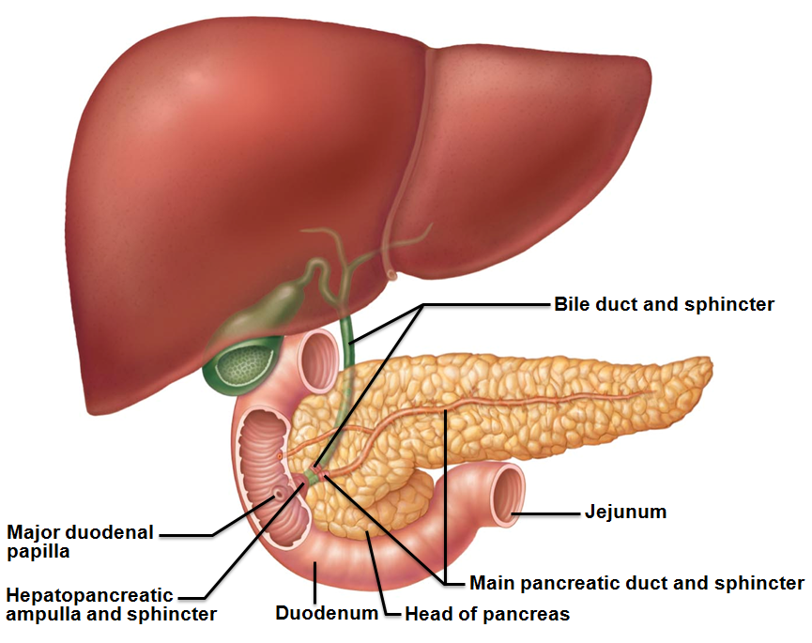
Duodenum
Curves around head of pancreas
shortest part of small intestine
Bile duct (from liver) and main pancreatic duct (from pancreas)
Join at hepatopancreatic ampulla
Enter duodenum at major duodenal papilla
Entry controlled by hepatopancreatic sphincter

Slide 81
Jejunum and Ileum
Jejunum
Extends from duodenum to ileum
Ileum
Joins large intestine at ileocecal valve

Slide 82
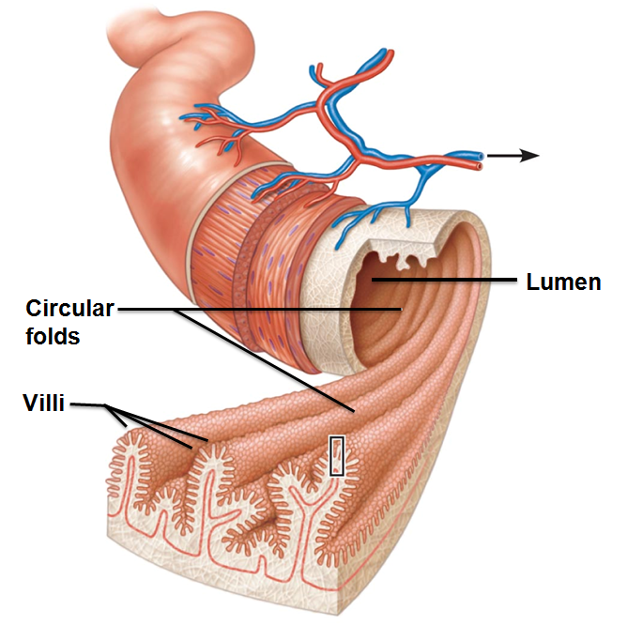
Structural Modifications
Increase surface area of proximal part for nutrient absorption
Circular folds (plicae circulares)
Permanent folds
force chyme to slowly spiral through lumen
More nutrient absorption
Villi
Extensions of mucosa
capillary bed
lacteal for absorption

Slide 83
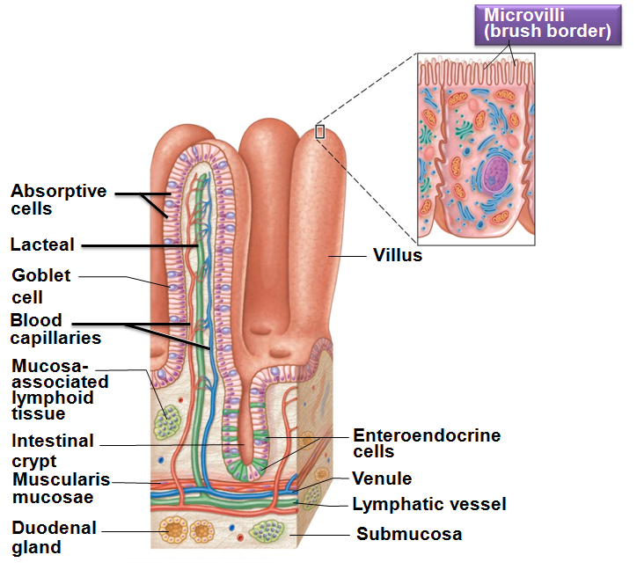
Structural Modifications
Microvilli (brush border)
contain enzymes for carbohydrate and protein digestion

Slide 84
Intestinal Crypts
Intestinal crypt
epithelium renewed every 2-4 days
Most
secretory cells that produce intestinal juice
Enteroendocrine cells → enterogastrones

Slide 85
Mucosa
Peyer's patches protect especially distal part against bacteria
May protrude into submucosa
B lymphocytes leave intestine, enter blood, protect intestinal lamina propria with their IgA
Duodenal (Brunner's) glands of the duodenum secrete alkaline mucus to neutralize acidic chyme

Slide 86
Intestinal Juice
1-2 L secreted daily
in response to distension or irritation of mucosa
Slightly alkaline; isotonic with blood plasma
Largely water
enzyme-poor
enzymes of small intestine only in brush border
contains mucus
Facilitates transport and absorption of nutrients
Notes:
Last slide of part I.

Slide 87
The Liver and Gallbladder
Accessory organs
Liver
Many functions
only digestive function → bile production
Bile – fat emulsifier
Gallbladder
Chief function → bile storage
Notes:
Starting point for part II

Slide 88
Liver
Largest gland in body
Four lobes—right, left, caudate, and quadrate

Slide 89
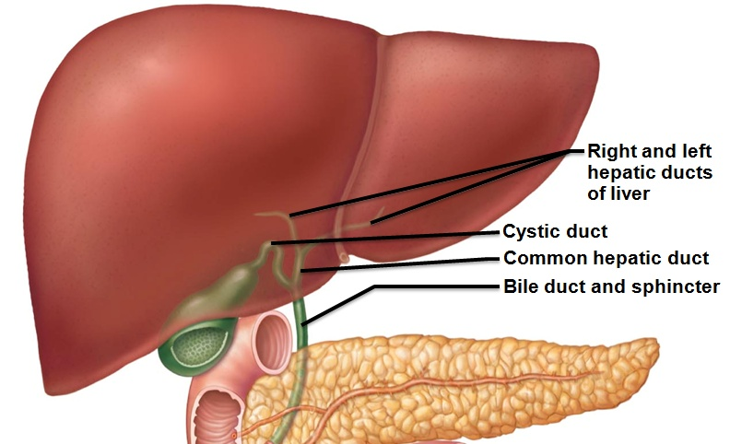
Liver: Associated Structures
Lesser omentum anchors liver to stomach
Bile ducts
Common hepatic duct leaves liver
Cystic duct connects to gallbladder
Bile duct formed by union of common hepatic and cystic ducts

Slide 90
Bile
Yellow-green, alkaline solution containing
Bile salts
cholesterol derivatives
function in fat emulsification and absorption
Bilirubin
pigment formed from heme
Cholesterol, neutral fats, phospholipids, and electrolytes

Slide 91
The Gallbladder
Thin-walled muscular sac on ventral surface of liver
Stores bile
concentrates bile by absorbing water and ions
Muscular contractions release bile
via cystic duct
flows into bile duct

Slide 92
The Gallbladder
High cholesterol and too few bile salts → gallstones
Obstruct flow of bile from gallbladder
May cause obstructive jaundice
Gallbladder contracts against sharp crystals → pain
Treated with drugs, ultrasound vibrations (lithotripsy), laser vaporization, surgery

Slide 93
Regulation of Bile Secretion
Bile secretion stimulated by
Secretin from intestinal cells exposed to HCl and fatty chyme
Hepatopancreatic sphincter closed unless digestion active
bile stored in gallbladder
Released to small intestine only with contraction

Slide 94
Regulation of Bile Secretion
Gallbladder contraction stimulated by
Cholecystokinin (CCK) from intestinal cells exposed to acidic, fatty chyme
Vagal stimulation (minor stimulus)
CCK also causes
Secretion of pancreatic juice
Hepatopancreatic sphincter to relax

Slide 95
Pancreas
Location
Mostly retroperitoneal, deep to greater curvature of stomach
Head encircled by duodenum
Tail points back towards the spleen

Slide 96
Pancreas
Endocrine function
Pancreatic islets secrete insulin and glucagon
Exocrine function
secrete pancreatic juice
To duodenum via main pancreatic duct

Slide 97
Pancreatic Juice
Watery alkaline solution (pH 8) neutralizes chyme
Electrolytes (primarily HCO₃–)
Enzymes
Amylase, lipases, nucleases secreted in active form but require ions or bile for optimal activity
Proteases secreted in inactive form

Slide 98
Regulation of Pancreatic Secretion
CCK induces secretion of enzyme-rich pancreatic juice
Secretin causes secretion of bicarbonate-rich pancreatic juice by duct cells
Vagal stimulation also causes release of pancreatic juice (minor stimulus)

Slide 99
Digestion in the Small Intestine
Chyme from stomach contains
Partially digested carbohydrates and proteins
Undigested fats
3–6 hours in small intestine
Most water absorbed
almost all nutrients absorbed
Small intestine, like stomach, no role in ingestion or defecation

Slide 100
Motility of the Small Intestine
Segmentation
Most common motion of small intestine
Mixes/moves contents toward ileocecal valve
Wanes in late intestinal (fasting) phase

Slide 101
Motility of the Small Intestine
Peristalsis
Initiated by rise in hormone motilin in late intestinal phase; every 90–120 minutes
Each wave starts distal to previous
Migrating motor complex
Meal remnants, bacteria, and debris moved to large intestine
From duodenum → ileum
about 2 hours

Slide 102
Motility of the Small Intestine
Ileocecal sphincter relaxes, admits chyme into large intestine when
Gastroileal reflex enhances force of segmentation in ileum
Gastrin increases motility of ileum
Ileocecal valve flaps close when chyme exerts backward pressure
Prevents regurgitation into ileum

Slide 103
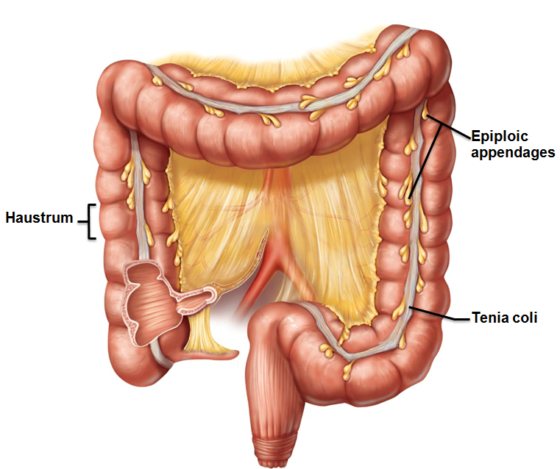
Large Intestine
Unique features
Teniae coli
Three bands of longitudinal smooth muscle in muscularis
Haustra
Pocketlike sacs caused by tone of teniae coli
Epiploic appendages
Fat-filled pouches of visceral peritoneum

Slide 104
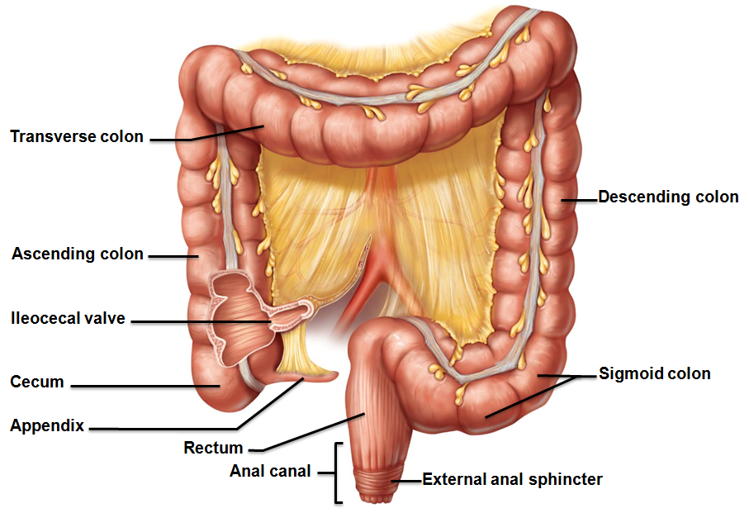
Large Intestine
Regions
Cecum
Appendix
Colon
Rectum
Anal canal

Slide 105
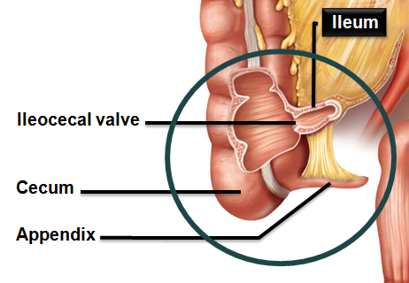
Subdivisions of the Large Intestine
Cecum
first part of large intestine
Appendix
masses of lymphoid tissue
Part of MALT of immune system
Bacterial storehouse →
recolonizes gut when necessary

Slide 106
Colon
Retroperitoneal except for transverse and sigmoid regions
Ascending colon
right colic (hepatic) flexure
Transverse colon
left colic (splenic) flexure
Descending colon
Sigmoid colon
→ rectum

Slide 107
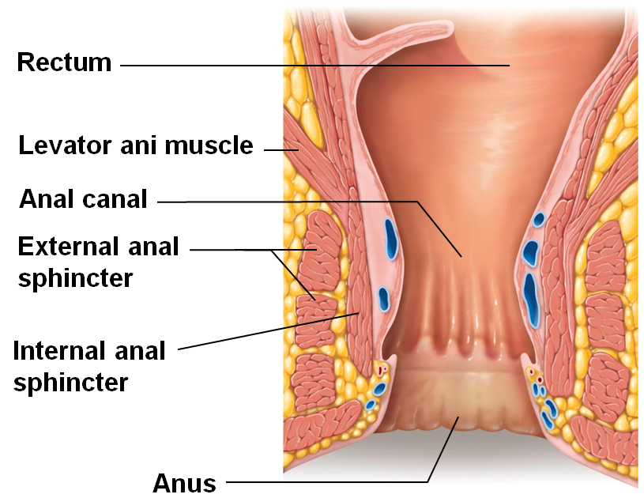
Rectum and Anus
Rectum
Three rectal valves stop feces from being passed with gas
Anal canal
Last segment of large intestine
Opens to body exterior at anus
Sphincters
Internal anal sphincter—smooth muscle
External anal sphincter—skeletal muscle

Slide 108
Large Intestine: Microscopic Anatomy
Thicker mucosa of simple columnar epithelium
except in anal canal which is stratified squamous to withstand abrasion
No circular folds, villi, digestive secretions
Abundant deep crypts with goblet cells
Superficial venous plexuses of anal canal form hemorrhoids if inflamed

Slide 109
Bacterial Flora
Enter from small intestine or anus
Colonize colon
Synthesize B complex vitamins and vitamin K
Ferment indigestible carbohydrates
Release irritating acids and gases (~500 ml/day)

Slide 110
Intestinal Flora
Viruses and protozoans
Bacteria prevented from breaching mucosal barrier
Epithelial cells recruit dendritic cells to mucosa → sample microbial antigens → present to T cells of MALT → IgA antibody-mediated response → restricts microbes

Slide 111
Digestive Processes in the Large Intestine
Residue remains in large intestine 12–24 hours
No food breakdown except by enteric bacteria
Vitamins (made by bacterial flora), water, and electrolytes (especially Na⁺ and Cl–) reclaimed
Major functions
propulsion of feces to anus
defecation
Colon not essential for life

Slide 112
Motility of the Large Intestine
Most contractions of colon
Haustral contractions
Slow segmenting movements
Haustra sequentially contract in response to distension

Slide 113
Motility of the Large Intestine
Gastrocolic reflex
Initiated by presence of food in stomach
Activates three to four slow powerful peristaltic waves per day in colon (mass movements)

Slide 114
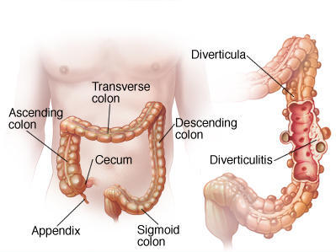
Homeostatic Imbalance
Low fiber diet → diverticula (herniations of mucosa)
Diverticulosis commonly in sigmoid colon
Affects ½ people > 70 years
Diverticulitis
Inflamed diverticula
may rupture and leak into peritoneal cavity
may be life threatening

Slide 115
Homeostatic Imbalance
Irritable bowel syndrome
Functional GI disorder
Recurring abdominal pain, stool changes, bloating, flatulence, nausea, depression
Stress common precipitating factor
Stress management important in treatment

Slide 116
Defecation
Mass movements force feces toward rectum
Distension initiates spinal defecation reflex
Parasympathetic signals
Stimulate contraction of sigmoid colon and rectum
Relax internal anal sphincter
Conscious control allows relaxation of external anal sphincter

Slide 117
Defecation
Muscles of rectum contract to expel feces
Assisted by Valsalva's maneuver
Closing of glottis, contraction of diaphragm and abdominal wall muscles → increased intra-abdominal pressure
Levator ani muscle contracts → anal canal lifted superiorly → feces leave body

Slide 118
Digestion of Carbohydrates
Only monosaccharides can be absorbed
Monosaccharides absorbed as ingested
Glucose, fructose, galactose
Digestive enzymes
Salivary amylase
pancreatic amylase
brush border enzymes
dextrinase, glucoamylase, lactase, maltase, and sucrase
Break down disaccharides sucrose, lactose, maltose; polysaccharides glycogen and starch

Slide 119
Digestion of Proteins
digested to amino acid monomers
Begins with pepsin in stomach at pH 1.5 – 2.5
Inactive in high pH of duodenum
Pancreatic proteases
Trypsin, chymotrypsin, and carboxypeptidase
Brush border enzymes
Aminopeptidases, carboxypeptidases, and dipeptidases

Slide 120
Digestion of Lipids
Pre-treatment: emulsification by bile salts
Does not break bonds
Enzymes
pancreatic lipases
→ Fatty acids and monoglycerides
Absorption of glycerol and short chain fatty acids
Absorbed into the capillary blood in villi
Transported via the hepatic portal vein

Slide 121
Digestion of Nucleic Acids
Enzymes
Pancreatic ribonuclease and deoxyribonuclease → nucleotide monomers
Brush border enzyme nucleosidases and phosphatases → free bases, pentose sugars, phosphate ions

Slide 122
Absorption
Absorbed into the small intestine before reaching the ileum
Almost all food
80% electrolytes
most water absorbed in small intestine
ileum
reclaims bile salts
Most absorbed by active transport into the blood
Exception
lipids

Slide 123
Absorption of Protein
Amino acids transported by several types of carriers
Dipeptides and tripeptides
actively absorbed
digested to amino acids within epithelial cells
Enter capillary blood by diffusion

Slide 124
Homeostatic Imbalance
Whole proteins not usually absorbed
Can be taken up by endocytosis/exocytosis
Most common in newborns → food allergies
Usually disappear with mucosa maturation
Allows IgA antibodies in breast milk to reach infant's bloodstream → passive immunity

Slide 125
Absorption of Lipids
Absorption of monoglycerides and fatty acids
Cluster with bile salts and lecithin to form micelles
Released by micelles
diffuse into epithelial cells
Combined with lecithin, phospholipids, cholesterol, & coated with proteins
form chylomicrons
Enter lacteals
transported to systemic circulation
Hydrolyzed to free fatty acids and glycerol by lipoprotein lipase of capillary endothelium
Cells can use for energy or stored fat
Absorption of short chain fatty acids
Diffuse into portal blood for distribution

Slide 126
Absorption of Nucleic Acids
Absorption
Active transport across epithelium → bloodstream

Slide 127
Absorption of Vitamins
In small intestine
Fat-soluble vitamins (A, D, E, and K) carried by micelles; diffuse into absorptive cells
Water-soluble vitamins (vitamin C and B vitamins) absorbed by diffusion or by passive or active transporters.
Vitamin B₁₂ (large, charged molecule)
binds with intrinsic factor
absorbed by endocytosis

Slide 128
Absorption of Vitamins
In large intestine
Vitamin K and B vitamins from bacterial metabolism are absorbed

Slide 129
Absorption of Water
9L water, most from GI tract secretions, enter small intestine
95% absorbed in the small intestine by osmosis
Most of rest absorbed in large intestine
Water uptake coupled with solute uptake

Slide 130
Malabsorption of Nutrients
Causes
Anything that interferes with delivery of bile or pancreatic juice
Damaged intestinal mucosa
bacterial infection
some antibiotics

Slide 131
Malabsorption of Nutrients
Gluten-sensitive enteropathy (celiac disease)
Immune reaction to gluten
Gluten causes immune cell damage to intestinal villi and brush border
Treated by eliminating gluten from diet
all grains but rice and corn
Oats have no gluten, but have a protein that is very similar

Slide 132
Cancer
Stomach and colon cancers rarely have early signs or symptoms
Metastasized colon cancers frequently cause secondary liver cancer
Prevention
Regular dental and medical examination

Slide 133
Kidney Functions
Regulating total water volume and total solute concentration in water
Regulating Extracellular Fluid ion concentrations
Ensuring long-term acid-base balance
Removal of metabolic wastes, toxins, drugs

Slide 134
Kidney Functions
Endocrine functions
Renin
regulation of blood pressure
Erythropoietin
regulation of RBC production
Activation of vitamin D
Gluconeogenesis during prolonged fasting

Slide 135
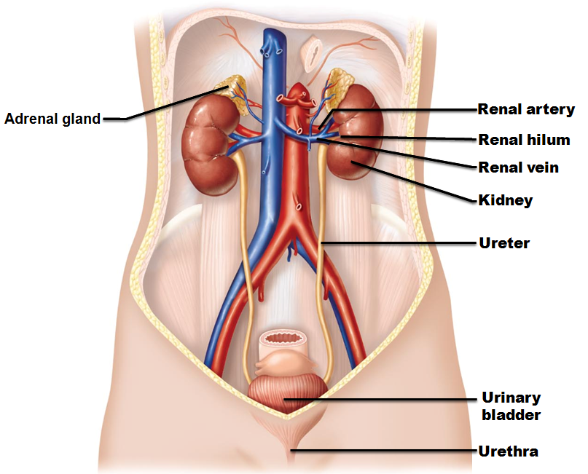
Urinary System Organs
Kidneys
major excretory organs
Ureters
transport urine from kidneys to urinary bladder
Urinary bladder
temporary storage reservoir for urine
Urethra transports urine out of body

Slide 136
Please note that due to differing operating systems, some animations will not appear until the presentation is viewed in Presentation Mode (Slide Show view). You may see blank slides in the “Normal” or “Slide Sorter” views. All animations will appear after viewing in Presentation Mode and playing each animation. Most animations will require the latest version of the Flash Player, which is available at http://get.adobe.com/flashplayer.
Notes:
Urinary overview

Slide 137
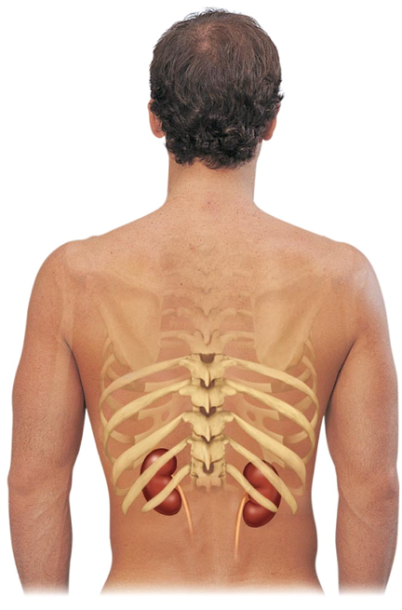
Kidney Anatomy
Retroperitoneal
in the superior lumbar region;
T₁₂ to L₅
Right kidney crowded by liver
lower than left
Adrenal (suprarenal) gland atop each kidney
Convex lateral surface, concave medial surface; vertical renal hilum leads to renal sinus
Ureters, renal blood vessels, lymphatics, and nerves enter and exit at hilum

Slide 138
Kidney Anatomy
Layers of surrounding supportive tissue
Renal fascia
Anchoring outer layer of dense fibrous connective tissue
Perirenal fat capsule
Fatty cushion
Fibrous capsule
Prevents spread of infection to kidney

Slide 139
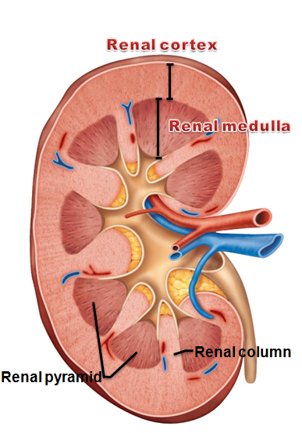
Internal Anatomy
Renal cortex
Granular-appearing superficial region
Renal medulla
Composed of cone-shaped medullary (renal) pyramids
Pyramids separated by renal columns
Inward extensions of cortical tissue

Slide 140
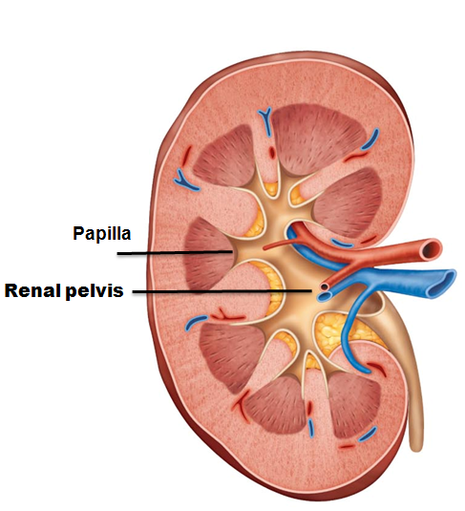
Internal Anatomy
Papilla
Tip of pyramid; releases urine into minor calyx
Lobe
Medullary pyramid and its surrounding cortical tissue; ~ 8/kidney
Renal pelvis
Funnel-shaped tube continuous with ureter

Slide 141
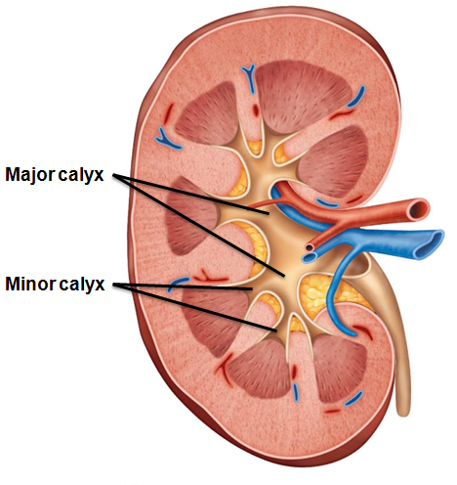
Internal Anatomy
Minor calyces
Drain pyramids at papillae
Major calyces
Collect urine from minor calyces
Empty urine into renal pelvis
Urine flow
Renal pyramid → minor calyx → major calyx → renal pelvis → ureter

Slide 142
Homeostatic Imbalance
Pyelitis
Infection of renal pelvis and calyces
Pyelonephritis
Infection/inflammation of entire kidney
Normally - successfully treated with antibiotics

Slide 143
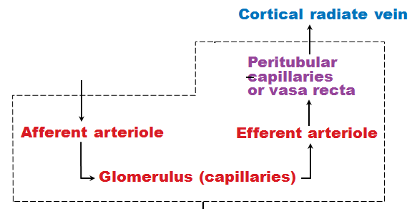
Blood and Nerve Supply
Kidneys
cleanse blood
adjust its composition
Needs a rich blood supply
Nerve supply via sympathetic fibers from renal plexus

Slide 144
Nephrons
Structural and functional units that form urine
1 million per kidney
Two main parts
Renal corpuscle
Renal tubule

Slide 145
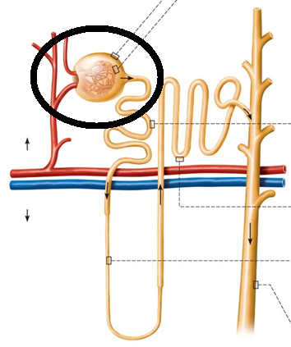
Renal Corpuscle
Two parts of renal corpuscle
Glomerulus
Capillaries
highly porous
allows filtrate formation
Glomerular capsule (Bowman's capsule)
Cup-shaped, hollow structure surrounding glomerulus

Slide 146
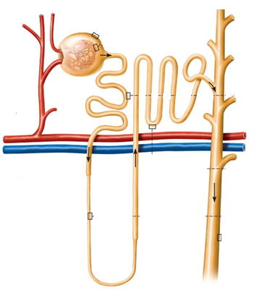
Renal Tubule
Three parts
Proximal convoluted tubule
Proximal → closest to renal corpuscle
Nephron loop
Distal convoluted tubule
Distal → farthest from renal corpuscle

Slide 147
Renal Tubule
Proximal convoluted tubule (PCT)
Cuboidal cells with dense microvilli
Increases surface area
Functions in reabsorption and secretion
Confined to cortex

Slide 148
Renal Tubule
Nephron loop
Descending and ascending limbs
Proximal descending limb continuous with proximal tubule
Distal descending limb
descending thin limb
simple squamous epithelium
Thick ascending limb
Cuboidal to columnar cells

Slide 149
Renal Tubule
Distal convoluted tubule (DCT)
Cuboidal cells with very few microvilli
Function more in secretion than reabsorption
Confined to cortex

Slide 150
Collecting Ducts
Receive filtrate from many nephrons
Run through medullary pyramids → striped appearance
Fuse together to deliver urine through papillae into minor calyces

Slide 151
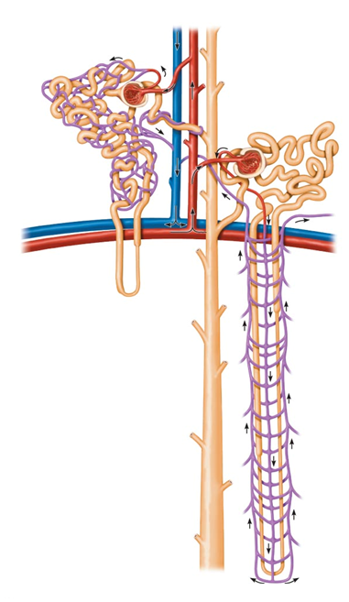
Classes of Nephrons
Cortical nephrons
85% of nephrons; almost entirely in cortex
Juxtamedullary nephrons
Long nephron loops deeply invade medulla
Ascending limbs have thick and thin segments
Important in production of concentrated urine

Slide 152
Please note that due to differing operating systems, some animations will not appear until the presentation is viewed in Presentation Mode (Slide Show view). You may see blank slides in the “Normal” or “Slide Sorter” views. All animations will appear after viewing in Presentation Mode and playing each animation. Most animations will require the latest version of the Flash Player, which is available at http://get.adobe.com/flashplayer.

Slide 153
Nephron Capillary Beds
Renal tubule associated with two capillary beds
Glomerulus
Peritubular capillaries
Juxtamedullary nephron associated with
Vasa recta

Slide 154
Nephron Capillary Beds
Glomerulus
specialized for filtration
Different from other capillary beds
fed and drained by arteriole
Afferent arteriole → glomerulus → efferent arteriole
Blood pressure in glomerulus high because
Afferent arterioles larger in diameter than efferent arterioles
Arterioles are high-resistance vessels

Slide 155
Nephron Capillary Beds
Peritubular capillaries
Low-pressure, porous capillaries adapted for absorption of water and solutes
Arise from efferent arterioles
Cling to adjacent renal tubules in cortex
Empty into venules

Slide 156
Nephron Capillary Beds
Vasa recta
Long, thin-walled vessels parallel to long nephron loops of juxtamedullary nephrons
Arise from efferent arterioles serving juxtamedullary nephrons
Instead of peritubular capillaries
Function in formation of concentrated urine

Slide 157
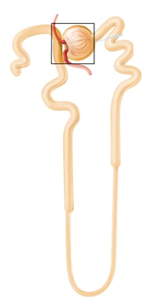
Juxtaglomerular Complex (JGC)
One per nephron
Involves modified portions of
Distal portion of ascending limb of nephron loop
Afferent arteriole
Important in regulation of rate of filtrate formation and blood pressure

Slide 158
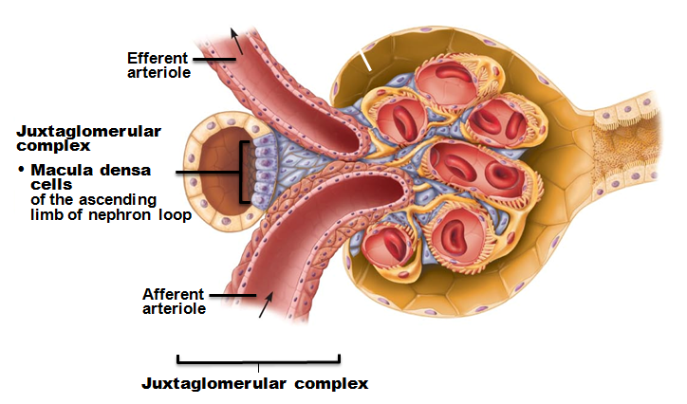
Juxtaglomerular Complex (JGC)
Three cell populations
Macula densa
granular cells,
extraglomerular mesangial cells
Macula densa
Tall, closely packed cells of ascending limb
Chemoreceptors; sense NaCl content of filtrate

Slide 159
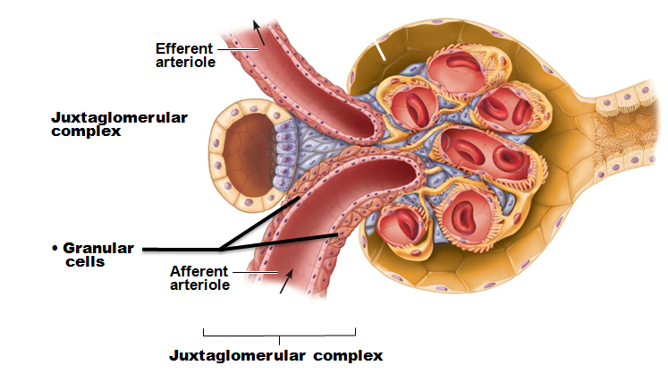
Juxtaglomerular Complex (JGC)
Granular cells (juxtaglomerular, or JG cells)
Enlarged, smooth muscle cells of arteriole
Secretory granules contain enzyme renin
Mechanoreceptors
sense blood pressure in afferent arteriole

Slide 160
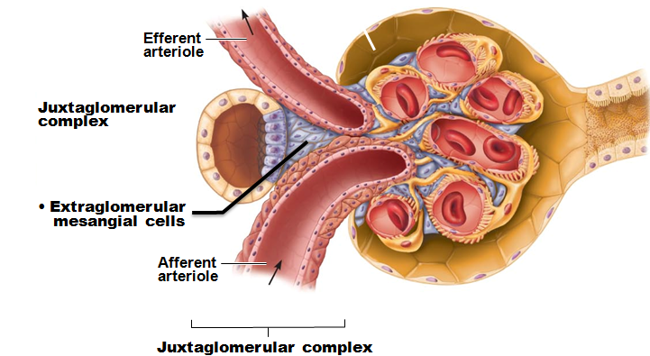
Juxtaglomerular Complex (JGC)
Extraglomerular mesangial cells
Between arteriole and tubule cells
Interconnected with gap junctions
May pass signals between macula densa and granular cells

Slide 161
Kidney Physiology: Mechanisms of Urine Formation
Three processes in urine formation and adjustment of blood composition
Glomerular filtration
Tubular reabsorption
Tubular secretion

Slide 162
Kidney Physiology: Mechanisms of Urine Formation
Glomerular filtration
produces cell-free and protein-free filtrate
Tubular reabsorption
Selectively returns 99% of substances from filtrate to blood in renal tubules and collecting ducts
Tubular secretion
Selectively moves substances from blood to filtrate in renal tubules and collecting ducts

Slide 163
Kidney Physiology: Mechanisms of Urine Formation
Kidneys filter body's entire plasma volume 60 times each day
consume 20-25% oxygen used by body at rest
produce urine from filtrate
Filtrate (produced by glomerular filtration)
Blood plasma minus proteins
Urine
<1% of original filtrate
Contains metabolic wastes and unneeded substances

Slide 164
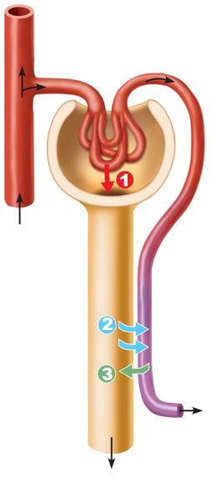
Glomerular Filtration
Passive process
No metabolic energy required
Hydrostatic pressure forces fluids and solutes through filtration membrane
No reabsorption into capillaries of glomerulus

Slide 165
The Filtration Membrane
Porous membrane between blood and interior of glomerular capsule
Water, solutes smaller than plasma proteins pass; normally no cells pass
Three layers
Fenestrated endothelium of glomerular capillaries
Basement membrane (fused basal laminae of two other layers)
Foot processes of podocytes with filtration slits

Slide 166
Pressures That Affect Filtration
Outward pressures promote filtrate formation
Hydrostatic pressure in glomerular capillaries
Glomerular blood pressure
Chief force pushing water, solutes out of blood
Quite high – 55 mm Hg
Because efferent arteriole is high resistance vessel with diameter smaller than afferent arteriole

Slide 167
Pressures That Affect Filtration
Inward forces inhibiting filtrate formation
Hydrostatic pressure in capsular space
Pressure of filtrate in capsule – 15 mm Hg
Colloid osmotic pressure in capillaries
"Pull" of proteins in blood – 30 mm Hg
Sum of forces → Net filtration pressure (NFP)
55 mm Hg forcing out; 45 mm Hg opposing = net outward force of 10 mm Hg

Slide 168
Net Filtration Pressure (NFP)
Pressure responsible for filtrate formation (10 mm Hg)
Main controllable factor determining glomerular filtration rate (GFR)

Slide 169
Glomerular Filtration Rate (GFR)
Volume of filtrate formed per minute by both kidneys (normal = 120–125 ml/min)
GFR directly proportional to
NFP
primary pressure is hydrostatic pressure in glomerulus
Total surface area available for filtration
glomerular mesangial cells control by contracting
Filtration membrane permeability
much more permeable than other capillaries

Slide 170
Regulation of Glomerular Filtration
Constant GFR allows kidneys to make filtrate and maintain extracellular homeostasis
Goal of intrinsic controls :
maintain GFR in kidney
GFR affects systemic blood pressure
increased GFR → increased urine output → decreased blood pressure, and vice versa
Goal of extrinsic controls
maintain systemic blood pressure

Slide 171
Regulation of Glomerular Filtration
Intrinsic controls
renal autoregulation
Act locally within kidney to maintain GFR
Extrinsic controls
Nervous and endocrine mechanisms that maintain blood pressure; can negatively affect kidney function
Take precedence over intrinsic controls if systemic BP < 80 or > 180 mm Hg

Slide 172
Regulation of Glomerular Filtration
Controlled via glomerular hydrostatic pressure
If rises → NFP rises → GFR rises

Slide 173
Intrinsic Controls
Maintains nearly constant GFR when arterial blood pressure is in range of 80–180 mm Hg
Autoregulation ceases if out of that range

Slide 174
Intrinsic Controls: Myogenic Mechanism
Smooth muscle contracts when stretched
↑ BP → muscle stretch → constriction of afferent arterioles → restricts blood flow into glomerulus
Protects glomeruli from damaging high BP
↓ BP → dilation of afferent arterioles
Both help maintain normal GFR despite normal fluctuations in blood pressure

Slide 175
Extrinsic Controls: Sympathetic Nervous System
Under normal conditions at rest
Renal blood vessels dilated
Renal autoregulation mechanisms prevail

Slide 176
Extrinsic Controls: Sympathetic Nervous System
If extracellular fluid volume extremely low (blood pressure low)
Norepinephrine released by sympathetic nervous system; epinephrine released by adrenal medulla →
Systemic vasoconstriction → increased blood pressure
Constriction of afferent arterioles → ↓ GFR → increased blood volume and pressure

Slide 177
Extrinsic Controls: Renin-Angiotensin- Aldosterone Mechanism
Three pathways to renin release by granular cells
Direct stimulation of granular cells by sympathetic nervous system
Stimulation by activated macula densa cells when filtrate NaCl concentration low
Reduced stretch of granular cells

Slide 178
Extrinsic Controls: Other Factors Affecting GFR
Kidneys release chemicals; some act as paracrines that affect renal arterioles
Adenosine
Prostaglandin E₂
Intrinsic angiotensin II
reinforces effects of hormonal angiotensin II

Slide 179
Tubular Reabsorption
Most of tubular contents reabsorbed to blood
Selective transepithelial process
organic nutrients reabsorbed
Water and ion reabsorption hormonally regulated and adjusted
Includes active and passive tubular reabsorption
Two routes
Transcellular or paracellular

Slide 180
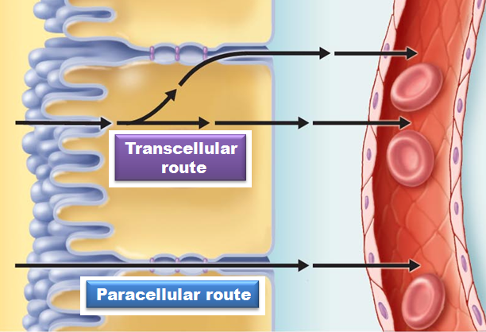
Tubular Reabsorption
Transcellular route
Passes into cells from lumen
Passes through the cytoplasm
Passes out of cell and into blood
Paracellular route
Between tubule cells

Slide 181
Tubular Reabsorption of Sodium
Na⁺ - most abundant cation in filtrate

Slide 182
Passive Tubular Reabsorption of Water
Movement of Na⁺ and other solutes creates osmotic gradient for water
Water reabsorbed by osmosis, aided by water-filled pores called aquaporins
Aquaporins always present in PCT
obligatory water reabsorption
Aquaporins inserted in collecting ducts only if ADH present
facultative water reabsorption

Slide 183
Passive Tubular Reabsorption of Solutes
Solute concentration in filtrate increases as water reabsorbed → concentration gradients for solutes →
Fat-soluble substances, some ions and urea, follow water into peritubular capillaries down concentration gradients
→ Lipid-soluble drugs, environmental pollutants difficult to excrete

Slide 184
Transport Maximum
Transcellular transport systems
specific
limited
Transport maximum for almost every reabsorbed substance;
reflects number of carriers in renal tubules available
When carriers saturated, excess excreted in urine
hyperglycemia → high blood glucose levels exceed transport maximum → glucose stays in urine

Slide 185
Reabsorptive Capabilities of Renal Tubules and Collecting Ducts
Proximal Convoluted Tubules
Site of most reabsorption
All nutrients, e.g., glucose and amino acids
65% of Na⁺ and water
Many ions
~ All uric acid; ½ urea (later secreted back into filtrate)

Slide 186
Reabsorptive Capabilities of Renal Tubules and Collecting Ducts
Nephron loop
Descending limb
H₂O can leave; solutes cannot
Ascending limb
H₂O cannot leave; solutes can

Slide 187
Reabsorptive Capabilities of Renal Tubules and Collecting Ducts
Distal Collecting Tubule and collecting duct
Reabsorption hormonally regulated
Antidiuretic hormone (ADH)
Water
Aldosterone
Na⁺ (therefore water)
Atrial natriuretic peptide (ANP)
Na⁺
PTH
Ca²⁺

Slide 188
Reabsorptive Capabilities of Renal Tubules and Collecting Ducts
Antidiuretic hormone (ADH)
Released by posterior pituitary gland
Causes principal cells of collecting ducts to insert aquaporins in apical membranes →
water reabsorption
As ADH levels increase → increased water reabsorption

Slide 189
Reabsorptive Capabilities of Renal Tubules and Collecting Ducts
Aldosterone
Targets collecting ducts and distal DCT
Promotes synthesis of Na⁺ and K⁺ channels
Na⁺ reabsorption and K⁺ secretion
water follows Na⁺
Functions
increase blood pressure; decrease K⁺ levels

Slide 190
Reabsorptive Capabilities of Renal Tubules and Collecting Ducts
Atrial natriuretic peptide
Reduces blood Na⁺
→ decreased blood volume and blood pressure
Released by cardiac atrial cells if blood volume or pressure elevated
Parathyroid hormone acts on DCT
increase Ca²⁺ reabsorption

Slide 191
Tubular Secretion
Reabsorption in reverse; almost all in PCT
Selected substances
K⁺, H⁺, NH₄⁺, creatinine, organic acids and bases move from peritubular capillaries through tubule cells into filtrate
Substances synthesized in tubule cells also secreted – e.g., HCO₃⁻

Slide 192
Tubular Secretion
Disposes of substances (e.g., drugs) bound to plasma proteins
Eliminates undesirable substances passively reabsorbed (e.g., urea and uric acid)
Rids body of excess K⁺ (aldosterone effect)
Controls blood pH by altering amounts of H⁺ or HCO₃– in urine

Slide 193
Countercurrent Mechanism
Role of countercurrent mechanisms
Establish and maintain osmotic gradient from renal cortex through medulla
Allow kidneys to vary urine concentration

Slide 194
Formation of Dilute or Concentrated Urine
Osmotic gradient used to raise urine concentration
Overhydration → large volume dilute urine
Dehydration → small volume concentrated urine
ADH released
Severe dehydration
99% water reabsorbed

Slide 195
Diuretics
Chemicals that enhance urinary output
ADH inhibitors
alcohol
Na⁺ reabsorption inhibitors
caffeine, drugs for hypertension or edema
Loop diuretics inhibit medullary gradient formation
Osmotic diuretics
substance not reabsorbed so water remains in urine
high glucose of diabetic patient

Slide 196
Clinical Evaluation of Kidney Function
Urine examined for signs of disease
Assessing renal function requires both blood and urine examination

Slide 197
Renal Clearance
Volume of plasma kidneys clear of particular substance in given time
Renal clearance tests used to determine GFR
To detect glomerular damage
To follow progress of renal disease

Slide 198
Renal Clearance
Inulin (a plant polysaccharide) is standard used
Freely filtered
neither reabsorbed nor secreted by kidneys
its renal clearance = GFR = 125 ml/min
Means that in one minute, the kidney has cleared all of the inulin present in 125 ml of plasma
If clearance value is less than inulin
substance was reabsorbed
If clearance value is 0
substance completely reabsorbed
Or not filtered
If clearance value is the same as inulin
no net reabsorption or secretion
If clearance is greater than inulin
substance secreted
Allows for adjustment of drug dosages. If the drugs break down and are eliminated in the urine, a larger or more frequent dosage may be needed.

Slide 199
Homeostatic Imbalance
Chronic renal disease
GFR is less than 60 ml/min for 3 months
Filtrate formation decreases gradually and wastes build up in the blood
diabetes mellitus; hypertension
Renal failure
GFR less than 15 ml/min
Causes uremia syndrome
“urine in the blood”
Wastes not removed
Symptoms:
fatigue, anorexia, nausea, mental changes, muscle cramps
Treated with hemodialysis or transplant

Slide 200
Physical Characteristics of Urine
Color and transparency
Clear
Cloudy may indicate urinary tract infection
Pale to deep yellow from urochrome
Pigment from hemoglobin breakdown; more concentrated urine → deeper color
Abnormal color (pink, brown, smoky)
Food ingestion, bile pigments, blood, drugs

Slide 201
Physical Characteristics of Urine
Odor
Slightly aromatic when fresh
Develops ammonia odor upon standing
As bacteria metabolize solutes
May be altered by some drugs and vegetables or diseases
Smells fruity with uncontrolled diabetes mellitis

Slide 202
Physical Characteristics of Urine
pH
Slightly acidic (~pH 6, with range of 4.5 to 8.0)
Acidic diet (protein, whole wheat) → ↓ pH
Alkaline diet (vegetarian), prolonged vomiting, or urinary tract infections → ↑pH
Specific gravity
1.001 to 1.035; dependent on solute concentration
Is a comparison of the mass of the urine to an equal volume of distilled water

Slide 203
Chemical Composition of Urine
95% water and 5% solutes
Nitrogenous wastes
Urea
from amino acid breakdown
largest solute component
Uric acid
from nucleic acid metabolism
Creatinine
metabolite of creatine phosphate

Slide 204
Chemical Composition of Urine
Other normal solutes
Na⁺, K⁺, PO₄^{3–}, and SO₄^{2–}, Ca²⁺, Mg²⁺ and HCO₃–
Abnormally high concentrations or abnormal components may indicate pathology
blood proteins
WBCs
bile pigments

Slide 205
Urine transport, Storage, and Elimination: Ureters
Convey urine from kidneys to bladder
Begin at L₂ as continuation of renal pelvis
Retroperitoneal
Enter base of bladder through posterior wall
As bladder pressure increases, distal ends of ureters close, preventing backflow of urine

Slide 206
Please note that due to differing operating systems, some animations will not appear until the presentation is viewed in Presentation Mode (Slide Show view). You may see blank slides in the “Normal” or “Slide Sorter” views. All animations will appear after viewing in Presentation Mode and playing each animation. Most animations will require the latest version of the Flash Player, which is available at http://get.adobe.com/flashplayer.

Slide 207
Ureters
Three layers of ureter wall from inside out
Mucosa
transitional epithelium
Muscularis
smooth muscle sheets
Contracts in response to stretch
Propels urine into bladder
Adventitia
outer fibrous connective tissue

Slide 208
Homeostatic Imbalance
Renal calculi
kidney stones in renal pelvis
Crystallized calcium, magnesium, or uric acid salts
Large stones block ureter → pressure & pain
May be due to
chronic bacterial infection
urine retention
↑Ca²⁺ in blood
↑pH of urine
Treatment - shock wave lithotripsy
noninvasive; shock waves shatter stones

Slide 209
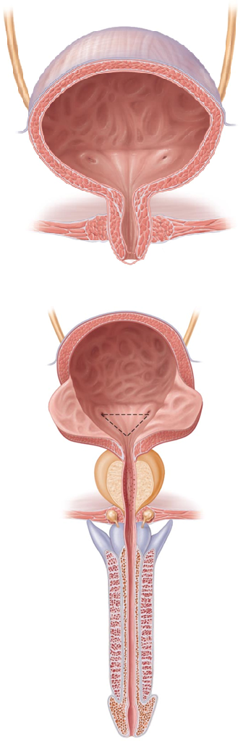
Urinary Bladder
Muscular sac for temporary storage of urine
Retroperitoneal, on pelvic floor posterior to pubic symphysis
Males
prostate gland inferior to bladder neck
Females
anterior to vagina and uterus

Slide 210
Urinary Bladder
Openings for ureters and urethra
Trigone
Smooth triangular area outlined by openings for ureters and urethra
Infections tend to persist in this region

Slide 211
Urinary Bladder
Layers of bladder wall
Mucosa
transitional epithelial mucosa
Thick detrusor muscle
three layers of smooth muscle
Fibrous adventitia

Slide 212
Urinary Bladder
Collapses when empty; rugae appear
Expands and rises superiorly during filling without significant rise in internal pressure
Full bladder 12 cm long; holds about 500 ml
Can hold twice that if necessary
Can burst if overdistended

Slide 213
Urethra
Muscular tube draining urinary bladder
Lining epithelium
Mostly pseudostratified columnar epithelium, except
Transitional epithelium near bladder
Stratified squamous epithelium near external urethral orifice

Slide 214
Urethra
Sphincters
Internal urethral sphincter
Involuntary (smooth muscle) at bladder-urethra junction
Contracts to open
External urethral sphincter
Voluntary (skeletal) muscle surrounding urethra as it passes through pelvic floor

Slide 215
Urethra
Female urethra (3–4 cm)
Tightly bound to anterior vaginal wall
External urethral orifice
Anterior to vaginal opening; posterior to clitoris

Slide 216
Urethra
Male urethra carries semen and urine
Three named regions
Prostatic urethra
within prostate gland
Intermediate part of the urethra (membranous urethra)
passes through urogenital diaphragm from prostate to beginning of penis
Spongy urethra
passes through penis; opens via external urethral orifice

Slide 217
Please note that due to differing operating systems, some animations will not appear until the presentation is viewed in Presentation Mode (Slide Show view). You may see blank slides in the “Normal” or “Slide Sorter” views. All animations will appear after viewing in Presentation Mode and playing each animation. Most animations will require the latest version of the Flash Player, which is available at http://get.adobe.com/flashplayer.

Slide 218
Micturition
Urination or voiding
Three simultaneous events must occur
Contraction of detrusor muscle by Autonomic Nervous System
Opening of internal urethral sphincter by Autonomic Nervous System
Opening of external urethral sphincter by somatic nervous system

Slide 219
Micturition
Reflexive urination (urination in infants)
Distension of bladder activates stretch receptors
Excitation of parasympathetic neurons in reflex center in sacral region of spinal cord
Contraction of detrusor muscle
Contraction (opening) of internal sphincter
Inhibition of somatic pathways to external sphincter, allowing its relaxation (opening)

Slide 220
Micturition
Pontine control centers mature between ages 2 and 3
Pontine storage center inhibits micturition
Inhibits parasympathetic pathways
Excites sympathetic and somatic efferent pathways
Pontine micturition center promotes micturition
Excites parasympathetic pathways
Inhibits sympathetic and somatic efferent pathways

Slide 221
Please note that due to differing operating systems, some animations will not appear until the presentation is viewed in Presentation Mode (Slide Show view). You may see blank slides in the “Normal” or “Slide Sorter” views. All animations will appear after viewing in Presentation Mode and playing each animation. Most animations will require the latest version of the Flash Player, which is available at http://get.adobe.com/flashplayer.

Slide 222
Homeostatic Imbalance
Incontinence usually from weakened pelvic muscles
Stress incontinence
Increased intra-abdominal pressure forces urine through external sphincter
Overflow incontinence
Urine dribbles when bladder overfills

Slide 223
Homeostatic Imbalance
Urinary retention
Bladder unable to expel urine
Common after general anesthesia
Hypertrophy of prostate
Treatment
catheterization

Slide 224
Homeostatic Imbalance
Three common congenital abnormalities
Horseshoe kidney
Two kidneys fuse across midline → single U-shaped kidney; usually asymptomatic
Hypospadias
Urethral orifice on ventral surface of penis
Corrected surgically at ~ 12 months

Slide 225
Homeostatic Imbalance
Polycystic kidney disease
Many fluid-filled cysts interfere with function
Autosomal dominant form
less severe but more common
Autosomal recessive
more severe
Cause unknown but involves defect in signaling proteins

Slide 226
Developmental Aspects
Most elderly people have abnormal kidneys histologically
Kidneys shrink
nephrons decrease in size and number
tubule cells less efficient
GFR ½ that of young adult by age 80
atherosclerosis of renal arteries
Bladder shrinks; loss of bladder tone
nocturia
Needing to get up during night/sleep to urinate
incontinence

