Slide 1
Exam Four and Assignment Four:

Slide 2
Function of the respiratory system
Goal:
to supply the body with oxygen
To dispose of carbon dioxide
Method: Respiration: Includes the following
Pulmonary ventilation
External respiration
Transport of respiratory gasses
Internal respiration

Slide 3
Pulmonary Ventilation
Movement of air into and out of the lungs
“breathing”

Slide 4
External Respiration
Movement of
oxygen
from lungs to the blood
Carbon dioxide
From blood to lungs

Slide 5
Transport of gasses
Oxygen is carried to the cells of the body via the red blood cells
Carbon dioxide is carried from the body to the lungs within the blood

Slide 6
Internal respiration
Moving oxygen from blood cells into tissues
Moving carbon dioxide from tissues into blood

Slide 7
Cells’ use for oxygen
Why transport oxygen?
We deliver oxygen to the cells
Within the cell, oxygen is used by the mitochondria in a process called cellular respiration
Production of ATP

Slide 8
Respiratory Anatomy
Respiratory system includes
Nose
Nasal cavity
Pharynx
Larynx
Trachea
Bronchi
Lungs
Alveoli

Slide 9
Respiratory system
Can be divided up into two functional zones
1. Respiratory zone
Actual location where gas exchange takes place
Respiratory bronchioles
Alveolar ducts
Alveoli
Microscopic structures

Slide 10
Respiratory system
2. Conducting zone
The passageways that provide the route, but do not participate in exchange
Rigid conduits
Also function to
Cleanse
Humidify
warm

Slide 11
Function of the Nose
The only externally visible part of the respiratory system
Provides an airway for respiration
Moistens and warms the entering air
Filters inspired air and cleans it of foreign matter

Slide 12
Structure of the Nose
Nose is divided into two regions:
External nose, including the root, bridge, dorsum nasi, and apex
Internal nasal cavity
Philtrum
a shallow vertical groove inferior to the apex
The external nares (nostrils) are bounded laterally by the alae

Slide 13
Structure of the Nose
Figure 22.2a

Slide 14
Structure of the Nose
Figure 22.2b

Slide 15
Nasal Cavity
Lies in and posterior to the external nose
Is divided by a midline nasal septum
Opens posteriorly into the nasal pharynx via internal nares
The ethmoid and sphenoid bones form the roof
The floor is formed by the hard and soft palates

Slide 16
Nasal Cavity
Vestibule – nasal cavity superior to the nares
Vibrissae – hairs that filter coarse particles from inspired air
Olfactory mucosa
Lines the superior nasal cavity
Contains smell receptors

Slide 17
Nasal Cavity
Respiratory mucosa
Lines the nasal cavity
Except for the olfactory portion
Glands secrete mucus containing lysozyme and defensins to help destroy bacteria

Slide 18
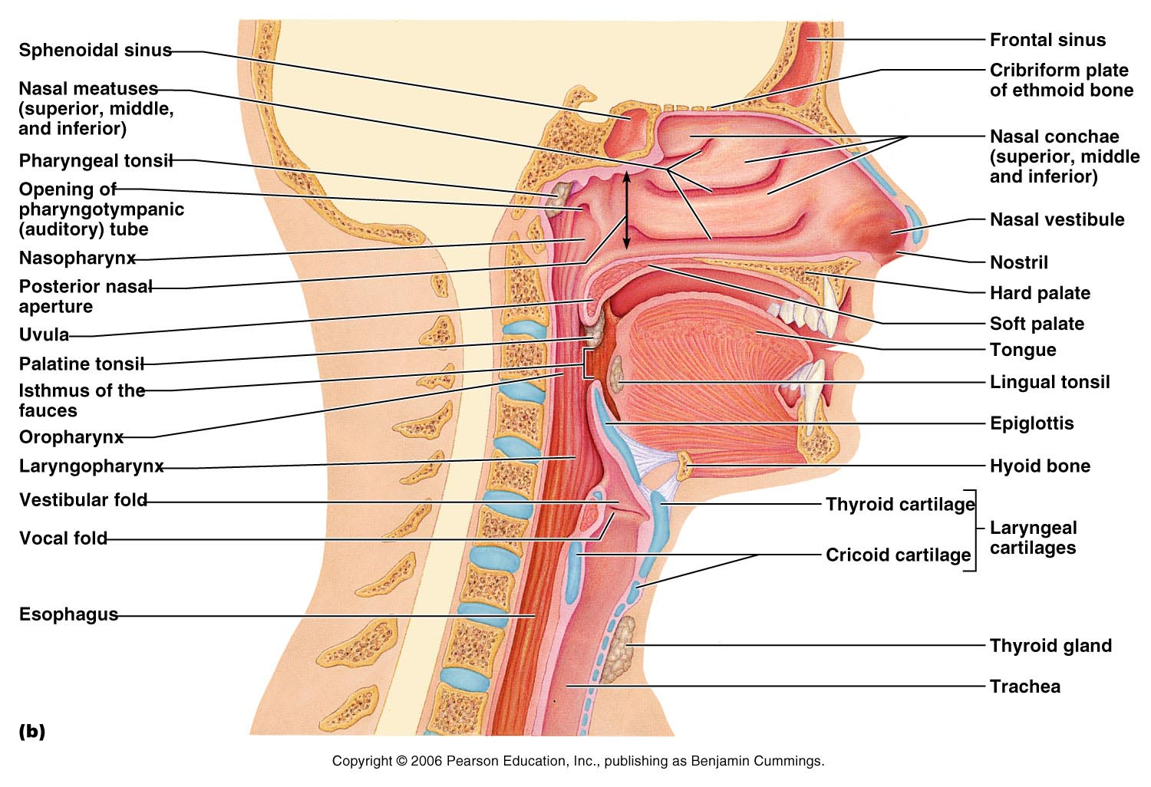
Nasal Cavity
Figure 22.3b

Slide 19
Nasal Cavity
Inspired air is:
Humidified by the high water content in the nasal cavity
Warmed by rich plexuses of capillaries
Remember: blood transports heat
Ciliated mucosal cells remove contaminated mucus

Slide 20
Nasal Cavity
Superior, medial, and inferior conchae:
Protrude medially from the lateral walls
Increase mucosal area
Enhance air turbulence and help filter air
Sensitive mucosa triggers sneezing when stimulated by irritating particles

Slide 21
Functions of the Nasal Mucosa and Conchae
During inhalation the conchae and nasal mucosa:
Filter, heat, and moisten air
During exhalation these structures:
Reclaim heat and moisture
Minimize heat and moisture loss

Slide 22
Paranasal Sinuses
Sinuses in bones that surround the nasal cavity
Sinuses lighten the skull and help to warm and moisten the air

Slide 23
Pharynx
The throat
Funnel-shaped tube of skeletal muscle that connects to the:
Nasal cavity and mouth superiorly
Larynx and esophagus inferiorly
Extends from the base of the skull to the level of the sixth cervical vertebra

Slide 24
Pharynx
It is divided into three regions
Nasopharynx
Oropharynx
Laryngopharynx

Slide 25
Nasopharynx
Lies posterior to the nasal cavity,
inferior to the sphenoid,
superior to the level of the soft palate
Strictly an air passageway
Lined with pseudostratified columnar epithelium

Slide 26
Nasopharynx
Closes during swallowing to prevent food from entering the nasal cavity
The pharyngeal tonsil lies high on the posterior wall
Pharyngotympanic (auditory) tubes open into the lateral walls

Slide 27
Oropharynx
Extends inferiorly from the level of the soft palate to the epiglottis
Serves as a common passageway for food and air

Slide 28
Oropharynx
The epithelial lining is protective stratified squamous epithelium
Palatine tonsils lie in the lateral walls
Lingual tonsil covers the base of the tongue

Slide 29
Laryngopharynx
Serves as a common passageway for food and air
Lies posterior to the upright epiglottis
Extends to the larynx, where the respiratory and digestive pathways diverge

Slide 31
Larynx (Voice Box)
Attaches to the hyoid bone
Continuous with the trachea
functions
To provide an open airway
To direct food and air into the proper pathways
To function in voice production

Slide 32
Framework of the Larynx
Cartilages (hyaline) of the larynx
thyroid cartilage: Shield-shaped
with a midline prominence (Adam’s apple)
cricoid cartilage
Three pairs of small
arytenoid,
cuneiform,
corniculate
Epiglottis
elastic cartilage that covers the laryngeal inlet during swallowing

Slide 33
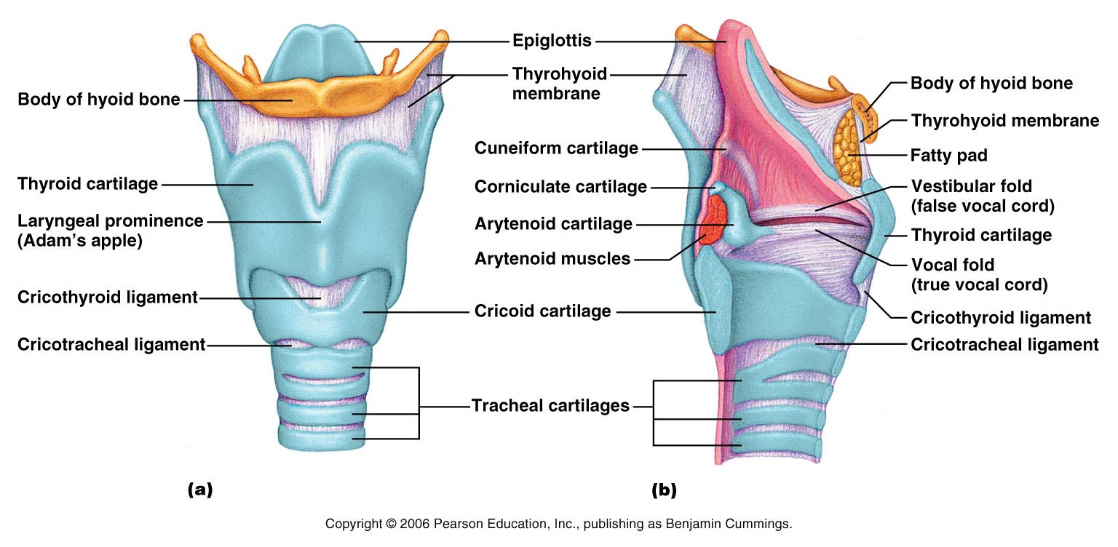
Framework of the Larynx
Figure 22.4a, b

Slide 34
Vocal Ligaments
Attach the arytenoid cartilages to the thyroid cartilage
Composed of elastic fibers that form mucosal folds called true vocal cords
The medial opening between them is the glottis
They vibrate to produce sound as air rushes up from the lungs

Slide 35
Vocal Ligaments
False vocal cords
Mucosal folds superior to the true vocal cords
Have no part in sound production

Slide 36
Vocal Production
Speech
intermittent release of expired air while opening and closing the glottis
Pitch
determined by the length and tension of the vocal cords
Loudness
depends upon the force at which the air rushes across the vocal cords

Slide 37
Vocal production
The pharynx
Resonates
Amplifies
enhances sound quality
Sound is shaped into language by action of the pharynx, tongue, soft palate, and lips

Slide 38
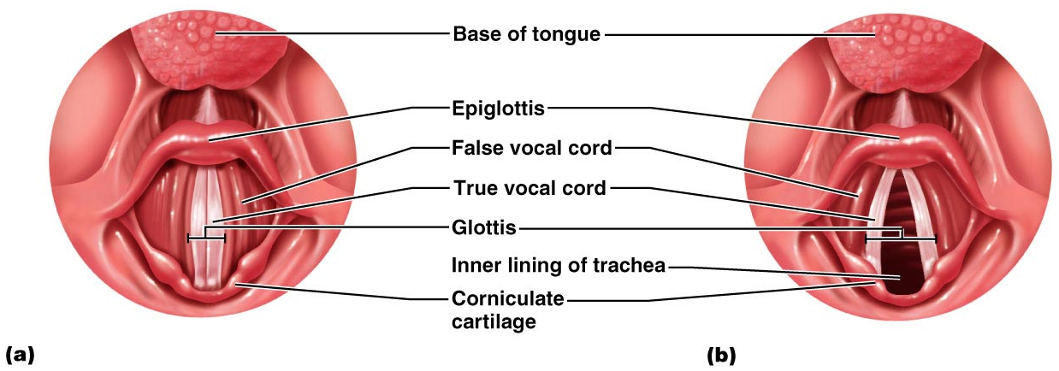
Movements of Vocal Cords
Figure 22.5

Slide 39
Trachea
Flexible and mobile tube extending from the larynx into the mediastinum
Composed of three layers
Mucosa
made up of goblet cells and ciliated epithelium
Submucosa
connective tissue deep to the mucosa
Adventitia
outermost layer made of C-shaped rings of hyaline cartilage

Slide 40
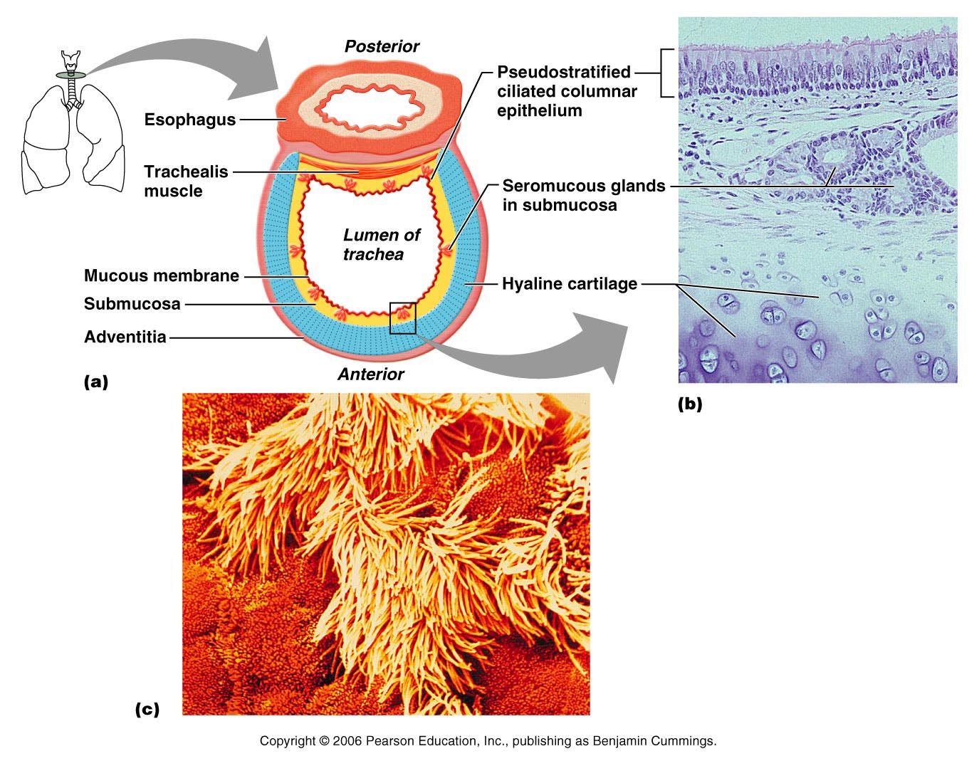
Figure 22.6a

Slide 41
Conducting Zone: Bronchi
Carina
last tracheal cartilage
marks the end of trachea and beginning of bronchi
Air reaching the bronchi is:
Warm and cleansed of impurities
Saturated with water vapor

Slide 42
Conducting Zone: Bronchial Tree
Bronchi subdivide into secondary bronchi, each supplying a lobe of the lungs
Air passages undergo 23 orders of branching
As conducting tubes become smaller, structural changes occur
Cartilage support structures change
Epithelium types change
Amount of smooth muscle increases

Slide 43
Conducting Zone: Bronchial Tree
Bronchioles
Consist of cuboidal epithelium
Have a complete layer of circular smooth muscle
Lack cartilage support and mucus-producing cells

Slide 44
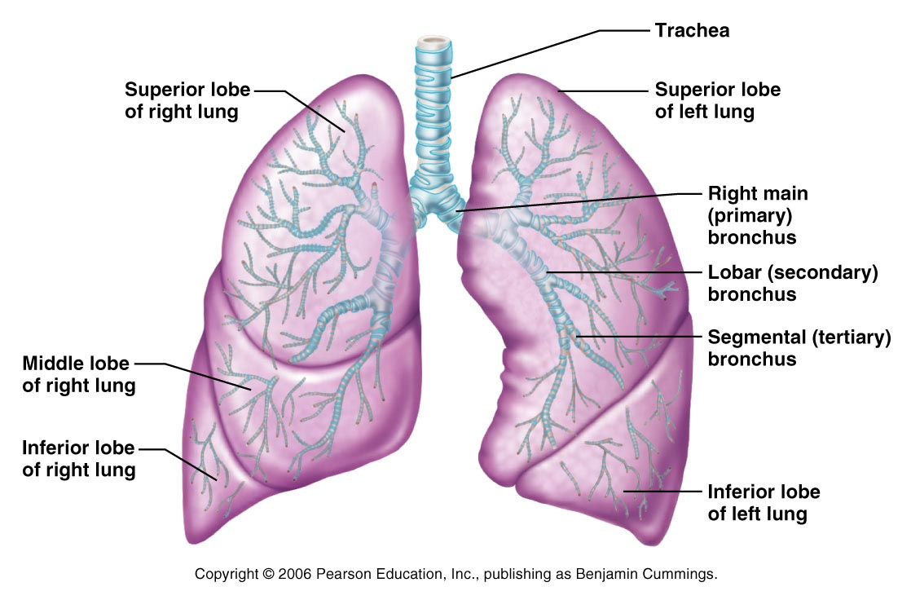
Conducting Zones
Figure 22.7

Slide 45
Respiratory Zone
Defined by
presence of alveoli
begins as terminal bronchioles feed into respiratory bronchioles
Respiratory bronchioles → alveolar ducts, → alveolar sacs composed of alveoli
Approximately 300 million alveoli:
Accounts for most of the lung volume
tremendous surface area for gas exchange

Slide 46
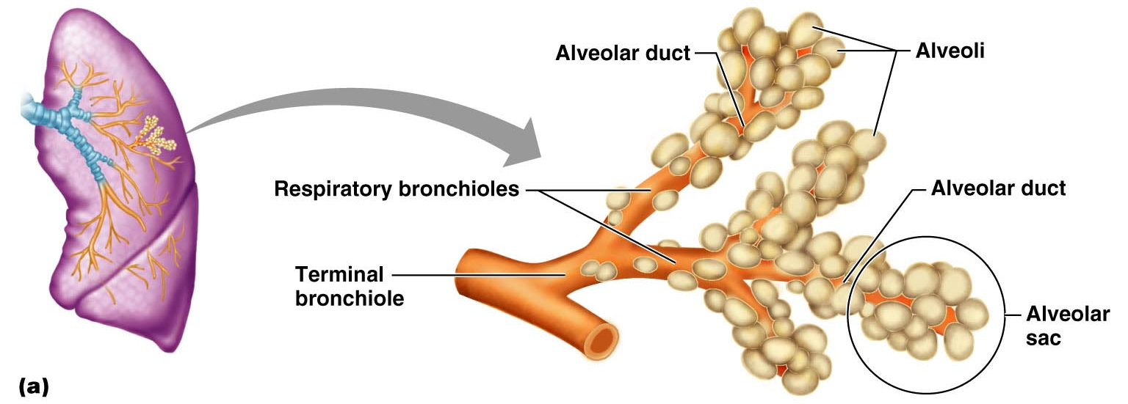
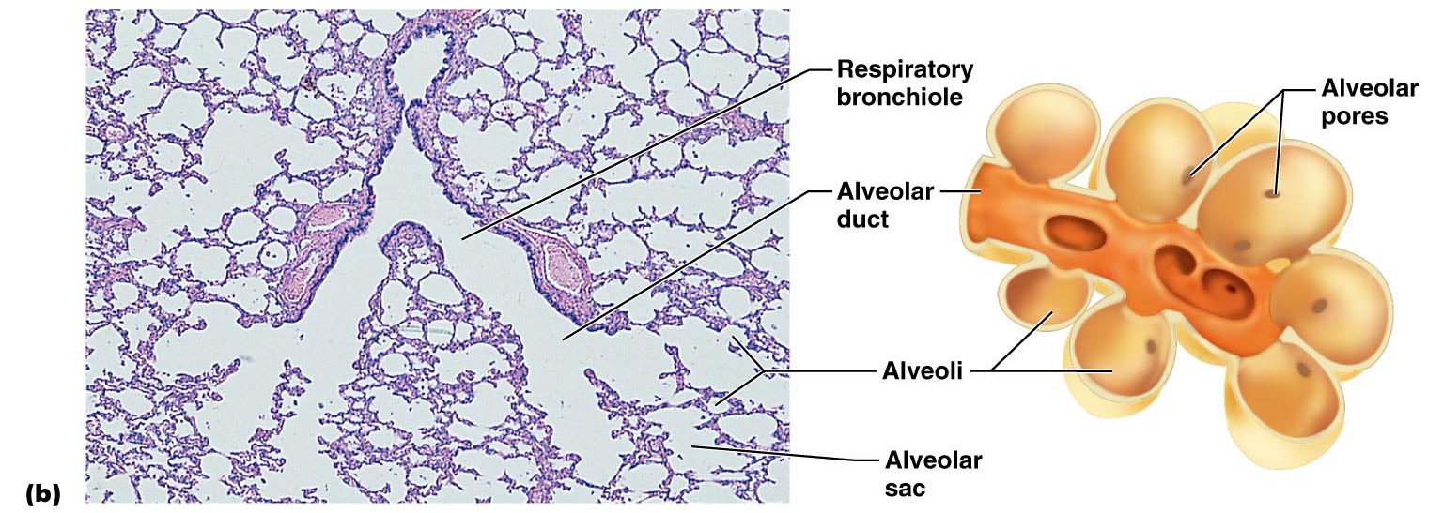
Figure 22.8a

Slide 47
Respiratory Membrane
Alveolar walls:
single layer of simple squamous epithelial cells
Permit gas exchange by simple diffusion
Secrete angiotensin converting enzyme (ACE)
Type II cells secrete surfactant

Slide 48
Alveoli
Surrounded by fine elastic fibers
Contain open pores that:
Connect adjacent alveoli
Allow air pressure throughout the lung to be equalized
House macrophages that keep alveolar surfaces sterile

Slide 49
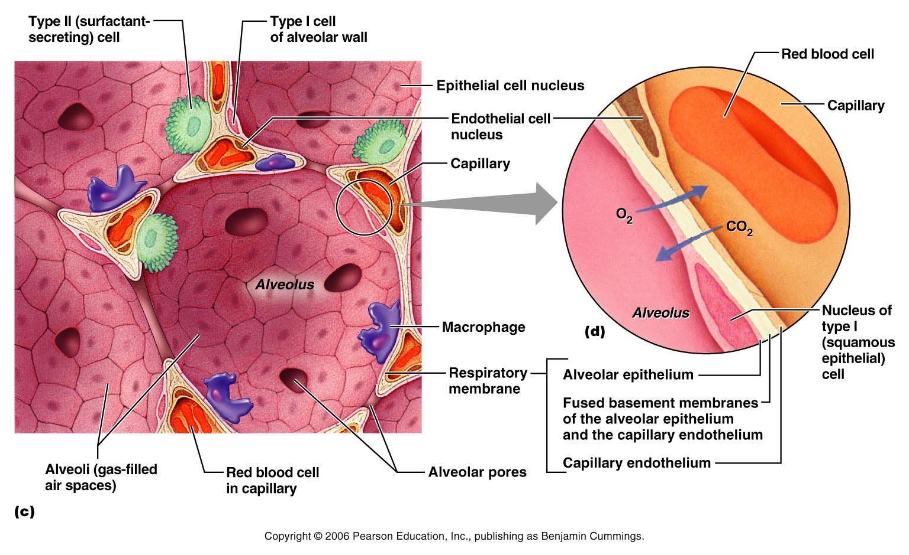
Respiratory Membrane
Figure 22.9b

Slide 50
Gross Anatomy of the Lungs
Lungs occupy all of the thoracic cavity except the mediastinum
Root
site of vascular and bronchial attachments
Costal surface
anterior, lateral, and posterior surfaces in contact with the ribs
Apex
narrow superior tip
Base
inferior surface that rests on the diaphragm
Hilus
indentation that contains pulmonary and systemic blood vessels

Slide 51
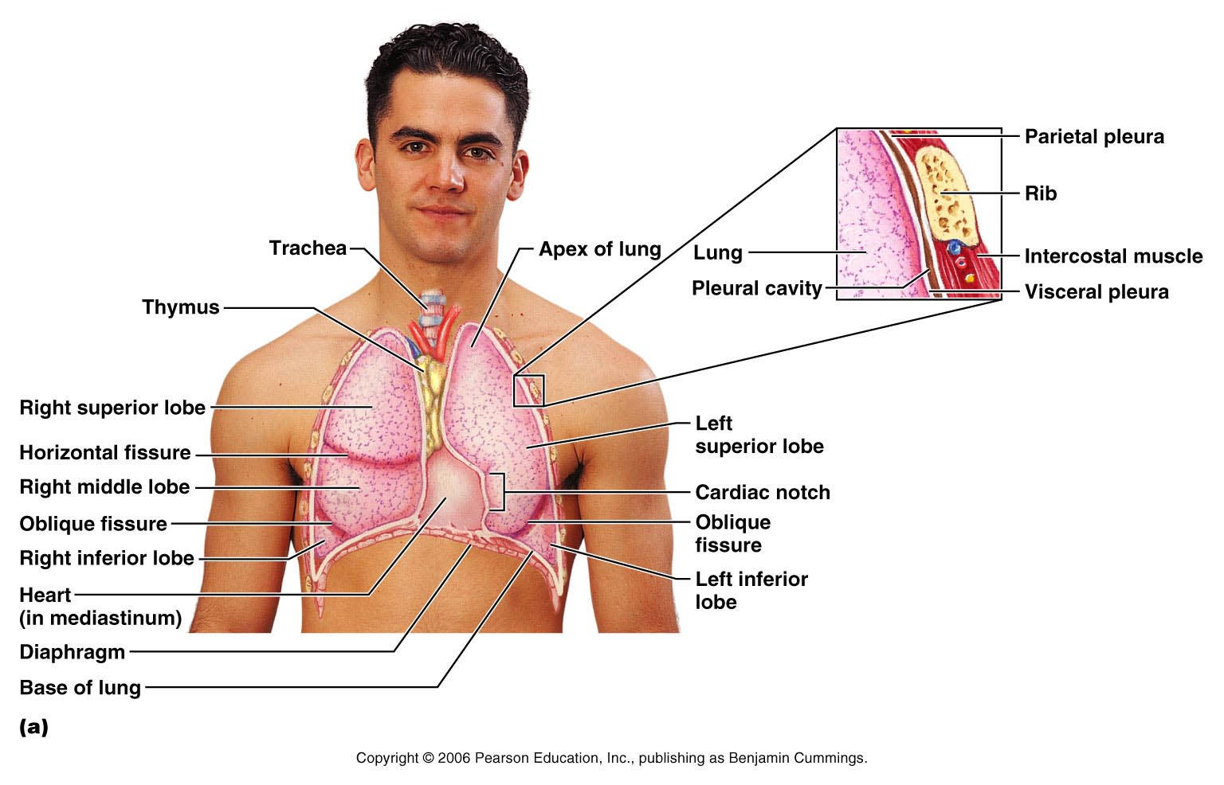
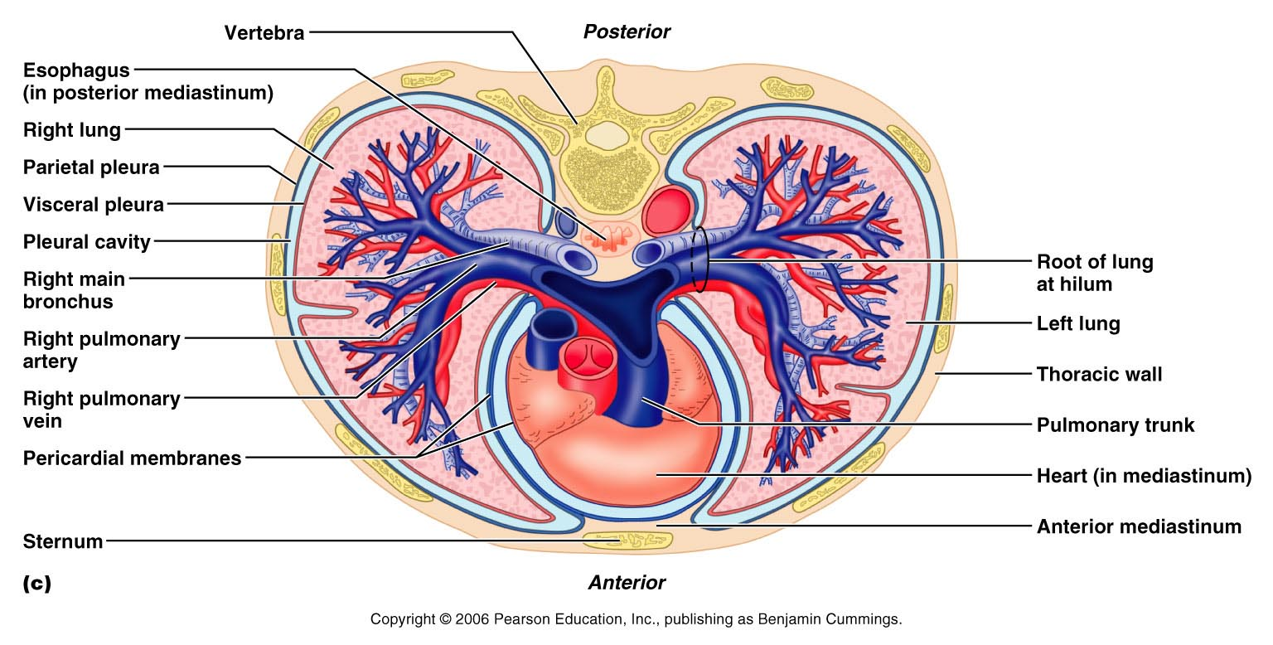
Figure 22.10a

Slide 52
Lungs
Cardiac notch (impression)
cavity that accommodates the heart
Left lung
separated into upper and lower lobes by the oblique fissure
Right lung
separated into three lobes by the oblique and horizontal fissures
There are 10 bronchopulmonary segments in each lung

Slide 53
Blood Supply to Lungs
Lungs are perfused by two circulations: pulmonary and bronchial
Pulmonary arteries
supply systemic venous blood to be oxygenated
Branch profusely, along with bronchi
Ultimately feed into the pulmonary capillary network surrounding the alveoli
Pulmonary veins
carry oxygenated blood from respiratory zones to the heart

Slide 54
Blood Supply to Lungs
Bronchial arteries
provide systemic blood to the lung tissue
Arise from aorta and enter the lungs at the hilus
Supply all lung tissue except the alveoli
Bronchial veins anastomose with pulmonary veins
Pulmonary veins carry most venous blood back to the heart

Slide 55
Pleurae
Parietal pleura
Covers the thoracic wall and superior face of the diaphragm
Continues around heart and between lungs

Slide 56
Pleurae
Visceral pleura
also pulmonary pleura
Covers the external lung surface

Slide 57
Breathing
Breathing, or pulmonary ventilation, consists of two phases
Inspiration
air flows into the lungs
Expiration
gas exits the lungs

Slide 58
Pressure Relationships in the Thoracic Cavity
Respiratory pressure is always described relative to atmospheric pressure
Atmospheric pressure (P_{atm})
Pressure exerted by the air surrounding the body
Negative respiratory pressure is less than P_{atm}
Positive respiratory pressure is greater than P_{atm}

Slide 59
Pressure Relationships in the Thoracic Cavity
Intrapulmonary pressure (P_{pul})
pressure within the alveoli
Intrapleural pressure (P_{ip})
pressure within the pleural cavity

Slide 60
Pressure Relationships
Intrapulmonary pressure and intrapleural pressure fluctuate with the phases of breathing
Intrapulmonary pressure always eventually equalizes itself with atmospheric pressure
Intrapleural pressure is always less than intrapulmonary pressure and atmospheric pressure

Slide 61
Pressure Relationships
Two forces act to pull the lungs away from the thoracic wall, promoting lung collapse
Elasticity of lungs causes them to assume smallest possible size
Surface tension of alveolar fluid draws alveoli to their smallest possible size
Opposing force – elasticity of the chest wall pulls the thorax outward to enlarge the lungs

Slide 62
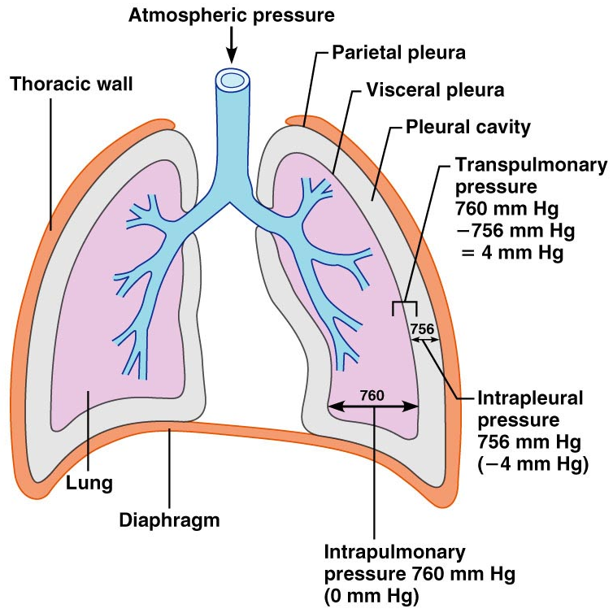
Pressure Relationships
Figure 22.12

Slide 63
Lung Collapse
Caused by equalization of the intrapleural pressure with the intrapulmonary pressure
Transpulmonary pressure keeps the airways open
Transpulmonary pressure – difference between the intrapulmonary and intrapleural pressures (P_{pul} – P_{ip})

Slide 64
Lung collapse: pneumothorax

Slide 65
Pulmonary Ventilation
A mechanical process that depends on volume changes in the thoracic cavity
Volume changes lead to pressure changes, which lead to the flow of gases to equalize pressure

Slide 66
Inspiration
The diaphragm contracts downward towards the abdomen
external intercostal muscles contract elevating the rib cage
The lungs are stretched
intrapulmonary volume increases
Intrapulmonary pressure drops below atmospheric pressure (−1 mm Hg)
Air flows into the lungs, down its pressure gradient to equilibrium

Slide 67
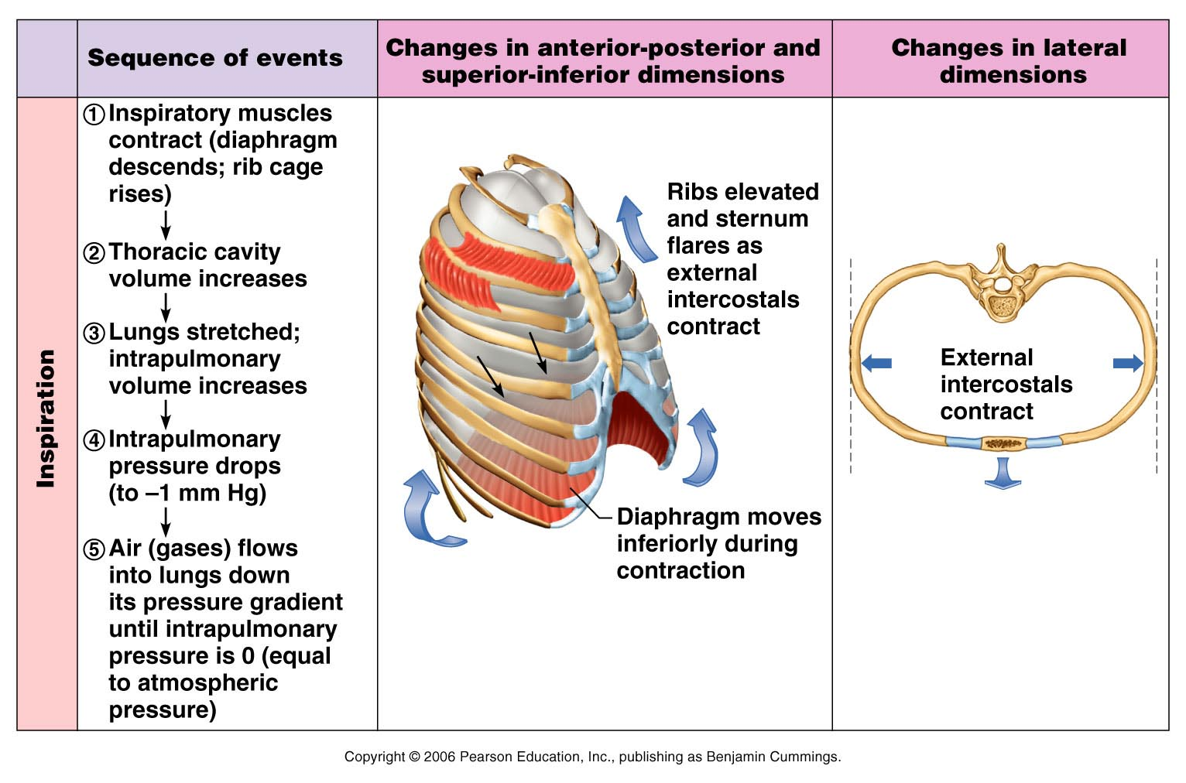
Inspiration
Figure 22.13.1

Slide 68
Expiration
Inspiratory muscles relax
rib cage descends due to gravity
Thoracic cavity volume decreases
Elastic lungs recoil passively
intrapulmonary volume decreases
Intrapulmonary pressure rises above atmospheric pressure
Gases flow out of the lungs down the pressure gradient

Slide 69
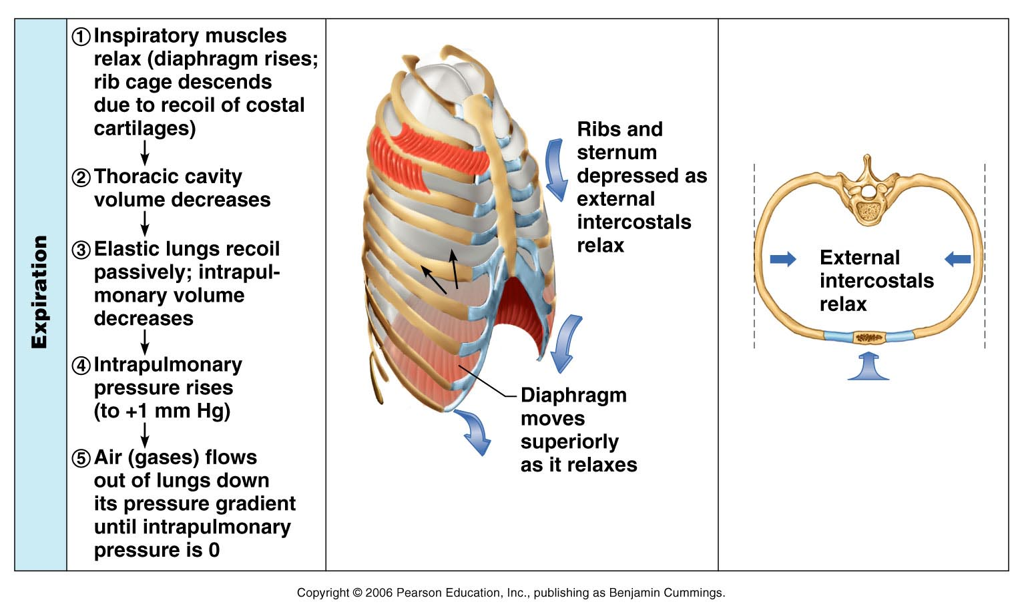
Expiration
Figure 22.13.2

Slide 70
Airway Resistance
As airway resistance rises
breathing movements become more strenuous
Severely constricted or obstructed bronchioles:
Can prevent life-sustaining ventilation
Can occur during acute asthma attacks which stops ventilation
Epinephrine release
from the sympathetic nervous system
dilates bronchioles
reduces air resistance

Slide 71
Alveolar Surface Tension
Surface tension
the attraction of liquid molecules to one another at a liquid-gas interface
The liquid coating the alveolar surface is always acting to reduce the alveoli to the smallest possible size
Surfactant, a detergent-like complex, reduces surface tension and helps keep the alveoli from collapsing

Slide 72
Lung Compliance
The ease with which lungs can be expanded
Determined by two main factors
Stretch of the lung tissue and surrounding thoracic cage
Surface tension of the alveoli

Slide 73
Factors That Diminish Lung Compliance
Scar tissue or fibrosis
reduces the resilience of the lungs
Seen in tuberculosis
Blockage of the smaller respiratory passages with mucus or fluid
Reduced production of surfactant
Decreased flexibility of the thoracic cage or its decreased ability to expand

Slide 74
Factors That Diminish Lung Compliance
Examples include:
Deformities of thorax
Ossification of the costal cartilage
Paralysis of intercostal muscles

Slide 75
Respiratory Volumes
Tidal volume (TV)
air that moves into and out of the lungs with each breath (approximately 500 ml)
Inspiratory reserve volume (IRV)
air that can be inspired forcibly beyond the tidal volume (2100–3200 ml)

Slide 76
Respiratory Volumes
Expiratory reserve volume (ERV)
air that can be evacuated from the lungs after a tidal expiration (1000–1200 ml)
Residual volume (RV)
air left in the lungs after strenuous expiration (1200 ml)

Slide 77
Respiratory Capacities
Inspiratory capacity (IC)
total amount of air that can be inspired after a tidal expiration (IRV + TV)
Functional residual capacity (FRC)
amount of air remaining in the lungs after a tidal expiration (RV + ERV)

Slide 78
Respiratory Capacities
Vital capacity (VC)
the total amount of exchangeable air (TV + IRV + ERV)
Total lung capacity (TLC)
sum of all lung volumes (approximately 6000 ml in males)

Slide 79
Dead Space
Anatomical dead space
volume of the conducting respiratory passages (150 ml)
Alveolar dead space
alveoli that cease to act in gas exchange due to collapse or obstruction
Total dead space
sum of alveolar and anatomical dead spaces

Slide 80
Pulmonary Function Tests
Spirometer
an instrument consisting of a hollow bell inverted over water, used to evaluate respiratory function
Spirometry can distinguish between:
Obstructive pulmonary disease – increased airway resistance
Restrictive disorders – reduction in total lung capacity from structural or functional lung changes

Slide 81
Pulmonary Function Tests
Total ventilation
total amount of gas flow into or out of the respiratory tract in one minute
Forced vital capacity (FVC)
gas forcibly expelled after taking a deep breath
Forced expiratory volume (FEV)
the amount of gas expelled during specific time intervals of the FVC

Slide 82
Pulmonary Function Tests
Increases in TLC, FRC, and RV may occur as a result of obstructive disease
Reduction in VC, TLC, FRC, and RV result from restrictive disease

Slide 83
Alveolar Ventilation
Alveolar ventilation rate (AVR)
measures the flow of fresh gases into and out of the alveoli during a particular time
Slow, deep breathing increases AVR and rapid, shallow breathing decreases AVR
AVR | = | frequency | X | (TV – dead space)
(ml/min) |  | (breaths/min) |  | (ml/breath)

Slide 84
Nonrespiratory Air Movements
Most result from reflex action
Examples include
Coughing
Sneezing
Crying
Laughing
Hiccupping
yawning

Slide 85
Composition of Alveolar Gas
The atmosphere is mostly oxygen and nitrogen
alveoli contain more carbon dioxide and water vapor
These differences result from:
Gas exchanges in the lungs – oxygen diffuses from the alveoli and carbon dioxide diffuses into the alveoli
Humidification of air by conducting passages
The mixing of alveolar gas that occurs with each breath

Slide 86
External Respiration: Pulmonary Gas Exchange
Factors influencing the movement of oxygen and carbon dioxide across the respiratory membrane
Partial pressure gradients and gas solubilities
Matching of alveolar ventilation and pulmonary blood perfusion
Structural characteristics of the respiratory membrane

Slide 87
Partial Pressure Gradients
The partial pressure oxygen (PO₂) of venous blood is 40 mm Hg; the partial pressure in the alveoli is 104 mm Hg
This steep gradient allows oxygen partial pressures to rapidly reach equilibrium (in 0.25 seconds), and thus blood can move three times as quickly (0.75 seconds) through the pulmonary capillary and still be adequately oxygenated

Slide 88
Partial Pressure Gradients and Gas Solubilities
Although carbon dioxide has a lower partial pressure gradient:
It is 20 times more soluble in plasma than oxygen
It diffuses in equal amounts with oxygen

Slide 89
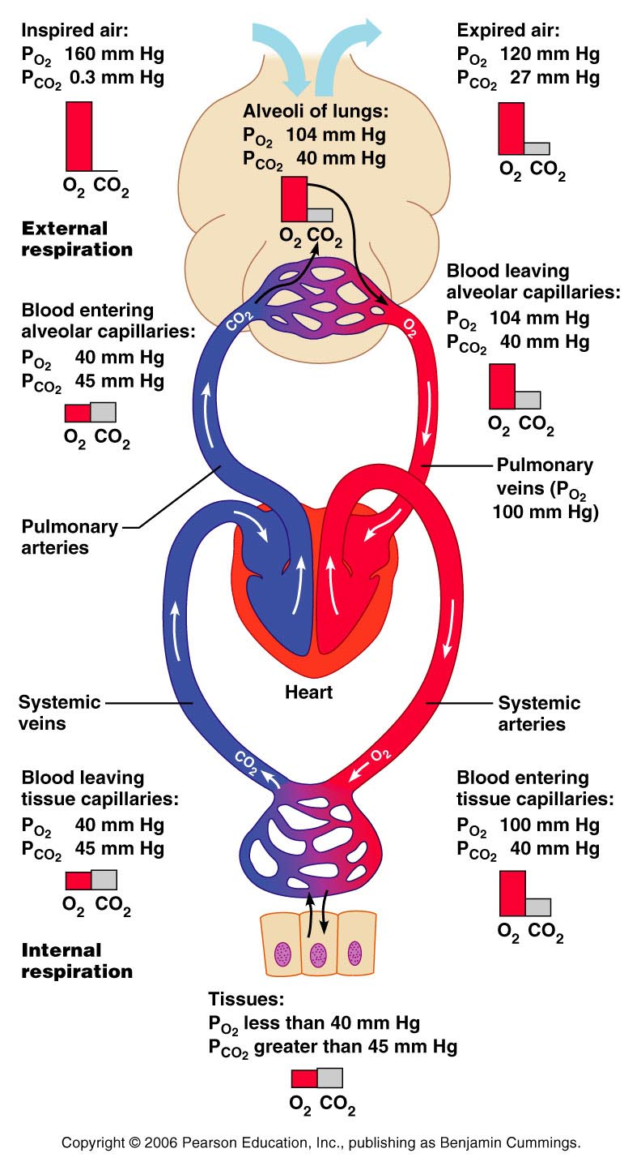
Figure 22.17

Slide 90
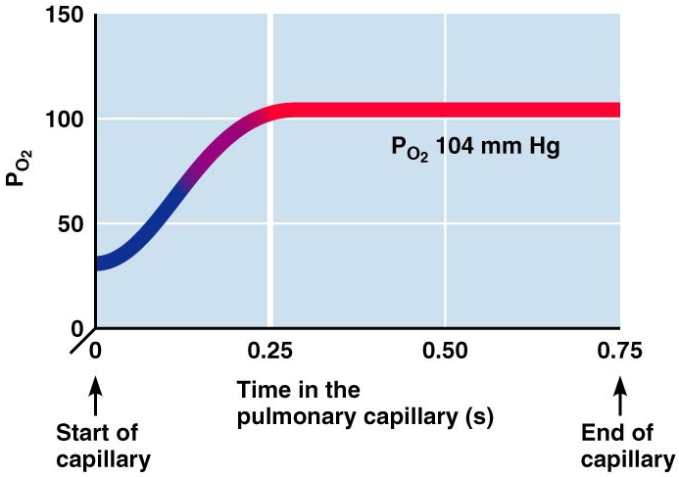
Oxygenation of Blood
Figure 22.18

Slide 91
Ventilation-Perfusion Coupling
Ventilation
the amount of gas reaching the alveoli
Perfusion
the blood flow reaching the alveoli
Ventilation and perfusion must be tightly regulated for efficient gas exchange

Slide 92
Ventilation-Perfusion Coupling
Changes in P_{CO2} in the alveoli cause changes in the diameters of the bronchioles
Passageways servicing areas where alveolar carbon dioxide is high dilate
Those serving areas where alveolar carbon dioxide is low constrict

Slide 93
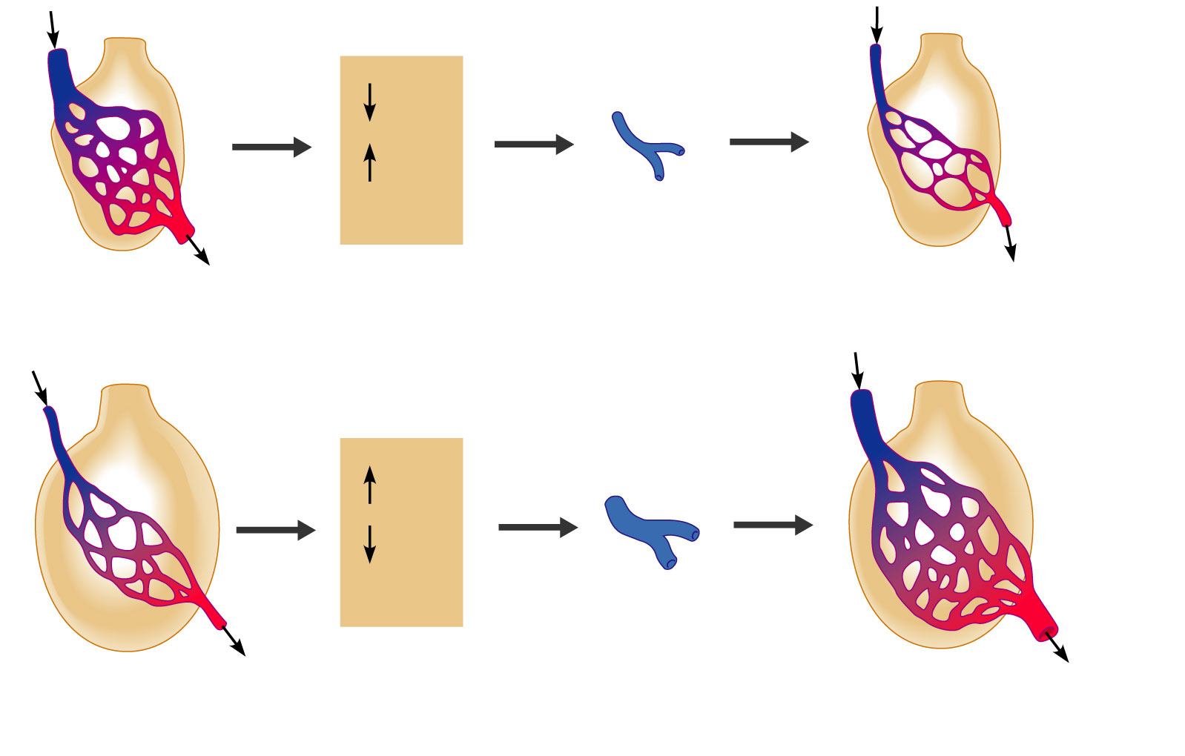
P_{O2}
P_{CO2}
in alveoli
Reduced alveolar ventilation;
excessive perfusion
Pulmonary arterioles
serving these alveoli
constrict
Reduced alveolar ventilation;
reduced perfusion
P_{O2}
P_{CO2}
in alveoli
Enhanced alveolar ventilation;
inadequate perfusion
Pulmonary arterioles
serving these alveoli
dilate
Enhanced alveolar ventilation;
enhanced perfusion
Figure 22.19

Slide 94
Reduced alveolar ventilation;
excessive perfusion
Figure 22.19

Slide 95
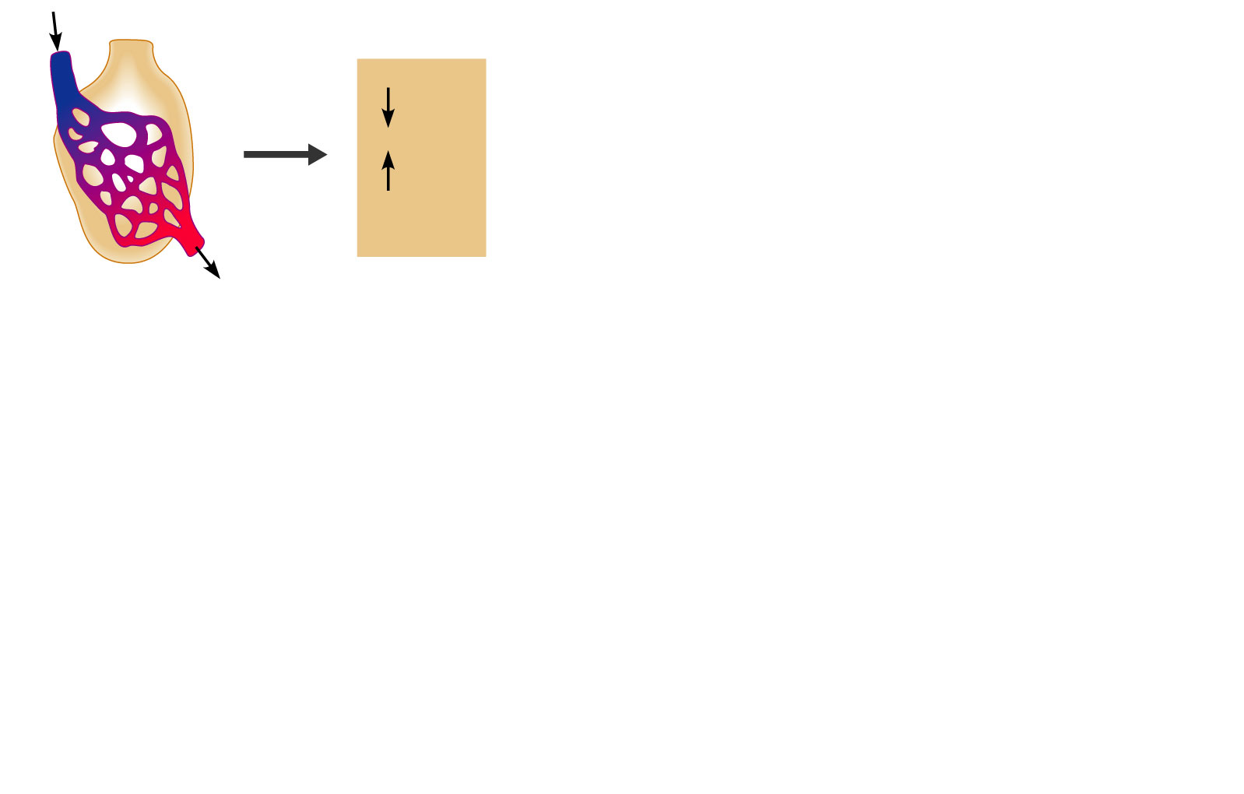
P_{O2}
P_{CO2}
in alveoli
Reduced alveolar ventilation;
excessive perfusion
Figure 22.19

Slide 96
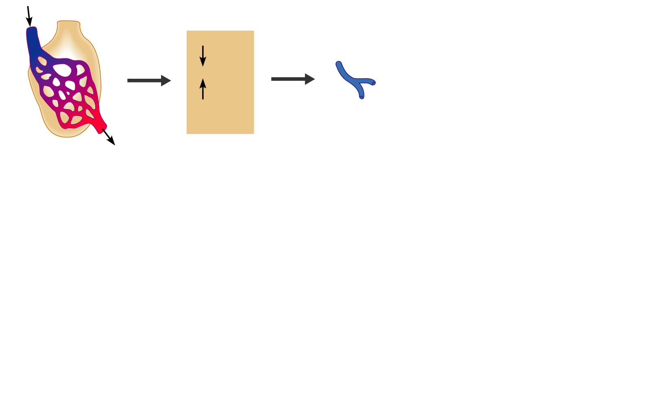
P_{O2}
P_{CO2}
in alveoli
Reduced alveolar ventilation;
excessive perfusion
Pulmonary arterioles
serving these alveoli
constrict
Figure 22.19

Slide 97
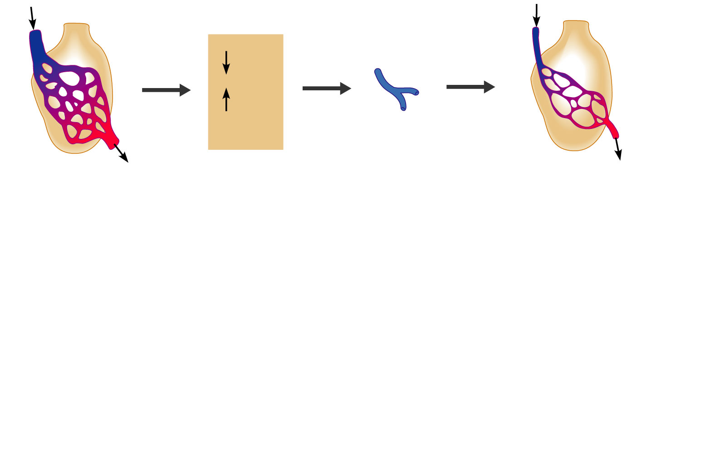
P_{O2}
P_{CO2}
in alveoli
Reduced alveolar ventilation;
excessive perfusion
Pulmonary arterioles
serving these alveoli
constrict
Reduced alveolar ventilation;
reduced perfusion
Figure 22.19

Slide 98
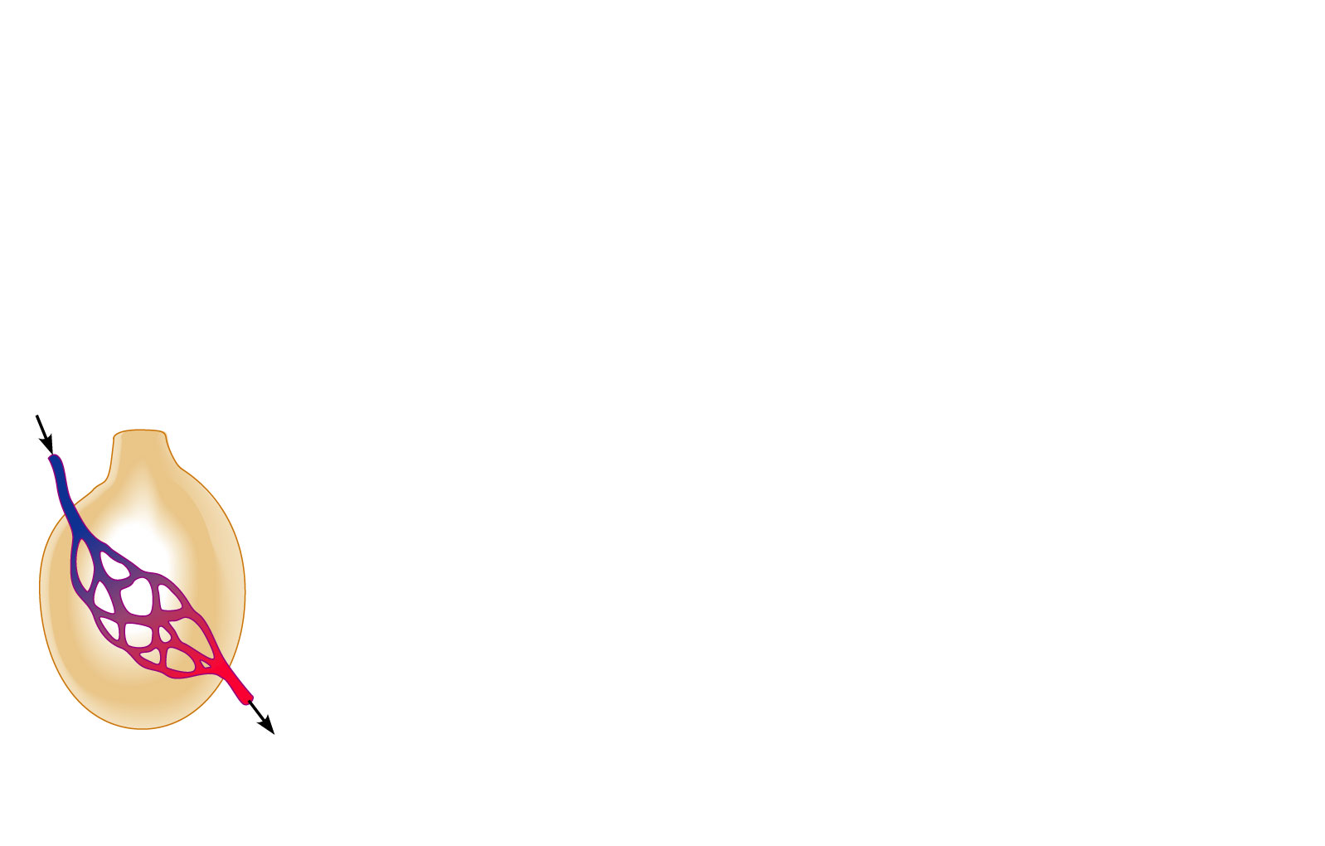
Enhanced alveolar ventilation;
inadequate perfusion
Figure 22.19

Slide 99
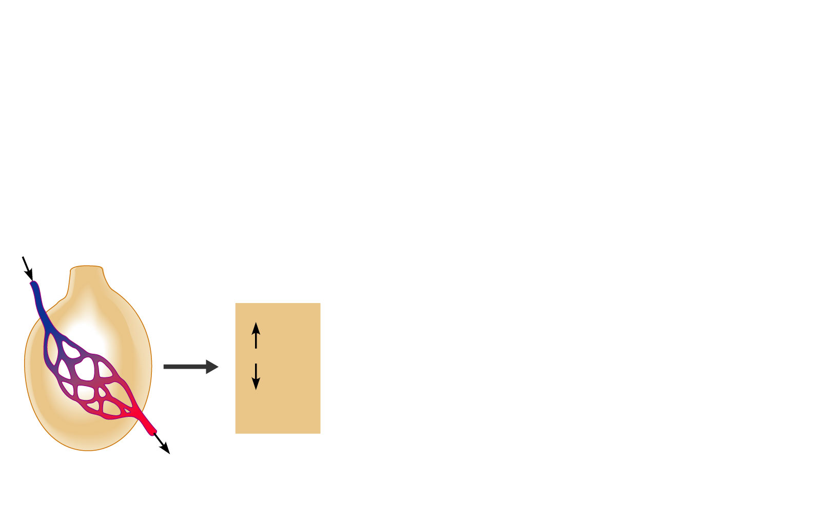
P_{O2}
P_{CO2}
in alveoli
Enhanced alveolar ventilation;
inadequate perfusion
Figure 22.19

Slide 100
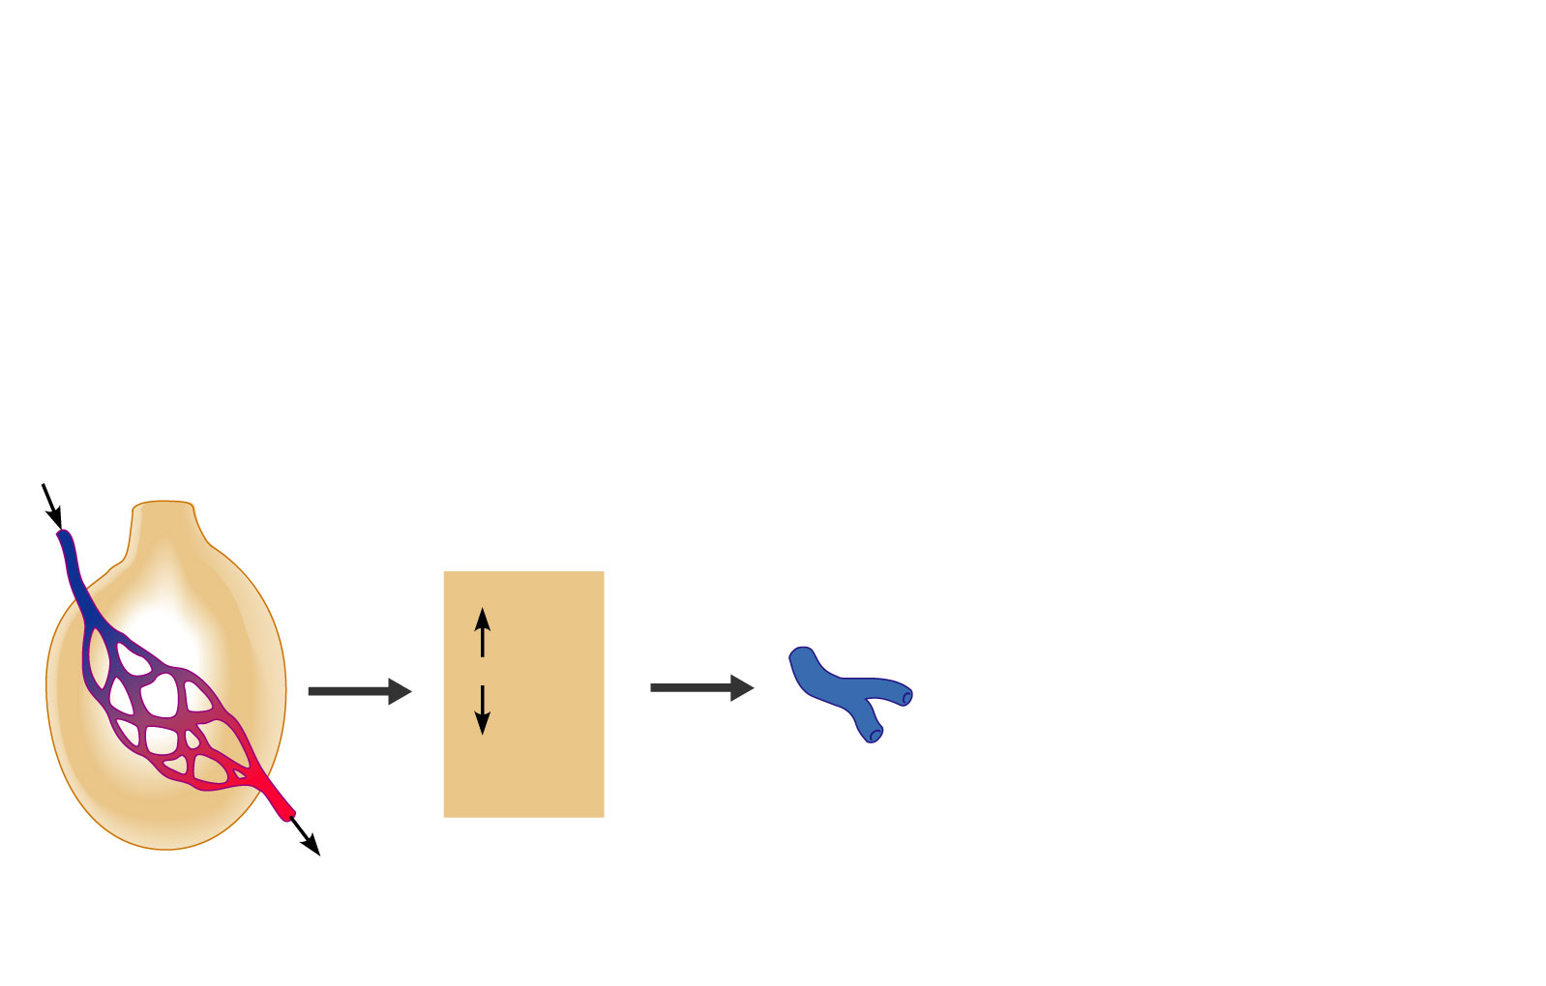
P_{O2}
P_{CO2}
in alveoli
Enhanced alveolar ventilation;
inadequate perfusion
Pulmonary arterioles
serving these alveoli
dilate
Figure 22.19

Slide 101
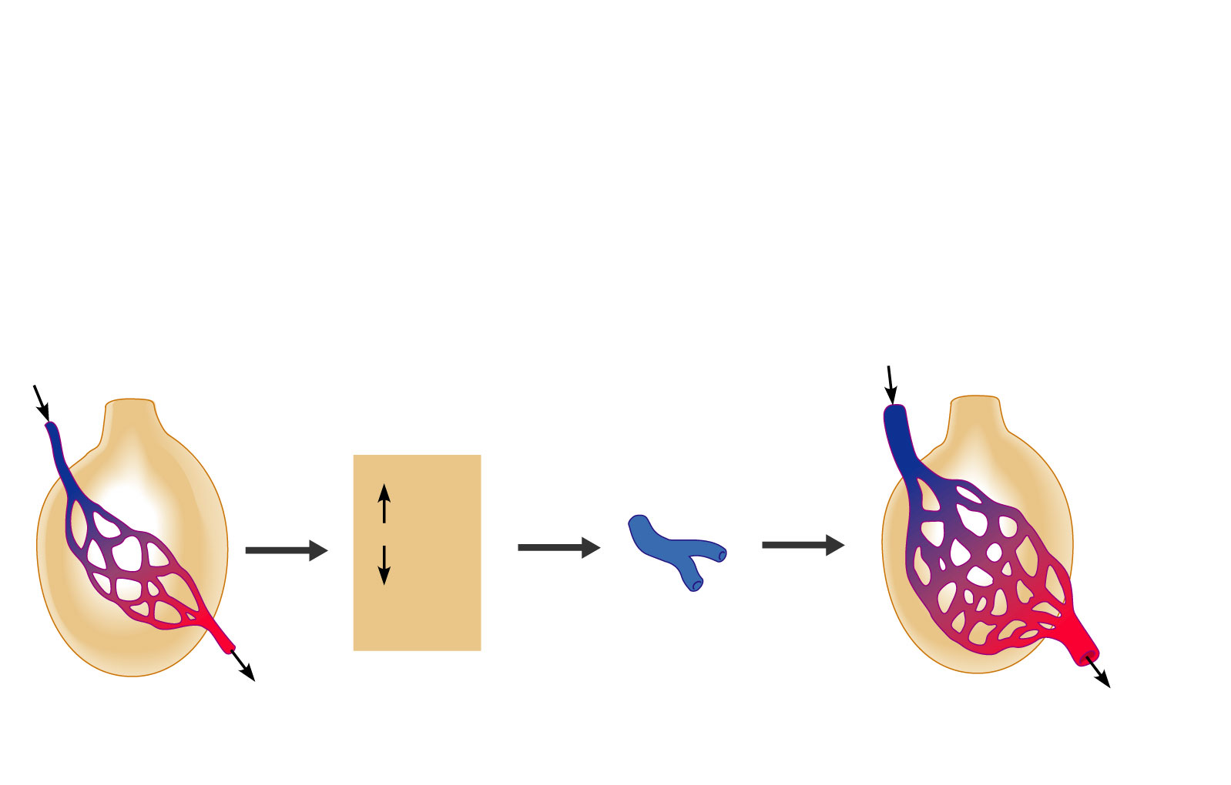
P_{O2}
P_{CO2}
in alveoli
Enhanced alveolar ventilation;
inadequate perfusion
Pulmonary arterioles
serving these alveoli
dilate
Enhanced alveolar ventilation;
enhanced perfusion
Figure 22.19

Slide 102
P_{O2}
P_{CO2}
in alveoli
Reduced alveolar ventilation;
excessive perfusion
Pulmonary arterioles
serving these alveoli
constrict
Reduced alveolar ventilation;
reduced perfusion
P_{O2}
P_{CO2}
in alveoli
Enhanced alveolar ventilation;
inadequate perfusion
Pulmonary arterioles
serving these alveoli
dilate
Enhanced alveolar ventilation;
enhanced perfusion
Figure 22.19

Slide 103
Surface Area and Thickness of the Respiratory Membrane
Respiratory membranes:
Are thin, allowing for efficient gas exchange
Have a total surface area (in males) of about 60 m² (40 times that of one’s skin)
Thicken if lungs become waterlogged and edematous,
gas exchange is inadequate
oxygen deprivation results
Decrease in surface area with emphysema, when walls of adjacent alveoli break through

Slide 104
Internal Respiration
The factors promoting internal respiration are the same as those for external respiration
The partial pressures and diffusion gradients are reversed
P_{O2} in tissue is always lower than in systemic arterial blood
P_{O2} of venous blood draining tissues is 40 mm Hg and P_{CO2} is 45 mm Hg

Slide 105
Oxygen Transport
Molecular oxygen is carried in the blood:
Bound to hemoglobin (Hb) within red blood cells
Dissolved in plasma

Slide 106
Oxygen Transport: Role of Hemoglobin
Each Hb molecule binds four oxygen atoms in a rapid and reversible process
The hemoglobin-oxygen combination is called oxyhemoglobin (HbO₂)
Hemoglobin that has released oxygen is called reduced hemoglobin (HHb)
Lungs
HHb + O₂
HbO₂ + H⁺
Tissues

Slide 107
Hemoglobin (Hb)
Saturated hemoglobin
when all four hemes of the molecule are bound to oxygen
Partially saturated hemoglobin
when one to three hemes are bound to oxygen

Slide 108
Hemoglobin Saturation Curve
Hemoglobin is almost completely saturated at a P_{O2} of 70 mm Hg
Further increases in P_{O2} produce only small increases in oxygen binding
Oxygen loading and delivery to tissue is adequate when P_{O2} is below normal levels

Slide 109
Hemoglobin Saturation Curve
Only 20–25% of bound oxygen is unloaded during one systemic circulation
If oxygen levels in tissues drop:
More oxygen dissociates from hemoglobin and is used by cells
Respiratory rate or cardiac output need not increase

Slide 110
Factors Influencing Hemoglobin Saturation
Temperature,
Acidity
Carbon dioxide pressure
BPG:
bisphosphoglycerate (produced by RBCs during glycolysis and can bind with Hb)
alters hemoglobin’s affinity for oxygen

Slide 111
Factors Influencing Hemoglobin Saturation
Increases of these factors:
Decrease hemoglobin’s affinity for oxygen
Enhance oxygen unloading from the blood
Decreases act in the opposite manner
These parameters are all high in systemic capillaries where oxygen unloading is the goal

Slide 112
Factors That Increase Release of Oxygen by Hemoglobin
As cells metabolize glucose, carbon dioxide is released into the blood causing:
Increases in
Carbon dioxide pressure
H⁺ concentration in capillary blood
Declining pH (acidosis), which weakens the hemoglobin-oxygen bond (Bohr effect)

Slide 113
Factors That Increase Release of Oxygen by Hemoglobin
Metabolizing cells have heat as a byproduct and the rise in temperature increases BPG synthesis
All these factors ensure oxygen unloading in the vicinity of working tissue cells

Slide 114
Carbon Dioxide Transport
Carbon dioxide is transported in the blood in three forms
Dissolved in plasma – 7 to 10%
Chemically bound to hemoglobin – 20% is carried in RBCs as carbaminohemoglobin
Bicarbonate ion in plasma – 70% is transported as bicarbonate (HCO₃–)

Slide 115
Transport and Exchange of Carbon Dioxide
Carbon dioxide diffuses into RBCs and combines with water to form carbonic acid (H₂CO₃), which quickly dissociates into hydrogen ions and bicarbonate ions
In RBCs, the enzyme carbonic anhydrase converts carbon dioxide and water to carbonic acid
CO₂ | + | H₂O | ↔ | H₂CO₃ | ↔ | H⁺ | + | HCO₃–
Carbon dioxide |  | Water |  | Carbonic acid |  | Hydrogen ion |  | Bicarbonate ion

Slide 116
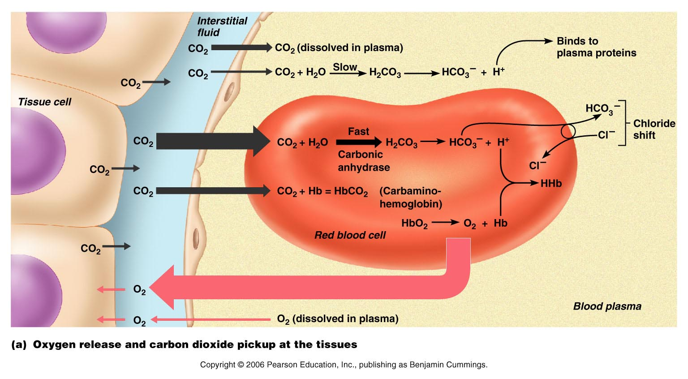
Transport and Exchange of Carbon Dioxide
Figure 22.22a

Slide 117
Transport and Exchange of Carbon Dioxide
At the tissues:
Bicarbonate quickly diffuses from RBCs into the plasma
The chloride shift
counterbalance the outrush of negative ions (bicarbonate) from the RBCs
chloride ions (Cl–) move from the plasma into the erythrocytes

Slide 118
Transport and Exchange of Carbon Dioxide
At the lungs, these processes are reversed
Bicarbonate ions move into the RBCs and bind with hydrogen ions to form carbonic acid
Carbonic acid is then split by carbonic anhydrase to release carbon dioxide and water
Carbon dioxide then diffuses from the blood into the alveoli

Slide 119
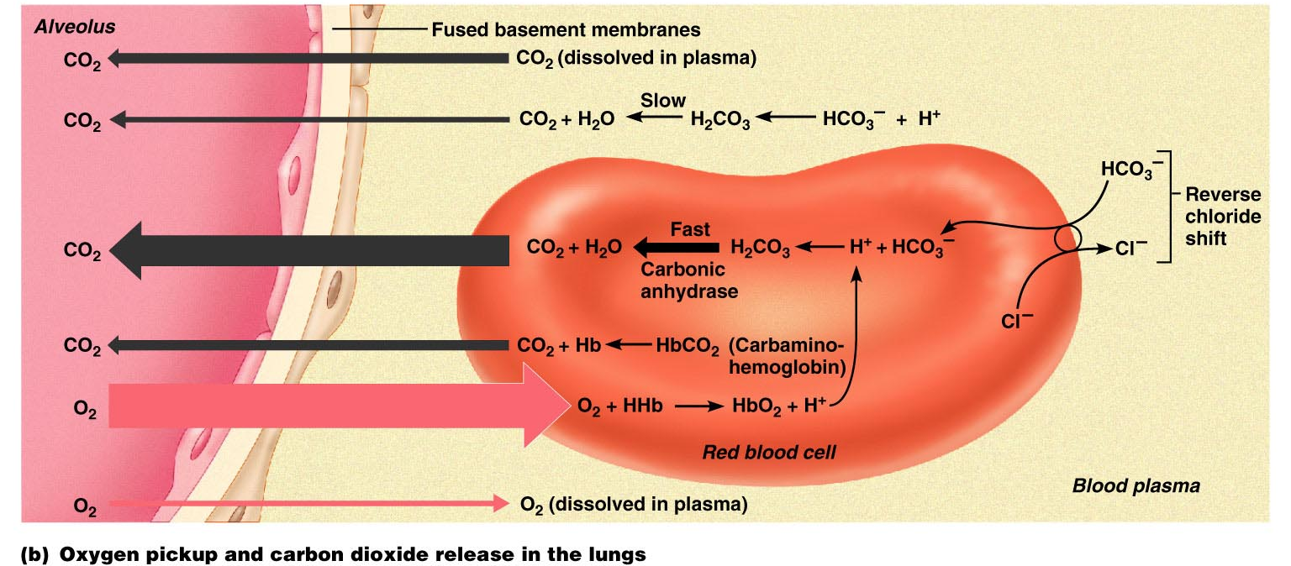
Transport and Exchange of Carbon Dioxide
Figure 22.22b

Slide 120
Haldane Effect
The amount of carbon dioxide transported is markedly affected by the P_{O2}
Haldane effect
the less oxygen and saturated Hb, the more carbon dioxide can be carried in the blood

Slide 121
Haldane Effect
At the tissues, as more carbon dioxide enters the blood:
More oxygen dissociates from hemoglobin
Weak binding allows oxygen to break away and diffuse into the tissues
More carbon dioxide combines with hemoglobin, and more bicarbonate ions are formed
This situation is reversed in pulmonary circulation

Slide 122
Influence of Carbon Dioxide on Blood pH
The carbonic acid–bicarbonate buffer system resists blood pH changes
If hydrogen ion concentrations in blood begin to rise, excess H⁺ is removed by combining with HCO₃–
If hydrogen ion concentrations begin to drop, carbonic acid dissociates, releasing H⁺
CO₂ | + | H₂O | ↔ | H₂CO₃ | ↔ | H⁺ | + | HCO₃–
Carbon dioxide |  | Water |  | Carbonic acid |  | Hydrogen ion |  | Bicarb ion

Slide 123
Influence of Carbon Dioxide on Blood pH
Changes in respiratory rate can also:
Alter blood pH
Provide a fast-acting system to adjust pH when it is disturbed by metabolic factors

Slide 124
Control of Respiration: Medullary Respiratory Centers
The dorsal respiratory group (DRG)
or inspiratory center:
Location: Medulla oblongata
Function: sets rate of respiration
Excites the inspiratory muscles
sets eupnea (12-15 breaths/minute)
Eu: good
Pnea: breath
Becomes dormant during expiration

Slide 125
Medullary respiratory centers
The ventral respiratory group (VRG)
involved in forced inspiration
expiration

Slide 126
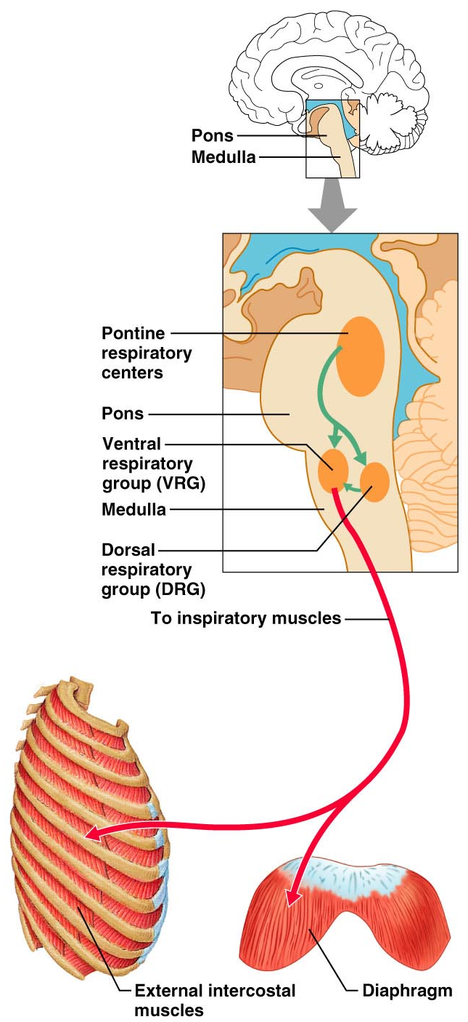
Control of Respiration: Pons Respiratory Centers
Pons centers:
Influences medullary centers
Smooth out transitions (inspiration/expiration)
The pontine respiratory group (PRG) – continuously inhibits the inspiration center

Slide 127
Respiratory Rhythm
A result of relationship between medullary and pons centers
Other theories include
Inspiratory neurons are pacemakers and are both automatic and rhythmic
Stretch receptors in the lungs establish respiratory rhythm

Slide 128
Depth and Rate of Breathing
Inspiratory depth is determined by how actively the respiratory center stimulates the respiratory muscles
Rate of respiration is determined by how long the inspiratory center is active
Respiratory centers in the pons and medulla are sensitive to both excitatory and inhibitory stimuli

Slide 129
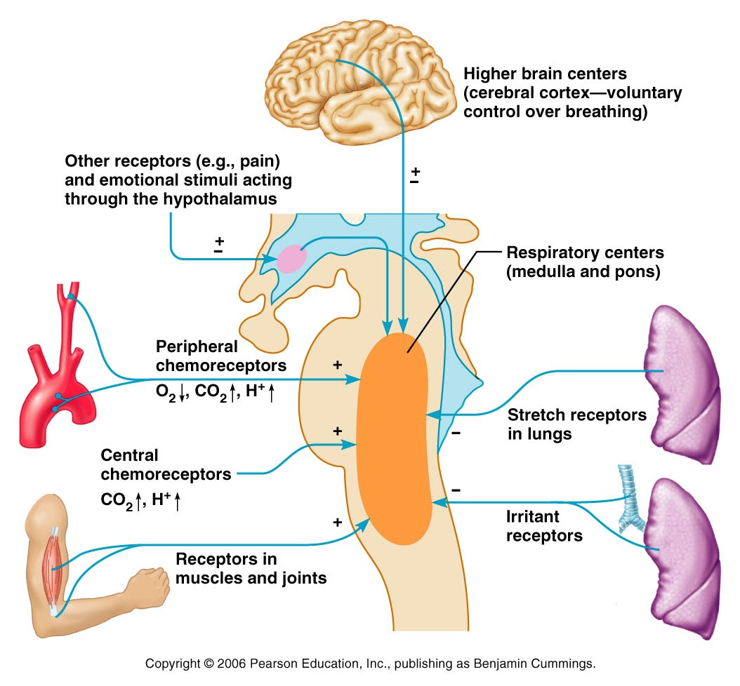
Medullary Respiratory Centers
Figure 22.25

Slide 130
Depth and Rate of Breathing: Reflexes
Pulmonary irritant reflexes
irritants promote constriction of air passages
Inflation reflex (Hering-Breuer)
stretch receptors in the lungs are stimulated by lung inflation
Prevents over-stretching
The body gives feedback based on stretch.

Slide 131
Depth and Rate of Breathing: Higher Brain Centers
Hypothalamic controls act with the limbic system (emotions) to modify rate and depth of respiration
Example: breath holding that occurs in anger
A rise in body temperature acts to increase respiratory rate
Cortical controls are direct signals from the cerebral motor cortex that bypass medullary controls
Examples: voluntary breath holding, taking a deep breath

Slide 132
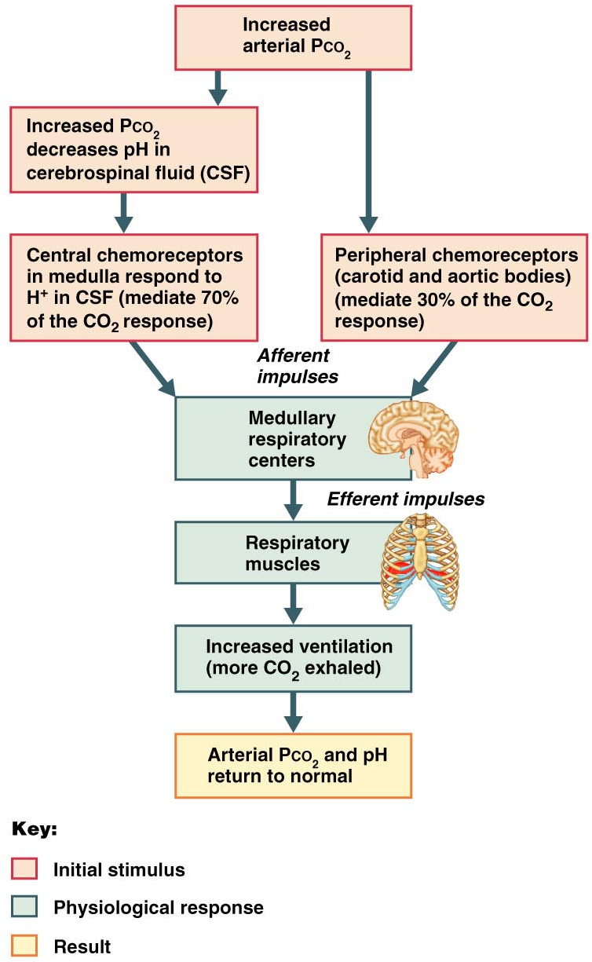
Depth and Rate of Breathing: P_{CO2}
levels are monitored by chemoreceptors of the brain stem
Carbon dioxide in the blood diffuses into the cerebrospinal fluid
Resulting carbonic acid dissociates, releasing hydrogen ions
Carbon dioxide levels rise
resulting in increased depth and rate of breathing

Slide 133
Depth and Rate of Breathing: P_{CO2}
Hyperventilation – increased depth and rate of breathing that:
Quickly flushes carbon dioxide from the blood
Occurs in response to hypercapnia
Elevated Carbon dioxide levels
Though a rise CO₂ acts as the original stimulus, control of breathing at rest is regulated by the hydrogen ion concentration in the brain

Slide 134
Depth and Rate of Breathing: P_{CO2}
Hypoventilation
slow and shallow breathing due to abnormally low P_{CO2} levels
Apnea (breathing cessation) may occur until P_{CO2} levels rise

Slide 135
Depth and Rate of Breathing: P_{CO2}
aortic and carotid bodies sense arterial oxygen levels
Oxygen levels are not a stimulus for ventilation unless the levels drop significantly
If carbon dioxide is not removed, chemoreceptors become unresponsive to Carbon dioxide
Then oxygen levels become the principal respiratory stimulus (hypoxic drive)

Slide 136
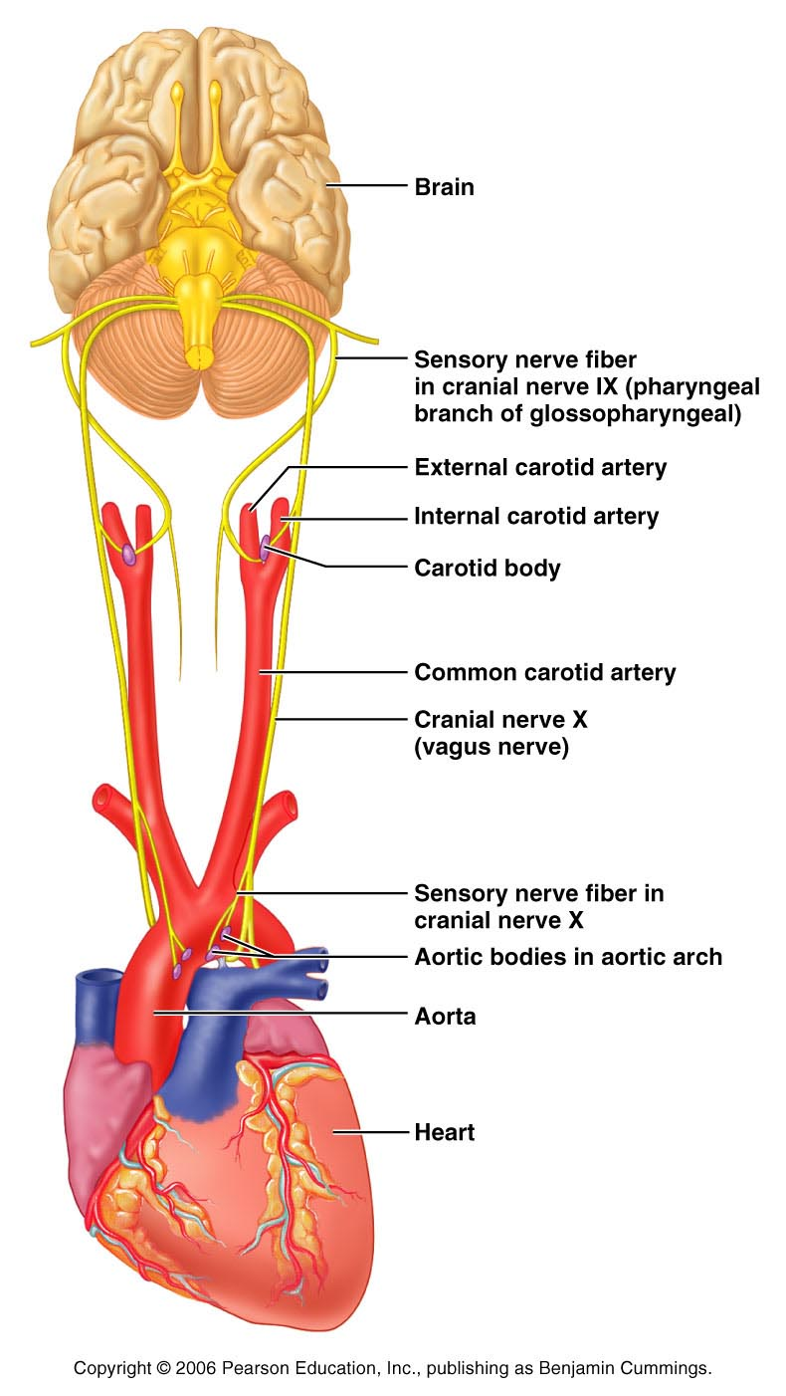
Depth and Rate of Breathing: Arterial pH
Changes in arterial pH can modify respiratory rate even if carbon dioxide and oxygen levels are normal
Increased ventilation in response to falling pH is mediated by peripheral chemoreceptors

Slide 137
Depth and Rate of Breathing: Arterial pH
Acidosis may reflect:
Carbon dioxide retention
Accumulation of lactic acid
Excess fatty acids in patients with diabetes mellitus
Respiratory system controls will attempt to raise the pH by increasing respiratory rate and depth

Slide 138
Respiratory Adjustments: Exercise
Respiratory adjustments are geared to both the intensity and duration of exercise
During vigorous exercise:
Ventilation can increase 20 fold
Breathing becomes deeper and more vigorous, but respiratory rate may not be significantly changed (hyperpnea)
Exercise-enhanced breathing is not prompted by an increase in P_{CO2} or a decrease in P_{O2} or pH
These levels remain surprisingly constant during exercise

Slide 139
Respiratory Adjustments: Exercise
As exercise begins:
Ventilation increases abruptly, rises slowly, and reaches a steady state
When exercise stops:
Ventilation declines suddenly, then gradually decreases to normal

Slide 140
Respiratory Adjustments: Exercise
Neural factors bring about the above changes, including:
Anticipation of excercise
Cortical motor activation
Both skeletal muscles and respiratory center
Excitatory impulses from moving muscles

Slide 141
Chronic Obstructive Pulmonary Disease (COPD)
Includes chronic bronchitis and obstructive emphysema
Patients have a history of:
Smoking
Dyspnea, where labored breathing occurs and gets progressively worse
Coughing
frequent pulmonary infections
COPD victims develop respiratory failure accompanied by hypoxemia, carbon dioxide retention, and respiratory acidosis

Slide 142
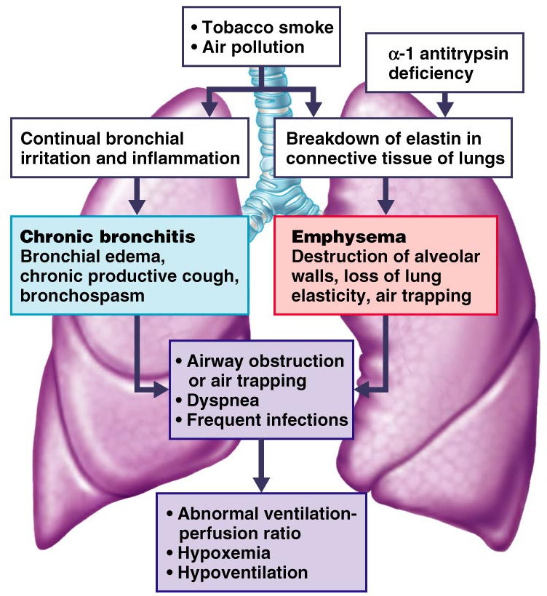
COPD
Figure 22.28

Slide 143
Asthma
Characterized by
Dyspnea
wheezing,
chest tightness
Active inflammation of the airways precedes bronchospasms

Slide 144
Asthma
Airway inflammation is an immune response
caused by release of IL-4 and IL-5
stimulate IgE
recruit inflammatory cells
Airways fill with fluids as a result of the inflammation. This magnifies the effect of bronchospasms

Slide 145
Tuberculosis
Infectious disease caused by the bacterium Mycobacterium tuberculosis
Symptoms include
Fever
night sweats,
weight loss,
racking cough
splitting headache
Treatment entails a 12-month course of antibiotics

Slide 146
Lung Cancer
Accounts for 1/3 of all cancer deaths in the U.S.
90% of all patients with lung cancer were smokers
The three most common types are:
Squamous cell carcinoma (20-40% of cases)
arises in bronchial epithelium
Adenocarcinoma (25-35% of cases)
originates in peripheral lung area
Small cell carcinoma (20-25% of cases)
contains lymphocyte-like cells that originate in the primary bronchi and subsequently metastasize

