Slide 1
Reproductive System
Primary sex organs: gonads
  testes
  ovaries
  Produce gametes: sex cells
    Sperm
    ova
  Secrete steroid sex hormones
    Androgens (males)
    Estrogens and progesterone (females)
Accessory reproductive organs
  ducts, glands, and external genitalia

Slide 2
Reproductive System
Sex hormones play roles in
  Development and function of reproductive organs
  Sexual behavior and drives
  Growth and development of organs and tissues

Slide 3
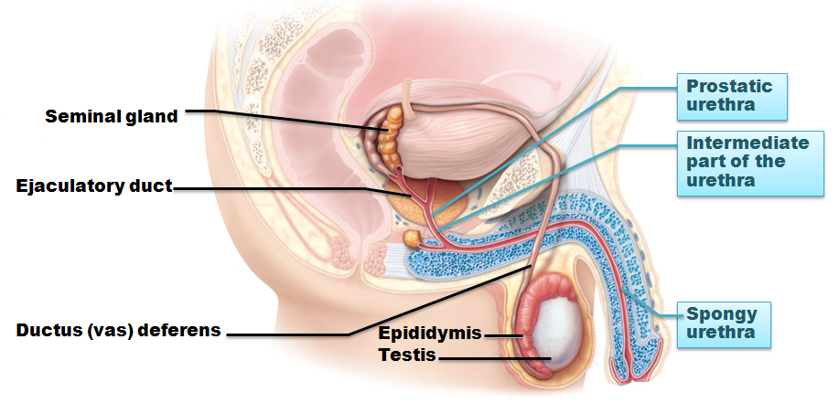
Male Reproductive System
Testes
  within scrotum
  produce sperm
Sperm delivered to exterior through system of ducts
  Epididymis → ductus deferens → ejaculatory duct → urethra

Slide 4
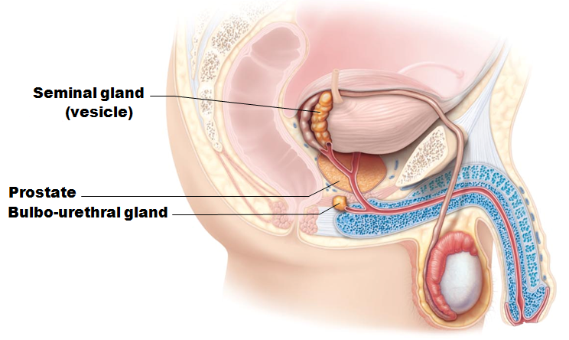
Male Reproductive System
Accessory sex glands
  Seminal vesicles
  Prostate
  Bulbourethral glands
  Empty secretions into ducts during ejaculation

Slide 5
The Scrotum
Sac of skin and superficial fascia
  Hangs outside abdominopelvic cavity
  Contains paired testes
    3°C lower than core body temperature
    Lower temperature necessary for sperm production

Slide 6
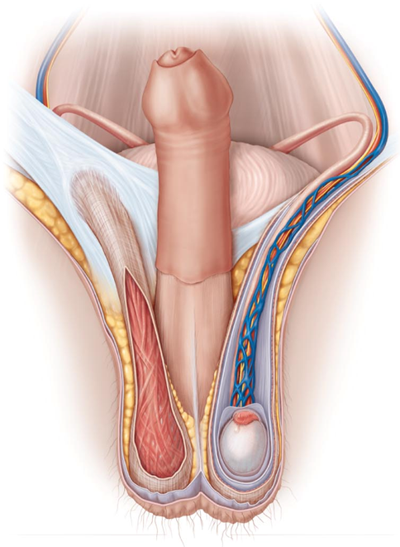
The Scrotum
Temperature kept constant by two sets of muscles
  Cremaster muscles
    bands of skeletal muscle
    that elevate testes
  Dartos muscle
    smooth muscle
    wrinkles scrotal skin
    pulls scrotum close to body

Slide 7
The Testes
Each surrounded by two tunics
  Tunica vaginalis
    outer layer
    derived from peritoneum
  Tunica albuginea
    inner layer
    fibrous capsule
Septa divide testis into ~250 lobules
  each containing 1–4 seminiferous tubules
  site of sperm production

Slide 8
Seminiferous Tubules
Thick, stratified epithelium surrounding central fluid-containing lumen
Epithelium
  spermatogenic cells embedded in Sustentacular cells(sustentocytes)
Myoid cells surround each tubule
  May squeeze sperm, testicular fluids out of testes
Tubules of each lobule form straight tubule

Slide 9
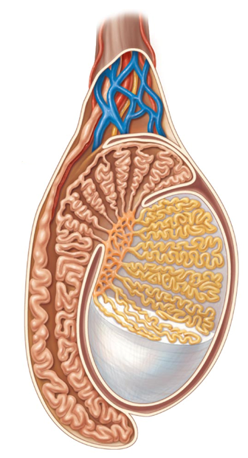
The Testes
Sperm conveyed from
  Seminiferous tubules
  Straight tubule
  Rete testis
  Efferent ductules
  Epididymis

Slide 10
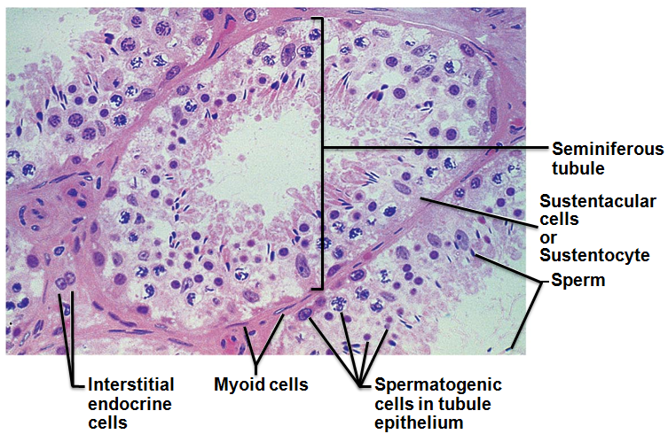
Seminiferous Tubules
Interstitial endocrine cells in soft tissue surrounding seminiferous tubules
Produce androgens
  testosterone
  Secrete it into interstitial fluid

Slide 11
The Testes
Blood supply
  Testicular arteries arise from abdominal aorta
  Testicular veins arise from pampiniform venous plexus surrounding each testicular artery
    Cooler
      absorb heat from testicular arteries
    Keep testes cool
Spermatic cord
  encloses nerve fibers, blood vessels, and lymphatics that supply testes

Slide 12
Homeostatic Imbalance
Testicular cancer
  Rare
    most common cancer in men 15-35
  Cryptorchidism is risk factor
  Sign
    painless, solid mass in testis
  90% cured by surgical removal of testis and often radiation or chemotherapy

Slide 13
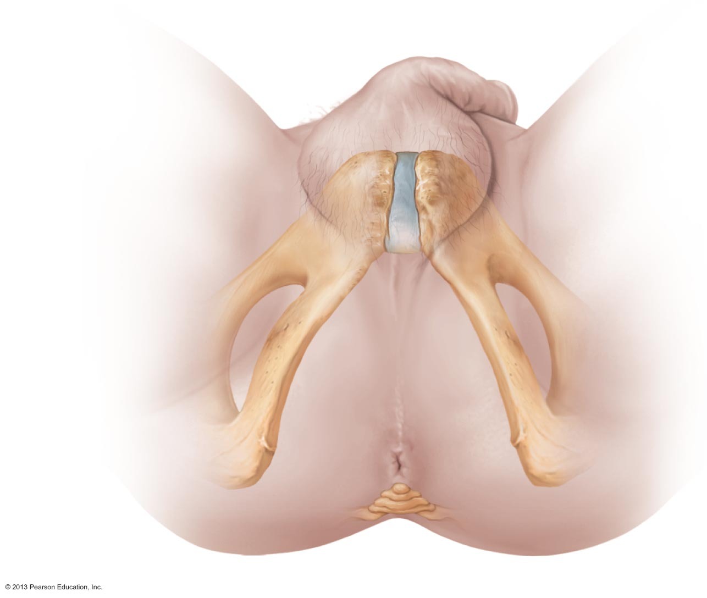
The Male Perineum
Diamond-shaped region between
  pubic symphysis
  Coccyx
  ischial tuberosities
Suspends scrotum
  contains root of penis and anus

Slide 14
The Penis
External genitalia
  scrotum and penis
Penis
  male copulatory organ

Slide 15
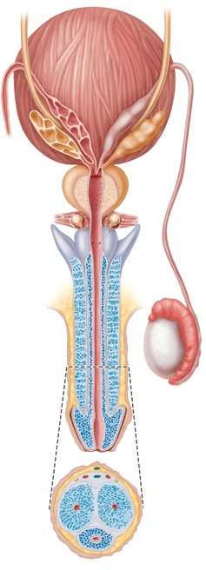
The Penis
Penis consists of
  Crura
    Proximal ends of corpora cavernosa surrounded by ischiocavernosus muscle
    anchors penis to pubic arch
  Root and shaft that ends in glans penis
  Prepuce
    Foreskin
      cuff of loose skin covering glans

Slide 16
Circumcision
Surgical removal of foreskin
60% newborn boys in US circumcised
  15% in other parts of world
  Some claim medically unnecessary
  Studies show
    60% reduction in HIV risk
    Reduced risk for other reproductive system infections

Slide 17
The Penis: Internally
Spongy urethra and three cylindrical bodies of erectile tissue
  spongy network of connective tissue and smooth muscle with vascular spaces
  Corpus spongiosum
    surrounds urethra and expands to form glans and bulb
  Corpora cavernosa
    paired dorsal erectile bodies
Erection
  erectile tissue fills with blood, causing penis to enlarge and become rigid

Slide 18
The Male Duct System
Ejaculatory duct
Ducts carry sperm from testes to body exterior
  Epididymis
  Ductus deferens
  Ejaculatory duct
  Urethra
urethra
Ductus deferens
Vas deferens
epididymis

Slide 19
Epididymis
Head
  contains efferent ductules
  superior aspect of testis
  body and tail on posterolateral area of testis
Duct of the epididymis
  Microvilli (stereocilia)
    absorb testicular fluid
    pass nutrients to stored sperm
Nonmotile sperm enter
  pass slowly through (~ 20 days)
  become motile
  can be stored several months
During ejaculation epididymis contracts, expelling sperm into ductus deferens
head
body
tail

Slide 20
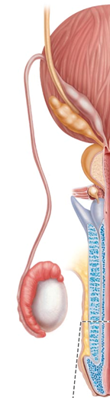
Ductus Deferens and Ejaculatory Duct
Ductus deferens (vas deferens)
  Passes through inguinal canal to pelvic cavity
  Expands to form ampulla
  joins duct of seminal vesicle to form ejaculatory duct
Smooth muscle in walls propels sperm from epididymis to urethra
Vasectomy
  cutting and ligating ductus deferens; nearly 100% effective form of birth control
ampulla
Seminal vesicle
Vas deferens

Slide 21
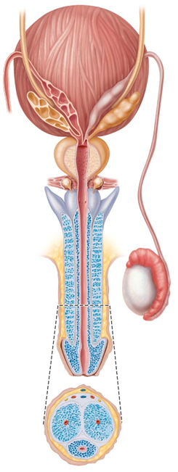
Urethra
Conveys both urine and semen (at different times)
Has three regions
  Prostatic urethra
    surrounded by prostate
  Intermediate part of the urethra (membranous urethra)
    in urogenital diaphragm
  Spongy urethra
    runs through penis
    opens at external urethral orifice
Prostatic
urethra
Membranous
urethra
Spongy
Urethra

Slide 22
The Male Accessory Glands
Paired seminal glands (seminal vesicles)
Paired bulbo-urethral glands
Prostate gland
Produce bulk of semen
  Remainder is sperm from testes
Seminal
vesicles
Prostate gland
Bulbourethral
glands

Slide 23
Accessory Glands: Seminal Glands
On posterior bladder surface
smooth muscle contracts during ejaculation
Produces viscous alkaline seminal fluid
  Fructose, citric acid, coagulating enzyme (vesiculase), and prostaglandins
  Yellow pigment fluoresces with UV light
  70% volume of semen
Duct of seminal vesicle joins ductus deferens to form ejaculatory duct
Seminal
vesicles

Slide 24
Accessory Glands: Prostate
Encircles urethra inferior to bladder;
  size of peach pit
  smooth muscle contracts during ejaculation
Secretes milky, slightly acid fluid
  Contains citrate, enzymes, and prostate-specific antigen (PSA)
  Role in sperm activation
  Enters prostatic urethra during ejaculation
33% semen volume
Prostate gland

Slide 25
Prostate Disorders
Prostatitis
  inflammatory disorder
  Bacterial infection
    acute
    Chronic
  treated with antibiotics
Benign prostatic hyperplasia
  May be age-related
  distorts urethra
    treated with surgery, microwaves, drugs, balloon compression, radio-frequency radiation

Slide 26
Prostate Disorders
Prostate cancer
  Second most common cause of cancer death in males
  Digital exam screening, PSA levels
    Biopsy if abnormal
  Treated with surgery and sometimes radiation; castration; drugs
  In clinical trials
    cryosurgery, chemotherapy, ultrasound, proton beam therapy

Slide 27
Accessory Glands: Bulbourethral Glands
Pea-sized glands inferior to prostate
Produce thick, clear mucus during sexual arousal
  Lubricates glans penis
  Neutralizes traces of acidic urine in urethra
Bulbourethral
glands

Slide 28
Semen
Milky-white mixture of sperm and accessory gland secretions
  Contains fructose for ATP production
  protects and activates sperm
  facilitates sperm movement
Alkaline secretion
  neutralizes acidity of male urethra
  neutralizes acidity of female vagina
  enhanced motility

Slide 29
Semen Functions
Prostaglandins
  decrease viscosity of mucus in cervix
  stimulate reverse peristalsis in uterus
Contains ATP for energy
Suppresses female immune response
Antibacterial action
Clotting factors coagulate semen initially to prevent draining out;
  then liquefied by fibrinolysin
  sperm begin journey

Slide 30

Male Reproductive System Overview
Please note that due to differing operating systems, some animations will not appear until the presentation is viewed in Presentation Mode (Slide Show view). You may see blank slides in the “Normal” or “Slide Sorter” views. All animations will appear after viewing in Presentation Mode and playing each animation. Most animations will require the latest version of the Flash Player, which is available at http://get.adobe.com/flashplayer.
Notes:
Male reproductive system overview 5:50

Slide 31
Male Sexual Response
Erection
  Arterioles are normally constricted
  Sexual excitement causes activation of parasympathetic neurons
    nitric oxide (NO) release
    local vascular smooth muscle relaxation
    arterioles dilate
      corpora cavernosa expands
      Slows venous drainage
    engorgement of erectile tissues with blood
    enlargement and stiffening of penis

Slide 32
Erection
Initiated by sexual stimuli
  Touch; mechanical stimulation of penis; erotic sights, sounds, and smells
Can be induced or inhibited by emotions or higher mental activity
Corpus spongiosum keeps urethra open

Slide 33
Male Sexual Response
Ejaculation
  Propulsion of semen from male duct system
  Sympathetic spinal reflex
    Bladder sphincter muscle constricts, preventing expulsion of urine
    Ducts and accessory glands contract and empty their contents
    Bulbospongiosus muscles undergo rapid series of contractions
      expulsion of semen at around 11 mph
  Ejaculatory event
    climax (orgasm)

Slide 34
Homeostatic Imbalance
Erectile dysfunction
  Parasympathetic nerves of penis release too little Nitric Oxide
  Causes
    Alcohol
    Drugs
    Hormones
    blood vessel or nervous system problems
    incompetent venous valves fail to retain blood in penis
  New drugs (Viagra, Cialis) enhance existing Nitric Oxidd effects

Slide 35
Spermatogenesis
Sperm (spermatozoa) production in seminiferous tubules
Most body cells have 46 chromosomes
  diploid chromosomal number (2n)
  Two sets (23 pairs) of chromosomes
    One maternal, one paternal
      Called homologous chromosomes
Gametes have 23 chromosomes
  haploid chromosomal number (n)
    Only one member of homologous pair

Slide 36
Meiosis
Gamete formation involves meiosis
  Differs from mitosis
  Two consecutive cell divisions
    meiosis I and meiosis II
    only one round of DNA replication
    Produces four daughter cells
Functions of meiosis
  Number of chromosomes halved (from 2n to n)
  Introduces genetic diversity

Slide 37
Meiosis
Random alignment of homologous pairs in meiosis I
  variability of gametes
Crossover
  variability of gametes
No two gametes exactly alike
All different from original parent cells

Slide 38
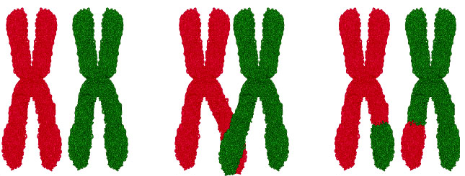
Meiosis I
Reduction division of meiosis
  reduces chromosome number from 2n → n
Events found only during Prophase I of Meiosis
  Synapsis
    homologous chromosomes pair forming tetrads of four chromatids
  Crossover
    exchange of genetic material between male and female chromatid
      unique chromosomes
Synapsis
Crossing over

Slide 39

Meiosis I
End of meiosis I each daughter cell
  Two copies of one member of each homologous pair (either maternal or paternal); none of the other
  Haploid chromosomal number
    still-united sister chromatids one chromosome (twice amount DNA in each chromosome)
Sister
chromatid

Slide 40
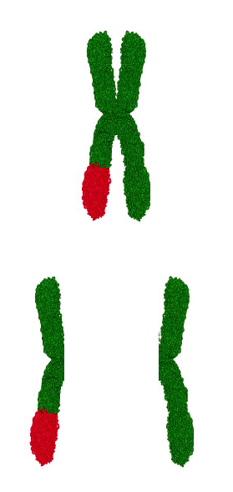
Meiosis II
Equational division of meiosis
  Sister chromatids from meiosis I separated, one per cell
Like mitosis except no chromosome replication before begins
Sister chromatids split
into two
daughter chromosomes

Slide 41
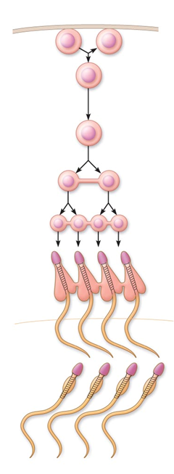
Spermatogenesis
spermatagonia
Spermatogenic cells give rise to sperm
  Mitosis of spermatogonia forms two spermatocytes
  Meiosis
    Spermatocytes → secondary spermatocytes → spermatids
  Spermiogenesis
    Spermatids become sperm
Daughter cells
from mitosis
Primary
spermatocytes
Secondary
spermatocytes
Spermatids

Slide 42
Mitosis of Spermatogonia
Type B
Type A
Spermatogenesis begins at puberty
Spermatogonia
  Stem cells in contact with epithelial basal lamina
  Each mitotic division → one type A daughter cell and one type B daughter cell

Slide 43
Mitosis of Spermatogonia
Type B
Type A
Type A cells maintain germ cell line at basal lamina
Type B cells move toward lumen and develop into primary spermatocytes
becomes
primary spermatocyte
used
later

Slide 44
Meiosis: Spermatocytes to Spermatids
Meiosis I
  Primary spermatocyte (46)
    two secondary spermatocytes (23)
Meiosis II
  Each secondary spermatocyte (23)
    two spermatids (23)
  Spermatid
    small, nonmotile cells close to lumen of tubule
Meiosis I
Meiosis II

Slide 45
Spermiogenesis: Spermatids to Sperm
Spermatids
  Correct chromosome number (n =23)
  Nonmotile
Spermiogenesis
  Spermatids elongate
  lose excess cytoplasm
  form a tail
    Become spermatozoon (sperm)

Slide 46
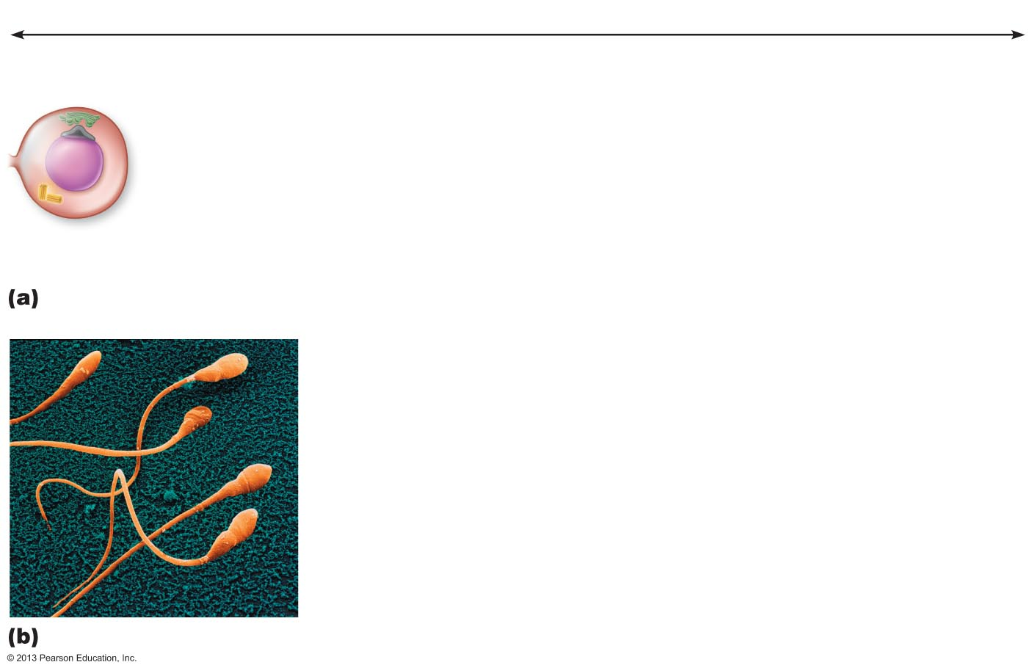
Figure 27.9 Spermiogenesis: transformation of a spermatid into a functional sperm.
Slide 2
Approximately 24 days
Golgi apparatus
Acrosomal
vesicle
1
Spermatid
nucleus

Slide 47
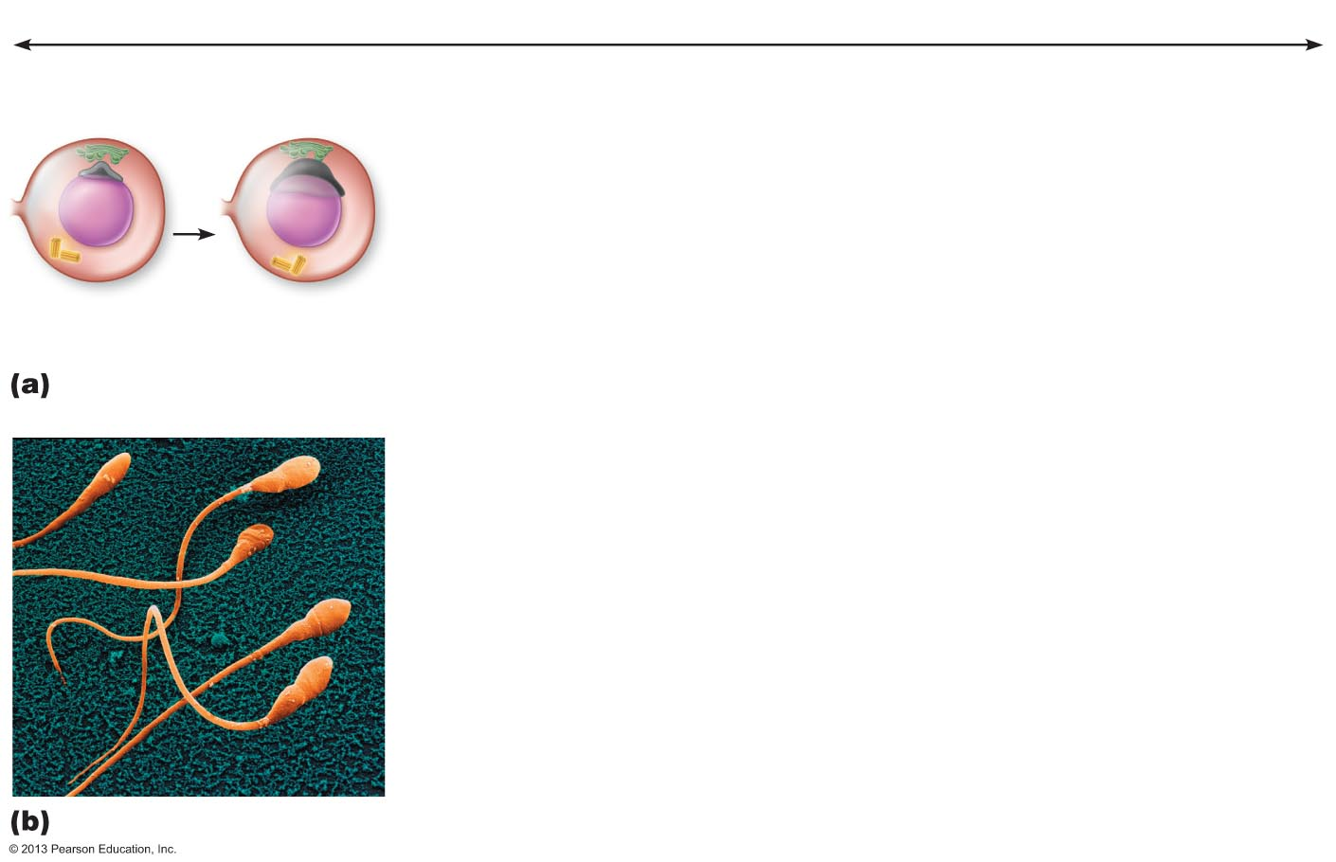
Figure 27.9 Spermiogenesis: transformation of a spermatid into a functional sperm.
Slide 3
Approximately 24 days
Golgi apparatus
Acrosomal
vesicle
1
2
Centrioles
Spermatid
nucleus

Slide 48
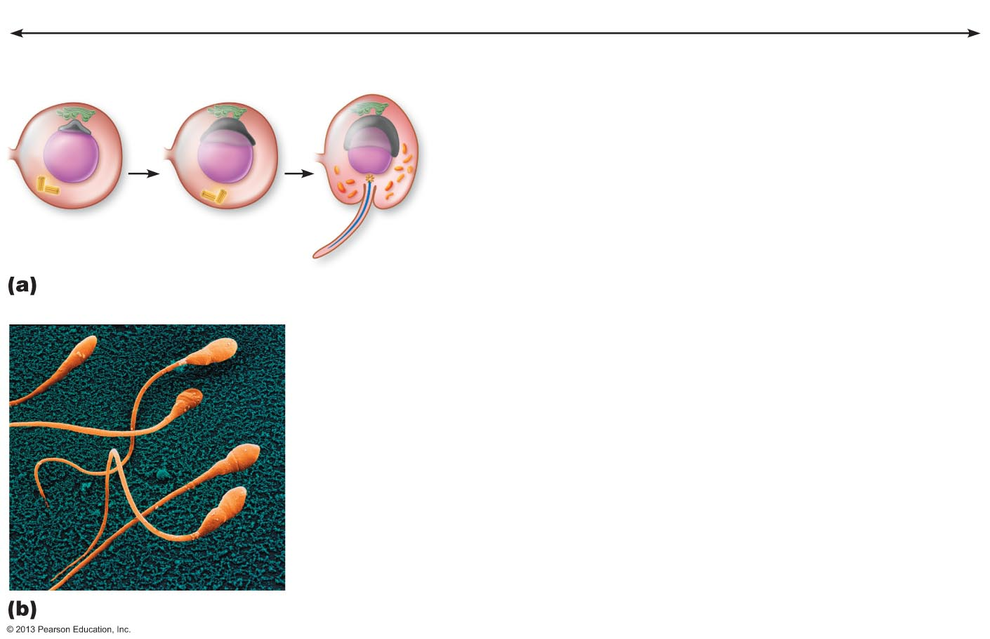
Figure 27.9 Spermiogenesis: transformation of a spermatid into a functional sperm.
Slide 4
Approximately 24 days
Golgi apparatus
Acrosomal
vesicle
1
2
Centrioles
Spermatid
nucleus
Microtubules
3
Flagellum

Slide 49
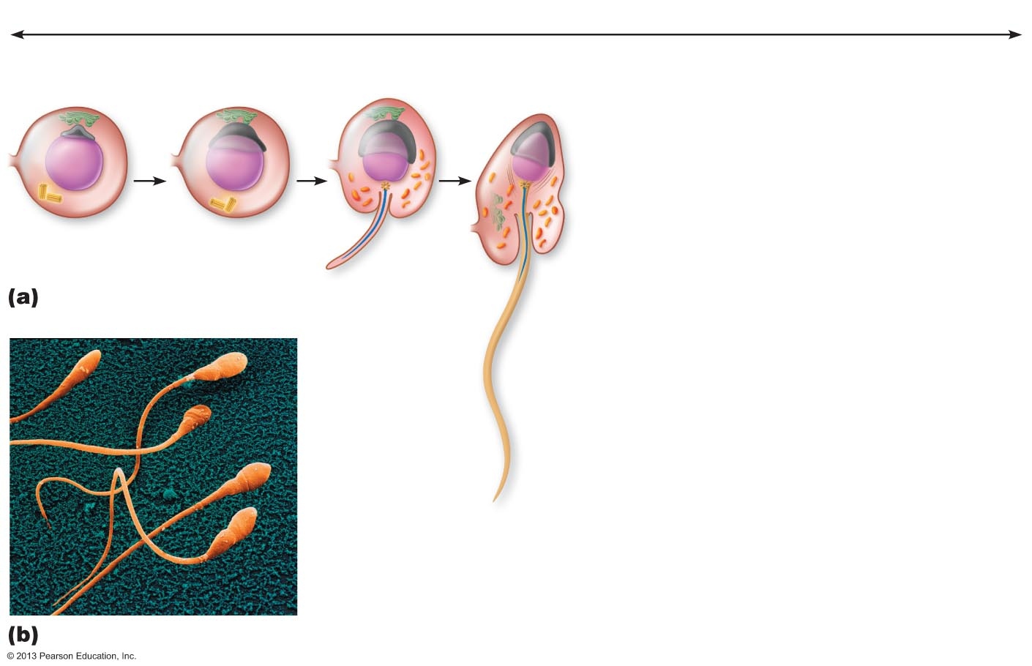
Figure 27.9 Spermiogenesis: transformation of a spermatid into a functional sperm.
Slide 5
Approximately 24 days
Golgi apparatus
Acrosomal
vesicle
Mitochondria
1
2
Centrioles
Spermatid
nucleus
Microtubules
3
Flagellum
4

Slide 50
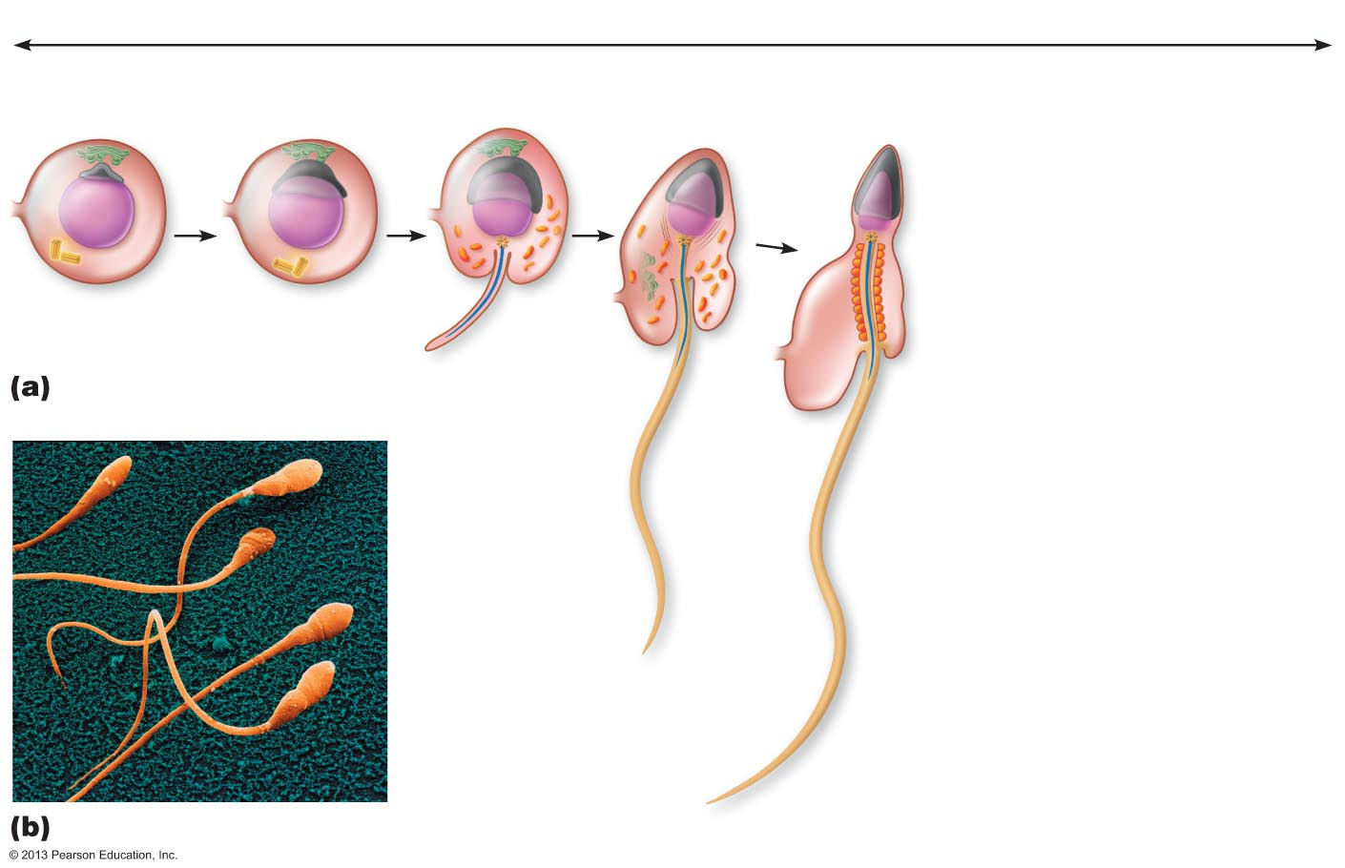
Figure 27.9 Spermiogenesis: transformation of a spermatid into a functional sperm.
Slide 6
Approximately 24 days
Golgi apparatus
Acrosomal
vesicle
Mitochondria
Acrosome
Nucleus
1
2
Centrioles
Spermatid
nucleus
Microtubules
3
Flagellum
Excess
cytoplasm
4
5

Slide 51
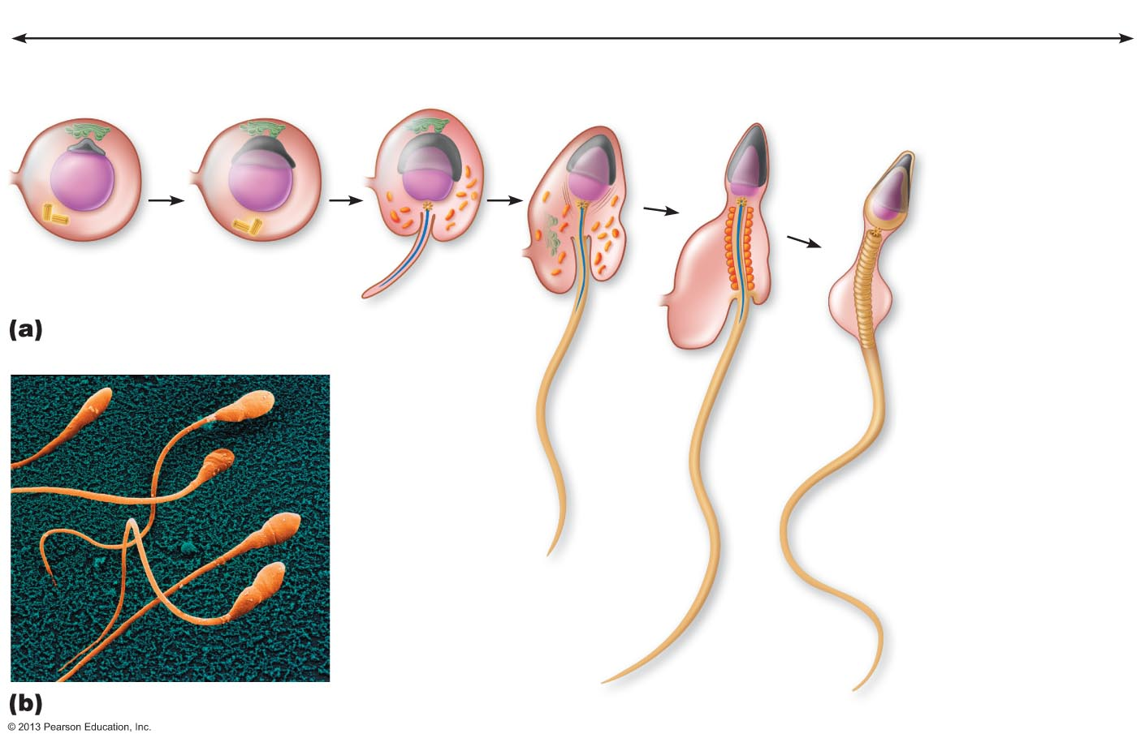
Figure 27.9 Spermiogenesis: transformation of a spermatid into a functional sperm.
Slide 7
Approximately 24 days
Golgi apparatus
Acrosomal
vesicle
Mitochondria
Acrosome
Nucleus
1
2
Centrioles
Spermatid
nucleus
Microtubules
3
Flagellum
Excess
cytoplasm
4
5
6

Slide 52
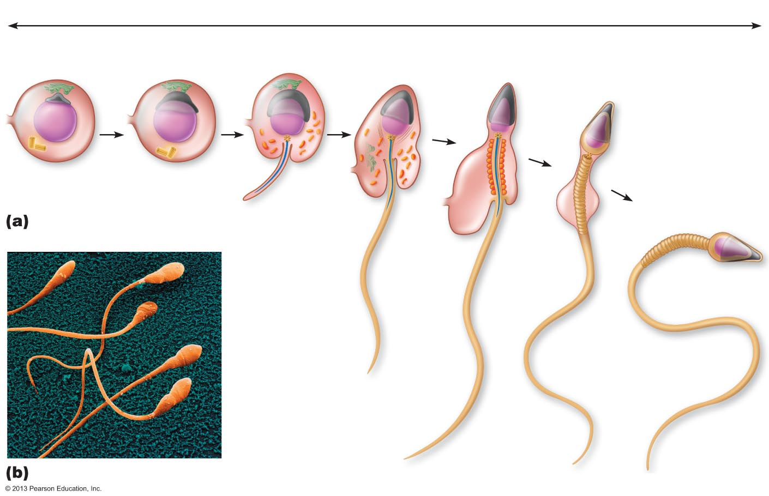
Figure 27.9 Spermiogenesis: transformation of a spermatid into a functional sperm.
Slide 8
Approximately 24 days
Golgi apparatus
Acrosomal
vesicle
Mitochondria
Acrosome
Nucleus
1
2
Centrioles
Spermatid
nucleus
Microtubules
Midpiece
Head
3
Flagellum
Excess
cytoplasm
4
Tail
5
6
7

Slide 53
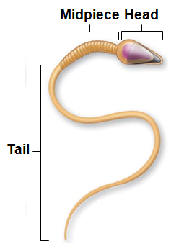
Sperm
Major regions
  Head
    genetic region
    nucleus and helmetlike acrosome containing hydrolytic enzymes
      enable sperm to penetrate egg
  Midpiece
    metabolic region
      mitochondria → ATP to move tail
  Tail
    locomotor region
    flagellum

Slide 54

Spermatogenesis
Please note that due to differing operating systems, some animations will not appear until the presentation is viewed in Presentation Mode (Slide Show view). You may see blank slides in the “Normal” or “Slide Sorter” views. All animations will appear after viewing in Presentation Mode and playing each animation. Most animations will require the latest version of the Flash Player, which is available at http://get.adobe.com/flashplayer.
Notes:
Spermatogenesis 1:22

Slide 55
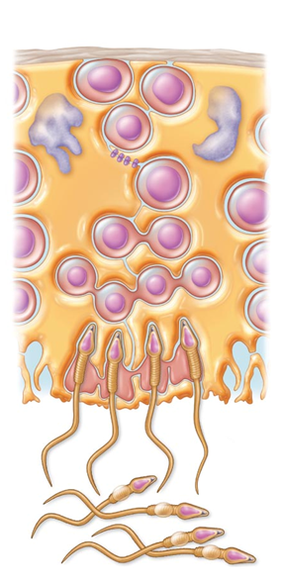
Role of Sustentocytes
Large supporting cells (Sertoli cells)
  Provide nutrients and signals to dividing cells
  Move cells along to lumen
  Secrete testicular fluid into lumen for sperm transport
  Phagocytize faulty germ cells and excess cytoplasm
  Produce chemical mediators to regulate spermatogenesis
Sertoli Cells

Slide 56
Role of Sustentacular Cells
Tight junctions form blood-testis barrier
  Prevents sperm antigens from escaping into blood
    activation of immune system
  Important
    sperm not formed until puberty
    absent during immune system development
      would not be recognized as "self"

Slide 57
Homeostatic Imbalance
Infertility
  Gradual decline in male fertility past 50 years
  Xenobiotics (alien molecules) may be cause
    Environmental toxins, PVCs, phthalates, pesticides, herbicides, compounds with estrogenic effects, antibiotics, radiation, lead, marijuana
  Also, lack of selenium, excessive alcohol, lack of specific Ca²⁺ channel, anatomical obstructions, hormonal imbalances, oxidative stress, fevers, hot tubs

Slide 58
Hormonal Regulation of Male Reproductive Function
Sequence of hormonal regulatory events involving hypothalamus, anterior pituitary gland, and testes
  Hypothalamic-pituitary-gonadal (HPG) axis
  Regulates production of gametes and sex hormones through 3 interacting sets of hormones
    GnRH indirectly stimulates testes via FSH & LH
    FSH & LH directly stimulate testes
    Testosterone & inhibin – negative feedback on hypothalamus and anterior pituitary
Notes:
Start template II

Slide 59
HPG Axis
Sequence of regulatory events
  Hypothalamus releases gonadotropin-releasing hormone (GnRH) →
    anterior pituitary to secrete FSH and LH
  FSH causes sustentocytes to release androgen-binding protein (ABP) →
    high concentration of testosterone near spermatogenic cells →
      spermatogenesis
  LH prods interstitial endocrine cells →
    testosterone →
      spermatogenesis

Slide 60
HPG Axis
Testosterone →
  sex organ maturation
  development/maintenance secondary sex characteristics,
  libido
Rising testosterone levels →
  feedback to inhibit gonadotropin release
Inhibin (released when sperm count high)
  inhibits GnRH and FSH release

Slide 61
HPG Axis
Three years to achieve balance, then testosterone and sperm production fairly stable throughout life
Without GnRH and gonadotropins → testes atrophy; sperm and testosterone production cease

Slide 62
Mechanism and Effects of Testosterone Activity
Testosterone
  Synthesized from cholesterol
  Transformed to exert its effects on some target cells
    Dihydrotestosterone (DHT) in prostate
    Estradiol in some neurons in brain

Slide 63
Mechanism and Effects of Testosterone Activity
Prompts spermatogenesis
Targets all accessory organs
Has multiple anabolic effects throughout body
Deficiency leads to atrophy; semen volume declines; erection and ejaculation impaired
  Treated with testosterone replacement

Slide 64
Male Secondary Sex Characteristics
Features induced in nonreproductive organs by male sex hormones (mainly testosterone)
  Appearance of pubic, axillary, and facial hair
  Enhanced growth of chest hair; deepening of voice
  Skin thickens and becomes oily
  Bones grow, increase in density
  Skeletal muscles increase in size and mass
  Boosts basal metabolic rate
  Basis of sex drive (libido) in males

Slide 65
Male Secondary Sex Characteristics
Testosterone
  Masculinizes embryonic brain
  Continues to exert effect well into adulthood
  Adrenal glands produce androgens in small amounts –
    insufficient to maintain normal testosterone-mediated functions

Slide 66
Female Reproductive Anatomy
Ovaries
  female gonads
  Produce female gametes (ova)
  Secrete female sex hormones
    estrogen (estradiol, estrone, estriol)
    progesterone
Accessory ducts include
  Uterine tubes
  Uterus
  Vagina

Slide 67
Female Reproductive Anatomy
Internal genitalia – in pelvic cavity
  Ovaries
  Uterine tubes
  Uterus
  Vagina
External genitalia
  External sex organs

Slide 68
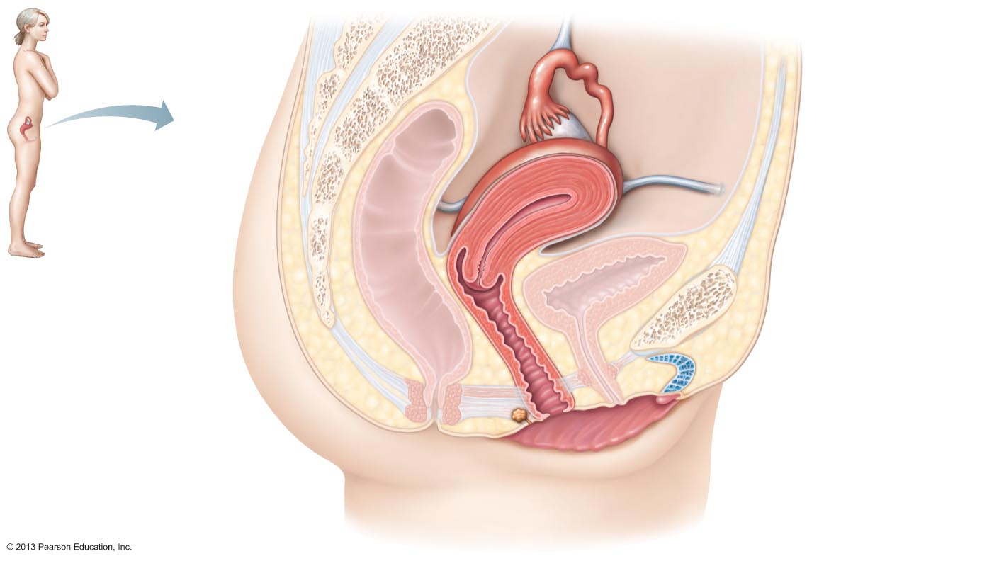
Figure 27.12 Internal organs of the female reproductive system, midsagittal section.
Suspensory
ligament
of ovary
Infundibulum
Uterine tube
Ovary
Fimbriae
Uterus
Round ligament
Perimetrium
Urinary bladder
Rectum
Pubic symphysis
Posterior fornix
Mons pubis
Cervix
Urethra
Anterior fornix
Clitoris
Vagina
External urethral
orifice
Anus
Urogenital diaphragm
Hymen
Greater vestibular
gland
Labium minus
Labium majus

Slide 69
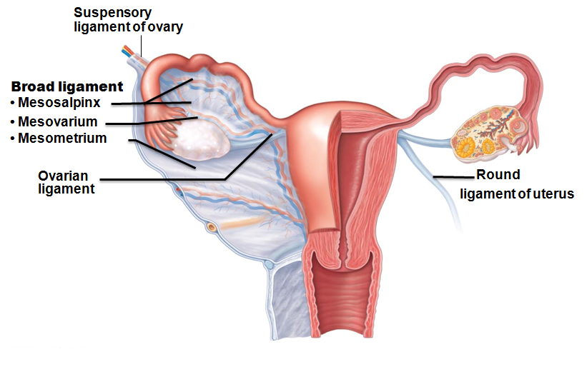
Ovaries
Held in place by several ligaments
  Ovarian ligament
    anchors ovary medially to uterus
  Suspensory ligament
    anchors ovary laterally to pelvic wall
  Mesovarium
    suspends ovary
Suspensory ligament and mesovarium part of broad ligament
  supports uterine tubes, uterus, and vagina

Slide 70
Ovaries
Blood supply
  ovarian arteries and ovarian branch of the uterine arteries
Surrounded by fibrous tunica albuginea
Germinal epithelium - outer layer
Two poorly defined regions
  Outer cortex – houses forming gametes
  Inner medulla - large blood vessels and nerves

Slide 71
Ovaries
Embedded in cortex
  Ovarian follicles
    Immature egg (oocyte) surrounded by
      Follicle cells (one cell layer thick)
      Granulosa cells (more than one layer present)

Slide 72
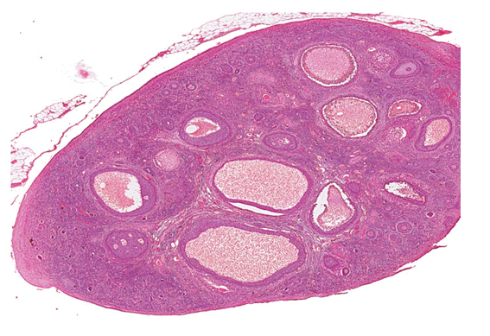
Follicles
Several stages of development
  Primordial follicle
    single layer of follicle cells + oocyte
  More mature follicles
    several layers of granulosa cells
Primordial
follicles

Slide 73
Ovaries
Vesicular (antral or tertiary) follicle – fully mature follicle
  Fluid-filled antrum forms; follicle bulges from ovary surface
Ovulation
  Ejection of oocyte from ripening follicle
Corpus luteum develops from ruptured follicle after ovulation
vesicular
follicles

Slide 74
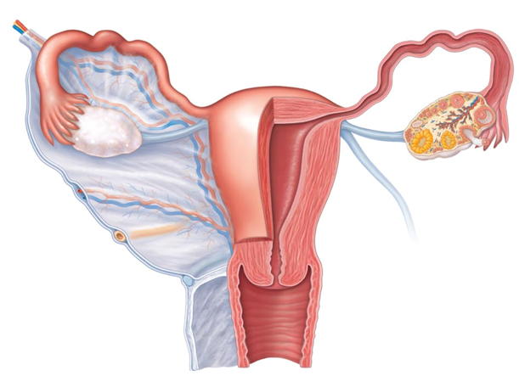
Female Duct System
Ducts have no contact with ovary
  Oocyte cast into peritoneal cavity; some lost there
Uterine (fallopian) tubes or oviducts
Uterus
Vagina
Fallopian
tubes
Uterus
Vagina

Slide 75
Uterine Tubes
Receive ovulated oocyte; usual site of fertilization
Isthmus
  constricted region where tube joins uterus
Ampulla
Distal expansion with infundibulum near ovary
  Ciliated fibriae of infundibulum create currents to move oocyte into uterine tube
Isthmus
Ampulla
Infundibulum

Slide 76
Uterine Tubes
Oocyte carried along by peristalsis and ciliary action
Nonciliated cells nourish oocyte and sperm
Covered externally by peritoneum

Slide 77
Homeostatic Imbalance
Ectopic pregnancy
  Oocyte fertilized in peritoneal cavity or distal uterine tube begins developing there
    Normally abort naturally with substantial bleeding
Pelvic inflammatory disease (PID)
  Spread of infection from reproductive tract to peritoneal cavity
    May cause scar tissue → infertility

Slide 78
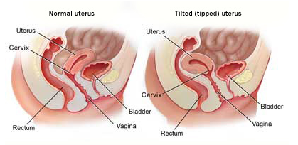
Uterus
Hollow, thick-walled, muscular organ
Function
  Receive, retain, nourish fertilized ovum
Anteverted
  inclined forward
retroverted
  inclined backward
Body
  major portion
Fundus
  rounded superior region
Isthmus
  narrowed inferior region
Fundus
Body
Isthmus
Cervix

Slide 79
Uterus
Cervix
  narrow neck, or outlet; projects into vagina
Cervical canal communicates with
  Vagina via external os
  Uterine body via internal os
Cervical glands secrete mucus that blocks sperm entry except during midcycle
Cervix
Internal os
externalos

Slide 80
Homeostatic Imbalance
Cervical cancer
  450,000 women worldwide each year
    killing half
  Most common between 30 – 50
  Risks
    frequent cervical inflammations
    STIs
    multiple pregnancies
  Papanicolaou (Pap) smear for detection
    Every two years 21 – 30; every year > 30; discontinue at 65 if negative for 10 years

Slide 81
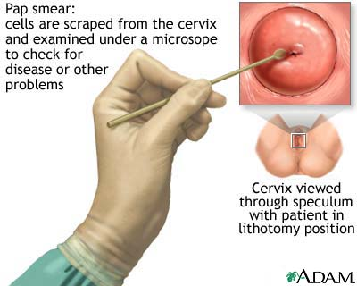
Homeostatic Imbalance
Pap smear results inconclusive
  Test for human papillomavirus
    cause of most cervical cancers
Gardasil
  three-dose vaccine
  protects against HPV
  Recommended for 11- and 12-year-old girls

Slide 82
Uterine Wall
Three layers
  Perimetrium
    serous layer (visceral peritoneum)
  Myometrium
    interlacing layers of smooth muscle
  Endometrium
    mucosal lining
perimetrium
myometrium
endometrium

Slide 83
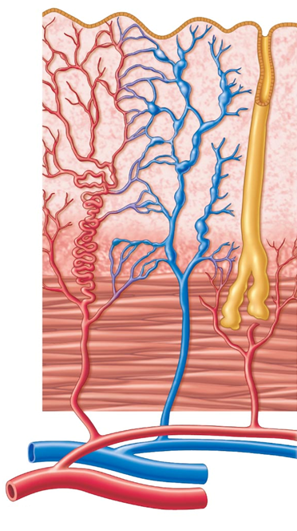
Endometrium
Stratum functionalis (functional layer)
  Changes in response to ovarian hormone cycles
  Shed during menstruation
Stratum basalis (basal layer)
  Forms new functionalis after menstruation
  Unresponsive to ovarian hormones
Stratum
Functonalis
Stratum
basalis

Slide 84
Uterine Vascular Supply
Uterine arteries →Arcuate arteries →Radial arteries in endometrium
  branch into
  Straight arteries → stratum basalis
  Spiral arteries → stratum functionalis
    Degenerate and regenerate; spasms → shedding of functionalis layer during menstruation
Straight arteries
Spiral arteries

Slide 85
Vagina
Thin-walled tube 8-10 cm in length
  Birth canal
  organ of copulation
Extends between bladder and rectum from cervix to exterior
Urethra parallels course anteriorly; embedded in anterior wall

Slide 86
Vagina
Layers of wall
  Fibroelastic adventitia
  Smooth muscle muscularis
  Stratified squamous mucosa with rugae
Dendritic cells in mucosa may provide route for HIV transmission
Mucosa near vaginal orifice forms incomplete partition called hymen
  ruptures with intercourse
Vaginal fornix
  upper end of vagina surrounding cervix

Slide 87
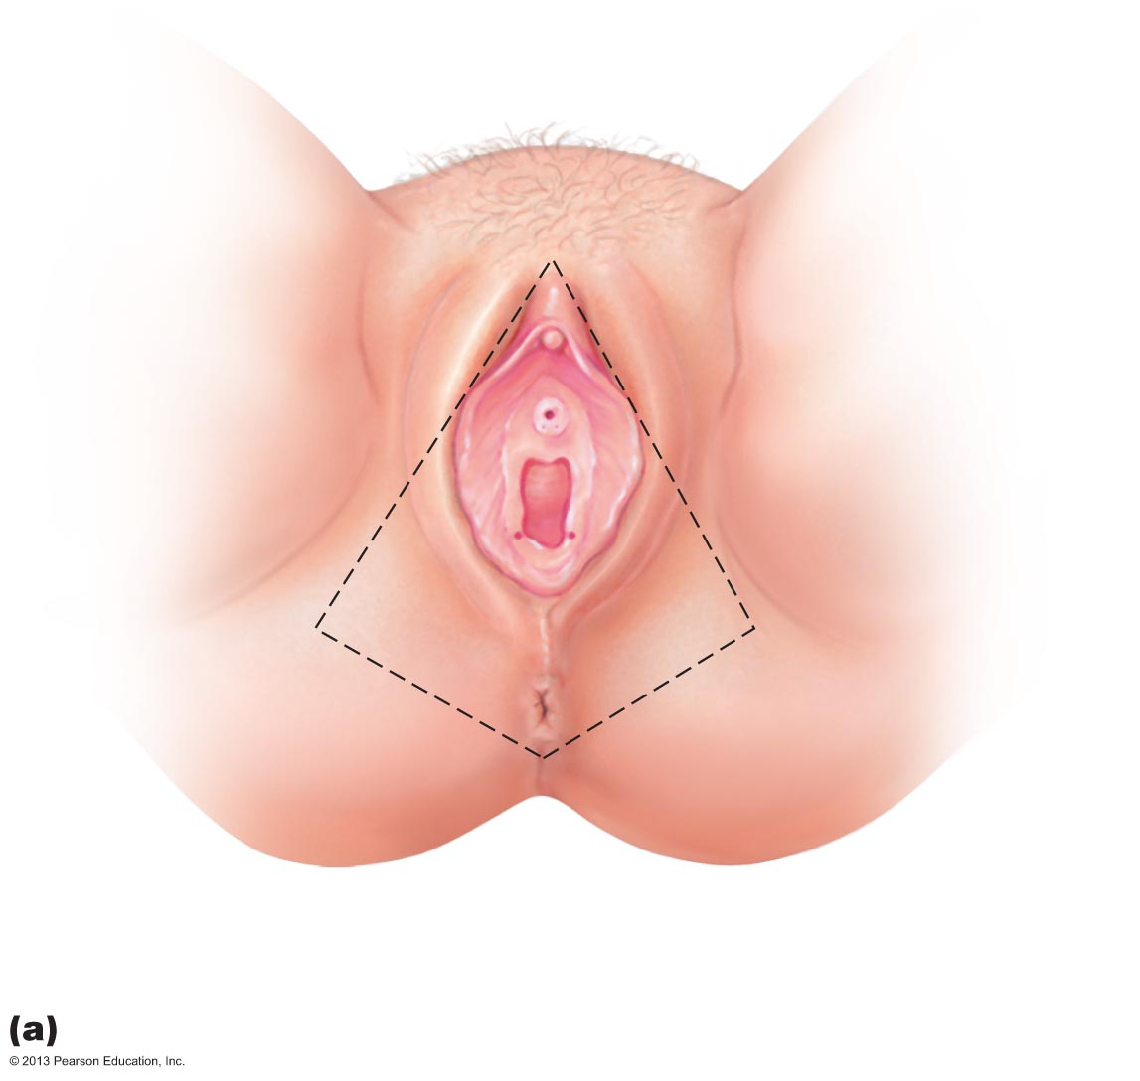
Figure 27.16a The external genitalia (vulva) of the female.
Mons
pubis
Labia
majora
Prepuce
of clitoris
Labia
minora
Clitoris
(glans)
External
urethral
orifice
Vestibule
Hymen
(ruptured)
Vaginal
orifice
Anus
Opening of the duct
of the greater
vestibular gland

Slide 88
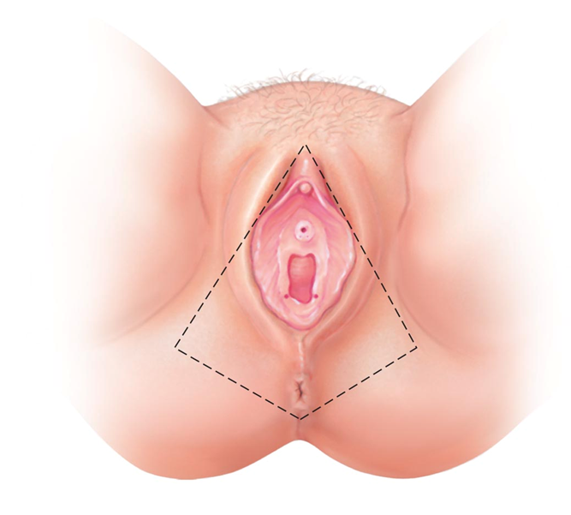
External Genitalia (Vulva or Pudendum)
Mons pubis
  fatty area overlying pubic symphysis
Labia majora
  hair-covered, fatty skin folds
  Counterpart of male scrotum
Labia minora
  skin folds lying within labia majora
  Join at posterior end of vestibule → fourchette
  Vestibule - recess within labia minora
Mons Pubis
Labia Majora
Labia Minora
Fourchette

Slide 89
External Genitalia
Greater vestibular glands
  Flank vaginal opening
  Homologous to bulbourethral glands
  Release mucus into vestibule for lubrication
Vestibular glands

Slide 90
External Genitalia
Clitoris – anterior to vestibule
  Glans of the clitoris
    exposed portion
  Prepuce of the clitoris
    hoods glans
  Counterpart of penis
Perineum
  Diamond-shaped region between pubic arch and coccyx
  Bordered by ischial tuberosities laterally
Prepuce of clitoris
Glans clitoris
Perineum

Slide 91
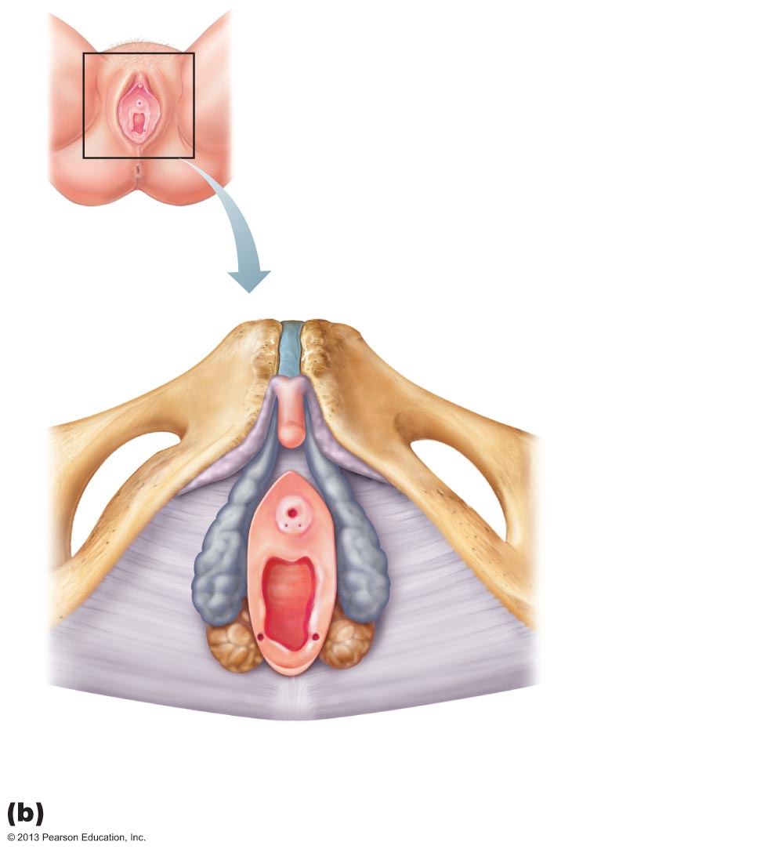
Figure 27.16b The external genitalia (vulva) of the female.
Clitoris
Labia minora
Labia majora
Anus
Pubic symphysis
Inferior
ramus
of pubis
Body of clitoris,
containing
corpora
cavernosa
Clitoris (glans)
Crus of clitoris
External
urethral orifice
Vaginal orifice
Greater
vestibular
gland
Bulb of
vestibule
Fourchette

Slide 92
Mammary Glands
Modified sweat glands consisting of 15–25 lobes
Function in milk production
Areola
  pigmented skin surrounding nipple
Suspensory ligaments
  attach breast to underlying muscle
Lobules within lobes contain glandular alveoli that produce milk

Slide 93
Mammary Glands
Milk → lactiferous ducts → lactiferous sinuses → open to outside at nipple
Breast size due to amount of fat deposits

Slide 94
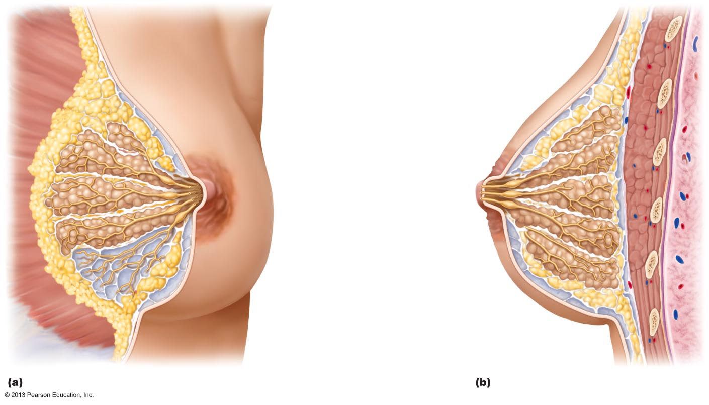
Figure 27.17 Structure of lactating mammary glands.
First rib
Skin (cut)
Pectoralis major muscle
Suspensory ligament
Adipose tissue
Lobe
Areola
Nipple
Opening of lactiferous duct
Lactiferous sinus
Lactiferous duct
Lobule containing alveoli
Hypodermis
(superficial fascia)
Intercostal muscles

Slide 95
Breast Cancer
Invasive breast cancer most common malignancy, second most common cause of cancer death in U.S. women
13% will develop condition

Slide 96
Breast Cancer
Usually arises from epithelial cells of smallest ducts; eventually metastasize
Risk factors include
  Early onset of menstruation and late menopause
  No pregnancies or first pregnancy late in life
  No or short periods of breast feeding
  Family history of breast cancer
70% of women with breast cancer have no known risk factors

Slide 97
Breast Cancer
10% due to hereditary defects, including mutations to genes BRCA1 and BRCA2
  50 – 80% develop breast cancer
  Greater risk of ovarian cancer as well

Slide 98
Breast Cancer: Diagnosis
Early detection via self-examination and mammography
  X-ray examination
  American Cancer Society recommends screening every year for women 40 and over
  U.S. Prevention Services Task Force on Breast Cancer Screening recommends 50 and over

Slide 99
Breast Cancer: Treatment
Radical mastectomy
  removes breast, all underlying muscles, fascia, associated lymph nodes
Lumpectomy
  excises only cancerous lump
Simple mastectomy
  removes only breast tissue
  sometimes some axillary lymph nodes
Some have breast reconstruction

Slide 100

Female Reproductive System Overview
Please note that due to differing operating systems, some animations will not appear until the presentation is viewed in Presentation Mode (Slide Show view). You may see blank slides in the “Normal” or “Slide Sorter” views. All animations will appear after viewing in Presentation Mode and playing each animation. Most animations will require the latest version of the Flash Player, which is available at http://get.adobe.com/flashplayer.
Notes:
Female reproductive system overview 4:44

Slide 101
Physiology of the Female Reproductive System
Always assumed females total supply of eggs determined at birth
New evidence stem cells can arise from epithelial cells at ovary surface
May overturn previous assumption

Slide 102
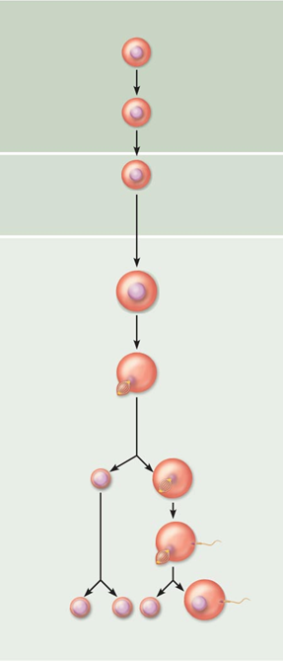
Oogenesis
Oogonia
Mitosis
Production of female gametes
  Takes years to complete
Begins in fetal period
  Oogonia (2n ovarian stem cells) multiply by mitosis and store nutrients
  Primary oocytes develop in primordial follicles
  Primary oocytes begin meiosis; stall in prophase I
Primary
Oocyte
incomplete meiosis
Meiosis I completed
Secondary
Oocyte
Ovulation
Ovum

Slide 103
Oogenesis
At birth female presumed to have lifetime supply of primary oocytes
Each month after puberty, a few primary oocytes activated
One "selected" each month to resume meiosis I
Result is two haploid cells of different sizes
  Secondary oocyte
    large cell with most cytoplasm and organelles of original cell
  First polar body
    small cell

Slide 104
Oogenesis
Secondary oocyte arrests in metaphase II
  ovulated ovum
If not penetrated by sperm it deteriorates
If penetrated by sperm second oocyte completes meiosis II, yielding
  Ovum (functional gamete)
  Second polar body

Slide 105
Ovarian Cycle
Monthly series of events associated with maturation of egg
Two consecutive phases (in 28-day cycle)
  Follicular phase - period of follicle growth (days 1–14)
  Ovulation occurs midcycle
  Luteal phase - period of corpus luteum activity (days 14–28)

Slide 106
Ovarian Cycle
Only 10 – 15% women have 28-day cycle
Follicular phase varies
Luteal phase constant
  always 14 days from ovulation to end of cycle

Slide 107
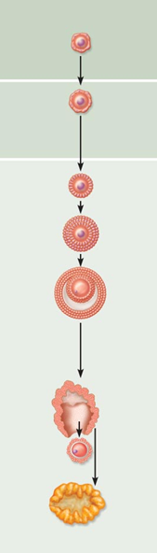
Follicular Phase
Primordial follicle
Primordial follicle becomes primary follicle
  Squamouslike cells become cuboidal; oocyte enlarges
Primary follicle becomes secondary follicle
Primary follicle
Secondary Follicle

Slide 108
Follicular Phase
Secondary follicle becomes late secondary follicle
  Connective tissue (theca folliculi) and granulosa cells cooperate to produce estrogens
  Inner thecal cells produce androgens in response to LH
  Zona pellucida forms around oocyte
  Fluid accumulates between granulosa cells

Slide 109
Follicular Phase
Late secondary follicle becomes vesicular follicle
  Antrum forms
    expands to isolate oocyte with corona radiata on stalk
  Vesicular follicle bulges from external surface of ovary
  Primary oocyte completes meiosis I → secondary oocyte and first polar body

Slide 110
Ovulation
Ovary wall ruptures, expels secondary oocyte with its corona radiata to peritoneal cavity
Mittelschmerz
  twinge of pain sometimes felt at ovulation
1–2% of ovulations release more than one secondary oocyte,
  if fertilized, results in fraternal twins
Identical twins result from fertilization of one oocyte, then separation of daughter cells

Slide 111
Luteal Phase of the Ovarian Cycle
Ruptured follicle collapses
  antrum fills with clotted blood
    corpus hemorrhagicum
Granulosa cells and internal thecal cells form corpus luteum
Corpus luteum secretes progesterone and some estrogen

Slide 112
Luteal Phase
If no pregnancy, corpus luteum degenerates into corpus albicans (scar) in 10 days
If pregnancy occurs, corpus luteum produces hormones that sustain pregnancy until placenta takes over at about 3 months

Slide 113
Establishing the Ovarian Cycle
During childhood, ovaries grow and secrete small amounts of estrogens that inhibit hypothalamic release of GnRH
As puberty nears, GnRH released; FSH and LH released by pituitary, and act on ovaries
These events continue until an adult cyclic pattern achieved and menarche occurs

Slide 114
Hormonal Regulation of the Ovarian Cycle
Hormone interaction produces cyclic events in ovaries
  Gonadotropin-releasing hormone (GnRH)
  Pituitary gonadotropins
  Ovarian estrogen
  Ovarian progesterone
Onset of puberty linked to amount of adipose tissue via hormone leptin

Slide 115
Establishing the Ovarian Cycle
During childhood, until puberty
  Ovaries secrete small amounts of estrogens
  Estrogen inhibits release of GnRH
  If leptin levels adequate hypothalamus less sensitive to estrogen as puberty nears; releases GnRH in rhythmic pulse-like manner → FSH and LH release → ovarian hormone release

Slide 116
Establishing the Ovarian Cycle
Gonadotropin levels increase over four years
  no ovulation
  no pregnancy
Then adult cyclic pattern achieved and menarche occurs
  First menstrual period

Slide 117
Hormonal Interactions During a 28-Day Ovarian Cycle
1. GnRH → release of FSH and LH
2. FSH and LH → growth of several follicles, and hormone release
3. ↑plasma estrogen levels inhibit release of FSH and LH
  ↑estrogen levels enhance further estrogen output
  Inhibin from granulosa cells also inhibits FSH release

Slide 118
Hormonal Interactions During a 28-Day Ovarian Cycle
4. When estrogen levels high → brief positive feedback on brain and anterior pituitary
5. Stored LH, and some FSH, suddenly released by anterior pituitary at midcycle → surge triggers ovulation
  → primary oocyte to complete meiosis I → secondary oocyte
Secondary oocyte → meiosis II

Slide 119
Hormonal Interactions During a 28-Day Ovarian Cycle
LH effects at midcycle
  Increases local vascular permeability
  Triggers inflammatory response
    weakens ovarian wall
  → Blood flow stops through protruding follicle wall → wall thins, bulges, ruptures → hole (stigma)
  → Oocyte with corona radiata exits (ovulation)

Slide 120
Hormonal Interactions During a 28-Day Ovarian Cycle
After ovulation
  Estrogen levels decline
  LH transforms ruptured follicle → corpus luteum
  LH stimulates corpus luteum →
    progesterone and some estrogen almost immediately
      Progesterone helps maintain stratum functionalis
      Maintains pregnancy, if occurs

Slide 121
Hormonal Interactions During a 28-Day Ovarian Cycle
6. Negative feedback (from rising plasma progesterone and estrogen levels) inhibits LH and FSH release
  Inhibin, from corpus luteum and granulosa cells, enhances effect
  Declining LH ends luteal activity, inhibits follicle development

Slide 122
Hormonal Interactions During a 28-Day Ovarian Cycle
If no fertilization
  Corpus luteum degenerates when LH levels fall →
    sharp decrease in estrogen and progesterone →
      ends blockage of FSH and LH secretion
  → Cycle starts anew
  Oocyte actually activated 12 months prior to ovulation, not 14 days

Slide 123
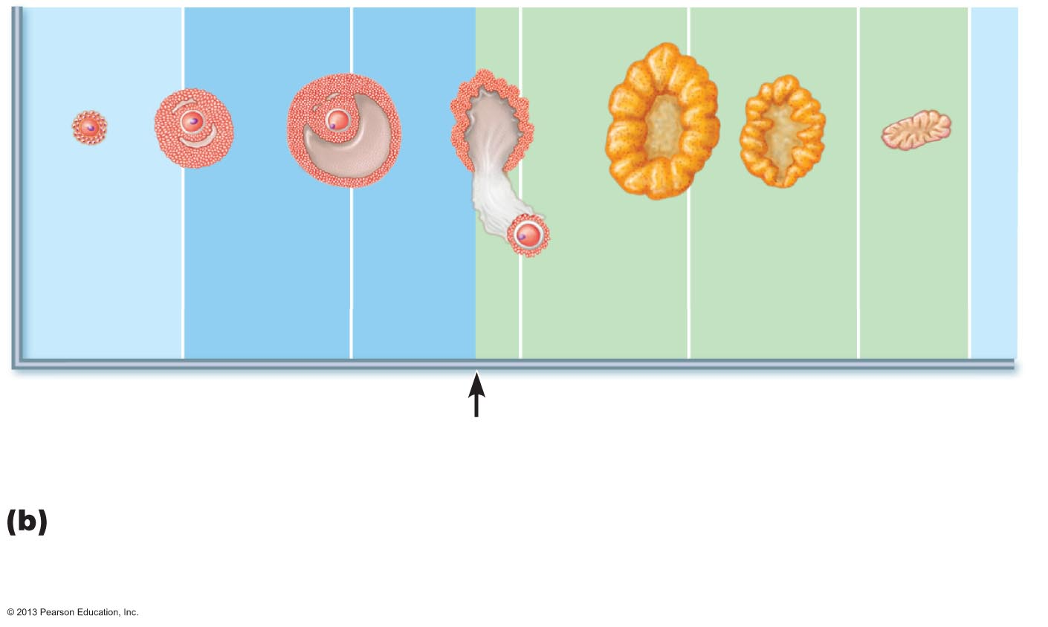
Figure 27.22b Correlation of anterior pituitary and ovarian hormones with structural changes of the ovary and uterus.
Primary
follicle
Secondary
follicle
Vesicular
follicle
Ovulation
Corpus
luteum
Degenerating
corpus luteum
Follicular
phase
Ovulation
(Day 14)
Luteal
phase
Ovarian cycle: Structural changes in the ovarian follicles during the
ovarian cycle are correlated with (d) changes in the endometrium of the
uterus during the uterine cycle.

Slide 124
The Uterine (Menstrual) Cycle
Cyclic changes in endometrium in response to fluctuating ovarian hormone levels
Three phases
  Days 1–5 - menstrual phase
  Days 6–14 - proliferative (preovulatory) phase
  Days 15–28 - secretory (postovulatory) phase (constant 14-day length)

Slide 125
Uterine Cycle
Menstrual phase (Days 1 - 5)
  Ovarian hormones at lowest levels
  Gonadotropins beginning to rise
  Stratum functionalis shed
    menstrual flow (blood and tissue) 3 - 5 days
  By day 5 growing ovarian follicles produce more estrogen

Slide 126
Uterine Cycle
Proliferative phase (Days 6 - 14)
  Rising estrogen levels prompt generation of new stratum functionalis layer
  glands enlarge and spiral arteries increase in number
  Normally thick, sticky cervical mucus thins in response to rising estrogen (allows sperm passage)
  Ovulation occurs at end of proliferative phase

Slide 127
Uterine Cycle
Secretory phase (Days 15 – 28)
  Most constant timewise
  Endometrium propares for embryo
  Rising progesterone levels prompt
    Functional layer → secretory mucosa
    Endometrial glands secrete nutrients
    Formation of cervical mucus plug

Slide 128
Uterine Cycle
If fertilization does not occur
  Corpus luteum degenerates toward end of secretory phase
  Progesterone levels fall
  Spiral arteries kink and spasm
  Endometrial cells begin to die; glands regress
  Spiral arteries constrict again, then relax and open wide
  Rush of blood fragments weakened capillary beds and functional layer sloughs

Slide 129
Effects of Estrogens
Promote oogenesis and follicle growth in ovary
Exert anabolic effects on female reproductive tract
Support rapid but short-lived growth spurt at puberty

Slide 130
Effects of Estrogens
Induce secondary sex characteristics
  Growth of breasts
  Increased deposit of subcutaneous fat (hips and breasts)
  Widening and lightening of pelvis

Slide 131
Effects of Estrogens
Metabolic effects (not true secondary sex characteristics)
  Maintain low total blood cholesterol and high HDL levels
  Facilitate calcium uptake

Slide 132
Effects of Progesterone
Progesterone works with estrogen to establish and regulate uterine cycle
Promotes changes in cervical mucus
Effects of placental progesterone during pregnancy
  Inhibits uterine motility
  Helps prepare breasts for lactation

Slide 133
Female Sexual Response
Initiated by touch and psychological stimuli
Clitoris, vaginal mucosa, bulbs of vestibule, and breasts engorge with blood; nipples erect
Vestibular gland secretions lubricate vestibule
Orgasm accompanied by muscle tension, increase in pulse rate and blood pressure, and rhythmic contractions of uterus

Slide 134
Female Sexual Response
Females have no refractory period after orgasm
  can experience multiple orgasms in single sexual experience
Orgasm not essential for conception
Female libido prompted by Adrenal cortex hormones
  Testosterone-like hormones

Slide 135
Female Reproductive Cycle
Please note that due to differing operating systems, some animations will not appear until the presentation is viewed in Presentation Mode (Slide Show view). You may see blank slides in the “Normal” or “Slide Sorter” views. All animations will appear after viewing in Presentation Mode and playing each animation. Most animations will require the latest version of the Flash Player, which is available at http://get.adobe.com/flashplayer.
Notes:
Female reproductive system 4:58

Slide 136
Sexually Transmitted Infections (STIs)
Also called sexually transmitted diseases (STDs) or venereal diseases (VDs)
U.S. – highest rates of infection among developed countries
Latex condoms help prevent spread
Single most important cause of reproductive disorders

Slide 137
Gonorrhea
Commonly called "the clap"
Bacterial infection of mucosae of reproductive and urinary tracts
Spread by contact with genital, anal, and pharyngeal mucosae
Number of cases in U.S. declining

Slide 138
Gonorrhea
Signs and symptoms
  Males
    Urethritis, painful urination, discharge of pus
  Females
    20% display no signs or symptoms
    Abdominal discomfort, vaginal discharge, or abnormal uterine bleeding
    Can result in pelvic inflammatory disease and sterility
Treatment
  antibiotics
  but resistant strains becoming prevalent

Slide 139
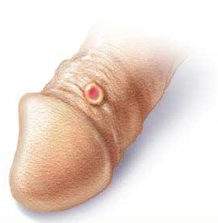
Syphilis
Bacterial infection transmitted sexually or contracted congenitally
  Infected fetuses stillborn or die shortly after birth
Infection asymptomatic for 2–3 weeks
Painless chancre appears at site of infection; disappears in few weeks

Slide 140
Syphilis
If untreated, secondary signs appear several weeks later for 3–12 weeks, then disappear
  Pink skin rash, fever, and joint pain
Latent period may or may not progress to tertiary syphilis, characterized by gummas (lesions of CNS, blood vessels, bones, and skin)
Treatment
  penicillin

Slide 141
Chlamydia
Most common bacterial STI in United States
Responsible for 25–50% of all diagnosed cases of pelvic inflammatory disease
Symptoms
  urethritis; penile and vaginal discharges; abdominal, rectal, or testicular pain; painful intercourse; irregular menses
  Can cause arthritis and urinary tract infections in men; sterility in women; newborns contract in birth canal → trachoma (painful eye infection), respiratory tract inflammation
Treatment - tetracycline

Slide 142
Trichomoniasis
Most common curable STI in active young women in U.S.
Parasitic infection
  easily, inexpensively treated
Yellow-green vaginal discharge with strong odor
  some symptomless

Slide 143
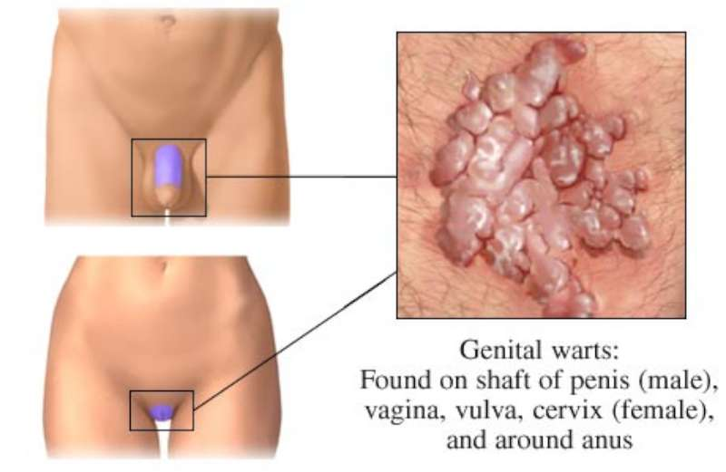
Viral Infections
Genital warts
  Caused by human papillomavirus (HPV)
  Second most common STI in United States
  Increased risk of cancers in infected body regions
    Linked to 80% cases of invasive cervical cancer; most strains do not cause cancer
  Treatment difficult; controversial

Slide 144
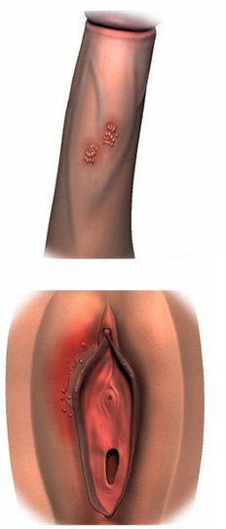
Viral Infections
Genital herpes
  Caused by herpes simplex virus 2
  Characterized by latent periods and flare-ups
    Congenital herpes can cause malformations of fetus
  Treatment - acyclovir and other antiviral drugs

Slide 145
Developmental Aspects: Determination of Genetic Sex
Of 46 chromosomes in fertilized egg, two (one pair) are sex chromosomes
Two sex chromosomes
  X chromosome (large)
  Y chromosome (quite small)
Females are XX; each ovum always has an X chromosome
Males are XY, so ~50% of sperm contain X, ~50% contain Y

Slide 146
Developmental Aspects: Determination of Genetic Sex
X egg + X sperm → XX (female offspring)
X egg + Y sperm → XY (male offspring)
The SRY gene on Y chromosome initiates testes development and maleness

Slide 147
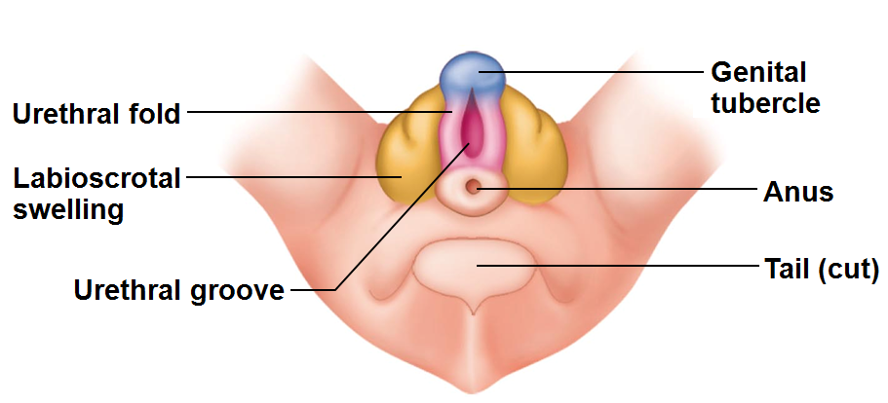
Developmental Aspects: Sexual Differentiation
Sexually indifferent stage
  Gonads begin development in fifth week as gonadal ridges
  Primordial germ cells migrate to gonadal ridges to provide germ cells destined to become spermatogonia or oogonia
Gonads begin development in seventh week in males, eighth week in females

Slide 148
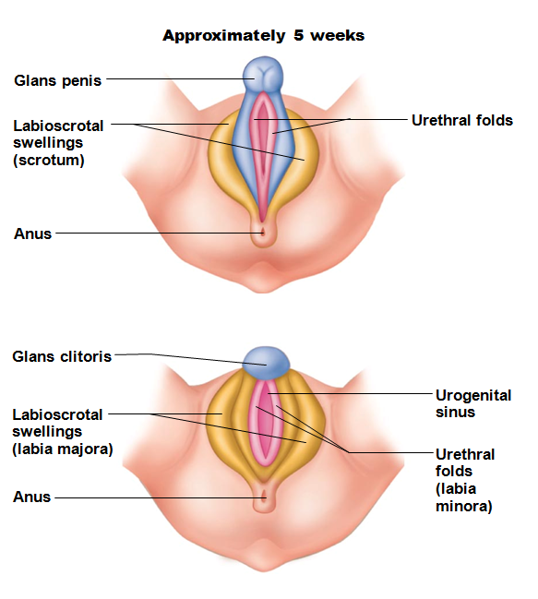
Development of External Genitalia
Genital tubercle→
  penis of male
  clitoris of female
Urethral fold →
  spongy urethra of male
  labia minora of female
Labioscrotal swellings →
  scrotum of male
  labia majora of female
If testosterone absent, all embryos develop into females

Slide 149
Development Aspects: Descent of the Gonads
About two months before birth
  Testosterone stimulates migration of testes toward scrotum
Gubernaculum
  fibrous cord from each testis to scrotum or from ovary to labium majus; guides descent
Ovaries also descend, but stopped by broad ligament at pelvic brim

Slide 150
Development Aspects: Puberty
FSH and LH elevated at birth but drop and remain low during prepubertal years
Reproductive organs grow to adult size and become functional
  puberty
Occurs in response to rising levels of gonadal hormones
Secondary sex characteristics appear
Earliest time that reproduction is possible

Slide 151
Menopause
Has occurred when menses have ceased for an entire year
No equivalent to menopause in males
  Males continue to produce sperm well into eighth decade of life, though numbers and motility decrease

Slide 152
Menopause
Declining estrogen levels →
  Atrophy of reproductive organs and breasts
  Irritability and depression in some
  Hot flashes as skin blood vessels undergo intense vasodilation
  Gradual thinning of skin and bone loss
  Increased total blood cholesterol levels and falling HDL

Slide 153
Menopause
Treatment with estrogen-progesterone preparations given for years
  Women's Health Initiative research reported increased risk of heart disease (51%), invasive breast cancer (24%), stroke (31%), dementia (risk doubled)
  Smallest does for shortest time alright to reduce symptoms if no breast cancer or mutated BRCA gene

Slide 154
Pregnancy
Secondary oocyte must enter uterine tube and be exposed to the male sperm cells.
Secondary oocyte lives 24 hours
Male sperm may exist for 72 hours in reproductive tract.

Slide 155
Ovulation Through Implantation
Please note that due to differing operating systems, some animations will not appear until the presentation is viewed in Presentation Mode (Slide Show view). You may see blank slides in the “Normal” or “Slide Sorter” views. All animations will appear after viewing in Presentation Mode and playing each animation. Most animations will require the latest version of the Flash Player, which is available at http://get.adobe.com/flashplayer.

Slide 156
Fertilization
Sperm reaches secondary oocyte and the acrosome and its enzymes helps the sperm to penetrate
  oocyte cell membrane becomes impenetrable after one sperm cell gains access

Slide 157
Fertilization
Once sperm within oocyte
  nucleus of the sperm head swells
  Secondary oocyte divides
    forms large cell and polar body.
Female meiosis completes only after the sperm enters the egg.
  Nuclei unite,
  chromosomes mingle
Zygote is oocyte and sperm, has 46 chromosomes.

Slide 158
Cleavage
Zygote undergoes mitosis.
Gives rise to two cells
  blastomeres
Two cells divide, turn to four cells, eight cells, etc.
  Phase of development called cleavage.

Slide 159
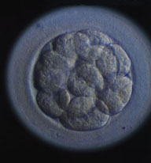
Morula
Travel time to uterus: three days.
solid ball of about 16 cells called the morula.
Remains unattached in the uterine cavity for three days.

Slide 160
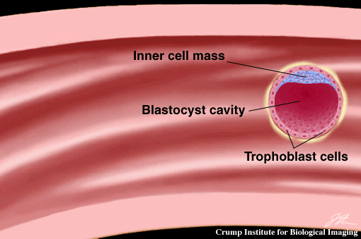
Blastocyst
Structure becomes a ball of cells, blastocyst.
Implants in the uterus by the end of the first week

Slide 161
Organization
Blastocysts organizes into
  Inner cell mass
    gives rise to the body
  Outer cells
    become embryonic portion of placenta
Embryo until 8th week
Fetus until time of birth.

Slide 162
Placenta
Placenta develops
attaches the embryo to uterine wall
  exchanges nutrients
  Gasses
  wastes
    between maternal blood and embryonic blood.
Placenta also secretes hormones.

Slide 163
Hormone changes
In non pregnant female,
  the corpus luteum degenerates
    estrogen and progesterone levels drop
    uterine lining sloughs off
In pregnant female, need to maintain the uterine lining.

Slide 164
HCG
HCG: human chorionic gonadotropin.
prevents spontaneous abortion (miscarriage)
HCG and some of the embryonic cells
  maintain the corpus luteum
  continues to secrete estrogen and progesterone
  inhibits FSH and LH.

Slide 165
HCG
HCG secretion is high for about two months and then declines.
Corpus luteum exists throughout pregnancy
  most important in the first few months before the placenta takes over the estrogen and progesterone production.

Slide 166
More hormones
Placental lactogen
  stimulates breast development and prepares the mammary glands for milk secretion.
Relaxin:
  hormone from corpus luteum.
  Inhibits the smooth muscles in the myometrium, suppresses uterine contractions until birth.
  relaxes the ligaments of the symphysis pubis and SI joints
    aids passage of fetus through birth canal.

Slide 167
More hormones
Increased secretion of aldosterone and of parathyroid hormone
Aldosterone from adrenal cortex
  promotes renal absorption of sodium
  fluid retention.
PTH helps to maintain high concentrations of calcium.

Slide 168
Parturition
Pregnancy continues for about 40 weeks and ends with parturition or birth.

Slide 169
Hormonal changes with birth
Decreased progesterone
  no longer preventing uterine contractions
oxytocin stimulate uterus to contract.

Slide 170
Labor
Contractions start at the top of the uterus and travel downward, forcing the contents toward the cervix.
Labor contractions force the fetal head against the cervix
  stretches the cervix
  elicits a reflex that stimulates contractions.

Slide 171
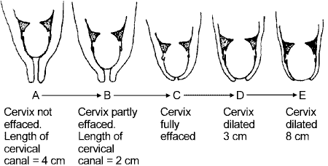
Dilation of cervix
positive feedback loop:
Dilation of cervix stimulates increased release of oxytocin→ more contractions.

Slide 172
Involution
After the birth, the placenta detaches form the uterine wall
expelled by the remaining uterine contractions,
  stimulated by oxytocin.

Slide 173
Involution
For several weeks the uterus undergoes involution,
  which is the shrinking of the uterus.
For several weeks
  will pass a bloody discharge
  then a yellow discharge
  until the uterine lining heals and returns to a non-pregnant state.

Slide 174
More hormones (breast)
During pregnancy, placental estrogen and progesterone stimulate mammary development.
  Estrogen: causes ductile system to grow and branch.
  Progesterone stimulates the development of alveolar glands at the end of the ducts.

Slide 175
More hormones (breast)
Prolactin, released in week 5 and present throughout pregnancy.
Prolactin causes milk secretion after birth.
Placental lactogen blocks prolactin during the pregnancy

Slide 176
Milk production and secretion
The placental hormones drop after birth. No longer will inhibit prolactin.
Prolactin stimulates the mammary glands to secrete large quantities of milk
  not until two or three days following birth
Until then, there is colostrum
  rich in proteins
  Antibodies
  low in carbohydrates and fats

Slide 177
Milk ejection
Milk must be actively ejected by contractions
When the breast is suckled or stimulated
  release of oxytocin
  causes the muscles to contract and eject the milk.

Slide 178
Milk production
Prolactin is released as long as milk is removed from the breasts.
If milk not removed regularly,
  prolactin is inhibited
  mammary glands lose their ability to produce milk.

Slide 179
Embryonic Stage
Extends from week two to week eight
  Placenta forms
  Internal organs develop
  Major external body structures appear

Slide 180
Week Two
Blastocyst implants
Amniotic cavity forms
Inner cell mass changes to embryonic disk

Slide 181
Week Three
Layers from
  Outer layer: ectoderm
    Nervous system, epidermis
  Inner layer: endoderm
    Linings of digestive respiratory, urinary and reproductive tracts
  Middle layer: mesoderm
    Muscle, bone, blood
  These are the primary germ layers. All organs come from these germ layers

Slide 182
Week Four
Chorionic villi form
Embryonic disk changes into a cylindrical structure
Head and jaws appear
Heart beats
Limb buds form

Slide 183
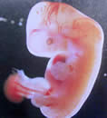
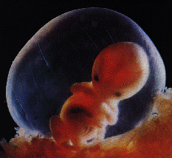
Weeks Five through Seven
Head grows rapidly
Eyes, nose, mouth
Fingers and toes
By end of week seven, all main internal organs are established

Slide 184
Umbilical Cord
Begins at umbilicus of embryo
Inserts into placenta
  Three vessels
    Two umbilical arteries
    One umbilical vein

Slide 185
Amniotic Fluid
Provides a watery environment
Provides protection

Slide 186
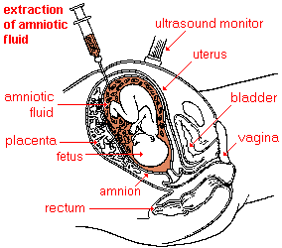
Amniocentesis
Performed after week fourteen
Needle inserted into amniotic sac
  Can determine chromosomal anomalies

Slide 187
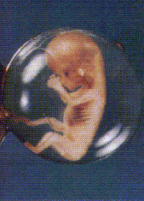
Week Eight
Embryo is usually 30 mm long and weighs 5 grams
Looks human
Disturbances to development in embryonic stage can cause major malformations or malfunctions

Slide 188
Fetal Stage
From end of week eight until birth
Month Three:
  Rapid growth
  Body proportions change
  Ossifications centersappear
  By week 12, male and female organs distinguishable

Slide 189
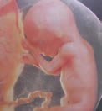
Month Four
Skeleton continues to ossify
Fetus has hair, eyebrows, lashes, nails
Still has rapid growth

Slide 190
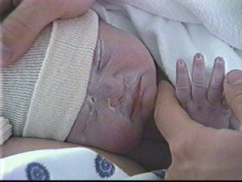
Month Five
Growth slows
Skeletal muscles become active
    Mom can feel kicking
  Lanugo: fine downy hair that covers skin
  Vernix caseosa: cheesy mix of sebum and dead cells covers the skin

Slide 191
Month Six
More weight gain
Month Seven
  Eyes opened

Slide 192
Final trimester
Brain cell networks formed
Fat deposited
Testes descend in male
Digestive and respiratory tracts mature

Slide 193
Neonatal period
Begins at birth
Ends at end of week four
  Breathing (first breath)
    Stimulated by increased carbon dioxide
    Decreasing pH
    Low oxygen
    Decrease in body temperature
    Mechanical stimulation

Slide 194
Neonatal period
Energy
  Fetus: glucose and fatty acids in mother’s blood
  Neonate: colostrum
    Rich in nutrients and antibodies
    Newborns will use stored fat for energy as well

Slide 195
Neonatal
Foramen ovale
  Used to allow blood from right atrium to left atrium, skipping lungs
  Closes due to blood pressure changes after birth
    Valve gradually fuses closed

Slide 196
Ductus arteriosus
In fetus:
  Allows blood in pulmonary trunk to go directly to the aorta, bypassing the lungs
  Neotanal:
    Constricts and closes off.

Slide 197
Infancy
From week four through end of year one
Rapid growth: may triple birth weight
Eruption of teeth
Increased coordination
First words

Slide 198
Infant nutrition requirements
Needs proteins
  new tissues
Calcium/Vit D
  bones and skeletal structures
Iron:
  blood cell formation
Vit C
  cartilage and bone

Slide 199
Childhood
From end of first year through puberty
  High rate of growth
  Primary and secondary teeth appear
  Bladder and bowel control
  Speech
  Reason

Slide 200
Adolescence
Between puberty and adulthood
  Anatomical and physiological changes that result in reproductive functionality
  Female puberty begins earlier than male
    Girls will be taller, stronger than male peers
      until male puberty

Slide 201
Adulthood
Maturity
From adolescence to old age
Male, age 18
  Producing highest amounts of testosterone for his lifetime
20’s:
  muscle strength peaks
  Hair fullest

Slide 202
Adulthood
30’s:
  Hearing less acute
  Heart muscle thickens
  Loss of ligamentous elasticity
40’s:
  Metabolism slows
  Vision less acute
  Hair grays
  Immune system less efficient

Slide 203
Adulthood
50’s
  Taste buds die
  Menopause
  Decreased pancreatic activity may lead to diabetes

Slide 204
Adulthood
60’s
  Memory changes (minor)
70’s
  Loss of height
  Skin loses integrity
  Cartilage continues to grow: nose, ears

Slide 205
Senescence
Senescence is the process of growing old
Result of normal wear and tear over years
  Decline of sensory functions more evident

Slide 206
Death
Following senescence, death usually results from mechanical failure

