Slide 1
Reproductive System
Primary sex organs: gonads
testes
ovaries
Produce gametes: sex cells
Sperm
ova
Secrete steroid sex hormones
Androgens (males)
Estrogens and progesterone (females)
Accessory reproductive organs
ducts, glands, and external genitalia

Slide 2
Reproductive System
Sex hormones play roles in
Development and function of reproductive organs
Sexual behavior and drives
Growth and development of organs and tissues

Slide 3
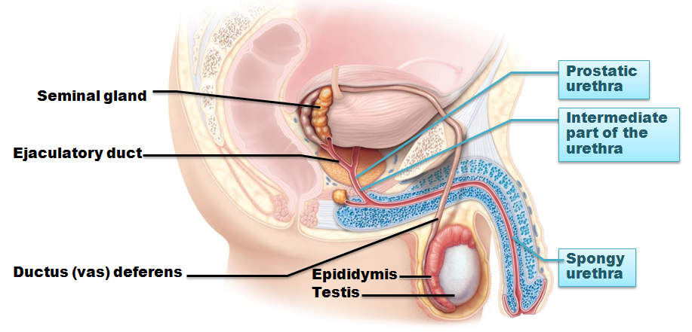
Male Reproductive System
Testes
within scrotum
produce sperm
Sperm delivered to exterior through system of ducts
Epididymis → ductus deferens → ejaculatory duct → urethra

Slide 4
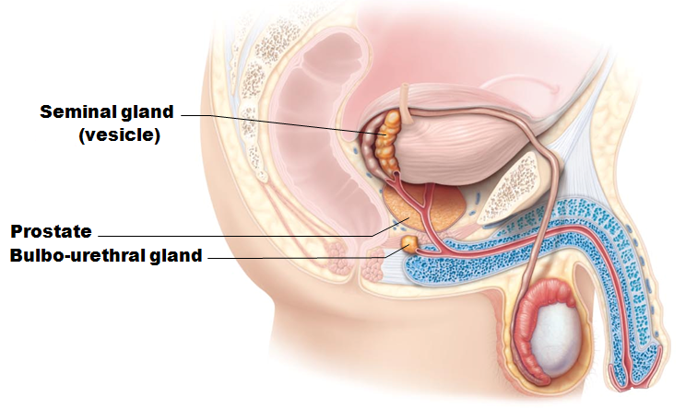
Male Reproductive System
Accessory sex glands
Seminal vesicles
Prostate
Bulbourethral glands
Empty secretions into ducts during ejaculation

Slide 5
The Scrotum
Sac of skin and superficial fascia
Hangs outside abdominopelvic cavity
Contains paired testes
3°C lower than core body temperature
Lower temperature necessary for sperm production

Slide 6
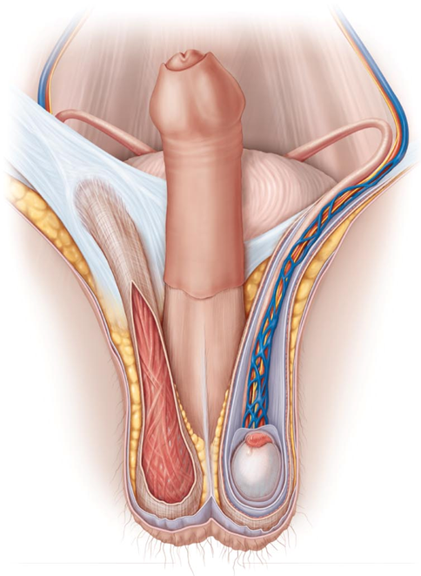
The Scrotum
Temperature kept constant by two sets of muscles
Cremaster muscles
bands of skeletal muscle that elevate testes
Dartos muscle
smooth muscle
wrinkles scrotal skin
pulls scrotum close to body

Slide 7
The Testes
Each surrounded by two tunics
Tunica vaginalis
outer layer derived from peritoneum
Tunica albuginea
inner layer
fibrous capsule
Septa divide testis into ~250 lobules
each containing 1–4 seminiferous tubules
site of sperm production

Slide 8
Seminiferous Tubules
Thick, stratified epithelium surrounding central fluid-containing lumen
Epithelium
spermatogenic cells embedded in Sustentacular cells(sustentocytes)
Myoid cells surround each tubule
May squeeze sperm, testicular fluids out of testes
Tubules of each lobule form straight tubule

Slide 9
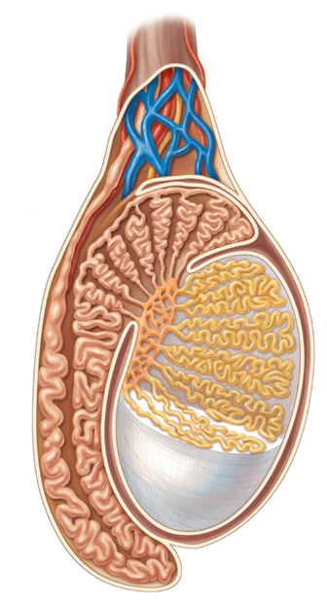
The Testes
Sperm conveyed from
Seminiferous tubules
Straight tubule
Rete testis
Efferent ductules
Epididymis

Slide 10
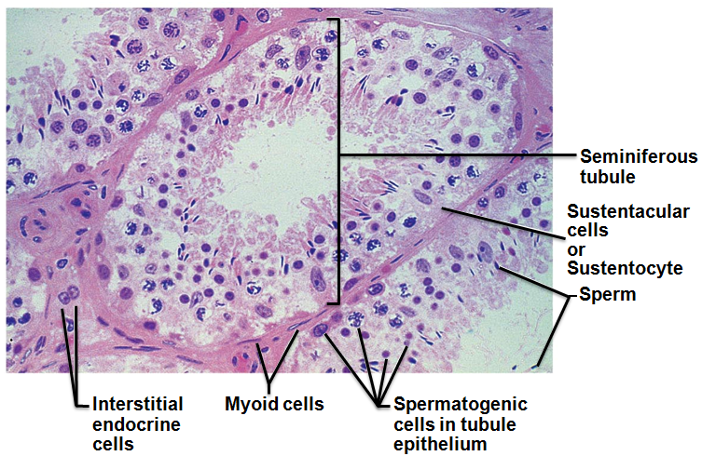
Seminiferous Tubules
Interstitial endocrine cells in soft tissue surrounding seminiferous tubules
Produce androgens
testosterone
Secrete it into interstitial fluid

Slide 11
The Testes
Blood supply
Testicular arteries arise from abdominal aorta
Testicular veins arise from pampiniform venous plexus surrounding each testicular artery
Cooler
absorb heat from testicular arteries
Keep testes cool
Spermatic cord
encloses nerve fibers, blood vessels, and lymphatics that supply testes

Slide 12
Homeostatic Imbalance
Testicular cancer
Rare
most common cancer in men 15-35
Cryptorchidism is risk factor
Sign
painless, solid mass in testis
90% cured by surgical removal of testis and often radiation or chemotherapy

Slide 13
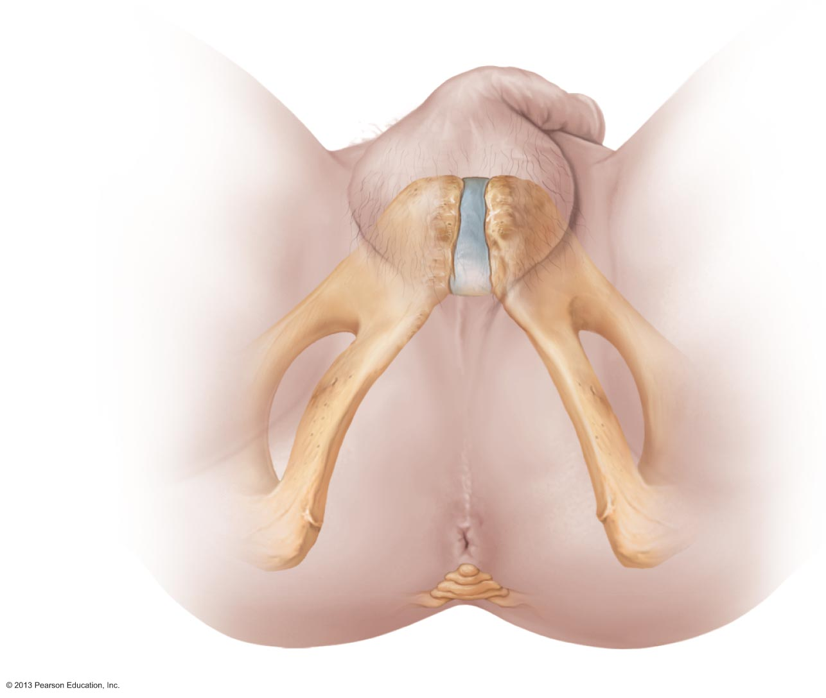
The Male Perineum
Diamond-shaped region between
pubic symphysis
Coccyx
ischial tuberosities
Suspends scrotum
contains root of penis and anus

Slide 14
The Penis
External genitalia
scrotum and penis
Penis
male copulatory organ

Slide 15
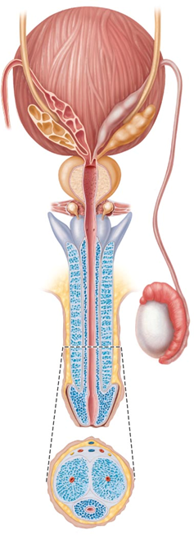
The Penis
Penis consists of
Crura
Proximal ends of corpora cavernosa surrounded by ischiocavernosus muscle
anchors penis to pubic arch
Root and shaft that ends in glans penis
Prepuce
Foreskin
cuff of loose skin covering glans

Slide 16
Circumcision
Surgical removal of foreskin
60% newborn boys in US circumcised
15% in other parts of world
Some claim medically unnecessary
Studies show
60% reduction in HIV risk
Reduced risk for other reproductive system infections

Slide 17
The Penis: Internally
Spongy urethra and three cylindrical bodies of erectile tissue
spongy network of connective tissue and smooth muscle with vascular spaces
Corpus spongiosum
surrounds urethra and expands to form glans and bulb
Corpora cavernosa
paired dorsal erectile bodies
Erection
erectile tissue fills with blood, causing penis to enlarge and become rigid

Slide 18
The Male Duct System
Ejaculatory duct
Ducts carry sperm from testes to body exterior
Epididymis
Ductus deferens
Ejaculatory duct
Urethra
urethra
Ductus deferens
Vas deferens
epididymis

Slide 19
Epididymis
Head
contains efferent ductules
superior aspect of testis
body and tail on posterolateral area of testis
Duct of the epididymis
Microvilli (stereocilia)
absorb testicular fluid
pass nutrients to stored sperm
Nonmotile sperm enter
pass slowly through (~ 20 days)
become motile
can be stored several months
During ejaculation epididymis contracts, expelling sperm into ductus deferens
head
body
tail

Slide 20
Ductus Deferens and Ejaculatory Duct
Ductus deferens (vas deferens)
Passes through inguinal canal to pelvic cavity
Expands to form ampulla
joins duct of seminal vesicle to form ejaculatory duct
Smooth muscle in walls propels sperm from epididymis to urethra
Vasectomy
cutting and ligating ductus deferens; nearly 100% effective form of birth control
ampulla
Seminal vesicle
Vas deferens

Slide 21
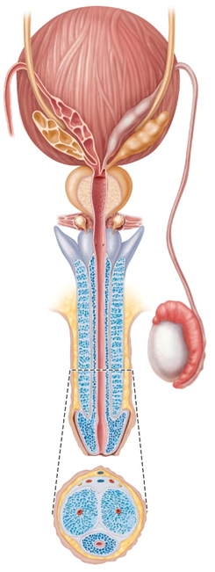
Urethra
Conveys both urine and semen (at different times)
Has three regions
Prostatic urethra
surrounded by prostate
Intermediate part of the urethra (membranous urethra)
in urogenital diaphragm
Spongy urethra
runs through penis
opens at external urethral orifice
Prostatic
urethra
Membranous
urethra
Spongy
Urethra

Slide 22
The Male Accessory Glands
Paired seminal glands (seminal vesicles)
Paired bulbo-urethral glands
Prostate gland
Produce bulk of semen
Remainder is sperm from testes
Seminal
vesicles
Prostate gland
Bulbourethral
glands

Slide 23
Accessory Glands: Seminal Glands
On posterior bladder surface
smooth muscle contracts during ejaculation
Produces viscous alkaline seminal fluid
Fructose, citric acid, coagulating enzyme (vesiculase), and prostaglandins
Yellow pigment fluoresces with UV light
70% volume of semen
Duct of seminal vesicle joins ductus deferens to form ejaculatory duct
Seminal
vesicles

Slide 24
Accessory Glands: Prostate
Encircles urethra inferior to bladder;
size of peach pit
smooth muscle contracts during ejaculation
Secretes milky, slightly acid fluid
Contains citrate, enzymes, and prostate-specific antigen (PSA)
Role in sperm activation
Enters prostatic urethra during ejaculation
33% semen volume
Prostate gland

Slide 25
Prostate Disorders
Prostatitis
inflammatory disorder
Bacterial infection
acute
Chronic
treated with antibiotics
Benign prostatic hyperplasia
May be age-related
distorts urethra
treated with surgery, microwaves, drugs, balloon compression, radio-frequency radiation

Slide 26
Prostate Disorders
Prostate cancer
Second most common cause of cancer death in males
Digital exam screening, PSA levels
Biopsy if abnormal
Treated with surgery and sometimes radiation; castration; drugs
In clinical trials
cryosurgery, chemotherapy, ultrasound, proton beam therapy

Slide 27
Accessory Glands: Bulbourethral Glands
Pea-sized glands inferior to prostate
Produce thick, clear mucus during sexual arousal
Lubricates glans penis
Neutralizes traces of acidic urine in urethra
Bulbourethral
glands

Slide 28
Semen
Milky-white mixture of sperm and accessory gland secretions
Contains fructose for ATP production
protects and activates sperm
facilitates sperm movement
Alkaline secretion
neutralizes acidity of male urethra
neutralizes acidity of female vagina
enhanced motility

Slide 29
Semen Functions
Prostaglandins
decrease viscosity of mucus in cervix
stimulate reverse peristalsis in uterus
Contains ATP for energy
Suppresses female immune response
Antibacterial action
Clotting factors coagulate semen initially to prevent draining out;
then liquefied by fibrinolysin
sperm begin journey

Slide 30
Male Sexual Response
Erection
Arterioles are normally constricted
Sexual excitement causes activation of parasympathetic neurons
nitric oxide (NO) release
local vascular smooth muscle relaxation
arterioles dilate
corpora cavernosa expands
Slows venous drainage
engorgement of erectile tissues with blood
enlargement and stiffening of penis

Slide 31
Erection
Initiated by sexual stimuli
Touch; mechanical stimulation of penis; erotic sights, sounds, and smells
Can be induced or inhibited by emotions or higher mental activity
Corpus spongiosum keeps urethra open

Slide 32
Male Sexual Response
Ejaculation
Propulsion of semen from male duct system
Sympathetic spinal reflex
Bladder sphincter muscle constricts, preventing expulsion of urine
Ducts and accessory glands contract and empty their contents
Bulbospongiosus muscles undergo rapid series of contractions
expulsion of semen at around 11 mph
Ejaculatory event
climax (orgasm)

Slide 33
Homeostatic Imbalance
Erectile dysfunction
Parasympathetic nerves of penis release too little Nitric Oxide
Causes
Alcohol
Drugs
Hormones
blood vessel or nervous system problems
incompetent venous valves fail to retain blood in penis
New drugs (Viagra, Cialis) enhance existing Nitric Oxidd effects

Slide 34
Spermatogenesis
Sperm (spermatozoa) production in seminiferous tubules
Most body cells have 46 chromosomes
diploid chromosomal number (2n)
Two sets (23 pairs) of chromosomes
One maternal, one paternal
Called homologous chromosomes
Gametes have 23 chromosomes
haploid chromosomal number (n)
Only one member of homologous pair

Slide 35
Meiosis
Gamete formation involves meiosis
Differs from mitosis
Two consecutive cell divisions
meiosis I and meiosis II
only one round of DNA replication
Produces four daughter cells
Functions of meiosis
Number of chromosomes halved (from 2n to n)
Introduces genetic diversity

Slide 36
Meiosis
Random alignment of homologous pairs in meiosis I
variability of gametes
Crossover
variability of gametes
No two gametes exactly alike
All different from original parent cells

Slide 37
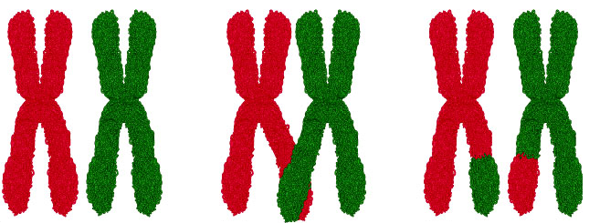
Meiosis I
Reduction division of meiosis
reduces chromosome number from 2n → n
Events found only during Prophase I of Meiosis
Synapsis
homologous chromosomes pair forming tetrads of four chromatids
Crossover
exchange of genetic material between male and female chromatid
unique chromosomes
Synapsis
Crossing over

Slide 38
Meiosis I
End of meiosis I each daughter cell
Two copies of one member of each homologous pair (either maternal or paternal); none of the other
Haploid chromosomal number
still-united sister chromatids one chromosome (twice amount DNA in each chromosome)
Sister
chromatid

Slide 39
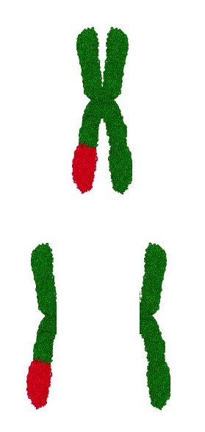
Meiosis II
Equational division of meiosis
Sister chromatids from meiosis I separated, one per cell
Like mitosis except no chromosome replication before begins
Sister chromatids split
into two
daughter chromosomes

Slide 40
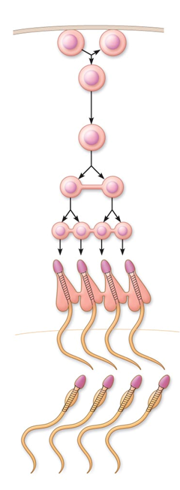
Spermatogenesis
spermatagonia
Spermatogenic cells give rise to sperm
Mitosis of spermatogonia forms two spermatocytes
Meiosis
Spermatocytes → secondary spermatocytes → spermatids
Spermiogenesis
Spermatids become sperm
Daughter cells
from mitosis
Primary
spermatocytes
Secondary
spermatocytes
Spermatids

Slide 41
Mitosis of Spermatogonia
Type B
Type A
Spermatogenesis begins at puberty
Spermatogonia
Stem cells in contact with epithelial basal lamina
Each mitotic division → one type A daughter cell and one type B daughter cell

Slide 42
Mitosis of Spermatogonia
Type B
Type A
Type A cells maintain germ cell line at basal lamina
Type B cells move toward lumen and develop into primary spermatocytes
becomes
primary spermatocyte
used
later

Slide 43
Meiosis: Spermatocytes to Spermatids
Meiosis I
Primary spermatocyte (46)
two secondary spermatocytes (23)
Meiosis II
Each secondary spermatocyte (23)
two spermatids (23)
Spermatid
small, nonmotile cells close to lumen of tubule
Meiosis I
Meiosis II

Slide 44
Spermiogenesis: Spermatids to Sperm
Spermatids
Correct chromosome number (n =23)
Nonmotile
Spermiogenesis
Spermatids elongate
lose excess cytoplasm
form a tail
Become spermatozoon (sperm)

Slide 45
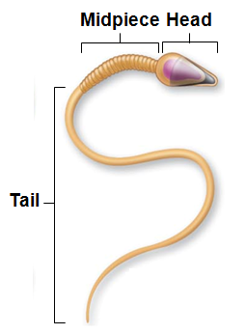
Sperm
Major regions
Head
genetic region
nucleus and helmetlike acrosome containing hydrolytic enzymes
enable sperm to penetrate egg
Midpiece
metabolic region
mitochondria → ATP to move tail
Tail
locomotor region
flagellum

Slide 46
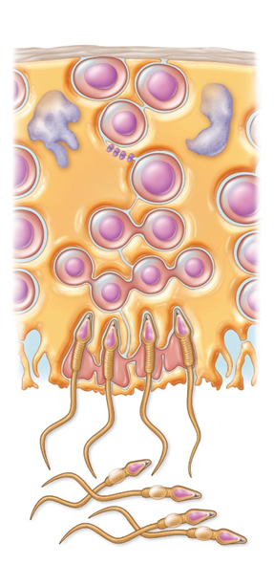
Role of Sustentocytes
Large supporting cells (Sertoli cells)
Provide nutrients and signals to dividing cells
Move cells along to lumen
Secrete testicular fluid into lumen for sperm transport
Phagocytize faulty germ cells and excess cytoplasm
Produce chemical mediators to regulate spermatogenesis
Sertoli Cells

Slide 47
Role of Sustentacular Cells
Tight junctions form blood-testis barrier
Prevents sperm antigens from escaping into blood
activation of immune system
Important
sperm not formed until puberty
absent during immune system development
would not be recognized as "self"

Slide 48
Homeostatic Imbalance
Infertility
Gradual decline in male fertility past 50 years
Xenobiotics (alien molecules) may be cause
Environmental toxins, PVCs, phthalates, pesticides, herbicides, compounds with estrogenic effects, antibiotics, radiation, lead, marijuana
Also, lack of selenium, excessive alcohol, lack of specific Ca²⁺ channel, anatomical obstructions, hormonal imbalances, oxidative stress, fevers, hot tubs

Slide 49
Hormonal Regulation of Male Reproductive Function
Sequence of hormonal regulatory events involving hypothalamus, anterior pituitary gland, and testes
Hypothalamic-pituitary-gonadal (HPG) axis
Regulates production of gametes and sex hormones through 3 interacting sets of hormones
GnRH indirectly stimulates testes via FSH & LH
FSH & LH directly stimulate testes
Testosterone & inhibin – negative feedback on hypothalamus and anterior pituitary

Slide 50
HPG Axis
Sequence of regulatory events
Hypothalamus releases gonadotropin-releasing hormone (GnRH) →
anterior pituitary to secrete FSH and LH
FSH causes sustentocytes to release androgen-binding protein (ABP) →
high concentration of testosterone near spermatogenic cells →
spermatogenesis
LH prods interstitial endocrine cells →
testosterone →
spermatogenesis

Slide 51
HPG Axis
Testosterone →
sex organ maturation
development/maintenance secondary sex characteristics,
libido
Rising testosterone levels →
feedback to inhibit gonadotropin release
Inhibin (released when sperm count high)
inhibits GnRH and FSH release

Slide 52
HPG Axis
Three years to achieve balance, then testosterone and sperm production fairly stable throughout life
Without GnRH and gonadotropins → testes atrophy; sperm and testosterone production cease

Slide 53
Mechanism and Effects of Testosterone Activity
Testosterone
Synthesized from cholesterol
Transformed to exert its effects on some target cells
Dihydrotestosterone (DHT) in prostate
Estradiol in some neurons in brain

Slide 54
Mechanism and Effects of Testosterone Activity
Prompts spermatogenesis
Targets all accessory organs
Has multiple anabolic effects throughout body
Deficiency leads to atrophy; semen volume declines; erection and ejaculation impaired
Treated with testosterone replacement

Slide 55
Male Secondary Sex Characteristics
Features induced in nonreproductive organs by male sex hormones (mainly testosterone)
Appearance of pubic, axillary, and facial hair
Enhanced growth of chest hair; deepening of voice
Skin thickens and becomes oily
Bones grow, increase in density
Skeletal muscles increase in size and mass
Boosts basal metabolic rate
Basis of sex drive (libido) in males

Slide 56
Male Secondary Sex Characteristics
Testosterone
Masculinizes embryonic brain
Continues to exert effect well into adulthood
Adrenal glands produce androgens in small amounts –
insufficient to maintain normal testosterone-mediated functions

Slide 57
Female Reproductive Anatomy
Ovaries
female gonads
Produce female gametes (ova)
Secrete female sex hormones
estrogen (estradiol, estrone, estriol)
progesterone
Accessory ducts include
Uterine tubes
Uterus
Vagina

Slide 58
Female Reproductive Anatomy
Internal genitalia – in pelvic cavity
Ovaries
Uterine tubes
Uterus
Vagina
External genitalia
External sex organs

Slide 59
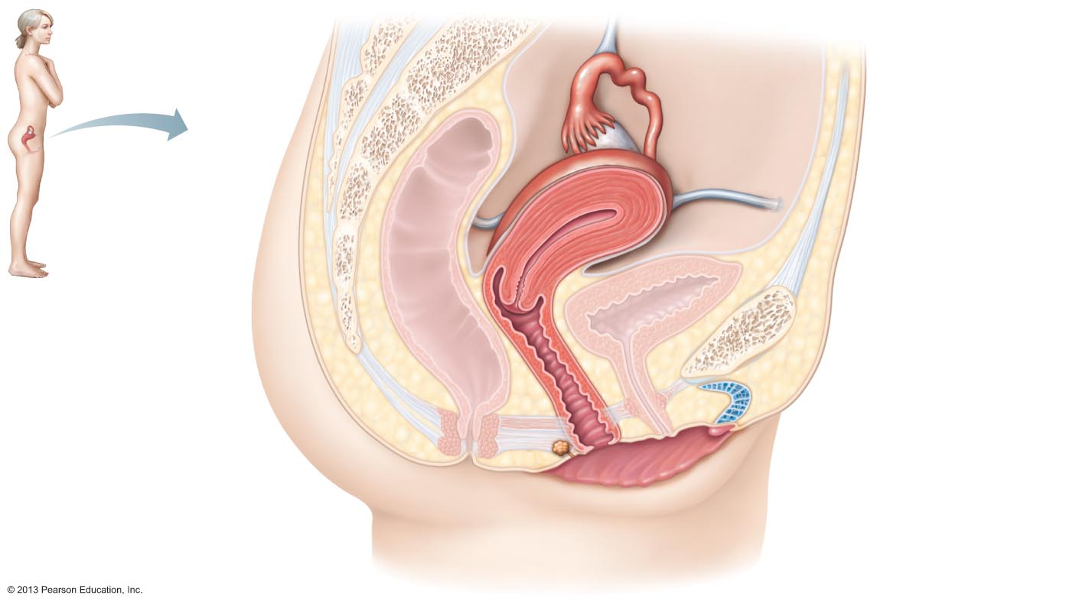
Figure 27.12 Internal organs of the female reproductive system, midsagittal section.
Suspensory ligament
of ovary
Infundibulum
Uterine tube
Ovary
Fimbriae
Uterus
Round ligament
Perimetrium
Urinary bladder
Rectum
Pubic symphysis
Posterior fornix
Mons pubis
Cervix
Urethra
Anterior fornix
Clitoris
Vagina
External urethral
orifice
Anus
Urogenital diaphragm
Hymen
Greater vestibular
gland
Labium minus
Labium majus

Slide 60
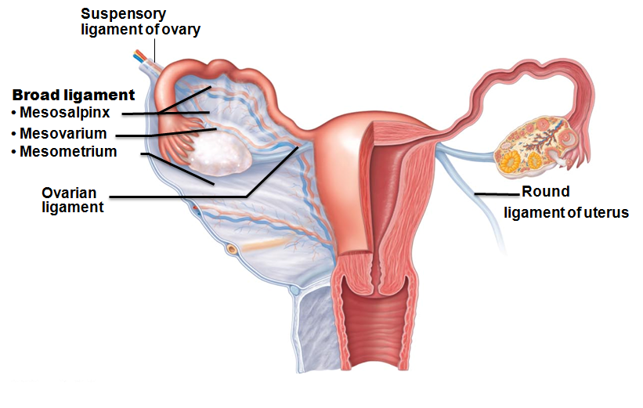
Ovaries
Held in place by several ligaments
Ovarian ligament
anchors ovary medially to uterus
Suspensory ligament
anchors ovary laterally to pelvic wall
Mesovarium
suspends ovary
Suspensory ligament and mesovarium part of broad ligament
supports uterine tubes, uterus, and vagina

Slide 61
Ovaries
Blood supply
ovarian arteries and ovarian branch of the uterine arteries
Surrounded by fibrous tunica albuginea
Germinal epithelium - outer layer
Two poorly defined regions
Outer cortex – houses forming gametes
Inner medulla - large blood vessels and nerves

Slide 62
Ovaries
Embedded in cortex
Ovarian follicles
Immature egg (oocyte) surrounded by
Follicle cells (one cell layer thick)
Granulosa cells (more than one layer present)

Slide 63
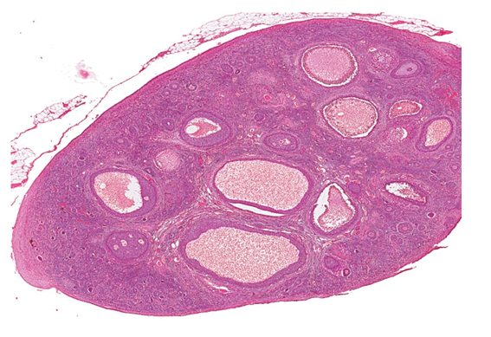
Follicles
Several stages of development
Primordial follicle
single layer of follicle cells + oocyte
More mature follicles
several layers of granulosa cells
Primordial
follicles

Slide 64
Ovaries
Vesicular (antral or tertiary) follicle – fully mature follicle
Fluid-filled antrum forms; follicle bulges from ovary surface
Ovulation
Ejection of oocyte from ripening follicle
Corpus luteum develops from ruptured follicle after ovulation
vesicular
follicles

Slide 65
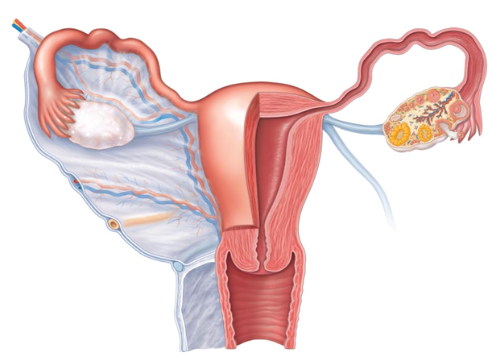
Female Duct System
Ducts have no contact with ovary
Oocyte cast into peritoneal cavity; some lost there
Uterine (fallopian) tubes or oviducts
Uterus
Vagina
Fallopian
tubes
Uterus
Vagina

Slide 66
Uterine Tubes
Receive ovulated oocyte; usual site of fertilization
Isthmus
constricted region where tube joins uterus
Ampulla
Distal expansion with infundibulum near ovary
Ciliated fibriae of infundibulum create currents to move oocyte into uterine tube
Isthmus
Ampulla
Infundibulum

Slide 67
Uterine Tubes
Oocyte carried along by peristalsis and ciliary action
Nonciliated cells nourish oocyte and sperm
Covered externally by peritoneum

Slide 68
Homeostatic Imbalance
Ectopic pregnancy
Oocyte fertilized in peritoneal cavity or distal uterine tube begins developing there
Normally abort naturally with substantial bleeding
Pelvic inflammatory disease (PID)
Spread of infection from reproductive tract to peritoneal cavity
May cause scar tissue → infertility

Slide 69
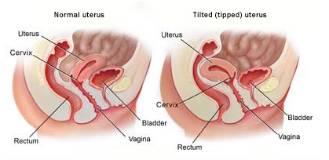
Uterus
Hollow, thick-walled, muscular organ
Function
Receive, retain, nourish fertilized ovum
Anteverted
inclined forward
retroverted
inclined backward
Body
major portion
Fundus
rounded superior region
Isthmus
narrowed inferior region
Fundus
Body
Isthmus
Cervix

Slide 70
Uterus
Cervix
narrow neck, or outlet; projects into vagina
Cervical canal communicates with
Vagina via external os
Uterine body via internal os
Cervical glands secrete mucus that blocks sperm entry except during midcycle
Cervix
Internal os
externalos

Slide 71
Homeostatic Imbalance
Cervical cancer
450,000 women worldwide each year
killing half
Most common between 30 – 50
Risks
frequent cervical inflammations
STIs
multiple pregnancies
Papanicolaou (Pap) smear for detection
Every two years 21 – 30; every year > 30; discontinue at 65 if negative for 10 years

Slide 72
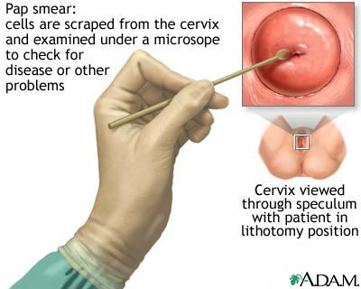
Homeostatic Imbalance
Pap smear results inconclusive
Test for human papillomavirus
cause of most cervical cancers
Gardasil
three-dose vaccine
protects against HPV
Recommended for 11- and 12-year-old girls

Slide 73
Uterine Wall
Three layers
Perimetrium
serous layer (visceral peritoneum)
Myometrium
interlacing layers of smooth muscle
Endometrium
mucosal lining
perimetrium
myometrium
endometrium

Slide 74
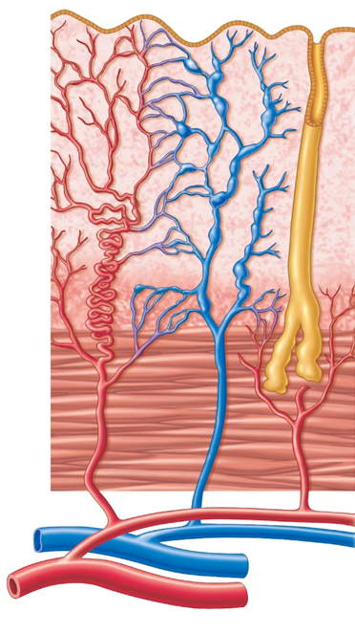
Endometrium
Stratum functionalis (functional layer)
Changes in response to ovarian hormone cycles
Shed during menstruation
Stratum basalis (basal layer)
Forms new functionalis after menstruation
Unresponsive to ovarian hormones
Stratum
Functonalis
Stratum
basalis

Slide 75
Uterine Vascular Supply
Uterine arteries →Arcuate arteries →Radial arteries in endometrium
branch into
Straight arteries → stratum basalis
Spiral arteries → stratum functionalis
Degenerate and regenerate; spasms → shedding of functionalis layer during menstruation
Straight arteries
Spiral arteries

Slide 76
Vagina
Thin-walled tube 8-10 cm in length
Birth canal
organ of copulation
Extends between bladder and rectum from cervix to exterior
Urethra parallels course anteriorly; embedded in anterior wall

Slide 77
Vagina
Layers of wall
Fibroelastic adventitia
Smooth muscle muscularis
Stratified squamous mucosa with rugae
Dendritic cells in mucosa may provide route for HIV transmission
Mucosa near vaginal orifice forms incomplete partition called hymen
ruptures with intercourse
Vaginal fornix
upper end of vagina surrounding cervix

Slide 78
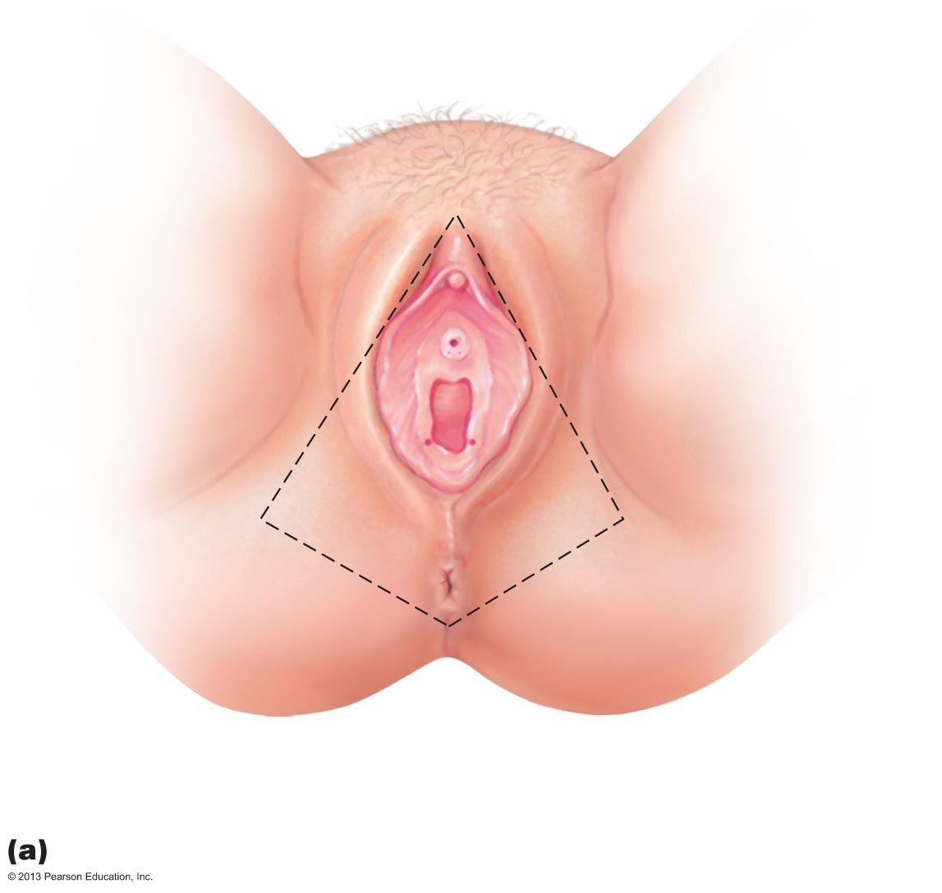
Figure 27.16a The external genitalia (vulva) of the female.
Mons
pubis
Labia
majora
Prepuce
of clitoris
Labia
minora
Clitoris
(glans)
External
urethral
orifice
Vestibule
Hymen
(ruptured)
Vaginal
orifice
Anus
Opening of the duct
of the greater
vestibular gland

Slide 79
External Genitalia (Vulva or Pudendum)
Mons pubis
fatty area overlying pubic symphysis
Labia majora
hair-covered, fatty skin folds
Counterpart of male scrotum
Labia minora
skin folds lying within labia majora
Join at posterior end of vestibule → fourchette
Vestibule - recess within labia minora
Mons Pubis
Labia Majora
Labia Minora
Fourchette

Slide 80
External Genitalia
Greater vestibular glands
Flank vaginal opening
Homologous to bulbourethral glands
Release mucus into vestibule for lubrication
Vestibular glands

Slide 81
External Genitalia
Clitoris – anterior to vestibule
Glans of the clitoris
exposed portion
Prepuce of the clitoris
hoods glans
Counterpart of penis
Perineum
Diamond-shaped region between pubic arch and coccyx
Bordered by ischial tuberosities laterally
Prepuce of clitoris
Glans clitoris
Perineum

Slide 82
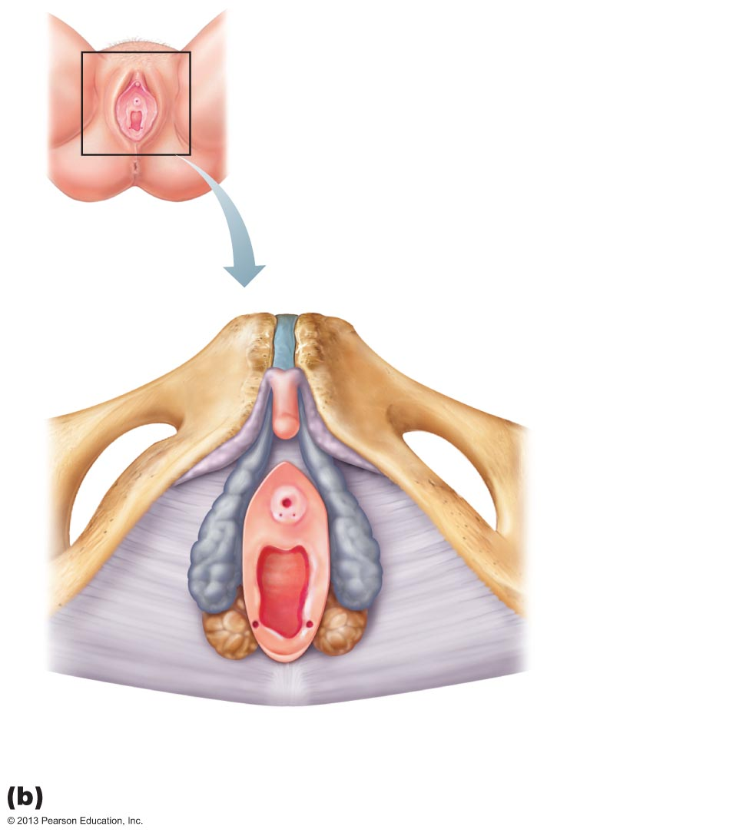
Figure 27.16b The external genitalia (vulva) of the female.
Clitoris
Labia minora
Labia majora
Anus
Pubic symphysis
Inferior
ramus
of pubis
Body of clitoris,
containing
corpora
cavernosa
Clitoris (glans)
Crus of clitoris
External
urethral orifice
Vaginal orifice
Greater
vestibular
gland
Bulb of
vestibule
Fourchette

Slide 83
Mammary Glands
Modified sweat glands consisting of 15–25 lobes
Function in milk production
Areola
pigmented skin surrounding nipple
Suspensory ligaments
attach breast to underlying muscle
Lobules within lobes contain glandular alveoli that produce milk

Slide 84
Mammary Glands
Milk → lactiferous ducts → lactiferous sinuses → open to outside at nipple
Breast size due to amount of fat deposits

Slide 85
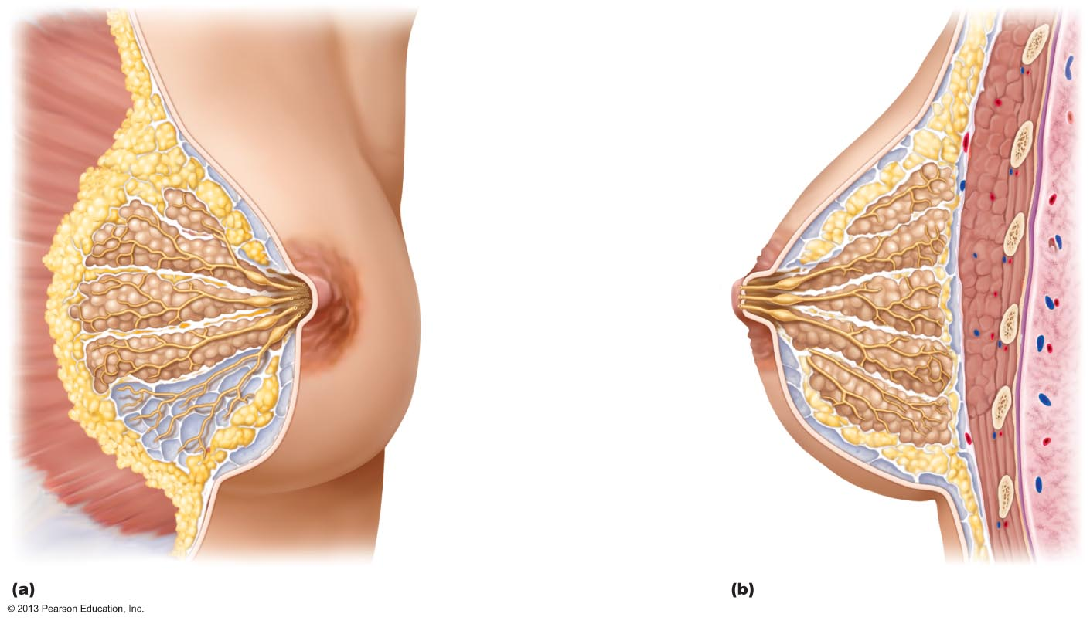
Figure 27.17 Structure of lactating mammary glands.
First rib
Skin (cut)
Pectoralis major muscle
Suspensory ligament
Adipose tissue
Lobe
Areola
Nipple
Opening of lactiferous duct
Lactiferous sinus
Lactiferous duct
Lobule containing alveoli
Hypodermis
(superficial fascia)
Intercostal muscles

Slide 86
Breast Cancer
Invasive breast cancer most common malignancy, second most common cause of cancer death in U.S. women
13% will develop condition

Slide 87
Breast Cancer
Usually arises from epithelial cells of smallest ducts; eventually metastasize
Risk factors include
Early onset of menstruation and late menopause
No pregnancies or first pregnancy late in life
No or short periods of breast feeding
Family history of breast cancer
70% of women with breast cancer have no known risk factors

Slide 88
Breast Cancer
10% due to hereditary defects, including mutations to genes BRCA1 and BRCA2
50 – 80% develop breast cancer
Greater risk of ovarian cancer as well

Slide 89
Breast Cancer: Diagnosis
Early detection via self-examination and mammography
X-ray examination
American Cancer Society recommends screening every year for women 40 and over
U.S. Prevention Services Task Force on Breast Cancer Screening recommends 50 and over

Slide 90
Breast Cancer: Treatment
Radical mastectomy
removes breast, all underlying muscles, fascia, associated lymph nodes
Lumpectomy
excises only cancerous lump
Simple mastectomy
removes only breast tissue
sometimes some axillary lymph nodes
Some have breast reconstruction

Slide 91
Physiology of the Female Reproductive System
Always assumed females total supply of eggs determined at birth
New evidence stem cells can arise from epithelial cells at ovary surface
May overturn previous assumption

Slide 92
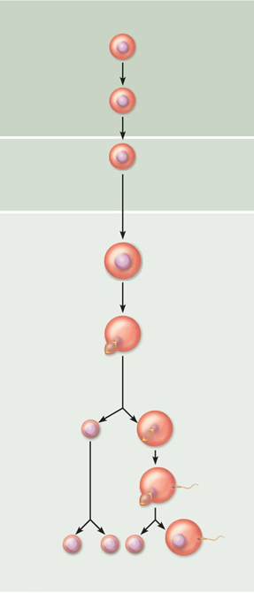
Oogenesis
Oogonia
Mitosis
Production of female gametes
Takes years to complete
Begins in fetal period
Oogonia (2n ovarian stem cells) multiply by mitosis and store nutrients
Primary oocytes develop in primordial follicles
Primary oocytes begin meiosis; stall in prophase I
Primary
Oocyte
incomplete meiosis
Meiosis I completed
Secondary
Oocyte
Ovulation
Ovum

Slide 93
Oogenesis
At birth female presumed to have lifetime supply of primary oocytes
Each month after puberty, a few primary oocytes activated
One "selected" each month to resume meiosis I
Result is two haploid cells of different sizes
Secondary oocyte
large cell with most cytoplasm and organelles of original cell
First polar body
small cell

Slide 94
Oogenesis
Secondary oocyte arrests in metaphase II
ovulated ovum
If not penetrated by sperm it deteriorates
If penetrated by sperm second oocyte completes meiosis II, yielding
Ovum (functional gamete)
Second polar body

Slide 95
Ovarian Cycle
Monthly series of events associated with maturation of egg
Two consecutive phases (in 28-day cycle)
Follicular phase - period of follicle growth (days 1–14)
Ovulation occurs midcycle
Luteal phase - period of corpus luteum activity (days 14–28)

Slide 96
Ovarian Cycle
Only 10 – 15% women have 28-day cycle
Follicular phase varies
Luteal phase constant
always 14 days from ovulation to end of cycle

Slide 97
Follicular Phase
Primordial follicle
Primordial follicle becomes primary follicle
Squamouslike cells become cuboidal; oocyte enlarges
Primary follicle becomes secondary follicle
Primary follicle
Secondary Follicle

Slide 98
Follicular Phase
Secondary follicle becomes late secondary follicle
Connective tissue (theca folliculi) and granulosa cells cooperate to produce estrogens
Inner thecal cells produce androgens in response to LH
Zona pellucida forms around oocyte
Fluid accumulates between granulosa cells

Slide 99
Follicular Phase
Late secondary follicle becomes vesicular follicle
Antrum forms
expands to isolate oocyte with corona radiata on stalk
Vesicular follicle bulges from external surface of ovary
Primary oocyte completes meiosis I → secondary oocyte and first polar body

Slide 100
Ovulation
Ovary wall ruptures, expels secondary oocyte with its corona radiata to peritoneal cavity
Mittelschmerz
twinge of pain sometimes felt at ovulation
1–2% of ovulations release more than one secondary oocyte,
if fertilized, results in fraternal twins
Identical twins result from fertilization of one oocyte, then separation of daughter cells

Slide 101
Luteal Phase of the Ovarian Cycle
Ruptured follicle collapses
antrum fills with clotted blood
corpus hemorrhagicum
Granulosa cells and internal thecal cells form corpus luteum
Corpus luteum secretes progesterone and some estrogen

Slide 102
Luteal Phase
If no pregnancy, corpus luteum degenerates into corpus albicans (scar) in 10 days
If pregnancy occurs, corpus luteum produces hormones that sustain pregnancy until placenta takes over at about 3 months

Slide 103
Establishing the Ovarian Cycle
During childhood, ovaries grow and secrete small amounts of estrogens that inhibit hypothalamic release of GnRH
As puberty nears, GnRH released; FSH and LH released by pituitary, and act on ovaries
These events continue until an adult cyclic pattern achieved and menarche occurs

Slide 104
Hormonal Regulation of the Ovarian Cycle
Hormone interaction produces cyclic events in ovaries
Gonadotropin-releasing hormone (GnRH)
Pituitary gonadotropins
Ovarian estrogen
Ovarian progesterone
Onset of puberty linked to amount of adipose tissue via hormone leptin

Slide 105
Establishing the Ovarian Cycle
During childhood, until puberty
Ovaries secrete small amounts of estrogens
Estrogen inhibits release of GnRH
If leptin levels adequate hypothalamus less sensitive to estrogen as puberty nears; releases GnRH in rhythmic pulse-like manner → FSH and LH release → ovarian hormone release

Slide 106
Establishing the Ovarian Cycle
Gonadotropin levels increase over four years
no ovulation
no pregnancy
Then adult cyclic pattern achieved and menarche occurs
First menstrual period

Slide 107
Hormonal Interactions During a 28-Day Ovarian Cycle
1. GnRH → release of FSH and LH
2. FSH and LH → growth of several follicles, and hormone release
3. ↑plasma estrogen levels inhibit release of FSH and LH
↑estrogen levels enhance further estrogen output
Inhibin from granulosa cells also inhibits FSH release

Slide 108
Hormonal Interactions During a 28-Day Ovarian Cycle
4. When estrogen levels high → brief positive feedback on brain and anterior pituitary
5. Stored LH, and some FSH, suddenly released by anterior pituitary at midcycle → surge triggers ovulation
→ primary oocyte to complete meiosis I → secondary oocyte
Secondary oocyte → meiosis II

Slide 109
Hormonal Interactions During a 28-Day Ovarian Cycle
LH effects at midcycle
Increases local vascular permeability
Triggers inflammatory response
weakens ovarian wall
→ Blood flow stops through protruding follicle wall → wall thins, bulges, ruptures → hole (stigma)
→ Oocyte with corona radiata exits (ovulation)

Slide 110
Hormonal Interactions During a 28-Day Ovarian Cycle
After ovulation
Estrogen levels decline
LH transforms ruptured follicle → corpus luteum
LH stimulates corpus luteum →
progesterone and some estrogen almost immediately
Progesterone helps maintain stratum functionalis
Maintains pregnancy, if occurs

Slide 111
Hormonal Interactions During a 28-Day Ovarian Cycle
6. Negative feedback (from rising plasma progesterone and estrogen levels) inhibits LH and FSH release
Inhibin, from corpus luteum and granulosa cells, enhances effect
Declining LH ends luteal activity, inhibits follicle development

Slide 112
Hormonal Interactions During a 28-Day Ovarian Cycle
If no fertilization
Corpus luteum degenerates when LH levels fall →
sharp decrease in estrogen and progesterone →
ends blockage of FSH and LH secretion
→ Cycle starts anew
Oocyte actually activated 12 months prior to ovulation, not 14 days

Slide 113
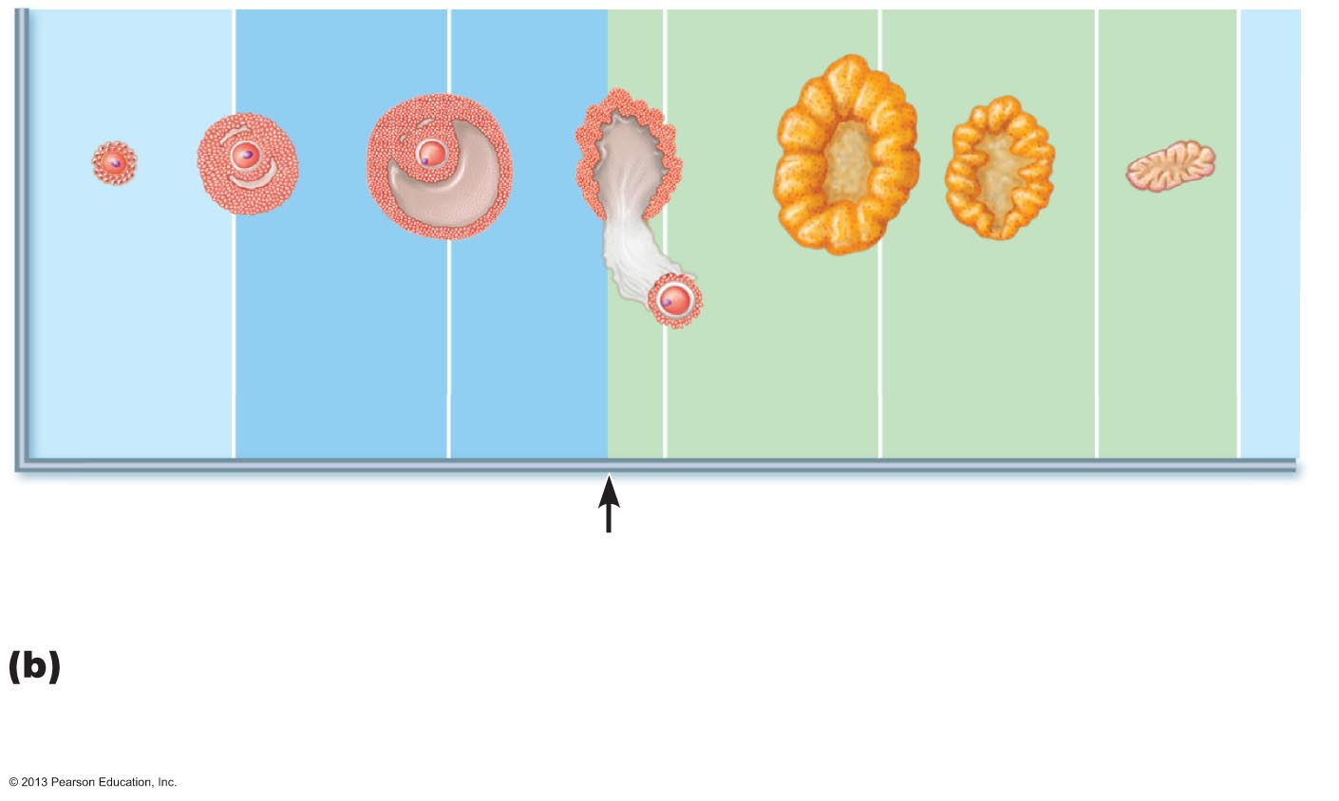
Figure 27.22b Correlation of anterior pituitary and ovarian hormones with structural changes of the ovary and uterus.
Primary
follicle
Secondary
follicle
Vesicular
follicle
Ovulation
Corpus
luteum
Degenerating
corpus luteum
Follicular
phase
Ovulation
(Day 14)
Luteal
phase
Ovarian cycle: Structural changes in the ovarian follicles during the ovarian cycle are correlated with (d) changes in the endometrium of the uterus during the uterine cycle.

Slide 114
The Uterine (Menstrual) Cycle
Cyclic changes in endometrium in response to fluctuating ovarian hormone levels
Three phases
Days 1–5 - menstrual phase
Days 6–14 - proliferative (preovulatory) phase
Days 15–28 - secretory (postovulatory) phase (constant 14-day length)

Slide 115
Uterine Cycle
Menstrual phase (Days 1 - 5)
Ovarian hormones at lowest levels
Gonadotropins beginning to rise
Stratum functionalis shed
menstrual flow (blood and tissue) 3 - 5 days
By day 5 growing ovarian follicles produce more estrogen

Slide 116
Uterine Cycle
Proliferative phase (Days 6 - 14)
Rising estrogen levels prompt generation of new stratum functionalis layer
glands enlarge and spiral arteries increase in number
Normally thick, sticky cervical mucus thins in response to rising estrogen (allows sperm passage)
Ovulation occurs at end of proliferative phase

Slide 117
Uterine Cycle
Secretory phase (Days 15 – 28)
Most constant timewise
Endometrium propares for embryo
Rising progesterone levels prompt
Functional layer → secretory mucosa
Endometrial glands secrete nutrients
Formation of cervical mucus plug

Slide 118
Uterine Cycle
If fertilization does not occur
Corpus luteum degenerates toward end of secretory phase
Progesterone levels fall
Spiral arteries kink and spasm
Endometrial cells begin to die; glands regress
Spiral arteries constrict again, then relax and open wide
Rush of blood fragments weakened capillary beds and functional layer sloughs

Slide 119
Effects of Estrogens
Promote oogenesis and follicle growth in ovary
Exert anabolic effects on female reproductive tract
Support rapid but short-lived growth spurt at puberty

Slide 120
Effects of Estrogens
Induce secondary sex characteristics
Growth of breasts
Increased deposit of subcutaneous fat (hips and breasts)
Widening and lightening of pelvis

Slide 121
Effects of Estrogens
Metabolic effects (not true secondary sex characteristics)
Maintain low total blood cholesterol and high HDL levels
Facilitate calcium uptake

Slide 122
Effects of Progesterone
Progesterone works with estrogen to establish and regulate uterine cycle
Promotes changes in cervical mucus
Effects of placental progesterone during pregnancy
Inhibits uterine motility
Helps prepare breasts for lactation

Slide 123
Female Sexual Response
Initiated by touch and psychological stimuli
Clitoris, vaginal mucosa, bulbs of vestibule, and breasts engorge with blood; nipples erect
Vestibular gland secretions lubricate vestibule
Orgasm accompanied by muscle tension, increase in pulse rate and blood pressure, and rhythmic contractions of uterus

Slide 124
Female Sexual Response
Females have no refractory period after orgasm
can experience multiple orgasms in single sexual experience
Orgasm not essential for conception
Female libido prompted by Adrenal cortex hormones
Testosterone-like hormones

Slide 125
Sexually Transmitted Infections (STIs)
Also called sexually transmitted diseases (STDs) or venereal diseases (VDs)
U.S. – highest rates of infection among developed countries
Latex condoms help prevent spread
Single most important cause of reproductive disorders

Slide 126
Gonorrhea
Commonly called "the clap"
Bacterial infection of mucosae of reproductive and urinary tracts
Spread by contact with genital, anal, and pharyngeal mucosae
Number of cases in U.S. declining

Slide 127
Gonorrhea
Signs and symptoms
Males
Urethritis, painful urination, discharge of pus
Females
20% display no signs or symptoms
Abdominal discomfort, vaginal discharge, or abnormal uterine bleeding
Can result in pelvic inflammatory disease and sterility
Treatment
antibiotics
but resistant strains becoming prevalent

Slide 128
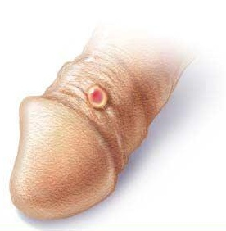
Syphilis
Bacterial infection transmitted sexually or contracted congenitally
Infected fetuses stillborn or die shortly after birth
Infection asymptomatic for 2–3 weeks
Painless chancre appears at site of infection; disappears in few weeks

Slide 129
Syphilis
If untreated, secondary signs appear several weeks later for 3–12 weeks, then disappear
Pink skin rash, fever, and joint pain
Latent period may or may not progress to tertiary syphilis, characterized by gummas (lesions of CNS, blood vessels, bones, and skin)
Treatment
penicillin

Slide 130
Chlamydia
Most common bacterial STI in United States
Responsible for 25–50% of all diagnosed cases of pelvic inflammatory disease
Symptoms
urethritis; penile and vaginal discharges; abdominal, rectal, or testicular pain; painful intercourse; irregular menses
Can cause arthritis and urinary tract infections in men; sterility in women; newborns contract in birth canal → trachoma (painful eye infection), respiratory tract inflammation
Treatment - tetracycline

Slide 131
Trichomoniasis
Most common curable STI in active young women in U.S.
Parasitic infection
easily, inexpensively treated
Yellow-green vaginal discharge with strong odor
some symptomless

Slide 132
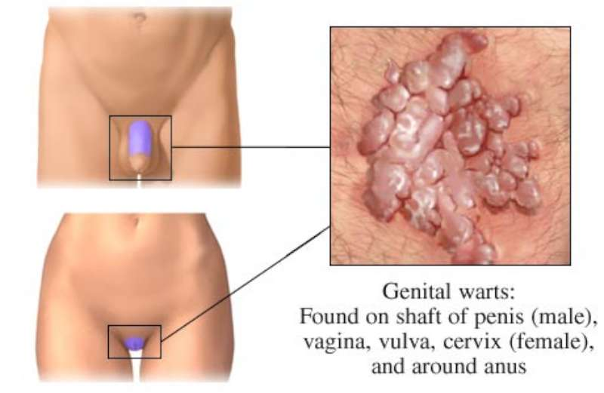
Viral Infections
Genital warts
Caused by human papillomavirus (HPV)
Second most common STI in United States
Increased risk of cancers in infected body regions
Linked to 80% cases of invasive cervical cancer; most strains do not cause cancer
Treatment difficult; controversial

Slide 133
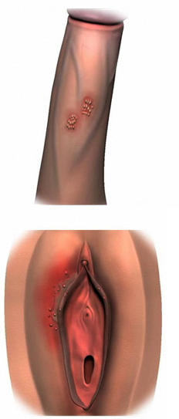
Viral Infections
Genital herpes
Caused by herpes simplex virus 2
Characterized by latent periods and flare-ups
Congenital herpes can cause malformations of fetus
Treatment - acyclovir and other antiviral drugs

Slide 134
Developmental Aspects: Determination of Genetic Sex
Of 46 chromosomes in fertilized egg, two (one pair) are sex chromosomes
Two sex chromosomes
X chromosome (large)
Y chromosome (quite small)
Females are XX; each ovum always has an X chromosome
Males are XY, so ~50% of sperm contain X, ~50% contain Y

Slide 135
Developmental Aspects: Determination of Genetic Sex
X egg + X sperm → XX (female offspring)
X egg + Y sperm → XY (male offspring)
The SRY gene on Y chromosome initiates testes development and maleness

Slide 136
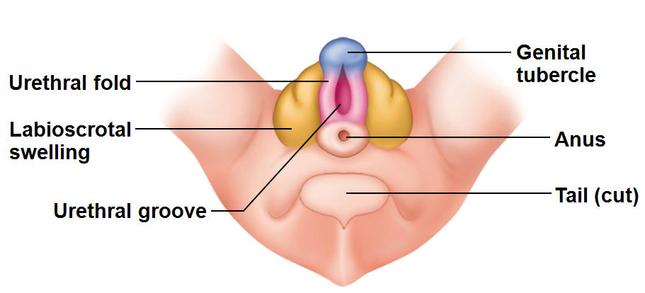
Developmental Aspects: Sexual Differentiation
Sexually indifferent stage
Gonads begin development in fifth week as gonadal ridges
Primordial germ cells migrate to gonadal ridges to provide germ cells destined to become spermatogonia or oogonia
Gonads begin development in seventh week in males, eighth week in females

Slide 137
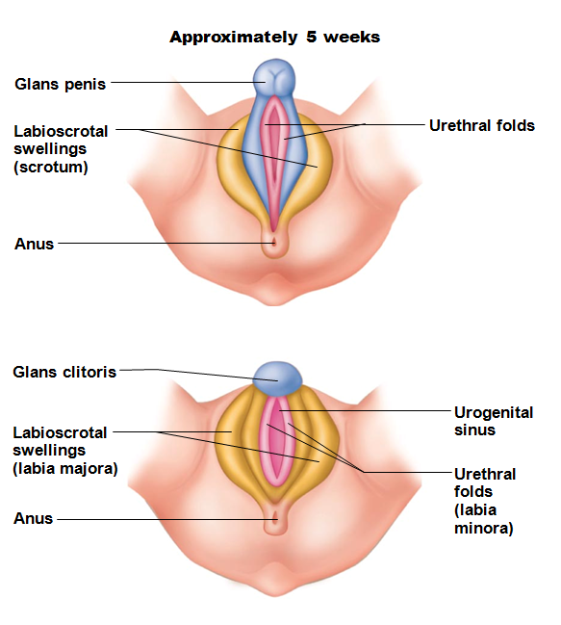
Development of External Genitalia
Genital tubercle→
penis of male
clitoris of female
Urethral fold →
spongy urethra of male
labia minora of female
Labioscrotal swellings →
scrotum of male
labia majora of female
If testosterone absent, all embryos develop into females

Slide 138
Development Aspects: Descent of the Gonads
About two months before birth
Testosterone stimulates migration of testes toward scrotum
Gubernaculum
fibrous cord from each testis to scrotum or from ovary to labium majus; guides descent
Ovaries also descend, but stopped by broad ligament at pelvic brim

Slide 139
Development Aspects: Puberty
FSH and LH elevated at birth but drop and remain low during prepubertal years
Reproductive organs grow to adult size and become functional
puberty
Occurs in response to rising levels of gonadal hormones
Secondary sex characteristics appear
Earliest time that reproduction is possible

Slide 140
Menopause
Has occurred when menses have ceased for an entire year
No equivalent to menopause in males
Males continue to produce sperm well into eighth decade of life, though numbers and motility decrease

Slide 141
Menopause
Declining estrogen levels →
Atrophy of reproductive organs and breasts
Irritability and depression in some
Hot flashes as skin blood vessels undergo intense vasodilation
Gradual thinning of skin and bone loss
Increased total blood cholesterol levels and falling HDL

Slide 142
Menopause
Treatment with estrogen-progesterone preparations given for years
Women's Health Initiative research reported increased risk of heart disease (51%), invasive breast cancer (24%), stroke (31%), dementia (risk doubled)
Smallest does for shortest time alright to reduce symptoms if no breast cancer or mutated BRCA gene

Slide 143
Pregnancy
Secondary oocyte must enter uterine tube and be exposed to the male sperm cells.
Secondary oocyte lives 24 hours
Male sperm may exist for 72 hours in reproductive tract.

Slide 144
Fertilization
Sperm reaches secondary oocyte and the acrosome and its enzymes helps the sperm to penetrate
oocyte cell membrane becomes impenetrable after one sperm cell gains access

Slide 145
Fertilization
Once sperm within oocyte
nucleus of the sperm head swells
Secondary oocyte divides
forms large cell and polar body.
Female meiosis completes only after the sperm enters the egg.
Nuclei unite,
chromosomes mingle
Zygote is oocyte and sperm, has 46 chromosomes.

Slide 146
Cleavage
Zygote undergoes mitosis.
Gives rise to two cells
blastomeres
Two cells divide, turn to four cells, eight cells, etc.
Phase of development called cleavage.

Slide 147
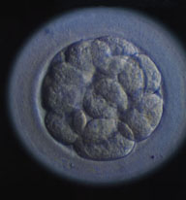
Morula
Travel time to uterus: three days.
solid ball of about 16 cells called the morula.
Remains unattached in the uterine cavity for three days.

Slide 148
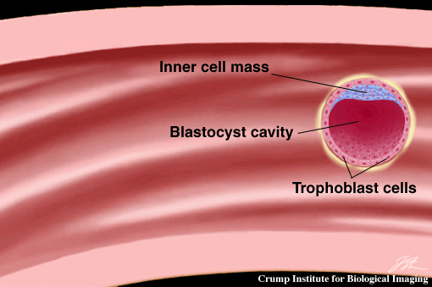
Blastocyst
Structure becomes a ball of cells, blastocyst.
Implants in the uterus by the end of the first week

Slide 149
Organization
Blastocysts organizes into
Inner cell mass
gives rise to the body
Outer cells
become embryonic portion of placenta
Embryo until 8th week
Fetus until time of birth.

Slide 150
Placenta
Placenta develops
attaches the embryo to uterine wall
exchanges nutrients
Gasses
wastes
between maternal blood and embryonic blood.
Placenta also secretes hormones.

Slide 151
Hormone changes
In non pregnant female,
the corpus luteum degenerates
estrogen and progesterone levels drop
uterine lining sloughs off
In pregnant female, need to maintain the uterine lining.

Slide 152
HCG
HCG: human chorionic gonadotropin.
prevents spontaneous abortion (miscarriage)
HCG and some of the embryonic cells
maintain the corpus luteum
continues to secrete estrogen and progesterone
inhibits FSH and LH.

Slide 153
HCG
HCG secretion is high for about two months and then declines.
Corpus luteum exists throughout pregnancy
most important in the first few months before the placenta takes over the estrogen and progesterone production.

Slide 154
More hormones
Placental lactogen
stimulates breast development and prepares the mammary glands for milk secretion.
Relaxin:
hormone from corpus luteum.
Inhibits the smooth muscles in the myometrium, suppresses uterine contractions until birth.
relaxes the ligaments of the symphysis pubis and SI joints
aids passage of fetus through birth canal.

Slide 155
More hormones
Increased secretion of aldosterone and of parathyroid hormone
Aldosterone from adrenal cortex
promotes renal absorption of sodium
fluid retention.
PTH helps to maintain high concentrations of calcium.

Slide 156
Parturition
Pregnancy continues for about 40 weeks and ends with parturition or birth.

Slide 157
Hormonal changes with birth
Decreased progesterone
no longer preventing uterine contractions
oxytocin stimulate uterus to contract.

Slide 158
Labor
Contractions start at the top of the uterus and travel downward, forcing the contents toward the cervix.
Labor contractions force the fetal head against the cervix
stretches the cervix
elicits a reflex that stimulates contractions.

Slide 159
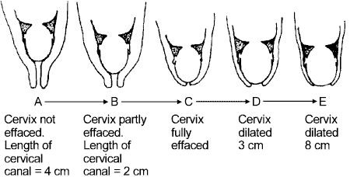
Dilation of cervix
positive feedback loop:
Dilation of cervix stimulates increased release of oxytocin→ more contractions.

Slide 160
Involution
After the birth, the placenta detaches form the uterine wall
expelled by the remaining uterine contractions,
stimulated by oxytocin.

Slide 161
Involution
For several weeks the uterus undergoes involution,
which is the shrinking of the uterus.
For several weeks
will pass a bloody discharge
then a yellow discharge
until the uterine lining heals and returns to a non-pregnant state.

