Slide 1
Reproductive System
Gonads
Primary sex organs
testes in males
ovaries in females
Gonads
produce sex cells called gametes
secrete sex hormones

Slide 2
Reproductive System
Accessory reproductive organs
ducts, glands, and external genitalia
Sex hormones
Androgens: males
estrogens and progesterone: females

Slide 3
Male Reproductive System
male gonads produce sperm and lie within the scrotum
Sperm are delivered through a system of ducts:
epididymis,
ductus deferens,
ejaculatory duct,
urethra
Accessory sex glands:
Empty secretions into ducts during ejaculation
Include the seminal vesicles, prostate gland, and bulbourethral glands

Slide 4
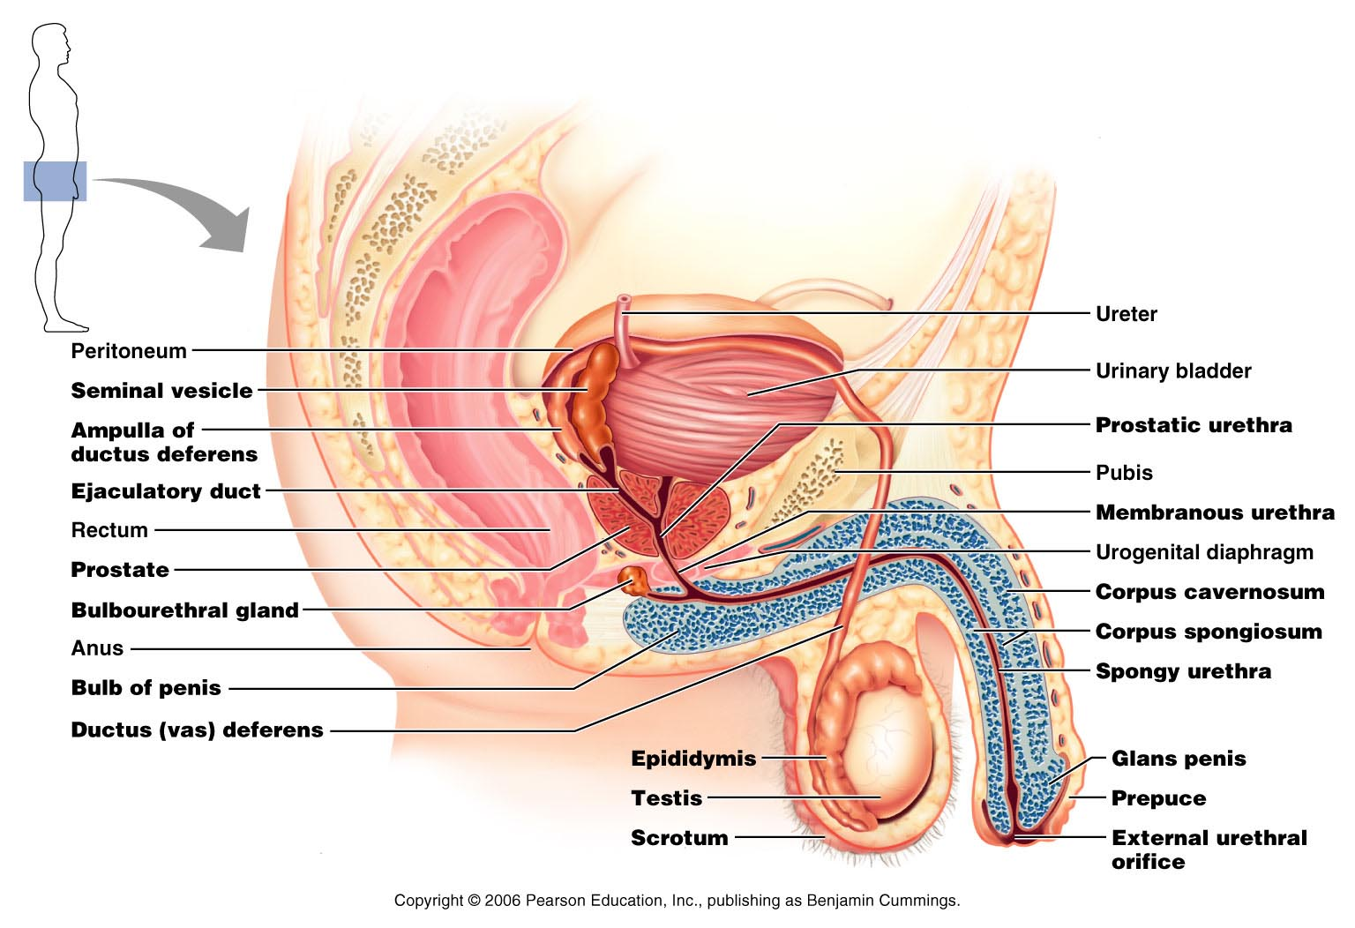
Figure 27.1

Slide 5
The Scrotum
Sac of skin and superficial fascia
hangs outside the body at the root of the penis
Contains paired testicles separated by a midline septum
keeps the testes 3°C lower than core body temperature

Slide 6
The Scrotum
Intrascrotal temperature is kept constant by two sets of muscles:
Dartos
smooth muscle that wrinkles scrotal skin
Cremaster
bands of skeletal muscle that elevate the testes

Slide 7
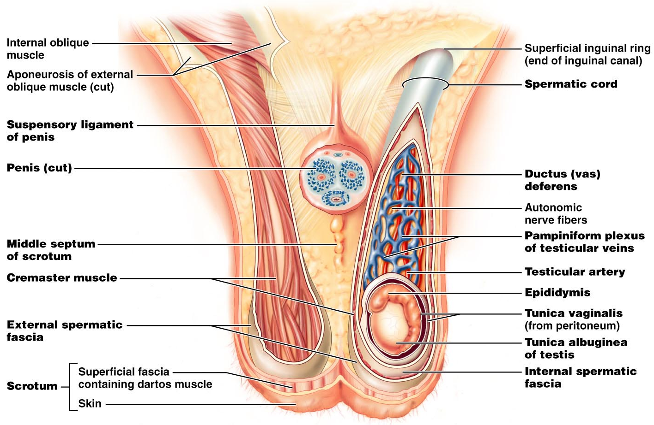
Figure 27.2

Slide 8
The Testes
Each testis is surrounded by two tunics:
tunica vaginalis
derived from peritoneum
tunica albuginea
fibrous capsule of the testis
Septa divide the testis into 250-300 lobules, each containing 1-4 seminiferous tubules

Slide 9
The Testes
Seminiferous tubules:
Produce the sperm
Converge to form the tubulus rectus
The straight tubulus rectus conveys sperm to the rete testis

Slide 10
The Testes
From the rete testis, the sperm:
Leave the testis via efferent ductules
Enter the epididymis
Surrounding the seminiferous tubules are interstitial cells
produce androgens

Slide 11
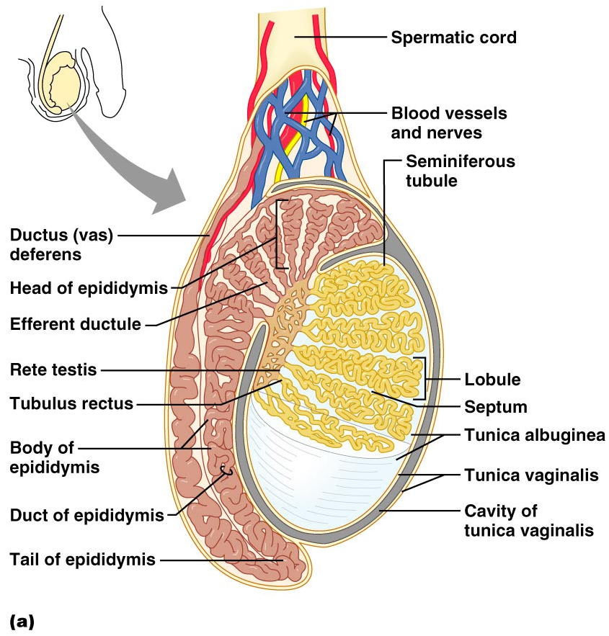
The Testes
Spermatic cord
encloses nerve fibers from autonomic nervous system,
blood vessels,
lymphatics that supply the testes

Slide 12
The Penis
A copulatory organ designed to deliver sperm into the female reproductive tract
Consists of
an attached root
a free shaft that ends in the glans penis
Prepuce
or foreskin
skin covering the distal end of the penis
Circumcision
surgical removal of the foreskin after birth

Slide 13
The Penis
Internal penis
the urethra and three cylindrical bodies of erectile tissue
Erectile tissue
spongy network of connective tissue and smooth muscle riddled with vascular spaces
Erection
during sexual excitement, the erectile tissue fills with blood causing the penis to enlarge and become rigid

Slide 14
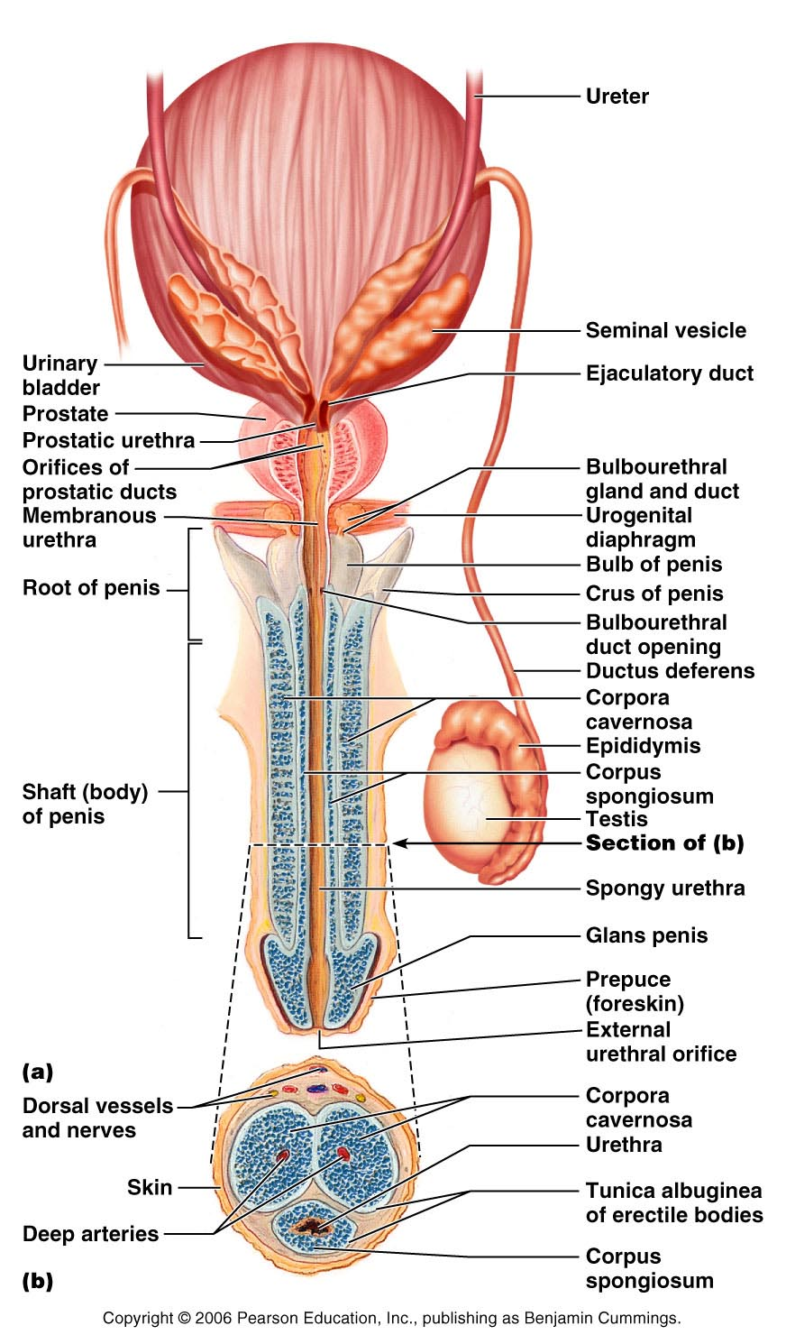
The Penis
Corpus spongiosum
surrounds the urethra
expands to form the glans and bulb of the penis
Corpora cavernosa
paired dorsal erectile bodies bound by fibrous tunica albuginea
Crura
proximal end of the penis surrounded by the ischiocavernosus muscle; anchors the penis to the pubic arch

Slide 15
Epididymis
Its head joins the efferent ductules and caps the superior aspect of the testis
The duct of the epididymis has stereocilia that:
Absorb testicular fluid
Pass nutrients to the sperm
Nonmotile sperm enter, pass through its tubes and become motile
Upon ejaculation the epididymis contracts, expelling sperm into the ductus deferens

Slide 16
Ductus Deferens and Ejaculatory Duct
Runs from the epididymis through the inguinal canal into the pelvic cavity
expands to form the ampulla
then joins the duct of the seminal vesicle to form the ejaculatory duct
Propels sperm from the epididymis to the urethra

Slide 17
Urethra
Consists of three regions
Prostatic
portion surrounded by the prostate
Membranous
lies in the urogenital diaphragm
Spongy, or penile
runs through the penis and opens to the outside at the external urethral orifice

Slide 18
Seminal Vesicles
Located at posterior wall of the bladder
secrete 60% of the volume of semen
Semen
viscous alkaline fluid containing fructose, ascorbic acid, coagulating enzyme (vesiculase), and prostaglandins

Slide 19
Seminal vesicles
Join the ductus deferens to form the ejaculatory duct
Sperm and seminal fluid mix in the ejaculatory duct and enter the prostatic urethra during ejaculation

Slide 20
Prostate Gland
Doughnut-shaped gland
surrounds part of the urethra inferior to the bladder
Plays a role in the activation of sperm
Secretions enter the prostatic urethra during ejaculation

Slide 21
Prostate Gland
It is milky, slightly acid fluid,
contains citrate,
enzymes,
prostate-specific antigen (PSA)
accounts for one-third of the semen volume

Slide 22
Bulbourethral Glands
Pea-sized glands inferior to the prostate
Produce thick, clear mucus prior to ejaculation
neutralizes traces of acidic urine in the urethra

Slide 23
Semen
Milky mixture of sperm and accessory gland secretions
Provides a transport medium and nutrients (fructose)
protects and activates sperm
facilitates movement of sperm

Slide 24
Semen
Prostaglandins in semen:
Decrease the viscosity of mucus in the cervix
Stimulate reverse peristalsis in the uterus
Facilitate the movement of sperm through the female reproductive tract

Slide 25
Semen
The hormone relaxin enhances sperm motility
Semen is alkaline
Neutralizes male urethra
Female vaginal canal
Seminalplasmin
antibiotic chemical that destroys bacteria
Clotting factors coagulate semen immediately after ejaculation,
then fibrinolysin liquefies the mass

Slide 26
Male Sexual Response: Erection
Enlargement and stiffening of the penis from engorgement of erectile tissue with blood
During arousal, a parasympathetic reflex promotes the release of nitric oxide
Nitric oxide causes erectile tissue to fill with blood

Slide 27
Male Sexual Response: Erection
Expansion of the corpora cavernosa:
Compresses their drainage veins
slows blood outflow and maintains engorgement
The corpus spongiosum functions in keeping the urethra open during ejaculation

Slide 28
Male Sexual Response
Erection is initiated by sexual stimuli including:
Touch and mechanical stimulation of the penis
Erotic sights, sounds, and smells
Erection can be induced or inhibited solely by emotional or higher mental activity

Slide 29
Ejaculation
The propulsion of semen from the male duct system
At ejaculation, sympathetic nerves cause:
Reproductive ducts and accessory organs to contract and empty their contents

Slide 30
Ejaculation
At ejaculation, sympathetic nerves cause: (continued)
The bladder sphincter muscle to constrict, preventing the expulsion of urine
Bulbospongiosus muscles to undergo a rapid series of contractions
Propulsion of semen from the urethra

Slide 31
Spermatogenesis
The sequence of events that produces sperm in the seminiferous tubules of the testes
Each cell has two sets of chromosomes (one maternal, one paternal) and is said to be diploid (2n chromosomal number)

Slide 32
Spermatogenesis
Humans have 23 pairs of homologous chromosomes
Gametes only have 23 chromosomes and are said to be haploid (n chromosomal number)
Gamete formation is by meiosis, in which the number of chromosomes is halved (from 2n to n)

Slide 33
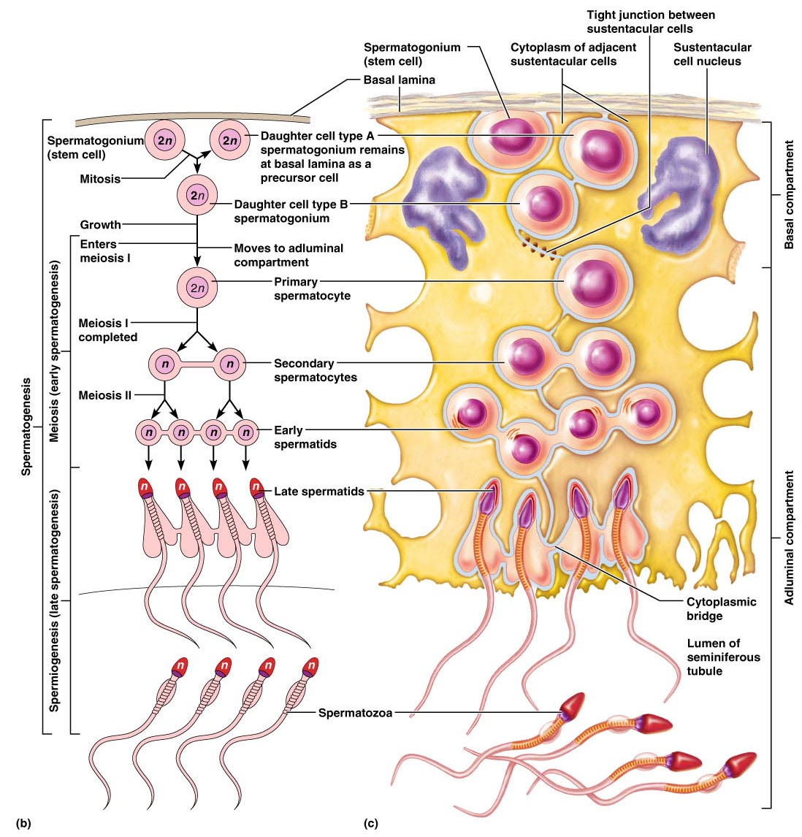
Figure 27.8b, c

Slide 34
Meiosis – Interphase
Two nuclear divisions halve the number of chromosomes
Chromosomes replicate prior to meiosis I
Figure 27.7.1

Slide 35
Meiosis – Prophase I
Homologous chromosomes undergo synapsis
Tetrads are formed with homologous partners
Crossing over takes place during prophase I
Figure 27.7.2.1

Slide 36
Meiosis – Metaphase I
Tetrads line up at the spindle equator during metaphase I
Figure 27.7.2.2

Slide 37
Meiosis – Anaphase I
Homologous chromosomes composed of joined sister chromatids are distributed to opposite ends of the cell
Figure 27.7.2.3

Slide 38
Meiosis – Telophase I
Nuclear membrane forms around chromosomal masses
Spindle break down
Chromatin reappears
With telophase and cytokinesis completed, two haploid daughter cells are formed (with 2n amount of DNA)
Figure 27.7.2.4

Slide 39
Meiosis II
Mirrors mitosis except that chromosomes are not replicated before it begins
Meiosis accomplishes two tasks:
It reduces the chromosome number by half (2n to n)
It introduces genetic variability

Slide 40
Brain-Testicular Axis
Hormonal regulation of sperm production and testicular hormones involving the
Hypothalamus
anterior pituitary gland
the testes

Slide 41
Brain-Testicular Axis
Testicular regulation: three sets of hormones:
GnRH: Gonadotrophin Releasing Hormone
indirectly stimulates the testes through:
Follicle stimulating hormone (FSH)
Luteinizing hormone (LH)
Gonadotropins, which directly stimulate the testes
Testicular hormones
exert negative feedback controls

Slide 42
Hormonal Regulation
The hypothalamus releases gonadotropin-releasing hormone (GnRH)
GnRH stimulates the anterior pituitary to secrete FSH and LH
FSH
causes sustentacular cells to release androgen-binding protein (ABP)
LH
stimulates interstitial cells to release testosterone
ABP binding of testosterone enhances spermatogenesis

Slide 43
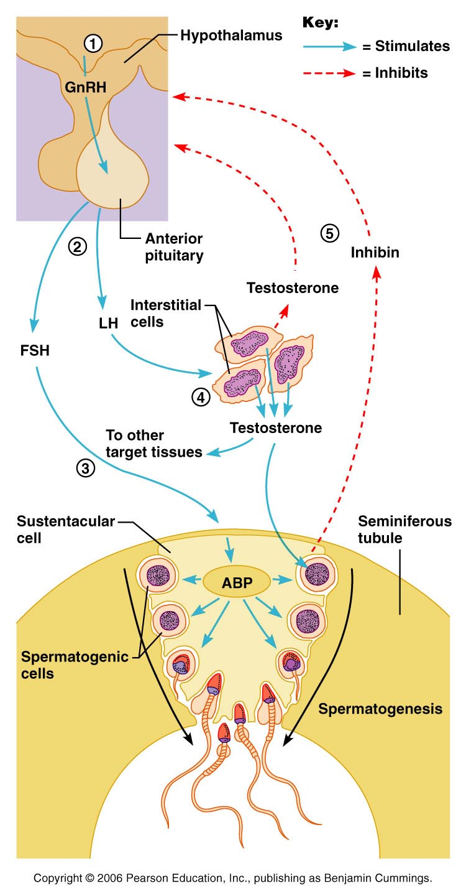
Hormonal Regulation
Feedback inhibition on the hypothalamus and pituitary results from:
Rising levels of testosterone
Increased inhibin
Figure 27.10

Slide 44
Testosterone Activity
Testosterone
Steroid hormone: synthesized from cholesterol
It must be transformed to exert its effects on some target cells
Prostate
it is converted into dihydrotestosterone (DHT) before it can bind within the nucleus
Neurons
it is converted into estrogen to bring about stimulatory effects

Slide 45
Testosterone
Testosterone targets all accessory organs
its deficiency causes these organs to atrophy

Slide 46
Male Secondary Sex Characteristics
Male hormones make their appearance at puberty and induce changes in non-reproductive organs
Appearance of pubic, axillary, and facial hair
Enhanced growth of the chest and deepening of the voice
Skin thickens and becomes oily
Bones grow and increase in density
Skeletal muscles increase in size and mass

Slide 47
Male Secondary Sex Characteristics
Testosterone is the basis of libido in both males and females

Slide 48
Female Reproductive Anatomy
Ovaries: primary female reproductive organs
Make female gametes
Ova
Secrete female sex hormones
estrogen and progesterone
Accessory ducts include uterine tubes, uterus, and vagina

Slide 49
Female Reproductive Anatomy
Internal genitalia
ovaries and the internal ducts
External genitalia
external sex organs

Slide 50
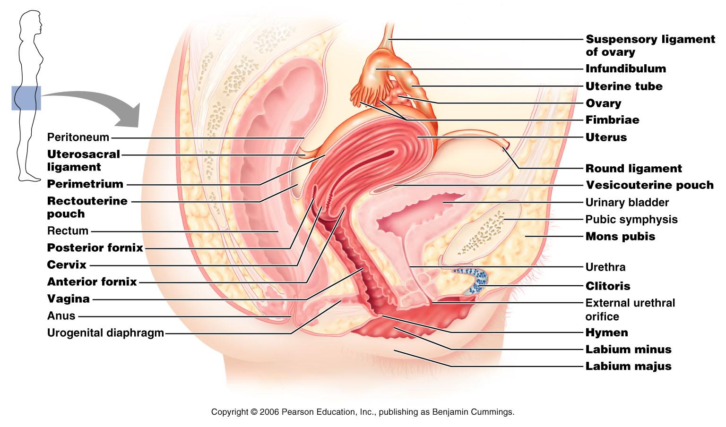
Female Reproductive Anatomy
Figure 27.11

Slide 51
The Ovaries
Paired organs on each side of the uterus held in place by several ligaments
Ovarian
Suspensory
Mesovarium
Broad ligament
contains the suspensory ligament and the mesovarium

Slide 52
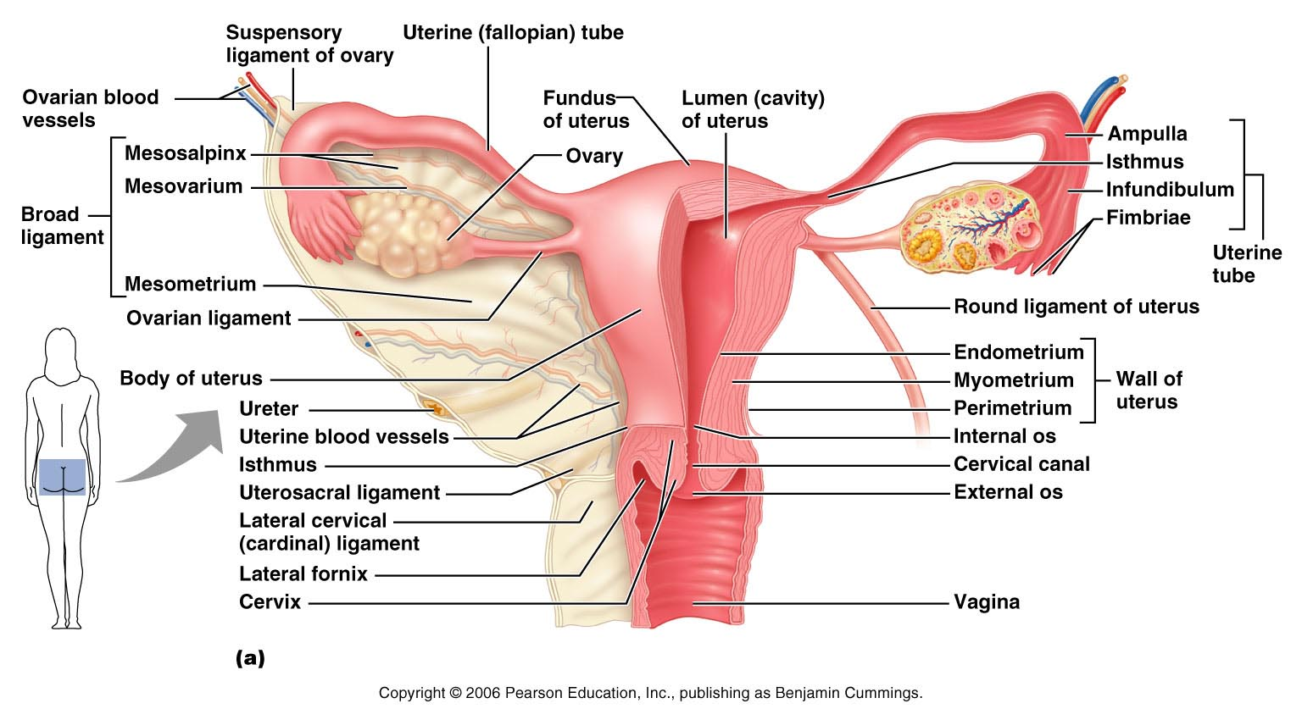
The Ovaries
Figure 27.14a

Slide 53
Ovaries
Blood supply
ovarian arteries and the ovarian branch of the uterine artery
They are surrounded by a fibrous tunica albuginea,
covered by a layer of epithelial cells called the germinal epithelium
Embedded in the ovary cortex are ovarian follicles

Slide 54
Ovaries
Each follicle consists of an immature egg called an oocyte
Cells around the oocyte are called:
Follicle cells
one cell layer thick
Granulosa cells
when more than one layer is present

Slide 55
Ovaries
Primordial follicle
one layer of squamous-like follicle cells surrounds the oocyte
Primary follicle
two or more layers of cuboidal granulosa cells enclose the oocyte
Secondary follicle
has a fluid-filled space between granulosa cells that coalesces to form a central antrum

Slide 56
Ovaries
Graafian follicle
secondary follicle at its most mature stage that bulges from the surface of the ovary
Ovulation
ejection of the oocyte from the ripening follicle
Corpus luteum
ruptured follicle after ovulation

Slide 57
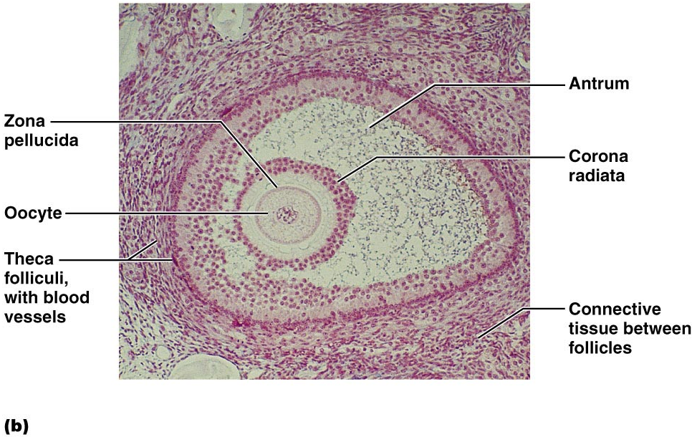
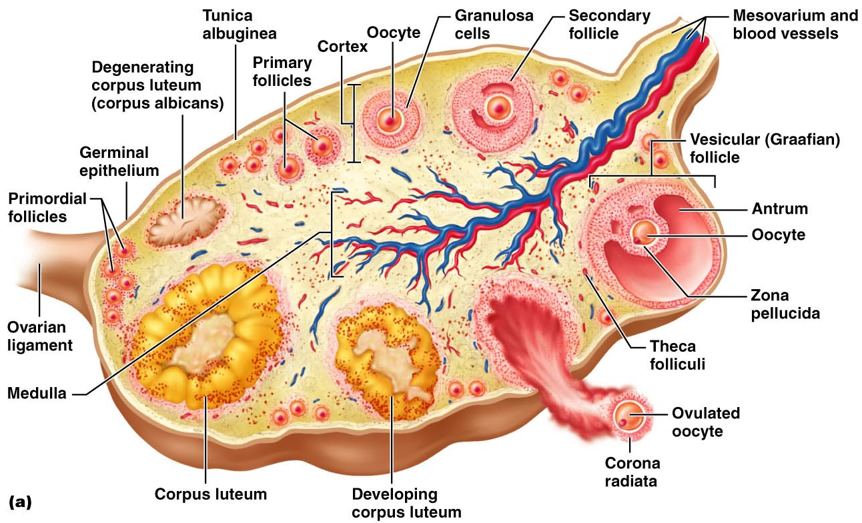
Ovaries

Slide 58
Fallopian Tubes
Receive the ovulated oocyte
provide a site for fertilization
Empty into the uterus via the isthmus
Expand distally around the ovary forming the ampulla
The ampulla ends in the funnel-shaped, ciliated infundibulum containing fingerlike projections called fimbriae

Slide 59
Uterine Tubes
The uterine tubes have no contact with the ovaries and the ovulated oocyte is cast into the peritoneal cavity
Beating cilia on the fimbriae create currents to carry the oocyte into the uterine tube

Slide 60
Uterine Tubes
The oocyte is carried toward the uterus by peristalsis and ciliary action
Nonciliated cells keep the oocyte and the sperm nourished and moist

Slide 61
Uterus
Hollow, thick-walled organ
located in the pelvis anterior to the rectum and posterosuperior to the bladder
Body
major portion of the uterus
Fundus
rounded region superior to the entrance of the uterine tubes
Isthmus
narrowed region between the body and cervix

Slide 62
Uterus
Cervix
narrow neck which projects into the vagina inferiorly
Cervical canal
cavity of the cervix that communicates with:
The vagina via the external os
The uterine body via the internal os
Cervical glands secrete mucus that covers the external os and blocks sperm entry except during midcycle

Slide 63
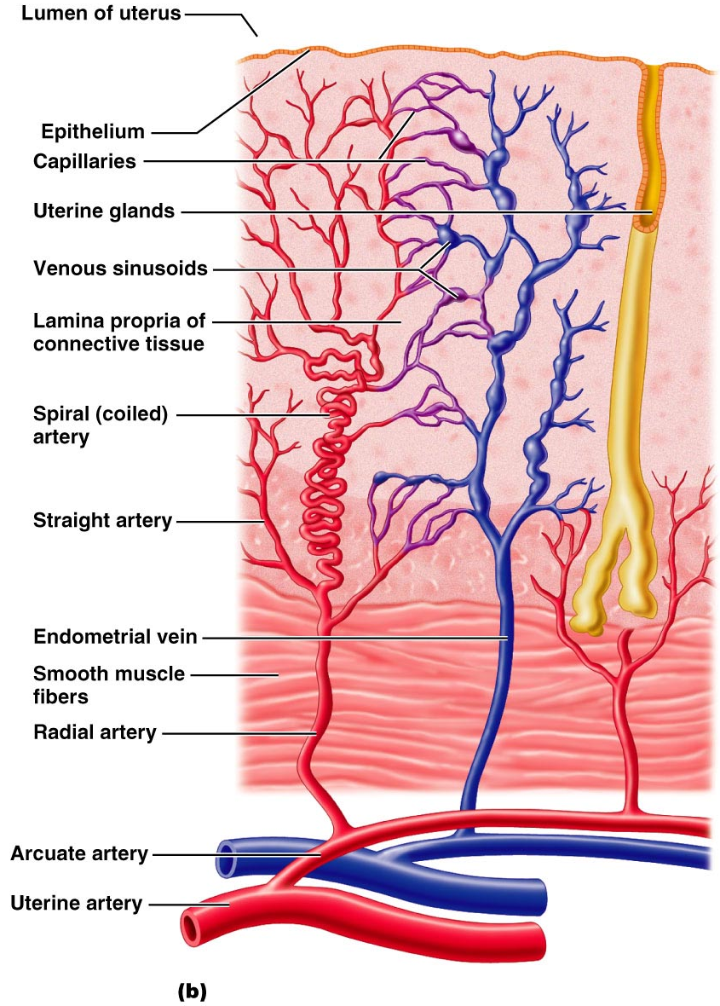
Uterine Wall
three layers
Perimetrium
outermost serous layer
the visceral peritoneum
Myometrium
middle layer
smooth muscle
Endometrium
mucosal lining of the uterine cavity

Slide 64
Endometrium
Has numerous uterine glands that change in length as the endometrial thickness changes
Stratum functionalis:
Undergoes cyclic changes in response to ovarian hormones
Is shed during menstruation
Stratum basalis:
Forms a new functionalis after menstruation ends
Does not respond to ovarian hormones

Slide 65
Uterine Vascular Supply
Uterine arteries
arise from the internal iliacs
ascend the sides of the uterus and send branches into the uterine wall
Arcuate arteries
branches of the uterine arteries in the myometrium that give rise to radial branches

Slide 66
Uterine Vascular Supply
Radial branches
descend into the endometrium and give off:
Spiral arteries to the stratum functionalis
Straight arteries to the stratum basalis

Slide 67
Uterine Vascular Supply
Degeneration and regeneration of spiral arteries causes the functionalis to shed during menstruation

Slide 68
Vagina
Thin-walled tube
between the bladder and the rectum,
The urethra is embedded in the anterior wall
Provides a passageway for birth, menstrual flow, and is the organ of copulation

Slide 69
Vagina
Wall consists of three coats:
fibroelastic adventitia
smooth muscle muscularis,
stratified squamous mucosa
Mucosa near the vaginal orifice forms an incomplete partition called the hymen
Vaginal fornix
upper end of the vagina surrounding the cervix

Slide 70
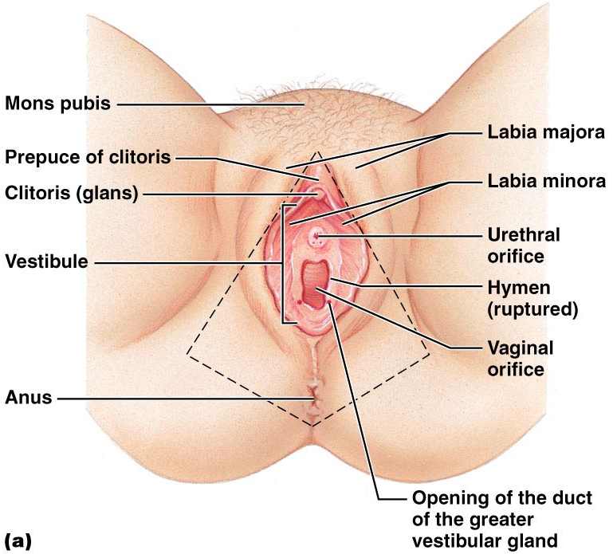
Vagina

Slide 71
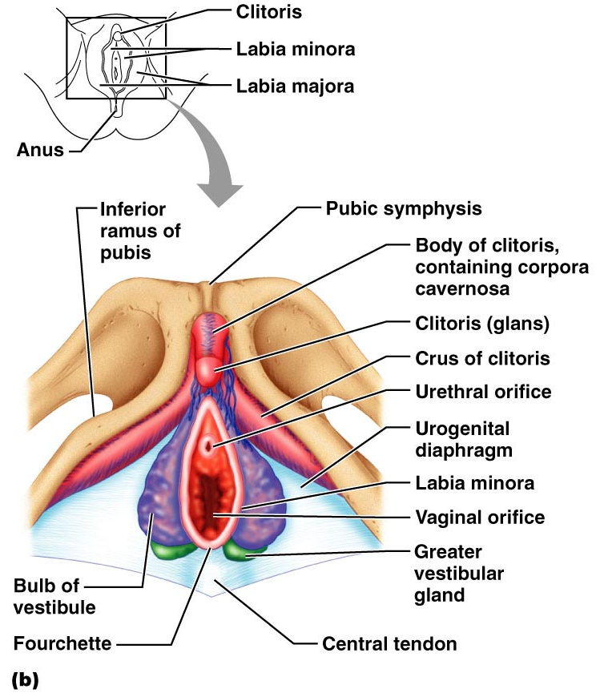
Female External Genitalia: Deep
Figure 27.16b

Slide 72
External Genitalia: Vulva
Vulva: Lies external to the vagina and includes
mons pubis
Labia
Clitoris
Vestibular structures

Slide 73
External Genitalia: Vulva
Mons pubis
round, fatty area overlying the pubic symphysis
Labia majora
elongated, hair-covered, fatty skin folds
homologous to the male scrotum

Slide 74
External Genitalia: Vulva
Labia minora
hair-free skin folds lying within the labia majora
homologous to the ventral penis
Greater vestibular glands
Pea-size glands flanking the vagina
Homologous to the bulbourethral glands
Keep the vestibule moist and lubricated

Slide 75
External Genitalia: Vulva (Pudendum)
Clitoris (homologous to the penis)
Erectile tissue
exposed portion is the glans
Perineum
Diamond-shaped region between the pubic arch and coccyx
Bordered by the ischial tuberosities laterally

Slide 76
Mammary Glands
Modified sweat glands consisting of 15-25 lobes that radiate around and open at the nipple
Areola
pigmented skin surrounding the nipple
Suspensory ligaments attach the breast to underlying muscle fascia

Slide 77
Mammary Glands
Lobes contain glandular alveoli that produce milk in lactating women
Compound alveolar glands pass milk to lactiferous ducts, which open to the outside

Slide 78
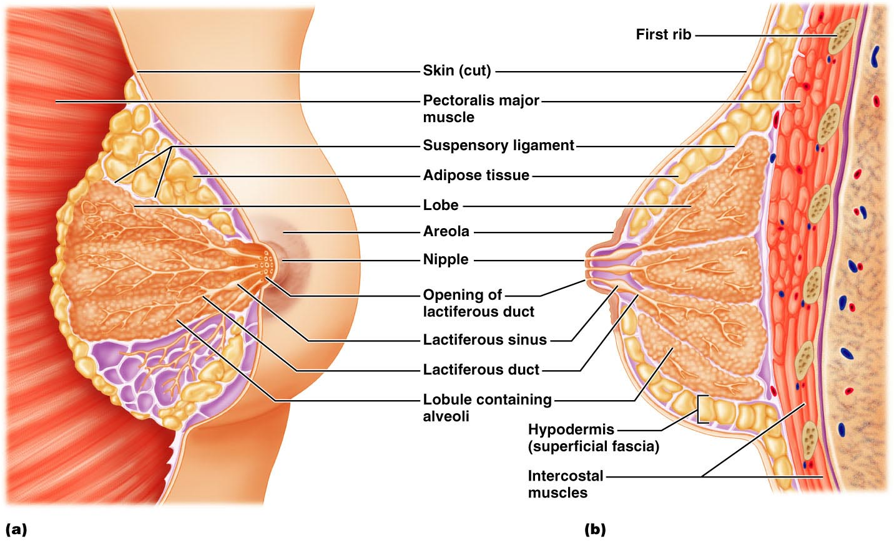
Structure of Lactating Mammary Glands
Figure 27.17

Slide 79
Breast Cancer
Usually arises from the epithelial cells of the ducts
Risk factors include:
Early onset of menses or late menopause
No pregnancies or the first pregnancy late in life
Previous history of breast cancer or family history of breast cancer
Hereditary factors including mutations to the genes BRCA1 and BRCA2
70% of women with breast cancer have no known risk factors

Slide 80
Detection and Treatment
Early detection is by self-examination and mammography
Treatment depends upon the characteristics of the lesion
Radiation, chemotherapy, and surgery followed by irradiation and chemotherapy
Today, lumpectomy is the surgery used rather than radical mastectomy

Slide 81
Oogenesis
Production of female sex cells by meiosis
In the fetal period, oogonia (2n ovarian stem cells) multiply by mitosis and store nutrients
Primordial follicles appear as oogonia are transformed into primary oocytes

Slide 82
Oogenesis: Puberty
Primary oocytes begin meiosis but stall in prophase I
At puberty, one activated primary oocyte produces two haploid cells
The first polar body
The secondary oocyte
The secondary oocyte arrests in metaphase II and is ovulated

Slide 83
Oogenesis: Puberty
If penetrated by sperm the second oocyte completes meiosis II, yielding:
One large ovum (the functional gamete)
A tiny second polar body

Slide 84
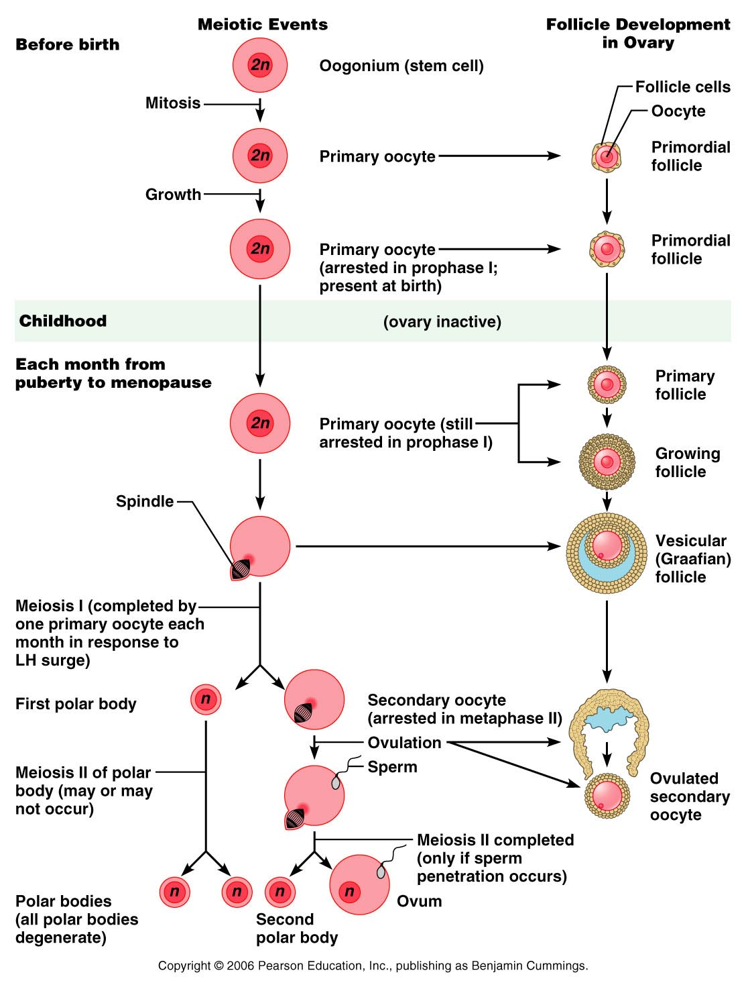

Slide 85
Ovarian Cycle
Monthly series of events associated with the maturation of an egg
Follicular phase
period of follicle growth (days 1–14)
Luteal phase
period of corpus luteum activity (days 14–28)
Ovulation occurs midcycle

Slide 86
Follicular Phase
The primordial follicle, directed by the oocyte, becomes a primary follicle
Primary follicle becomes a secondary follicle
The theca folliculi and granulosa cells cooperate to produce estrogens
The zona pellucida forms around the oocyte
The antrum is formed

Slide 87
Follicular Phase
The secondary follicle becomes a vesicular follicle
The antrum expands and isolates the oocyte and the corona radiata
The full size follicle (vesicular follicle) bulges from the external surface of the ovary
The primary oocyte completes meiosis I, and the stage is set for ovulation

Slide 88
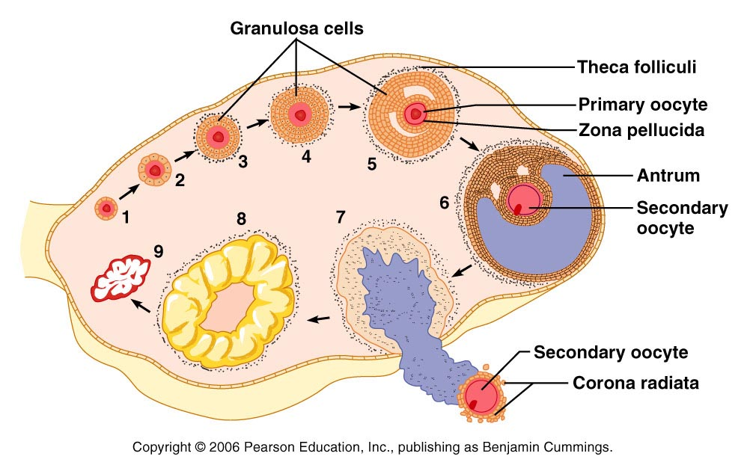
Ovarian Cycle
Figure 27.20

Slide 89
Ovulation
Ovulation occurs when the ovary wall ruptures and expels the secondary oocyte
Mittelschmerz
a twinge of pain sometimes felt at ovulation
1-2% of ovulations release more than one secondary oocyte, which if fertilized, results in fraternal twins

Slide 90
Luteal Phase
After ovulation,
the ruptured follicle collapses
forms the corpus luteum
The corpus luteum secretes progesterone and estrogen

Slide 91
Luteal Phase
If pregnancy does not occur:
the corpus luteum degenerates in 10 days, leaving a scar
corpus albicans
If pregnancy does occur
the corpus luteum produces hormones until the placenta takes over that role
at about 3 months

Slide 92
Establishing the Ovarian Cycle
During childhood,
ovaries grow
secrete small amounts of estrogens
inhibit the hypothalamic release of GnRH
As puberty nears,
GnRH is released
FSH and LH are released by the pituitary, which act on the ovaries
These events continue until an adult cyclic pattern is achieved and menarche occurs

Slide 93
Hormonal Interactions During the Ovarian Cycle
Day 1
GnRH from hypothalamus stimulates the release of FSH and LH from anterior pituitary
Over the next several days, FSH and LH stimulate follicle growth and maturation
As the follicle matures, it begins to produce and release estrogen
Rising estrogen levels:
Inhibit the release of FSH and LH

Slide 94
Hormonal Interactions During the Ovarian Cycle
Estrogen levels increase
high estrogen levels have a positive feedback effect on the pituitary, causing a sudden surge of LH

Slide 95
Hormonal Interactions During the Ovarian Cycle
The LH spike stimulates the primary oocyte to complete meiosis I, and the secondary oocyte continues on to metaphase II
Day 14 – LH triggers ovulation

Slide 96
Hormonal Interactions & the Ovarian Cycle
LH transforms the ruptured follicle into a corpus luteum
produces inhibin, progesterone, and estrogen
These hormones shut off FSH and LH release and declining LH ends luteal activity
Days 26-28 – decline of the ovarian hormones
Ends the blockade of FSH and LH
The cycle starts anew

Slide 97
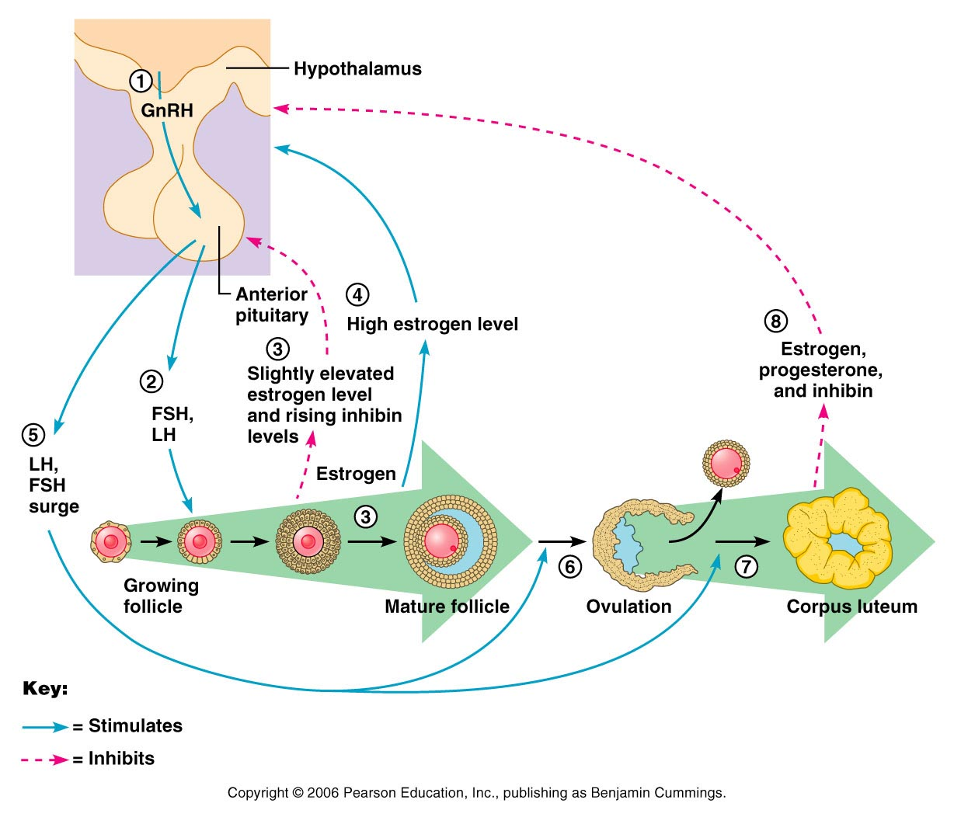
Feedback Mechanisms in Ovarian Function

Slide 98
Uterine (Menstrual) Cycle
Series of cyclic changes that the uterine endometrium goes through each month in response to ovarian hormones in the blood
Days 1-5:
Menstrual phase – uterus sheds all but the deepest part of the endometrium
Days 6-14:
Proliferative (preovulatory) phase – endometrium rebuilds itself
Days 15-28:
Secretory (postovulatory) phase – endometrium prepares for implantation of the embryo

Slide 99
Menses
If fertilization does not occur
progesterone levels fall
deprives the endometrium of hormonal support
Spiral arteries spasms and endometrial cells begin to die as blood flow is interupted
The functional layer begins to digest itself
Spiral arteries constrict one final time then suddenly relax and open wide
The rush of blood fragments weakened capillary beds and the functional layer sloughs

Slide 100
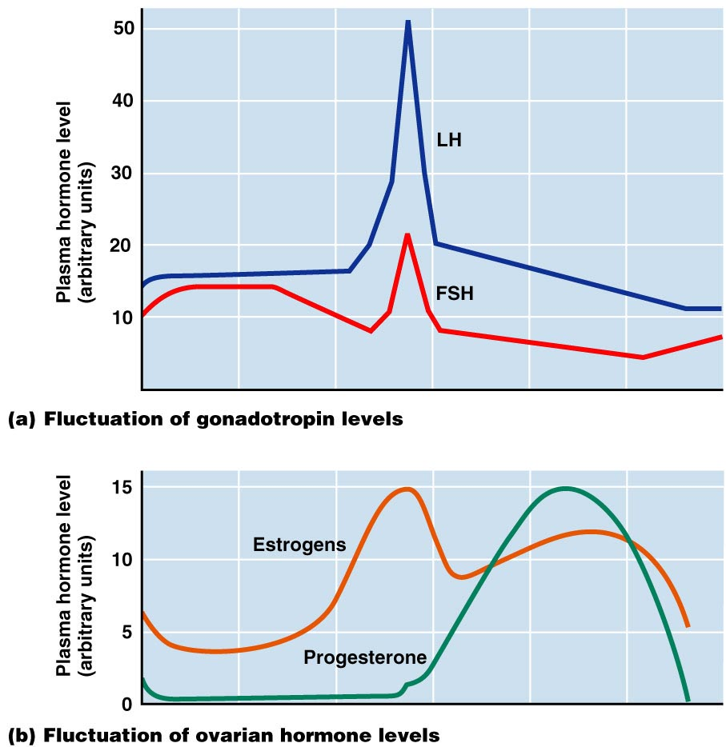
Hormones: the Ovarian & Uterine Cycles

Slide 101
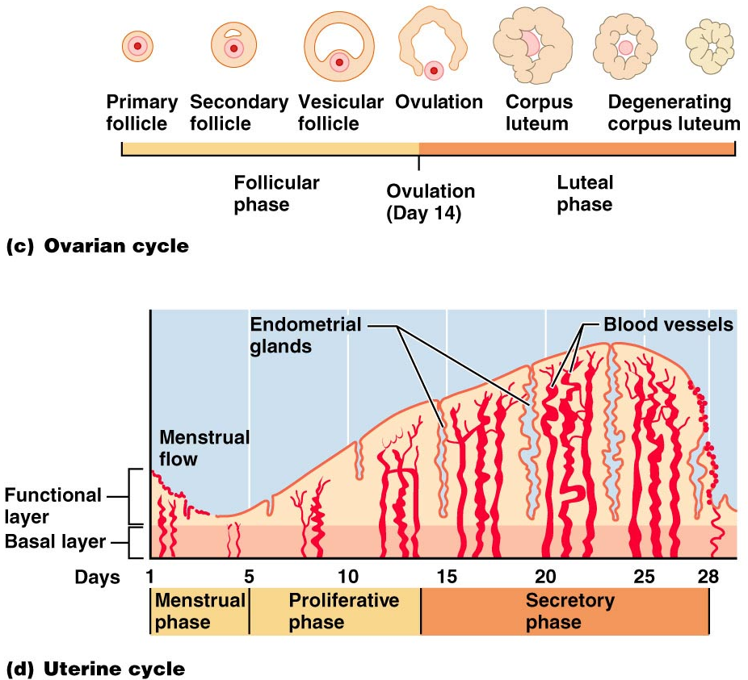

Slide 102
Extrauterine Effects of Estrogens and Progesterone
Estrogen levels rise during puberty
Promote oogenesis and follicle growth in the ovary
Exert anabolic effects on the female reproductive tract
Uterine tubes, uterus, and vagina grow larger and become functional
Uterine tubes and uterus exhibit enhanced motility
Vaginal mucosa thickens and external genitalia mature

Slide 103
Estrogen-Induced Secondary Sex Characteristics
Growth of the breasts
Increased deposition of subcutaneous fat, especially in the hips and breasts
Widening and lightening of the pelvis
Growth of axillary and pubic hair

Slide 104
Female Sexual response
parasympathetic nerve impulses cause arteries of erectile tissues to dilate
Blood flow increases
erectile tissues swell
Vagina begins to expand and elongate.

Slide 105
Female Sexual Response
parasympathetic impulses stimulate
vestibular glands to secrete mucus into the vestibule.
serves to moisten and lubricate the tissues,
facilitates the insertion of the penis
prevent irritation of tissues and reduces friction.

Slide 106
Female orgasm
The culmination of stimulation is orgasm.
the vagina engorges and swells resulting in an increased friction.
Orgasm initiates a series of reflexes in which the
muscles of the perineum
walls of the uterus and fallopian tubes contract rhythmically.
The contractions help to transport the sperm towards the uterine tubes.

Slide 107
Female Sexual Response
Females do not have a refractory period after orgasm and can experience multiple orgasms in a single sexual experience
Orgasm is not essential for conception

Slide 108
Sexually Transmitted Diseases: Gonorrhea
Bacterial infection caused by Neisseria gonorrhoeae,
spread by contact with genital, anal, and pharyngeal mucosal surfaces
Signs and symptoms
In males
painful urination, discharge of pus from the penis
In females
none (20%),
abdominal discomfort, vaginal discharge, abnormal uterine bleeding
Often mild symptoms are mistaken for UTI or vaginosis

Slide 109
STD: Gonorrhea
Left untreated, can result in
pelvic inflammatory disease in women
May damage fallopian tubes and result in ectopic pregnancies or infertility
Epidydimitis in men
According to the CDC:
In the United States, the highest reported rates of infection are among sexually active teenagers, young adults, and African Americans.

Slide 110
STD: Gonorrhea
Prevention
Abstinence
uninfected partner
Condom use reduces transmission
Treatment:
antibiotics, but resistant strains are becoming more prevalent

Slide 111
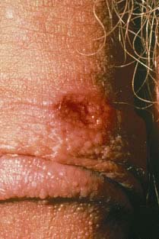
STD: Syphilis
Bacterial infection from Treponema pallidum
transmitted sexually or contracted congenitally
“The great imitator” because signs and symptoms coincide with other disorders
Primary stage:
A painless chancre appears at the site of infection and disappears in a few weeks

Slide 112
sTD: Syphilis
time between infection and the start of the first symptom
from 10 to 90 days (average 21 days).
The chancre is usually firm, round, small, and painless.
It appears at the spot where syphilis entered the body.
The chancre lasts 3 to 6 weeks, and it heals without treatment. However, if adequate treatment is not administered, the infection progresses to the secondary stage.

Slide 113
STD: Syphilis
Secondary syphilis shows signs of pink skin rash, fever, and joint pain
Other symptoms include swollen lymph glands, sore throat, patchy hair loss, headaches, weight loss, muscle aches, and fatigue.
All symptoms will disappear without treatment.
A latent period follows, which may progress to tertiary syphilis characterized by gummas (lesions of the CNS, blood vessels, bones, and skin)
difficulty coordinating muscle movements, paralysis, numbness, gradual blindness, and dementia.
Treatment: penicillin in early stages will kill bacteria

Slide 114
STD: Chlamydia
Most common STD in the U.S.
Bacteria: Chlamydia trachomatis
Symptoms include
urethritis;
penile and vaginal discharges;
abdominal, rectal, or testicular pain;
painful intercourse;
irregular menses
Can cause arthritis and urinary tract infections in men, and sterility in women
"silent" disease because about three quarters of infected women and about half of infected men have no symptoms
Prevention: abstinence, latex condoms reduce risk
Treatment is with tetracycline

Slide 115
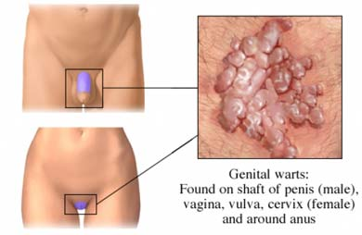
STD: Viral Infections
human papillomaviruses (HPV)
Low risk varieties can cause genital warts and abnormal Pap smears
High risk varieties can increase the risk of penile, vaginal, anal, and cervical cancers
Transmitted through genital contact
Condoms do not prevent transmission of HPV, but have been show to reduce rates of cervical cancer

Slide 116
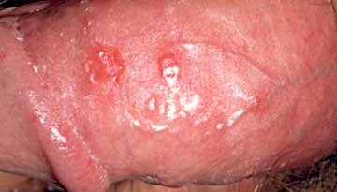
Sexually Transmitted Diseases: Viral Infections
Genital herpes
caused by Herpes Simplex Virus (HSV)
Herpetic lesions appear as blisters
characterized by latent periods and flare-ups
Can be passed to partner when sores are present OR absent
Congenital herpes can cause malformations of a fetus
Has been implicated with cervical cancer
Treatment: acyclovir and other antiviral drugs

Slide 117
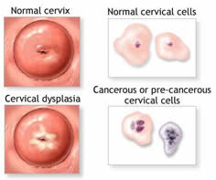
Pap Smears
Named for Dr. Papanicolaou
Scrapings of epithelial tissues taken from external os and surrounding tissues for evaluation
Samples taken from the Squamo-columnar Junction.
circular area right at the opening of the cervix where the pink, smooth skin of the cervix meets the fiery-red, fragile, mucous-producing lining of the cervical canal.
If there is a problem with cancer or precancerous changes, it is this area that is most likely to be effected. This area of unstable skin is also known as the transition zone.

Slide 118
Pelvic Inflammatory Disease
General term for infection of uterus and fallopian tubes
Often stemming from sexually transmitted diseases
Chlamydia
Gonorrhea
Can damage uterus, fallopian tubes, and ovaries resulting in infertility, ectopic pregnancies, abscesses, and chronic pain

Slide 119
Pelvic Inflammatory Disease
Risk factors
STDs and recurrence
Numerous sexual partners
Douching
alters vaginal environment and allows bacteria to thrive
Forces bacteria through cervical canal
Symptoms: most commonly include lower abdominal pain.
fever, unusual vaginal discharge that may have a foul odor,
painful intercourse, painful urination, irregular menstrual bleeding, and pain in the right upper abdomen (rare).

Slide 120
Endometriosis
Endometrial tissue normally found within the uterus is located within the pelvic cavity, commonly on ovaries
Fallopian tubes, uterine ligaments, intestines, bladder, vagina, cervix
Sympoms:
pain before and during periods
pain during or after sexual activity
Infertility
heavy or irregular bleeding.
Other symptoms may include fatigue; painful bowel movements with periods; lower back pain with periods; diarrhea and/or constipation and other intestinal upset with some periods.
Some women with endometriosis have no symptoms. Infertility affects about 30-40% of women with endometriosis and is a common result with progression of the disease.

Slide 121
PMS: pre Menstrual syndrome
symptoms usually begin 5 to 11 days before the start of menstruation.
Symptoms usually stop when menstruation begins, or shortly thereafter.
exact cause of PMS has not been identified
estimated to affect up to 75% of women during their childbearing years
Symptoms:
headache, ankle swelling, back ache, abdominal cramps, abdominal pain, breast tenderness, weight gain, cold sores, acne flare-ups, nausea, constipation/diarrhea, food cravings, irritable, clumsy

Slide 122
Dysmenorrhea
Painful menstruation
Begins a day or so before menstruation and ends when the bleeding stops
May be related to hormone prostaglandin
Primary dysmenorrhea:
occurs in “healthy” women.
not related to any specific problems with the uterus or other pelvic organs.
Secondary dysmenorrhea:
caused by underlying disease or structural abnormality either within or outside the uterus

Slide 123
Genetic Sex Determination
Genetic sex is determined by the sex chromosomes each gamete contains
There are two types of sex chromosomes: X and Y
Females have two X chromosomes; males have one X and one Y
Hence, all eggs have an X chromosome; half the sperm have an X, and the other half a Y
A single gene on the Y chromosome, the SRY gene, initiates testes development and determines maleness

Slide 124
Development of Internal Reproductive Organs

Slide 125
Development of External Genitalia: Male
Under the influence of testosterone
Genital tubercle enlarges forming the penis
Urethral groove elongates and closes completely
Urethral folds give rise to the penile urethra
Labioscrotal swellings develop into the scrotum

Slide 126
Development of External Genitalia: Male

Slide 127
Development of External Genitalia: Female
In the absence of testosterone
Genital tubercle gives rise to the clitoris
The urethral groove remains open as the vestibule
The urethral folds become labia minora
The labioscrotal swellings become labia majora

Slide 128
Development of External Genitalia: Female

Slide 129
Descent of the Gonads
About 2 months before birth and stimulated by testosterone, the testes leave the pelvic cavity and enter the scrotum
Gubernaculum
fibrous cord that extends from the testes to the scrotum
Spermatic cord
blood vessels, nerves, and fascial layers that help suspend the testes
Ovaries also descend, but are stopped by the broad ligament at the pelvic brim

Slide 130
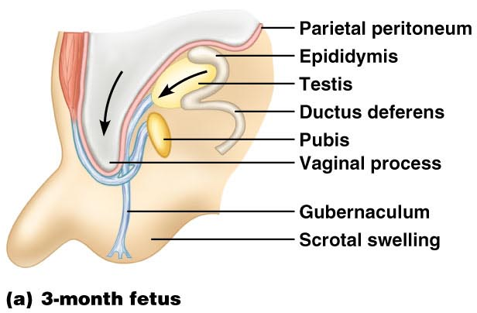
Development Aspects: Descent of the Gonads

Slide 131
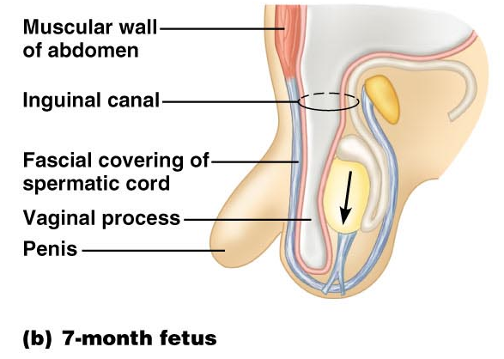
Development Aspects: Descent of the Gonads

Slide 132
Development Aspects: Descent of the Gonads

Slide 133
Development Aspects: Puberty
Reproductive organs grow to adult size and become functional
Secondary sex characteristics appear
Characteristics of puberty
Males
enlargement of the testes and scrotum, appearance of axillary and facial hair, and growth of the penis
Females
enlarging of the breasts, menarche, and dependable ovulation

Slide 134
Menopause
Ovulation and menses cease entirely
Without sufficient estrogen, reproductive organs and breasts atrophy
Irritability and depression result
Skin blood vessels undergo intense vasodilation (hot flashes occur)
Gradual thinning of the skin and bone loss
Males have no equivalent to menopause

Slide 135
From Egg to Embryo
Pregnancy
events that occur from fertilization until the infant is born
Conceptus
the developing offspring
Gestation period
from the last menstrual period until birth

Slide 136
From Egg to Embryo
Preembryo
conceptus from fertilization until it is two weeks old
Embryo
conceptus during the third through the eighth week
Fetus
conceptus from the ninth week through birth

Slide 137
Accomplishing Fertilization
The oocyte is viable for 12 to 24 hours
Sperm is viable 24 to 72 hours
For fertilization to occur, coitus must occur no more than:
Three days before ovulation
24 hours after ovulation
Fertilization
when a sperm fuses with an egg to form a zygote

Slide 138
Sperm Transport and Capacitation
Fates of ejaculated sperm:
Leak out of the vagina immediately after deposition
Destroyed by the acidic vaginal environment
Fail to make it through the cervix
Dispersed in the uterine cavity or destroyed by phagocytic leukocytes
Reach the uterine tubes
Sperm must undergo capacitation before they can penetrate the oocyte

Slide 139
Acrosomal Reaction and Sperm Penetration
An ovulated oocyte is encapsulated by:
The corona radiata and zona pellucida
Extracellular matrix
Sperm binds to the zona pellucida and undergoes the acrosomal reaction
Enzymes are released near the oocyte
Hundreds of acrosomes release their enzymes to digest the zona pellucida

Slide 140
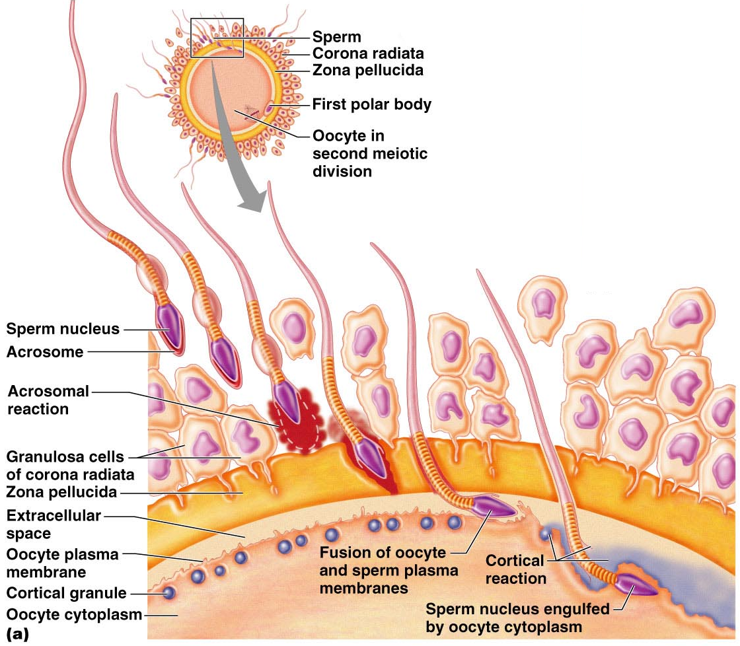

Slide 141
Completion of Meiosis II and Fertilization
Upon entry of sperm, the secondary oocyte:
Completes meiosis II
Casts out the second polar body
The ovum nucleus swells, and the two nuclei approach each other
When fully swollen, the two nuclei are called pronuclei
Fertilization
when the pronuclei come together

Slide 142
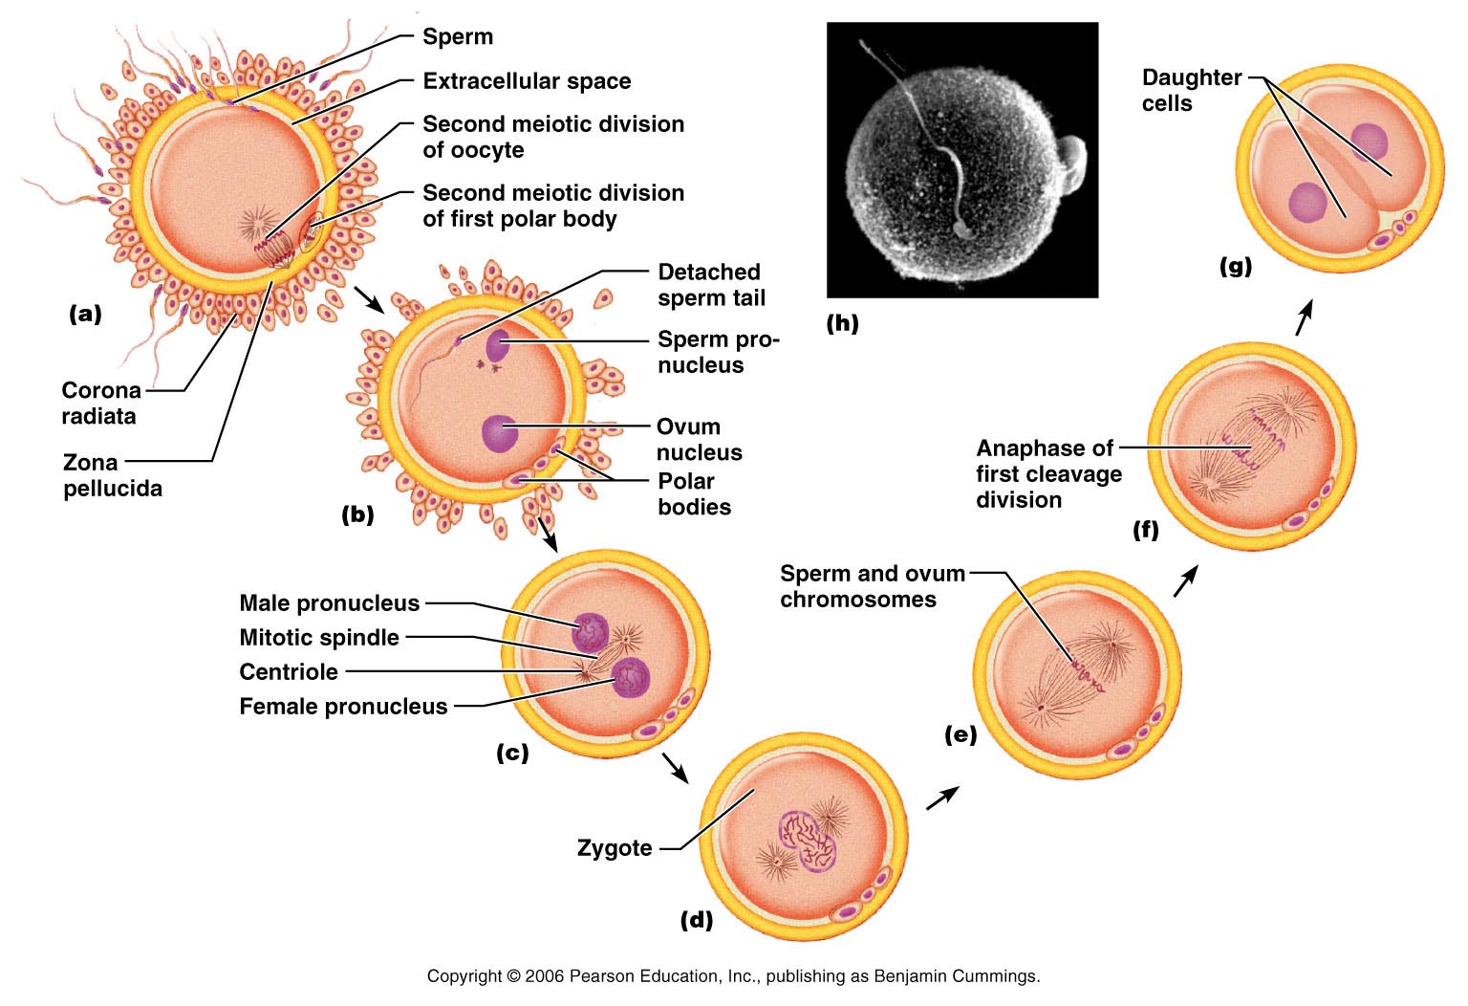
Events Immediately Following Sperm Penetration

Slide 143
Preembryonic Development
The first cleavage produces two daughter cells called blastomeres
Morula
the 16 or more cell stage (72 hours old)
By the fourth or fifth day the preembryo consists of 100 or so cells (blastocyst)

Slide 144
Preembryonic Development
Blastocyst
a fluid-filled hollow sphere composed of:
A single layer of trophoblasts
An inner cell mass
Trophoblasts take part in placenta formation
The inner cell mass becomes the embryonic disc

Slide 145
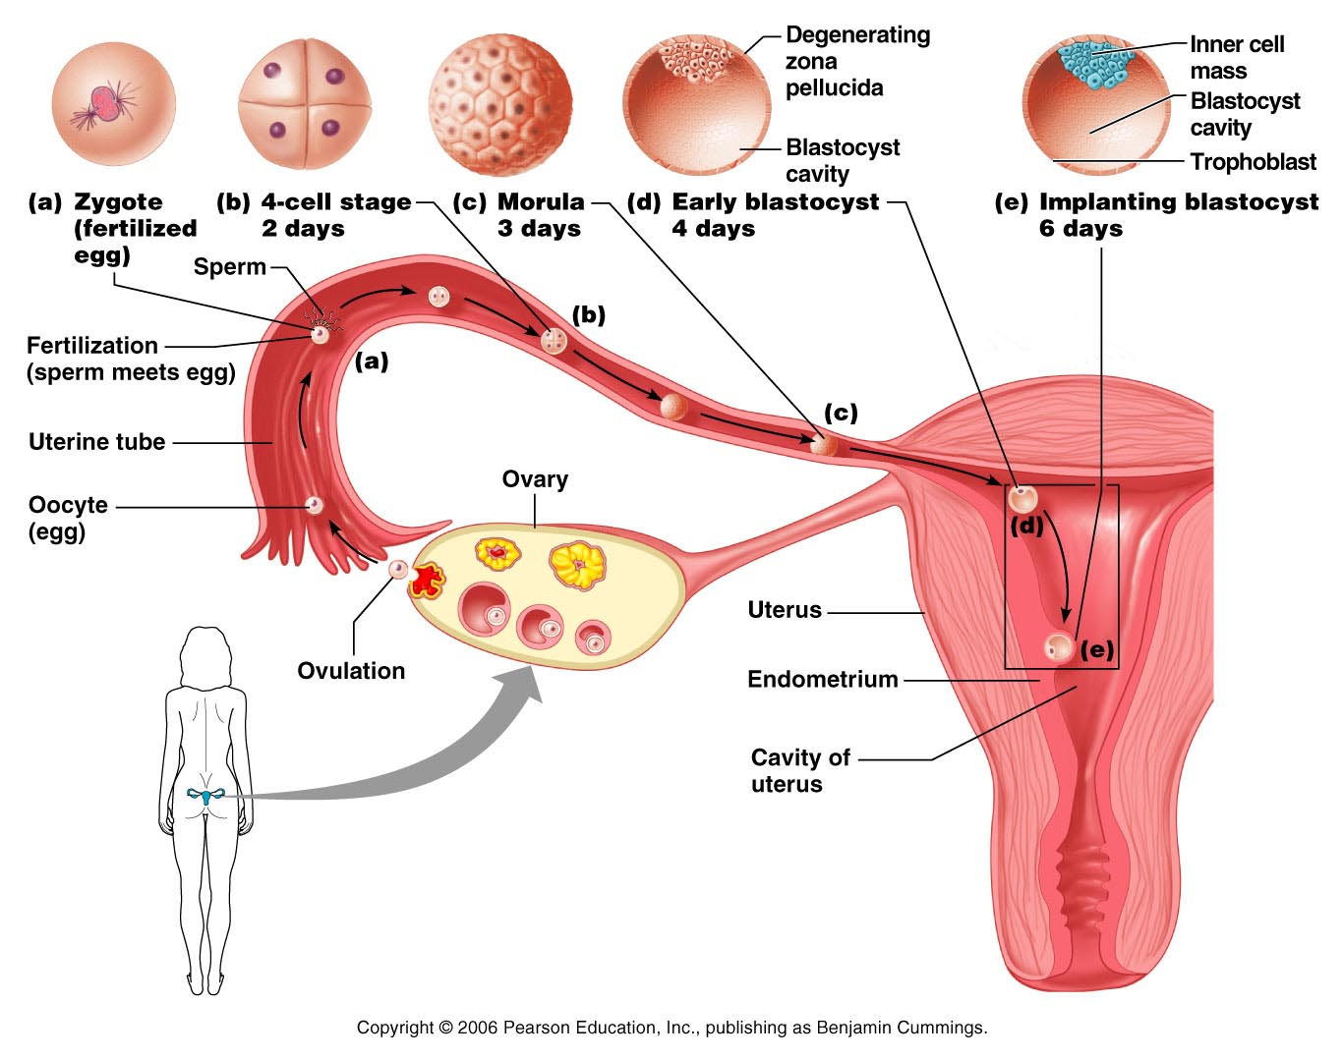
Cleavage: From Zygote to Blastocyst

Slide 146
Implantation
Begins six to seven days after ovulation when the trophoblasts adhere to a properly prepared endometrium
The trophoblasts then proliferate and form two distinct layers
Cytotrophoblast
cells of the inner layer that retain their cell boundaries
Syncytiotrophoblast
cells in the outer layer that lose their plasma membranes and invade the endometrium

Slide 147
Implantation
The implanted blastocyst is covered over by endometrial cells
Implantation is completed by the fourteenth day after ovulation

Slide 148
Implantation of the Blastocyst

Slide 149
Implantation of the Blastocyst

Slide 150
Implantation
Viability of the corpus luteum is maintained by human chorionic gonadotropin (hCG) secreted by the trophoblasts
hCG prompts the corpus luteum to continue to secrete progesterone and estrogen
Chorion
developed from trophoblasts after implantation, continues this hormonal stimulus
Between the second and third month, the placenta:
Assumes the role of progesterone and estrogen production
Is providing nutrients and removing wastes

Slide 151
Placentation
Formation of the placenta from:
Embryonic trophoblastic tissues
Maternal endometrial tissues
The placenta is fully formed and functional by the end of the third month

Slide 152
Placentation
Embryonic placental barriers include:
The chorionic villi
The endothelium of embryonic capillaries
The placenta also secretes other hormones
human placental lactogen, human chorionic thyrotropin, and relaxin

Slide 153
Embryonic Membranes
Amnion
Provides a buoyant environment that protects the embryo
Helps maintain a constant homeostatic temperature
Amniotic fluid comes from maternal blood, and later, fetal urine

Slide 154
Embryonic Membranes
Yolk sac
Forms part of the digestive tube
Produces earliest blood cells and vessels
Is the source of primordial germ cells

Slide 155
Embryonic Membranes
Allantois
a small outpocketing at the caudal end of the yolk sac
Structural base for the umbilical cord
Becomes part of the urinary bladder
Chorion
helps form the placenta
Encloses the embryonic body and all other membranes

Slide 156
Gastrulation
During the 3rd week, the two-layered embryonic disc becomes a three-layered embryo
The primary germ layers are ectoderm, mesoderm, and endoderm

Slide 157
Primary Germ Layers
Serve as primitive tissues from which all body organs will derive
Ectoderm
forms structures of the nervous system and skin epidermis
Endoderm
forms epithelial linings of the digestive, respiratory, and urogenital systems
Mesoderm
forms all other tissues
Endoderm and ectoderm are securely joined and are considered epithelia

Slide 158
Effects of Pregnancy
Chadwick’s sign
the vagina develops a purplish hue
Breasts enlarge and their areolae darken
The uterus expands, occupying most of the abdominal cavity

Slide 159
Effects of Pregnancy
Lordosis is common due to the change of the body’s center of gravity
Relaxin causes pelvic ligaments and the pubic symphysis to relax
Typical weight gain is about 29 pounds

Slide 160
Effects of Pregnancy: Metabolic Changes
The placenta secretes human placental lactogen (hPL),
stimulates the maturation of the breasts
promotes growth of the fetus and exerts a maternal glucose-sparing effect
Human chorionic thyrotropin (hCT) increases maternal metabolism
Parathyroid hormone levels are high, ensuring a positive calcium balance

Slide 161
Effects of Pregnancy: Physiological Changes
GI tract
morning sickness occurs due to elevated levels of estrogen and progesterone
Urinary system
urine production increases to handle the additional fetal wastes
Respiratory system
edematous and nasal congestion may occur
Dyspnea (difficult breathing) may develop late in pregnancy

Slide 162
Effects of Pregnancy: Physiological Changes
Cardiovascular system
blood volume increases 25-40%
Venous pressure from lower limbs is impaired, resulting in varicose veins

Slide 163
Parturition: Initiation of Labor
Estrogen reaches a peak during the last weeks of pregnancy causing myometrial weakness and irritability
Weak Braxton Hicks contractions may take place
As birth nears, oxytocin and prostaglandins cause uterine contractions
Emotional and physical stress:
Activates the hypothalamus
Sets up a positive feedback mechanism, releasing more oxytocin

Slide 164
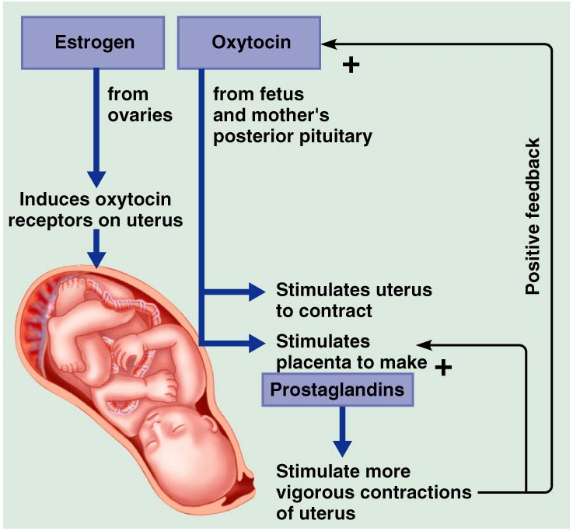
Parturition: Initiation of Labor

Slide 165
Stages of Labor: Dilation Stage
From the onset of labor until the cervix is fully dilated (10 cm)
Initial contractions are 15–30 minutes apart and 10–30 seconds in duration
The cervix effaces and dilates
The amnion ruptures, releasing amniotic fluid (breaking of the water)
Engagement occurs as the infant’s head enters the true pelvis

Slide 166
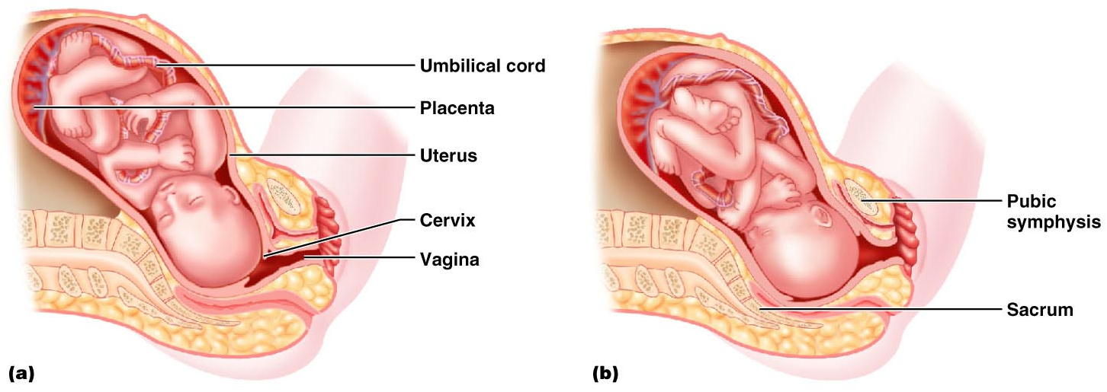
Stages of Labor: Dilation Stage

Slide 167
Stages of Labor: Expulsion Stage
From full dilation to delivery of the infant
Strong contractions occur every 2–3 minutes and last about 1 minute
The urge to push increases in labor without local anesthesia
Crowning occurs when the largest dimension of the head is distending the vulva

Slide 168
Stages of Labor: Expulsion Stage

Slide 169
Stages of Labor: Expulsion Stage
The delivery of the placenta is accomplished within 30 minutes of birth
Afterbirth
the placenta and its attached fetal membranes
All placenta fragments must be removed to prevent postpartum bleeding

Slide 170
Stages of Labor: Expulsion Stage

Slide 171
Extrauterine Life
At 1-5 minutes after birth, the infant’s physical status is assessed based on five signs:
heart rate, respiration, color, muscle tone, and reflexes
Each observation is given a score of 0 to 2
Apgar score
the total score of the above assessments
8-10 indicates a healthy baby
Lower scores reveal problems

Slide 172
Occlusion of Fetal Blood Vessels
Umbilical arteries and vein constrict and become fibrosed
Fates of fetal vessels
Proximal umbilical arteries become superior vesical arteries and distal parts become the medial umbilical ligaments
The umbilical vein becomes the ligamentum teres
The ductus venosus becomes the ligamentum venosum
The foramen ovale becomes the fossa ovalis
The ductus arteriosus becomes the ligamentum arteriosum

Slide 173
Transitional Period
Unstable period lasting 6-8 hours after birth
The first 30 minutes the baby is alert and active
Heart rate increases (120-160 beats/min.)
Respiration is rapid and irregular
Temperature falls

Slide 174
Transitional Period
Activity then diminishes and the infant sleeps about three hours
A second active stage follows in which the baby regurgitates mucus and debris
After this, the infant sleeps, with waking periods occurring every 3-4 hours

Slide 175
Lactation
The production of milk by the mammary glands
Estrogens, progesterone, and lactogen stimulate the hypothalamus to release prolactin-releasing hormone (PRH)
The anterior pituitary responds by releasing prolactin

Slide 176
Lactation
Colostrum
Solution rich in vitamin A, protein, minerals, and IgA antibodies
Is released the first 2–3 days
Is followed by true milk production

Slide 177
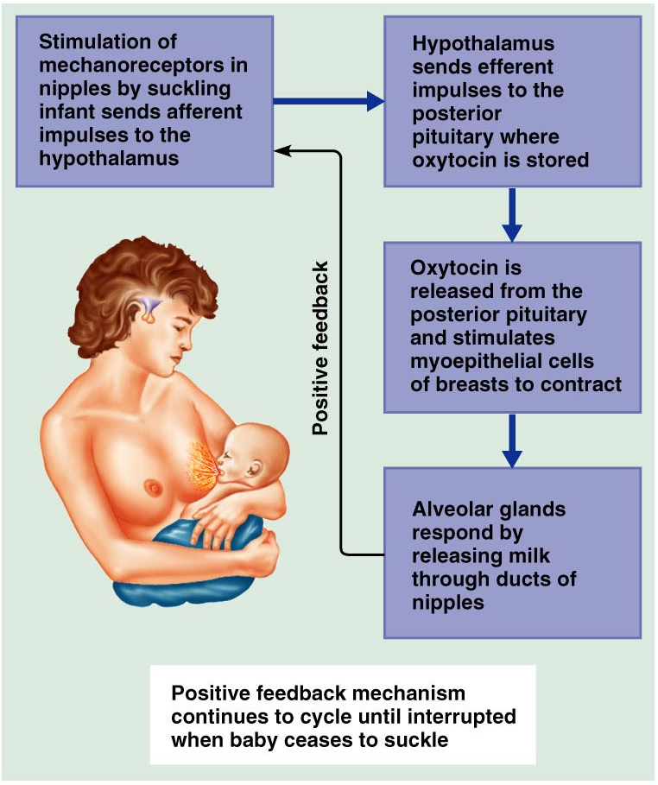
Lactation and Milk Let-down Reflex
After birth, milk production is stimulated by the sucking infant
Figure 28.18

Slide 178
Breast Milk
Advantages of breast milk for the infant
Fats and iron are better absorbed
Its amino acids are metabolized more efficiently than those of cow’s milk
Beneficial chemicals are present – IgA, other immunoglobulins, complement, lysozyme, interferon, and lactoperoxidase
Interleukins and prostaglandins are present, which prevent overzealous inflammatory responses
Its natural laxatives help cleanse the bowels of meconium

