Slide 1
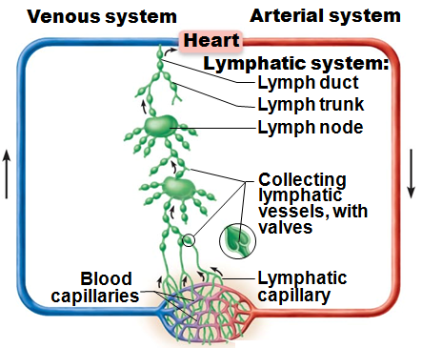
Lymphatic System
Returns fluids that leaked from blood vessels back to blood
Consists of three parts
  Network of lymphatic vessels (lymphatics)
  Lymph
    The fluid in vessels
  Lymph nodes
    filter and cleanse lymph

Slide 2
Lymphoid Organs and Tissues
Provide structural basis of immune system
House phagocytic cells and lymphocytes
Structures include spleen, thymus, tonsils, other lymphoid tissues

Slide 3
Lymphatic System: Functions
Lymphatic vessels (lymphatics)
  Return interstitial fluid and leaked plasma proteins back to blood
  Once interstitial fluid enters lymphatics, called lymph

Slide 4
Lymphatic Vessels: Distribution and Structure
One-way system; lymph flows toward heart
Lymph vessels (lymphatics) include:
  Lymphatic capillaries
  Collecting lymphatic vessels
  Lymphatic trunks and ducts

Slide 5
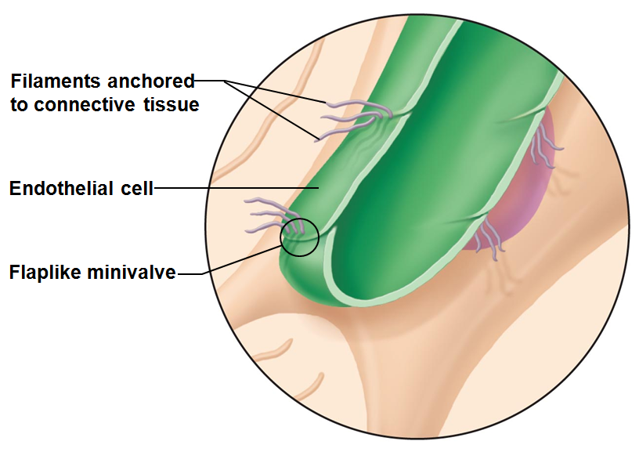
Lymphatic Capillaries
Similar to blood capillaries, except
  Very permeable
    take up proteins
    cell debris
    Pathogens
    cancer cells
  Endothelial cells overlap loosely to form one-way minivalves
  Pathogens travel throughout body via lymphatics

Slide 6
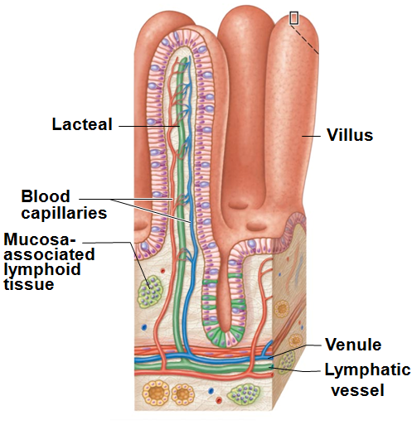
Lymphatic Capillaries
Absent from bones, teeth, bone marrow, and CNS
Lacteals: specialized lymph capillaries present in intestinal mucosa
  Absorb digested fat and deliver fatty lymph (chyle) to the blood

Slide 7
Lymphatic Collecting Vessels
Similar to veins, except
  Have thinner walls, with more internal valves
  Anastomose more frequently
Collecting vessels in skin travel with superficial veins
Deep vessels travel with arteries
Nutrients supplied from branching vasa vasorum

Slide 8
Lymphatic Trunks
Formed by union of largest collecting ducts
  Paired lumbar
  Paired bronchomediastinal
  Paired subclavian
  Paired jugular trunks
  Single intestinal trunk

Slide 9
Lymphatic Ducts
Lymph delivered into one of two large ducts
  Right lymphatic duct
    drains right upper arm and right side of head and thorax
  Thoracic duct
    arises as cisterna chyli; drains rest of body
Each empties lymph into venous circulation at junction of internal jugular and subclavian veins on its own side of body

Slide 10
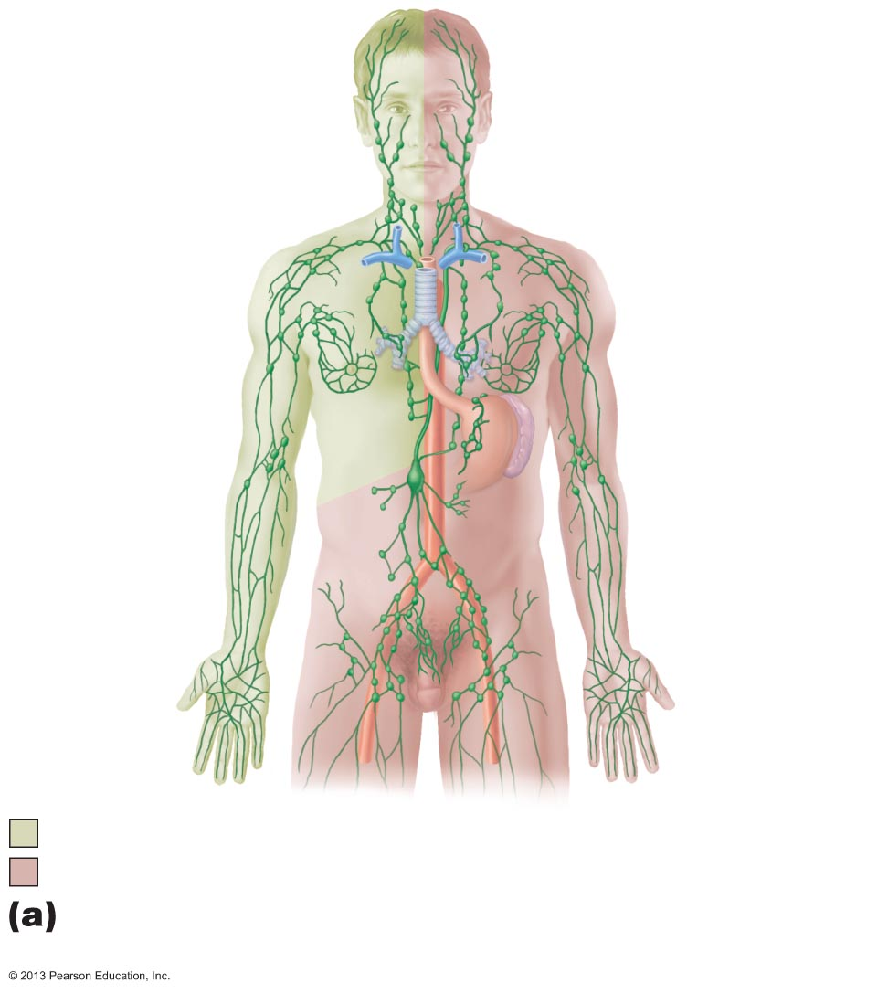
Internal
jugular vein
Entrance of
thoracic duct
into vein
Entrance of
right lymphatic
duct into vein
Thoracic
duct
Cisterna
chyli
Aorta
Collecting
lymphatic
vessels
Drained by the right lymphatic duct
Drained by the thoracic duct

Slide 11
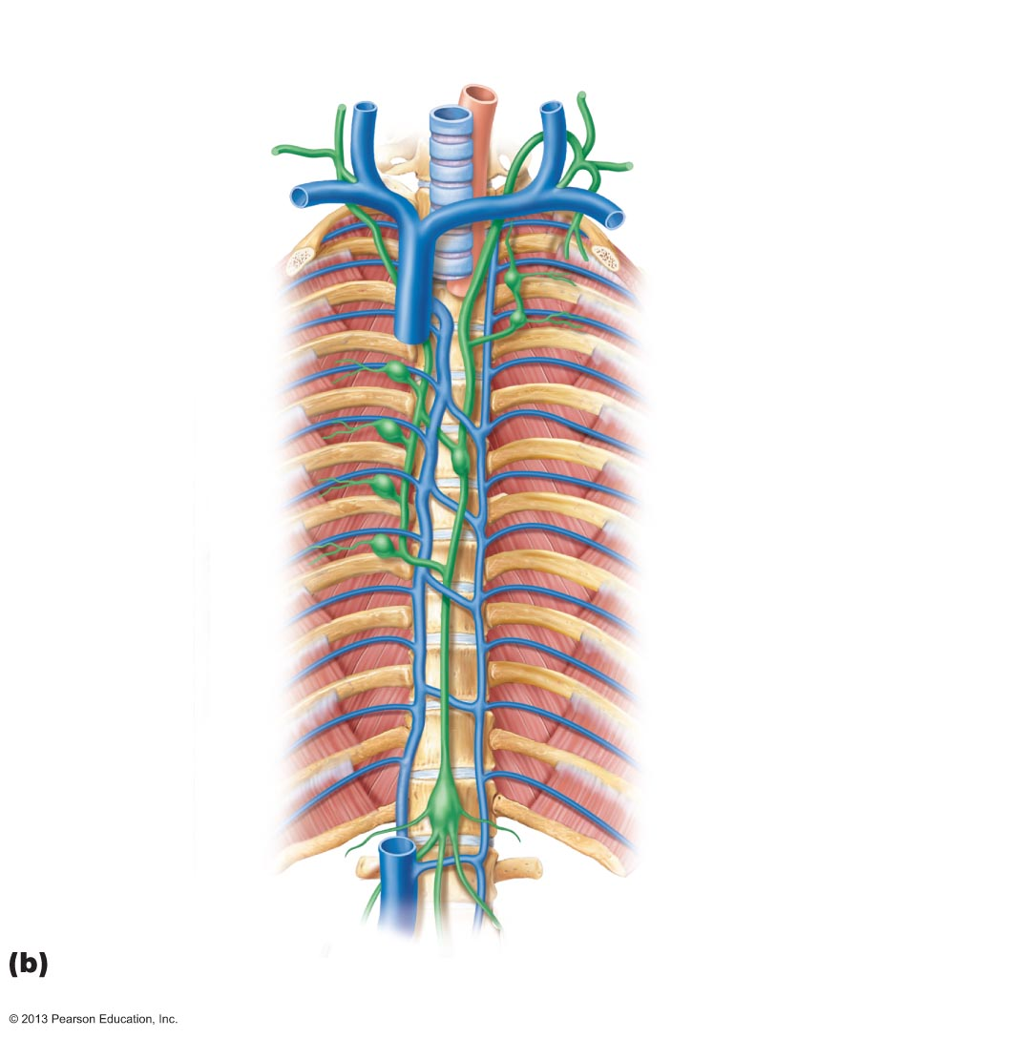
Figure 20.2b The lymphatic system.
Right jugular trunk
Internal
jugular veins
Right lymphatic
duct
Right subclavian
trunk
Left jugular
trunk
Right subclavian
vein
Left subclavian
trunk
Right broncho-
mediastinal trunk
Left subclavian
vein
Entrance of
thoracic duct
into vein
Superior
vena cava
Left broncho-
mediastinal
trunk
Azygos vein
Thoracic duct
Cisterna chyli
Right lumbar
trunk
Left lumbar
trunk
Inferior vena cava
Intestinal trunk

Slide 12
Lymph Transport
Lymph propelled by
  Milking action of skeletal muscle
  Pressure changes in thorax during breathing
  Valves to prevent backflow
  Pulsations of nearby arteries
  Contractions of smooth muscle in walls of larger lymphatics

Slide 13
Lymphoid Cells
Lymphocytes main warriors of immune system
  Arise in red bone marrow
Mature into one of two main varieties
  T cells (T lymphocytes)
  B cells (B lymphocytes)

Slide 14
Lymphocytes
T cells and B cells protect against antigens
  Anything body perceives as foreign
    Bacteria
    bacterial toxins
    Viruses
    mismatched RBCs
    cancer cells

Slide 15
Lymphocytes
T cells
  Manage immune response
  Attack and destroy infected cells
B cells
  Produce plasma cells, which secrete antibodies
    Antibodies mark antigens for destruction by phagocytosis or other means

Slide 16
Other Lymphoid Cells
Macrophages
  phagocytize foreign substances
  help activate T cells
Dendritic cells
  capture antigens and deliver them to lymph nodes
Reticular cells
  produce reticular fiber that supports other cells in lymphoid organs

Slide 17
Lymphoid Tissue
Houses, and provides proliferation site for, lymphocytes
Surveillance vantage point for lymphocytes and macrophages
Largely reticular connective tissue
  type of loose connective tissue
Two main types
  Diffuse lymphoid tissue
  Lymphoid follicles

Slide 18
Lymphoid Tissue
Diffuse lymphoid tissue of lymphoid cells and reticular fibers in almost every body organ
  Larger collections in lamina propria of mucous membranes

Slide 19
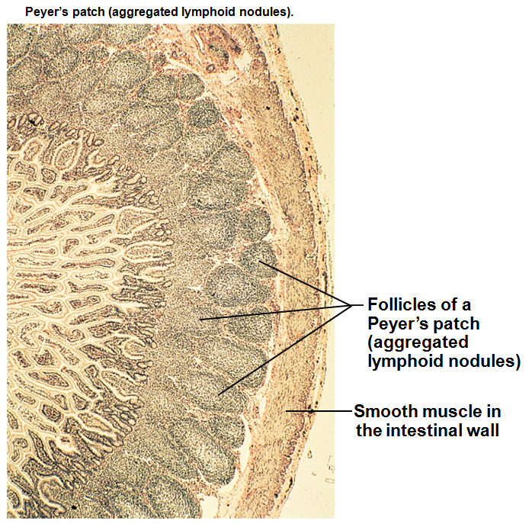
Lymphoid Tissue
Lymphoid follicles (nodules) are solid, spherical bodies of tightly packed lymphoid cells and reticular fibers
  Germinal centers of proliferating B cells
  May form part of larger lymphoid organs
  Isolated aggregations of Peyer's patches and in appendix

Slide 20
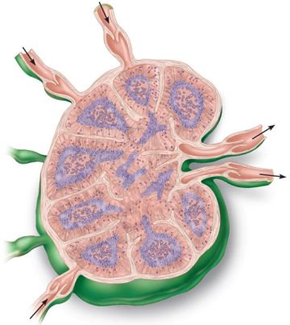
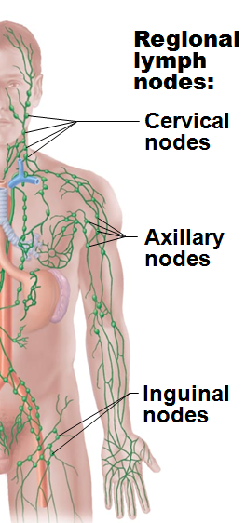
Lymph Nodes
Principal lymphoid organs of body
Embedded in connective tissue, in clusters along lymphatic vessels
Near body surface in inguinal, axillary, and cervical regions of body

Slide 21
Lymph Nodes
Functions
  Filter lymph
    macrophages destroy microorganisms and debris
  Immune system activation
    lymphocytes activated and mount attack against antigens

Slide 22
Structure of a Lymph Node
Vary in shape and size but most bean shaped
External fibrous capsule
Trabeculae extend inward and divide node into compartments
Two histologically distinct regions
  Cortex
  Medulla

Slide 23
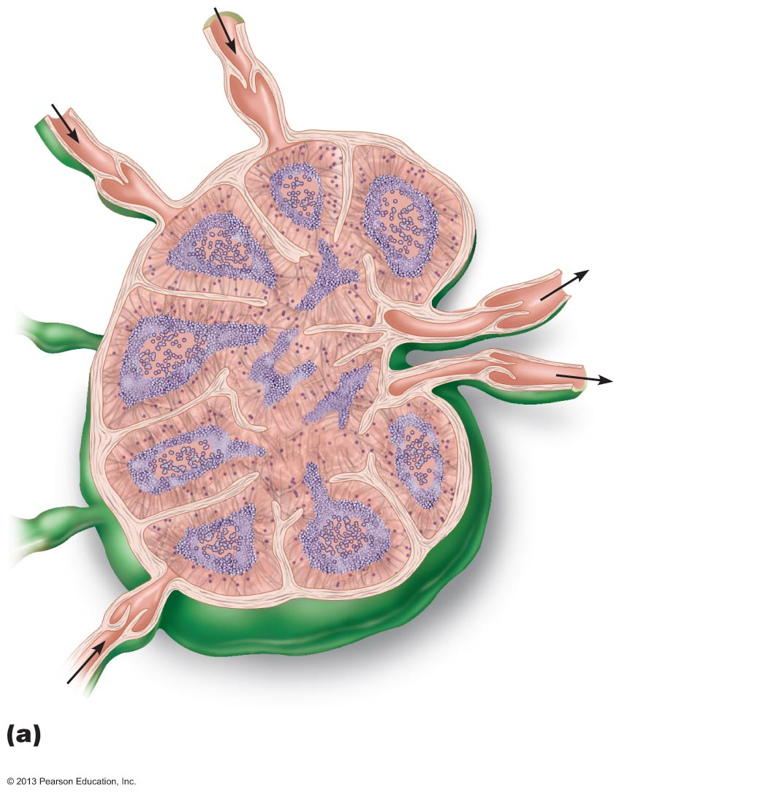
Figure 20.4a Lymph node.
Afferent
lymphatic
vessels
Cortex
• Lymphoid follicle
• Germinal center
• Subcapsular sinus
Efferent
lymphatic
vessels
Hilum
Medulla
• Medullary
cord
• Medullary
sinus
Trabeculae
Capsule
Longitudinal view of the internal structure of a lymph
node and associated lymphatics

Slide 24
Structure of a Lymph Node
Cortex contains follicles with germinal centers, heavy with dividing B cells
Dendritic cells nearly encapsulate follicles
Deep cortex houses T cells in transit
T cells circulate continuously among blood, lymph nodes, and lymph

Slide 25
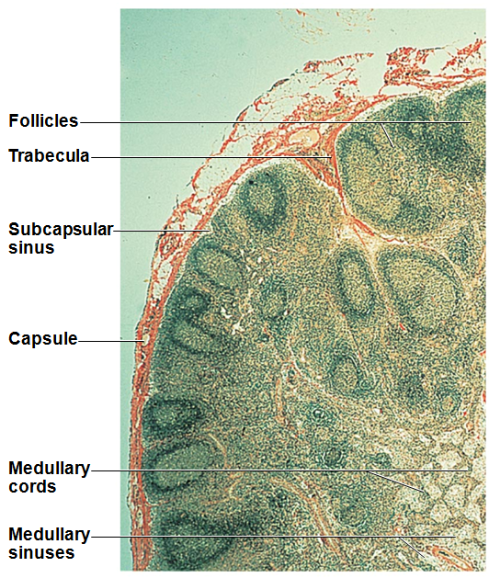
Structure of a Lymph Node
Medullary cords extend inward from cortex
  contain B cells, T cells, and plasma cells
Lymph sinuses contain macrophages

Slide 26
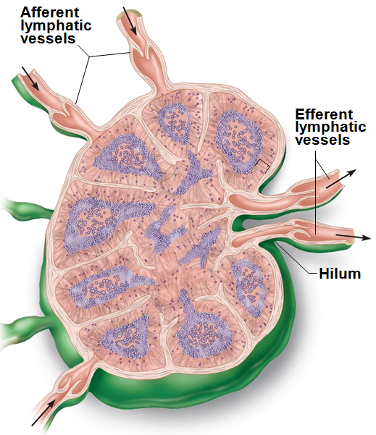
Circulation in the Lymph Nodes
Lymph
  Enters convex side via afferent lymphatic vessels
  travels through large subcapsular sinus and smaller sinuses to medullary sinuses
  exits concave side at hilum via efferent vessels
Fewer efferent vessels so flow somewhat stagnates; allows lymphocytes and macrophages time to function

Slide 27
Spleen
Largest lymphoid organ
Served by splenic artery and vein, which enter and exit at the hilum
Functions
  Site of lymphocyte proliferation and immune surveillance and response
  Cleanses blood of aged cells and platelets, macrophages remove debris

Slide 28
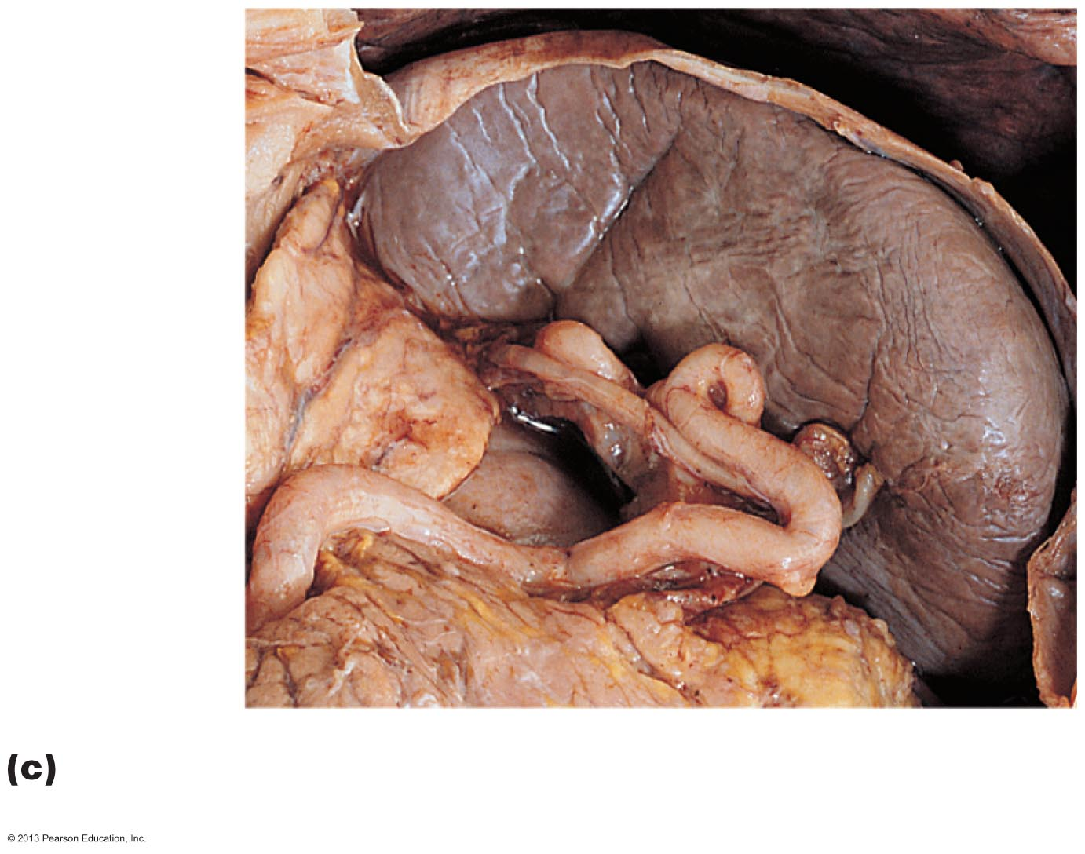
Figure 20.6c The spleen.
Diaphragm
Spleen
Adrenal
gland
Kidney
Splenic
artery
Pancreas
Photograph of the spleen in its normal position in
the abdominal cavity, anterior view.

Slide 29
Spleen: Additional Functions
Stores
  breakdown products of RBCs (e.g., iron) for later reuse
  blood platelets and monocytes
site of fetal erythrocyte production
  ceases before birth
Encased by fibrous capsule; has trabeculae
Contains lymphocytes, macrophages, and huge numbers of erythrocytes

Slide 30
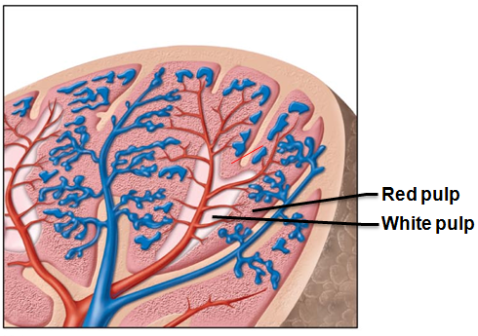
Structure of the Spleen
Two distinct areas
  White pulp around central arteries
    Mostly lymphocytes on reticular fibers; involved in immune functions
  Red pulp in venous sinuses and splenic cords
    Rich in RBCs and macrophages
      for disposal of worn-out RBCs and bloodborne pathogens
    Composed of splenic cords and sinusoids

Slide 31
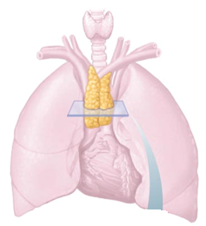
Thymus
Important functions early in life
Found in inferior neck
  extends into mediastinum
  partially overlies heart
Increases in size and most active during childhood
Stops growing during adolescence, then gradually atrophies
  Still produces immunocompetent cells, though slowly

Slide 32
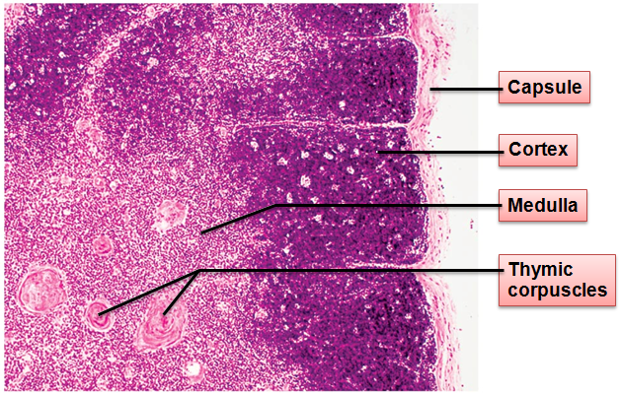
Thymus
Thymic lobules contain
  outer cortex
  inner medulla
Most thymic cells are lymphocytes
  Cortex contains
    rapidly dividing lymphocytes
    scattered macrophages
Medulla contains fewer lymphocytes and thymic corpuscles involved in regulatory T cell development (prevent autoimmunity)

Slide 33
Thymus
Differs from other lymphoid organs in important ways
  Has no follicles because it lacks B cells
  Does not directly fight antigens
    Functions strictly in T lymphocyte maturation
      Keeps isolated via blood thymus barrier
Stroma of epithelial cells (not reticular fibers)
  Provide environment in which T lymphocytes become immunocompetent

Slide 34
Mucosa-associated Lymphoid Tissue (MALT)
Lymphoid tissues in mucous membranes throughout body
Protects from pathogens trying to enter body
Largest collections of MALT in tonsils, Peyer's patches, appendix
Also in mucosa of respiratory and genitourinary organs; rest of digestive tract

Slide 35
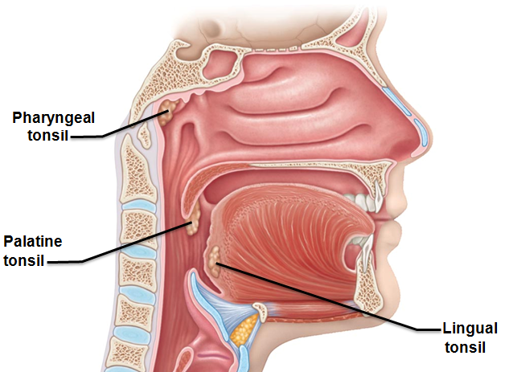
Tonsils
Simplest lymphoid organs
Form ring of lymphatic tissue around pharynx
  Palatine tonsils
    at posterior end of oral cavity
  Lingual tonsil
    grouped at base of tongue
  Pharyngeal tonsil
    in posterior wall of nasopharynx
  Tubal tonsils
    surrounding openings of auditory tubes into pharynx
Gather and remove pathogens in food or air

Slide 36
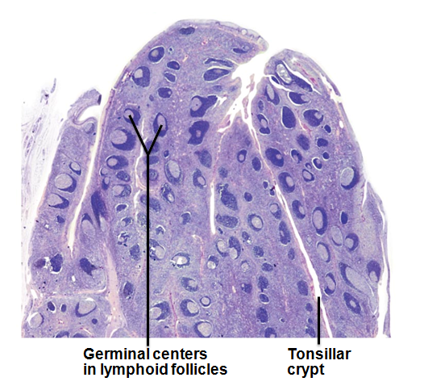
Tonsils
Contain follicles with germinal centers
Are not fully encapsulated
Overlying epithelium invaginates forming tonsillar crypts
  Trap and destroy bacteria and particulate matter
  Allow immune cells to build memory for pathogens

Slide 37
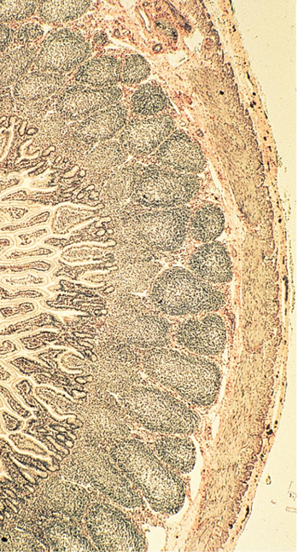
Aggregates of Lymphoid Follicles
Peyer's patches
  Clusters of lymphoid follicles
  In wall of distal portion of small intestine
  Similar structures are also found in the appendix
Peyer's patches and appendix
  Destroy bacteria, preventing them from breaching intestinal wall
  Generate "memory" lymphocytes

Slide 38
Immunity
Resistance to disease
Immune system
  Two intrinsic systems
    Innate
      (nonspecific) defense system
    Adaptive
      (specific) defense system

Slide 39
Immune System
Functional system
  rather than organ system
Innate and adaptive defenses intertwined
Innate defenses do have specific pathways for certain substances
Innate responses release proteins that alert cells of adaptive system to foreign molecules

Slide 40
Immunity
Innate defense system has two lines of defense
  First
    external body membranes (skin and mucosa)
  Second
    antimicrobial proteins, phagocytes, and other cells
      Inhibit spread of invaders
      Inflammation most important mechanism

Slide 41
Immunity
Adaptive defense system
  Third line of defense attacks particular foreign substances
    Takes longer to react than innate system

Slide 42
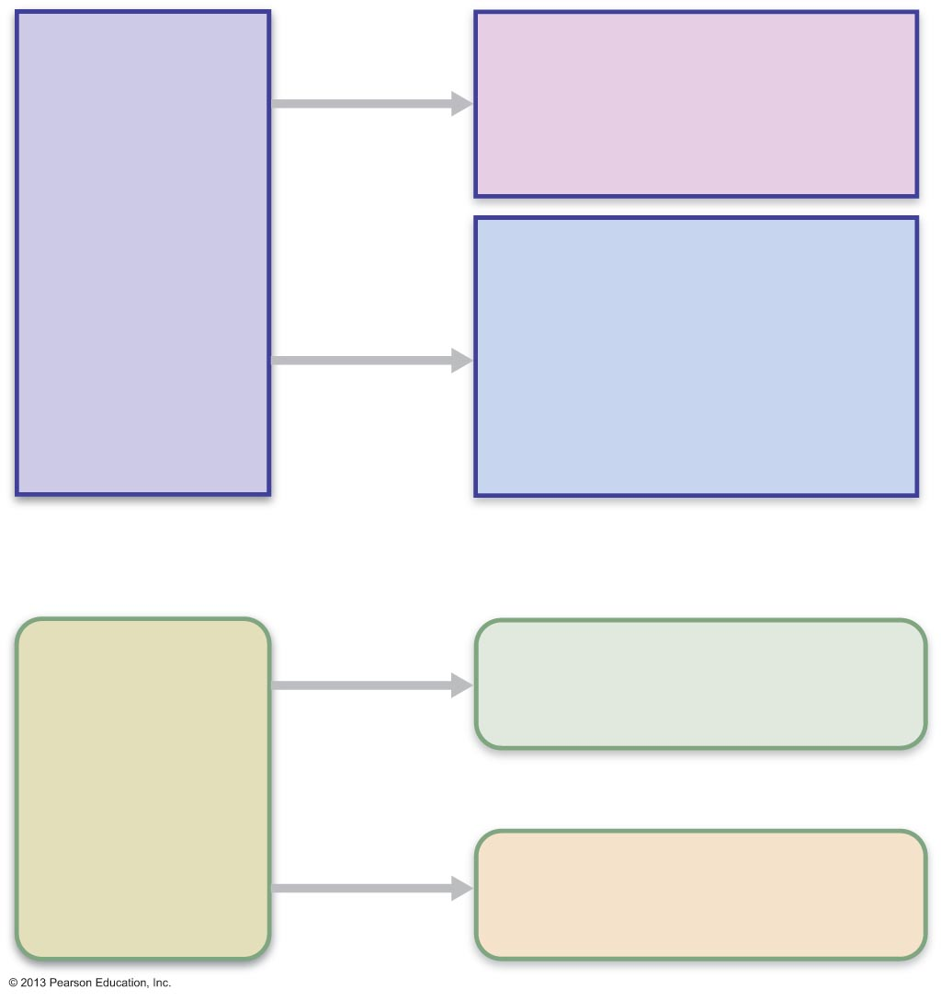
Surface barriers
• Skin
• Mucous membranes
Innate
defenses
Internal defenses
• Phagocytes
• Natural killer cells
• Inflammation
• Antimicrobial proteins
• Fever
Humoral immunity
• B cells
Adaptive
defenses
Cellular immunity
• T cells

Slide 43
Innate Defenses
Surface barriers ward off invading pathogens
  Skin, mucous membranes, and their secretions
    Physical barrier to most microorganisms
    Keratin resistant to weak acids and bases, bacterial enzymes, and toxins

Slide 44
Surface Barriers
Protective chemicals inhibit or destroy microorganisms
  Acidity of skin and secretions inhibits growth
  Enzymes have antimicrobial properties
    lysozyme of saliva
    respiratory mucus
    lacrimal fluid
  Defensins
    antimicrobial peptides – inhibit growth
  Other chemicals are toxic
    lipids in sebum
    dermcidin in sweat

Slide 45
Surface Barriers
Respiratory system modifications
  Mucus-coated hairs in nose
  Cilia of upper respiratory tract sweep dust and bacteria-laden mucus toward mouth
Surface barriers breached by nicks or cuts
  second line of defense must protect deeper tissues

Slide 46
Internal Defenses: Cells and Chemicals
Necessary if microorganisms invade deeper tissues
  Phagocytes
  Natural killer (NK) cells
  Antimicrobial proteins
    interferons and complement proteins
  Fever
  Inflammatory response
    macrophages, mast cells, WBCs, and inflammatory chemicals

Slide 47
Phagocytes
Neutrophils most abundant but die fighting
  Become phagocytic on exposure to infectious material
Macrophages develop from monocytes
    Free macrophages
      wander through tissue spaces
    Fixed macrophages
      permanent residents of some organs
        Kupffer cells (liver)
        microglia (brain)

Slide 48
Mechanism of Phagocytosis
Phagocyte must adhere to particle
  Some microorganisms evade adherence with capsule
    Opsonization marks pathogens—coating by complement proteins or antibodies
Cytoplasmic extensions bind to and engulf particle in vesicle called phagosome
Phagosome fuses with lysosome → phagolysosome

Slide 49
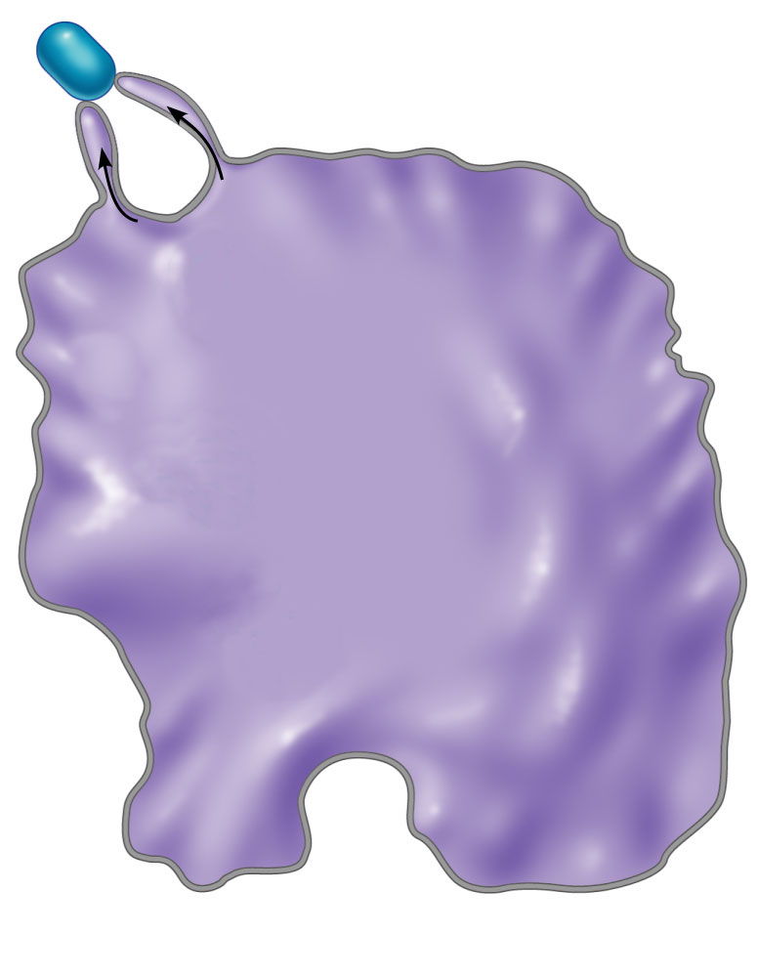
Slide 2
1
Microbe adheres to phagocyte.
(b)

Slide 50
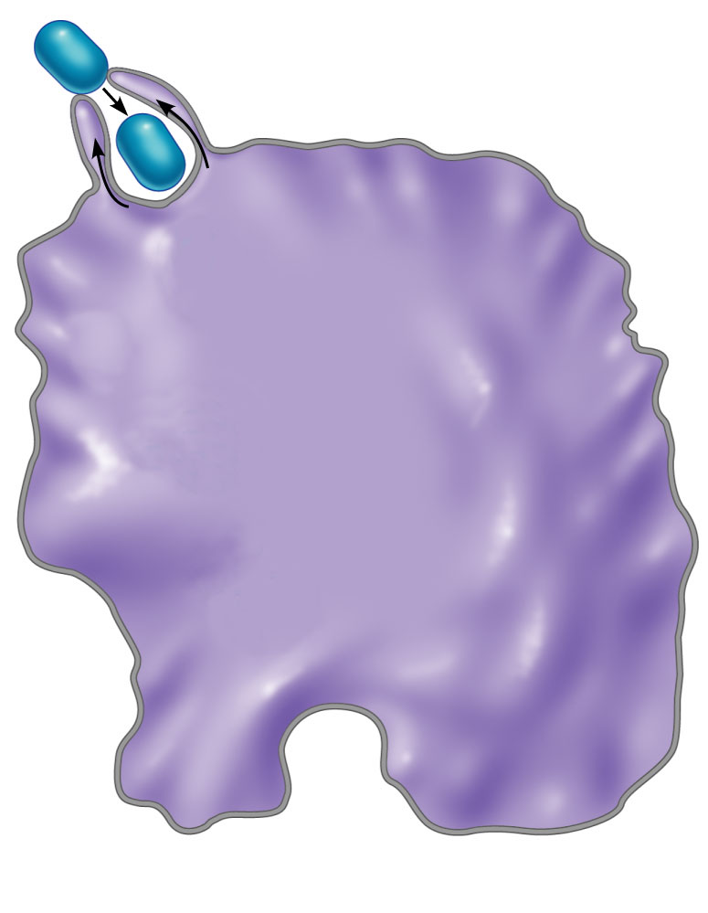
Slide 3
2
Phagocyte forms pseudopods that
eventually engulf the particle.
(b)

Slide 51
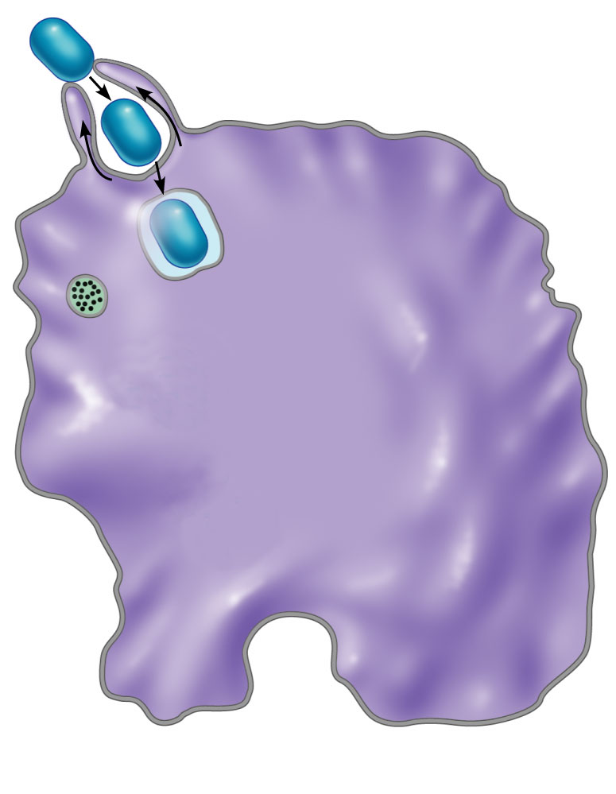
Slide 4
Phagocytic vesicle
containing antigen
(phagosome).
Lysosome
(b)

Slide 52
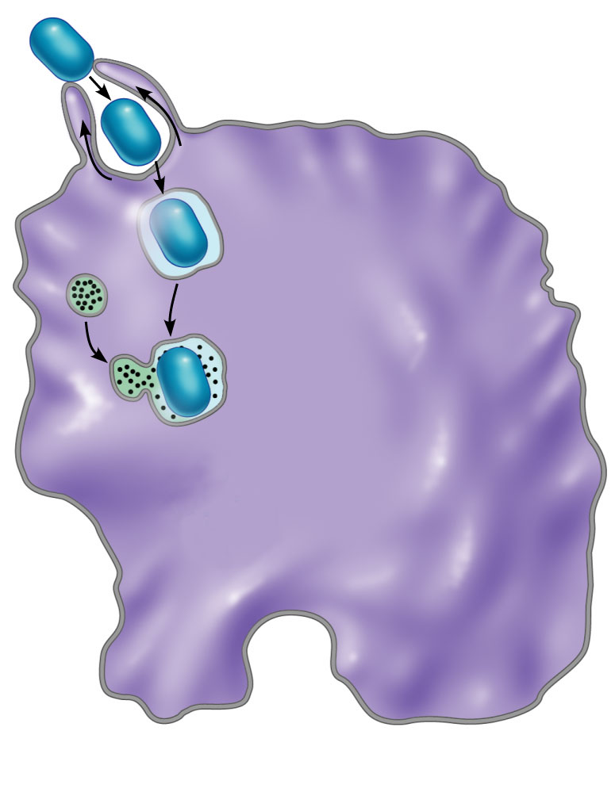
Slide 5
Phagocytic vesicle
containing antigen
(phagosome).
3
Phagocytic vesicle is
fused with a lysosome.
Phagolysosome
(b)

Slide 53
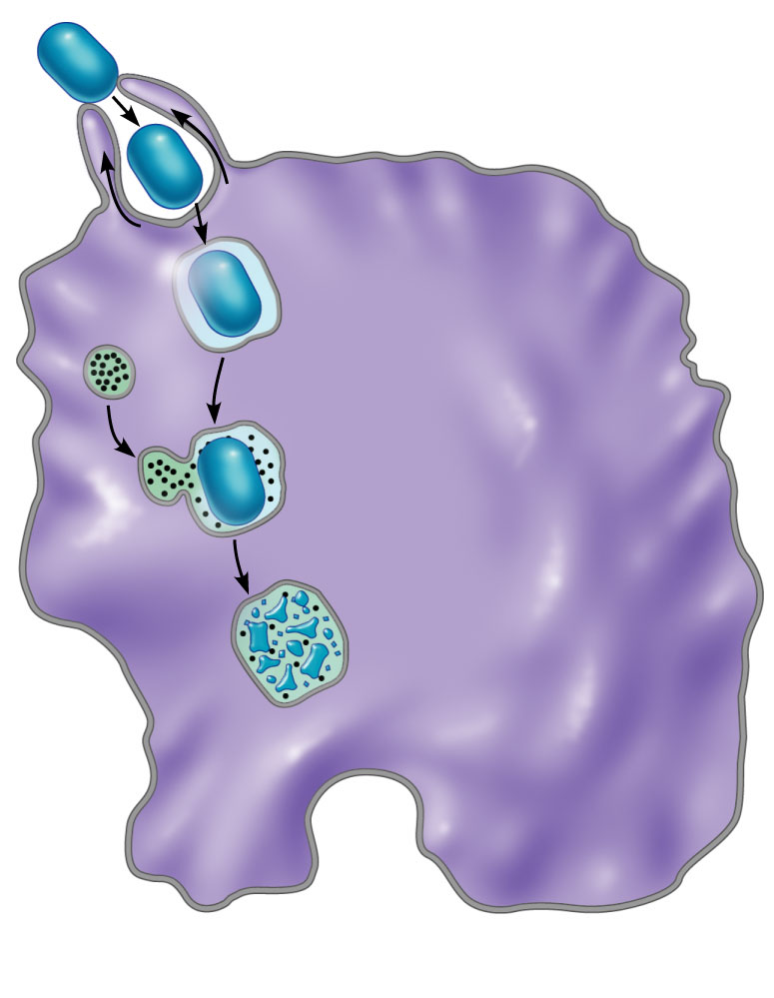
Slide 6
4
Microbe in fused vesicle
is killed and digested by
lysosomal enzymes within
the phagolysosome, leaving
a residual body.
(b)

Slide 54
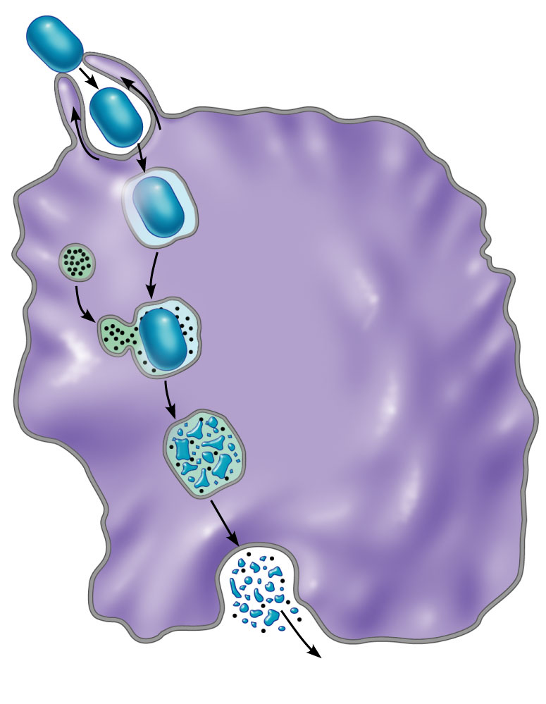
Slide 7
Residual body
Indigestible and
residual material
is removed by
exocytosis.
5
(b)

Slide 55
Mechanism of Phagocytosis
Pathogens killed by acidifying and digesting with lysosomal enzymes
Helper T cells cause release of enzymes of respiratory burst
Defensins (in neutrophils) pierce membrane

Slide 56
Natural Killer (NK) Cells
Nonphagocytic large granular lymphocytes
Attack cells that lack "self" cell-surface receptors
  Induce apoptosis in cancer cells and virus-infected cells
Secrete potent chemicals that enhance inflammatory response

Slide 57
Inflammatory Response
Triggered whenever body tissues injured
Prevents spread of damaging agents
Disposes of cell debris and pathogens
Alerts adaptive immune system
Sets the stage for repair

Slide 58
Inflammatory Response
Cardinal signs of acute inflammation:
  Redness
    rubor
  Heat
    calor
  Swelling
    tumor
  Pain
    Dolor
  (Sometimes 5. Impairment of function)

Slide 59
Inflammatory Response
Inflammatory mediators
  Histamine
    from mast cells
  Blood proteins
  Kinins, prostaglandins (PGs), leukotrienes, and complement
    Released by injured tissue, phagocytes, lymphocytes, basophils, and mast cells

Slide 60
Vasodilation and Increased Vascular Permeability
Inflammatory chemicals cause
  Dilation of arterioles, resulting in hyperemia
  Increased permeability of local capillaries and edema
    leakage of exudate
Exudate contains proteins, clotting factors, and antibodies

Slide 61
Inflammatory Response: Edema
↑ Capillary permeability → exudate to tissues
  Fluid containing clotting factors and antibodies
  Causes local swelling (edema)
  Swelling pushes on nerve endings → pain
  Moves foreign material into lymphatic vessels

Slide 62
Phagocyte Mobilization
Neutrophils lead and then macrophages follow
  As attack continues, monocytes arrive
    12 hours after leaving bloodstream they become macrophages
    These "late-arrivers" replace dying neutrophils and remain for clean up prior to repair
If inflammation due to pathogens, complement activated;
  adaptive immunity elements arrive

Slide 63
Phagocyte Mobilization
Neutrophils, then other phagocytes flood to inflamed sites
  Leukocytosis:
    release of neutrophils from bone marrow in response to chemicals from injured cells
  Margination:
    neutrophils cling to the walls of capillaries in the inflamed area
  Diapedesis of neutrophils
    Neutrophils squeeze out of the capillary walls and into the surrounding tissue
  Chemotaxis:
    inflammatory chemicals (chemotactic agent) promote positive chemotaxis of neutrophils

Slide 64
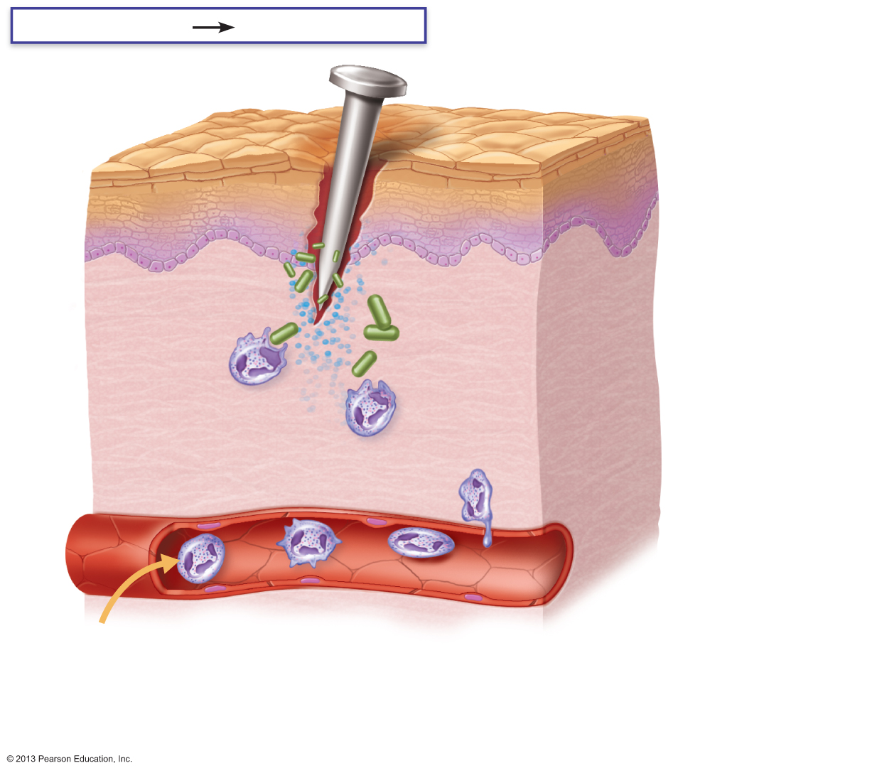
Figure 21.4 Phagocyte mobilization.
Slide 2
Innate defenses
Internal defenses
Inflammatory
chemicals from tissue damage
Capillary wall
Leukocytosis
Neutrophils enter
blood from bone
marrow.
1.

Slide 65

Figure 21.4 Phagocyte mobilization.
Slide 3
Innate defenses
Internal defenses
Capillary wall
Margination.
Neutrophils cling
to capillary wall.
2

Slide 66

Figure 21.4 Phagocyte mobilization.
Slide 4
Innate defenses
Internal defenses
Capillary wall
Diapedesis.
Neutrophils flatten
and squeeze out of
capillaries.
3

Slide 67

Figure 21.4 Phagocyte mobilization.
Slide 5
Innate defenses
Internal defenses
Inflammatory
chemicals
Chemotaxis.
Neutrophils follow chemical trail.
4
Capillary wall

Slide 68
Antimicrobial Proteins
Interferons (IFNs) and complement proteins
  Attack microorganisms directly
  Hinder microorganisms’ ability to reproduce

Slide 69
Interferons
Viral-infected cells are activated to secrete IFNs
IFNs enter neighboring cells
Neighboring cells produce antiviral proteins that block viral reproduction

Slide 70
Interferons
Produced by a variety of body cells
  Interferons also activate macrophages and mobilize NKs

Slide 71
Interferons
Functions
  Anti-viral
  Reduce inflammation
  Activate macrophages and mobilize NK cells
Genetically engineered IFNs for
  Antiviral agents against hepatitis and genital warts virus
  Multiple sclerosis treatment

Slide 72
Complement
about 20 blood proteins that circulate in an inactive form
Major mechanism for destroying foreign substances

Slide 73
Complement
Amplifies all aspects of the inflammatory response
Kills bacteria and certain other cell types by cell lysis
Enhances both nonspecific and specific defenses

Slide 74
Complement Activation
Activated complement
  Enhances inflammation
  Promotes phagocytosis
  Causes cell lysis

Slide 75
Fever
Abnormally high body temperature
Systemic response to invading microorganisms
Leukocytes and macrophages exposed to foreign substances secrete pyrogens
Pyrogens act on body's thermostat in hypothalamus, raising body temperature

Slide 76
Fever
Benefits of moderate fever
  Causes liver and spleen to sequester iron and zinc (needed by microorganisms)
  Increases metabolic rate → faster repair

Slide 77
Adaptive Defenses
Adaptive immune (specific defense) system
  Protects against infectious agents and abnormal body cells
  Amplifies inflammatory response
  Activates complement
  Must be primed by initial exposure to specific foreign substance
    Priming takes time

Slide 78
Adaptive Defenses
Specific
  recognizes and targets specific antigens
Systemic
  not restricted to initial site
Have memory
  stronger attacks to "known" antigens
Two separate, overlapping arms
  Humoral (antibody-mediated) immunity
  Cellular (cell-mediated) immunity

Slide 79
Humoral Immunity
Antibodies
  produced by lymphocytes circulate freely in body fluids
Bind temporarily to target cell
  Temporarily inactivate
  Mark for destruction by phagocytes or complement

Slide 80
Cellular Immunity
Lymphocytes act against target cell
  Directly
    by killing infected cells
  Indirectly
    by releasing chemicals that enhance inflammatory response; or activating other lymphocytes or macrophages

Slide 81
Antigens
Substances that can mobilize adaptive defenses and provoke an immune response
Targets of all adaptive immune responses
Most are large, complex molecules not normally found in body (nonself)

Slide 82
Complete Antigens
Important functional properties
  Immunogenicity:
    ability to stimulate proliferation of specific lymphocytes and antibodies
  Reactivity:
    ability to react with products of activated lymphocytes and antibodies released
Examples: foreign protein, polysaccharides, lipids, and nucleic acids

Slide 83
Haptens (Incomplete Antigens)
Small molecules
  peptides, nucleotides, and hormones
Not immunogenic by themselves
  become immunogenic when attached to body proteins
  Cause the immune system to mount a harmful attack
Examples: poison ivy, animal dander, detergents, and cosmetics

Slide 84
Self-Antigens: MHC Proteins
Protein molecules (self-antigens) on the surface of cells
Antigenic to others in transfusions or grafts
Example: MHC proteins
  Coded for by genes of the major histocompatibility complex (MHC) and are unique to an individual

Slide 85
MHC Proteins
Classes of MHC proteins
  Class I MHC proteins, found on virtually all body cells
  Class II MHC proteins, found on certain cells in the immune response
MHC proteins display peptides (usually self-antigens)
In infected cells, MHC proteins display fragments of foreign antigens

Slide 86
Cells of the Adaptive Immune System
Three types of cells
  Two types of lymphocytes
    B lymphocytes (B cells)
      humoral immunity
    T lymphocytes (T cells)
      cell-mediated immunity
  Antigen-presenting cells (APCs)
    **APC is not a cell name, it’s a cell’s job or ability**
    Do not respond to specific antigens
    Play essential auxiliary roles in immunity

Slide 87
Maturation
B cells mature in bone marrow
T cells mature in thymus
  Immunocompetence
    lymphocyte can recognize one specific antigen by binding to it
      B or T cells display unique receptor on surface when achieve maturity – bind only one antigen
  Self-tolerance
    Lymphocytes unresponsive to own antigens

Slide 88
T cells
T cells mature in thymus under negative and positive selection pressures ("tests")
  Positive selection
    Keep (positive selection) the T cells that can correctly identify MHC proteins as “self”
      Failing T cells destroyed by apoptosis
  Negative selection
    Eliminates Tcells that destory “self” antigens
      Ensures self-tolerance

Slide 89
B cells
B cells mature in red bone marrow
Positively selected if successfully make antigen receptors
Those that are self-reactive
  Eliminated by apoptosis (clonal deletion)

Slide 90
Antigen-presenting Cells (APCs)
Engulf antigens
Present fragments of antigens to T cells for recognition
Major types
  Dendritic cells in connective tissues and epidermis
  Macrophages in connective tissues and lymphoid organs
  B cells

Slide 91
Dendritic Cells and Macrophages
Dendritic cells phagocytize pathogens, enter lymphatics to present antigens to T cells in lymph node
  Most effective antigen presenter known
  Key link between innate and adaptive immunity
Macrophages widespread in lymphoid organs and connective tissues
Can activate naive T cells
Present antigens to T cells to activate themselves into voracious phagocytes that secrete bactericidal chemicals

Slide 92
B lymphocytes
Do not activate naive T cells
Present antigens to helper T cell to assist own activation

Slide 93
Adaptive Immunity: Summary
Uses lymphocytes, APCs, and specific molecules to identify and destroy nonself substances
Depends upon ability of its cells to
  Recognize antigens by binding to them
  Communicate with one another so that whole system mounts specific response

Slide 94
Activation and Differentiation of B Cells
B cell activated when antigens bind to its surface receptors and cross-link them →
Receptor-mediated endocytosis of cross-linked antigen-receptor complexes (clonal selection) →
Proliferation and differentiation into effector cells

Slide 95
Fate of the Clones
Most clone cells become plasma cells
  Secrete specific antibodies at rate of 2000 molecules per second for four to five days, then die
  Antibodies circulate in blood or lymph
    Bind to free antigens and mark for destruction by innate or adaptive mechanisms

Slide 96
Fate of the Clones
Clone cells that do not become plasma cells become memory cells
  Provide immunological memory
  Mount an immediate response to future exposures to same antigen

Slide 97
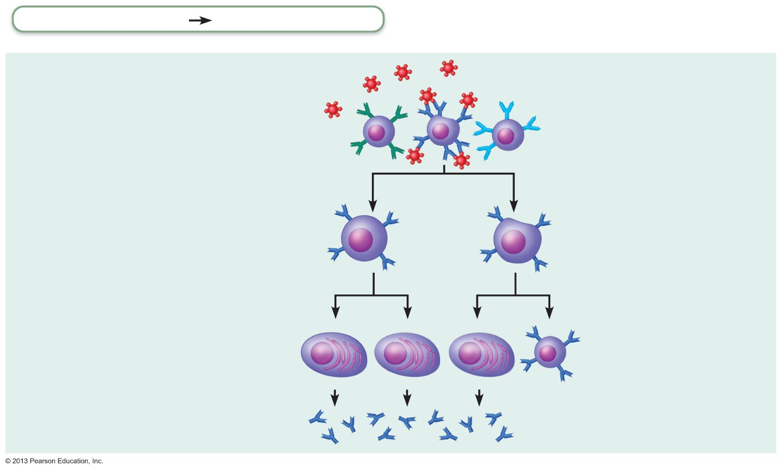
Figure 21.11a Clonal selection of a B cell.
Adaptive defenses
Humoral immunity
Primary response
(initial encounter
with antigen)
Antigen
Antigen binding
to a receptor on a
specific B lymphocyte
(B lymphocytes with
noncomplementary
receptors remain
inactive)
Proliferation to
form a clone
Activated B cells
Plasma cells
(effector B cells)
Memory B cell—
primed to respond
to same antigen
Secreted
antibody
molecules

Slide 98
Immunological Memory
Primary immune response
  Cell proliferation and differentiation upon first antigen exposure
  Lag period: three to six days
  Peak levels of plasma antibody are reached in 10 days
  Antibody levels then decline

Slide 99
Immunological Memory
Secondary immune response
  Re-exposure to same antigen gives faster, more prolonged, more effective response
    Sensitized memory cells respond within hours
    Antibody levels peak in two to three days at much higher levels
    Antibodies bind with greater affinity
    Antibody level can remain high for weeks to months

Slide 100

Primary Response
(initial encounter
with antigen)
Antigen
Antigen binding
to a receptor on a
specific B lymphocyte
(B lymphocytes with
non-complementary
receptors remain
inactive)

Slide 101
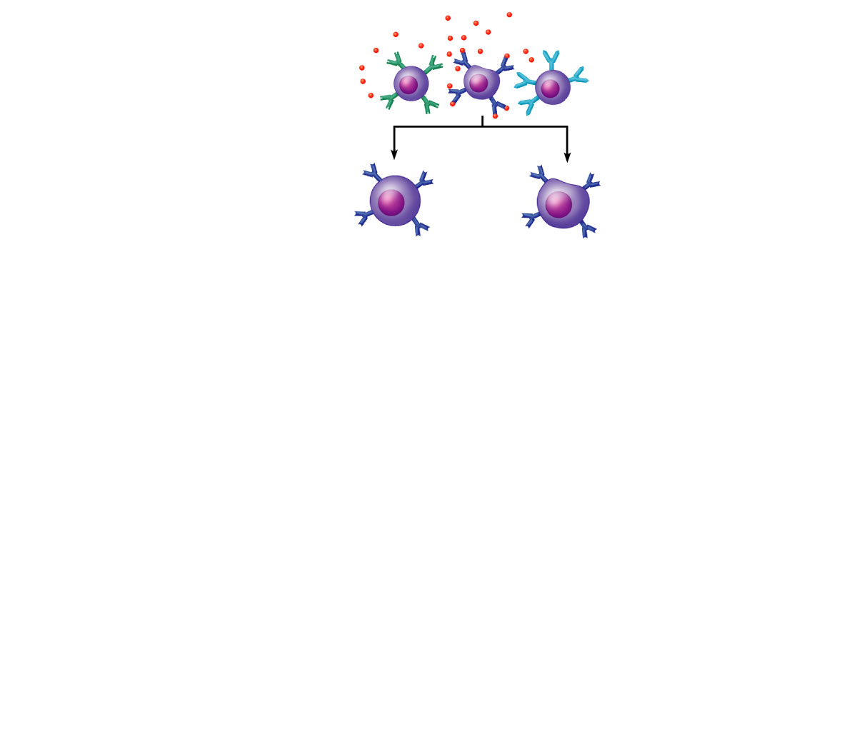
Primary Response
(initial encounter
with antigen)
Antigen
Antigen binding
to a receptor on a
specific B lymphocyte
(B lymphocytes with
non-complementary
receptors remain
inactive)
Proliferation to
form a clone
B lymphoblasts

Slide 102
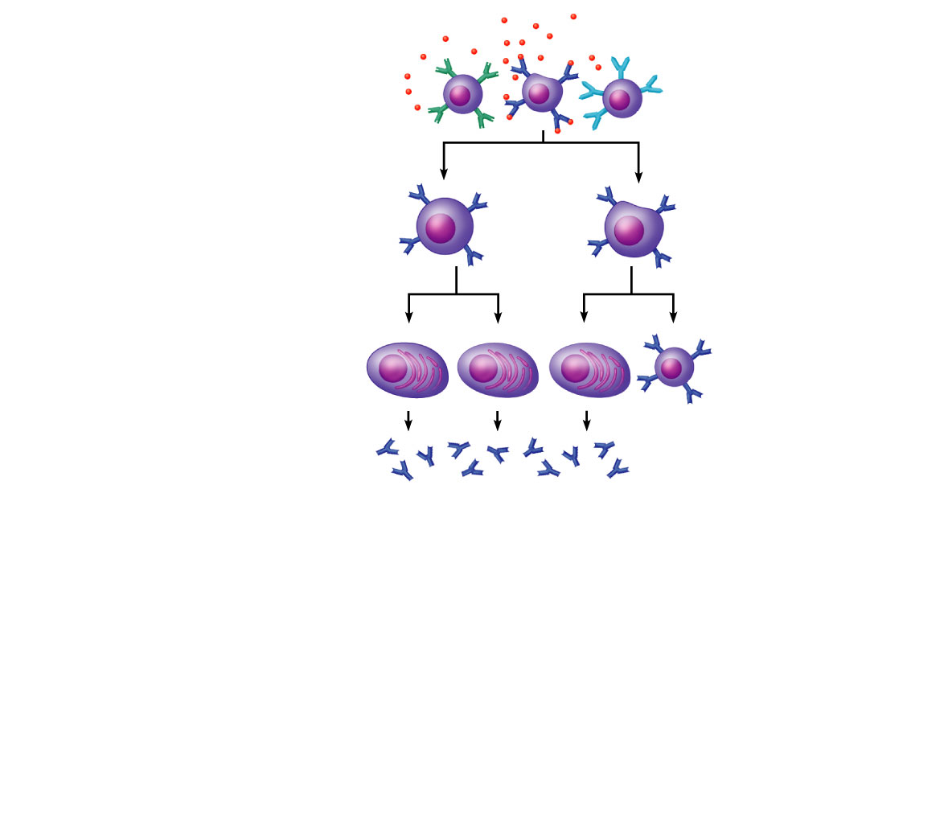
Primary Response
(initial encounter
with antigen)
Antigen
Antigen binding
to a receptor on a
specific B lymphocyte
(B lymphocytes with
non-complementary
receptors remain
inactive)
Proliferation to
form a clone
B lymphoblasts
Plasma
cells
Memory
B cell
Secreted
antibody
molecules

Slide 103
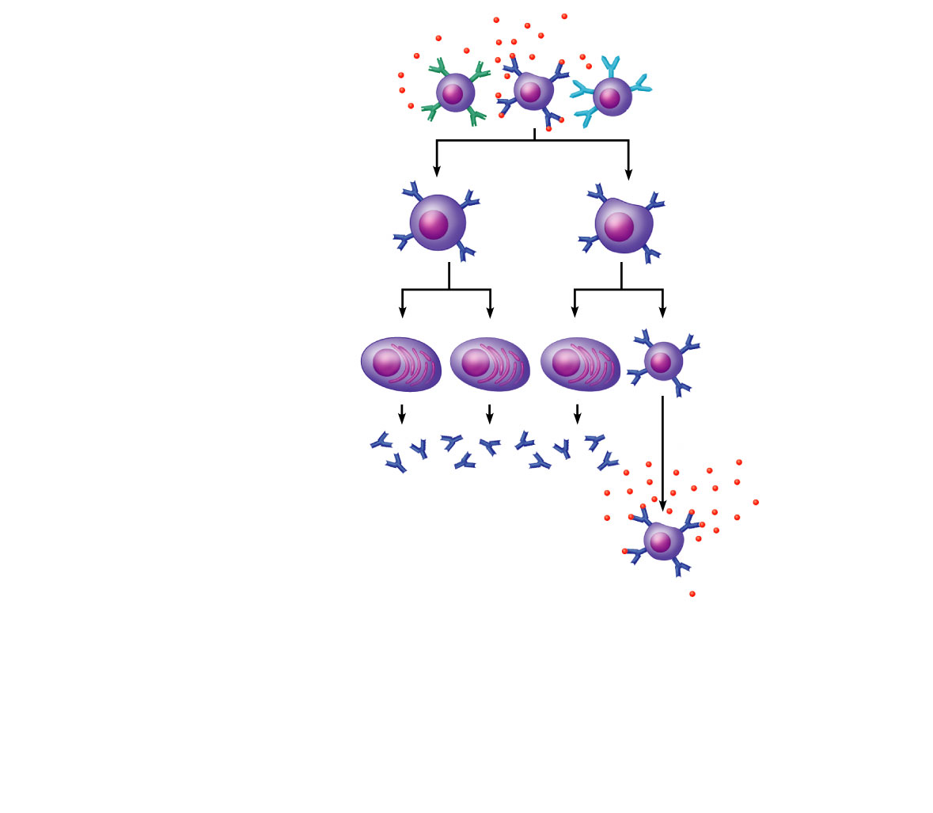
Primary Response
(initial encounter
with antigen)
Antigen
Antigen binding
to a receptor on a
specific B lymphocyte
(B lymphocytes with
non-complementary
receptors remain
inactive)
Proliferation to
form a clone
B lymphoblasts
Plasma
cells
Memory
B cell
Secreted
antibody
molecules
Secondary Response
(can be years later)
Clone of cells
identical to
ancestral cells
Subsequent
challenge by
same antigen

Slide 104
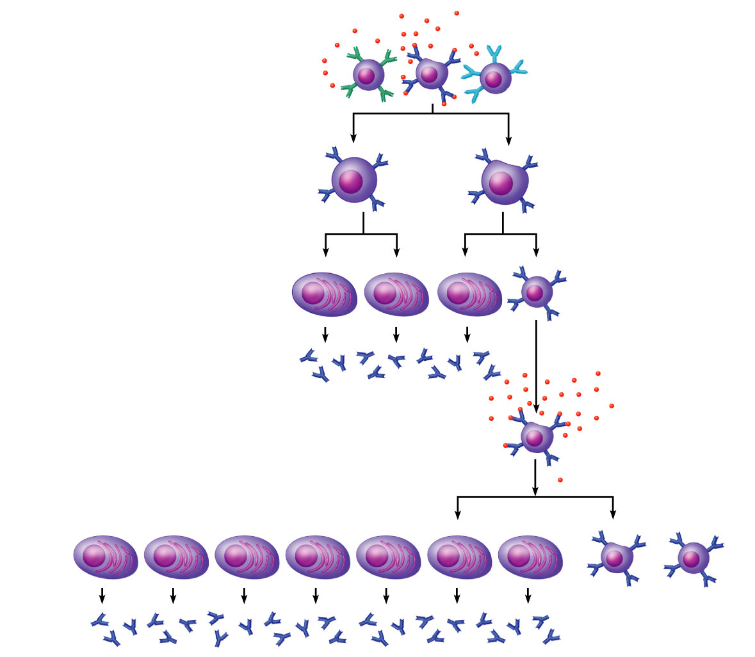
Primary Response
(initial encounter
with antigen)
Antigen
Antigen binding
to a receptor on a
specific B lymphocyte
(B lymphocytes with
non-complementary
receptors remain
inactive)
Proliferation to
form a clone
B lymphoblasts
Plasma
cells
Memory
B cell
Secreted
antibody
molecules
Secondary Response
(can be years later)
Clone of cells
identical to
ancestral cells
Subsequent
challenge by
same antigen
Plasma
cells
Secreted
antibody
molecules
Memory
B cells

Slide 105
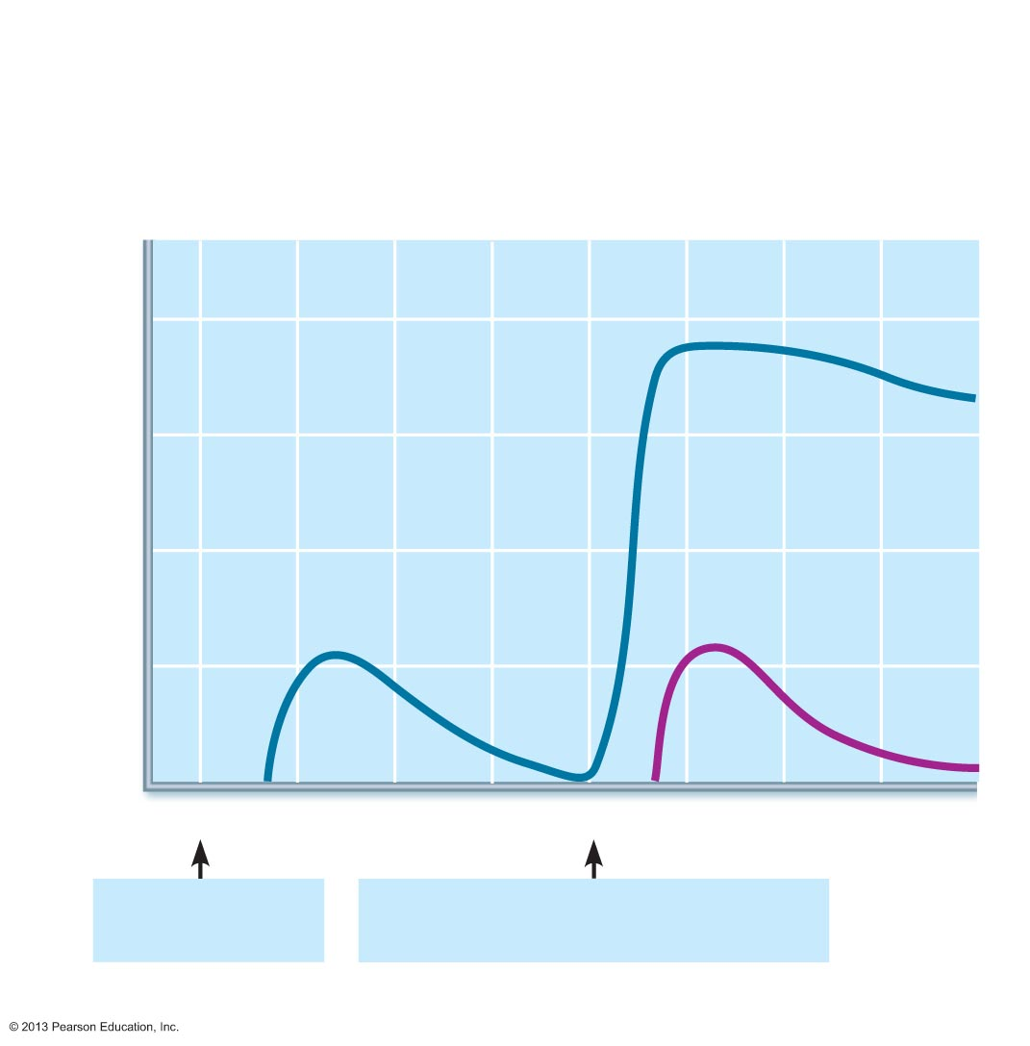
Figure 21.12 Primary and secondary humoral responses.
Secondary immune response to
antigen A is faster and larger; primary
immune response to antigen B is
similar to that for antigen A.
Primary immune
response to antigen
A occurs after a delay.
10⁴
10³
Antibody titer (antibody concentration)
in plasma (arbitrary units)
10²
10¹
Anti-
Bodies
to B
Anti-
Bodies
to A
10⁰
0
7
14
21
28
35
42
49
56
First exposure
to antigen A
Second exposure to antigen A;
first exposure to antigen B
Time (days)

Slide 106
Active Humoral Immunity
When B cells encounter antigens and produce specific antibodies against them
Two types of active humoral immunity:
  Naturally acquired
    response to bacterial or viral infection
    Exposure to actual pathogen
  Artificially acquired
    response to vaccine of dead or attenuated pathogens
    Exposure to antigens, but not the actual pathogen

Slide 107
Active Humoral Immunity
Vaccines
  Most of dead or attenuated pathogens
  Spare us symptoms of primary response
  Provide antigenic determinants that are immunogenic and reactive

Slide 108
Passive Humoral Immunity
Antibodies given rather than made
B cells are not challenged by antigens
  No plasma cells or antibodies formed
Immunological memory does not occur
Protection ends when antibodies degrade

Slide 109
Passive Humoral Immunity
Two types
  Naturally acquired
    antibodies delivered to fetus via placenta or to infant through milk
  Artificially acquired
    Introduction of antibodies intravenously
    Protection immediate but ends when antibodies naturally degrade in body

Slide 110
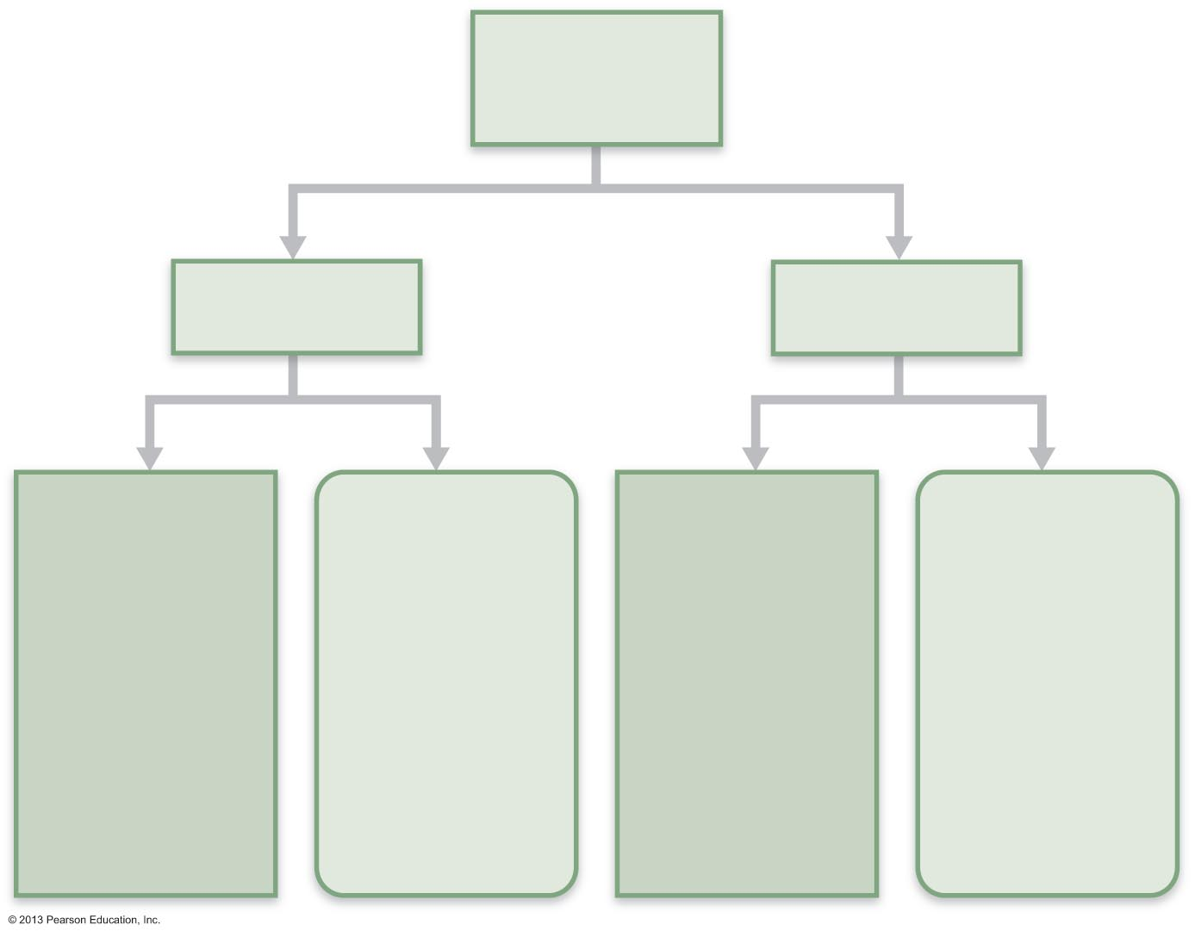
Figure 21.13 Active and passive humoral immunity.
Humoral
immunity
Active
Passive
Naturally
acquired
Artificially
acquired
Naturally
acquired
Artificially
acquired
Infection;
contact
with
pathogen
Vaccine;
dead or
attenuated
pathogens
Antibodies
passed from
mother to
fetus via
placenta; or
to infant in
her milk
Injection of
exogenous
antibodies
(gamma
globulin)

Slide 111
Antibodies
Immunoglobulins
  gamma globulin portion of blood
Proteins secreted by plasma cells
Capable of binding specifically with antigen detected by B cells
Grouped into one of five Ig classes

Slide 112
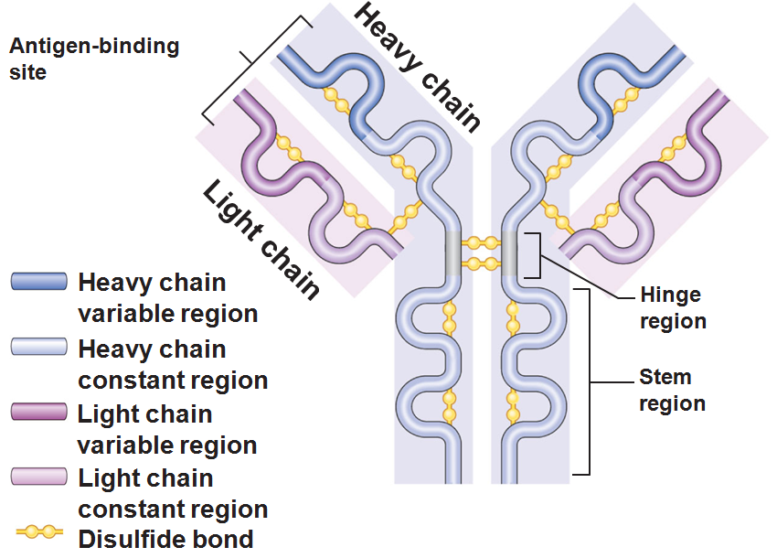
Basic Antibody Structure
T-or Y-shaped monomer
  four linked polypeptide chains
Two identical heavy chains
Two identical light chains

Slide 113
Basic Antibody Structure
Variable (V) regions of each arm combine to form two identical antigen-binding sites
Constant (C) region of stem determines
  The antibody class (IgM, IgA, IgD, IgG, or IgE)
  The cells and chemicals that the antibody can bind to
  How the antibody class functions in antigen elimination

Slide 114
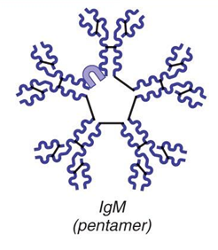
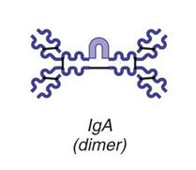
Classes of Antibodies
IgM
  A pentamer; first antibody released
  Potent agglutinating agent
  Readily fixes and activates complement
IgA (secretory IgA)
  Monomer or dimer; in mucus and other secretions
  Helps prevent entry of pathogens

Slide 115


Classes of Antibodies
IgD
  Monomer attached to the surface of B cells
  Functions as a B cell receptor
IgG
  Monomer; 75–85% of antibodies in plasma
  From secondary and late primary responses
  Crosses the placental barrier

Slide 116

Classes of Antibodies
IgE
  Monomer active in some allergies and parasitic infections
  Causes mast cells and basophils to release histamine

Slide 117
Antibody Targets
Antibodies inactivate and tag antigens
  Form antigen-antibody (immune) complexes
Defensive mechanisms used by antibodies
  Precipitation
  Lysis by Complement fixation
  Agglutination
  Neutralization
  Memory tool: Think “P.L.A.N” of attack

Slide 118
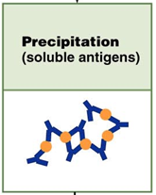
Precipitation
Soluble molecules are cross-linked
Complexes precipitate and are subject to phagocytosis

Slide 119
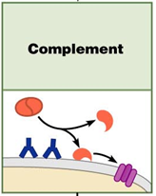
Complement Fixation and Activation
Main antibody defense against cellular antigens
Several antibodies bind close together on a cellular antigen
Their complement-binding sites trigger complement fixation into the cell’s surface
Complement triggers cell lysis

Slide 120
Complement Fixation and Activation
Activated complement functions
  Amplifies the inflammatory response
  Opsonization
  Enlists more and more defensive elements

Slide 121
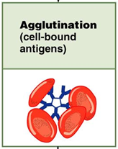
Agglutination
Antibodies bind the same determinant on more than one cell-bound antigen
Cross-linked antigen-antibody complexes agglutinate
  Example: clumping of mismatched blood cells

Slide 122
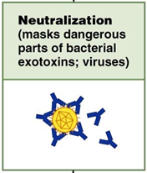
Neutralization
Simplest mechanism
Antibodies block specific sites on viruses or bacterial exotoxins
Prevent these antigens from binding to receptors on tissue cells
Antigen-antibody complexes undergo phagocytosis

Slide 123
Summary of Antibody Actions
Antigen-antibody complexes do not destroy antigens; prepare them for destruction by innate defenses
Antibodies do not invade solid tissue unless lesion present
Can act intracellularly if attached to virus before it enters cell
  Activate mechanisms that destroy virus

Slide 124
Cell-Mediated Immune Response
T cells provide defense against intracellular antigens
  Two types of surface receptors of T cells
      CD4 or CD8
      Play a role in T cell interactions with other cells

Slide 125
Cell-Mediated Immune Response
Major types of T cells
  CD4 cells become helper T cells (T_{H}) when activated
  CD8 cells become cytotoxic T cells (T_{C}) that destroy cells harboring foreign antigens
Other types of T cells
  Regulatory T cells (T_{REG})
  Memory T cells

Slide 126
Comparison of Humoral and Cell-Mediated Response
Antibodies of the humoral response
  The simplest ammunition of the immune response
Targets
  Bacteria and molecules in extracellular environments (body secretions, tissue fluid, blood, and lymph)

Slide 127
Comparison of Humoral and Cell-Mediated Response
T cells of the cell-mediated response
  Recognize and respond only to processed fragments of antigen displayed on the surface of body cells
Targets
  Body cells infected by viruses or bacteria
  Abnormal or cancerous cells
  Cells of infused or transplanted foreign tissue

Slide 128
Antigen Recognition
Immunocompetent T cells are activated when their surface receptors bind to a recognized antigen: nonself
T cells must simultaneously recognize
  Nonself : the antigen
  Self: an MHC protein of a body cell

Slide 129

Antigen Processing
Please note that due to differing operating systems, some animations will not appear until the presentation is viewed in Presentation Mode (Slide Show view). You may see blank slides in the “Normal” or “Slide Sorter” views. All animations will appear after viewing in Presentation Mode and playing each animation. Most animations will require the latest version of the Flash Player, which is available at http://get.adobe.com/flashplayer.
Notes:
Antigen processing,

Slide 130
MHC Proteins
Two types of MHC proteins are important to T cell activation
  Class I MHC proteins
    displayed by all cells except RBCs
  Class II MHC proteins
    displayed by APCs: dendritic cells, macrophages and B cells

Slide 131
Class I MHC Proteins
Bind with fragment of a protein synthesized in the cell (endogenous antigen)
Endogenous antigen is a self-antigen in a normal cell;
  Would be a nonself antigen in an infected or abnormal cell
Informs cytotoxic T cells of the presence of microorganisms hiding in cells

Slide 132
Class II MHC Proteins
Bind with fragments of exogenous antigens that have been engulfed and broken down
Recognized by helper T cells

Slide 133
T cell activation: step one
Phagocytic cell engulfs material
Becomes APC: antigen presenting cell
MHC protein will present the antigen on the APC surface
T cells will bind to the antigen on the APC
  Helper T (CD4) cells bind to class II MHC
  Cytotoxic T (CD8) cells will be activated through class I MHC

Slide 134
T cell activation: step two
Once the T cell has found the MHC and the antigen, it needs a few more signals from the APC
  Co-stimulatory signals
    Surface proteins on the APC help to activate T cells
    Cytokines (Interleukins 1 and 2) are released and cause the T cell to activate and differentiate
      Results in clone formation

Slide 135
Cytokines
Cytokines
  General term for mediators that influence cell development, differentiation and response
  Interleukin 1 (IL-1)
    Released by macrophages
    Stimulates T cells to release IL-2
    Synthesizes more receptors for IL-2
  Interleukin 2 (Il-2)
    Growth factor
    Encourages activated T cells to divide rapidly

Slide 136
Roles of Helper T(T_{H}) Cells
Play a central role in the adaptive immune response
Once primed by APC presentation of antigen, they
  Help activate T and B cells
  Induce T and B cell proliferation
  Activate macrophages and recruit other immune cells
Without T_{H}, there is no immune response

Slide 137
Helper T Cells
Interact directly with B cells
Stimulate B cells to divide more rapidly and begin antibody formation
Most antigens require T_{H} co-stimulation to activate B cells

Slide 138

Helper T Cells
Please note that due to differing operating systems, some animations will not appear until the presentation is viewed in Presentation Mode (Slide Show view). You may see blank slides in the “Normal” or “Slide Sorter” views. All animations will appear after viewing in Presentation Mode and playing each animation. Most animations will require the latest version of the Flash Player, which is available at http://get.adobe.com/flashplayer.
Notes:
Helper T cells

Slide 139
Roles of Cytotoxic T(T_{C}) Cells
Directly attack and kill other cells
Activated T_{C} cells circulate in blood and lymph and lymphoid organs in search of body cells displaying antigen they recognize

Slide 140
Roles of Cytotoxic T(T_{C}) Cells
Targets
  Virus-infected cells
  Cells with intracellular bacteria or parasites
  Cancer cells
  Foreign cells (transfusions or transplants)

Slide 141
Cytotoxic T Cells
Bind to a self-nonself complex
Can destroy all infected or abnormal cells

Slide 142
Cytotoxic T Cells
Lethal hit
  T_{c} cell releases perforins and granzymes by exocytosis
  Perforins create pores through which granzymes enter the target cell
  Granzymes stimulate apoptosis

Slide 143

Cytotoxic Cells
Please note that due to differing operating systems, some animations will not appear until the presentation is viewed in Presentation Mode (Slide Show view). You may see blank slides in the “Normal” or “Slide Sorter” views. All animations will appear after viewing in Presentation Mode and playing each animation. Most animations will require the latest version of the Flash Player, which is available at http://get.adobe.com/flashplayer.
Notes:
Cytotoxic T cells

Slide 144
Natural Killer Cells
Recognize other signs of abnormality
  Lack of class I MHC
  Antibody coating a target cell
  Different surface marker on stressed cells
Use the same key mechanisms as Tc cells for killing their target cells

Slide 145
Regulatory T (T_{Reg}) Cells
Dampen the immune response by direct contact or by inhibitory cytokines
Important in preventing autoimmune reactions

Slide 146
Organ Transplants
Four varieties
  Autografts:
    from one body site to another in the same person
  Isografts:
    between identical twins
  Allografts:
    between individuals who are not identical twins
  Xenografts:
    from another animal species

Slide 147
Prevention of Rejection
Depends on the similarity of the tissues
Patient is treated with immunosuppressive therapy
  Corticosteroid drugs to suppress inflammation
  Antiproliferative drugs
  Immunosuppressant drugs
Many of these have severe side effects

Slide 148
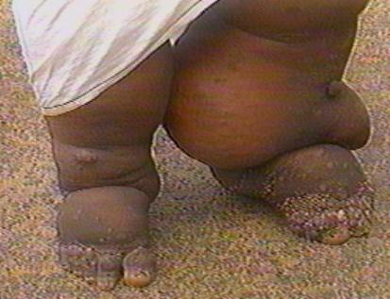
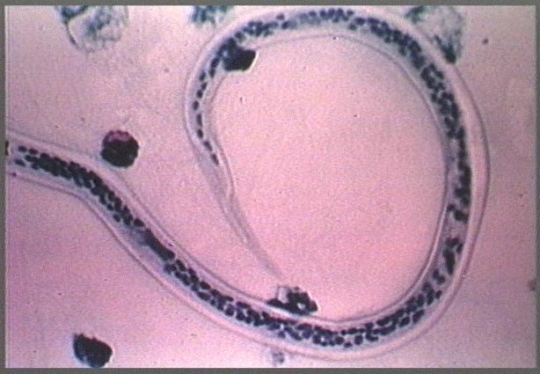
Clinical Terms
Elephantiasis
  Caused by parasitic roundworms invading the lymphatic system in the lower extremities
    Lymphatic filariasis
  Results in lymphatic blockage and edema
    Lower limbs and scrotum
    May be a combination of
    lymph blockage and immune
    response to the parasite
  Typically a tropical disease

Slide 149
Hodgkin’s disease
Lymphoid tissue malignancy
  Cancerous growth of cells in the lymph system
  Symptoms:
    Swollen, nontender lymph nodes
    Fatigue
    Fever
    Night sweats

Slide 150
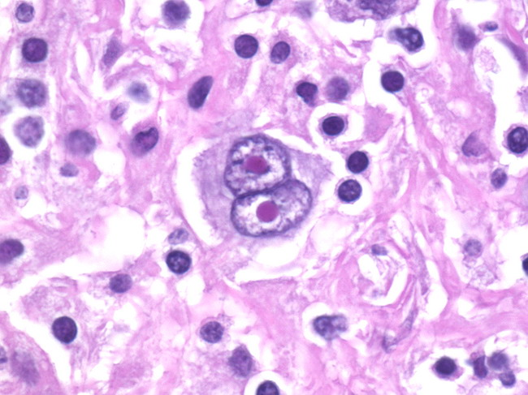
Hodgkin’s disease
Characterized by Reed Sternberg Cells
  Thought to be a malignant B lymphocyte
  Treatment:
    Chemotherapy and radiation
    High cure rate

Slide 151
Non-Hodgkin’s lymphoma
Includes all cancers of lymphoid tissue except Hodgkin’s disease
Uncontrolled multiplication and metastasis of undifferentiated lymphocytes
  Swelling of they lymph nodes
  Spleen
  Peyer’s patches
  Is the 5th most common type of cancer

Slide 152
Lymphoma
General term
Any tumor of the lymphoid tissue
  Benign
  Malignant

Slide 153
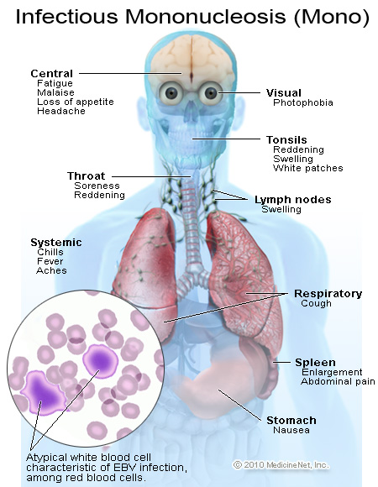
Mononucleosis
Viral disease “mono”
Caused by Epstein-Barr Virus
  Present in saliva and mucus
    “kissing disease”
    Also passed by coughing
  Virus attacks B lymphocytes → activation of T lymphocytes which attack infected B cells
Symptoms
  Fatigue
  Fever
  Sore throat
  Swollen lymph nodes
  Duration: 4-6 weeks

Slide 154
Hypersensitivities
Immune responses to perceived (otherwise harmless) threat cause tissue damage
Different types distinguished by
  Their time course
  Whether antibodies or T cells involved
Antibodies cause immediate and subacute hypersensitivities
T cells cause delayed hypersensitivity

Slide 155
Immediate Hypersensitivity
Acute (type I) hypersensitivities (allergies) begin in seconds after contact with allergen
Initial contact is asymptomatic but sensitizes person
Reaction may be local or systemic

Slide 156
Immediate Hypersensitivity
The mechanism involves IL-4
  stimulates B cells to produce IgE
  IgE binds to mast cells and basophils
  flood of histamine release
  Results in inflammatory response
Later encounter with same allergen → allergic reaction

Slide 157
Immediate Hypersensitivities
Allergic reactions local or systemic
  Local
    mast cells of skin and respiratory and gastrointestinal mucosa
    Histamines → blood vessels dilated and leaky → runny nose, hives, watery eyes
      Asthma if allergen inhaled
    Antihistamines to control
  Systemic response is anaphylactic shock

Slide 158
Anaphylactic Shock
Systemic response to allergen that directly enters blood and circulates rapidly
Basophils and mast cells enlisted throughout body
Systemic histamine release may cause
  Constriction of bronchioles; tongue may swell
  Sudden vasodilation and fluid loss from bloodstream
    Circulatory collapse (hypotensive shock)
    death
Treatment: epinephrine

Slide 159
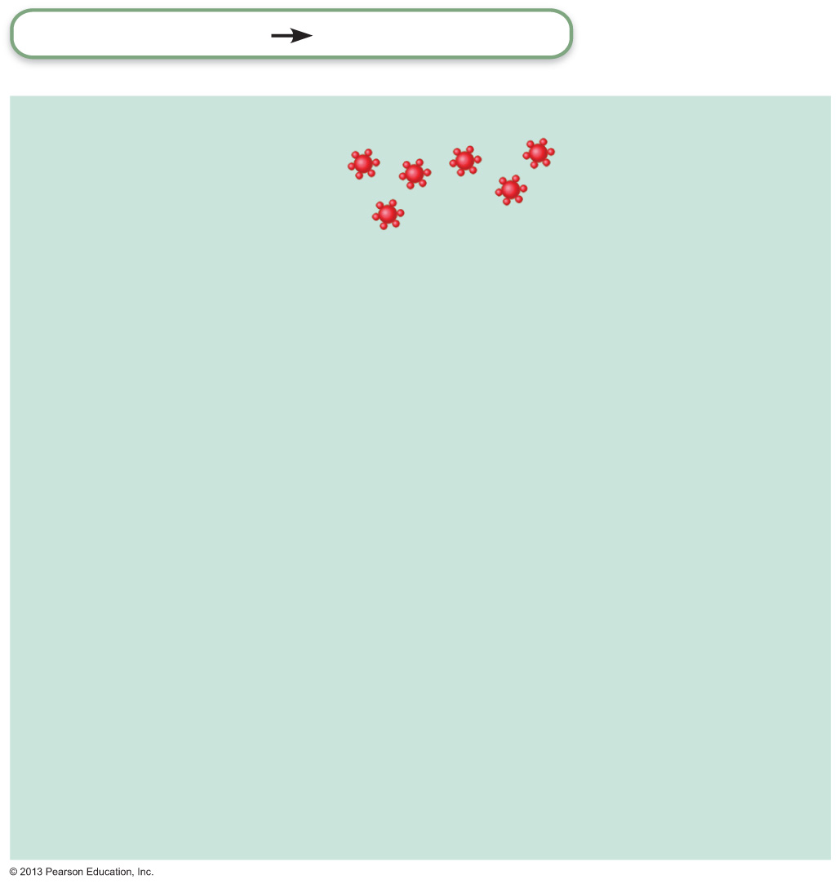
Figure 21.21 Mechanism of an acute allergic (immediate hypersensitivity) response.
Slide 2
Adaptive defenses
Humoral immunity
Sensitization stage
Antigen
Antigen (allergen)
invades body.
1

Slide 160
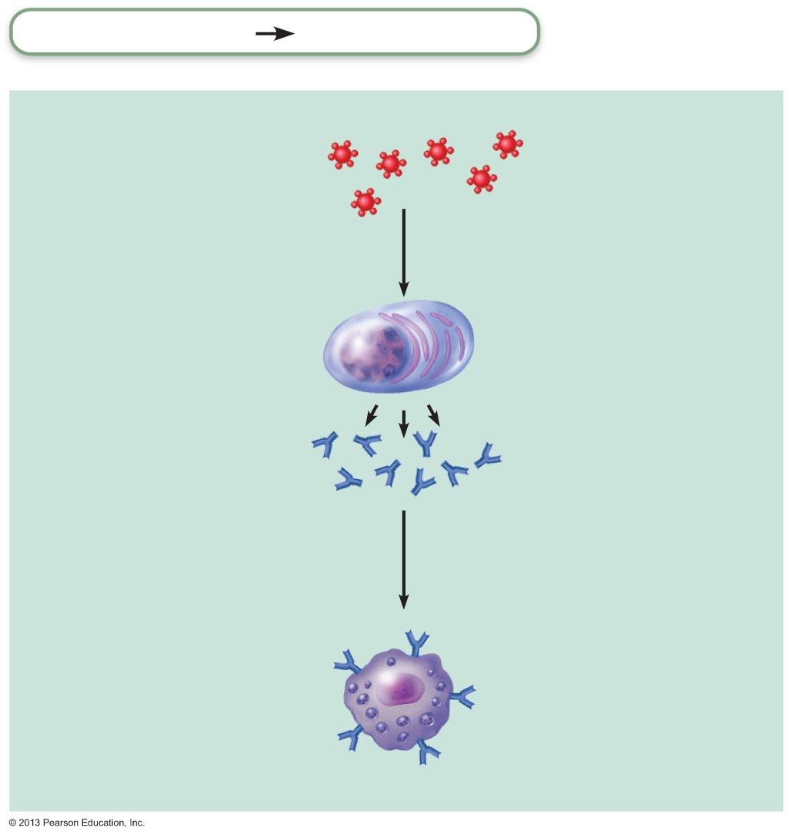
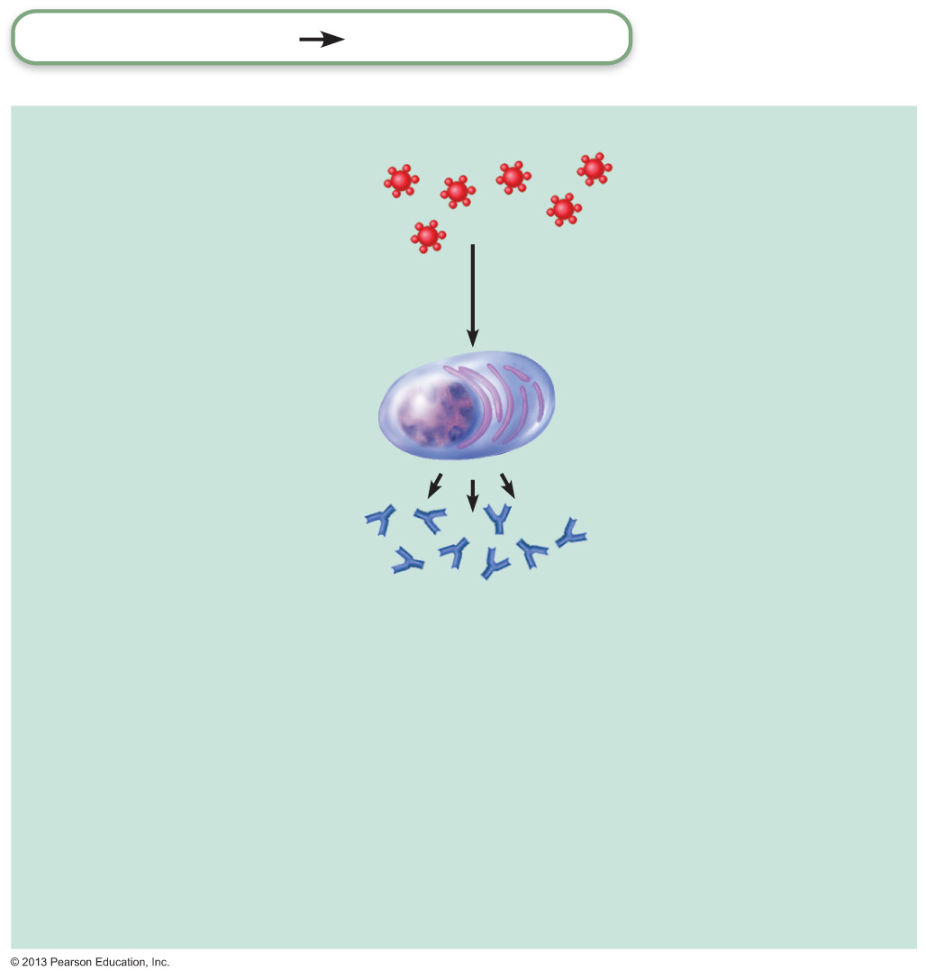
Figure 21.21 Mechanism of an acute allergic (immediate hypersensitivity) response.
Slide 3
Adaptive defenses
Humoral immunity
Sensitization stage
Antigen
Antigen (allergen)
invades body.
1
Plasma cells
produce large amounts of class
IgE antibodies against allergen.
2

Slide 161
Figure 21.21 Mechanism of an acute allergic (immediate hypersensitivity) response.
Slide 4
Adaptive defenses
Humoral immunity
Sensitization stage
Antigen
Antigen (allergen)
invades body.
1
Plasma cells
produce large amounts of class
IgE antibodies against allergen.
2
Mast cell with
fixed IgE
antibodies
3
IgE
IgE antibodies
attach to mast cells in
body tissues (and to
circulating basophils).
Granules
containing
histamine

Slide 162

Figure 21.21 Mechanism of an acute allergic (immediate hypersensitivity) response.
Slide 5
Subsequent (secondary)
responses
4
More of same
antigen invades body.

Slide 163
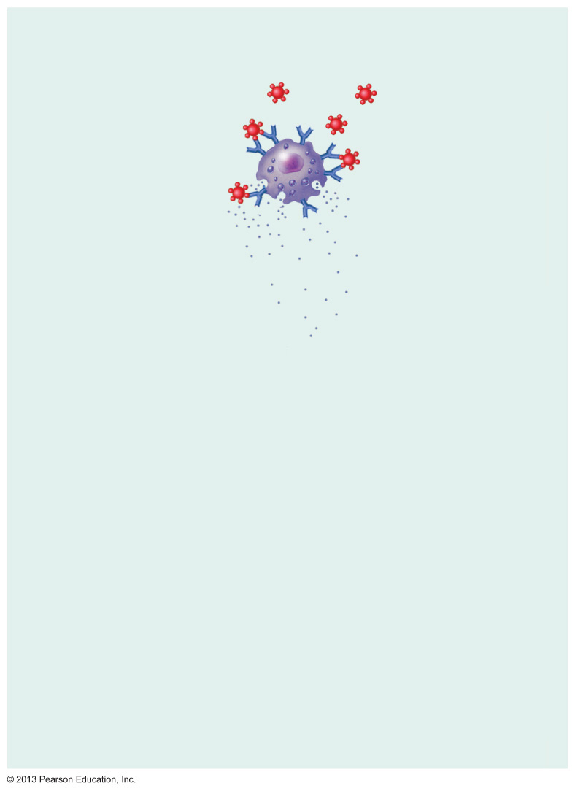
Figure 21.21 Mechanism of an acute allergic (immediate hypersensitivity) response.
Slide 6
Subsequent (secondary)
responses
4
More of same
antigen invades body.
Antigen combines
with IgE attached
to mast cells (and
basophils), which triggers degranulation and release
of histamine (and other chemicals).
Mast cell granules
release contents
after antigen binds
with IgE antibodies
5
Histamine

Slide 164
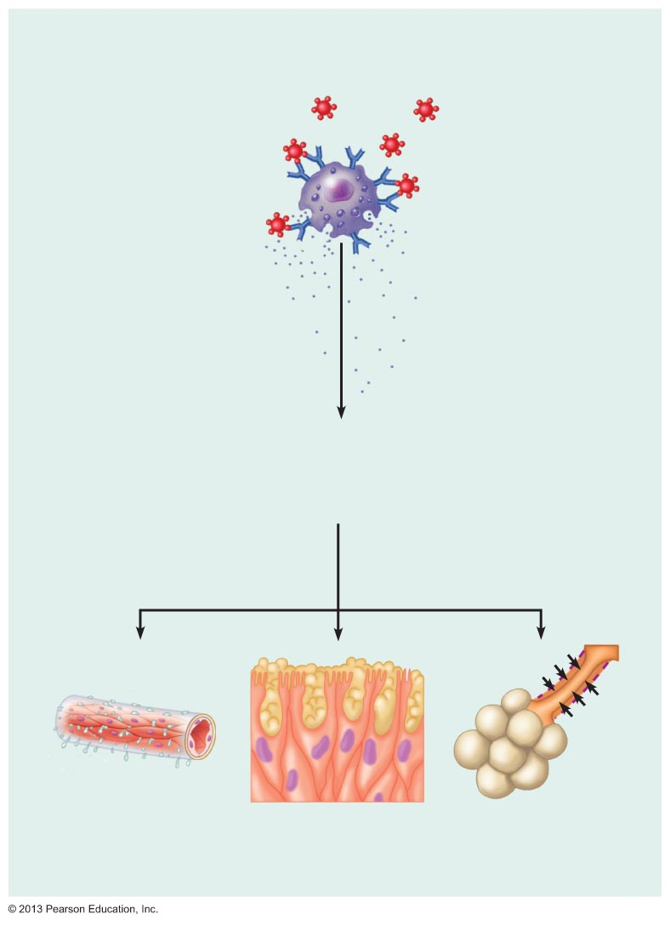
Figure 21.21 Mechanism of an acute allergic (immediate hypersensitivity) response.
Slide 7
Subsequent (secondary)
responses
4
More of same
antigen invades body.
Antigen combines
with IgE attached
to mast cells (and
basophils), which triggers degranulation and release
of histamine (and other chemicals).
Mast cell granules
release contents
after antigen binds
with IgE antibodies
5
Histamine
Histamine causes blood vessels to dilate and become leaky, which promotes edema; stimulates secretion of large amounts of mucus; and causes smooth muscles to contract. (If respiratory system is site of antigen entry, asthma may ensue.)
6
Outpouring of
fluid from
capillaries
Release of
mucus
Constriction of
small respiratory
passages
(bronchioles)

Slide 165
Delayed Hypersensitivities (Type IV)
Slow onset (one to three days)
Mechanism depends on helper T cells
  Cytokine-activated macrophages and cytotoxic T cells cause damage
Example:
  allergic contact dermatitis (e.g., poison ivy)
Agents act as haptens

