Slide 1
Hormone Control
Most hormones are controlled by _
A certain level of a hormone will shut down production of that same hormone or a related hormone

Slide 2
Endocrine Gland Stimulation
Three main types of stimuli for endocrine glands
1.
“Humor” used to refer to __________
Humoral stimuli refers to blood levels of ions and nutrients
Ex: __________________________________________________ act as a control for Parathyroid hormone release
Low blood calcium stimulates _

Slide 3
Endocrine Stimulation
2. Neural
With stress, sympathetic nerve fibers cause the release of norepinephrine and epinephrine from the adrenal medulla

Slide 4
Endocrine Stimulation
3. Hormonal
One type of hormone will act as a __________________________________________________ on another hormone
Hypothalamus releases “Releasing Hormones” to stimulate cells in the anterior pituitary
Also releases Inhibiting Hormones

Slide 5
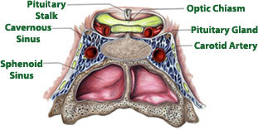
Pituitary gland
Also called _
Hypo:
Physis:
Hypophysis: “to grow under”
Located at _____________________________________
Attached to hypothalamus by pituitary stalk_
Like a pea on a stalk

Slide 6
Pituitary gland
Adenohypophysis

Slide 7
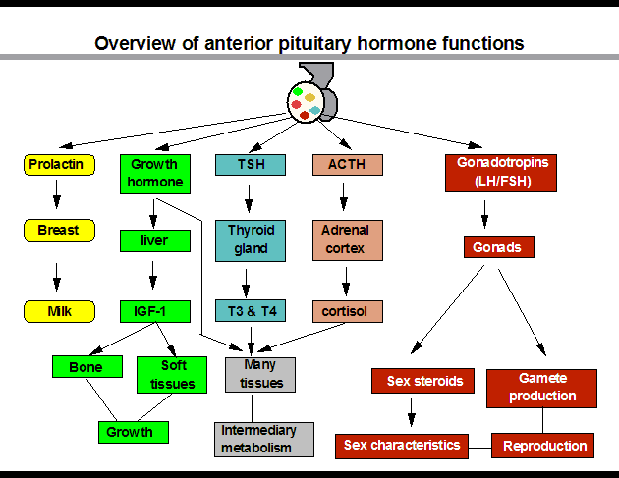

Slide 8
Pituitary gland
Neurohypophysis
Does not _______________________________________ hormones
Neurosecretory cells ________________________________ ADH and OT
Cell bodies of neurosecretory cells are located within the hypothalamus
Hormones release into bloodstream based on input from hypothalamus

Slide 9
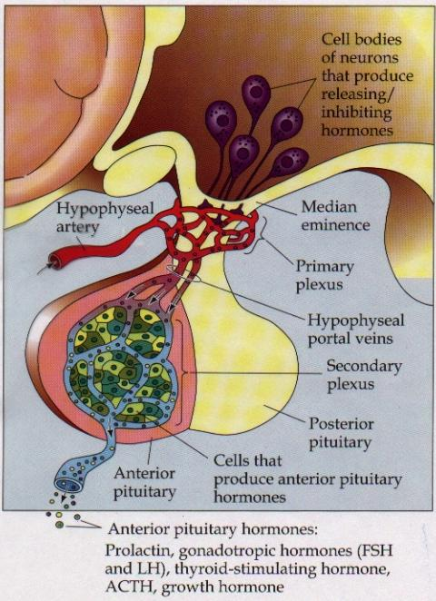
Hypophyseal portal
Causes release of hormones in _
Hypothalamus produces _
rH carried through capillaries into anterior pituitary

Slide 10
Anterior/Posterior
Hypothalamus to Anterior Pituitary
Blood pathway
Hypophyseal _
Hypothalamus to Posterior Pituitary
Modified neurons
Hypothalamic- _

Slide 11
Anterior Pituitary Hormones
Anterior pituitary houses five types of secretory cells
1. Somatotrophs:
2. Lactotrophs (Mammatrophs):
3. Thyrotropes:
4. Corticotropes:
5. Gonadotropes:

Slide 12
Growth Hormone
Protein (non steroidal)
Stimulates cells to _
Anabolic: _
Encourages use of _

Slide 13
Growth hormone
Control of GH
Secreted from _
Growth hormone releasing hormone
Stimulates secretion of GH
Growth Hormone Inhibiting Hormone = Somatostatin
Secreted from hypothalamus
(and the gut)
Inhibits secretion of GH
(and decreases gastrointestinal secretions)

Slide 14
Growth hormone
Direct and indirect stimulation
Direct:
Mobilizes fats and decreases glucose uptake
Indirect:
GH →
liver →
produces ____________________________________________ (IGF)→
Encourages _
encourages _

Slide 15
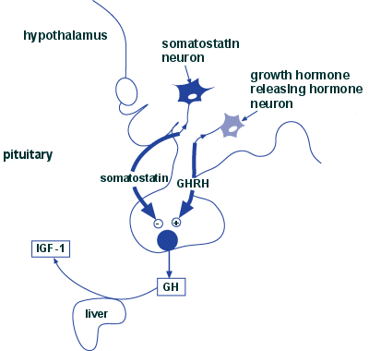

Slide 16
GH hyposecretion
GH ____________________________________ in childhood:
Body proportions and mental development normal
Maximum growth: _
If diagnosed before puberty, GH can be given supplementally

Slide 17
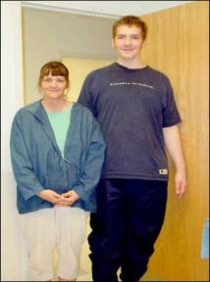
GH hypersecretions
GH oversecretion
In childhood: _
May reach heights exceeding 8 feet
Typically from ____________________________ of pituitary gland
Epiphyseal plates open in long bones
Stimulation results in _

Slide 18
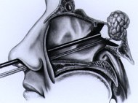
GH hypersecretions
In adults:
__________________________________________________, GH released, body can not grow taller, tends to _________________________________________________
Also associated with pituitary tumor

Slide 19
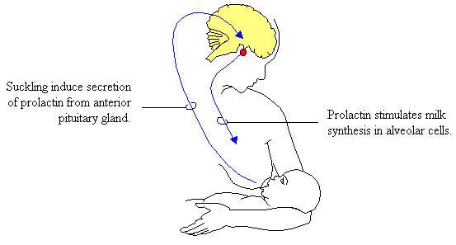
Prolactin
PRL: _
Pro: for
Lact: _
______________________________________________ in females
Excess may cause _

Slide 20
Prolactin
_______________________________________ regulates prolactin secretion
PIH: prolactin release inhibiting hormone
Reduces secretion of prolactin
PRF: Prolactin releasing factor
Thought to stimulate PRL, but not yet been identified in the body

Slide 21
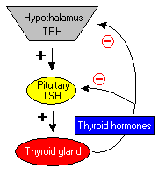
Thyroid Stimulating Hormone
Called _
Glycoprotein
Controls secretions of hormones from thyroid
Increased TSH: _

Slide 22
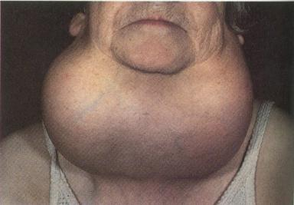
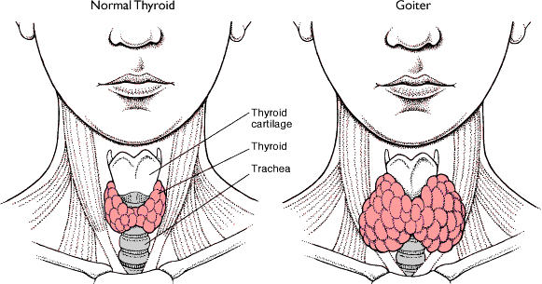
Goiter
Causes of Goiter
Hyperthyroidism
Hypothyroidism
HCG

Slide 23
TSH regulation
TRH: thyrotropin-releasing Hormone
Presence of thyroid hormones _
Inhibits release of _
As thyroid hormones increase → TSH and TRH decrease

Slide 24
ACTH: Adrenocorticotropic Hormone
Peptide
Controls other hormones that are released from the _
Adrenal hormones _
Regulation: _
Released from hypothalamus cortical hormones are low
Has daily rhythm: increased levels in morning before waking

Slide 25
FSH: Follicle stimulating hormone
Glycoprotein
Gonadotropins: target the gonads
Follicle:

Slide 26
FSH
FSH:
stimulates _______________________________________ to mature egg
Stimulates follicular cells to _
FSH:
Stimulates production of _

Slide 27
LH: Luteinizing hormone
Glycoprotein
Promotes _____________________________________ in both male and female
_____________________________________: essential for release of egg: ovulation

Slide 28
FSH and LH
Regulation
Controlled by _
Gonadotropin releasing Hormone
Secreted from the hypothalamus
GnRH _

Slide 29
Posterior pituitary
Composed of nerve fibers and _
Neurosecretory cells: secretions _
Hormones:
ADH antidiuretic
OT: oxytocin

Slide 30
Posterior pituitary hormones
Neurons in hypothalamus produce _
Hormones travel down axons
From hypothalamus → pituitary stalk → posterior pituitary → stored in _
Released when _____________________________ passes through axon

Slide 31
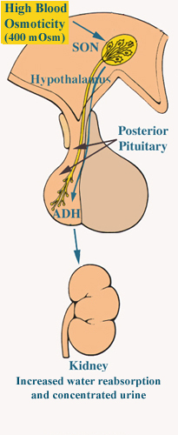
ADH
Short polypeptide
____________________________: increases urine production
Antidiuretic: _
ADH causes kidneys to ___________________________ excreted

Slide 32
ADH and alcohol
Alcohol consumption _____________________________________
Increased alcohol → _____________________________________ → more water moved through kidneys → _
Excess alcohol consumption can _

Slide 33
ADH
Also called _______________________________ for its effects on _____________________________________ in blood vessels
Can increase vascular resistance → increase blood pressure
Secretion increases following severe blood loss
Helps to _

Slide 34
ADH
Regulation
Hypothalamus has ________________________________________ that sense changes in body fluid concentrations
______________________________________: solutes in blood more concentrated → sensed by osmoreceptors →posterior pituitary will release ADH → kidneys retain water → solutes in blood become less concentrated

Slide 35
Oxytocin
Also has ___________________________________, but not as strong as ADH
Causes ___________________________________:
Uterine wall: childbirth
One of the few _______________________________________________ systems:
uterus stretches → signals hypothalamus to release Oxytocin → causes uterine contraction

Slide 36
Oxytocin
Breasts
OT contracts _
Forces milk from glands _
Suckling: mechanical stimulation → stimulates hypothalamus → release of Oxytocin → _

Slide 37
Oxytocin
Males
May play a role in _
Your textbook refers to it as a “Cuddle Hormone” in non-sexual relationships
Present in posterior pituitary.

