Slide 1
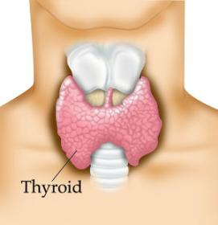
Thyroid gland
Two lateral lobes
Connected by _
Composed of secretory parts called _
Follicular cells produce and secrete hormones that can be _
____________________________________________: located outside of follicles

Slide 2
Thyroid
Produces three hormones
Thyroxine T4
Triiodothyronine T3
________________________________________________ (extrafollicular) cells

Slide 3
Thyroid hormones
T3 and T4
Regulate metabolism of _
Determine how many calories body needs for Basal Metabolic Rate
Maturation of nervous system
Controlled by _____________from _

Slide 4
Thyroid hormones
Follicular cells require _______________________________________ to produce T3 and T4
Iodine absorbed from intestine carried to thyroid gland
__________________________________________ moves it into follicular cells
Iodine and _________________________________ used to synthesize thyroid hormones

Slide 5
Thyroid hormones
Thyroid hormones enter blood and _
Transported to body cells

Slide 6
Thyroid hormones
Parafollicular (Extrafollicular)
Role in blood calcium and phosphate ion concentrations
_________________________________________ → less bone minerals put into bloodstream → _________________________________________ and phosphate concentration in blood

Slide 7
Calcitonin
Calcitonin is _
Seen following meals
May protect bones of mother from resorption during _
Make sure that the fetal need are not met by robbing the mother’s bones of calcium

Slide 8
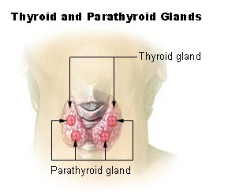
Parathyroid
Located on ___________________________________ of thyroid gland
Discovered accidentally
Patients with thyroid surgery in which the thyroid was completely removed would have __________________________ __________________________________________________________ They eventually realized there was more than just the Thyroid gland.
Four:
two superior
two inferior
Produces:
parathyroid hormone

Slide 9
PTH
Protein hormone
Decreased blood phosphate ion concentration
PTH stimulates bone resorption by osteoclasts

Slide 10
PTH
________________________________ stimulates absorption of calcium ions from intestine by _
Increased PTH →Increased Vitamin D → more calcium absorbed in intestines → _

Slide 11
Calcitonin and PTH
Calcitonin (thyroid) and PTH (parathyroid)
Have _
Maintain _

Slide 12
Adrenal Glands
Associated with the _
Two portions
Adrenal medulla: _
_________________________: outer portion

Slide 13
Adrenal medulla
Closely associated _
Adrenal medullary cells are _
Central nervous system → sympathetic nervous system: preganglionic fiber → postganglionic fiber: in this case adrenal medulla

Slide 14
Hormones of Adrenal Medulla
Adrenal medulla cells: _
Produce epinephrine and norepinephrine
Epinephrine is _

Slide 15
Adrenal Medulla
Effects of epinephrine and norepinephrine are similar to sympathetic nerve stimulation
Increased _
Increased breath rate
____________________________________ activity of digestive system
Duration: up to 10 X longer than neurotransmitter effects
Removed from the tissues slowly

Slide 16
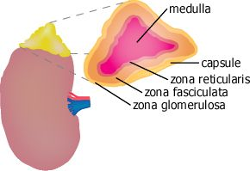
Adrenal cortex
Makes up _
Divided into _____________________________ of epithelial layers
Mineralocorticoids
Balance minerals and water in blood
glucocorticoids
Sex hormones

Slide 17
Adrenal cortex hormones
Mineralocorticoid
Glucocorticoids
Help to maintain blood glucose and blood pressure
Gluconeogenesis: formation of glucose from fats and proteins
Sex hormones
Adrenal testosterone influences female sex drive

Slide 18
Cortisol
Regulation:
Hypothalamus:
releases _
Anterior pituitary:
ACTH Adrenocorticotrophic hormone
adrenal cortex produces _
Cortisol inhibits _

Slide 19
Pancreas
Two types of tissues for secretion
______________________________________: digestive juices deposited into the duodenum
______________________________________: releases hormones: insulin, glucagon, and somatostatin

Slide 20
Pancreas
polypeptide
Stimulates liver to _
Glycogenolysis
Converts non-carbs into glucose
Stimulates breakdown of fats into _

Slide 21
Pancreas
Low blood sugar → release of glucagon from _____________________________________→
Glycogen broken into glucose
Gluconeogenesis
_________________________________________ to blood stream
Blood glucose returns to normal and glucagon release inhibited

Slide 22
Pancreas
Insulin
Protein
Effect is _
Stimulates liver to _
Inhibits conversion of non carbs into glucose
Moves glucose _
Decreases the concentration of blood glucose

Slide 23
Pancreas
Insulin
Blood glucose high following a meal → ______________________________ release insulin →
Promotes glycogen formation
Moves glucose into cells
Blood _

Slide 24
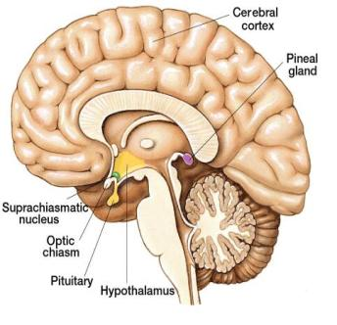
Pineal gland
Small and oval
Located between cerebral hemispheres
Near third ventricle
Consists of _

Slide 25
Pineal gland
Hormone:
Synthesized from _
Controlled by _
_________________________________________ → nerve impulses from retina → hypothalamus →spinal cord → join sympathetic nerve fibers back to brain and pineal gland → _

Slide 26
Pineal gland
Dark → impulses from retina _____________________________ → melatonin _
Part of circadian rhythm
Fertility cycles in some mammals

Slide 27
Pineal gland
Melatonin can bind to receptors and _
Melatonin _______________________________ _____________________ from anterior pituitary
Helps to regulate female reproductive cycle
May also control onset of puberty

Slide 28
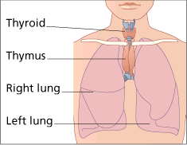
Thymus
Lies in _
Large in children
Diminishes with age
Secretes _______________________: hormones that affect production and _
Plays role in immune system

Slide 29
Other Structures
Heart
ANP:
Volume of blood increases→ _________________________________________________ → ANP released → sodium lost in kidneys → water lost in kidneys → _
Gastrointestinal tract
Along the mucosa of the GI tract
Many have _
Estrogen, progesterone, hCG

Slide 30
Other Structures
Erythropoetin
Eryth: red
Renin
Skin
Cholecalciferol
Adipose tissue
Functions in CNS for appetite control: satiety
Insulin antagonist

Slide 31
Terms: Ch 17
Eryth
Leuko:
Hem a/ato/o: blood
Ferr: iron
Cytes: cell
Poeisis:
Baso: base
Eosino: red acidic dye
Retic:
Blast:
a/an:

Slide 32
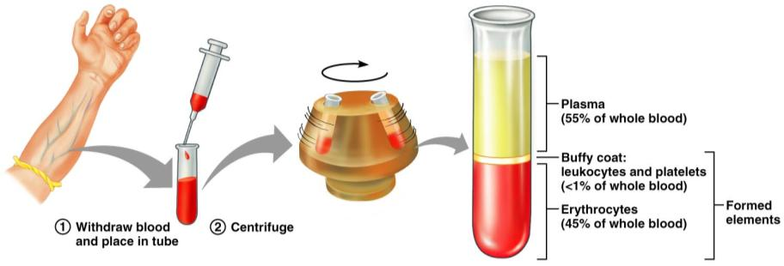
Blood
Info from blood can be clinically valuable
Blood sample is _
Hematocrit: HCT: is the _

Slide 33
Hematocrit
Men: 47 +/- 5 ml/100 ml
Women 42 +/- 5 ml/100 ml
Children 35-49 ml/100 ml

Slide 34
Blood
Plasma: the remaining _
55% by volume
Includes water, amino acids, proteins, carbohydrates, lipids, vitamins, hormones, electrolytes and cellular wastes

Slide 35
Functions

Slide 36
Functions
Distribution
______________________________________ from lungs
Nutrients _
____________________________________________ from cells to lungs or kidney
Hormones

Slide 37
Functions
Regulation
Maintains _
Carries _
Maintains _
Maintains fluid volume

Slide 38
Functions
Protection
Prevention of blood loss
Antibodies, complement proteins, White Blood Cells

