Slide 1
Blood Plasma
Mostly water that _
Nutrients, gas, hormone, wastes, ions, proteins
Most abundant solutes are the _

Slide 2
Plasma proteins
Most are _
exceptions: hormones and gamma globulins
Are proteins that are _____________________________________ or nutrients by the body

Slide 3
Plasma Proteins

Slide 4
Blood Plasma
Albumin
Aid in determining _
Regulates water movement between blood and tissues
Affects _
Transports bilirubin and free fatty acids

Slide 5
Dissolved plasma proteins
Globulins
Subdivided into
Alpha globulin
Beta globulin
Transports _

Slide 6
Dissolved Plasma Proteins
Fibrinogen
Primary role is _
Synthesized in the _
_____________________________________ plasma protein in terms of size

Slide 7
Origin of Blood cells
Blood cells originate in the _
Hemocytoblasts: a type of _

Slide 8
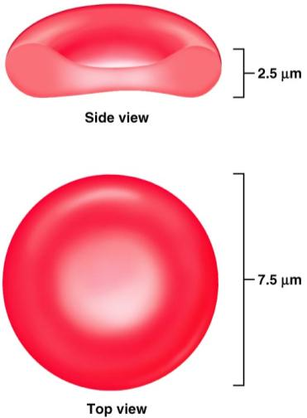
Erythrocytes
Shape effective for transporting gasses (oxygen, carbon dioxide)
Cell membrane is closer to the hemoglobin
Great for _
Greater _

Slide 9
Hemoglobin
Within the RBC the Hb transports the oxygen
Erythrocytes are more than _
When Hb combines with Oxygen it _
And turns _

Slide 10
Red Blood Cells?
Cells by definition have a nucleus.
RBCs when mature,
have no _
Have no _
More appropriately called _
Provides more space for Hb
Doesn’t consume the Oxygen it’s carrying

Slide 11
RBCs
Effect of having no nucleus:
Can not _____________________________________ (no DNA to base it on…)
Therefore, they _
Life span of a RBC is about 120 days

Slide 12
RBCs
Need to be flexible to navigate vessels
Can’t repair themselves
Become worn and damaged with use
Pass through the _____________________________________ where damaged cells are filtered and removed from the circulation.

Slide 13
Damaged RBCs
RBC _
Hb becomes exposed and break down
Composed of globin chains surrounding a heme group (Iron)
Heme group _
Biliverdin: _

Slide 14
Biliverdin
Biliverdin is eventually decomposed into
Bilirubin:
Think of a bruise. Consider the color changes it goes through as it heals.

Slide 15
Bilirubin
Both biliverdin and bilirubin _

Slide 16
Embryonic hematopoeisis
Red blood cell formation begins in the

Slide 17
Hematopoeisis
After birth, RBC formation takes place in the red bone marrow
Hemocytoblasts: hematopoietic stem cell
Hemocytoblast → ______________________________________________→ proerythroblast → early erythroblasts (produce lots of ribosomes) → late erythroblast _________________________________________________ (this is the stage where organelles and nucleus are lost) → ____________________________________________→ released into blood stream and mature in two days to erythrocytes

Slide 18
Erythropoeitin
Erythropoeitin: hormone that _
Small amount produced by __
Most comes from _
_____________________________________________stimulates release of erythropoietin

Slide 19
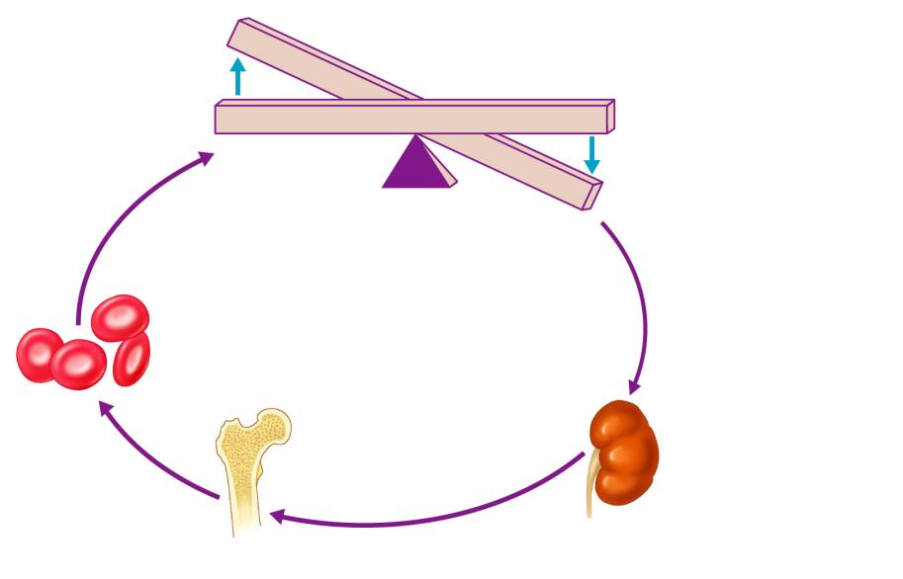
Imbalance
Start
Homeostasis: Normal blood oxygen levels
Stimulus: Hypoxia due to
decreased RBC count,
decreased amount of
hemoglobin, or decreased
availability of O₂
Imbalance
Increases
O₂-carrying
ability of blood
Reduces O₂ levels
in blood
Enhanced
erythropoiesis
increases
RBC count
Kidney (and liver to a smaller
extent) releases erythropoietin
Erythropoietin
stimulates red
bone marrow
Figure 17.6

Slide 20
Erythrocyte Disorders
Anemia
blood has _
It is a _________________________________________ rather than a disease itself
Blood oxygen levels cannot support normal metabolism
Signs/symptoms include _

Slide 21
Anemia: Insufficient Erythrocytes
Hemorrhagic anemia
Hemolytic anemia
destruction or inhibition of red bone marrow

Slide 22
Anemia: Decreased Hemoglobin Content
Iron-deficiency anemia results from:
A secondary result of _
Not enough ___________________in the diet
Impaired iron _
Pernicious anemia results from:
Deficiency of _
Lack of __________________________________________ needed for absorption of B₁₂

Slide 23
Anemia: Abnormal Hemoglobin
Thalassemias
absent or faulty globin chain in Hb
RBCs are _
Sickle-cell anemia
results from an abnormal Hb called HbS
HbS differs from Hb by _
This defect causes RBCs to become _

Slide 24
Polycythemia
Polycythemia
Increases _
HCT can reach _
Three main polycythemias are:
Polycythemia vera
Secondary polycythemia
Blood doping

Slide 25
White Blood Cells
Leuko: __________________ Cytes___________
Distinguishing characteristics:
Cytoplasm (granulocytes and agranulocytes)
Staining of the cytoplasm

Slide 26
Diapedesis
Leukocytes can _
Entering or leaving circulatory system
Will move to _
Will move by amoeboid motion
Cytoplasmic extensions
Follow a chemical trail

Slide 27
Granulocytes
A collection of white blood cells whose cytoplasm has a _____________________________________ when viewed under a microscope
Function: generally _
Generated in red bone marrow

Slide 28
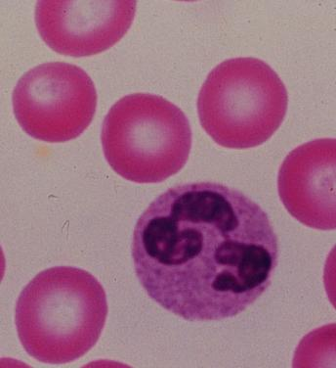
Granulocytes
Neutrophils
Appearance:
Very fine _
Multi-lobed nucleus
Aka: PML: Polymorphonuclear Leukocytes
Function
First WBCs to arrive at the infection site
Phagocytize bacteria and fungus

Slide 29
Neutrophils
Kill bacteria by process called _
Oxygen is metabolized to form _________________________________________ by the neutrophil
Able to ________________________________ offending bacteria

Slide 30
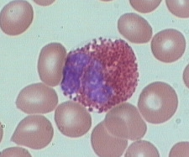
Granulocytes
Eosinophils
Eosin:
Phil: loving
Appearance:

Slide 31
Eosinophils
Function:
Lysosome-like: filled with _
tapeworms, flukes, pinworms, hookworms

Slide 32
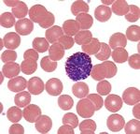
Granulocytes
Basophils
Baso: basic
Phils: loving
Appearance:
Bi-lobed nucleus
Fewer, but larger granules… _
Function
Promotes inflammation: histamines

Slide 33
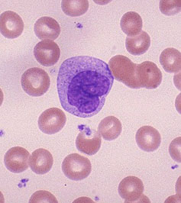
Agranulocytes
________________________develop in the bone marrow
Appearance:
__________________________. (2-3 times larger than RBC)
Nuclei is large and _

Slide 34
Agranulocytes
Monocytes
Function:
Become ________________________________________ as they leave the blood stream
Highly mobile, _
Phagocytize bacteria, viruses, cellular debris

Slide 35
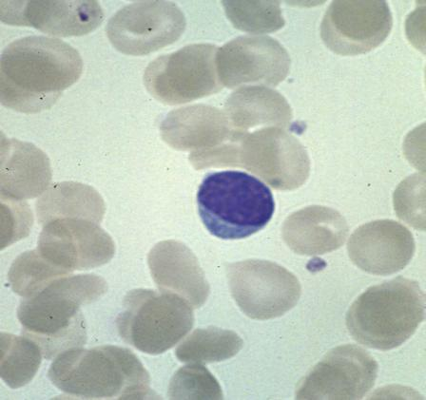
Agranulocytes
Lymphocytes ___________________________as well as lymph tissues
Appearance
About the same _____________________________
Mostly nucleus. Thin crescent of cytoplasm

Slide 36
Lymphocytes
Function:
_____________________________: cell mediated responses against _
______________________________: change into plasma cells which release antibodies

Slide 37
White Blood Cells
Distribution:
Neutrophils 54-62%
Eosinophils 1-3 %
Basophils 1%
Monocytes 3-9%
Lymphocytes 25-33%

