Slide 1
Leukopoeisis
___________________________________: production of white blood cells
Stimulated by chemical messengers
Two types of glycoproteins
Colony Stimulating Factors

Slide 2
Leukopoiesis
Hemocytoblast →
Will give rise to basophils, eosinophils, neutrophils, and monocytes
Will give rise to _

Slide 3
Leukopoiesis: granulocytes
Myeloid cells → ______________________________________ → promyelocytes →
_________________________________ myelocytye
_________________________________ myelocyte
_________________________________ myelocyte

Slide 4
Leukopoiesis: monocyte
Hemocytoblast → myeloid stem cell → myeloblast
Up to this point, no changes from the granular leukocytes
→ ___________________________________________ → monocyte

Slide 5
Leukopoiesis: Lymphocyte
Hemocytoblast →
__________________________________→
Lymphoblast →
__________________________________ →
Lymphocyte

Slide 6
White Blood Cell Counts
Percentages of the WBCs are of clinical value
Increased leukocytes (overall)
May indicate infection, exercise, strong emotions or loss of body fluids

Slide 7
White Blood Cell counts
Decreased Leukocytes
Penia: _
Flu, measles, mumps, chicken pox, AIDS, polio
___________________________________________, lead, arsenic or mercury poisoning

Slide 8
Leukemia
Group of cancerous conditions _
Increased _
Impairs bone marrow function
Severe _
Named according to the _
Myelocytic: myeloblast descendants: granulocytes and monocytes
Lymphocytic: lymphocytes

Slide 9
Leukemias
_______________________________________ advancing
Seen in _
Seen more in children
_______________________________________ advancing
Seen in later cells stages _
Seen more in elderly

Slide 10
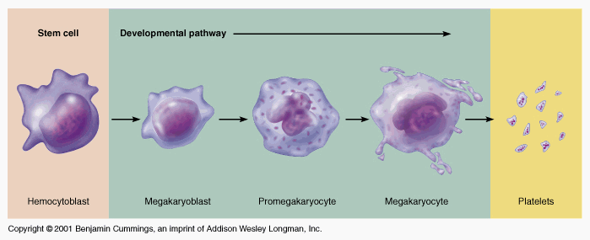
Platelets
fragments
Hemocytoblast→
________________________________________ →
_________________________________________ →
megakaryocyte →

Slide 11
Hemostasis
Heme: blood stasis: stopping
Process is fast, localized and controlled
Hemostasis causes

Slide 12
Vascular Spasm
Damage to blood vessel→ stimulates ________________________________________ → results in less blood loss
Allows for formation of _
Platelets release _______________________________ which further constricts the smooth muscle in the vessel wall.

Slide 13
Platelet Plug Formation
Platelets adhere to _
Particularly the __________________________________ in the connective tissue
Platelets + collagen→
change in shape
Becomes _
Effective for ______________________________ but not large ones

Slide 14
Blood Coagulation
A set of reactions in which blood is transformed _
Coagulation follows _

Slide 15
Blood coagulation
Blood coagulation is dependent on balance
The ________________________________ of pro-coagulants and anti-coagulants
Inability to synthesize procoagulants by the ______________________________________ results in severe bleeding disorders

Slide 16
Major event of coagulation
The ______________________________ of the plasma protein _
Fibrin is composed of insoluble threads

Slide 17
Extrinsic Clotting Factors
Triggered when contacts
Any _______________________________ outside the blood vessels

Slide 18
Extrinsic Clotting
Damaged tissues release thromboplastin also called Factor III
Depends also on _

Slide 19
Extrinsic Clotting
End result: Fibrinogen pieces _
Before: soluble
After:
Fibrin sticks to exposed surfaces, _____________________________________, and prevents blood loss

Slide 20
Intrinsic Clotting
Initiated by Factor VII aka Hageman Factor
Due to _________________________________ in the _
Foreign substances in the blood
Blood stored in _

Slide 21
Clots
Fibrin prevents blood loss by forming clots
Plasminogen converted to Plasmin
Plasmin _

Slide 22
Clots
Thrombus: _
DVT
Deep Vein Thrombosis
Embolus:
if a thrombus fragments or breaks loose and travels through the blood stream, it becomes an embolus

Slide 23
Clots
Embolism: the traveling embolus becomes lodged at a _
Pulmonary embolism: blood clot gets lodged in lung vessels

Slide 24
Hemostasis Disorders
Disseminated Intravascular Coagulation (DIC):
Residual blood cannot clot
Most common as:
A complication of pregnancy
A result of ___________________________________________ or incompatible blood transfusions

Slide 25
Hemostasis Disorders: Bleeding Disorders
Thrombocytopenia
condition where the number of _
Patients show petechiae due to _
Caused by suppression or destruction of bone marrow (e.g., malignancy, radiation)
Platelet counts less than 50,000/mm³ is diagnostic for this condition
Treated with _

Slide 26
Hemostasis Disorders: Bleeding Disorders
Hemophilias
hereditary bleeding disorders caused by lack of clotting factors
Symptoms include _

Slide 27
Hemostasis Disorders: Bleeding Disorders
Hemophilia A
____________________________________________ due to a deficiency of factor VIII
Hemophilia B
due to a deficiency of _
Hemophilia C
___________________________________________, due to a deficiency of factor XI

Slide 28
Transfusions
Whole blood transfusions
Used _
Rapid and voluminous blood loss
Infusions
_________________________________________ are transferred

Slide 29
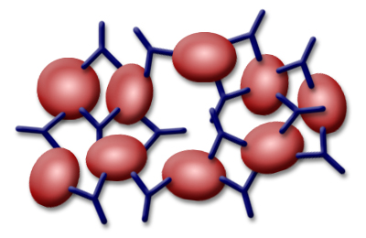
Antigens and Antibodies
Agglutination is caused by the interaction of _____________________________________ and the _

Slide 30
ABO
Type A Blood: Has _________________________________ on surface
Has _____________________________________ in blood plasma, Anti-B
Will agglutinate when exposed to Anti-A

Slide 31
ABO
Type B Blood: Has ______________________ on surface
Has Antibody A in blood plasma: Anti-A
Will _

Slide 32
ABO Blood groups
Type AB Blood: Has _
Has _
Will agglutinate when exposed to either

Slide 33
ABO Blood Groups
Type O Blood: Has neither antigen on the surface
Has both _

Slide 34
Rh Factor
Named after _
Antigen originally found in the monkey, later found in humans as Antigen D
If any of the rhesus antigens are present_
Antigen D

Slide 35
Rh –
If an Rh – person is exposed to Rh antigens, _
No complications following first exposure

Slide 36
Rh-
If Rh- person again exposed to Rh antigens, _
Erythroblastosis fetalis: hemolytic disease of newborn. Mother’s antibodies can cross placental barrier and _

Slide 37
Exam Format
About 50 questions:
Yes, if it’s in the notes, it’s fair game for the exam
But, do I have to know…?
Yes.
Bring a pencil and eraser
About 90% will be multiple choice questions with only one correct answer.
About 10% will ask you to find a series of correct responses.

