Slide 1
BSC 182 Human Physiology & Anatomy II
Dr. Betsy A. Wargo

Slide 2
Introduction
Dr. Wargo
bawargo@ilstu.edu
Office hours: 11:00 – 1:30, Tuesday & Thursday, by appointment please
Background
Graduated from ISU 1994
Major: Biology
Graduated from National College of Chiropractic 1997
B.S. in Human Biology
Doctorate for Chiropractic

Slide 3
Introduction
Syllabus
Exams
Six semester exams worth 100 points
Lowest exam from exams 1 – 5 automatically dropped when calculating grades
No make up exams
Grading
Standard 90% A; 80% B etc

Slide 4
Introduction
Assignments
Encourage one type of Active Study
Ten high-quality quiz questions
Eight multiple choice questions that include at least four options. Indicate the correct response.
Two short answer questions. Asked and answered correctly
Assignment should be typed and submitted by the beginning of class on the date of the exam. Emailed assignments will not be returned.
No late assignments will be accepted

Slide 5
Introduction
Format
Class will consist of PowerPoint lecture based on the information from your text book.
Lectures are intended to help you digest and comprehend the material from your book, not replace it.
Templates for the lectures will be available online for you to download and print.
A picture is worth a thousand words…
Generally, if I draw it on the board, make sure it gets into your notes.

Slide 6
Introduction
Studying
Read before you come in.
Don’t leave confused.
Study as soon after class as possible.
Spread study time out.
Ask for help when you don’t understand.

Slide 7
Introduction
Active versus Passive Studying
Passive:
reading or re-reading notes, listening to taped lectures
Low energy requirements
Begin to understand material

Slide 8
Introduction
Active Studying
Developing comprehension
Re-writing sections you don’t understand
Study efficiently!
Note-cards
Study groups
Discussing pathways or processes
Explaining to those who don’t get it yet
Forcing verbal recall of written material
Making exam questions
Answering exam questions correctly
Exchanging and reviewing assignments. This then becomes a study guide for class material.
Using supplemental study sites for practice quizzes

Slide 9
Introduction
Exam Format
Exams will be created mostly from material presented in lecture
You may be responsible for diagrams (Anatomy)
Multiple choice options will have one correct response unless otherwise noted.
Indicate all that are correct
Short answer (not essay) questions will allow you to demonstrate your comprehension in your own words.

Slide 10
Ready?
Before we begin, take a moment to introduce yourself to your neighbors make sure you have contact information from a classmate should you need to get a copy of the notes

Slide 11
Chapter 16: Endocrine
Vocab:
Auto:
Endo:
Exo:
Para: beside, near
Neuro: nerve
Hormon: to excite
Adeno: gland, gland-shaped
Hypo:

Slide 12
Autocrine & Paracrine
Autocrine function- the hormone released _
______________________________ function- hormone is carried a short distance via interstitial fluid.
Autocrines and paracrines are __________________________________ chemical messengers and will not be considered part of the endocrine system

Slide 13
Comparing Endocrine & Neurocrine
function- hormone is carried to _
function- hormone and is then carried by bloodstream.

Slide 14
Exocrine
Secretions into _
Leads to _
Stomach acid
Sweat glands

Slide 15
Endocrine system
Based on secretion of hormones that act on target cells
Nervous system:
Endocrine
Signals sent through blood

Slide 16
Endocrine
Based on chemical signals that bind to receptor molecules
Help regulate _
Control rates of _
___________________________________ through membranes
Regulate balances
Reproduction
growth

Slide 17
Hormones
Released from _
Diffuse into bloodstream
Carried to all parts of body
Affect _

Slide 18
Target Cell Specificity
Hormones circulate to all tissues but only activate cells referred to as _
Target cells must have __________________________________________ to which the hormone binds
These receptors may be _____________________________________ or located on the _

Slide 19
Target Cell Specificity
Examples of hormone activity
_________________________ receptors are only found on certain cells of the _
_________________________ receptors are found _

Slide 20
Target Cell Activation
Target cell activation depends on three factors
___________________________________of the hormone
Relative ____________________________________________ on the target cell
The ______________________________________ of those receptors for the hormone
target cells form more receptors in response to the hormone
target cells lose receptors in response to the hormone

Slide 21
Chemistry of Hormones
Steroid hormones
Synthesized from _
non-steroid hormones: Amines, peptides
Synthesized from _

Slide 22
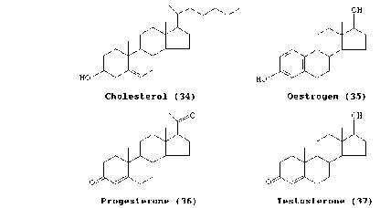
Steroid hormones
Derived from cholesterol
Differ by the types and numbers of atoms attached to complex rings and the way they are joined
_________________________________, estrogen, cortisol, Vitamin D

Slide 23
Steroid Hormone actions
Carried bloodstream _______________________________________
Soluble in ________________________________ that make up cell membranes
Can _

Slide 24
Steroid hormone actions
Once inside target cells, combine with _
Hormone receptor complex binds with DNA and
Synthesize new proteins
Turns off gene

Slide 25
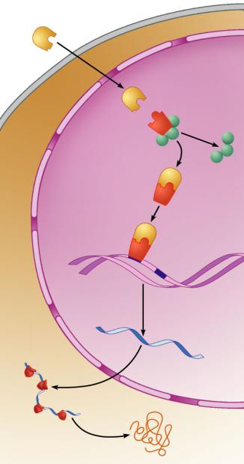
Steroid
hormone
Cytoplasm
Steroid
hormone
Receptor-
chaperonin
complex
Receptor-hormone
complex
Molecular
chaperones
Binding
Hormone
response
elements
Chromatin
Transcription
mRNA
mRNA
Nucleus
Ribosome
New protein
Translation
Figure 16.4

Slide 26
Non steroid hormones
Amines
Norepinephrine
Epinephrine
Derived from _
Synthesized in the __________________________________________ from the amino acid _

Slide 27
Non steroid hormones
Protein hormones
Composed of _
From parathyroid gland,
Some secreted by _
Glycoproteins
Anterior pituitary hormone

Slide 28
Non steroid hormones
Peptide hormones
Associated with posterior pituitary gland

Slide 29
Non steroid hormones
Not able to diffuse through plasma membrane
Combines with _

Slide 30
Non steroid hormones
________________________________________: the initial hormone that causes the reaction
_______________________________________: the biochemicals produced as a result of the action of the first hormone

Slide 31
Non steroid hormones
Second messenger:
cyclic adenosine monophosphate: _____________
Hormone/receptor →
activates G protein →
activates adenylate cyclase →
removes two phosphates from ATP →
forms cAMP

Slide 32
Non steroid hormones
cAMP activates more enzymes
cAMP → activates _
Protein kinases _______________________________________________ from ATP to molecules
Adding Phosphates to other molecules changes their shapes from _

Slide 33
Non steroid hormones
Inactivation of cAMP
Phosphodiesterase:

Slide 34
Second Messengers
Inositol triphosphate ____________
_________________: cyclic Guanosine Monophosphate
Derived from nucleotide

Slide 35
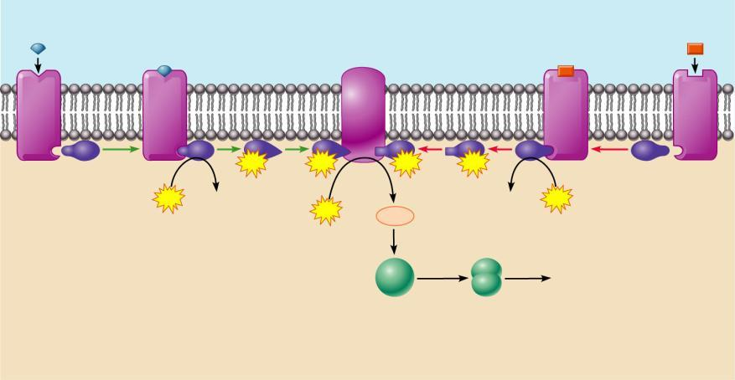
Amino Acid-Based Hormone Action: cAMP Second Messenger
Extracellular fluid
Hormone A
Adenylate cyclase
Hormone B
1
1
2
GTP
3
GTP
GTP
3
GTP
2
Receptor
G_{s}
4
G_{i}
Receptor
GTP
GDP
GDP
GTP
Catecholamines
ACTH
FSH
LH
Glucagon
PTH
TSH
Calcitonin
ATP
cAMP
5
Triggers responses of target
cell (activates enzymes,
stimulates cellular
secretion, opens ion
channels, etc.)
Inactive
protein
kinase A
Active
protein
kinase A
Cytoplasm
Figure 16.2

Slide 36
Hormone Control
Most hormones are controlled by _
A certain level of a hormone will shut down production of that same hormone or a related hormone

Slide 37
Endocrine Gland Stimulation
Three main types of stimuli for endocrine glands
1.
“Humor” used to refer to __________
Humoral stimuli refers to blood levels of ions and nutrients
Ex: __________________________________________________ act as a control for Parathyroid hormone release
Low blood calcium stimulates _

Slide 38
Endocrine Stimulation
2. Neural
With stress, sympathetic nerve fibers cause the release of norepinephrine and epinephrine from the adrenal medulla

Slide 39
Endocrine Stimulation
3. Hormonal
One type of hormone will act as a __________________________________________________ on another hormone
Hypothalamus releases “Releasing Hormones” to stimulate cells in the anterior pituitary
Also releases Inhibiting Hormones

