Slide 1
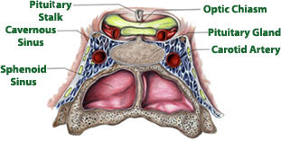
Pituitary gland
Also called _
Hypo:
Physis:
Hypophysis: “to grow under”
Located at _____________________________________
Attached to hypothalamus by pituitary stalk_
Like a pea on a stalk

Slide 2
Pituitary gland
Adenohypophysis

Slide 3
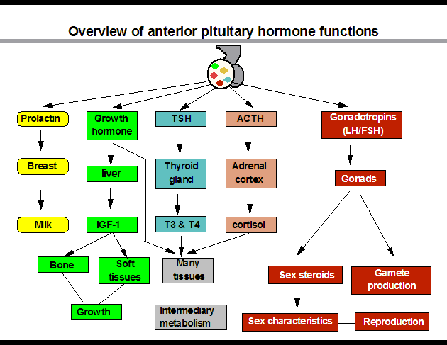

Slide 4
Pituitary gland
Neurohypophysis
Does not _______________________________________ hormones
Neurosecretory cells ________________________________ ADH and OT
Cell bodies of neurosecretory cells are located within the hypothalamus
Hormones release into bloodstream based on input from hypothalamus

Slide 5
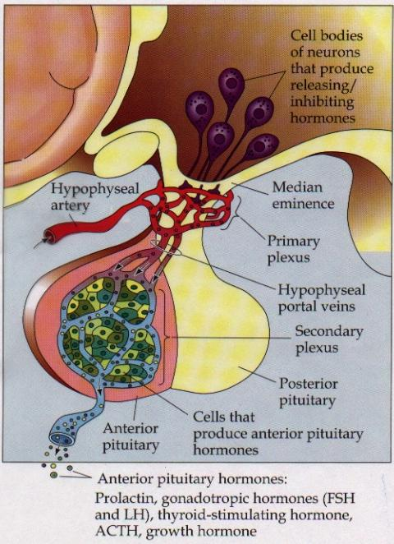
Hypophyseal portal
Causes release of hormones in _
Hypothalamus produces _
rH carried through capillaries into anterior pituitary

Slide 6
Anterior/Posterior
Hypothalamus to Anterior Pituitary
Blood pathway
Hypophyseal _
Hypothalamus to Posterior Pituitary
Modified neurons
Hypothalamic- _

Slide 7
Anterior Pituitary Hormones
Anterior pituitary houses five types of secretory cells
1. Somatotrophs:
2. Lactotrophs (Mammatrophs):
3. Thyrotropes:
4. Corticotropes:
5. Gonadotropes:

Slide 8
Growth Hormone
Protein (non steroidal)
Stimulates cells to _
Anabolic: _
Encourages use of _

Slide 9
Growth hormone
Control of GH
Secreted from _
Growth hormone releasing hormone
Stimulates secretion of GH
Growth Hormone Inhibiting Hormone = Somatostatin
Secreted from hypothalamus
(and the gut)
Inhibits secretion of GH
(and decreases gastrointestinal secretions)

Slide 10
Growth hormone
Direct and indirect stimulation
Direct:
Mobilizes fats and decreases glucose uptake
Indirect:
GH →
liver →
produces ____________________________________________ (IGF)→
Encourages _
encourages _

Slide 11
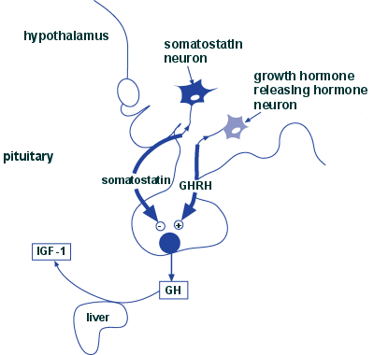

Slide 12
GH hyposecretion
GH ____________________________________ in childhood:
Body proportions and mental development normal
Maximum growth: _
If diagnosed before puberty, GH can be given supplementally

Slide 13
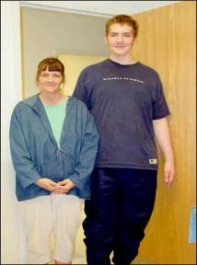
GH hypersecretions
GH oversecretion
In childhood: _
May reach heights exceeding 8 feet
Typically from ____________________________ of pituitary gland
Epiphyseal plates open in long bones
Stimulation results in _

Slide 14
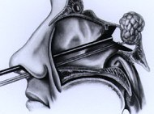
GH hypersecretions
In adults:
__________________________________________________, GH released, body can not grow taller, tends to _________________________________________________
Also associated with pituitary tumor

Slide 15
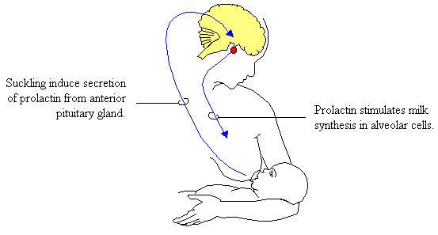
Prolactin
PRL: _
Pro: for
Lact: _
______________________________________________ in females
Excess may cause _

Slide 16
Prolactin
_______________________________________ regulates prolactin secretion
PIH: prolactin release inhibiting hormone
Reduces secretion of prolactin
PRF: Prolactin releasing factor
Thought to stimulate PRL, but not yet been identified in the body

Slide 17
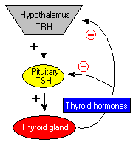
Thyroid Stimulating Hormone
Called _
Glycoprotein
Controls secretions of hormones from thyroid
Increased TSH: _

Slide 18
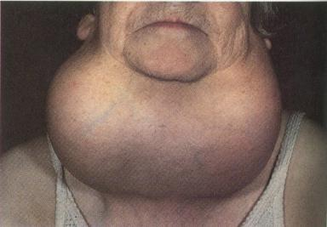
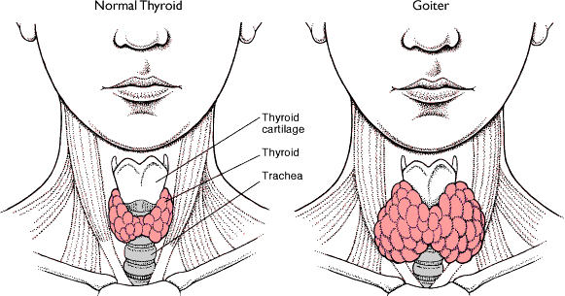
Goiter
Causes of Goiter
Hyperthyroidism
Hypothyroidism
HCG

Slide 19
TSH regulation
TRH: thyrotropin-releasing Hormone
Presence of thyroid hormones _
Inhibits release of _
As thyroid hormones increase → TSH and TRH decrease

Slide 20
ACTH: Adrenocorticotropic Hormone
Peptide
Controls other hormones that are released from the _
Adrenal hormones _
Regulation: _
Released from hypothalamus cortical hormones are low
Has daily rhythm: increased levels in morning before waking

Slide 21
FSH: Follicle stimulating hormone
Glycoprotein
Gonadotropins: target the gonads
Follicle:

Slide 22
FSH
FSH:
stimulates _______________________________________ to mature egg
Stimulates follicular cells to _
FSH:
Stimulates production of _

Slide 23
LH: Luteinizing hormone
Glycoprotein
Promotes ___________________________________________ in both male and female
______________________________________: essential for release of egg: ovulation

Slide 24
FSH and LH
Regulation
Controlled by _
Gonadotropin releasing Hormone
Secreted from the hypothalamus
GnRH _

Slide 25
Posterior pituitary
Composed of nerve fibers and _
Neurosecretory cells: secretions _
Hormones:
ADH antidiuretic
OT: oxytocin

Slide 26
Posterior pituitary hormones
Neurons in hypothalamus produce _
Hormones travel down axons
From hypothalamus → pituitary stalk → posterior pituitary → stored in _
Released when _____________________________ passes through axon

Slide 27
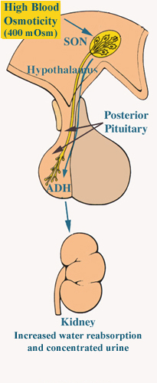
ADH
Short polypeptide
_______________________________: increases urine production
Antidiuretic: _
ADH causes kidneys to ________________________________ excreted

Slide 28
ADH and alcohol
Alcohol consumption ____________________________________________
Increased alcohol → __________________________________________ → more water moved through kidneys → _
Excess alcohol consumption can _

Slide 29
ADH
Also called _______________________________ for its effects on _____________________________________ in blood vessels
Can increase vascular resistance → increase blood pressure
Secretion increases following severe blood loss
Helps to _

Slide 30
ADH
Regulation
Hypothalamus has ________________________________________ that sense changes in body fluid concentrations
______________________________________: solutes in blood more concentrated → sensed by osmoreceptors →posterior pituitary will release ADH → kidneys retain water → solutes in blood become less concentrated

Slide 31
Oxytocin
Also has ___________________________________, but not as strong as ADH
Causes ___________________________________:
Uterine wall: childbirth
One of the few __________________________________________________ systems:
uterus stretches → signals hypothalamus to release Oxytocin → causes uterine contraction

Slide 32
Oxytocin
Breasts
OT contracts _
Forces milk from glands _
Suckling: mechanical stimulation → stimulates hypothalamus → release of Oxytocin → _

Slide 33
Oxytocin
Males
May play a role in _
Your textbook refers to it as a “Cuddle Hormone” in non-sexual relationships
Present in posterior pituitary.

Slide 34
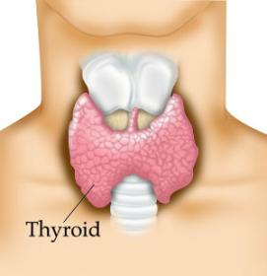
Thyroid gland
Two lateral lobes
Connected by _
Composed of secretory parts called _
Follicular cells produce and secrete hormones that can be _
____________________________________________: located outside of follicles

Slide 35
Thyroid
Produces three hormones
Thyroxine T4
Triiodothyronine T3
________________________________________________ (extrafollicular) cells

Slide 36
Thyroid hormones
T3 and T4
Regulate metabolism of _
Determine how many calories body needs for Basal Metabolic Rate
Maturation of nervous system
Controlled by _____________from _

Slide 37
Thyroid hormones
Follicular cells require _______________________________________ to produce T3 and T4
Iodine absorbed from intestine carried to thyroid gland
__________________________________________ moves it into follicular cells
Iodine and _________________________________ used to synthesize thyroid hormones

Slide 38
Thyroid hormones
Thyroid hormones enter blood and _
Transported to body cells

Slide 39
Thyroid hormones
Parafollicular (Extrafollicular)
Role in blood calcium and phosphate ion concentrations
______________________________________________ → less bone minerals put into bloodstream → _____________________________________________ and phosphate concentration in blood

Slide 40
Calcitonin
Calcitonin is _
Seen following meals
May protect bones of mother from resorption during _
Make sure that the fetal need are not met by robbing the mother’s bones of calcium

Slide 41
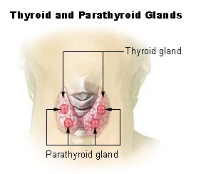
Parathyroid
Located on ___________________________________ of thyroid gland
Discovered accidentally
Patients with thyroid surgery in which the thyroid was completely removed would have __________________________ __________________________________________________________ They eventually realized there was more than just the Thyroid gland.
Four:
two superior
two inferior
Produces:
parathyroid hormone

Slide 42
PTH
Protein hormone
Decreased blood phosphate ion concentration
PTH stimulates bone resorption by osteoclasts

Slide 43
PTH
________________________________ stimulates absorption of calcium ions from intestine by _
Increased PTH →Increased Vitamin D → more calcium absorbed in intestines → _

Slide 44
Calcitonin and PTH
Calcitonin (thyroid) and PTH (parathyroid)
Have _
Maintain _

Slide 45
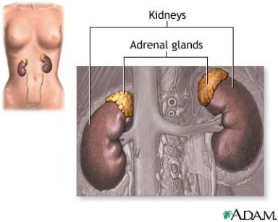
Adrenal Glands
Associated with the _
Two portions
Adrenal medulla: _
_________________________: outer portion

Slide 46
Adrenal medulla
Closely associated _
Adrenal medullary cells are _
Central nervous system → sympathetic nervous system: preganglionic fiber → postganglionic fiber: in this case adrenal medulla

Slide 47
Hormones of Adrenal Medulla
Adrenal medulla cells: _
Produce epinephrine and norepinephrine
Epinephrine is _

Slide 48
Adrenal Medulla
Effects of epinephrine and norepinephrine are similar to sympathetic nerve stimulation
Increased _
Increased breath rate
____________________________________ activity of digestive system
Duration: up to 10 X longer than neurotransmitter effects
Removed from the tissues slowly

Slide 49
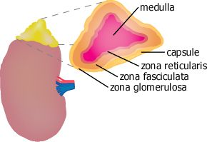
Adrenal cortex
Makes up _
Divided into _____________________________ of epithelial layers
Mineralocorticoids
Balance minerals and water in blood
glucocorticoids
Sex hormones

Slide 50
Adrenal cortex hormones
Mineralocorticoid
Glucocorticoids
Help to maintain blood glucose and blood pressure
Gluconeogenesis: formation of glucose from fats and proteins
Sex hormones
Adrenal testosterone influences female sex drive

Slide 51
Cortisol
Regulation:
Hypothalamus:
releases _
Anterior pituitary:
ACTH Adrenocorticotrophic hormone
adrenal cortex produces _
Cortisol inhibits _

