Slide 1
Pancreas
Two types of tissues for secretion
__________________________________________: digestive juices deposited into the duodenum
__________________________________________: releases hormones: insulin, glucagon, and somatostatin

Slide 2
Pancreas
polypeptide
Stimulates liver to _
Glycogenolysis
Converts non-carbs into glucose
Stimulates breakdown of fats into _

Slide 3
Pancreas
Low blood sugar → release of glucagon from ______________________________________→
Glycogen broken into glucose
Gluconeogenesis
________________________________________________ to blood stream
Blood glucose returns to normal and glucagon release inhibited

Slide 4
Pancreas
Insulin
Protein
Effect is _
Stimulates liver to _
Inhibits conversion of non carbs into glucose
Moves glucose _
Decreases the concentration of blood glucose

Slide 5
Pancreas
Insulin
Blood glucose high following a meal → ______________________________ release insulin →
Promotes glycogen formation
Moves glucose into cells
Blood _

Slide 6
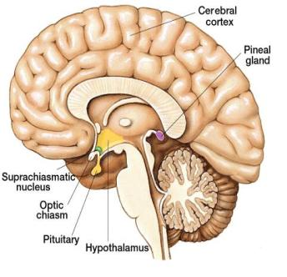
Pineal gland
Small and oval
Located between cerebral hemispheres
Near third ventricle
Consists of _

Slide 7
Pineal gland
Hormone:
Synthesized from _
Controlled by _
_____________________________________________ → nerve impulses from retina → hypothalamus →spinal cord → join sympathetic nerve fibers back to brain and pineal gland → _

Slide 8
Pineal gland
Dark → impulses from retina _____________________________ → melatonin _
Part of circadian rhythm
Fertility cycles in some mammals

Slide 9
Pineal gland
Melatonin can bind to receptors and _
Melatonin _______________________________ _____________________ from anterior pituitary
Helps to regulate female reproductive cycle
May also control onset of puberty

Slide 10
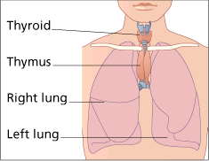
Thymus
Lies in _
Large in children
Diminishes with age
Secretes _______________________: hormones that affect production and _
Plays role in immune system

Slide 11
Other Structures
Heart
ANP:
Volume of blood increases→ _________________________________________________ → ANP released → sodium lost in kidneys → water lost in kidneys → _
Gastrointestinal tract
Along the mucosa of the GI tract
Many have _
Estrogen, progesterone, hCG

Slide 12
Other Structures
Erythropoetin
Eryth: red
Renin
Skin
Cholecalciferol
Adipose tissue
Functions in CNS for appetite control: satiety
Insulin antagonist

Slide 13
Terms: Ch 17
Eryth
Leuko:
Hem a/ato/o: blood
Ferr: iron
Cytes: cell
Poeisis:
Baso: base
Eosino: red acidic dye
Retic:
Blast:
a/an:

Slide 14
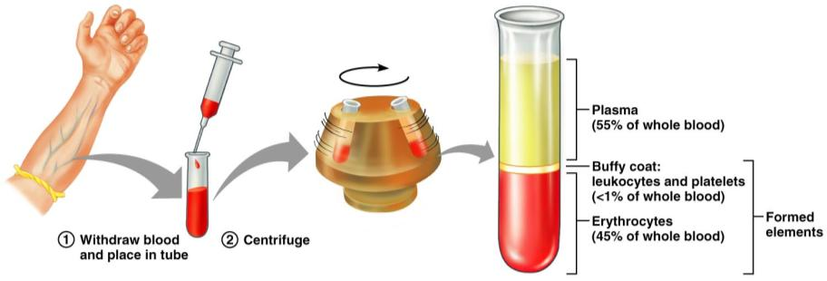
Blood
Info from blood can be clinically valuable
Blood sample is _
Hematocrit: HCT: is the _

Slide 15
Hematocrit
Men: 47 +/- 5 ml/100 ml
Women 42 +/- 5 ml/100 ml
Children 35-49 ml/100 ml

Slide 16
Blood
Plasma: the remaining _
55% by volume
Includes water, amino acids, proteins, carbohydrates, lipids, vitamins, hormones, electrolytes and cellular wastes

Slide 17
Functions

Slide 18
Functions
Distribution
______________________________________ from lungs
Nutrients _
______________________________________________ from cells to lungs or kidney
Hormones

Slide 19
Functions
Regulation
Maintains _
Carries _
Maintains _
Maintains fluid volume

Slide 20
Functions
Protection
Prevention of blood loss
Antibodies, complement proteins, White Blood Cells

Slide 21
Blood Plasma
Mostly water that _
Nutrients, gas, hormone, wastes, ions, proteins
Most abundant solutes are the _

Slide 22
Plasma proteins
Most are _
exceptions: hormones and gamma globulins
Are proteins that are ___________________________________________ or nutrients by the body

Slide 23
Plasma Proteins

Slide 24
Blood Plasma
Albumin
Aid in determining _
Regulates water movement between blood and tissues
Affects _
Transports bilirubin and free fatty acids

Slide 25
Dissolved plasma proteins
Globulins
Subdivided into
Alpha globulin
Beta globulin
Transports _

Slide 26
Dissolved Plasma Proteins
Fibrinogen
Primary role is _
Synthesized in the _
_____________________________________ plasma protein in terms of size

Slide 27
Origin of Blood cells
Blood cells originate in the _
Hemocytoblasts: a type of _

Slide 28
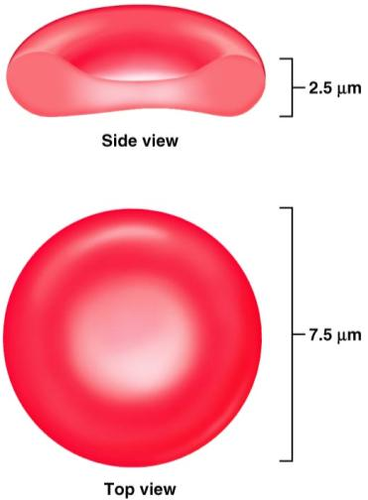
Erythrocytes
Shape effective for transporting gasses (oxygen, carbon dioxide)
Cell membrane is closer to the hemoglobin
Great for _
Greater _

Slide 29
Hemoglobin
Within the RBC the Hb transports the oxygen
Erythrocytes are more than _
When Hb combines with Oxygen it _
And turns _

Slide 30
Red Blood Cells?
Cells by definition have a nucleus.
RBCs when mature,
have no _
Have no _
More appropriately called _
Provides more space for Hb
Doesn’t consume the Oxygen it’s carrying

Slide 31
RBCs
Effect of having no nucleus:
Can not ____________________________________________ (no DNA to base it on…)
Therefore, they _
Life span of a RBC is about 120 days

Slide 32
RBCs
Need to be flexible to navigate vessels
Can’t repair themselves
Become worn and damaged with use
Pass through the _________________________________________ where damaged cells are filtered and removed from the circulation.

Slide 33
Damaged RBCs
RBC _
Hb becomes exposed and break down
Composed of globin chains surrounding a heme group (Iron)
Heme group _
Biliverdin: _

Slide 34
Biliverdin
Biliverdin is eventually decomposed into
Bilirubin:
Think of a bruise. Consider the color changes it goes through as it heals.

Slide 35
Bilirubin
Both biliverdin and bilirubin _

Slide 36
Embryonic hematopoeisis
Red blood cell formation begins in the

Slide 37
Hematopoeisis
After birth, RBC formation takes place in the red bone marrow
Hemocytoblasts: hematopoietic stem cell
Hemocytoblast → ______________________________________________→ proerythroblast → early erythroblasts (produce lots of ribosomes) → late erythroblast _________________________________________________ (this is the stage where organelles and nucleus are lost) → ____________________________________________→ released into blood stream and mature in two days to erythrocytes

Slide 38
Erythropoeitin
Erythropoeitin: hormone that _
Small amount produced by __
Most comes from _
_____________________________________________________stimulates release of erythropoietin

Slide 39
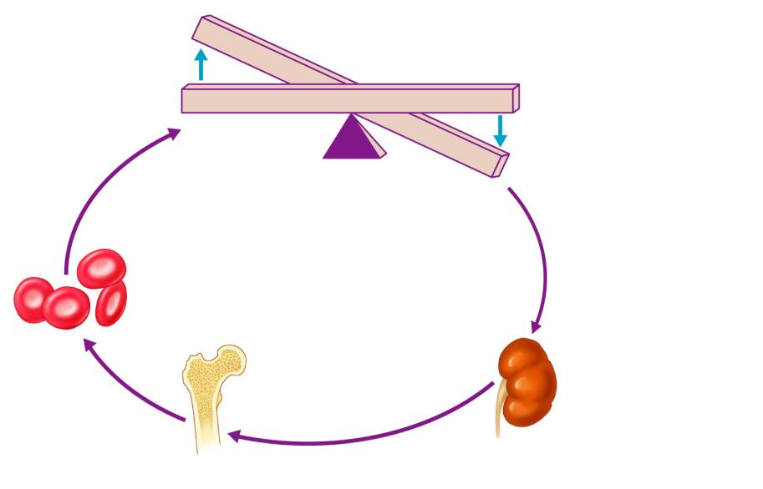
Imbalance
Start
Homeostasis: Normal blood oxygen levels
Stimulus: Hypoxia due to
decreased RBC count,
decreased amount of
hemoglobin, or decreased
availability of O₂
Imbalance
Increases
O₂-carrying
ability of blood
Reduces O₂ levels
in blood
Enhanced
erythropoiesis
increases
RBC count
Kidney (and liver to a smaller
extent) releases erythropoietin
Erythropoietin
stimulates red
bone marrow
Figure 17.6

Slide 40
Erythrocyte Disorders
Anemia
blood has _
It is a _________________________________________ rather than a disease itself
Blood oxygen levels cannot support normal metabolism
Signs/symptoms include _

Slide 41
Anemia: Insufficient Erythrocytes
Hemorrhagic anemia
Hemolytic anemia
destruction or inhibition of red bone marrow

Slide 42
Anemia: Decreased Hemoglobin Content
Iron-deficiency anemia results from:
A secondary result of _
Not enough ___________________in the diet
Impaired iron _
Pernicious anemia results from:
Deficiency of _
Lack of __________________________________________ needed for absorption of B₁₂

Slide 43
Anemia: Abnormal Hemoglobin
Thalassemias
absent or faulty globin chain in Hb
RBCs are _
Sickle-cell anemia
results from an abnormal Hb called HbS
HbS differs from Hb by _
This defect causes RBCs to become _

Slide 44
Polycythemia
Polycythemia
Increases _
HCT can reach _
Three main polycythemias are:
Polycythemia vera
Secondary polycythemia
Blood doping

Slide 45
White Blood Cells
Leuko: __________________ Cytes___________
Distinguishing characteristics:
Cytoplasm (granulocytes and agranulocytes)
Staining of the cytoplasm

Slide 46
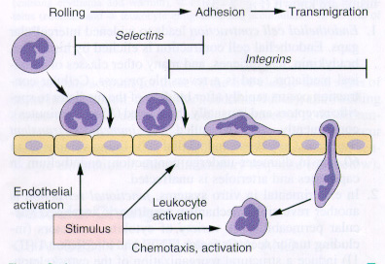
Diapedesis
Leukocytes can _
Entering or leaving circulatory system
Will move to _
Will move by amoeboid motion
Cytoplasmic extensions
Follow a chemical trail

