Slide 1
BSC 182 Human Physiology & Anatomy II
Dr. Betsy A. Wargo

Slide 2
Introduction
Dr. Wargo
bawargo@ilstu.edu
Office hours: MWF, by appointment please
Background
Graduated from ISU 1994
Major: Biology
Graduated from National College of Chiropractic 1997
B.S. in Human Biology
Doctorate for Chiropractic

Slide 3
Introduction
Syllabus
Exams
Six semester exams worth 100 points
Lowest exam automatically dropped when calculating grades
No make up exams
Grading
90% A; 80% B etc

Slide 4
Introduction
Assignments
Encourage one type of Active Study
Ten high-quality quiz questions
Eight multiple choice questions that include at least four options. Indicate the correct response.
Two short answer questions. Asked and answered correctly
Assignment should be submitted through Blackboard
No late assignments will be accepted

Slide 5
Introduction
Format
Class will consist of PowerPoint lecture based on the information from your text book.
Lectures are intended to help you digest and comprehend the material from your book, not replace it.
Templates for the lectures will be available online for you to download and print.
A picture is worth a thousand words…
Generally, if I draw it on the board, make sure it gets into your notes.

Slide 6
Introduction
Studying
Read before you come in.
Don’t leave confused.
Study as soon after class as possible.
Spread study time out.
Ask for help when you don’t understand.

Slide 7
Introduction
Active versus Passive Studying
Passive:
reading or re-reading notes, listening to taped lectures
Low energy requirements
Begin to understand material

Slide 8
Introduction
Active Studying
Developing comprehension
Re-writing sections you don’t understand
Study efficiently!
Note-cards
Study groups
Discussing pathways or processes
Explaining to those who don’t get it yet
Forcing verbal recall of written material
Making exam questions
Answering exam questions correctly
Exchanging and reviewing assignments. This then becomes a study guide for class material.
Using supplemental study sites for practice quizzes

Slide 9
Introduction
Exam Format
Exams will be created mostly from material presented in lecture
You will be responsible for diagrams (Anatomy)
Multiple choice options will have one correct response unless otherwise noted.
Indicate all that are correct

Slide 10
Lab
There will be lab this week
Please be sure to bring the BSC 182 lab manual with you to lab
Lab manuals can be purchased at the Phi Sigma bookstore (Felmley 101A) this week and next
Lab format
There will be four lab practicals this semester
Lab assignments (case studies or article summaries) may be assigned throughout the semester.

Slide 11
Ready?
Before we begin, take a moment to introduce yourself to your neighbors make sure you have contact information from a classmate should you need to get a copy of the notes

Slide 12
Chapter 16: Endocrine
Vocab:
Auto:
Endo:
Exo:
Para: beside, near
Neuro: nerve
Hormon: to excite
Adeno: gland, gland-shaped
Hypo:

Slide 13
Autocrine & Paracrine
Autocrine function- the hormone released _
______________________________ function- hormone is carried a short distance via interstitial fluid.
Autocrines and paracrines are __________________________________ chemical messengers and will not be considered part of the endocrine system

Slide 14
Comparing Endocrine & Neurocrine
function- hormone is carried to _
function- hormone and is then carried by bloodstream.

Slide 15
Exocrine
Secretions into _
Leads to _
Stomach acid
Sweat glands

Slide 16
Endocrine system
Based on secretion of hormones that act on target cells
Nervous system:
Endocrine
Signals sent through blood

Slide 17
Endocrine
Based on chemical signals that bind to receptor molecules
Help regulate _
Control rates of _
___________________________________ through membranes
Regulate balances
Reproduction
growth

Slide 18
Hormones
Released from _
Diffuse into bloodstream
Carried to all parts of body
Affect _

Slide 19
Target Cell Specificity
Hormones circulate to all tissues but only activate cells referred to as _
Target cells must have __________________________________________ to which the hormone binds
These receptors may be _____________________________________ or located on the _

Slide 20
Target Cell Specificity
Examples of hormone activity
_________________________ receptors are only found on certain cells of the _
_________________________ receptors are found _

Slide 21
Target Cell Activation
Target cell activation depends on three factors
___________________________________of the hormone
Relative ____________________________________________ on the target cell
The ______________________________________ of those receptors for the hormone
target cells form more receptors in response to the hormone
target cells lose receptors in response to the hormone

Slide 22
Chemistry of Hormones
Steroid hormones
Synthesized from _
non-steroid hormones: Amines, peptides
Synthesized from _

Slide 23
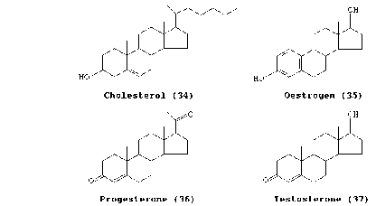
Steroid hormones
Derived from cholesterol
Differ by the types and numbers of atoms attached to complex rings and the way they are joined
_________________________________, estrogen, cortisol, Vitamin D

Slide 24
Steroid Hormone actions
Carried bloodstream _______________________________________
Soluble in ________________________________ that make up cell membranes
Can _

Slide 25
Steroid hormone actions
Once inside target cells, combine with _
Hormone receptor complex binds with DNA and
Synthesize new proteins
Turns off gene

Slide 26
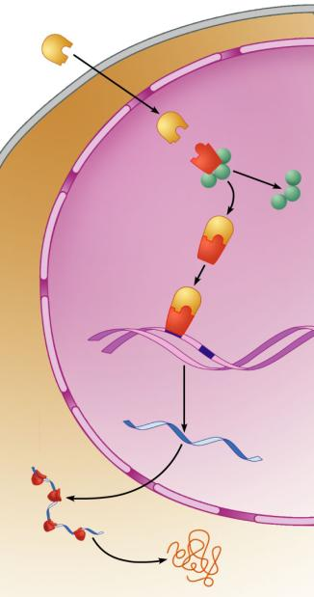
Steroid
hormone
Cytoplasm
Steroid
hormone
Receptor-
chaperonin
complex
Receptor-hormone
complex
Molecular
chaperones
Binding
Hormone
response
elements
Chromatin
Transcription
mRNA
mRNA
Nucleus
Ribosome
New protein
Translation
Figure 16.4

Slide 27
Non steroid hormones
Amines
Norepinephrine
Epinephrine
Derived from _
Synthesized in the __________________________________________ from the amino acid _

Slide 28
Non steroid hormones
Protein hormones
Composed of _
From parathyroid gland,
Some secreted by _
Glycoproteins
Anterior pituitary hormone

Slide 29
Non steroid hormones
Peptide hormones
Associated with posterior pituitary gland

Slide 30
Non steroid hormones
Not able to diffuse through plasma membrane
Combines with _

Slide 31
Non steroid hormones
________________________________________: the initial hormone that causes the reaction
_______________________________________: the biochemicals produced as a result of the action of the first hormone

Slide 32
Non steroid hormones
Second messenger:
cyclic adenosine monophosphate: _____________
Hormone/receptor →
activates G protein →
activates adenylate cyclase →
removes two phosphates from ATP →
forms cAMP

Slide 33
Non steroid hormones
cAMP activates more enzymes
cAMP → activates _
Protein kinases _______________________________________________ from ATP to molecules
Adding Phosphates to other molecules changes their shapes from _

Slide 34
Non steroid hormones
Inactivation of cAMP
Phosphodiesterase:

Slide 35
Second Messengers
Inositol triphosphate ____________
_________________: cyclic Guanosine Monophosphate
Derived from nucleotide

Slide 36
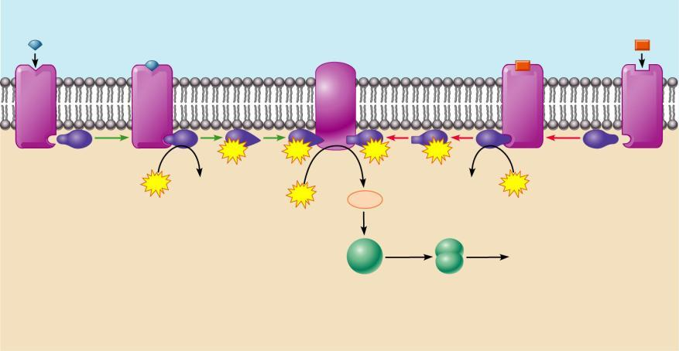
Amino Acid-Based Hormone Action: cAMP Second Messenger
Extracellular fluid
Hormone A
Adenylate cyclase
Hormone B
1
1
2
GTP
3
GTP
GTP
3
GTP
2
Receptor
G_{s}
4
G_{i}
Receptor
GTP
GDP
GDP
GTP
Catecholamines
ACTH
FSH
LH
Glucagon
PTH
TSH
Calcitonin
ATP
cAMP
5
Triggers responses of target
cell (activates enzymes,
stimulates cellular
secretion, opens ion
channels, etc.)
Inactive
protein
kinase A
Active
protein
kinase A
Cytoplasm
Figure 16.2

Slide 37
Hormone Control
Most hormones are controlled by _
A certain level of a hormone will shut down production of that same hormone or a related hormone

Slide 38
Endocrine Gland Stimulation
Three main types of stimuli for endocrine glands
1.
“Humor” used to refer to __________
Humoral stimuli refers to blood levels of ions and nutrients
Ex: __________________________________________________ act as a control for Parathyroid hormone release
Low blood calcium stimulates _

Slide 39
Endocrine Stimulation
2. Neural
With stress, sympathetic nerve fibers cause the release of norepinephrine and epinephrine from the adrenal medulla

Slide 40
Endocrine Stimulation
3. Hormonal
One type of hormone will act as a __________________________________________________ on another hormone
Hypothalamus releases “Releasing Hormones” to stimulate cells in the anterior pituitary
Also releases Inhibiting Hormones

Slide 41
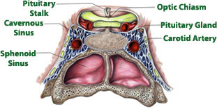
Pituitary gland
Also called _
Hypo:
Physis:
Hypophysis: “to grow under”
Located at _____________________________________
Attached to hypothalamus by pituitary stalk_
Like a pea on a stalk

Slide 42
Pituitary gland
Adenohypophysis

Slide 43
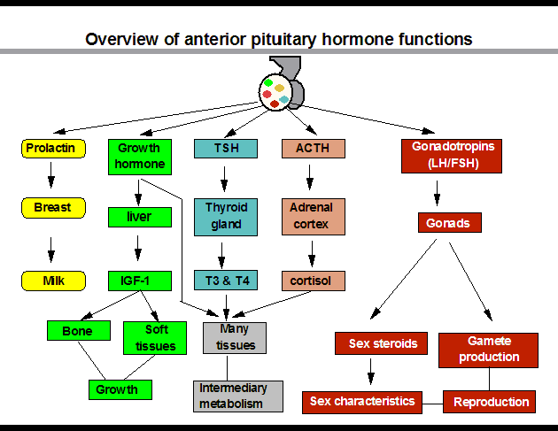

Slide 44
Pituitary gland
Neurohypophysis
Does not _______________________________________ hormones
Neurosecretory cells ________________________________ ADH and OT
Cell bodies of neurosecretory cells are located within the hypothalamus
Hormones release into bloodstream based on input from hypothalamus

Slide 45
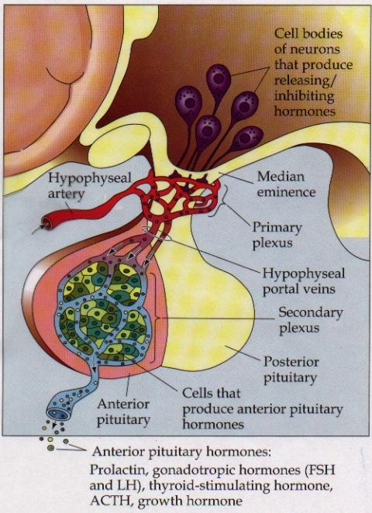
Hypophyseal portal
Causes release of hormones in _
Hypothalamus produces _
rH carried through capillaries into anterior pituitary

Slide 46
Anterior/Posterior
Hypothalamus to Anterior Pituitary
Blood pathway
Hypophyseal _
Hypothalamus to Posterior Pituitary
Modified neurons
Hypothalamic- _

Slide 47
Anterior Pituitary Hormones
Anterior pituitary houses five types of secretory cells
1. Somatotrophs:
2. Lactotrophs (Mammatrophs):
3. Thyrotropes:
4. Corticotropes:
5. Gonadotropes:

Slide 48
Growth Hormone
Protein (non steroidal)
Stimulates cells to _
Anabolic: _
Encourages use of _

Slide 49
Growth hormone
Control of GH
Secreted from _
Growth hormone releasing hormone
Stimulates secretion of GH
Growth Hormone Inhibiting Hormone = Somatostatin
Secreted from hypothalamus
(and the gut)
Inhibits secretion of GH
(and decreases gastrointestinal secretions)

Slide 50
Growth hormone
Direct and indirect stimulation
Direct:
Mobilizes fats and decreases glucose uptake
Indirect:
GH →
liver →
produces ____________________________________________ (IGF)→
Encourages _
encourages _

Slide 51
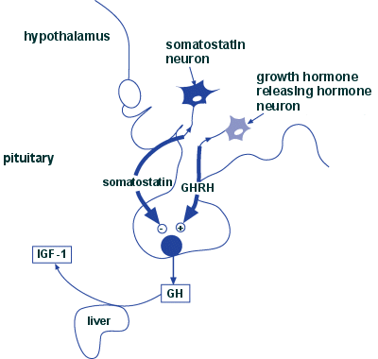

Slide 52
GH hyposecretion
GH ____________________________________ in childhood:
Body proportions and mental development normal
Maximum growth: _
If diagnosed before puberty, GH can be given supplementally

Slide 53
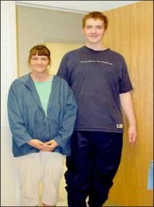
GH hypersecretions
GH oversecretion
In childhood: _
May reach heights exceeding 8 feet
Typically from ____________________________ of pituitary gland
Epiphyseal plates open in long bones
Stimulation results in _

Slide 54
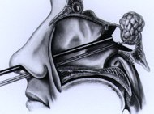
GH hypersecretions
In adults:
__________________________________________________, GH released, body can not grow taller, tends to _________________________________________________
Also associated with pituitary tumor

Slide 55
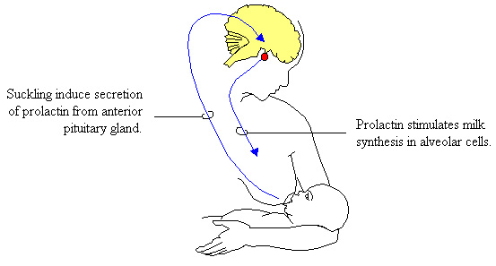
Prolactin
PRL: _
Pro: for
Lact: _
______________________________________________ in females
Excess may cause _

Slide 56
Prolactin
_______________________________________ regulates prolactin secretion
PIH: prolactin release inhibiting hormone
Reduces secretion of prolactin
PRF: Prolactin releasing factor
Thought to stimulate PRL, but not yet been identified in the body

Slide 57
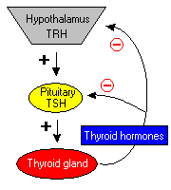
Thyroid Stimulating Hormone
Called _
Glycoprotein
Controls secretions of hormones from thyroid
Increased TSH: _

Slide 58
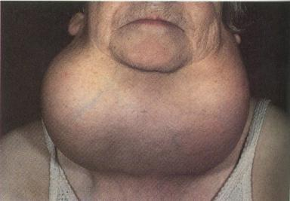
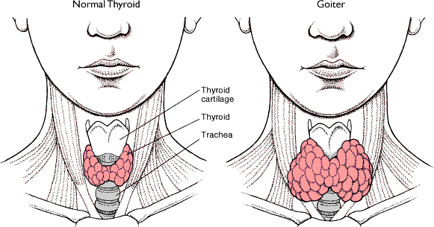
Goiter
Causes of Goiter
Hyperthyroidism
Hypothyroidism
HCG

Slide 59
TSH regulation
TRH: thyrotropin-releasing Hormone
Presence of thyroid hormones _
Inhibits release of _
As thyroid hormones increase → TSH and TRH decrease

Slide 60
ACTH: Adrenocorticotropic Hormone
Peptide
Controls other hormones that are released from the _
Adrenal hormones _
Regulation: _
Released from hypothalamus cortical hormones are low
Has daily rhythm: increased levels in morning before waking

Slide 61
FSH: Follicle stimulating hormone
Glycoprotein
Gonadotropins: target the gonads
Follicle:

Slide 62
FSH
FSH:
stimulates _______________________________________ to mature egg
Stimulates follicular cells to _
FSH:
Stimulates production of _

Slide 63
LH: Luteinizing hormone
Glycoprotein
Promotes ___________________________________________ in both male and female
______________________________________: essential for release of egg: ovulation

Slide 64
FSH and LH
Regulation
Controlled by _
Gonadotropin releasing Hormone
Secreted from the hypothalamus
GnRH _

Slide 65
Posterior pituitary
Composed of nerve fibers and _
Neurosecretory cells: secretions _
Hormones:
ADH antidiuretic
OT: oxytocin

Slide 66
Posterior pituitary hormones
Neurons in hypothalamus produce _
Hormones travel down axons
From hypothalamus → pituitary stalk → posterior pituitary → stored in _
Released when _____________________________ passes through axon

Slide 67
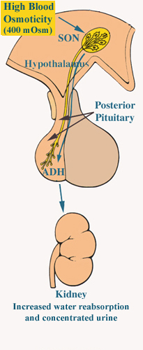
ADH
Short polypeptide
_______________________________: increases urine production
Antidiuretic: _
ADH causes kidneys to ________________________________ excreted

Slide 68
ADH and alcohol
Alcohol consumption ____________________________________________
Increased alcohol → __________________________________________ → more water moved through kidneys → _
Excess alcohol consumption can _

Slide 69
ADH
Also called _______________________________ for its effects on _____________________________________ in blood vessels
Can increase vascular resistance → increase blood pressure
Secretion increases following severe blood loss
Helps to _

Slide 70
ADH
Regulation
Hypothalamus has ________________________________________ that sense changes in body fluid concentrations
______________________________________: solutes in blood more concentrated → sensed by osmoreceptors →posterior pituitary will release ADH → kidneys retain water → solutes in blood become less concentrated

Slide 71
Oxytocin
Also has ___________________________________, but not as strong as ADH
Causes ___________________________________:
Uterine wall: childbirth
One of the few __________________________________________________ systems:
uterus stretches → signals hypothalamus to release Oxytocin → causes uterine contraction

Slide 72
Oxytocin
Breasts
OT contracts _
Forces milk from glands _
Suckling: mechanical stimulation → stimulates hypothalamus → release of Oxytocin → _

Slide 73
Oxytocin
Males
May play a role in _
Your textbook refers to it as a “Cuddle Hormone” in non-sexual relationships
Present in posterior pituitary.

Slide 74
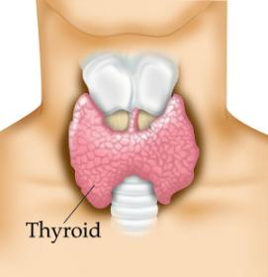
Thyroid gland
Two lateral lobes
Connected by _
Composed of secretory parts called _
Follicular cells produce and secrete hormones that can be _
____________________________________________: located outside of follicles

Slide 75
Thyroid
Produces three hormones
Thyroxine T4
Triiodothyronine T3
________________________________________________ (extrafollicular) cells

Slide 76
Thyroid hormones
T3 and T4
Regulate metabolism of _
Determine how many calories body needs for Basal Metabolic Rate
Maturation of nervous system
Controlled by _____________from _

Slide 77
Thyroid hormones
Follicular cells require _______________________________________ to produce T3 and T4
Iodine absorbed from intestine carried to thyroid gland
__________________________________________ moves it into follicular cells
Iodine and _________________________________ used to synthesize thyroid hormones

Slide 78
Thyroid hormones
Thyroid hormones enter blood and _
Transported to body cells

Slide 79
Thyroid hormones
Parafollicular (Extrafollicular)
Role in blood calcium and phosphate ion concentrations
______________________________________________ → less bone minerals put into bloodstream → _____________________________________________ and phosphate concentration in blood

Slide 80
Calcitonin
Calcitonin is _
Seen following meals
May protect bones of mother from resorption during _
Make sure that the fetal need are not met by robbing the mother’s bones of calcium

Slide 81
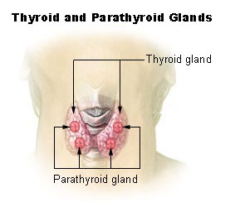
Parathyroid
Located on ___________________________________ of thyroid gland
Discovered accidentally
Patients with thyroid surgery in which the thyroid was completely removed would have __________________________ __________________________________________________________ They eventually realized there was more than just the Thyroid gland.
Four:
two superior
two inferior
Produces:
parathyroid hormone

Slide 82
PTH
Protein hormone
Decreased blood phosphate ion concentration
PTH stimulates bone resorption by osteoclasts

Slide 83
PTH
________________________________ stimulates absorption of calcium ions from intestine by _
Increased PTH →Increased Vitamin D → more calcium absorbed in intestines → _

Slide 84
Calcitonin and PTH
Calcitonin (thyroid) and PTH (parathyroid)
Have _
Maintain _

Slide 85
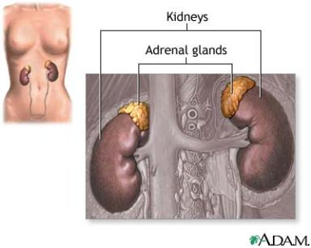
Adrenal Glands
Associated with the _
Two portions
Adrenal medulla: _
_________________________: outer portion

Slide 86
Adrenal medulla
Closely associated _
Adrenal medullary cells are _
Central nervous system → sympathetic nervous system: preganglionic fiber → postganglionic fiber: in this case adrenal medulla

Slide 87
Hormones of Adrenal Medulla
Adrenal medulla cells: _
Produce epinephrine and norepinephrine
Epinephrine is _

Slide 88
Adrenal Medulla
Effects of epinephrine and norepinephrine are similar to sympathetic nerve stimulation
Increased _
Increased breath rate
____________________________________ activity of digestive system
Duration: up to 10 X longer than neurotransmitter effects
Removed from the tissues slowly

Slide 89
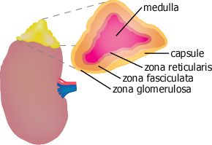
Adrenal cortex
Makes up _
Divided into _____________________________ of epithelial layers
Mineralocorticoids
Balance minerals and water in blood
glucocorticoids
Sex hormones

Slide 90
Adrenal cortex hormones
Mineralocorticoid
Glucocorticoids
Help to maintain blood glucose and blood pressure
Gluconeogenesis: formation of glucose from fats and proteins
Sex hormones
Adrenal testosterone influences female sex drive

Slide 91
Cortisol
Regulation:
Hypothalamus:
releases _
Anterior pituitary:
ACTH Adrenocorticotrophic hormone
adrenal cortex produces _
Cortisol inhibits _

Slide 92
Pancreas
Two types of tissues for secretion
__________________________________________: digestive juices deposited into the duodenum
__________________________________________: releases hormones: insulin, glucagon, and somatostatin

Slide 93
Pancreas
polypeptide
Stimulates liver to _
Glycogenolysis
Converts non-carbs into glucose
Stimulates breakdown of fats into _

Slide 94
Pancreas
Low blood sugar → release of glucagon from ______________________________________→
Glycogen broken into glucose
Gluconeogenesis
________________________________________________ to blood stream
Blood glucose returns to normal and glucagon release inhibited

Slide 95
Pancreas
Insulin
Protein
Effect is _
Stimulates liver to _
Inhibits conversion of non carbs into glucose
Moves glucose _
Decreases the concentration of blood glucose

Slide 96
Pancreas
Insulin
Blood glucose high following a meal → ______________________________ release insulin →
Promotes glycogen formation
Moves glucose into cells
Blood _

Slide 97
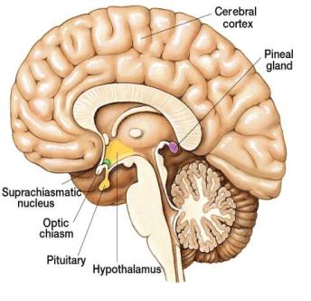
Pineal gland
Small and oval
Located between cerebral hemispheres
Near third ventricle
Consists of _

Slide 98
Pineal gland
Hormone:
Synthesized from _
Controlled by _
_____________________________________________ → nerve impulses from retina → hypothalamus →spinal cord → join sympathetic nerve fibers back to brain and pineal gland → _

Slide 99
Pineal gland
Dark → impulses from retina _____________________________ → melatonin _
Part of circadian rhythm
Fertility cycles in some mammals

Slide 100
Pineal gland
Melatonin can bind to receptors and _
Melatonin _______________________________ _____________________ from anterior pituitary
Helps to regulate female reproductive cycle
May also control onset of puberty

Slide 101
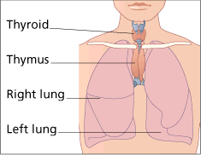
Thymus
Lies in _
Large in children
Diminishes with age
Secretes _______________________: hormones that affect production and _
Plays role in immune system

Slide 102
Other Structures
Heart
ANP:
Volume of blood increases→ _________________________________________________ → ANP released → sodium lost in kidneys → water lost in kidneys → _
Gastrointestinal tract
Along the mucosa of the GI tract
Many have _
Estrogen, progesterone, hCG

Slide 103
Other Structures
Erythropoetin
Eryth: red
Renin
Skin
Cholecalciferol
Adipose tissue
Functions in CNS for appetite control: satiety
Insulin antagonist

Slide 104
Terms: Ch 17
Eryth
Leuko:
Hem a/ato/o: blood
Ferr: iron
Cytes: cell
Poeisis:
Baso: base
Eosino: red acidic dye
Retic:
Blast:
a/an:

Slide 105
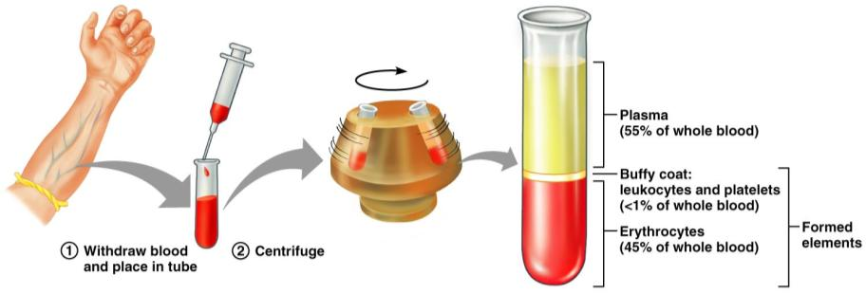
Blood
Info from blood can be clinically valuable
Blood sample is _
Hematocrit: HCT: is the _

Slide 106
Hematocrit
Men: 47 +/- 5 ml/100 ml
Women 42 +/- 5 ml/100 ml
Children 35-49 ml/100 ml

Slide 107
Blood
Plasma: the remaining _
55% by volume
Includes water, amino acids, proteins, carbohydrates, lipids, vitamins, hormones, electrolytes and cellular wastes

Slide 108
Functions

Slide 109
Functions
Distribution
______________________________________ from lungs
Nutrients _
______________________________________________ from cells to lungs or kidney
Hormones

Slide 110
Functions
Regulation
Maintains _
Carries _
Maintains _
Maintains fluid volume

Slide 111
Functions
Protection
Prevention of blood loss
Antibodies, complement proteins, White Blood Cells

Slide 112
Blood Plasma
Mostly water that _
Nutrients, gas, hormone, wastes, ions, proteins
Most abundant solutes are the _

Slide 113
Plasma proteins
Most are _
exceptions: hormones and gamma globulins
Are proteins that are ___________________________________________ or nutrients by the body

Slide 114
Plasma Proteins

Slide 115
Blood Plasma
Albumin
Aid in determining _
Regulates water movement between blood and tissues
Affects _
Transports bilirubin and free fatty acids

Slide 116
Dissolved plasma proteins
Globulins
Subdivided into
Alpha globulin
Beta globulin
Transports _

Slide 117
Dissolved Plasma Proteins
Fibrinogen
Primary role is _
Synthesized in the _
_____________________________________ plasma protein in terms of size

Slide 118
Origin of Blood cells
Blood cells originate in the _
Hemocytoblasts: a type of _

Slide 119
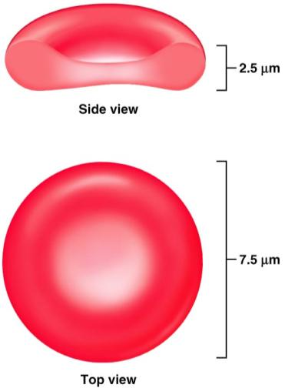
Erythrocytes
Shape effective for transporting gasses (oxygen, carbon dioxide)
Cell membrane is closer to the hemoglobin
Great for _
Greater _

Slide 120
Hemoglobin
Within the RBC the Hb transports the oxygen
Erythrocytes are more than _
When Hb combines with Oxygen it _
And turns _

Slide 121
Red Blood Cells?
Cells by definition have a nucleus.
RBCs when mature,
have no _
Have no _
More appropriately called _
Provides more space for Hb
Doesn’t consume the Oxygen it’s carrying

Slide 122
RBCs
Effect of having no nucleus:
Can not ____________________________________________ (no DNA to base it on…)
Therefore, they _
Life span of a RBC is about 120 days

Slide 123
RBCs
Need to be flexible to navigate vessels
Can’t repair themselves
Become worn and damaged with use
Pass through the _________________________________________ where damaged cells are filtered and removed from the circulation.

Slide 124
Damaged RBCs
RBC _
Hb becomes exposed and break down
Composed of globin chains surrounding a heme group (Iron)
Heme group _
Biliverdin: _

Slide 125
Biliverdin
Biliverdin is eventually decomposed into
Bilirubin:
Think of a bruise. Consider the color changes it goes through as it heals.

Slide 126
Bilirubin
Both biliverdin and bilirubin _

Slide 127
Embryonic hematopoeisis
Red blood cell formation begins in the

Slide 128
Hematopoeisis
After birth, RBC formation takes place in the red bone marrow
Hemocytoblasts: hematopoietic stem cell
Hemocytoblast → ______________________________________________→ proerythroblast → early erythroblasts (produce lots of ribosomes) → late erythroblast _________________________________________________ (this is the stage where organelles and nucleus are lost) → ____________________________________________→ released into blood stream and mature in two days to erythrocytes

Slide 129
Erythropoeitin
Erythropoeitin: hormone that _
Small amount produced by __
Most comes from _
_____________________________________________________stimulates release of erythropoietin

Slide 130
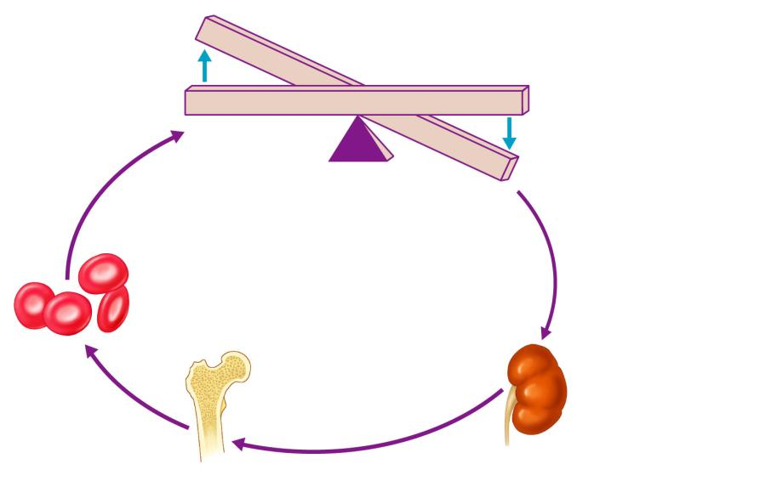
Imbalance
Start
Homeostasis: Normal blood oxygen levels
Stimulus: Hypoxia due to
decreased RBC count,
decreased amount of
hemoglobin, or decreased
availability of O₂
Imbalance
Increases
O₂-carrying
ability of blood
Reduces O₂ levels
in blood
Enhanced
erythropoiesis
increases
RBC count
Kidney (and liver to a smaller
extent) releases erythropoietin
Erythropoietin
stimulates red
bone marrow
Figure 17.6

Slide 131
Erythrocyte Disorders
Anemia
blood has _
It is a _________________________________________ rather than a disease itself
Blood oxygen levels cannot support normal metabolism
Signs/symptoms include _

Slide 132
Anemia: Insufficient Erythrocytes
Hemorrhagic anemia
Hemolytic anemia
destruction or inhibition of red bone marrow

Slide 133
Anemia: Decreased Hemoglobin Content
Iron-deficiency anemia results from:
A secondary result of _
Not enough ___________________in the diet
Impaired iron _
Pernicious anemia results from:
Deficiency of _
Lack of __________________________________________ needed for absorption of B₁₂

Slide 134
Anemia: Abnormal Hemoglobin
Thalassemias
absent or faulty globin chain in Hb
RBCs are _
Sickle-cell anemia
results from an abnormal Hb called HbS
HbS differs from Hb by _
This defect causes RBCs to become _

Slide 135
Polycythemia
Polycythemia
Increases _
HCT can reach _
Three main polycythemias are:
Polycythemia vera
Secondary polycythemia
Blood doping

Slide 136
White Blood Cells
Leuko: __________________ Cytes___________
Distinguishing characteristics:
Cytoplasm (granulocytes and agranulocytes)
Staining of the cytoplasm

Slide 137
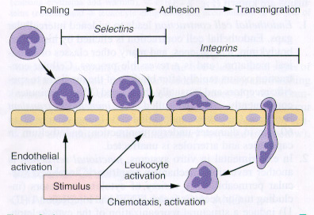
Diapedesis
Leukocytes can _
Entering or leaving circulatory system
Will move to _
Will move by amoeboid motion
Cytoplasmic extensions
Follow a chemical trail

Slide 138
Granulocytes
A collection of white blood cells whose cytoplasm has a _________________________________________ when viewed under a microscope
Function: generally _
Generated in red bone marrow

Slide 139
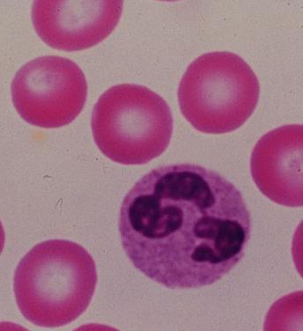
Granulocytes
Neutrophils
Appearance:
Very fine _
Multi-lobed nucleus
Aka: PML: Polymorphonuclear Leukocytes
Function
First WBCs to arrive at the infection site
Phagocytize bacteria and fungus

Slide 140
Neutrophils
Kill bacteria by process called _
Oxygen is metabolized to form _________________________________________________ by the neutrophil
Able to ________________________________ offending bacteria

Slide 141
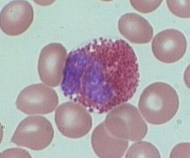
Granulocytes
Eosinophils
Eosin:
Phil: loving
Appearance:

Slide 142
Eosinophils
Function:
Lysosome-like: filled with _
tapeworms, flukes, pinworms, hookworms

Slide 143
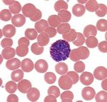
Granulocytes
Basophils
Baso: basic
Phils: loving
Appearance:
Bi-lobed nucleus
Fewer, but larger granules… _
Function
Promotes inflammation: histamines

Slide 144
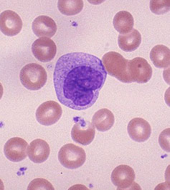
Agranulocytes
________________________develop in the bone marrow
Appearance:
__________________________. (2-3 times larger than RBC)
Nuclei is large and _

Slide 145
Agranulocytes
Monocytes
Function:
Become ________________________________________ as they leave the blood stream
Highly mobile, _
Phagocytize bacteria, viruses, cellular debris

Slide 146
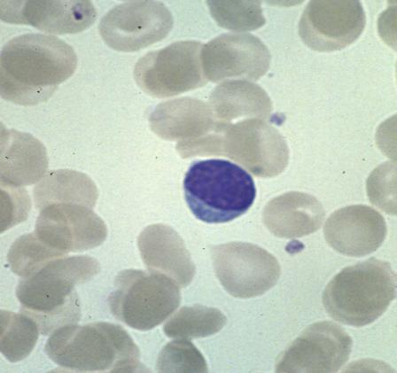
Agranulocytes
Lymphocytes ___________________________as well as lymph tissues
Appearance
About the same _____________________________
Mostly nucleus. Thin crescent of cytoplasm

Slide 147
Lymphocytes
Function:
_____________________________: cell mediated responses against _
______________________________: change into plasma cells which release antibodies

Slide 148
White Blood Cells
Distribution:
Neutrophils 54-62%
Eosinophils 1-3 %
Basophils 1%
Monocytes 3-9%
Lymphocytes 25-33%

Slide 149
Leukopoeisis
___________________________________: production of white blood cells
Stimulated by chemical messengers
Two types of glycoproteins
Colony Stimulating Factors

Slide 150
Leukopoiesis
Hemocytoblast →
Will give rise to basophils, eosinophils, neutrophils, and monocytes
Will give rise to _

Slide 151
Leukopoiesis: granulocytes
Myeloid cells → ______________________________________ → promyelocytes →
_________________________________ myelocytye
_________________________________ myelocyte
_________________________________ myelocyte

Slide 152
Leukopoiesis: monocyte
Hemocytoblast → myeloid stem cell → myeloblast
Up to this point, no changes from the granular leukocytes
→ ___________________________________________ → monocyte

Slide 153
Leukopoiesis: Lymphocyte
Hemocytoblast →
__________________________________→
Lymphoblast →
__________________________________ →
Lymphocyte

Slide 154
White Blood Cell Counts
Percentages of the WBCs are of clinical value
Increased leukocytes (overall)
May indicate infection, exercise, strong emotions or loss of body fluids

Slide 155
White Blood Cell counts
Decreased Leukocytes
Penia: _
Flu, measles, mumps, chicken pox, AIDS, polio
___________________________________________, lead, arsenic or mercury poisoning

Slide 156
Leukemia
Group of cancerous conditions _
Increased _
Impairs bone marrow function
Severe _
Named according to the _
Myelocytic: myeloblast descendants: granulocytes and monocytes
Lymphocytic: lymphocytes

Slide 157
Leukemias
_______________________________________ advancing
Seen in _
Seen more in children
_______________________________________ advancing
Seen in later cells stages _
Seen more in elderly

Slide 158
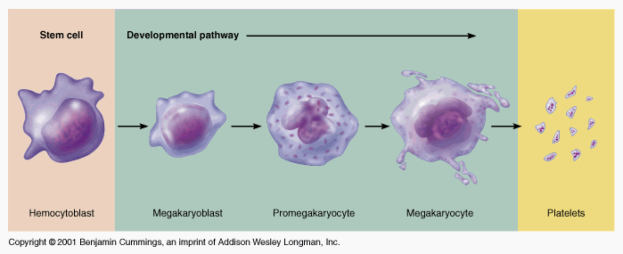
Platelets
fragments
Hemocytoblast→
________________________________________ →
_________________________________________ →
megakaryocyte →

Slide 159
Hemostasis
Heme: blood stasis: stopping
Process is fast, localized and controlled
Hemostasis causes

Slide 160
Vascular Spasm
Damage to blood vessel→ stimulates ________________________________________ → results in less blood loss
Allows for formation of _
Platelets release _______________________________ which further constricts the smooth muscle in the vessel wall.

Slide 161
Platelet Plug Formation
Platelets adhere to _
Particularly the __________________________________ in the connective tissue
Platelets + collagen→
change in shape
Becomes _
Effective for ______________________________ but not large ones

Slide 162
Blood Coagulation
A set of reactions in which blood is transformed _
Coagulation follows _

Slide 163
Blood coagulation
Blood coagulation is dependent on balance
The ____________ ______________________of pro-coagulants and anti-coagulants
Inability to synthesize procoagulants by the ______________________________________ results in severe bleeding disorders

Slide 164
Major event of coagulation
The ______________________________ of the plasma protein _
Fibrin is composed of insoluble threads

Slide 165
Extrinsic Clotting Factors
Triggered when contacts
Any _______________________________ outside the blood vessels

Slide 166
Extrinsic Clotting
Damaged tissues release thromboplastin also called Factor III
Depends also on _

Slide 167
Extrinsic Clotting
End result: Fibrinogen pieces _
Before: soluble
After:
Fibrin sticks to exposed surfaces, ____________________________________________, and prevents blood loss

Slide 168
Intrinsic Clotting
Initiated by Factor VII aka Hageman Factor
Due to _________________________________ in the _
Foreign substances in the blood
Blood stored in _

Slide 169
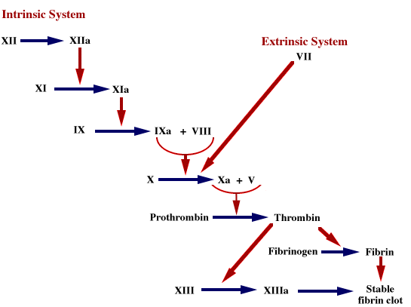

Slide 170
Clots
Fibrin prevents blood loss by forming clots
Plasminogen converted to Plasmin
Plasmin _

Slide 171
Clots
Thrombus: _
DVT
Deep Vein Thrombosis
Embolus:
if a thrombus fragments or breaks loose and travels through the blood stream, it becomes an embolus

Slide 172
Clots
Embolism: the traveling embolus becomes lodged at a _
Pulmonary embolism: blood clot gets lodged in lung vessels

Slide 173
Hemostasis Disorders
Disseminated Intravascular Coagulation (DIC):
Residual blood cannot clot
Most common as:
A complication of pregnancy
A result of ___________________________________________ or incompatible blood transfusions

Slide 174
Hemostasis Disorders: Bleeding Disorders
Thrombocytopenia
condition where the number of _
Patients show petechiae due to _
Caused by suppression or destruction of bone marrow (e.g., malignancy, radiation)
Platelet counts less than 50,000/mm³ is diagnostic for this condition
Treated with _

Slide 175
Hemostasis Disorders: Bleeding Disorders
Hemophilias
hereditary bleeding disorders caused by lack of clotting factors
Symptoms include _

Slide 176
Hemostasis Disorders: Bleeding Disorders
Hemophilia A
________________________________________________ due to a deficiency of factor VIII
Hemophilia B
due to a deficiency of _
Hemophilia C
______________________________________________, due to a deficiency of factor XI

Slide 177
Transfusions
Whole blood transfusions
Used _
Rapid and voluminous blood loss
Infusions
_____________________________________________ are transferred

Slide 178
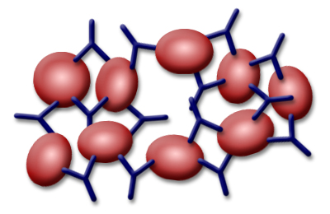
Antigens and Antibodies
Agglutination is caused by the interaction of ___________________________________________ and the _

Slide 179
ABO
Type A Blood: Has _________________________________ on surface
Has ______________________________________ in blood plasma, Anti-B
Will agglutinate when exposed to Anti-A

Slide 180
ABO
Type B Blood: Has __________________________ on surface
Has Antibody A in blood plasma: Anti-A
Will _

Slide 181
ABO Blood groups
Type AB Blood: Has _
Has _
Will agglutinate when exposed to either

Slide 182
ABO Blood Groups
Type O Blood: Has neither antigen on the surface
Has both _

Slide 183
Rh Factor
Named after _
Antigen originally found in the monkey, later found in humans as Antigen D
If any of the rhesus antigens are present_
Antigen D

Slide 184
Rh –
If an Rh – person is exposed to Rh antigens, _
No complications following first exposure

Slide 185
Rh-
If Rh- person again exposed to Rh antigens, _
Erythroblastosis fetalis: hemolytic disease of newborn. Mother’s antibodies can cross placental barrier and _

Slide 186
Exam Format
About 50 questions:
Yes, if it’s in the notes, it’s fair game for the exam
But, do I have to know…?
Yes.
Bring a pencil and eraser
About 90% will be multiple choice questions with only one correct answer.
About 10% will ask you to find a series of correct responses.

