Slide 1
Immunity
Resistance to disease
Immune system
Two intrinsic systems
(nonspecific) defense system
(specific) defense system

Slide 2
Immune System
Functional system
rather than organ system
Innate and adaptive defenses _
Innate defenses do have specific pathways for certain substances
Innate responses ____________________________________ that alert cells of adaptive system to foreign molecules

Slide 3
Immunity
Innate defense system has two lines of defense
First
Second
antimicrobial proteins, phagocytes, and other cells
Inhibit spread of invaders

Slide 4
Immunity
Adaptive defense system
Third line of defense attacks _
Takes longer to react than innate system

Slide 5
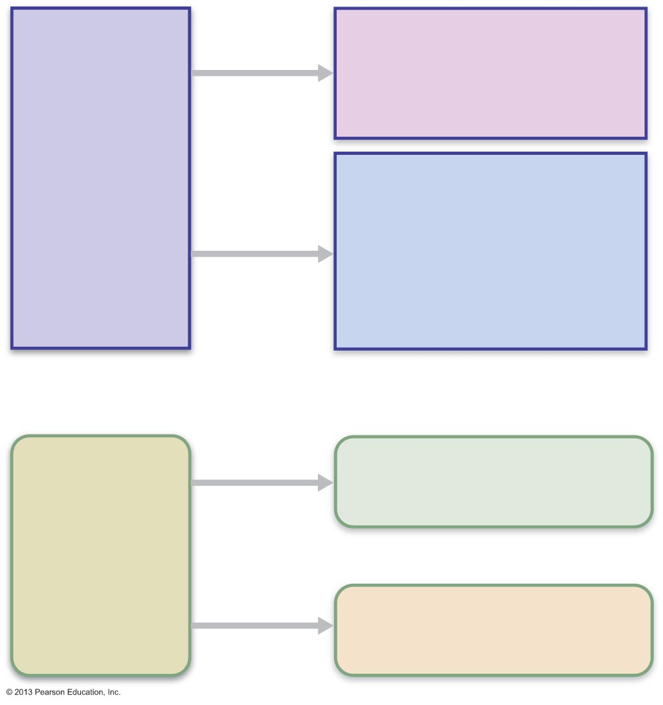
Surface barriers
• Skin
• Mucous membranes
Innate
defenses
Internal defenses
• Phagocytes
• Natural killer cells
• Inflammation
• Antimicrobial proteins
• Fever
Humoral immunity
• B cells
Adaptive
defenses
Cellular immunity
• T cells

Slide 6
Innate Defenses
Surface barriers ward off invading pathogens
Skin, mucous membranes, and their secretions
__________________________________________________ to most microorganisms
______________________________________ resistant to weak acids and bases, bacterial enzymes, and toxins

Slide 7
Surface Barriers
Protective chemicals inhibit or destroy microorganisms
Acidity of skin and secretions inhibits growth
Enzymes have antimicrobial properties
lysozyme of _
respiratory mucus
Defensins
antimicrobial peptides – _
Other chemicals are toxic
lipids in sebum
dermcidin in sweat

Slide 8
Surface Barriers
Respiratory system modifications
________________________ of upper respiratory tract sweep dust and bacteria-laden mucus toward mouth
Surface barriers _
second line of defense must protect deeper tissues

Slide 9
Internal Defenses: Cells and Chemicals
Necessary if microorganisms invade deeper tissues
interferons and complement proteins
macrophages, mast cells, WBCs, and inflammatory chemicals

Slide 10
Phagocytes
Neutrophils most abundant _
Become phagocytic on exposure to infectious material
Macrophages develop from _
________________________________________ macrophages
wander through tissue spaces
_________________________________________ macrophages
permanent residents of some organs
Kupffer cells (liver)
microglia (brain)

Slide 11
Mechanism of Phagocytosis
Phagocyte must _
Some microorganisms evade adherence with capsule
_______________________________________ marks pathogens
coating by complement proteins or antibodies
Cytoplasmic extensions bind to and engulf particle in vesicle called phagosome
Phagosome fuses with lysosome → phagolysosome

Slide 12
Mechanism of Phagocytosis
Pathogens killed by acidifying and digesting with _
Helper T cells cause release of enzymes of _
Defensins (in neutrophils) pierce membrane

Slide 13
Natural Killer (NK) Cells
Nonphagocytic large _
Attack cells _
Induce apoptosis in cancer cells and virus-infected cells
Secrete potent chemicals that enhance _

Slide 14
Inflammatory Response
Triggered whenever _
Disposes of cell debris and pathogens
Alerts adaptive immune system
Sets the stage for repair

Slide 15
Inflammatory Response
Cardinal signs of acute inflammation:
rubor
calor
tumor
Dolor
(Sometimes 5. Impairment of function)

Slide 16
Inflammatory Response
Inflammatory mediators
from mast cells
Kinins, prostaglandins (PGs), leukotrienes, and complement
Released by injured tissue, phagocytes, lymphocytes, basophils, and mast cells

Slide 17
Vasodilation and Increased Vascular Permeability
Inflammatory chemicals cause
Increased permeability of local capillaries and _
leakage of exudate
Exudate contains proteins, clotting factors, and antibodies

Slide 18
Inflammatory Response: Edema
↑ Capillary permeability → exudate to tissues
Fluid containing _
Causes _
Swelling pushes on nerve endings → _
Moves foreign material into lymphatic vessels

Slide 19
Phagocyte Mobilization
_____________________________________ lead and then _
As attack continues, monocytes arrive
12 hours after leaving bloodstream they become _
These "late-arrivers" replace dying neutrophils and remain for clean up prior to repair
If inflammation due to pathogens, complement activated;
adaptive immunity elements arrive

Slide 20
Phagocyte Mobilization
Neutrophils, then other phagocytes flood to inflamed sites
release of neutrophils from bone marrow in response to chemicals from injured cells
neutrophils cling to the walls of capillaries in the inflamed area
Neutrophils squeeze out of the capillary walls and into the surrounding tissue
inflammatory chemicals (chemotactic agent) promote positive chemotaxis of neutrophils

Slide 21
Antimicrobial Proteins
Interferons (IFNs) and complement proteins
Hinder microorganisms’ _

Slide 22
Interferons
_____________________________________ are activated to secrete IFNs
IFNs enter _
Neighboring cells produce ___________________________________ that block viral reproduction

Slide 23
Interferons
Produced by a variety of body cells
Interferons also

Slide 24
Interferons
Functions
Activate macrophages and mobilize NK cells
Genetically engineered IFNs for
Antiviral agents against hepatitis and genital warts virus

Slide 25
Complement
about _________________________________ that circulate in an inactive form
Major mechanism for _

Slide 26
Complement
___________________________ all aspects of the inflammatory response
Kills bacteria and certain other cell types by _
Enhances both _

Slide 27
Complement Activation
Activated complement
Enhances inflammation
Causes _

Slide 28
Fever
Abnormally high body temperature
____________________________________ to invading microorganisms
Leukocytes and macrophages exposed to foreign substances secrete _
Pyrogens act on body's thermostat in hypothalamus, raising body temperature

Slide 29
Fever
Benefits of ______________________________ fever
Causes liver and spleen to _____________________________________________ (needed by microorganisms)
Increases metabolic rate →

Slide 30
Adaptive Defenses
Adaptive immune (specific defense) system
Protects against infectious agents and _
Amplifies inflammatory response
Activates _
Must be primed by initial exposure to specific foreign substance
Priming takes time

Slide 31
Adaptive Defenses
recognizes and targets specific antigens
not restricted to initial site
Have _
stronger attacks to "known" antigens
Two separate, overlapping arms
Humoral (antibody-mediated) immunity
Cellular (cell-mediated) immunity

Slide 32
Humoral Immunity
produced by lymphocytes circulate freely in body fluids
Bind temporarily to target cell
Temporarily inactivate
______________________________________________ by phagocytes or complement

Slide 33
Cellular Immunity
Lymphocytes act against target cell
Directly
Indirectly
by ________________________________________________ that enhance inflammatory response; or _____________________________________________________ or macrophages

Slide 34
Antigens
Substances that ___________________________________________ and provoke an immune response
Targets of all adaptive immune responses
Most are large, complex molecules not normally found in body (__________________________)

Slide 35
Complete Antigens
Important functional properties
ability to stimulate proliferation of specific lymphocytes and antibodies
ability to react with products of activated lymphocytes and antibodies released
Examples: foreign protein, polysaccharides, lipids, and nucleic acids

Slide 36
Haptens (Incomplete Antigens)
Small molecules
peptides, nucleotides, and hormones
become immunogenic _
Cause the immune system to mount a harmful attack
Examples: poison ivy, animal dander, detergents, and cosmetics

Slide 37
Self-Antigens: MHC Proteins
Protein molecules (_______________________) on the surface of cells
Example: MHC proteins
Coded for by genes of the major histocompatibility complex (MHC) and are unique to an individual

Slide 38
MHC Proteins
Classes of MHC proteins
Class I MHC proteins, _
Class II MHC proteins, found on certain cells in the _
MHC proteins display peptides (usually self-antigens)
In ____________________________ cells, MHC proteins display fragments of _

Slide 39
Cells of the Adaptive Immune System
Three types of cells
Two types of lymphocytes
B lymphocytes (B cells)
T lymphocytes (T cells)
Antigen-presenting cells (APCs)
**APC is not a cell name, it’s a _
Play essential auxiliary roles in immunity

Slide 40
Maturation
B cells mature in _
T cells mature in _
Immunocompetence
lymphocyte can recognize one specific antigen by binding to it
B or T cells display unique receptor on surface when achieve maturity –
Self-tolerance
Lymphocytes

Slide 41
T cells
T cells mature in thymus under negative and positive selection pressures ("tests")
Positive selection
_____________________________ (positive selection) the T cells that can
Failing T cells destroyed by apoptosis
Negative selection
_________________________________________________ that destory “self” antigens
Ensures self-tolerance

Slide 42
B cells
B cells mature in red bone marrow
Positively selected if successfully make _
Those that are _
Eliminated by ________________________________ (clonal deletion)

Slide 43
Antigen-presenting Cells (APCs)
Engulf antigens
__________________________________________ to T cells for recognition
Major types
__________________________________________ in connective tissues and epidermis
__________________________________________ in connective tissues and lymphoid organs
B cells

Slide 44
Dendritic Cells and Macrophages
Dendritic cells phagocytize pathogens, enter lymphatics to present antigens to T cells in lymph node
___________________________________ between innate and adaptive immunity
Macrophages widespread in lymphoid organs and connective tissues
Can
Present antigens to T cells to activate themselves into voracious phagocytes that secrete bactericidal chemicals

Slide 45
B lymphocytes
Do not activate naive T cells
Present antigens __________________________________________ to assist own activation

Slide 46
Adaptive Immunity: Summary
Uses lymphocytes, APCs, and specific molecules to _
Depends upon ability of its cells to
Recognize antigens by binding to them
_____________________________________________ with one another so that whole system mounts specific response

Slide 47
Activation and Differentiation of B Cells
B cell activated when antigens bind to its surface receptors and cross-link them →
Receptor-mediated endocytosis of cross-linked antigen-receptor complexes (_______________________________________) →
_______________________________ and differentiation into effector cells

Slide 48
Fate of the Clones
Most clone cells become _
Secrete specific antibodies at rate of ________________________________________ for four to five days, then die
Antibodies circulate in _
Bind to free antigens and mark for destruction by innate or adaptive mechanisms

Slide 49
Fate of the Clones
Clone cells that do not become plasma cells _
Provide immunological memory
Mount an ______________________________________ to_

Slide 50
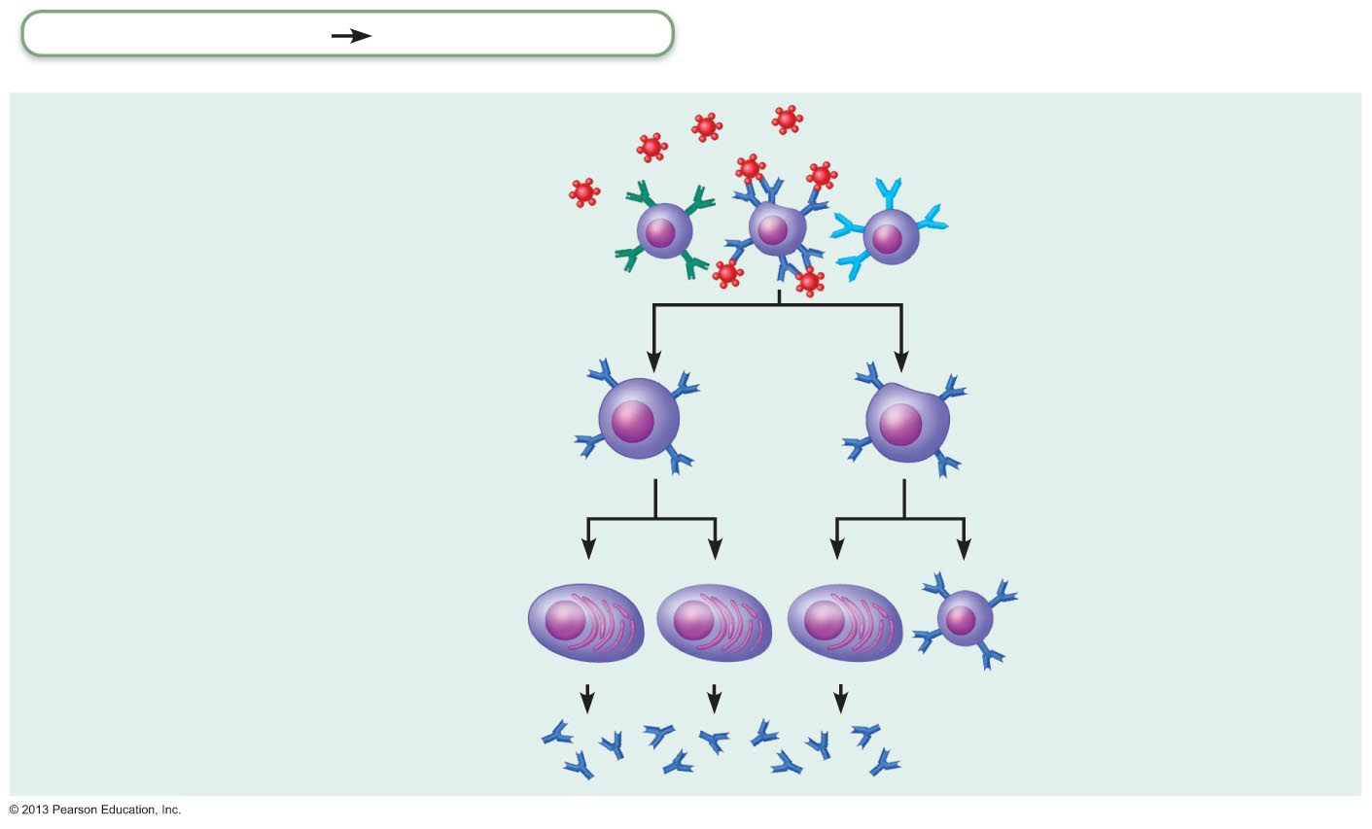
Figure 21.11a Clonal selection of a B cell.
Adaptive defenses
Humoral immunity
Primary response
(initial encounter
with antigen)
Antigen
Antigen binding
to a receptor on a
specific B lymphocyte
(B lymphocytes with
noncomplementary
receptors remain
inactive)
Proliferation to
form a clone
Activated B cells
Plasma cells
(effector B cells)
Memory B cell—
primed to respond
to same antigen
Secreted
antibody
molecules

Slide 51
Immunological Memory
Primary immune response
Cell proliferation and differentiation upon first antigen exposure
Lag period:
Peak levels of ___________________________________ are reached in _
Antibody levels then decline

Slide 52
Immunological Memory
Secondary immune response
Re-exposure to same antigen gives faster, more prolonged, more effective response
Sensitized memory cells respond _
Antibody levels ________________________________________ at much higher levels
Antibodies bind with greater affinity
Antibody level can _

Slide 53
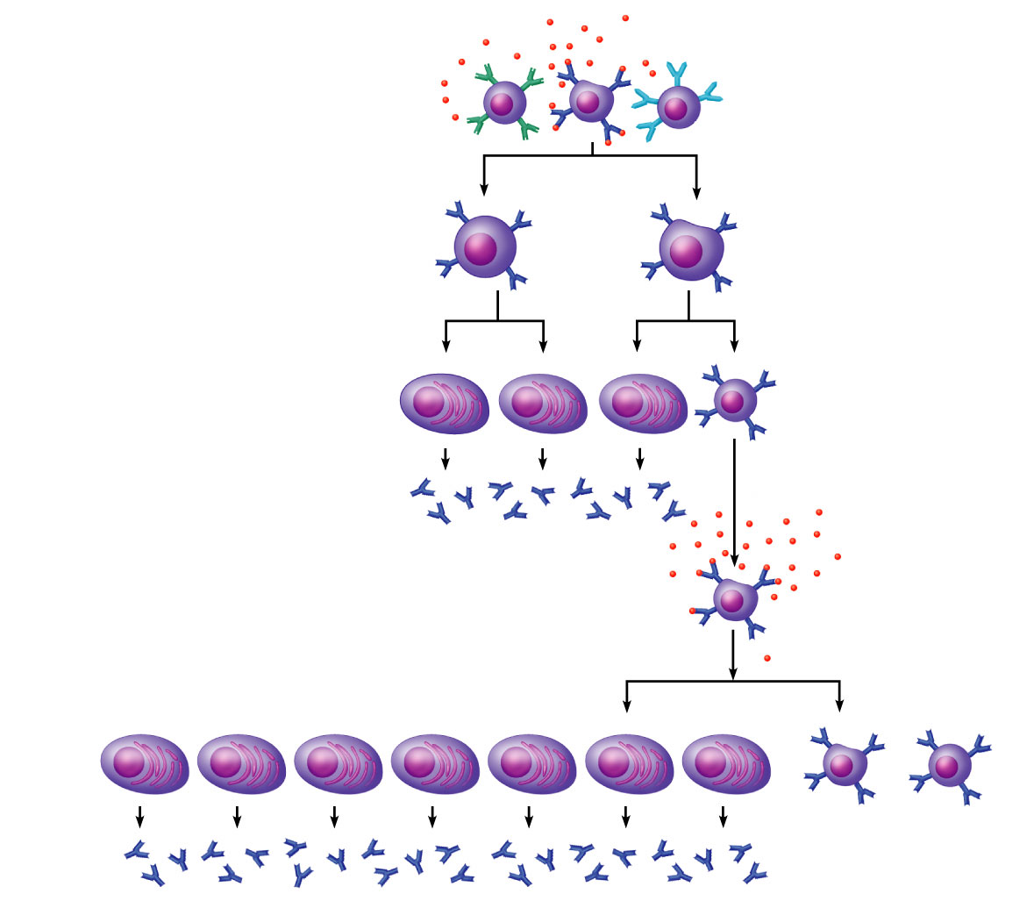
Primary Response
(initial encounter
with antigen)
Antigen
Antigen binding
to a receptor on a
specific B lymphocyte
(B lymphocytes with
non-complementary
receptors remain
inactive)
Proliferation to
form a clone
B lymphoblasts
Plasma
cells
Memory
B cell
Secreted
antibody
molecules
Secondary Response
(can be years later)
Clone of cells
identical to
ancestral cells
Subsequent
challenge by
same antigen
Plasma
cells
Secreted
antibody
molecules
Memory
B cells

Slide 54
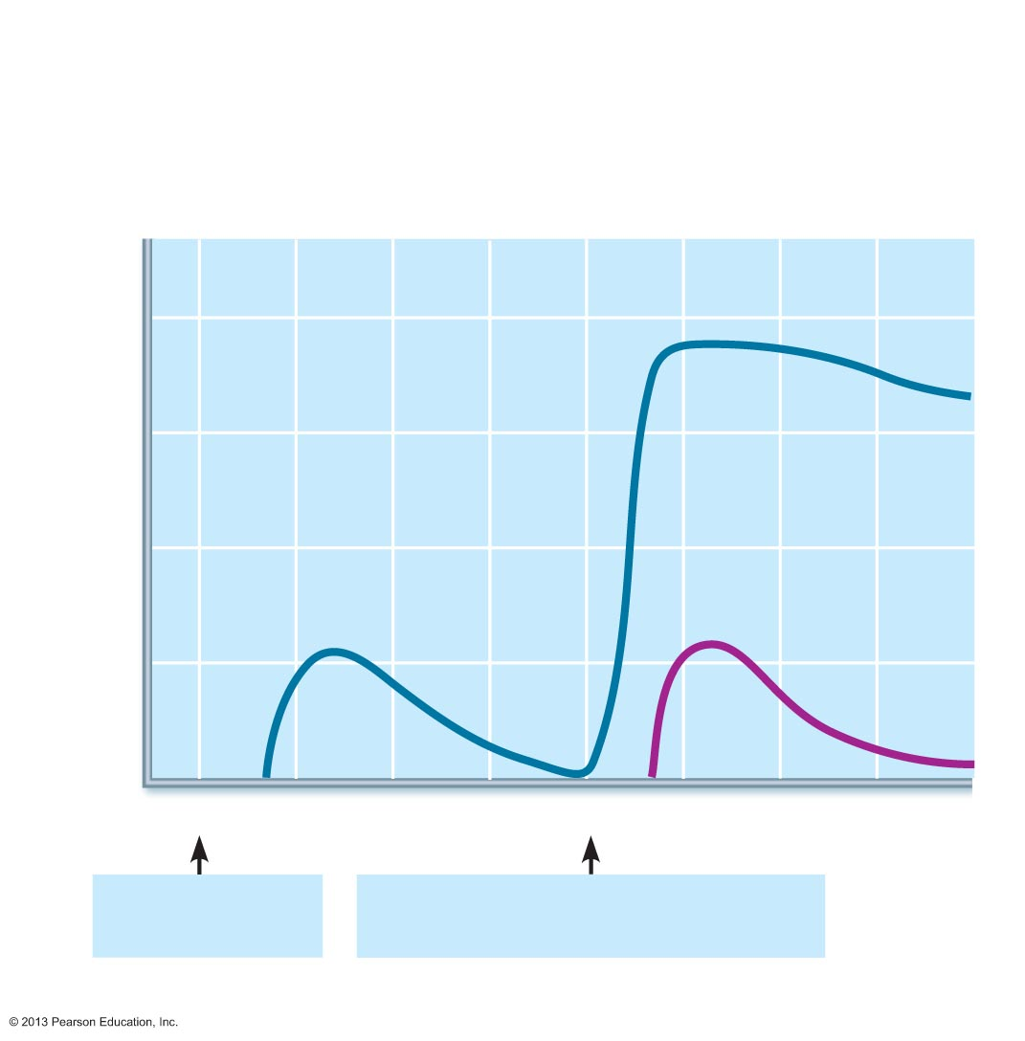
Figure 21.12 Primary and secondary humoral responses.
Secondary immune response to
antigen A is faster and larger; primary
immune response to antigen B is
similar to that for antigen A.
Primary immune
response to antigen
A occurs after a delay.
10⁴
10³
Antibody titer (antibody concentration)
in plasma (arbitrary units)
10²
10¹
Anti-
Bodies
to B
Anti-
Bodies
to A
10⁰
0
7
14
21
28
35
42
49
56
First exposure
to antigen A
Second exposure to antigen A;
first exposure to antigen B
Time (days)

Slide 55
Active Humoral Immunity
When B cells encounter antigens and produce specific antibodies against them
Two types of active humoral immunity:
response to bacterial or viral infection
Exposure to _
Artificially acquired
response to vaccine of dead or attenuated pathogens
Exposure to __________________________________, but not the actual pathogen

Slide 56
Active Humoral Immunity
Vaccines
Most of
Spare us symptoms of primary response
Provide antigenic determinants that are _

Slide 57
Passive Humoral Immunity
Antibodies _____________________ rather than made
B cells are not challenged by antigens
Immunological memory _
Protection ends when antibodies degrade

Slide 58
Passive Humoral Immunity
Two types
Naturally acquired
antibodies ___________________________________ via placenta or to infant through milk
Artificially acquired
Introduction of antibodies _
Protection immediate but ends when antibodies naturally degrade in body

Slide 59
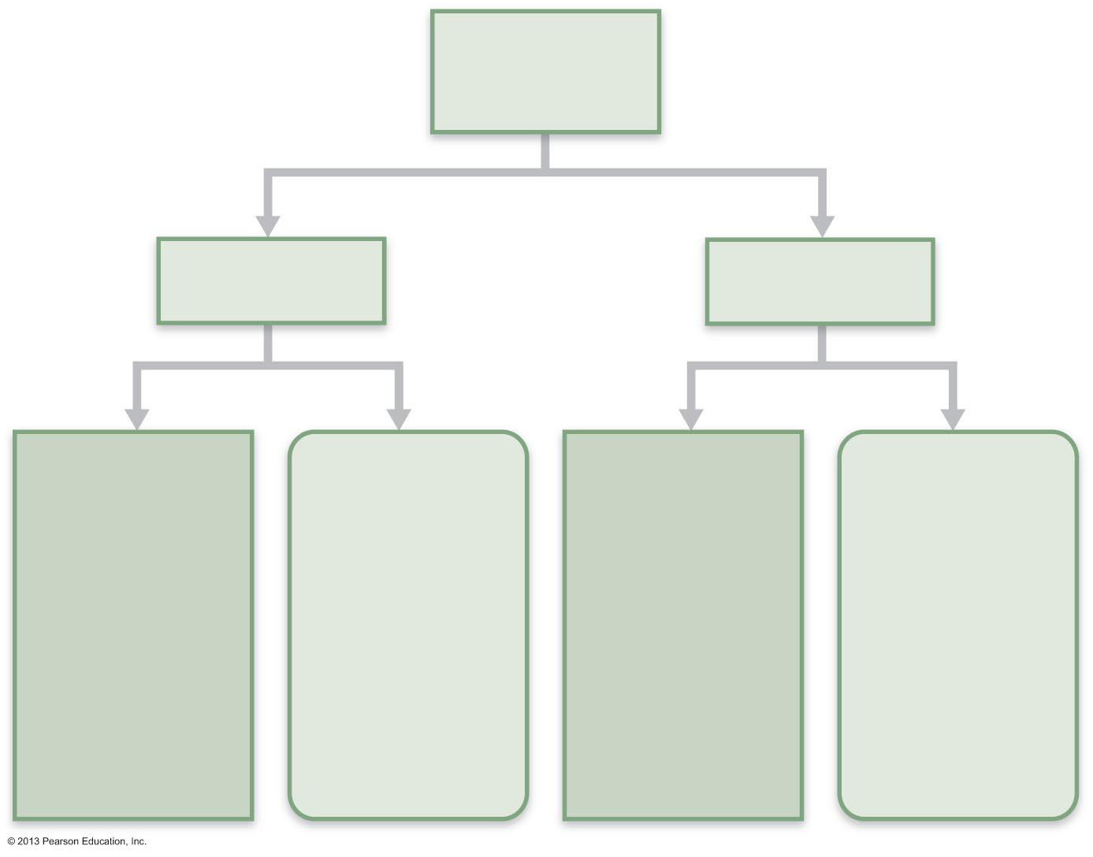
Figure 21.13 Active and passive humoral immunity.
Humoral
immunity
Active
Passive
Naturally
acquired
Artificially
acquired
Naturally
acquired
Artificially
acquired
Infection;
contact
with
pathogen
Vaccine;
dead or
attenuated
pathogens
Antibodies
passed from
mother to
fetus via
placenta; or
to infant in
her milk
Injection of
exogenous
antibodies
(gamma
globulin)

Slide 60
Antibodies
Immunoglobulins
gamma globulin portion of blood
Proteins secreted by _
Capable of binding specifically with antigen detected by B cells
Grouped into one of _____________________ Ig classes

Slide 61
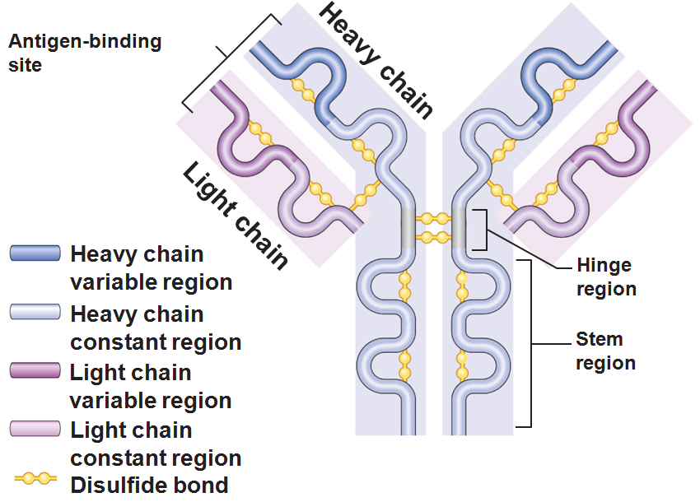
Basic Antibody Structure
T-or Y-shaped monomer
four linked polypeptide chains
Two identical _
Two identical _

Slide 62
Basic Antibody Structure
Variable (V) regions of each arm combine to form two _
Constant (C) region of stem determines
The antibody __________________ (IgM, IgA, IgD, IgG, or IgE)
The cells and chemicals that the antibody can bind to
How the antibody class functions in antigen elimination

Slide 63
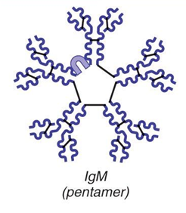
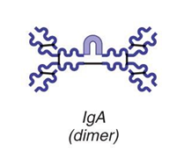
Classes of Antibodies
IgM
A ____________________________; first antibody released
Potent agglutinating agent
Readily fixes and activates complement
IgA (secretory IgA)
Monomer or _______________________; in __________________________and other secretions
Helps prevent entry of pathogens

Slide 64
Classes of Antibodies
IgD
Monomer attached to the _
Functions as a _
IgG
Monomer; 75–85% of antibodies in plasma
From _

Slide 65
Classes of Antibodies
IgE
Monomer active in some _
Causes mast cells and basophils to release histamine

Slide 66
Antibody Targets
Antibodies _
Form antigen-antibody (immune) complexes
Defensive mechanisms used by antibodies
____________________________ by Complement fixation
Memory tool: Think “P.L.A.N” of attack

Slide 67
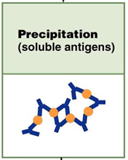
Precipitation
Complexes precipitate and are subject to phagocytosis

Slide 68
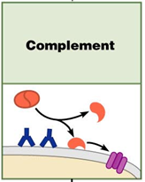
Complement Fixation and Activation
Main antibody defense against cellular antigens
Several antibodies bind close together on a cellular antigen
Their complement-binding sites _________________________________ into the cell’s surface
Complement triggers _

Slide 69
Complement Fixation and Activation
Activated complement functions
Enlists more and more defensive elements

Slide 70
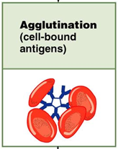
Agglutination
Antibodies bind the same determinant _
Cross-linked antigen-antibody complexes _
Example: clumping of mismatched blood cells

Slide 71
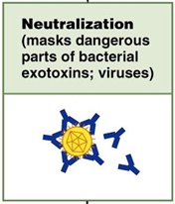
Neutralization
Simplest mechanism
Antibodies block specific sites on viruses or _
Prevent these ___________________________________ to receptors on tissue cells
Antigen-antibody complexes _

Slide 72
Summary of Antibody Actions
Antigen-antibody complexes _________________________________________; prepare them for destruction by innate defenses
Antibodies do not invade solid tissue unless lesion present
Can act __________________________________ if attached to virus before it enters cell
Activate mechanisms that destroy virus

Slide 73
Cell-Mediated Immune Response
T cells provide defense against intracellular antigens
Two types of surface receptors of T cells
Play a role in T cell interactions with other cells

Slide 74
Cell-Mediated Immune Response
Major types of T cells
CD4 cells become ___________________________ (T_{H}) when activated
CD8 cells become _________________________________ (T_{C}) that destroy cells harboring foreign antigens
Other types of T cells
________________________________________ T cells (T_{REG})
________________________________________ T cells

Slide 75
Comparison of Humoral and Cell-Mediated Response
Antibodies of the _
The simplest ammunition of the immune response
Targets
Bacteria and molecules in _ (body secretions, tissue fluid, blood, and lymph)

Slide 76
Comparison of Humoral and Cell-Mediated Response
T cells of the cell-mediated response
Recognize and respond _
Targets
Body cells ______________________________ by viruses or bacteria
Abnormal or _
Cells of infused or transplanted foreign tissue

Slide 77
Antigen Recognition
Immunocompetent T cells are activated _
T cells must simultaneously recognize
Nonself : the antigen
Self: an MHC protein of a body cell

Slide 78
MHC Proteins
Two types of MHC proteins are important to T cell activation
Class I MHC proteins
displayed by _
Class II MHC proteins
displayed by ________________________________ : dendritic cells, macrophages and B cells

Slide 79
Class I MHC Proteins
Bind with fragment of a protein synthesized in the cell (____________________________________)
Endogenous antigen is a self-antigen in a normal cell;
Would be a nonself antigen in an infected or abnormal cell
Informs cytotoxic T cells of the _

Slide 80
Class II MHC Proteins
Bind with fragments of _____________________ antigens that have been engulfed and broken down
Recognized by _

Slide 81
T cell activation: step one
Phagocytic cell engulfs material
Becomes APC: antigen presenting cell
__________________________________________ on the APC surface
T cells will bind to the antigen on the APC
Helper T (CD4) cells bind to class II MHC
Cytotoxic T (CD8) cells will be activated through class I MHC

Slide 82
T cell activation: step two
Once the T cell has found the MHC and the antigen, it needs a few more signals from the APC
Co-stimulatory signals
_____________________________________________ on the APC help to activate T cells
_____________________________________ (Interleukins 1 and 2) are released and cause the T cell to activate and differentiate
Results in _

Slide 83
Cytokines
Cytokines
General term for mediators that influence cell development, differentiation and response
Interleukin 1 (IL-1)
Stimulates T cells to release IL-2
Interleukin 2 (Il-2)
Growth factor

Slide 84
Roles of Helper T(T_{H}) Cells
Play a central role in the adaptive immune response
Once primed by APC presentation of antigen, they
Help _
Induce T and B cell _
Activate macrophages and recruit other immune cells
Without T_{H}, there is _

Slide 85
Helper T Cells
Interact _
Stimulate B cells to divide more rapidly and begin antibody formation
Most antigens require T_{H} ______________________________ to activate B cells

Slide 86
Roles of Cytotoxic T(T_{C}) Cells
Activated T_{C} cells circulate in blood and lymph and lymphoid organs in search of body cells displaying antigen they recognize

Slide 87
Roles of Cytotoxic T(T_{C}) Cells
Targets
Cells with intracellular bacteria or parasites
Foreign cells (___________________________________________)

Slide 88
Cytotoxic T Cells
Bind to a ________________________________ complex
Can destroy all infected or abnormal cells

Slide 89
Cytotoxic T Cells
Lethal hit
T_{c} cell releases _____________________________________________ by exocytosis
Perforins create _________________________ through which granzymes enter the target cell
Granzymes stimulate _

Slide 90
Natural Killer Cells
Recognize other signs of abnormality
Different surface marker on stressed cells
Use the same key mechanisms as Tc cells for killing their target cells

Slide 91
Regulatory T (T_{Reg}) Cells
__________________________________________ by direct contact or by inhibitory cytokines
Important in preventing _

Slide 92
Organ Transplants
Four varieties
from one body site to another in the same person
between identical twins
between individuals who are not identical twins
from another animal species

Slide 93
Prevention of Rejection
Depends on the similarity of the tissues
Patient is treated with immunosuppressive therapy
Corticosteroid drugs to _
Antiproliferative drugs
Many of these have severe side effects

Slide 94
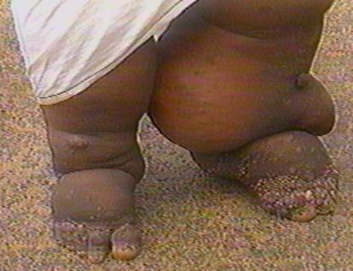
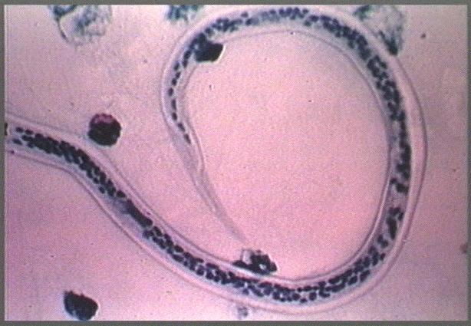
Clinical Terms
Elephantiasis
Caused by __________________________ invading the lymphatic system in the lower extremities
Lymphatic filariasis
Results in _
May be a combination of lymph blockage and immune response to the parasite
Typically a tropical disease

Slide 95
Hodgkin’s disease
Lymphoid tissue malignancy
Cancerous growth of _
Symptoms:
Swollen, _______________________________ lymph nodes
Fever

Slide 96
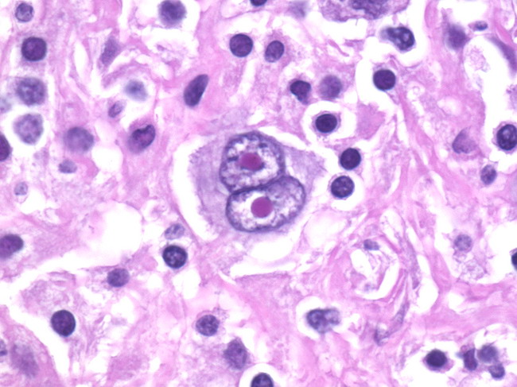
Hodgkin’s disease
Characterized by _
Thought to be a _
Treatment:
Chemotherapy and radiation
High cure rate

Slide 97
Non-Hodgkin’s lymphoma
Includes all cancers of lymphoid tissue _
Uncontrolled multiplication and ________________________________ of undifferentiated lymphocytes
Swelling of they lymph nodes
Spleen
Peyer’s patches
Is the 5th most common type of cancer

Slide 98
Lymphoma
General term
Any ________________________________ of the lymphoid tissue
Malignant

Slide 99
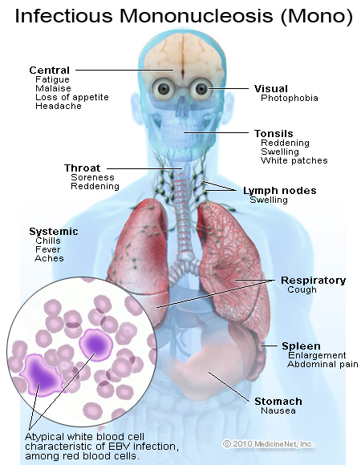
Mononucleosis
Viral disease “_________________”
Caused by Epstein-Barr Virus
Present in _
“kissing disease”
Also passed by coughing
Virus attacks B lymphocytes →
Symptoms
Fever
Sore throat
Swollen lymph nodes
Duration:

Slide 100
Hypersensitivities
Immune responses to perceived (___________________________________) threat cause tissue damage
Different types distinguished by
Whether
Antibodies cause _______________________________ and subacute hypersensitivities
T cells cause

Slide 101
Immediate Hypersensitivity
Acute (type I) hypersensitivities (_____________________________ ) begin in seconds after contact with allergen
Initial contact is ____________________________ but _
Reaction may be local or systemic

Slide 102
Immediate Hypersensitivity
The mechanism involves IL-4
stimulates B cells to _
IgE binds to _
flood of histamine release
Results in _
Later encounter with same allergen →

Slide 103
Immediate Hypersensitivities
Allergic reactions local or systemic
Local
mast cells of ____________________________ and respiratory and _______________________________________ mucosa
Histamines → blood vessels dilated and leaky → _
Asthma if allergen inhaled
Antihistamines to control
________________________________________ is anaphylactic shock

Slide 104
Anaphylactic Shock
Systemic response to allergen that __________________________________ and circulates rapidly
Basophils and mast cells enlisted throughout body
___________________________________________ may cause
Sudden vasodilation and _
Circulatory collapse (hypotensive shock)
death
Treatment: epinephrine

Slide 105
Delayed Hypersensitivities (Type IV)
_________________________________ (one to three days)
Mechanism depends on _
Cytokine-activated macrophages and cytotoxic T cells cause damage
Example:
allergic contact dermatitis (_____________________________)
Agents act as _

