Slide 1
Lymphocytes
When mature, they have
Immunocompetence; they are able to _
Self-tolerance
unresponsive to self antigens
Naive (unexposed) B and T cells are exported to lymph nodes, spleen, and other lymphoid organs

Slide 2
T Cells
T cells mature in the thymus under negative and positive selection pressures
Positive selection
Negative selection
Prompts _______________________________ of T cells that bind to self-antigens displayed by self-MHC
Ensures _

Slide 3
Antigen-Presenting Cells (APCs)
Present fragments of antigens to be recognized by T cells
Major types
Dendritic cells in connective tissues and epidermis
___________________________________ in connective tissues and lymphoid organs

Slide 4
Macrophages and Dendritic Cells
Present antigens and activate T cells
Macrophages mostly remain fixed in the lymphoid organs
Dendritic cells internalize pathogens and enter lymphatics to present the antigens to T cells in lymphoid organs
Activated T cells _
Prod macrophages to become _____________________________________________ and to secrete bactericidal chemicals

Slide 5
Adaptive Immunity: Summary
Uses __________________________, APCs, and specific molecules to identify and destroy nonself substances
Depends upon the ability of its cells to
______________________________________ by binding to them
Communicate with one another so that the whole system mounts a specific response

Slide 6
Humoral Immunity Response
Antigen challenge
First encounter between an antigen and a naive immunocompetent lymphocyte
Usually occurs in the _
If the lymphocyte is a B cell
The antigen provokes a humoral immune response

Slide 7
Clonal Selection
Antigen binding activates B cells
Antigen taken into B cells by _
B cell produces clones that have receptors for the antigen that originally bound to it.
Needs _____________________________ to do this
Most clone cells _
secrete specific antibodies at the rate of 2000 molecules per second for four to five days

Slide 8
Fate of the Clones
Secreted antibodies
Circulate in _
Bind to free _

Slide 9
Fate of the Clones
Clone cells that do not become plasma cells become _
Provide immunological memory
Mount an ______________________________ response to ______________________________ of the same antigen

Slide 10
Immunological Memory
Primary immune response
Occurs on the first exposure to a specific antigen
Lag period:
Peak levels of plasma antibody are reached in _
Antibody levels _

Slide 11
Immunological Memory
Secondary immune response
Occurs on _______________________________ to the same antigen
Sensitized memory cells respond within _
Antibody levels peak in _______________________________________ at much higher levels
Antibodies bind with greater affinity
Antibody level can remain high for _

Slide 12
Active Humoral Immunity
Occurs when B cells encounter ____________________________ and produce specific antibodies against them
Two types
Naturally acquired
response to a _
Artificially acquired
response to _

Slide 13
Active Humoral Immunity
Vaccines
Spare us the symptoms of the primary response
Provide ____________________________________ that are immunogenic and reactive
Target only ______________________________________, so fail to fully establish cellular immunological memory

Slide 14
Passive Humoral Immunity
Antibodies introduced, but not _
B cells are not challenged by antigens
Immunological _________________________ does not occur

Slide 15
Passive Humoral Immunity
Two types
Naturally acquired
injection of serum, such as gamma globulin
Protection is immediate but ends _
End Chapter 20. Start Chapter 21

Slide 16
Antibodies
Immunoglobulins
Proteins secreted by _
Capable of binding specifically with _________________________________ detected by B cells

Slide 17
Basic Antibody Structure
T-or Y-shaped monomer
four linked polypeptide chains
Two _
Two _

Slide 18
Basic Antibody Structure
Variable (V) regions of each arm combine to form two identical _
Constant (C) region of stem determines
The antibody class (IgM, IgA, IgD, IgG, or IgE)
How the antibody class functions in antigen elimination

Slide 19
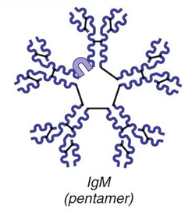
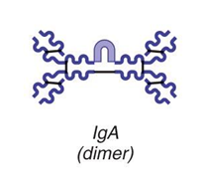
Classes of Antibodies
IgM
A _____________________________; first antibody released
Potent agglutinating agent
Readily fixes and activates complement
IgA (secretory IgA)
Monomer or _____________________ ; in _____________________and other secretions
Helps prevent entry of pathogens

Slide 20
Classes of Antibodies
IgD
Monomer attached to the surface of _
Functions as a _
IgG
Monomer; 75–85% of antibodies in plasma
From _
Crosses the _

Slide 21
Classes of Antibodies
IgE
Monomer active in some _
Causes mast cells and basophils to release _

Slide 22
Antibody Targets
Antibodies _
Form antigen-antibody (immune) complexes
Defensive mechanisms used by antibodies
Agglutination
Lysis by Complement fixation

Slide 23
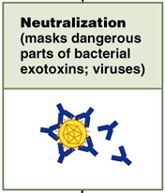
Neutralization
___________________mechanism
Antibodies block _____________________________ or bacterial exotoxins
Prevent these antigens from binding to receptors on tissue cells
Antigen-antibody complexes undergo _

Slide 24
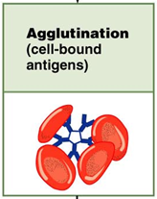
Agglutination
Antibodies bind the same determinant on _
Cross-linked antigen-antibody complexes agglutinate
Example: clumping of _

Slide 25
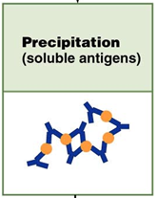
Precipitation
___________________________ are cross-linked
Complexes precipitate and are subject to _

Slide 26
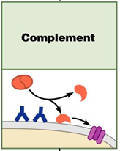
Complement Fixation and Activation
Main antibody defense against cellular antigens
Several antibodies __________________________ on a cellular antigen
Their complement-binding sites trigger ____________________________ into the cell’s surface
Complement triggers cell _

Slide 27
Complement Fixation and Activation
Activated complement functions
Amplifies the _
Enlists more and more defensive elements

Slide 28
Cell-Mediated Immune Response
T cells provide defense against ____________________________ antigens
Two types of surface receptors of T cells
Play a role in T cell interactions with other cells

Slide 29
Cell-Mediated Immune Response
Major types of T cells
CD4 cells become _
CD8 cells become _______________________________________ that destroy cells harboring foreign antigens
Other types of T cells
Regulatory T cells (T_{REG})

Slide 30
Comparison of Humoral and Cell-Mediated Response
Antibodies of the _
The simplest ammunition of the immune response
Targets
__________________________________ and molecules in extracellular environments (body secretions, tissue fluid, blood, and lymph)

Slide 31
Comparison of Humoral and Cell-Mediated Response
T cells of the cell-mediated response
Recognize and respond _____________________________________ displayed on the surface of body cells
Targets
_______________________________________ infected by viruses or bacteria
Abnormal or _
Cells of infused or ____________________________________ foreign tissue

