Slide 1
Exam Three material: Chapter 20

Slide 2
Lymphatic
Lymphatic system
assoc. with the cardiovascular system
Includes
network of lymphatic vessels
circulating body fluids.
Lymphoid tissues and organs
Houses phagocytic cells
Filtration sites

Slide 3
Lymph
Lymphatic _____________________ transport _____________________________ away from interstitial spaces between cells and return it to the _

Slide 4
Lymphatic Capillaries
Microscopic, _.
Extends into _
Parallels the networks of the blood capillaries.
Absent in
Central nervous system

Slide 5
Lymphatic capillaries
____________________________ permeable
Endothelial cells are not tightly joined
They _
Form mini-valves
Collagen filaments anchor the endothelial cells
Any _____________________________________ in interstitial fluid volume opens the mini-valves

Slide 6
Lymphatic capillaries
Increase interstitial pressure causes fluid to be _______________________________________
Mini-valves open due to pressure
Increased pressure within the capillaries prevents fluid from leaking out into the _
Mini-valves _

Slide 7
Lymphatic capillaries
Lymph capillaries responsible for
Can pick up _
blood vessels can not
During inflammation, capillaries open to pick up
Bacteria

Slide 8
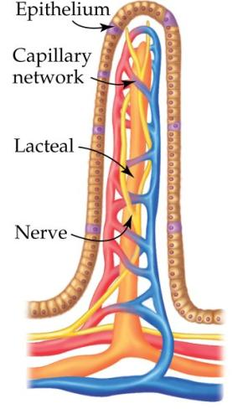
Lacteals
Highly specialized
Present in _
Helps to absorb digested ___________________ from the intestines
Chyle: _
Will be returned to the circulatory system

Slide 9
Lymphatic vessels
Lymphatic Vessels
similar to _
Three layers
Smooth muscle and elastic fibers
outer layer of _

Slide 10
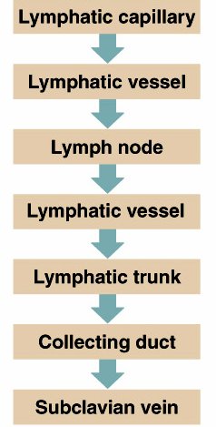
Lymphatic Vessels
Have ________________________ valves.
Lymphatic vessels lead to
From nodes, vessels go to lymphatic _

Slide 11
Lymphatic Trunks
Lymphatic trunks: drain lymph.
Named for the ____________________________ they serve.
drains from lower limbs, lower abdominal wall and pelvic organs.
abdominal viscera
Subclavian:
upper limb
head and neck

Slide 12
Lymphatic trunks
Lymphatic trunks join _
Right Lymphatic duct:
Drains lymph from
right side of _
thorax
Empties into ________________________________________ near junction of the R jugular vein.

Slide 13
Collecting Ducts
Thoracic duct
_______________________________________________ of the two ducts.
Begins as an enlarged sac anterior to L1/L2
Thoracic duct drains lymph from
Cisterna chyli
Left side of thorax
Left upper limb
head
empties into the ______________________________________________ near the left jugular vein

Slide 14
Lymphatic ducts
Lymph enters the venous system and becomes ___________________________________ before blood returns to Right atrium.

Slide 15
Lymph movement
Other forces that help with lymphatic movement include
contraction of _
pressure changes due to the _
contraction of ________________________________________ in the walls of the larger lymphatic trunks.

Slide 16
Lymph
breathing muscles aid in lymph circulation:
______________________________ in thorax during _
Contracting diaphragm increases the pressure in the abdominal cavity….
Lymph fluid squeezed out of _____________________________________________________________________________. Valves prevent back-flow.

Slide 17
Lymph movement
Obstruction of movement:
________________________________: may result from __________________________ of lymphatic tissue
breast cancer patient with ______________________________ removed and swollen arms
Lymph vessels will eventually _

Slide 18
Lymphoid tissue
Important part of immune system
Houses and provides ____________________________________ for lymphocytes
Provides a place in which the lymphocytes and macrophages have the _

Slide 19
Types of lymphoid tissue
__________________________________ connective tissue
Found in all lymphoid organs _
_____________________________________ live along the fibers
Lymphocytes live within the spaces of the network

Slide 20
Lymphoid tissue arrangement
Few reticular elements
Fount in _
Large collections found in lymph organs
Lymphoid _
Solid
Tightly packed reticular elements
Light-staining centers called germinal centers

Slide 21
Lymph Nodes
Lymph nodes:
Located along _
Contain large numbers of lymphatocytes _
fight invading microorganisms.

Slide 22
Lymph Nodes
Lymph nodes:
less than 2.5 cm and bean-shaped.
Indention is called ________________________________ where blood vessels and nerves connect with structure.
Covered by _
Trabeculae extend inward to divide the node into compartments called nodules
Centers of nodules stain lighter and are called _

Slide 23
Lymph Nodes
Lymphatic vessels lead to a node
__________________________________ vessels enter at various points.
__________________________________ vessel ___________________________ from the hilum

Slide 24
Lymph Nodes
Nodes occur _
Lymph nodes are divided into
Superficial
Densely _
Germinal centers are location of _
Medulla
Medullary cords
Tissue contains _

Slide 25
Lymph Nodes
____________________________ functions of lymph nodes
_________________________________________ potentially harmful particles from lymph
Lymph nodes are the only lymphatic structures that filter lymph
centers for _______________________________________________ (along with bone marrow)
Macrophages within the nodes engulf and destroy foreign substances, damaged cells, cellular debris.
Tonsils are ___________________________________________ lymph nodes.
Peyer’s patches are nodules in the _

Slide 26
Thymus
Thymus…lymphatic organ.
Soft, _
Located within the __________________________________________, anterior to aortic arch, posterior to upper part of the sternum.
Varies in size from person to person.
Can be small or replaced by connective and _
Loses lymphatic properties in _

Slide 27
Thymus
Divided into lobules.
Precursor cells. Inactive thymocytes. Some mature into _
provide _
Stimulated by ____________________________, produced by epithelial cells in thymus.

Slide 28
Thymus
Contains Thymic corpuscles
A.k.a __________________________________ corpuscles
Function: Site of _

Slide 29
Spleen
____________________________________ of the lymphatic organs.
Location:
upper left portion of abdominal cavity, inferior to diaphragm.
Appearance:
Resembles a _
Connective tissue divides spleen into chambers/nodules.
Hilum on surface where _

Slide 30
Spleen
Spleen function
Site of _
Blood _
Removes debris
Removes aged and defective RBCs

Slide 31
Additional Spleen function
1. _______________________________ breakdown products of RBCs for later use
2. Site of _
3. Stores blood _

Slide 32
Spleen
Two types of tissues in spleen:
located throughout the spleen in _
Composed of nodules.
Forms around _
Contain many _

Slide 33
Spleen
Red pulp:
fills remaining spaces of lobules,
surrounds _
Contains __________________________________ where it gets its color
many lymphocytes and macrophages

Slide 34
Tonsils
Simplest lymphoid organs
Named for locations
Bilateral, _
Largest
Most often _
Lingual
Base of _
Posterior wall of nasopharynx

Slide 35
Tonsils
Contains follicles with germinal centers
Not fully _
Epithelium forms tonsillar crypts

Slide 36
Additional lymphoid follicles
Peyer’s Patches
Large, _
Located in wall of small intestine
Works along with Peyers Patches to ______________________________________ and generate _

Slide 37
MALT
Located by passages that are open to the exterior
Respiratory
Genitourinary

Slide 38
Clinical Terms
Elephantiasis
Caused by ________________________ invading the lymphatic system in the lower extremities
Lymphatic filariasis
Results in _
May be a combination of lymph blockage and immune response to the parasite
Typically a _

Slide 39
Hodgkin’s disease
Lymphoid tissue _
Cancerous growth of cells in the lymph system
Symptoms:
Fatigue
Fever

Slide 40
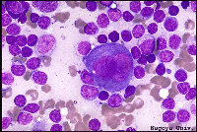
Hodgkin’s disease
Characterized by _
Thought to be a malignant _
Treatment:
Chemotherapy and radiation
High cure rate

Slide 41
Non-Hodgkin’s lymphoma
Includes all cancers of lymphoid tissue _
Uncontrolled multiplication and _
Swelling of the lymph nodes
Peyer’s patches
Is the 5th most common type of cancer

Slide 42
Lymphoma
General term

