Slide 1
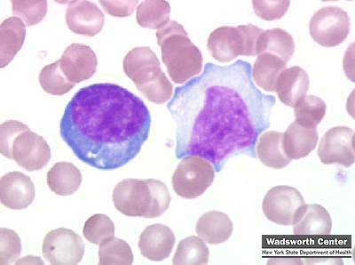
Mononucleosis
_______________________________ disease “mono”
Caused by Epstein-Barr Virus
Present in _
“kissing disease”
Also passed by _
Virus attacks B lymphocytes → activation of T lymphocytes which _
Symptoms
Fever
Swollen lymph nodes
Duration:

Slide 2
Chapter 21: The Immune System
Means of defense
External membranes provided first line of defense
Inflammation is a indication of a second line of defense
A __________________________________ attack to wipe out invaders
Goes after specific _
Third line of defense

Slide 3
Immunity
Body defends against infection:
__________________________________ of entry or
_________________________________ after entry.
___________________________________: disease causing agent….
Microorganisms, protozoa, fungal spores

Slide 4
Innate/Non-Specific Defense
skin and mucus membranes lining respiratory, digestive, urinary, reproductive.
Prevent entrance.
epidermis sloughs off and removes superficial bacterial.
____________________________________ nepithelium of respiratory system
traps particles and brushes them out into _
Swallowed. Destroyed by digestive system

Slide 5
Innate Defenses
Epithelial membranes have the following protective features
Skin acidity prevents _
Same is true of vaginal canal
Stomach ______________________________ secretes two relevant factors
Protein digesting enzymes

Slide 6
Innate defenses
Epithelial membranes have the following protective features
Saliva and tears contain _
Enzymes that _
____________________________________ acts as a sticky trap
Respiratory passageways: debris enters and gets trapped instead of traveling to lungs

Slide 7
Non Specific Defenses
Most diseases are unique to species.
No _
Failure to provide temperature or chemical environment for _

Slide 8
Internal innate defenses
Natural _
Antimicrobial proteins

Slide 9
Internal: Phagocytes
Phage:
Free macrophages
Alveolar macrophages
“____________________________” throughout the tissues looking for debris
____________________________ macrophages
__________________________________ cells
Permanent residents of a particular organ

Slide 10
Internal: Phagocytes
Neutrophils
Most _
Phagocytic once they encounter infectious materials
Also produce antimicrobial chemical called _
________________________________________ pathogen’s membrane
Eosinophils
__________________________________ phagocytes
Important against _

Slide 11
Phagocytosis
Steps
1.
2. Phagocyte forms ____________________________________ and engulfs microbe
3. _____________________________formed by phagocyte _
4. Lysosomal ______________________________ break down microbe
5. Residual material is removed by _

Slide 12
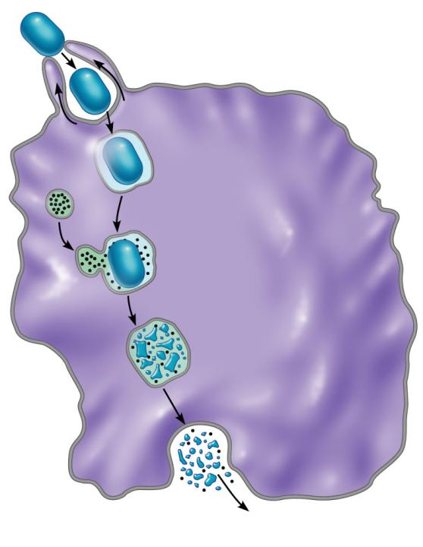
1
Microbe adheres to phagocyte.
2
Phagocyte forms pseudopods that eventually engulf the particle.
Phagocytic vesicle
containing antigen
(phagosome).
Lysosome
3
Phagocytic vesicle is
fused with a lysosome.
Phagolysosome
4
Microbe in fused vesicle
is killed and digested by
lysosomal enzymes within
the phagolysosome, leaving
a residual body.
Acid
hydrolase
enzymes
Residual body
5
Indigestible and
residual material
is removed by
exocytosis.
(b)

Slide 13
Internal Innate: NK cells
Defensive cells that can _
Identify a “_____________________________” on foreign cells
Direct contact that causes apoptosis (programmed cell death)
Enhance the inflammatory response

Slide 14
Internal Innate: Inflammation
Inflammation triggered by
Intense heat
Irritating chemicals

Slide 15
Internal Innate: Inflammation
Benefits
________________________________________ of damaging agents to nearby tissues
_________________________________________ and pathogens
Encourages _

Slide 16
Internal Innate: Inflammation
Cardinal signs of Inflammation:
Vasodilation brings in increased blood
Vasodilation brings in increased blood
Increased capillary permeability
Chemicals released during tissue damage
Swelling can trigger free nerve endings

Slide 17
Goal of Inflammation
1. wall off injured area to prevent spread of bacteria or microbes
2. Release ________________________________ to increase permeability
Exudate containing ____________________________________________ are introduced to the damaged area
Goal is to ________________________________, prevent further damage, and _

Slide 18
Internal Innate: Results of Inflammation
Inflammations _
Neutrophils first
Then _
1. Leukocytosis:
chemicals release __________________________________ from red bone marrow
2.
Neutrophils will “stick” to capillary walls near the damage
Due to CAMs:

Slide 19
Internal Innate: Results of Inflammation
3.
Neutrophils will _____________________________________________and begin moving towards site of damage
4. Chemotaxis
Movement _

Slide 20
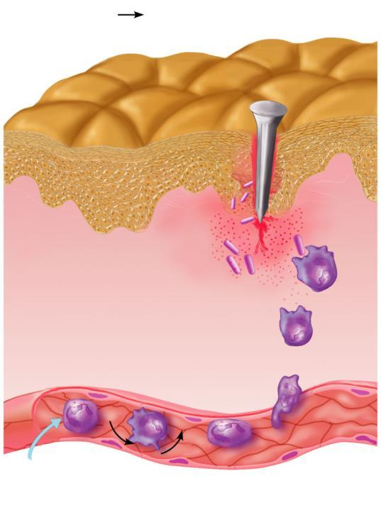
Innate defenses
Internal defenses
4
Positive
chemotaxis
Inflammatory
chemicals diffusing
from the inflamed
site act as chemotactic
agents
1
Neutrophils enter blood
from bone marrow
3
2
Diapedesis
Margination
Capillary wall
Endothelium
Basement membrane

Slide 21
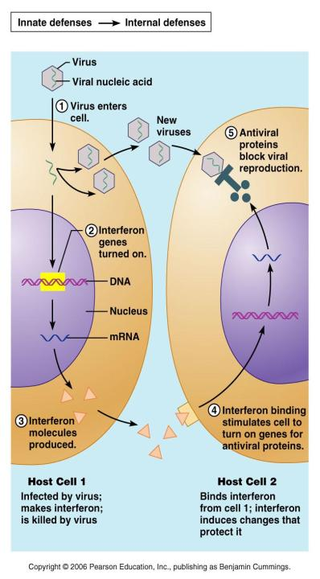
Non Specific defense
hormone-like peptide
Produced by _
Once released from virus infected cell,
binds to _
stimulates them to make ________________________________ that block viral replication.
Effect is _
Also stimulates _

Slide 22
Internal Innate: Complement
________________________________: a group of about _______________________________ that circulate in the blood stream in an _
Once activated, they can stimulate inflammation and cause cell _
Punctures hole in cell membranes
Both the non-specific defenses AND the ____________________________________ can utilize the complement system

Slide 23
Internal Innate: Fever
infection _________________________________ to proliferate, producing cells that secrete _
Raises the thermoregulatory set point in hypothalamus

Slide 24
Fever…non-specific
Fever indirectly counters growth by providing _________________________________ environment to pathogens
High temp causes ___________________________________ and zinc:
bacteria require both of these to multiply
Phagocytic cells ____________________________________ when temp rises.

Slide 25
Specific Defenses
Immunity:
Antigen: mostly proteins, polysaccharides, glycoproteins, or glycolipids

Slide 26
Immune System
Nonspecific Defenses: Innate
Adaptive Defenses: Specific
1. It is directed against ________________________________________ or foreign substances
2. It is _
Not restricted to the _
3. Has a _
Stores “data” and then mounts a stronger attack after the second exposure

Slide 27
Adaptive Defenses
Antibody-mediated immunity
Present in the _
Uses _
Cellular
Cell mediated immunity
Lymphocytes mount responses directly (____________________________________) or indirectly (_______________________________)

Slide 28
Specific Defenses
Our bodies contain proteins, polysaccharides, glycoproteins and glycolipids…why are they not seen as antigens?
Body learns to recognize its own tissues as “__________________________”. Therefore, it won’t attack its own tissues. __________________________ antigens come from a source outside of the body: _

Slide 29
Complete Antigens
_____________________________________ antigens have two important functions
Ability to stimulate proliferation of lymphocytes and antibodies
Ability to interact with activated lymphocytes and antibodies
Antigens include foreign ______________________ , polysaccharides, some ____________________________ and nucleic acids

Slide 30
Incomplete antigens
_
Incomplete antigen
Needs a _
Materials include peptides, nucleotides and hormones
If linked to a protein, they become _
Poison ivy, penicillin
Animal dander, detergents, cosmetics

Slide 31
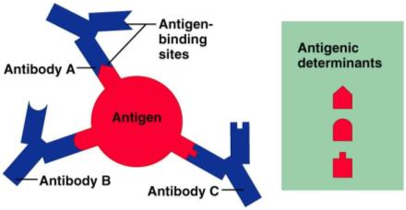
Antigenic Determinants
Only _________________________________ of an entire antigen are immunogenic
Antibodies and activated lymphocytes bind to these _

Slide 32
Antigenic Determinants
Most naturally occurring antigens have numerous antigenic determinants that:
Mobilize _________________________________________ populations
Form different kinds of antibodies against it

Slide 33
Self-Antigens: MHC Proteins
Our cells are dotted with protein molecules
Our bodies see these as “self”
Should they get into someone else’s body, they are seen as foreign
____________________________ is a “self” protein
Major Histocompatibility Complex

Slide 34
Cells of the Adaptive Immune System
Two types of lymphocytes
____________________________________ immunity
non-antibody-producing cells that constitute the ______________________________________ of immunity
_______________________________________ (APCs):
Do not respond to specific antigens
Play essential helping roles in immunity

Slide 35
Lymphocytes
Immature lymphocytes are released from _
essentially identical
Location determines “_____________________________” or immunocompetence
B cells mature in the _
T cells mature in _

Slide 36
T Cells
T cells mature in the thymus under negative and positive selection pressures
Negative selection
______________________________T cells that are strongly _
Positive selection
selects T cells with a ____________________________________ to self-antigens, which thus become both immunocompetent and _

Slide 37
Antigen-Presenting Cells (APCs)
Antigen Presenting Cells:
_________________________________________ of antigens on their own surfaces, to be recognized by T cells
Major APCs are
Dendritic cells (DCs)
Present in connective tissues and the epidermis
Activated _

Slide 38
Lymphocytes….B
B is for Bursa of Fabricius. An organ in a _______________________________ where the cells were first identified.
Blood contains ____________________________ circulating B lymphocytes.
Abundant in lymphatic organs, lymph nodes, spleen, bone marrow, and intestinal linings.

Slide 39
B cells and Antibody mediated Immunity
B cell approach to foreign objects is different than T cells.
B cells _____________________________________and produce ____________________________________ called antibodies

Slide 40
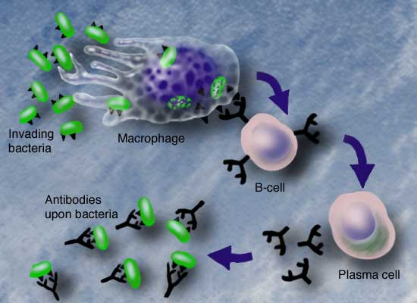
B Cell activation

Slide 41
Plasma cell
A plasma cell functions to make _
With infection, one cell may produce _
Ab are carried by body fluids to site of infection.
Response is Antibody mediated (as compared to Cellular Mediated T cells)

Slide 42
B Cell activation
to activate a B cell, it must find an antigen that ___________________________ its antigen receptors.
When it has the “key in lock” configuration, the B cell reproduces rapidly, _
Dependant _

Slide 43
B cell activation
Activated helper T cell meets B cell + antigen,
T cell releases _
_______________________________ the B cell to _
Creates _

Slide 44
B Cells
Activated B cells clones differentiate into plasma cells.

Slide 45
B Cells
The antibodies are similar in shape to the antigen receptors on the B cell,
therefore, it will have the _______________________ “key in lock” configuration when it meets the antigen

Slide 46
B cells
Single B cell carries info to _
However, with the different antigens on a pathogen surface, there will be a repetition of that process, and there will be _

Slide 47
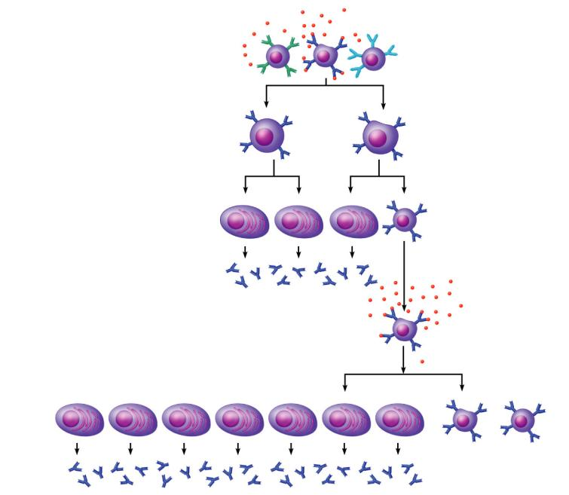
Primary Response
(initial encounter
with antigen)
Antigen
Antigen binding
to a receptor on a
specific B lymphocyte
(B lymphocytes with
non-complementary
receptors remain
inactive)
Proliferation to
form a clone
B lymphoblasts
Plasma
cells
Memory
B cell
Secreted
antibody
molecules
Secondary Response
(can be years later)
Clone of cells
identical to
ancestral cells
Subsequent
challenge by
same antigen
Plasma
cells
Secreted
antibody
molecules
Memory
B cells
Figure 21.10

Slide 48
B Cells
_______________________________ response:
One type of antibody manufactured against a _
________________________________ response
_________________________________ types of antibodies manufactured against a single microbe or virus.

