Slide 1
Immune Responses
When B and T activated after their _________________________________of Ag, their responses constitute a ________________________________ immune response.
Lag time of ________________________________ before antibodies produced
B cells need time to proliferate and produce plasma cells
Antibody levels _

Slide 2
Immune responses
Following primary response, B cells can _
If a memory B cells meets up with an antigen for the second time, antibodies can begin production _
Antibody levels are _
Compared to 10 for primary response
Antibody levels remain _

Slide 3
Secondary Immune Responses
Memory B cells and Memory T cells _
Cells in lymph nodes harbor and release viral ___________________________, but not virus.
Stimulates immune system to _____________________________________, so the immunity is maintained.

Slide 4
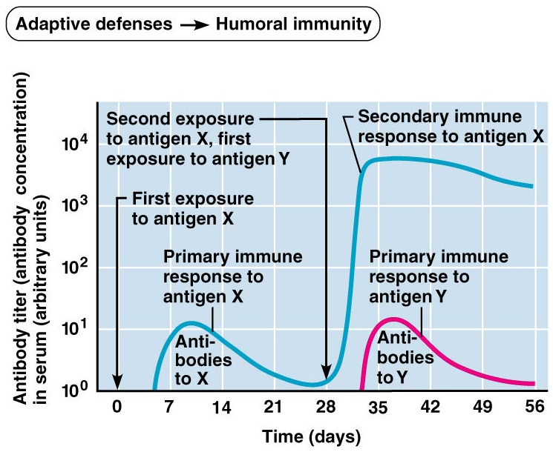

Slide 5
Types of Immunity
Immunity can be
we create our own antibodies
We are given antibodies

Slide 6
Types of Immunity
Naturally acquired active immunity
“active” tells us we ________________________ our own antibodies
“naturally acquired” tells us that those antibodies were made after our bodies were _

Slide 7
Types of Immunity
Artificially acquired active immunity:
develops after exposure to an ________________________________ vaccine, artificially introduced into the environment.
Active: our bodies make the antibodies
Artifically acquired: the antibodies are made off of the _

Slide 8
Types of Immunity
Naturally acquired passive immunity:
Naturally acquired: the antibodies are made after exposure to pathogen
Passive:
Fetus
Mother IgG passes into placenta. Provides immunity. Fetus is not exposed to antigens, nor does it make its own antibodies.

Slide 9
Passive Immunity
Artificially acquired passive immunity
Antibodies provided from _
Immunoglobulin therapies
Artificially acquired: Is short term, lasts a few weeks.
_________________________________________________________________________________ or develop an immune response, so if exposed to the pathogenic agent in the future, there is no immunity.

Slide 10
Antibodies
Soluble, _
____________________________globulin fraction of plasma proteins (alpha, beta, and gamma).
Each is composed of _______________ chains. Two light chains. Two heavy chains.

Slide 11
Antibodies
Antibodies have a 3D shape that forms a pocket around the antigen.
The part of the ABS that ____________________________________ to the antigen is called the _

Slide 12
Antibody

Slide 13
Immunoglobulins
Types of Immunoglobulins
5 major types
Spell “gamed”
IgG
IgA
IgM
IgE
IgD

Slide 14
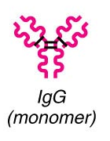
IgG
Most abundant
found in ______________________________ and tissue fluids.
Effective against _
Activates the _
Functions in ________________ primary immune response and __________________ of the secondary immune response

Slide 15
IgG
Small enough to pass through the _
Provides _________________________________. Fetus can not yet make its own antibodies.
IgG stays in system, but is not produced in fetal system.
Once baby born, no longer gets IgG from placenta.

Slide 16
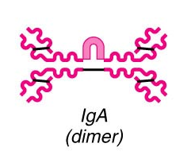
IgA
13%
found in __________________________________ secretions….
breast milk, tears, nasal fluid, gastric, intestinal juices, bile, and urine.
Acts against _
The baby that breast feeds gets immunity from Mom through the colostrum.
Helps to protect against _

Slide 17
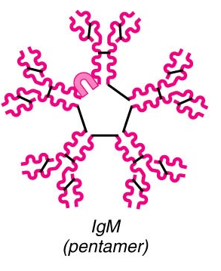
IgM
6%
Can be
attached to _
_____________________________________________develops in blood plasma in response to contact with antigens.
The antibodies that are responsible for ____________________________________ when blood types are mixed are IgM antibodies.

Slide 18
IgM
_________________________________________________________________________ during Primary Immune response
Presence of IgM indicates _
Also serves to _

Slide 19
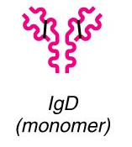
IgD
is circulated while attached _
Helps in _
Functions as an _

Slide 20
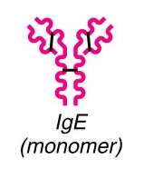
IgE
Slightly larger than IgG
appears in ____________________________________ along with IgA.
Trace levels found in plasma.
Levels elevate with _
Promotes _
Ab is attached to the membranes of mast cells and basophils.
Mast cell releases _________________________________ → inflammation

Slide 21
Antibody functions
Antibodies _
They can _
They can _
Antibodies block specific sites on viruses or bacterial exo-toxins
Results in a _
Soluble molecules are cross-linked and come out of solution where they are easily _

Slide 22
Antibody functions
Antibodies can bind to more than one antigen at a time
They form antigen-antibody complexes that are cross-linked
IgM is especially good at this since it has got ten binding sites on its pentamer form.
Seen in blood _

Slide 23
Antibody functions
__________________________________ fixation and activation
Antibodies bind to cells → antibodies change shape to expose _
Complement (soluble circulating plasma proteins) become activate and _

Slide 24
Antibody function
Antibodies have a “PLAN” of attack
P:
L:
A:
N:

Slide 25
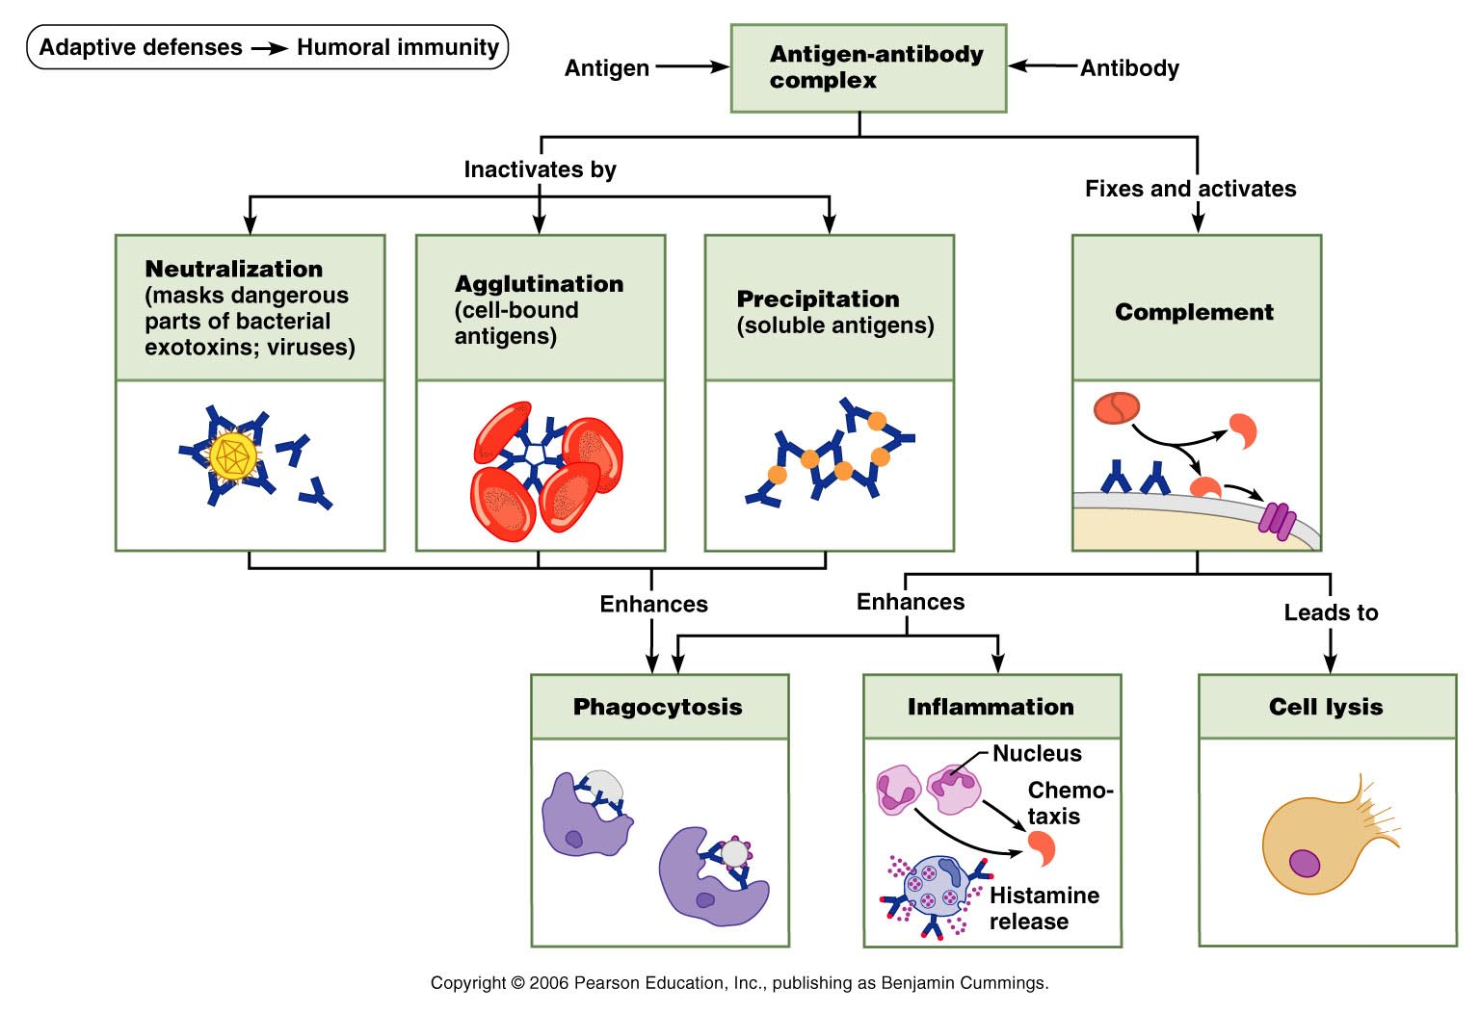

Slide 26
Cell mediated immunity
T cells are divided into two main categories based on their surface receptors
CD
Primarily _
CD
Primarily _

Slide 27
T cells
T cells have to be able to recognize two important things
They must identify “_______________________”
Must be able to find _
They must identify the _
MHCs are the self-proteins that will be presenting the foreign antigens

Slide 28
T cell activation: step one
Phagocytic cell engulfs material
Becomes _
MHC protein will present the antigen on the APC surface
T cells will bind to the antigen on the APC
Helper T (CD4) cells bind to _
Cytotoxic T (CD8) cells will be activated _

Slide 29
T cell activation: step two
Once the T cell has found the MHC and the antigen, it needs a _____________________________from the APC
Co-stimulatory signals
__________________________________________ on the ______________________help to activate T cells
___________________________________(Interleukins 1 and 2) are released and cause the T cell to activate and differentiate
Results in _

Slide 30
Cytokines
Cytokines
General term for ____________________________ that influence cell development, differentiation and response
Interleukin 1 (IL-1)
Released by _
Stimulates T cells to _
Synthesizes more _
Interleukin 2 (Il-2)
Encourages activated T cells to _

Slide 31
T Cells
Helper cells
Can help _
Can help _
Macrophage engulfs bacteria.
antigens move to the surface of the APC
Helper T cell makes contact
Releases _
Chemicals cause _

Slide 32
Cytotoxic T cells
Only T cell type that can _
Activated Tc cells circulate thrugh blood, lymph, and lymph organs searching _______________________________________ they’d been shown previously
Main targets:
________________________________________ bacteria or parasites

Slide 33
Cytotoxic cells: Method One
Bind with cells _
Releases _
Perforin inserts into plasma membrane
Reacts with calcium to _
_______________________________________ enter pores
Destroys cell

Slide 34
Cytotoxic Cells: Method Two
Tc finds ____________________________________ on target cell
Stimulation of that target receptor causes _

Slide 35
NK cells: Natural Killer cells
Do not seek foreign antigen on class I MHC
Search for _
Lack of ______________________ MHC on cells
Antibodies coating a _
_____________________________________ cells with altered surface markers
Means of destroying target cells is the same as for Tc cells

Slide 36
Regulatory T cells
Used to be called _
______________________________________ immune response
Useful in preventing _

Slide 37
T Cells
Memory cell produced upon initial exposure to antigen but, are only those cells __________________________________________________________________________. They are not active
When they are activated after a ________________________________________ they become _______________________________ and provide an immediate removal of the invading particle

