Slide 1
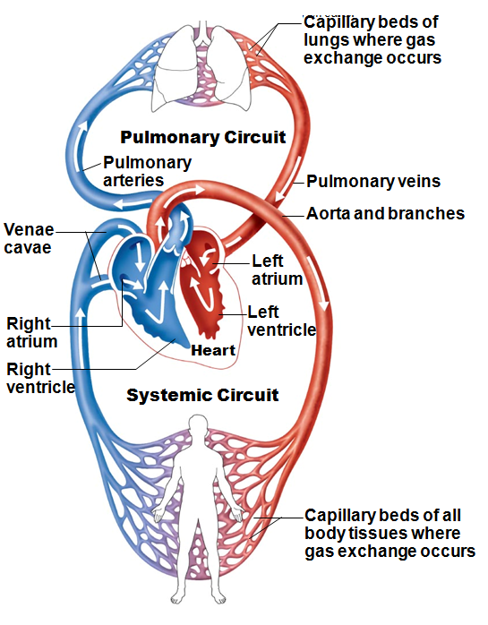
The Pulmonary and Systemic Circuits
Heart is transport system; two side-by-side pumps
receives deoxygenated blood from tissues
Pumps to lungs
pulmonary circuit
oxygenated blood from lungs
Pumps to body tissues
systemic circuit

Slide 2
The Pulmonary and Systemic Circuits
Receiving chambers of heart:
Right atrium
Receives blood _
Left atrium
Receives blood returning _

Slide 3
The Pulmonary and Systemic Circuits
Pumping chambers of heart:
Pumps blood through pulmonary circuit
Pumps blood through systemic circuit

Slide 4
Heart Anatomy
Approximately size _
Location:
In mediastinum between _
On superior surface of diaphragm
Anterior to vertebral column, posterior to sternum

Slide 5
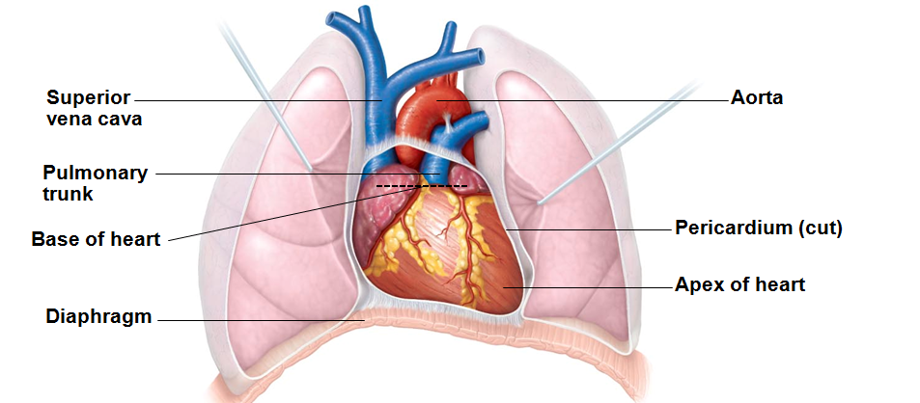
Heart Anatomy
_________________________________ (posterior surface) leans toward right shoulder
______________________________ points toward left hip
Apical impulse palpated between fifth and sixth ribs, just below left nipple

Slide 6
Coverings of the Heart: Pericardium
Superficial fibrous pericardium
Protects, anchors to surrounding structures, _

Slide 7
Pericardium
Deep two-layered
lines internal surface of fibrous pericardium
___________________________________________ (epicardium)
on external surface of heart
Two layers separated by fluid-filled pericardial cavity (____________________________________________)

Slide 8
Homeostatic Imbalance
Inflammation of pericardium
Roughens membrane surfaces → (creaking sound) heard with stethoscope
Three heart sounds as opposed to two
_____________________________________________________ sometimes compresses heart → limited pumping ability

Slide 9
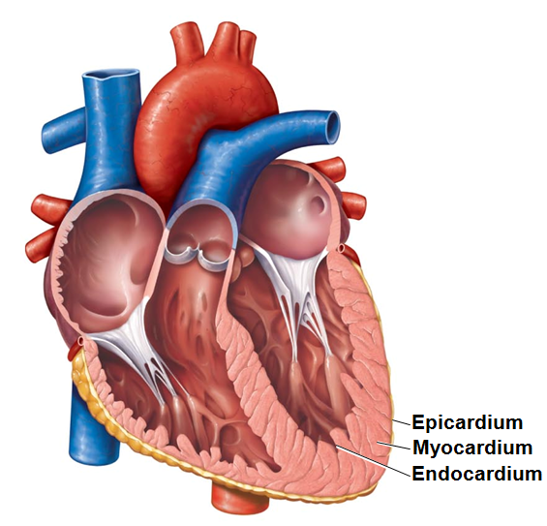
Layers of the Heart Wall
Three layers of heart wall:
Epicardium
Visceral layer of serous pericardium

Slide 10
Layers of the Heart Wall
Myocardium
Cardiac skeleton
Anchors cardiac muscle fibers
Supports great vessels and valves
Limits spread of action potentials to specific paths

Slide 11
Layers of the Heart Wall
_____________________________________ continuous with endothelial lining of blood vessels
____________________________________ heart chambers; covers cardiac skeleton of valves

Slide 12
Chambers
Four chambers:
Two _
Two _
____________________________________________ – separates atria
Fossa ovalis
remnant of _
Interventricular septum – _

Slide 13
Chambers and Associated Great Vessels
_________________________________________ (atrioventricular groove)
Encircles junction of atria and ventricles
Anterior interventricular sulcus
Anterior position of interventricular septum
Posterior interventricular sulcus
________________________________ on posteroinferior surface

Slide 14
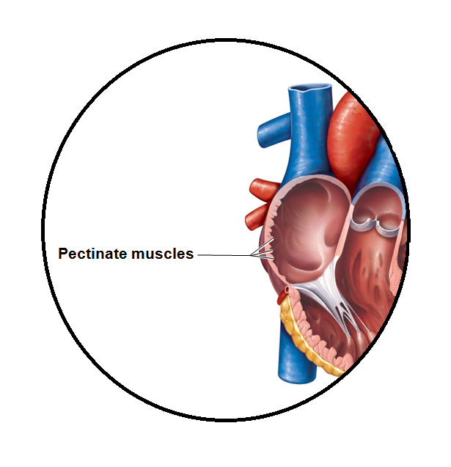
Atria: The Receiving Chambers
Appendages that increase _
Right atrium
Posterior and anterior regions separated by crista terminalis
Left atrium
Pectinate muscles only in auricles

Slide 15
Atria: The Receiving Chambers
Contribute ____________________________ to propulsion of blood
Three veins empty into right atrium:
Superior vena cava, inferior vena cava, coronary sinus
__________________________________________ empty into left atrium

Slide 16
Ventricles: The Discharging Chambers
Most of the volume of heart
Right ventricle
Left ventricle
posteroinferior surface
Trabeculae carneae
anchor chordae tendineae

Slide 17
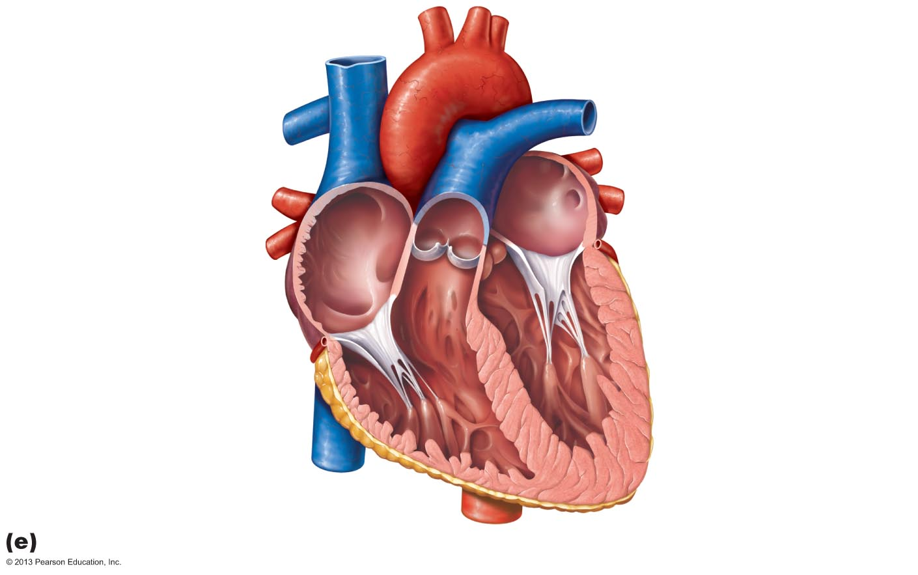
Figure 18.5e Gross anatomy of the heart.
Left atrium
Right atrium
Mitral (bicuspid) valve
Fossa ovalis
Aortic valve
Pectinate muscles
Pulmonary valve
Tricuspid valve
Right ventricle
Left ventricle
Chordae tendineae
Papillary muscle
Trabeculae carneae
Interventricular septum
Frontal section

Slide 18
Ventricles: The Discharging Chambers
Actual _____________________________ of heart
Right ventricle
Pumps blood into pulmonary trunk
Left ventricle
Pumps blood into aorta (largest artery in body)

Slide 19
Heart Valves
Ensure ______________________________________________ through heart
Open and close in response to pressure changes
Two atrioventricular (___________) valves
________________________________________ (right AV valve)
________________________________________ (left AV valve, bicuspid valve)
Prevent backflow into atria when ventricles contract
Chordae tendineae anchor cusps to papillary muscles
Hold valve flaps in closed position

Slide 20
Heart Valves
Two _
________________________________________ semilunar valve
________________________________________ semilunar valve
Prevent backflow into ventricles when ventricles relax
Open and close in response to pressure changes

Slide 21
Homeostatic Imbalance
Two conditions severely weaken heart:
Blood backflows so heart repumps same blood over and over
Stiff flaps – constrict opening → heart must exert more force to pump blood
Valve replaced with mechanical, animal, or cadaver valve

Slide 22
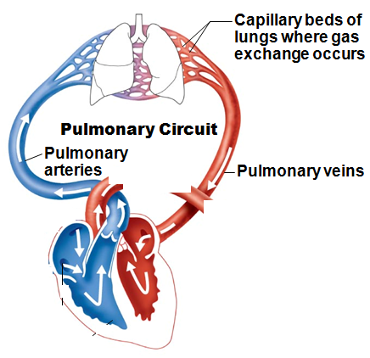
Pathway of Blood Through the Heart
Pulmonary circuit
Right atrium → ____________________ → right ventricle
Right ventricle → pulmonary semilunar valve → ______________________ → pulmonary arteries → lungs
Lungs → _______________________ → left atrium

Slide 23
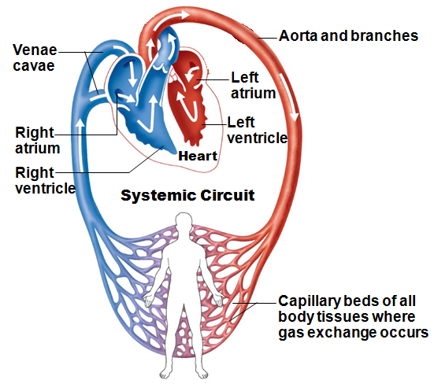
Pathway of Blood Through the Heart
Systemic circuit
Left atrium → ____________________ → left ventricle
Left ventricle → aortic semilunar valve → _
Aorta → systemic circulation

Slide 24
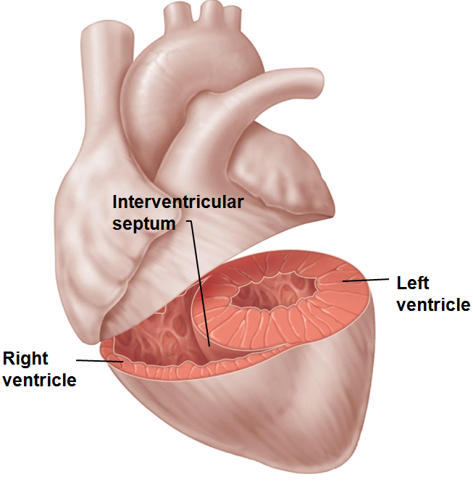
Pathway of Blood Through the Heart
Equal volumes of blood pumped to pulmonary and systemic circuits
Pulmonary circuit _
Systemic circuit _
Anatomy of ventricles reflects differences
Left ventricle walls 3X thicker than right
Pumps with greater pressure

Slide 25
Coronary Circulation
Functional blood supply to heart muscle itself
Left ventricle receives most blood supply
Contains many anastomoses (________________________)
Provide _______________________________________ for blood delivery
Cannot compensate for coronary artery occlusion

Slide 26
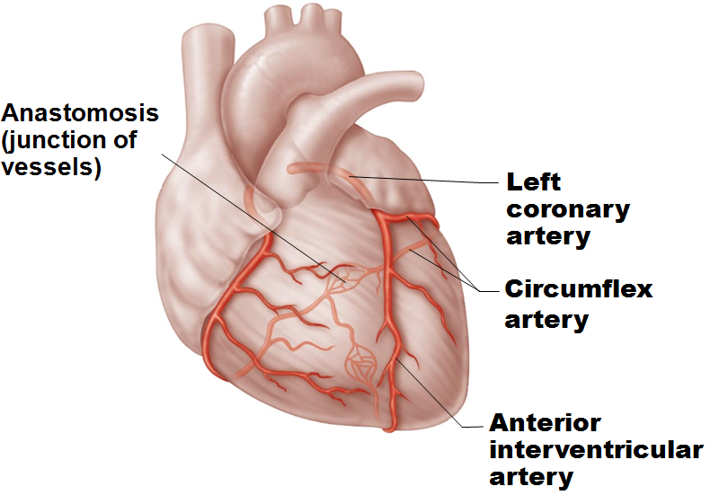
Coronary Circulation: Arteries
Arteries arise from base of aorta
Left coronary artery branches
Supplies interventricular septum, anterior ventricular walls, left atrium, and posterior wall of left ventricle

Slide 27
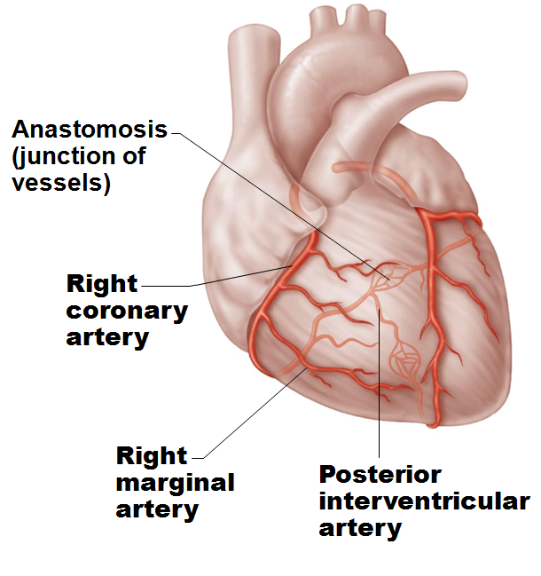
Coronary Circulation: Arteries
Right coronary artery branches
Supplies right atrium and most of right ventricle

Slide 28
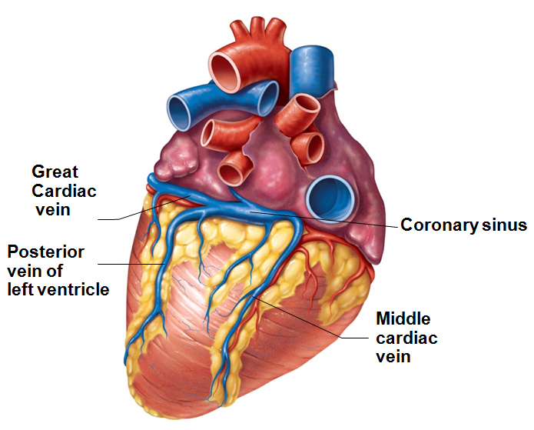
Coronary Circulation: Veins
________________________ collect blood from capillary beds
_________________________ empties into right atrium; formed by merging cardiac veins
Great cardiac vein of anterior interventricular sulcus
Middle cardiac vein in posterior interventricular sulcus
Small cardiac vein from inferior margin
Several anterior cardiac veins empty directly into right atrium anteriorly

Slide 29
Homeostatic Imbalances
Thoracic _____________________________ caused by fleeting deficiency in blood delivery to myocardium
Cells weakened
____________________________________________ (heart attack)
Prolonged coronary blockage
Areas of cell death repaired with non-contractile scar tissue

Slide 30
Heart Physiology: Electrical Events
Heart depolarizes and contracts _________________________ nervous system stimulation
Rhythm can be __________________________________ by autonomic nervous system

Slide 31
Heart Physiology: Setting the Basic Rhythm
Coordinated heartbeat is a function of
Presence of _
_______________________________________ cardiac conduction system
Network of non-contractile (autorhythmic) cells
Initiate and distribute impulses → coordinated depolarization and contraction of heart

Slide 32
Sequence of Excitation
Cardiac pacemaker cells pass impulses, in order, across heart in ~220 ms
___________________________________________ →
Atrioventricular node →
___________________________________________→
Right and left bundle branches →
Subendocardial conducting network (_______________________________)

Slide 33
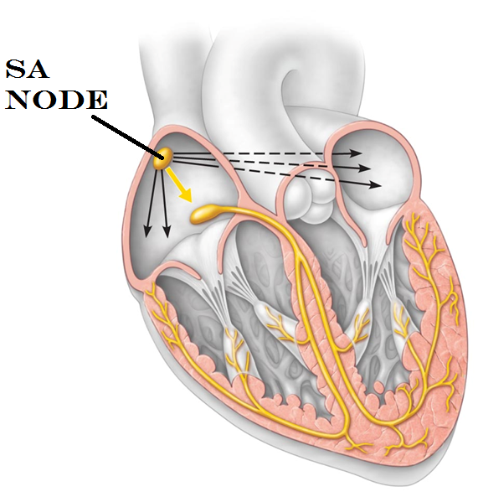
Heart Physiology: Sequence of Excitation
Sinoatrial (SA) node
Pacemaker of heart in right atrial wall
Generates impulses about 75X/minute (sinus rhythm)
Inherent rate of _______________________ tempered by extrinsic factors
Impulse spreads across atria, and to AV node

Slide 34
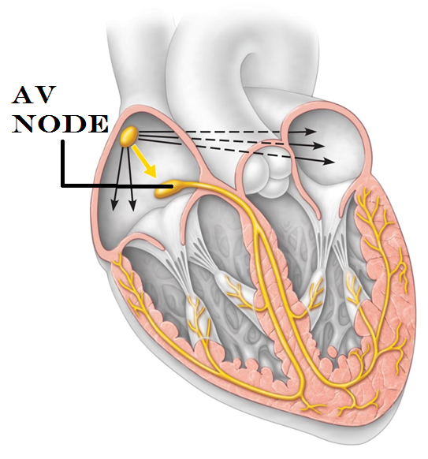
Heart Physiology: Sequence of Excitation
Atrioventricular (AV) node
In _
_____________________________________________ approximately 0.1 second
Because fibers are smaller diameter, have fewer gap junctions
Allows atrial contraction prior to ventricular contraction
Inherent rate _______________________ in absence of SA node input

Slide 35
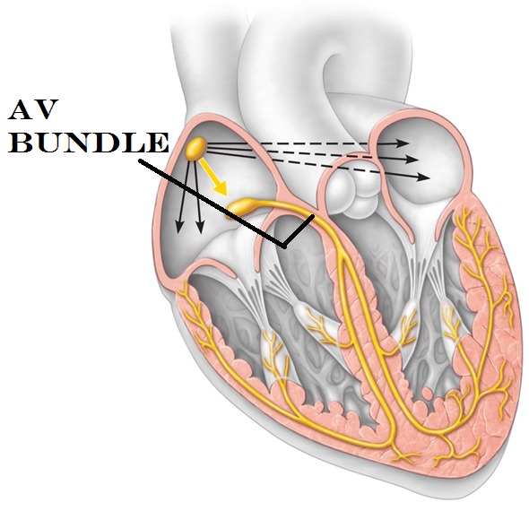
Heart Physiology: Sequence of Excitation
Atrioventricular (AV) bundle (__________________)
Only electrical connection between atria and ventricles
Atria and ventricles not connected via gap junctions

Slide 36
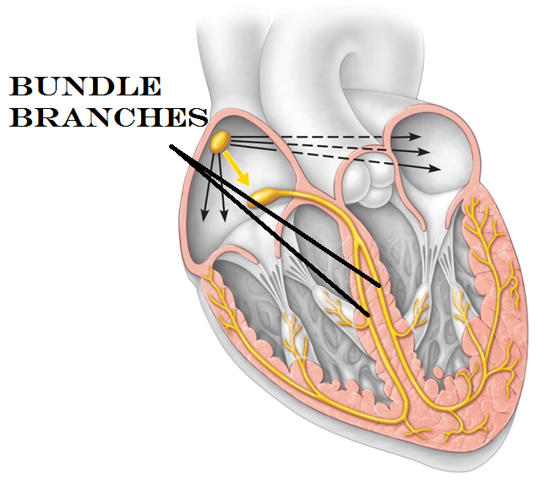
Heart Physiology: Sequence of Excitation
Right and left bundle branches
Carry impulses toward _

Slide 37
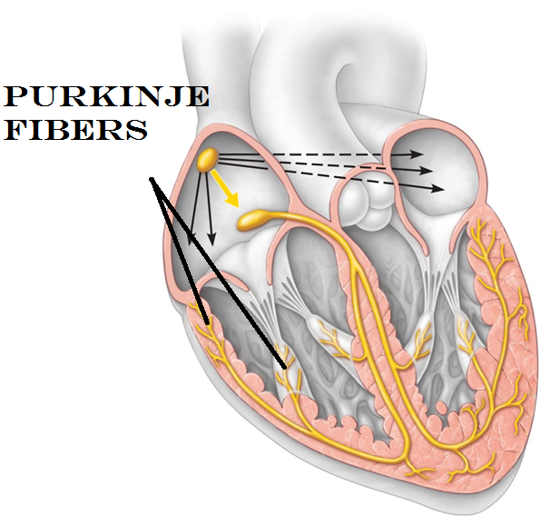
Heart Physiology: Sequence of Excitation
Subendocardial conducting network (_____________________)
Complete pathway through interventricular septum _
More elaborate on left side of heart
AV bundle and subendocardial conducting network depolarize __________________________ in absence of AV node input
Ventricular contraction immediately follows from apex toward atria

Slide 38
Extrinsic Innervation of the Heart
Heartbeat modified by ___________________________________________ via cardiac centers in medulla oblongata
Sympathetic
Increases _
Increases _
Parasympathetic
Cardioacceleratory center
sympathetic
affects SA, AV nodes, heart muscle, coronary arteries
Cardioinhibitory center
inhibits SA and AV nodes via _

Slide 39
Electrocardiography
Electrocardiogram (ECG or EKG)
Composite of ___________________________________ generated by nodal and contractile cells at given time
Three waves:
P wave
QRS complex
T wave
ventricular _

Slide 40
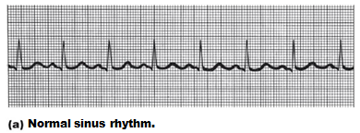
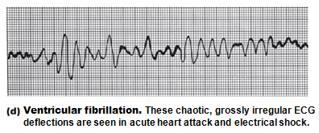
Homeostatic Imbalances
Defects in intrinsic conduction system may cause
irregular heart rhythms
Uncoordinated atrial and ventricular contractions
Fibrillation
______________________________________________; useless for pumping blood
circulation ceases → brain death
Defibrillation to treat

Slide 41
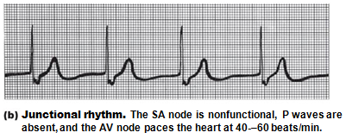
Homeostatic Imbalances
Defective SA node may cause
abnormal pacemaker
AV node may take over; sets _
Extrasystole (premature contraction)
Ectopic focus sets high rate
Can be from _

Slide 42
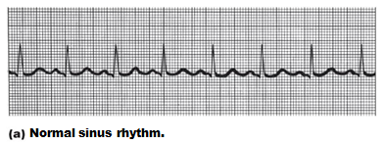
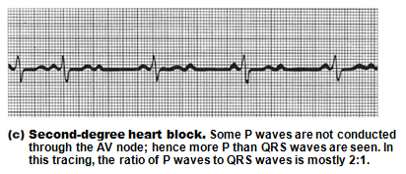
Homeostatic Imbalance
To reach ventricles, impulse must pass through AV node
Defective AV node may cause
Few (partial block) or no (total block) impulses reach ventricles
Ventricles beat at _
Artificial pacemaker to treat

Slide 43
Heart Sounds
Two sounds (lub-dup) associated with closing of heart valves
First as ________________________________________; beginning of _
Second as SL valves close; beginning _
Pause indicates heart relaxation
Heart _________________________- abnormal heart sounds; usually indicate _

Slide 44
Figure 18.20 Areas of the thoracic surface where the sounds of individual valves can best be detected.
Aortic valve sounds
heard in 2nd intercostal
space at right sternal
margin
Pulmonary valve
sounds heard in 2nd
intercostal space at left
sternal margin
Mitral valve sounds
heard over heart apex
(in 5th intercostal space)
in line with middle of
clavicle
Tricuspid valve sounds
typically heard in right
sternal margin of 5th
intercostal space

Slide 45
Mechanical Events: The Cardiac Cycle
Cardiac cycle
Blood flow through heart during _____________________________________________: atrial systole and diastole followed by ventricular systole and diastole
Systole
Diastole
Series of pressure and blood volume changes

Slide 46
Phases of the Cardiac Cycle
1. Ventricular filling
takes place in mid-to-late diastole
80% of blood passively flows into ventricles
___________________________________________ occurs, delivering remaining 20%

Slide 47
Phases of the Cardiac Cycle
2. Ventricular systole
Atria relax;
Rising ventricular pressure → _
Isovolumetric contraction phase (______________________________________________)
In ejection phase, ventricular pressure exceeds pressure in large arteries, _

Slide 48
Phases of the Cardiac Cycle
3. Isovolumetric relaxation - early diastole
Ventricles relax; _
Backflow of blood in aorta and pulmonary trunk _
Ventricles totally closed chambers
When atrial pressure exceeds that in ventricles → AV valves open; cycle begins again

Slide 49
Cardiac Output (CO)
Volume of blood pumped by each ventricle in one minute
CO =
HR = number of beats per minute
SV = volume of blood pumped out by one ventricle with each beat
Normal – 5.25 L/min

Slide 50
Regulation of Stroke Volume
Three main factors affect SV:
degree of stretch of cardiac muscle cells before they contract
Most important factor stretching cardiac muscle is amount of blood returning to heart: venous return
Slow heartbeat and exercise increase venous return
Increased venous return distends (stretches) ventricles and increases contraction force
contractile strength at given muscle length
pressure ventricles must overcome to eject blood

Slide 51
Autonomic Nervous System Regulation
Sympathetic nervous system activated by emotional or physical stressors
Norepinephrine causes pacemaker
to _
and _
Results in faster relaxation and filling
Increases heart-rate

Slide 52
Autonomic Nervous System Regulation
Parasympathetic nervous system ____________________________sympathetic effects
Acetylcholine →
Little to no effect on contractility
Heart at rest exhibits Vagal tone
Parasympathetic dominant influence

Slide 53
Chemical Regulation of Heart Rate
Hormones
_______________________________from adrenal medulla
Increases contractility
increases heart rate
enhances effects of norepinephrine and epinephrine

Slide 54
Homeostatic Imbalance
Not enough Calcium
Hypercalcemia →
Too much calcium
increased HR and contractility
Not enough Potassium (K)
Hyperkalemia →
Too much Potassium (K)

Slide 55
Other Factors that Influence Heart Rate
Fetus has fastest HR
Females faster than males
Exercise
Increases HR
Body temperature

Slide 56
Homeostatic Imbalances
_______________________________________- abnormally fast heart rate
Exceeds _
If persistent, may lead to fibrillation
________________________________________
heart rate slower than _
May result in inadequate blood circulation in non-athletes
May be _________________________________________ result of endurance training

Slide 57
Homeostatic Imbalance
Congestive heart failure (CHF)
Progressive condition
Cardiac Output is _
Reflects weakened myocardium caused by
Coronary atherosclerosis— _
Persistent high blood pressure
Dilated cardiomyopathy (DCM)

Slide 58
Homeostatic Imbalance
Pulmonary congestion
Left side fails →
Peripheral congestion
Right side fails → blood pools in _
Failure of either side ultimately weakens other
Treat by removing fluid, reducing afterload, increasing contractility

Slide 59
Developmental Aspects of the Heart
Fetal heart structures that bypass pulmonary circulation
__________________________________________ connects two atria
Remnant is _
__________________________________________ connects pulmonary trunk to aorta
Remnant - _
Close at or shortly after birth

Slide 60
Developmental Aspects of the Heart
Congenital heart defects
Most common birth defects; treated with surgery
Most are one of two types:
Mixing of oxygen-poor and oxygen-rich blood
Both types of disorders present

Slide 61
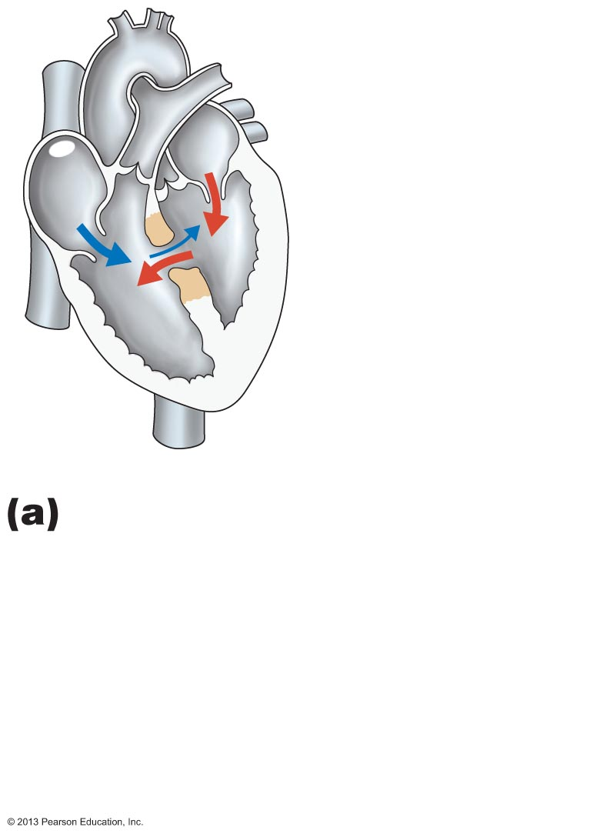
Figure 18.25a Three examples of congenital heart defects.
Ventricular septal defect.
The superior part of the inter-ventricular septum fails to form, allowing _
More blood is shunted _

Slide 62
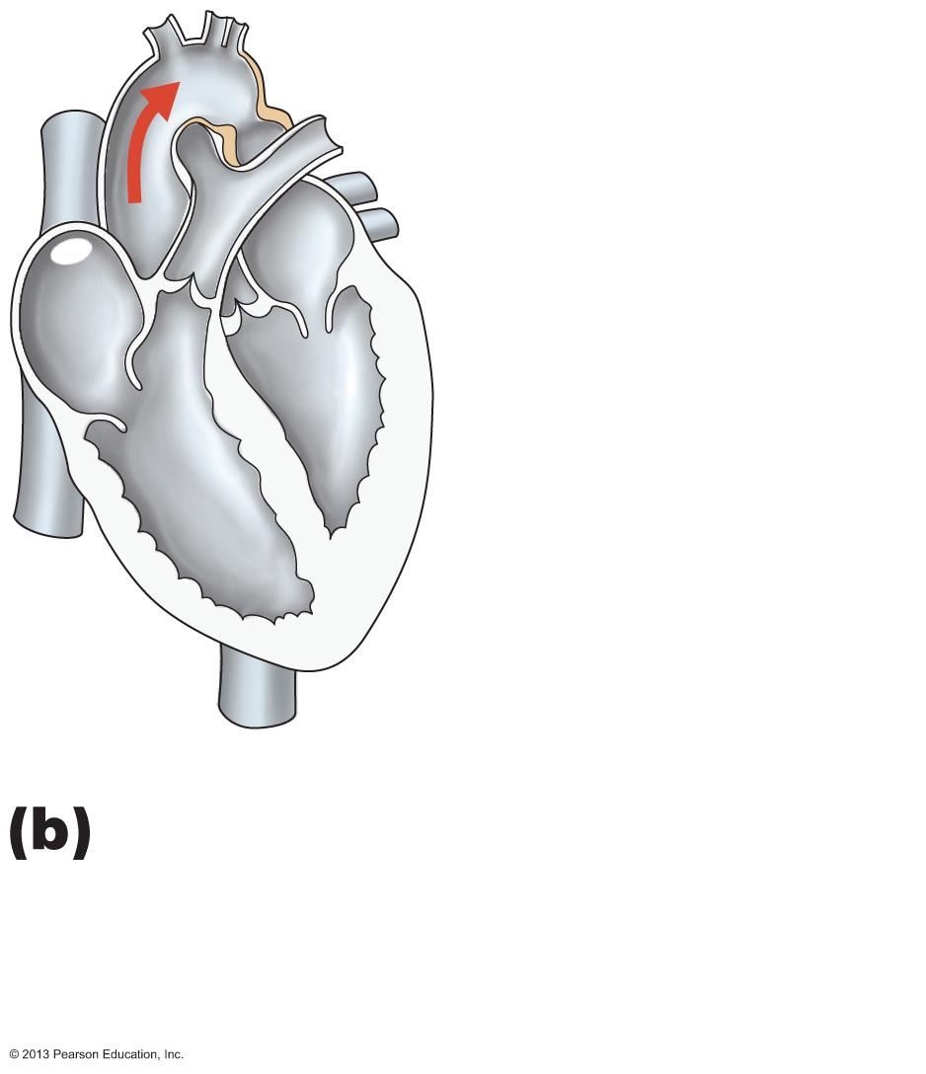
Figure 18.25b Three examples of congenital heart defects.
Coarctation of the aorta.
A part of the aorta is _________________, increasing the workload of the left ventricle.
Narrowed
aorta

Slide 63
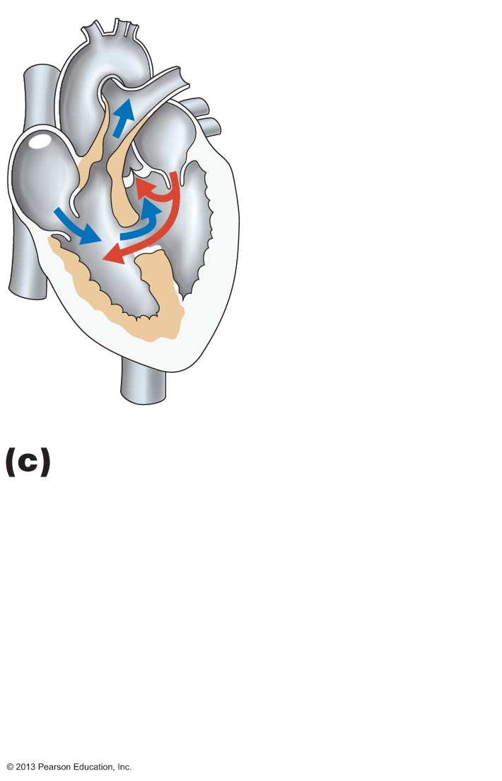
Figure 18.25c Three examples of congenital heart defects.
Tetralogy of Fallot.
Multiple defects (tetra =four):
Pulmonary trunk ________________________ and pulmonary valve stenosed (narrowed), resulting in
Ventricular septal defect
.

Slide 64
Age-Related Changes Affecting the Heart
_________________________________ and _________________________________ of valve flaps
Decline in cardiac reserve
Atherosclerosis

Slide 65
Blood Vessels
Delivery system of dynamic structures that begins and ends at heart
Arteries:
carry blood _________________________________ from heart
oxygenated except for
umbilical vessels of fetus
Capillaries:
contact tissue cells;
Veins:
carry blood _

Slide 66
Structure of Blood Vessel Walls
Lumen
Central
Three wall layers in arteries and veins
Tunica intima, tunica media, and tunica externa
Capillaries
____________________________________ with sparse basal lamina

Slide 67
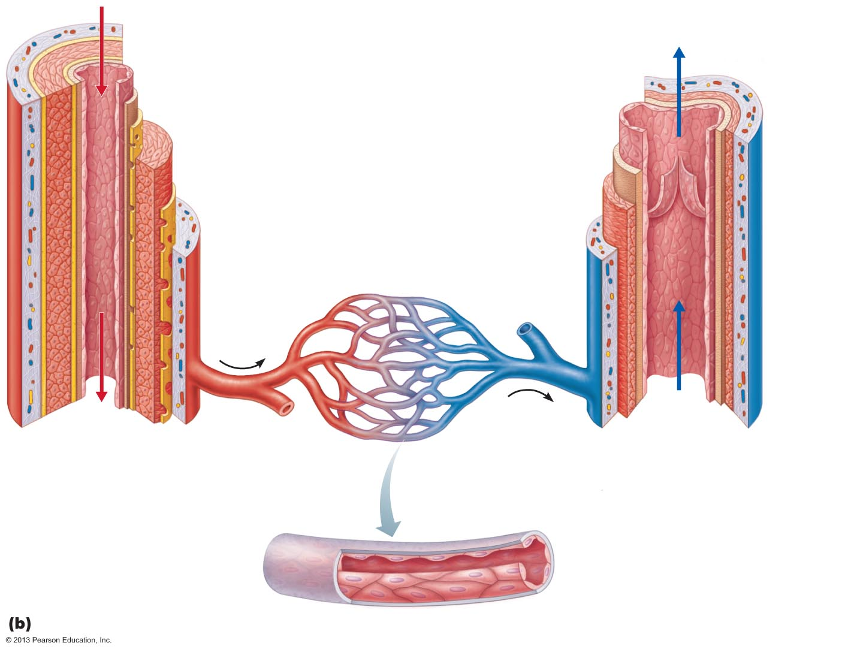
Figure 19.1b Generalized structure of arteries, veins, and capillaries.
Tunica intima
• Endothelium
• Subendothelial layer
• Internal elastic membrane
Tunica media
(smooth muscle and
elastic fibers)
Valve
• External elastic membrane
Tunica externa
(collagen fibers)
• Vasa vasorum
Lumen
Lumen
Artery
Capillary network
Vein
Basement membrane
Endothelial cells
Capillary

Slide 68
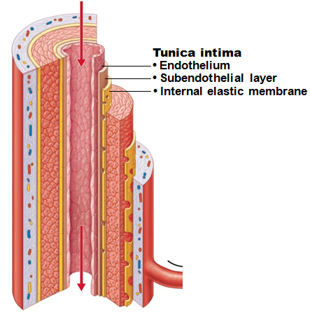
Tunics
Tunica intima
Continuous with endocardium
Slick surface reduces friction
Subendothelial layer in vessels larger than 1 mm; connective tissue basement membrane

Slide 69
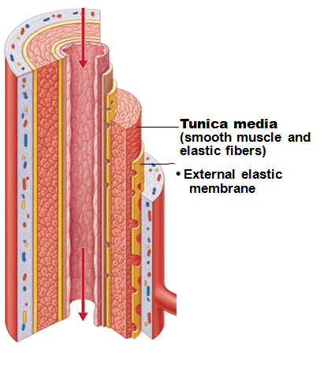
Tunics
Tunica media
_____________________and sheets of elastin
Sympathetic vasomotor nerve fibers control vasoconstriction and vasodilation of vessels

Slide 70
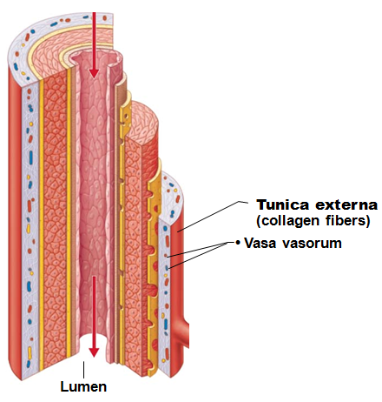
Tunics
Tunica externa (tunica adventitia)
Collagen fibers protect and reinforce; _
Contains _
“vessel’s vessels”
of larger vessels nourishes external layer

Slide 71
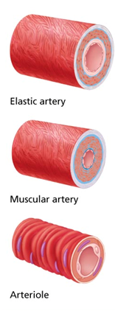
Arterial System: Elastic Arteries
Large thick-walled arteries with ________________________ in all three tunics
Aorta and its major branches
Large lumen offers _
Act as pressure reservoirs
Smooths pressure downstream

Slide 72
Arterial System: Muscular Arteries
__________________ to elastic arteries
Deliver blood to body organs
Thick tunica media with _
Active in _
Can help to control blood pressure

Slide 73
Arterial System: Arterioles
Lead to _
Control flow into capillary beds via vasodilation and vasoconstriction

Slide 74
Capillaries
Microscopic blood vessels
Walls of _
In the smallest capillaries, one squamous cell forms entire circumference
Diameter allows _

Slide 75
Capillaries
In all tissues except for cartilage, epithelia, cornea and lens of eye
Provide _
Functions
Exchange of gases, nutrients, wastes, hormones, etc., between blood and interstitial fluid

Slide 76
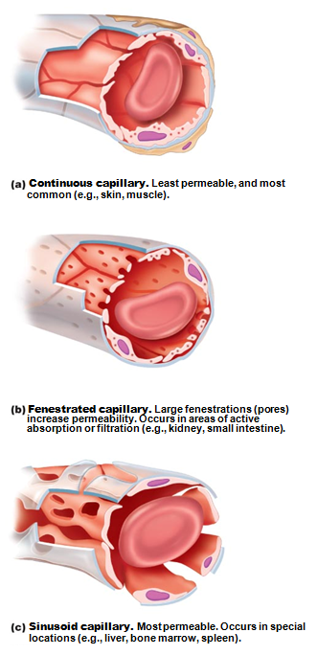
Capillaries
Three structural types
Fenestrated capillaries
_______________________ (sinusoids)
Also called “discontinuous”

Slide 77
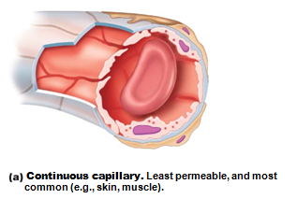
Continuous Capillaries
Abundant in _
Tight junctions connect endothelial cells
Intercellular clefts allow passage of fluids and _
Continuous capillaries of brain unique
_____________________________________ complete, forming _

Slide 78
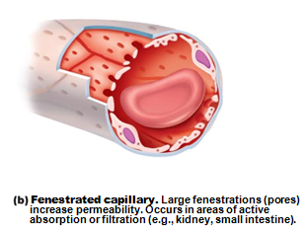
Fenestrated Capillaries
Some endothelial cells contain _
______________________________________ than continuous capillaries
Function in _________________________________________ formation
small intestines, endocrine glands, and kidneys

Slide 79
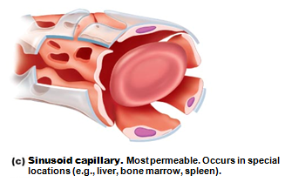
Sinusoid Capillaries
Fewer tight junctions
usually fenestrated
large lumens
Blood flow sluggish
_________________________________________________ pass between blood and surrounding tissues
Found only in the liver, bone marrow, spleen, adrenal medulla
_________________________________________ in lining to destroy bacteria

Slide 80
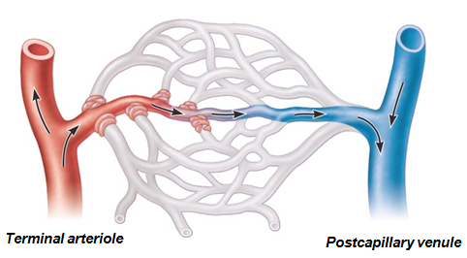
Blood Flow Through Capillary Beds
True capillaries normally branch from meta-arteriole and return to thoroughfare channel
______________________________________ regulate blood flow into true capillaries
Blood may go into true capillaries or to shunt
Regulated by local chemical conditions and _

Slide 81
Venous System: Venules
Formed when _
Smallest postcapillary venules
_________________________________________; allow fluids and WBCs into tissues
Consist mostly of _
Larger venules have one or two layers of _

Slide 82
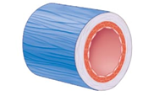
Veins
Formed when _
Have thinner walls, _____________________________ compared with corresponding arteries
Blood pressure lower than in arteries
Thin tunica media; thick tunica externa of collagen fibers and elastic networks
Called _
Acts as blood reservoirs
contain up to ___________of blood supply

Slide 83
Veins
Adaptations ensure return of blood to heart _
Large-diameter lumens offer _
________________________________________ prevent backflow of blood
Most abundant in veins of limbs

Slide 84
Vascular Anastomoses
Interconnections of blood vessels
Arterial anastomoses provide ___________________________________ to given body region
Common at joints, in abdominal organs, brain, and heart; none in retina, kidneys, spleen
Vascular shunts of capillaries are examples of arteriovenous anastomoses
Venous anastomoses are common

Slide 85
Physiology of Circulation: Definition of Terms
Force per unit area exerted on wall of blood vessel by blood
Expressed in mm Hg
Measured as _______________________________________ _BP in large arteries near heart
Pressure gradient provides driving force that keeps blood moving from higher to lower pressure areas

Slide 86
Physiology of Circulation: Definition of Terms
_____________________________________ (peripheral resistance)
Measure of amount of friction blood encounters with vessel walls, generally in peripheral (systemic) circulation
Three important sources of resistance
Total blood vessel _
Blood vessel _

Slide 87
Resistance
Factors that remain relatively constant:
Blood viscosity
The “___________________________________" of blood due to formed elements and plasma proteins
Increased viscosity = _
Blood vessel length
Longer vessel =
Blood vessel diameter
Small arterioles greatly influence resistance

Slide 88
Systemic Blood Pressure
Pumping action of heart generates blood flow
Pressure results when flow is _
Systemic pressure
Declines throughout pathway
0 mm Hg in right atrium
Steepest drop _

Slide 89
Arterial Blood Pressure
Reflects two factors of arteries close to heart
____________________________________________ (compliance or distensibility)
Volume of blood forced into them at any time
Blood pressure near heart is _

Slide 90
Arterial Blood Pressure
pressure exerted in aorta during ventricular contraction
Averages 120 mm Hg in normal adult
lowest level of aortic pressure
difference between systolic and diastolic pressure
Expansion and recoil of arteries as they are exposed to the changing pressures

Slide 91
Factors Aiding Venous Return
contraction of skeletal muscles "milks" blood toward heart; valves prevent backflow
pressure changes during breathing move blood toward heart by squeezing abdominal veins as thoracic veins expand
Venoconstriction under _______________________________ pushes blood toward heart

Slide 92
Maintaining Blood Pressure
Requires
Cooperation of heart, blood vessels, and kidneys
Supervision by brain
Main factors influencing blood pressure

Slide 93
Control of Blood Pressure
Short-term neural and hormonal controls
Counteract fluctuations in blood pressure by _
Long-term renal regulation
Counteracts fluctuations in blood pressure by _

Slide 94
Short-term Mechanisms: Neural Controls
Neural controls of peripheral resistance
If low blood volume all vessels constricted _
Alter blood distribution to organs in response to specific demands

Slide 95
Short-term Mechanisms: Neural Controls
Neural controls operate via _______________________________that involve
Carotid sinuses
Aortic arch
Walls of large arteries of neck and thorax
Cardiovascular center of medulla
Vasomotor fibers to heart and vascular smooth muscle
Sometimes input from ________________________________ and higher brain centers

Slide 96
The Cardiovascular Center
Clusters of _________________________________ in medulla oversee changes in CO and blood vessel diameter
Consists of cardiac centers and vasomotor center
Vasomotor center sends steady impulses via sympathetic efferents to blood vessels →
Receives inputs from baroreceptors, chemoreceptors, and higher brain centers

Slide 97
Short-term Mechanisms: Chemoreceptor Reflexes
__________________________________ in aortic arch and large arteries of neck detect increase in CO₂, or drop in pH or O₂
Cause increased blood pressure by
Signaling cardioacceleratory center →
Signaling vasomotor center →

Slide 98
Short-term Mechanisms: Influence of Higher Brain Centers
Reflexes in _
Hypothalamus and cerebral cortex can modify arterial pressure via relays to medulla
Hypothalamus _____________________________ during stress
Hypothalamus mediates redistribution of blood flow during exercise and changes in body temperature

Slide 99
Short-term Mechanisms: Hormonal Controls
Short term regulation via changes in _
Long term regulation via changes in _

Slide 100
Short-term Mechanisms: Hormonal Controls
Cause increased blood pressure
Epinephrine and norepinephrine from adrenal gland →
Angiotensin II stimulates _
High ADH levels cause _
Cause lowered blood pressure
__________________________________________ causes decreased blood volume by antagonizing aldosterone

Slide 101
Long-term Mechanisms: Renal Regulation
Baroreceptors _______________________________ to chronic high or low BP so are ineffective for long term support
Long-term mechanisms control BP by altering blood volume via kidneys
Increased BP or blood volume causes elimination of more urine, thus reducing BP
Decreased BP or blood volume causes kidneys to conserve water, and BP rises
Indirect renal mechanism
Dependent on _______________________________: renin-angiotensin-aldosterone

Slide 102
Indirect Mechanism
The renin-angiotensin-aldosterone mechanism
Decreased Arterial blood pressure triggers release of renin
Renin catalyzes conversion of _______________________________ from liver to angiotensin I
Angiotensin converting enzyme, especially from lungs, converts angiotensin I to _
Increases blood volume because angiotensin II
Stimulates _____________________________________secretion
Retains water
Causes _____________________________ release
Retains water by reducing urine output
Triggers the thirst center in the brain
Brings external water into the system

Slide 103
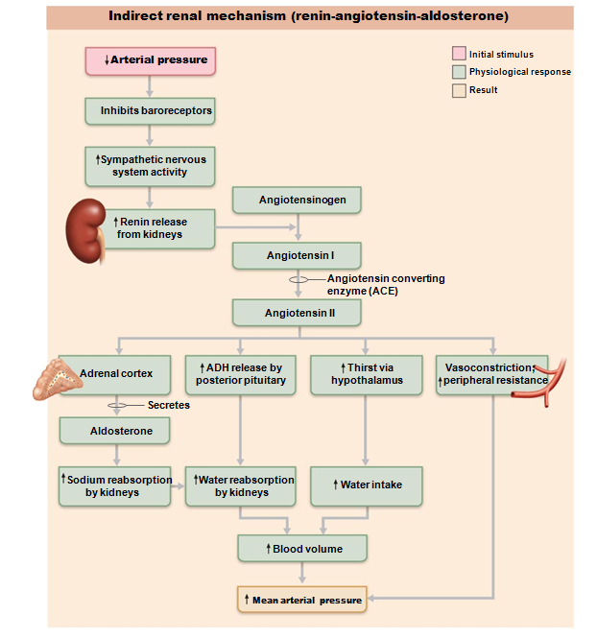
Indirect:
triggers hormones

Slide 104
Monitoring Circulatory Efficiency
pulse and blood pressure, along with respiratory rate and body temperature
pressure wave caused by expansion and recoil of arteries
(taken at the Radial Artery in the wrist) routinely used
Pressure points
where arteries close to body surface
Can be compressed to stop blood flow

Slide 105
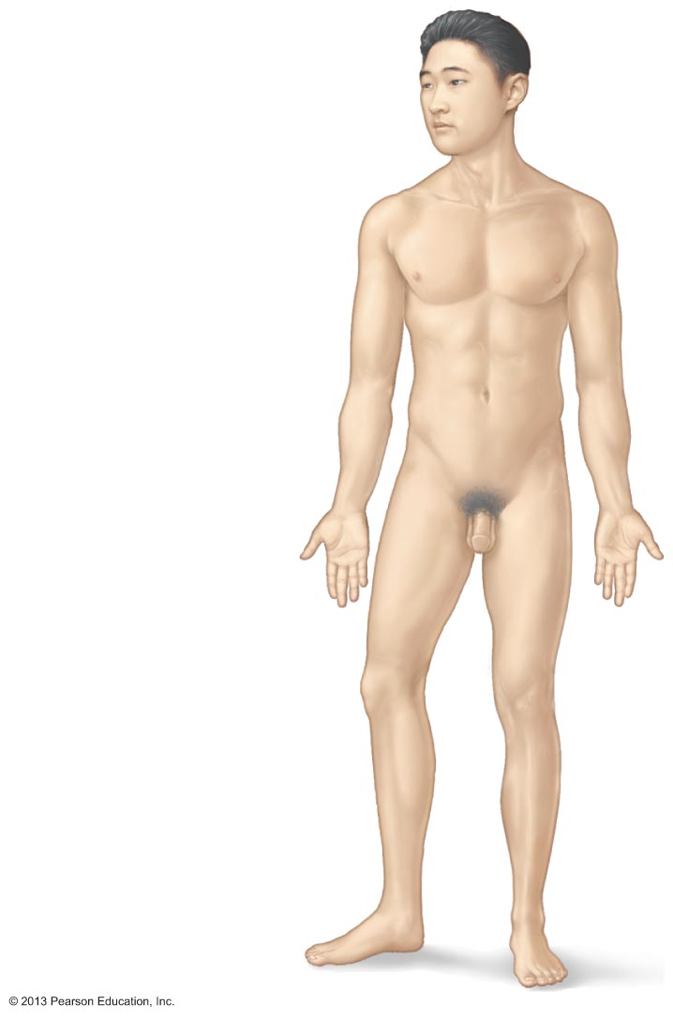
Figure 19.12 Body sites where the pulse is most easily palpated.
Superficial temporal artery
Facial artery
Common carotid artery
Brachial artery
Radial artery
Femoral artery
Popliteal artery
Posterior tibial
artery
Dorsalis pedis
artery

Slide 106
Measuring Blood Pressure
Systemic arterial BP
Measured indirectly by auscultatory method using a sphygmomanometer
Pressure increased in cuff until it exceeds systolic pressure in brachial artery

Slide 107
Measuring Blood Pressure
Systolic pressure,
when sounds first occur as
Diastolic pressure
normally _
when sounds disappear because artery _
blood flowing freely

Slide 108
Variations in Blood Pressure
Transient elevations occur during changes in
physical exertion
fever
Age, sex, weight, race, mood, and posture may cause BP to vary

Slide 109
Alterations in Blood Pressure
Hypertension:
Sustained elevated arterial pressure of 140/90 or higher
Prehypertension if values _
May be transient adaptations during fever, physical exertion, and emotional upset
Often persistent in obese people

Slide 110
Homeostatic Imbalance: Hypertension
Prolonged hypertension ______________________________________, vascular disease, renal failure, and stroke
Heart must work harder → _
accelerates atherosclerosis

Slide 111
Primary or Essential Hypertension
90% of hypertensive conditions
Risk factors include heredity, diet, obesity, age, diabetes mellitus, stress, and smoking
No cure but can be controlled
Increase exercise, lose weight, stop smoking
Antihypertensive drugs

Slide 112
Homeostatic Imbalance: Hypertension
______________________________________ less common
Due to identifiable disorders including obstructed renal arteries, kidney disease, and endocrine disorders such as hyperthyroidism and Cushing's syndrome
Treatment focuses on correcting underlying cause

Slide 113
Alterations in Blood Pressure
Hypotension:
Blood pressure below _
Usually not a concern
Only if leads to inadequate blood flow to tissues
Often associated with _____________________ and lack of cardiovascular illness

Slide 114
Homeostatic Imbalance: Hypotension
:
temporary low BP and dizziness when suddenly rising from sitting or reclining position
May point towards poor nutrition
warning sign for Addison's disease or hypothyroidism
Acute hypotension:
important sign of _

Slide 115
Capillary Exchange of Respiratory Gases and Nutrients
Diffusion down concentration gradients
O₂ and nutrients from _
CO₂ and metabolic wastes from _
Lipid-soluble molecules diffuse directly through endothelial membranes
Water-soluble solutes pass through _
Larger molecules, such as proteins, are __________________________________________ in pinocytotic vesicles or caveolae

Slide 116
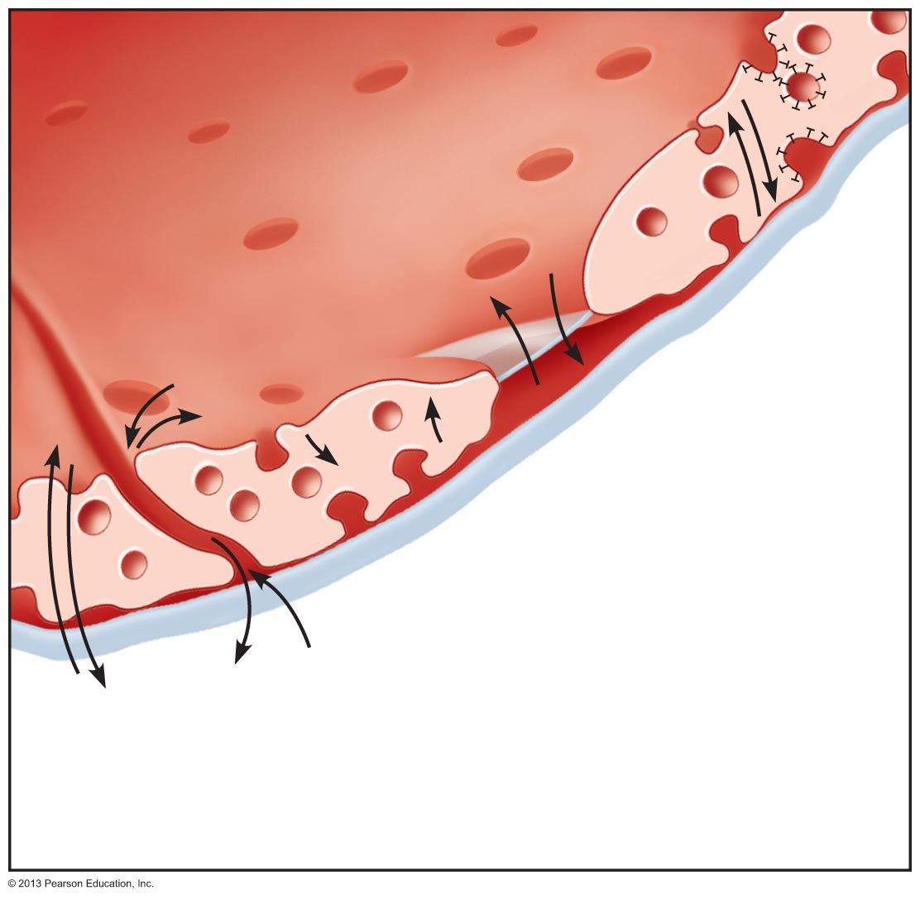
Figure 19.16 Capillary transport mechanisms. (2 of 2)
Lumen
Caveolae
Pinocytotic
vesicles
Endothelial
fenestration
(pore)
Intercellular
cleft
4
Transport
via vesicles
or caveolae
(large
substances)
3
Movement
through
fenestrations (water-soluble
substances)
Basement
membrane
2
Movement
through
intercellular
clefts (water-
soluble
substances)
1
Diffusion
through
membrane
(lipid-soluble
substances)

Slide 117
Circulatory Shock
Any condition in which
Blood vessels _
Blood _
Results in inadequate blood flow to meet tissue needs

Slide 118
Circulatory Shock
results from large-scale blood loss
results from extreme vasodilation and decreased peripheral resistance
results when an inefficient heart cannot sustain adequate circulation

Slide 119
Identifying Arteries and Veins
Most arteries and veins share a name
Many vessels are named for _
Renal Artery
Gonadal Artery
Iliac Artery
Axillary Artery

Slide 120
Note on Vessel Images
The upcoming images have been edited to reflect the structures I’d like for you to know.
They match up with the images in your worksheets. In the presentation, you’ll notice that some of the veins are in brown. These are the structures that do not have an arterial twin.
Example
Internal Carotid Artery does NOT have an Internal Carotid Vein that runs with it.
Instead, we have an Internal Jugular Vein

Slide 121
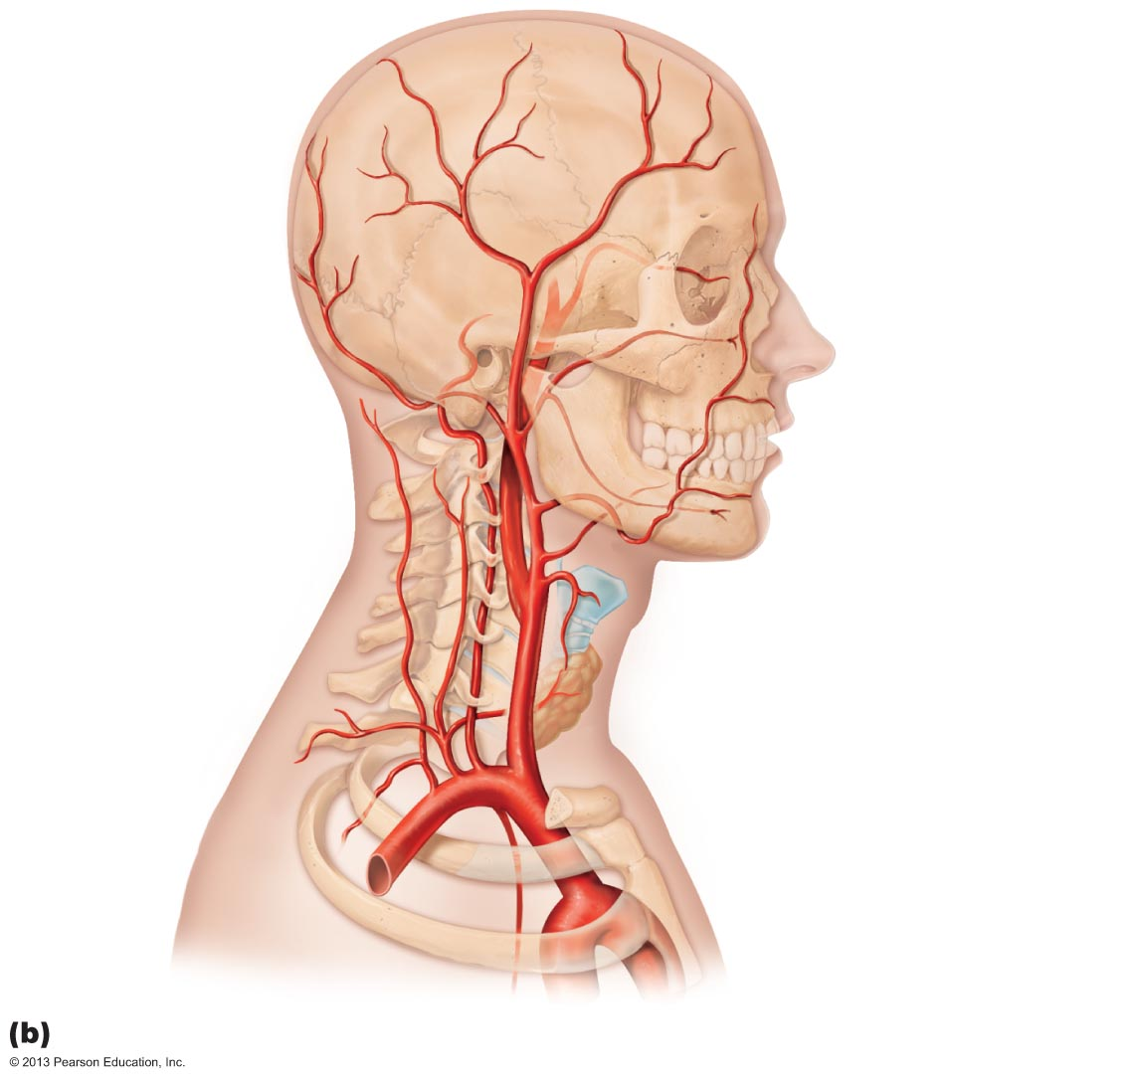
Figure 19.22b Arteries of the head, neck, and brain.
Ophthalmic artery
Branches of
the external
carotid artery
Vertebral
artery
• Superficial
temporal artery
Internal
carotid artery
External
carotid artery
Common
carotid artery
Arteries of the head and neck, right aspect

Slide 122
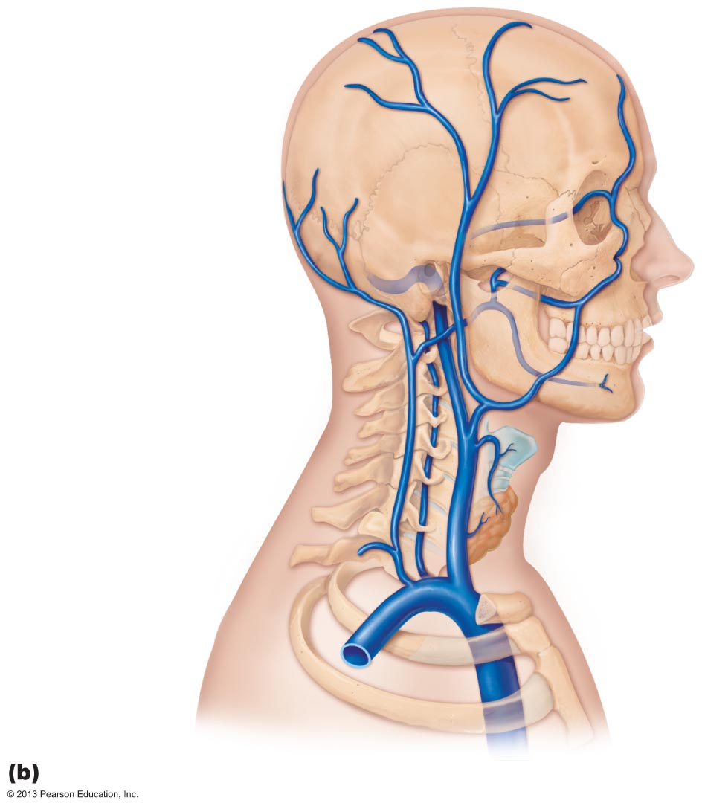
Figure 19.27b Venous drainage of the head, neck, and brain.
Ophthalmic vein
Facial vein
Occipital vein
Superficial
temporal vein
Posterior
auricular vein
External
jugular vein
Vertebral vein
Internal
jugular vein
Brachiocephalic
vein
Subclavian vein
Superior
vena cava

Slide 123
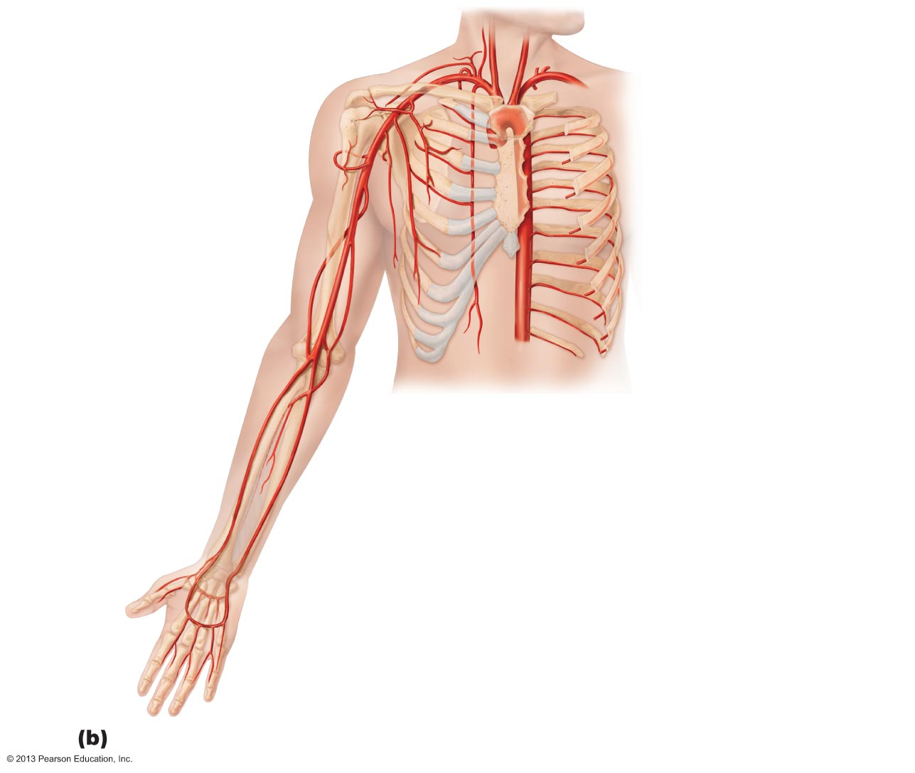
Common carotid arteries
Right subclavian artery
Left subclavian artery
Axillary artery
Brachiocephalic trunk
Subscapular artery
Brachial artery
Deep artery of arm
Thoracic aorta
Common
interosseous artery
Radial artery
Ulnar artery
Deep palmar arch
Superficial palmar arch
Digital arteries

Slide 124
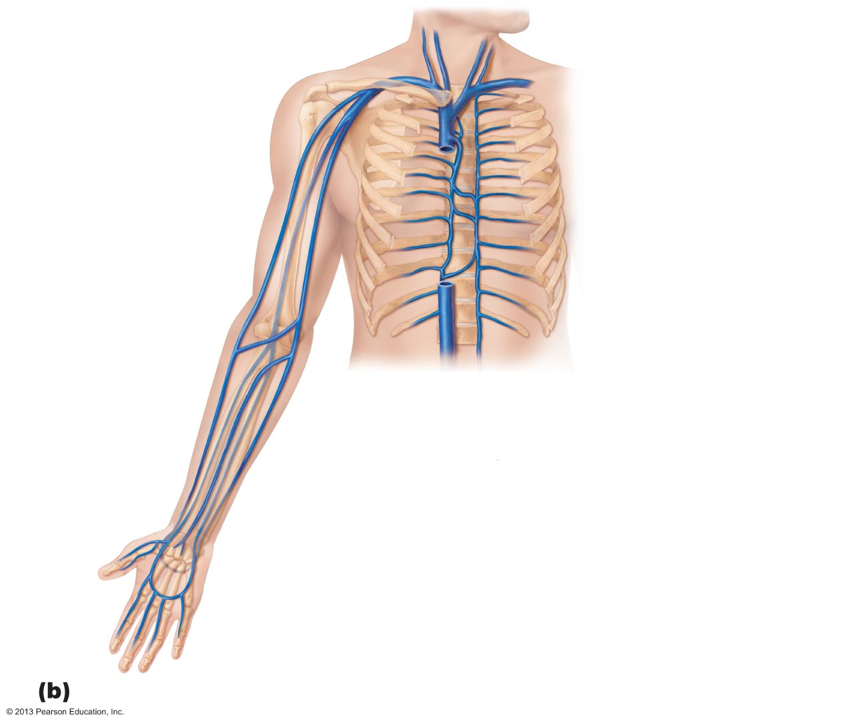
Brachiocephalic veins
Internal jugular vein
Right subclavian vein
External jugular vein
Axillary vein
Left subclavian vein
Brachial vein
Superior vena cava
Cephalic vein
Azygos vein
Basilic vein
Accessory hemiazygos
vein
Hemiazygos vein
Inferior vena cava
Median cubital
vein
Median
antebrachial vein
Cephalic vein
Basilic vein
Radial vein
Ulnar vein
Deep venous
palmar arch
Superficial venous
palmar arch
Digital veins

Slide 125
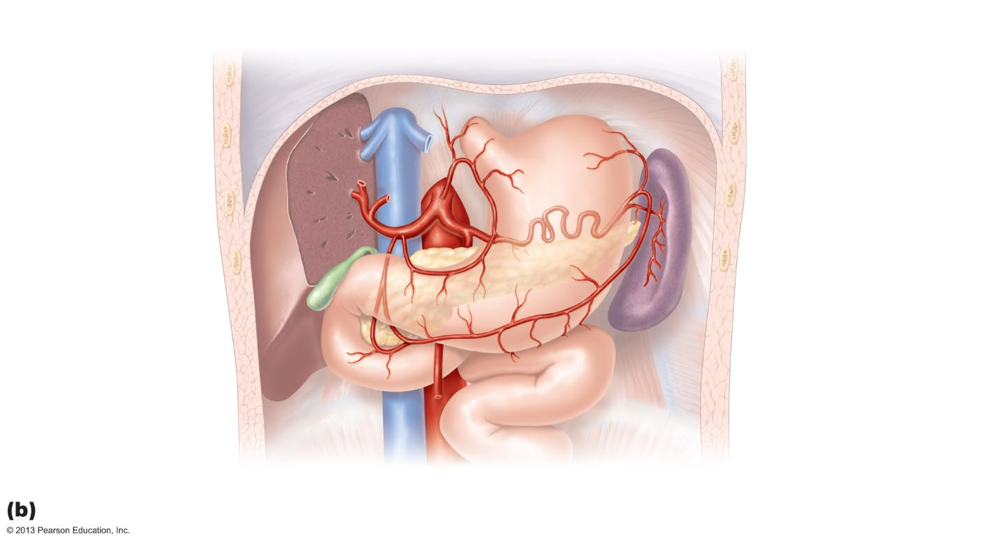
Figure 19.24b Arteries of the abdomen.
Inferior vena cava
Celiac trunk
Common
hepatic artery
Left gastric artery
Hepatic
artery proper
Splenic artery
Gastroduodenal
artery
Right
gastric artery
Superior mesenteric
artery
Abdominal aorta

Slide 126
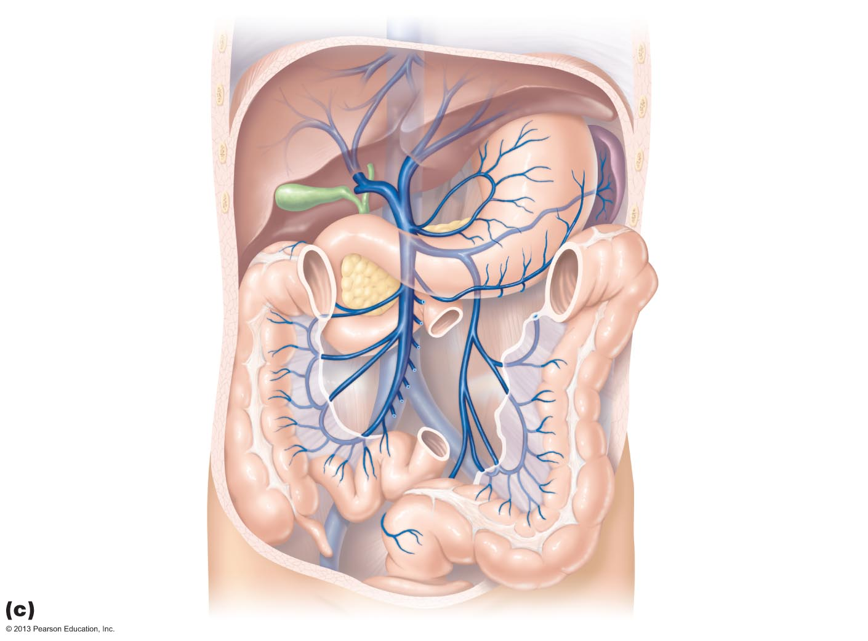
Figure 19.29c Veins of the abdomen.
Hepatic veins
Gastric veins
Inferior vena cava
Hepatic portal
vein
Splenic vein
Right
gastroepiploic vein
Inferior
mesenteric vein
Superior
mesenteric vein
The hepatic portal circulation.

Slide 127
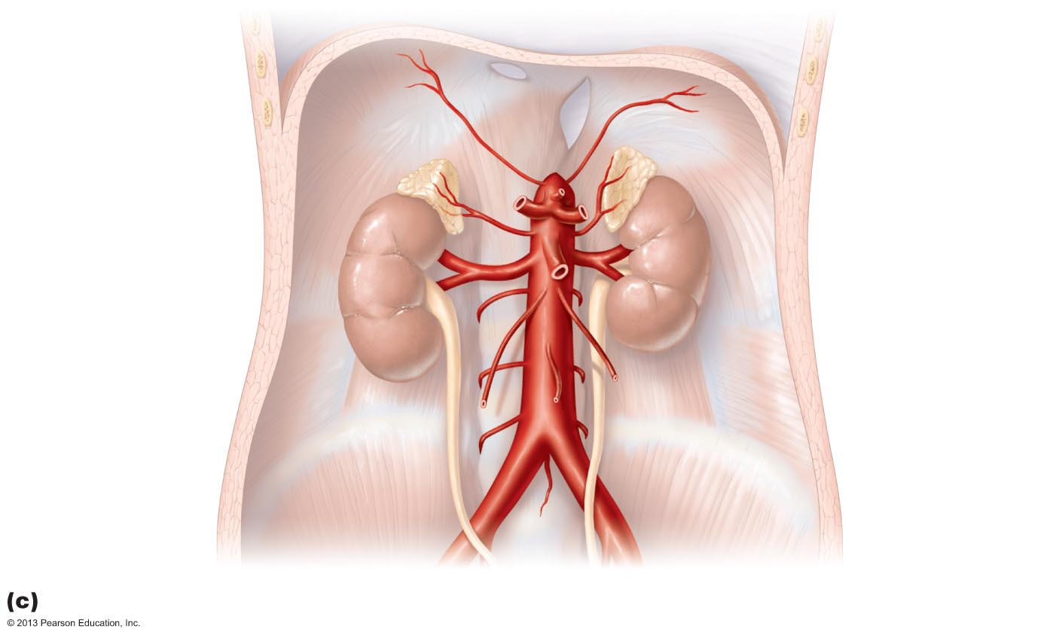
Figure 19.24c Arteries of the abdomen.
Inferior
phrenic artery
Adrenal
(suprarenal) gland
Middle
suprarenal artery
Celiac trunk
Renal artery
Superior
mesenteric artery
Abdominal aorta
Gonadal
(testicular
or ovarian) artery
Lumbar arteries
Inferior
mesenteric artery
Median
sacral artery
Common
iliac artery

Slide 128
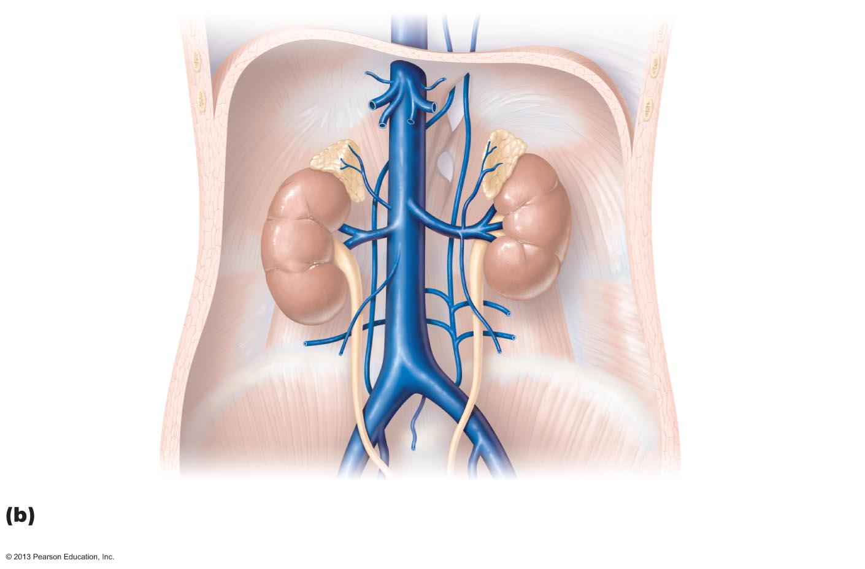
Figure 19.29b Veins of the abdomen.
Inferior phrenic
vein
Hepatic veins
Inferior vena cava
Left suprarenal
vein
Right suprarenal
vein
Renal veins
Left ascending
lumbar vein
Right gonadal
vein
Lumbar veins
Left gonadal
vein
Common iliac
vein
External iliac
vein
Internal iliac
vein

Slide 129
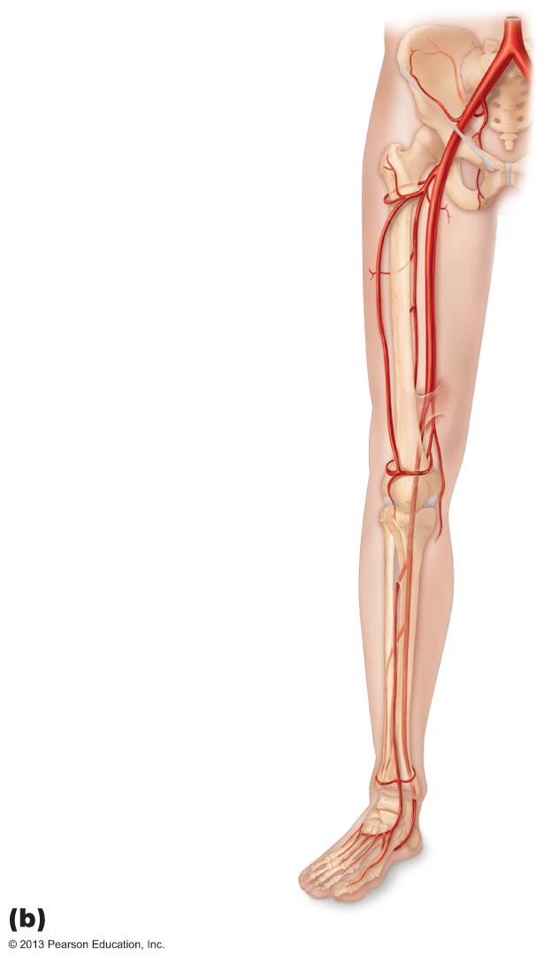
Common iliac artery
Internal iliac artery
External iliac artery
Deep artery of thigh
Lateral circumflex
femoral artery
Femoral artery
Popliteal artery
Anterior tibial artery
Posterior tibial artery
Fibular artery
Dorsalis pedis artery
Dorsal metatarsal
arteries
Anterior view

Slide 130
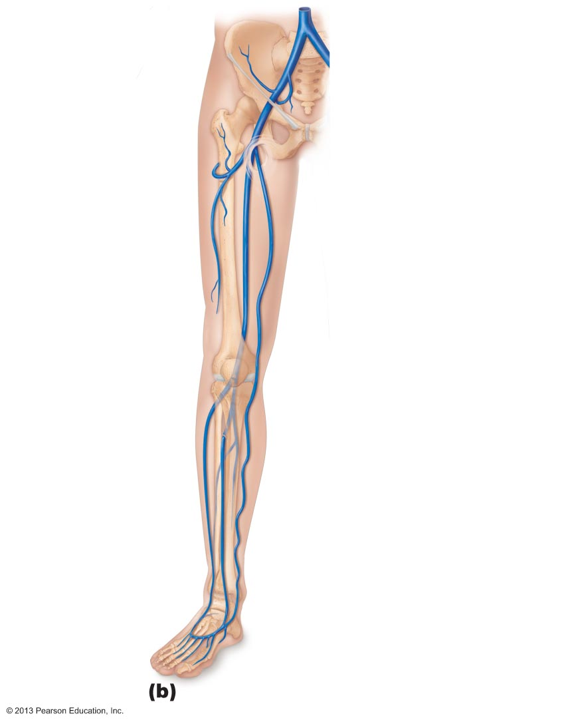
Common iliac vein
Internal iliac vein
External iliac vein
Femoral vein
Great saphenous
vein (superficial)
Popliteal vein
Small
saphenous vein
Fibular vein
Anterior
tibial vein
Dorsalis
pedis vein
Dorsal
venous arch
Dorsal
metatarsal veins

Slide 131
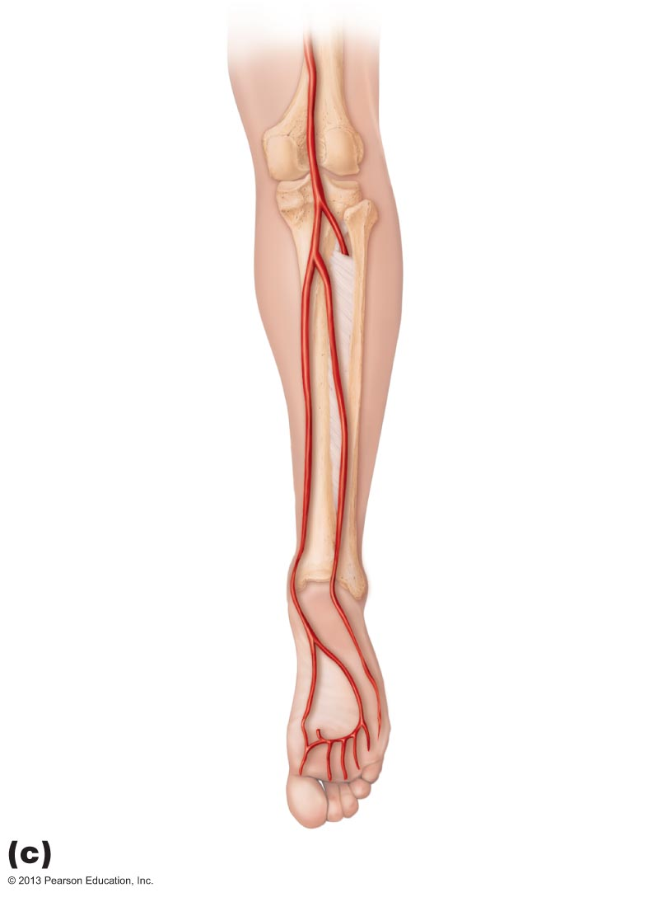
Figure 19.25c Arteries of the right pelvis and lower limb.
Popliteal artery
Anterior tibial
artery
Fibular artery
Posterior tibial
artery
Dorsalis pedis
artery (from top
of foot)
Plantar arch

Slide 132
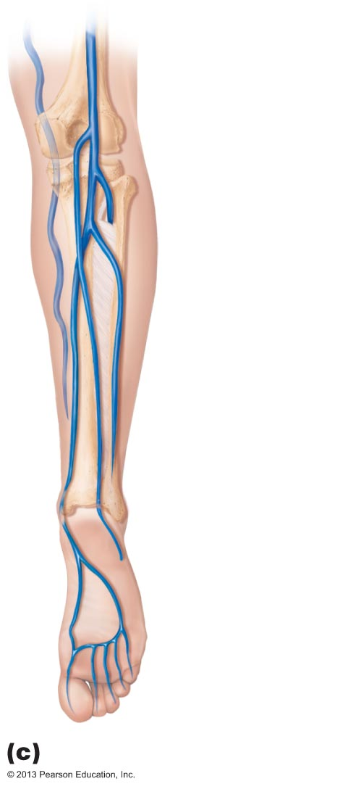
Figure 19.30c Veins of the right lower limb.
Great
saphenous
vein
Popliteal
vein
Anterior
tibial vein
Fibular
vein
Small
saphenous
vein
(superficial)
Posterior
tibial
vein
Plantar
veins
Deep
plantar arch
Digital veins

