Slide 1
Exam Two Material
Chapters 18 & 19

Slide 2
Heart Anatomy
Approximately the _
Location
In the mediastinum between _
On the superior surface of diaphragm
Anterior to the vertebral column, posterior to the sternum
Enclosed in __________________________________, a double-walled sac

Slide 3
Pericardium
Superficial fibrous pericardium

Slide 4
Pericardium
Deep two-layered serous pericardium
lines the internal surface of the fibrous pericardium
(epicardium) on external surface of the heart
Separated by ________________________________________
decreases friction

Slide 5
Layers of the Heart Wall
_____________________________ layer of the serous pericardium

Slide 6
Layers of the Heart Wall
Spiral bundles of cardiac muscle cells
_________________________________ of the heart
connective tissue
________________________ cardiac muscle fibers
_______________________________ great vessels and valves
Limits spread of action potentials to specific paths

Slide 7
Layers of the Heart Wall
Endocardium is _

Slide 8
Chambers
Four chambers
Two _
Separated by the _
Coronary _
atrioventricular groove
encircles the junction of the atria and ventricles
_________________________________ increase atrial volume

Slide 9
Chambers
Two _
Separated by the _
Anterior and posterior interventricular sulci mark the position of the septum externally

Slide 10
Atria: The Receiving Chambers
Walls are ridged by _
Vessels entering right atrium
Vessels entering left atrium
Right and left pulmonary veins

Slide 11
Ventricles: The Discharging Chambers
Walls are ridged by trabeculae carneae
_________________________________ project into the ventricular cavities
Vessel leaving the _
Vessel leaving the _

Slide 12
Pathway of Blood Through the Heart
The heart is two _
Right side is the pump for _
Vessels that carry blood to and from the lungs
Left side is the pump for the _
Vessels that carry the blood to and from all body tissues

Slide 13
Pathway of Blood Through the Heart
Right atrium → _______________________________→ right ventricle
Right ventricle → _________________________________ → pulmonary trunk → pulmonary arteries → lungs

Slide 14
Pathway of Blood Through the Heart
Lungs → ________________________ → left atrium
Left atrium → _____________________ → left ventricle
Left ventricle → aortic semilunar valve → aorta
Aorta → _

Slide 15
Pathway of Blood Through the Heart
Equal volumes of blood are pumped to the pulmonary and systemic circuits
Pulmonary circuit
is _
Systemic circuit blood
encounters _
Anatomy of the ventricles reflects these differences

Slide 16
Coronary Circulation
The functional blood supply to _
Arterial supply varies considerably and contains many anastomoses (junctions) among branches
__________________________ routes provide additional routes for blood delivery

Slide 17
Coronary Circulation
Arteries
Right and left coronary (in atrioventricular groove)
__________________________________ interventricular arteries

Slide 18
Coronary Circulation
Veins
anterior cardiac,
great cardiac veins

Slide 19
Homeostatic Imbalances
Thoracic pain caused by a ______________________________________ to the myocardium
Cells are _
Myocardial infarction (heart attack)
Prolonged _
Areas of _______________________________ are repaired with _

Slide 20
Heart Valves
Ensure _____________________________________ blood flow through the heart
Atrioventricular ___________ valves
______________________________________________ into the atria when ventricles contract
Chordae tendineae anchor AV valve cusps to papillary muscles

Slide 21
Heart Valves
Semilunar valves
______________________________________________________________________ when ventricles relax
Aortic semilunar valve

Slide 22
Microscopic Anatomy of Cardiac Muscle
Cardiac muscle cells are ____________________, short, fat, ______________________________, and interconnected
Numerous large _

Slide 23
Microscopic Anatomy of Cardiac Muscle
________________________________: junctions between cells anchor cardiac cells
__________________________________ prevent cells from separating during contraction
__________________________________ allow ions to pass; electrically couple adjacent cells
Heart muscle behaves as a functional _

Slide 24
Cardiac Muscle Contraction
Depolarization of the heart is _
Gap junctions ensure the heart contracts as a unit

Slide 25
Heart Physiology: Electrical Events
________________________ cardiac conduction system
A network of noncontractile, __________________________________ cells that initiate and distribute impulses to coordinate the depolarization and contraction of the heart

Slide 26
Heart Physiology: Sequence of Excitation
SA node or _
Generates impulses about 75 times/minute (sinus rhythm)
Depolarizes faster than any other part of the myocardium

Slide 27
Heart Physiology: Sequence of Excitation
Atrioventricular _
Smaller diameter fibers; fewer gap junctions
__________________________________ approximately 0.1 second
Depolarizes 50 times per minute in absence of SA node input

Slide 28
Heart Physiology: Sequence of Excitation
Atrioventricular (AV) bundle (bundle of His)

Slide 29
Heart Physiology: Sequence of Excitation
Right and left bundle branches
Two pathways in the ___________________________________ that carry the impulses toward the __________________________of the heart

Slide 30
Heart Physiology: Sequence of Excitation
Purkinje fibers
__________________________________ into the apex and ventricular walls
AV bundle and Purkinje fibers depolarize only 30 times per minute in absence of AV node input

Slide 31
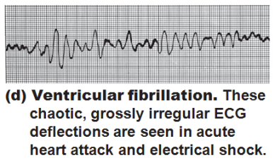
Homeostatic Imbalances
Defects in the intrinsic conduction system may result in
Arrhythmias
Uncoordinated atrial and ventricular contractions
rapid, irregular contractions; useless for pumping blood

Slide 32
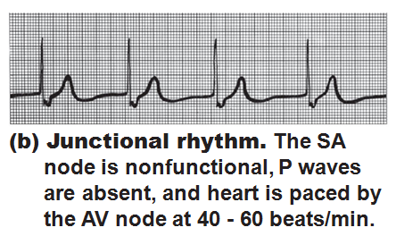
Homeostatic Imbalances
Defective ___________________ may result in
Ectopic focus: abnormal pacemaker takes over
If AV node takes over, there will be _

Slide 33
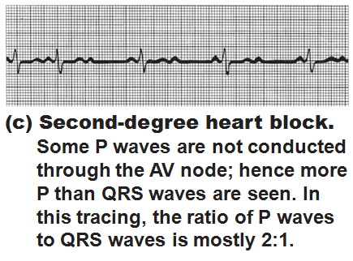
Homeostatic Imbalances
Defective AV node may result in
Few or no impulses from SA node reach the ventricles

Slide 34
Extrinsic Innervation of the Heart
Heartbeat is modified by the _
Cardiac centers are located in the ________________________________
______________________________________ center innervates SA and AV nodes, heart muscle, and coronary arteries through sympathetic neurons
______________________________________ center inhibits SA and AV nodes through parasympathetic fibers in _

