Slide 1
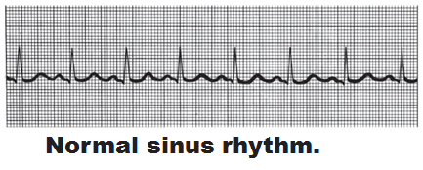
Electrocardiography
Electrocardiogram (ECG or EKG): a composite of all the _
Three waves
P wave:
QRS complex:
T wave:

Slide 2
Heart Sounds
Two sounds (lub-dup) associated with ____________________________________
First sound occurs as ____________________________________ and signifies beginning of systole
Second sound occurs when __________________________________________ at the beginning of ventricular diastole
Heart murmurs
abnormal heart sounds most often indicative _

Slide 3
Mechanical Events: The Cardiac Cycle
_________________________________: all events associated with blood flow through the heart during one complete heartbeat
Systole—
Diastole—

Slide 4
Phases of the Cardiac Cycle
Ventricular filling—takes place in mid-to-late diastole
80% of blood _______________________________ flows into ventricles
________________________________ occurs, delivering the remaining 20%

Slide 5
Phases of the Cardiac Cycle
Ventricular systole
Atria relax and ventricles begin to contract
Rising ventricular pressure results in _
In ejection phase, ventricular pressure exceeds pressure in the large arteries, forcing the _

Slide 6
Phases of the Cardiac Cycle
Isovolumetric relaxation occurs in early diastole
Ventricles relax
Backflow of blood in aorta and pulmonary trunk closes _

Slide 7
Cardiac Output (CO)
Volume of blood pumped by each ventricle in one minute
CO =
HR = number of beats per minute
SV = volume of blood pumped out by a ventricle with each beat

Slide 8
Autonomic Nervous System Regulation
Sympathetic nervous system is activated by _
_________________________________ causes the pacemaker to fire more rapidly and at the same time increases contractility

Slide 9
Autonomic Nervous System Regulation
Parasympathetic nervous system opposes sympathetic effects
Acetylcholine __________________________________ cells by opening K⁺ channels
The heart at rest exhibits _________________________________ (parasympathetic)

Slide 10
Chemical Regulation of Heart Rate
Hormones
Epinephrine from _____________________________________ enhances heart rate and contractility
Thyroxine increases heart rate and enhances the effects of norepinephrine and epinephrine
Takes longer to act, but causes a _
Can lead to weakened heart in hyperthyroid conditions

Slide 11
Chemical Regulation of Heart Rate
Intra- and extracellular ion concentrations (e.g., __________________) must be maintained for normal heart function

Slide 12
Chemical regulation
Ion imbalances:
Hypocalcemia
Increase heart _
Spastic heart contractions

Slide 13
Chemical regulation
Ion imbalances:
Hypokalemia
Hyperkalemia
Interferes with depolarization
Can lead to _

Slide 14
Other Factors that Influence Heart Rate
Gender
Body temperature

Slide 15
Homeostatic Imbalances
abnormally fast heart rate
Above _
If persistent, may lead to fibrillation
heart rate slower than _
May result in grossly inadequate blood circulation
May be desirable result of _

Slide 16
Congestive Heart Failure (CHF)
Progressive condition where the ___________________________ is so low that blood circulation is inadequate to meet tissue needs
Caused by
Persistent high blood pressure
Dilated cardiomyopathy (DCM)

Slide 17
Developmental Aspects of the Heart
Fetal heart structures that _
__________________________________ connects the two atria
__________________________________ connects the pulmonary trunk and the aorta

Slide 18
Developmental Aspects of the Heart
Congenital heart defects
Lead to mixing of _
Involve _____________________________ or vessels that increase the workload on the heart

Slide 19
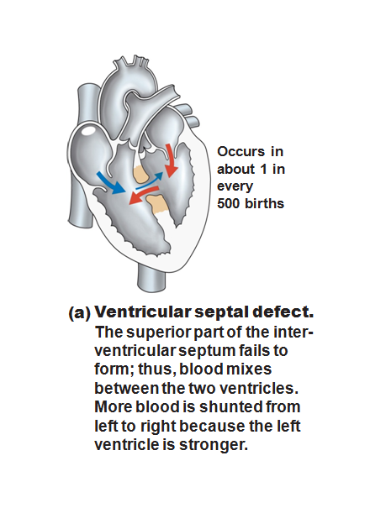

Slide 20
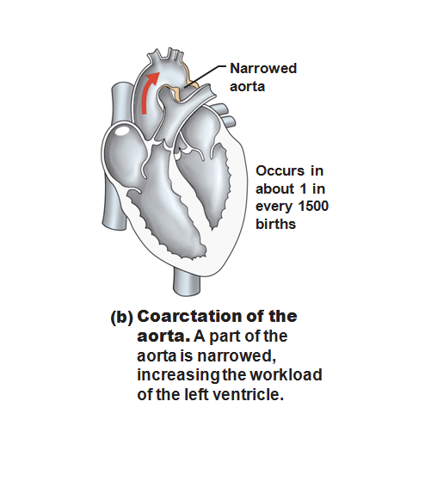

Slide 21
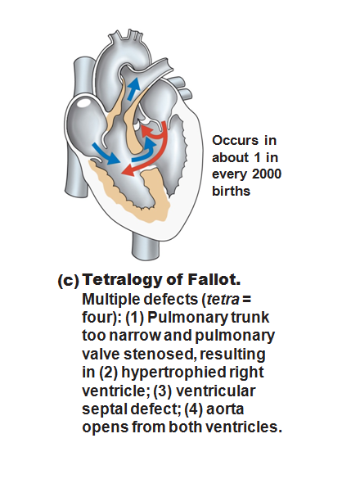

Slide 22
Age-Related Changes Affecting the Heart
____________________________ and thickening of valve flaps
Decline in _
______________________________ of cardiac muscle
End Chapter 18, begin Chapter 19

Slide 23
Blood Vessels
Delivery system of dynamic structures that _
Arteries:
carry blood _________________________________________; oxygenated except for pulmonary circulation and umbilical vessels of a fetus
Capillaries:
contact tissue cells and _
Veins:
carry blood _

Slide 24
Structure of Blood Vessel Walls
Arteries and veins
Tunica _
Tunica _
Tunica _
Central blood-containing space
Capillaries
___________________________________ with sparse basal lamina

Slide 25
Tunics
Tunica intima
Endothelium _________________________________ of all vessels
In vessels larger than 1 mm, a connective tissue basement membrane is present

Slide 26
Tunics
Tunica media
___________________________________ and sheets of elastin
___________________________________ nerve fibers control vasoconstriction and vasodilation of vessels

Slide 27
Tunics
Tunica externa (tunica adventitia)
_________________________________ fibers protect and reinforce
Larger vessels contain __________________________________ to nourish the external layer

Slide 28
Elastic (Conducting) Arteries
Large thick-walled arteries with _
___________________________ and its major branches
Large lumen offers low resistance
Act as _
expand and recoil as blood is ejected from the heart

Slide 29
Muscular (Distributing) Arteries and Arterioles
______________________to elastic arteries; deliver blood to body organs
Have ________________________________ with more smooth muscle
Active in _

Slide 30
Arterioles
Lead to capillary beds
________________________________ beds via vasodilation and vasoconstriction

Slide 31
Capillaries
Walls of thin tunica intima, _
Size allows only a _________________________________ at a time

Slide 32
Capillaries
Present in all tissues except for
Functions: exchange of gases, nutrients, wastes, hormones, etc.

Slide 33
Capillaries
Three structural types
_____________________________ capillaries
_____________________________ capillaries
Sinusoidal capillaries (sinusoids)

Slide 34
Continuous Capillaries
Abundant in the _
_____________________________ connect endothelial cells
Intercellular clefts allow the passage of fluids and small solutes
Continuous capillaries of the brain
Tight junctions are complete, forming the _

Slide 35
Fenestrated Capillaries
Some endothelial cells contain pores
_
_____________________________ than continuous capillaries
Function in _
small intestines, endocrine glands, and kidneys

Slide 36
Sinusoidal Capillaries
Fewer tight junctions, _________________________________, large lumens
Usually _
Allow ____________________________ and blood cells to pass between the blood and surrounding tissues
Found in the _______________________, bone marrow, spleen

Slide 37
Blood Flow Through Capillary Beds
________________________________ regulate blood flow into true capillaries
Regulated by local chemical conditions and vasomotor nerves

Slide 38
Venules
Formed when _
Very porous
allow _
Larger venules have one or two layers of smooth muscle cells

