Slide 1
Pulse
the expansion/recoil of artery walls due to increased pressure _.
Felt near surfaces.

Slide 2
Head and neck pulses
Temporal artery
Branches off of _
Pulse is palpable ___________________ to the zygomatic arch, anterior and superior to the _

Slide 3
Head and neck pulses
Common carotid artery
The left common carotid artery is one of three arteries that originate along the _
The right common carotid artery arises from the _
Pulse: palpated in the neck at _
Baroreceptors in carotids are sensitive to bilateral palpation, may cause _

Slide 4
Upper limb pulses
Brachial artery
Origin: ______________________→ axillary artery → to brachial artery
Palpation: at the _
Is the artery used to determine _

Slide 5
Upper limb pulses
Radial Artery
Origin: Subclavian a → axillary a → brachial a → splits into _
Palpation: at the ____________________ wrist: three finger-widths _

Slide 6
Lower Limb Pulses
___________________ arterial pulses are routinely felt in the lower limb.
Posterior tibial
Dorsalis pedis (dorsum of foot)

Slide 7
Femoral pulse
Most of the blood supply to the lower limb is carried in the _
Aorta →
descending aorta →
_________________________________→
external iliac artery →
becomes _________________________→
deep femoral

Slide 8
Finding the Femoral Pulse
Locate the superior border of the ___________________ in the mid line of the body;
Feel the _______________________________. The femoral pulse can be found midway between these two bony points
(the ___________________________________ point)

Slide 9
Popliteal
The femoral artery leaves enters the popliteal fossa by passing through the _
The name of the vessel then changes to the _

Slide 10
Palpating popliteal artery
bend the knee so that it is flexed to about _
press the tips of your fingers into the popliteal fossa.
The popliteal pulse is deep and __________________
Can be difficult to palpate

Slide 11
Posterior Tibial
The Popliteal artery branches into _

Slide 12
Palpating Posterior tibial artery
Locate the medial _
_______________________________ to the medial malleolus you should find the posterior tibial pulse.

Slide 13
Dorsalis Pedis
Below the knee, the popliteal artery divides into the anterior and posterior tibial arteries.
The anterior branch enters the ____________________________________________ of the leg by passing between the tibia and fibula above the interosseous membrane.
It continues on to the _______________________________ as the dorsalis pedis artery

Slide 14
Palpating dorsalis pedis pulse
Place your fingers _____________________ down the dorsum of the foot in the line between the _
The bones you can feel are the dorsal aspect of the navicular and the intermediate cuneiform bones.
The pulse is palpated where the artery passes over this area.

Slide 15
Measuring Blood Pressure
Systemic arterial BP
Measured ________________________ by the __________________________________ method using a sphygmomanometer
Pressure is increased in the cuff until it exceeds systolic pressure in the brachial artery

Slide 16
Alterations in Blood Pressure
Hypotension:
Systolic pressure below _
Often associated with long life and lack of cardiovascular illness

Slide 17
Homeostatic Imbalance: Hypotension
Orthostatic hypotension
_____________________________________ and dizziness when suddenly rising from a sitting or reclining position
Chronic hypotension
hint of _
warning sign for Addison’s disease or hypothyroidism
___________________________ hypotension
important sign of _

Slide 18
Alterations in Blood Pressure
Hypertension
______________________________ elevated arterial pressure of 140/90 or higher
May be transient adaptations during fever, physical exertion, and emotional upset
Often persistent in _

Slide 19
Temperature Regulation
As temperature rises (e.g., heat exposure, fever, vigorous exercise)
Hypothalamic ___________________________________ of the skin vessels
Heat radiates from the skin

Slide 20
Temperature Regulation
Sweat also causes ____________________________ via bradykinin in perspiration
Bradykinin stimulates the _
As temperature decreases, blood is shunted to deeper, more _

Slide 21
Capillary Exchange of Respiratory Gases and Nutrients
Diffusion of
O₂ and nutrients from _
CO₂ and metabolic wastes from _
Lipid-soluble molecules diffuse directly through endothelial membranes
Water-soluble solutes pass through _
Larger molecules, such as proteins, are actively transported in ________________________________ or caveolae

Slide 22
Circulatory Shock
Any condition in which
Blood vessels _
Blood _
Results in inadequate blood flow to meet tissue needs

Slide 23
Circulatory Shock
Hypovolemic shock
results from _
results from _____________________________________ and ____________________peripheral resistance
Cardiogenic shock
results when an ________________________________________ cannot sustain adequate circulation

Slide 24
Circulatory Pathways
Two main circulations
__________________________________: short loop that runs from the heart to the lungs and back to the heart
__________________________________: long loop to all parts of the body and back to the heart

Slide 25
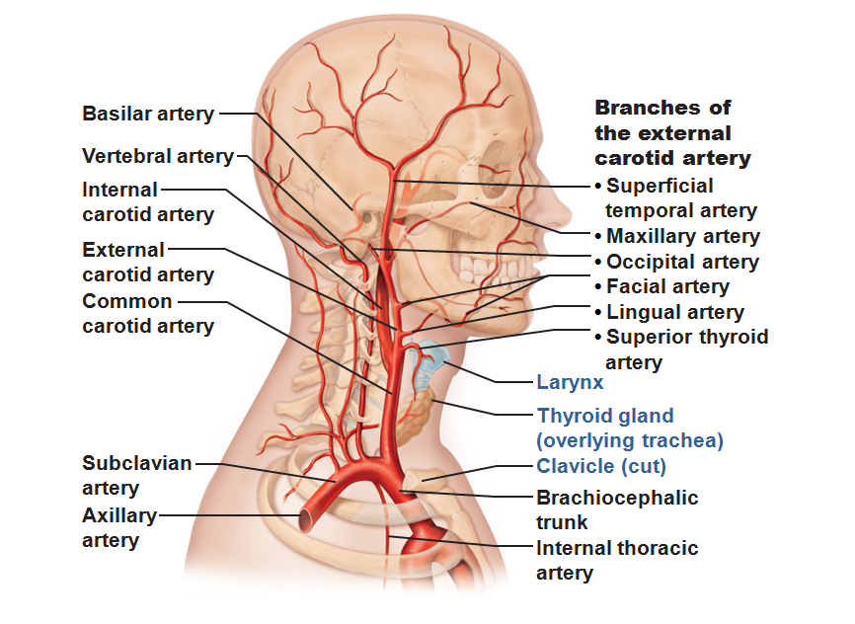

Slide 26
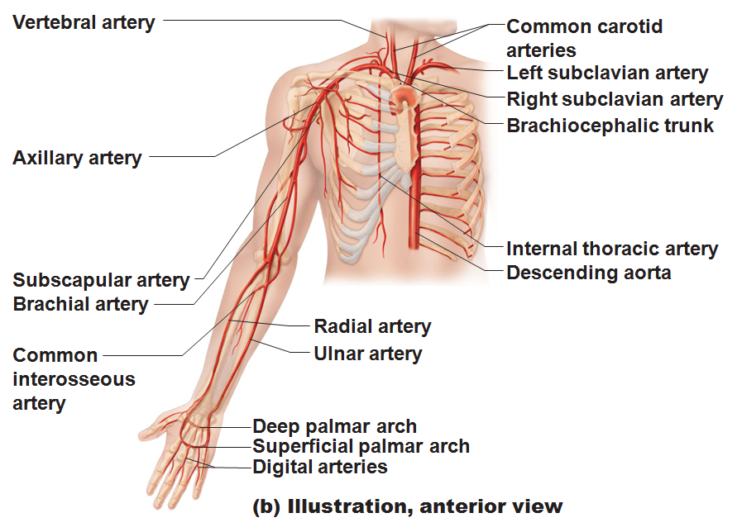

Slide 27
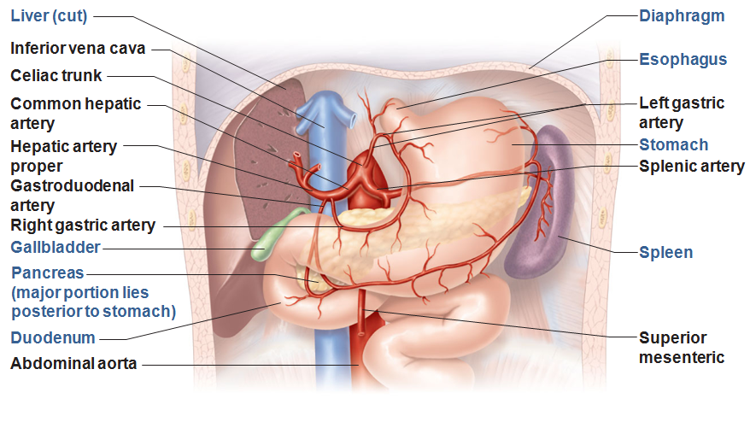

Slide 28
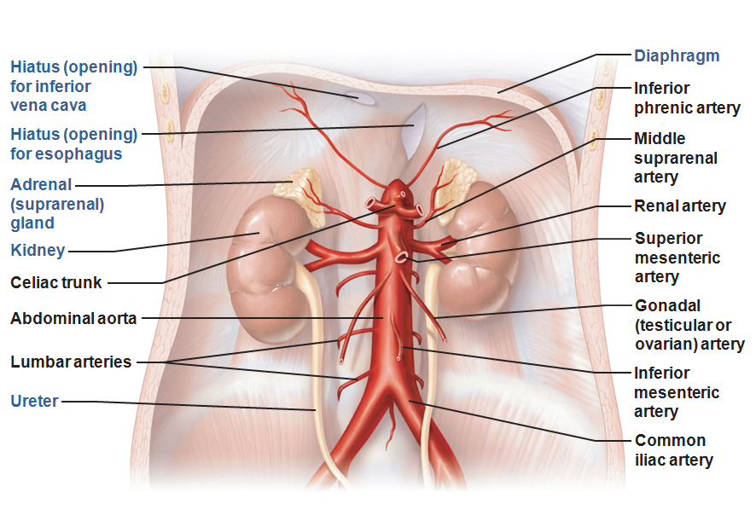

Slide 29
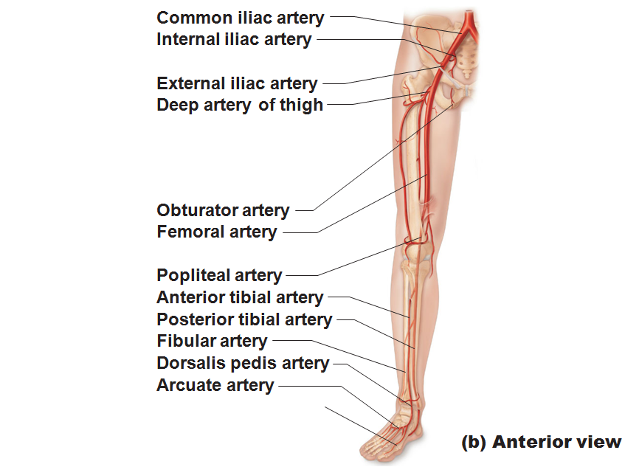

Slide 30
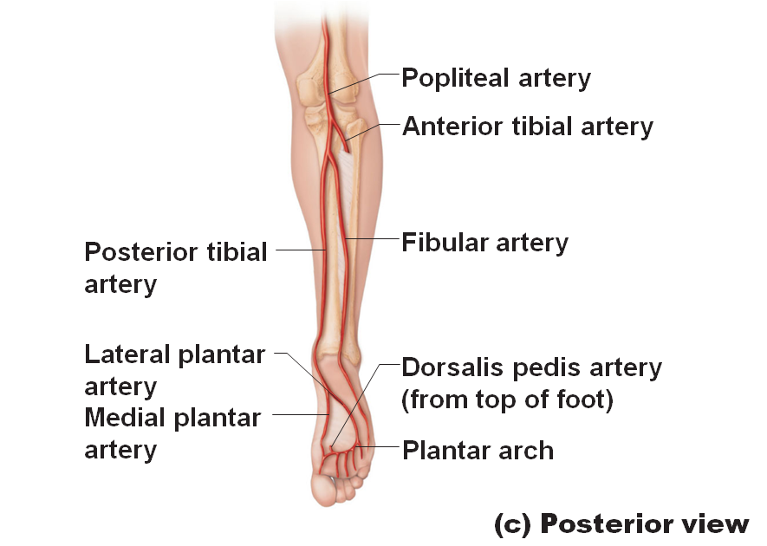

Slide 31
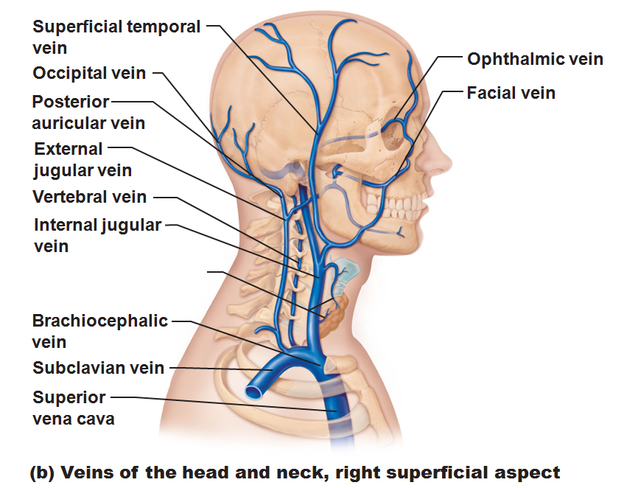

Slide 32
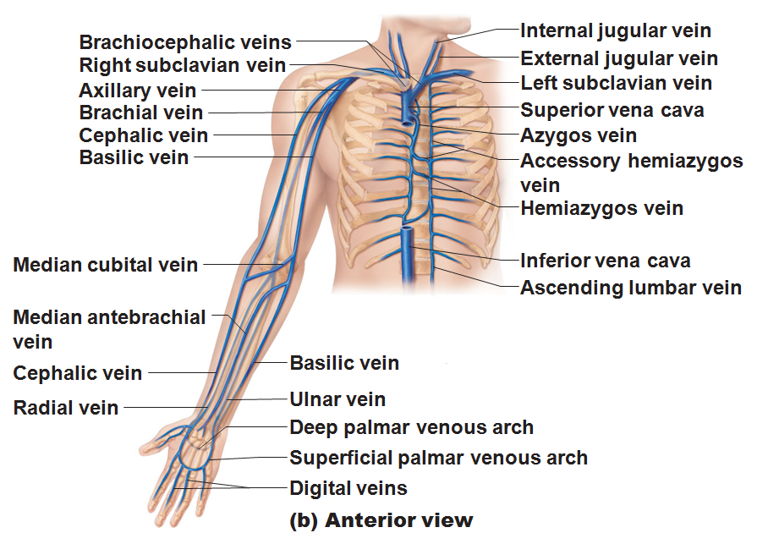

Slide 33
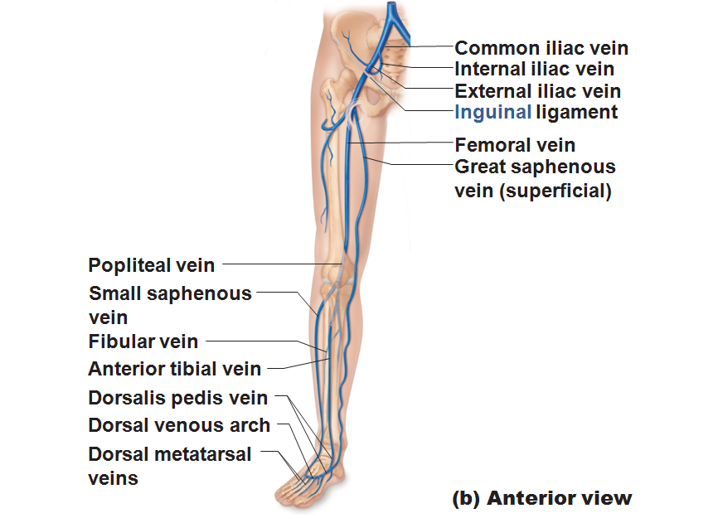

Slide 34
