Slide 1
Other Factors that Influence Heart Rate
Gender
Body temperature

Slide 2
Homeostatic Imbalances
abnormally fast heart rate
Above _
If persistent, may lead to fibrillation
heart rate slower than _
May result in grossly inadequate blood circulation
May be desirable result of _

Slide 3
Congestive Heart Failure (CHF)
Progressive condition where the ___________________________ is so low that blood circulation is inadequate to meet tissue needs
Caused by
Persistent high blood pressure
Dilated cardiomyopathy (DCM)

Slide 4
Developmental Aspects of the Heart
Fetal heart structures that _
__________________________________ connects the two atria
__________________________________ connects the pulmonary trunk and the aorta

Slide 5
Developmental Aspects of the Heart
Congenital heart defects
Lead to mixing of _
Involve _____________________________ or vessels that increase the workload on the heart

Slide 6
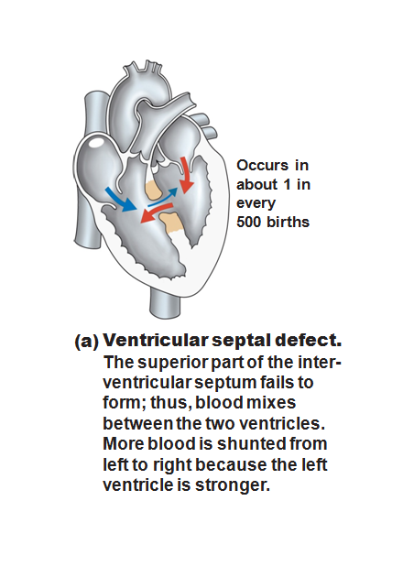

Slide 7
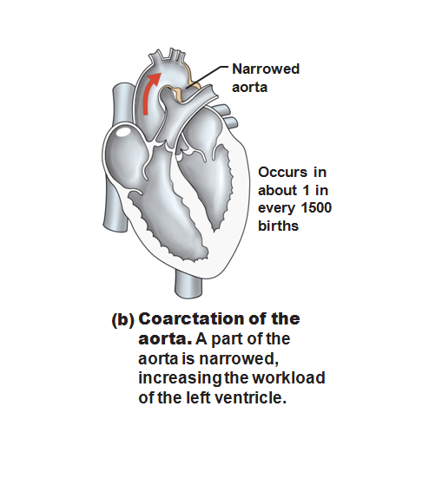

Slide 8
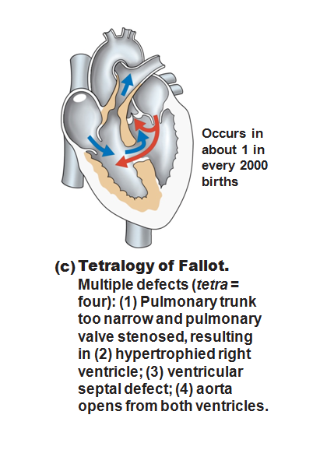

Slide 9
Age-Related Changes Affecting the Heart
____________________________ and thickening of valve flaps
Decline in _
______________________________ of cardiac muscle
End Chapter 18, begin Chapter 19

Slide 10
Blood Vessels
Delivery system of dynamic structures that _
Arteries:
carry blood _________________________________________; oxygenated except for pulmonary circulation and umbilical vessels of a fetus
Capillaries:
contact tissue cells and _
Veins:
carry blood _

Slide 11
Structure of Blood Vessel Walls
Arteries and veins
Tunica _
Tunica _
Tunica _
Central blood-containing space
Capillaries
___________________________________ with sparse basal lamina

Slide 12
Tunics
Tunica intima
Endothelium _________________________________ of all vessels
In vessels larger than 1 mm, a connective tissue basement membrane is present

Slide 13
Tunics
Tunica media
___________________________________ and sheets of elastin
___________________________________ nerve fibers control vasoconstriction and vasodilation of vessels

Slide 14
Tunics
Tunica externa (tunica adventitia)
_________________________________ fibers protect and reinforce
Larger vessels contain __________________________________ to nourish the external layer

Slide 15
Elastic (Conducting) Arteries
Large thick-walled arteries with _
___________________________ and its major branches
Large lumen offers low resistance
Act as _
expand and recoil as blood is ejected from the heart

Slide 16
Muscular (Distributing) Arteries and Arterioles
______________________to elastic arteries; deliver blood to body organs
Have ________________________________ with more smooth muscle
Active in _

Slide 17
Arterioles
Lead to capillary beds
________________________________ beds via vasodilation and vasoconstriction

Slide 18
Capillaries
Walls of thin tunica intima, _
Size allows only a _________________________________ at a time

Slide 19
Capillaries
Present in all tissues except for
Functions: exchange of gases, nutrients, wastes, hormones, etc.

Slide 20
Capillaries
Three structural types
_____________________________ capillaries
_____________________________ capillaries
Sinusoidal capillaries (sinusoids)

Slide 21
Continuous Capillaries
Abundant in the _
_____________________________ connect endothelial cells
Intercellular clefts allow the passage of fluids and small solutes
Continuous capillaries of the brain
Tight junctions are complete, forming the _

Slide 22
Fenestrated Capillaries
Some endothelial cells contain pores
_
_____________________________ than continuous capillaries
Function in _
small intestines, endocrine glands, and kidneys

Slide 23
Sinusoidal Capillaries
Fewer tight junctions, _________________________________, large lumens
Usually _
Allow ____________________________ and blood cells to pass between the blood and surrounding tissues
Found in the _______________________, bone marrow, spleen

Slide 24
Blood Flow Through Capillary Beds
________________________________ regulate blood flow into true capillaries
Regulated by local chemical conditions and vasomotor nerves

Slide 25
Venules
Formed when _
Very porous
allow _
Larger venules have one or two layers of smooth muscle cells

Slide 26
Veins
Formed when _
Have ______________________________, larger lumens compared with corresponding arteries
Blood pressure is _
Thin tunica media and a thick tunica externa consisting of collagen fibers and elastic networks
Called capacitance vessels (blood reservoirs); contain up _

Slide 27
Veins
Adaptations that ensure return of blood to the heart
Large-diameter lumens offer _
_________________________________ prevent backflow of blood
Most abundant in veins of the limbs
___________________________________: flattened veins with extremely thin walls (e.g., coronary sinus of the heart and dural sinuses of the brain)

Slide 28
Veins
_________________________________ helps maintain bp by returning more blood to the heart.
Ensures a nearly normal blood flow _

Slide 29
Veins
Blood flow through the venous system depends more on the contraction of skeletal muscles, breathing movements, and vasoconstriction of veins than on the direct result of _

Slide 30
Veins
______________________________ muscles press on veins, squeezing the blood inside ______________________ from one valved section to another.
The presence of the valves keeps the blood _

Slide 31
Veins
_______________________________ move venous blood.
Pressure in thoracic cavity is ______________________________ as the diaphragm ____________________ and the rib cage _

Slide 32
Veins
The pressure in the abdominal cavity is ____________________________ as the diaphragm presses on the abdominal viscera….
the blood moves from area of _
from abdomen towards thoracics. (towards heart)

Slide 33
Terms for circulation
Volume of blood flowing through a structure/time
Relatively constant at rest
Varies with individual organs: based on need
Blood pressure
The _____________________________ on the vessel wall based on the blood

Slide 34
Terms for circulation
Resistance
_____________________________, mostly occurring peripherally
Causes of Peripheral resistance
______________________________________________:
Increased viscosity yields increased resistance
______________________________________________:
The longer the vessel the greater the resistance
______________________________________________
the smaller the vessel, the greater the resistance

Slide 35
Viscosity
the _______________________________ with which its molecules flow past one another.
The ___________________________________, the more difficult the fluid is to move
Blood cells and plasma _
The greater the blood’s resistance to flowing, the greater the force needed to move it through the system.

Slide 36
Viscosity
Anemia _
Lowers _
Excess red blood cells _

Slide 37
Central Venous Pressure
All veins except for the _
the pressure within the right atrium is called the _
Affects the pressure within the _

Slide 38
Central Venous Pressure
Heart beats weakly →_
blood backs up into the venous network →_

Slide 39
Central Venous Pressure
if heart is beating _____________________________, the CVP and the pressure within the venous network ________________________________.

Slide 40
Central Venous Pressure
Factors that increase the blood flow into RA…elevate the CVP:
Widespread _
Increased CVP can lead ________________________________ due to the _______________________________ forcing fluid into tissues.

