Slide 1
Exam Two Material
Chapters 18 & 19

Slide 2
Heart Anatomy
Approximately the _
Location
In the mediastinum between _
On the superior surface of diaphragm
Anterior to the vertebral column, posterior to the sternum
Enclosed in __________________________________, a double-walled sac

Slide 3
Pericardium
Superficial fibrous pericardium

Slide 4
Pericardium
Deep two-layered serous pericardium
lines the internal surface of the fibrous pericardium
(epicardium) on external surface of the heart
Separated by ________________________________________
decreases friction

Slide 5
Layers of the Heart Wall
_____________________________ layer of the serous pericardium

Slide 6
Layers of the Heart Wall
Spiral bundles of cardiac muscle cells
_________________________________ of the heart
connective tissue
________________________ cardiac muscle fibers
_______________________________ great vessels and valves
Limits spread of action potentials to specific paths

Slide 7
Layers of the Heart Wall
Endocardium is _

Slide 8
Chambers
Four chambers
Two _
Separated by the _
Coronary _
atrioventricular groove
encircles the junction of the atria and ventricles
_________________________________ increase atrial volume

Slide 9
Chambers
Two _
Separated by the _
Anterior and posterior interventricular sulci mark the position of the septum externally

Slide 10
Atria: The Receiving Chambers
Walls are ridged by _
Vessels entering right atrium
Vessels entering left atrium
Right and left pulmonary veins

Slide 11
Ventricles: The Discharging Chambers
Walls are ridged by trabeculae carneae
_________________________________ project into the ventricular cavities
Vessel leaving the _
Vessel leaving the _

Slide 12
Pathway of Blood Through the Heart
The heart is two _
Right side is the pump for _
Vessels that carry blood to and from the lungs
Left side is the pump for the _
Vessels that carry the blood to and from all body tissues

Slide 13
Pathway of Blood Through the Heart
Right atrium → _______________________________→ right ventricle
Right ventricle → _________________________________ → pulmonary trunk → pulmonary arteries → lungs

Slide 14
Pathway of Blood Through the Heart
Lungs → ________________________ → left atrium
Left atrium → _____________________ → left ventricle
Left ventricle → aortic semilunar valve → aorta
Aorta → _

Slide 15
Pathway of Blood Through the Heart
Equal volumes of blood are pumped to the pulmonary and systemic circuits
Pulmonary circuit
is _
Systemic circuit blood
encounters _
Anatomy of the ventricles reflects these differences

Slide 16
Coronary Circulation
The functional blood supply to _
Arterial supply varies considerably and contains many anastomoses (junctions) among branches
__________________________ routes provide additional routes for blood delivery

Slide 17
Coronary Circulation
Arteries
Right and left coronary (in atrioventricular groove)
__________________________________ interventricular arteries

Slide 18
Coronary Circulation
Veins
anterior cardiac,
great cardiac veins

Slide 19
Homeostatic Imbalances
Thoracic pain caused by a ______________________________________ to the myocardium
Cells are _
Myocardial infarction (heart attack)
Prolonged _
Areas of _______________________________ are repaired with _

Slide 20
Heart Valves
Ensure _____________________________________ blood flow through the heart
Atrioventricular ___________ valves
______________________________________________ into the atria when ventricles contract
Chordae tendineae anchor AV valve cusps to papillary muscles

Slide 21
Heart Valves
Semilunar valves
______________________________________________________________________ when ventricles relax
Aortic semilunar valve

Slide 22
Microscopic Anatomy of Cardiac Muscle
Cardiac muscle cells are ____________________, short, fat, ______________________________, and interconnected
Numerous large _

Slide 23
Microscopic Anatomy of Cardiac Muscle
________________________________: junctions between cells anchor cardiac cells
__________________________________ prevent cells from separating during contraction
__________________________________ allow ions to pass; electrically couple adjacent cells
Heart muscle behaves as a functional _

Slide 24
Cardiac Muscle Contraction
Depolarization of the heart is _
Gap junctions ensure the heart contracts as a unit

Slide 25
Heart Physiology: Electrical Events
________________________ cardiac conduction system
A network of noncontractile, __________________________________ cells that initiate and distribute impulses to coordinate the depolarization and contraction of the heart

Slide 26
Heart Physiology: Sequence of Excitation
SA node or _
Generates impulses about 75 times/minute (sinus rhythm)
Depolarizes faster than any other part of the myocardium

Slide 27
Heart Physiology: Sequence of Excitation
Atrioventricular _
Smaller diameter fibers; fewer gap junctions
__________________________________ approximately 0.1 second
Depolarizes 50 times per minute in absence of SA node input

Slide 28
Heart Physiology: Sequence of Excitation
Atrioventricular (AV) bundle (bundle of His)

Slide 29
Heart Physiology: Sequence of Excitation
Right and left bundle branches
Two pathways in the ___________________________________ that carry the impulses toward the __________________________of the heart

Slide 30
Heart Physiology: Sequence of Excitation
Purkinje fibers
__________________________________ into the apex and ventricular walls
AV bundle and Purkinje fibers depolarize only 30 times per minute in absence of AV node input

Slide 31
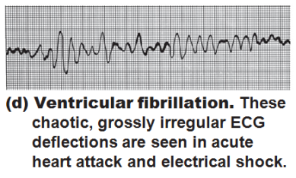
Homeostatic Imbalances
Defects in the intrinsic conduction system may result in
Arrhythmias
Uncoordinated atrial and ventricular contractions
rapid, irregular contractions; useless for pumping blood

Slide 32
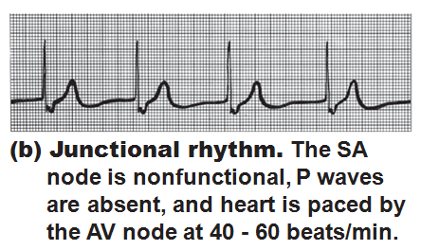
Homeostatic Imbalances
Defective ___________________ may result in
Ectopic focus: abnormal pacemaker takes over
If AV node takes over, there will be _

Slide 33
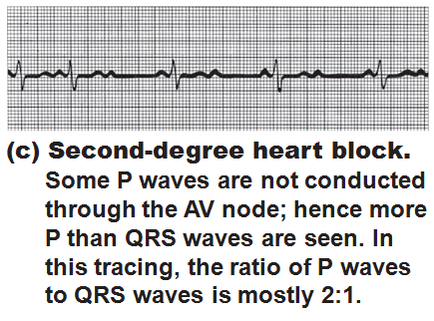
Homeostatic Imbalances
Defective AV node may result in
Few or no impulses from SA node reach the ventricles

Slide 34
Extrinsic Innervation of the Heart
Heartbeat is modified by the _
Cardiac centers are located in the ________________________________
______________________________________ center innervates SA and AV nodes, heart muscle, and coronary arteries through sympathetic neurons
______________________________________ center inhibits SA and AV nodes through parasympathetic fibers in _

Slide 35
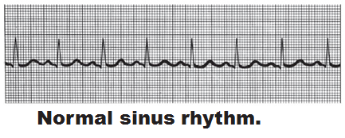
Electrocardiography
Electrocardiogram (ECG or EKG): a composite of all the _
Three waves
P wave:
QRS complex:
T wave:

Slide 36
Heart Sounds
Two sounds (lub-dup) associated with ____________________________________
First sound occurs as ____________________________________ and signifies beginning of systole
Second sound occurs when __________________________________________ at the beginning of ventricular diastole
Heart murmurs
abnormal heart sounds most often indicative _

Slide 37
Mechanical Events: The Cardiac Cycle
_________________________________: all events associated with blood flow through the heart during one complete heartbeat
Systole—
Diastole—

Slide 38
Phases of the Cardiac Cycle
Ventricular filling—takes place in mid-to-late diastole
80% of blood _______________________________ flows into ventricles
________________________________ occurs, delivering the remaining 20%

Slide 39
Phases of the Cardiac Cycle
Ventricular systole
Atria relax and ventricles begin to contract
Rising ventricular pressure results in _
In ejection phase, ventricular pressure exceeds pressure in the large arteries, forcing the _

Slide 40
Phases of the Cardiac Cycle
Isovolumetric relaxation occurs in early diastole
Ventricles relax
Backflow of blood in aorta and pulmonary trunk closes _

Slide 41
Cardiac Output (CO)
Volume of blood pumped by each ventricle in one minute
CO =
HR = number of beats per minute
SV = volume of blood pumped out by a ventricle with each beat

Slide 42
Autonomic Nervous System Regulation
Sympathetic nervous system is activated by _
_________________________________ causes the pacemaker to fire more rapidly and at the same time increases contractility

Slide 43
Autonomic Nervous System Regulation
Parasympathetic nervous system opposes sympathetic effects
Acetylcholine __________________________________ cells by opening K⁺ channels
The heart at rest exhibits _________________________________ (parasympathetic)

Slide 44
Chemical Regulation of Heart Rate
Hormones
Epinephrine from _____________________________________ enhances heart rate and contractility
Thyroxine increases heart rate and enhances the effects of norepinephrine and epinephrine
Takes longer to act, but causes a _
Can lead to weakened heart in hyperthyroid conditions

Slide 45
Chemical Regulation of Heart Rate
Intra- and extracellular ion concentrations (e.g., __________________) must be maintained for normal heart function

Slide 46
Chemical regulation
Ion imbalances:
Hypocalcemia
Increase heart _
Spastic heart contractions

Slide 47
Chemical regulation
Ion imbalances:
Hypokalemia
Hyperkalemia
Interferes with depolarization
Can lead to _

Slide 48
Other Factors that Influence Heart Rate
Gender
Body temperature

Slide 49
Homeostatic Imbalances
abnormally fast heart rate
Above _
If persistent, may lead to fibrillation
heart rate slower than _
May result in grossly inadequate blood circulation
May be desirable result of _

Slide 50
Congestive Heart Failure (CHF)
Progressive condition where the ___________________________ is so low that blood circulation is inadequate to meet tissue needs
Caused by
Persistent high blood pressure
Dilated cardiomyopathy (DCM)

Slide 51
Developmental Aspects of the Heart
Fetal heart structures that _
__________________________________ connects the two atria
__________________________________ connects the pulmonary trunk and the aorta

Slide 52
Developmental Aspects of the Heart
Congenital heart defects
Lead to mixing of _
Involve _____________________________ or vessels that increase the workload on the heart

Slide 54
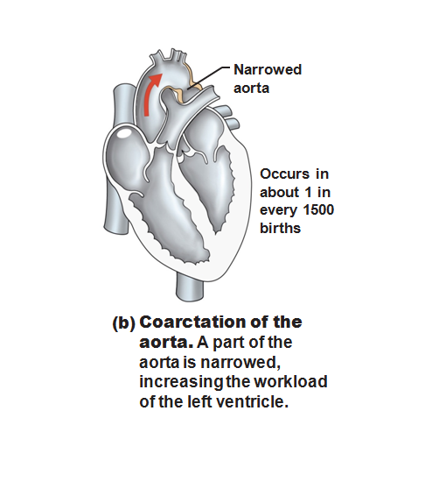

Slide 55
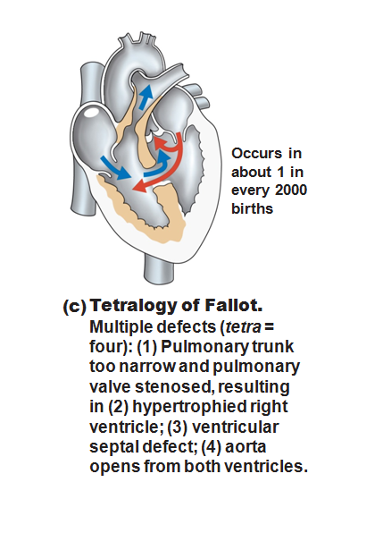

Slide 56
Age-Related Changes Affecting the Heart
____________________________ and thickening of valve flaps
Decline in _
______________________________ of cardiac muscle
End Chapter 18, begin Chapter 19

Slide 57
Blood Vessels
Delivery system of dynamic structures that _
Arteries:
carry blood _________________________________________; oxygenated except for pulmonary circulation and umbilical vessels of a fetus
Capillaries:
contact tissue cells and _
Veins:
carry blood _

Slide 58
Structure of Blood Vessel Walls
Arteries and veins
Tunica _
Tunica _
Tunica _
Central blood-containing space
Capillaries
___________________________________ with sparse basal lamina

Slide 59
Tunics
Tunica intima
Endothelium _________________________________ of all vessels
In vessels larger than 1 mm, a connective tissue basement membrane is present

Slide 60
Tunics
Tunica media
___________________________________ and sheets of elastin
___________________________________ nerve fibers control vasoconstriction and vasodilation of vessels

Slide 61
Tunics
Tunica externa (tunica adventitia)
_________________________________ fibers protect and reinforce
Larger vessels contain __________________________________ to nourish the external layer

Slide 62
Elastic (Conducting) Arteries
Large thick-walled arteries with _
___________________________ and its major branches
Large lumen offers low resistance
Act as _
expand and recoil as blood is ejected from the heart

Slide 63
Muscular (Distributing) Arteries and Arterioles
______________________to elastic arteries; deliver blood to body organs
Have ________________________________ with more smooth muscle
Active in _

Slide 64
Arterioles
Lead to capillary beds
________________________________ beds via vasodilation and vasoconstriction

Slide 65
Capillaries
Walls of thin tunica intima, _
Size allows only a _________________________________ at a time

Slide 66
Capillaries
Present in all tissues except for
Functions: exchange of gases, nutrients, wastes, hormones, etc.

Slide 67
Capillaries
Three structural types
_____________________________ capillaries
_____________________________ capillaries
Sinusoidal capillaries (sinusoids)

Slide 68
Continuous Capillaries
Abundant in the _
_____________________________ connect endothelial cells
Intercellular clefts allow the passage of fluids and small solutes
Continuous capillaries of the brain
Tight junctions are complete, forming the _

Slide 69
Fenestrated Capillaries
Some endothelial cells contain pores
_
_____________________________ than continuous capillaries
Function in _
small intestines, endocrine glands, and kidneys

Slide 70
Sinusoidal Capillaries
Fewer tight junctions, _________________________________, large lumens
Usually _
Allow ____________________________ and blood cells to pass between the blood and surrounding tissues
Found in the _______________________, bone marrow, spleen

Slide 71
Blood Flow Through Capillary Beds
________________________________ regulate blood flow into true capillaries
Regulated by local chemical conditions and vasomotor nerves

Slide 72
Venules
Formed when _
Very porous
allow _
Larger venules have one or two layers of smooth muscle cells

Slide 73
Veins
Formed when _
Have ______________________________, larger lumens compared with corresponding arteries
Blood pressure is _
Thin tunica media and a thick tunica externa consisting of collagen fibers and elastic networks
Called capacitance vessels (blood reservoirs); contain up _

Slide 74
Veins
Adaptations that ensure return of blood to the heart
Large-diameter lumens offer _
_________________________________ prevent backflow of blood
Most abundant in veins of the limbs
___________________________________: flattened veins with extremely thin walls (e.g., coronary sinus of the heart and dural sinuses of the brain)

Slide 75
Veins
_________________________________ helps maintain bp by returning more blood to the heart.
Ensures a nearly normal blood flow _

Slide 76
Veins
Blood flow through the venous system depends more on the contraction of skeletal muscles, breathing movements, and vasoconstriction of veins than on the direct result of _

Slide 77
Veins
______________________________ muscles press on veins, squeezing the blood inside ______________________ from one valved section to another.
The presence of the valves keeps the blood _

Slide 78
Veins
_______________________________ move venous blood.
Pressure in thoracic cavity is ______________________________ as the diaphragm ____________________ and the rib cage _

Slide 79
Veins
The pressure in the abdominal cavity is ____________________________ as the diaphragm presses on the abdominal viscera….
the blood moves from area of _
from abdomen towards thoracics. (towards heart)

Slide 80
Terms for circulation
Volume of blood flowing through a structure/time
Relatively constant at rest
Varies with individual organs: based on need
Blood pressure
The _____________________________ on the vessel wall based on the blood

Slide 81
Terms for circulation
Resistance
_____________________________, mostly occurring peripherally
Causes of Peripheral resistance
______________________________________________:
Increased viscosity yields increased resistance
______________________________________________:
The longer the vessel the greater the resistance
______________________________________________
the smaller the vessel, the greater the resistance

Slide 82
Viscosity
the _______________________________ with which its molecules flow past one another.
The ___________________________________, the more difficult the fluid is to move
Blood cells and plasma _
The greater the blood’s resistance to flowing, the greater the force needed to move it through the system.

Slide 83
Viscosity
Anemia _
Lowers _
Excess red blood cells _

Slide 84
Central Venous Pressure
All veins except for the _
the pressure within the right atrium is called the _
Affects the pressure within the _

Slide 85
Central Venous Pressure
Heart beats weakly →_
blood backs up into the venous network →_

Slide 86
Central Venous Pressure
if heart is beating _____________________________, the CVP and the pressure within the venous network ________________________________.

Slide 87
Central Venous Pressure
Factors that increase the blood flow into RA…elevate the CVP:
Widespread _
Increased CVP can lead ________________________________ due to the _______________________________ forcing fluid into tissues.

Slide 88
Blood Pressure
Is the force the blood exerts against the inner walls of the blood vessels.
Most commonly refers to pressure in the _

Slide 89
Blood Pressure
Arterial blood pressure: rises and falls in a pattern with the _
When ventricles contract: ________________________________: walls squeeze blood into pulmonary trunk and aorta. Pressure in the _

Slide 90
Blood Pressure
Maximum pressure achieved during _________________________________ is _

Slide 91
Blood Pressure
When ventricles relax =_
the arterial pressure drops, and the lowest pressure that remains in the arteries before the next contraction is the _

Slide 92
Blood Pressure
BP read as _________________________________ which translates into
ventricular contraction pressure/ventricular relaxation pressure.

Slide 93
Short term BP control
Short term controls of blood pressure
Function to correct minor fluctuations in BP
By altering _
By altering _

Slide 94
Vasomotor Center
Short term control: _
Two main goals
Maintaining adequate mean arterial pressure by _
Distributing blood to those _

Slide 95
Vasomotor center
Vasomotor center: neurons _
With the cardiac center in the medulla, they form the _
Vasomotor center in medulla →_______________________________ efferent fibers → ______________________________ of the arterioles
Arterioles under state of constant constriction called vasomotor tone

Slide 96
Vasomotor activity
Vasomotor control modified by
Higher brain centers

Slide 97
Vasomotor: Baroreceptors
Increased ___________________________ causes stretch in baroreceptors
Located in _
Carotid provides the major blood flow to the brain
Carotid __________________________________ protects the brain
Located in _____________________________ and walls of large arteries
Aortic sinus reflex protects the systemic circuit

Slide 98
Vasomotor: baroreceptors
Increased BP →
______________________________________→
triggers baroreceptors →
impulses sent _____________________________→
arterioles and veins ________________________ →

Slide 99
Vasomotor: chemoreceptors
Sensitive to
Carbon dioxide
Locations:
________________________________________ located in Carotid artery
Aortic bodies located in Aorta
Main function:
regulating respiratory rate, but does have some blood pressure function

Slide 100
Vasomotor: chemoreceptors
Decreased oxygen → ______________________________→
signals sent to cardioacceleratory center → cardiac output increases
AND signals sent to vasomotor center → vasoconstriction → _____________________________→ blood supply returns to heart (and lungs) quickly

Slide 101
Vasomotor: brain functions
Medulla is not the only brain area that controls blood pressure
Both of these regions have input into medulla to ___________________________ control BP

Slide 102
Hormone effects on BP
Adrenal medulla
increases _
General _
Specific vasodilation: skeletal and cardiac muscles
Norepinephrine
Enhance sympathetic fight/flight response

Slide 103
Hormone effects on BP
Atrial natriuretic peptide: _
_________________________________ stimulates ANP release.
Results in ____________________________________ after ANP causes sodium to be excreted from kidneys
Where sodium goes, water goes

Slide 104
Hormone effects on BP
Antidiuretic Hormone ADH/ vasopressin
Results in the _____________________________________ in the body
If low BP or blood volume, ADH will prevent water from being lost as urine
Water restores blood volume/pressure
Also can cause _

Slide 105
Hormone effects on BP
stimulates vasoconstriction
Causes the release of ADH and _
Causes long-term regulation by increasing blood volume

Slide 106
Hormone effects on BP
Angiotensin II
Low BP →
Kidneys release _
Renin acts as an _______________________, breaking _____________________________ into angiotensin I
Angiotensin I is changed into angiotensin ____ by _________________________ : Angiotensin Converting Enzyme

Slide 107
BP Control: Long term
Will change blood pressure based on changes in blood volume
Recall that short term controls dealt mostly with ________________________________ to control blood pressure
Short term solutions like baroreceptors can
Respond _
_______________________________ to chronic conditions

Slide 108
BP control: long term
Kidneys
_____________________________ regulate arterial pressure
Alters ____________________________________ as a function of filtration pressure
High blood pressure forces blood to be filtered and processed quickly through the renal system. Larger amounts of water will be lost as urine causing the blood pressure to lower
________________________________ regulates arterial pressure
Renin-angiotensin mechanism:
stimulates ___________________________________ which reabsorbs sodium and in turn causes the _

Slide 109
Monitoring Circulatory Efficiency
_________________________________:
pulse and blood pressure, along with respiratory rate and body temperature
Pulse:
pressure wave caused by the _

Slide 110
Pulse
the expansion/recoil of artery walls due to increased pressure _.
Felt near surfaces.

Slide 111
Head and neck pulses
Temporal artery
Branches off of _
Pulse is palpable ___________________ to the zygomatic arch, anterior and superior to the _

Slide 112
Head and neck pulses
Common carotid artery
The left common carotid artery is one of three arteries that originate along the _
The right common carotid artery arises from the _
Pulse: palpated in the neck at _
Baroreceptors in carotids are sensitive to bilateral palpation, may cause _

Slide 113
Upper limb pulses
Brachial artery
Origin: ______________________→ axillary artery → to brachial artery
Palpation: at the _
Is the artery used to determine _

Slide 114
Upper limb pulses
Radial Artery
Origin: Subclavian a → axillary a → brachial a → splits into _
Palpation: at the ____________________ wrist: three finger-widths _

Slide 115
Lower Limb Pulses
___________________ arterial pulses are routinely felt in the lower limb.
Posterior tibial
Dorsalis pedis (dorsum of foot)

Slide 116
Femoral pulse
Most of the blood supply to the lower limb is carried in the _
Aorta →
descending aorta →
_________________________________→
external iliac artery →
becomes _________________________→
deep femoral

Slide 117
Finding the Femoral Pulse
Locate the superior border of the ___________________ in the mid line of the body;
Feel the _______________________________. The femoral pulse can be found midway between these two bony points
(the ___________________________________ point)

Slide 118
Popliteal
The femoral artery leaves enters the popliteal fossa by passing through the _
The name of the vessel then changes to the _

Slide 119
Palpating popliteal artery
bend the knee so that it is flexed to about _
press the tips of your fingers into the popliteal fossa.
The popliteal pulse is deep and __________________
Can be difficult to palpate

Slide 120
Posterior Tibial
The Popliteal artery branches into _

Slide 121
Palpating Posterior tibial artery
Locate the medial _
_______________________________ to the medial malleolus you should find the posterior tibial pulse.

Slide 122
Dorsalis Pedis
Below the knee, the popliteal artery divides into the anterior and posterior tibial arteries.
The anterior branch enters the ____________________________________________ of the leg by passing between the tibia and fibula above the interosseous membrane.
It continues on to the _______________________________ as the dorsalis pedis artery

Slide 123
Palpating dorsalis pedis pulse
Place your fingers _____________________ down the dorsum of the foot in the line between the _
The bones you can feel are the dorsal aspect of the navicular and the intermediate cuneiform bones.
The pulse is palpated where the artery passes over this area.

Slide 124
Measuring Blood Pressure
Systemic arterial BP
Measured ________________________ by the __________________________________ method using a sphygmomanometer
Pressure is increased in the cuff until it exceeds systolic pressure in the brachial artery

Slide 125
Alterations in Blood Pressure
Hypotension:
Systolic pressure below _
Often associated with long life and lack of cardiovascular illness

Slide 126
Homeostatic Imbalance: Hypotension
Orthostatic hypotension
_____________________________________ and dizziness when suddenly rising from a sitting or reclining position
Chronic hypotension
hint of _
warning sign for Addison’s disease or hypothyroidism
___________________________ hypotension
important sign of _

Slide 127
Alterations in Blood Pressure
Hypertension
______________________________ elevated arterial pressure of 140/90 or higher
May be transient adaptations during fever, physical exertion, and emotional upset
Often persistent in _

Slide 128
Temperature Regulation
As temperature rises (e.g., heat exposure, fever, vigorous exercise)
Hypothalamic ___________________________________ of the skin vessels
Heat radiates from the skin

Slide 129
Temperature Regulation
Sweat also causes ____________________________ via bradykinin in perspiration
Bradykinin stimulates the _
As temperature decreases, blood is shunted to deeper, more _

Slide 130
Capillary Exchange of Respiratory Gases and Nutrients
Diffusion of
O₂ and nutrients from _
CO₂ and metabolic wastes from _
Lipid-soluble molecules diffuse directly through endothelial membranes
Water-soluble solutes pass through _
Larger molecules, such as proteins, are actively transported in ________________________________ or caveolae

Slide 131
Circulatory Shock
Any condition in which
Blood vessels _
Blood _
Results in inadequate blood flow to meet tissue needs

Slide 132
Circulatory Shock
Hypovolemic shock
results from _
results from _____________________________________ and ____________________peripheral resistance
Cardiogenic shock
results when an ________________________________________ cannot sustain adequate circulation

Slide 133
Circulatory Pathways
Two main circulations
__________________________________: short loop that runs from the heart to the lungs and back to the heart
__________________________________: long loop to all parts of the body and back to the heart

Slide 134
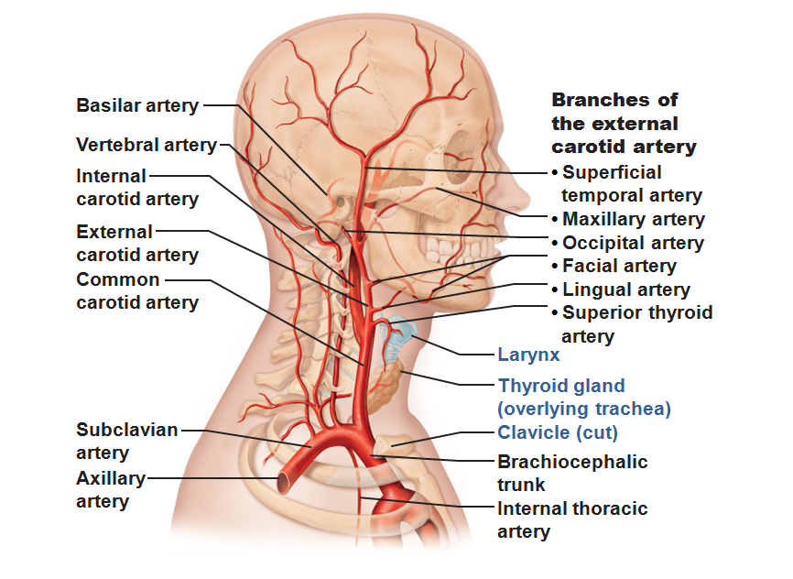

Slide 135
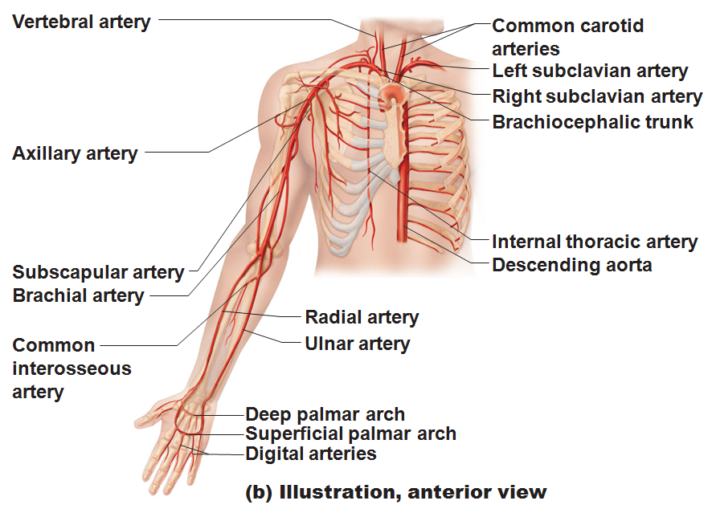

Slide 136
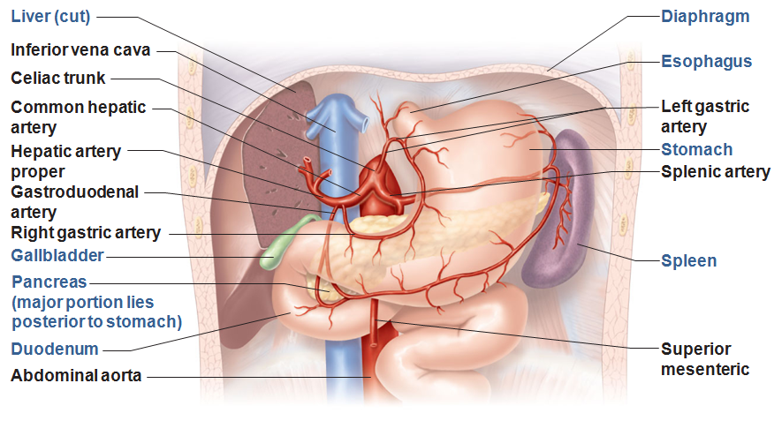

Slide 137
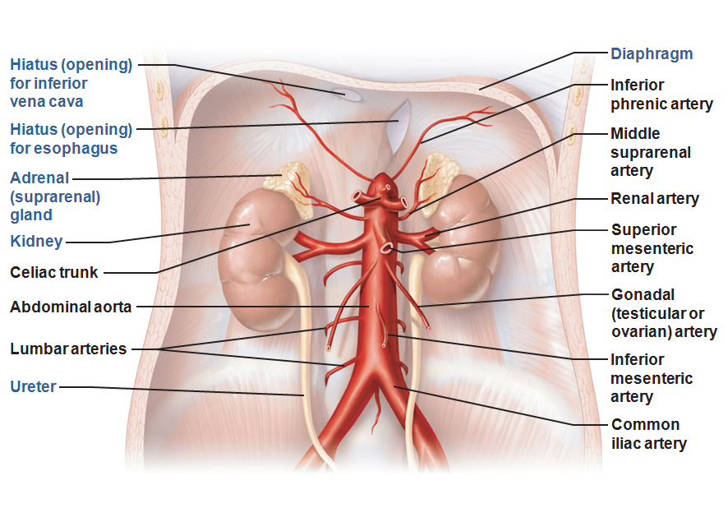

Slide 138
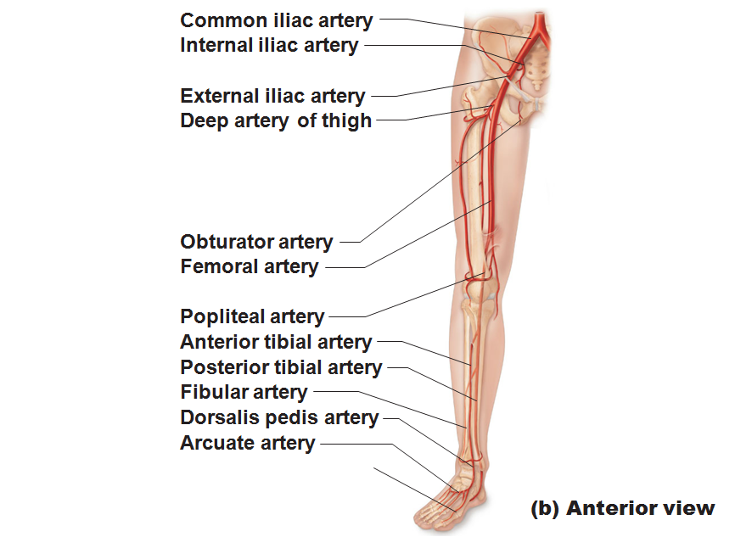

Slide 139
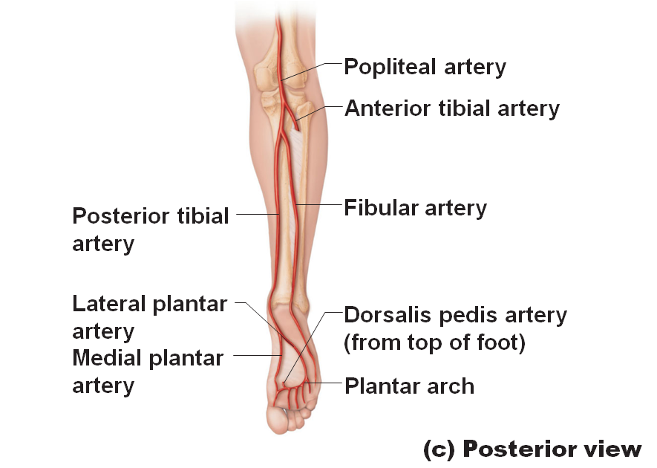

Slide 140
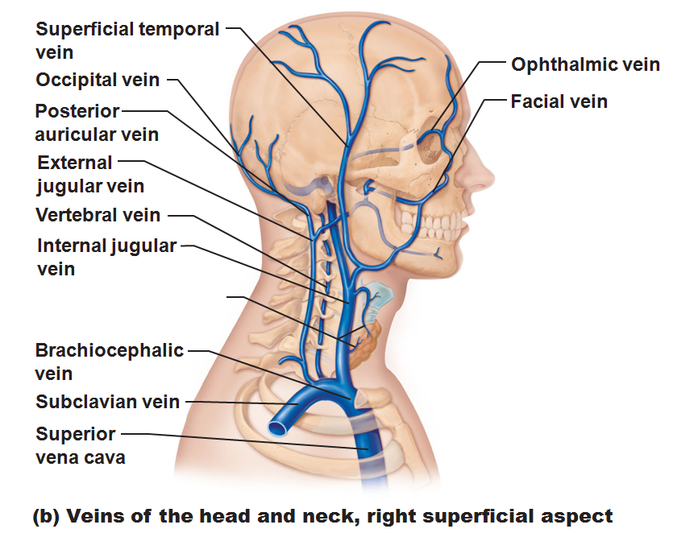

Slide 141
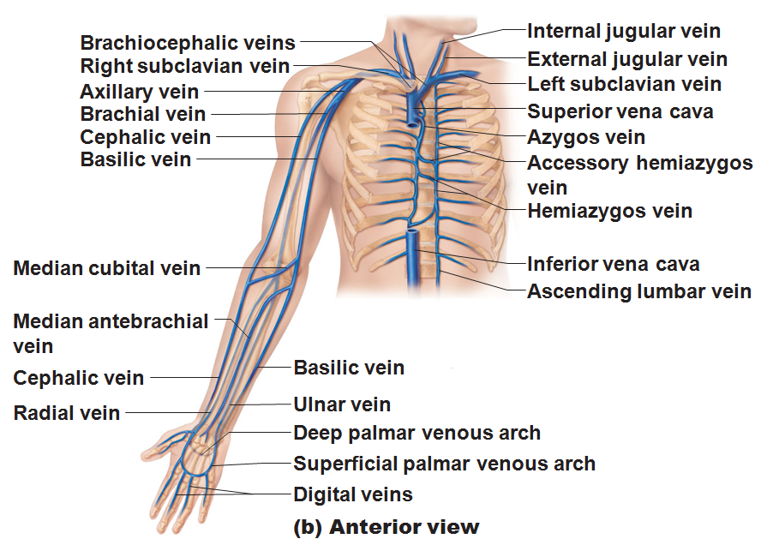

Slide 142
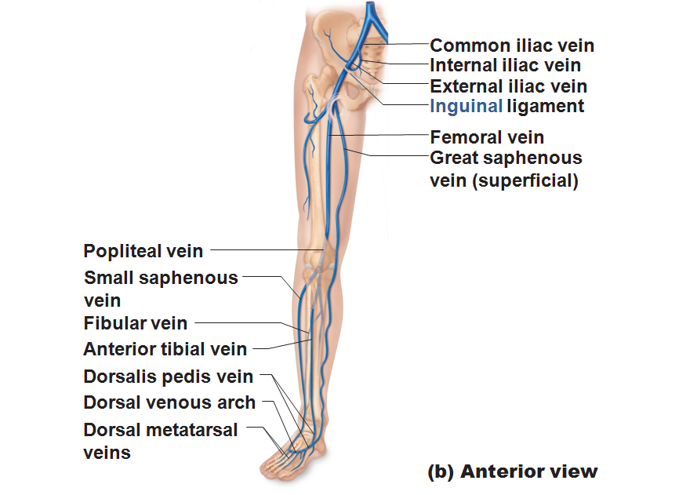

Slide 143
