Slide 1
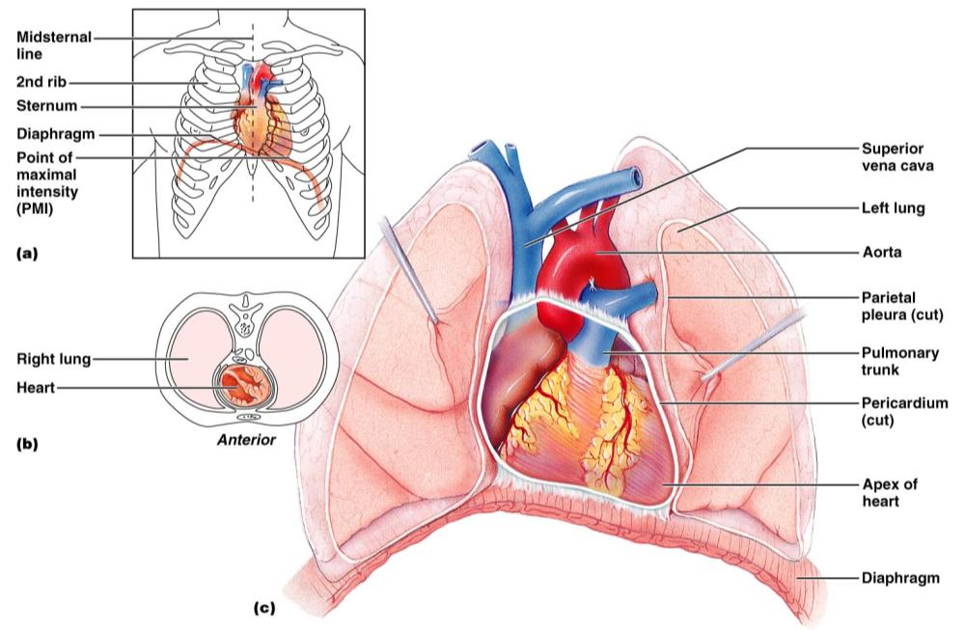
The Heart
Structure: hollow, cone shaped _
Found in the middle _

Slide 2
The Heart
Size varies with person.
Length runs from second _
About the size of a _
Weighs less than a pound
Heart borders:
Laterally:
Posteriorly:
Anteriorly:

Slide 3
The Heart
attached to large blood vessels, lies beneath second rib
Distal end:
Apex:
area of apical heartbeat.
Referred to as PMI: point of maximum intensity

Slide 4
Pericardium
encloses the heart and the _
Consists of an _
fibrous pericardium surrounds visceral pericardium (epicardium) which covers the heart.

Slide 5
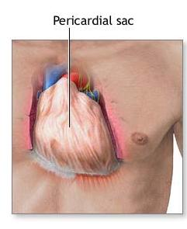
Pericardium
At the base of the heart, the lining turns back and _
This in turn forms the inner lining of the fibrous pericardium.

Slide 6
Pericardium
Three layers of pericardium:
1. fibrous outer layer:
Two inner layers (serous):
2. ___________________________________: adheres to heart. Epicardium
3__________________________________: adherent to fibrous pericardium

Slide 7
Pericardial Cavity
________________________________: Space between parietal and visceral layers
contains small amount of ___________________________________ that is secreted by the pericardial membrane.

Slide 8
Pericardial Cavity
Functions to _____________________________________ between the membranes as the heart moves.
Allows the heart to work in a relatively friction free environment.

Slide 9
Pericarditis
due to viral or bacterial infection
results in _________________________________ that attach the layers of the pericardium.

Slide 10
Pericardititis
____________________________________ of serous fluid,
_________________________________ and interferes with heart movements.
Beating heart rubs against pericardial sac causes a _____________________________________ that can be heard with a stethoscope…
Pericardial friction rub

Slide 11
Walls of the Heart
Three Layers

Slide 12
Epicardium
corresponds to _
Protective outer layer_

Slide 13
Myocardium
Middle layer
Consists largely of the _
Fibers are arranged in planes, separated by _

Slide 14
Endocardium
inner layer…
Contains _
Purkinje fibers.
Protective inner lining of the chambers and valves.
_____________________________________ with the endothelial linings of the blood vessels leaving and entering the heart.

Slide 15
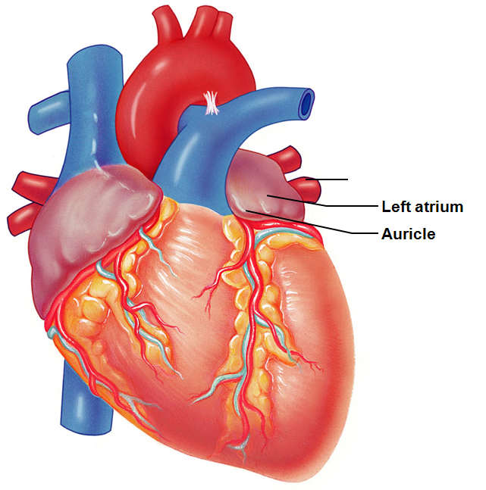
Chambers of the Heart
Atria:
Have thin walls. ___________________ returning to heart.
__________________: small ear-like projections extend anteriorly.

Slide 16
Chambers of the Heart
Atria
Pectinate muscles
Present in the anterior right atrium
Also found in both _
Anterior and posterior atria are separated by crista terminalis _

Slide 17
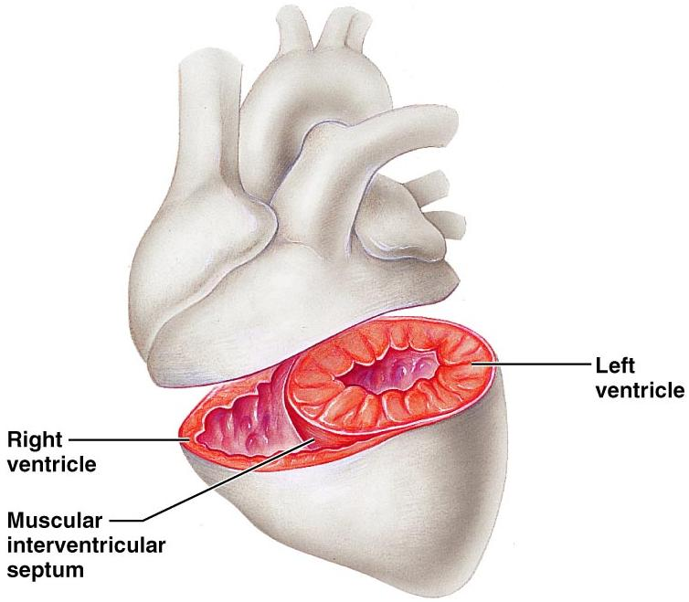
Chambers of the Heart
Ventricles_
Force the blood out of heart _

Slide 18
Septums
_____________________________________: separates right from left atrium.
____________________________________: shallow depression that was once an opening in the fetal heart
_____________________________________: separates right from left ventricle.

Slide 19
Right side of Heart
Right side =
Right atrium:
Receives blood from

Slide 20
Right side of heart
guards the AV _
Composed of three leaflets or cusps.
Permits blood to move from _
Close passively due to pressure

Slide 21
Right side of heart
_____________________________________: strong fibrous strings attach to cusps and ventricles.
Originate from ____________________________________. Papillary muscles contract and pull on the chordae tendinae and _

Slide 22
Right side of the heart
Right ventricle is _
Right pumps to _
Left pumps to entire body and has a greater resistance to overcome.

Slide 23
Tricuspid Valve
Right vent contracts and the pressure rises.
Tricuspid valve _
Exit is through the ____________________________________…turns into pulmonary arteries.
Must pass through _

Slide 24
Pulmonary Valve
Opens as right ventricle contracts. When there is ventricular relaxation: blood begins to back up into pulmonary trunk _

Slide 25
Left side of heart
Left side of heart is the ____________________________________ pump.
Left atrium:
receives blood from lungs through _

Slide 26
Left side of the heart
Blood goes from atrium through
into the left ventricle.
____________________________________ prevent valve from flapping up into atrium

Slide 27
Left side of heart
Ventricle contracts,
mitral valve closes passively
blood is _
Which has _____________________________ valves. When ventricle relaxes, valve closes.

Slide 28
Mitral valve prolapse
cusps of the mitral valve __________________________________________________________________________ during the ventricular contraction.
Blood ______________________________ into the left atrium.

Slide 29
Mitral valve prolapse
Symptoms:
chest pain, ______________________________,
fatigue, and anxiety.
Can be damaged by Streptococcus. May lead to __________________________________: an inflammation of the endocardium due to infection.

Slide 30
Heart Skeleton
Rings of dense _
provide _______________________________ for the heart valves and muscle fibers and
prevents ______________________________ during contraction.
Helps heart keep its shape. Otherwise, the heart would balloon outward with the increased pressure.

Slide 31
Pathway of Blood
Enters _______________________________ from Superior Vena Cava, Inferior Vena Cava, and Coronary Sinus
Blood ________________________________. High in CO₂. Low in O₂

Slide 32
Pathway
Pressure in R. Atrium forces open
Blood passes into _

Slide 33
Pathway
From the Right Ventricle, contractions force blood
through _____________________________________ (pressure closes the Tricuspid Valve)
Blood travels to Lungs

Slide 34
Pathway
Blood returns from lungs freshly _
Enters _
Passes through Bicuspid Valve (also called Mitral Valve)
Into _

Slide 35
Pathway
L. Ventricle contracts.
Bicuspid/Mitral valve closes due to pressure
Blood passes through _
Into Aorta

Slide 36
Heart’s blood supply
Aorta…branches off.
First two branches are called _
They supply blood to the

Slide 37
Heart’s Blood supply
From the Left coronary artery….
__________________________________ follows AV sulcus on left.
Supplies blood to walls of the _
anterior interventricular artery or LAD Left Anterior Descending…
travels in the anterior Interventricular sulcus and branches supply walls _

Slide 38
Heart’s Blood Supply
From the Right Coronary Artery
Two major branches:
supplies the walls of both ventricles.
Supplies right atrium and right ventricles.

Slide 39
Heart’s blood supply
Cardiac veins _
Veins join the coronary sinus at the _
Coronary sinus empties into _

Slide 40
Heart Activity
Atrial walls contract while the ventricular walls relax;
ventricular walls contract while the atrial walls relax.
There is a moment of relaxation. _

